Slide 1



Health and Safety in Agriculture: Ergonomic Shoveling and Pitchforking for Women Farmers
Enhancing Comfort and Reducing Strain
Felix Oguche, Jianfeng Zhou, Karen Funkenbusch, Marcia Shannon
FarmTechForHer
2024 ISASH Annual Conference Portland, Oregon

Slide 2
Presentation Outline
Background – Addressing Musculoskeletal Disorders
Ergonomic tools compare to conventional tools
Research Findings – Physiological and Ergonomic
Comprehensive Benefits, Insights, and Implications
Conclusions and Recommendations

Slide 3
Introduction to Ergonomics in Agriculture
.
What is Ergonomics?
The science of designing tools and tasks to fit the human body, reducing strain and improving efficiency.
Why Focus on Women Farmers?
Women face unique ergonomic challenges due to different body dimensions and tasks.
Notes:
Conventional tools contribute to high MSD risks. Can ergonomic enhancements provide relief?

Slide 4
Key Highlights of Ergonomic Tools
.
Lift Angle and Handle Height:
Critical for reducing strain and improving comfort.
Personalized Tool Design:
Tools designed to fit women’s anthropometric data reduce back pain and improve efficiency.
Data-Driven Design:
Ergonomic design based on empirical research reduces MSD risk.
Notes:
Conventional tools contribute to high MSD risks. Can ergonomic enhancements provide relief?

Slide 5
Why Ergonomics?
.
Reduces Muscle Fatigue:
Minimizes muscle strain during repetitive tasks.
Increases Productivity:
Comfortable tools allow for longer work periods with less fatigue.
Prevents Injuries:
Proper tool design reduces the risk of MSDs.
Notes:
Conventional tools contribute to high MSD risks. Can ergonomic enhancements provide relief?

Slide 6
Understanding Musculoskeletal Disorders (MSDs)
.
Common Areas Affected by MSDs
Key Affected Areas:
  Neck, shoulders, elbows, wrists, lower back, hips, thighs, knees, ankles, feet.
Risk Factors:
  Poor tool design, improper posture, lack of training.
Notes:
Conventional tools contribute to high MSD risks. Can ergonomic enhancements provide relief?

Slide 7
The Role of AI in Ergonomic Assessment
.
Using AI for Advanced Body Mechanics Analysis
Content:
AI-Powered Software:
  Leveraged to analyze body mechanics during tool use.
3D Pose Estimation:
  Converts 2D video footage into 3D models to assess posture and movement.
Ergonomic Evaluation:
  AI identifies high-risk postures and calculates effort angles for joints such as hips, elbows, shoulders, and wrists.
Notes:
Conventional tools contribute to high MSD risks. Can ergonomic enhancements provide relief?

Slide 8

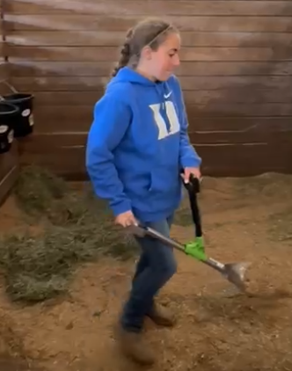

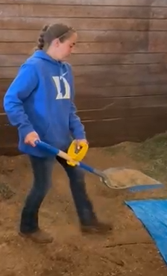
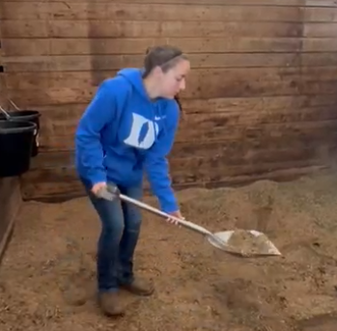

How can ergonomic enhancements reduce MSD risks for women farmers?
What are the impacts of ergonomic shovels and pitchforks compared to conventional tools?
Three treatments of using scoop shovels and pitchforks

Slide 9
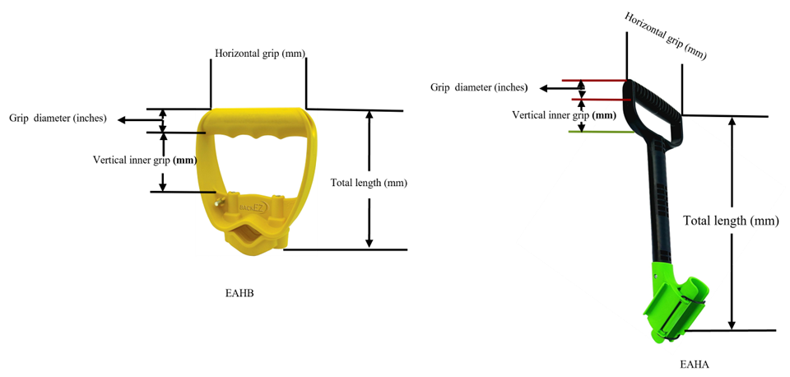
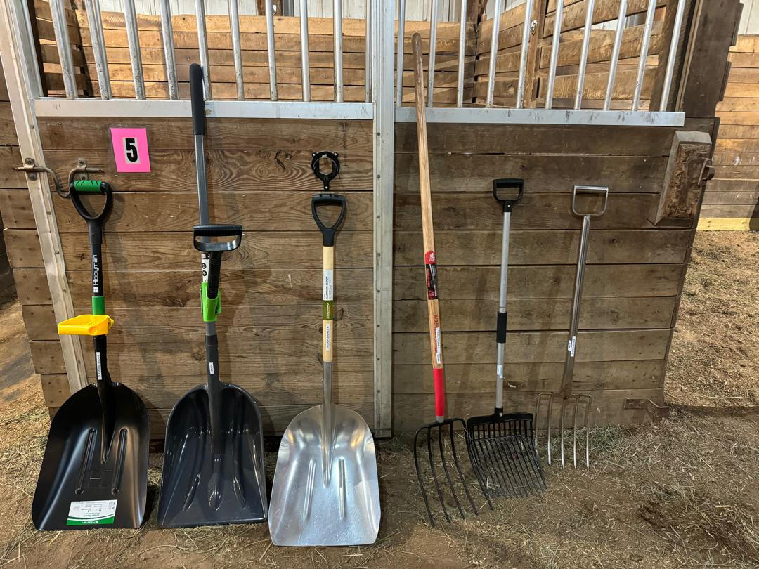
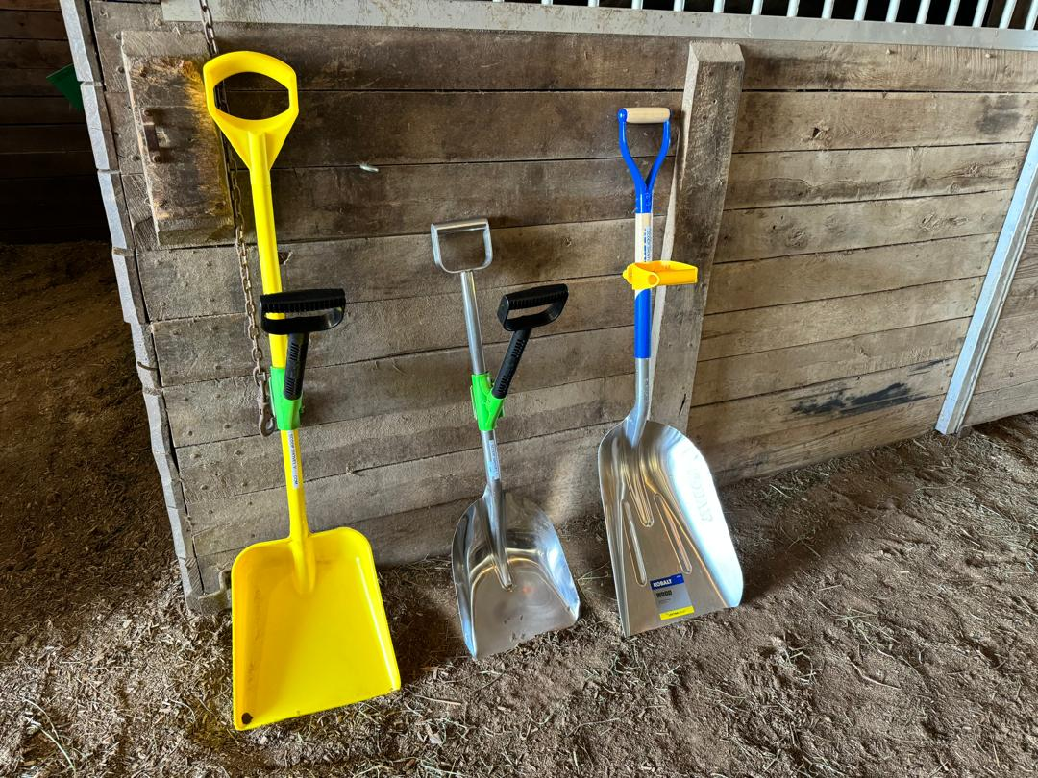
Study Approach for MSD
Comprehensive study with eight women farmers.
Task 1: Throwing straw with conventional pitchforks.
Task 2: Transferring straw with conventional scoop shovels.
Task 3: Repeating tasks with ergonomic auxiliary handles (EAHA / EAHB).
Notes:
Statement: "We investigated the effects of ergonomic tools on MSD risk factors through a detailed study."

Slide 10
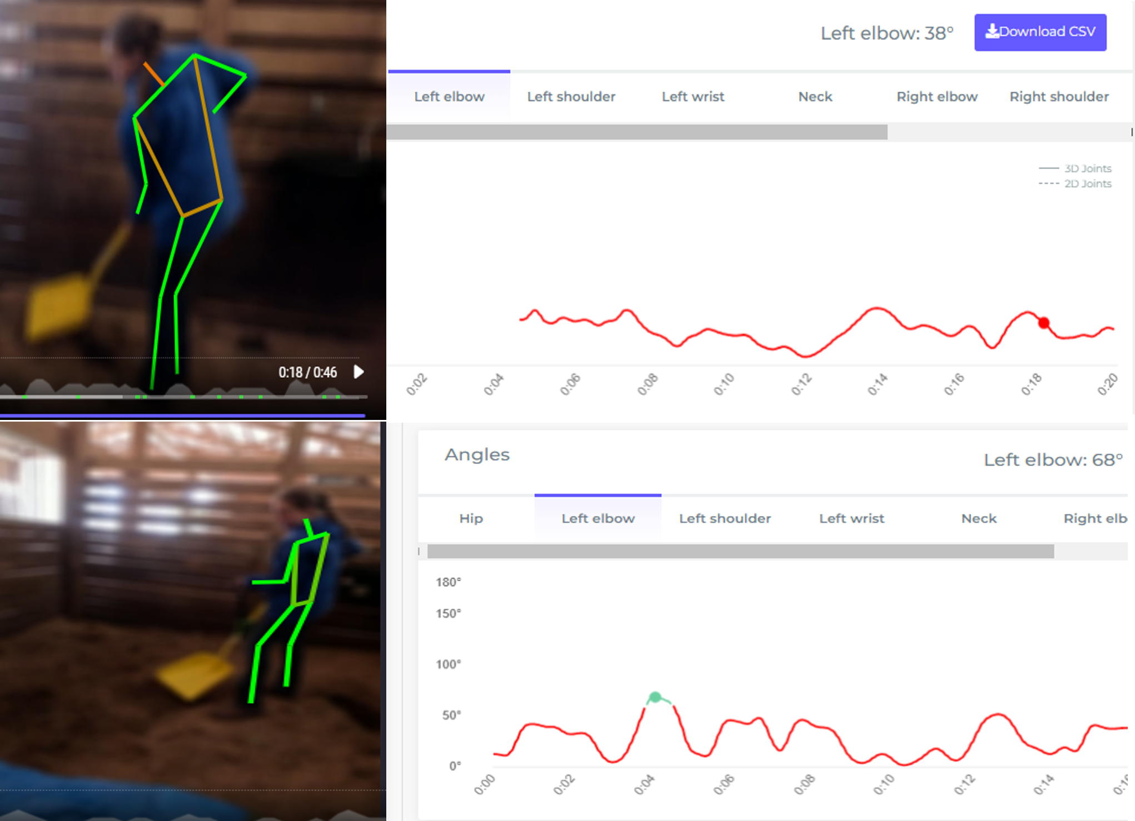
Study Approach: Methodology and Measurements
During tasks, measure:
Physiological:
  Heart rate
  Blood pressure
  Oxygen update
Ergonomic:
  Joint angles
  Load weight
AI-Enhanced Posture Analysis
Notes:
Visual Aid: Photos of participants performing tasks with both tool types. Statement: "We used a structured approach to measure the impacts of ergonomic tools.

Slide 11
Energy Expenditure and Cardiac Cost Analysis
Energy expenditure (Kj.m-1) = 0.159 x Average working heart rate (bpm-1) - 8.72
Cardiac Cost of Work = (Average Working Heart Rate − Average Resting Heart Rate) × Duration of work
Notes:
Heart Rate: Ergonomic tools reduced average heart rate to 81 bpm compared to 86 bpm with conventional tools.
Energy Expenditure: Lower with ergonomic tools (4.29 KJ/kg vs. 4.98 KJ/kg) (Figure 1) Findings support that ergonomic tools reduce task effort (Varghese et al., 1994) and align with reduced cardiovascular strain (Lehto and Buck, 2008), potentially reducing fatigue and improving comfort over prolonged use.
Cardiac Cost of Work: Lower with ergonomic tools (18.17 vs. 31.26).
Motion Efficiency: Improved with ergonomic tools (46.85 vs. 48.05).

Slide 12

Data Analysis Summary
  Welch Two Sample t-test: Compared physiological and effort angles variables between tool groups.
  One-way ANOVA: Tested differences in effort angles and physiological indicators.
  Tukey’s HSD: Identified significant group differences.
  Linear Regression: Examined relationships between physiological outcomes and ergonomic variables.
Notes:
Descriptive Statistics
Calculated mean, median, standard deviation, variance, min, max for each variable.
Comparative Analysis
Welch Two Sample t-test: Compared heart rate, oxygen uptake, energy expenditure, and effort angles (hip, shoulder, elbow, neck, leg, wrist) between conventional and ergonomic tools.
One-way ANOVA: Tested differences in mean effort angles (hip, shoulder, elbow, neck, leg, wrist) and physiological indicators (heart rate, oxygen uptake, energy expenditure) across tool types.
Tukey’s HSD: Identified specific significant differences between tool groups.
Linear Regression: Analyzed relationships between average heart rate, oxygen uptake, energy expenditure, and effort angles with tool type and type of auxiliary handle. Variables Tested
Physiological Indicators:
Average working heart rate
Average resting heart rate
Energy expenditure (Kj.m-1)
Cardiac cost of work
These formulas were used to calculate the energy expenditure and physiological cost of tasks performed with ergonomic and conventional tools.

Slide 13
Presentation Outline
Background – Addressing Musculoskeletal Disorders
Ergonomic tools compare to conventional tools
Research Findings – Physiological and Ergonomic
Comprehensive Benefits, Insights, and Implications
Conclusions and Recommendations

Slide 14
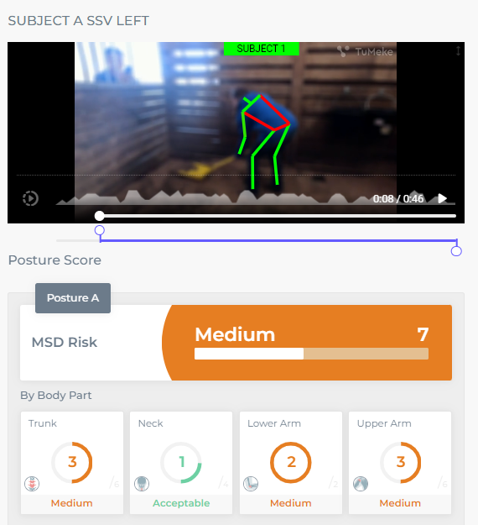
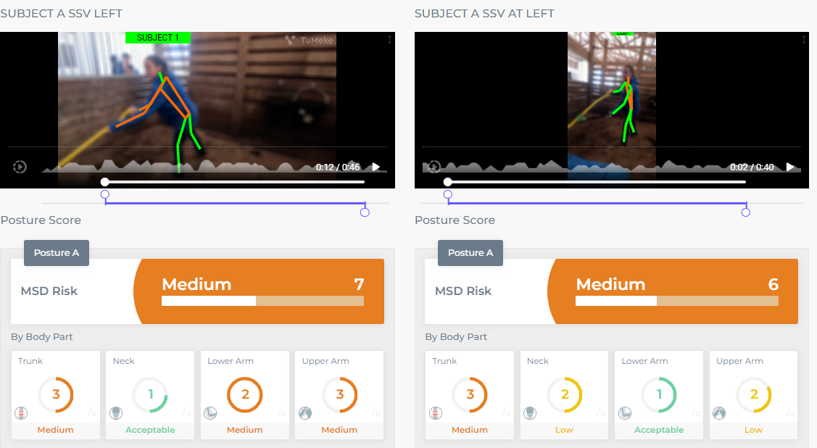
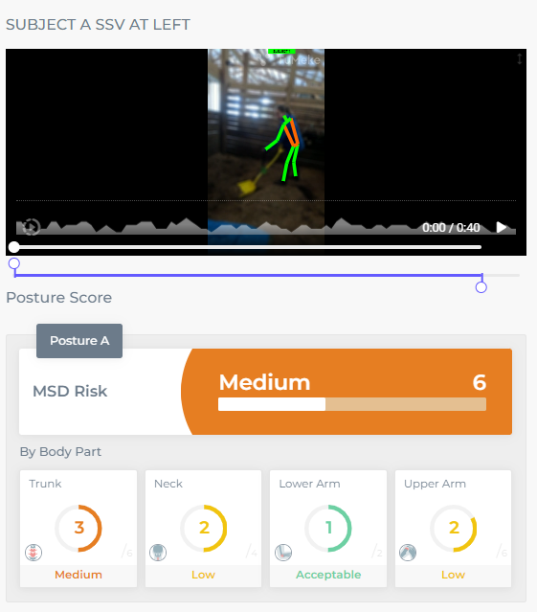
Biomechanical and Ergonomic Analysis A
Examples of imagery analysis
Conventional Tool Use
Task: Lifting
Throwing
56º
^{30o}
Hip Flexion
Ergonomic Tool Use
28º
^{22o}
Reduced Hip Flexion
Task: Lifting
Throwing
Notes:
Visual Aid: Diagram illustrating the ergonomic tool design. Statement: "How do ergonomic tools affect the physiological and ergonomic aspects of farming tasks?“Title: Evaluating Biomechanical and Ergonomic Impacts - Trunk Flexion and Strain
Content:
The images on this slide show the biomechanical analysis of participants using different tools.
Top Images: Conventional tool usage with higher trunk flexion angles (56° and 30°), resulting in higher MSD risks (score of 7 and 6).
Bottom Images: Ergonomic tool usage with reduced trunk flexion angles (28° and 22°), leading to lower MSD risks (score of 6 and 6).
Implication: Understanding these impacts helps improve tool design by identifying areas that reduce physical strain and enhance ergonomics.

Slide 15
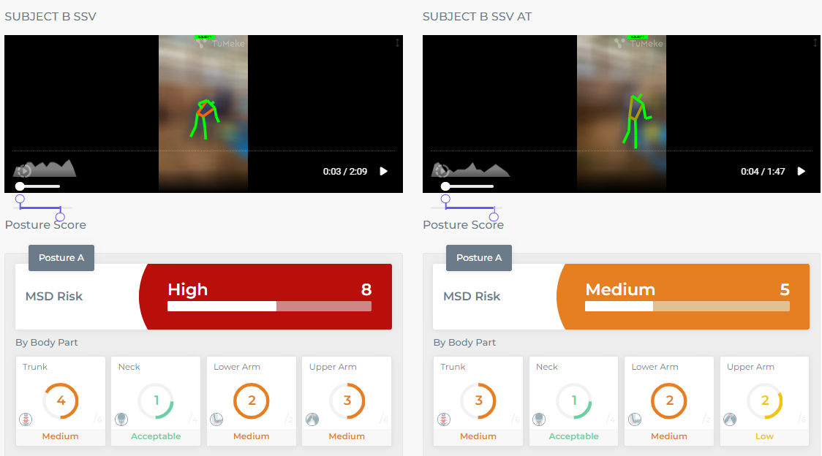
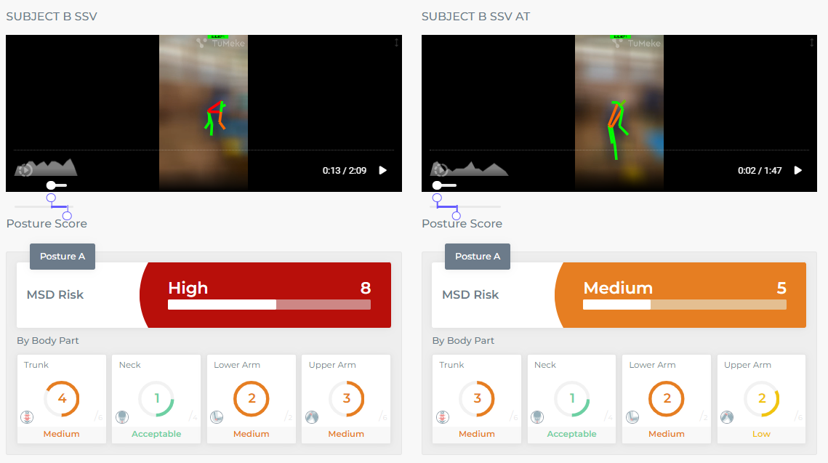
Biomechanical and Ergonomic Analysis B
Examples of imagery analysis
Conventional Tool Use
Task: Lifting
Throwing
88º
45º
21º
Hip Flexion
Ergonomic Tool Use
31º
21º
Reduced Hip Flexion
Task: Lifting
Throwing
Notes:
Visual Aid: Diagram illustrating the ergonomic tool design. Statement: "How do ergonomic tools affect the physiological and ergonomic aspects of farming tasks?“Title: Biomechanical and Ergonomic Analysis - Subject B
Content:
The images illustrate the biomechanical analysis for Subject B using different tools.
Top Images: High trunk flexion (88° and 45°) with conventional tools, resulting in high MSD risk scores (8 and 6).
Bottom Images: Lower trunk flexion (31° and 21°) with ergonomic tools, leading to reduced MSD risks (6 and 6).
Conclusion: Implementing ergonomic tools significantly reduces trunk flexion, lowers MSD risks, and improves overall tool design for user safety and efficiency for Subject B.
These titles and content summaries clearly differentiate the analysis for Subject A and Subject B while highlighting the specific impacts of ergonomic tool usage on reducing physical strain and MSD risks.

Slide 16
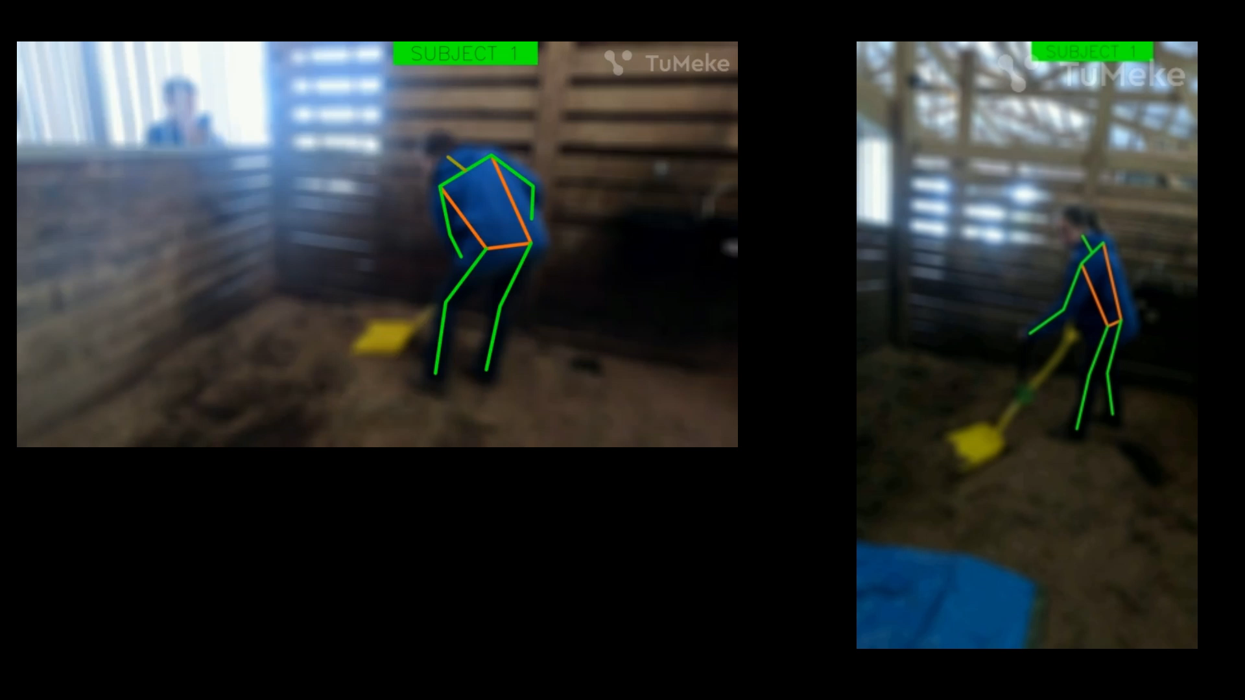
AI-Enhanced Posture Analysis
Notes:
Visual Aid: Photos of participants performing tasks with both tool types. Statement: "We used a structured approach to measure the impacts of ergonomic tools.

Slide 17


AI-Enhanced Posture Analysis
Subject B PFE
Subject C PFE
Subject B Height 159cm
Subject C Height 185cm
52º
74º
Subject B SSA
Subject C SSA
Subject B Height 159cm
Subject C Height 185cm
64º
79º
Notes:
Insights from statistical models on ergonomic outcomes.
Emphasis on lift angle, handle lift height, and mechanical advantage.

Slide 18
Presentation Outline
Background – Addressing Musculoskeletal Disorders
Ergonomic tools compare to conventional tools
Research Findings – Physiological and Ergonomic
Comprehensive Benefits, Insights, and Implications
Conclusions and Recommendations

Slide 19
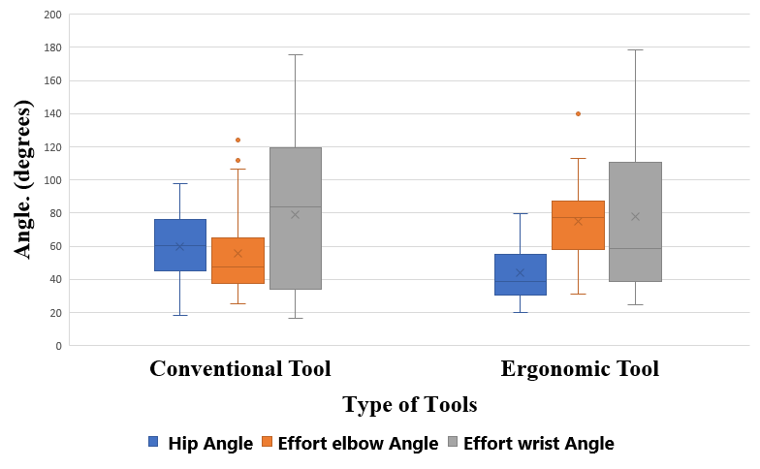
Research Finding - Ergonomic Benefits
Hip Effort
    Reduced hip effort by 14.76 degrees.
    p < 0.0001
Wrist Effort
    Reduced wrist strain
    p < 0.05
Elbow Effort
    Increased elbow effort
    p < 0.0001
Notes:
Visual Aid: Graphs showing joint angle measurements for hip, wrist, and elbow. Statement: "Ergonomic tools reduce hip and wrist strain but increase elbow effort."

Slide 20
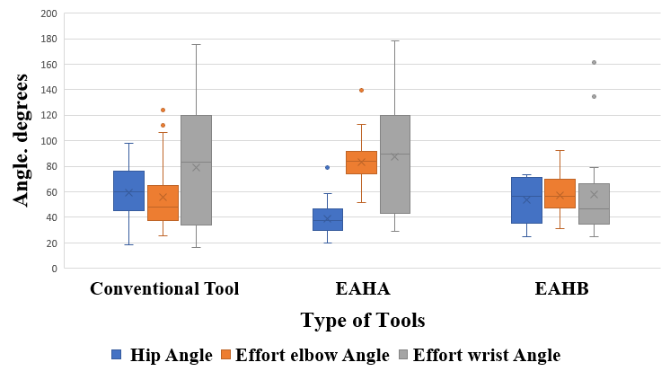
Ergonomic Handle Impact
EAHA Handle:
  Highest reduction in hip angle.
  Increased elbow effort compared to conventional tools and EAHB.
EAHB Handle:
  Lower wrist angle than conventional tools, reducing wrist strain.
  More neutral wrist position than EAHA.
Notes:
Photos of participants lifting loads with ergonomic and conventional tools. Statement: "Ergonomic tools support higher loads without increasing joint strain."

Slide 21
Research Finding - Physiological Benefits
Average Heart Rate
    Ergonomic tools: 81 bpm.
    Conventional tools: 86 bpm.
Energy Expenditure
    Ergonomic tools: 4.29 KJ/kg.
    Conventional tools: 4.98 KJ/kg.
Motion Efficiency
    Ergonomic tools: 46.85.
    Conventional tools: 48.05.
Reaching, Bending, Stooping
Conventional Tools
Conventional Tools
Ergonomic Tools
Awkward Positions
MSD Risks
Physiological & Ergonomic Impacts
Identify Problems
Conventional Tools
Repetition
Ergonomic Enhancements
Comparison to Conventional Tools
Frequency
Strength
MSD
Reduce MSD Risks
Improved Outcomes
Notes:
Imagine starting your day with the tools designed to ease your workload, but ending it with intense back pain and sore wrists. This is the daily reality for many women farmers using conventional tools. Our study aims to change that."

Slide 22
Presentation Outline
Background – Addressing Musculoskeletal Disorders
Ergonomic tools compare to conventional tools
Research Findings – Physiological and Ergonomic
Comprehensive Benefits, Insights, and Implications
Conclusions and Recommendations

Slide 23
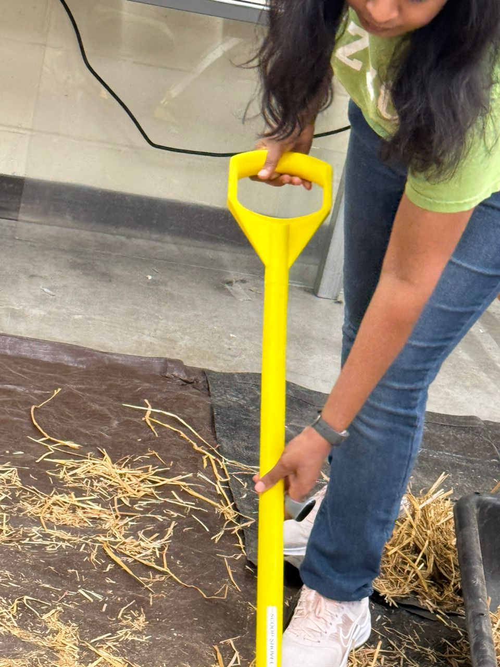
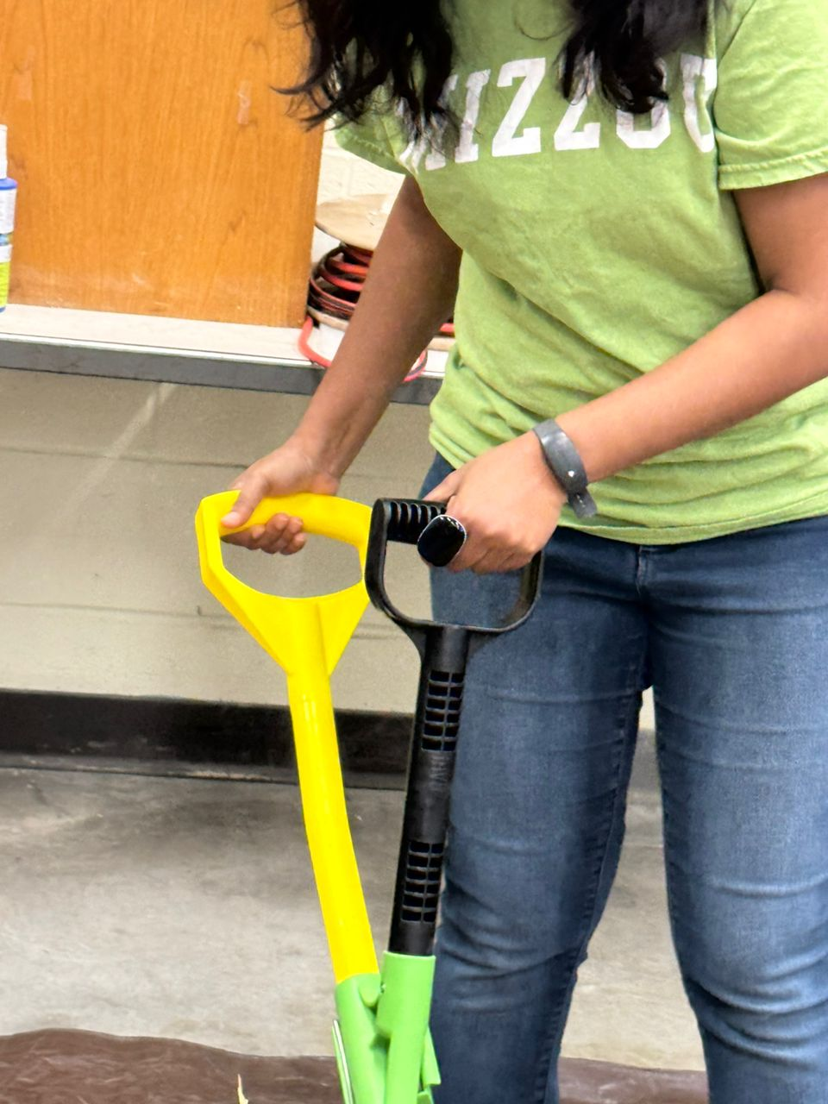
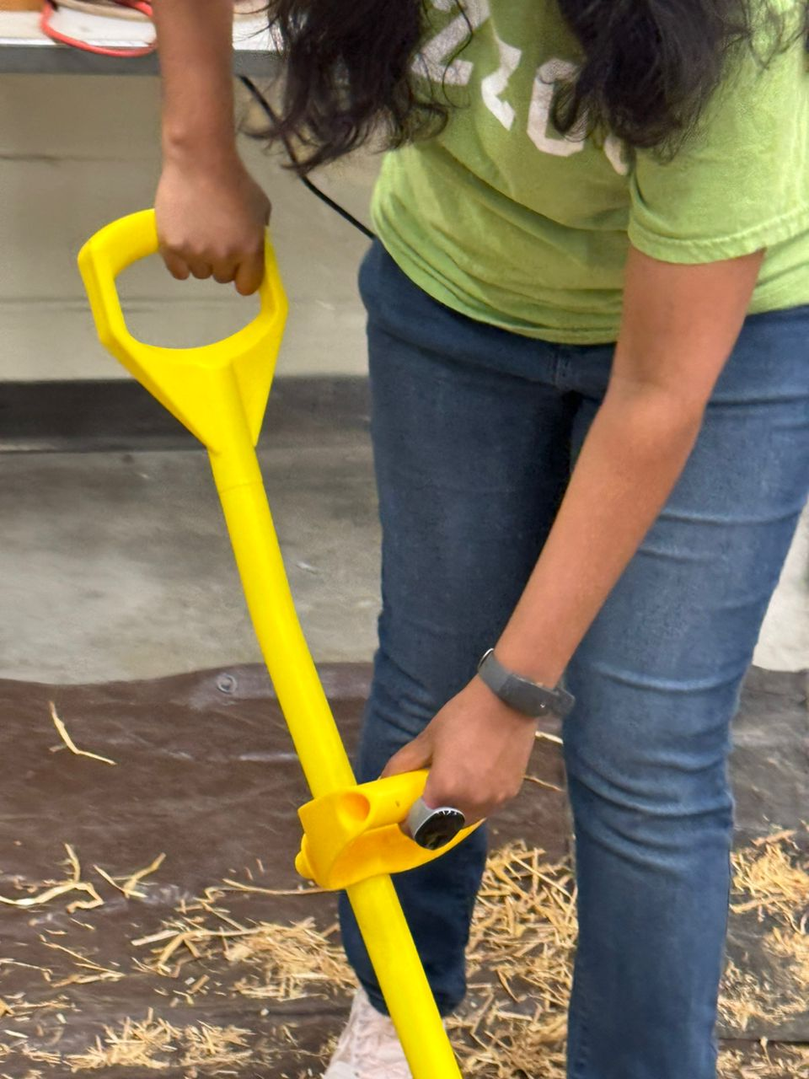
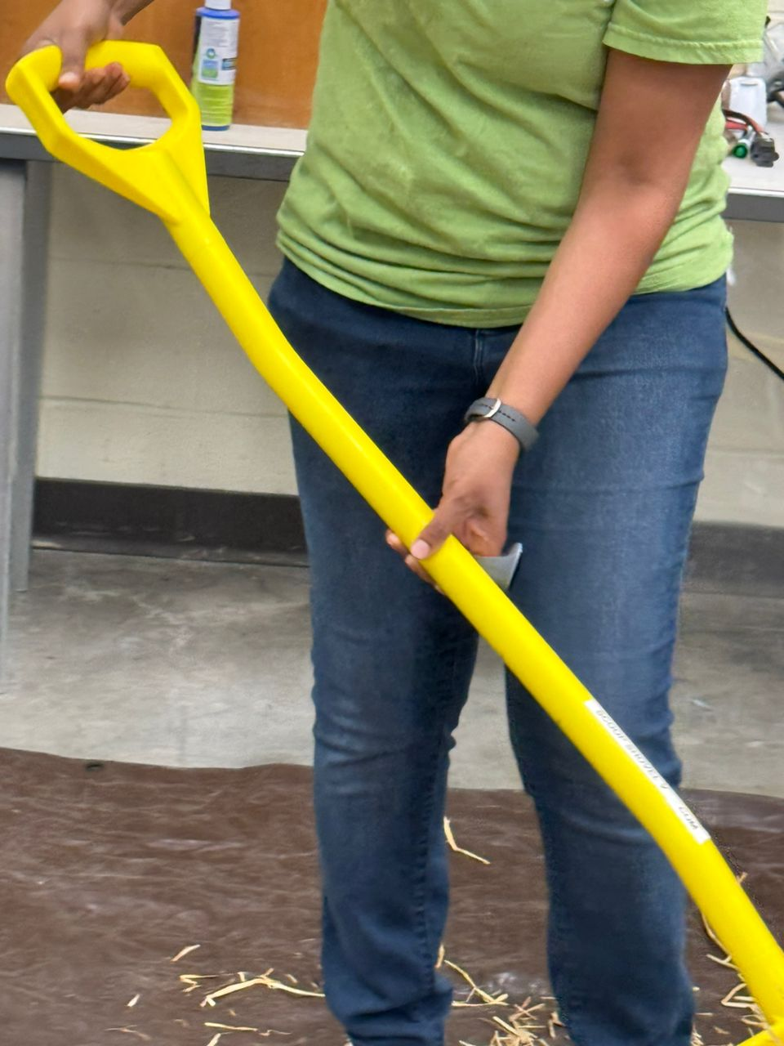
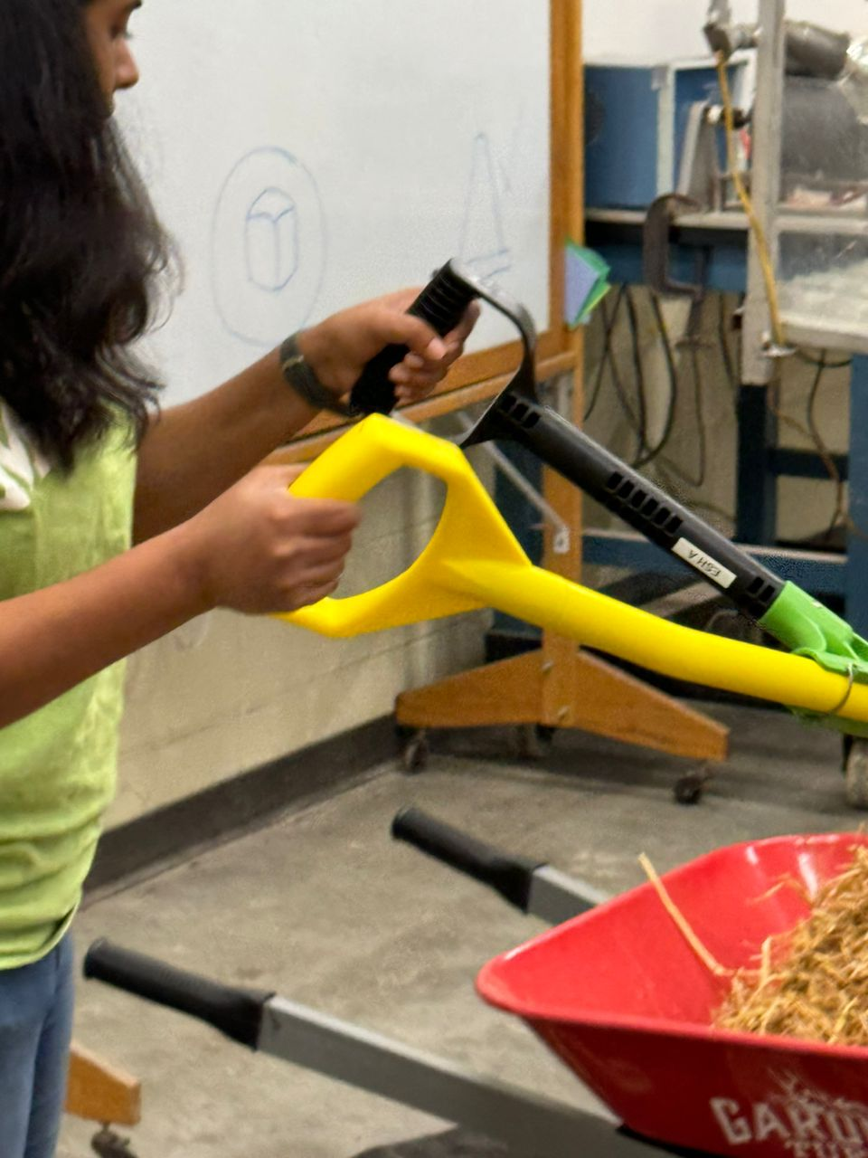
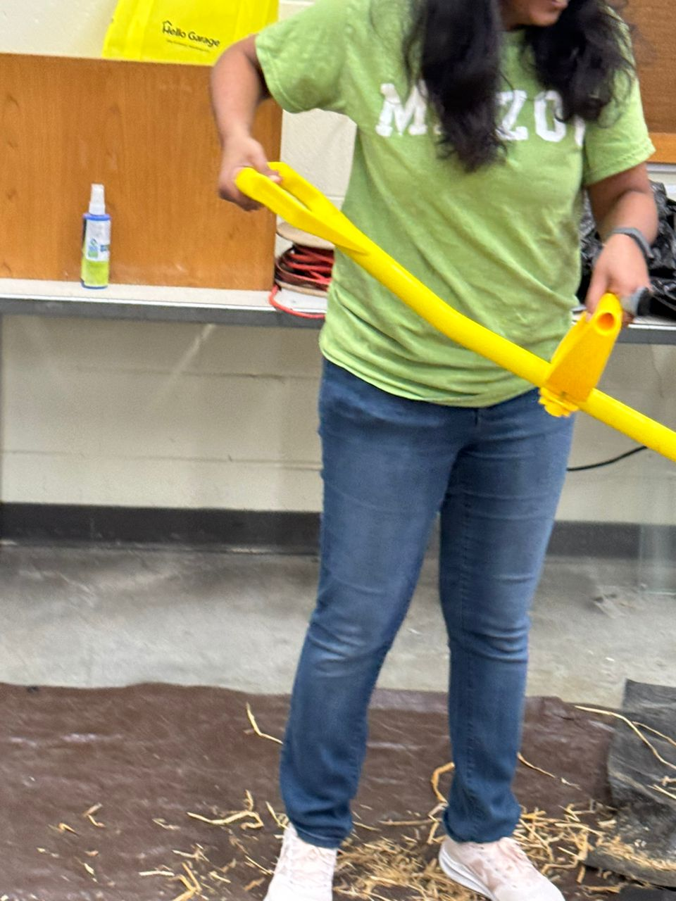
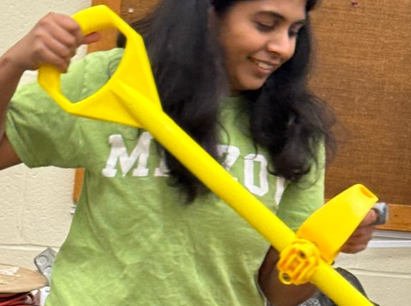
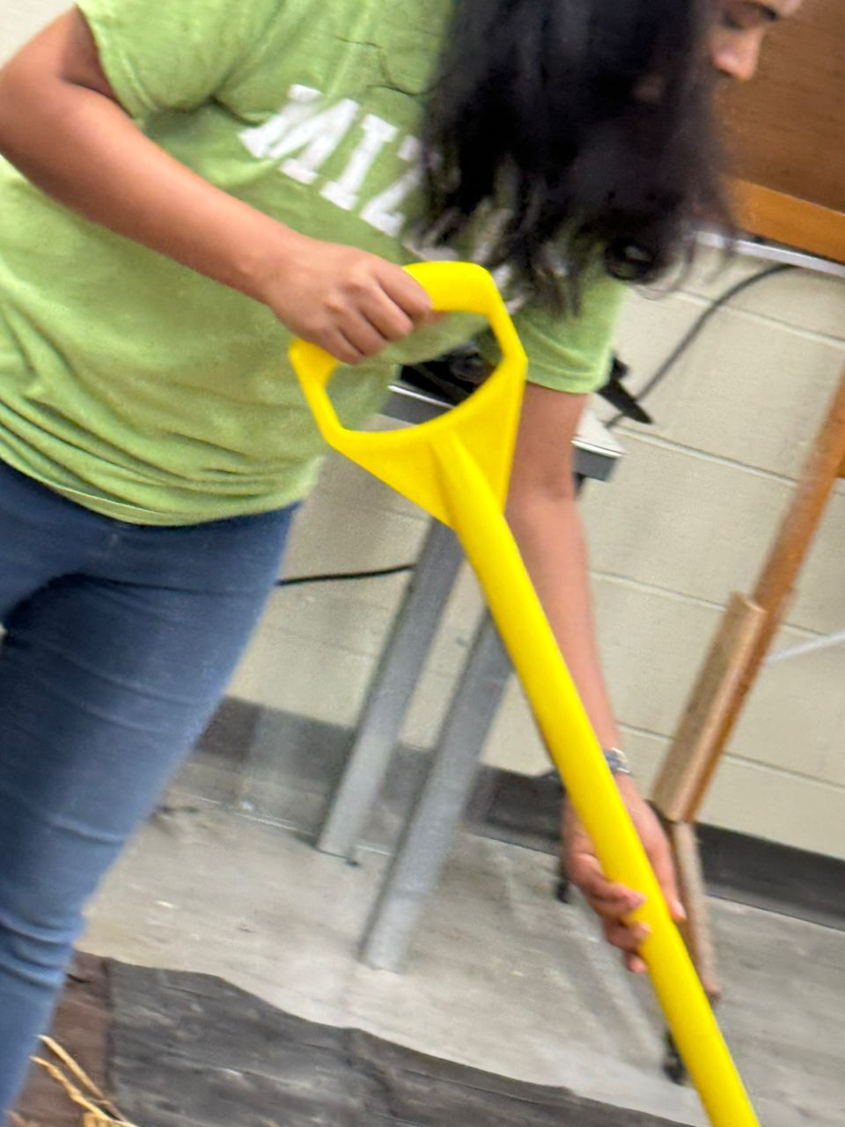
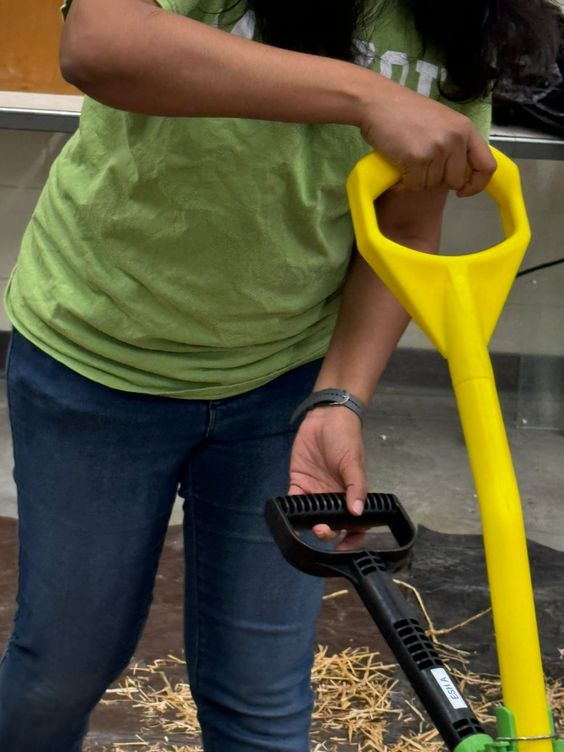
Subject A Wrist and Forearm Postures: Shovel
Placement
Conventional Tool
EAHA Handle
EAHB Handle
Supination Close
to neutral
supination
Supination, but less than EAHA
Flexion 10º Adduction 10º
Increase Flexion 25º
Adduction 15º
Flexion 18º Adduction 7º
Lifting
Higher angle of supination compared to conventional tools.
Balanced supination, facilitating easier lifting
Supination Close
to neutral
Most Extension
and Abduction
Increased Extension and Adduction
Extension and Abduction
Throwing/
Release
Pronation 45º
Pronation 90º
Supination 45º
Less Extension and Abduction compared to EAHA.
Extension and Abduction
Most Extension and Abduction
Notes:
Conventional Tools:
Moderate wrist flexion and adduction
Consistent forearm pronation
Associated with higher strain due to less ergonomic design
EAHA Handles:
Increased wrist flexion and adduction
Higher angles of supination
Mixed strain reduction results
EAHB Handles:
Balanced wrist flexion and adduction
Optimal supination
Minimized overall strain, better ergonomic design
Static handles prevent natural wrist position, causing increased ulnar deviation and dorsiflexion.
Implications - Motion Efficiency and Biomechanical Insights
Visual Aid: Diagram illustrating the ergonomic improvements and trade-offs identified. Statement: "Ergonomic tools provide significant benefits but also present new challenges."
Implications:
Ergonomic tools show lower and more consistent heart rates, indicating reduced cardiovascular strain and better efficiency.
95% reported reduced trunk and lower back strain but increased elbow stress.
Static handles prevent natural wrist position, causing increased ulnar deviation and dorsiflexion.

Slide 24
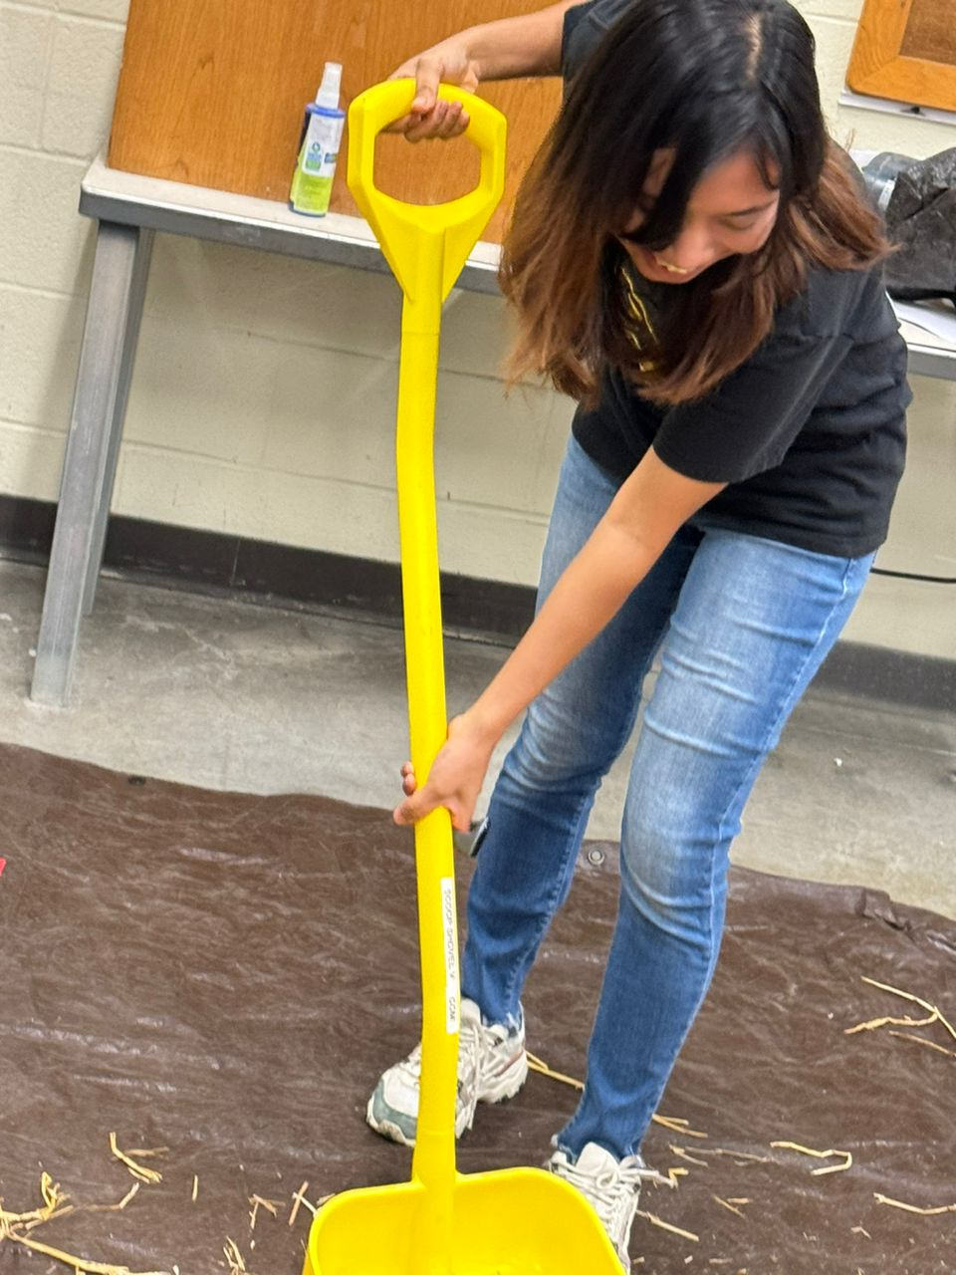
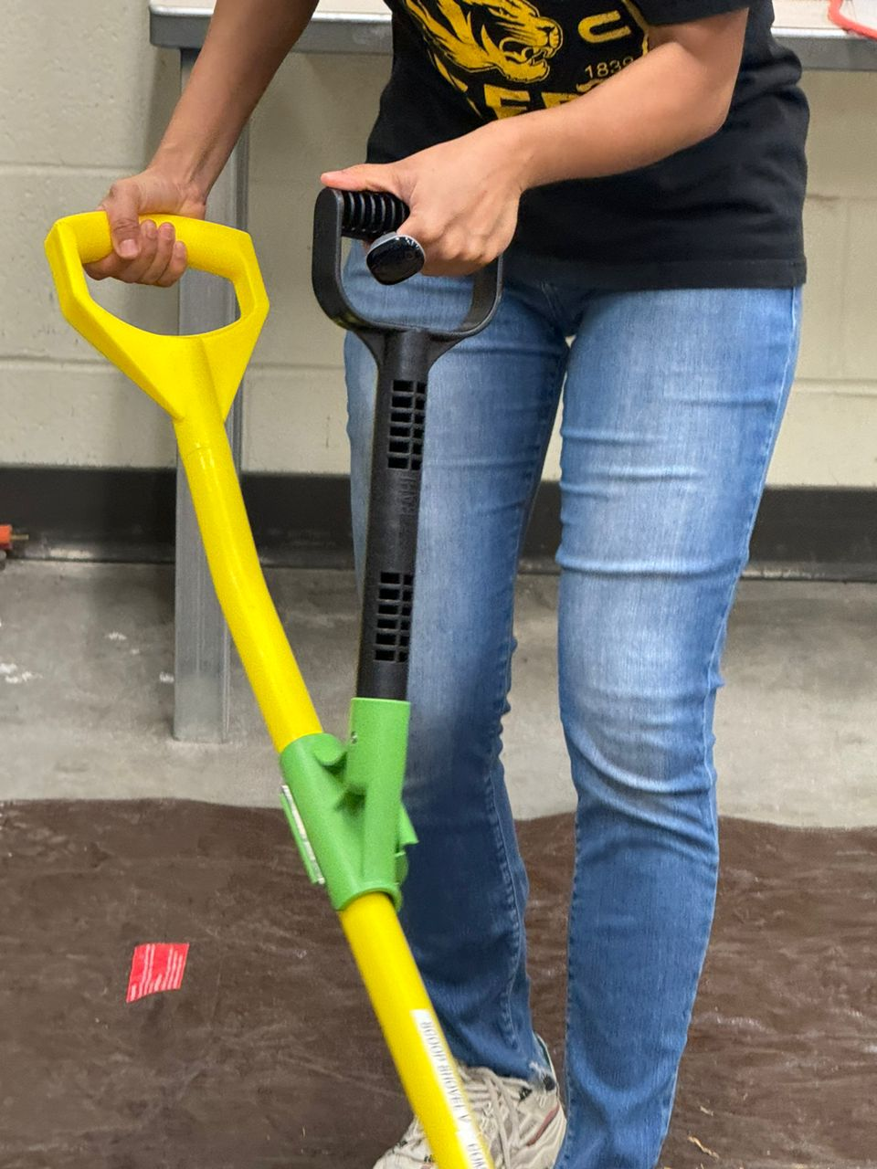
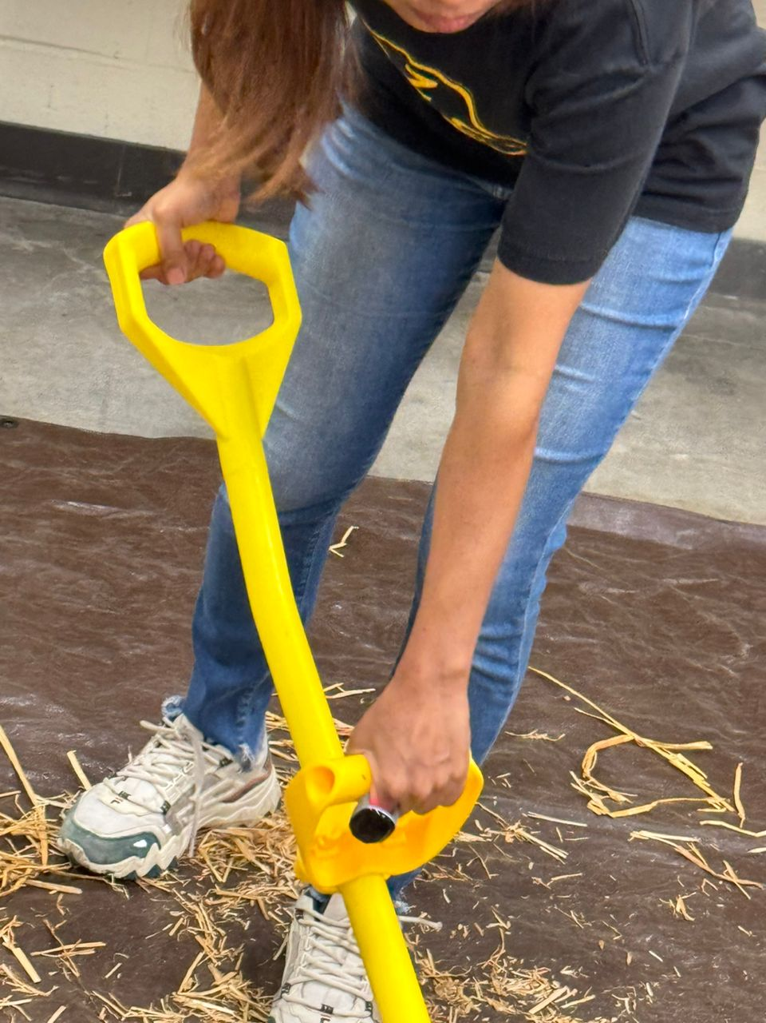
Wrist and Forearm Postures: Subject A and B: Shovel
Conventional Tool
EAHA Handle
EAHB Handle
Placement
Subject A
Supination, but less than Subject B
Supination Close
to neutral
Supination
Extension 20º Adduction 10º
Flexion 25º Adduction 15º
Flexion 18 Adduction 12
Placement
Subject B
More supination compared to Subject A
Supination
More supination compared to Subject A
Increased Extension and Abduction
Increased Extension and Adduction
Increased Extension and Adduction
Notes:
Visual Aid: Diagram illustrating the ergonomic improvements and trade-offs identified. Statement: "Ergonomic tools provide significant benefits but also present new challenges."
Sure! Here are improved image descriptions for the nine images on the slide:
Conventional Tool - Placement
Image Description: The wrist is slightly bent forward (10° flexion) and tilted inward toward the body’s midline (10° adduction).
Explanation: The wrist is in a mild forward bend and an inward tilt, positioning the hand closer to the body.
EAHA Handle - Placement
Image Description: The wrist is noticeably bent forward (25° flexion) and tilted more inward (15° adduction).
Explanation: The wrist has a significant forward bend and a pronounced inward tilt, positioning the hand closer to the body.
EAHB Handle - Placement
Image Description: The wrist is moderately bent forward (18° flexion) and slightly tilted inward (7° adduction).
Explanation: The wrist shows a moderate forward bend and a slight inward tilt, positioning the hand closer to the body.
Conventional Tool - Lifting
Image Description: The wrist is rotated so the palm faces upward or forward (supination close to neutral).
Explanation: The forearm rotation is mild, allowing the palm to face slightly upward or forward.
EAHA Handle - Lifting
Image Description: The wrist is rotated more so the palm faces further upward or forward (higher angle of supination).
Explanation: The forearm is rotated more significantly, making the palm face more upward or forward compared to the conventional tool.
EAHB Handle - Lifting
Image Description: The wrist maintains a balanced rotation, allowing easier lifting (balanced supination).
Explanation: The forearm is rotated in a balanced way, optimizing the position for easier lifting.
Conventional Tool - Throwing/Release
Image Description: The wrist is straightened (extension) and moved outward (abduction), with the palm facing downward (45° pronation).
Explanation: The wrist is extended and abducted, with the forearm rotated so the palm faces downward at a 45° angle.
EAHA Handle - Throwing/Release
Image Description: The wrist is maximally straightened (most extension) and moved outward (abduction), with the palm facing completely downward (90° pronation).
Explanation: The wrist is in maximal extension and abduction, with the forearm rotated so the palm faces completely downward at a 90° angle.
EAHB Handle - Throwing/Release
Image Description: The wrist is straightened (extension) and moved outward (abduction), with the palm facing upward (45° supination).
Explanation: The wrist is extended and abducted, with the forearm rotated so the palm faces upward at a 45° angle.
These descriptions provide a clearer and more detailed understanding of the wrist and forearm positions in each scenario.
Implications:
Ergonomic tools show lower and more consistent heart rates, indicating reduced cardiovascular strain and better efficiency.
95% reported reduced trunk and lower back strain but increased elbow stress.
Static handles prevent natural wrist position, causing increased ulnar deviation and dorsiflexion.

Slide 25
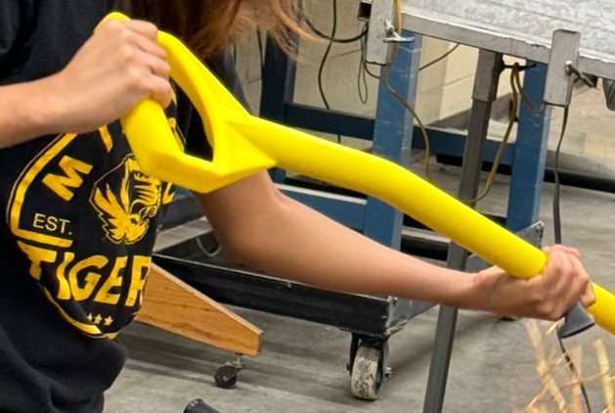
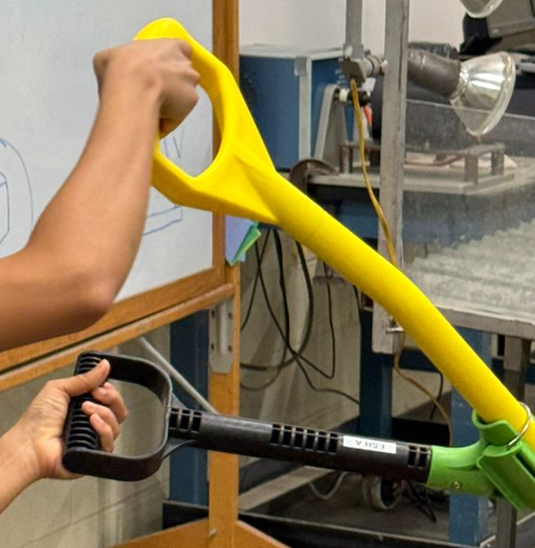
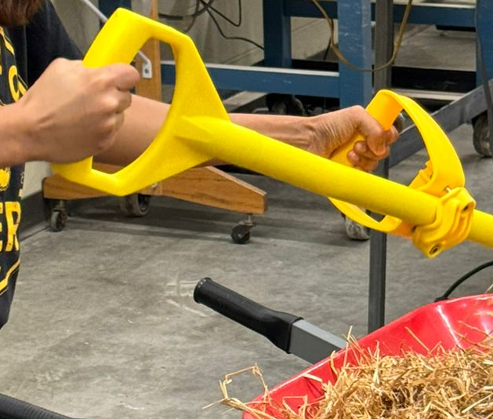
Wrist and Forearm Postures: Subject A and B: Shovel
Throwing/
Release Subject A
Conventional Tool
EAHA Handle
EAHB Handle
Supination, but less than Subject B
Pronation 45º
Pronation 90º
Flexion and Abduction
Extension and Abduction
Extension and Abduction
Throwing/
Release Subject B
Less Pronation compared to Subject A
Pronation 90º
More Pronation 90º
Increased Flexion and Abduction
Increased Extension
and Abduction
Increased Extension and Abduction
Notes:
Visual Aid: Diagram illustrating the ergonomic improvements and trade-offs identified. Statement: "Ergonomic tools provide significant benefits but also present new challenges."
Implications:
Ergonomic tools show lower and more consistent heart rates, indicating reduced cardiovascular strain and better efficiency.
95% reported reduced trunk and lower back strain but increased elbow stress.
Static handles prevent natural wrist position, causing increased ulnar deviation and dorsiflexion.

Slide 26
Presentation Outline
Background – Addressing Musculoskeletal Disorders
Ergonomic tools compare to conventional tools
Research Findings – Physiological and Ergonomic
Comprehensive Benefits, Insights, and Implications
Conclusions and Recommendations

Slide 27
Conclusions
Summary
Reduced Strain: Ergonomic tools significantly reduce hip and wrist strain. and energy expenditure
Increased Elbow Strain: Trade-off with increased elbow strain.
User Feedback: Reduced lower back strain but some challenges.
Recommendation: Design shorter auxiliary handles than EAHA (18 inches) or adjustable handles with tunable grips to minimize wrist strain and repetitive injuries.
Conventional Tools
Ergonomic Tools
Physiological & Ergonomic Impacts
MSD Risks
Conventional Tools
Ergonomic Enhancements
Comparison to Conventional Tools
Reduce MSD Risks
Improved Outcomes
Notes:
Evaluate Ergonomic Benefits:
Ergonomic tools significantly reduce heart rate, hip effort (by 15 degrees), and energy expenditure, indicating lower physical strain.
Identify Trade-offs:
Ergonomic tools reduce hip and wrist strain but increase elbow effort. EAHA handles increase elbow strain, while EAHB handles provide a more balanced ergonomic solution.
Collect User Feedback:
Participants noted reduced hip and back strain but found ergonomic handles harder to maneuver, increasing elbow stress. This suggests the need for adjustable designs.
Recommendation:
Design shorter auxiliary handles than EAHA with tunable grips to minimize wrist strain and repetitive injuries.
4o

Slide 28






Acknowledgments
Special thanks to the North Central Sustainable Agriculture Research & Education (SARE) for their generous support and funding.
Appreciate the National Institute for Occupational Safety and Health (NIOSH) and the United States Department of Agriculture (USDA) for their support and guidance.
Jianfeng Zhou, Karen Funkenbusch, and Marcia Shannon, University of Missouri for their mentorship and guidance.
Aaron Yoder and Central States Center for Agricultural Safety and Health at the University of Nebraska Medical Center for their support.
Thank you to the women at the University of Missouri who participated in this research study
Grateful to my colleagues for their feedback and assistance.
Jianfeng Zhou
Karen Funkenbusch
Marcia Shannon
Notes:
Visual Aid: Summary infographic highlighting key findings and recommendations. Statement: "Future research will refine ergonomic designs for better health outcomes."
Imagine starting your day with the tools designed to ease your workload, but ending it with intense back pain and sore wrists. This is the daily reality for many women farmers using conventional tools. Our study aims to change that."

Slide 29

Conventional Tools
Ergonomic Tools
Physiological & Ergonomic Impacts
MSD Risks
Conventional Tools
Ergonomic Enhancements
Comparison to Conventional Tools
Reduce MSD Risks
Improved Outcomes

