Slide 1








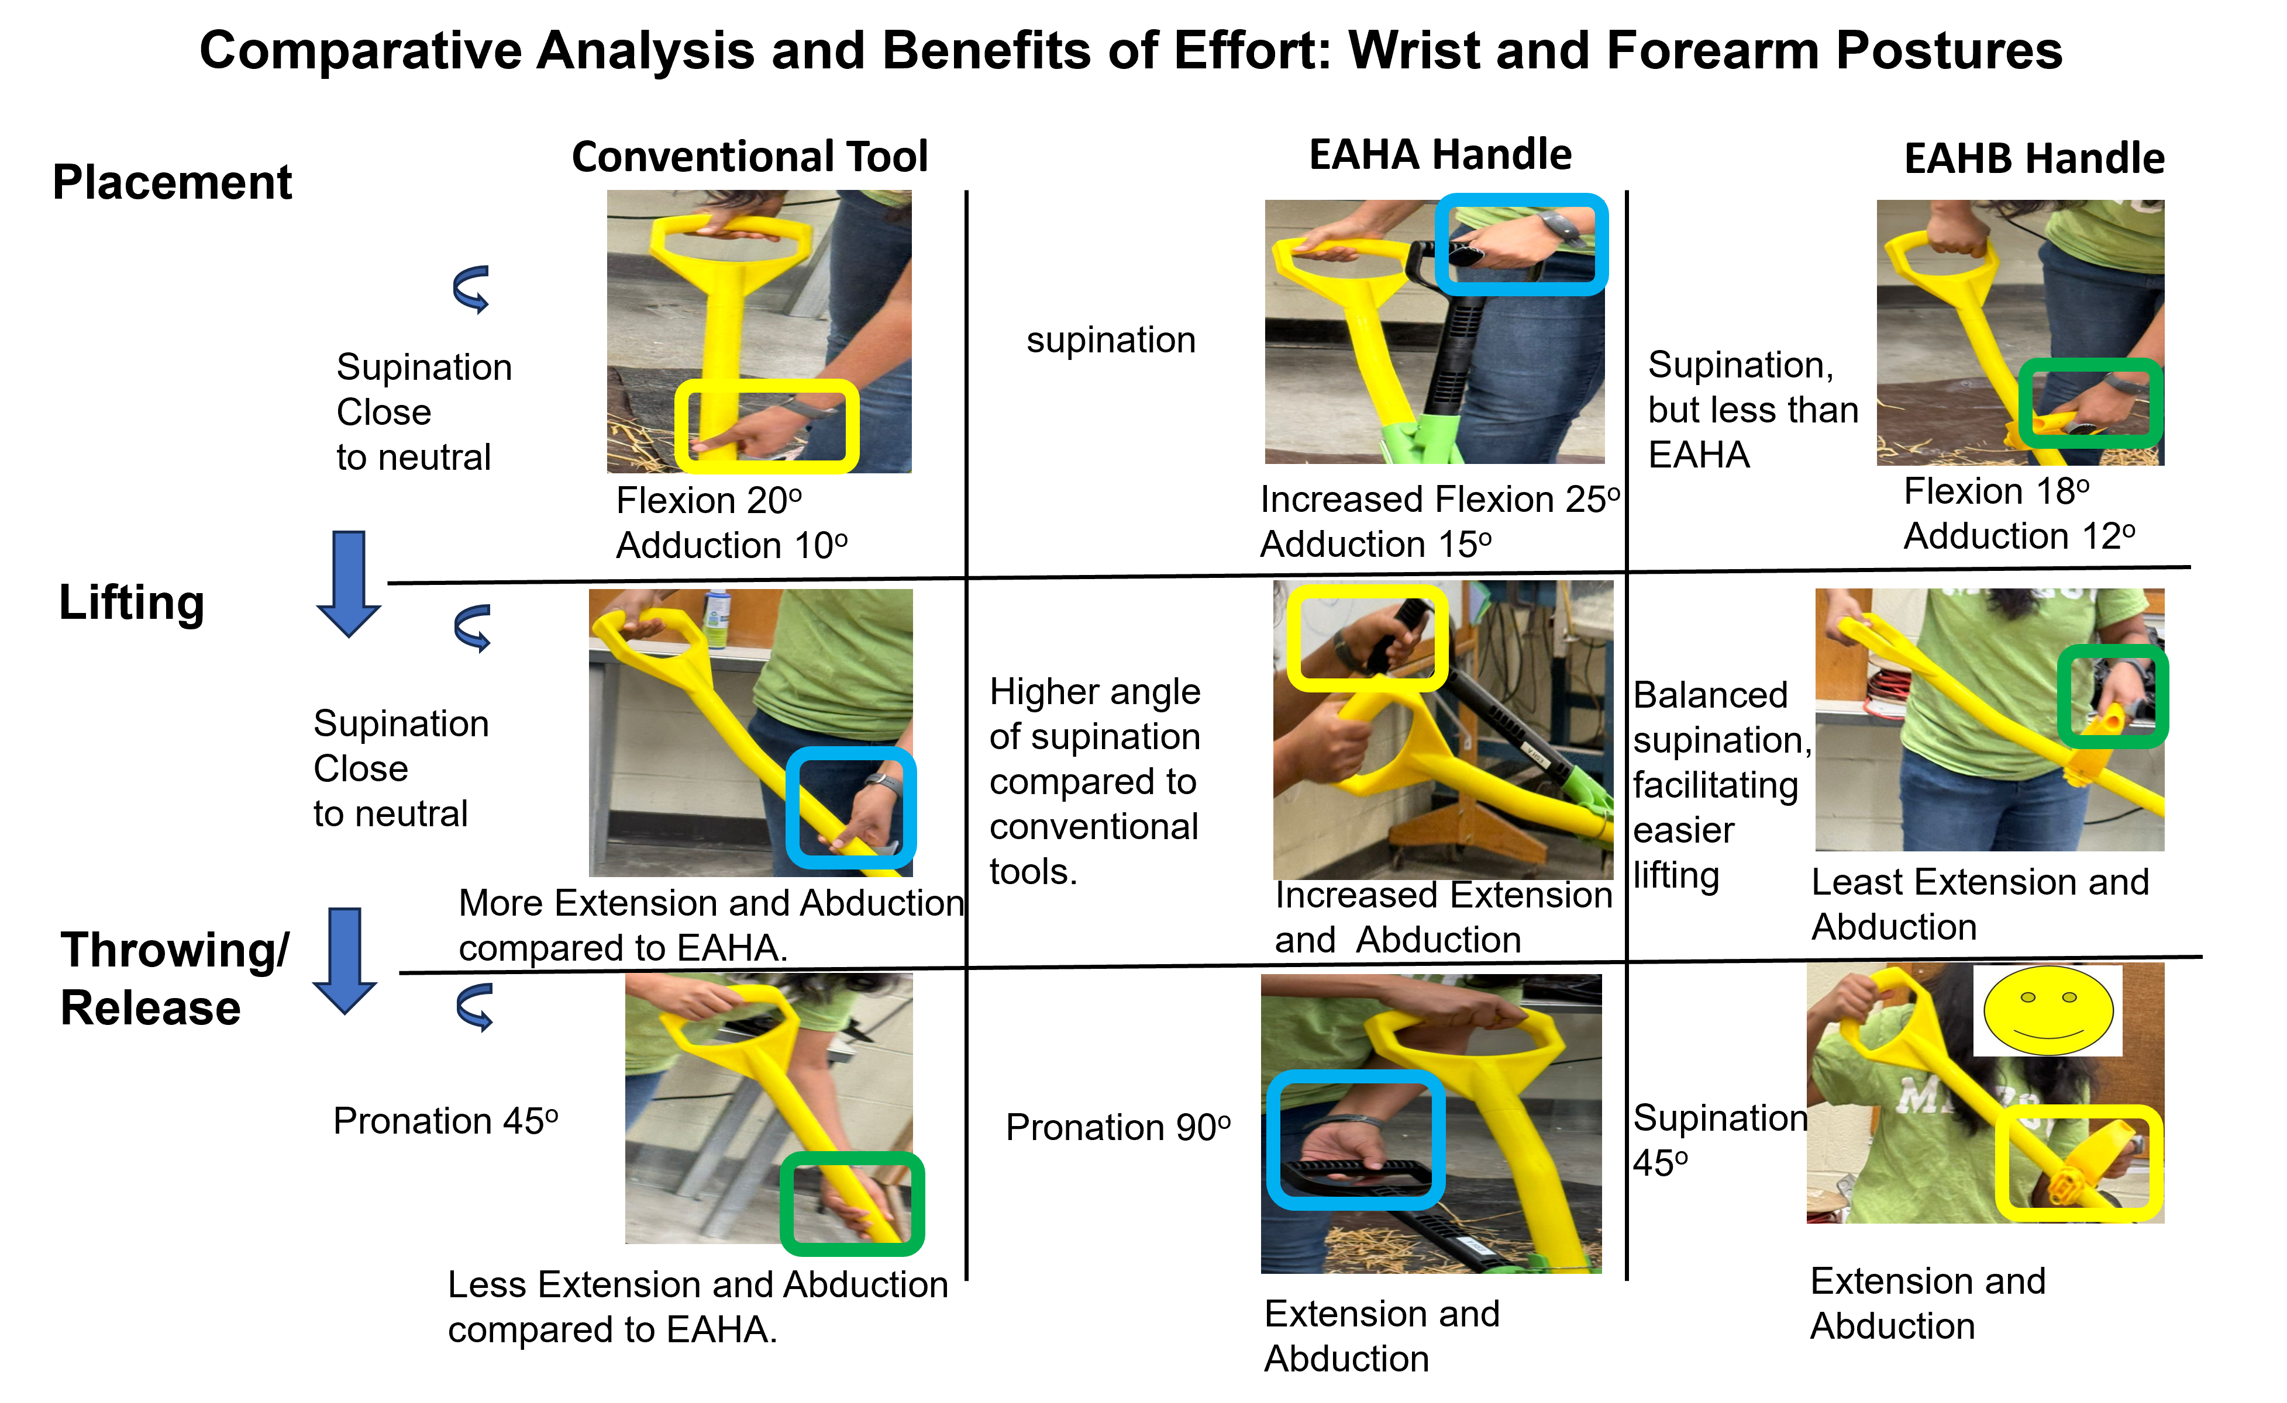
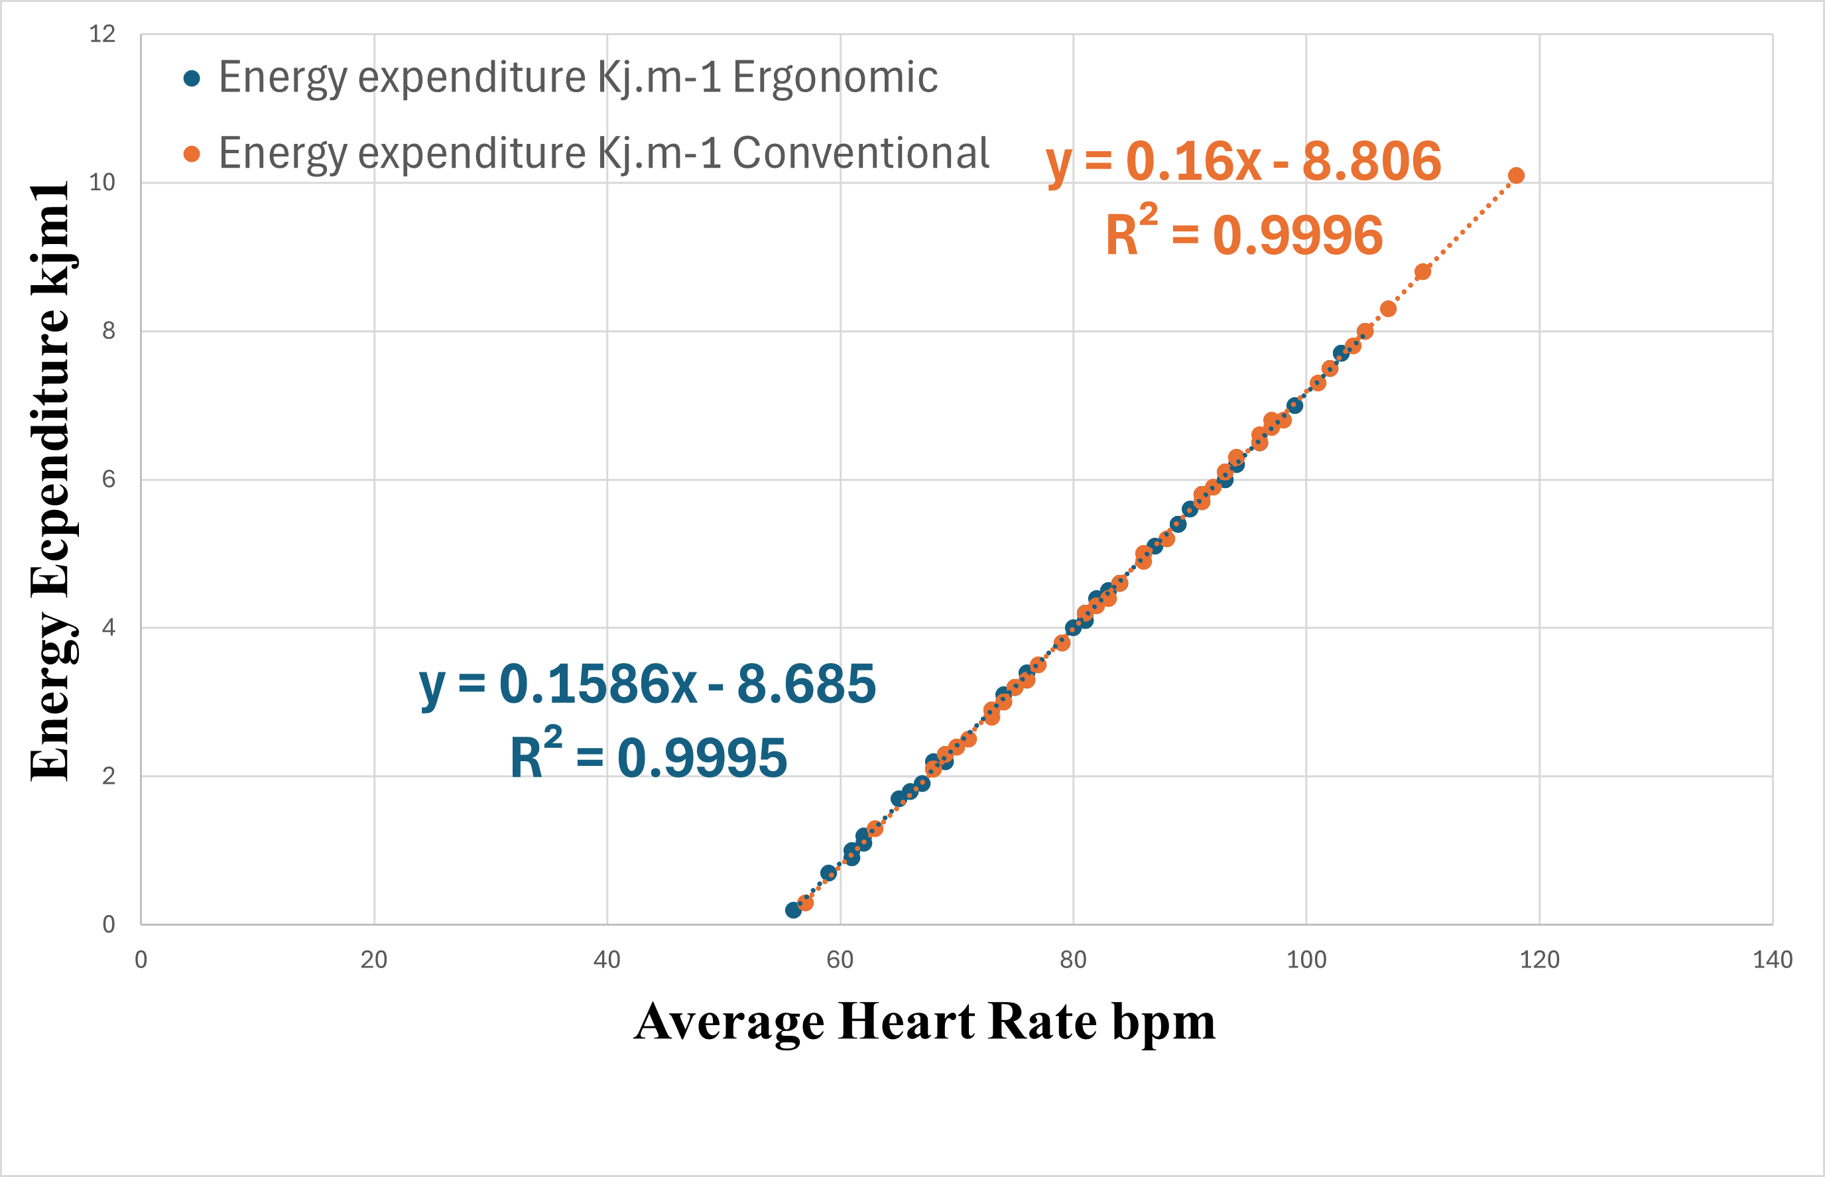
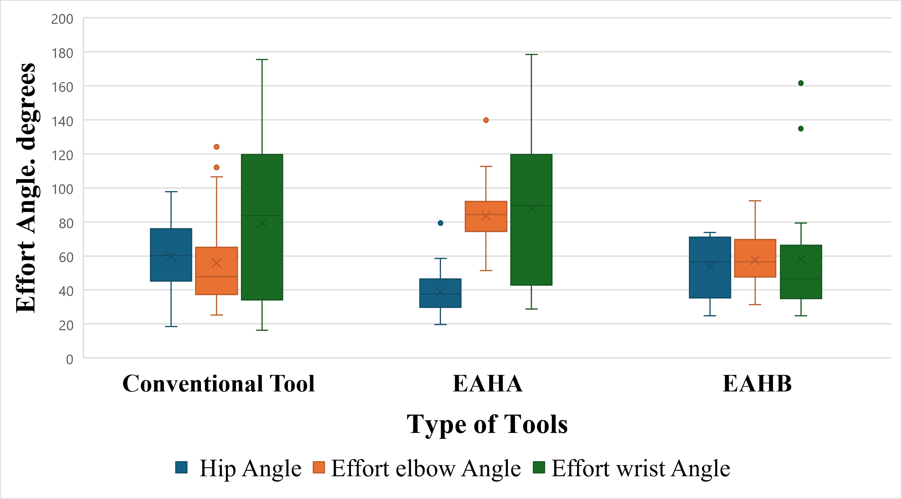
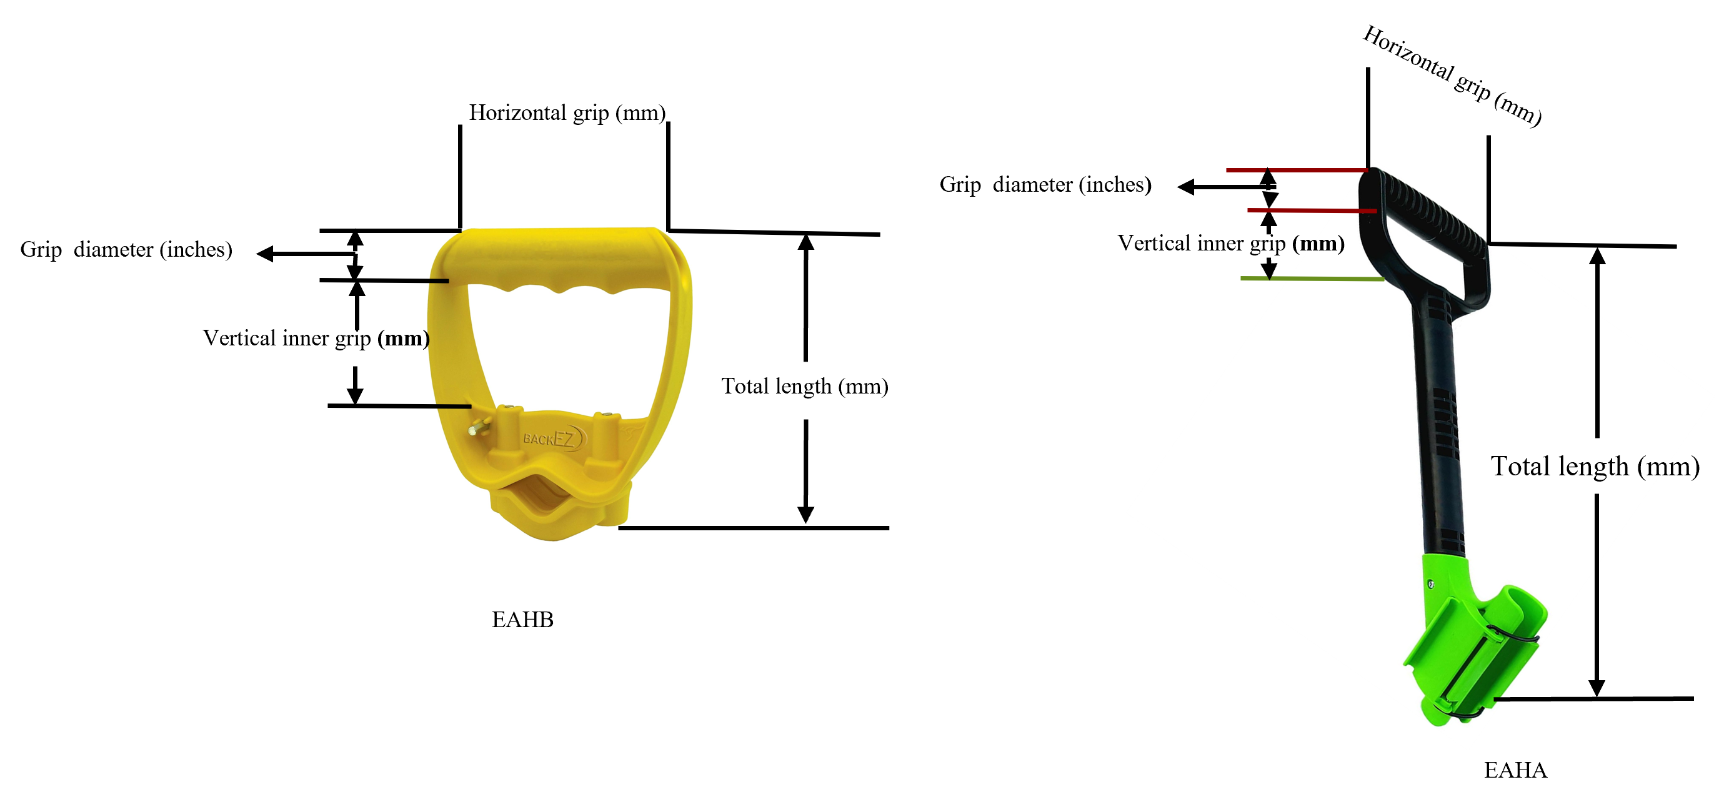
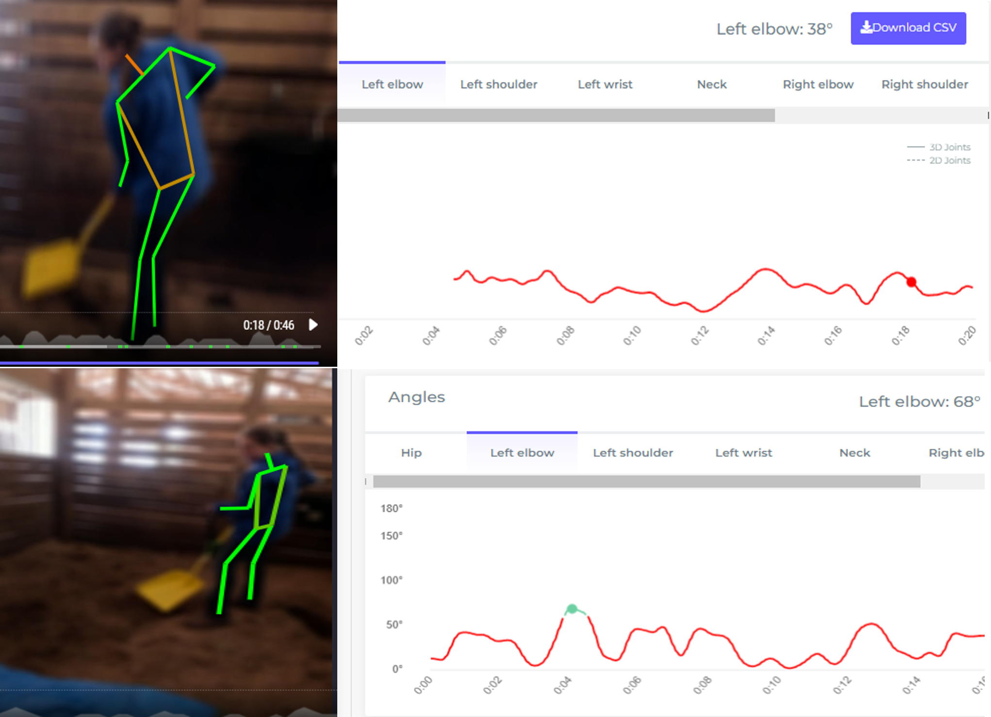
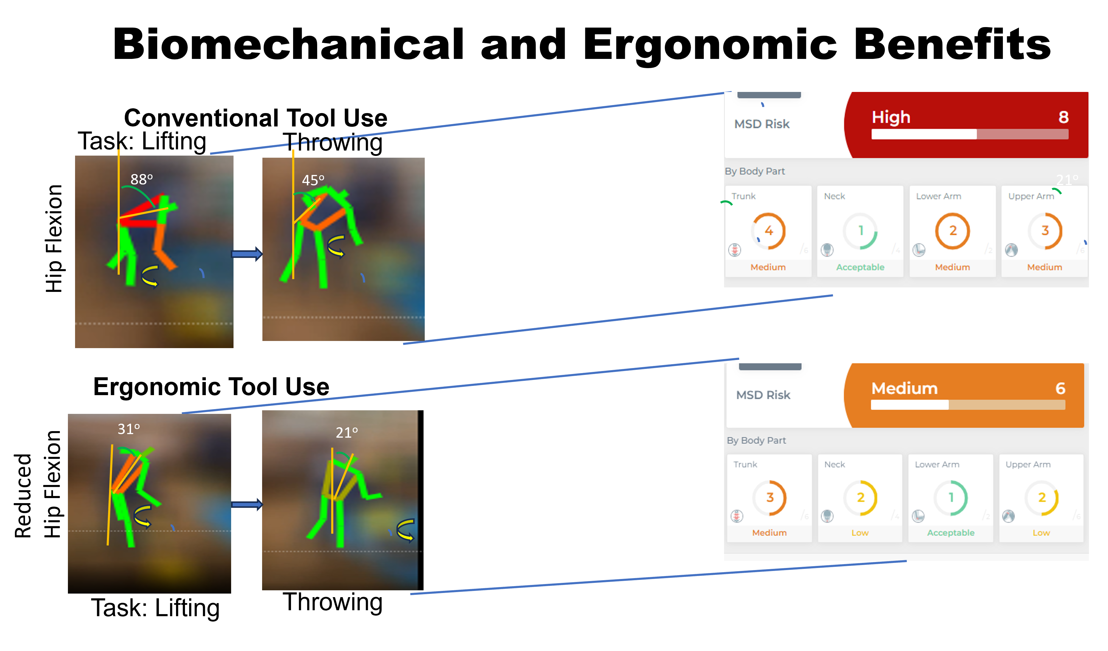
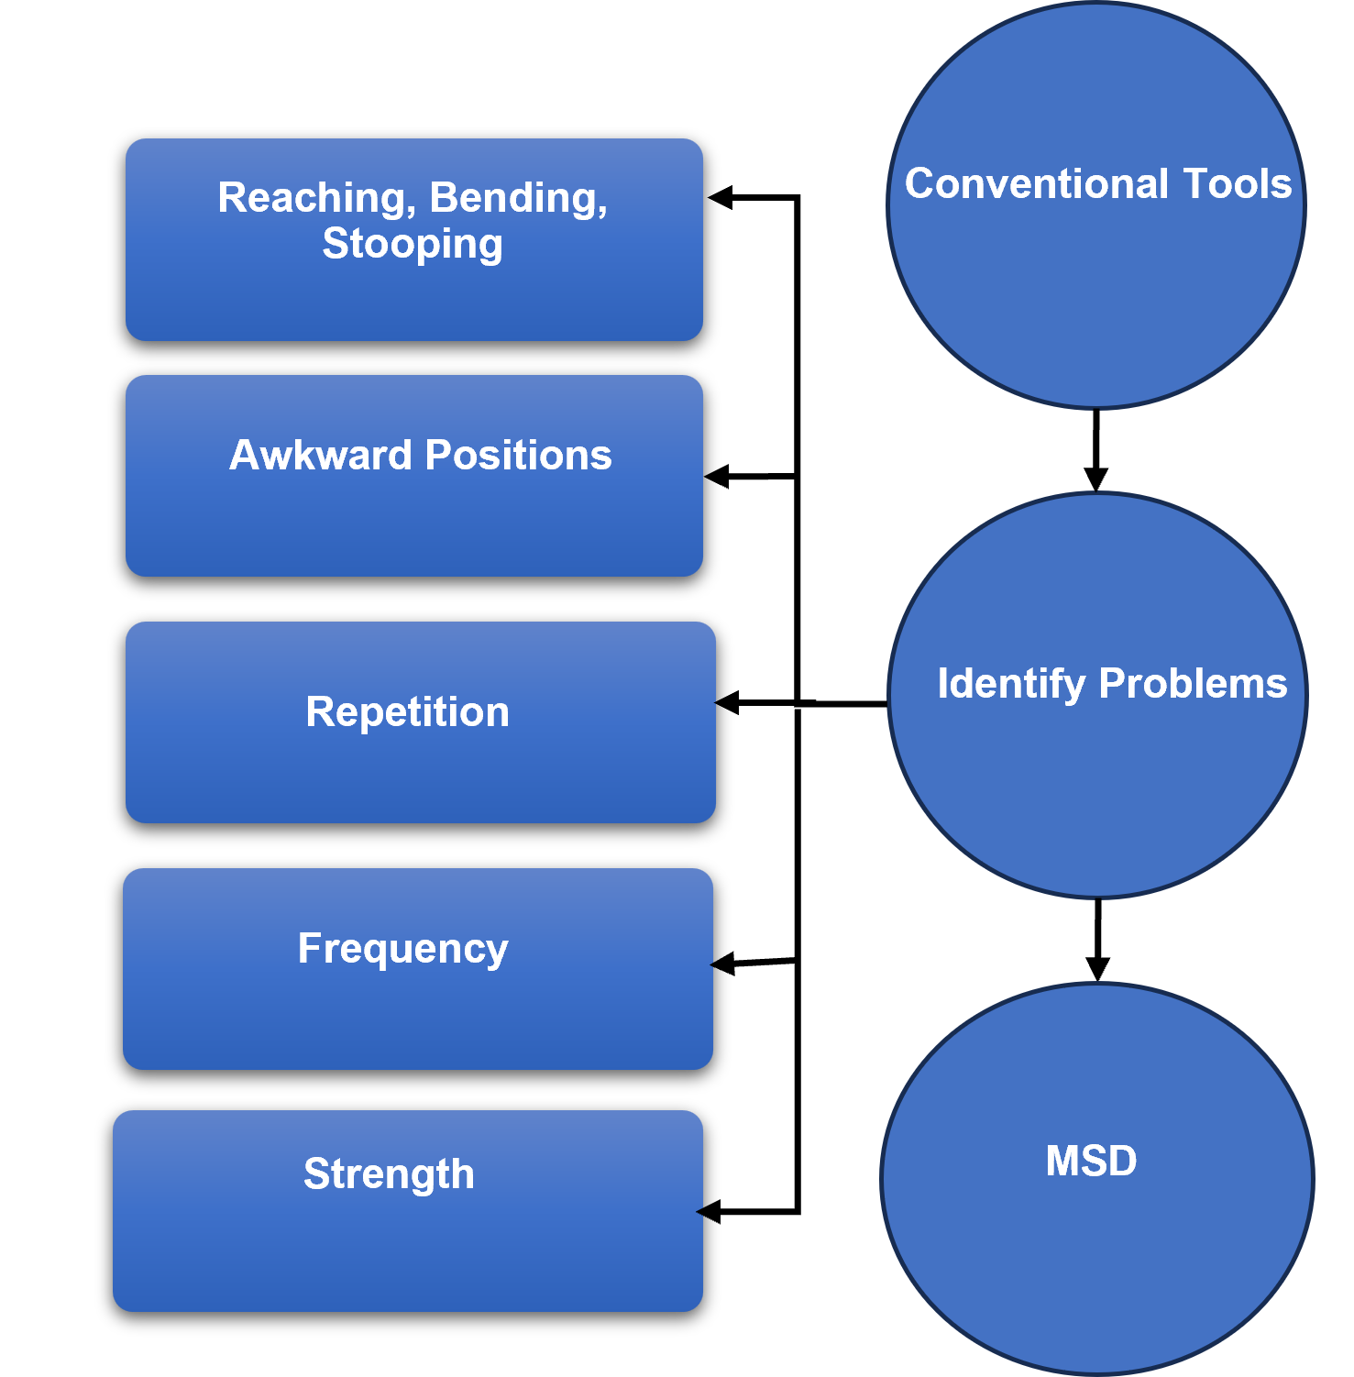
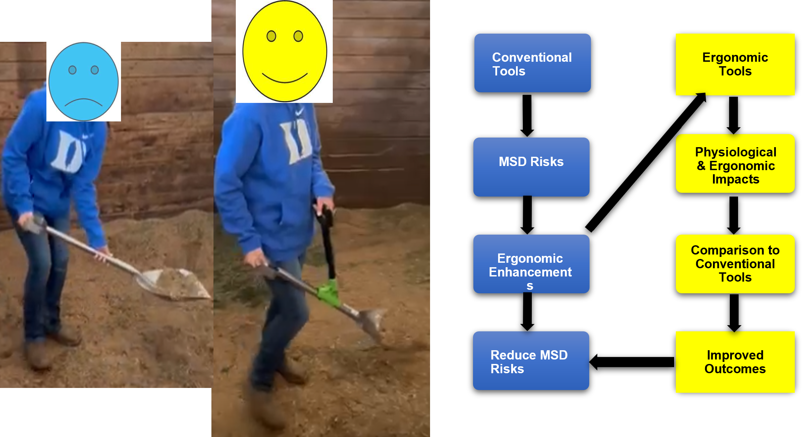

Ergonomic Benefits of Auxiliary Handles on Shovels and Pitchforks for Women Farmers
Felix Michael Oguche, Jianfeng Zhou, Karen Funkenbusch, Marcia C. Shannon,
University of Missouri, Columbia, MO (contact: fofdt@missouri.edu)
Introduction
Results
Agricultural work often involves manual tools such as shovels and pitchforks, posing significant risks of musculoskeletal disorders (MSDs), especially among women (Freivalds, 1986a; McPhee, 2005).
Traditional tool designs typically do not consider the specific ergonomic needs of female farmers, potentially exacerbating these risks (Thariq et al., 2022).
Women face unique ergonomic challenges due to anatomical and physiological differences from men, including generally lower upper-body strength and different body anthropometry (Engberg, 1992; Jäger et al., 1991).
These findings support that ergonomic tools reduce task effort, consistent with Varghese et al. (1994), and highlight the direct impact on cardiovascular strain, aligning with Lehto and Buck (2008). Ergonomic tools may reduce fatigue and improve comfort over prolonged use.
Physiological Analysis:
Heart Rate: Ergonomic tools reduced average heart rate to 81 bpm compared to 86 bpm with conventional tools.
Energy Expenditure: Lower with ergonomic tools (4.29 KJ/kg vs. 4.98 KJ/kg) (Figure 1) Findings support that ergonomic tools reduce task effort (Varghese et al., 1994) and align with reduced cardiovascular strain (Lehto and Buck, 2008), potentially reducing fatigue and improving comfort over prolonged use.
Cardiac Cost of Work: Lower with ergonomic tools (18.17 vs. 31.26).
Motion Efficiency: Improved with ergonomic tools (46.85 vs. 48.05).
Research Motivation
Objective: Research has been prompted to design agricultural tools that better accommodate the anatomical and physiological characteristics of women (Sung & Freivalds, 1996; Kotowski et al., 2009).
Ergonomic improvements can reduce strain in one area but may introduce new strains elsewhere (Mani & Gerr, 2000; Moore & Scott, 2009).
This study focuses on evaluating the ergonomic benefits of auxiliary handles on shovels and pitchforks equipped with auxiliary handles for women farmers.
Ergonomic Measures
Hip Effort: Reduced significantly with ergonomic handles (p < 0.01) (Figure 2).
Wrist Effort: Increased significantly with ergonomic handles (p < 0.05).
Elbow Effort: Increased with ergonomic tools (p < 0.01).
Shoulder, Neck, and Leg Efforts: No significant differences observed
(p = 0.15, 0.53, and 0.73, respectively).
Conventional
EAHA
EAHB
Methods
Participants: Eight women participants representing a diverse range of body types and ages.
Tasks: Participants used both conventional and ergonomically enhanced tools to move straw mixed with dung in three-minute intervals with rest periods.
Tools: Included the EAHA and EAHB auxiliary handles.
Measurements: Physiological measurements such as heart rate, blood pressure, and oxygen saturation were recorded before and after tasks. Ergonomic assessments were conducted using RULA and REBA methods, along with video analysis to evaluate posture and movement.
Figure 1. Relationship between energy expenditure and average heart rate
Figure 2. Effort Angles (Hip, Elbow, Wrist) Across Conventional and Ergonomic Tools
Energy expenditure (Kj.m-1) =
0.159 x Average working heart rate (bpm-1) - 8.72 (Varghese et al., 1994). (1)
Cardiac Cost of Work =
(Average Working Heart Rate − Average Resting Heart Rate) × Duration of work. (Madhuri & Priyanka , 2021) (2)
Benefits and Insights
Ergonomic tools lowered heart rate and hip effort angle (15 degrees).
Lower Hip strain but increase wrist strain and elbow effort.
Better motion efficiency and lower energy expenditure .
Conclusions
Benefits: Ergonomic tools significantly reduce physical strain and may improve work efficiency for women farmers.
Trade-offs: Potential trade-offs in ergonomic design, such as increased elbow and wrist strain, need to be addressed.
Future Research: Focus on refining ergonomic designs to balance strain reduction across all body parts while minimizing cardiac costs. Integrating user-centric customization and conducting long-term field studies will be crucial to refine these tools further.
This material is based upon work that is supported by the National Institute of Food and Agriculture, U.S. Department of Agriculture, under agreement number 2021-38640-34714 through the North Central Region SARE program under project number LNC21-458. USDA is an equal opportunity employer and service provider. Any opinions, findings, conclusions, or recommendations expressed in this publication are those of the author(s) and do not necessarily reflect the view of the U.S. Department of Agriculture.

