Slide 1
Indigenous Foodways of the Midwest: The Impacts of Contact and the Importance of Revitalization
Christina Gish Hill
World Languages and Cultures

Slide 2
Land Acknowledgement
I would like to open by taking a moment to acknowledge my presence as a guest on Indigenous land. For generations, Ioway, Meskwaki, Sauk, Dakota, and Oto peoples, among others, have stewarded the lands where I live. Also, as faculty at Iowa State University, I would like to acknowledge that it is located on the ancestral lands and territory of the Baxoje (bah-kho-dzhe), or Ioway Nation. The United States obtained the land from the Meskwaki and Sauk nations in the Treaty of 1842. I wish to recognize our obligations to this land and to the Indigenous people who care for it, as well as to the 17,000 Native people who live in Iowa today."

Slide 3
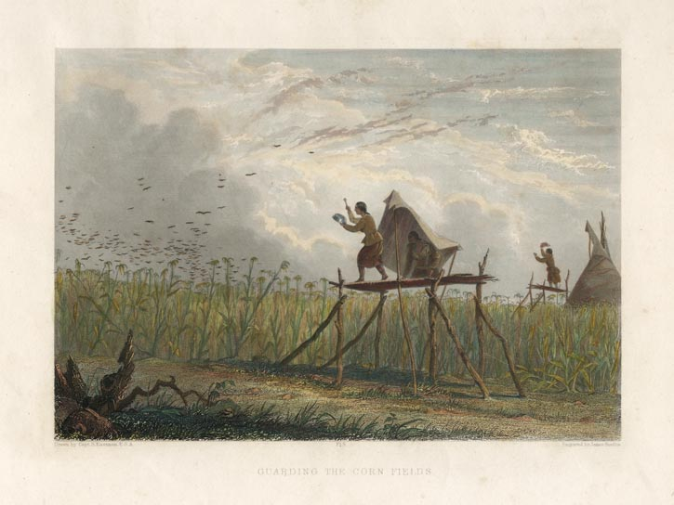
Indigenous Agriculture in the Midwest
Guarding the Corn Fields
Engraving hand-colored, 1851-57.
Image size 5 5/8 x 8 1/8" (14.3 x 22.7 cm).
From Henry Schoolcraft's "Historical Information...Respecting the Indian Tribes of North America."

Slide 4
Indigenous Trade Routes
James H. Merrell, The Indians' New World: Catawbas and Their Neighbors from European Contact through the Era of European Removal (Chapel Hill: University of North Carolina Press, 1989); Daniel Richter, The Ordeal of the Longhouse: The Peoples of the Iroquois League in the Era of European Colonization (Chapel Hill: University of North Carolina Press, 1992); Richard White, The Middle Ground: Indians, Empires, and Republics in the Great Lakes Region, 1650-1815 (Cambridge: Cambridge University Press, 1991).

Slide 5
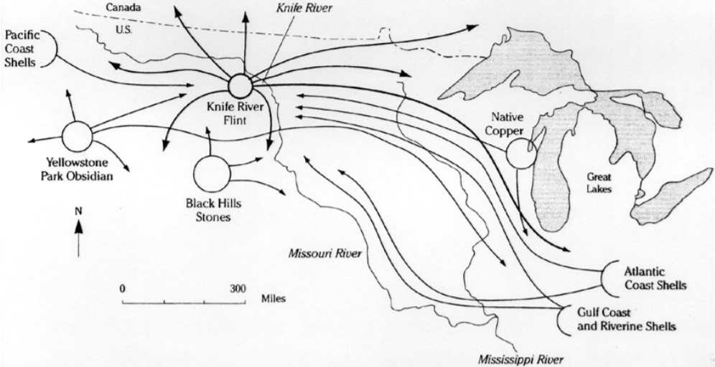
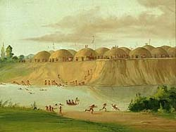
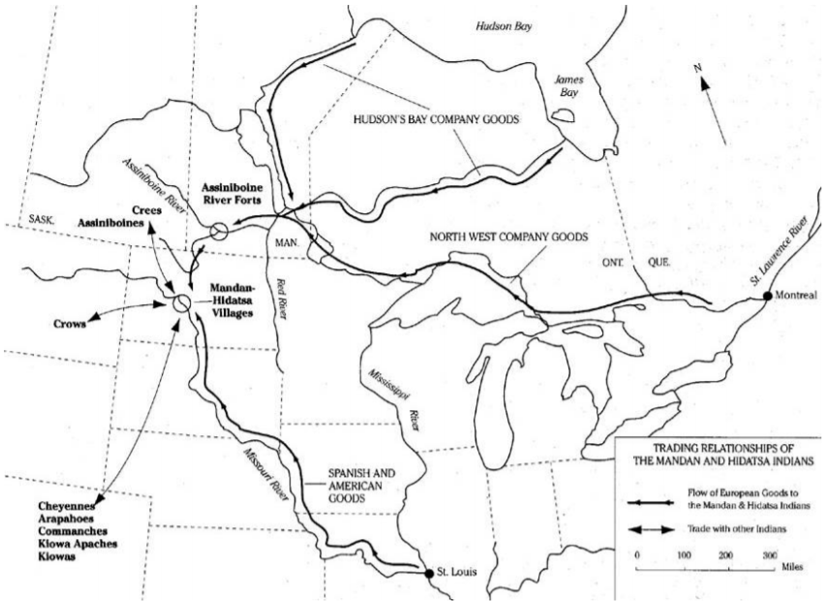
Mandan and Hidatsa: Center of Trade
1832 Image of the Knife River Village, George Caitlin

Slide 6
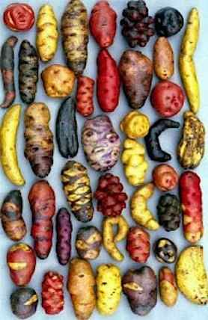
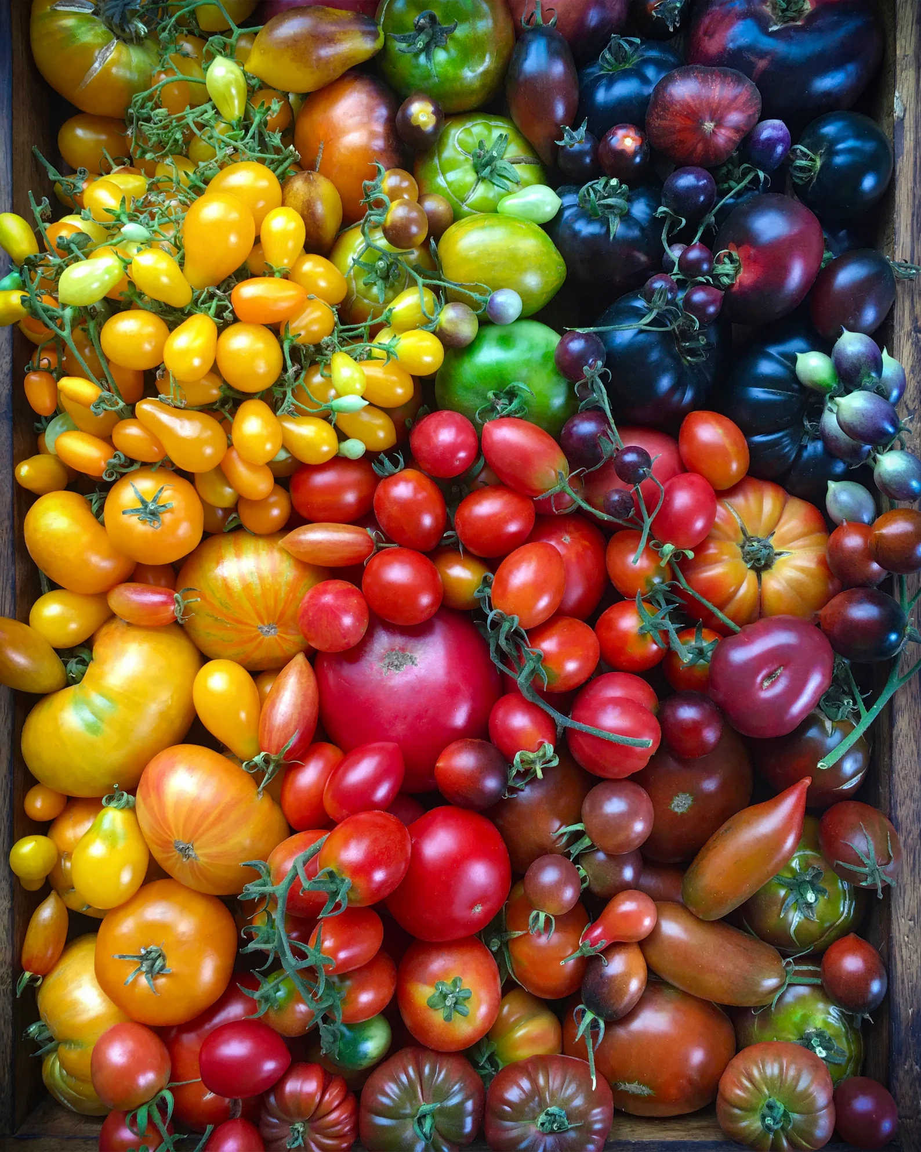
The impact of exchange on Europe: Foods
Buffalo
Turkey
Corn
Beans
Squash
Potatoes
Tomatoes
Peppers
Avocados
Chocolate

Slide 7
Cultural and Biological Impacts of European Contact
Population loss:
Up to 95%
Diseases
Malnutrition
Murder and warfare
Loss of culture and traditional knowledge
Loss of Land
Changes to ecosystems

Slide 8
Fur Trade
Major economic endeavor by all European powers
Impact on Native people
Competition with other tribes
Changes in political structures to suit Europeans
Economic shift from subsistence to trapping
Dependency on trade, trade items
New emphasis on territorial defense
Larger groups settle near trading posts

Slide 9
Fort Pitt Canada: Cree Natives & Fur Traders

Slide 10
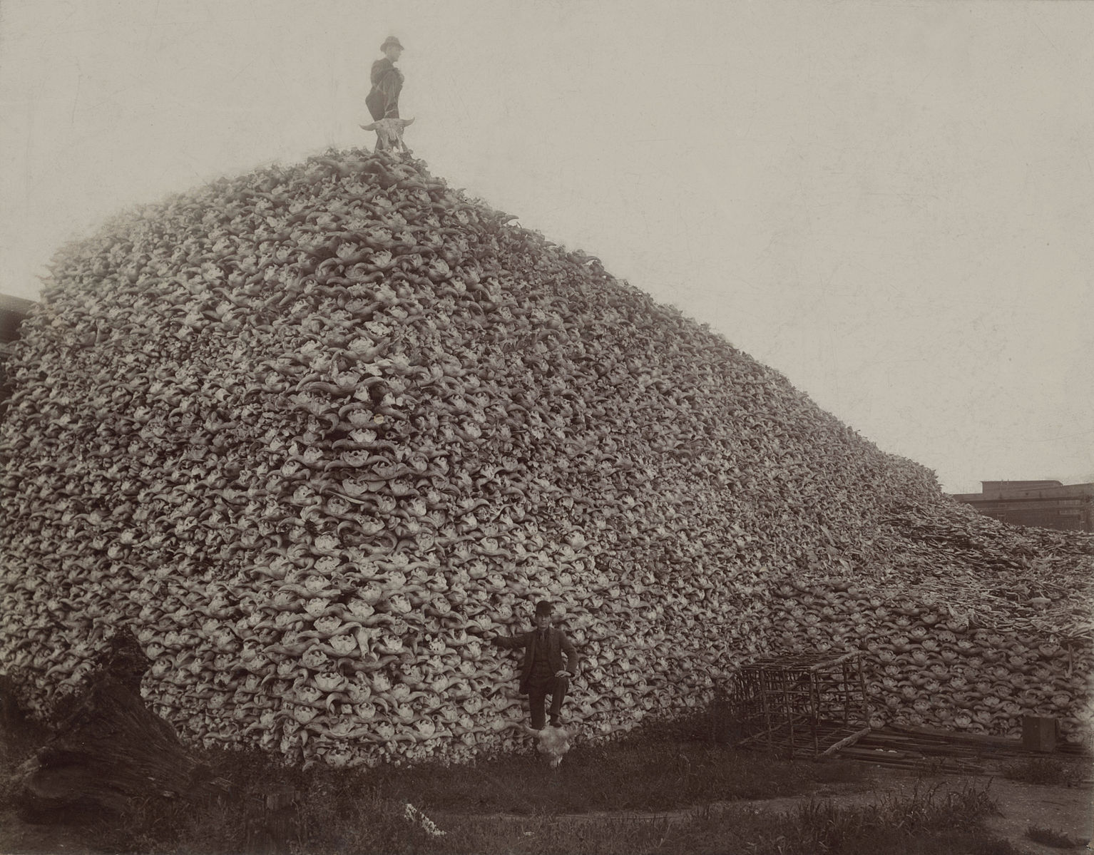
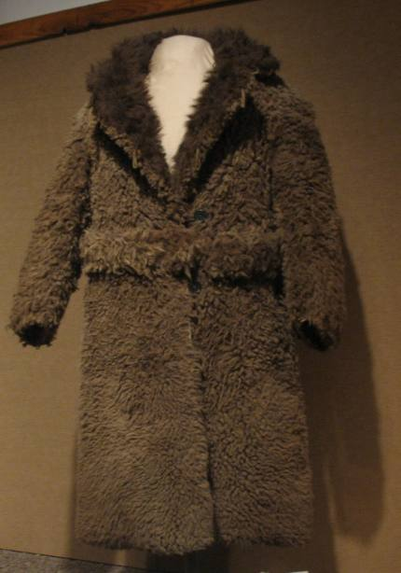
Buffalo Hide Trade

Slide 11
The Indian Removal Act (1830)
Proposed to exchange Cherokee land in Georgia for federal lands west of the Mississippi.
Based on Georgia’s claim to own the land; Georgia held title and the Cherokee only had occupancy rights.
This was a very contentious bill, but it passed and Andrew Jackson signed it.

Slide 12
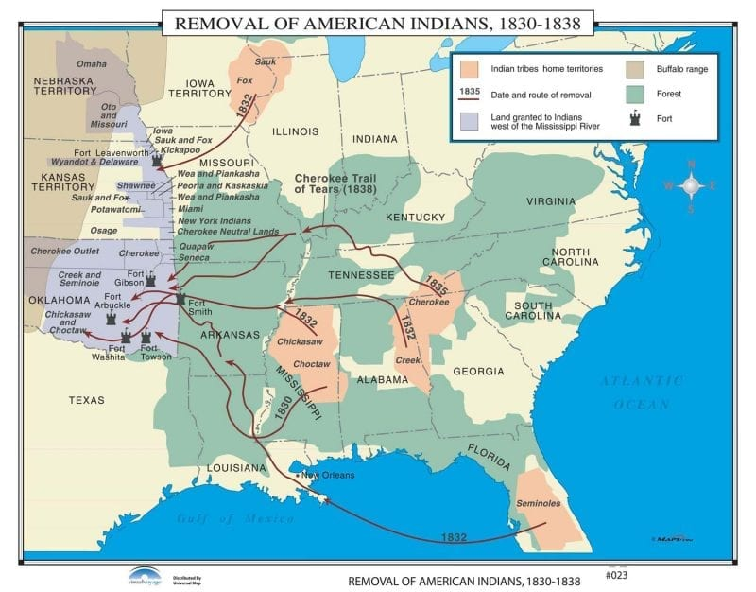
Removal

Slide 13
Map of Iowa 1845

Slide 14
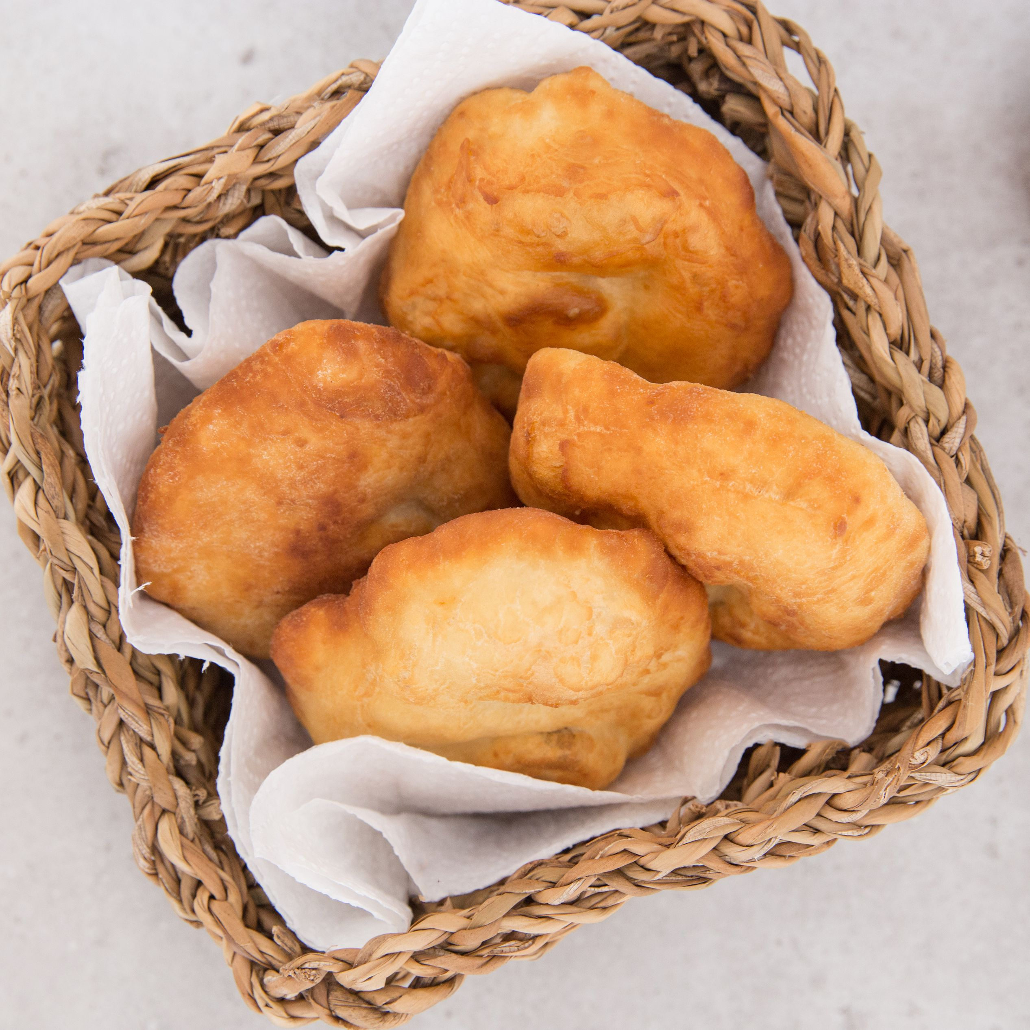
Impacts on Indigenous Agriculture and Diet
New lands with different ecologies
Seeds struggled to grow
People struggled to access land
They often had to depend on rations

Slide 15
The Dawes General Allotment Act (1887)
Divided reservations into plots and opened the “surplus” land for sale to non-Natives.
Every head of household received 160 and every single adult received 80 (including single women).
American Indian nations lost over 90 million acres of land through this act.

Slide 16
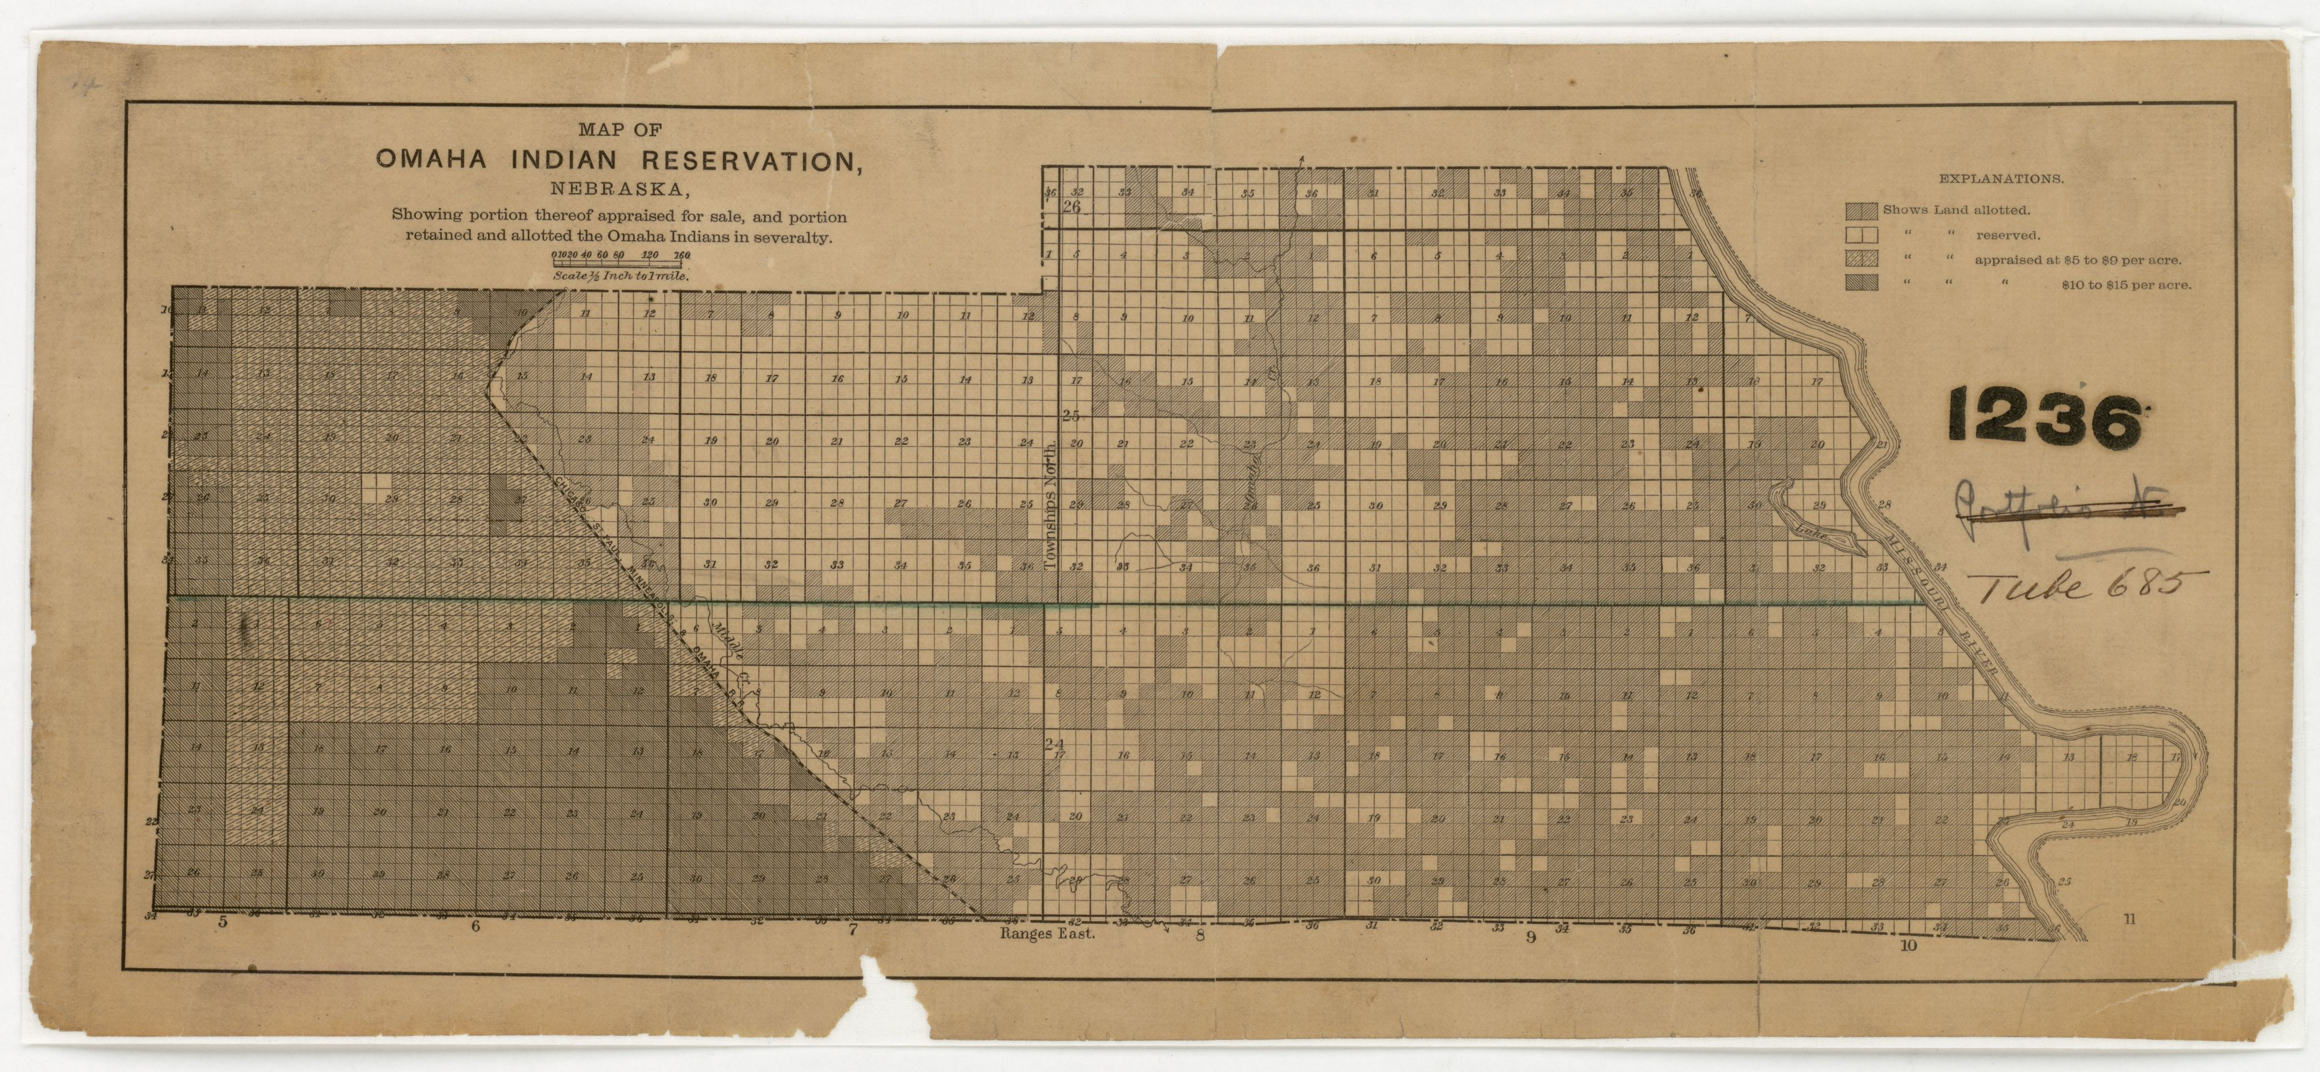
Allotment on the Omaha Reservation in Nebraska
Notes:
Willamette Pulp & Paper Company Map
OHS Map 259
Oregon State Historical Society

Slide 17
Federal Boarding Schools
Carlisle, the first federal school, was established in 1879 by Captain Richard Pratt.
The government established multiple agency schools and 20 off reservation boarding schools.

Slide 18
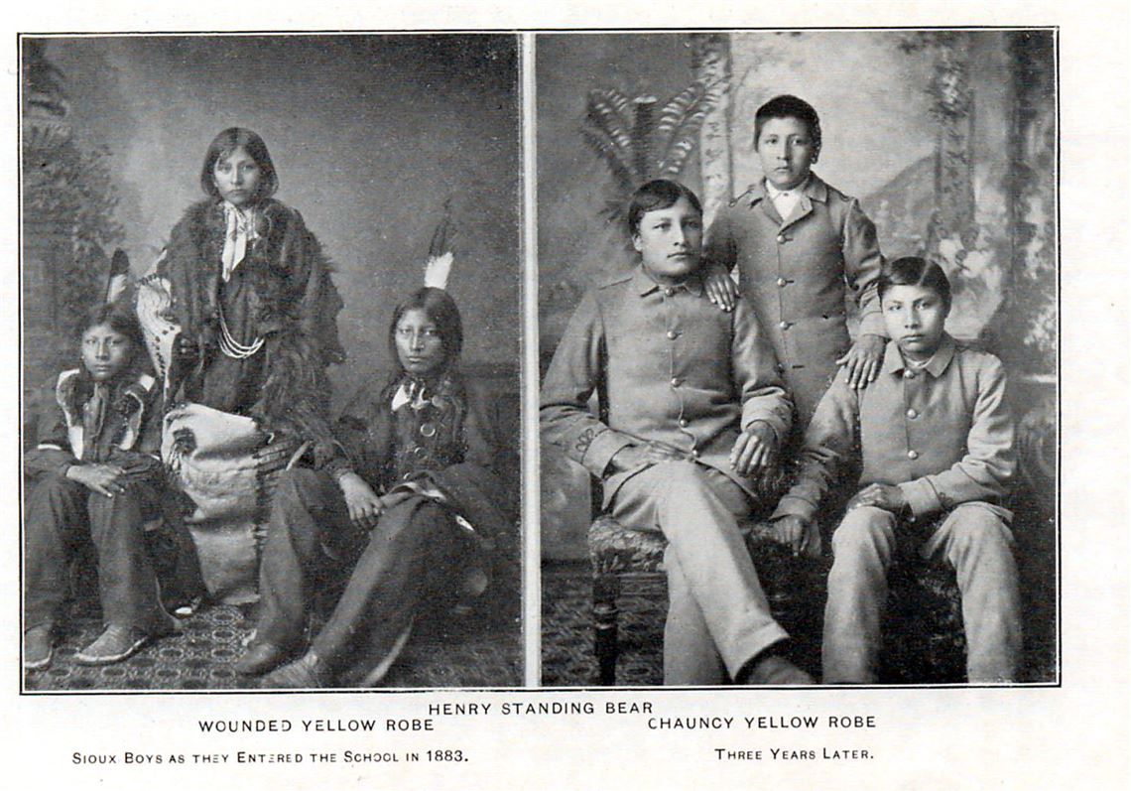
Advertising Assimilation
Notes:
dcinsideout.blogspot.com/beforeandafter.jpg

Slide 19
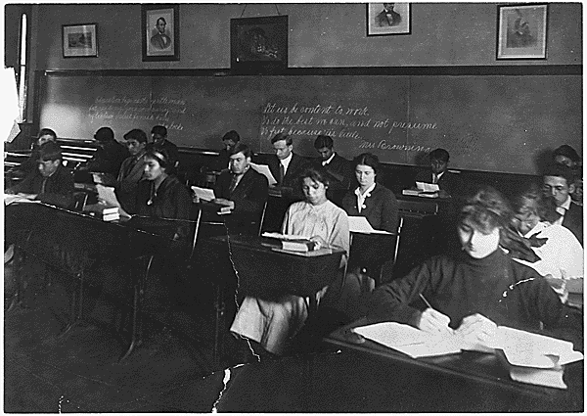
A classroom at Carlisle
Notes:
NARA's Pacific Alaska Region (Seattle, WA) (NRIS), 6125 Sand Point Way NE, Seattle, WA 98115-7999 (NRIS-75-PAOLAVATTA-CARL39)

Slide 20
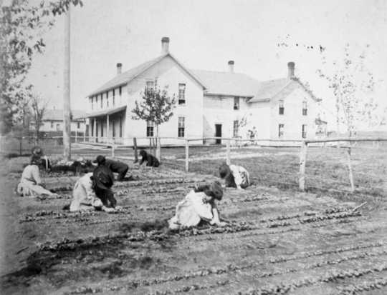
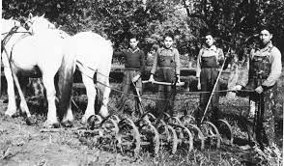
Farming Programs for Students

Slide 21
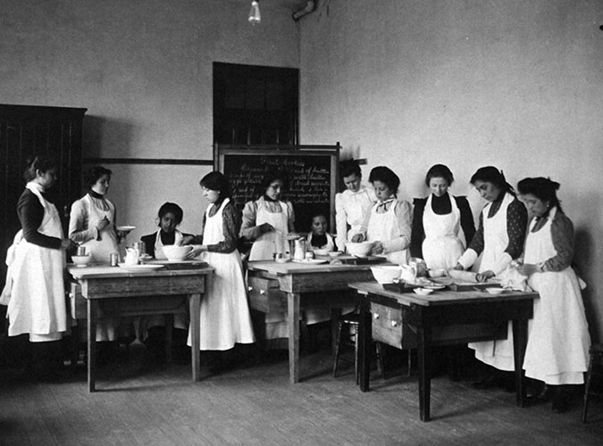
Learning to Cook

Slide 22
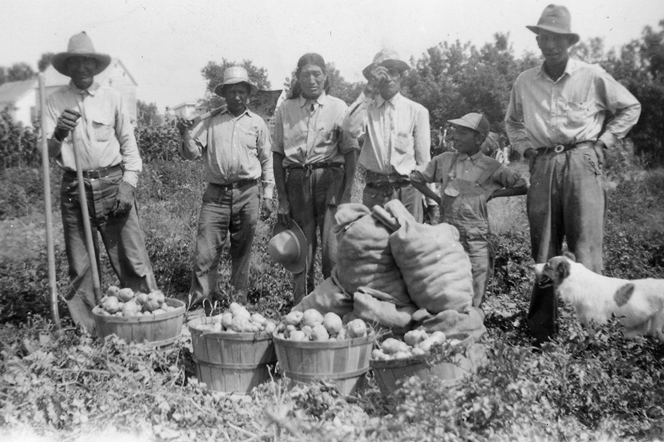
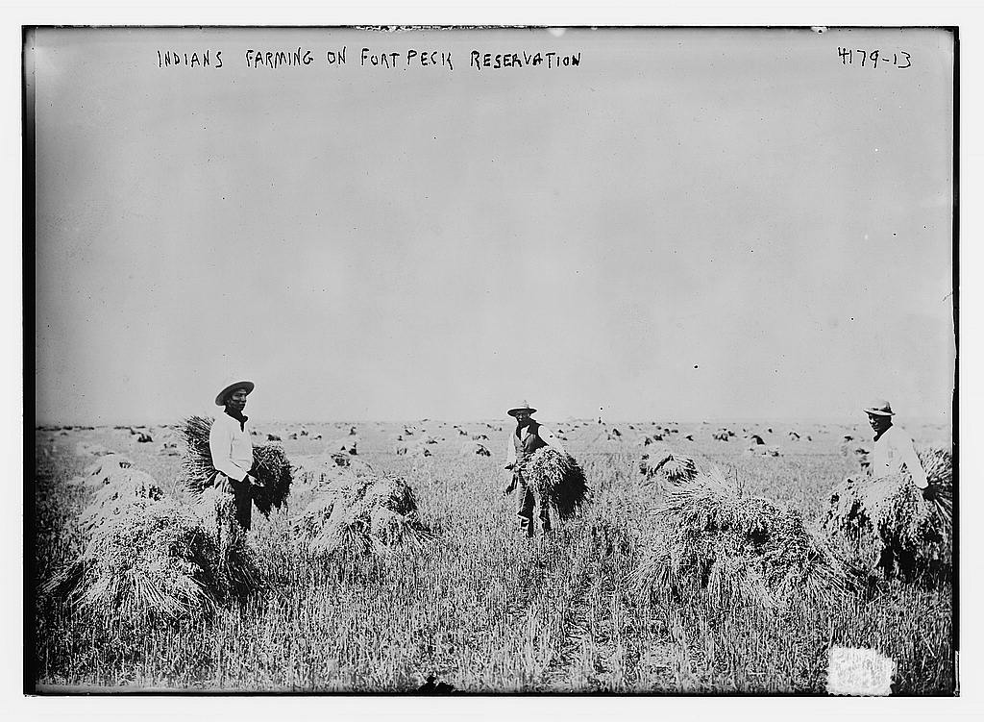
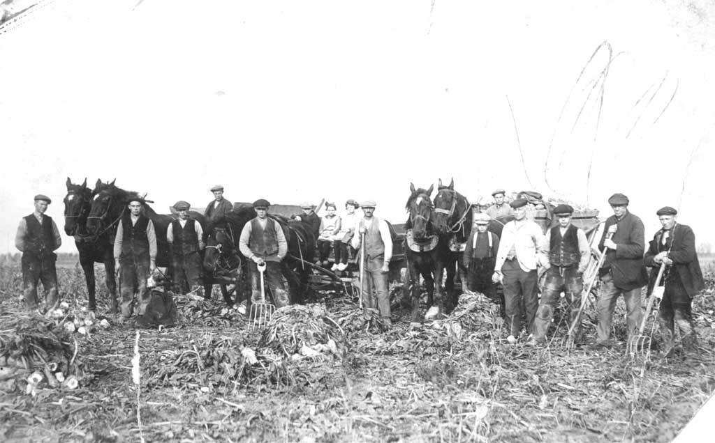
Indian Agents Teach Euro-American Style Agriculture

Slide 23
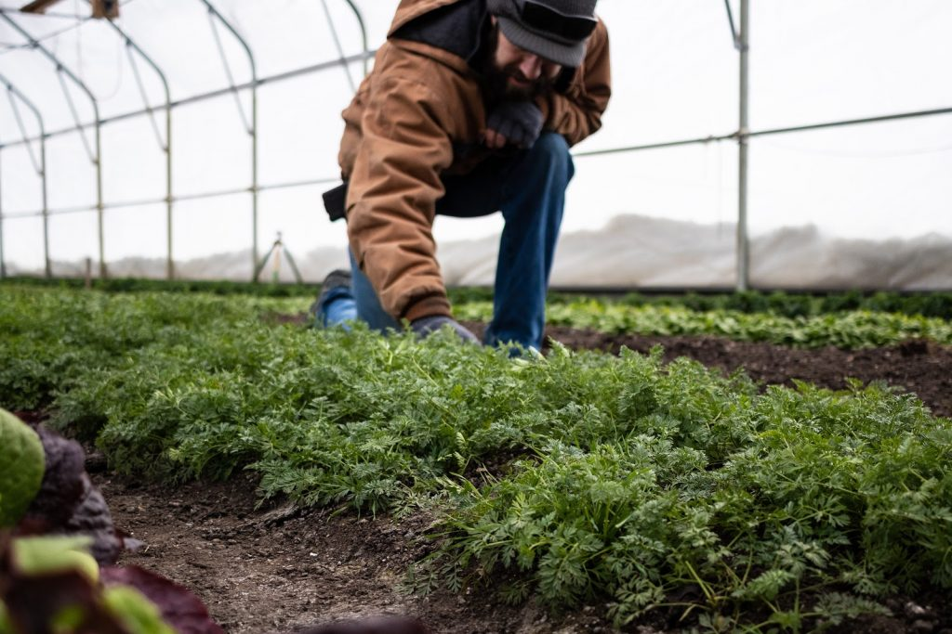
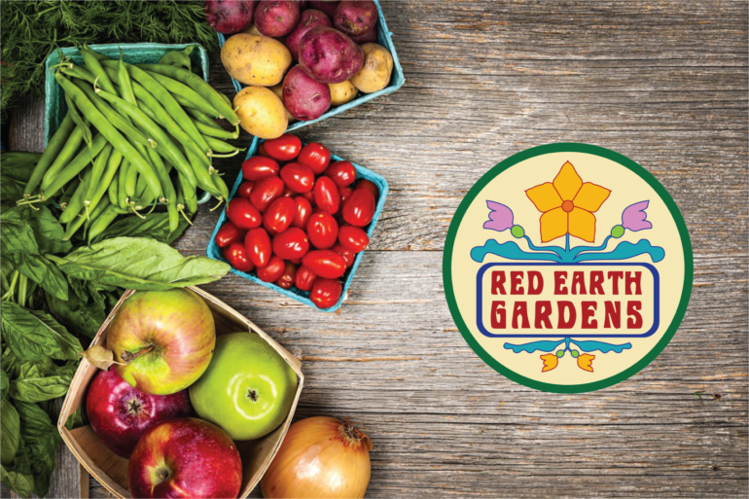
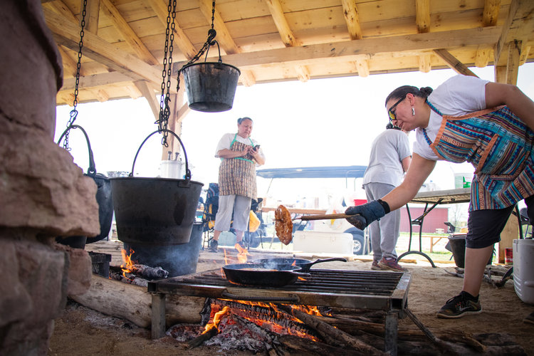
Red Earth Gardens: Meskwaki

Slide 24
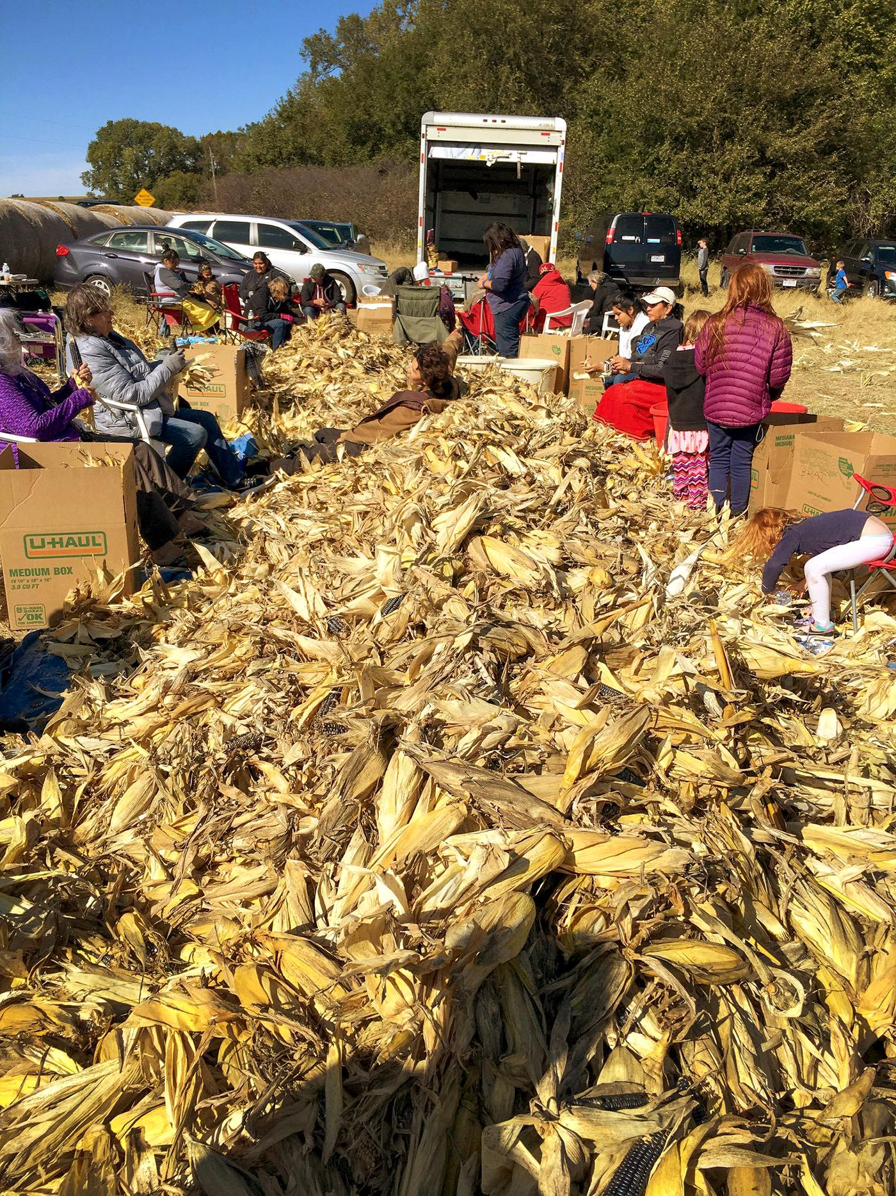
Pawnee Nation Growing In Nebraska
A collaboration between farmers in Nebraska and the Pawnee, who resided in the area before being displaced from their traditional homelands. Photo from Pawnee Seed Preservation Project
Electa Hare-RedCorn, Deb Echo-Hawk, and Sonny Howell. Hare-RedCorn and Howell were the first interns for the Pawnee Seed Preservation Project, both recruited by Echo-Hawk, who traveled to Nebraska from Oklahoma to reconnect Pawnee seed with Pawnee people. Photo by Robert Wood Johnson Foundation
The fall harvest on October 15, 2019, volunteers visit a spot where Pawnee blue corn grows strong in Pleasant Dale, Nebraska.

Slide 25
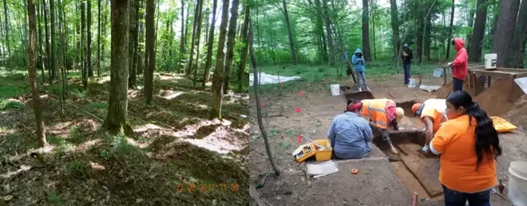
Ancient Ridge Gardens: Menominee Nation
The site before and during excavation
David Overstreet maps garden sites.
These gardens are 1,000 years old and were farmed until the 20th century

Slide 26
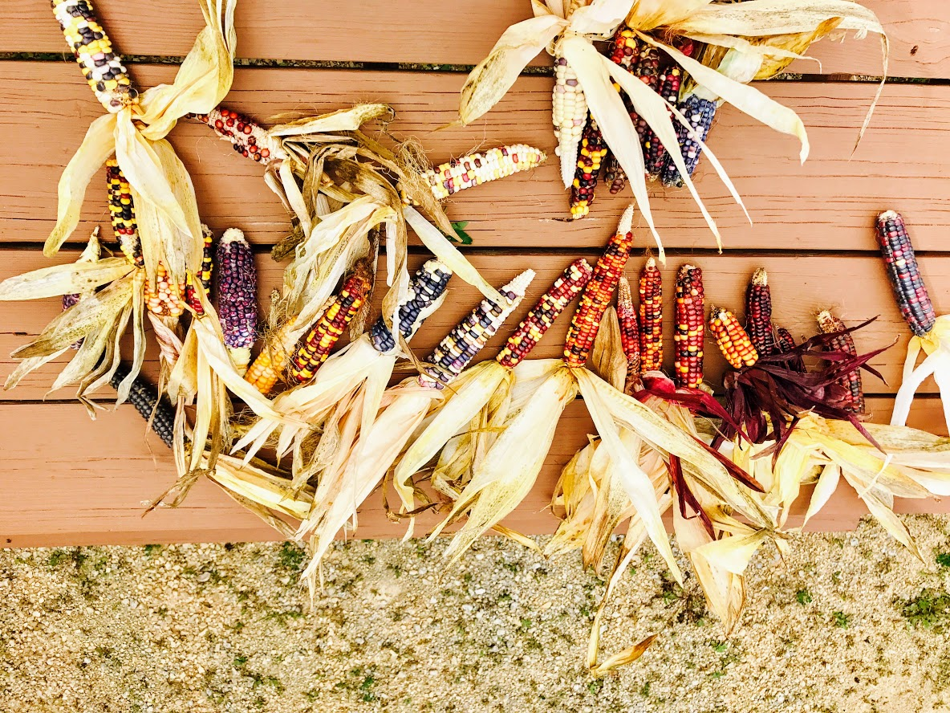
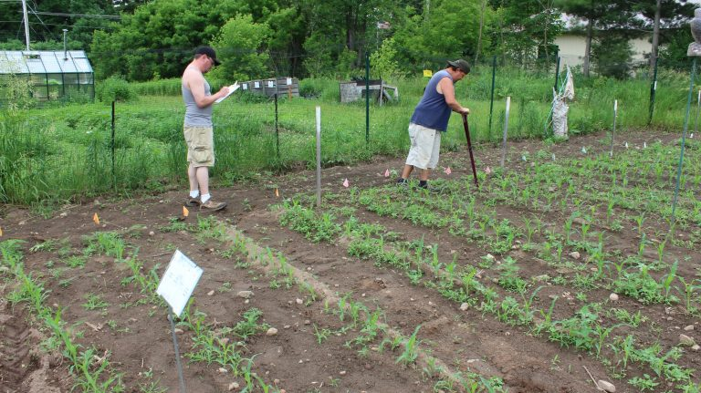
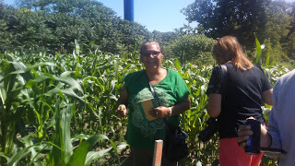
Bear Island Flint Study: Menominee Nation

Slide 27
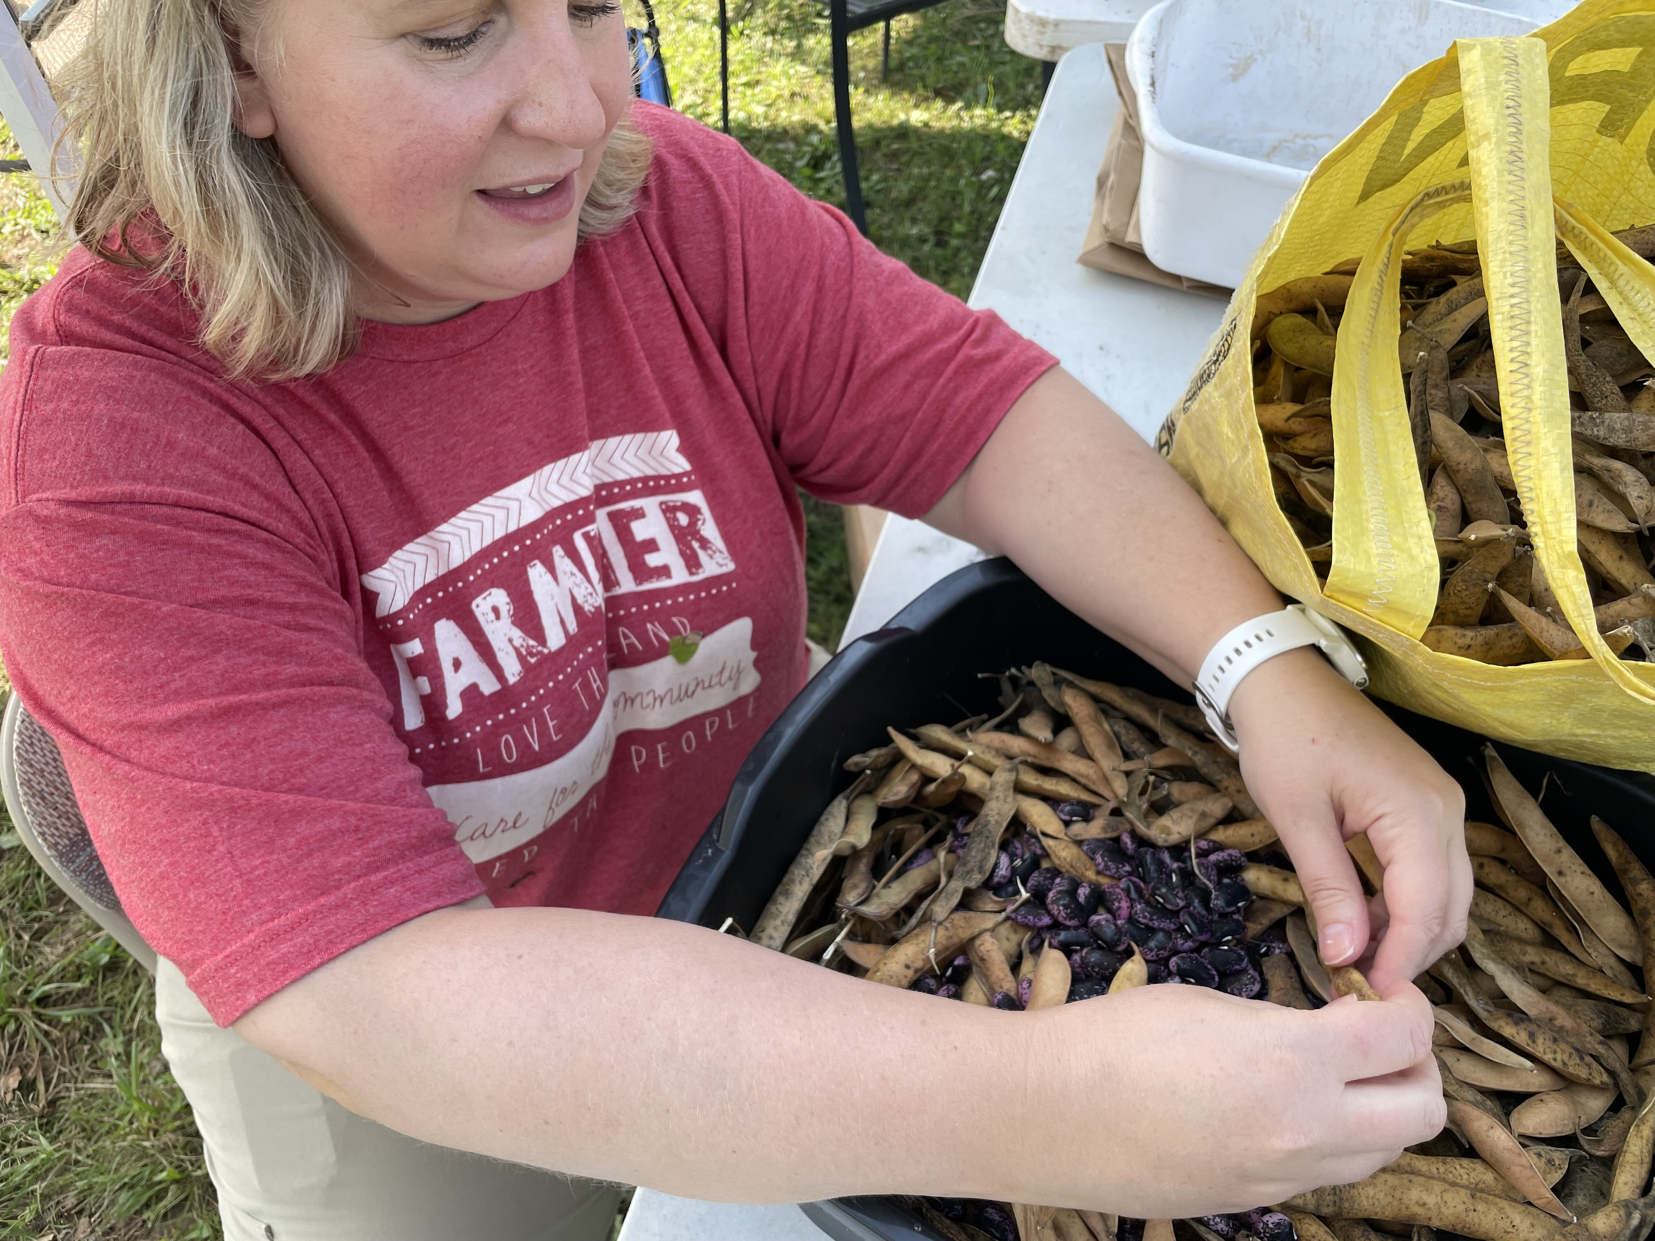
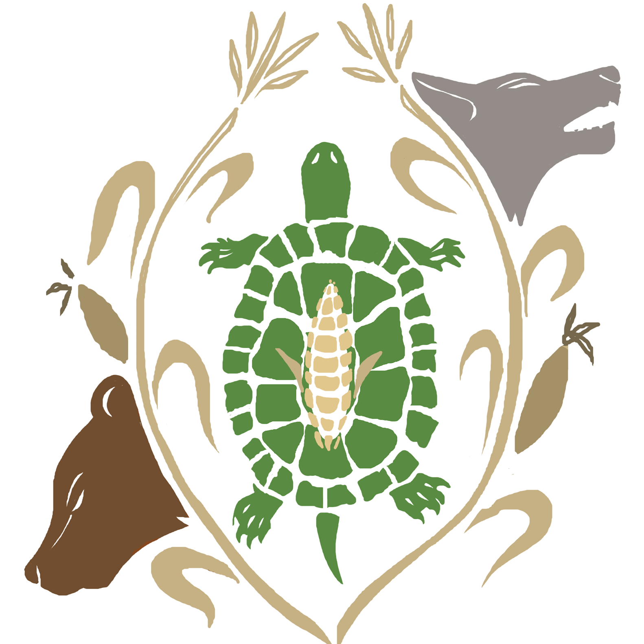
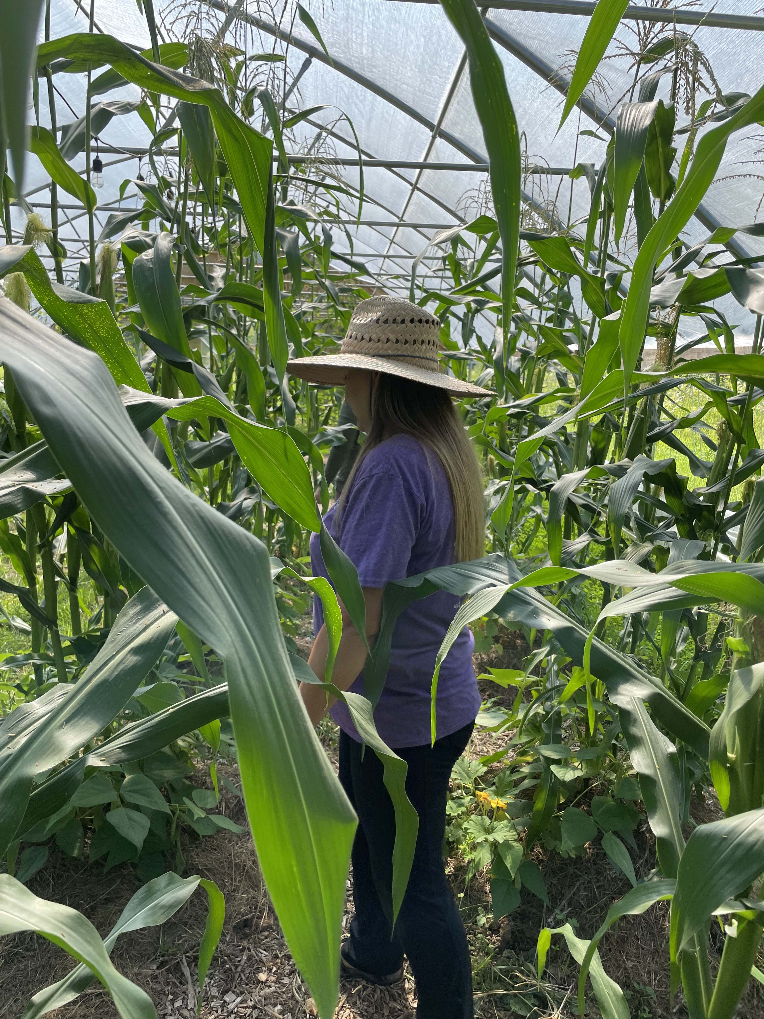
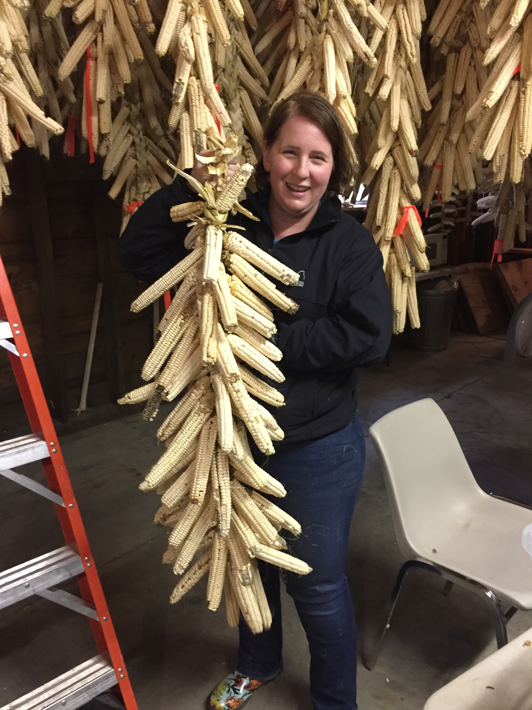
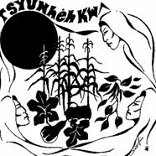
Revitalizing Indigenous Foodways: Oneida Nation

Slide 28
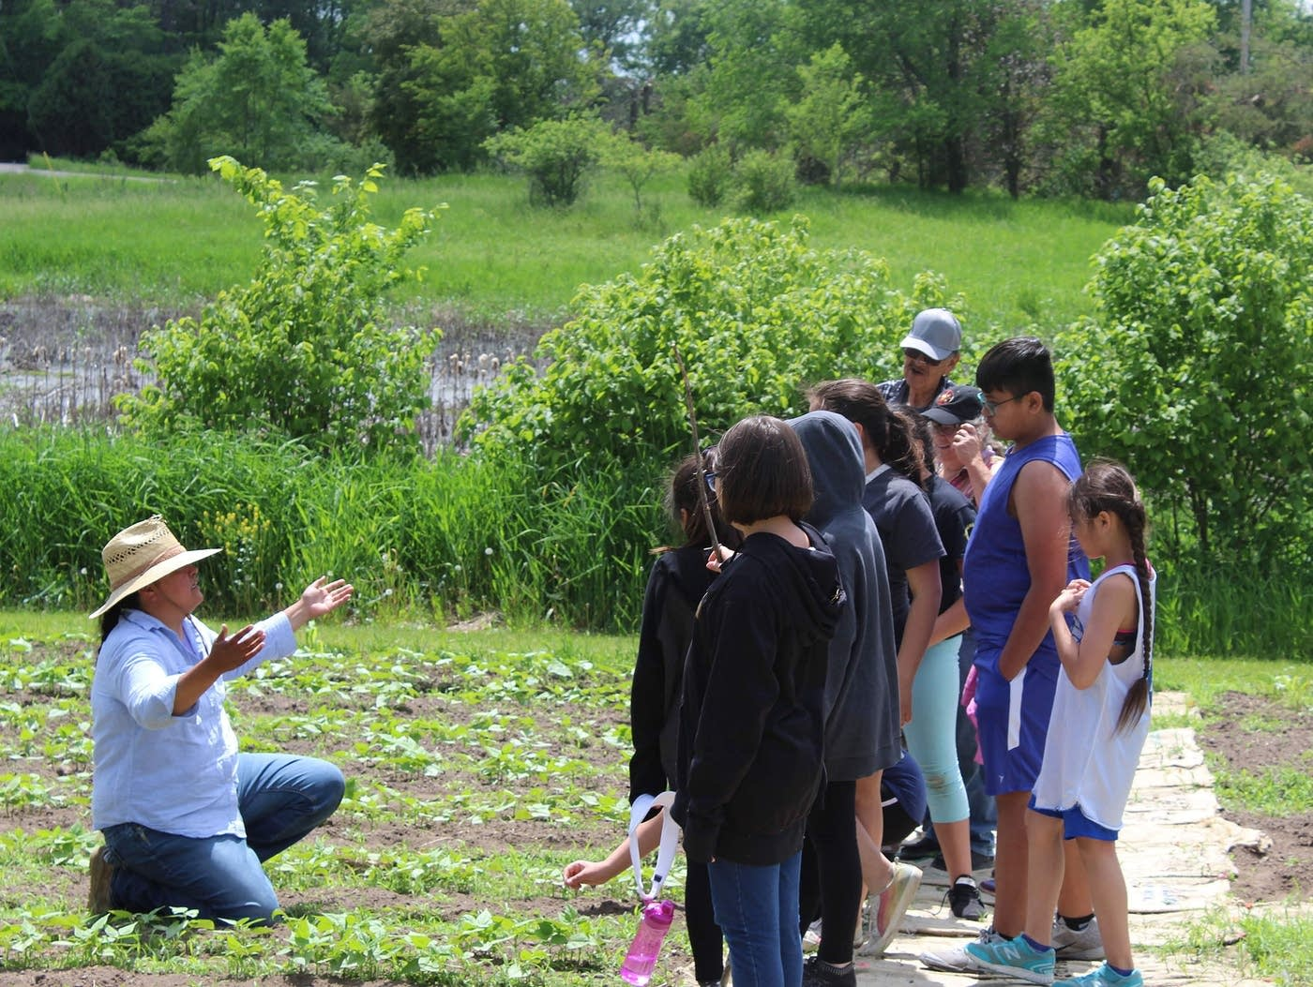
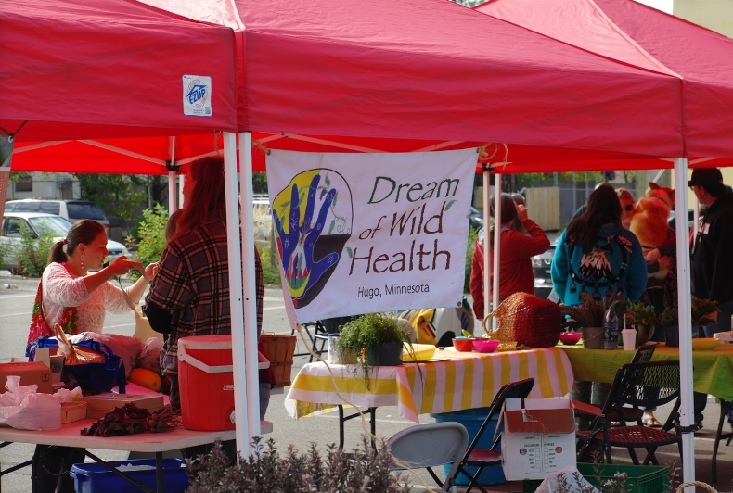
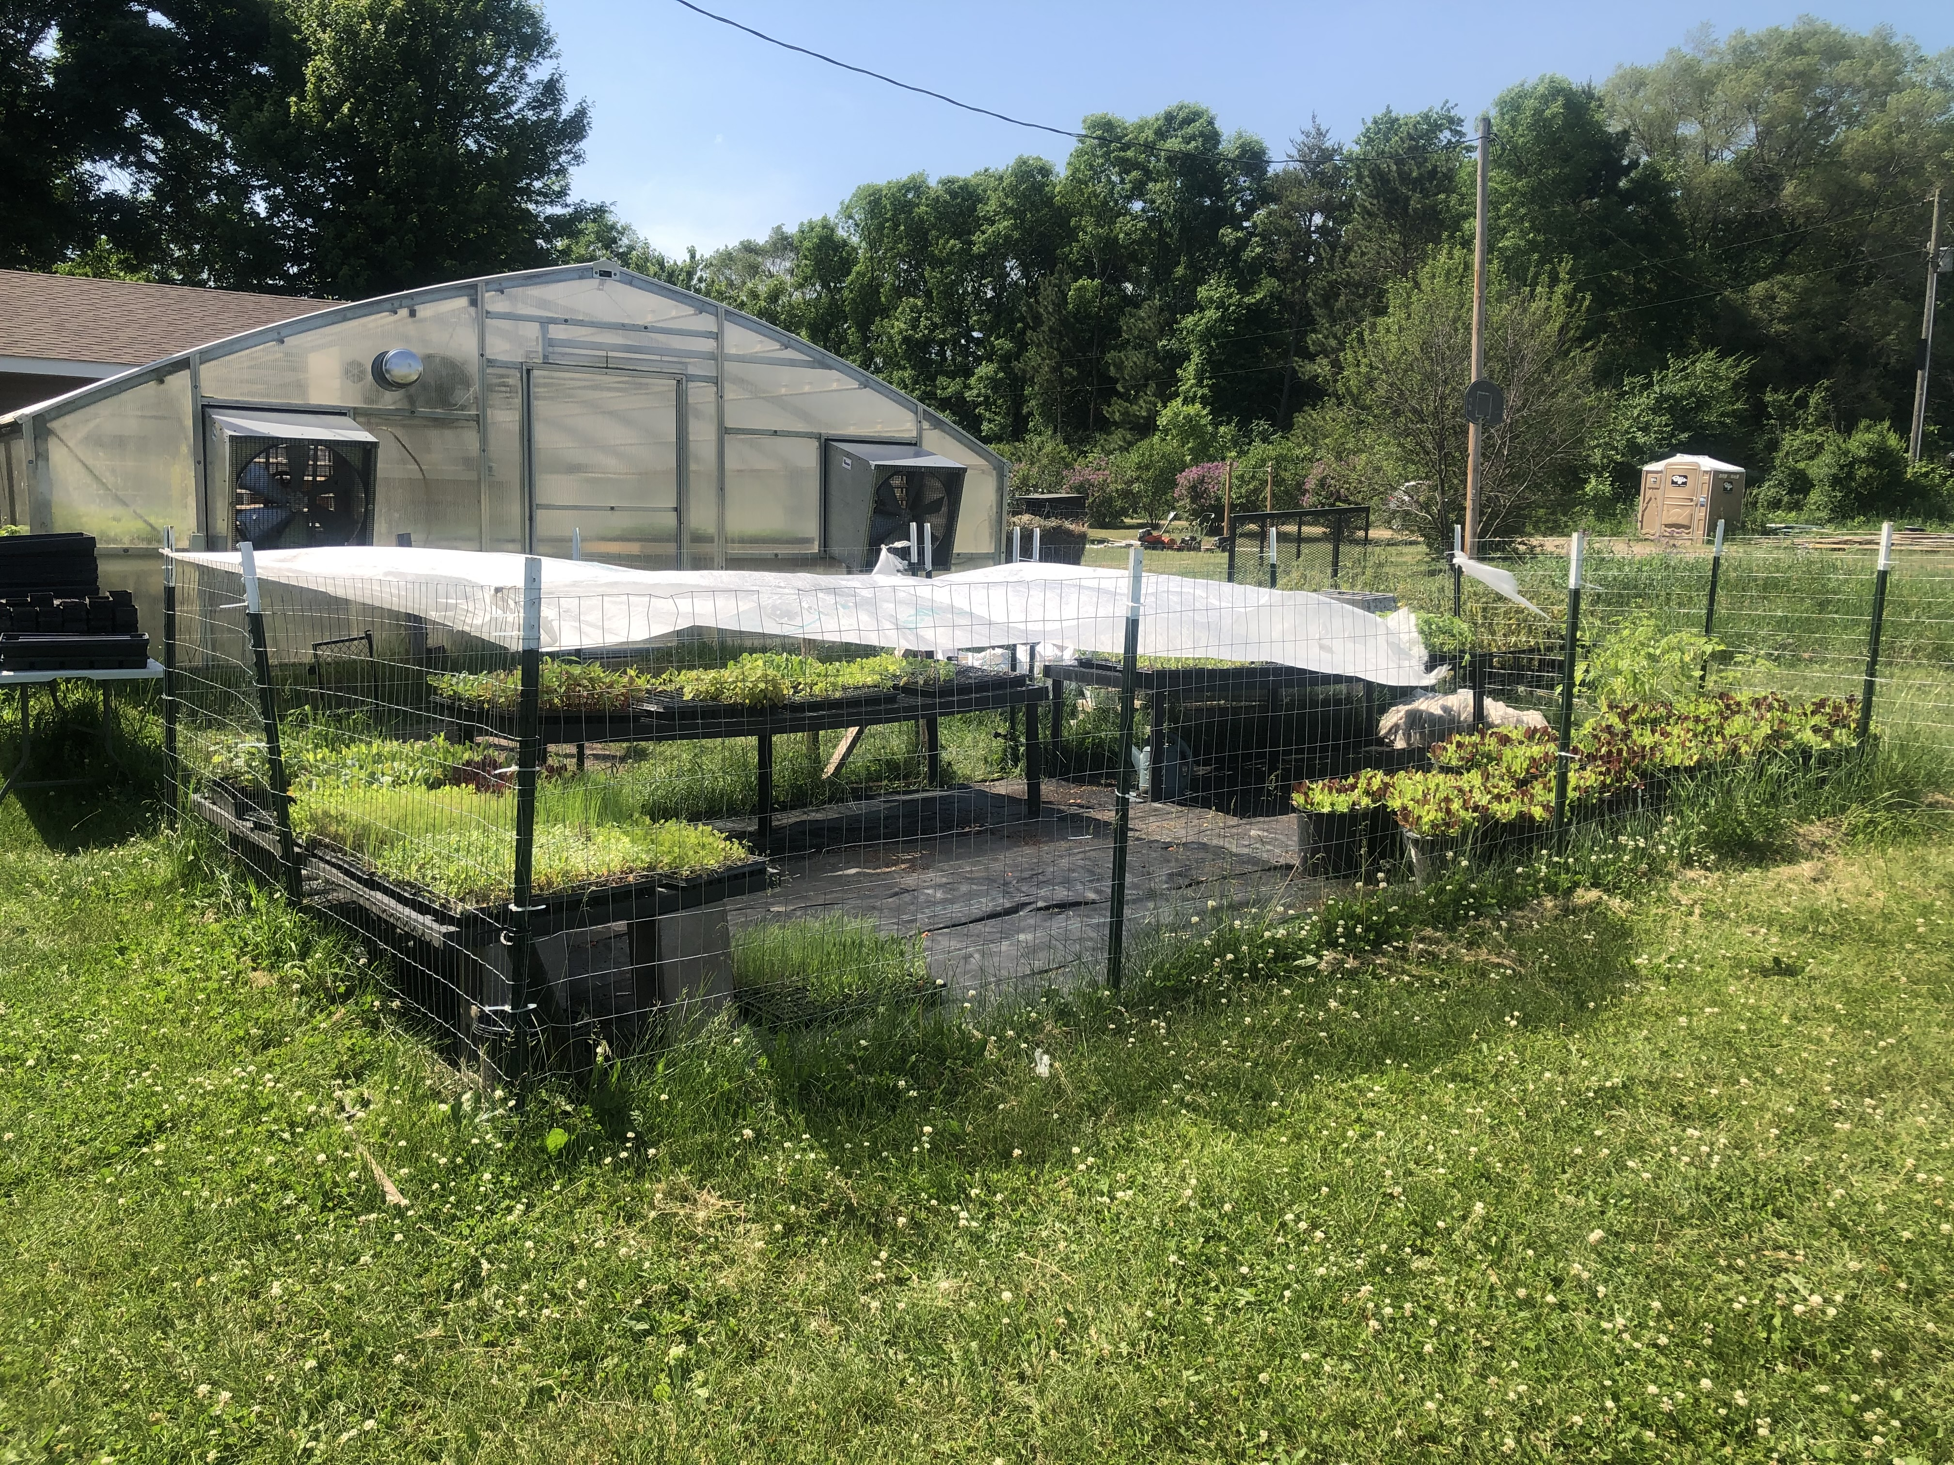
Dream of Wild Health: Minnesota

Slide 29
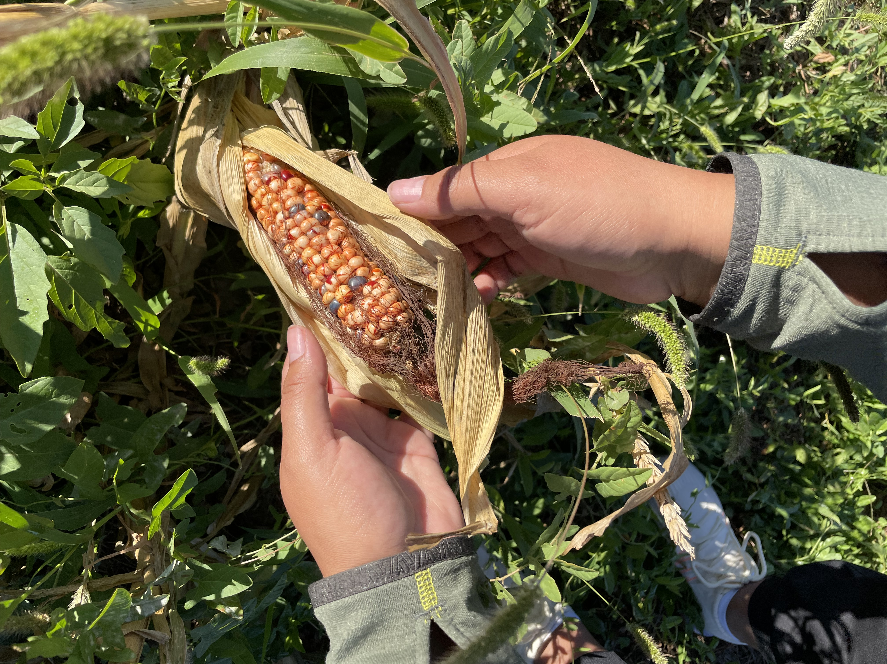
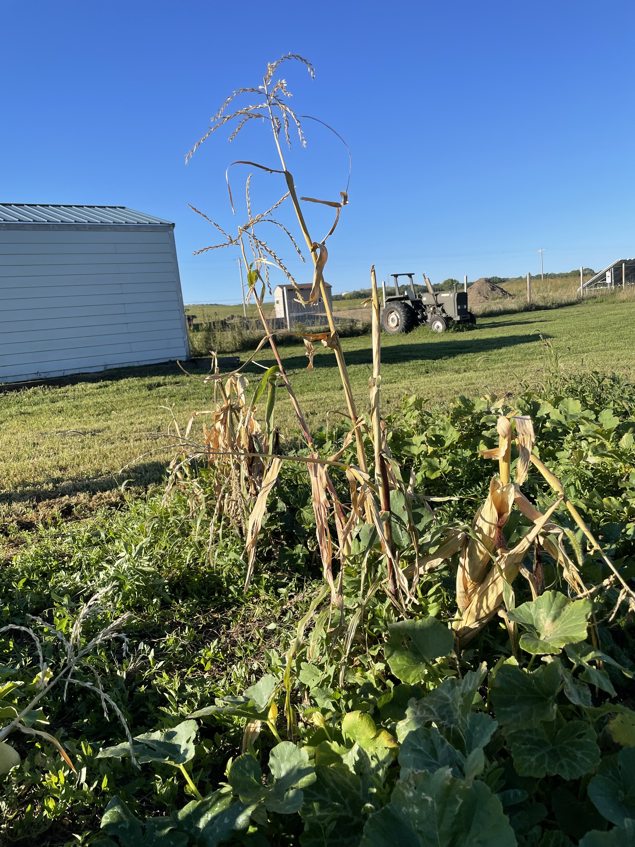
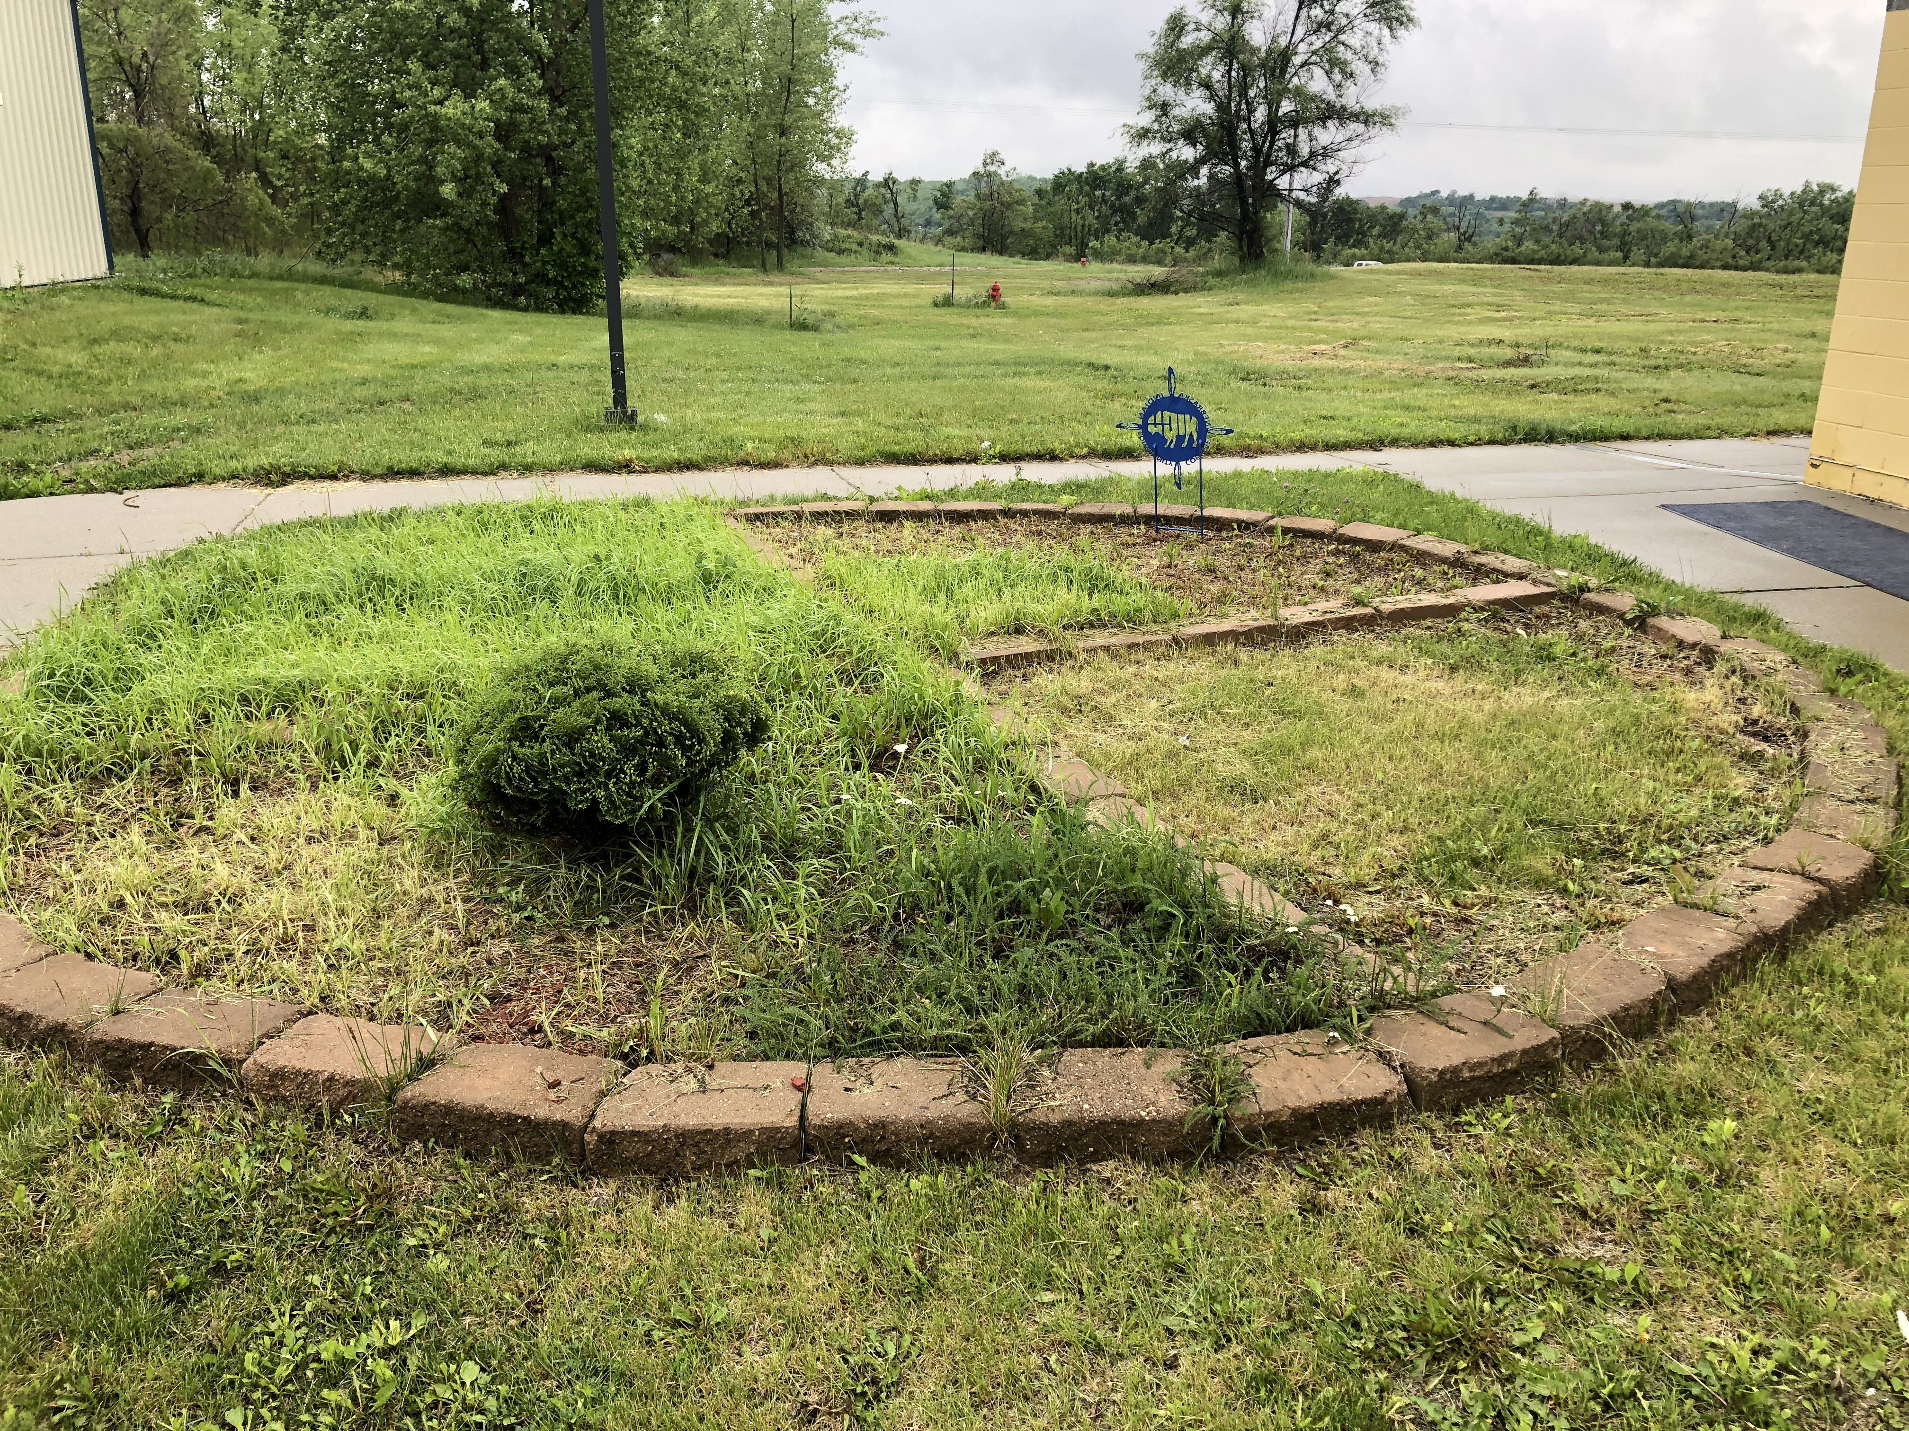
Three Sisters and Medicine Gardens: Nebraska Indian College

Slide 30
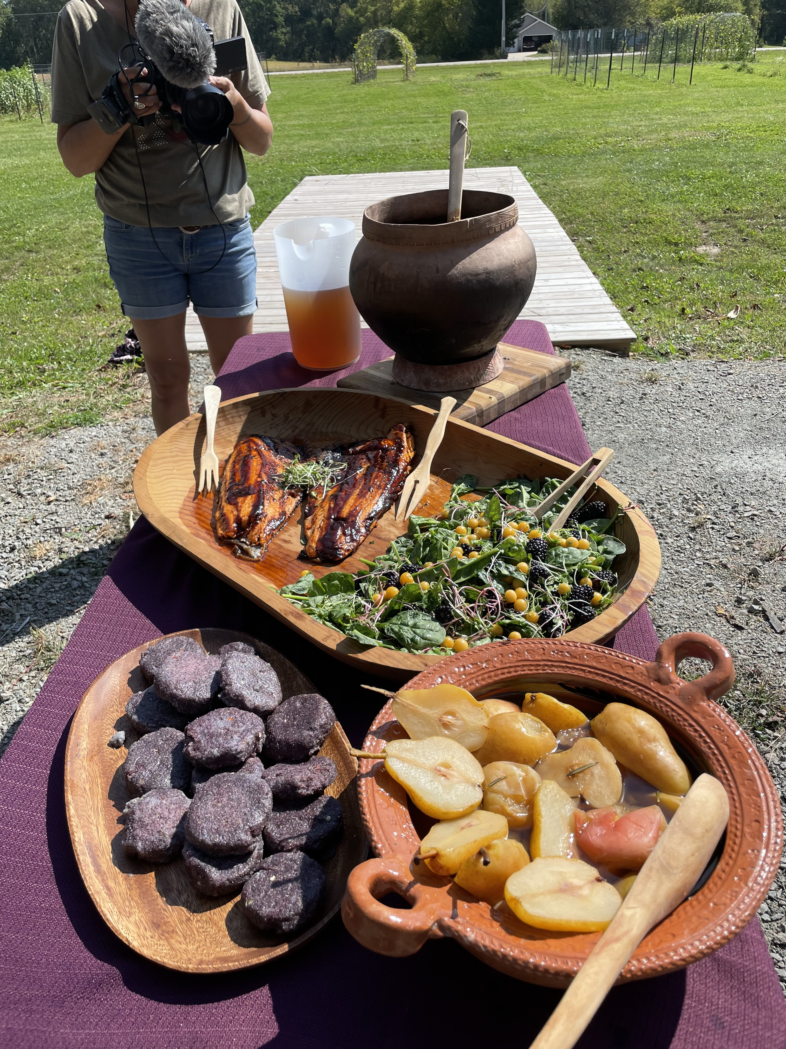
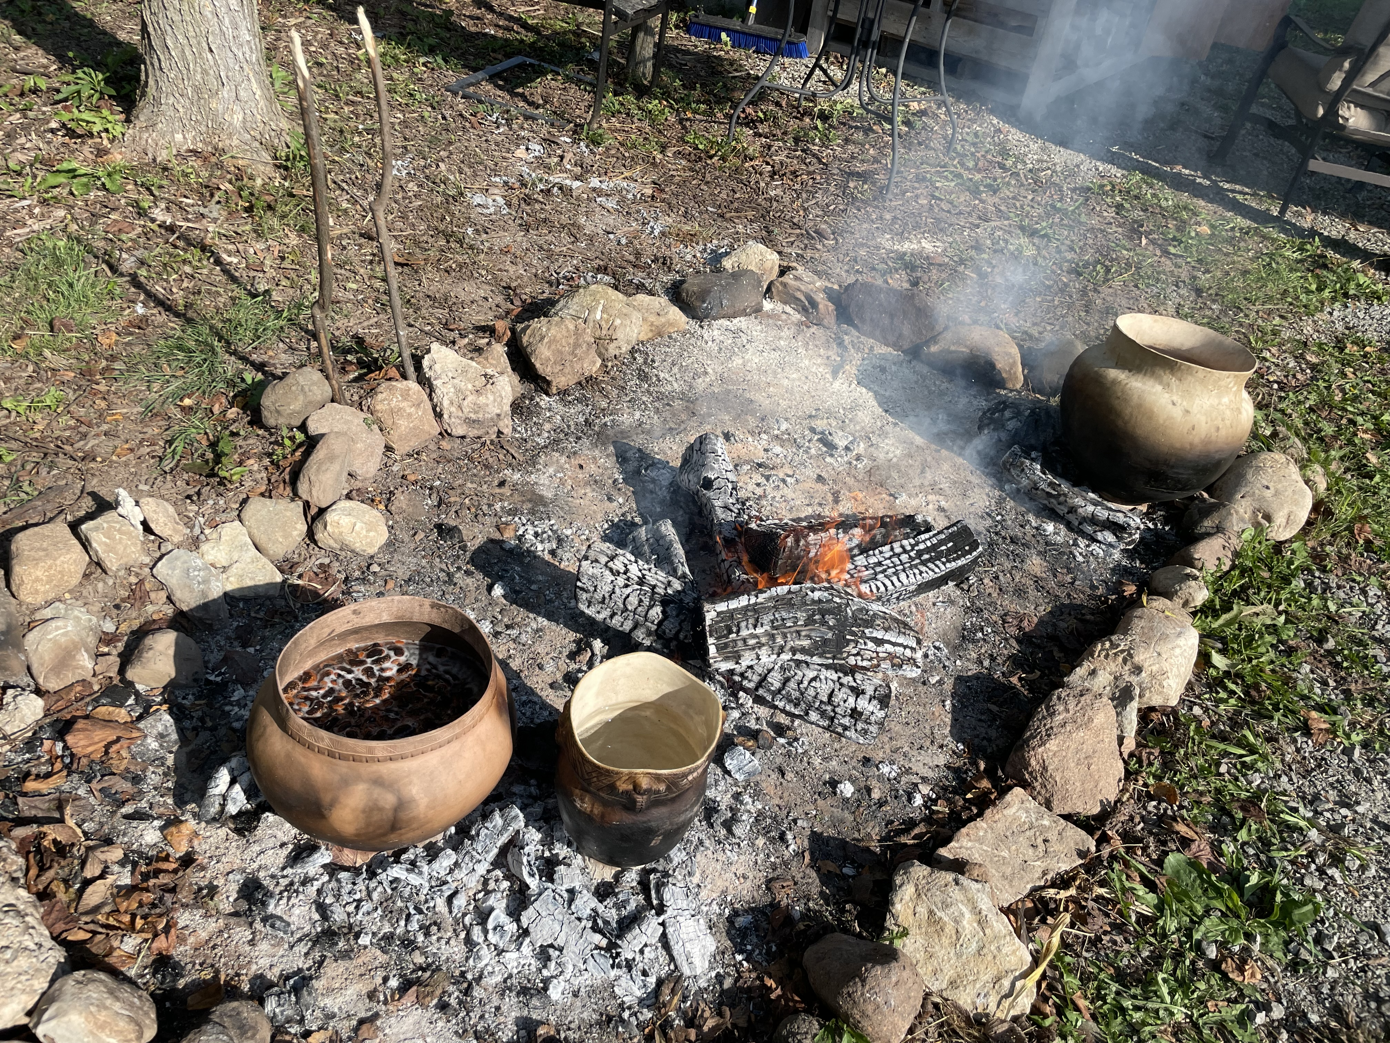
Importance of Revitalization: Healthy Food systems Healthy Ecosystems

Slide 31
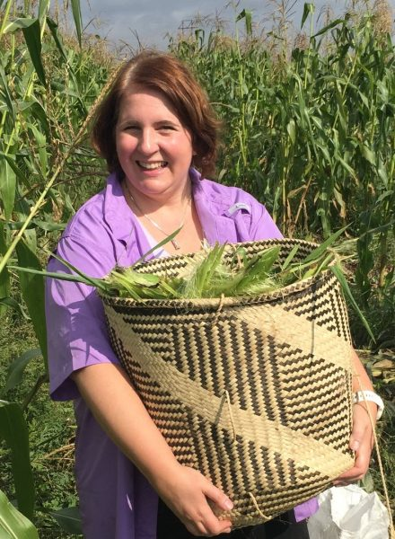
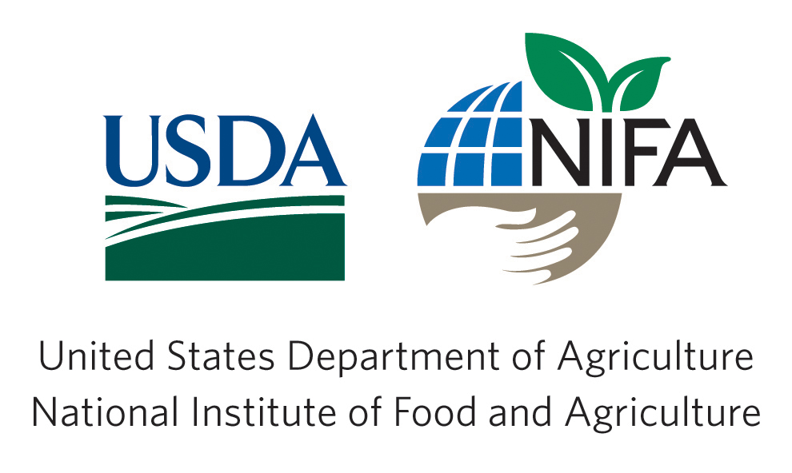
Thank you
To learn more about our project:
Christina Gish Hill
cghill@iastate.edu
https://threesistersproject.language.iastate.edu/

