Slide 1

Insect Identification, Damage, and Control
Emily Zobel
AgFS Agent Dorchester County
ezobel@umd.edu
This material is based upon work supported by the National Institute of Food and Agriculture, U.S. Department of Agriculture, through the Northeast Sustainable Agriculture Research and Education program under subaward number SNE22-005-MD and NIFA award 2021-70006-35384.

Slide 2

University programs, activities, and facilities are available to all without regard to race, color, sex, gender identity or expression, sexual orientation, marital status, age, national origin, political affiliation, physical or mental disability, religion, protected veteran status, genetic information, personal appearance, or any other legally protected class.
Notes:
Script to accompany this slide: “I'd like to bring your attention to this poster. It is a direct message from our federal funder who wants to be sure you know you have a right to access our program and an accommodation if necessary. If you have any questions or concerns we hope you will let us know and the poster lets you know how you can contact the federal government directly as well.”
If you are doing your presentation virtually, this is a great time to use the poll feature in Zoom to collect demographic info of your attendees!

Slide 3
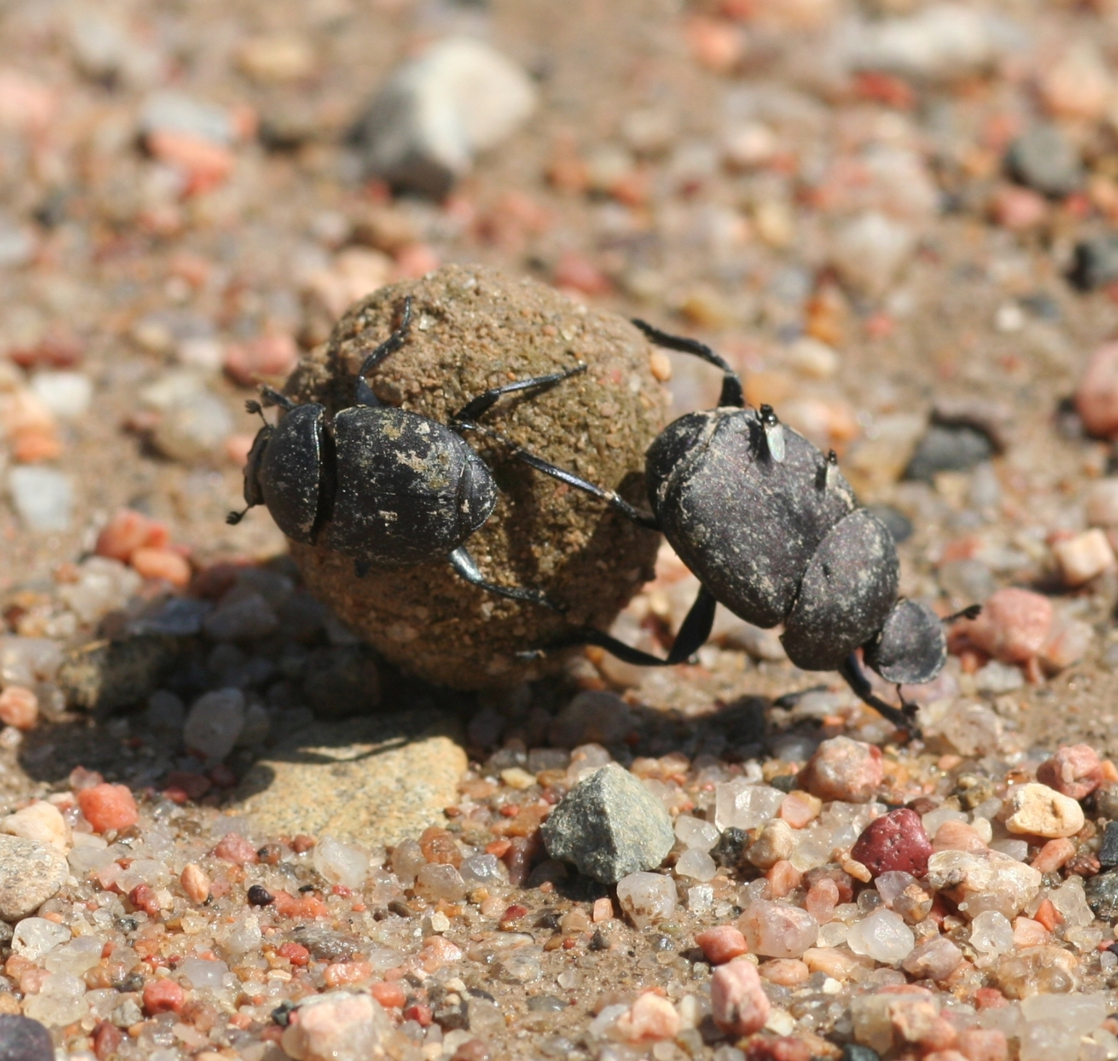
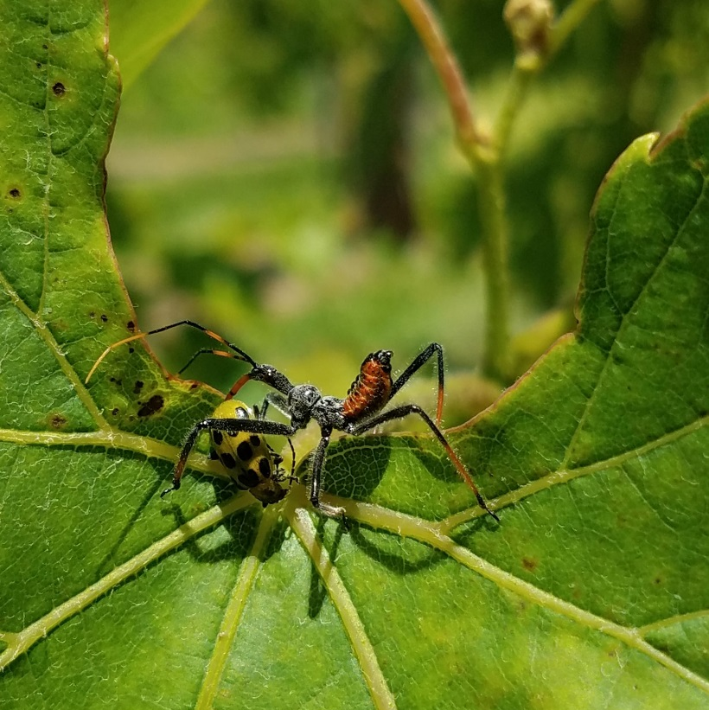
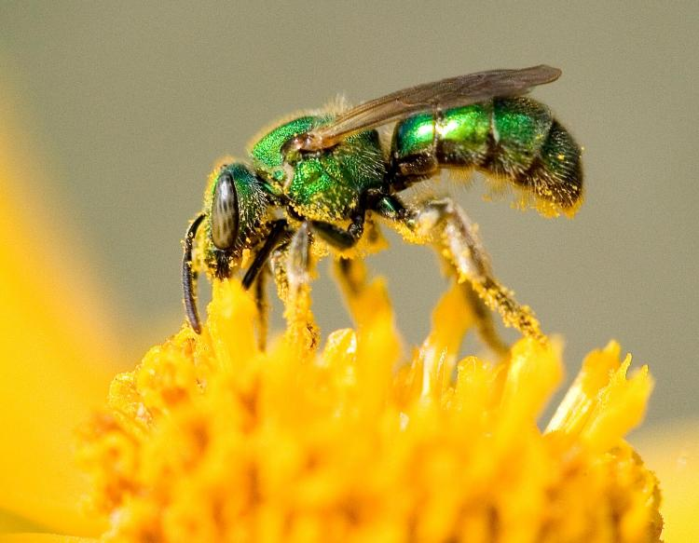
Why Do We Care About Insects?
>1 million species
Pest (~10%)
Beneficial
Pollination
Recycle
Food Chain
Pest control
Whitney Cranshaw, Colorado State University, Bugwood.org
Notes:
Why are insects important?
Insects are the most successful group of animals in the world. There are more than 100,000 species in North America alone. They are extremely adaptable and inhabit a wide range of habitats from deserts to mountain tops, freshwater lakes, rivers and streams and even along ocean shorelines.
The vast majority of insects are beneficial or harmless.
They pollinate plants including some of our crops, landscape plants and native plants. Many plants have coevolved with specific insects so that only that specific insect or group of insects can pollinate that plant or group plants.
Insects are high in protein making them a great food for animals such as birds and fish. Most Northern American song birds feed their young exclusively caterpillars.
They play a key role in recycling the natural world, such as dead wood, leaf litter, dead animals, and poop.
They produce products such as honey, wax, and silk which many of us enjoy and find useful.
Some prey on or parasitize pest insects
Less than 10 percent of insects are considered pests. Some pest insects may cause damage to crops, ornamental trees and plants, stored products, fabrics, and other items. Others attack humans and animals. Some are vectors for diseases on human, pest, livestock and plants.

Slide 4
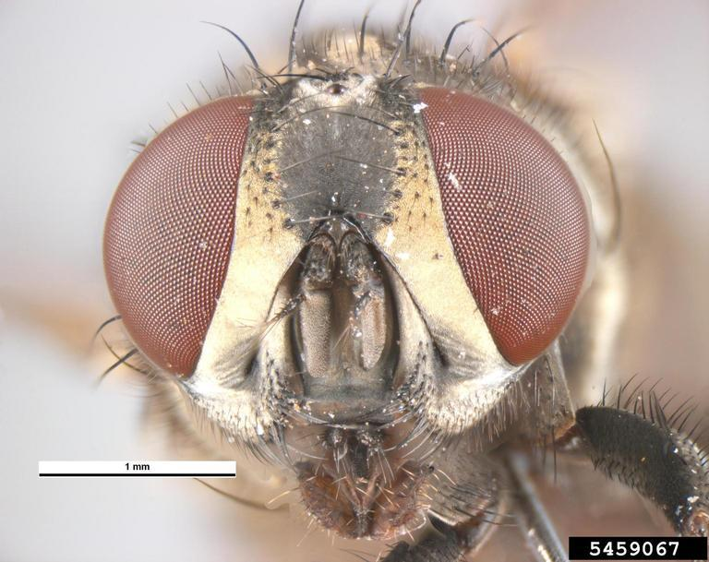
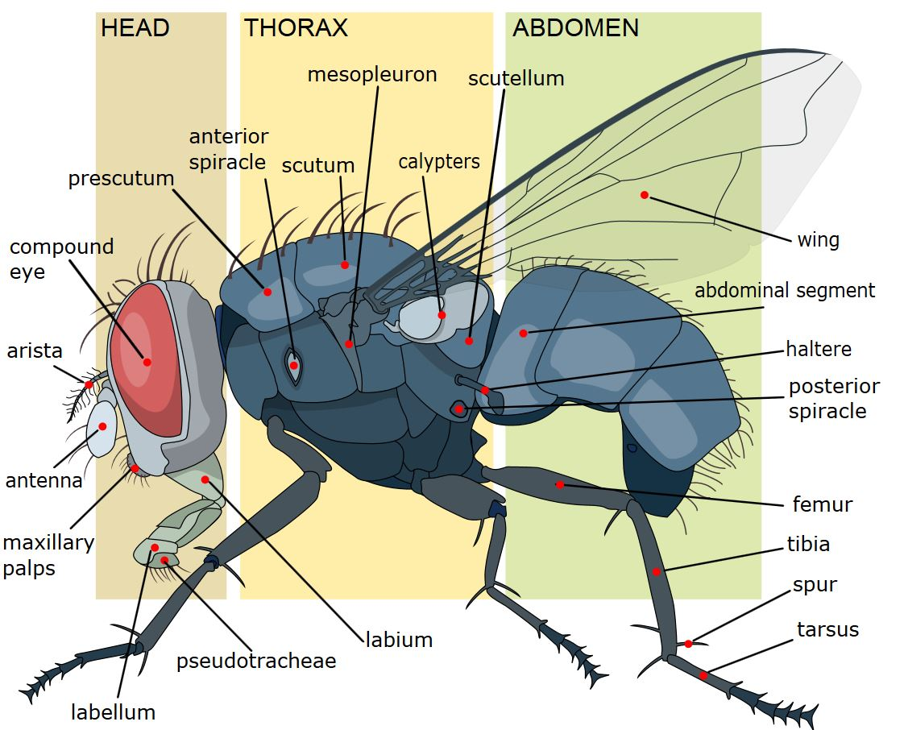
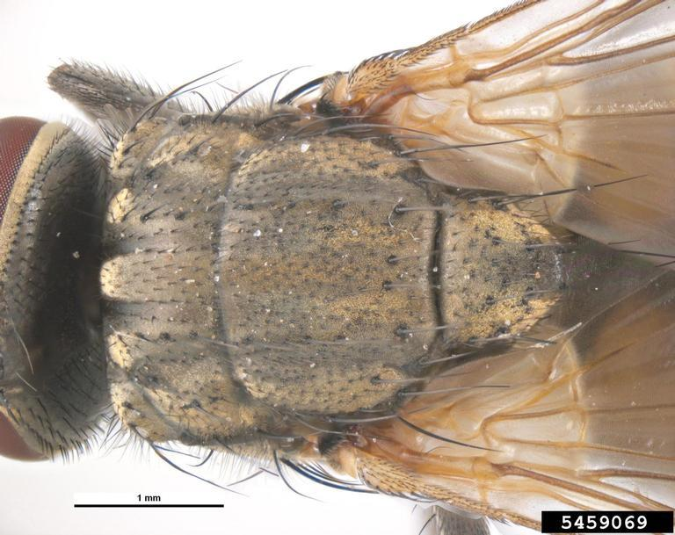
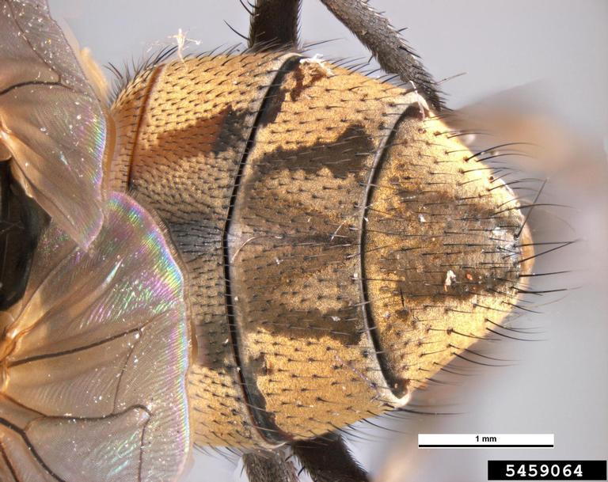
The Diagnostic Characteristics of Insects
Arthropod
Exoskeleton
3 body segments
Head, Thorax, Abdomen
6 legs
0,1,2 pairs of wings
Pest and Diseases Image Library , Bugwood.org
Notes:
All adult insects possess the following characteristics:
Three body regions: the head, thorax, and abdomen
Three pairs of segetment legs
One pair of antennae
Zero-to-four wings
Most immature insect will also have the some three body regions, three pairs segment legs and one pair of antennae.
Now let's explore insect anatomy.
-----------------------------------------------------------------------------------
Photo by Pest and Diseases Image Library , Bugwood.org
Whole fly: https://www.insectimages.org/browse/detail.cfm?imgnum=5459068
Head: https://www.insectimages.org/browse/detail.cfm?imgnum=5459067
Thoax: https://www.insectimages.org/browse/detail.cfm?imgnum=5459069
Abdomen: https://www.insectimages.org/browse/detail.cfm?imgnum=5459064

Slide 5
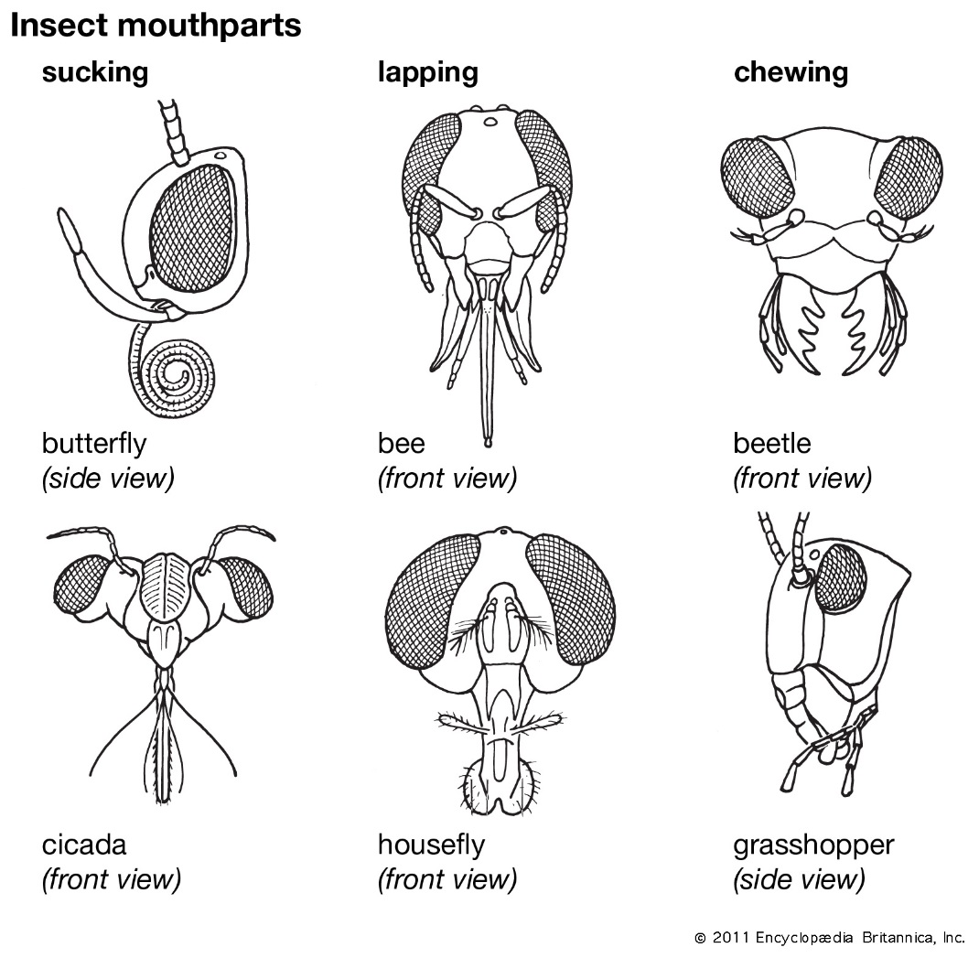
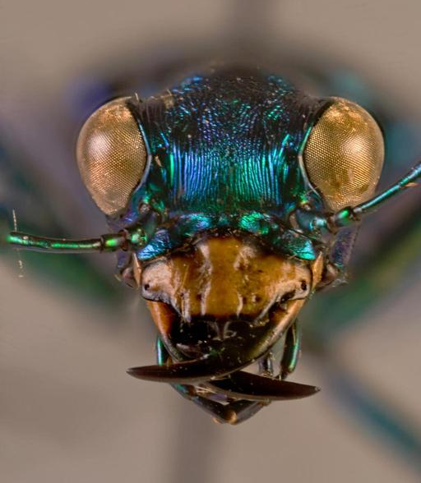
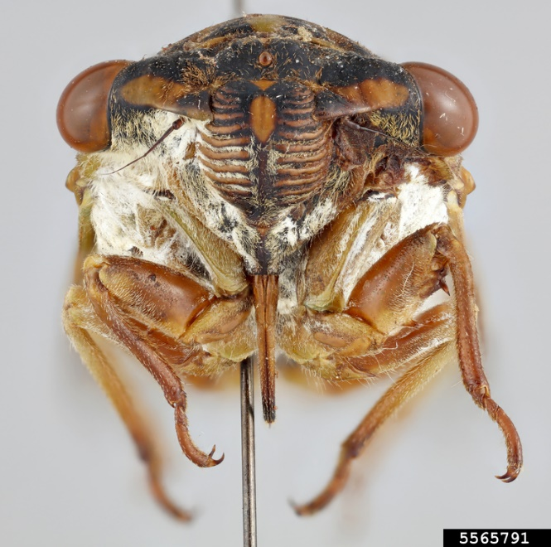
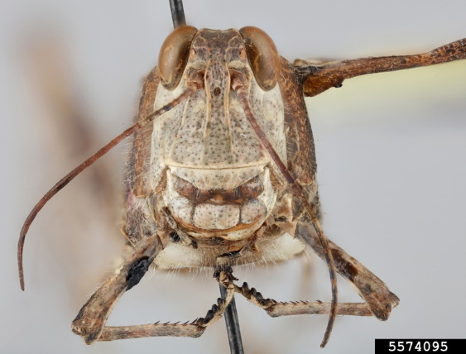
Insect Mouth
Different shapes = Different feeding types= Different feeding damage
Lindsey Seastone, Museum Collections: USDA APHIS PPQ, Bugwood.org
Notes:
The mouthparts of insects vary in form and function. They can be located on either the anterior or ventral part of the head.
There are generally of two types of mouths or feeding habits in insects: chewing and sucking. Insects with chewing mouthparts have mandibles that move laterally to chew the food. Sucking mouthparts are modified into a beak or proboscis, through which liquid food is sucked.
Some adult insects have vestigial or non-functional mouthparts. These species have short adult lives, living only long enough to mate and lay eggs.
The mouthparts of larval insects (immature insects with complete metamorphosis) tend to be chewing, regardless of the type the adult possesses.
Nymphs (immature insects with gradual metamorphosis) tend to have the same type of mouthparts as the adults.

Slide 6
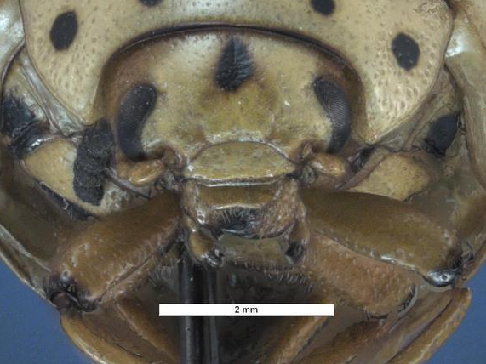
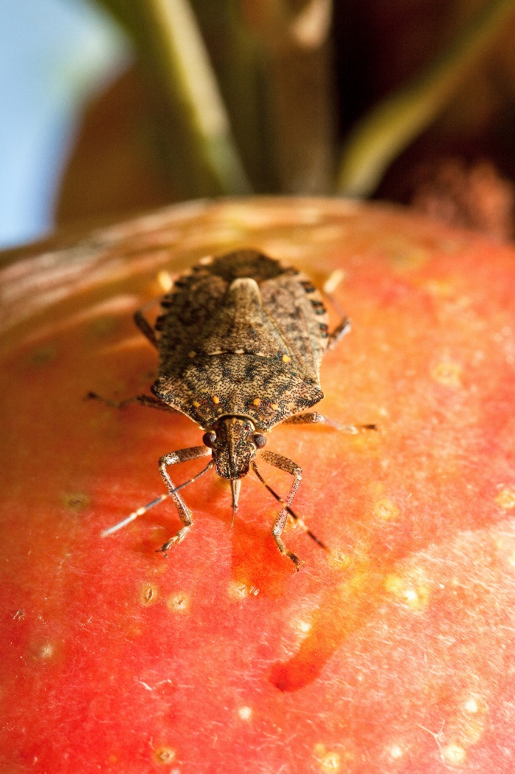
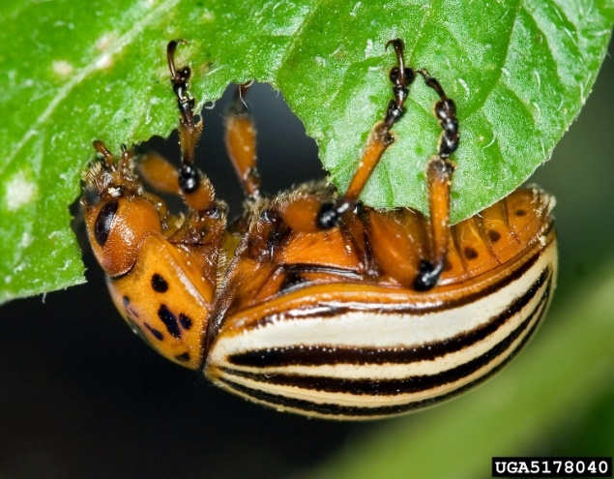
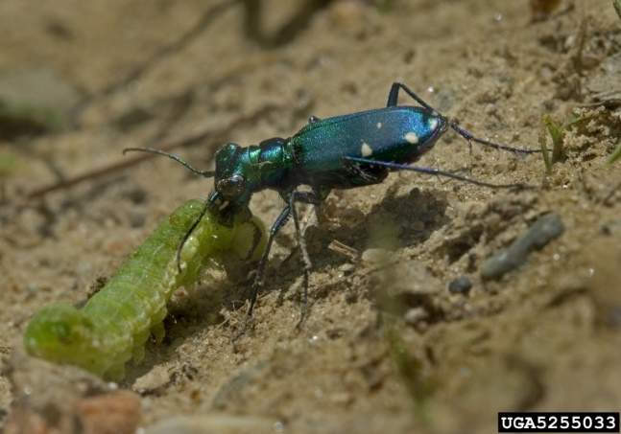
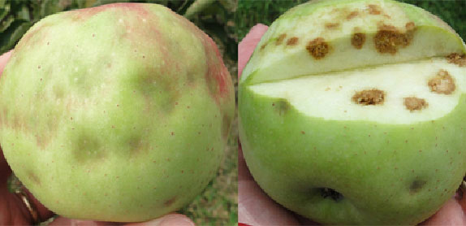
Insect Feed Damage
David Cappaert, Bugwood.org, Pest and Diseases Image Library , Bugwood.org; Douglas C. Pfeiffer, Virginia Tech
Notes:
The structure of mouthparts can help identify the insect and, more importantly, what kind of feeding habits it has. This will help us determine if it is a pest or not.
Here are 3 different insects with different mouth shapes. Notice that both species of beetle have chewing mouthparts, but just like in mammals, they have different shapes based on their feeding habits. The Colorado potato beetle has short mandibles used for chewing leaves while the tiger beetle has large mandibles which it uses to capture prey.
The third insect is a stink bug, which has a sucking mouth. Notice it's feeding damage doesn’t look like chewing damage, but rather starbursts or brown areas where it has inserted it’s beak and removed or killed plant cells.

Slide 7
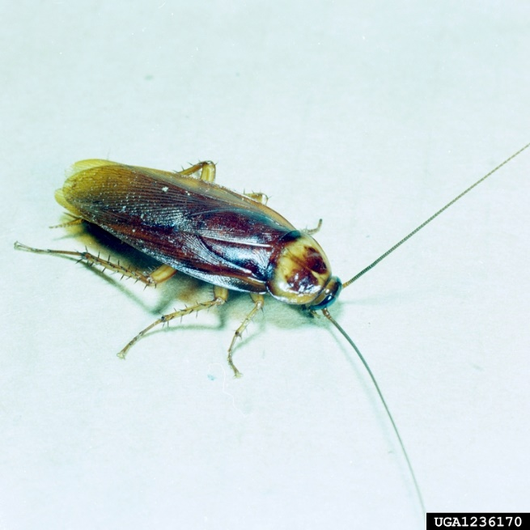
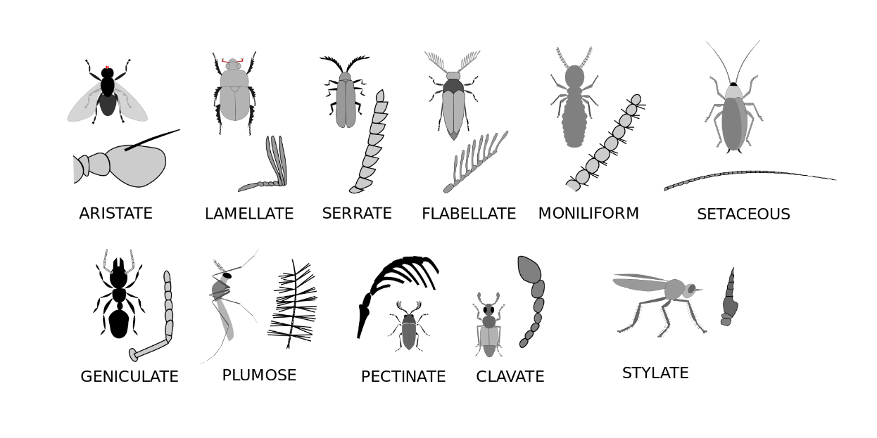
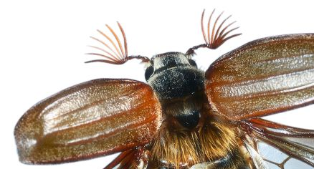
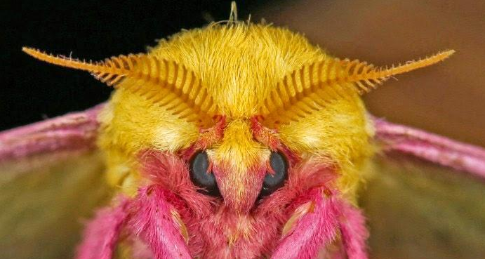
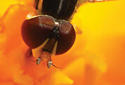
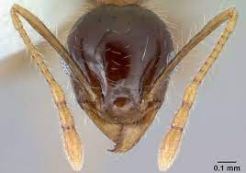
Insect Biology: Antenna
Notes:
Antennae are primarily used to sense odors or pheromones. Insects use these to find food, water, a mate and sites for egg-laying. Most insects have one pair of antennae located on the front of the head.
Antennae are extremely variable in shape and number of segments, which can be useful in aiding in the identification of many insects. In many insect groups, male insects have larger and flashier antennae to help them find and attract a mate.

Slide 8
Thorax
Pronotum: Plate-like structure that covers all of part of the thorax of some insect.
Scutellum: A small triangular plate behind the pronotum and between the forewing bases.

Slide 9
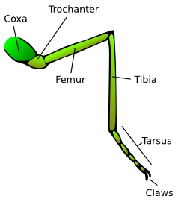
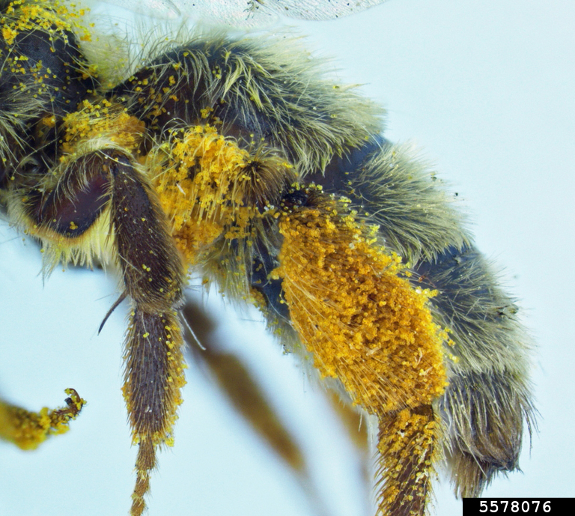
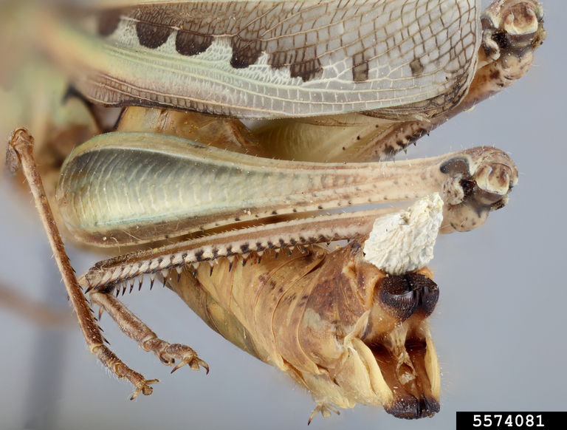
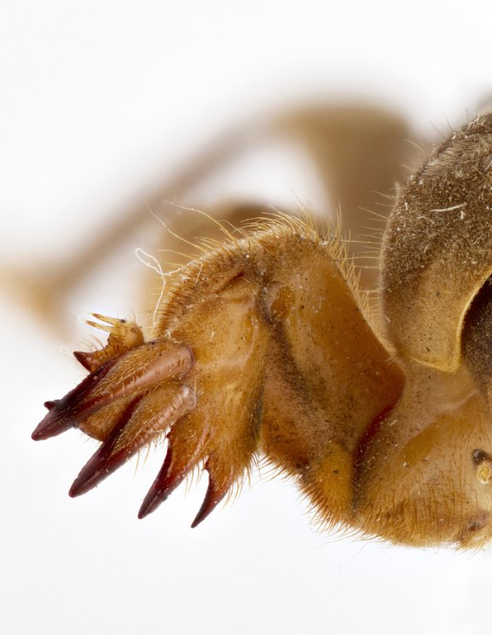
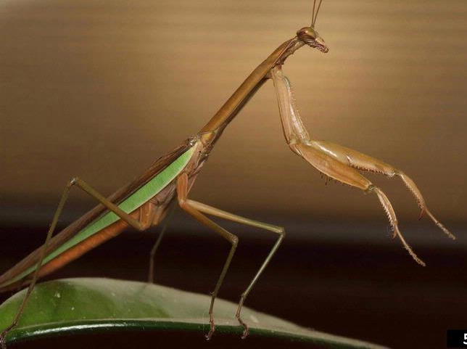
Insect Biology: Leg
Allan Smith-Pardo, Bees of the United States, USDA APHIS PPQ, Bugwood.org; Joseph Berger, Bugwood; Seastone, L. and B. Parks, Museum Collections: Orthoptera, USDA APHIS PPQ
Notes:
Most adult and many immature insects have three pairs of jointed legs that are attached to each segment on the thorax. Legs of insects have five parts: coxa, trochanter (trow-can-ter), femur, tibia, and tarsus. The tarsi, or feet, are also segmented and may have claws and pads to aid in holding onto a surface or food.
The legs are usually used for walking or running, but may be modified for other activities such as jumping, grasping, digging, and swimming. The legs vary greatly in size and form depending on the insect and may be useful in classification.
Immature insects such as caterpillars may also have short abdominal legs called prolegs, which aid in moving the long body around.

Slide 10
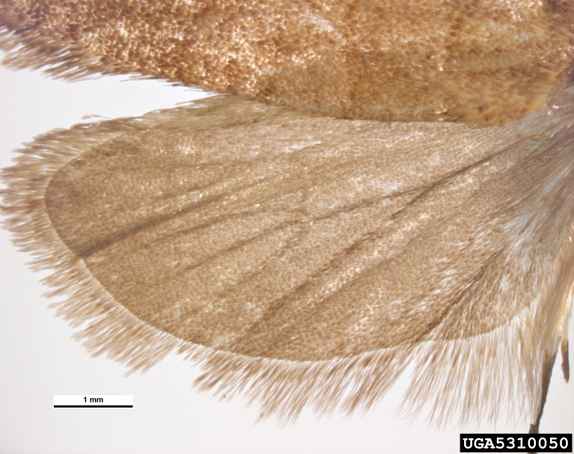
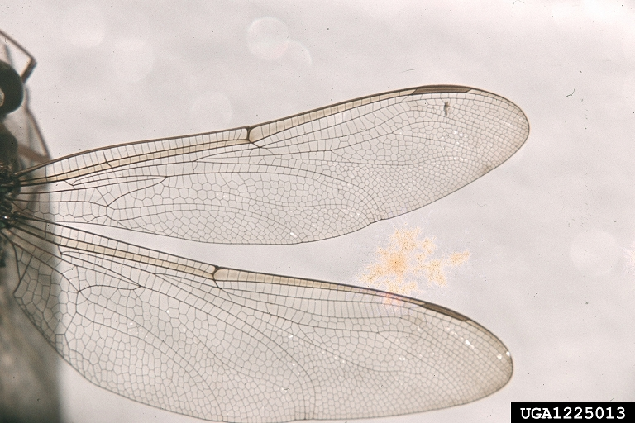
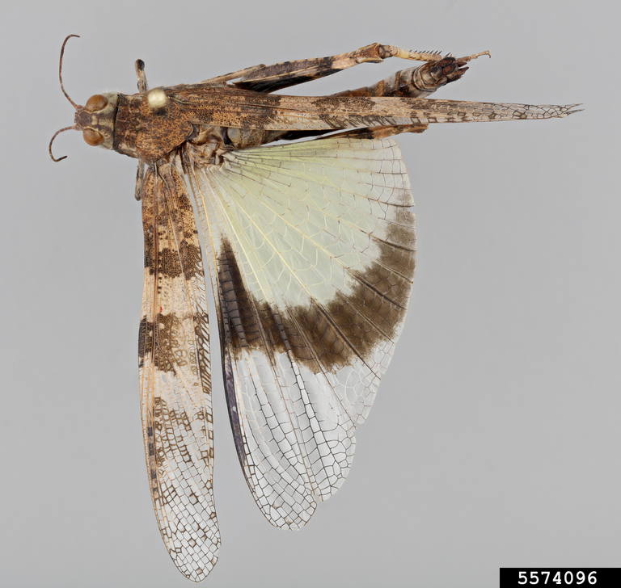
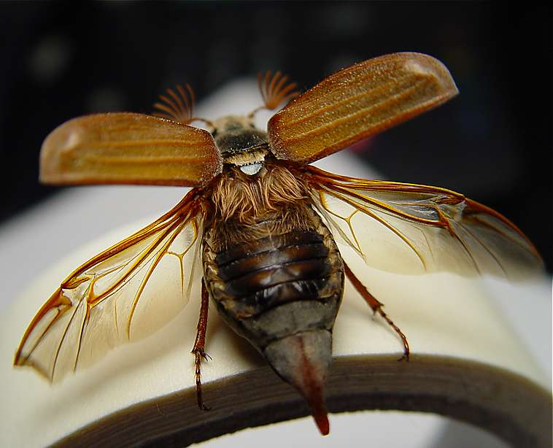
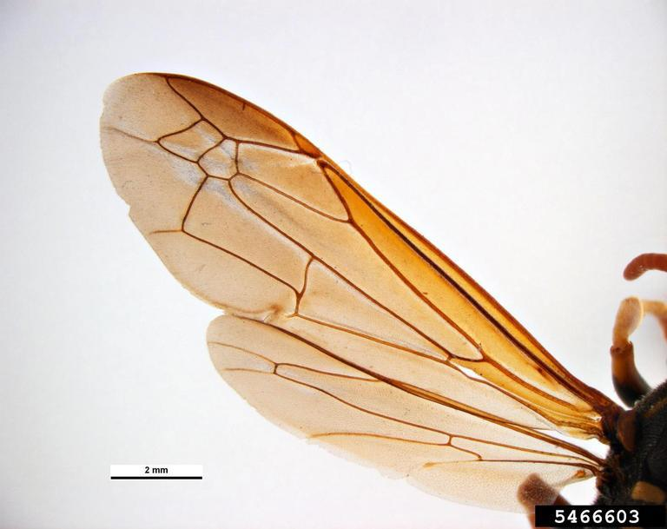
Insect Biology: Wing
Pest and Diseases Image Library , Bugwood.org, Edward L. Manigault, Clemson University Donated Collection, Bugwood.org, Paul Langlois, Museum Collections: Orthoptera, USDA APHIS PPQ, Bugwood.org
Notes:
Most insects have two pairs of wings; others only have one pair or none. Insect wings vary greatly in size, shape, and texture depending on the insect. The forewings and hindwings can be similar or different from each other. Most are transparent or membranous, some are leathery, and others are covered with hairs or scales.
All wings have veins. Their pattern or arrangement is called venation and is different for each species of insect. Venation is an important descriptive characteristic in classification and identification.
Many insect order names end in “ptera,” which comes from the Greek word meaning “with wings.” The scientific order names can give us an idea of what type of wings are commonly found within that order. For example, Lepidoptera in latin means scaly-winged, which the name of the order that contains are moths and butterflies, which have scale on their wings, seen in the picture here.
--------------------------
Photos:
Wasp wing: Pest and Diseases Image Library , Bugwood.org
Dragonfly wing: Edward L. Manigault, Clemson University Donated Collection, Bugwood.org https://www.insectimages.org/browse/detail.cfm?imgnum=1225013
Moth wing: Pest and Diseases Image Library , Bugwood.org, https://www.insectimages.org/browse/detail.cfm?imgnum=5310050 Grasshopper: Paul Langlois, Museum Collections: Orthoptera, USDA APHIS PPQ, Bugwood.org https://www.insectimages.org/browse/detail.cfm?imgnum=5574096

Slide 11
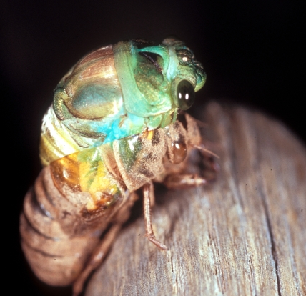
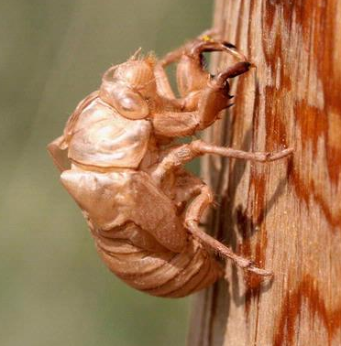
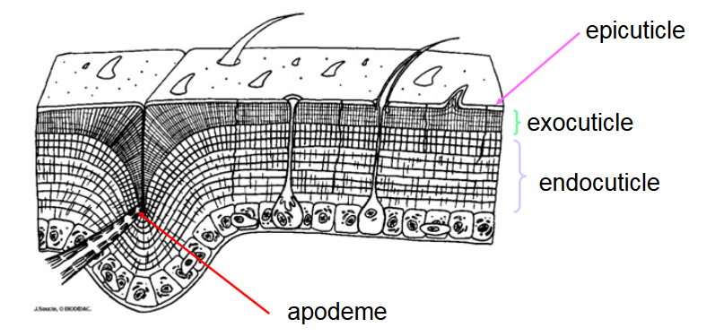
Insect Biology : Exoskeleton
Multi-layered structure: Chitin
Protection
Muscle attachment
Water-tight barrier
Sensory interface with the environment
Need to molt to grow
Jim Occi, BugPics, Bugwood.org; Whitney Cranshaw, Colorado State University, Bugwood.org
Notes:
One big difference between insect and humans is that they are soft on the inside and hard on the outside and we are the opposite. Our endo or internal skeleton holds us up and gives our muscles places to attach, which, in turn, allows us to move. Their exo or external skeleton does the same. The body wall of a bug is a boneless tube, but rather than being smooth on the inside like a tennis ball can, the interior has ridges and knobs that strengthen it and provide places of attachment for the muscles. The exoskeleton offers protection from predators, parasites, and excess water loss or gain. The problem is that an exoskeleton, even though it’s somewhat flexible, it can’t grow larger, so in order to get bigger, an insect must molt, as seen in this photograph of a cicada.
The exoskeleton is a multi-layered structure with four functional regions: epicuticle, procuticle, epidermis, and basement membrane. The top layer is the thin epicuticle that is covered in wax and is the insect’s first/last line of defense against outside water getting in/interior water getting out.
Just below the epicuticle is the procuticle, which is comprised of an upper exocuticle and a lower endocuticle. This layer contains protein strands woven together with a tough material called chitin. This is similar but not the same as chiton, which is found in marine invertebrate. The exocuticle layer can be quite stiff because its proteins are hardened, while the endocuticle layer is more flexible because its protein is unhardened. An insect’s body segments typically have one hard “plate” across the top, one on each side, and several across the underside, and flexible cuticle between the plates, which allow for movement and expansion. An insect’s color, both pigmented color and structural color (the layers of tiny, reflective plates that cause iridescence) is found in the procuticle layer.
Below the cuticle layers is the epidermis, a living, cellular layer that secretes the non-living cuticle that lies above it. Sensory hairs originate in this layer and poke up through cuticle; the hairs give information to nerves at their base. The innermost layer of the endoskeleton is the “basement membrane,” which supports the epidermis and separates the exoskeleton from the body cavity.

Slide 12
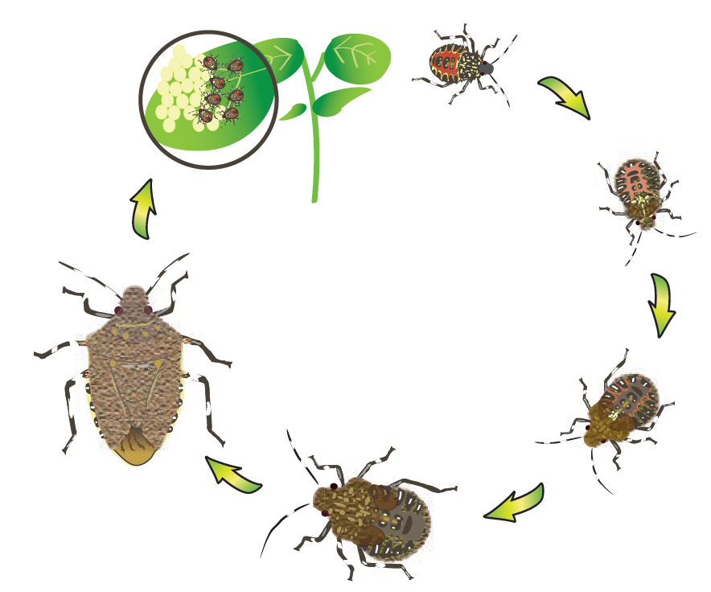
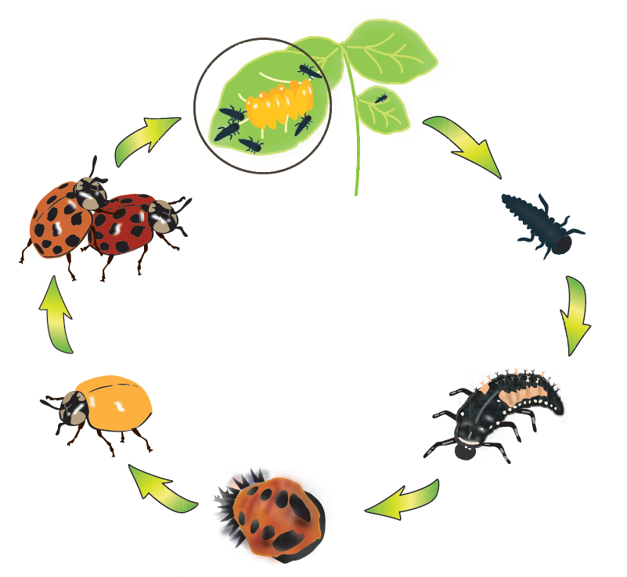
Insect Development
Incomplete Metamorphosis
(Egg, Nymph stages, Adult)
Complete Metamorphosis (Egg, Larvae stages , Pupa, Adult)
Iowa State University Extension
Notes:
There are two types of insect metamorphosis: gradual also known as incomplete and complete. Both require the immature insect to undergo a series of phases between molts called instars. The growth sequence is denoted as first instar, second instar, etc. Unlike other arthropods, once insects reach adulthood they do not continue to molt and grow.
Gradual, or incomplete metamorphosis, includes three life stages: an egg, several nymphal instars, and an adult. The nymphs resemble adults in appearance and differ mostly in size and wing development. If the adult stage has wings, they will develop externally and can be seen as wing pads on fourth to fifth instar nymphs. Some examples of insects with incomplete metamorphosis include grasshoppers, aphids,
stink bugs, and praying mantises.
Complete metamorphosis has four life stages: an egg, several larval instars, a pupa, and an adult. Larvae and adults might have different habitats, food sources, and behaviors. During pupation, the insect does not feed or move around much. The larval structures are broken down and the adult structures are formed, resulting in changes to the insect’s mouthparts, legs, and body shape, and formation of the wings. Some examples of insects with complete metamorphosis include beetles, bees, wasps, ants, butterflies, and flies.

Slide 13
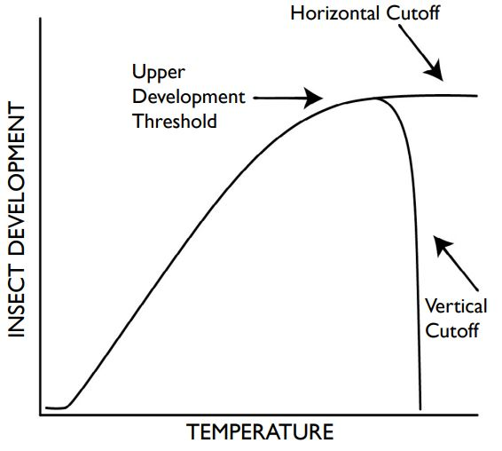
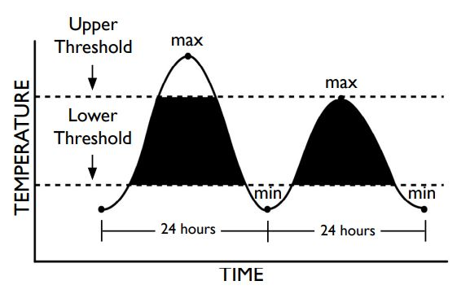
Degree Days
[(daily maximum temperature + daily minimum temperature) ÷ 2] – lower threshold
Notes:
What is a degree day? A degree day is a measurement of heat unit accumulation over time.
Because insect development depends largely on the temperatures they experience, their development is predictable using GDD. There is an ideal temperature range, which differs by species, for optimal reproduction and longevity. There are three key things we need to know about insect development to use the formula:
Lower developmental threshold: The lowest temperature at which the insect can complete development. This varies by species but usually tells us when the pest becomes active after overwintering in Iowa. This is not the same as the lowest temperature that will kill an insect. See Table 1 for examples of lower developmental thresholds.
Upper developmental threshold: The highest temperature at which the insect can develop. Some insects do not have an upper threshold, but we use 90°F as the upper threshold for many species. Some insects cannot withstand warm temperatures and have a lower maximum. See Table 1 for examples of upper developmental thresholds.
Biofix: The starting point for accumulating degree days. This varies by species, but most of the time we use January 1 as a starting point even though insects are not generally active during the winter months. See Table 1 for examples of various biofix indicator

Slide 14
Degree Days
Common name | Lower Threshold | Upper Threshold | Biofix
alfalfa weevil | 48°F | 90°F | January 1 | 200-250 DD
bean leaf beetle | 46°F |  | Egg-laying (soybean emergence) | 1,212 DD
European corn borer | 50°F | 86°F | First spring moth capture | 1st -212 DD 2nd – 1,404 DD
Japanese beetle | 50°F | 88°F | January 1 | 1,030-2,150
seedcorn maggot | 39°F | 84°F | January 1 | 1st Gen 360-781 DD 2nd Gen 1,116 – 1,537 DD 3rd Gen 1-872-2,293 DD
western corn rootworm | 52°F (soil) | 86°F | January 1 | 684-767 DD

Slide 15
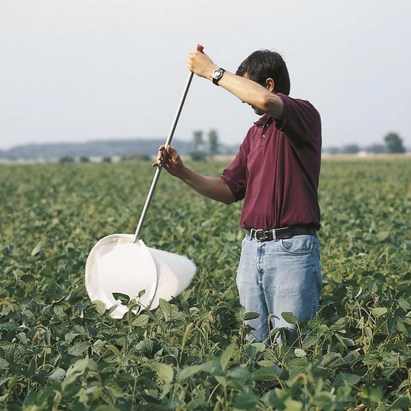
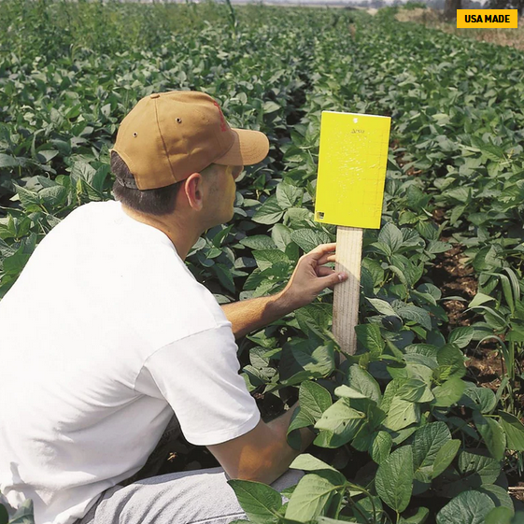
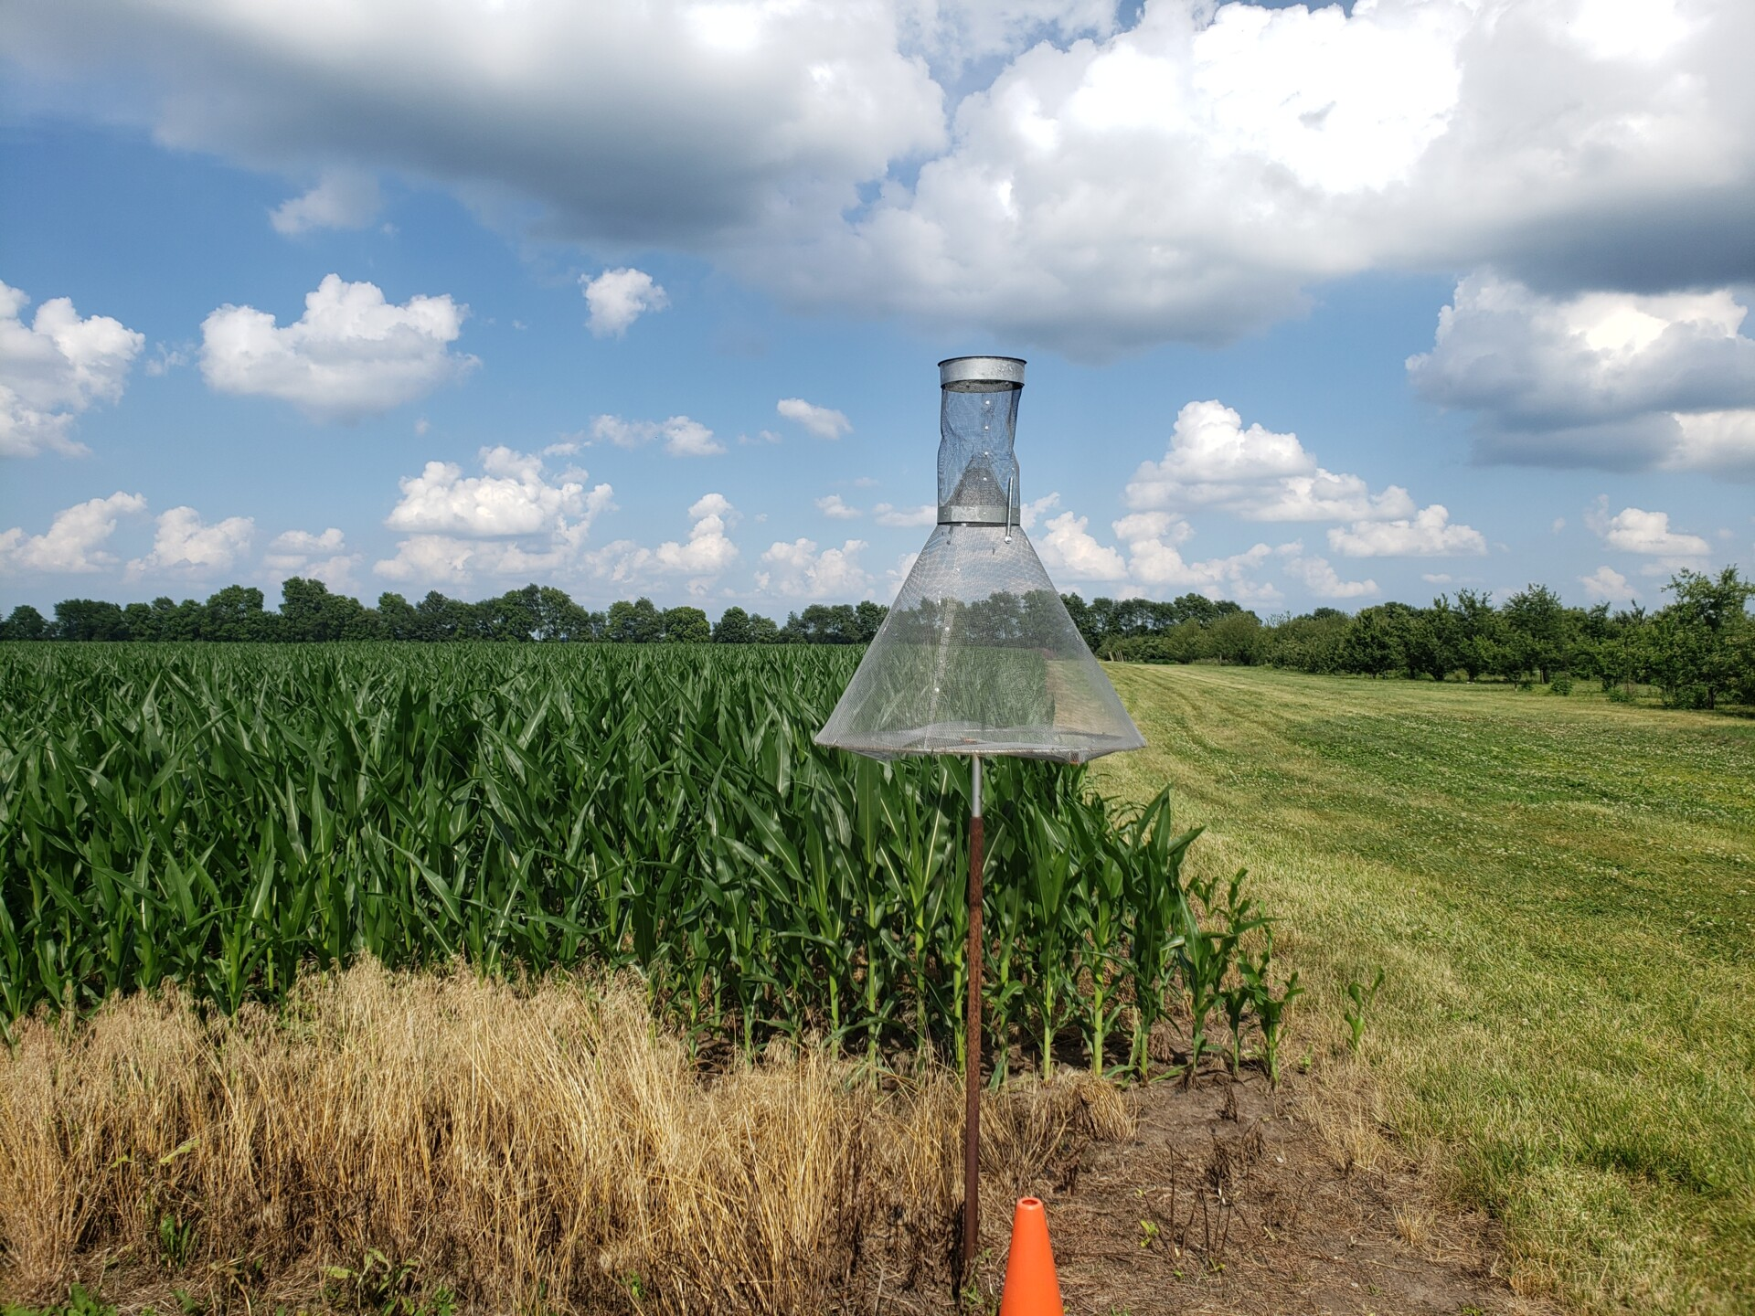
Scouting for Insect

Slide 16
Insect Damage

Slide 17
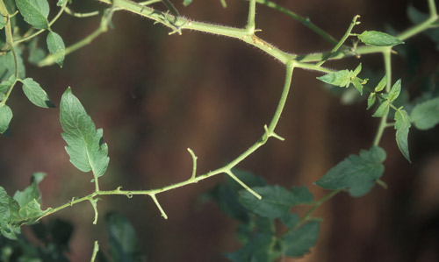
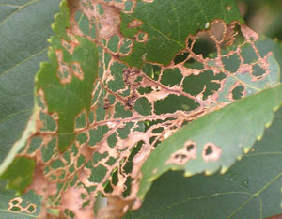
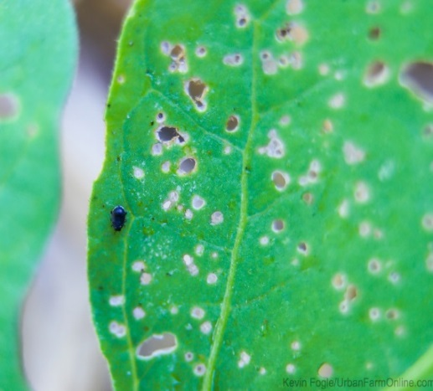
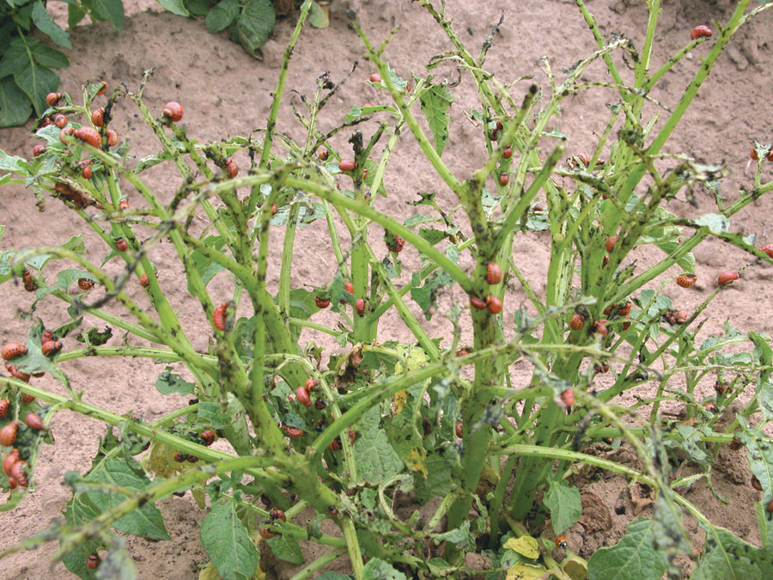
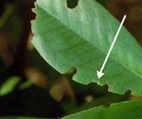
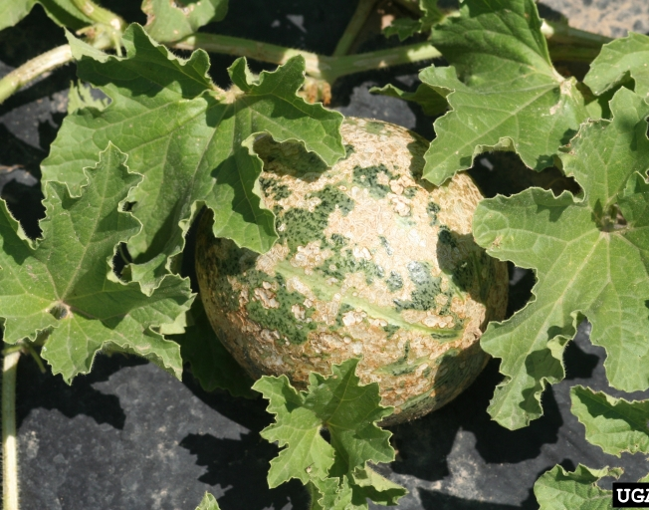
Chewing Damage
Skeletonization
Shot holes
Defoliation
Feeding damage: beetles, caterpillars, sawfly larvae, grasshoppers
Whitney Cranshaw, Colorado State University, Bugwood.org
Notes:
Shot hole damage- Small/ young caterpillars, flea beetles,
Defoliation : Caterpillars,. Slug, Grasshoppers
Skeleronization: Sawfly Larvae, beetles

Slide 18
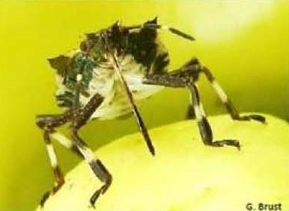
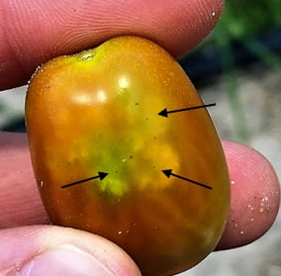


Sucking Damage
Stippling
Streaking
Starburst on fruit
“Hopper burn”
Feeding damage: true bugs, thrips, mites
Whitney Cranshaw, Colorado State University, Bugwood.org.

Slide 19




Mining and Boring Damage
Leaf mining
Larvae of flies, moths, sawflies, beetles
Boring
Beetles (adult & larvae), fly larvae, & caterpillars
Signs: holes, frass, sap/ pitch, sawdust
Mariusz Sobieski, Bugwood.org, Whitney Cranshaw, Colorado State University, Bugwood.org

Slide 20
General Control
Crop Rotation
Overwintering in soil
Crop timing
Resistant and tolerant varieties
Weed management around the field
Biocontrol
Trap Crop
Thresholds
Insecticide –
Target life stage
Good coverage
Contract vs systemic pesticide
Host specify –
Bacillus thuringiensis (Bt)

Slide 21


Notes:
The following are images of a dichotomous key, which are tool that can be use to help used to identify different organisms, based the organism's observable traits. Dichotomous keys consist of a series of statements with two choices in each step that will lead users to the correct identification.

Slide 22


Using a Key to ID the insect.
B
A
C
D
Gerald J. Lenhard, Louisiana State University, Bugwood.org
Notes:
Gerald J. Lenhard, Louisiana State University, Bugwood.org

Slide 23
Insect Orders
Thysanurs – Silverfish
Odonata – Dragonflies
Ephemeroptera – Mayflies
Orthoptere – Grasshoppers
Dermaptera – Earwigs
Blattodea – Cockroaches Termites
Mantodea – Mantis
Phasmatodea - Stick insects
Plecoptera – Stoneflies
Hemiptera – True bugs
Embioptera – Webspinners
Psocoptera – Booklice
Phthiraptera – Lice
Thysanoptera – Thirps
--------------------------------------------------------
Neuroptera – Lacewings, Owlflies, Dobsonflies
Mecoptera – Scorpionflies
Strepsiptera – Twisted-winged parasites
Coleoptera – Beetles
Hymenoptera – Sawflies, Ants, Bees and Wasps
Siphonatera – Fleas
Trichoptera – Caddisflies
Lepidoptera – Moths and Butterflies
Diptera – Flies
Notes:
The follower insect orders are undergo incomplete metamorphosis. They have several nymphal stage, where the nymphs resemble adults in appearance. Not all of these order are relevant to agriculture so we will just cover the one in bold.

Slide 24


Grasshopper
Order: Orthoptera
Incomplete metamorphosis
Chewing mouthparts: herbivores
Jagged-edged holes
Jumping hind legs
Sporadic pest soybeans
Clemson University - USDA Cooperative Extension Slide Series , Bugwood.org,
Kelly Estes, Illinois Natural History Survey
Notes:
Grasshopper, Cricket, Katydid are in the order Orthoptera.(Pronunciation:[Or·THOP·ter·a])
This is a large order with about 700 species found in Europe. Insects in this order have chewing mouthparts and are herbaceous.
Adults range in size from 1/4 inch to 2 inches long. Antennae may be long and thread-like (crickets and katydids) or shorter (most grasshoppers). Hind legs are generally long and robust, fitted for jumping.
The front pair of wings is usually slender and the hind pair is broad and fan-like. Wings are reduced to small pads in some grasshoppers and crickets. Adults in several groups in this order never develop wings. These include such odd insects as the cave crickets. Nymphs resemble the adults. Wingpads are often visible on the thorax in older nymphs. Some members of this group are quite destructive to crops if population become high, but most are not considered major pest.
-----------
Photos:
Grasshopper: David Cappaert, Bugwood.org https://www.insectimages.org/browse/detail.cfm?imgnum=5110050
Cricket: by Joseph Berger, Bugwood.org https://www.insectimages.org/browse/detail.cfm?imgnum=5573934
Katydid: Whitney Cranshaw, Colorado State University, Bugwood.org https://www.insectimages.org/browse/detail.cfm?imgnum=1455087

Slide 25


Earwigs
Order: Dermaptera
Incomplete metamorphosis
Chewing mouthparts
Scavengers
Thread-like antennae
2 pairs of wings
Front leathery short and the Hind membranous and fold under front wings
Pair forceps-like cerci on rear
David Cappaert, Bugwood.org
Notes:
Earwigs are in the order Dermaptera. (Pronunciation: [Der·MAP·te·ra])
Adults are about 1/2 – 3/4 inch in length with elongated, brown, slender, beaded antennae. Their front pair of wings is short, leathery and meets down the center of the back, which leaves most of the abdomen exposed. The hind wings are folded under these. A pair on non-poisonous pinchers are found at the end of the abdomen.
They have chewing mouthparts and are mostly scavengers feeding on a wide variety of plant or animal matter, but a few species are predatory. They tend to hide in dark recesses during the day and become active at night. Usually earwigs are found outdoors hiding under leaves, boards, or in cracks during the day. Earwigs can be pest in greenhouses, but are rarely considered pests in gardens or agriculture fields. They have been used as biocontrol in organic fruit tree operations.
Earwigs undergo incomplete metamorphosis, with the nymphs resembling adults. Some earwigs provide some parental care for the young.
-----------------------
Photos: https://www.insectimages.org/browse/detail.cfm?imgnum=2158034 David Cappaert, Bugwood.org;
https://www.insectimages.org/browse/detail.cfm?imgnum=5568978 Whitney Cranshaw, Colorado State University, Bugwood.org

Slide 26




True Bugs
Order: Hemiptera
Piercing-sucking mouthparts
Incomplete metamorphosis
“Half –Wing”
Diverse - pest & biocontrol
Transmit virus
Toxic salvia
Russ Ottens, University of Georgia, Bugwood.org , David Cappaert, Bugwood.org; Steven Katovich, Bugwood.org, Lesley Ingram, Bugwood.org
Notes:
True bugs are the order Hemiptera.
This order is very diverse containing species that are well known for being landscape and agricultural pests, as well as species that are well know biological control agents. All insect in this order have a piercing-sucking mouth or “beak”.
This order can further be separated into 3 suborders: Heteroptera, Auchenorrhyncha, and Sternorrhyncha.
-------------------------------
Photos:
Spined soldier bug nymph - Russ Ottens, University of Georgia, Bugwood.org https://www.insectimages.org/browse/detail.cfm?imgnum=1242093 Oleander aphids - David Cappaert, Bugwood.org https://www.insectimages.org/browse/detail.cfm?imgnum=5490092
European peach scale - Lesley Ingram, Bugwood.org https://www.insectimages.org/browse/detail.cfm?imgnum=5402150
Dog-Days Cicada - Steven Katovich, Bugwood.org https://www.insectimages.org/browse/detail.cfm?imgnum=5550236

Slide 27









Stink Bugs
Albert (Bud) Mayfield, USDA Forest Service, Bugwood.org, M.J. Raupp, UMD, Whitney Cranshaw, Colorado State University, Bugwood.org, Susan Ellis, Bugwood.org, Gary Bernon, USDA APHIS, Bugwood.org , J. Obermeyer Penn State Extesion, Russ Ottens, University of Georgia, Bugwood.org, Herb Pilcher, USDA Agricultural Research Service
Daren Mueller, Iowa State University, Bugwood.org,
Notes:
Assassin bug
Stink bug
Plant bug
Leaf-footed bug
Cicadas
Leafhopper
Froghopper/Spittlebug
Treehopper
Plant hopper
Aphids
Scale insects
Psyllids
Adelgid
Whiteflies
--------------------------------
DE, Chemnitz, Zeisigwald, https://arthropodafotos.de/;

Slide 28





Stink Bug Damage
https://www.canr.msu.edu/news, https://www.stopbmsb.org, Cesar Rodriguez-Saona,
Whitney Cranshaw, Colorado State University, Bugwood.org
Notes:
Light- colored stippling of leaves
Pimple or warts growths on beans
Light color start brust on tomatoes, peppers – depression
Incomplete kerneal – brown kernal in corn

Slide 29

Stink Bugs Control
Hard to control
Damage Nuisance
Value Added products
Biological control – Eggs
Weed management
https://calag.ucanr.edu/
Notes:
extremely difficult pests
Hard to scout for since they drop to the ground when the plant is disturbed
White tray shake plant
Entrust – spinosad
Stinkbugs are extremely difficult pests to control. As alluded to earlier, there are no good methods for monitoring these pests. Traps do not work well, visually scouting for them has proven to be unreliable and too time consuming. Usually stinkbug damage is only a nuisance, but so far this year it has resulted in moderate losses in some fields. Growers should examine the edges of their fields carefully for tomato fruit with cloudy spot. There are some acceptable chemical choices for stink bug control. Pyrethroids (Warrior II, Hero EC, Tombstone and Mustang Maxx) or Venom or Scorpion can be used to reduce damage. Sprays should be directed towards the center of the plant with high pressure and a high gallonage (50-100 gal/a).
If harvest has started there are neonics and pyrethroids that have very short PHIs – check your Mid-Atlantic Commercial Vegetable Production Recommendations guide. It should be understood that none of the chemicals will give complete control but will reduce damage compared with no chemical usage. Organic growers can try Entrust or Azera or Pyganic for control of nymphs, but not for adults, i.e., these materials will not control adults.

Slide 30








Beneficial True Bugs
spined soldier bug
Two-spotted Stink Bug
Rebekah D. Wallace, University of Georgia, Bugwood.org, Russ Ottens, University of Georgia, Bugwood.org,
Kevin D. Arvin, Bugwood.org , Jack Dykinga, USDA, Lyle J. Buss, University of Florida.

Slide 31



Feeding Damage: Plant Burn
Whitney Cranshaw, Colorado State University, Bugwood.org, Bruce Watt, University of Maine, Bugwood.org
Bruce Potter, University of Minnesota
Notes:
Hopper burn –
Select hairy varieties
Keep weeds down
Parasitoids and general predator
Diatomaceous earth, insecticidal soap, horticultural oil, neem, pyrethrum
Spray early in the day
Thoroughly wet leaf undersides

Slide 32



Aphids
Small, soft-bodied, tear-drop shaped, Tubular cornicles
Start May through June
Feed on plant sap
Favor one type of plant
Damage
Leaves curl
White or yellow stippling
Sooty mold
Transmit Virus
Alton N. Sparks, Jr., University of Georgia, Bugwood.org, William M. Brown Jr., Bugwood.org
Notes:
Appearance - Small, soft-bodied, tear-drop shaped, ranging in color. Most have a pair of tubular cornicles near the tip of the abdomen (looks like a “dual-exhaust” system). Dispersing adults have wings.
Life cycle - Eggs laid in fall overwinter and hatch in spring.
True Bug
Small, soft-bodied, tear-drop shaped, Tubular cornicles
May through June
Parthenogenetic
Damage
Leaves curl
White or yellow stippling
Honey dew & sooty mold
Common species
Melon Aphids
Cabbage Aphids
Green Pea Aphids
Root Aphids
Feeding Damage
Leaves curl
White or yellow stippling
Honey dew & sooty mold
Control –
1) Do not plant infested transplants.
2) Aphids are mainly a problem May through June, but have many natural enemies (e.g. lady bird beetles, lacewings, syrphid fly, parasitic wasps) that keep numbers controlled. Look for brown, swollen parasitized bodies.
3)Encourage predators with attractant plants and avoid toxic pesticides.
4)Control low aphid infestations with a robust spray of water.
5) If damage is obvious and predators and parasitoids few, use insecticidal soap. Check product label for directions before spraying.

Slide 33



Aphids Control
Select hairy varieties
Weed management
Heavy stream of water
*Biological control*
Remove plants immediately following harvest
Systemic pesticide
David Cappaert, Bugwood.org, Merle Shepard, Gerald R.Carner, and P.A.C Ooi, Bugwood.org,z
Drexel University/Alex Wild

Slide 34


Thrips
More common on vegetables
May – September
Small
Fringe of hairs around wings is a diagnostic character
Predatory
Main Pest species
Eastern Flower thrips
Western flower thrips
Onion thrips
Alton N. Sparks, Jr., University of Georgia, Bugwood.org

Slide 35



Damage
Metin Gülesci, Bugwood.org
Gerald Holmes, Strawberry Center, Cal Poly San Luis Obispo, Bugwood.org
Notes:
Damage:
Tiny yellow speck on fruit
Foliage & flower – distorted, stunted, silver gray specked feeding, black fecal spots
Tomato spotted wilt virus
This damage also look very similar to lace bug damage, leafhopper damage and nutrient deficiency – so always scout
Feed on leaves of petals
Stippling
Leaves become papery
Stunt plant growth
Flower terminate
Vectors
Tomato spotted wilt virus

Slide 36
Insects with Complete Metamorphosis

Slide 37



Beetles
Order: Coleoptera
Complete metamorphosis
Chewing mouthparts
Predators, plant feeders, scavengers
Hard front wing – elytra, meet in a line down back
Gerald J. Lenhard, Louisiana State University, Bugwood.org, Joseph Berger, Bugwood.org , Erich G. Vallery, USDA Forest Service - SRS-4552, Bugwood.org , Whitney Cranshaw, Colorado State University, Bugwood.org
Notes:
Beetle and weevils are in the order coleoptera. ( Pronunciation: [Co·le·OP·ter·a]) This is the largest order of animals by number of species. One in five living animal species is a beetle.
This order is very diverse with species having a wide variety of shapes, sizes, habitat and feeding habits. They have chewing mouthparts as an adult and also during all larval stages.
Adults have two pairs of wings. The front pair of wings, called elytra, are thick and form a hard shell over the abdomen of most beetles. Elytra meet in a straight line down the middle of the back. Some have short elytra and may be confused with earwigs. The hind wings are membranous and are folded under the front wings when at rest.
Many beetles species are herbivores, both in their larval and adult stages, and are considered major pests of garden, landscape and agricultural plants. They do this by eating leaves, stalks and flowers, and sometimes plant roots. Their snout-nosed cousins, weevils and curculios, primarily inflict damage by boring into stems, flower buds and fruit.
Others beetles are scavengers are useful as decomposers and recyclers of organic nutrients. Predatory species, such as lady bird beetles, are important biological control agents of aphids and scale insects.
-------------------------
Photo:
Southern Pine Beetle wing - Erich G. Vallery, USDA Forest Service - SRS-4552, Bugwood.org https://www.insectimages.org/browse/detail.cfm?imgnum=5289036
Japanese beetle: Joseph Berger, Bugwood.org https://www.insectimages.org/browse/detail.cfm?imgnum=5558527
Bess Beetle larvae/ grub : Gerald J. Lenhard, Louisiana State University, Bugwood.org https://www.insectimages.org/browse/detail.cfm?imgnum=0014083
Ladybird beetle feeding on eggs Whitney Cranshaw, Colorado State University, Bugwood.org https://www.insectimages.org/browse/detail.cfm?imgnum=1475029

Slide 38





Beetle Larvae

Slide 39


Scarab Beetles
Heavy bodied, oval to elongate
Lamellate antennae with club
Larva – Grubs
Landscape & turf pest
Karla Salp, Washington State Department of Agriculture, Bugwood.org
Notes:
The scarab beetle family is very large, with lots of variety, that occupy different habitats. They can range in size from less than ¼ inch to 2 inches (adults); to about 2 inches (larvae). They are oval or elongated, stout, usually with rounded backs. They have clubbed antennae with segments that can press tightly together or can be fanned open like leaves. While some species are black, brownish, or drab, many scarabs are colorful, some with iridescent greens and other colors.
The larvae of most scarab beetles are whitish, C-shaped grubs that live underground or in other protected places. The heads are often brownish or black, and they have three pairs of legs.
Both adults and larvae have mouthparts are mostly adapted for chewing. Adults feed on various materials, according to species. Some eat decaying materials such as manure, carrion, rotting and fermenting fruits, and composting plant material. Some eat fungi and mushrooms, or sap. Others burrow into the soil and chew plant roots. Some eat flowers, pollen, and nectar, pollinating flowers in the process. Many eat leaves and fruits. The larvae of most eat decaying materials or plant roots.
While some scarab beetle, such as the introduced Japanese beetle, are serious agricultural pests, most scarabs are beneficial since they help to break down decomposing materials and thus nourish the soil.
Delta Flower Scarab

Slide 40





Leaf Beetles
Small-Medium
Domed with rounded abdomens
Short antenna
Feed on leaves
Shot hole, leaf miners
Mourad Louadfel, Retired, Bugwood.org, Ward Upham, Kansas State University, Bugwood.org, USDA APHIS PPQ - Oxford, North Carolina , USDA APHIS PPQ, Bugwood.org
Notes:
Leaf beetles are a large and diverse group. They are small to medium size beetle that have oval or round shape. Their antennae are usually no more than half the length of the body. Although some are drab browns and blacks, many are brightly colored with striped, spotted, or blotched patterns, and some are shiny gold, silver, or other metallic colors. Leaf beetle larvae are can be found in a variety of forms from segmented worms or grubs.
Some, like the Colorado potato beetle larva (seen in the bottom left photo) are pudgy grubs. Others, like the larvae of tortoise beetles, have spines or hide beneath a roof made of excrement or other debris. Some have two “tails” at the hind end. Other look like early-stage butterfly caterpillars or lady beetle larvae.
The adults feed on leaves, flowers, and other plant parts. Although some eat a variety of plants, many species are limited to one type, such as plants in the bean family, or to milkweeds. The larvae of leaf beetles eat foliage, roots, or underground stems of plants. The larvae of some species are leaf miners, chomping the soft tissues within leaves, creating a light-colored, meandering pattern.
Several species of this beetle family are crop and garden pests. Among these are the bean leaf beetle, which attacks soybean leaves, pods, and seeds, the striped and spotted cucumber beetles, Colorado potato beetle, elm leaf beetle, corn rootworms, flea beetles of corn, potato, eggplant, cabbage, spinach, and the asparagus beetles. Some species, however, are a valuable biological control for invasive weeds.

Slide 41





Leaf Beetle Feeding Damage
Whitney Cranshaw, Colorado State University, Bugwood.org, Jim Jasinski, Ohio State University Extension, Bugwood.org
Gerald Holmes, Strawberry Center, Cal Poly San Luis Obispo, Bugwood.org
Notes:
Direct feeding by either cucumber beetle adult can kill or severely stunt young plants by feeding on stems and cotyledons or on fruit, but most importantly adult striped cucumber beetles can vector bacterial wilt disease of cucumber, cantaloupe, and squash and to a lesser extent pumpkins. Although feeding damage by adult beetles is less serious to plants that are large and already leafed out, feeding on fruits can result in scarring and decreases the marketability and storage life of the crop. Spotted cucumber beetle feeding can vector mosaic viruses, although this is not very common in Maryland cucurbit fields.
Overwinter as adults in plant debris
Larvae feed on roots and burrow in young plant stems
Pupating in soil
Adults feed on seedlings, leaves, flowers, pollen and fruit (spotted)
1-3 generations per year
Vectors of diseases
Fusarium wilt
Mosaic viruses
Muskmelon necrotic spot virus
Cucurbit bacterial wilt

Slide 42

Leaf Beetles Control Methods
Clean up and remove debris
Lightly tilling in spring or fall
Floating row cover
Kaolin clay (Surround)
Insecticide
Pyrethrum, neem, or Spinosad
Whitney Cranshaw, Colorado State University, Bugwood.org
Notes:
Clean up and remove garden debris to reduce overwintering sites for the beetle
Lightly tilling your garden in spring or fall may also help reduce flea beetle populations

Slide 43

Click Beetles & Wireworms
Small-Medium, Flat
Adults feed on leaves & pollen
Wireworms (larvae) feed on roots
Bait sampling
Rescue treatments are not effective
Fall clean up
Cultivation: 6-8 inches (fall & spring)
Frank Peairs, Colorado State University, Bugwood.org; Roger S Key, English Nature, Bugwood.org
Notes:
https://extension.umn.edu/soybean-pest-management/wireworm-soybean
Adult click beetles feed on the leave and pollen of plant but the larvae also know as wireworms tend to be the largest pest issue.
Wireworms are 1/3 to 1 1/2" long, dark brown to yellowish, jointed, hard shelled and cylindrical. Unlike millipedes, with their many pairs of legs, wireworms have only 3 pairs, located directly behind the head.
Wireworms chew on underground stems, roots, seeds and tubers of a wide variety of plants, causing them to wilt and die. They will feed on many fruits and vegetables crops, but prefer beets, snap beans, carrots, corn, lettuce, muskmelons, onions, peas, potatoes, strawberries, and sweet potatoes. Larvae of click beetles may attack germinating seeds, the stem base and young roots.
The best way to to know if you have wireworms in a field is with traps fashioned from pieces of potato. Spear the potato pieces with sticks, and bury them 2 to 4 inches deep at 3 to 10 foot intervals, leaving a portion of the stick above ground. The wireworms will bury into the potato pieces to feed. After one week, dig up the traps and destroy them, along with the unsuspecting wireworms that are feeding inside. For long term control, plant a cover crop such as alfalfa or clover; this is particularly effective for corn crops.
Since wireworms overwinter in soil, the best way to prevent future problems is to reduce their numbers with a thorough fall cleanup. In fall, remove all old plants and overgrown weeds as soon as you finish harvesting each crop, eventually leaving the soil completely bare. Cultivate the soil thoroughly to a depth of 6 to 8 inches with a hand tool or a rotary tiller. About 2 to 3 weeks later, give the field a shallow cultivation to a depth of about 2 inches with a rotary tiller or a garden rake. Then, plant your winter cover crop or lay down 4 to 6 inches of winter mulch. About 2 weeks before planting in early spring, give the field one more shallow cultivation. Give the soil one final shallow cultivation upon planting.
Rescue treatments are not available for this pest. Preventative use of seed–applied or in–furrow insecticides may be considered for fields with high risk for economic infestation by wireworm (see above risk factors). Follow instructions on the insecticide label.

Slide 44



Beetle Borers
soybean stem borer (Dectes texanus)
J.P. Michaud, Kansas State University, Bugwood.org,
John C. French Sr., Retired, Universities:Auburn, GA, Clemson and U of MO, Bugwood.org

Slide 45







Beneficial Beetles
Whitney Cranshaw, Colorado State University, Bugwood.org,
Susan Ellis, Bugwood.org
Notes:
There are several families and species of beetles that are predatory and are consider beneficial bio control agents. This would include ladybird beetles, tiger beetle and ground beetle. Both larvae and adults are predators, with different species prefer different prey. The larvae often feeding on softer bodied insects like aphids, other insect eggs, or young caterpillars.
There are many species in the lady beetle family. Most are brightly colored, often shiny, typically red, orange, or yellow, and usually spotted, often with black. Several are all or mostly black(Upper left photo) . Their larvae are long, segmented, soft-bodied, and rather lizard-like ( Upper right photo), with six legs; they are often camouflaged with patterns in gray, tan, black, and brown, and often have small bristles. Adults mainly feed on other insects, especially aphids and scale insects, which suck plant juices and can injure crops. They also eat the larvae of flies and other minute caterpillars, insect eggs, and more. Some lady beetle species eat plants, fungi that grow on plants, or pollen.
The ground beetle (Lower right photo) and tiger beetle adults (Lower leftphoto) are typical found on the ground and run down prey insects, snatching them with their strong jaws. Many hunt for caterpillars; others prefer slugs and snails. Some also eat fruit or seeds, or scavenge from dead material, as well. The larvae of some species are parasitic on other insects.

Slide 46



Moths & Butterflies
Order: Lepidoptera
Complete metamorphosis
Chewing (larvae) and sucking mouthparts (adult)
Larvae – PEST stage
Karla Salp, Washington State Department of Agriculture, Bugwood.org
Emily Zobel, UME,
Notes:
Moths and butterflies are found in the order lepidoptera. Pronunciation: [Lep·i·DOP·ter·a]
This is the second largest order of insects and one of the best known. Adults usually have 2 pairs of well-developed wings covered with overlapping scales. Mouthparts of the adults are a coiled proboscis but some have reduced or non-functional mouthparts.
All Lepidoptera have complete metamorphosis. The larvae stages are known as caterpillars.
--------------------------- photos: Spongy moth: Karla Salp, Washington State Department of Agriculture, Bugwood.org https://www.insectimages.org/browse/detail.cfm?imgnum=5551083 Monarch butterfly: Emily Zobel, UME Hornworm Caterpillar: Emily Zobel, UME

Slide 47


Caterpillar
Chewing mouth parts
2-5 pairs of pro-leg
Pest: Feed on leaf, stem borer, tent/webbing
Whitney Cranshaw, Colorado State University, Bugwood.org,
R.J. Reynolds Tobacco Company, Bugwood.org
Notes:
In addition to three pairs of legs on the thorax, caterpillars have two to eight pairs of fleshy abdominal prolegs. These prolegs are non-segmented. Most lepidopteran larvae have chewing mouthparts and are herbivores. Some species eat foliage, some burrow into stems or roots, and some are leaf-miners.
Although many Lepidoptera are valued for their beauty, and a few are useful in commerce (the silkworm), the larvae of these insects are probably more destructive to agricultural crops and forest trees than any other group of insects.

Slide 48



Feeding Damage
Whitney Cranshaw, Colorado State University, Bugwood.org

Slide 49


Caterpillar Control
Track Migration/ Degree Days
Inspect transplants carefully
Frass/poop
Early maturing or fast-maturing plants
Remove plant debris after the growing season
Tillage
Biocontrol
Bacillus thuringiensis (Bt)
Insecticide good coverage – Under the leaves
Whitney Cranshaw, Colorado State University, Bugwood.org

Slide 50





Flies
Order: Diptera
Complete metamorphosis
Larvae – maggots
Piercing-sucking or sucking-sponging mouthparts
One pair of wings
Janco Tanis, jancology.com, Bugwood.org; Sturgis McKeever, Georgia Southern University, Bugwood.org, Jim Baker, North Carolina State University, Bugwood.org
Notes:
True Flies are in the order Diptera. (Pronunciation: [DIP·ter·a])
Adults are usually winged, but have only one pair of wings with few veins. Hind wings are represented by a pair of slender, knobbed structures called halteres. A few forms are wingless as adults, primarily parasites. Mouthparts are formed for sucking or piercing and sucking. Adult flies live in a wide range of habitats and display enormous variation in appearance and lifestyle.
In many families, their mouth is adapted for sponging and/or lapping. These flies survive on honeydew, nectar, or the exudates of various plants and animals. In other families, the mouth is adapted for cutting or piercing the tissues of a host. Some of these flies are predators of other arthropods, but most of them are external parasites (e.g., mosquitoes and deer flies) that feed on the blood of their vertebrate hosts, including humans, wild and domestic animals.
Flies undergo Complete metamorphosis, with fly larvae appearing entirely different from the adults. All fly larvae are legless. Some larvae will have a head capsule with chewing mouth parts, while others will not have a defined head capsule and only mouth hooks present. They live in aquatic (fresh water), semi-aquatic, or moist terrestrial environments. Some are internal parasites of mammals.
---------------------
Photos:
Crane fly: Janco Tanis, jancology.com, Bugwood.org, https://www.insectimages.org/browse/detail.cfm?imgnum=1265149
House fly larva: Jim Baker, North Carolina State University, Bugwood.org https://www.insectimages.org/browse/detail.cfm?imgnum=1543826
Fruit Fly: Pest and Diseases Image Library , Bugwood.org :
Horse fly & Tachinid fly - Sturgis McKeever, Georgia Southern University, Bugwood.org

Slide 51




Fly Damage
Whitney Cranshaw, Colorado State University, Bugwood.org,
John C. French Sr., Retired, Universities:Auburn, GA, Clemson and U of MO, Bugwood.org
Notes:
Flies can cause damage to crop by direct feeding on the plant leaves or burrows in stems, fruit, or roots. This feeding damage can kill seeds or young seedlings. Feeding on direct on the crop can make it unmarketable.
-------------------------------------------

Slide 52





Beneficial Flies
Merle Shepard, Gerald R.Carner, and P.A.C Ooi, Bugwood.org, Drexel University,
David Cappaert, Bugwood.org, John Davidson, UMD

Slide 53





Quiz: Who Caused this Damage?
A
C
B
D
Notes:
- Shot hole damage -

Slide 54
Beneficial Insects

Slide 55




Parasitic Wasp
R.J. Reynolds Tobacco Company , R.J. Reynolds Tobacco Company, Bugwood.org,
Whitney Cranshaw, Colorado State University, Bugwood.org
Notes:
Parasitic wasps area large group of wasps that need to lay their eggs inside other insects to complete their life cycle.
There are many species of parasitoid wasps, but most are so tiny that they are rarely noticed. They are very diverse in appearance, ranging in size from as small as a fleck of pepper up to nearly 3” long, and from uniformly dark in color to brightly colored and patterned. Adults usually feed on nectar, pollen, and honeydew, although a few may feed on host insects as well. The larvae are ectoparasitoids or endoparasitoids of other arthropods. They do not sting or bite people, and they do not have hives that they protect.
----------------------------
https://extension.umn.edu/beneficial-insects/parasitoid-wasps
R.J. Reynolds Tobacco Company , R.J. Reynolds Tobacco Company, Bugwood.org,
Whitney Cranshaw, Colorado State University, Bugwood.org

Slide 56



Lacewing
Joseph Berger, Bugwood.org, David Cappaert, Bugwood.org
Notes:
Net-winged insects are the order Neuroptera. (Pronunciation: [NEUR-op-ter-a]) This order gets its name from the numerous cross veins near the leading edge of their wings, which creates a net-like pattern. This order includes the lacewings, antlions, mantisflies, and owlflies along with several other minor groups.
They have chewing mouthparts and most are predatory during the larvae stages, typically feeding on aphids, mites, and scale insects. In most cases, the adults of these insects are also predators — the non-predatory species usually feed on nectar, pollen, or honeydew. The most common species found in the garden include green and brown lacewings.
Photo:
Adult: Joseph Berger, Bugwood.org : https://www.insectimages.org/browse/detail.cfm?imgnum=5497277
Larvae: David Cappaert, Bugwood.org https://www.insectimages.org/browse/detail.cfm?imgnum=2158012

Slide 57





Spiders
David Cappaert, Bugwood.org
Ronald F. Billings, Texas A&M Forest Service , Bugwood.org
Sturgis McKeever, Georgia Southern University, Bugwood.org

Slide 58


?
This material is based upon work supported by the National Institute of Food and Agriculture, U.S. Department of Agriculture, through the Northeast Sustainable Agriculture Research and Education program under subaward number SNE22-005-MD and NIFA award 2021-70006-35384.
Emily Zobel
Ezobel@umd.edu

