Slide 1
Integrated Tests to Better Understand Soil Biology
Alan Sundermeier
Coordinator – Conservation Action Project

Slide 2
ONC 24‐157
Soil and Crop Biology Testing ‐
What It Means ‐ Why Do It
Conservation Action Project

Slide 3

Conservation Action Project
Conservation Action Project (CAP) is a local, non-governmental organization established “to be a positive influence and voice in promoting Ohio’s agriculture through innovative programs that will improve the quality of Ohio’s soil and water resources.” Led by a board of trustees made up of farmers, agricultural product dealer, OSU Extension, and soil and water conservation district (SWCD) staff or supervisors from Defiance, Fulton, Henry, Lucas, Paulding, Williams, and Wood Counties, these trustees work together to be on the cutting edge of technology and agricultural practices.
Coordinator – Alan Sundermeier
Website – www.capofohio.org
Western Lake Erie Basin Watershed

Slide 4
Biology Testing Options
Cover Crop Biomass
Haney Test
PLFA
BeCrop
Total Nutrient Digestion
POXC
Microbiometer
Soil 1
SAP
Corn Stalk Nitrate

Slide 5
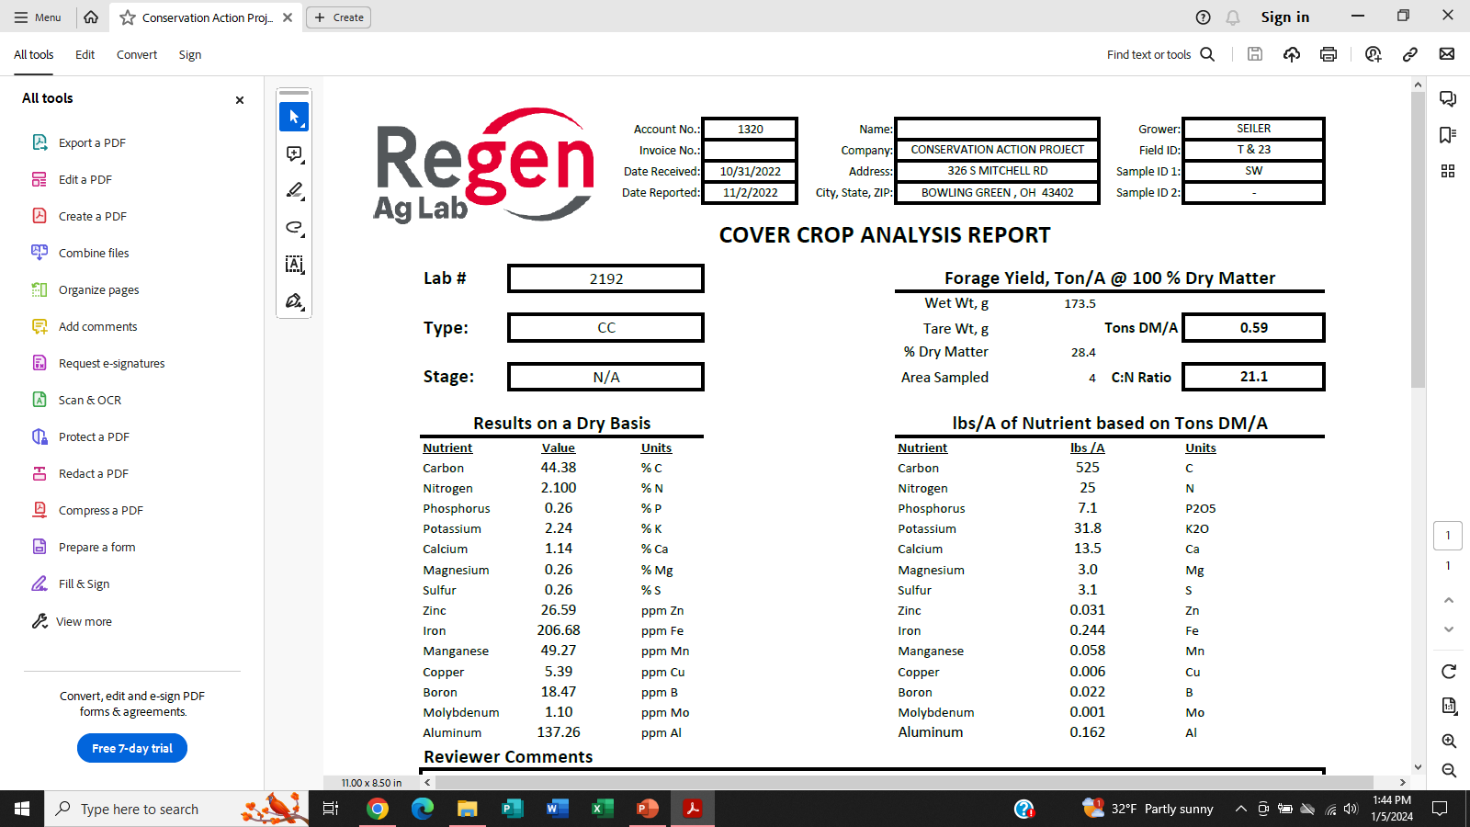

Slide 6
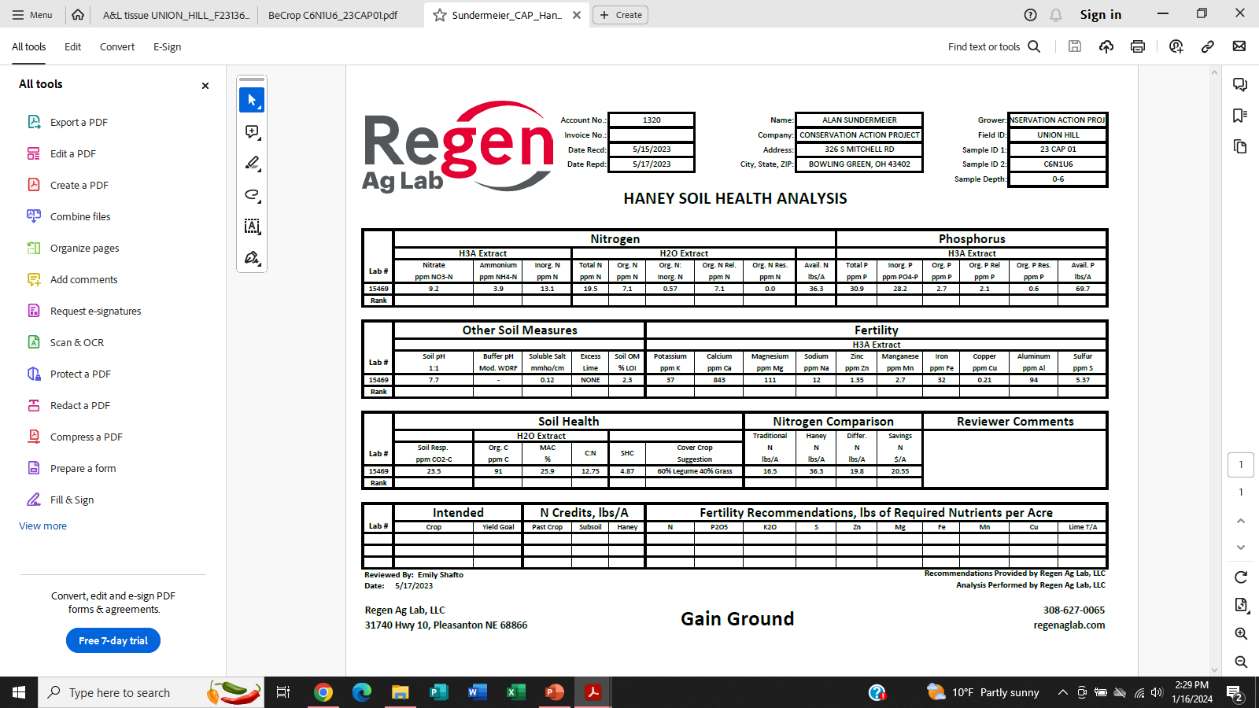

Slide 7

Nature’s Solvent – H2O
Water Extract
  Organic C
  Total N
  Nitrate
  Ammonium
Calculated
  Organic N
  Organic C:N
  Organic N Release
  Soil Health Score
Microorganisms have the greatest access to nutrients and food that are either suspended, dissolved, or solubilized in soil water.
Therefore, the water extract represents what the microbes see in their soil environment.

Slide 8
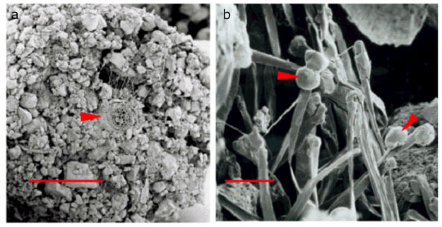
Green Chemistry – H3A
A soil extractant that mimics soil solution by using organic acids produced by living plant roots to temporarily change soil pH and increase nutrient availability.
http://www.nature.com/scitable/knowledge/library/the-rhizosphere-roots-soil-and-67500617

Slide 9
Relationship between PSNT and Haney N (0-12”) pools

Slide 10
Relationship between Haney N (0-12”) and corn yield

Slide 11
Relationship between PSNT and corn yield

Slide 12
Relationship between high N and less N rates corn yield

Slide 13
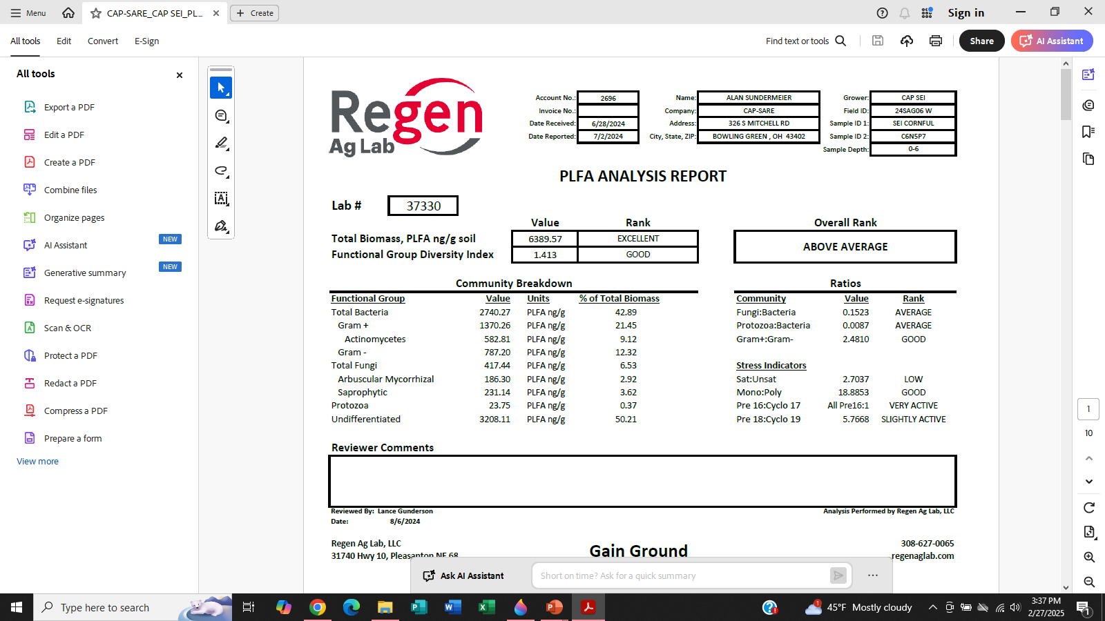

Slide 14
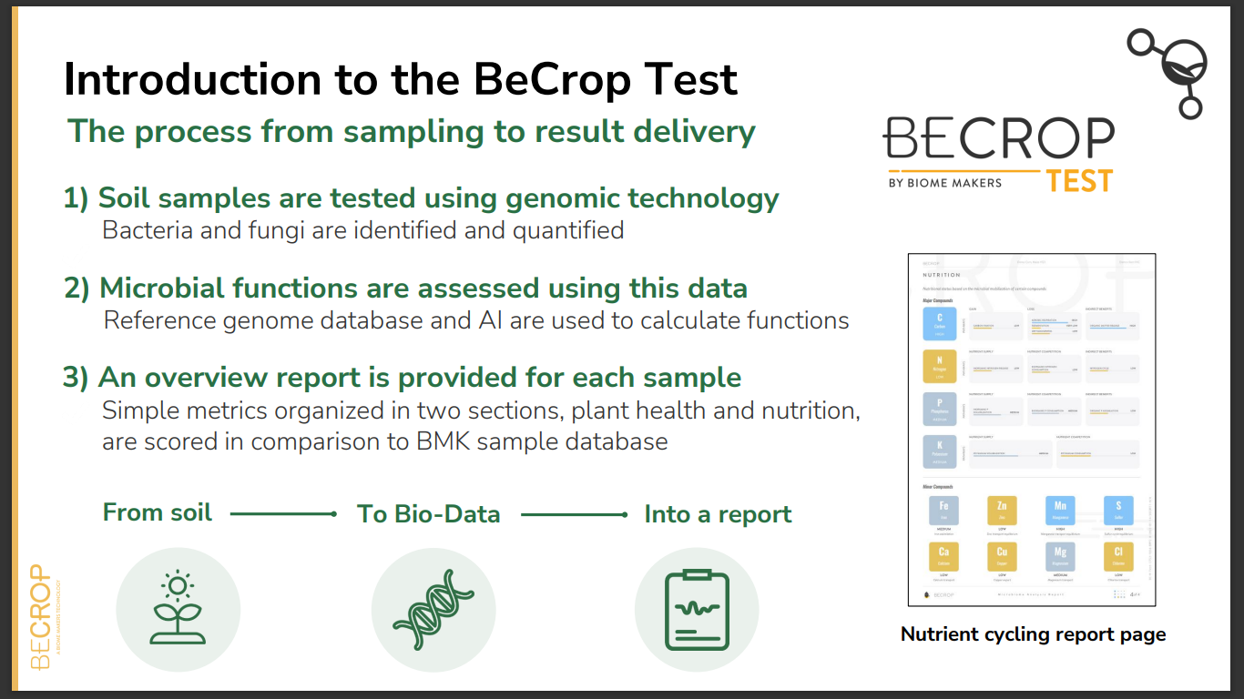

Slide 15
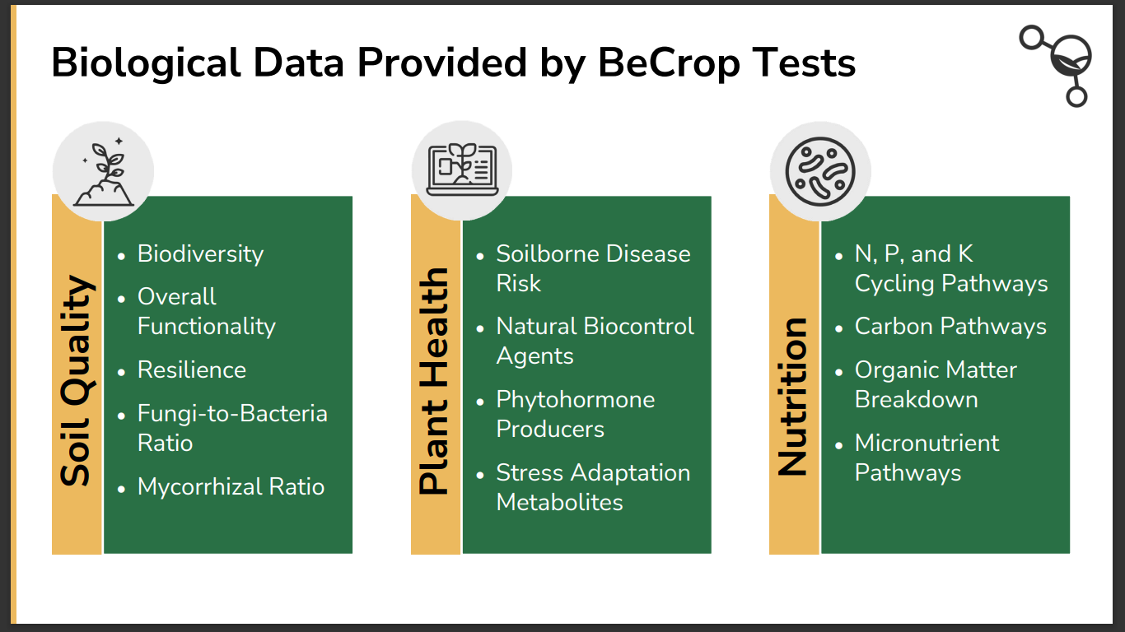

Slide 16
The Total Nutrient Digest (TND) is a measure of the soil’s net worth when it comes to nutrients. While most extract tests provide you with what is “available”, the TND provides you with the nutrient potential of your soil.

Slide 17
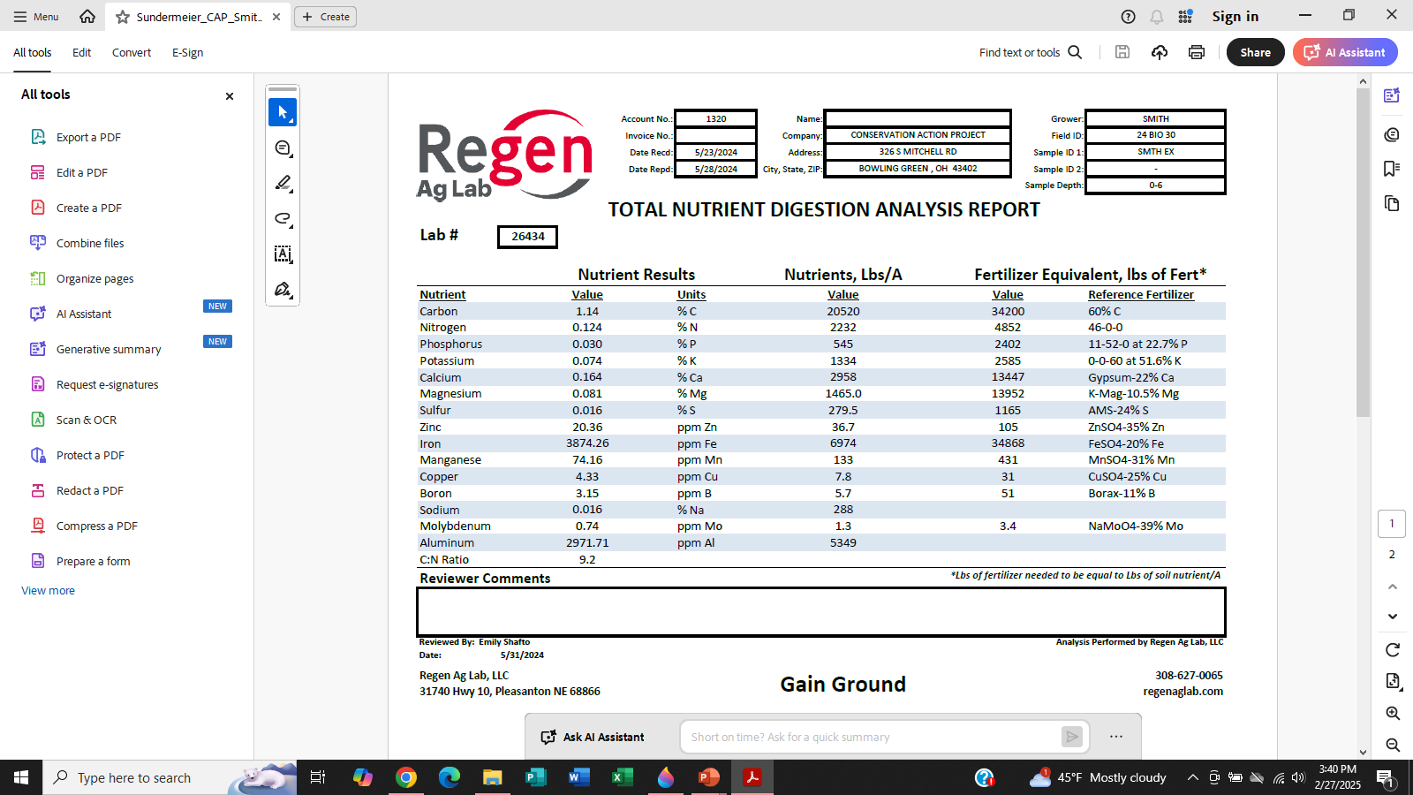

Slide 18
Permanganate oxidizable carbon (POXC) is a measure of the biologically active carbon fraction of the soil. This portion of carbon often contains easily consumed energy sources, such as plant sugars, polysaccharides, and glomalin, that fuels microbial activity. POXC quickly responds to soil management changes and can provide an early indication of practices that promote stabilization of organic matter. Active Organic Matter
POX-C , ppm C , KMnO4 value = 429

Slide 19
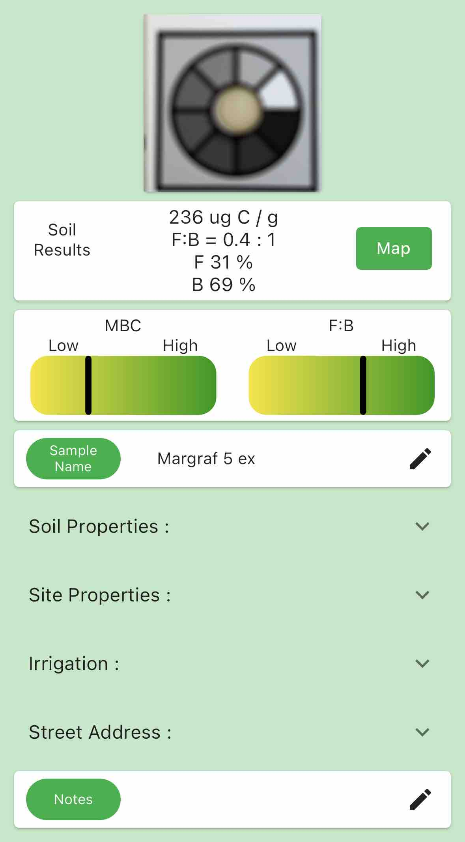
Prolific Earth Sciences has developed a field test that measures microbial biomass for soil, and provides the Fungal to Bacterial Ratio
.

Slide 20
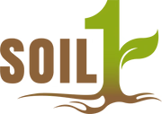
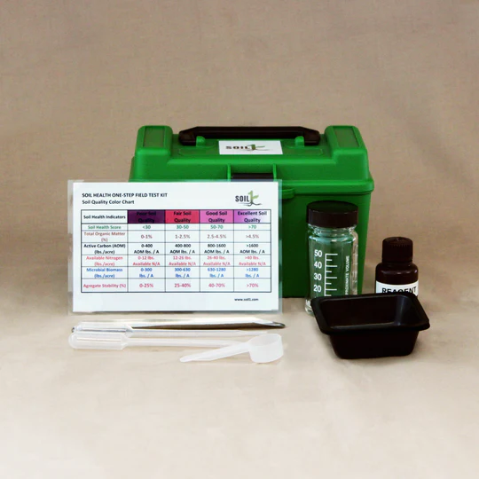
Soil 1: this one step field test kit gives a real-time measurement of soil active organic matter, nitrogen, and microbial vitality in the field.

Slide 21
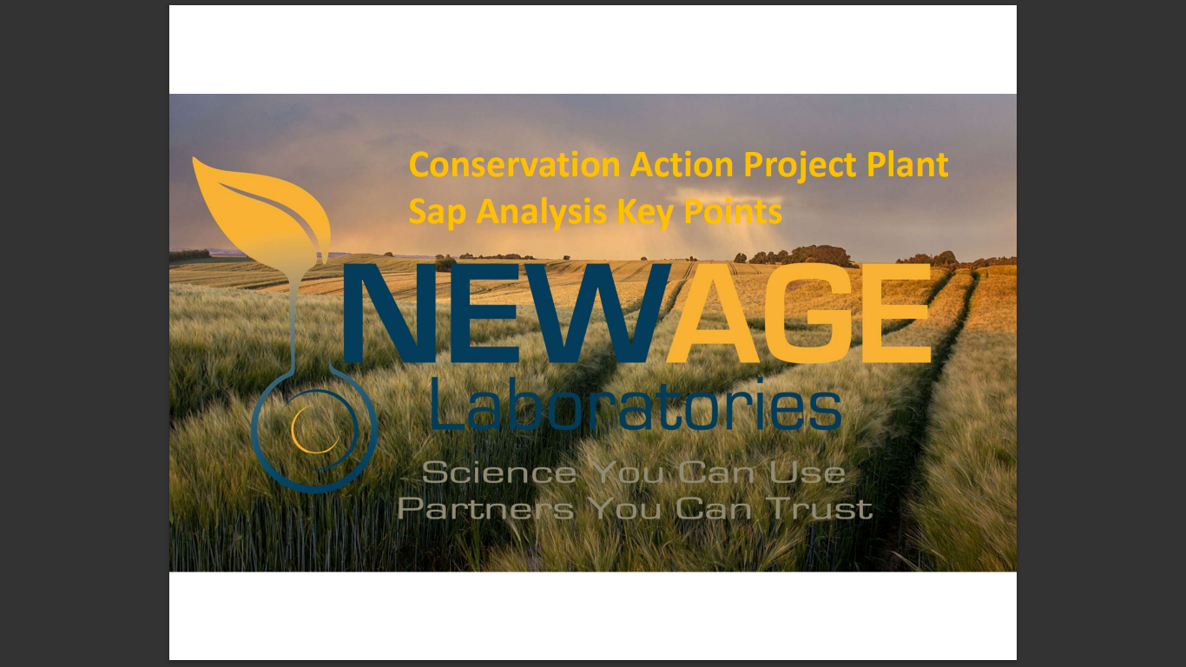

Slide 22
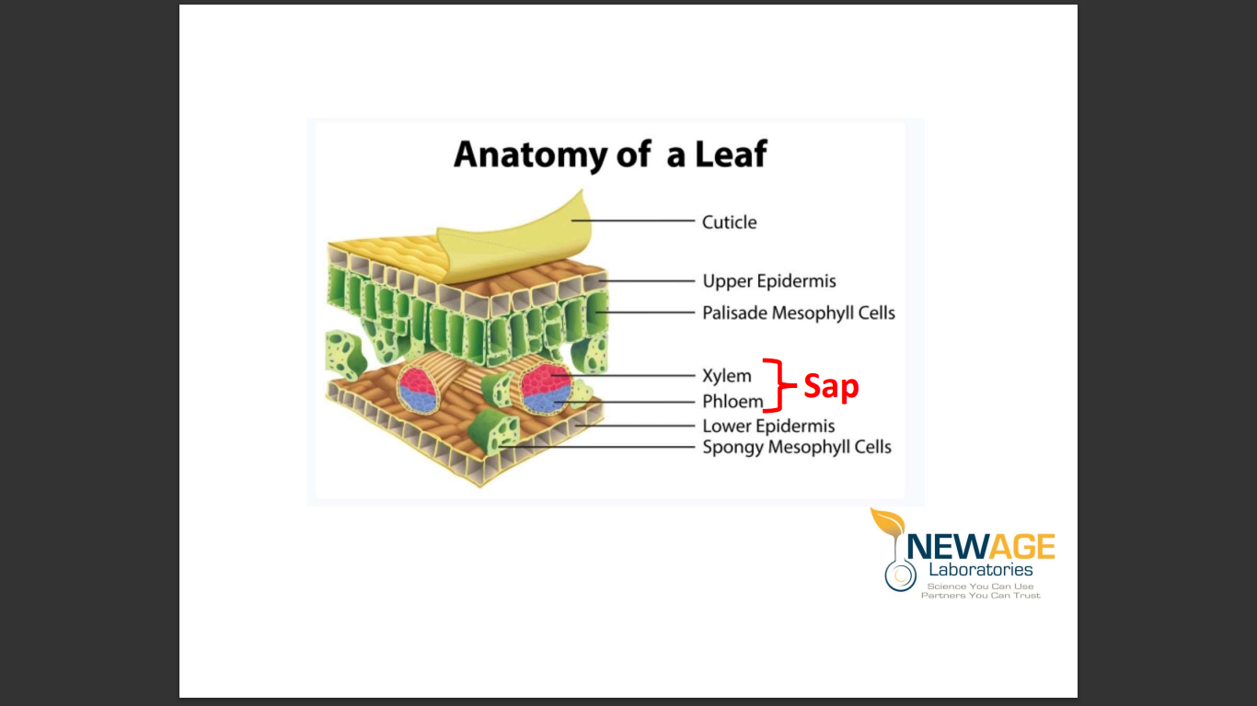

Slide 23
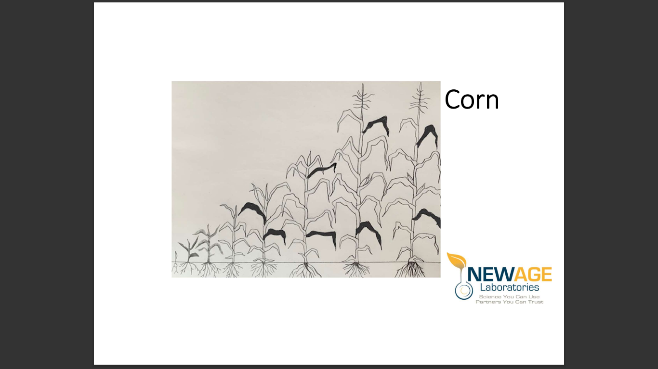

Slide 24
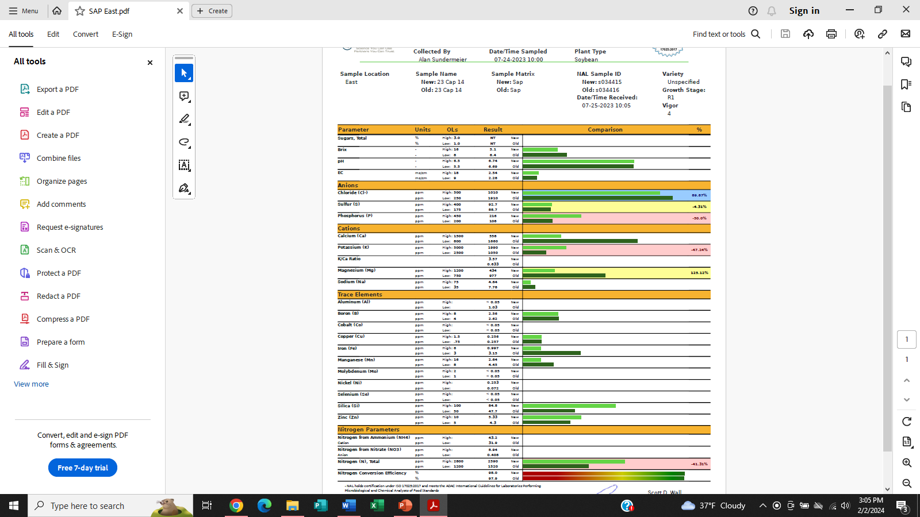

Slide 25
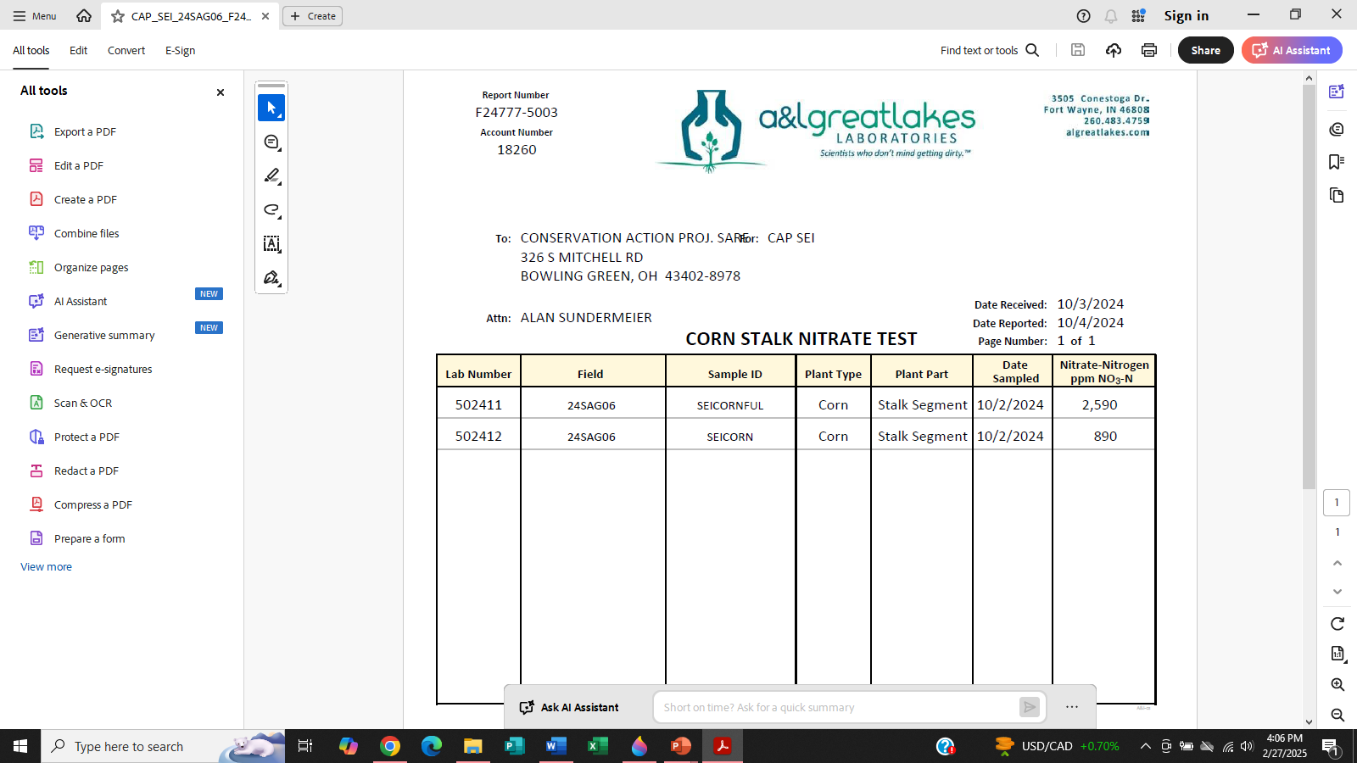

Slide 26
The Soil Health Effect
Improving soil health and biological function increases nutrient use efficiency by the crop.
Using conventional tests and fertilizer requirements can lead to excess fertility being applied.
Healthier soils require fewer fertility inputs due to the increased ability of plants to acquire necessary nutrients.

