Slide 1
Work Session on Incorporating Conservation into Leases
This work is supported by the National Institute of Food and Agriculture, U.S. Department of Agriculture, through the Northeast Sustainable Agriculture Research and Education program under subaward number ENE18-151.

Slide 2
Interactive Exercises
For each scenario, please work with your group and discuss:
What conservation leasing strategies can be used to resolve the issue for both parties?
Come up with as many options as possible and try to craft a mutually beneficial resolution.

Slide 3
Exercise 1
Lenny Landowner is interested in installing a riparian buffer on the farm to protect a waterway.
Farmer Dell is concerned the practice will hurt his bottom line by taking land out of production.
Dell is also concerned about the potential maintenance responsibility and associated costs.
Lenny doesn’t want to lose Dell as a tenant and doesn’t need any of the cost-share funding.
What can the parties do to facilitate the implementation of the buffer and alleviate some of the concerns?

Slide 4
Exercise 2
Larry Landowner and Farmer McDonald have just met for the first time and tentatively agreed on a farming arrangement.
Larry is concerned about the nutrient levels in his soil and, although he doesn’t know a lot about farming, would like to be able to monitor McDonald’s practices.
How can the lease be structured to accomplish these goals and allow McDonald to profitably farm?
Notes:
Right of Re-entry to allow or not allow the Landowner access, if the landowner wants NMP access it should be put in the lease.

Slide 5
Exercise 3
After all of the rain this season, Farmer Brown has noticed an area of increasing soil erosion on the farm.
Brown knows the property could benefit from a grassed waterway.
Brown farms Lisa Landowner’s land on a handshake and doesn’t want to risk applying for cost-share funding for a practice on land he doesn’t own and may not even be farming next year.
What can the parties do to work this out?

Slide 6
Exercise 4
Leo Landowner recently purchased land that Farmer Tom has farmed for a decade without a lease.
Leo would like to assess the natural resources on the land and get some advice on what farming practices can be used to reduce impacts.
Leo wants to start off this year with a lease which sets expectations but doesn’t scare Tom off of farming the land.
What can the parties do?

Slide 7
Exercise 5
Les Landowner has leased his farmland for many years to Farmer Bill on a year-to-year lease and is happy with Bill’s work.
Les is starting to plan for a retirement in Florida and although he would like to offer Bill a lease for a term longer than a year, he is afraid if he does so it will hamper his ability to sell the property and fund his retirement.
What can Les do to give Bill security while keeping the property free of a long term lease?

Slide 8
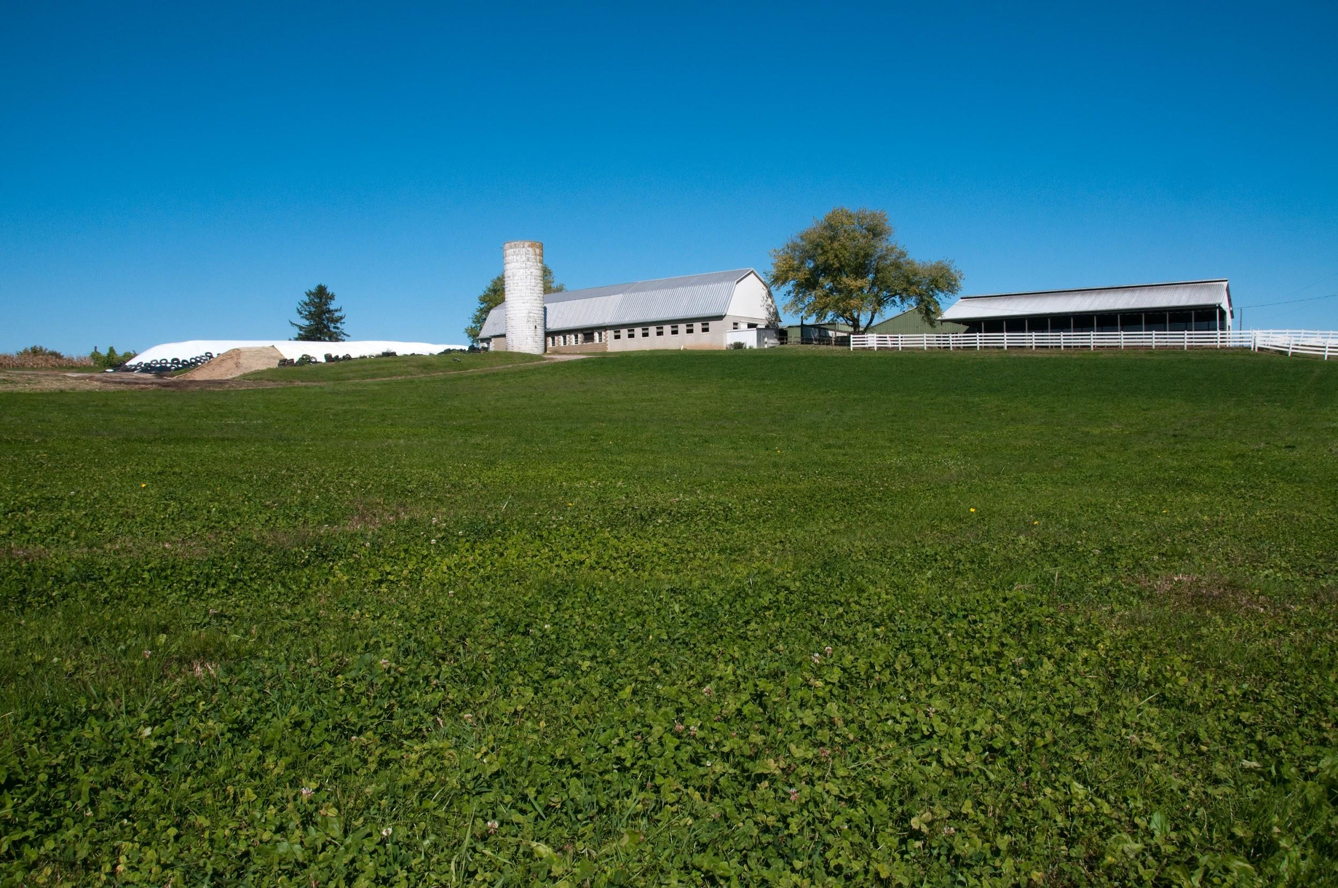
Thanks
Questions?
Sarah Everhart
severhart@law.umaryland.edu/ 410-458-2475

