Slide 1
Progress Report as of September 1, 2018
SARE Grant Project FNC18-1138
SARE Project: Mitigation of Potential Adverse Effects of Transgenic Crop Production for Long-Term Improvement of Soil Health

Slide 2
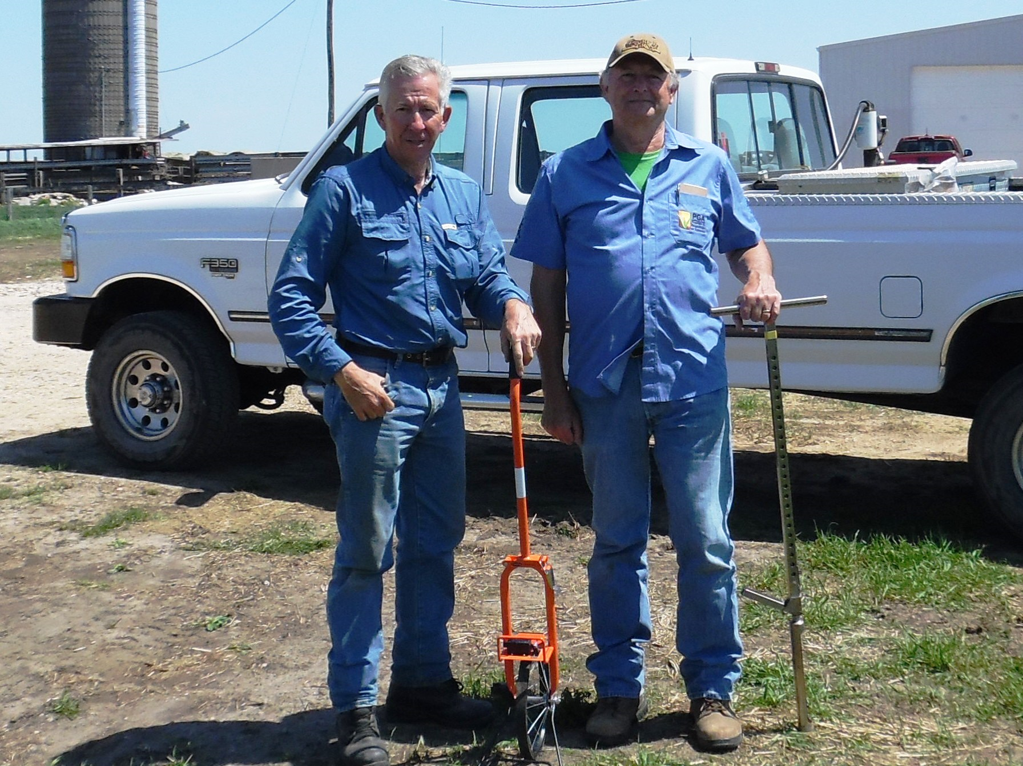
Dr. Robert Kremer (right) and Mike Osweiler (left) meet on Osweiler’s farm May 7, 2018 to establish soil sampling sites using GPS mapping.

Slide 3
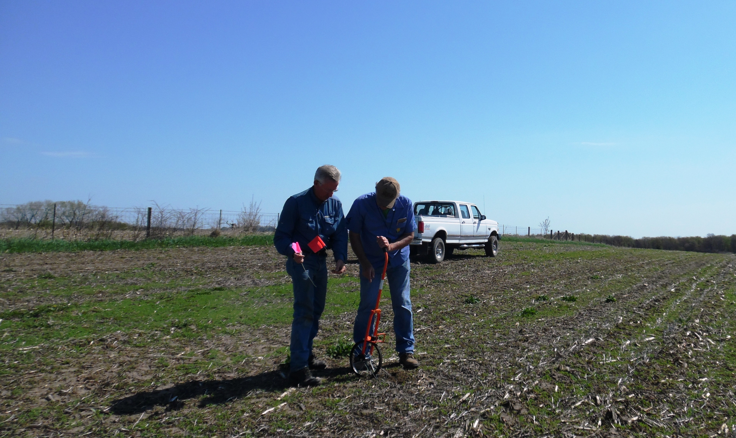
Dr. Robert Kremer (right) and Mike Osweiler (left) laying out transects for production season soil on north field. Bordering fence to the left is neighbor’s field that has had consistent annual applications of glyphosate. North field crop was soybeans in 2017;
crop in 2018 will be corn. (May 7, 2018)

Slide 4
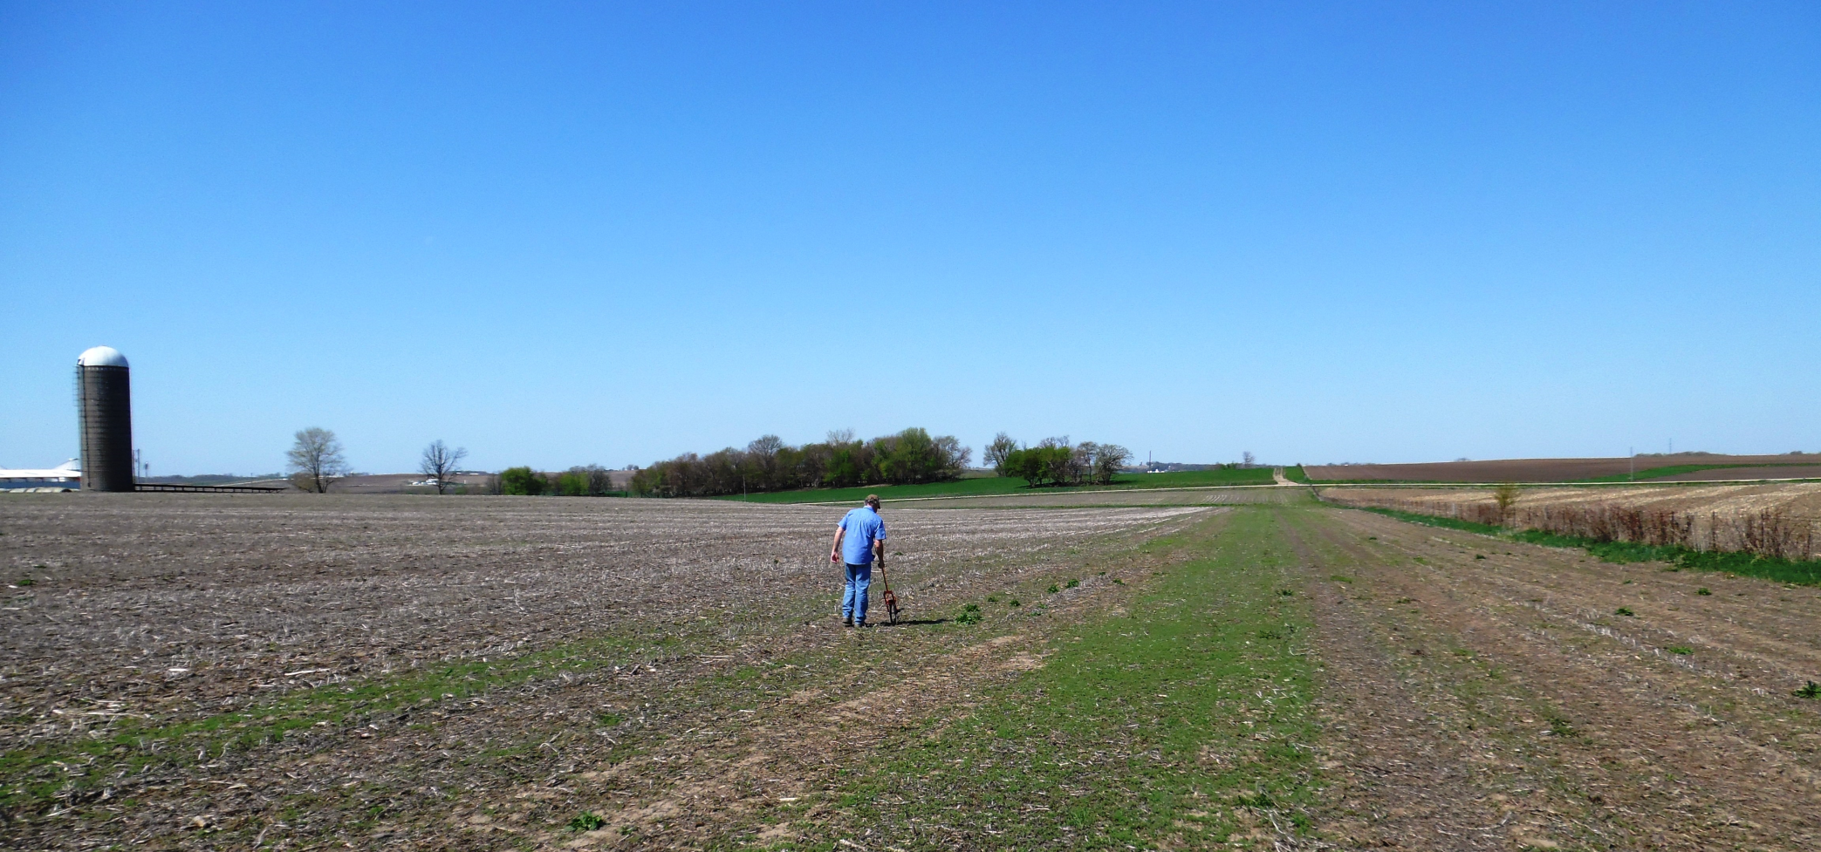
Another view of the north field. Bordering fence to the right is neighbor’s field that has had consistent annual applications of glyphosate. (May 7, 2018)

Slide 5
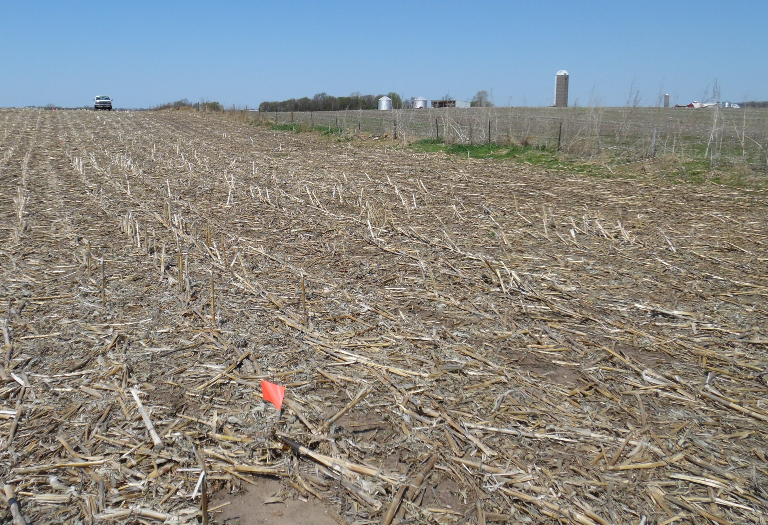
Below is a view of the south field. In 2017 the crop was corn; in 2018 the crop will be soybeans. Note: on the other side of the fence (right) is the north field that was shown in the previous two slides. (May 7, 2018)

Slide 6
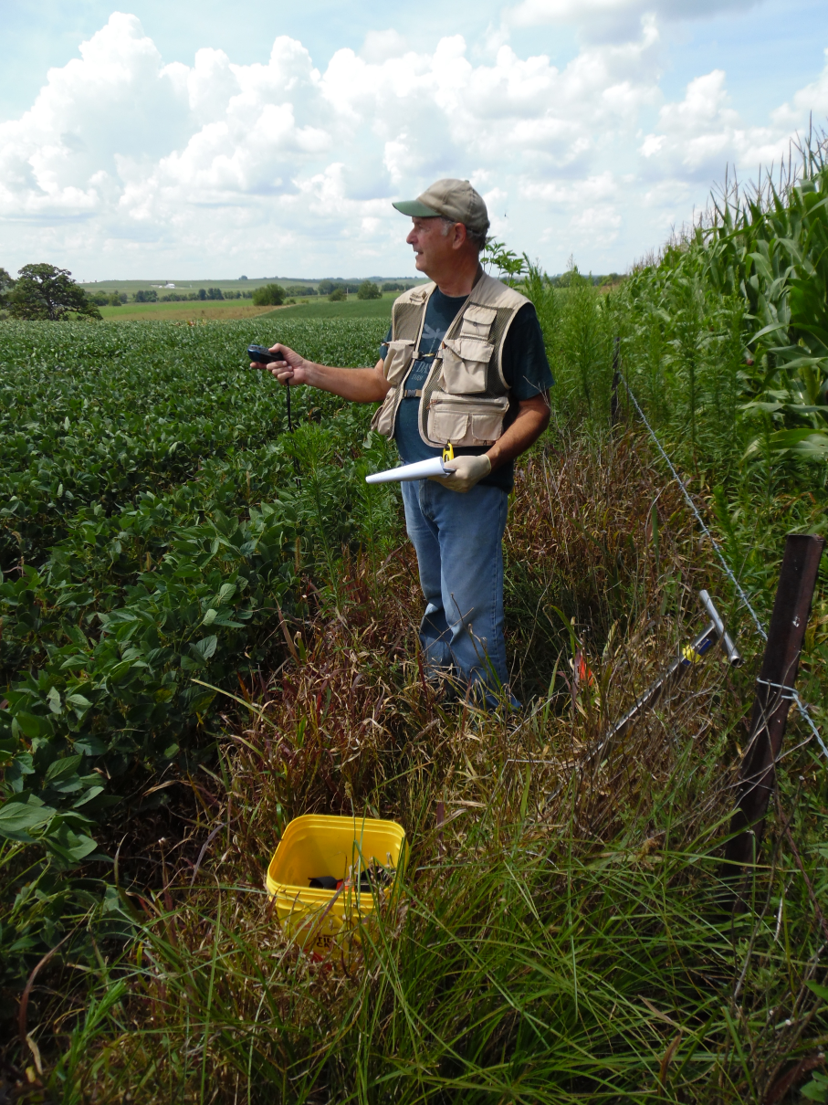
Dr. Kremer locating the sampling points in the south soybean field using GPS.
(July 30, 2018)

Slide 7
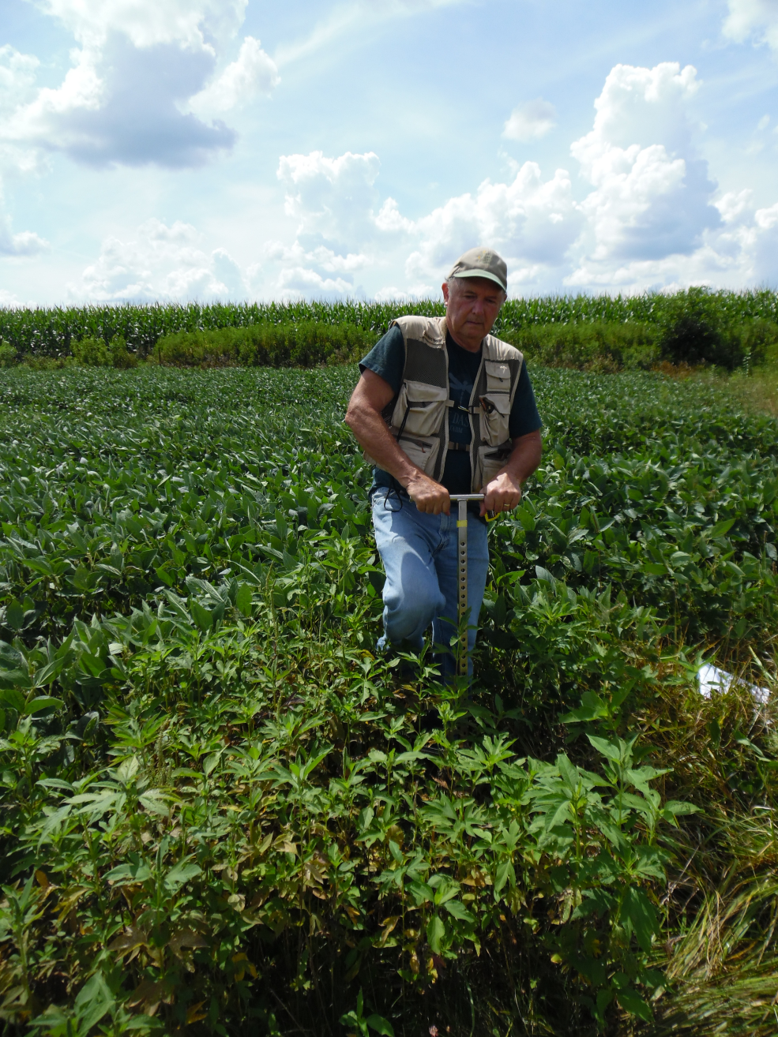
Dr. Kremer collecting a soil sample for glyphosate analysis along grass waterway in south soybean field. (July 30, 2018)

Slide 8
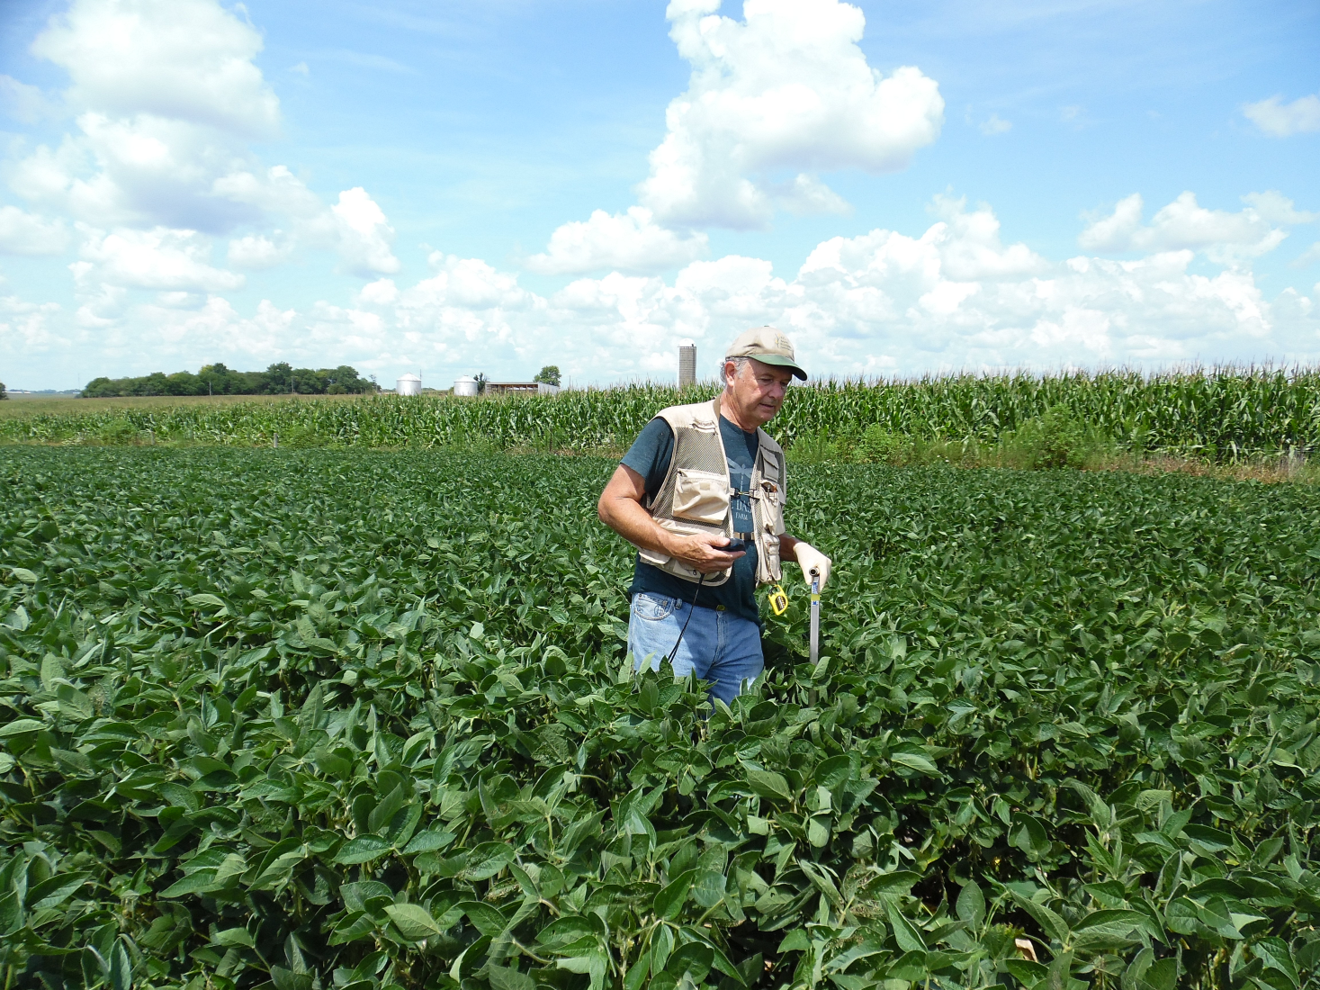
Dr. Kremer confirming position of a sampling point using GPS in south soybean field. (July 30, 2018)

Slide 9
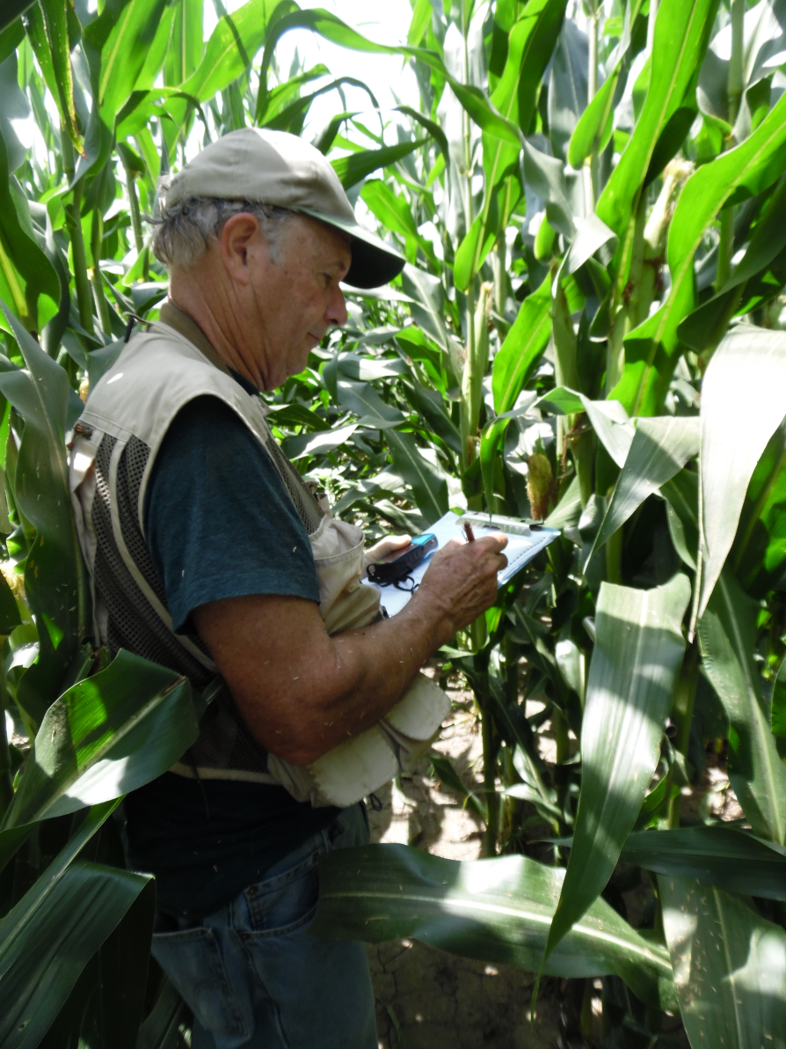
Dr. Kremer noting position of sampling point along a transect established in southern part of the north corn field.
(July 30, 2018)

Slide 10
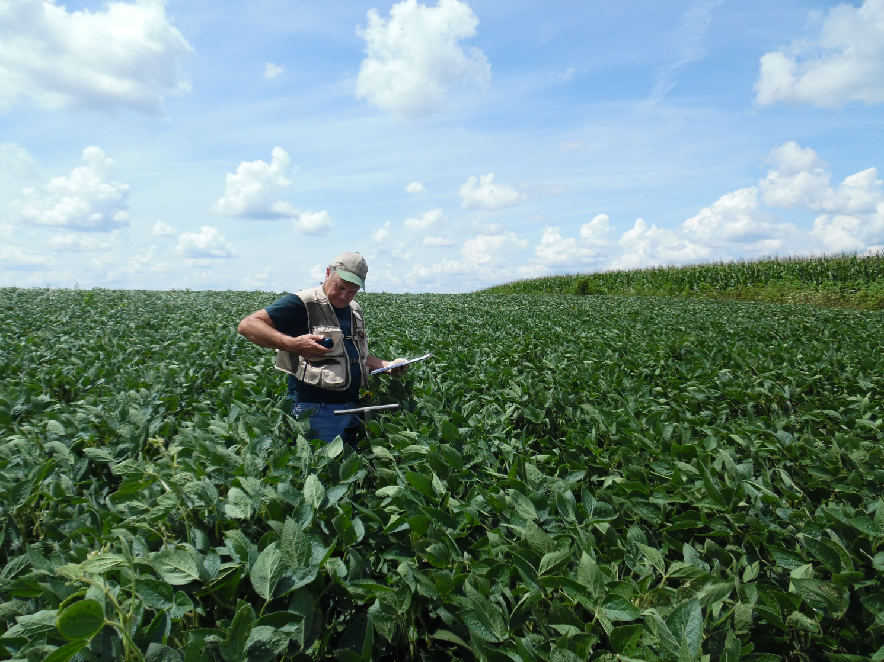
Dr. Kremer collecting a soybean leaf sample for tissue nutrient analysis at a sampling point in south soybean field. (July 30, 2018)

Slide 11
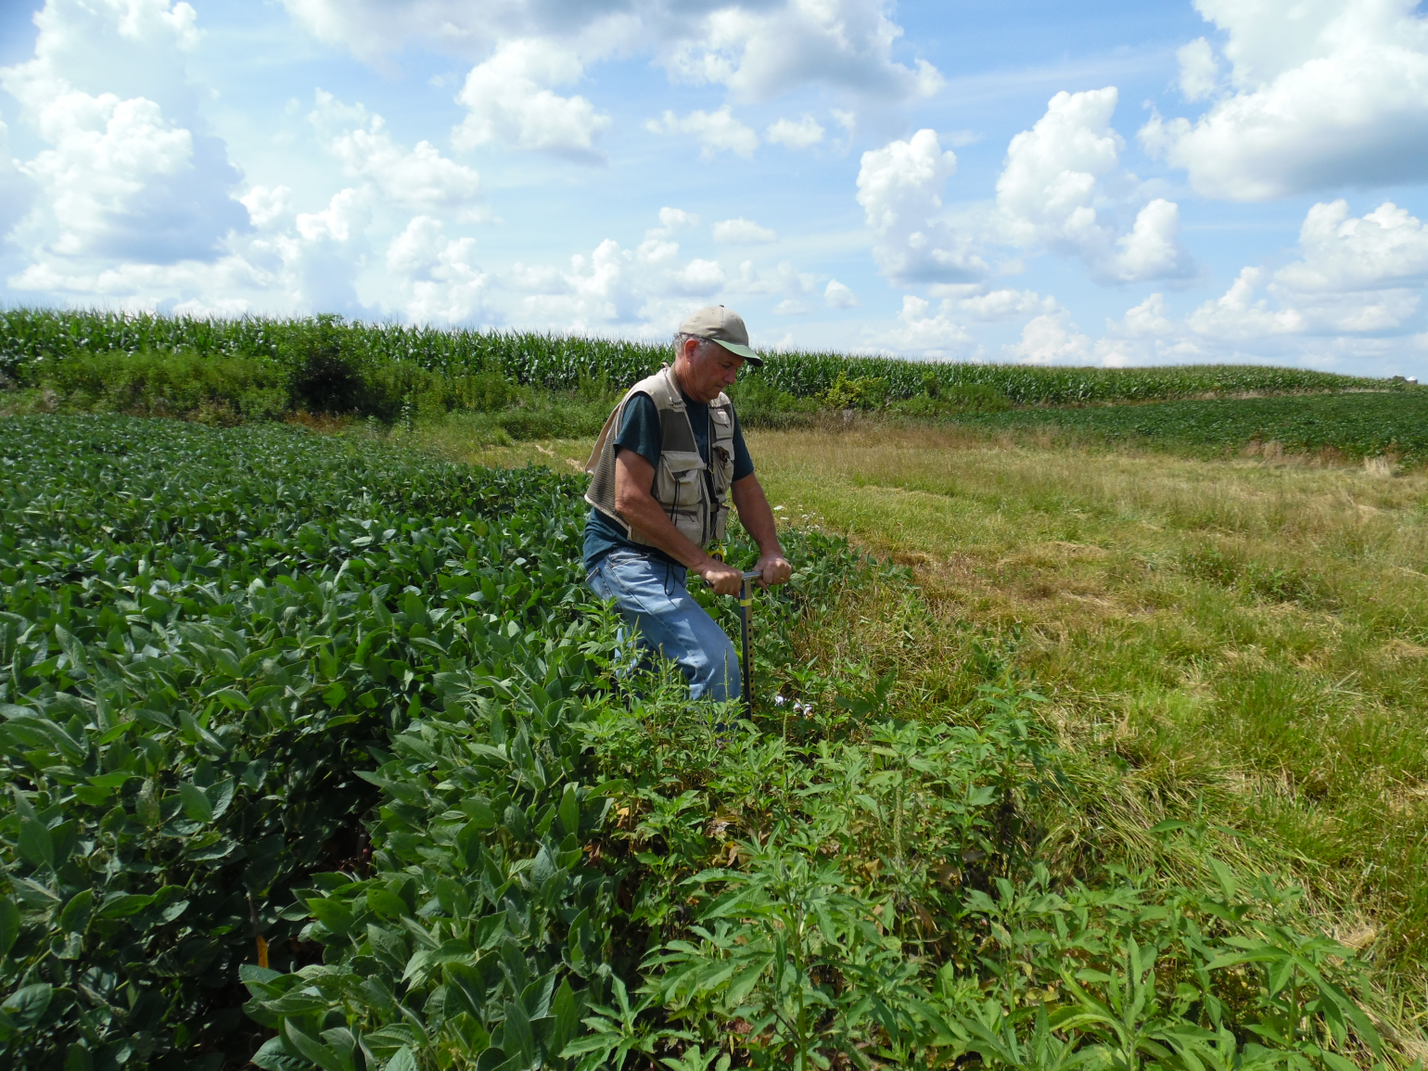
Dr. Kremer collecting a soil sample for glyphosate analysis along grass waterway in south soybean field. (July 30,2018)

Slide 12
Financial Summary Dated September 1, 2018
February 15, 2018
SARE approved Grant FNC18-1138 $7,481.00
April 3, 2018
Grant allocation from Regents of the University
of Minnesota to Michael Osweiler $3,740.50
May 14, 2018
Payment mailed to Dr. Robert J. Kremer
for Invoice # 05072018 ($437.00)
- Consulting Fee $100.00
On-farm site visit – May 7, 2018
Lay out transects for production season soil,
plant tissue sampling, and other measurements
per SARE grant objectives for 2018
- Travel Expenses $337.00
Round trip mileage:
630 miles x $0.535 miles = $337.00
August 14, 2018
Payment mailed to Dr. Robert J. Kremer
for Invoice # 08132018 ( 487.00)
- Consulting Fee $150.00
On-farm site visit – July 30, 2018
Soil, plant tissue sampling, and SPAD
measurements per SARE grant
objectives for 2018
- Travel Expenses $337.00
Round trip mileage:
630 miles x $0.535 miles = $337.00
Total Debits ($924.00)
Amount of 2018 Grant Money Remaining $2,816.50

