Slide 1
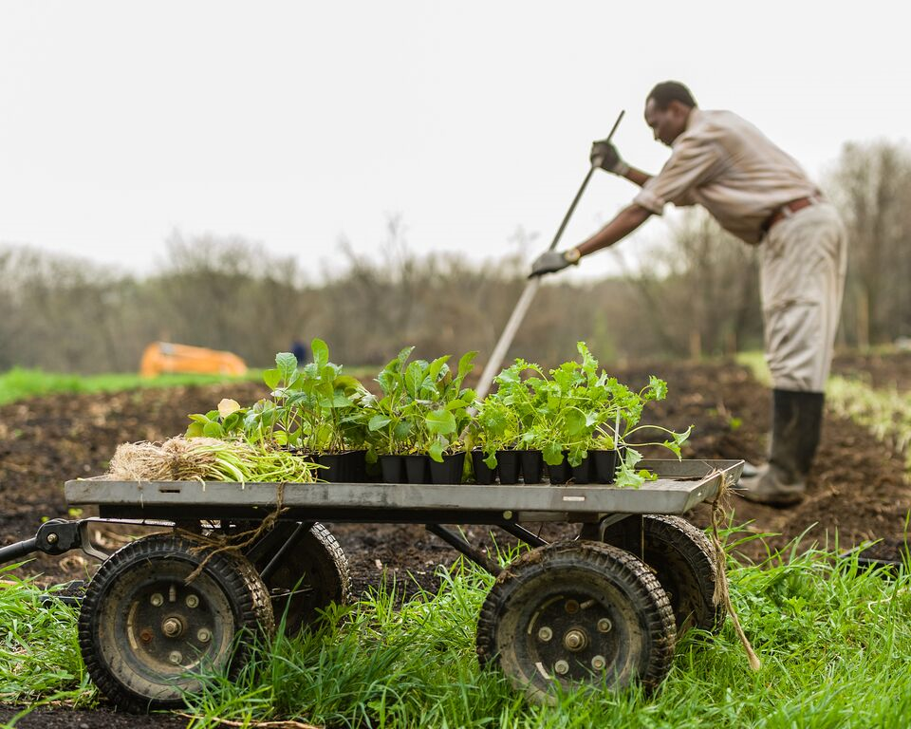
Lutheran Services in Iowa
Mickey Goggin, Economic Development Supervisor
Jess Soulis, Farm Marketing Specialist

Slide 2
What is Global Greens?
LSI’s Global Greens is an urban agriculture program connecting people who have come to the U.S. as refugees with land, tools, and training to become successful farmers in the Des Moines community.
Helping people reconnect with the land at whatever level fits their circumstances since 2010.

Slide 3
Program Spectrum
Community Gardener
Beginning Market Farmer (BMF), 50x50 ft. plot
Advanced Market Farmer (AMF), ¼ acre plot
Partial Transition:
¼ acre at GG Farm, some land on another site
Full Transition
no land at GG Farm, transitioned onto individual land

Slide 4
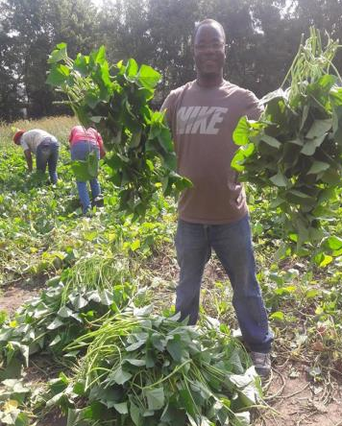
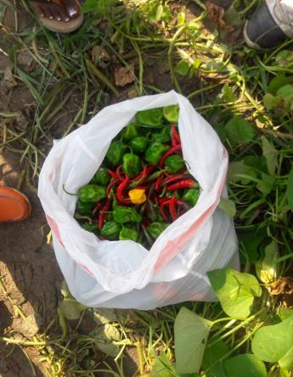
Community Gardens Program

Slide 5
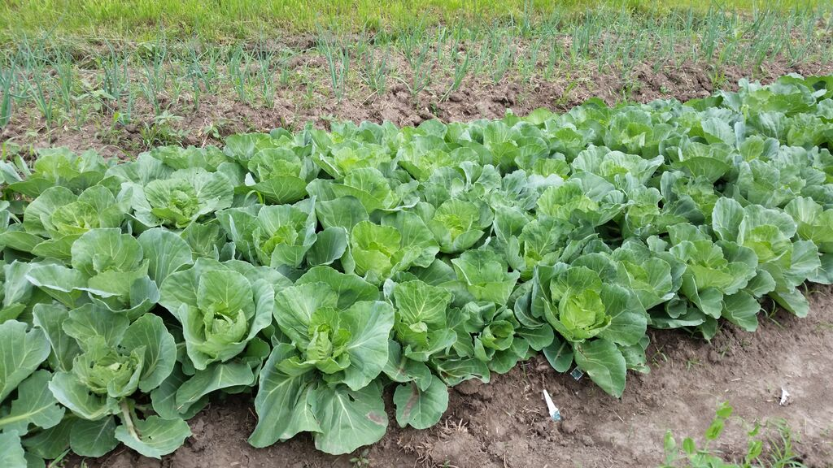
Over 250 families in community gardens at 18 different sites

Slide 6
Community Gardens
Green Shapes-Ideal Locations for new Gardens/Partnerships

Slide 7
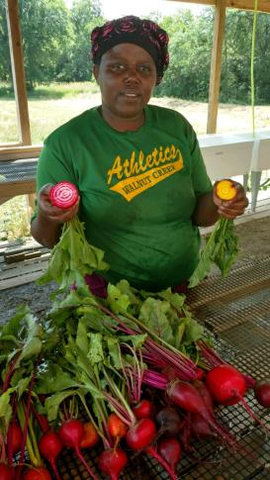
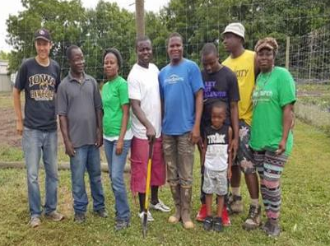
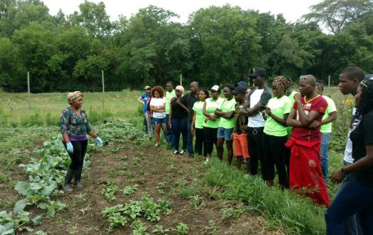
Notes:
2013 began @ GG farm on land owned by Valley – great partnership!
Total 6.5 acres, 20-25 families/year
Larger plots of land – growing for families, communities & selling, establishing farming business (Bizimana quote)
Shared infrastructure, educational opportunities

Slide 8
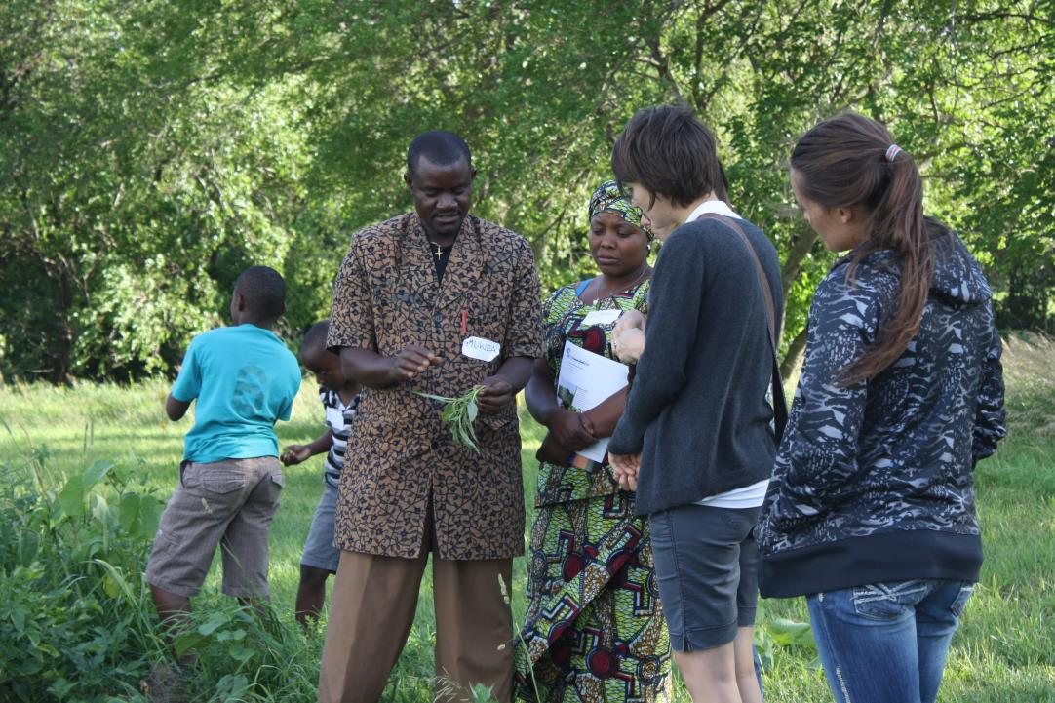
- Burundi - Bhutan - Burma - Rwanda
Farmer Backgrounds
Notes:
Gifts they bring with them – skills, knowledge, experience – great farmers, great produce!

Slide 9
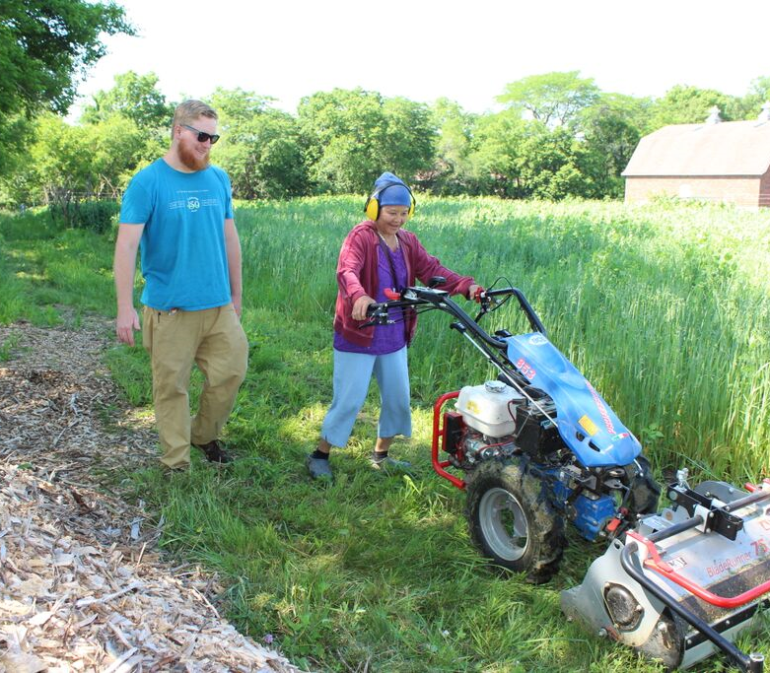
Community Gardens
Notes:
some of the trainings done on farm site, in classroom, informally while working side by side or at market, and field walks
Topics include: small machinery and tools, crop planning, organic ag, market-specific, food safety, farm finances
Navigating food system – many things are very different – learning about business (TKP quote)

Slide 10
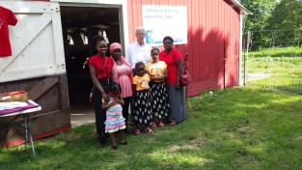
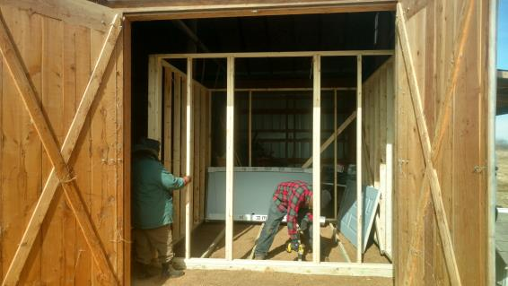
Transition Sites
2015 - today
Ankeny
Van Meter
Carlisle
Altoona
Notes:
4 advanced market farming families currently in phases 4 & 5 of the program – 3 are running their farming small businesses off the GG training farm site, another has land at GG farm & off site
We help match farmers w landowners – walk through setting things up, trouble shooting – technical assistance, ongoing support managing business

Slide 11
Notes:
Larger scale (Simon quote)

Slide 12
Notes:
Chance to learn new systems – use drip, weed fabric, etc
Also to be a peer mentor/teacher

Slide 13
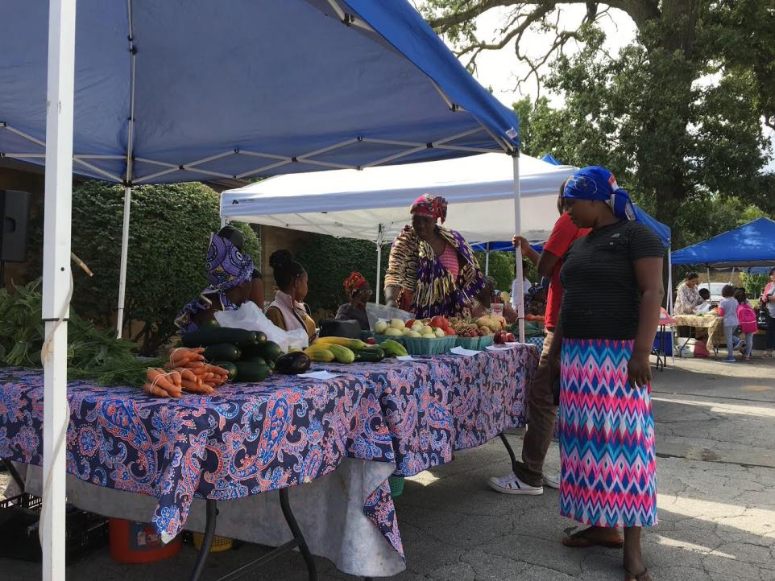
Global Greens farmers Market
Global Greens Farmers’ Market
Notes:
Markets! Variety of options – education around customer relations, managing & admin (applications, etc.) – goal is to find market channels that work best for each family and their unique circumstances
GG market – location, time and dates
Place to learn, grow business, establish customer base: diverse, including neighbors, community members, many share cultures of GG farmers – farmers provide access to culturally preferred foods they can’t find anywhere else

Slide 14
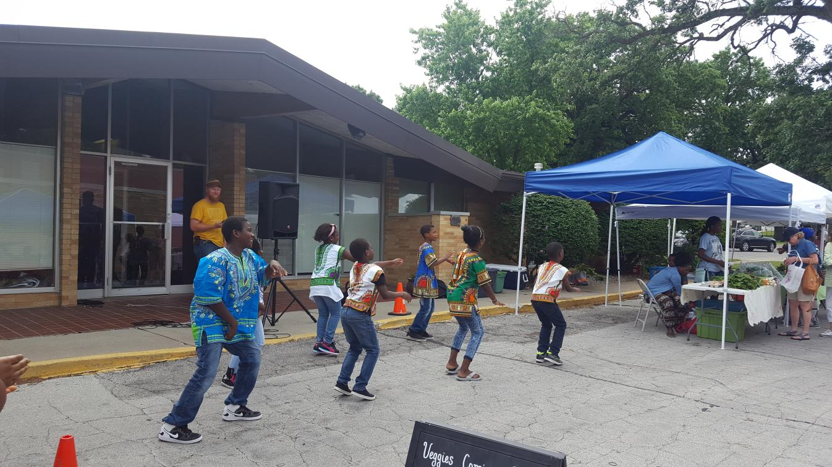
Notes:
Entertainment – celebration of cultures and food the farmers are sharing with new neighbors
WIC & SFMNP, SNAP EBT & DUFB – big part of our sales, our mission, important to our customers & our farmers - sales in 2016= 24, 351, over 8,000 from SNAP & DUFB

Slide 15
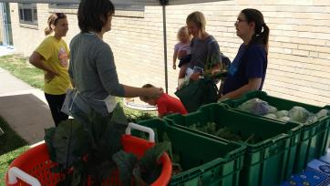
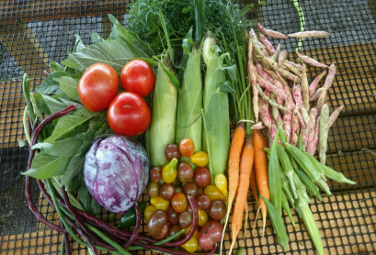
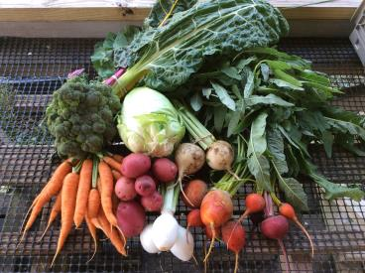
Community Supported Agriculture (CSA)
Notes:
CSA overview – piloted as part of Eat Greater DSM food box in 2015
2016 – launched our own CSA

Slide 16
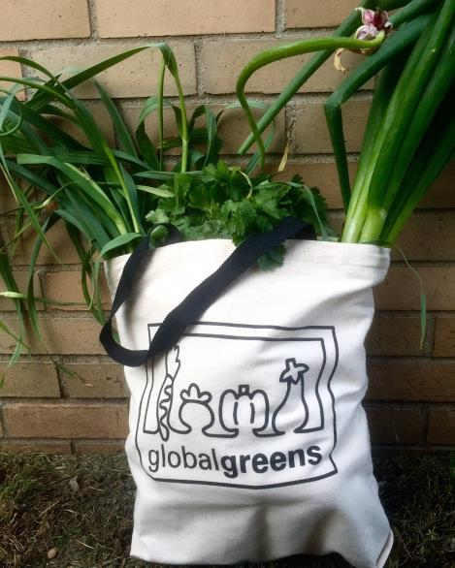
CSA Program Quick Facts
2016:
18 members
18 weeks
Nearly $7,000 to farmers
2017:
74 members
3 Share Types
$20,000+ to farmers
40 Fall Shares
Notes:
Talk about CSA numbers and a quote from mid-season survey perhaps
We do the marketing, addresses language/cultural barriers – it’s a great market for farmers – they know what they’ll sell when they plant

Slide 17
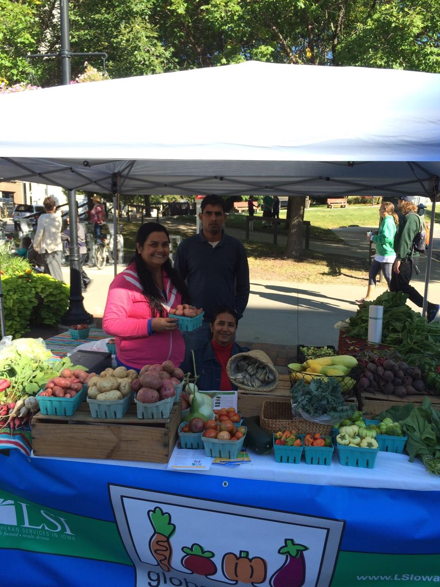
Downtown Des Moines Farmers’ Market
Notes:
Farmers rotating at our booth at the DT market ~ twice a month during market season -> going independently (2 in 2016, 1 more in 2017)
Much bigger market – more exposure, learning opportunities for all of us

Slide 18
Notes:
IFC – great market – all our markets are our partners
Across market spectrum – figure out what works well for their family and circumstances – plays to their strengths and how they want to spend their time and can best direct their energy

Slide 19
Market and Home Sale Totals
Notes:
Churches, other farmers’ markets, home sales, some wholesale – individual or through us
Income patching (“as a farmer I don’t have to wait two weeks for a paycheck to have money in my pocket”) -> paying some bills -> replacing an income

Slide 20
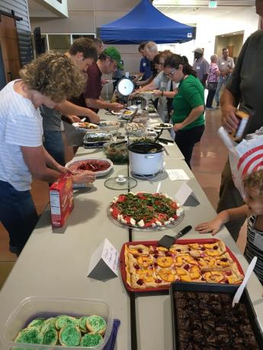
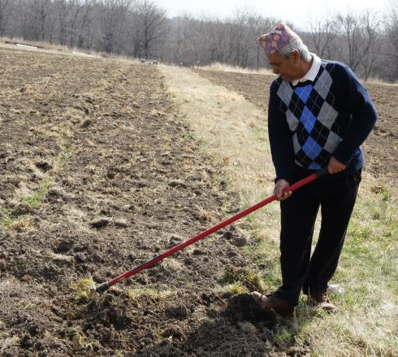
Land acquisition and community partnerships

Slide 21
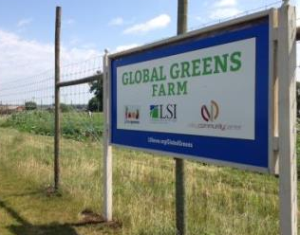
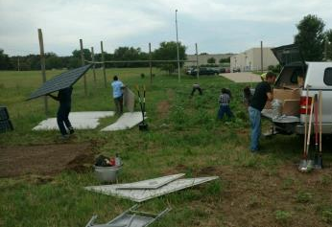
Training Farm Infrastructure Development
Installing irrigation system
Fence
Walk-in cooler
Wash station
Equipment (BCS, tractor, wheel barrows, garden carts, bins, storage shed, hoses, wheel hoes, seeders, hand tools)

Slide 22
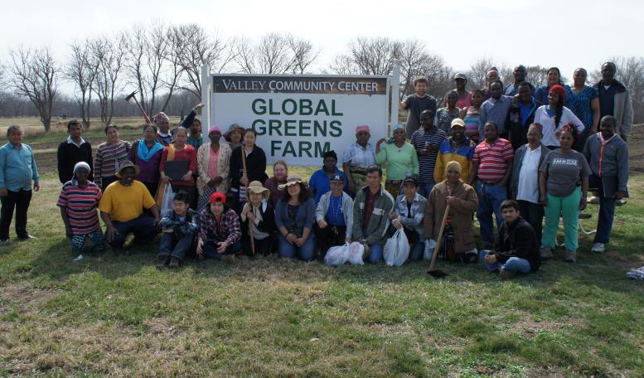
Some lessons learned

Slide 23
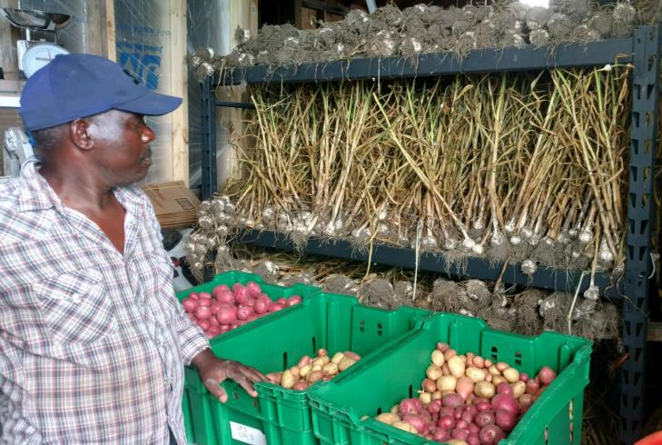
Challenges

Slide 24
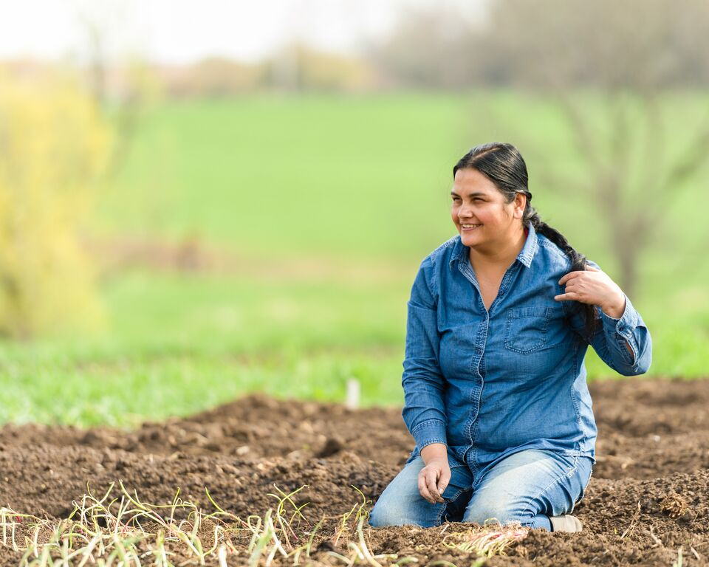
Global Greens Program Benefits
Global Greens provides:
1. A source of local, healthy food for our communities
2. An opportunity to reconnect with the land
3. Integration into the community
4. Healing and mental health benefits for those who have experienced trauma
5. Supplemental income when produce is sold
Notes:
Mickey

Slide 25
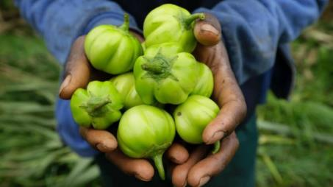
Ways to get involved-Local!
Sign up for “The Dirt” on our website or at our table
Volunteer
Donate
Partner
Advocate
Come to our markets!
Join our CSA!
lsiowa.org/globalgreens iowastandswithrefugees.org

Slide 26
Ways to get involved-statewide!
Support similar programs around the state
Partner with refugee communities in your area
We will always share resources, our toolkit, and host visits!
Advocate
lsiowa.org/globalgreens iowastandswithrefugees.org
Notes:
(Alex quote)

Slide 27
Thank you!
Notes:
Mickey

