Slide 1
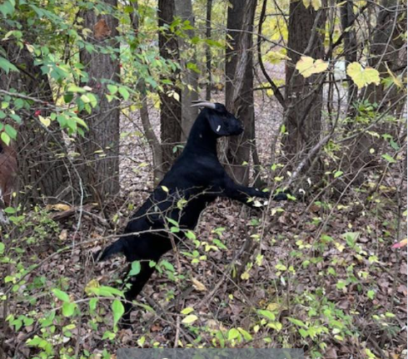

Is Goat Brush Clearing a viable Business for Small Farmers?

Slide 2
Presentation Content
Why start a Targeted Goat Grazing Business / Service
Tools and Equipment to Get Started
Year 1 and 2 Recap
Before and After Pictures
What’s Next?

Slide 3
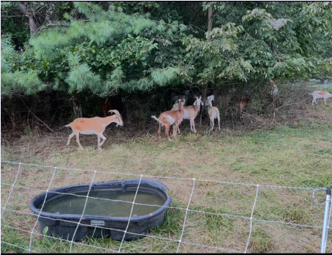
Why start a Targeted Goat Grazing Business / Service?
Prairie Hills Farm started to raise goats for a sustainable meat option, but wanted to explore what other benefits goats can provide.
Target Goat Grazing to combat invasive plant species and reclaim land for property owners
Explore the viability of offsetting cost of ownership and feed costs for goats

Slide 4
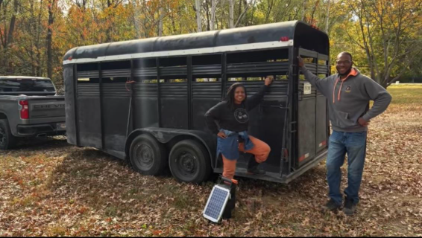
Tools and Equipment to Get Started
A herd of goats
Can be owned or rented
Herd of 20 goats to buy cost about $200 - $400 per goat ($4K-$8K)
A vehicle and trailer to transport goats
Average used truck $5-20K depending on age and truck type
Average 16 Foot livestock trailer cost $3-$5K
Fencing and solar energizer
Portable netting fence $175 per 164 foot roll
Solar charger cost $200 - $500 per charger
Voltage tester cost about $20 per tester
Water trough for 50 gallons cost $100 per trough
Addition poles for support
Step in Poles $2 each
Overall initial start up cost ranges from ~$9K – $25K

Slide 5
Year 1 and 2 Recap
Year 1 Recap
Total Jobs Served
Inquiries received 6
3 Jobs Completed
Acres serviced 5 acres
Revenue generated $7,200
Year 2 Recap
Total Jobs Served
Inquiries received to date 21
13 Jobs Completed
Acres serviced 18* acres
Revenue generated $~$22K
*There are jobs actively being worked to date

Slide 6
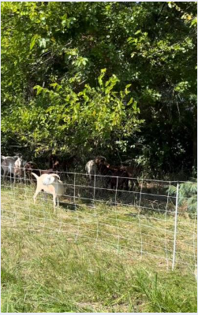
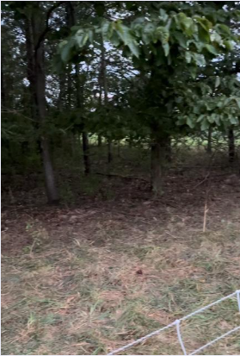
Before and After Pictures
Before
After

Slide 7
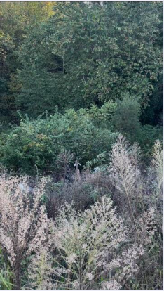
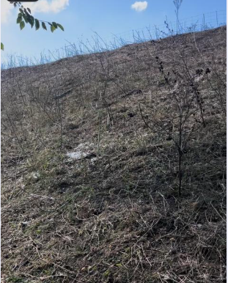
Before and After Pictures
Before
After

Slide 8
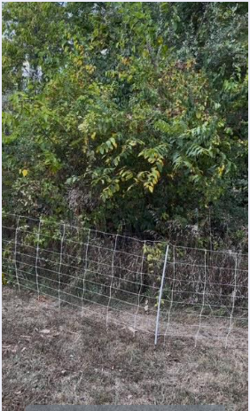
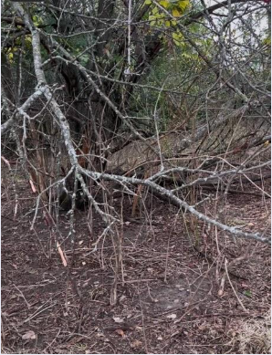
Before and After Pictures
Before
After

Slide 9
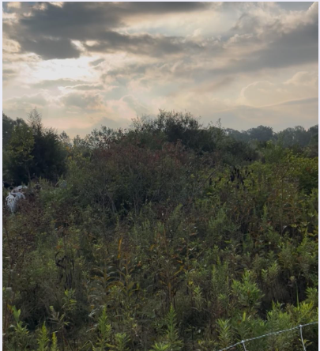
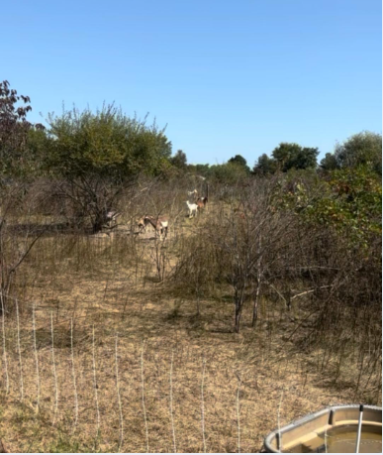
Before and After Pictures
Before
After

Slide 10
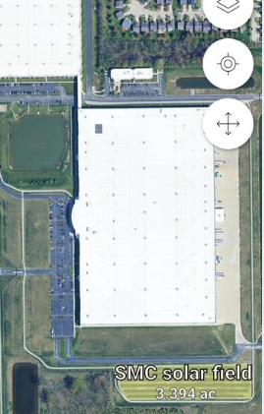
What’s Next?
Expanding to service solar fields. We have partnered with a corporate location to maintain their dedicated solar field using lamb.

Slide 11

SARE Acknowledgement
This material is based upon work that is supported by the National Institute of Food and Agriculture, U.S. Department of Agriculture, under agreement number 2023-38640-39573 through the North Central Region SARE program under project number FCN24-1414. USDA is an equal opportunity employer and service provider. Any opinions, findings, conclusions, or recommendations expressed in this publication are those of the author(s) and should not be construed to represent any official USDA or U.S. Government determination or policy.

