Slide 1
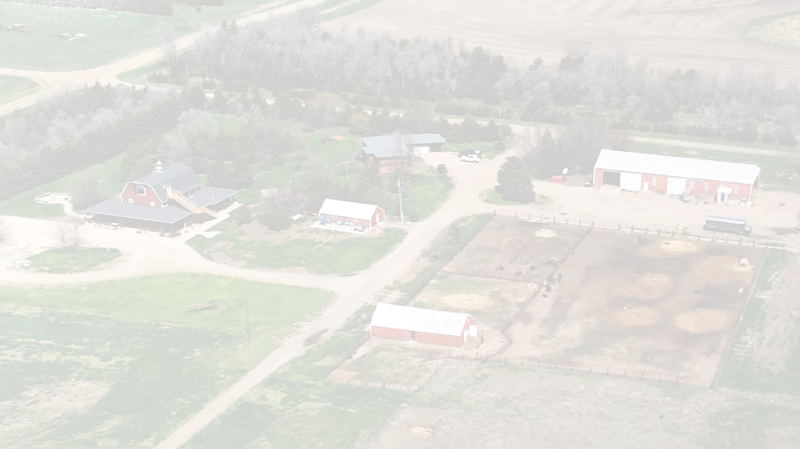
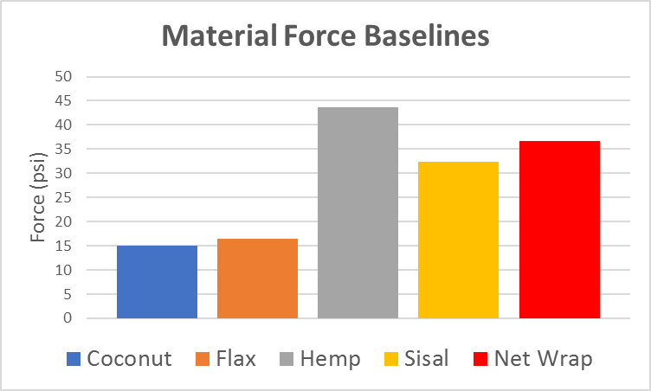
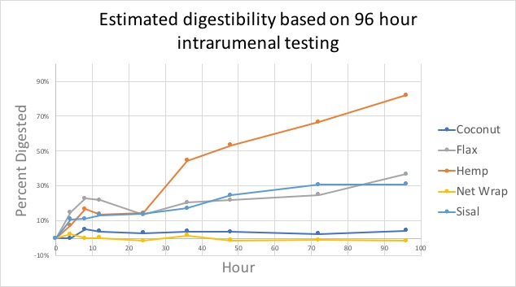
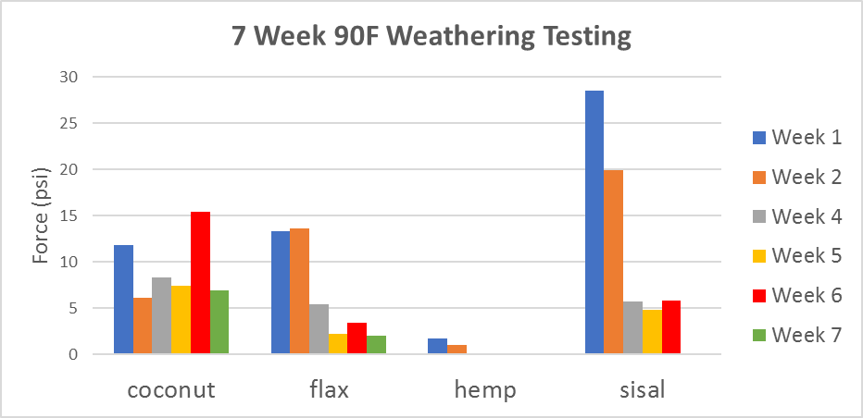
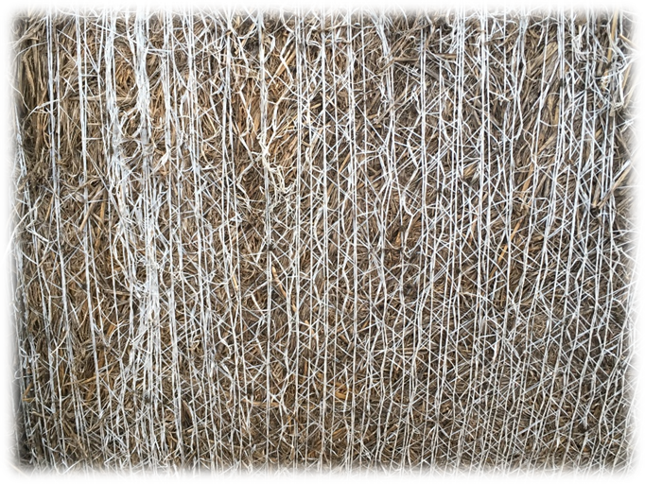
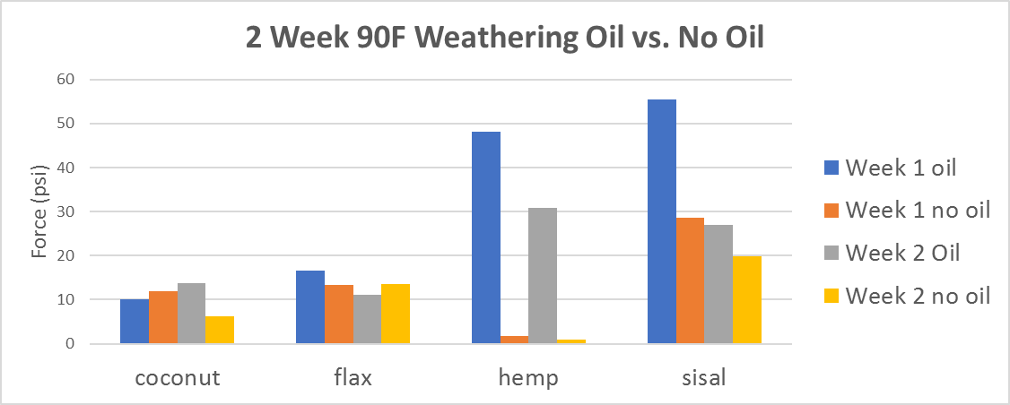
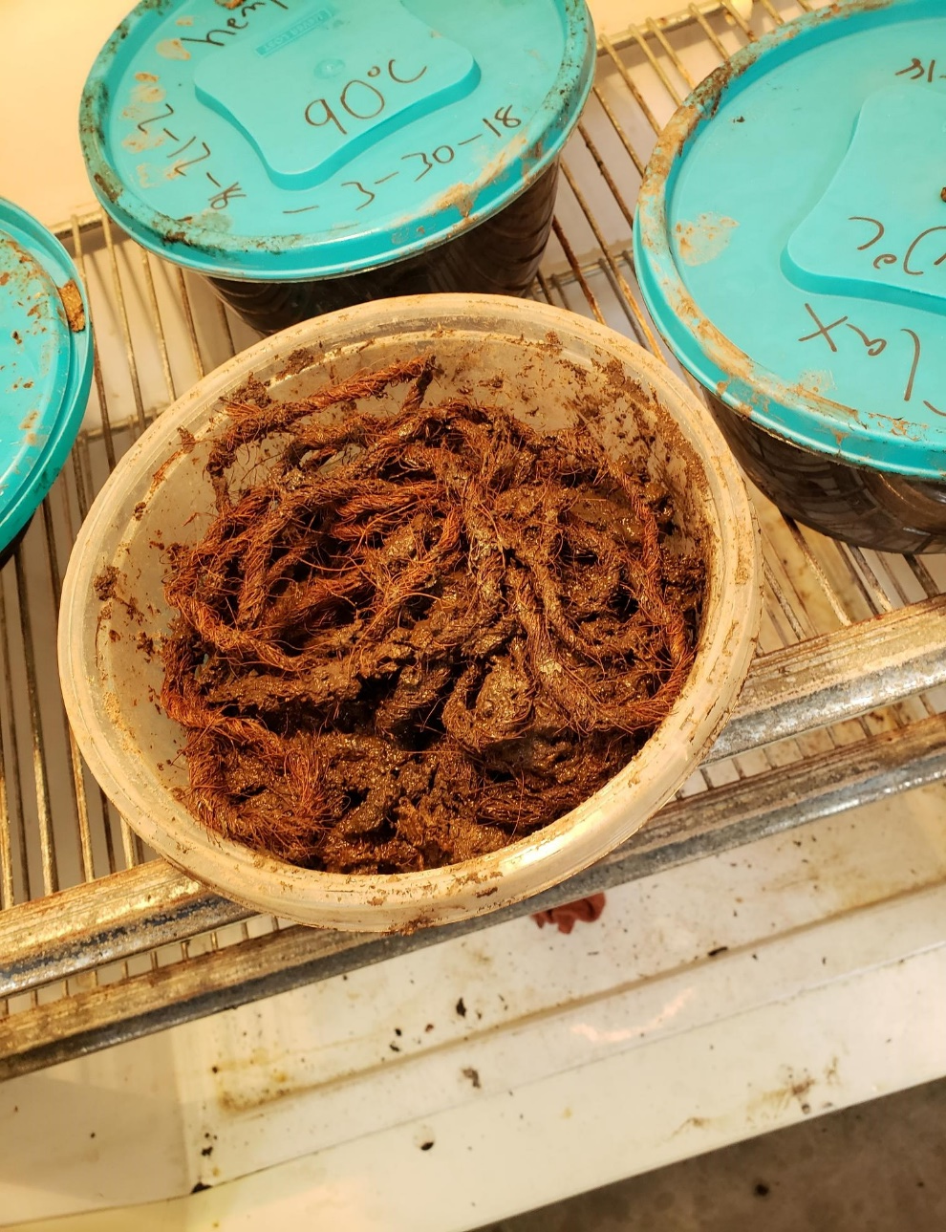
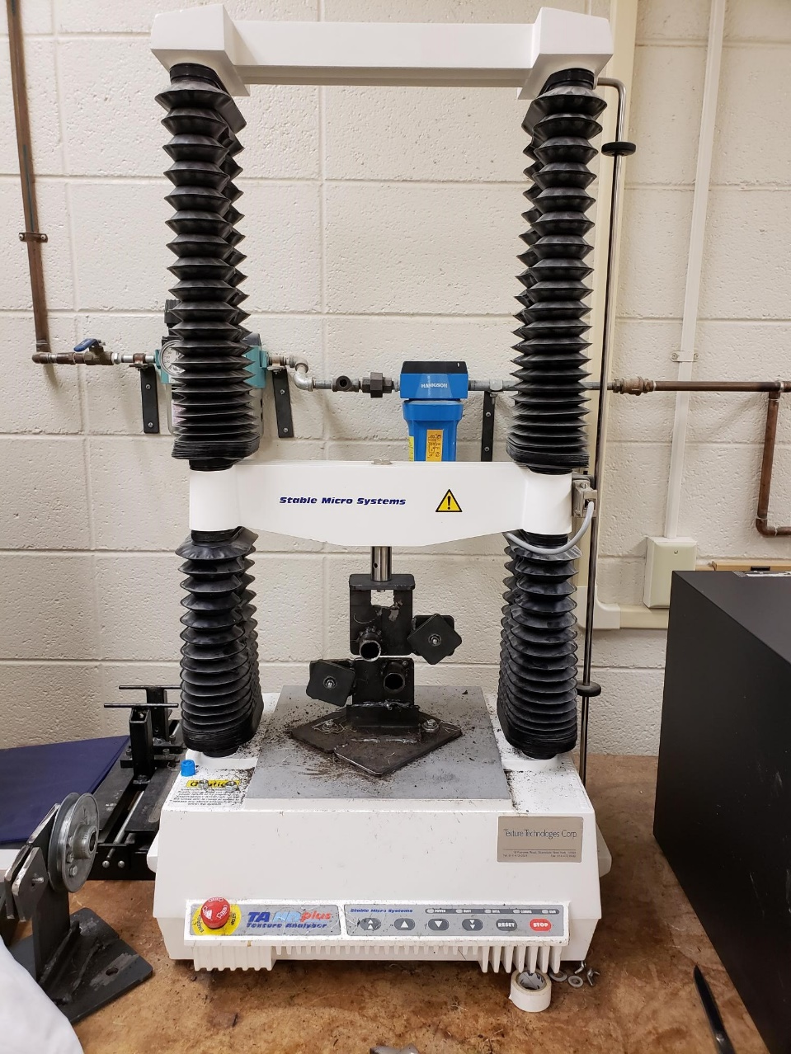
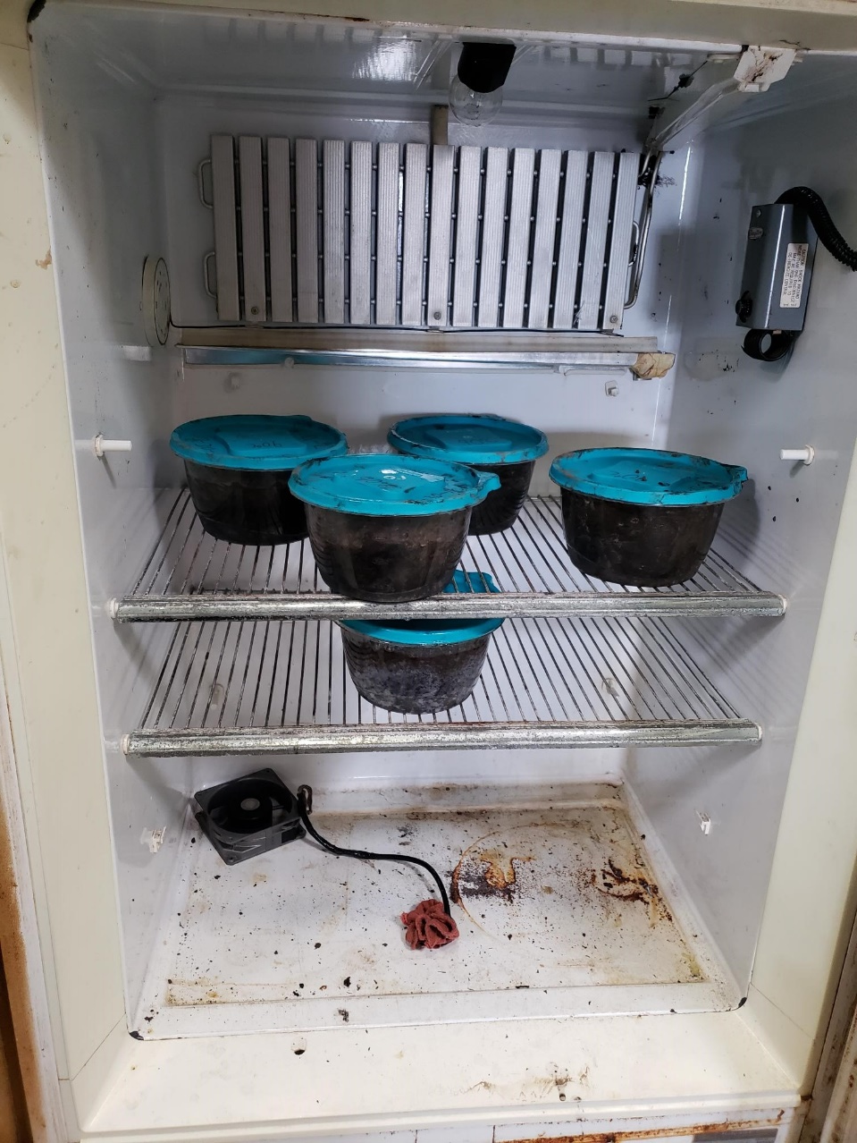
Justin Spies, ABE Macey Zeinstra, ABE Douglas Prairie, Advisor Joseph Darrington, Advisor Amanda Konechne, Sponsor
Jack Wrap It
Digestible Net Wrap
Problem Statement
Strength Testing
Digestive Testing
Approximately, 120 million round bales consumed nationally each year. For large operations, removing the net wrap off of forage bails is unfeasible. Based off multiple studies such as a study from NDSU, large amounts of net wrap consumption results in health issues of livestock. A survey about the usage of net wrap was sent out by our team, and found a significant amount of operations that believe net wrap causes health issues. The Konechne family had a previous design conducted that failed due to the forces provided by the bailer.
Worked with the animal science department and used two fistulated steers
Filled in-situ bags and placed them in the rumen of the steers
Bags were removed at time periods ranging from hour 0 to hour 96 and dried before the weights were measured.
Percent digested was calculated
Hemp, flax and sisal were the most digestible.
Goals
Find individual materials to withstand everyday farming operations.
Weathering
Strength from bailing and storage
Net wrap can withstand the forces up to 36 psi.
Cost-effective at $0.60 to $1.85 per bale.
Does not have negative feedback on digestive system of livestock.
The average from 10 baseline tests were conducted for each material baseline. The net wrap is the average of 50 data set points from doing 10 tests each on net wrap strands ranging from 1 to 5 strands.
Materials
Coconut
Flax
Hemp
Sisal
Further Research Needed
Narrowed down to Hemp and Sisal for materials.
Digestibility in various livestock.
Protectant covering for durability.
Cost efficiency.
Application of net wrap from round bailer
Developing during the offseason
Material availability for mass production
Testing Methods
Utilized fistulated cows from the animal science department to track percent disappearance.
Strength and displacement testing.
American Testing Standards.
Baselines
Weather Testing
7 week high humidity at 90°F in compost.
7 week freeze-thaw in compost.
2 week corn oil protectant at 90°F in compost
Weekly tests were conducted with each material being tested 3 times and averaging the data. Week 3 was skipped due to spring break.
Benefits
Health of livestock.
Increase in growing capabilities of livestock.
Lower Death Rates.
Reduction in operational downtime and maintenance.
Natural product will degrade as protectant is worn away.
Decreased environmental impact.
Reduction in plastic products sent to waste facilities.
The protectant was a corn oil and put into a 2 week study using the same environment of high moisture with compost. Data was than compared with the first 2 weeks of the 7 week weathering study.

