Slide 1
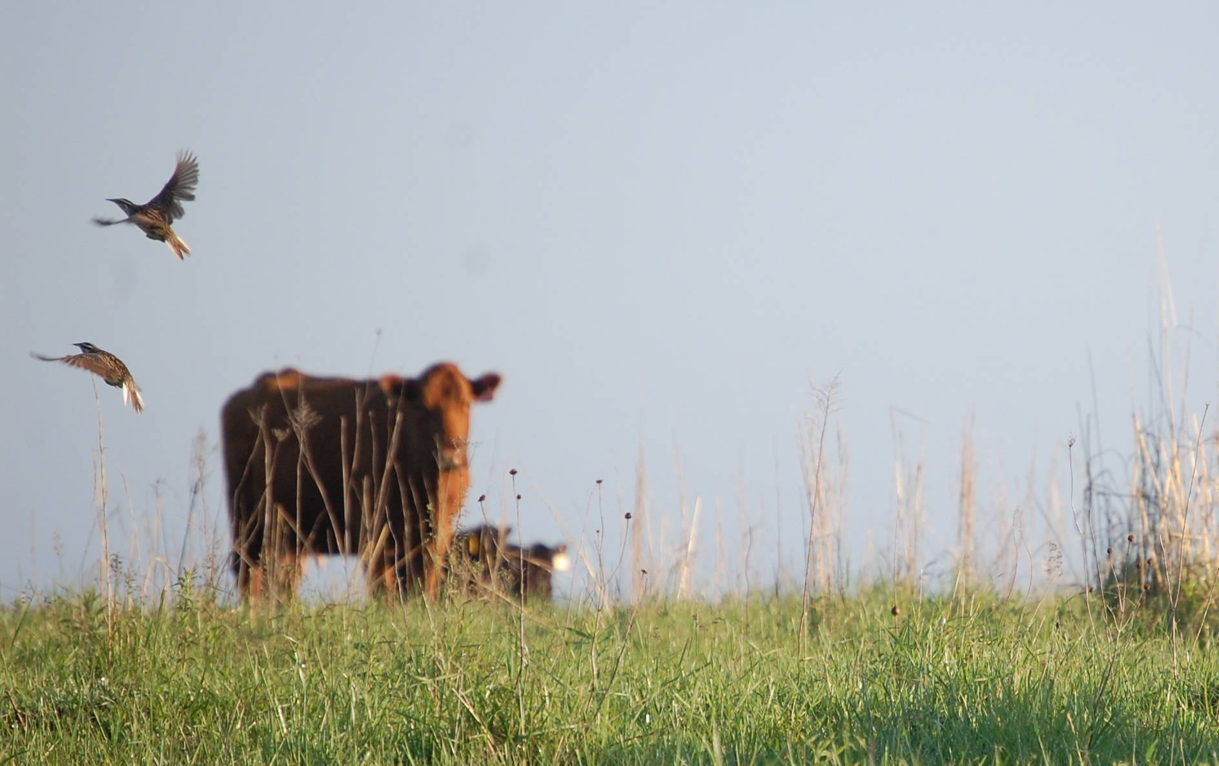
Grazing, Prescribed Fire, and Non-native Grasses: Possibilities for conserving biodiversity on privately-owned grasslands
Jaime J. Coon
EJ Raynor
Lois Wright Morton
Carena van Riper
James R. Miller
S. Maresh Nelson

Slide 2
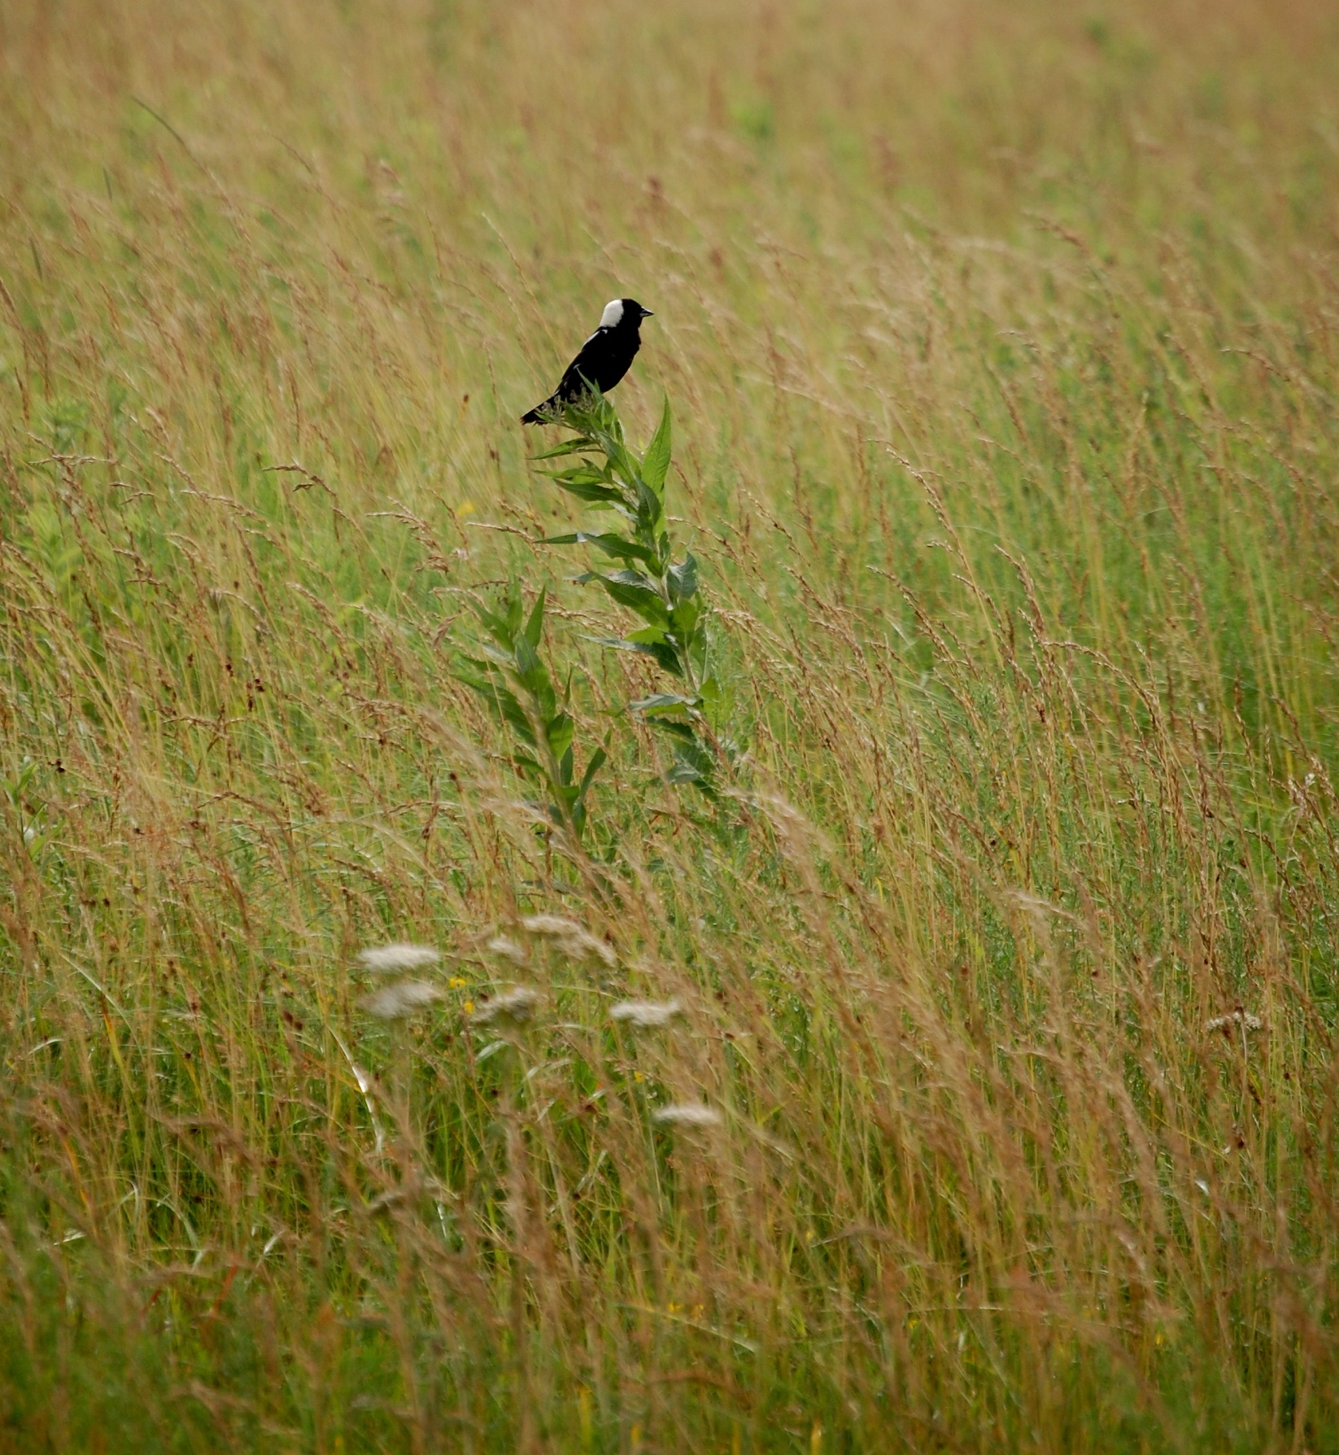
Native Grassland Loss & Biodiversity Declines
Most native grasslands converted to other uses (cropland, pasture)
Steep declines in grassland biodiversity
Current grassland reserves are insufficient to conserve biodiversity
75% of grasslands are privately owned in U.S.
Most private lands are grazed and dominated by non-native grasses
With et al, 2008, Biol Cons
Miller et al, 2012, Front Ecol Env
S. Maresh Nelson

Slide 3
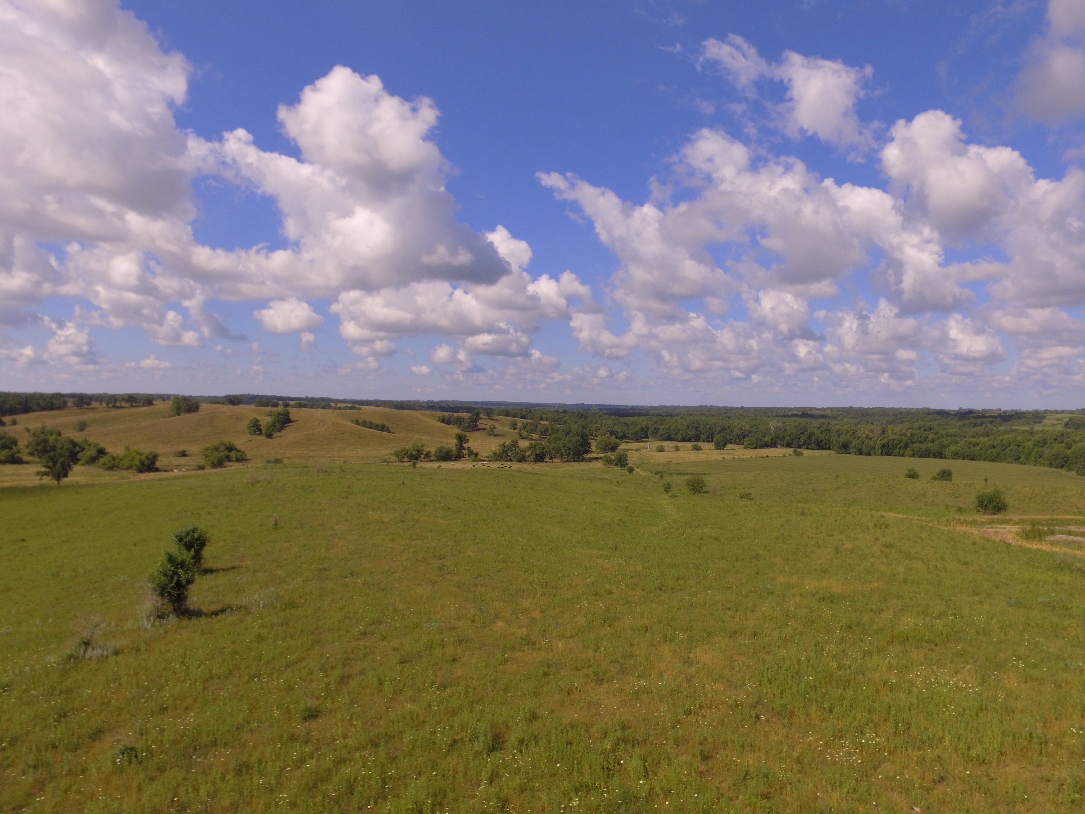
Conservation of grassland biodiversity must consider human enterprise – and private lands
Miller et al, 2012, Front Ecol Env
Schulz, 2014, Cons Biol
T. Swartz

Slide 4
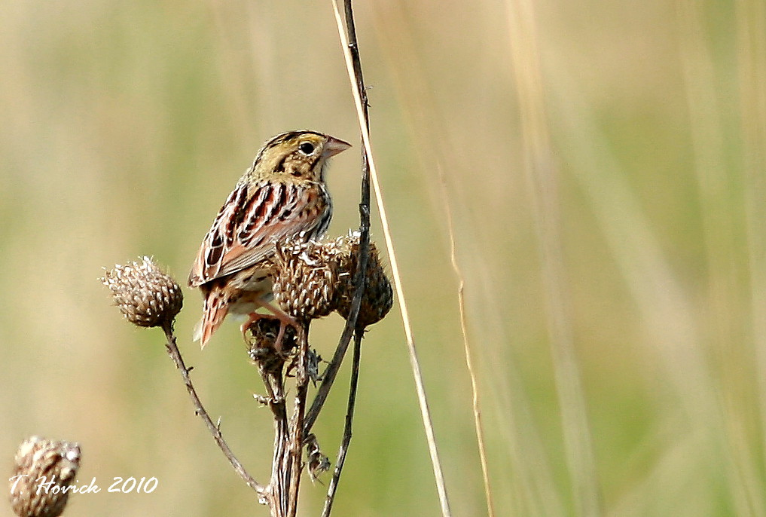
How can we maximize conservation on private land?
Grasshopper Sparrow
Bobolink
Dickcissel
Upland Sandpiper
Henslow’s Sparrow
Eastern Meadowlark

Slide 5
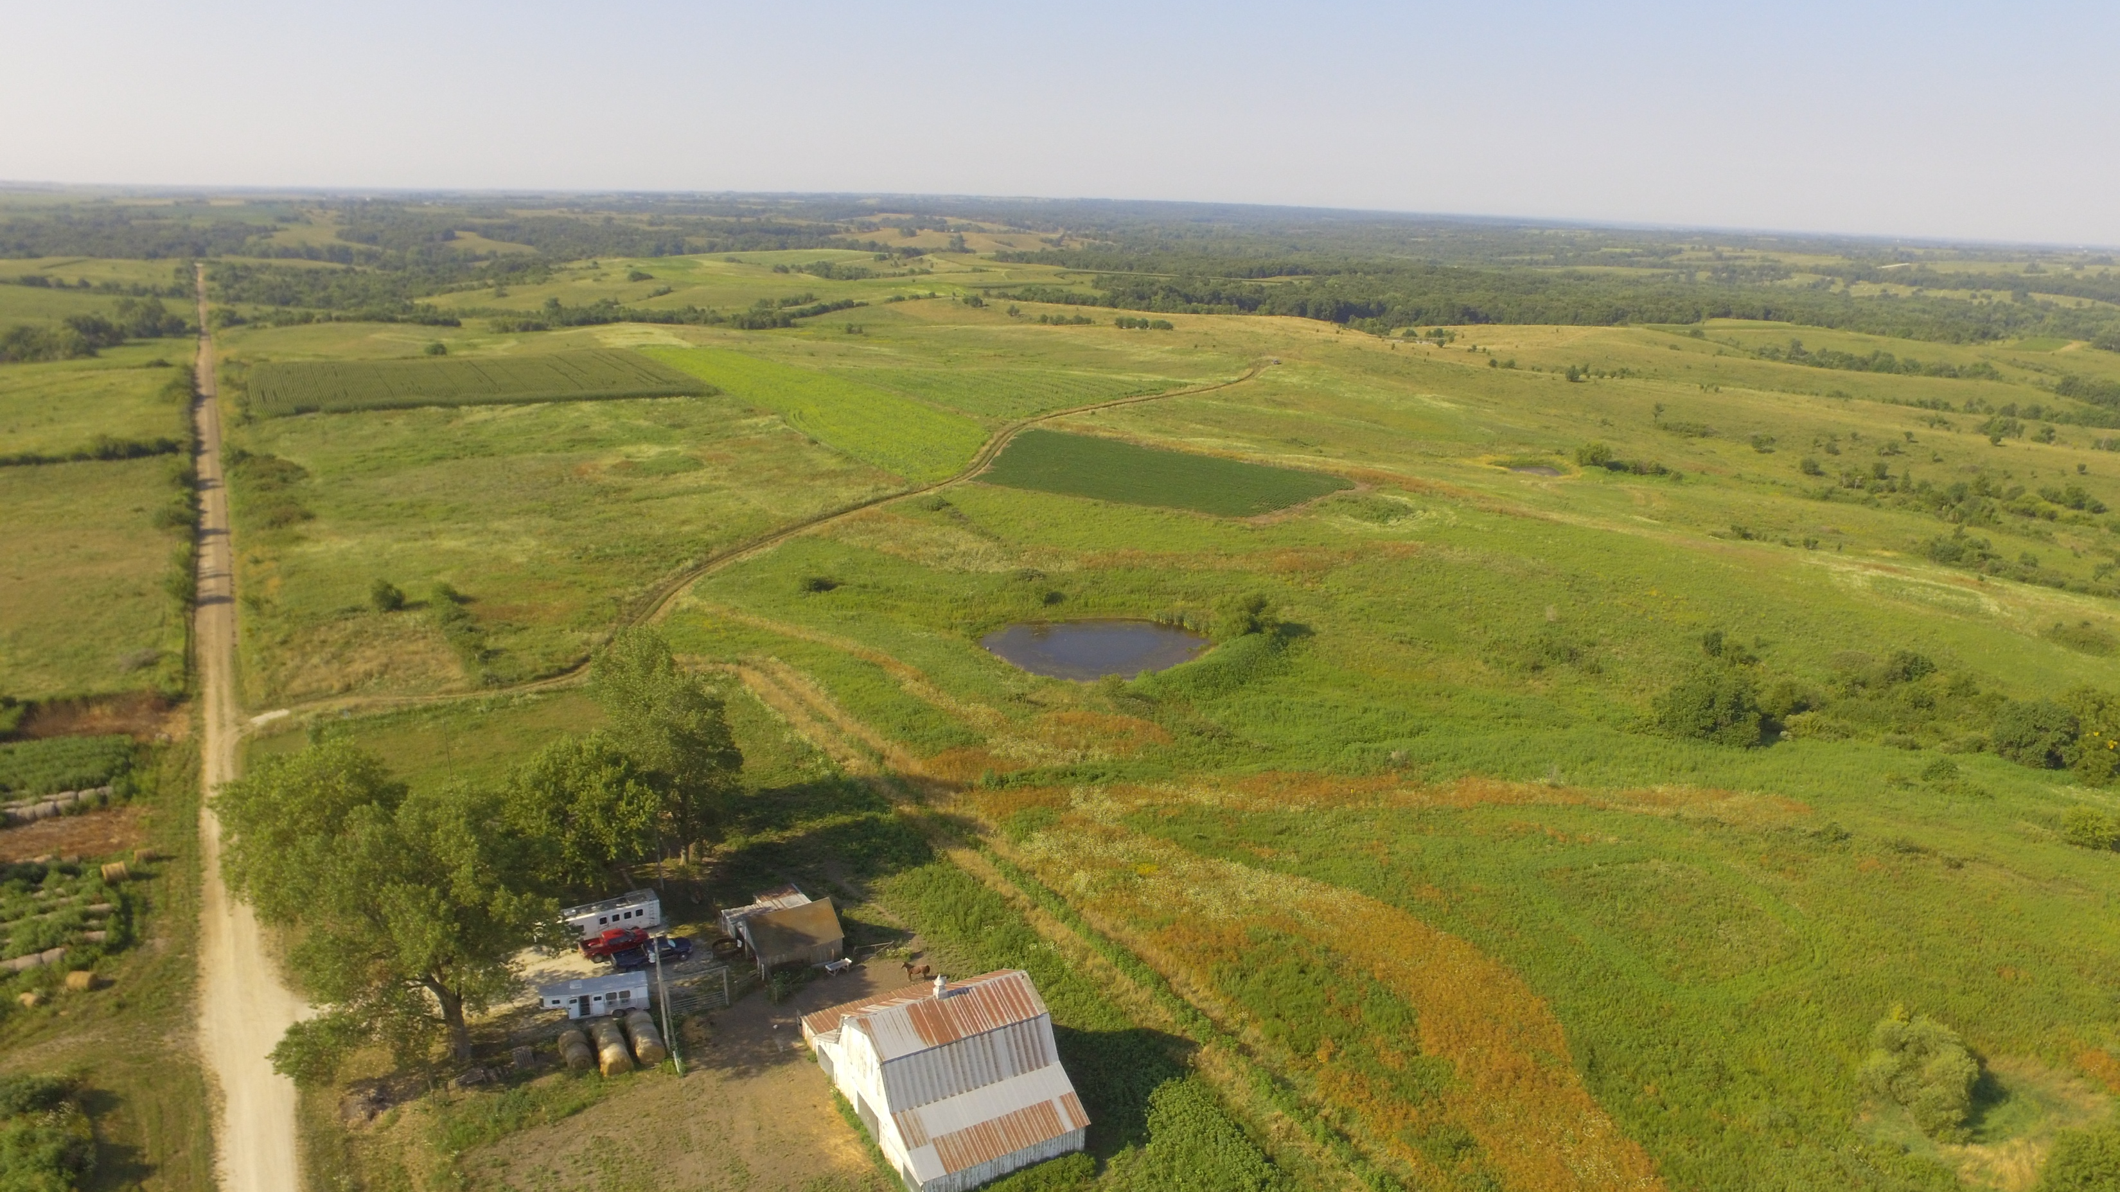
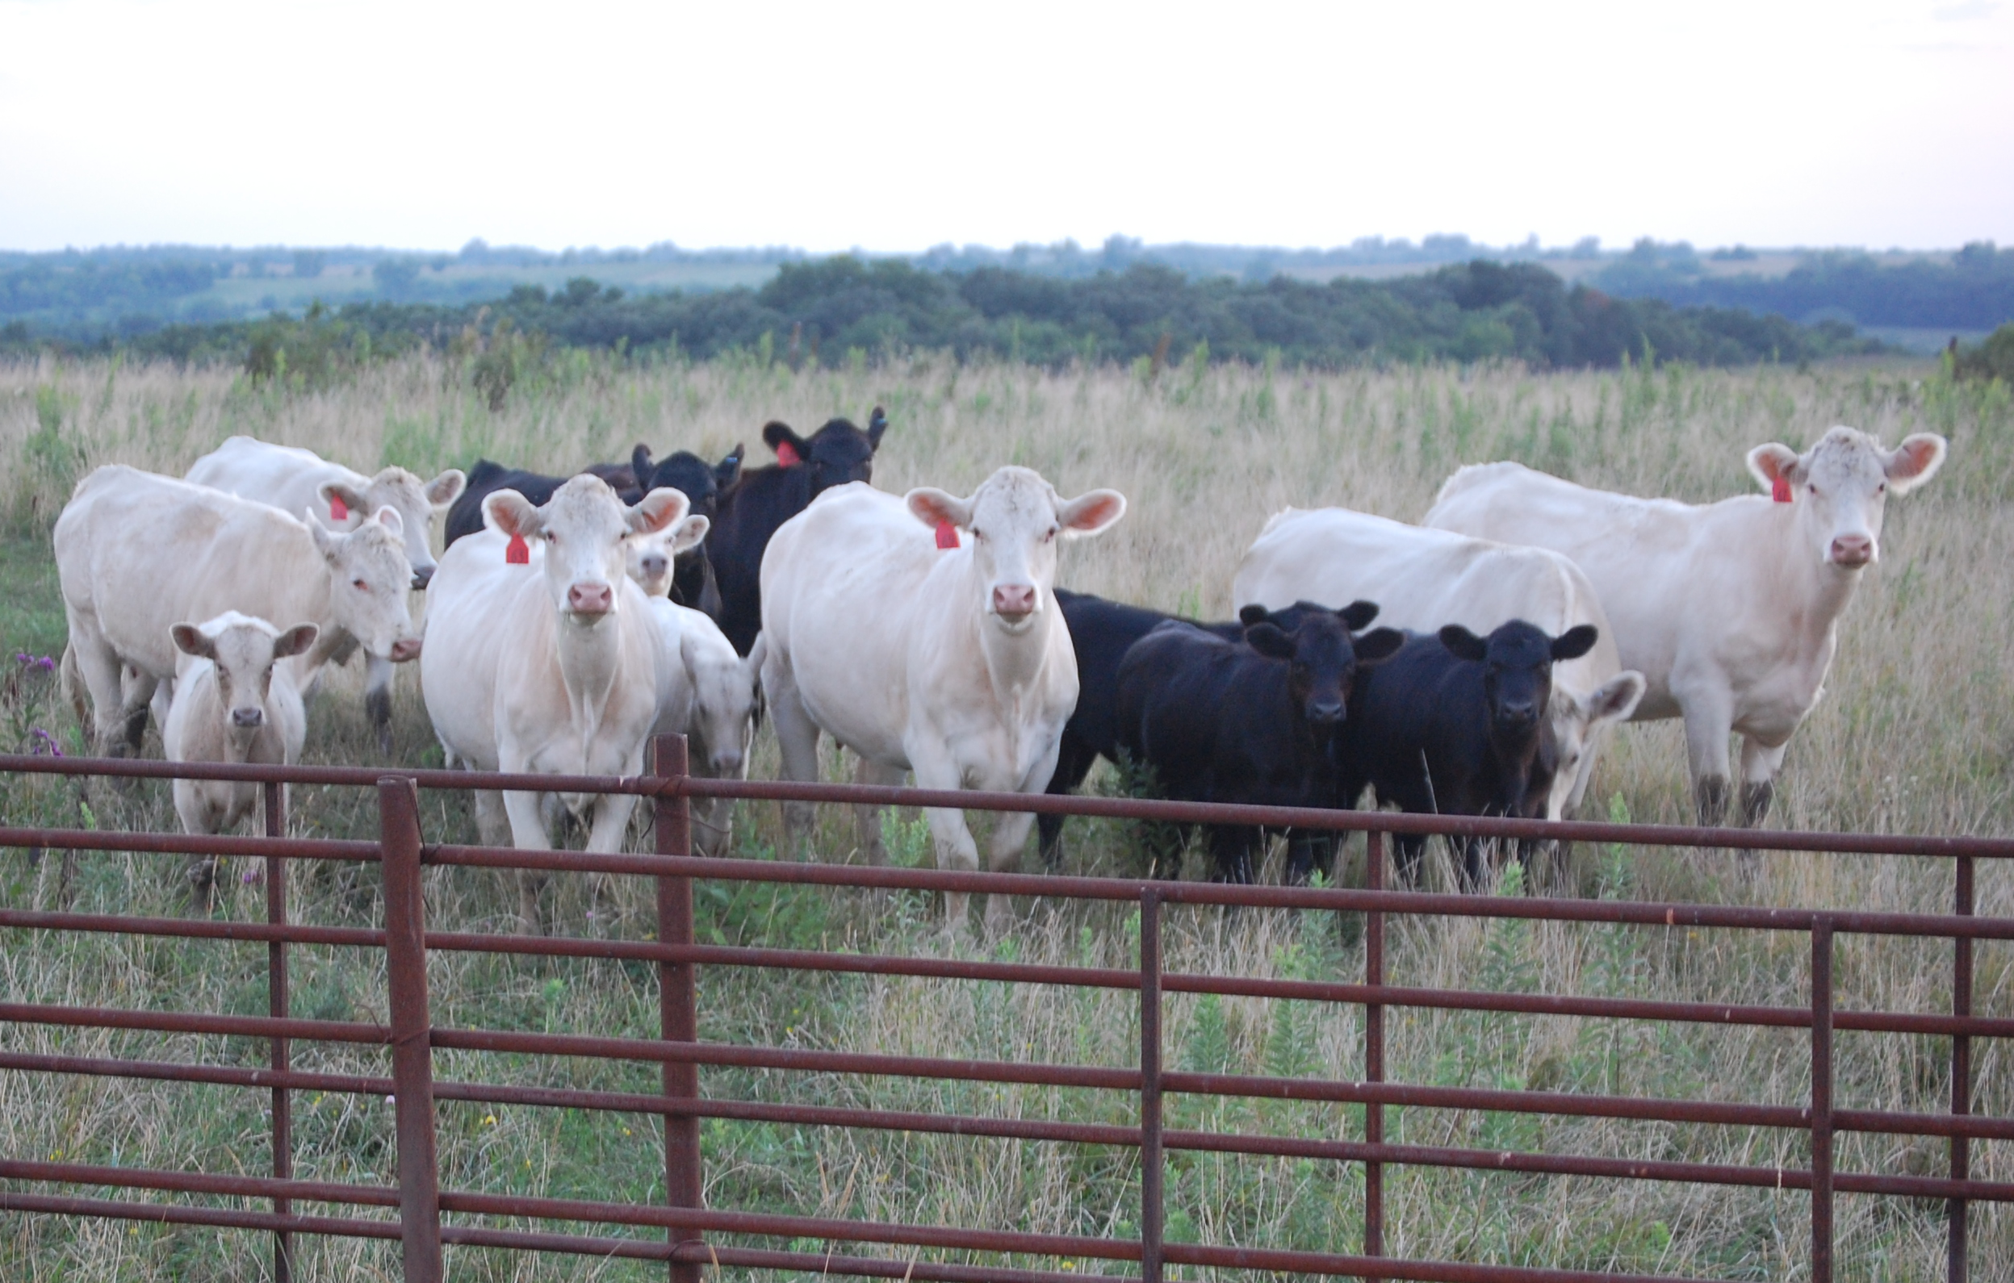
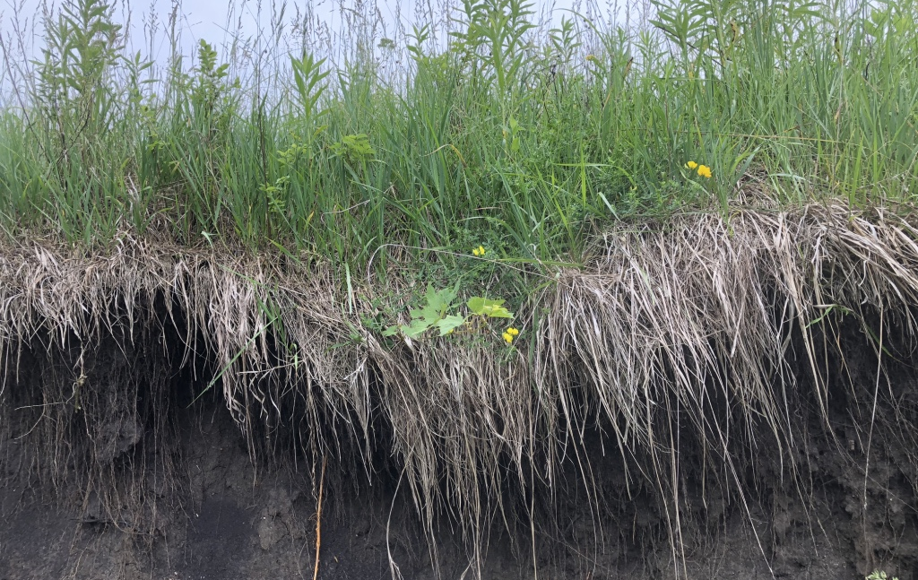
Grasslands Provide Many Ecosystem Services
T. Hovick
S. Maresh Nelson
T. Swartz

Slide 6
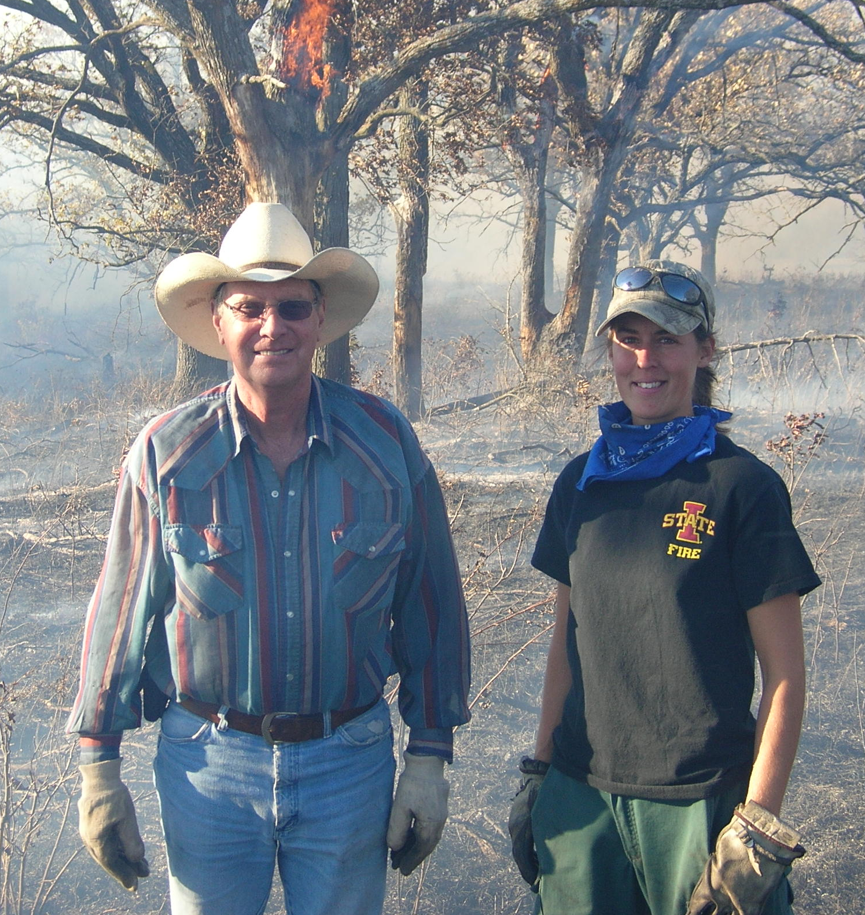
Research Framework
Ecosystem Services
Behavioral Drivers
Management Decisions
Grassland Systems
Landowners
Social System
Social-Ecological Interface
Ecological System
1
2
What factors influence management decisions on private land?
How do these management decisions impact grassland birds?
J. Miller
T. Hovick
Flow diagram adapted from Miller, Coon, Swartz et al, in prep

Slide 7
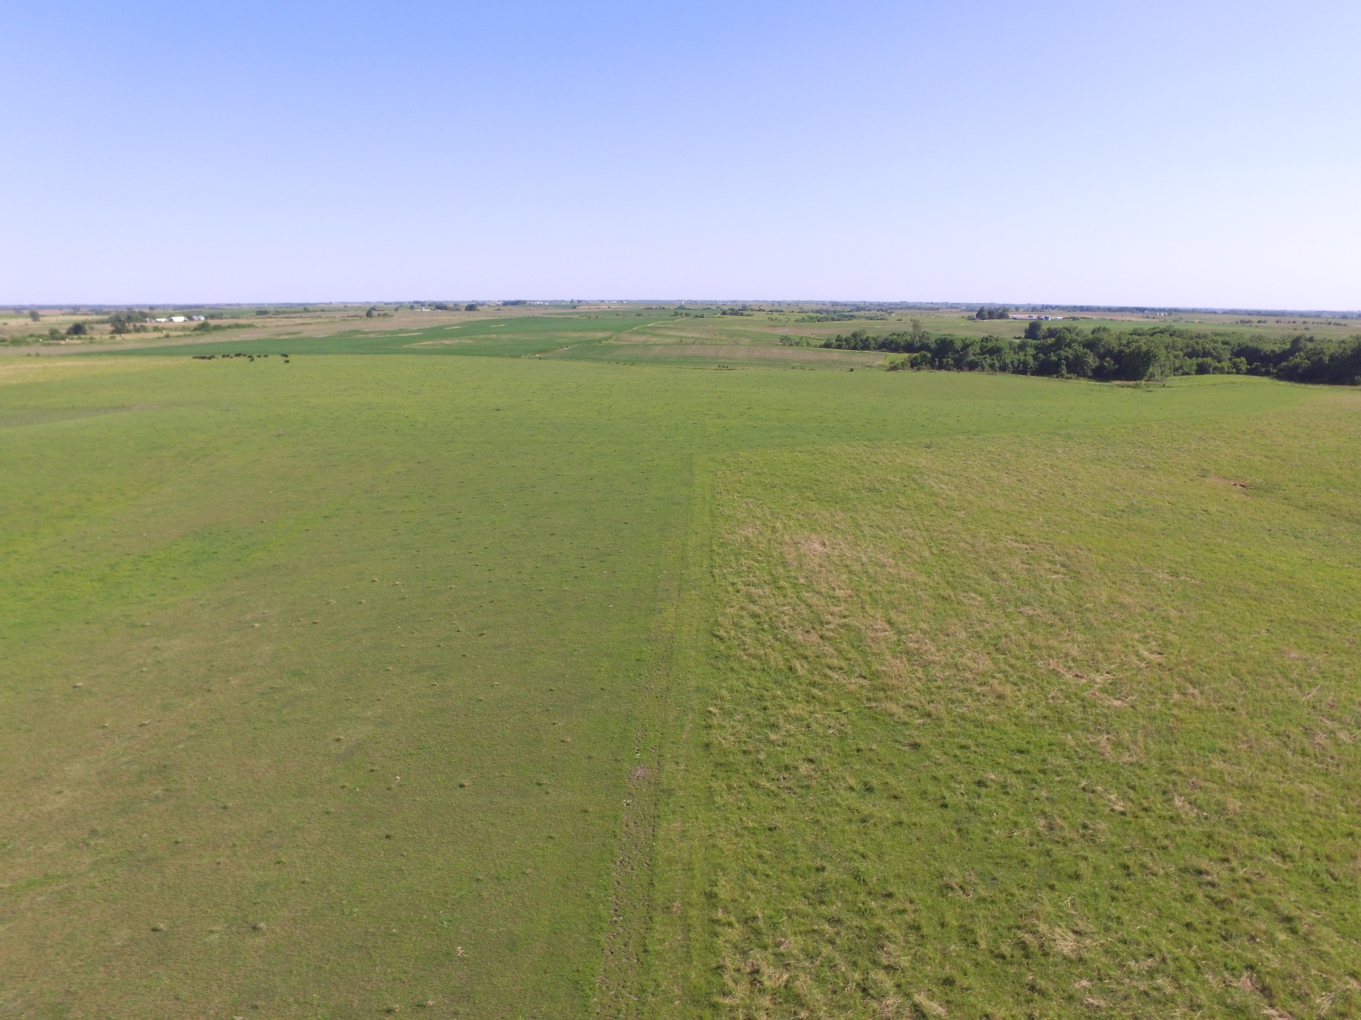
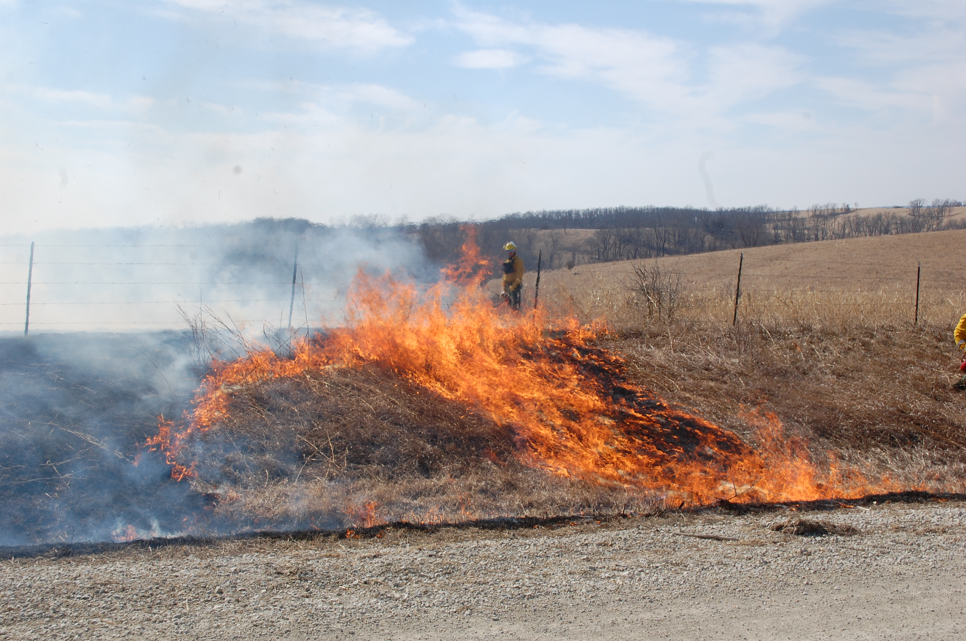
Prescribed fire
Managing for heterogeneity can increase grassland bird diversity
Upland Sandpiper
Henslow’s Sparrow
S. Maresh Nelson
T. Hovick
0 Years-Since-Fire
2 Years-Since-Fire
Duchardt et al, 2016, REM
T. Swartz

Slide 8
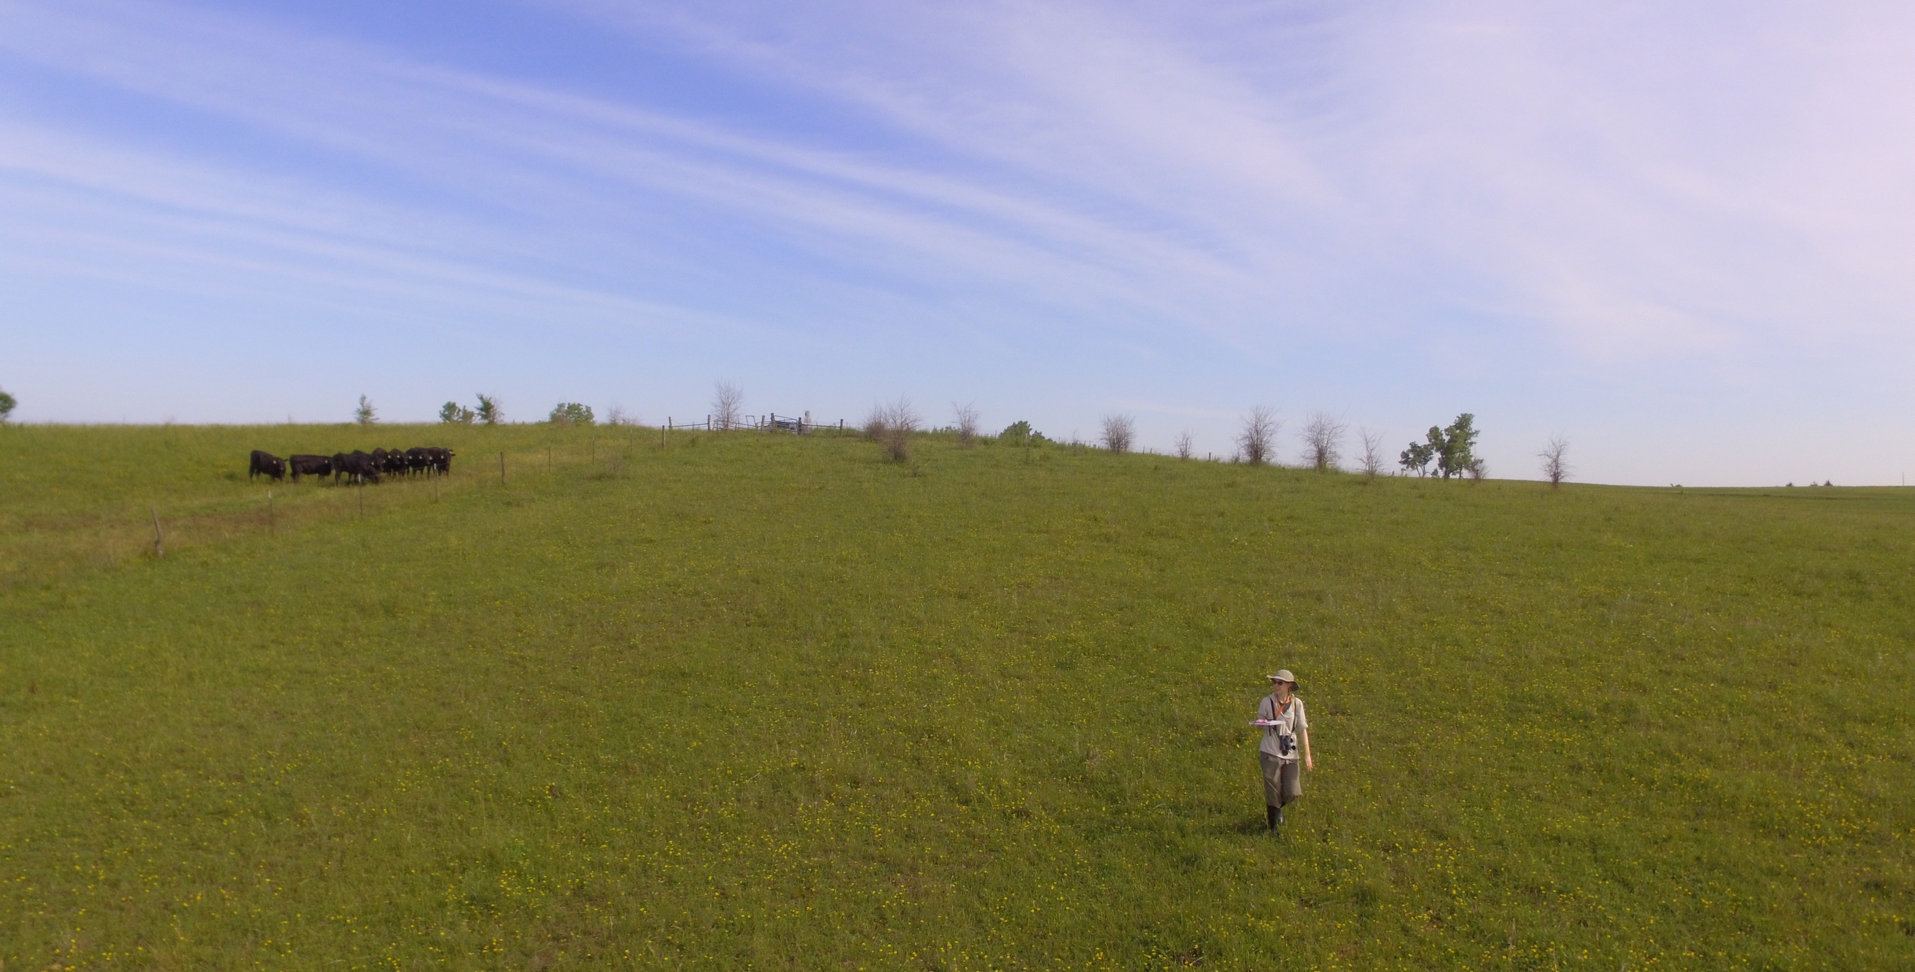
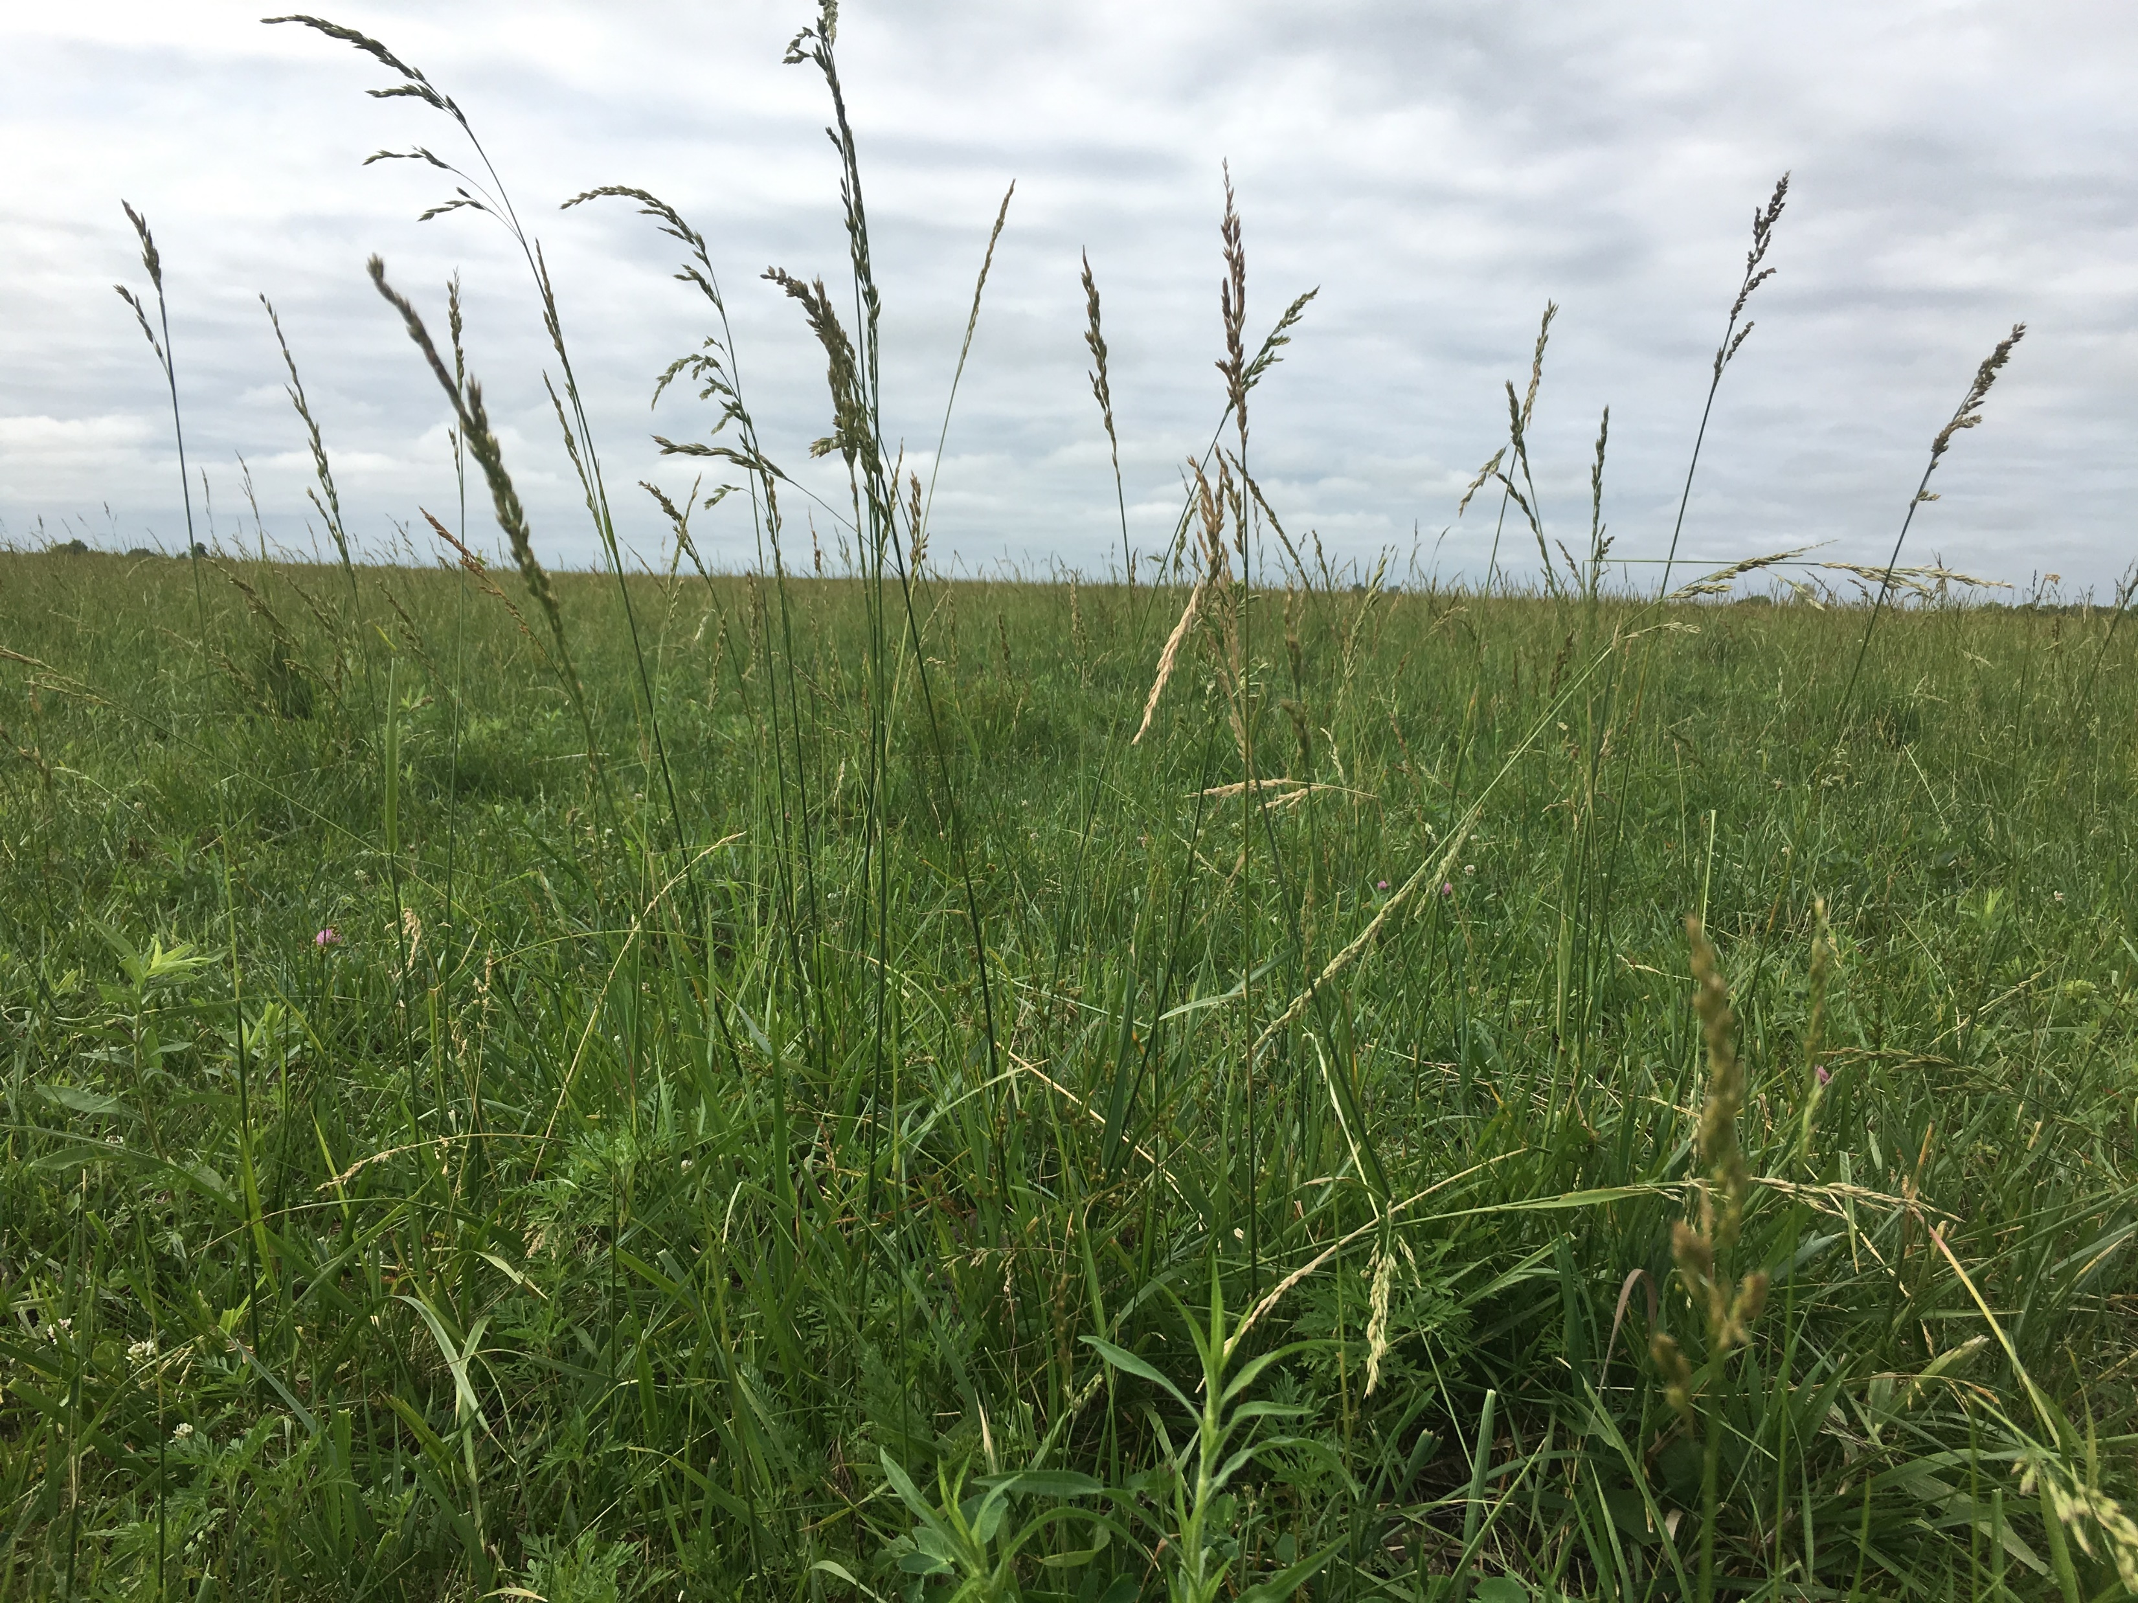
Some grassland management practices can reduce heterogeneity and can harm grassland birds
Overgrazing
Non-native grasses
Duchardt et al, 2016, REM
Maresh Nelson, Coon et al, 2018, Landsc Ecol
Raynor, Coon et al, In Review
T. Swartz

Slide 9
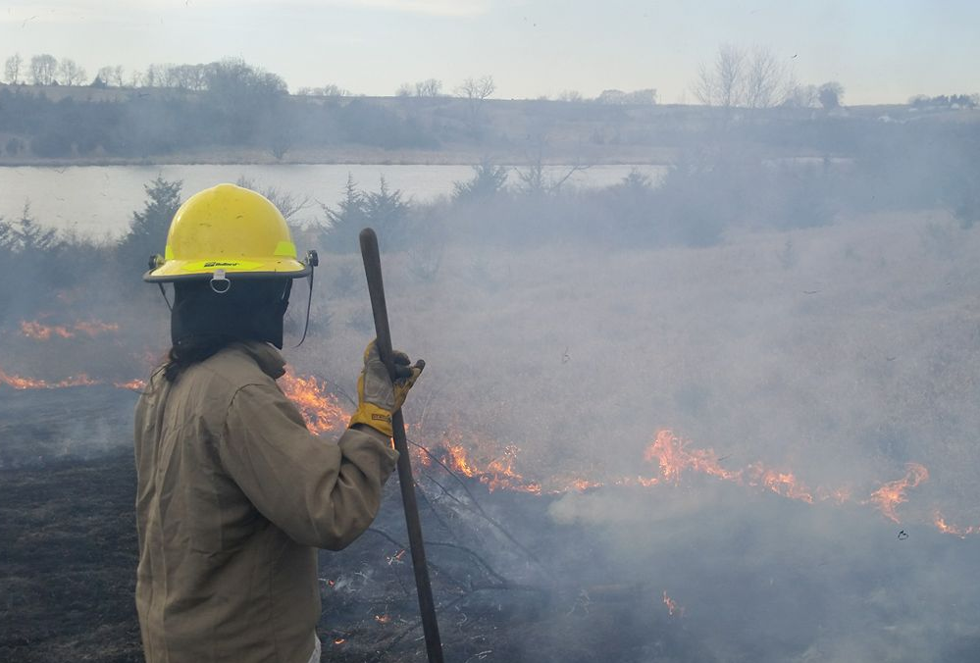
Research Objectives: Focused on Three Management Techniques
Using prescribed fire
Lowering stocking rate
Controlling non-native grasses
T. Swartz
Investigate whether landowners are increasing heterogeneity
Identify behavioral drivers influencing landowners’ management

Slide 10
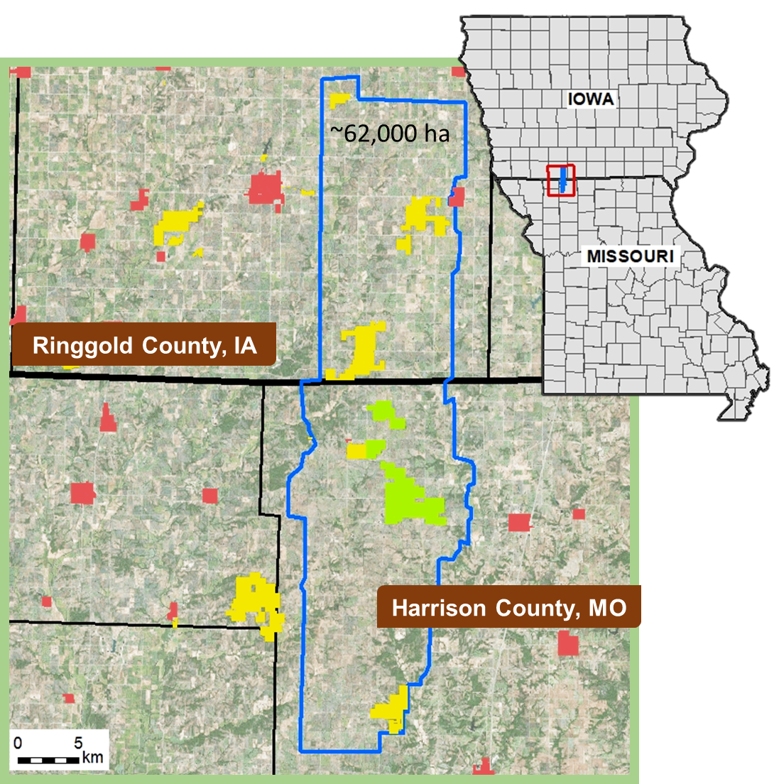
Study Region
Grand River Grasslands
Mixed cattle and crop
15% protected land
12-year project on social and ecological considerations of grassland management
Major goal: restoration of native ecological communities side-by-side with cattle production
Coon et al, 2018, GRG Report 04-18, UIUC NRES
J. Coon

Slide 11
Methods
Mixed mode survey in 2017
Sent to 456 landowners owning >8 ha (20 acres) of land
Used multiple methods aimed at increasing response rate (32.7%)
Checked for non-response bias (Coon et al, in prep)
Some questions were replicated from an earlier survey (2007)
Dillman et al, 2014

Slide 12
Analysis and Theory
Prescribed fire
Grazing regimes
Controlling non-native grasses
Correlations
Management priorities
Demographics
Willingness
Structural Equation Modeling
Theory of Planned Behavior
Norm Activation Model
Ajzen, 1991, Organ Behav Hum Dec
Schwartz, 1977, Adv Exp Soc Psychol
Harland, 1999, J Appl Psychol
Attitudes
Morton et al, 2010, REM
SN 1
Social norms
Personal norms
Willingness
Management
SN 2
SN 3
Perceived ability

Slide 13
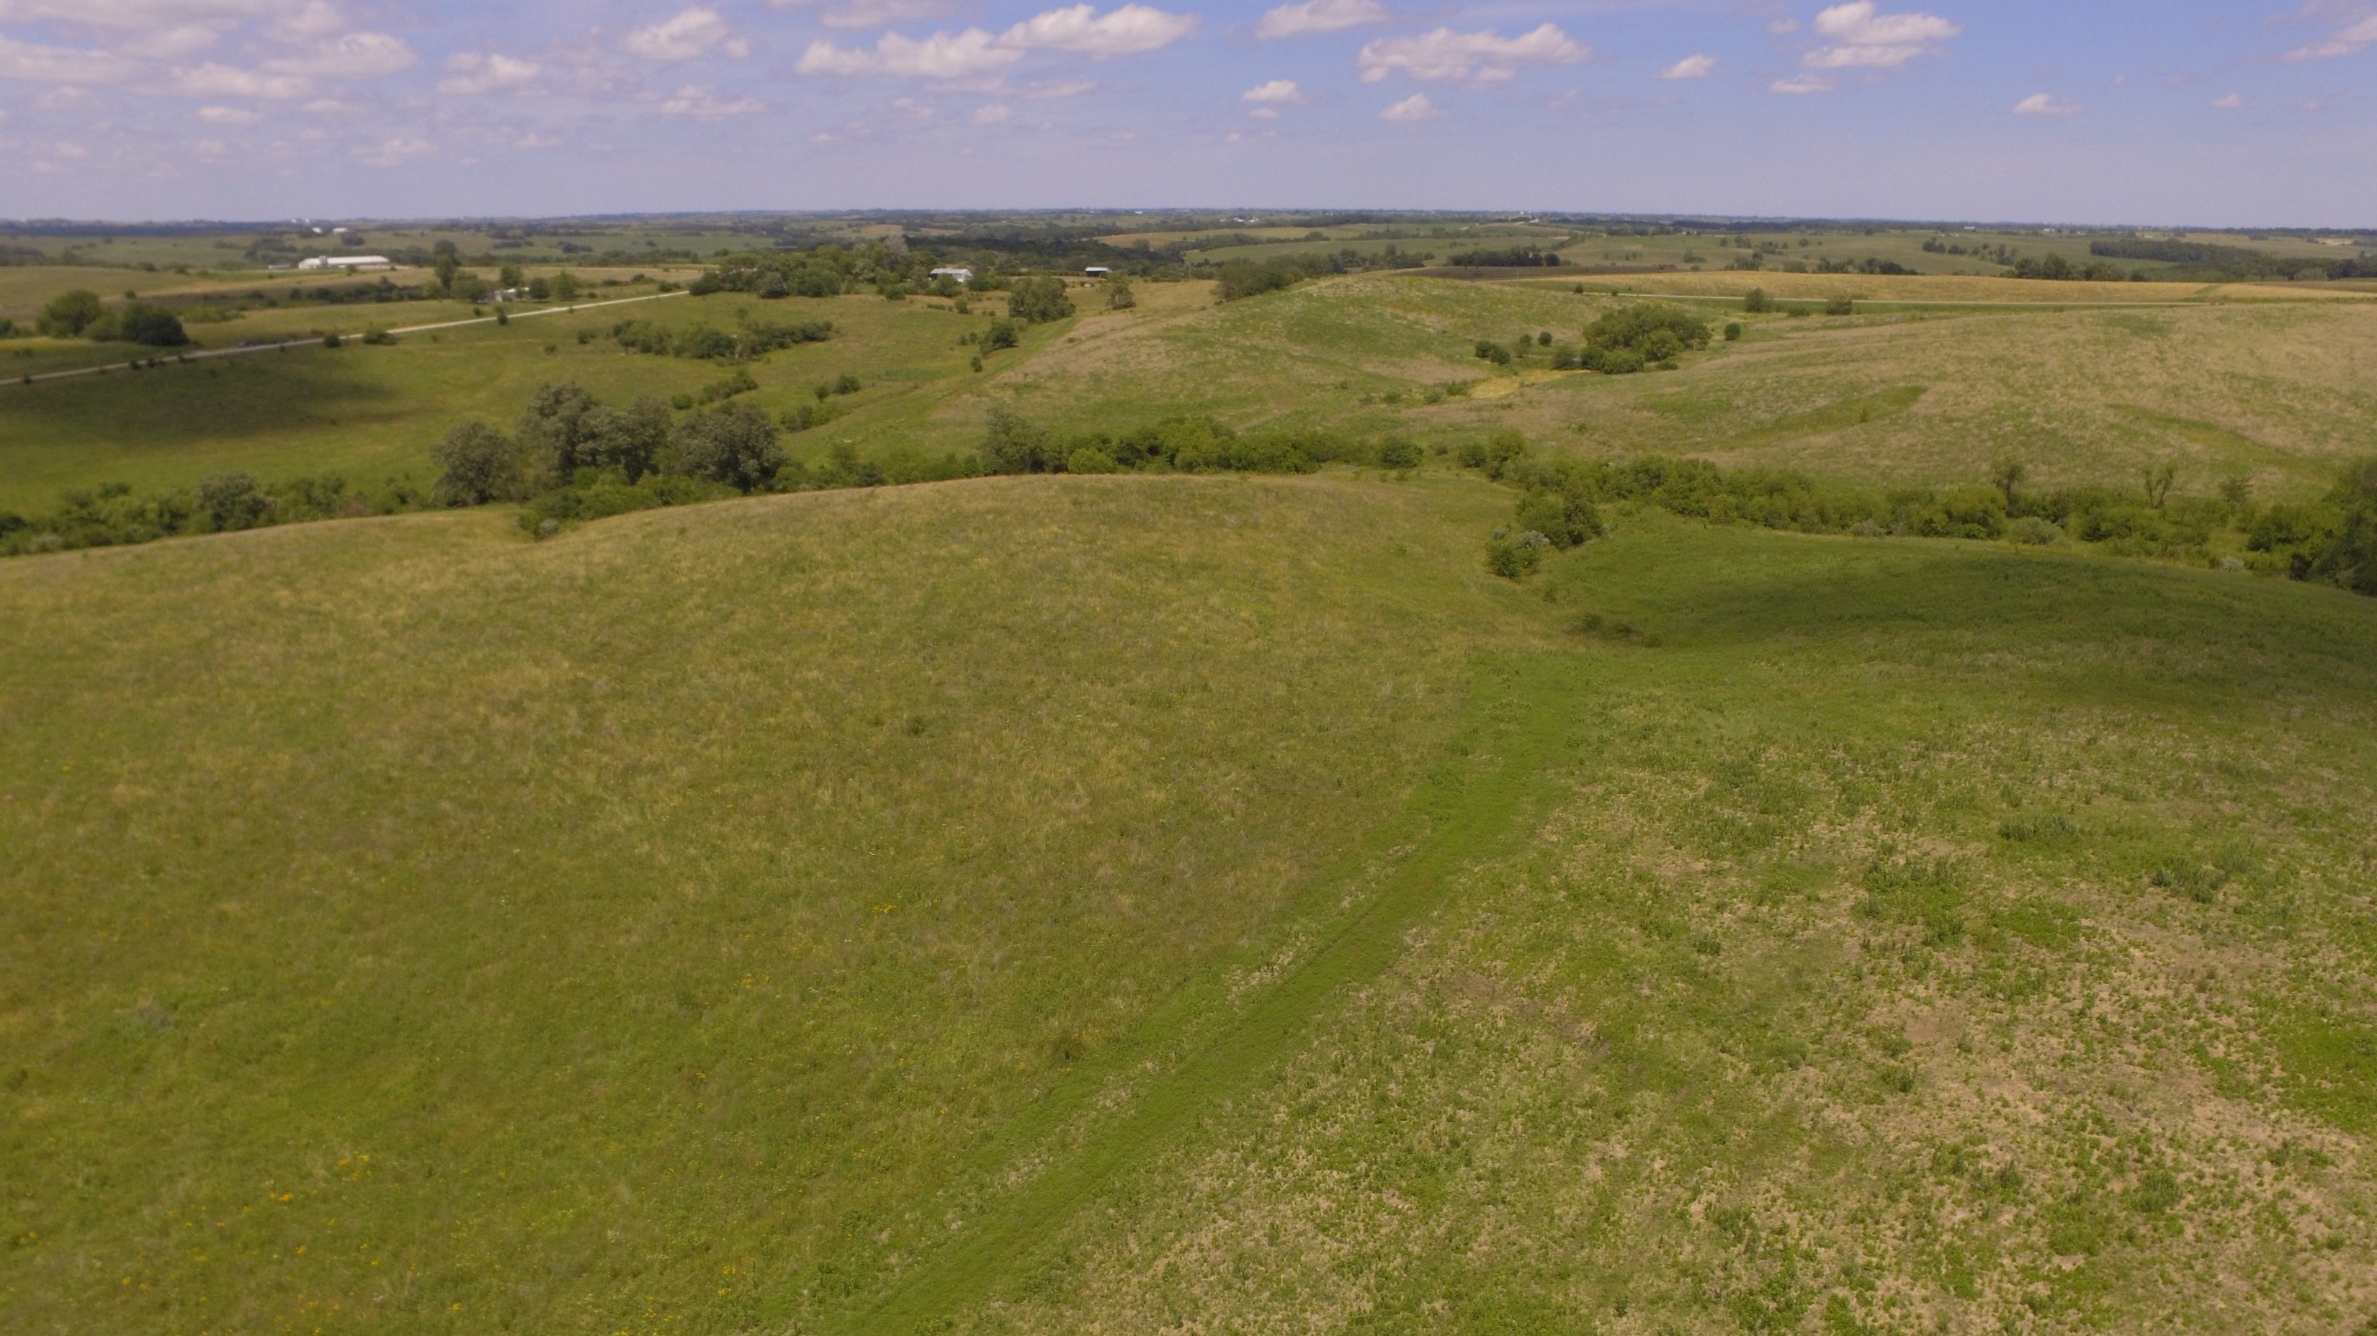
General Results
70% of landowners grazed cattle
Changes between 2007 and 2017:
More renters, older residents
Fewer residents valued grassland restoration and wildlife habitat
% Respondents rating Habitat Restoration as important
2007
51%
2017
31%
Coon et al, 2018, GRG Report 04-18, UIUC NRES
T. Swartz

Slide 14
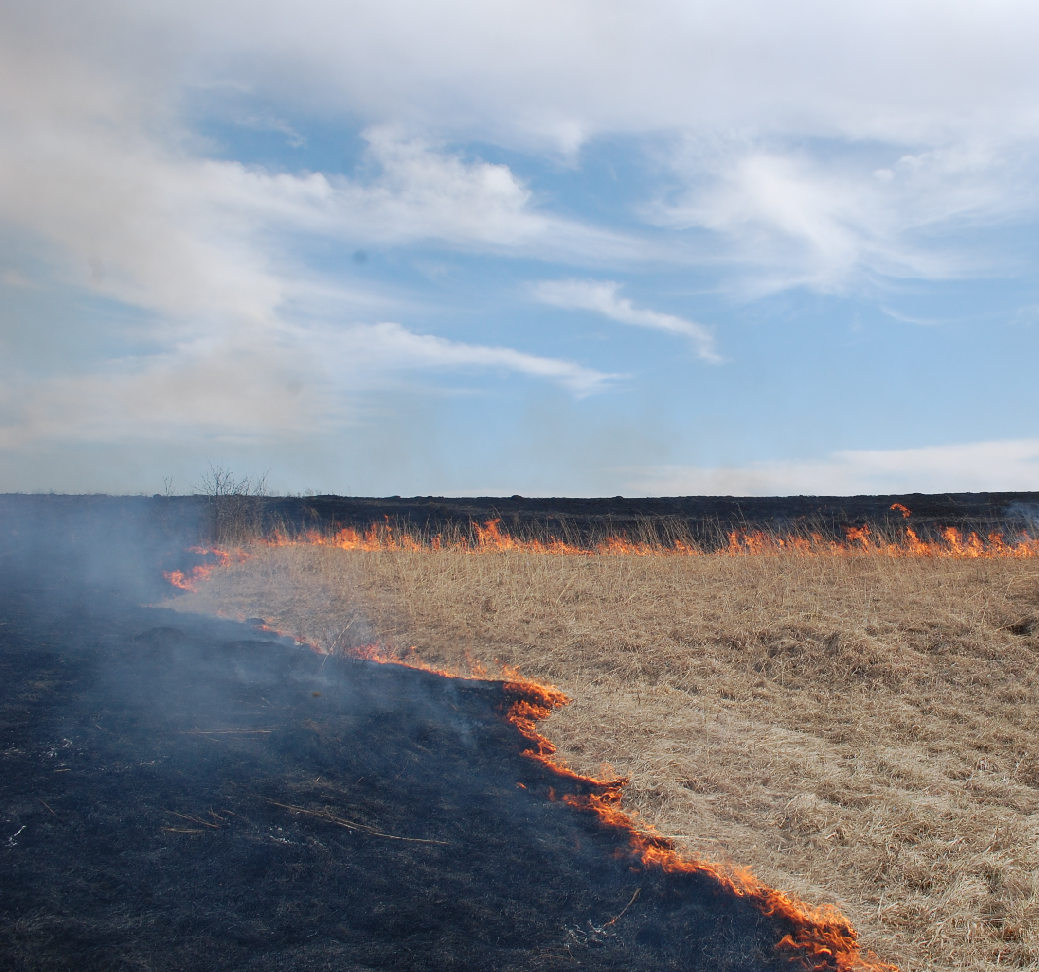
Prescribed fire
% of landowners using fire
2007 | 2017
25% (N=84) | 41% (N=129)
Notable increase in prescribed fire
25% of landowners use every 1-5 years!
Matches ideal fire frequency on reserves
In 2017, landowners who managed with fire strongly valued…
Recreation
Income from government programs
GLMS (p<0.05)
S. Maresh Nelson

Slide 15
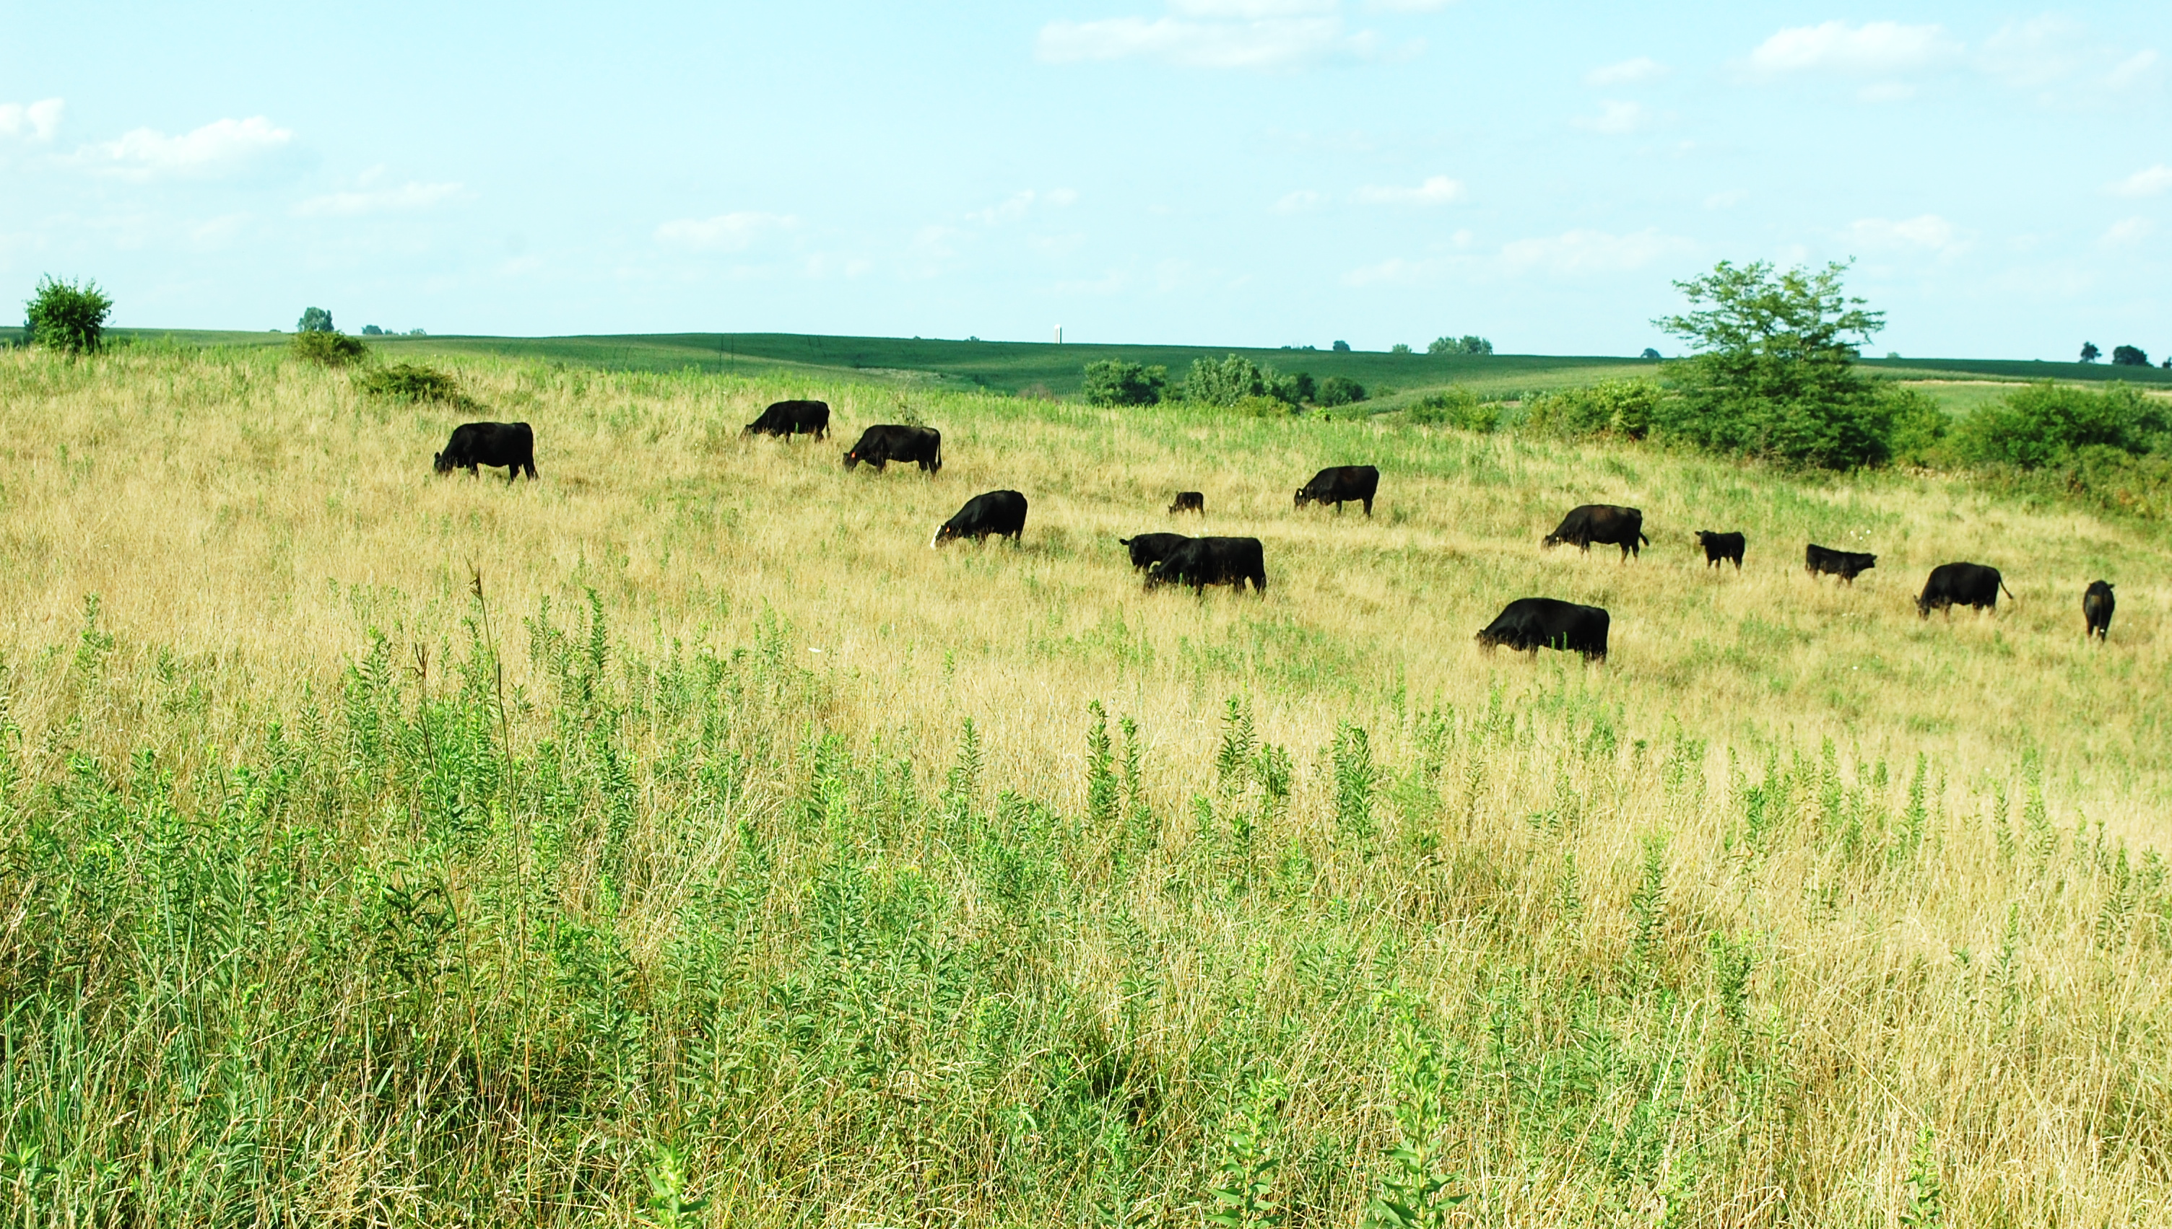
Grazing regimes
How likely are cattle producers to reduce stocking rate if it resulted in the following…
75%
63%
Moderately, very, or extremely likely (%)
55%
36%
Reducing Soil Erosion (N=79)
Restoring Prairies (N=79)
Controlling Invasive Plants (N=81)
Increasing gamebirds (N=80)
Raynor, Coon et al, In Review
Raynor, Coon et al, In Review
2/13/2019
@jaimejcoon
15

Slide 16
Grazing regimes
Landowners most willing to lower stocking rate were associated with…
Lower pasture quality
Environmental priorities
Higher levels of education
Landowners less willing to lower stocking rate were associated with…
Renters (vs. owners)
Economic priorities
Had more invasive grasses on their land
Raynor, Coon et al, In Review
GLMS (p<0.05)

Slide 17
Controlling non-native grasses
Non-native grasses are dominant on private lands in Grand River Grasslands
Protected lands have been working to reduce abundance
Some non-native grasses (e.g., tall fescue)
Reduce nest survival for grassland birds
Are avoided by cattle
Exclude native plants
Tall fescue (Schedonorus arundinaceus)
Smooth brome (Bromus inermis)
Kentucky bluegrass (Poa pratensis)
Maresh Nelson, Coon et al, 2018, Landsc Ecol
Maresh Nelson, Coon et al, In Press, Grass For Sci
Raynor, Coon et al, In Review

Slide 18
Controlling non-native grasses
Assumptions about non-native grasses…
Too widespread to reduce, a ‘lost cause’
Too valuable to convince landowners to manage
Managing is a simple cost-benefit analysis
Complicated topic requiring in-depth exploration of willingness and behavior
NOTE: Not discussing eradication

Slide 19
What are the behavioral drivers behind non-native grass management on private land?
Controlling non-native grasses
Theory of Planned Behavior
Norm Activation Theory
Structural Equation Modeling Techniques
Attitudes
Positive/negative feelings
Social norms
Expectations from neighbors
Personal norms
Obligation and responsibility
Willingness
Management of non-native grasses
R² =0.51
R² = 0.31
R² = 0.31
Social norms
Expectations from agencies
Perceived ability
Access to resources or skills
Ajzen, 1991, Organ Behav Hum Dec
Schwartz, 1977, Adv Exp Soc Psychol
Harland, 1999, J Appl Psychol

Slide 20
Integrated Discussion
Ecosystem Services
Behavioral Drivers
Management Decisions
Grassland Systems
Landowners
Social System
Social-Ecological Interface
Ecological System
Many using or interested in using practices that increase heterogeneity
Increasing use of patchy fires
Moderating stocking rates
Reducing non-native grasses
Management techniques likely to help grassland birds!
Flow diagram adapted from Miller, Coon, Swartz et al, in prep

Slide 21
Integrated Discussion
Ecosystem Services
Behavioral Drivers
Management Decisions
Grassland Systems
Landowners
Social System
Social-Ecological Interface
Ecological System
Behavioral drivers are not simple
Most not interested in restoration
Moral + social expectations
Cost, skills, and other resources
Co-benefits for multiple ecosystem services
Cattle production
Recreational opportunities
Biodiversity conservation
Flow diagram adapted from Miller, Coon, Swartz et al, in prep

Slide 22
Decisions are not just economic
We recommend activating feelings of moral responsibility and utilizing social networks in messaging/interactions
Vital to explore all behavioral drivers and multiple ecosystem services
Some cause for optimism
Many feel a strong sense of stewardship toward their land, which could benefit conservation
Thompson et al, 2015, Agric Hum Val
Cooke et al, 2015, Ecol Econ
Larson et al, 2015, J Environ Psychol
S. Maresh Nelson
22

Slide 23
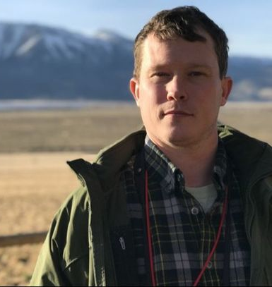
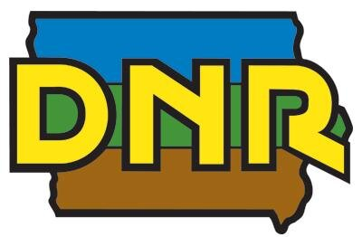
Funding
Collaborators
Any Questions?
EJ Raynor
Carena van Riper
Contact:
Jim Miller
Lois Wright Morton
Miller Lab Members: Samniqueka Halsey, Scott Maresh Nelson, Lauren Lynch, Jane Capozzelli, Maddy Kangas
Grand River Grasslands Team: Nick Lyon, Timothy Swartz, Diane Debinski, Walter Schacht, Dave Engle
Undergraduate Researchers: Jenna Mattes, Cora Wessman, Sara Dong
jjcoon2@Illinois.edu
@jaimejcoon

Slide 24
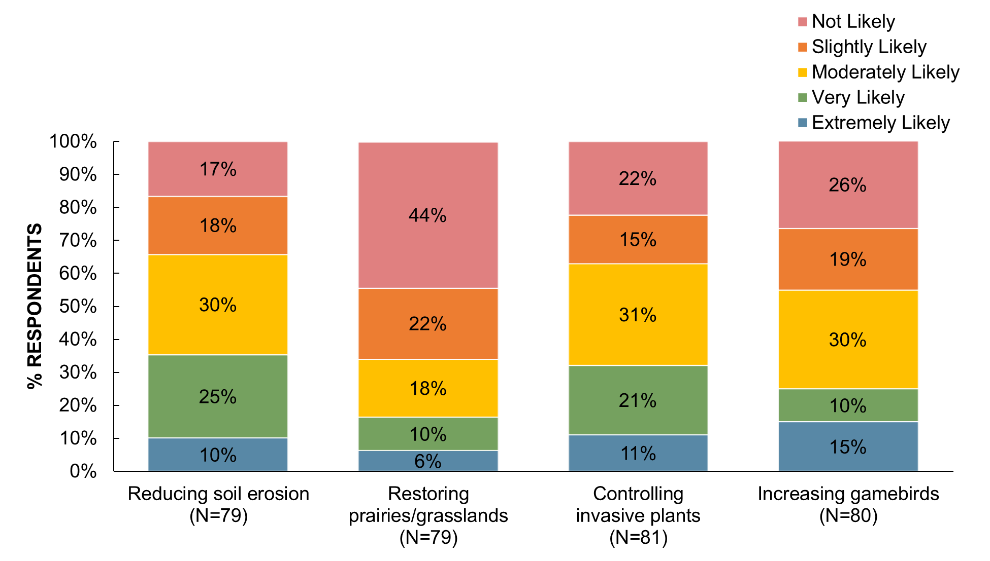
Grazing regimes
How likely is it that cattle producers would reduce stocking rate if it resulted in the following:
Raynor, Coon et al, In Review

