Slide 1
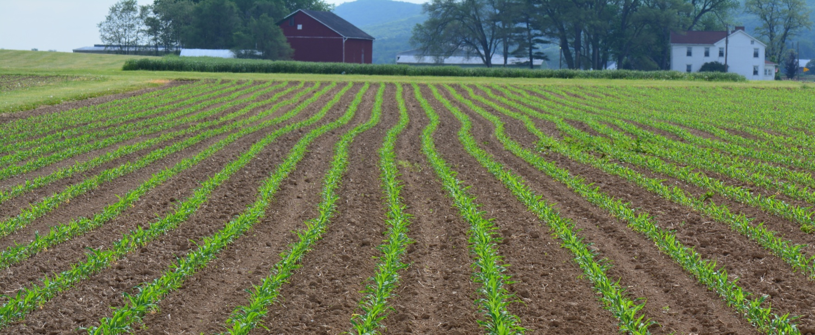
Impacts of cover crop diversification on attraction, dispersal, and pest suppression by generalist predators.
Jermaine Hinds, James Hagler, and Mary Barbercheck
The Pennsylvania State University
Notes:
Title slide

Slide 2
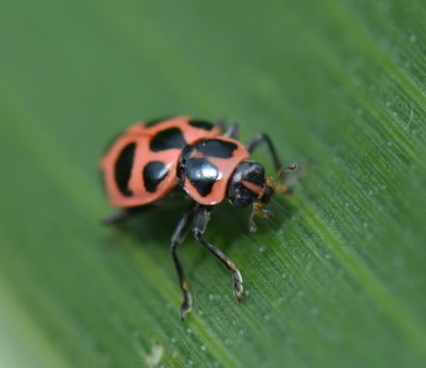
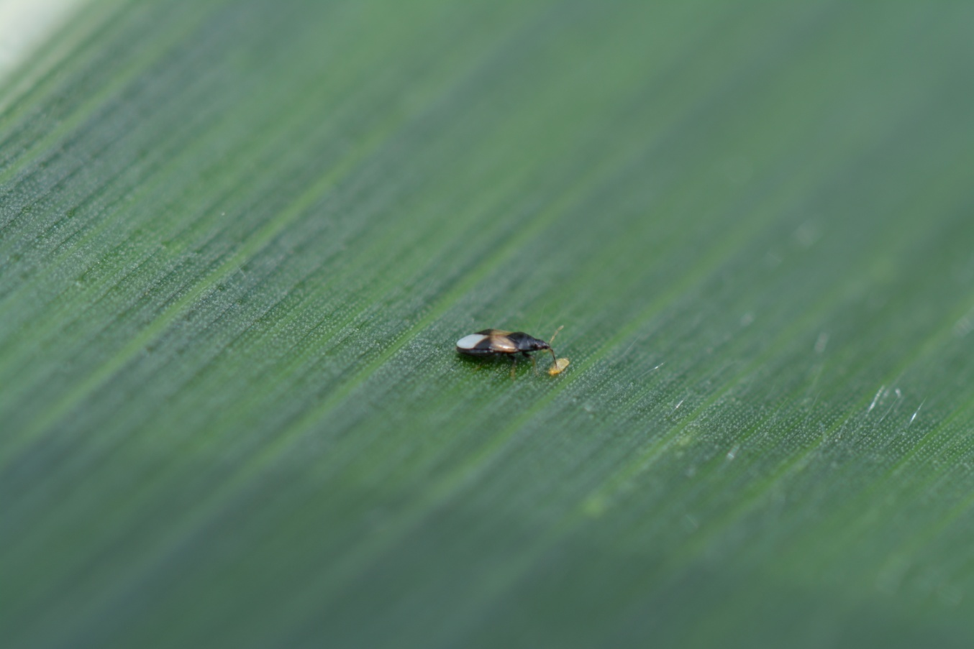
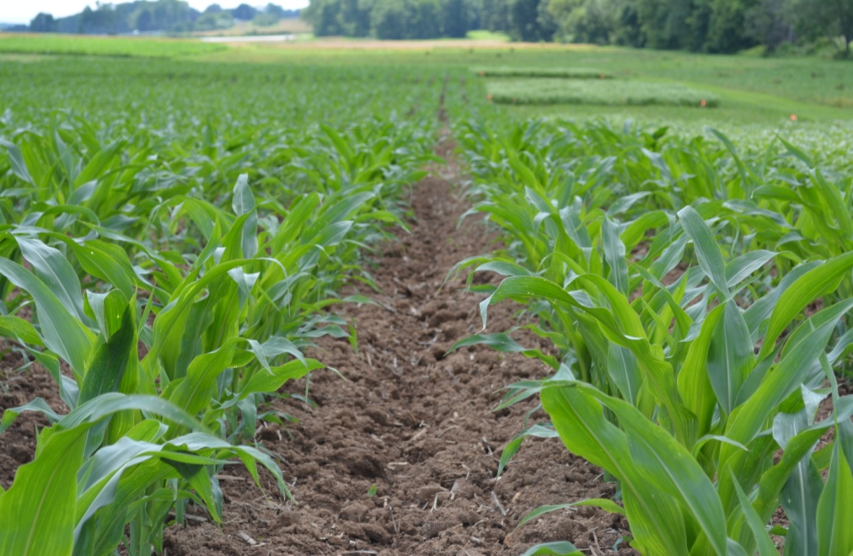
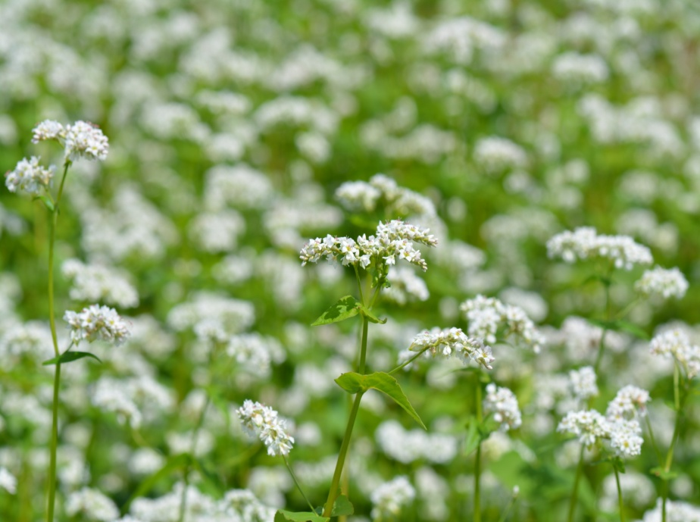
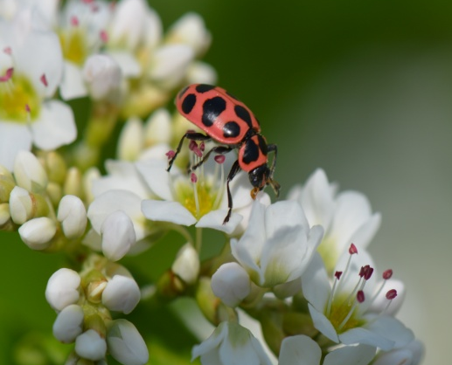
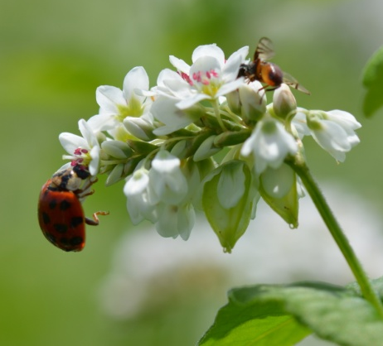
Natural Enemies
Notes:
Discuss the importance of natural enemies in agriculture.
Natural enemies provide a vital pest suppression service.
Quote 6bn value of natural enemies annually to demonstrate importance.
Emphasize how dominant agricultural landscapes often lack resources to support beneficial insects early in the season after they are emerging from overwintering sites often starved and ready to reproduce..
Farmers are increasingly interested in using common cover crop species to support beneficial insects
Insectary strips provide food and shelter resources to support natural enemies when usual prey is scarce.
Highlighting the importance of beneficial insects in agricultural agroecosystems, constraints of their effectiveness in agroecosystems, and a proposed method to promote the presence of beneficial insects in the agroecosystem.

Slide 3
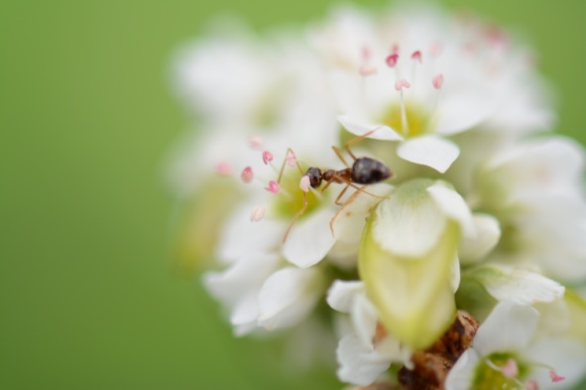
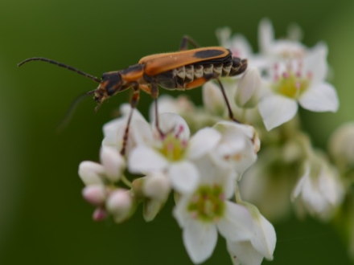
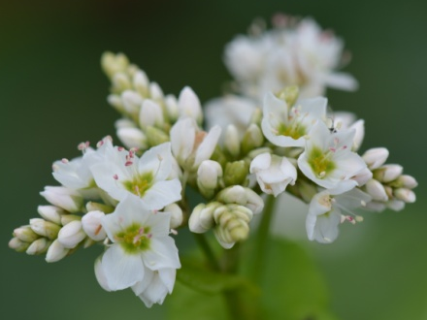
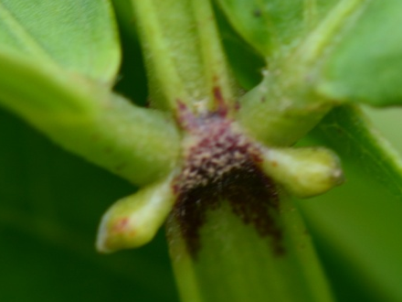

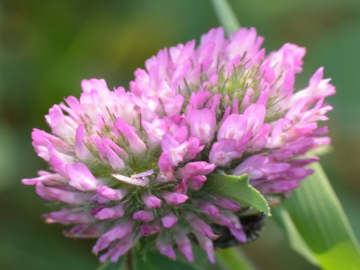
Provisioning by plants
Insectary plants provision natural enemies (Lundgren, 2009).
Natural enemies shown to prefer specific resource plants and differentially benefit from different host plants (Hogg et al. 2011; Vatalla et al., 2006).
Insectary mixtures with complementary resources may support more natural enemies.
Notes:
Insectary plants provision natural enemies (habitat, food resources, low disturbance, oviposition sites, etc)
We are discovering that natural enemies are attracted to different types of floral resources based on morphological (structure, color, accessibility) characteristics.
As such different natural enemies benefit differently from different insectary plant species.

Slide 4
Research Question
Can plant-based resources promote natural enemy abundance and promote pest suppression?
Can mixtures enhance these effects?
Do natural enemies necessarily disperse into nearby crop and contribute to pest suppression?
  Objectives:
    Evaluate potential of two plant species to support natural enemies by assessing:
      Resource availability
      Natural enemy abundance
      Predation
      Dispersal

Slide 5
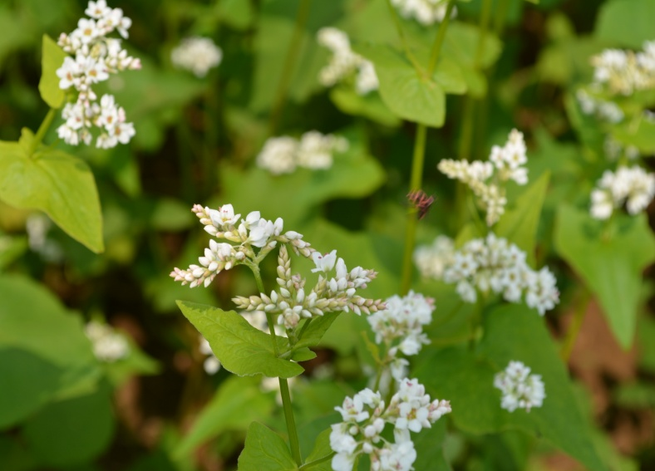
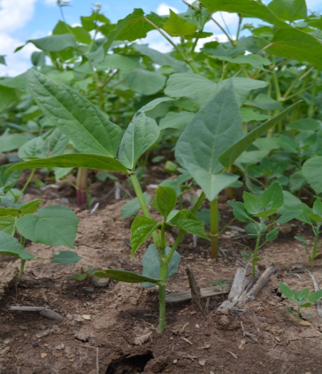
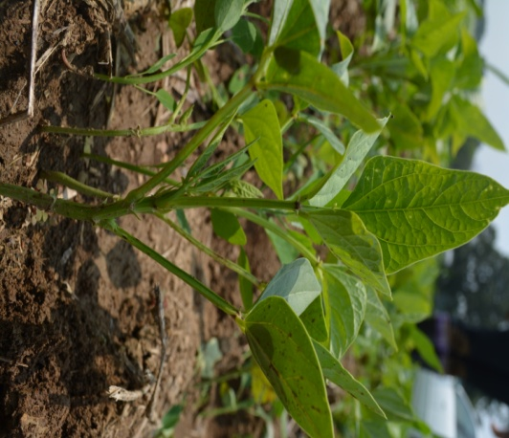
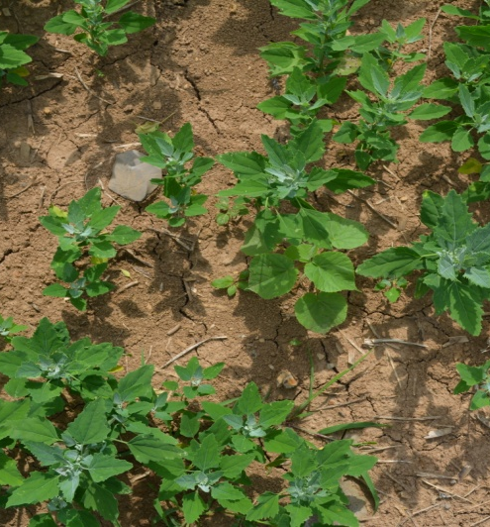

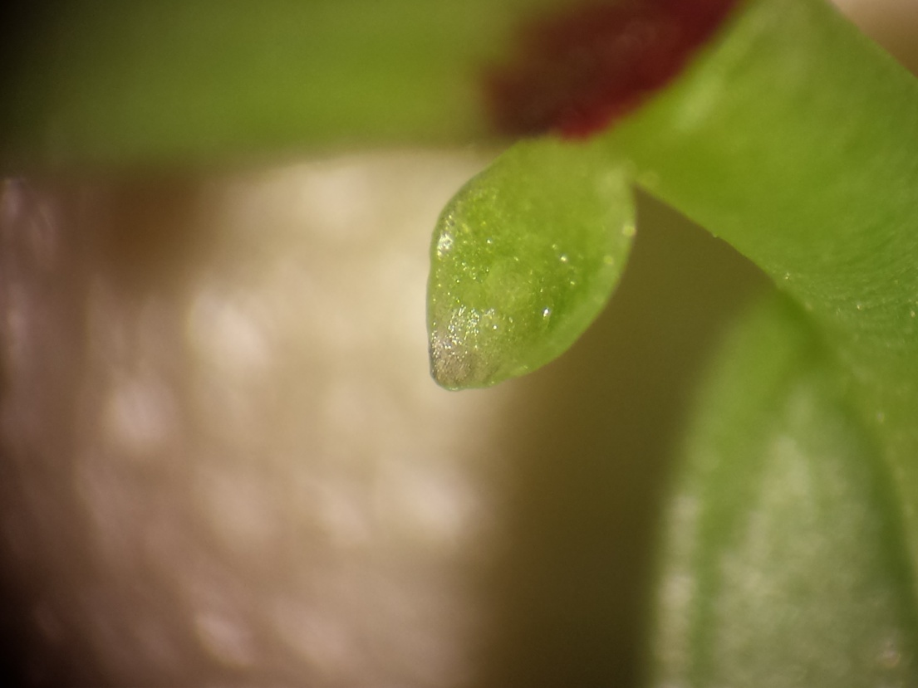
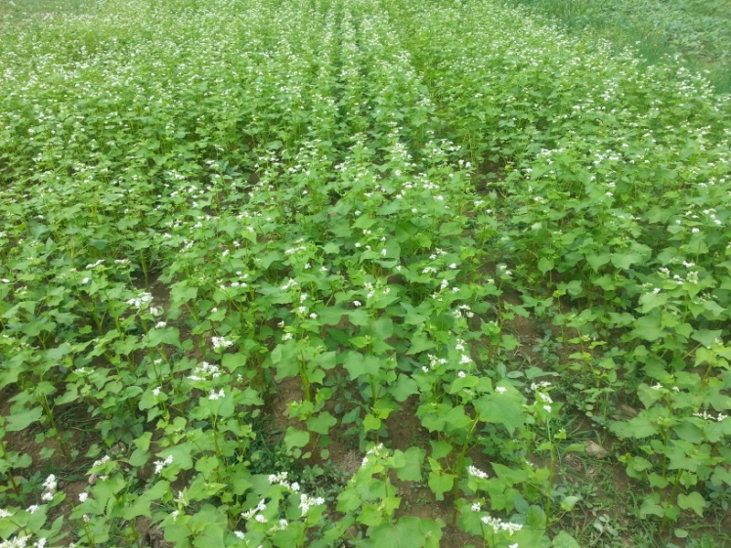
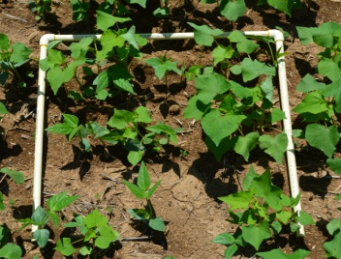

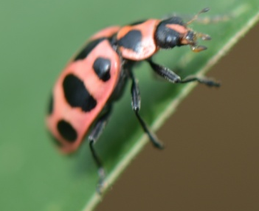

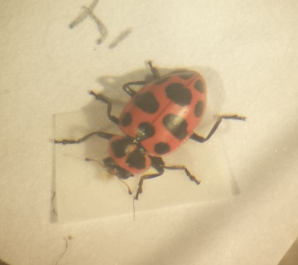
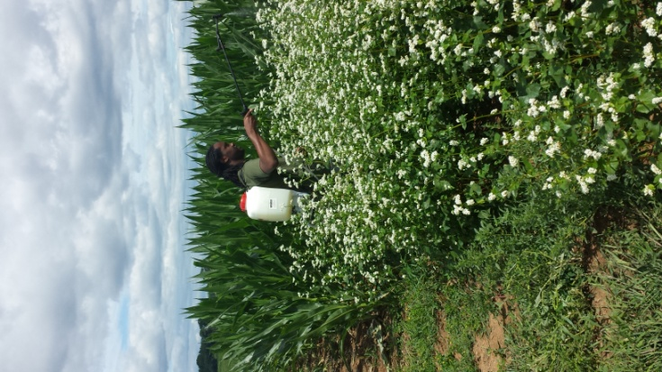
Buckwheat (BW) (Fagopyrum esculenum) | Biculture (MX) | Cowpea (CP) (Vigna unguiculata) | Weedy Fallow (WF)
Sampling Methods
Notes:
Mention both marks here
Randomized Complete Block Design
Four replicates
Four 18m x 13.7m plots
Consist of insectary border and cash crop
Insectary border 4.5m x 13.7m
Cash crop area 13.7m x 13.7m
Four Insectary Treatments
Buckwheat (Fagopyrum esculentum)
Cowpea (Vigna unguiculata)
Buckwheat-Cowpea Biculture
Weedy fallow – disturbed resource poor
Sampling:
Resource abundance
Sweep net samples
Sentinel eggs (Ostrinia nubilalis)
Why I chose these plants in particular.
Cover crops and functions
The species I am evaluating for insectary properties include Buckwheat and cowpea.
Buckwheat:
Summer annual
Rapid growth and biomass production
Soil coverage
Weed Suppression
Scavenge phosphorus
Nectar and pollen for beneficial insects.
Flower production rapids. Blooms 3 weeks after planting.
Cowpea:
Summer annual legume
Nitrogen supply
Weed suppression
Erosion prevention
Floral production – delayed 60-90days after planting
Extrafloral nectary production ~2 weeks after planting
Can a mixture of these two species support beneficial insects?

Slide 6



Resource abundance increases in time.
Cowpea EFN representation poor in mixture
*
*
*
*
Notes:
Resource density estimated as average number of plants within a .25m2 quadrat.
Means compared using a repeated measures analysis of variance.
Buckwheat resource density higher

Slide 7
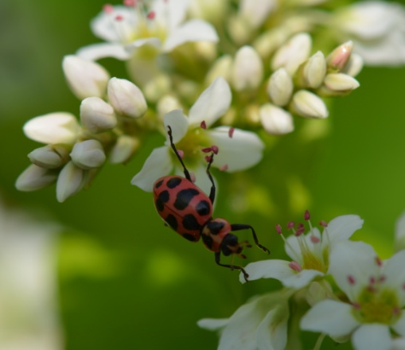
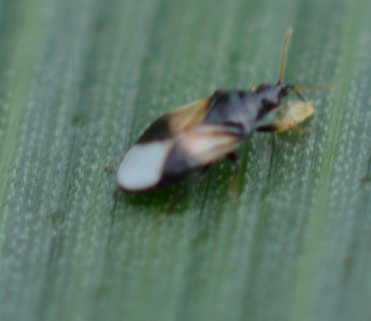
C. maculata and O. insidiosus more abundant where buckwheat is present. Cowpea not attractive
*
Notes:
Ladybeetles:
By week 7
BW>CP = 0.0031
BW>WF = 0.0460
MX>CP=0.0001
MX>0.0031
Insidious Flower Bug
Insidious flower bugs were influenced by treatment effects (F3,173= 80.69; P< 0.0001)(figure 3.2c). They were more abundant in buckwheat compared to cowpea and weedy fallow 6(P<0.0001; P<0.0001) and 7 (P<0.0001; P<0.0001) weeks after planting, respectively. Insidious flower bugs were more abundant in biculture treatments compared to cowpea 6(P<0.0001; P<0.0001) and 7(P<0.0001; P<0.0001) weeks after planting.

Slide 8
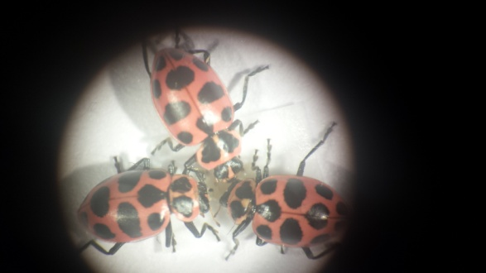
Combined predation lower in borders compared to crop plot and similar across treatments
*
*
*

Slide 9
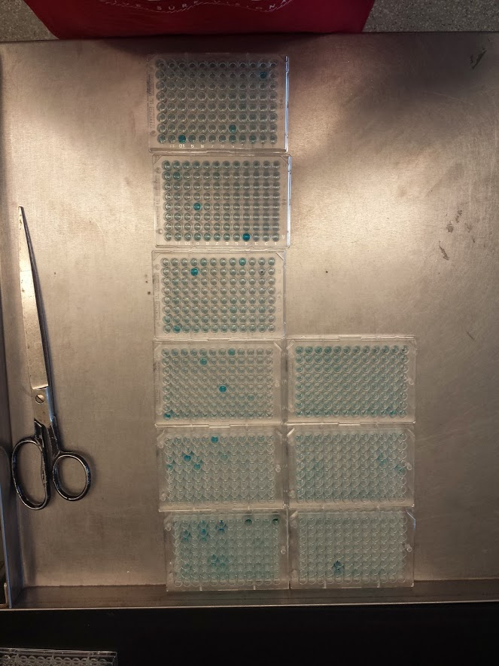
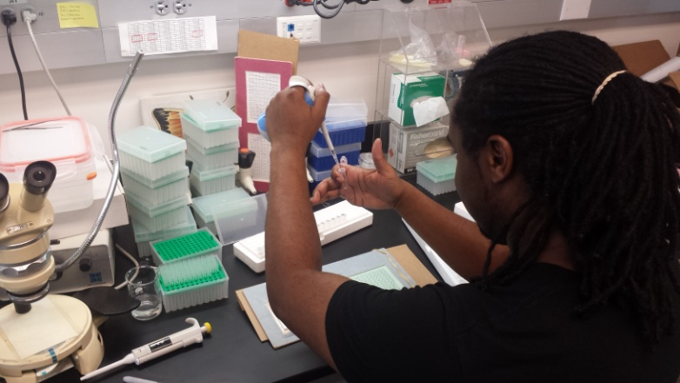
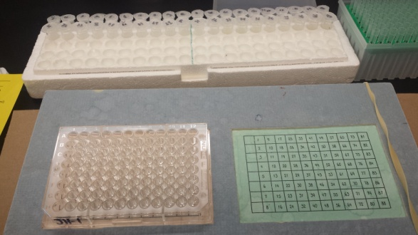
Natural enemies disperse from cover crop into main crop
 | C. maculata Dispersal | O. insidiosus Dispersal | C. maculata Predation | O. insidiosus Predation
Positive Marks | 22 | 15 | 15 | 37
Total | 1052 | 1292 | 1052 | 1292
Percentage Marked | 2.09% | 1.16% | 0.99% | 2.86%

Slide 10
Findings
Can plant-based resources promote natural enemy abundance in insectary strips?
  C. maculata and Orius spp. greater in presence of buckwheat
  Natural enemies not abundant in cowpea
Can mixture further support natural enemies?
  Not apparent. Biculture again, dominated by buckwheat
Does insectary strip enhance predation?
  Predation levels similar across treatments, but lower in border compared to crop
Do natural enemies disperse into nearby crop and contribute to pest suppression?
  C. maculata and O. insidiosus move into adjacent crop
  C. maculata and O. insidiosus predation on protein marked sentinel prey
Notes:
You might want to say Preliminary Findings or
Summary
Numbers of buckwheat inflorescences per plant greatest in biculture
Numbers of cowpea EFNs per plant (?) greatest in monoculture
Cmac greatest…..
Orius spp greatest….
Again, you can’t say predation is low without comparing it something…..that is higher. Either the adjacent corn, or expected level of predation (based on your experience or literature reports)(

Slide 11




Acknowledgements
USDA NIFA-OREI Program
  Cover Crop Cocktails Research Group
USDA ALARC
  James Hagler & Scott Machtley
NE-SARE Graduate Student Grant
Bunton-Waller Fellowship
Alfred P. Sloan Foundation
Lloyd. E. Adams Memorial Award
International Association of Black Entomologists
Russell E. Larson Ag Research Center Staff
Photo Credits: Jermaine Hinds
Notes:
Credit Russel E larson farm crew

