Slide 1
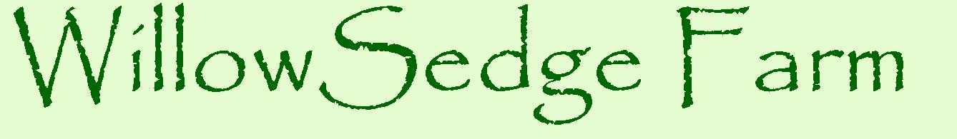

Finishing time and weights of grass-fed beef animals
A Farmer-Rancher Grant Project supported by North Central Region Sustainable Agriculture Research and Education (NCR-SARE)
Project # FNC12-860
Jane Grimsbo Jewett, jane@janesfarm.com
Practical Farmers of Iowa 1/23/2016
Notes:
This was a farmer-rancher grant project supported by North Central Region SARE.

Slide 2




Finishing time and weights of grass-fed beef animals
Jane Grimsbo Jewett, jane@janesfarm.com
Notes:
I also work for both the Minnesota Institute for Sustainable Agriculture and the Green Lands Blue Waters collaborative. Both of those organizations have provided moral support and helped inform this work. I also had help and involvement from University of Minnesota Extension educators.

Slide 3
Acknowledgements:
Edgar Brown, Willow River, MN
Jake and Lindsay Grass, Pine City, MN
Bill McMillin, Plainview, MN
Troy Salzer, Carlton County Extension
Wayne Martin, University of MN Extension
Joe Jewett
The Jewett and Grimsbo Families
Kate Clancy, Senior Fellow, Minnesota Institute for
Sustainable Agriculture (MISA)
Helene Murray, Executive Director, MISA
Kris Johnson, MISA Board of Directors
Kate Seager, Minnesota SARE Co-Coordinator
Betsy Wieland, Minnesota SARE Co-Coordinator
Midwest Perennial Forage Working Group
Rich Pirog, C.S. Mott Group for Sustainable Food Systems, Michigan State University
Laura Paine, Southwest Badger RC & D Council
Notes:
Edgar, the Grasses (Jake and Lindsay), and Bill McMillin were my farmer-cooperators. Troy Salzer also raises beef cattle and was very helpful in working with Edgar and making the Carlton Co. livestock scale available. Wayne Martin, Alternative Livestock Specialist, is someone I bounce ideas off of a lot. My husband, Joe, and my parents put up with a lot of extra messing around with cattle to get weights at the right time and many other things. Kate Clancy’s earlier work helped shape my thinking on the environmental impact of grass-fed beef. Helene Murray, my boss, has been great about moral support. Kris Johnson originally circulated the Pelletier paper to MISA board members and staff, which launched me toward this project. Kate Seager and Betsy Wieland were also great about moral support and help with some of the intricacies of SARE grants. The Midwest Perennial Forage Working group is part of Green Lands Blue Waters and is a great group for networking, discussion, and bouncing of ideas. Rich Pirog was co-author on the paper that launched me toward this, and was generous in answering my questions and concerns about that paper. Laura Paine is a grass-fed producer and education in SW Wisconsin and has been helpful with framing ideas and interpreting results.

Slide 4
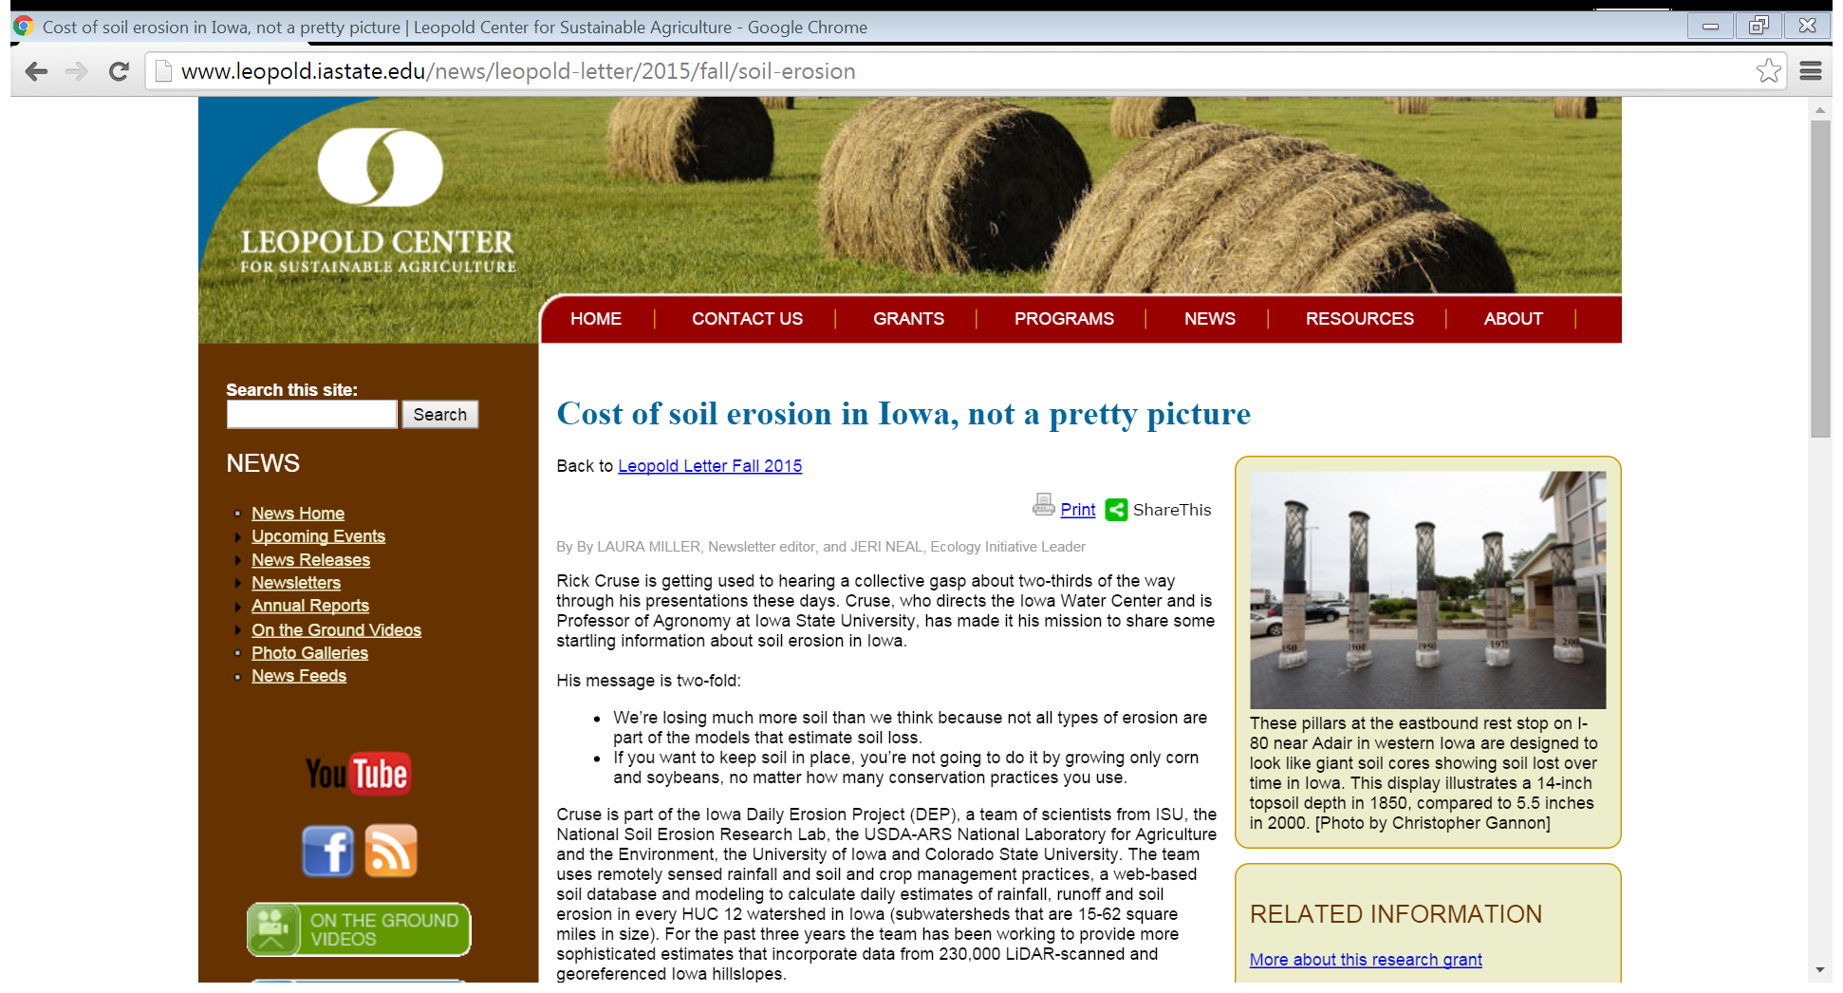
Soil Erosion Research led by Rick Cruse, Iowa Water Center
Notes:
Research by Rick Cruse suggests that around 30% of soil loss from annual row-cropped fields happens via ephemeral gullies, which are not accounted for in standard soil loss equations. Soil loss is actually much greater than the T-value of 5.5 tons/acre/year. Also, soil formation rate is not as high as has been assumed. Cruse estimates 0.5 tons/acre/year is the actual soil formation rate.

Slide 5
Leopold Center/Iowa Water Center
T = 5.5 tons/acre/year of soil loss …
BUT does not account for ephemeral gullies …
Which cause up to 30% of total soil loss.
Formation rate of soil has been assumed to be = T, 5.5 tons/acre/year …
BUT is really more like 0.5 tons/acre/year

Slide 6
Reduction in soil loss % due to cropping system
% reduction
Cropping System
Control of Soil Erosion Fact Sheet. Robert P. Stone and Neil Moore. Ontario Ministry of Agriculture and Food. http://www.omafra.gov.on.ca/english/engineer/facts/95-089.htm
Notes:
Why is grass-fed or pasture-based beef production important? Hay and Permanent pasture reduces soil erosion, and soil erosion is both loss of wealth to farmers and cost to people living downstream.

Slide 7
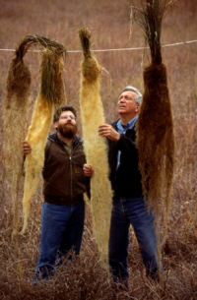
Perennial Grasses have a phenomenal root system
Jerry Glover
and Wes Jackson
The Land Institute
Salina, KS
Notes:
Perennial grasses have extensive, deep and fibrous root systems that all interlock with each other in a field setting and are present and living in the soil year-round, preventing soil loss.

Slide 8
Comparative life cycle environmental impacts of three beef production strategies in the Upper Midwestern United States
Nathan Pelletier, Rich Pirog, Rebecca Rasmussen
July 2010. Agricultural Systems 103(6):380-389.
Notes:
This is the paper that launched me on this project.

Slide 9
“Impacts per live-weight kg of beef produced were highest for pasture-finished beef for all impact categories and lowest for feedlot-finished beef”
Notes:
Quote from the Results & Discussion section of the Pelletier paper. I read this and thought, how could this possibly be?

Slide 10
Materials & Methods:
“Calves weaned to pasture in Iowa finish at 505 kg in 450 days
on a ration of forage and hay.”
Notes:
I started to get an inkling of how the authors could have found that result in this assumption that went into their life cycle analysis. That is a long time to spend finishing cattle, post-weaning. Rich Pirog confirmed that the length of time to finish was a major contributing factor to the poor performance of grass-fed beef relative to feedlot beef in their analysis.

Slide 11
Grass-fed beef finish time:
1,111 lbs. live wt.
450 days = 1 year + 3 mo.
Compare to:
Feedlot beef finish time
1,400 lbs. live wt.
303 days = 10 mos.
Notes:
These figures are from the Pelletier paper, and are post-weaning figures.

Slide 12
Age @ Weaning, 7 months + Finishing Time = Age @ Slaughter
Grass-fed: Total of 22 months to get a 1,100-lb. animal
Feedlot beef: Total of 17 months to get a 1,400-lb. animal
Notes:
The paper assumed spring calving and weaning in November, so in my calculations which you’ll see further on, I used a weaning age of 7 months. I realize that many grass-fed beef producers, including myself, are weaning at a later age, like 9 or 10 months. That was a nuance not dealt with in this study.

Slide 13
“Calves weaned to pasture in Iowa finish at 505 kg in 450 days
on a ration of forage and hay.”
Where did these figures come from?
Notes:
Back to this figure, which did not match my experience or that of several other farmers I was familiar with. So I had an opportunity to ask Rich Pirog about this.

Slide 14
Where did these figures come from?
Rich Pirog: Iowa State U. Extension beef experts’ estimate, personal communication to authors
Grass-fed Beef Production Method
CONFOUNDED
Heritage Beef Breeds
Poor Pasture Quality/
Management
Notes:
Rich Pirog told me that they were not able to find published reports of grass-fed beef productivity that they could use for the life cycle analysis. The Iowa researchers had been collecting some information on grass-fed beef carcass weights in Iowa, and they advised Rich Pirog on what numbers to use for the analysis. I suspected confounding of the data.

Slide 15
What if the Life Cycle Analysis used input numbers obtained through use of modern beef genetics and good pasture with good management?
Notes:
So, the question I asked Rich:

Slide 16
What if the Life Cycle Analysis used input numbers obtained through use of modern beef genetics and good pasture with good management?
That question is where this project starts.
Notes:
and he said, yes, that could make a real difference in the life cycle analysis. And then he said to me, if you get a chance to collect the data, do it! So that put the responsibility for answering this lack-of-data problem squarely on my shoulders.

Slide 17
Collaborators:
Edgar Brown
Jake & Lindsay Grass
Jane Jewett
Bill McMillin
All using managed rotational grazing on improved pastures.

Slide 18
Livestock Breeds:
Edgar Brown - Shorthorn
Jake & Lindsay Grass – 2 Groups:
*Black Angus, British White, Ayrshire
*Scottish Highlander
Jane Jewett – Black Angus
Bill McMillin – Black Angus, British White
Notes:
It was kind of serendipity that Jake had a group of Scottish Highlander animals and wanted to enroll them in the study. I was a little dubious because my idea was to focus on the modern British breeds only, but this is why you want collaborators – things happen that you didn’t intend, and it is often better.

Slide 19
Hay and haylage average RFV and winter feeding system on the four farms
Brown | Grass Meadows | Jewett | McMillin
RFV = 90 | RFV = 105 | RFV = 108 | RFV = 138
Round bales Animals allowed to sort for preferred portions (No bale rings) | Several types of hay and haylage Animals fed 3 forage types at a time | Round bales Bale rings used | Hay and haylage Bunk feeding Some bale ring use
Notes:
The four farms were pretty different in terms of their forage quality and feeding system for their winter feed.

Slide 20
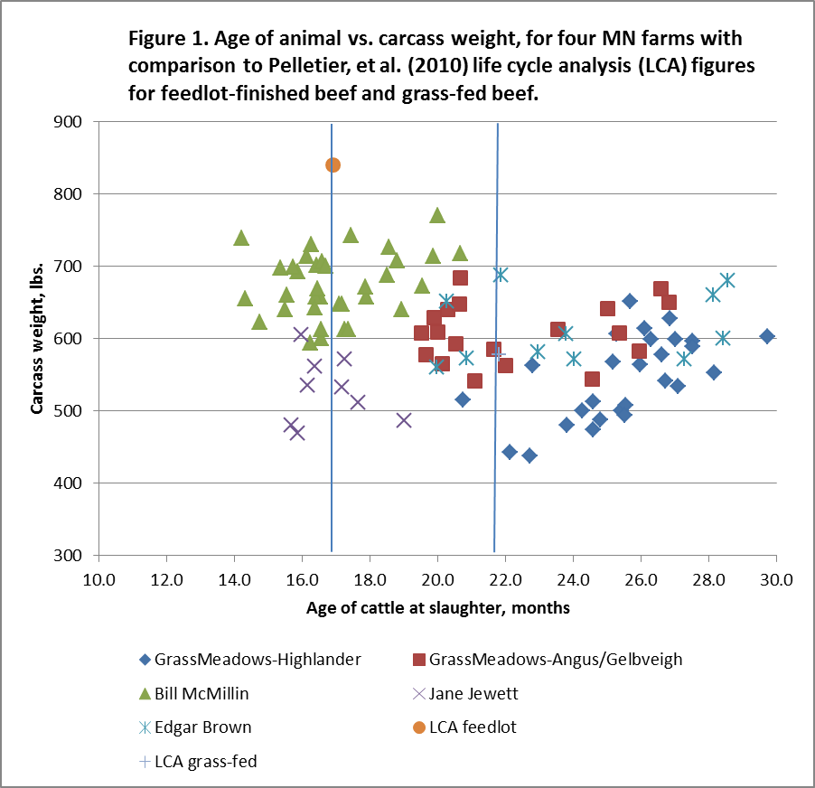

Feedlot
Grass-fed
Notes:
So, here’s the bottom line. The vertical lines show average age at slaughter for feedlot beef and grass-fed beef, according to the Pelletier study. The average feedlot carcass and average grass-fed carcass according to that study are circled. Then we have all of the data points coming from the farms in this study.

Slide 21
Feedlot
Grass-fed
Notes:
Here’s the cluster of Grass Meadows’s Scottish Highlander cattle. It overlaps the average grass-fed carcass, but most of his were either lighter or took longer finish.

Slide 22
Feedlot
Grass-fed
Notes:
Here’s Grass Meadows’s Angus-Gelbveigh herd, which is closest to the average grass-fed beef carcass.

Slide 23
Feedlot
Grass-fed
Notes:
This is Edgar Brown’s herd; more spread out for finishing ages. Edgar was disappointed about that. He ran into some breeding problems that set him back.

Slide 24
Feedlot
Grass-fed
Notes:
So here are those three clusters of farms that overlapped the average grass-fed carcass to some degree.

Slide 25
Feedlot
Grass-fed
Notes:
Bill McMillin’s steers; all of his animals finished sooner and at higher carcass weight than the grass-fed average. His slaughter ages were right in line with the feedlot average.

Slide 26
Feedlot
Grass-fed
Notes:
Jane Jewett’s farm; also finishing all animals at an age similar to feedlot beef but not achieving the weights that Bill McMillin was getting.

Slide 27
Feedlot
Grass-fed
Notes:
All five clusters of steers

Slide 28
Estimate of Age-Weight index of the feedlot beef and grass-fed beef in the Pelletier, et al. study.
 | Feedlot beef | Grass-fed beef
Age at slaughter (months) | 16.9 | 21.8
Carcass weight (estimate)ƚ | 840 lbs. | 577 lbs.
Age-weight index | 49.7 | 26.5
Ƚ Assuming a carcass yield of 60% for feedlot beef and 52% for grass-fed beef
Notes:
So looking at the age vs. carcass weight plot is interesting, but also a little hard to draw conclusions on some of the things I was interested in. So, I calculated an age-weight index, which is simply the hanging carcass weight of the steer divided by its age in months at slaughter. This lets us compare the performance of different systems. Here are the age-weight indexes for feedlot beef and grass-fed beef calculated from the Pelletier paper.

Slide 29
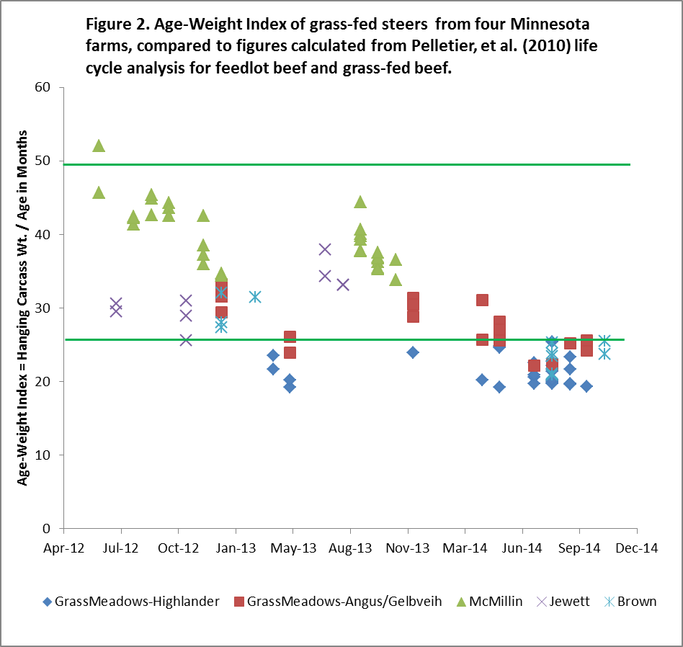
LCA Feed-lot: 49.7
LCA Grass-fed
26.5
Notes:
This chart shows the same data points for all farms that you saw previously, but now they are age-weight indexes for each animal with reference lines for the average feedlot and average grass-fed index. Here you can see that Bill McMillin had one grass-fed animal that actually exceeded the feedlot average when viewed this way. All of the Scottish Highlander cattle fell below the index line for grass-fed beef. This is important: this chart makes it really clear that heritage breeds are a confounding factor when you are trying to compare feedlot systems to grass-fed systems. Another important thing to see here is that every farm had a range of steer performance. That tells me that there is potential for these farms to improve and try to figure out ways to push more of their animals toward the more productive end of their range. And, a final important thing from this slide: when you look at these four farms’ results together, if you’re a farmer on the lower side of this, you also start to realize that other people are doing this better than you, and you can start to look at ways to improve your system to push your productivity towards theirs.

Slide 30
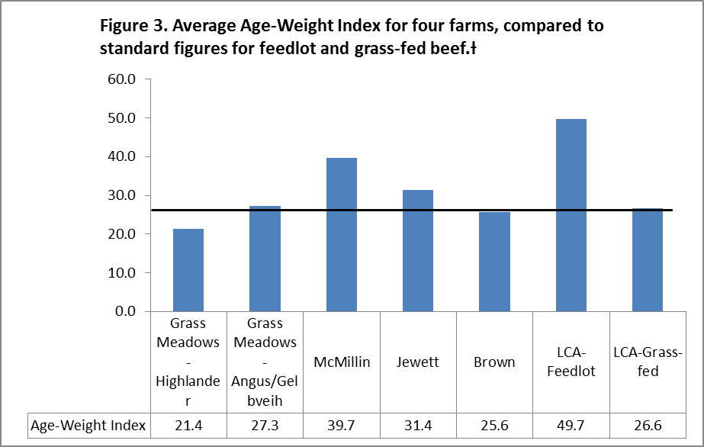
LCA Grass-fed:
26.5
Notes:
Here are the averages per farm shown against the Pelletier paper’s averages for feedlot and grass-fed beef; the reference line is the grass-fed beef average age-weight index from that paper. Again, you can see that heritage breeds are a confounding factor when you are trying to compare feedlot systems to grass-fed systems.

Slide 31
What do we know, now?
Livestock breed matters when you are comparing grass-fed systems to feedlot systems.
A grass-fed system has the potential to approach the feedlot system in productivity, as measured by carcass weight produced in a given time frame.
There is room for improvement of grass-fed beef production systems, within farms and across farms.

Slide 32
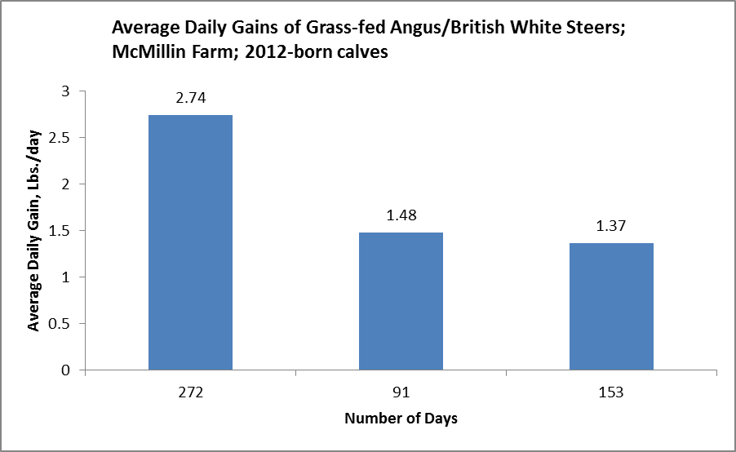



Birth to Wean
Wean to Pasture
Pasture to Finish
Notes:
This chart and the next one from the Grass Meadows Farm show pretty typical patterns of change in ADG over time as grass-fed cattle are weaned, put on stored forage for the winter, and then moved to pasture.

Slide 33
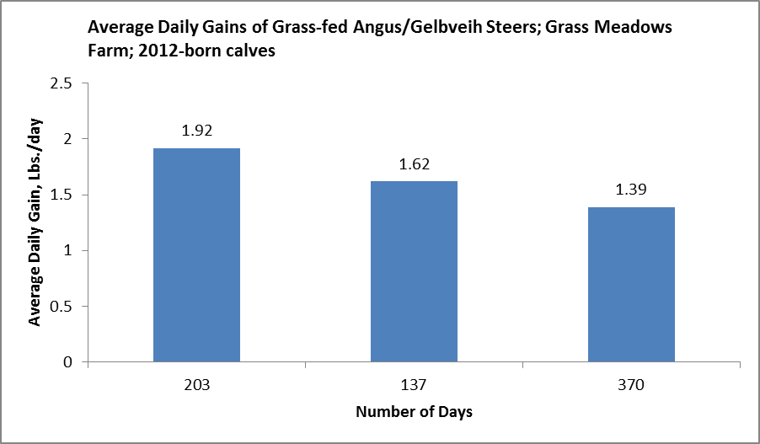






Notes:
The Grass Meadows farm had a much shorter birth-to-wean period and a much longer pasture-to-finish period than the McMillin Farm did.

Slide 34
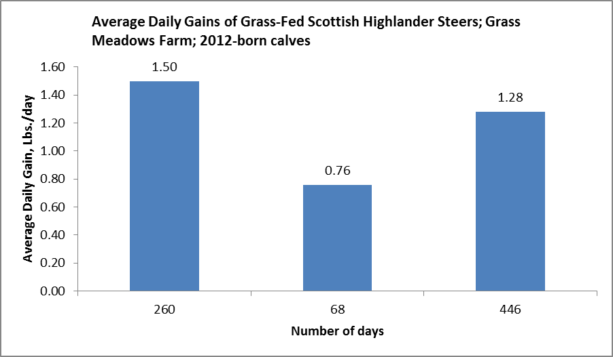



Notes:
Scottish Highlander cattle on Grass Meadows Farm were kept with their mothers longer and had a far longer finishing period than the Angus/Gelbveih cattle on the same farm. The ADGs were also lower.

Slide 35
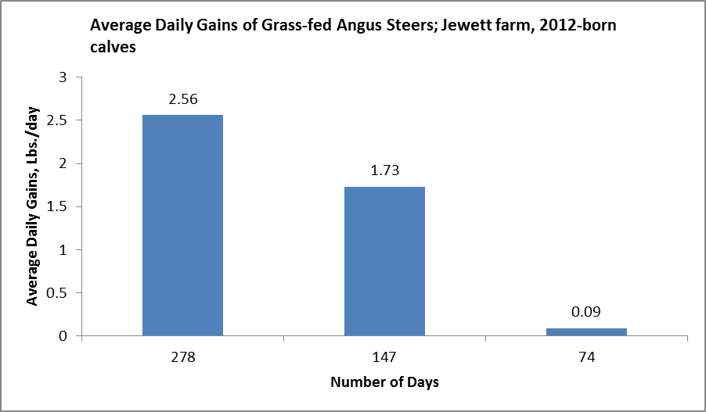

Pasture to Finish
Notes:
Oh, boy. Then there’s the Jewett farm, with virtually zero ADG in the pasture-to-finish period for the 2012-born calves.

Slide 36
What happened on the Jewett farm?
0.09 ADG
for the Pasture-to-Slaughter period

Slide 37
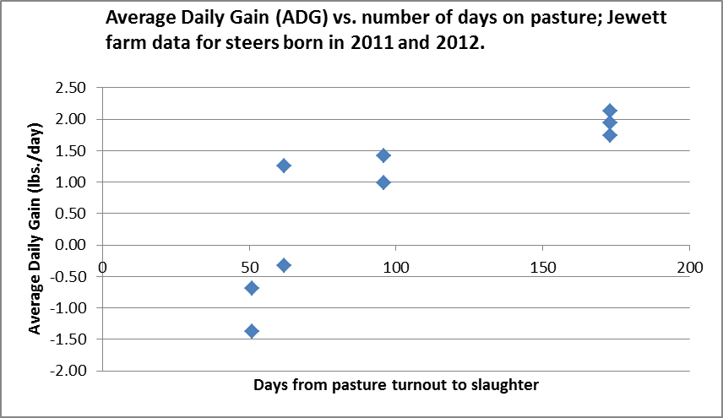
Notes:
During 2012 and 2013, the Jewett farm was doing summer marketing of grass-fed beef. This happened in July and August, and meant a short time window, sometimes as short as 50 to 65 days, between pasture turn-out and slaughter. It looks like there was an adjustment period for going from winter hay to spring pasture for some steers, and they didn’t have time to gain back what they had lost during that adjustment.

Slide 38
Hay and haylage average RFV and winter feeding system on the four farms
Brown | Grass Meadows | Jewett | McMillin
RFV = 90 | RFV = 105 | RFV = 108 | RFV = 138
Round bales Animals allowed to sort for preferred portions (No bale rings) | Several types of hay and haylage Animals fed 3 forage types at a time | Round bales Bale rings used | Hay and haylage Bunk feeding Some bale ring use
Notes:
The four farms were pretty different in terms of their forage quality and feeding system for their winter feed.

Slide 39
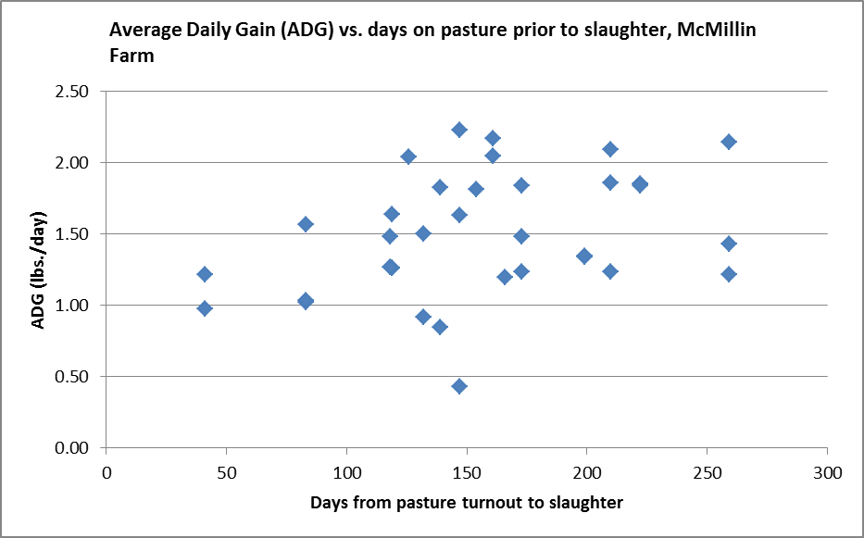
Notes:
There was no similar pattern of negative ADG at the McMillin farm, even in animals marketed a short time after pasture turn-out. This might be related to the higher-quality winter forage on the McMillin farm – there may have been less of an adjustment in going from winter stored forage to spring pasture.

Slide 40
Comparative Economics of four farms
 | Brown | Grass Meadows | Jewett | McMillin
Feed $/steer | $ 947 | $ 1,135 | $ 968 | $ 1,346
Avg. lbs. carcass wt. | 617 | 571 | 528 | 675
$ /steer gross | $ 1,990 | $ 1,841 | $ 1,703 | $ 2,177
$ /steer net | $ 1,043 | $ 707 | $ 735 | $ 831
$ /acre net | $ 124 | $ 212 | $ 73 | $ 332
Notes:
Here’s how the economics shake out. This is the quick-and-dirty; I go into exhaustive detail about how these numbers were calculated in my report, which I will be happy to send to anyone who sends me a request.

Slide 41


Slide 43
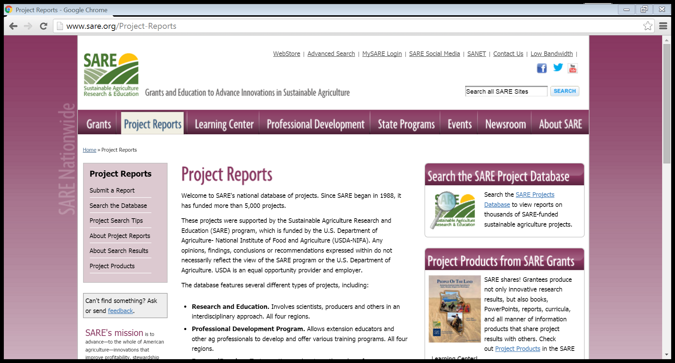

Slide 45



Finishing time and weights of grass-fed beef animals
Thank you!
Jane Grimsbo Jewett
jane@janesfarm.com
jewet006@umn.edu
www.northcentralsare.org
www.misa.umn.edu
www.greenlandsbluewaters.net

