Slide 1
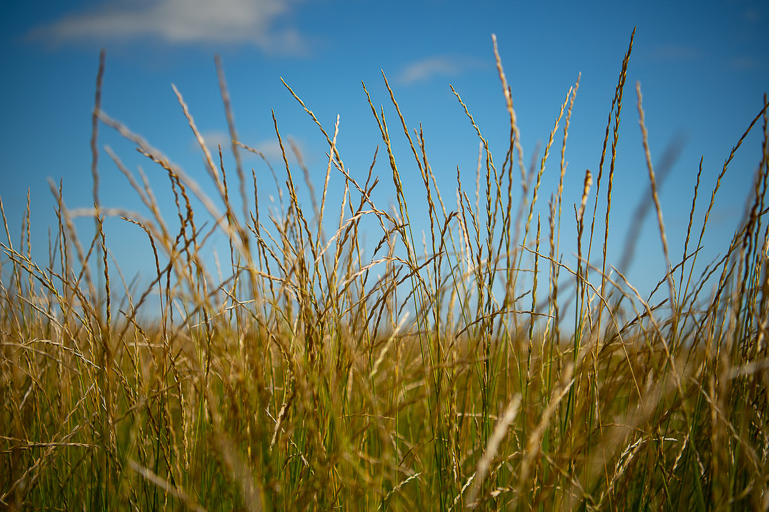
Kernza® - An perennial grain crop for the Midwest
Jacob Jungers
Assistant Professor, University of Minnesota
MOSES Conference 2020

Slide 2
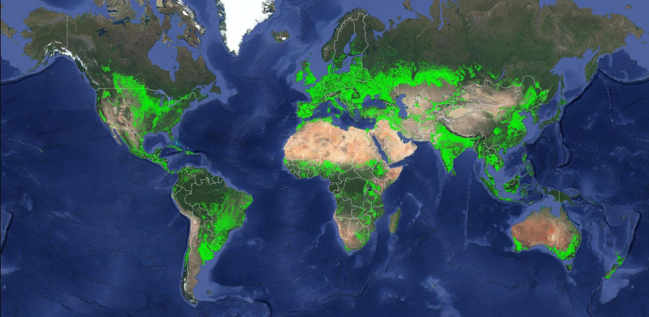
44% of cropland occupied by
Corn
Wheat
Rice
Notes:
For more than 20,000 years, humans have collected wild plants with traits that make them useful for food production. Some of these desirable traits include fast growth to compete against weeds, big seeds for high yield, and sweet and nutritious seeds that function as quality attributes. Very early in the history of agriculture, we realized that we could take the pollen from one plant with desirable traits and sprinkle that on the flowers of another plant with desirable traits and indeed, the seeds from that plant would produce more plants with those same desirable traits. This practice of plant domestication occurred around the world, and as a result, humans now farm 3.8 billion acres of land globally – or 12% of all land surface.

Slide 3
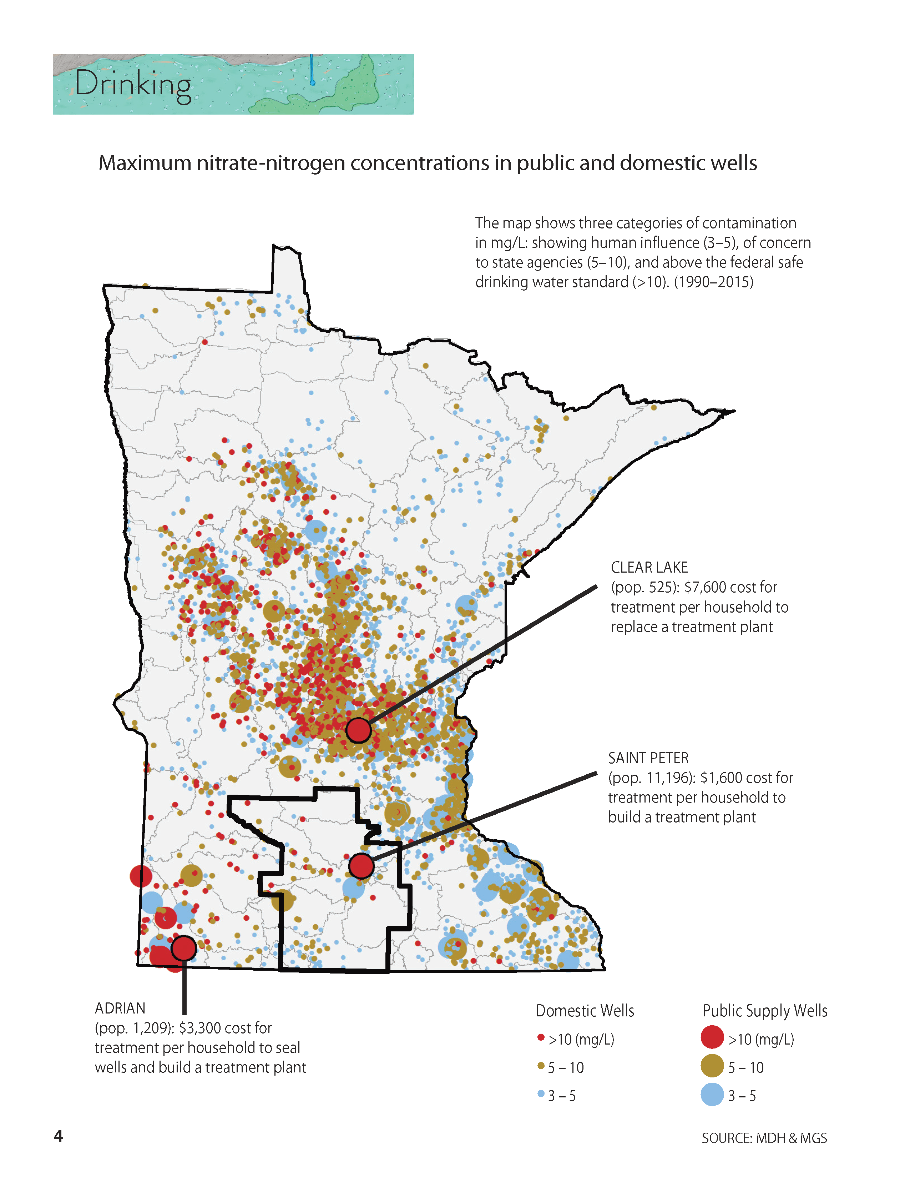
Annual low-diversity agriculture
Crop production
Pollinator resources
Natural enemies
Regional climate and air quality
Clear Lake: $7,600 per household
Habitat and biodiversity
Carbon sequestration
Water quantity
Saint Peter: $1,600 per household
Water quality
Notes:
Massive productivity of these crops have resulted in huge economic gains that have position the US as a leader in the global agricultural economy.

Slide 4
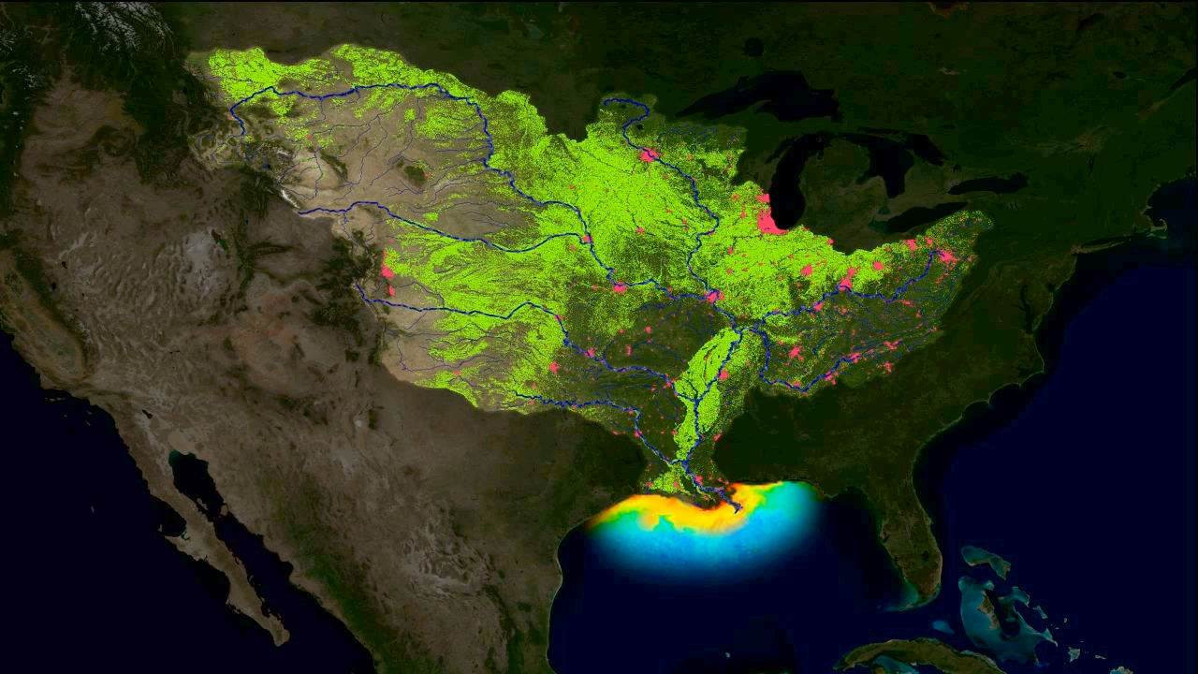

Slide 5
Annual low-diversity agriculture
Perennial high-diversity agriculture
Crop production
Crop production
Pollinator resources
Pollinator resources
Natural enemies
Natural enemies
Regional climate and air quality
Regional climate and air quality
Habitat and biodiversity
Habitat and biodiversity
Carbon sequestration
Water quantity
Carbon sequestration
Water quantity
Water quality
Water quality

Slide 6
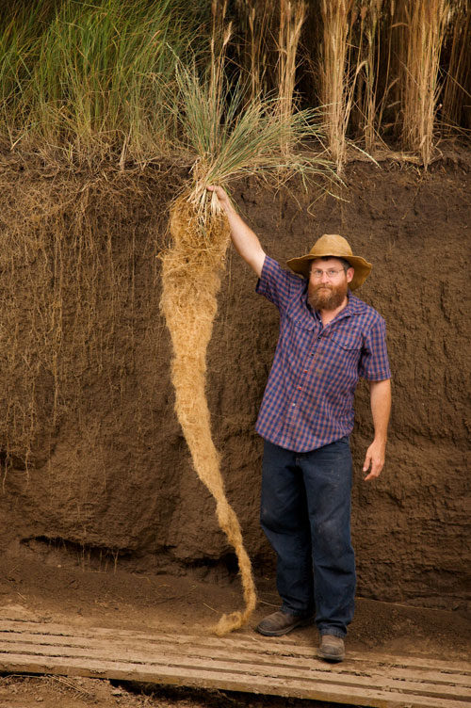
Kernza as a Perennial Grain Crop
Relatively large seeds for a perennial grass
Deep, dense root system
Tolerant to a wide range of temperature and precipitation patterns
Jerry Glover of The Land Institute: Photo by Jim Richardson
Notes:
We believe the solution to these challenges lies in perenniality and deep roots!
Kernza is the world’s first widely available perennial grain crop.
-IWG was selected for development into a perennial grain crop because it has relatively large seeds for a perennial grass.
-It has a very dense root system that stores carbon, and can also transfer carbon deep into the soil where it is protected from tillage if Kernza is used in a rotation
-Kernza is grown from Utah to New York, as well as in Sweden and Australia.

Slide 7
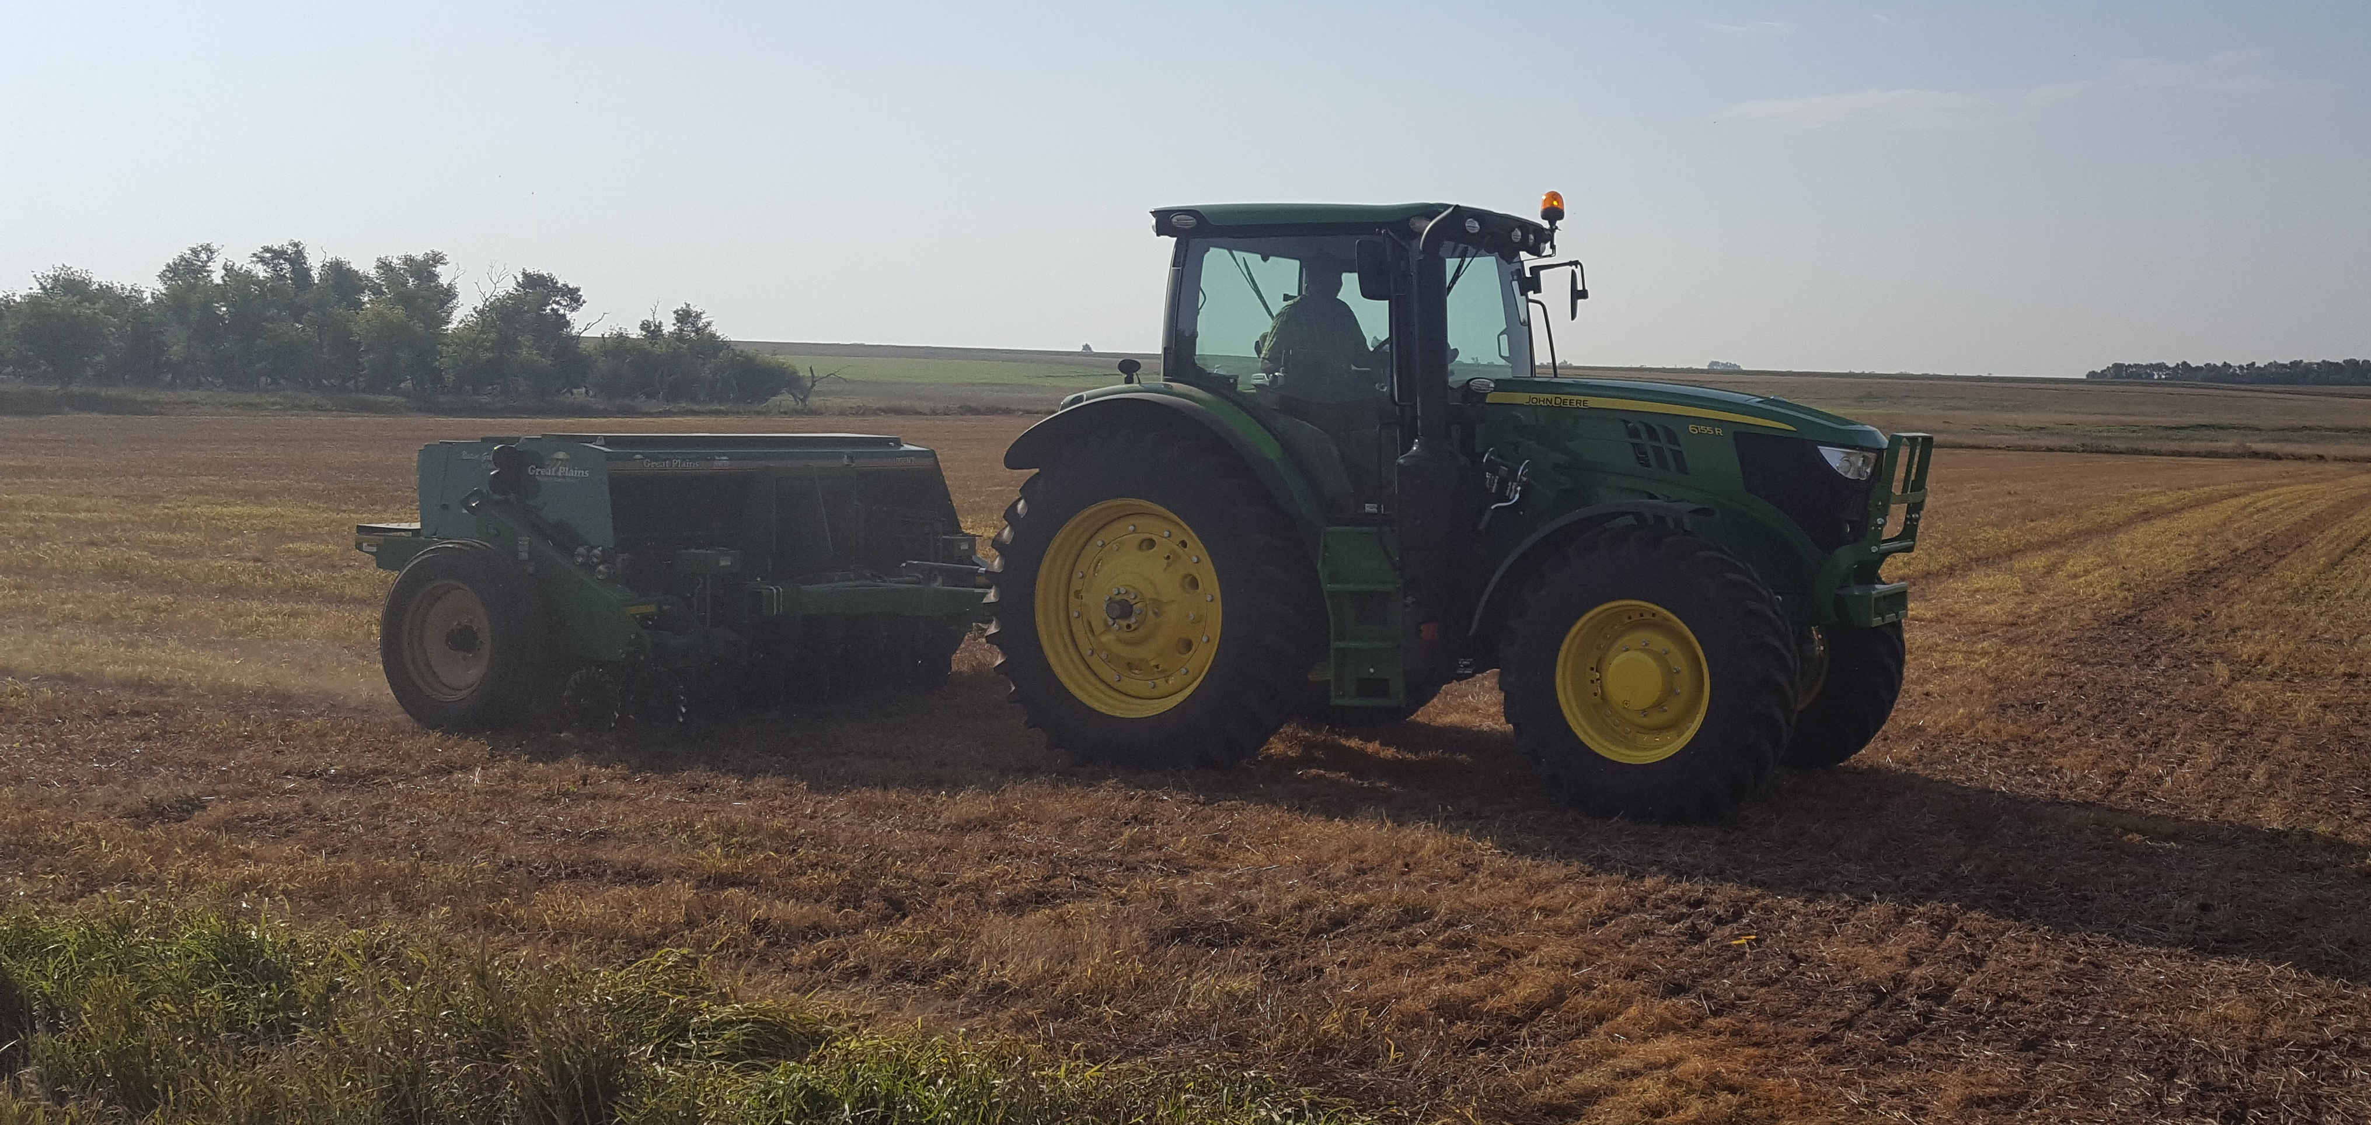
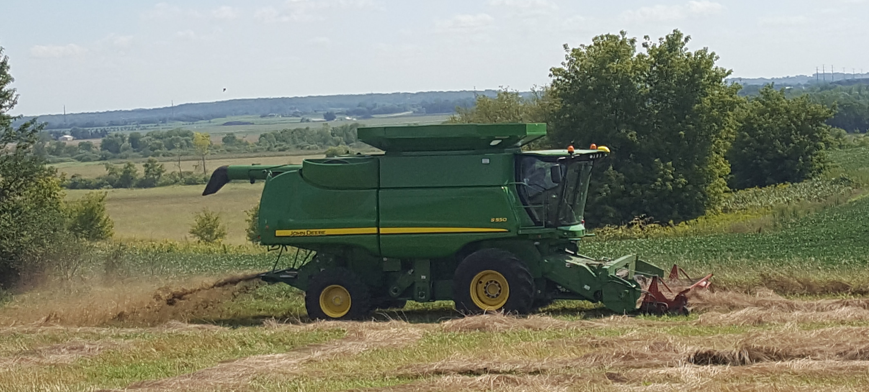
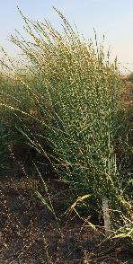

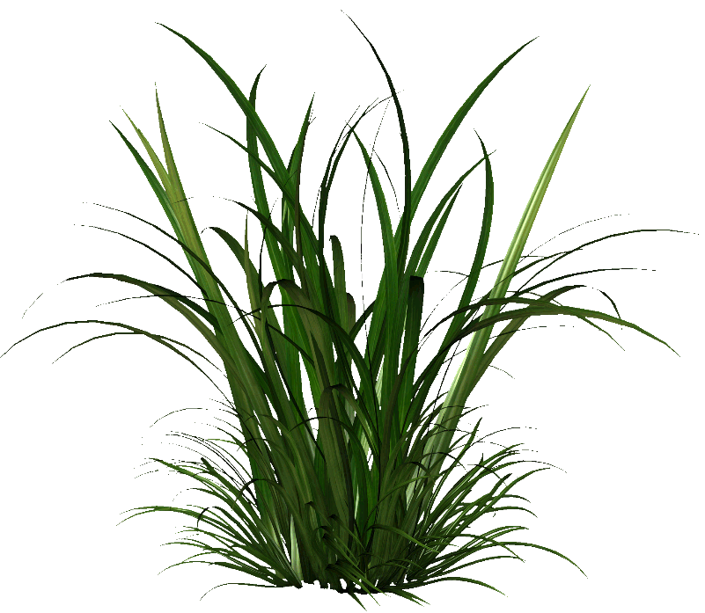
Grain Harvest
Planting
Aug
Jan
May
Aug
Oct
Jan

Slide 8
Breeding &
Genetics
Environmental Impacts
Agronomy
Food
Science
Commercialization
Implementation
Notes:
There are many layers to the Kernza research program at UMN.

Slide 9
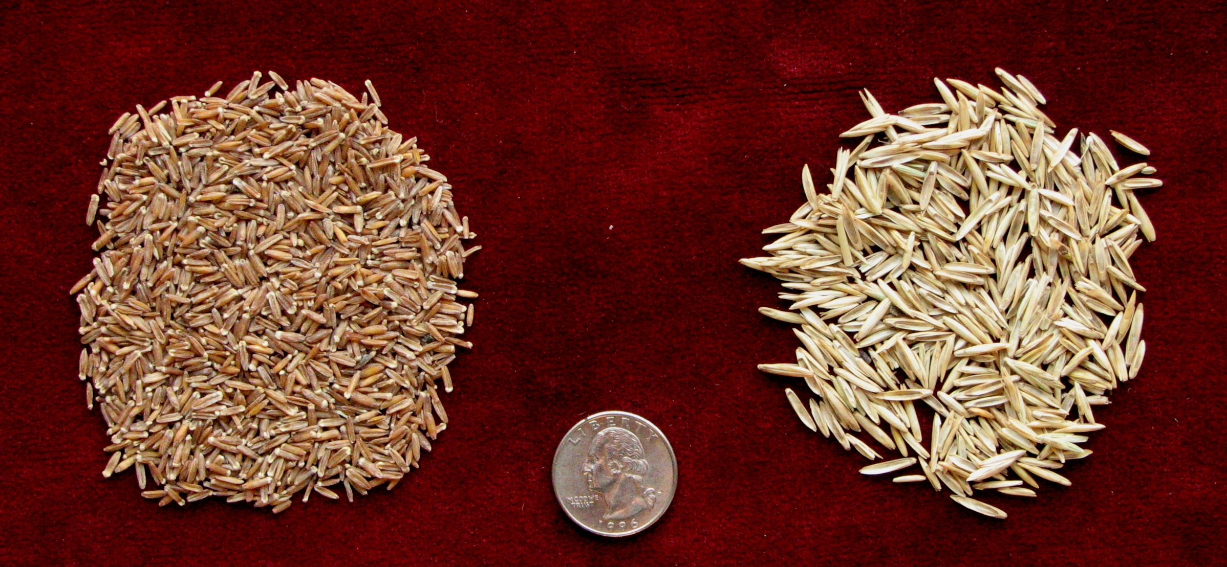
Kernza Breeding
Increase seed size and grain yield
Increased grain yield by ~5-10% / yr.
Notes:
Here at UMN, Jim Anderson and his team run a breeding program to improve the profitability and sustainability of this new perennial grain crop.
The UMN breeding team has been working with The Land Institute, where a group of breeders have been working on Kernza for about 15 years.
Seed size has nearly tripled in the last 15 years.
Larger seed results in greater yield, which has increased somewhere between 5-10% / year. To give you some perspective on that rate of progress, wheat yields have increased 6 fold since 1919. That’s a rate of 1.8% per year.
This is extremely rapid progress, but new genomic technology can help us increase breeding progress.

Slide 10
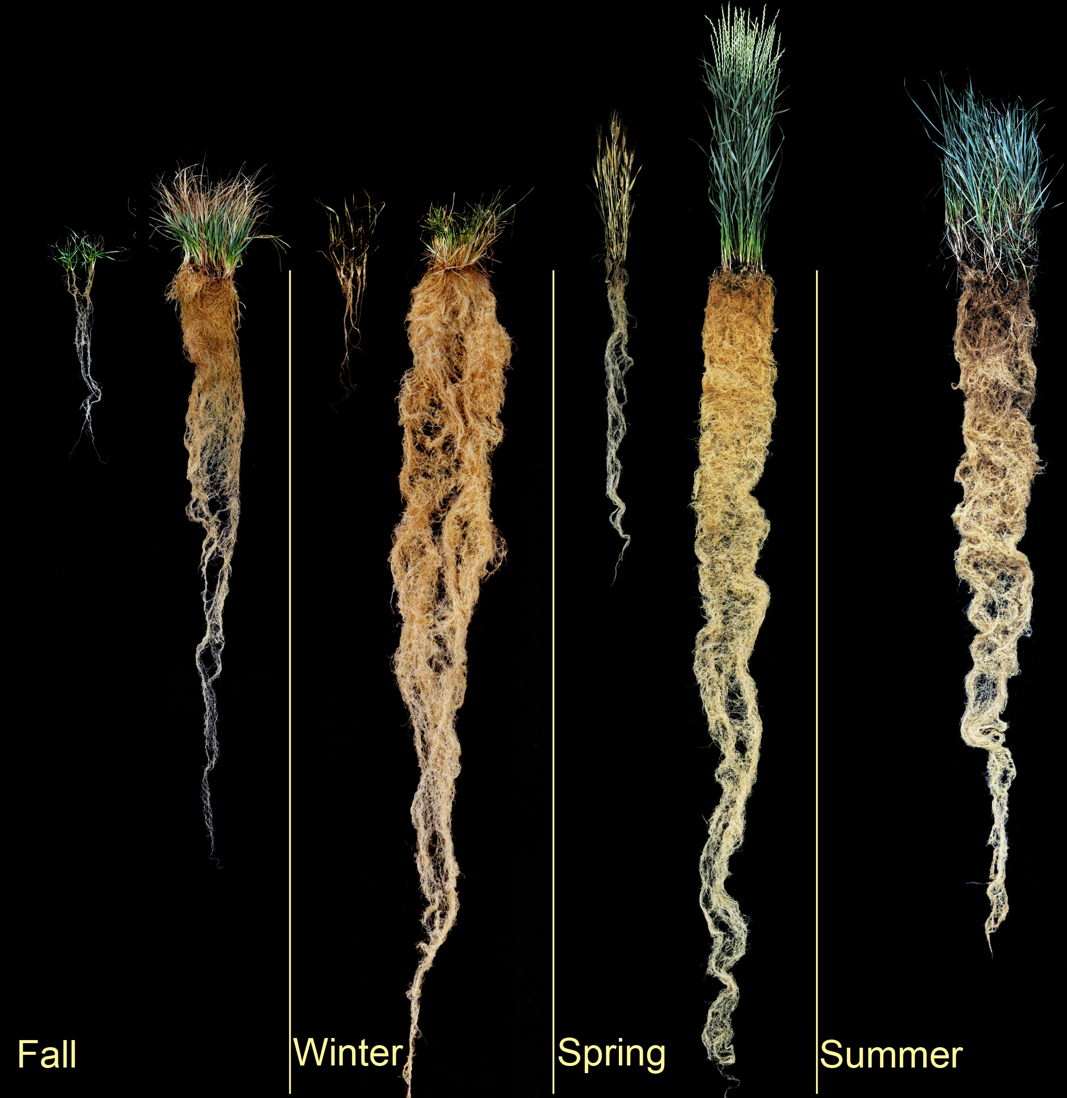
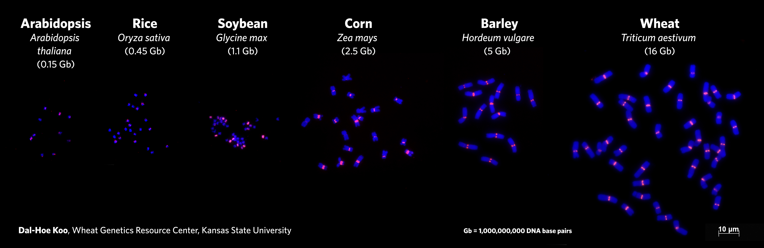
Kernza Genomics
The problem: Plant genomes are huge and complex
Kernza
25 Gb
Human 3 Gb
New DNA sequencing tools have made utilizing genomics in species like Kernza possible
Notes:
Kevin Dorn and his team are working to sequence the genome of Kernza. This is a challenge because it’s huge and complex, 10 times the size of corn.

Slide 11
Economic Viability
Climate Adaptation
Yield Longevity
Agronomy
Harvest Challenges
Weed Management
Establishment
Fertility

Slide 12
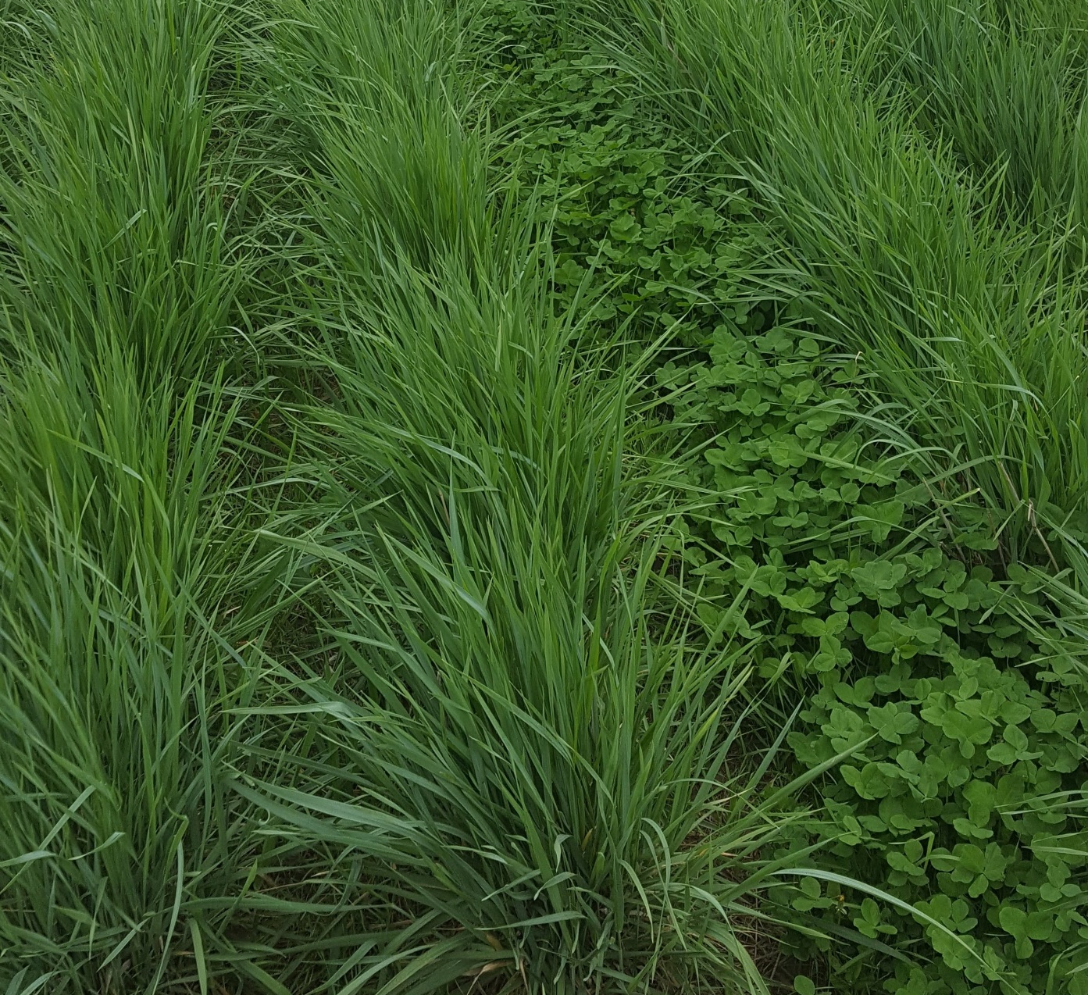
Kernza Agronomics Research
Research Objectives
Increase grain yield
  Nitrogen fertility and intercropping
  Row spacing
  Harvest techniques – swathing vs. direct combining
  Companion cropping

Slide 13
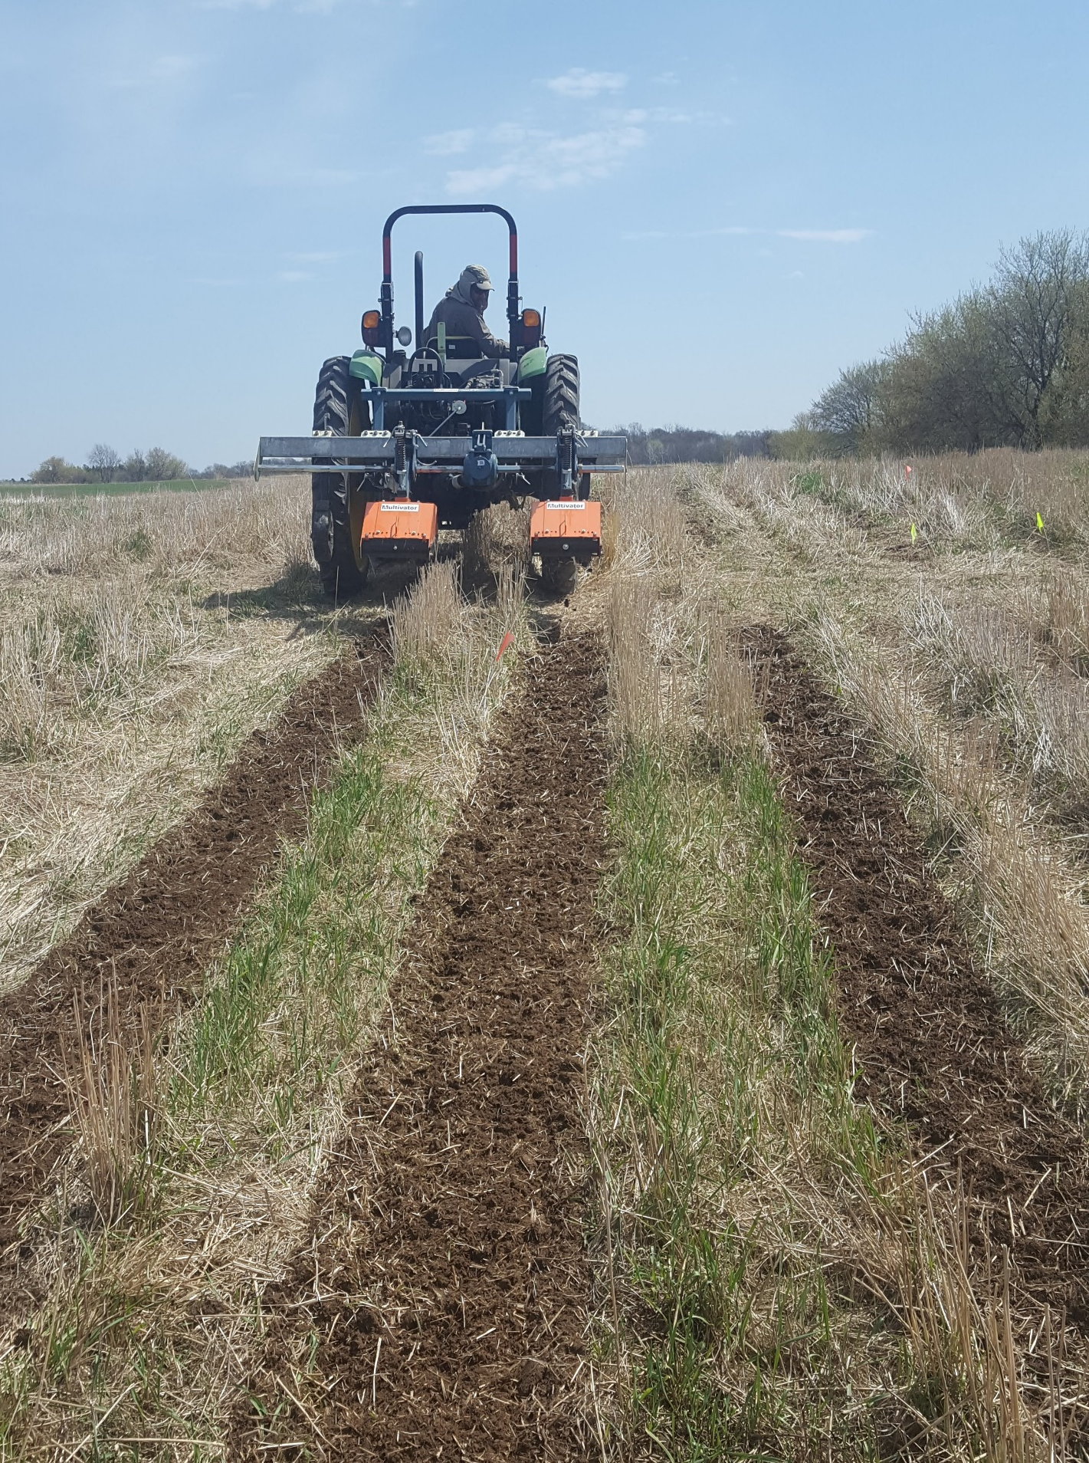
Kernza Agronomics Research
Research Objectives
Increase grain yield longevity
  Between row disturbance
  Basic science on mechanisms of yield decline
  Grazing, clipping, fire

Slide 14
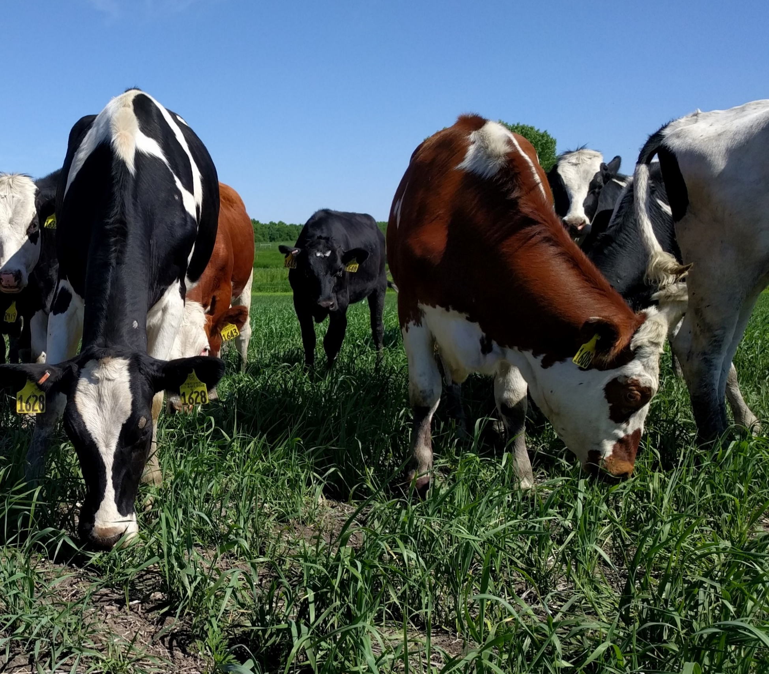
Kernza Agronomics Research
Research Objectives
Increase profitability
  Reduce inputs
    Legume intercropping
  Dual-use
    Grazing
    Forage harvest

Slide 15
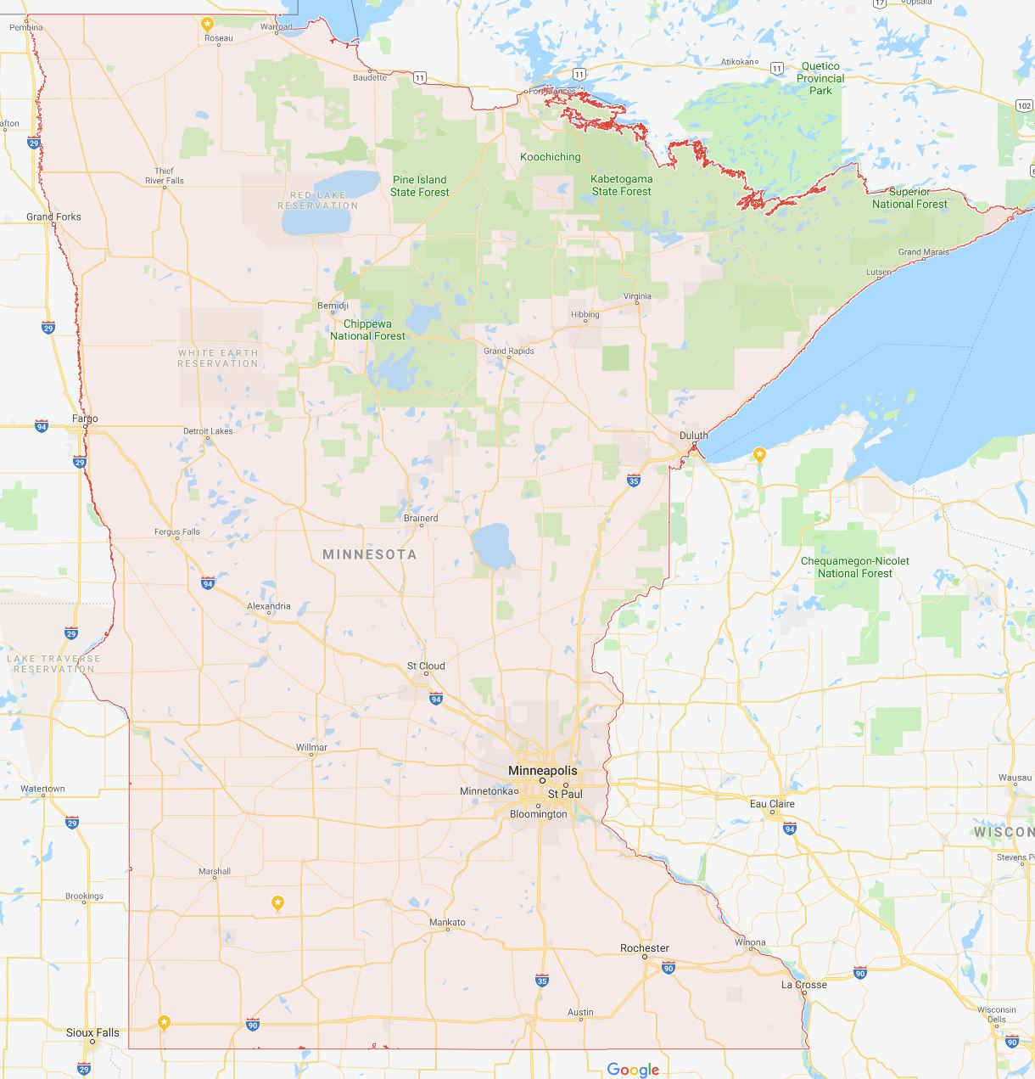
Roseau/Warroad:
Variety seed increase
Mob graze
Anoka:
Variety trial
St. Paul:
GHG emissions
Legume intercrop
Root morphology
Staples:
Water quality
Variety trial
N fertilizer rate & timing
Cold Spring/St Cloud:
Variety seed increase
Lysimeters
LCCMR demo field
Rosemount:
Forage trial
GHG emissions
Rotation
Maintenance
Alfalfa intercrop
Legume intercrop
Variety trial
N fertilizer rate & timing
Companion crop
Fall seeding into soy
Morris:
Clipping trial
Mob graze
Strip graze
Madison:
Variety seed increase
Lamberton:
GHG emissions
Legume intercrop
Variety trial
Waseca:
Variety trial
SW MN:
LPRW – Water quality
Edgerton – Water quality
SE MN:
Chatfield – Water quality
Goodhue – Grazing

Slide 16
Biodiversity
Enhancement
Environmental Impacts
GHG Mitigation
Nutrient Retention
Carbon Sequestration
Soil Conservation
Notes:
Perennial crops can provide a suite of ecosystem services, and we’re working to measure many of these under various management regimes.

Slide 17
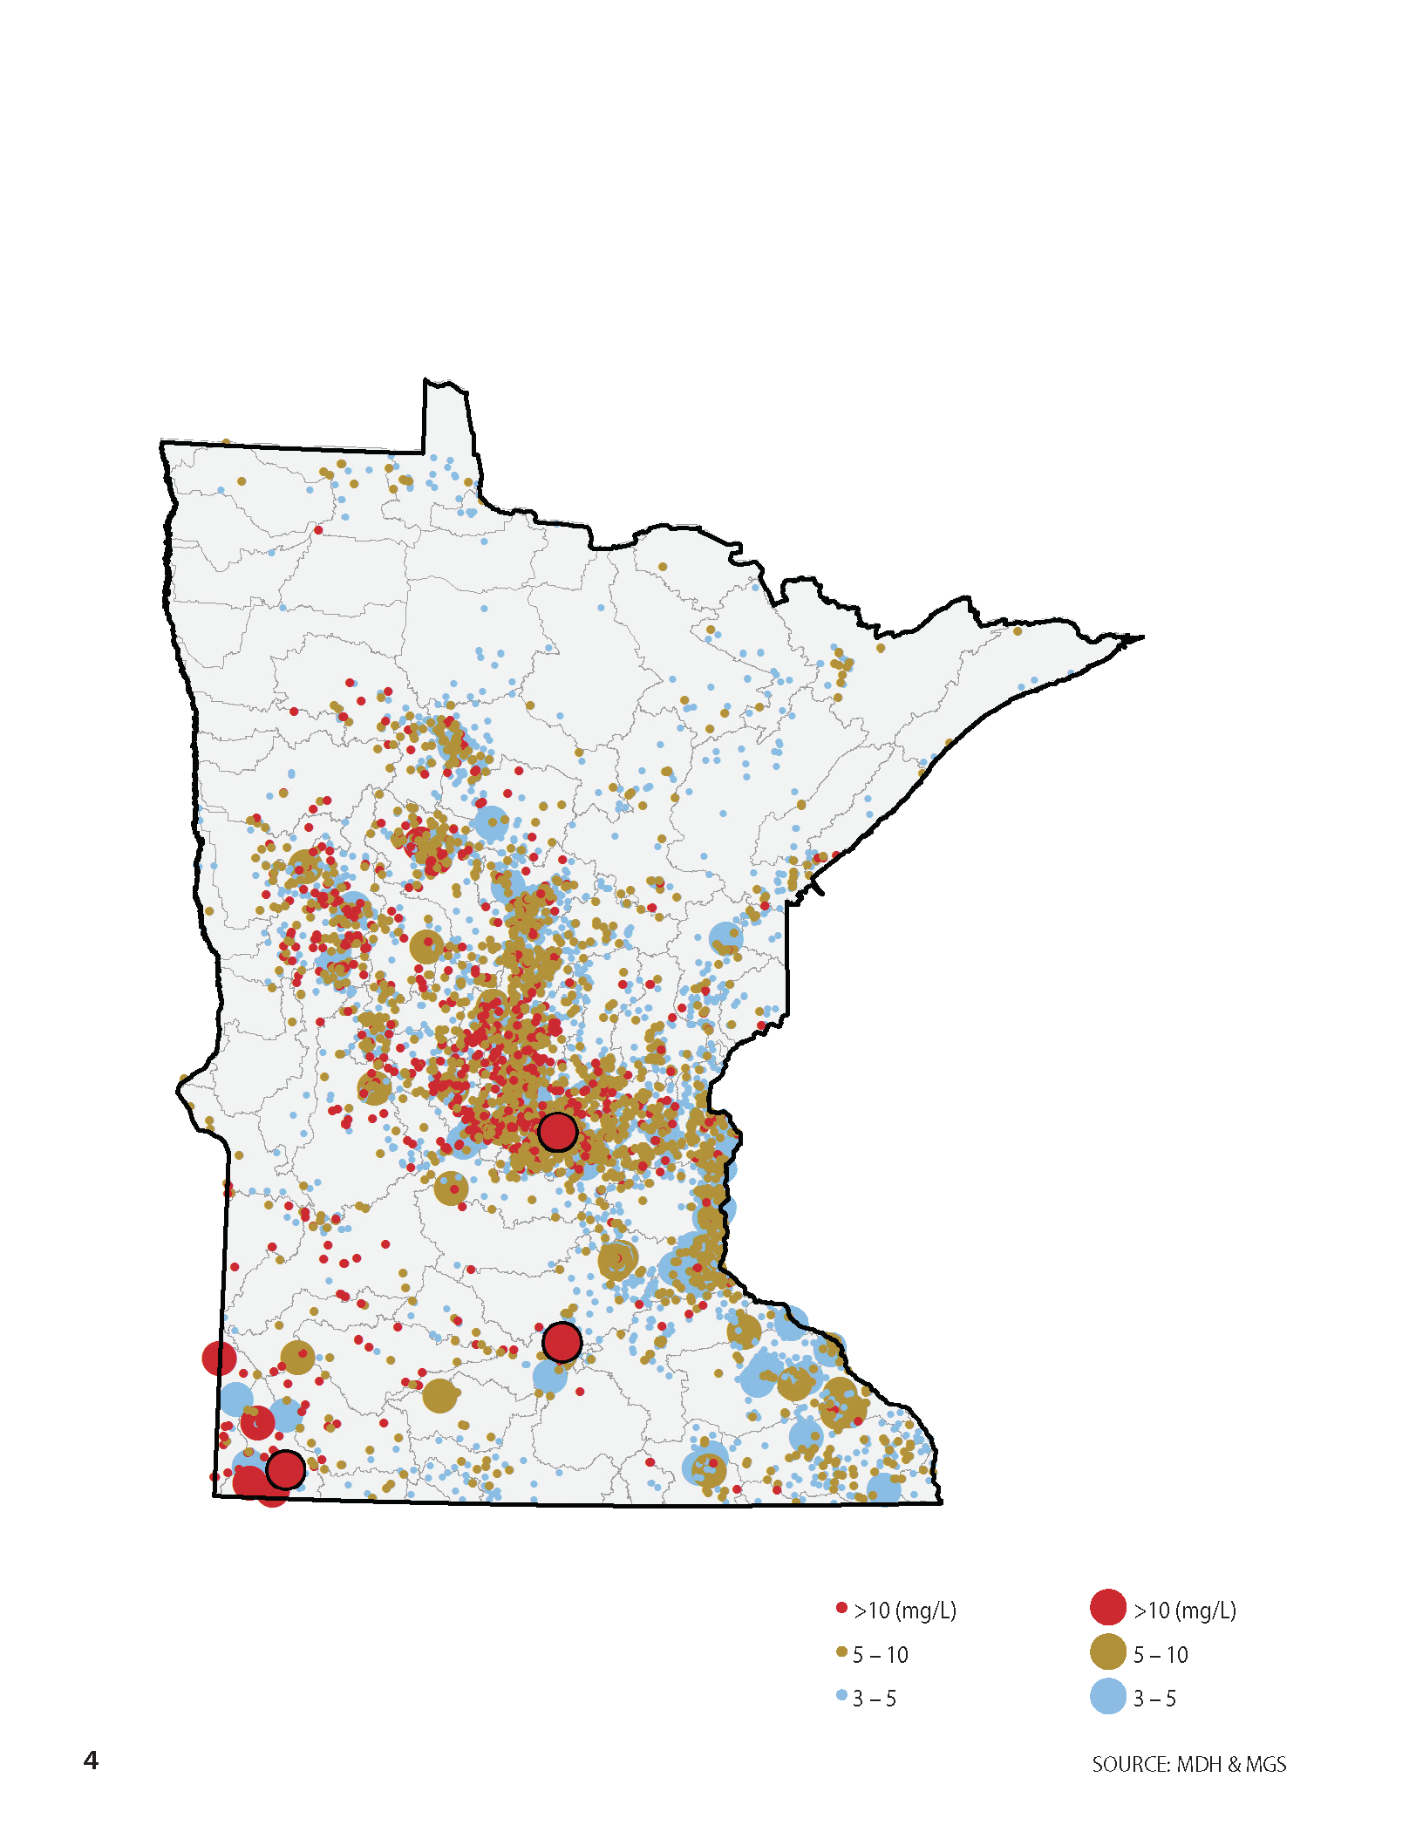
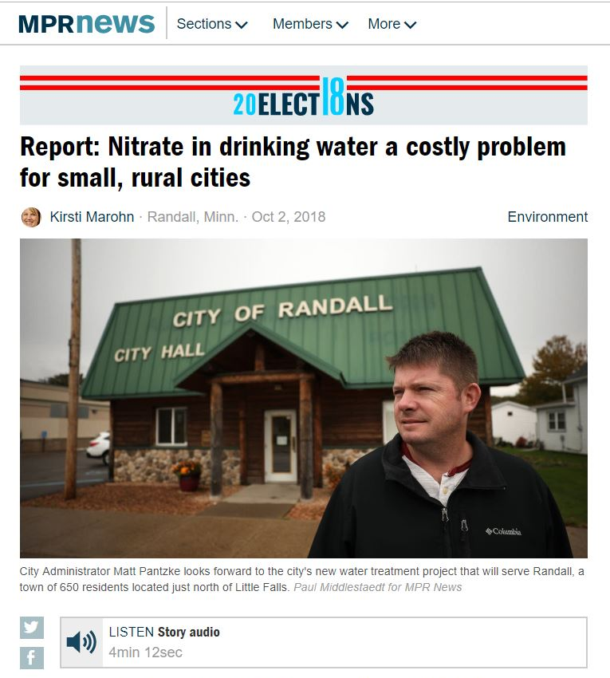
Nitrate Leaching
Notes:
Just a couple of weeks ago we saw a report of another MN community having forced to pay for a treatment facility to remove nitrate from their drinking water.

Slide 18
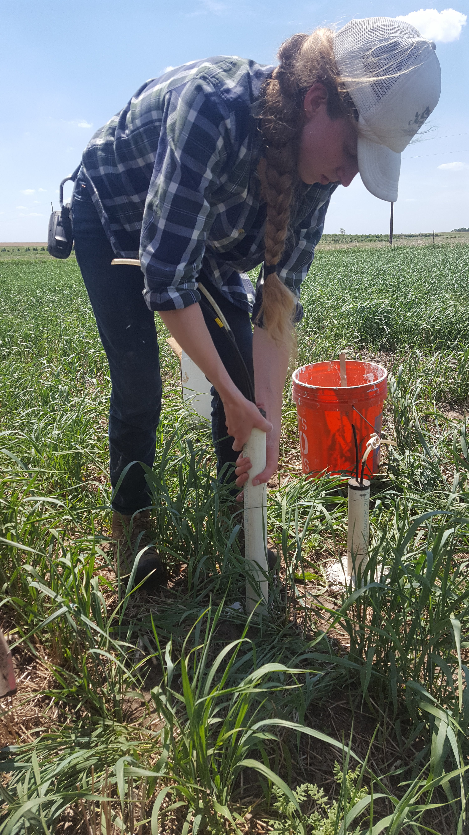
Nitrate Leaching

Slide 19
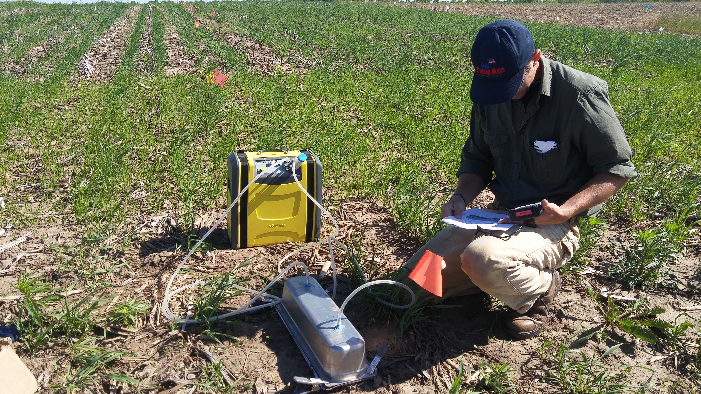
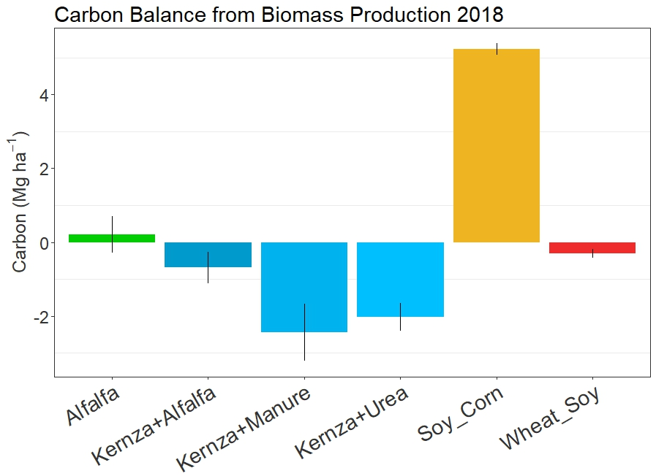
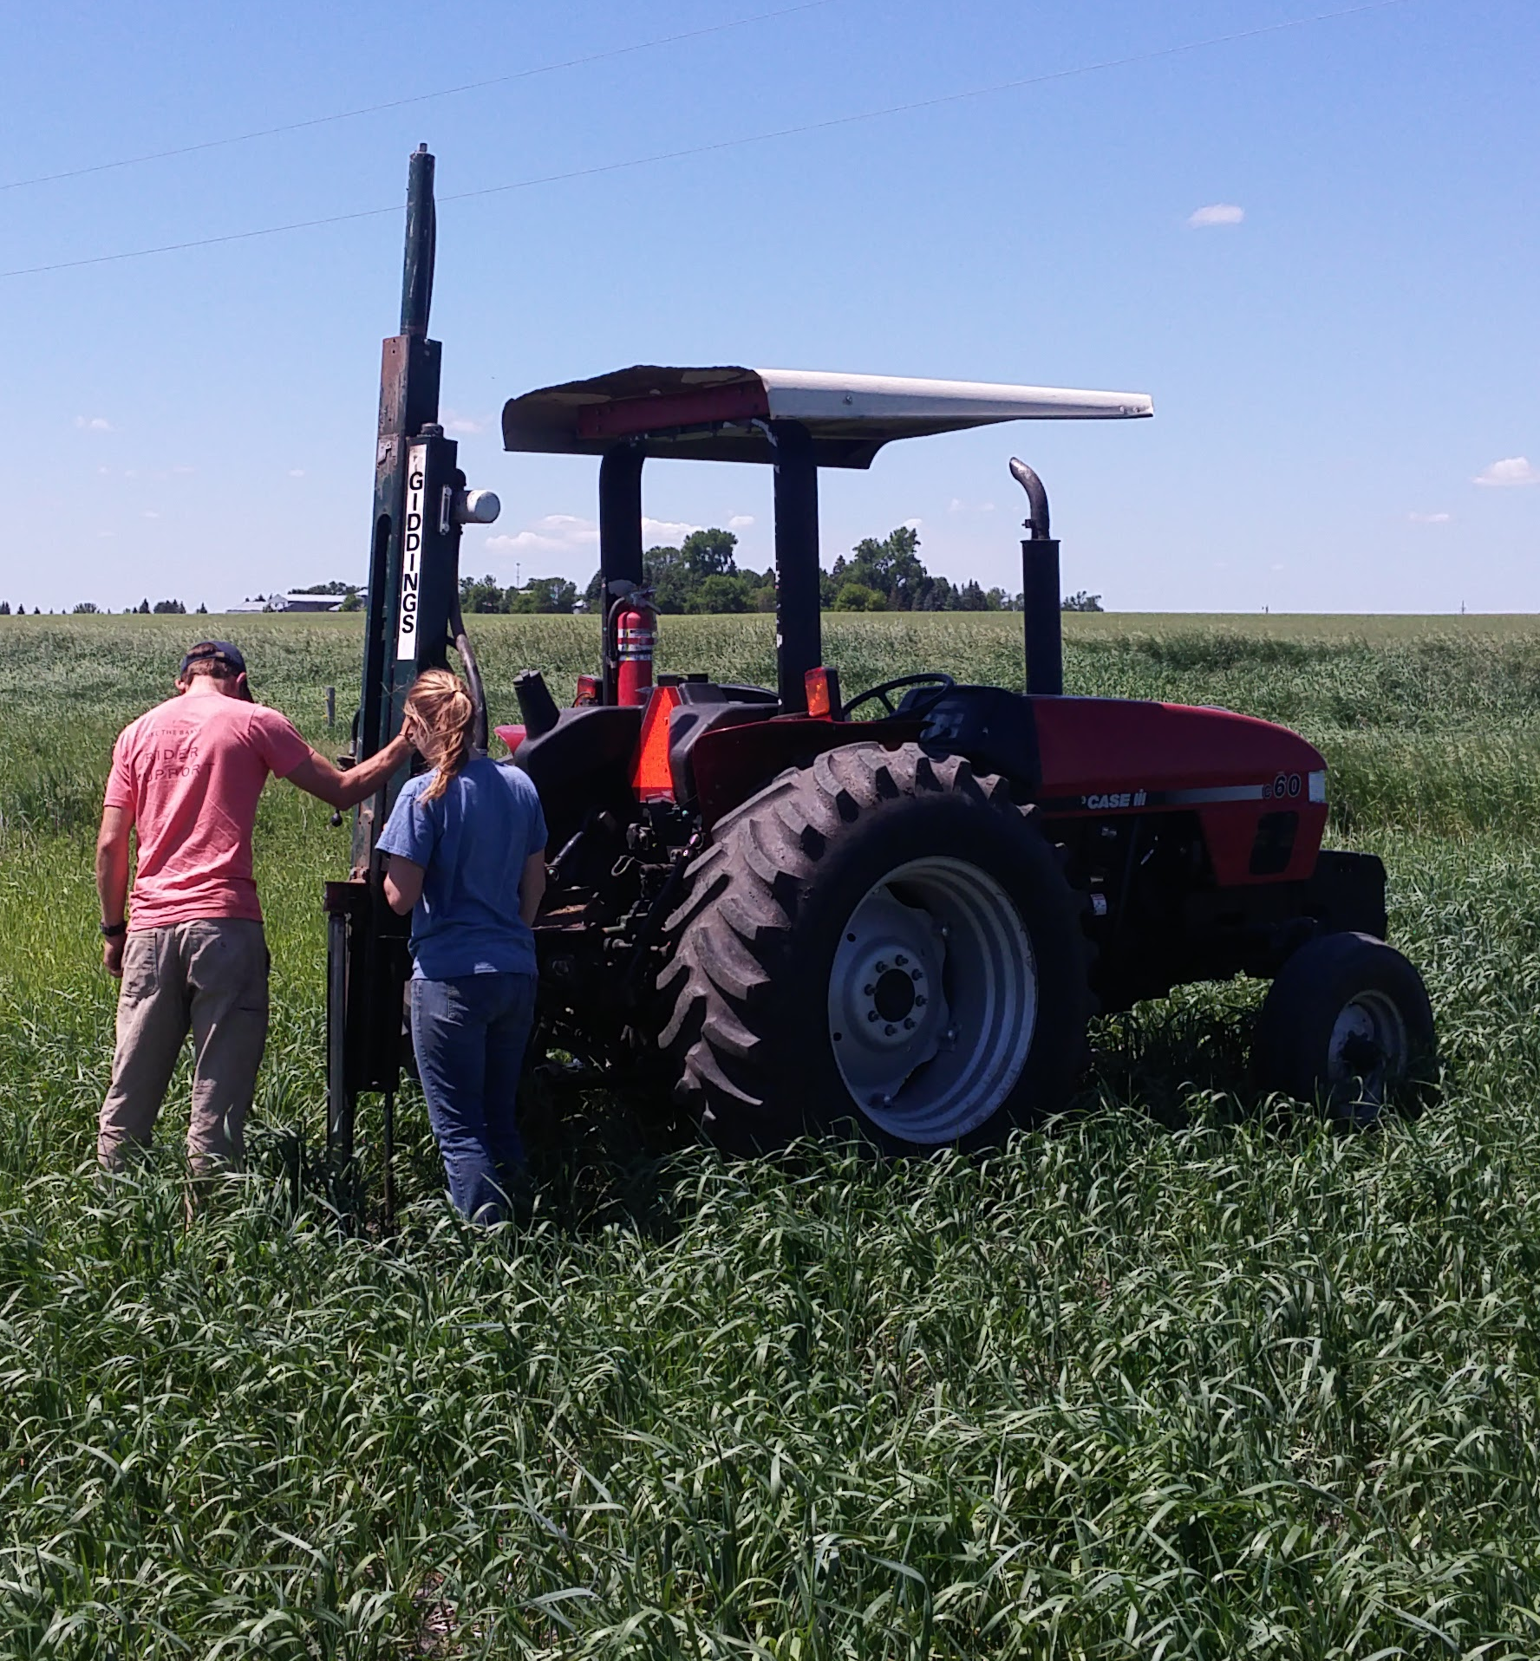

Slide 20
Grower Tool Development
Extension and Outreach
Modelling
Implementation
Notes:
Another important component of our program is implementation. This takes place through cross-sector collaborations and private-public partnerships, and through relationships and projects with farmers.

Slide 21
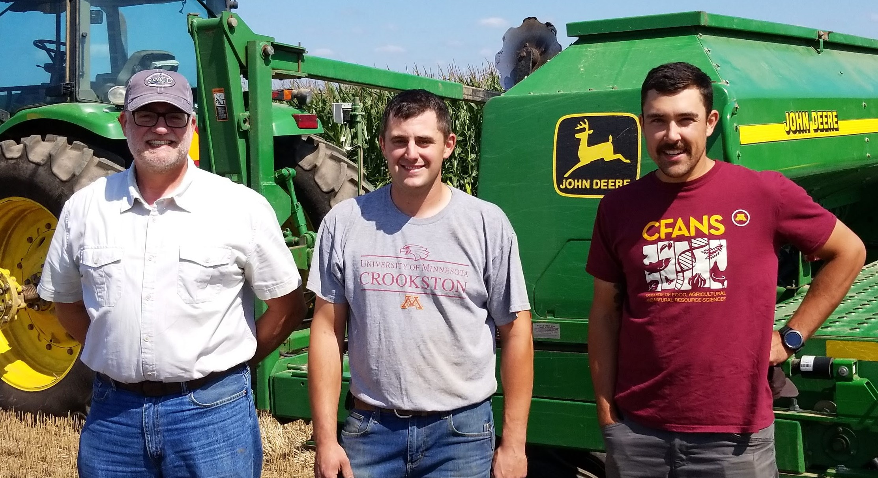
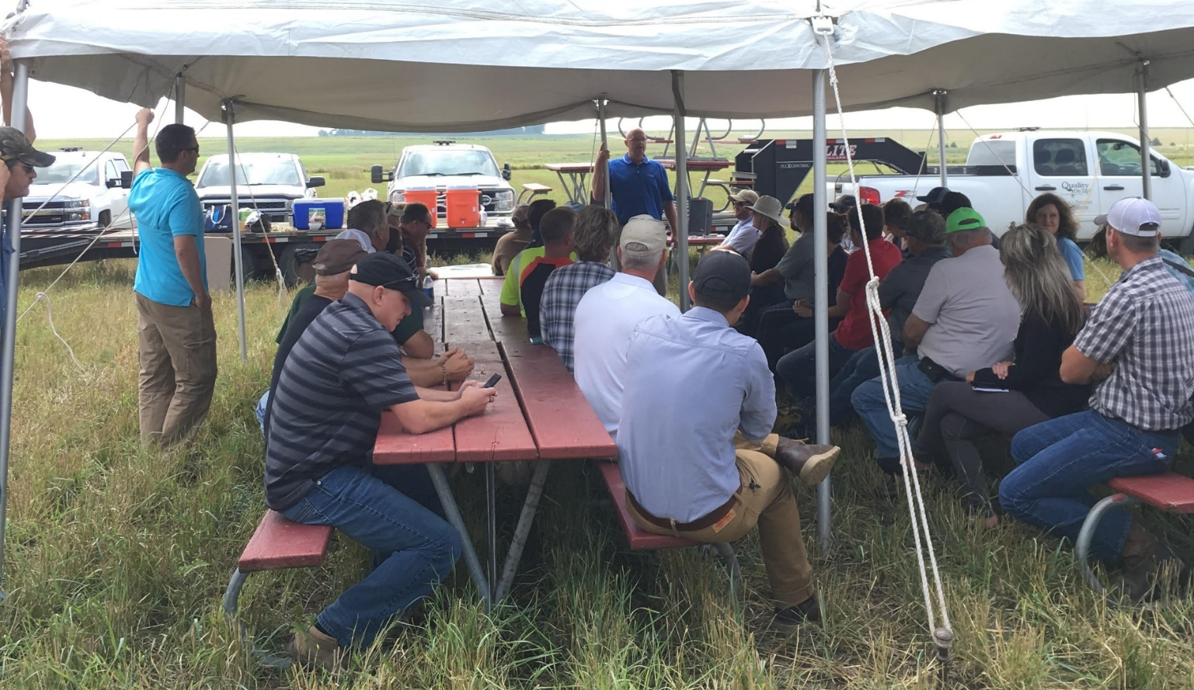
Kernza Implementation
LCCMR Project - 2018
MN Dept. of Ag and Health
City of Chatfield
Lincoln-Pipestone Rural Water
Ag Utilization Research Institute (AURI)
Minnesota Rural Water Association
Green Lands Blue Waters
LCCMR Project - 2019
Stearns County SWCD
St. Cloud Public Services
Cold Spring Brewery
Minnesota Native Landscapes

Slide 22
Roseau/Warroad: ~200
R. Magnusson
J. Estling
T. Diedrickson
Cold Spring/St Cloud: ~90
B. Dingmann
M. Thieland
City of St. Cloud
Northfield Cluster: ~56
S. Johnson
K. Kimber
K. Anderson
D. Honken
Madison: 30
C. Fernholz
SW MN: 90
Lincoln-Pipestone Rural Water
City of Edgerton
SE MN: 12
City of Chatfield
P. Novatny

Slide 23
Acknowledgments
Team
UMN: Craig Sheaffer, Jessica Gutknecht, Don Wyse, Colin Cureton, Connie Carleson, Jim Anderson, Prabin Bajgain
Perennial Crop Pioneers – Carmen Fernholz, Kaleb Anderson, Dan Honken, Kurt Kimber, Scott Johnson
The Land Institute
Minnesota Rural Water Association
Minnesota Dept. of Agriculture
Minnesota Department of Health
City of Chatfield
Lincoln Pipestone Rural Water
Central Lakes College
Agricultural Utilization Research Institute
Pope, Stearns, and Pipestone County SWCD
Green Lands Blue Waters
Funding
North Central SARE
USDA NIFA Organic Transitions
Minnesota Legislative Trust Fund for Natural Resources
Clean Water Fund – Forever Green Initiative
The Land Institute and Malone Family Foundation
Minnesota Department of Agriculture

Slide 24
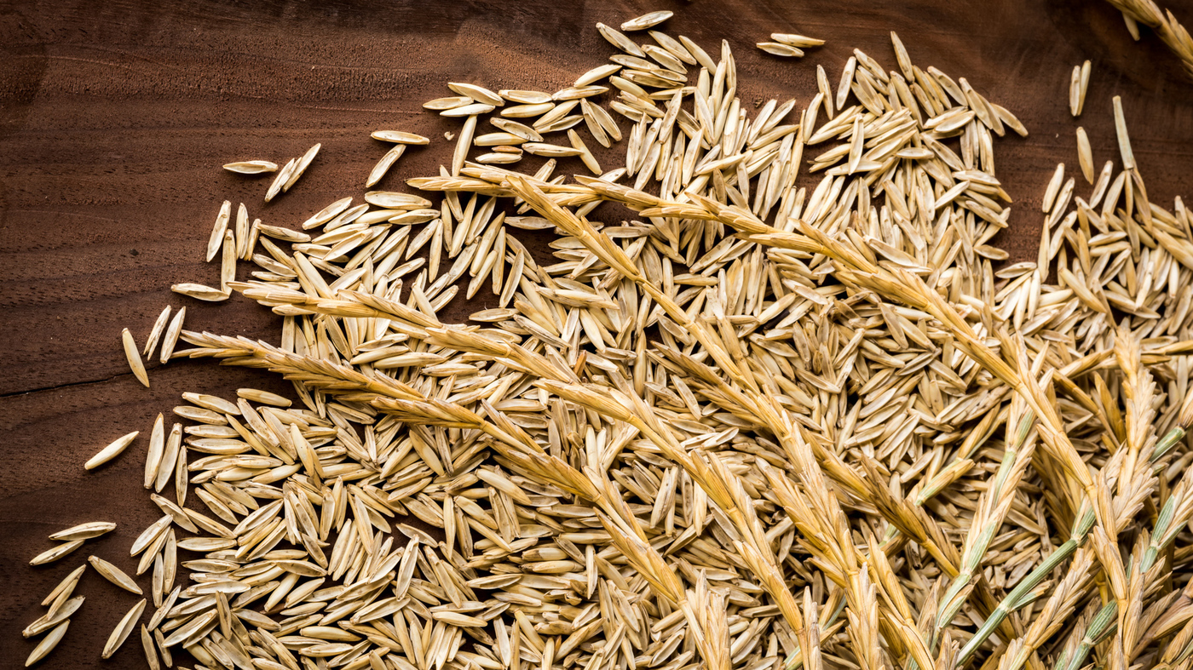
Questions
Notes:
That was a very fast introduction to Kernza and a quick summary of the research and implementation activities that are going on at UMN. I’d be happy to answer any questions now or leave it to the panel moderators to let us know how to proceed.

Slide 25
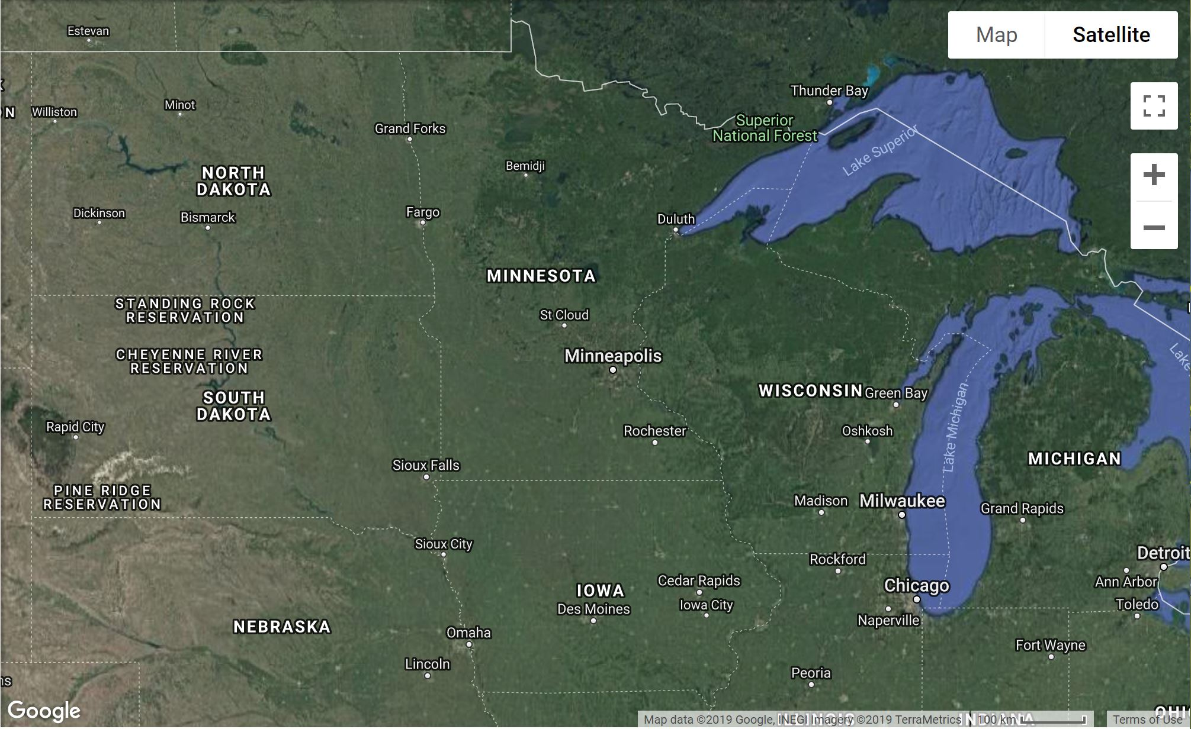
Notes:
Zooming into home a bit, here we can see land cover in the Upper Midwest is also dominated by a handful of annual crops.
and beyond – depending on how many of these delicious beers we drink tonight, we may or may not end up debating the boundaries of the Upper Midwest.

Slide 26
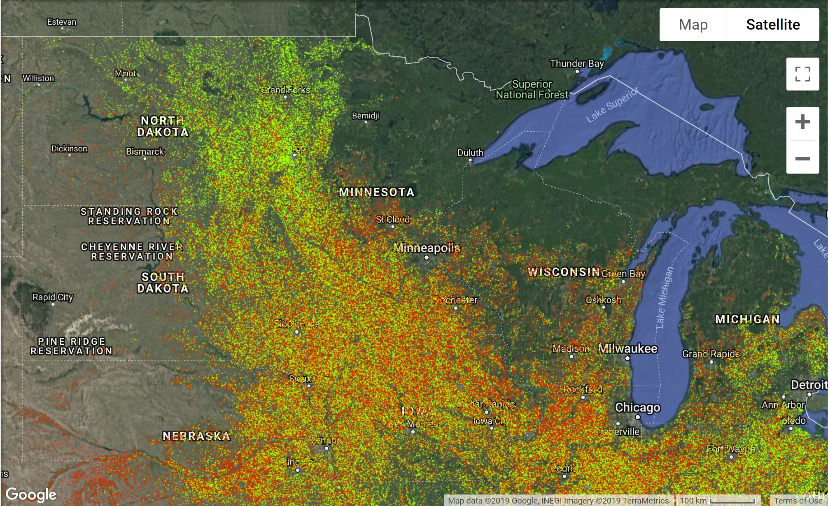
Corn
Soybean
Notes:
In this case it’s Corn and Soybean, together they make up 66% of agricultural acres in this region.

Slide 27
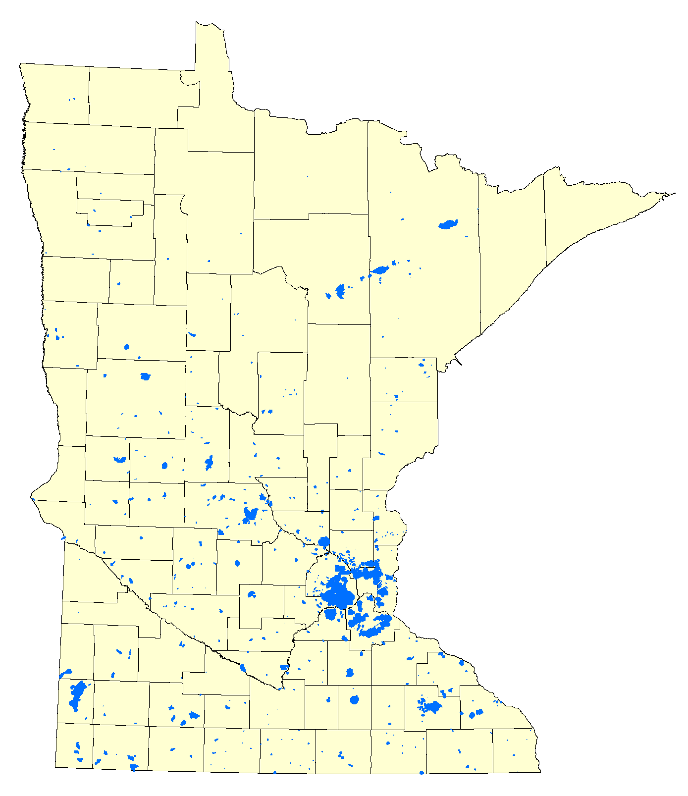
Crop Yield
Proximity to End User
Proximity to Supply Chain
Transportation
Economic Layer
LCCMR Project - 2018
MN Dept. of Ag and Health
City of Chatfield
Lincoln-Pipestone Rural Water
Ag Utilization Research Institute (AURI)
Minnesota Rural Water Association
Green Lands Blue Waters
Community Capacity
Institutional Support
Farmer Perceptions
Social Layer
Water Quality
Greenhouse Gasses
Soil Conservation
Environmental Layer
Notes:
After many presentations, meetings, and conversations with these stakeholders, we decided to scale this work up from the plot to the field scale. I took the lead in organizing this team and obtaining funding from LCCMR to conduct a projects that’s uniting state agencies, municipalities, water providers, and non-profits. This project will collect the multi-layered data necessary for ensuring strategic placement of IWG to achieve rural water quality goals and economic enhancement.

Slide 28
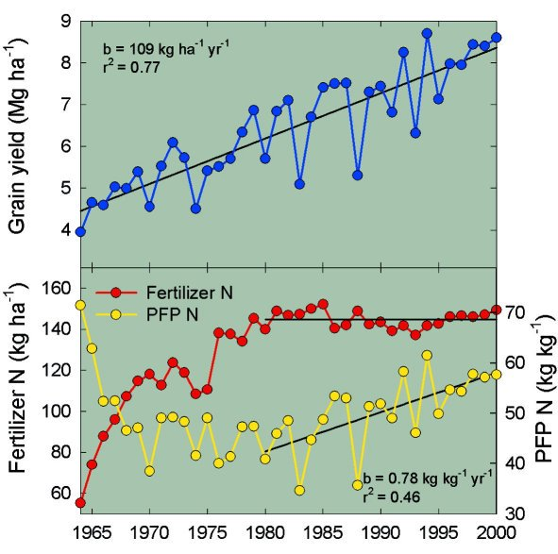
Notes:
Massive productivity of these crops have resulted in huge economic gains that have position the US as a leader in the global agricultural economy.

Slide 29
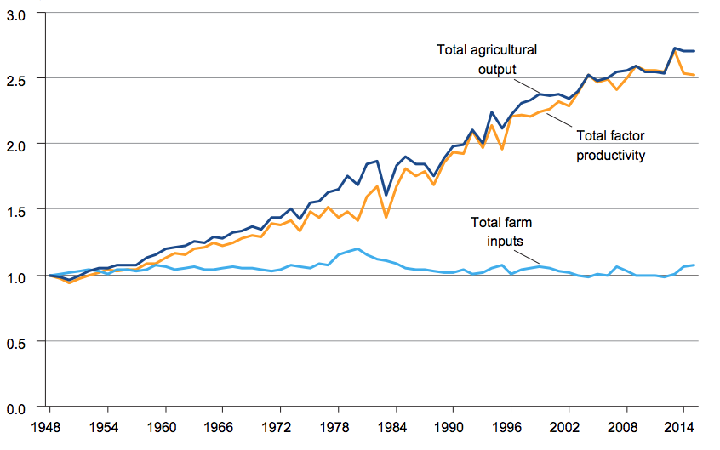
Notes:
Massive productivity of these crops have resulted in huge economic gains that have position the US as a leader in the global agricultural economy.

