Slide 1
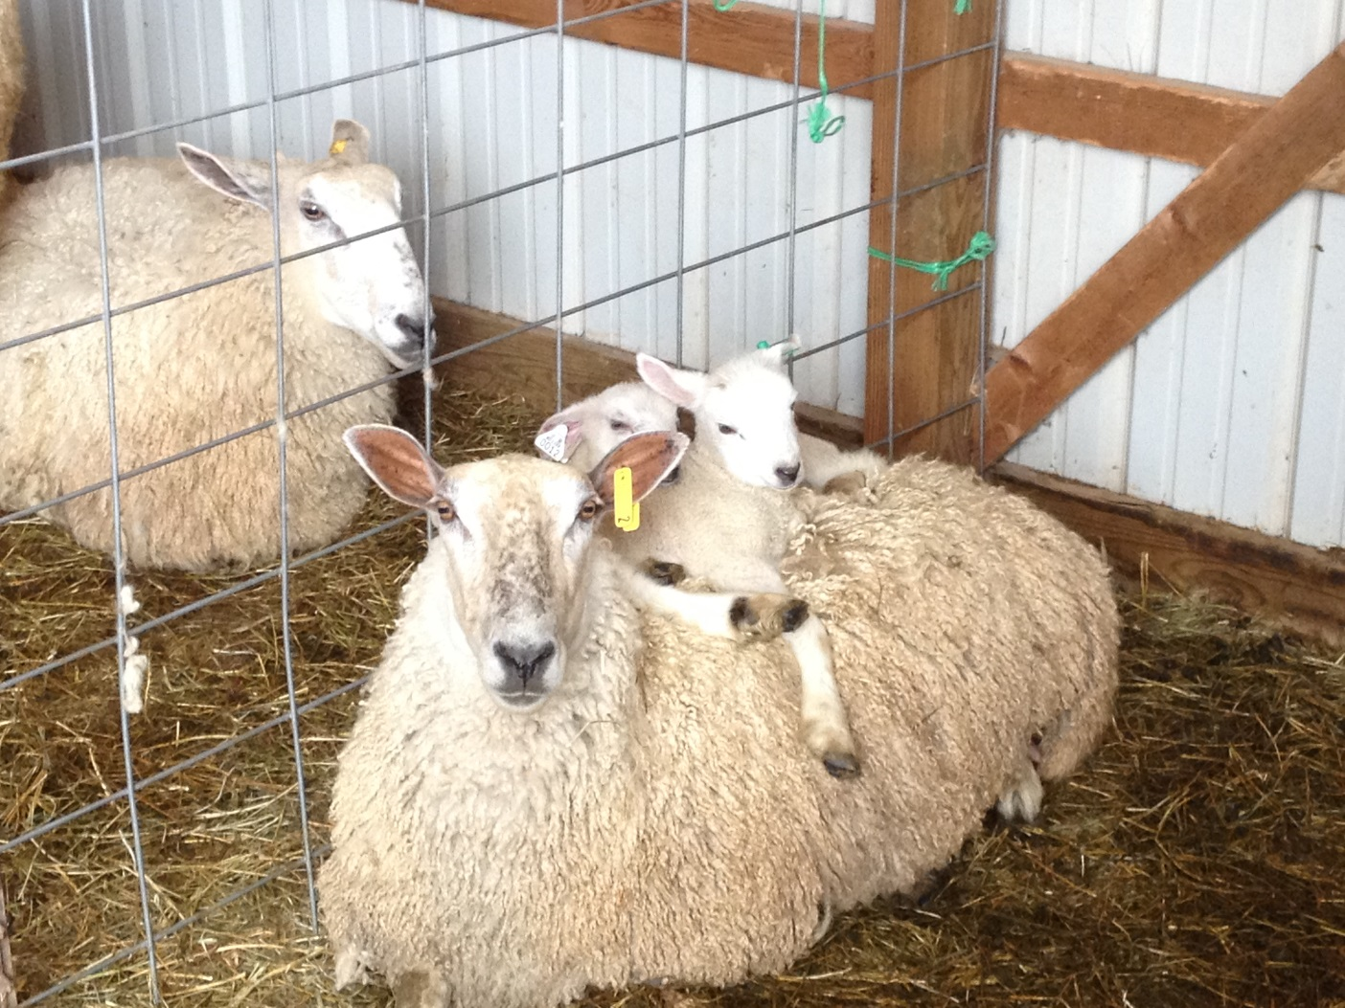
Using real-time generated rate-of-gain to determine anthelmintic need in pastured Blue Faced Leicester Maryland lambs.
Andrew Keller, Farmer
Susan Schoenian, UMD Extension

Slide 2
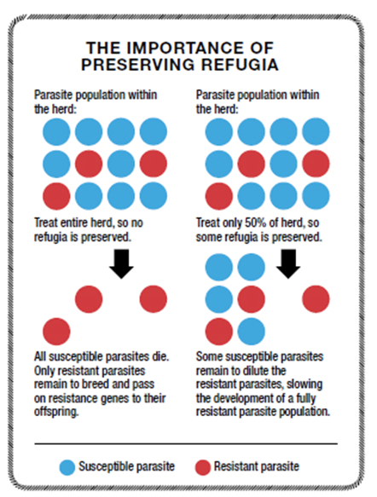
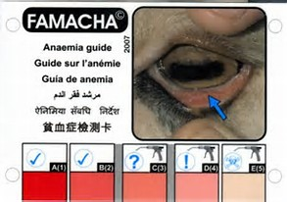
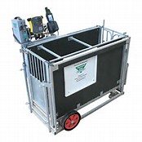
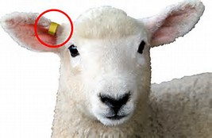
About Anthelmintics
Parasites are a major problem in lambs
There are a limited number of anthelmintic classes
Parasites are becoming resistant to anthelmintics
Drenching only animals that need treatment maintains refugia
Goal: Use Rate of Gain to determine which lambs need to be drenched

Slide 3
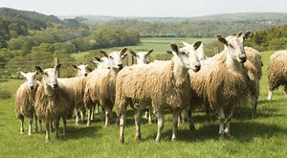
Findings & Recommendations
70% of the time the determination to drench using the ROG factor was consistent with drenching animals with a 4 or 5 FAMACHA© score
In this study it was a good selection tool for determining which animals to drench
Using ROG was less time consuming than conducting FAMACHA©
Setting the ROG cut-off value is difficult
Every 2 weeks should be sufficient
Financial investment
Use of ROG is sensitive to other lamb/weather issues
More research in different breeds/management practices needed

