Slide 1

Maryland Agriculture’s Role and Progress toward the Chesapeake Bay Restoration
Agricultural Conservation Leasing Workshops
Jason Keppler

Slide 2
Outline
How is the Bay Responding to our efforts?
What programs have brought us this far?
What are the remaining reductions needed and what is the gap?
How will Maryland develop the Phase III WIP and close any remaining pollution reduction gaps?
Agriculture Phase III Strategy

Slide 3
How is the Bay Responding to our efforts?

Slide 4

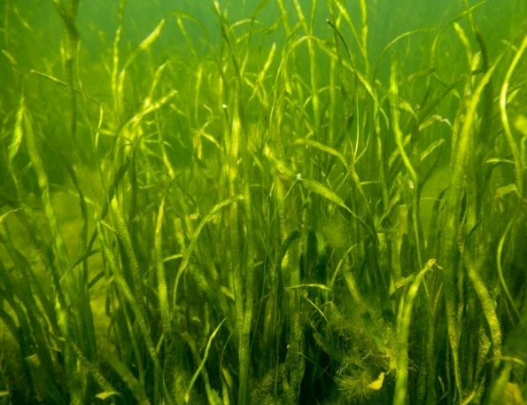
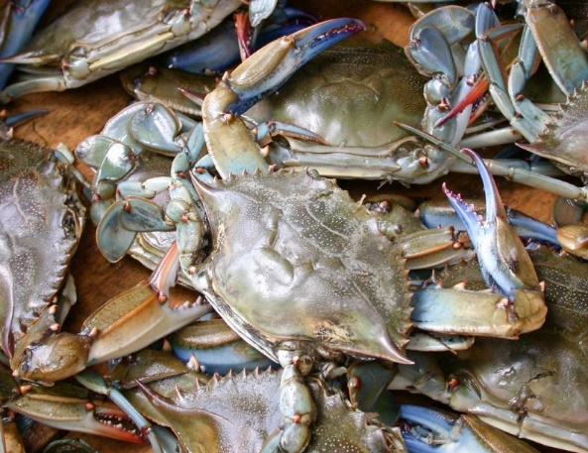
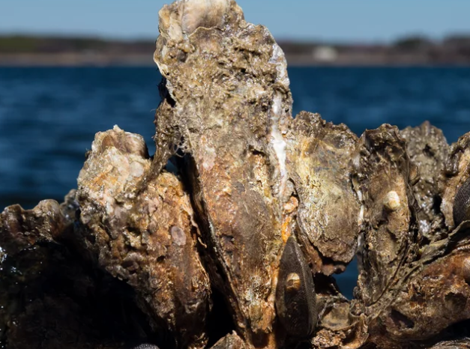
Living Resources are Recovering
Indicators for a healthy Bay and to important to Maryland’s economy
Bay Grasses
Blue Crabs
Oysters
Submerged aquatic vegetation recovery is linked to nutrient reductions.
Blue crab populations respond to fisheries management, habitat restoration, and SAV recovery.
Harris Creek, MD is the first fully restored oyster reef in Chesapeake Bay.
4

Slide 5

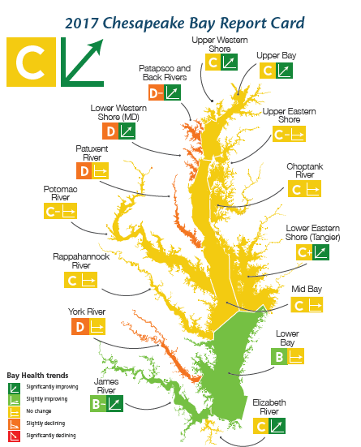

Slide 6
What programs have brought us this far?

Slide 7
Wastewater
Dedicated Fund
67 Majors to ENR
Economies of Scale
Incentives
Minors
Septic Upgrades & Connections
Agriculture
Locally Developed SCD Plans
CREP
Cover Crops
PMT
Nutrient Management
Cost Share
P3
Financial Assurance
MS4 Phase I
Urban Stormwater
Local Restoration
Compliance
New development stormwater standards
New technologies
Funding

Slide 8

Maryland Nitrogen Loads (1985 – 2017)
Maryland has made the most progress in reducing nitrogen since 1985 compared to the other 6 Bay jurisdictions
Where did the
Nitrogen reductions
come from?
1985 (84.1 M lbs/yr)
2017 (54.2 M lbs/yr)
Source: USEPA Chesapeake bay Program
Notes:
8.4 M lbs/yr REMAINING 2025 planning target 45.8 M lbs

Slide 9
Maryland Phosphorus Loads (1985 – 2017)
While Maryland has almost met its 2025 phosphorus reduction goals,
managing phosphorus is still critically important for restoring local waters
Where did the
Phosphorus reductions
come from?
1985 (7.42 M lbs/yr)
2017 (3.67 M lbs/yr)
Source: USEPA Chesapeake Bay Program
Notes:
(-0.01M lbs under 2025 Planning Target) 2025 planning target 3.68 M lbs

Slide 10
Agriculture WIPII Plan Goals
BMP | Unit | 2013 Milestones | 2017 Goal | 2025 Goal
10' Fertilizer Setback | Acres | 5,280 | 3168 | 5,280
Alternative Crops | Acres | 200 | 498 | 830
Barnyard Runoff Control | Acres | 168 | 219 | 1,180
CAFO Manure Application Setback | Acres | 2,500 | 1500 | 2,500
Conservation Tillage | Acres | 764,630 | 704,198 | 765,487
Cover Crop | Acres | 355,000 | 424,086 | 424,086
Cropland Irrigation Management | Acres | 92,000 | 119,728 | 119,728
Dairy Manure Incorporation | Acres | 3,976 | 16,703 | 27,838
Decision Agriculture - Cropland | Acres | 84,920 | 356,665 | 594,441
Enhanced Nutrient Management - Tier I | Acres | 14,285 | 60,000 | 100,000
Enhanced Nutrient Management - Tier II | Acres | 14,285 | 60,000 | 100,000
Enhanced Nutrient Management - Tier III | Acres | 25,000 | 105,000 | 175,000
Forest Buffers | Acres | 335 | 1,406 | 2,344
Grass Buffers; Vegetated Open Channel - Agriculture | Acres | 538 | 2,258 | 3,763
Heavy Use Poultry Area Concrete Pads | Operations | 19 | 81 | 136
Horse Pasture Management | Acres | 712 | 2,994 | 4,990
Irrigation Water Capture Reuse | Acres | 1,000 | 2,120 | 3,533
Land Retirement to hay without nutrients (HEL) | Acres | 2,030 | 8,536 | 14,226
Land Retirement to pasture (HEL) | Acres | 5,285 | 22,200 | 37,000
Loafing Lot Management | Acres | 34 | 145 | 241

Slide 11
Agriculture WIPII Plan Goals
BMP | Unit | 2013 Milestones | 2017 Goal | 2025 Goal
Manure Transport - Out of Watershed | Tons | 37,000 | 51,000 | 85,000
Mortality Composters | Operations | 20 | 87 | 145
Non Urban Stream Restoration | Linear Feet | 6,919 | 29,061 | 48,435
Nutrient Management - Cropland | Acres | 685,000 | 211,036 | 351,726
Nutrient Management - Hayland | Acres | 75,000 | 11,207 | 18,679
Nutrient Management - Nursery | Acres | 1,836 | 1,836 | 3,060
Off Stream Watering Without Fencing | Acres | 655 | 2,500 | 4,167
Poultry Litter Incorporation | Acres | 23,876 | 100,283 | 167,138
Poultry Litter Treatment | Operations | 64 | 270 | 450
Precision Intensive Rotational Grazing | Acres | 398 | 1,671 | 2,785
Prescribed Grazing | Acres | 2,614 | 10,982 | 18,304
Shallow Wildlife Wetland Habitat Management | Acres | 35 | 150 | 250
Shoreline Erosion Control | Linear Feet | 3,649 | 15,326 | 25,543
Soil Conservation and Water Quality Plans | Acres | 826,000 | 1,026,413 | 1,145,326
Sorbing Materials in Ag Ditches | Acres | 737 | 3,097 | 5,162
Stream Access Control with Fencing | Acres | 5,050 | 20,956 | 35,355
Tree Planting; Vegetative Environmental Buffers - Poultry | Acres | 118 | 500 | 830
Water Control Structures | Acres | 2,453 | 10,289 | 17,173
Wetland Restoration | Acres | 502 | 2,110 | 3,516
Phytase | % | 24%
Poultry Waste Structures | Operations | 7 | 31 | 52
Livestock Waste Structures | Operations | 20 | 87 | 145

Slide 12
Pounds N Delivered to Bay: 2017
Phase 5.3.2

Slide 13
Implementation Highlights
Fiscal Year 2017
  924,000 acres under a Soil Conservation and Water Quality Plan
  827,000 acres in compliance with nutrient management regulations
  559,000 acres of winter cover crop
  794,000 acres of conservation tillage
Programmatic Highlights
  Phosphorus Management Tool (PMT) regulations
  Animal Waste Technology Fund
  Manure Matching Services
  Soil Health and Climate Change Initiatives
  Agricultural Certainty Program
  Nutrient Trading

Slide 14
What are the remaining reductions needed and what is the gap?

Slide 15
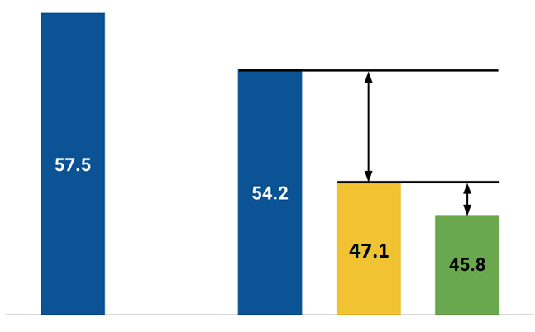
Where the Phase II WIP Level of Effort will Get Them in Terms of Nitrogen Load Reductions
Phase II WIP
7.1 million lbs.
Remaining Reductions to Achieve Phase III WIP Planning Target
1.3 million lbs.
About another ~1 – 1.5 million lbs to Offset Future Growth
2009 Progress
2017 Progress
Phase II WIP
Phase III WIP Planning Target
Source: USEPA Chesapeake bay Program
Notes:
8.4 million lbs N/yr total remaining reduction.

Slide 16
How will Maryland develop the Phase III WIP and close any remaining pollution reduction gaps?

Slide 17
Set Working Targets, Evaluate Current Strategies, Identify Challenges and Opportunities
Factor In
Wastewater
Urban Stormwater
Agriculture
New Tools
Future Conditions
WWTPs
  Majors
  Minors
  Water reuse
Phase I MS4
Revisit Current Plan
Clean Water Commerce
Climate Resiliency and Adaptation
Pay for performance
Phase II MS4
Aligning for Growth
Septic systems
  Upgrades
  Connections
  Stewardship
Nutrient Trading
Non-MS4
Crediting Conservation
Targeting
Notes:
Thin words down

Slide 18
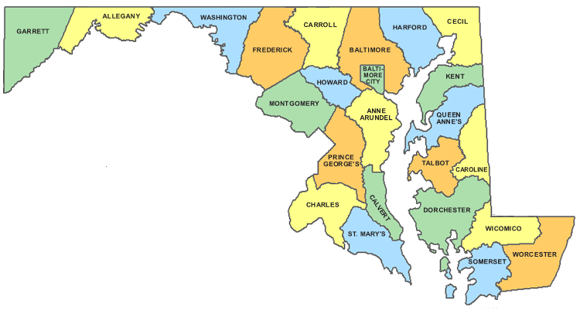
Local Goals, Local Input & Local Benefits

Slide 19

MD’s Phase III WIP Approach
Aug– Nov 2018: Work with Partners to
  compile county Inventory
  evaluate Phase II WIP feasibility
  inform the Phase III WIP
Nov-Dec 2018: 6 Regional Workshops
  Review, Evaluate and refine Statewide and local Strategies
  County WIP Summary
Dec 2018 – Feb 2019: Bay Cabinet
  Cabinet Approval
  Phase III WIP Sector targets
  County Goals and Strategies
  Phase III WIP Draft Report
Apr 2019: 60 day Public Comment
  Informational meetings
  Bay Cabinet – local elected official invitations
5. Aug 2019: Final Report

Slide 20
Agriculture Sector Phase III

Slide 21

Reaching our 2025 WIP goal has three primary components
#1
#2
#3
50%
70%
100%
Progress toward WIP 2 goals
BMP re-verification
Maintaining progress and addressing any remaining gap

Slide 22
Ensuring BMP Performance
Since 2017, the Chesapeake Bay Program requires all states and sectors to provide enhanced verification of BMPs to receive WIP credit.
100% of BMPs have to be verified to receive initial “credit” and ~10% of BMPs will have to be re-verified annually to receive continued “credit”

Slide 23
Verification Results
More than 10,000 agricultural BMPs reviewed since October 2016

Slide 24
New BMPs in the “WIP III Toolbox”
Cropland Irrigation Management
Agricultural Stormwater Management
Nursery/Greenhouse water capture and reuse
Agricultural Drainage Management
Manure Treatment Technologies
Manure Incorporation

Slide 25
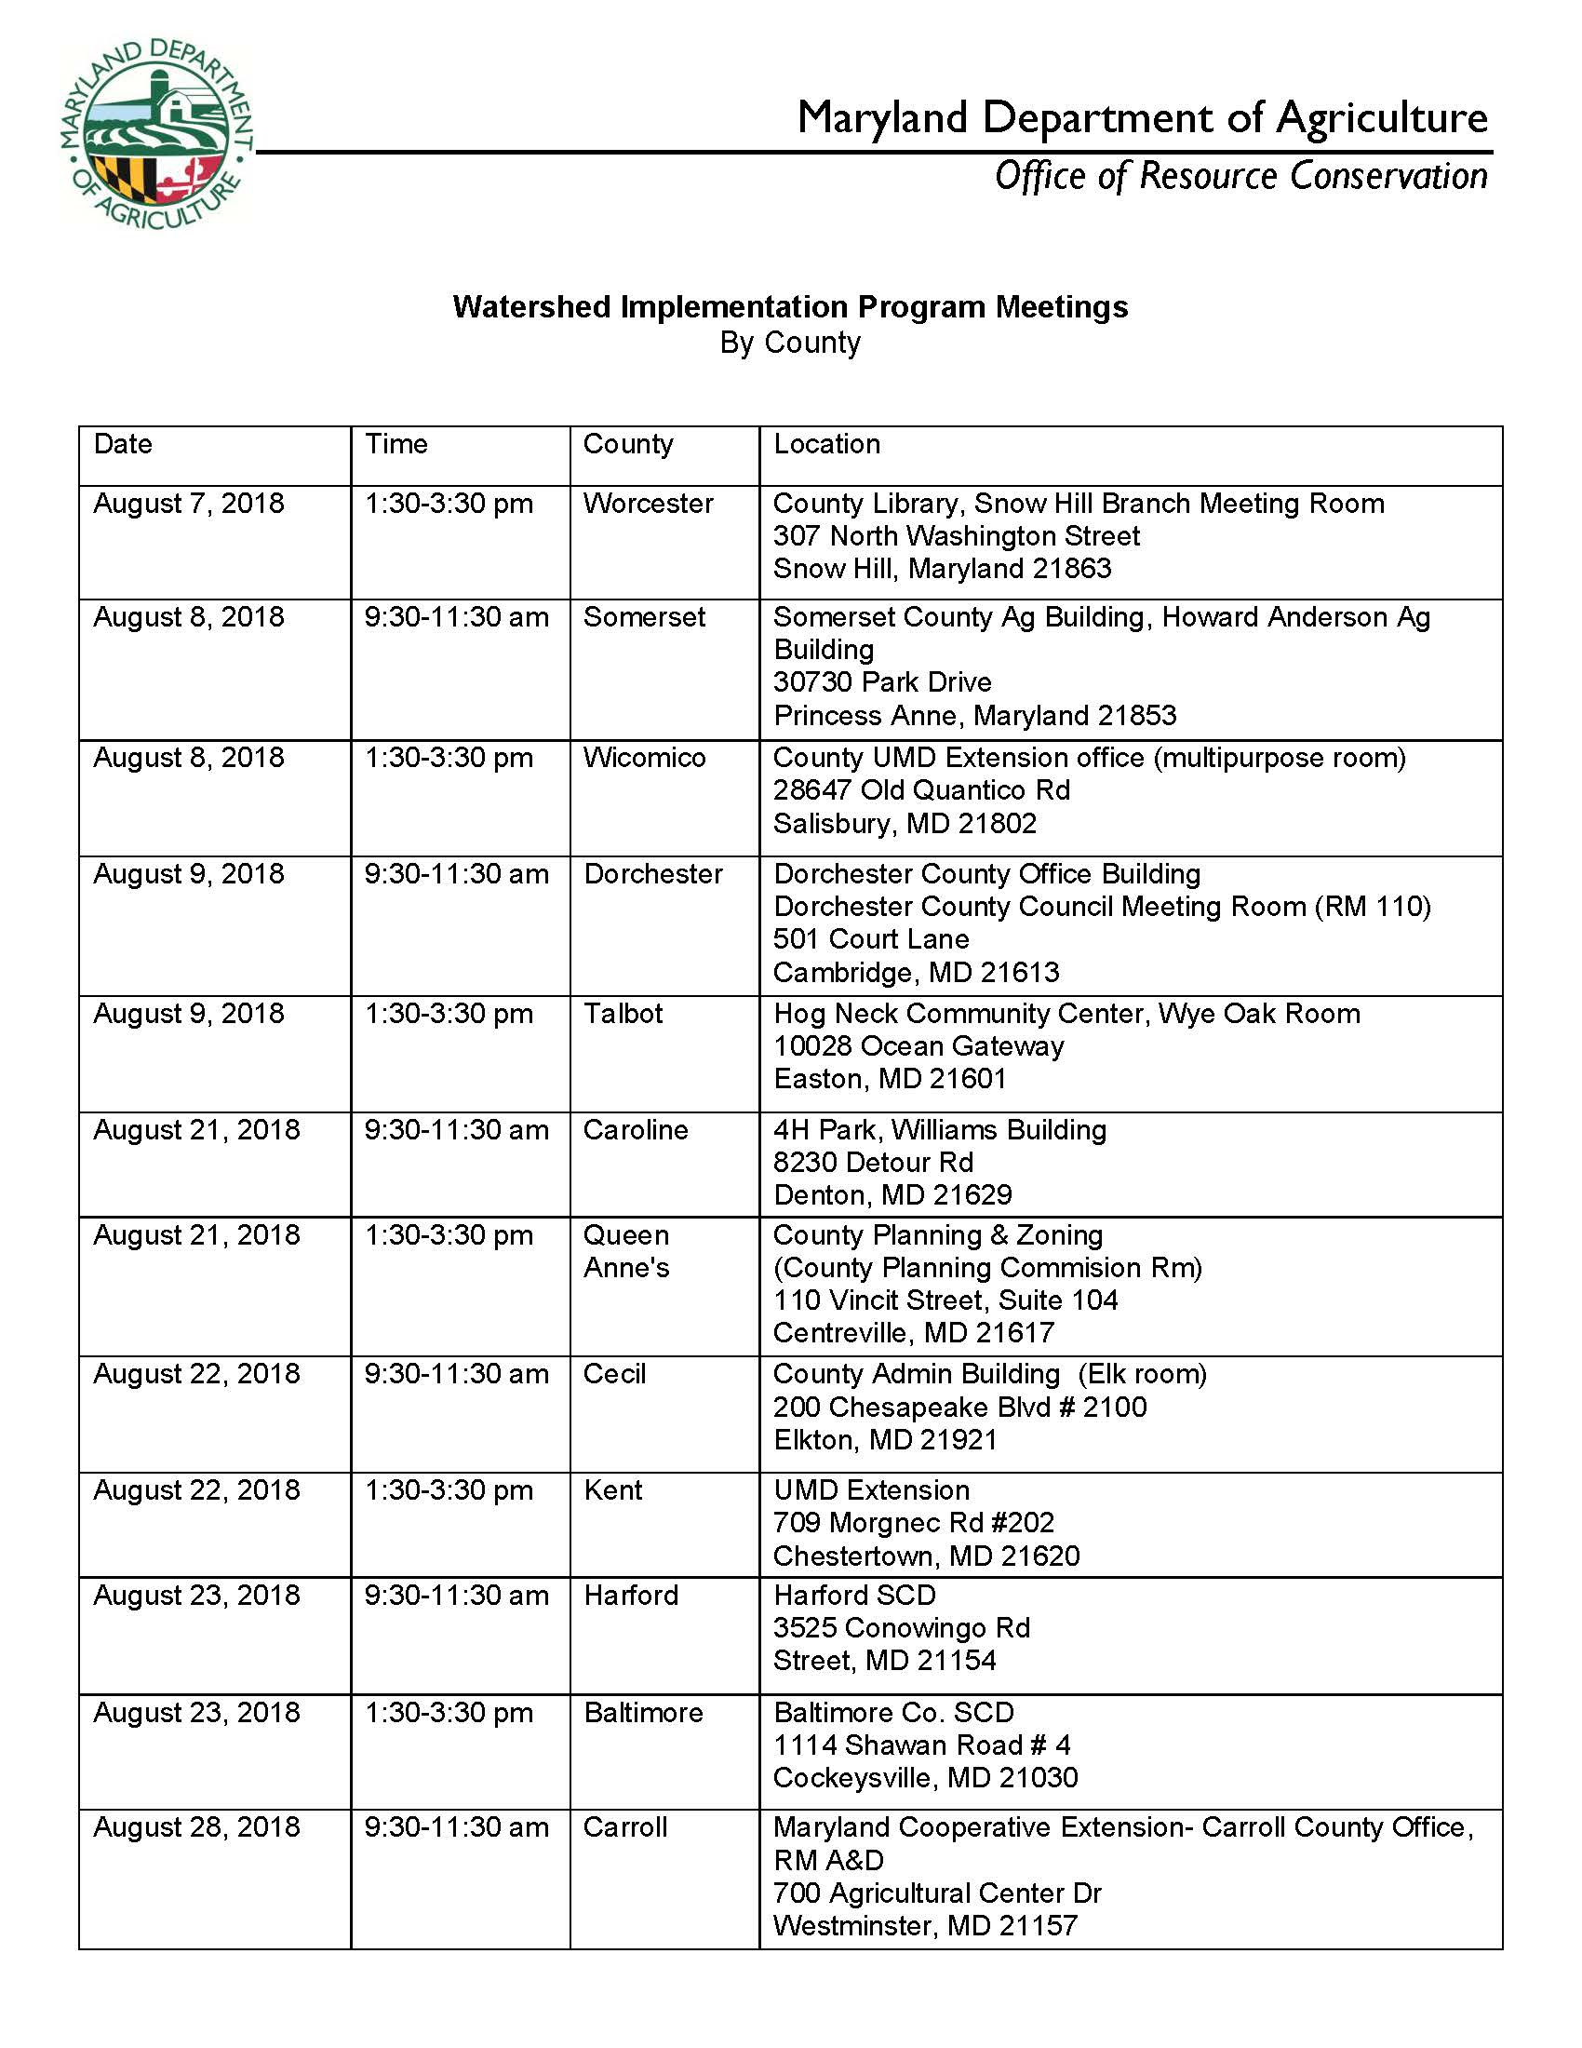

Slide 26
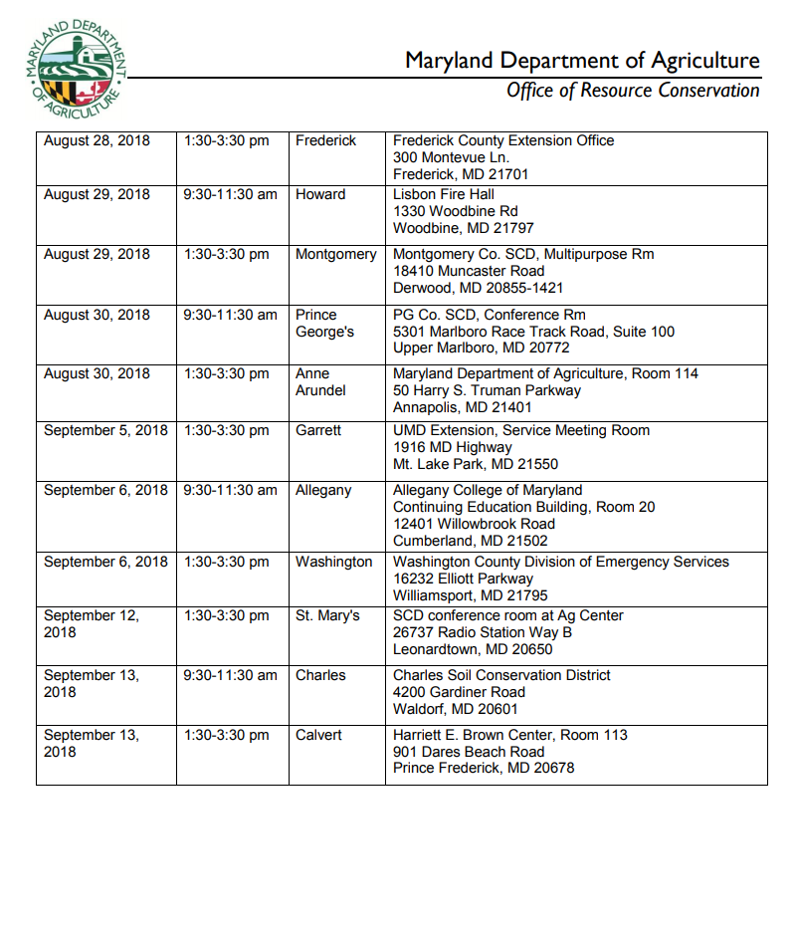

Slide 27
Agriculture WIP III Draft

Slide 28
Agriculture WIP III Draft

Slide 29
Draft WIP III Highlights
BMP Implementation
  100,000 additional acres under a Soil Conservation and Water Quality Plan (1 million total)
  20,000 additional tons manure transported annually (~100,000 tons)
  Maintain Cover Crop enrollment (470,000 ac/yr)
  Additional Riparian Buffers
    4,400 Grassed
    1,200 Forest
    4,100 Wetland
  Agricultural Drainage Management (18,500 acres)
  Cropland Conversion
    5,200 Open Space
    2,500 Pasture

Slide 30
Implementation Highlights
Programmatic
  BMP Verification
    Verify Remaining Practices
    Identify and Account for Unreported Practices
  Nutrient Management
    Increase Compliance
    Accounting for 4R Practices (Rate, Timing & Placement)
    Livestock Exclusion
    Nutrient Application Setbacks
  MACS Payment Structure
    Incentives
    Rates
    Practices
  Co-benefits
    Soil Health
    Climate Change Initiatives

Slide 31
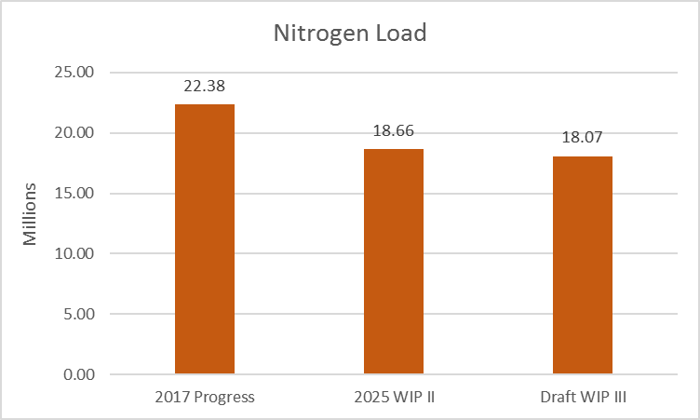

Draft Ag WIP III Results
585,934 beyond WIP II
48,607 beyond WIP II

Slide 32
Next Steps
Address Data Gap
  NM AIR
  USDA NASS
  Fertilizer
  Industry
Cost Analysis
  State Federal Resources (TA & FA)
  Private

Slide 33


Questions
Jason Keppler
jason.keppler@maryland.gov
410-841-5879
Follow MDA on Twitter @MdAgDept
Follow MDA on Facebook www.facebook.com/MdAgDept

