Slide 1
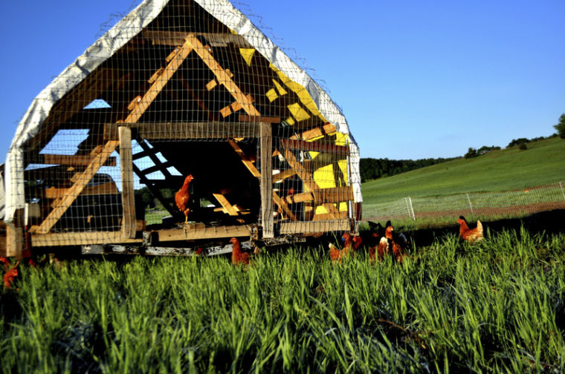
Laying Chickens
Chickens? Chickens!

Slide 2
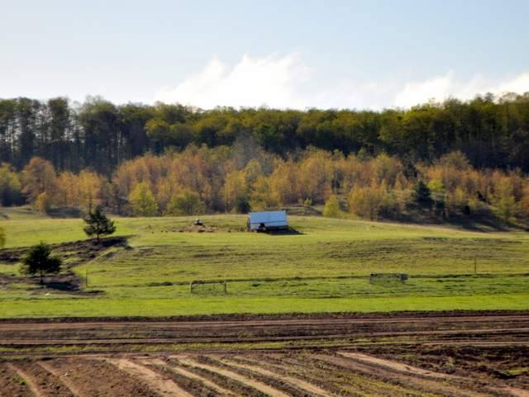
Why chickens?
Farming is awesome. Farming with chickens is more awesome.
An eggsellent addition to any diversified, market farm.
A gateway drug for you and for your customers
Part of a broader picture

Slide 3
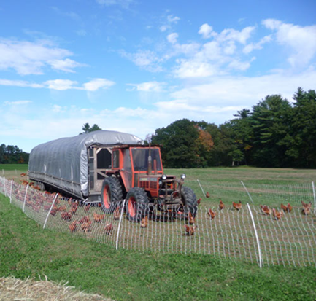
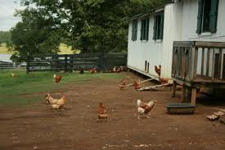
Pastured vs. free range
So many ways to raise chickens
Confinement
Pastured
Always access to grass
Can you pasture in the winter?
Free range
Not confined
but access to grass?
How many chickens is too many to free range?

Slide 4
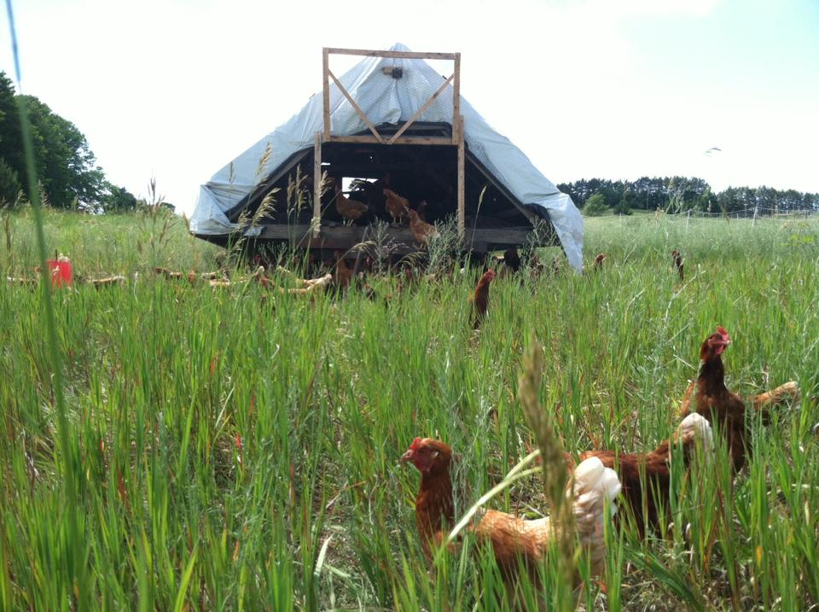
Why (not) pasture chickens?
Why pasture
Healthier chickens
Cluck around like a chicken
Healthier eggs
Healthier soil
Input feed, output mostly balanced nutrients
100 layers produce about 6 tons of manure per year.
Healthier farm
Market exposure
Year-round income
Why not?
More loss to predator
More time consuming
More overhead costs
Is more, better?
An extra hour per day

Slide 5
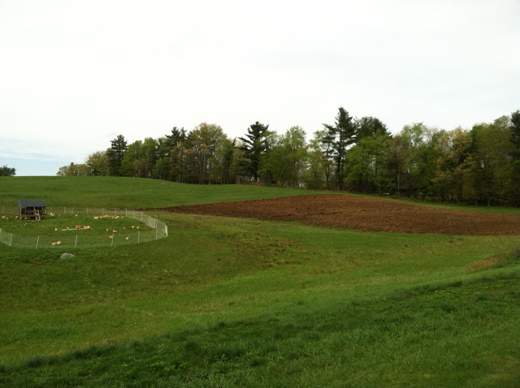
Chicken Basics
1 ½ to 2 year commitment
Start to lay at 18-22 weeks
Peak 30-50 weeks
225-275 eggs per year in good conditions
We keep for one year of laying: slaughter or sell at about 1.5 years
This varies based on breeds and practices
Molt around 80 weeks
This varies with seasonality
Afterward: bigger eggs, less frequent

Slide 6
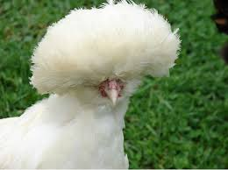
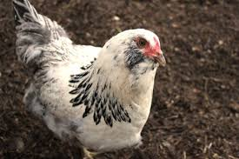
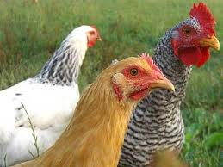
Breeds
Tons of information on hatchery websites.
Choose what suits you
Experiment
Red sex links (or black or brown)
Isa brown, red star, golden comet, etc
Most common for pastured operations
Excellent layers, calm disposition
250 + eggs per year
Won’t breed true
Dual purpose
Reasonable layers
Eat more
Heavier for meat but NOT meat birds
Standard old-time farm and homestead chickens
Breed true to type
Leghorn
280+ eggs per year
Skiddish
White eggs
Easter eggers
Ameracuana
250+ eggs per year in an ideal situation

Slide 7
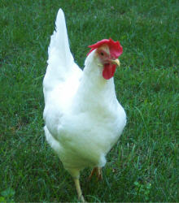
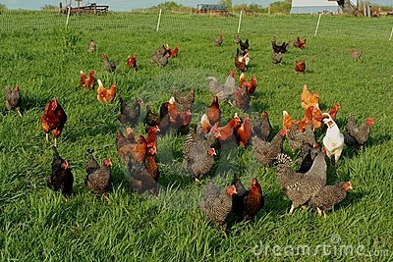
Layer, broiler, dual purpose

Slide 8
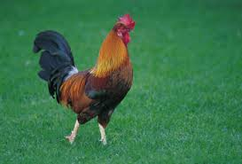
Roosters
What happens when I buy all lady chicks?
Necessary?
Hen management
Flock organization
Fertilization
For meat?

Slide 9
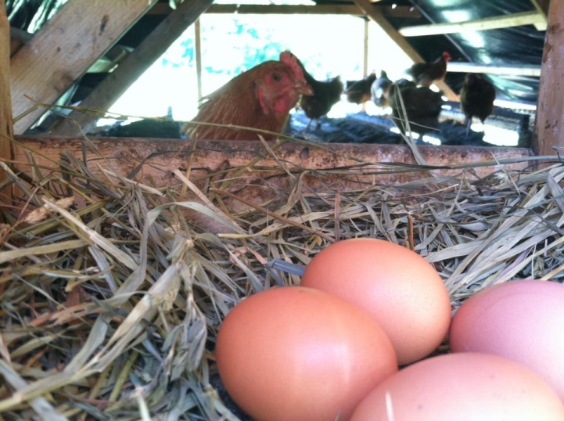
First the Egg
Buy pullets, day olds, or hatch your own?
Hatch your own
What will you do with half of your roosters?
Day old
Shipped on the day of birth
Find a hatchery as close as possible
$8 to Point Of Lay
You control their life during the crucial years of development
20 weeks of risk before any eggs
Pullets: 16 weeks
Save time and Reduce risk
Availability when you need it?
Usually $8-$12 at 16-18 weeks
Less infrastructure needed

Slide 10
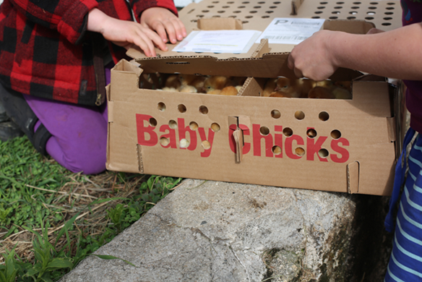
Then the Chick
Plenty of information online and in books. Here are a few notes:
90 – 95 degrees for first week
Decrease by 5 degrees per week
Watch the chicks
Piled up – too cold
Scattered around edges – too warm
Comfortably and evenly distributed – perfect
Heat lamp
Extreme fire danger: ceramic, not plastic base
Why not brood outside in a portable shelter?

Slide 11
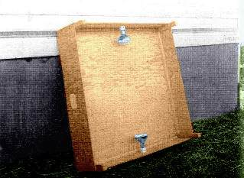
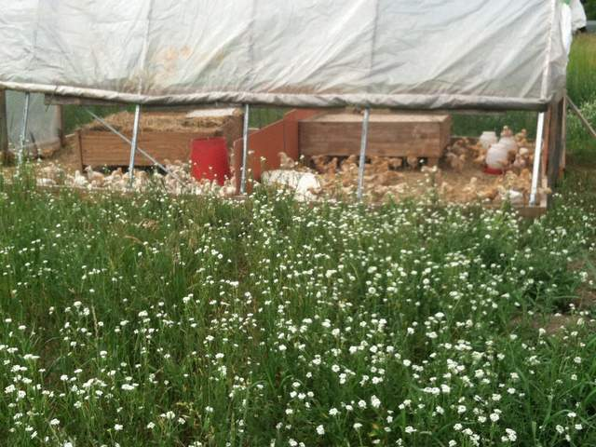
Chicken brooders

Slide 12
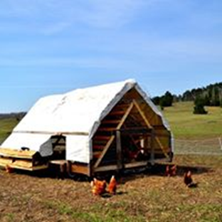
Out to pasture
Don’t mix old birds with new
This is an ideal that we can not always follow ourselves
Feed considerations
Higher protein in the summer and on pasture; lower protein in the winter
Pullets shouldn’t have such high calcium until they start to lay
We expect higher predator loss at first
Lock inside the first few night for training
Keep skunks and owls out
If mixed, leg rings help to distinguish age
Colored zip ties

Slide 13
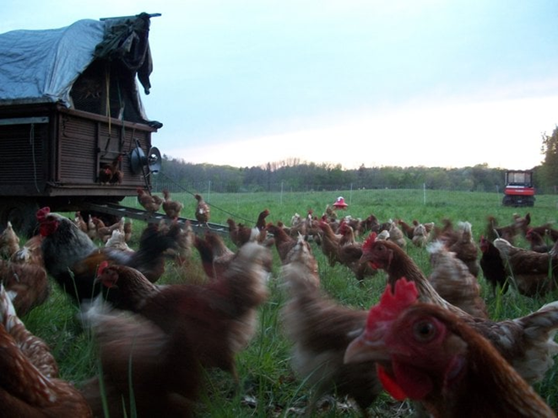
Pastured poultry needs
Clean water
Security
Shelter
Roosts
Nests
Feed

Slide 14
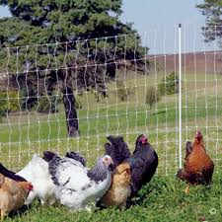
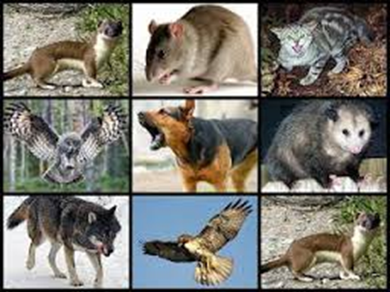
Chicken security
If your birds are outside they will be at risk
Quality of life vs. protected life
Land and sky attack
Everything loves to each chicken
No single tactic will eliminate all threats
Poultry netting
Keeps most land predators out
Skunks a likely exception
Electrified
Battery powered
portable
AC fence charger
More reliable and stronger
As powerful as you can afford
15 joules for us
Don’t bother with less than 6 joules
Ground is extremely important
Ship is best high off the ground
Train the birds to sleep inside from the beginning
More problems with cats and weasels in the first 6 weeks.
Hardware cloth preferable to chicken wire

Slide 15
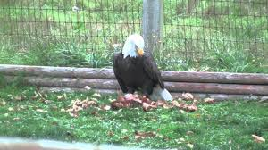
Chickens fleeced!
Air protection
Eagles, owls
Plenty of overhead protection for chickens to take cover
Fishing line spider web may help deter air attacks
Night lights
Guard animals
Dogs
Geese
Guinea fowl
Roosters
Other ingenious ideas?
We defeat them with numbers
Always raise more chickens than we need

Slide 16
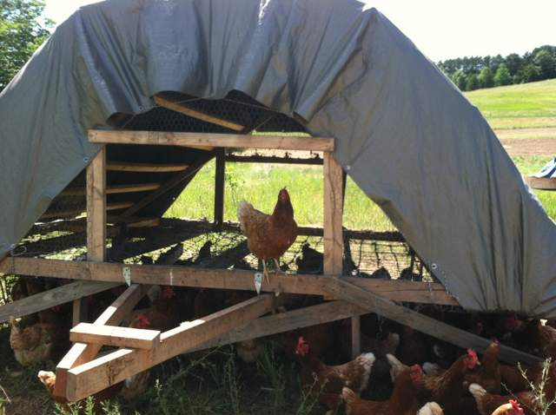
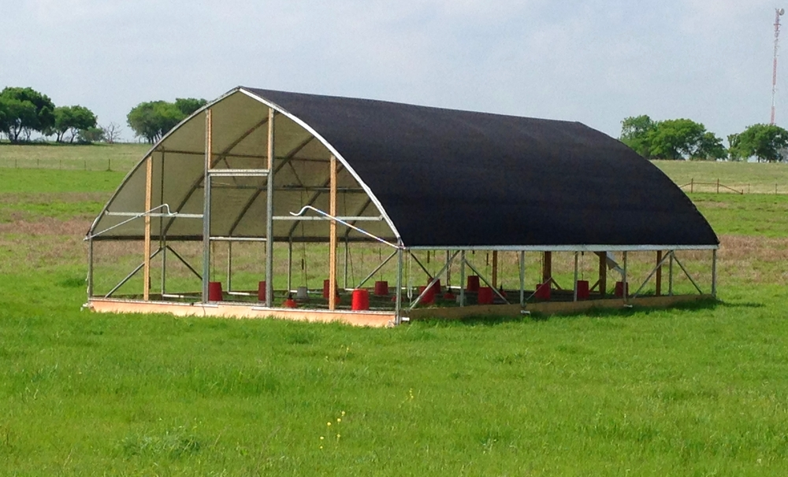
Chicken ships

Slide 17
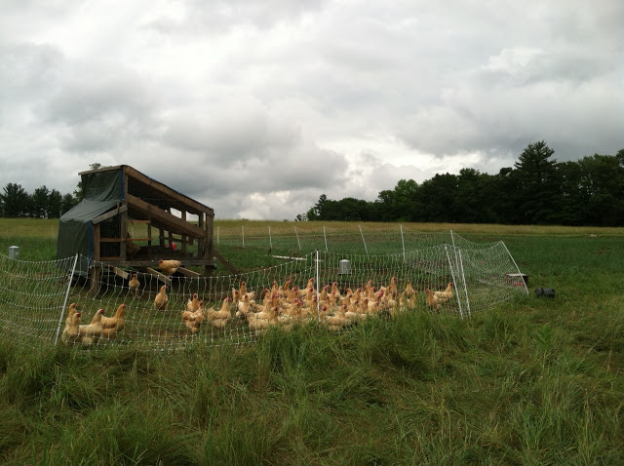
Nests and roosts
Think like a chicken but smarter
Nest boxes
Roll out
They seem expensive but do the math
Dark, out of the way, and off the ground
At least 1 per 15-20 birds
Straw vs. wood shavings
12” – 18” wide; 10-12” tall
Community boxes?
Roosts
1 foot per bird
Slanted vs platform
They congregate toward the top
Ideally in winter A shaped
Summer V shaped
Not necessary until 3 – 4 months

Slide 18
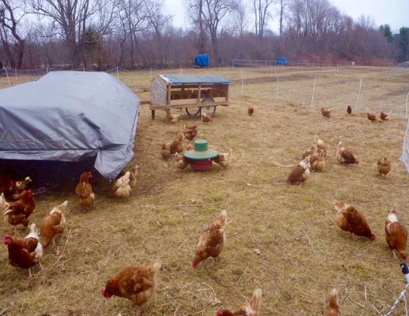
More Chicken ship
Design possibilities
Grated vs solid floor
Trailer, sled, high tunnel
Running gear
High clearance
readily available
Air flow
Completely enclosed?
Open and close by hand every day
Rotation
By tractor/atv/truck?
By hand?
How often? Depends on circumstances
Chickens are tools, use them best for your situation
After done laying
Early afternoon

Slide 19
Manure from the ships
100 layers produce about 6.5 tons of manure per year.
This does not include bedding from winter
The industry says its nutrient content fresh is about 1.5/1/.5 N/P/K
Morgan would charge you nearly $500 for that and you don’t know what those birds were fed
Full of micro nutrients
Good feed keeps healthy chickens producing healthy eggs and feeding healthy soils.
Roaming layers stimulate the microbes of the soil
Nutrient content
Calcium 3.200
Magnesium 0.290
Sulfur 0.310
Iron 0.046
Boron 0.060
Copper 0.002
Chlorine 0.080
Manganese 0.089
Molybdenum 0.006
Zinc 0.090

Slide 20
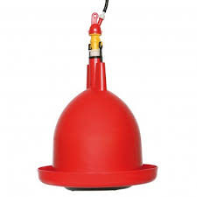
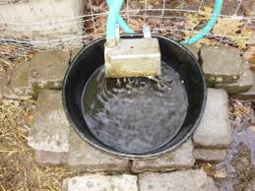
Feed and water
Water
Always available and clean
Keep wild birds out
So very important in the heat
Stressed in a few hours if extremely hot and no water
Pressurized water lines
Buried?

Slide 21
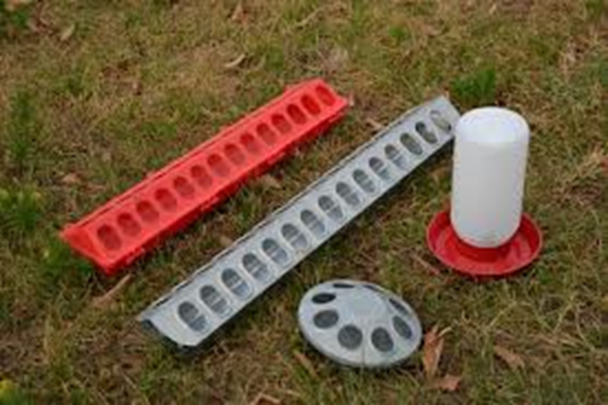
Feeding chickens
Day-old to 6 weeks
Fine mash or crumbles
starter feed: 20%
Grit – start early
Medicated?
Layer chicks: 6 weeks to Point of lay (POL)
15-18% protein
Mash or pellets
Layers
We typically give 17% protein but chickens eat for calories
15% or lower in the middle of winter
19% or higher in the heat of the summer
Higher calcium: 3-4%
Always Grit
Conventional, non GMO, organic, vegetarian, soy and corn free…
So many alternatives
What suits your situation
Freshness
Never older than 3 weeks in the summer

Slide 22
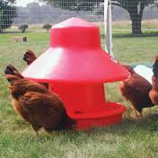
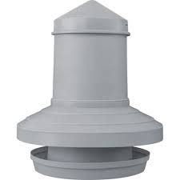
More feed
Complicated or simple
At 100 birds, you probably do not have too many options
Protein % and source
Soybeans or other oil seeds, fishmeal, meat and bone meal…
Amino acids: lysine, methionine
Calcium
1% until POL, 3-4% as layers
CCC – finely ground and cheap
Oyster shell
Mineral mix
Generic mill variety, fertrell, many others
Grain
Corn, wheat, oats, barley, milo

Slide 23
More feed
Scratch
Candy
About 10% protein, high energy but low everything else
Grit: starter, grower/developer, layer
Local mill vs farm store
Freshness: 3 weeks old or less, especially in summer
Don’t buy more than your chickens can consume in a month
Know the ingredients
ask questions, expect answers

Slide 24
More feed
Restricted feed
.27/layer/day for red sex links; More for heritage birds
Free choice?
We did this for years but are now restricting diet.
How much do they eat?
100 birds: about 200#/week
Variability depending on breed and season
More in winter for warmth
Adjust protein and mineral content as possible.
In excess heat (85) provide ample trough and waterer space
They won’t eat in mid day so they crowd the feeders in the morning and night and still won’t eat enough to produce
Raise calcium and provide fresh, cool water
How much from pasture or free range?
Depends on what’s available and how much you want them to lay
15-30% is my estimate

Slide 25
Our Northern Chicken calendar
Spring
Out to pasture as soon as there is enough grass
First move is as far away from winter homes as possible
Move to chicken ships at night
Transport crates are invaluable
Make good habits from the first night
Are they all roosting in their housing?
Potentially lock them in their houses the first couple days?
Summer
Watch the heat stress. Raise protein?
Provide plenty of waterer and feeder space
Fall
We start moving closer to barns in early October
Have your winter housing ready early. Winter doesn’t arrive on schedule.
lights
Winter
In barn when snow falls
The permanent season
Stewing hens or old layers.
We mostly cull in fall or late winter

Slide 26
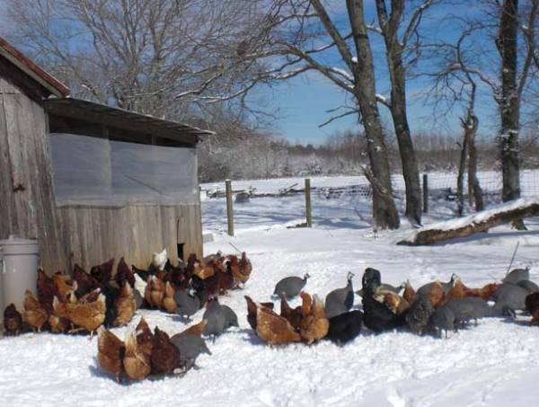
Winter
They lay all winter, can you sell all winter?
Labeling: we change from “pasture raised” to “local, non-gmo”
If you want people to trust your label, you must be trust worthy.
Warmth
Plenty of ventilation but no drafts
Below 45 they begin to consume more
Too cold and they may stop laying
Feed
More energy, Less protein
15-16% if laying
Hay, alfalfa pellets or sprouts to replace pasture?
Egg collection
Frozen eggs
Water
Heater?
insulated

Slide 27
Light and Heat
Heat: Fire danger!
Consider the risks
Could you insulate rather than heat?
Or adjust feed
Light
15-17 hours of light
Supplement with artificial light
Doesn’t take more than a 40w bulb
It is better to have at least 2 in case one burns out
Use a timer
Best if turned on early and allow the day light to fade but more prone to frozen eggs at coldest part of the day

Slide 28
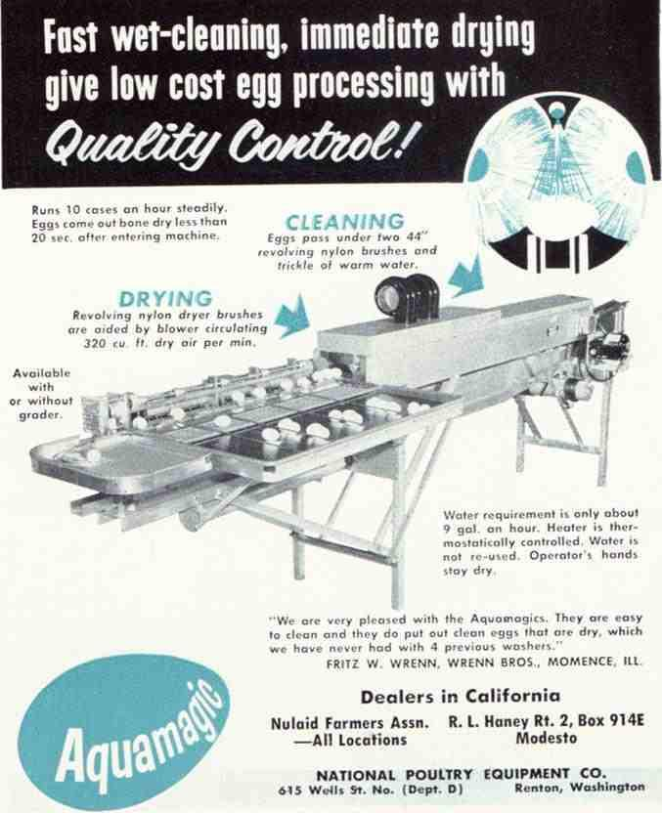
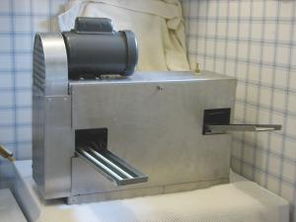
Post harvest handling
Eggs are beautiful, present them as beautiful
We handle eggs like vegetables
Sell fresh and clean
Collect mid day and straight to cooler
Egg washer
At what point is it worth the investment?
For us 250 layers
Egg washing went from the worst chore on the farm to a zen-like activity.
Aquamatic/sanitouch
$5-10,000 if you can find one
Old technology, repairable
Gibson ridge egg washer
$2000
Portable, single user
Always new technology
Immersion egg washers
Are they sanitary and legal?
Does it save time and clean eggs?

Slide 29
Chicken Business
Market farming – direct (or nearly direct) sales to consumers.
Do you have a winter outlet for eggs?
Do you have a spare hour everyday?
Notice that market is half of market farming.
A farmer may only get $1 or $2 per dozen. A market farmer should get $3 - $6 (or higher)
Spends a great deal of time and effort marketing
I’ve read that it doesn’t make financial sense to raise only 100 layers, but those people may not be charging enough or they may not see the whole picture

Slide 30
Chicken Math
Chicken expenses | $/week for 100 layers | 250 layers | 500 layers | 1000 layers
Feed @/.27#/bird/day @ $400/ton (highly variable) | 40 | 95 | 190 | 380
Cost to raise a pullet @ $9/ bird laying for 52 weeks | 22 | 55 | 110 | 220
Bedding/nesting (straw in winter, wood shavings) | 7 | 15 | 25 | 42
Equipment: Fencing: charger, poultry netting (($330) $1000/350 hens/3yrs)), Feeders: $100/100, Nest boxes: $500/100 birds/ 3 years waterers $50/100, totals: $/yr 500/52= $10 for 100 $/yr= 700 /52= $15 for 250 $/yr= 1400/52 = $30 for 500 $/yr = 2500 /52= $50 | 10 | 15 | 30 | 50
Pasture housing ($1000/100 hens, $1500/300) | 20 | 30 | 60 | 90
Winter housing | 7 | 7 | 12 | 12
Egg washer $2000/3 yrs ($660/yr) | 0 | 0 | 13 | 13
Cartons and labels | 13 | 30 | 50 | 100
Sub total | 119 | 247 | 490 | 907
$ Egg sales | 70% @ $5 dz = $200 | 70% @ $4 = $408 | 70% @ $3.75 = $765 | 70% @ $3.75 = $1,530
Gross profit (not including labor) | $81 | $161 | $275 | $623
labor: washing /packing: 3 hr/100 dz; feeding, egg collecting, pasture rotation: 7-20 hr/k; delivery, marketing: ? | ?
Overhead : mortgage, tractor, egg storage, etc | ?

Slide 31
Rate of Lay: We consistently get 85-87%, but with breakage and staining, our average is slightly above 80%, however, it used to be closer to 70%, which is what one should expect as a base rate of lay.
Market outlets
Wholesale
Consistent but lower price
Farm markets
Best price, most time consuming, erratic
CSA
Diversify and differentiate your csa
A winter market for eggs?
Farm stand
Poultry on pasture are the best advertising
Signs on your ship

Slide 32
Pasturing animals
Pasturing animals makes them public.
Part of the landscape, part of society
Raising animals is a political statement, whether one likes it or not. Take the role seriously.
Pasturing animals is a public service. People need to observe the food they consume.
email: aaronbrower@yahoo.com

