Slide 1
Legacy taste of the garden llc
John Jamerson
Denise Jamerson
Deanthony jamerson

Slide 2
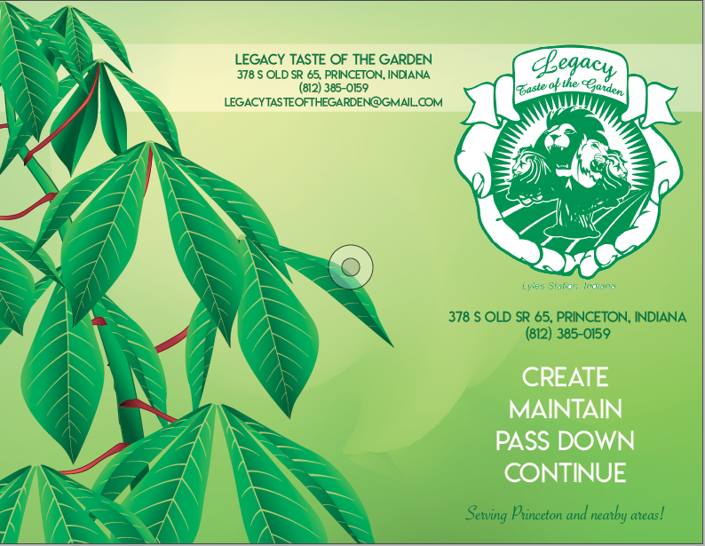

Slide 3
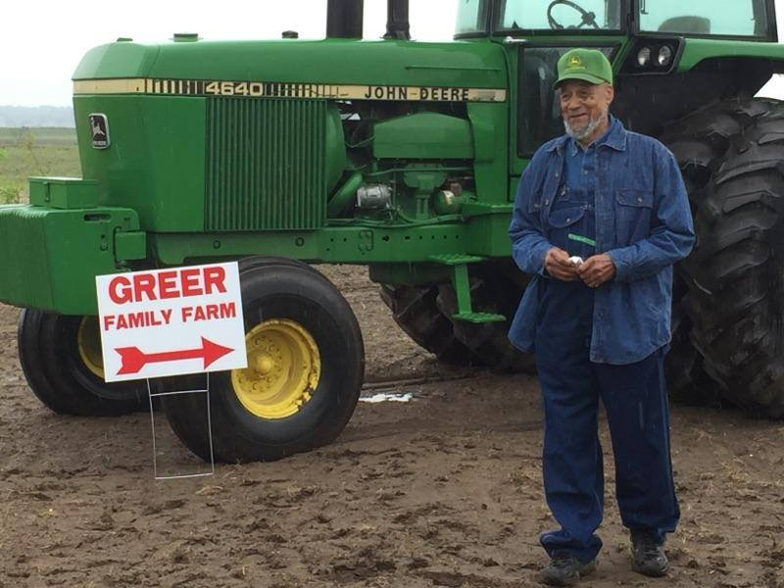

Slide 4
Seed to Sales

Slide 5
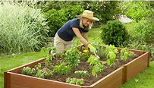
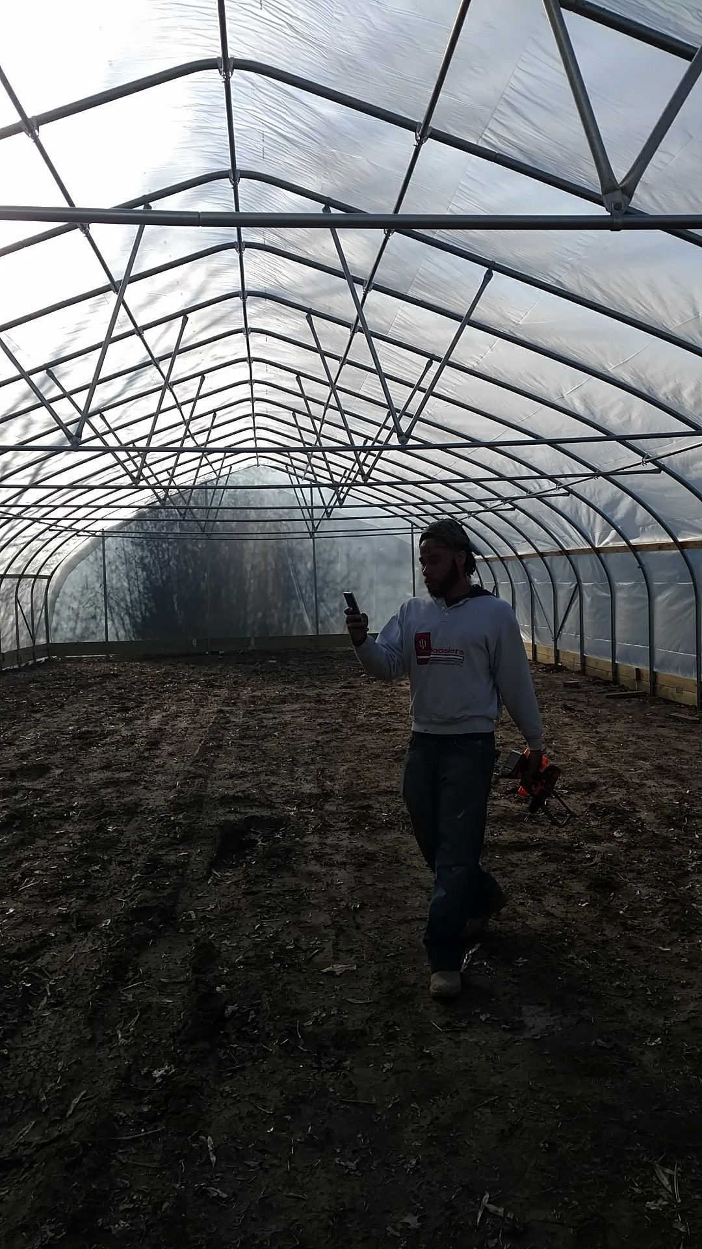
Garden styles
Raised Beds
Hoop House
Aquaponics
This Photo by Unknown Author is licensed under CC BY-SA-NC

Slide 6
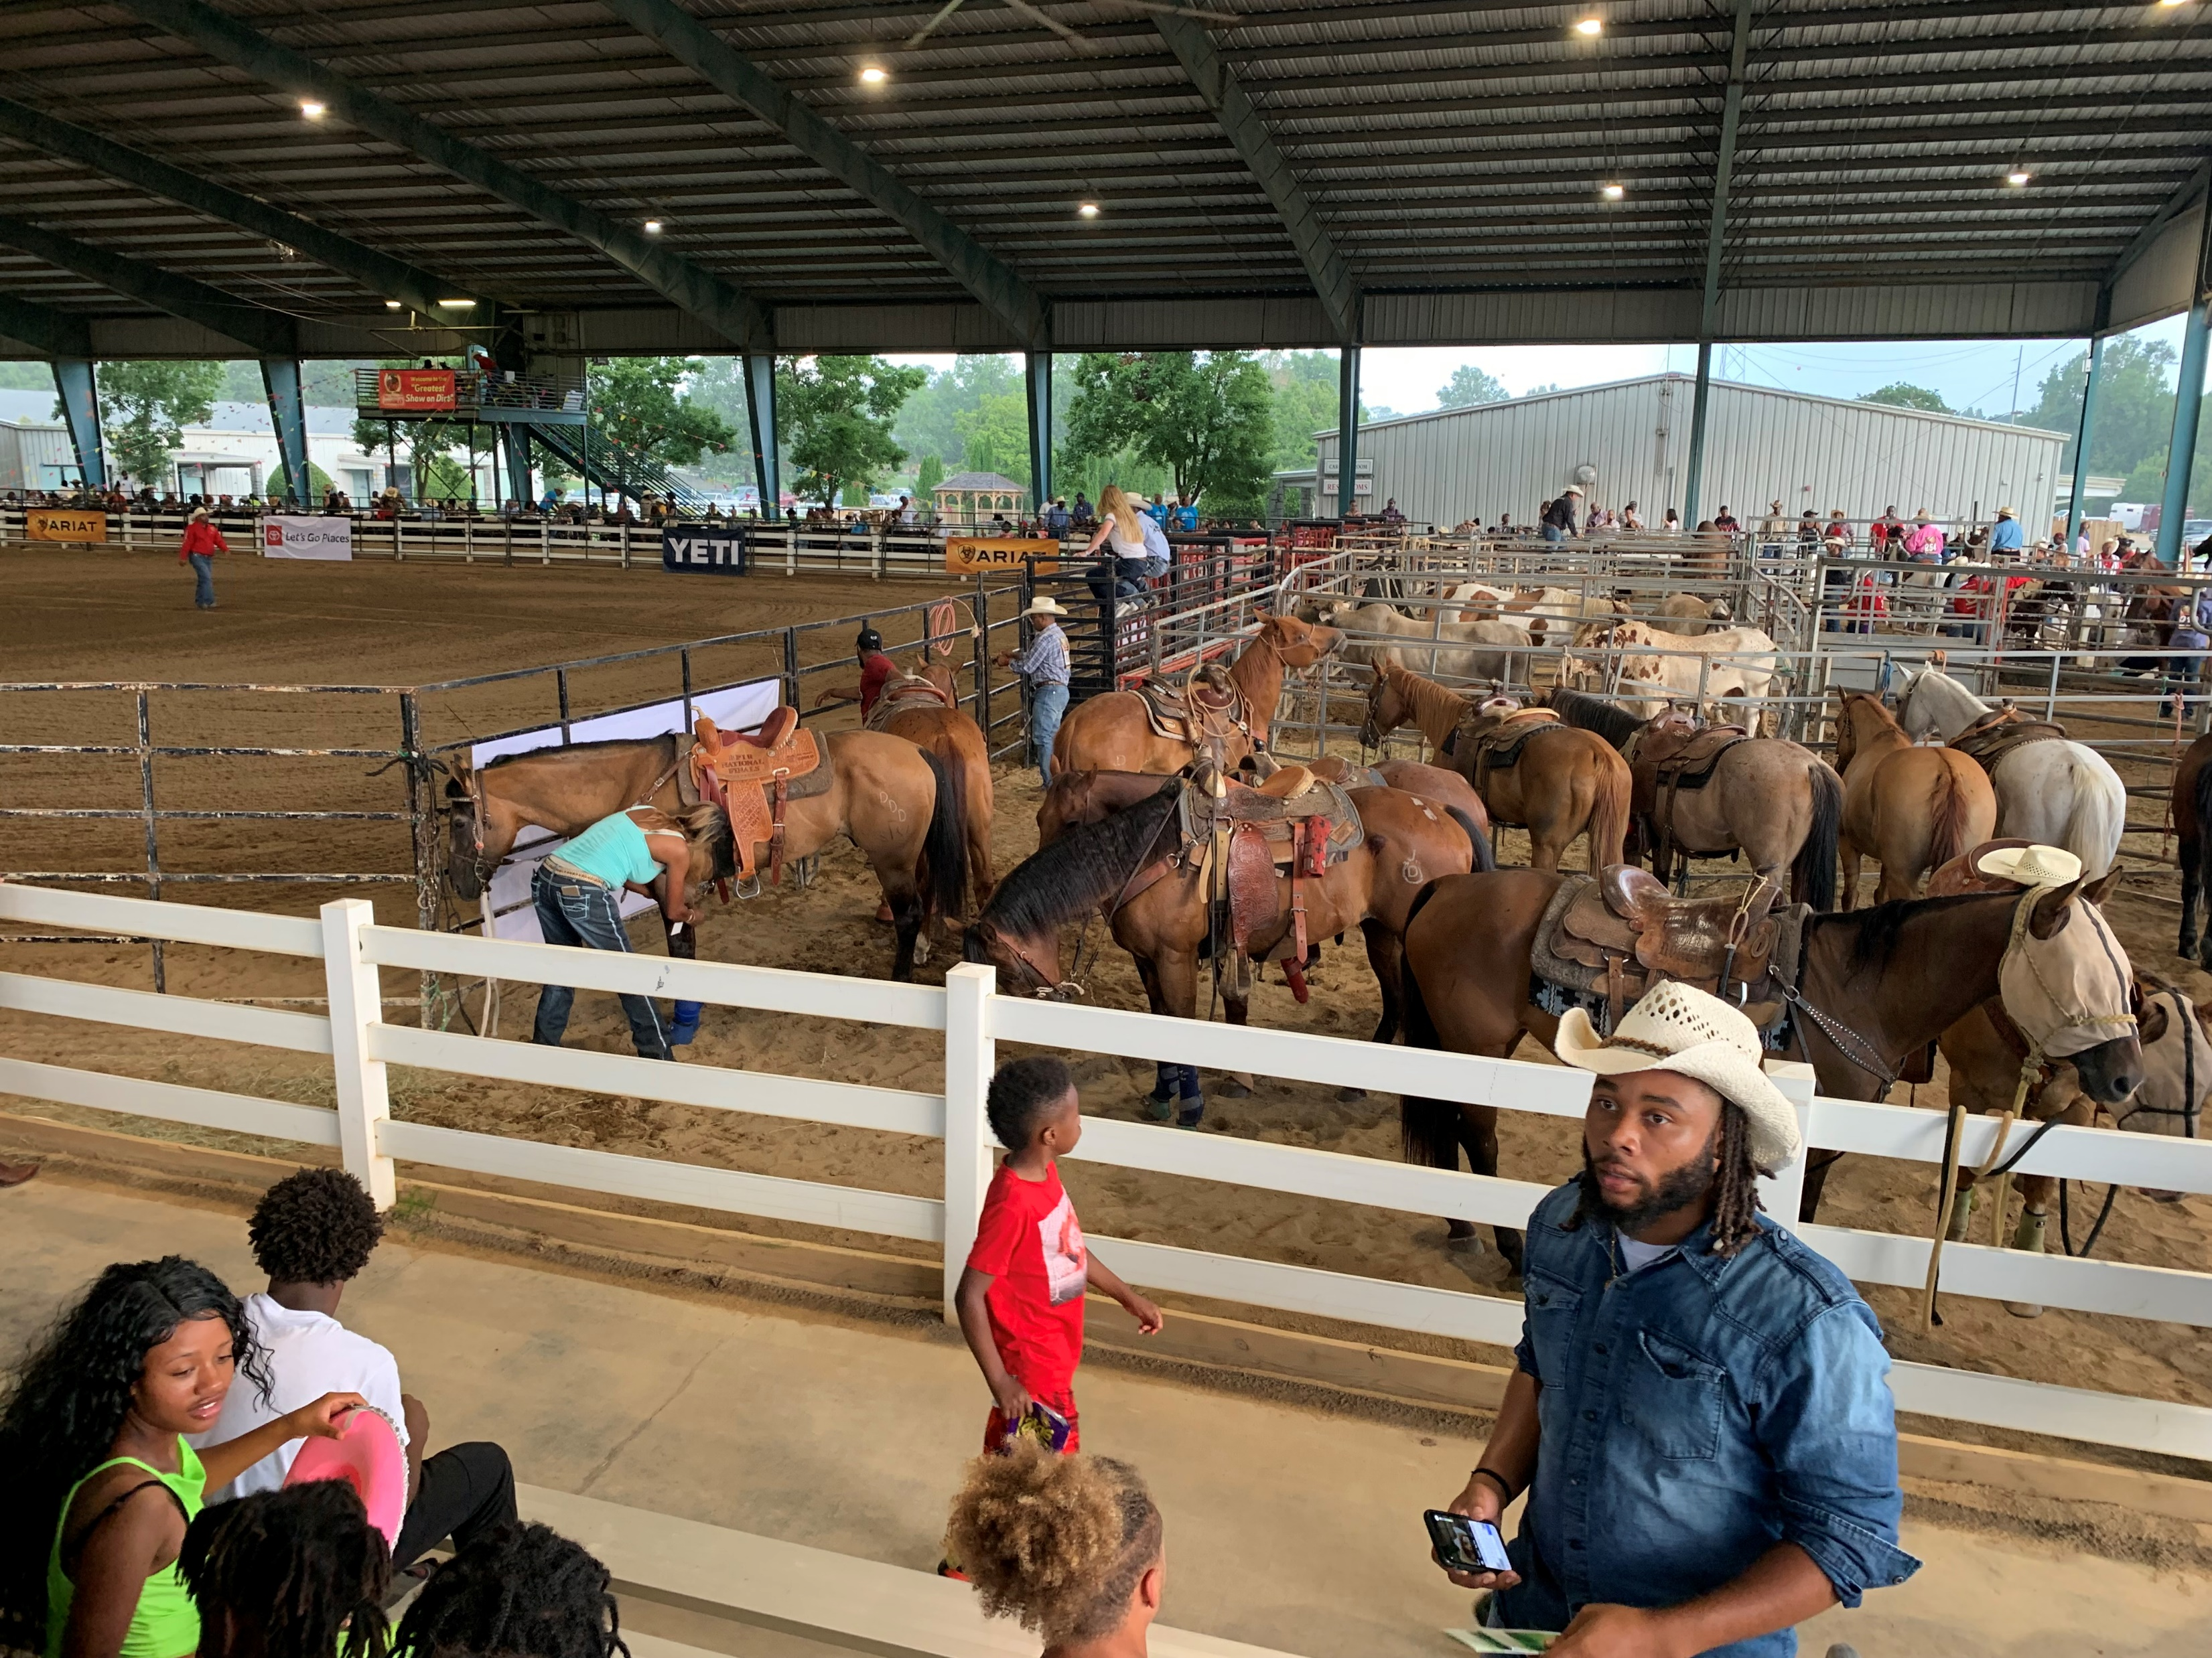
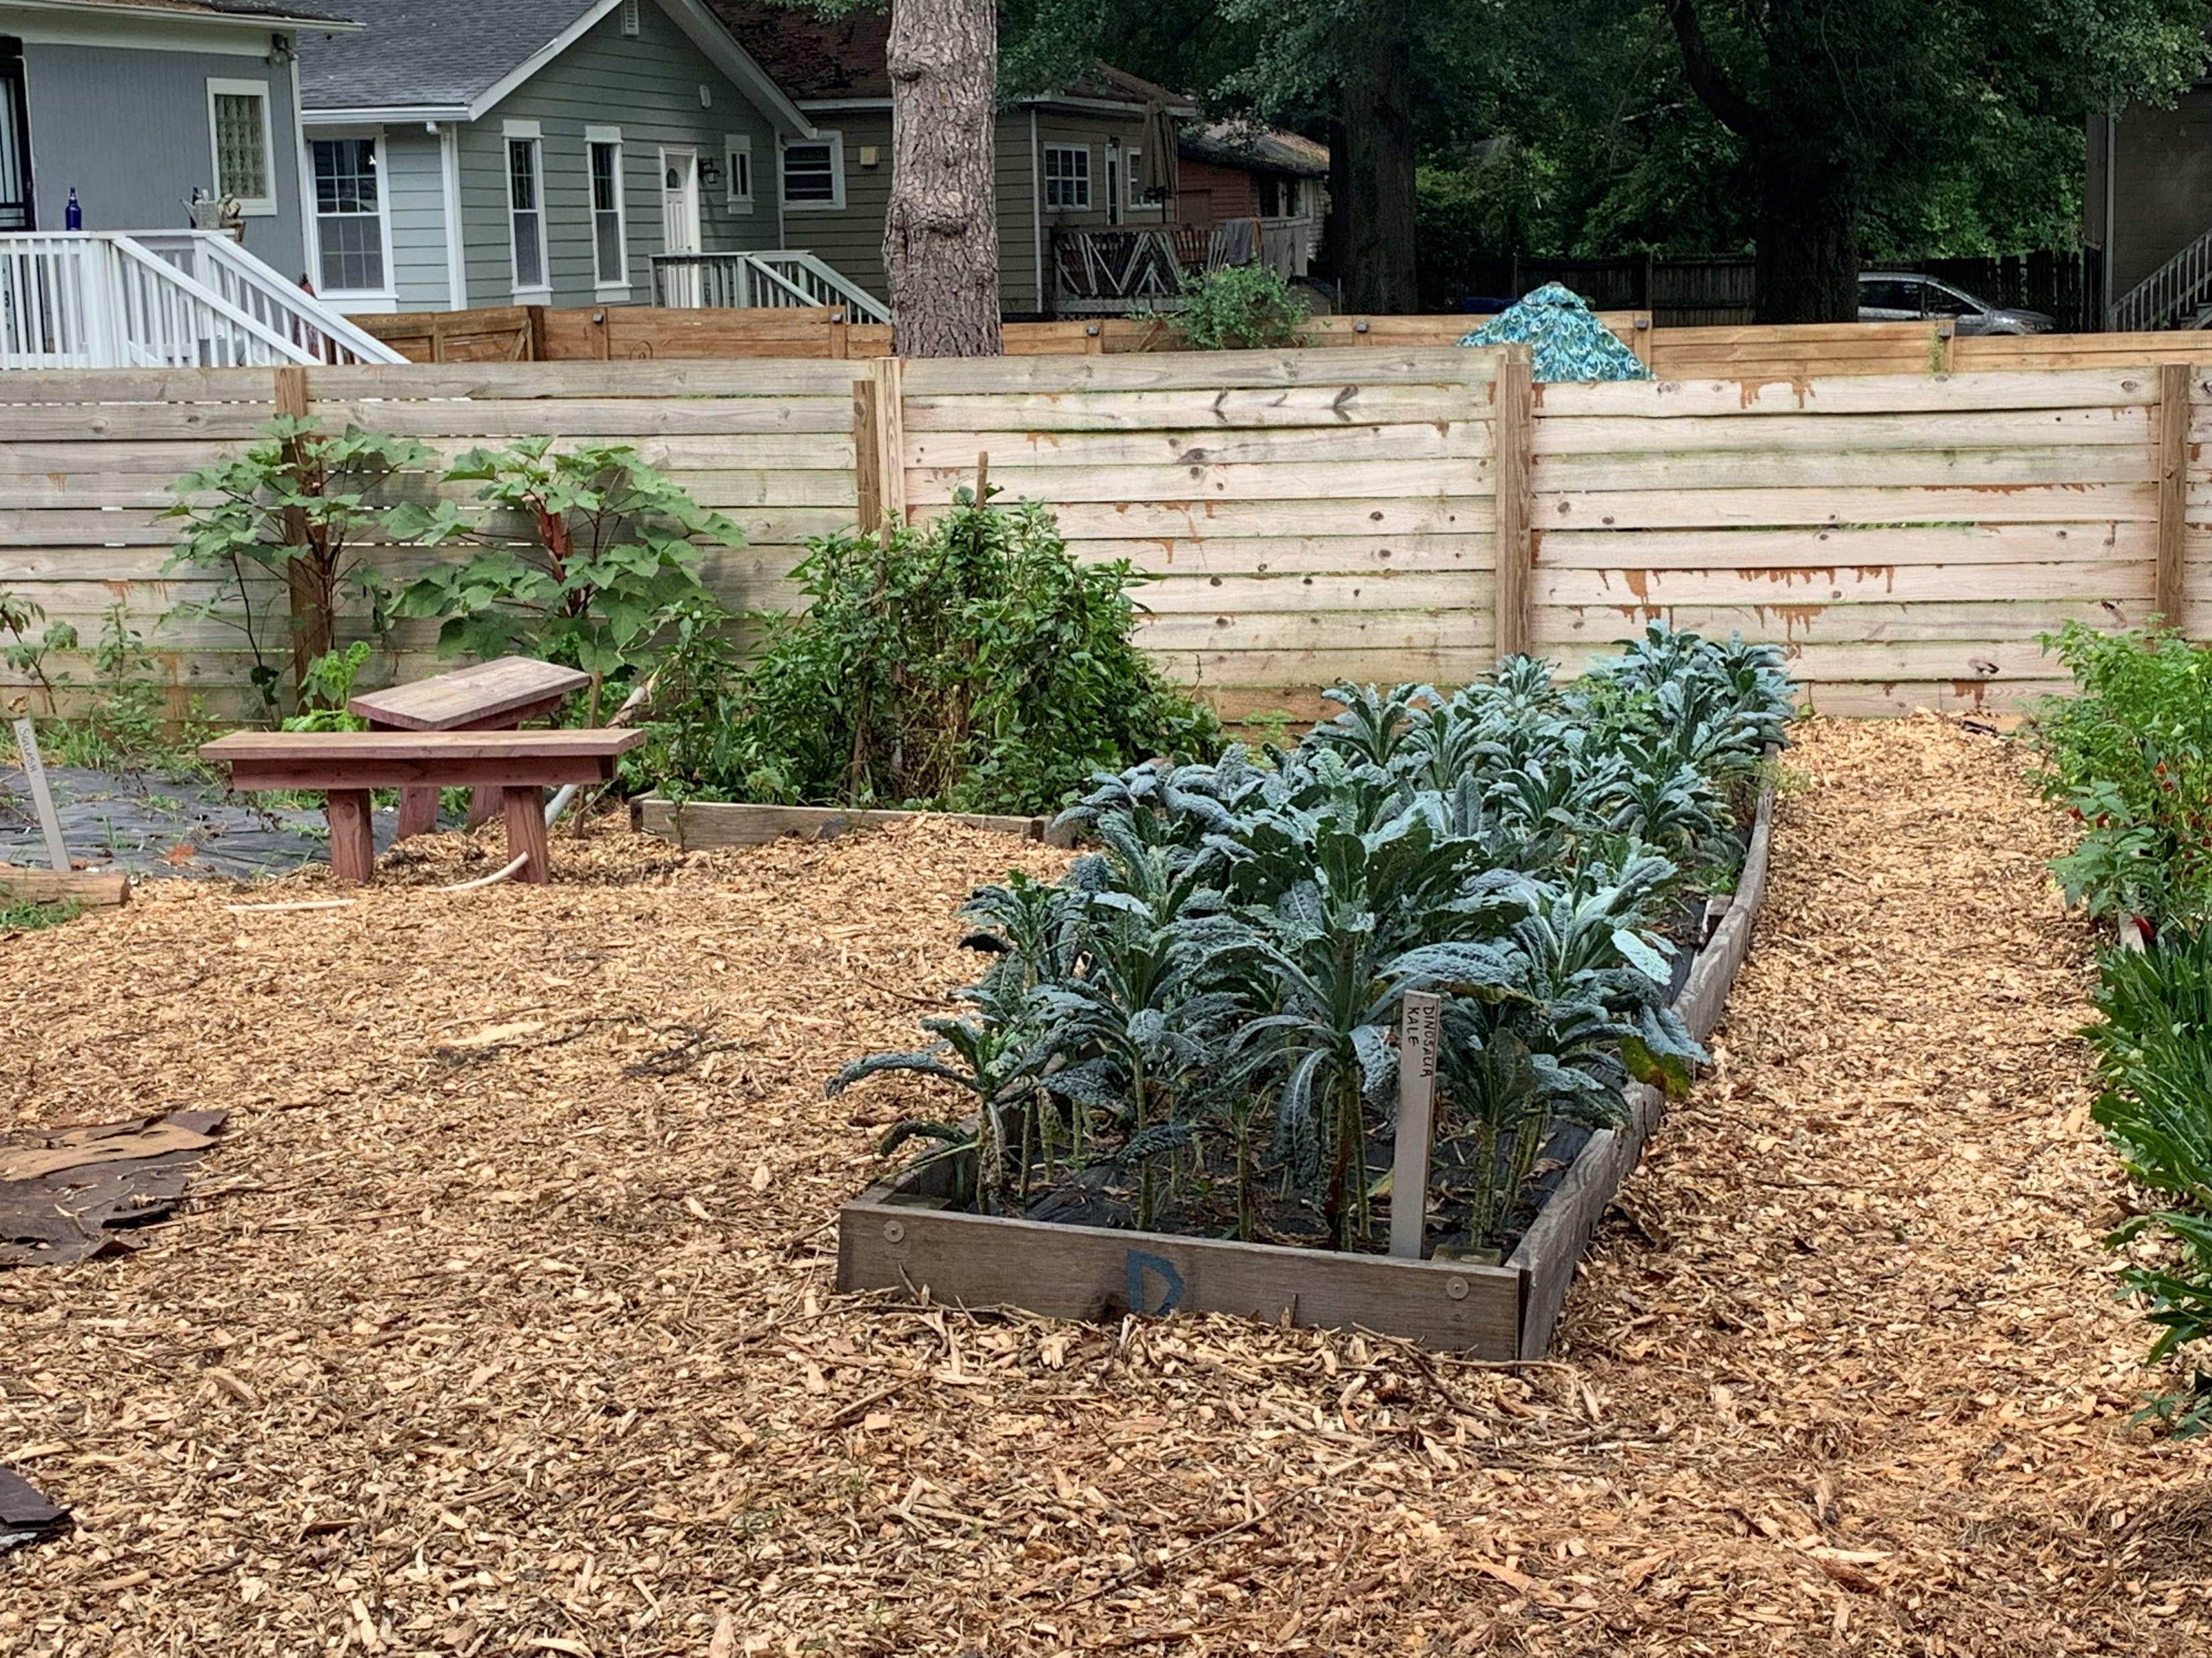
Introducing the wide world of agriculture
Rodeos -Marketing
Urban Gardening

Slide 7
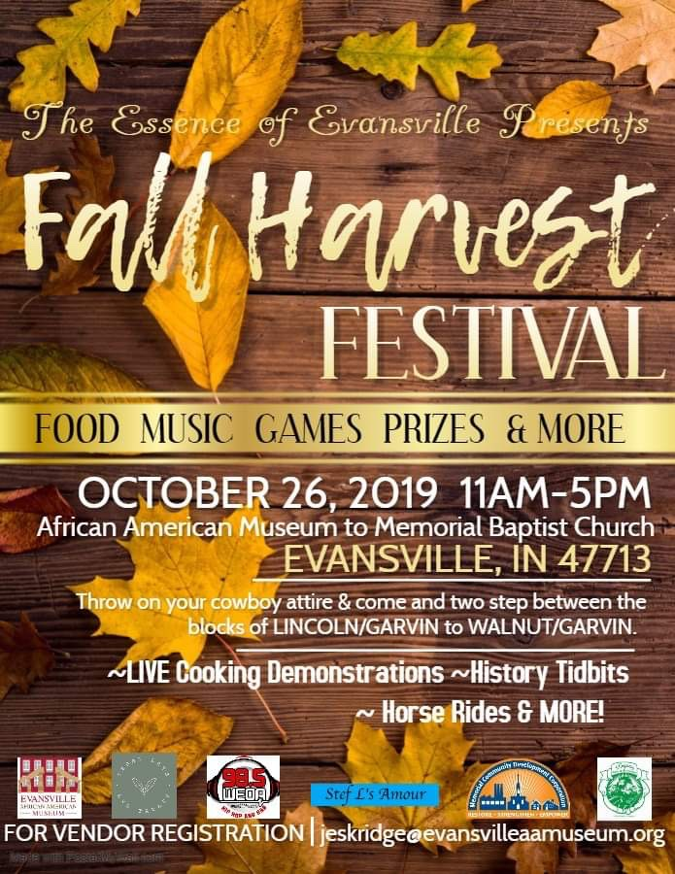
Garden designs

Slide 8
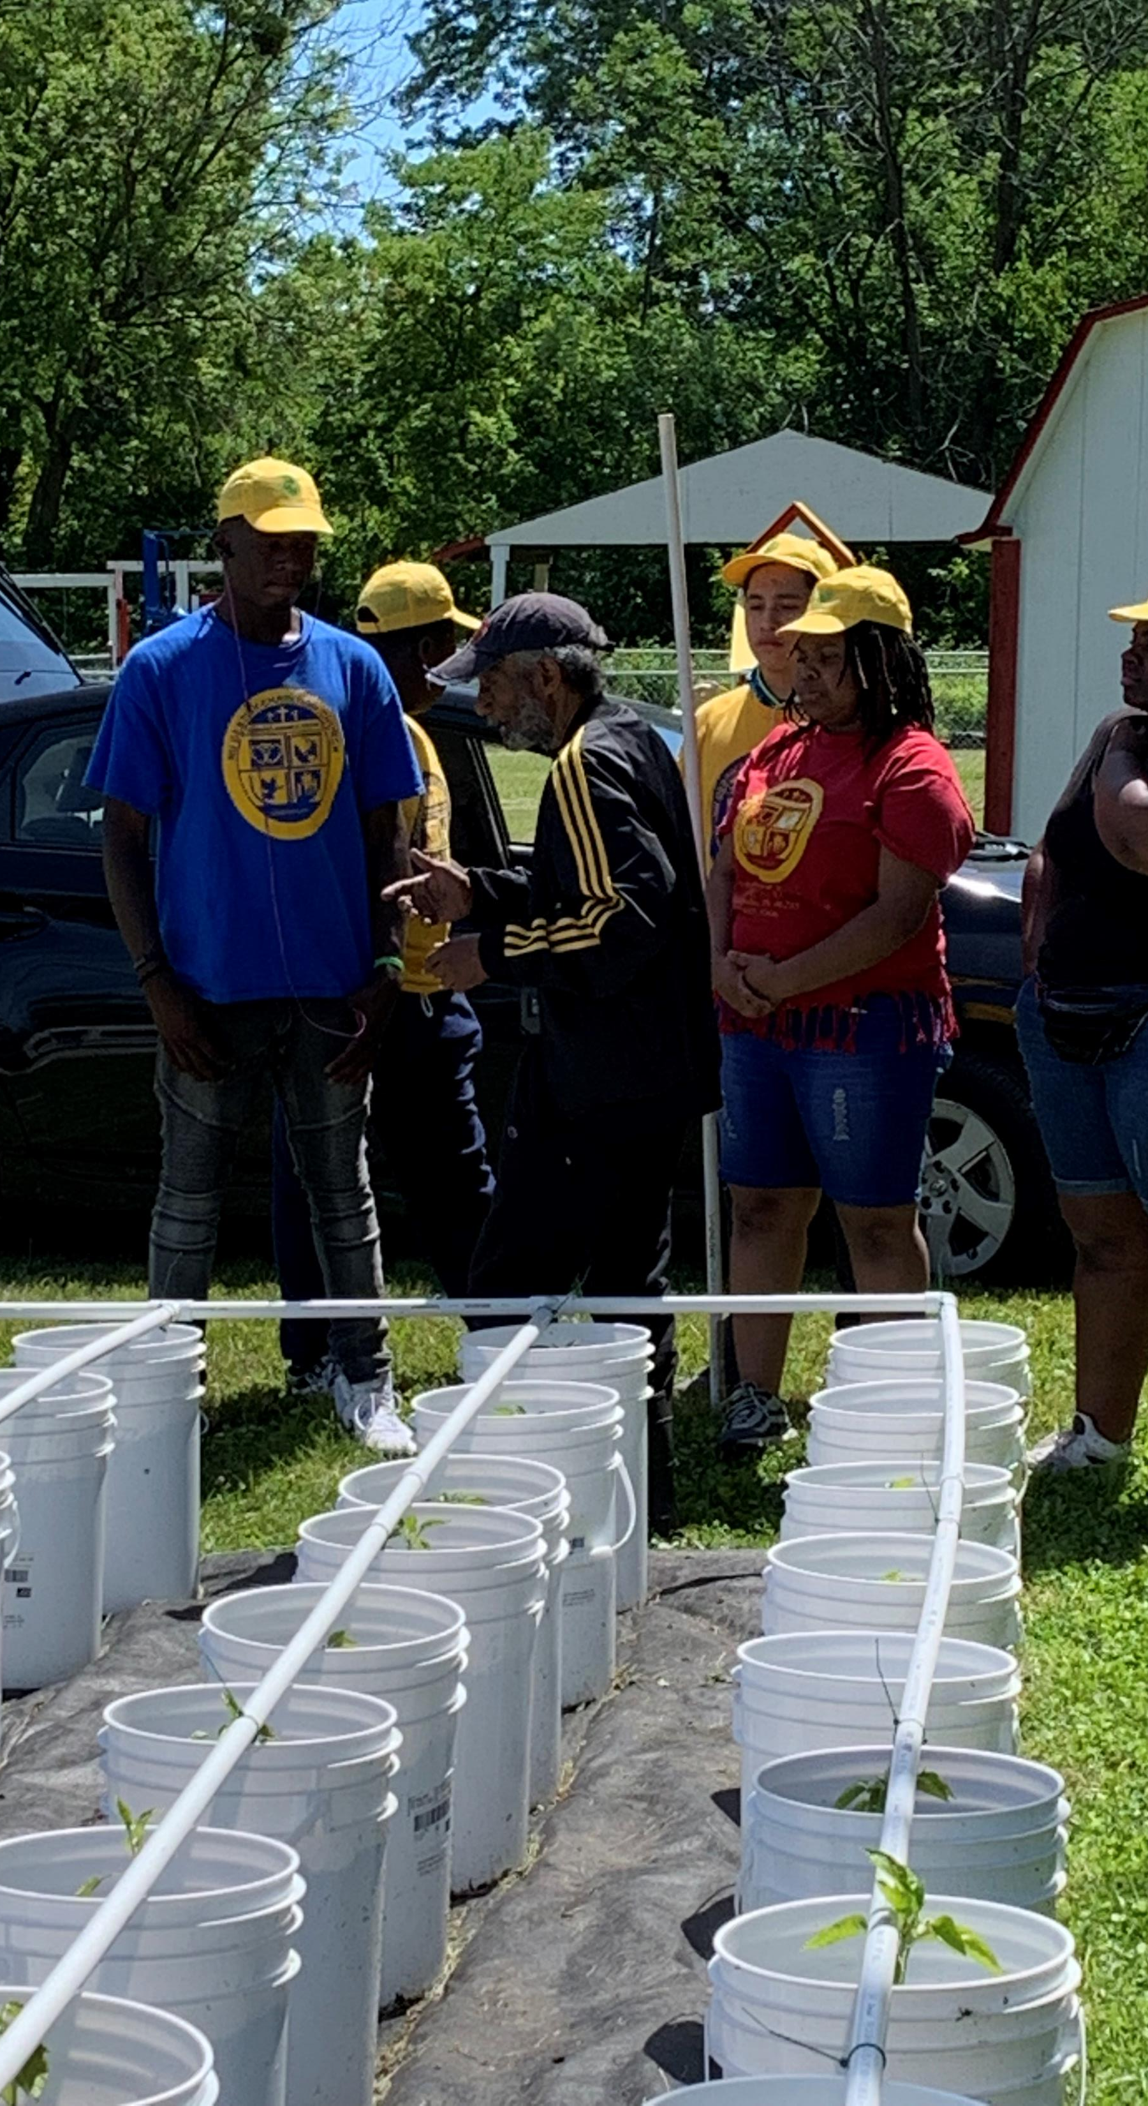
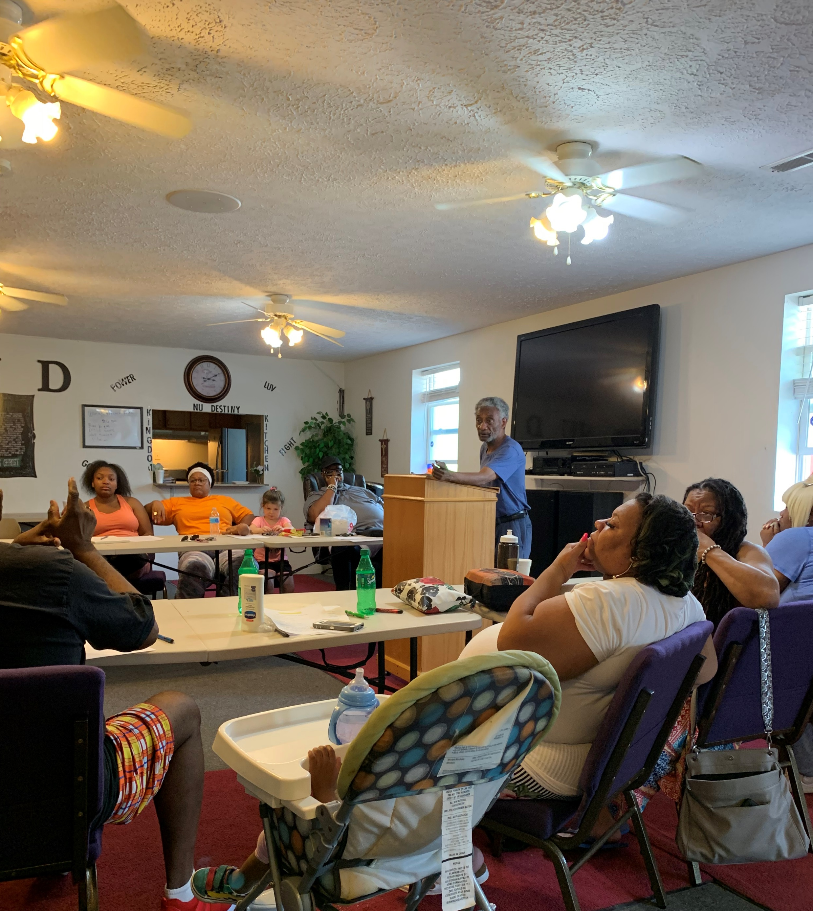
Various growing techniques
Traditional
Bucket irrigation
Urban Garden classes
Jr Master Gardeners program

Slide 9
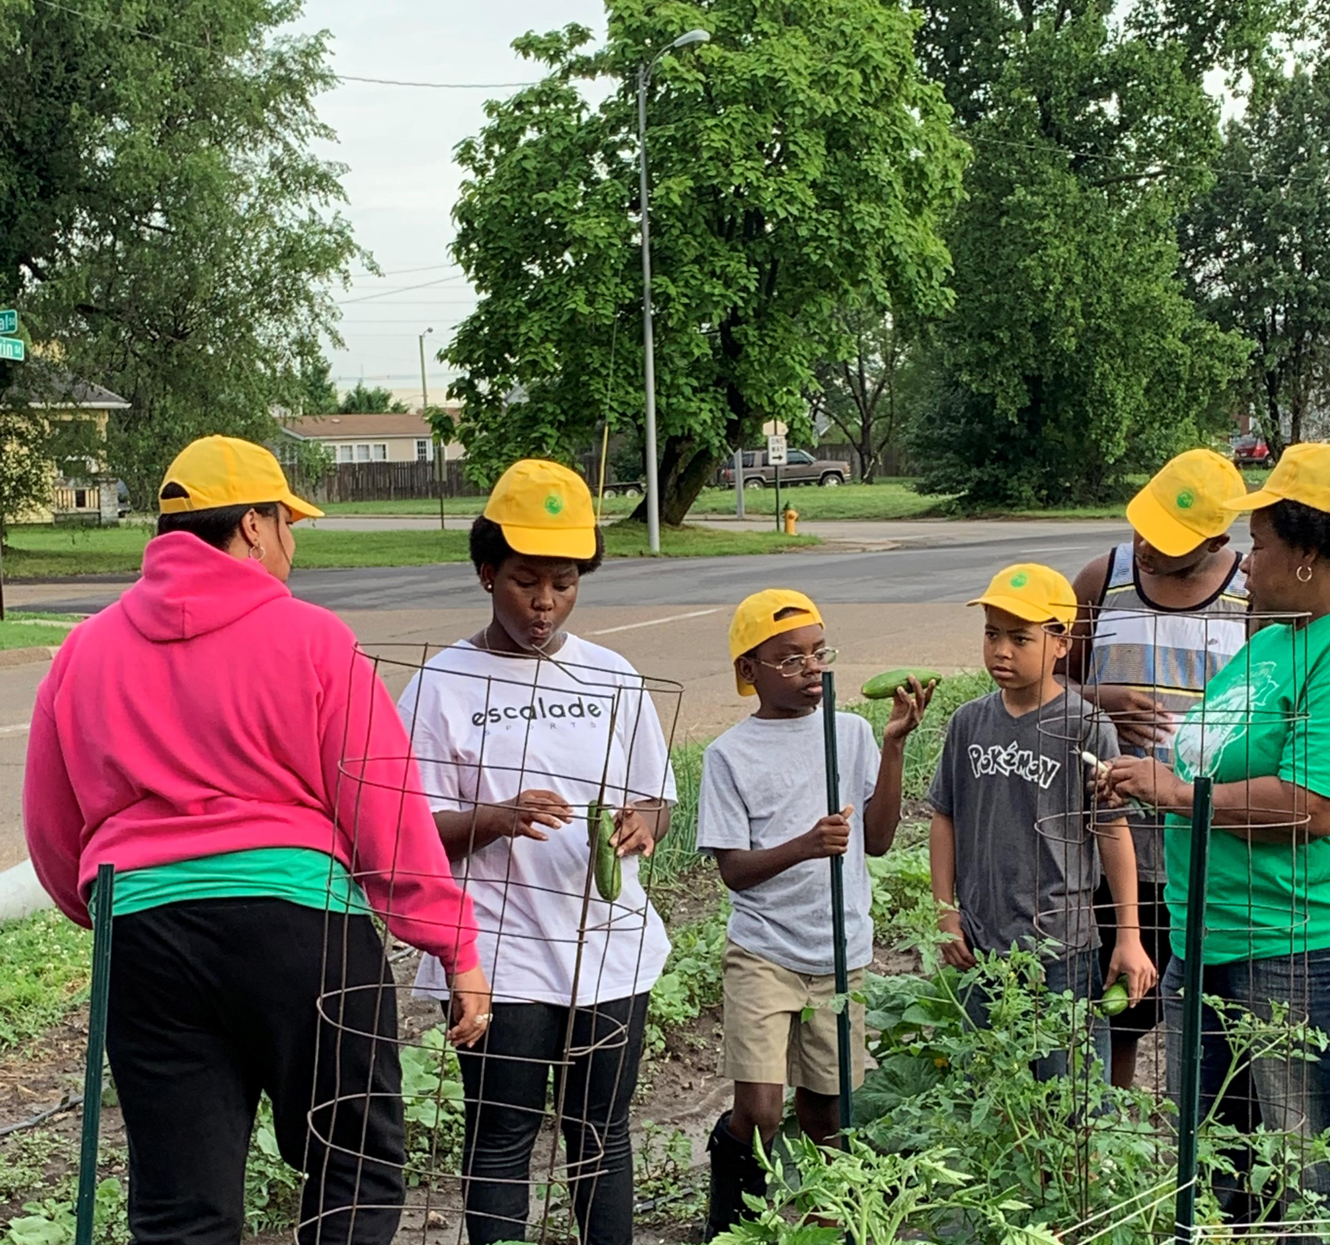
Marketing the harvest

Slide 10
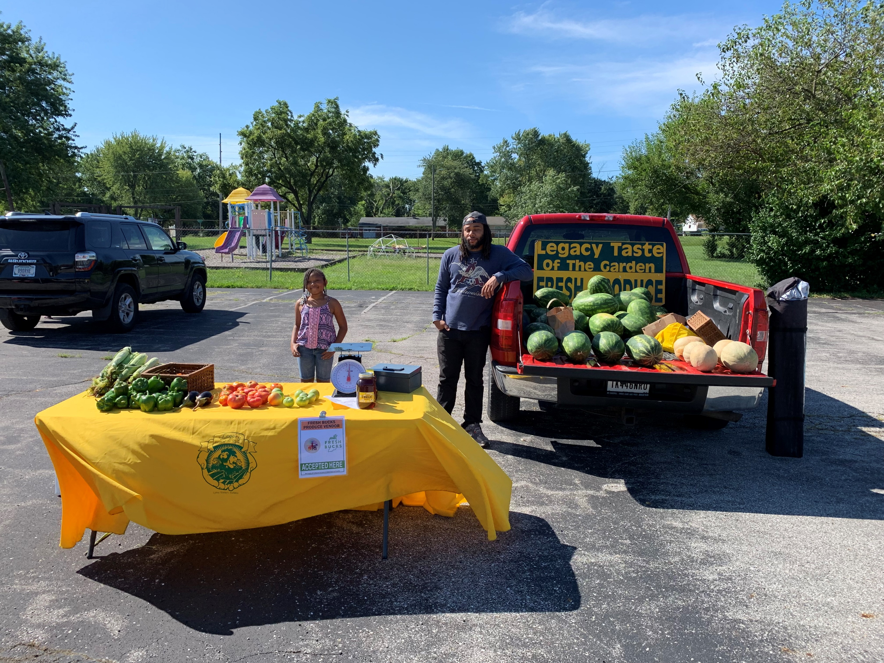
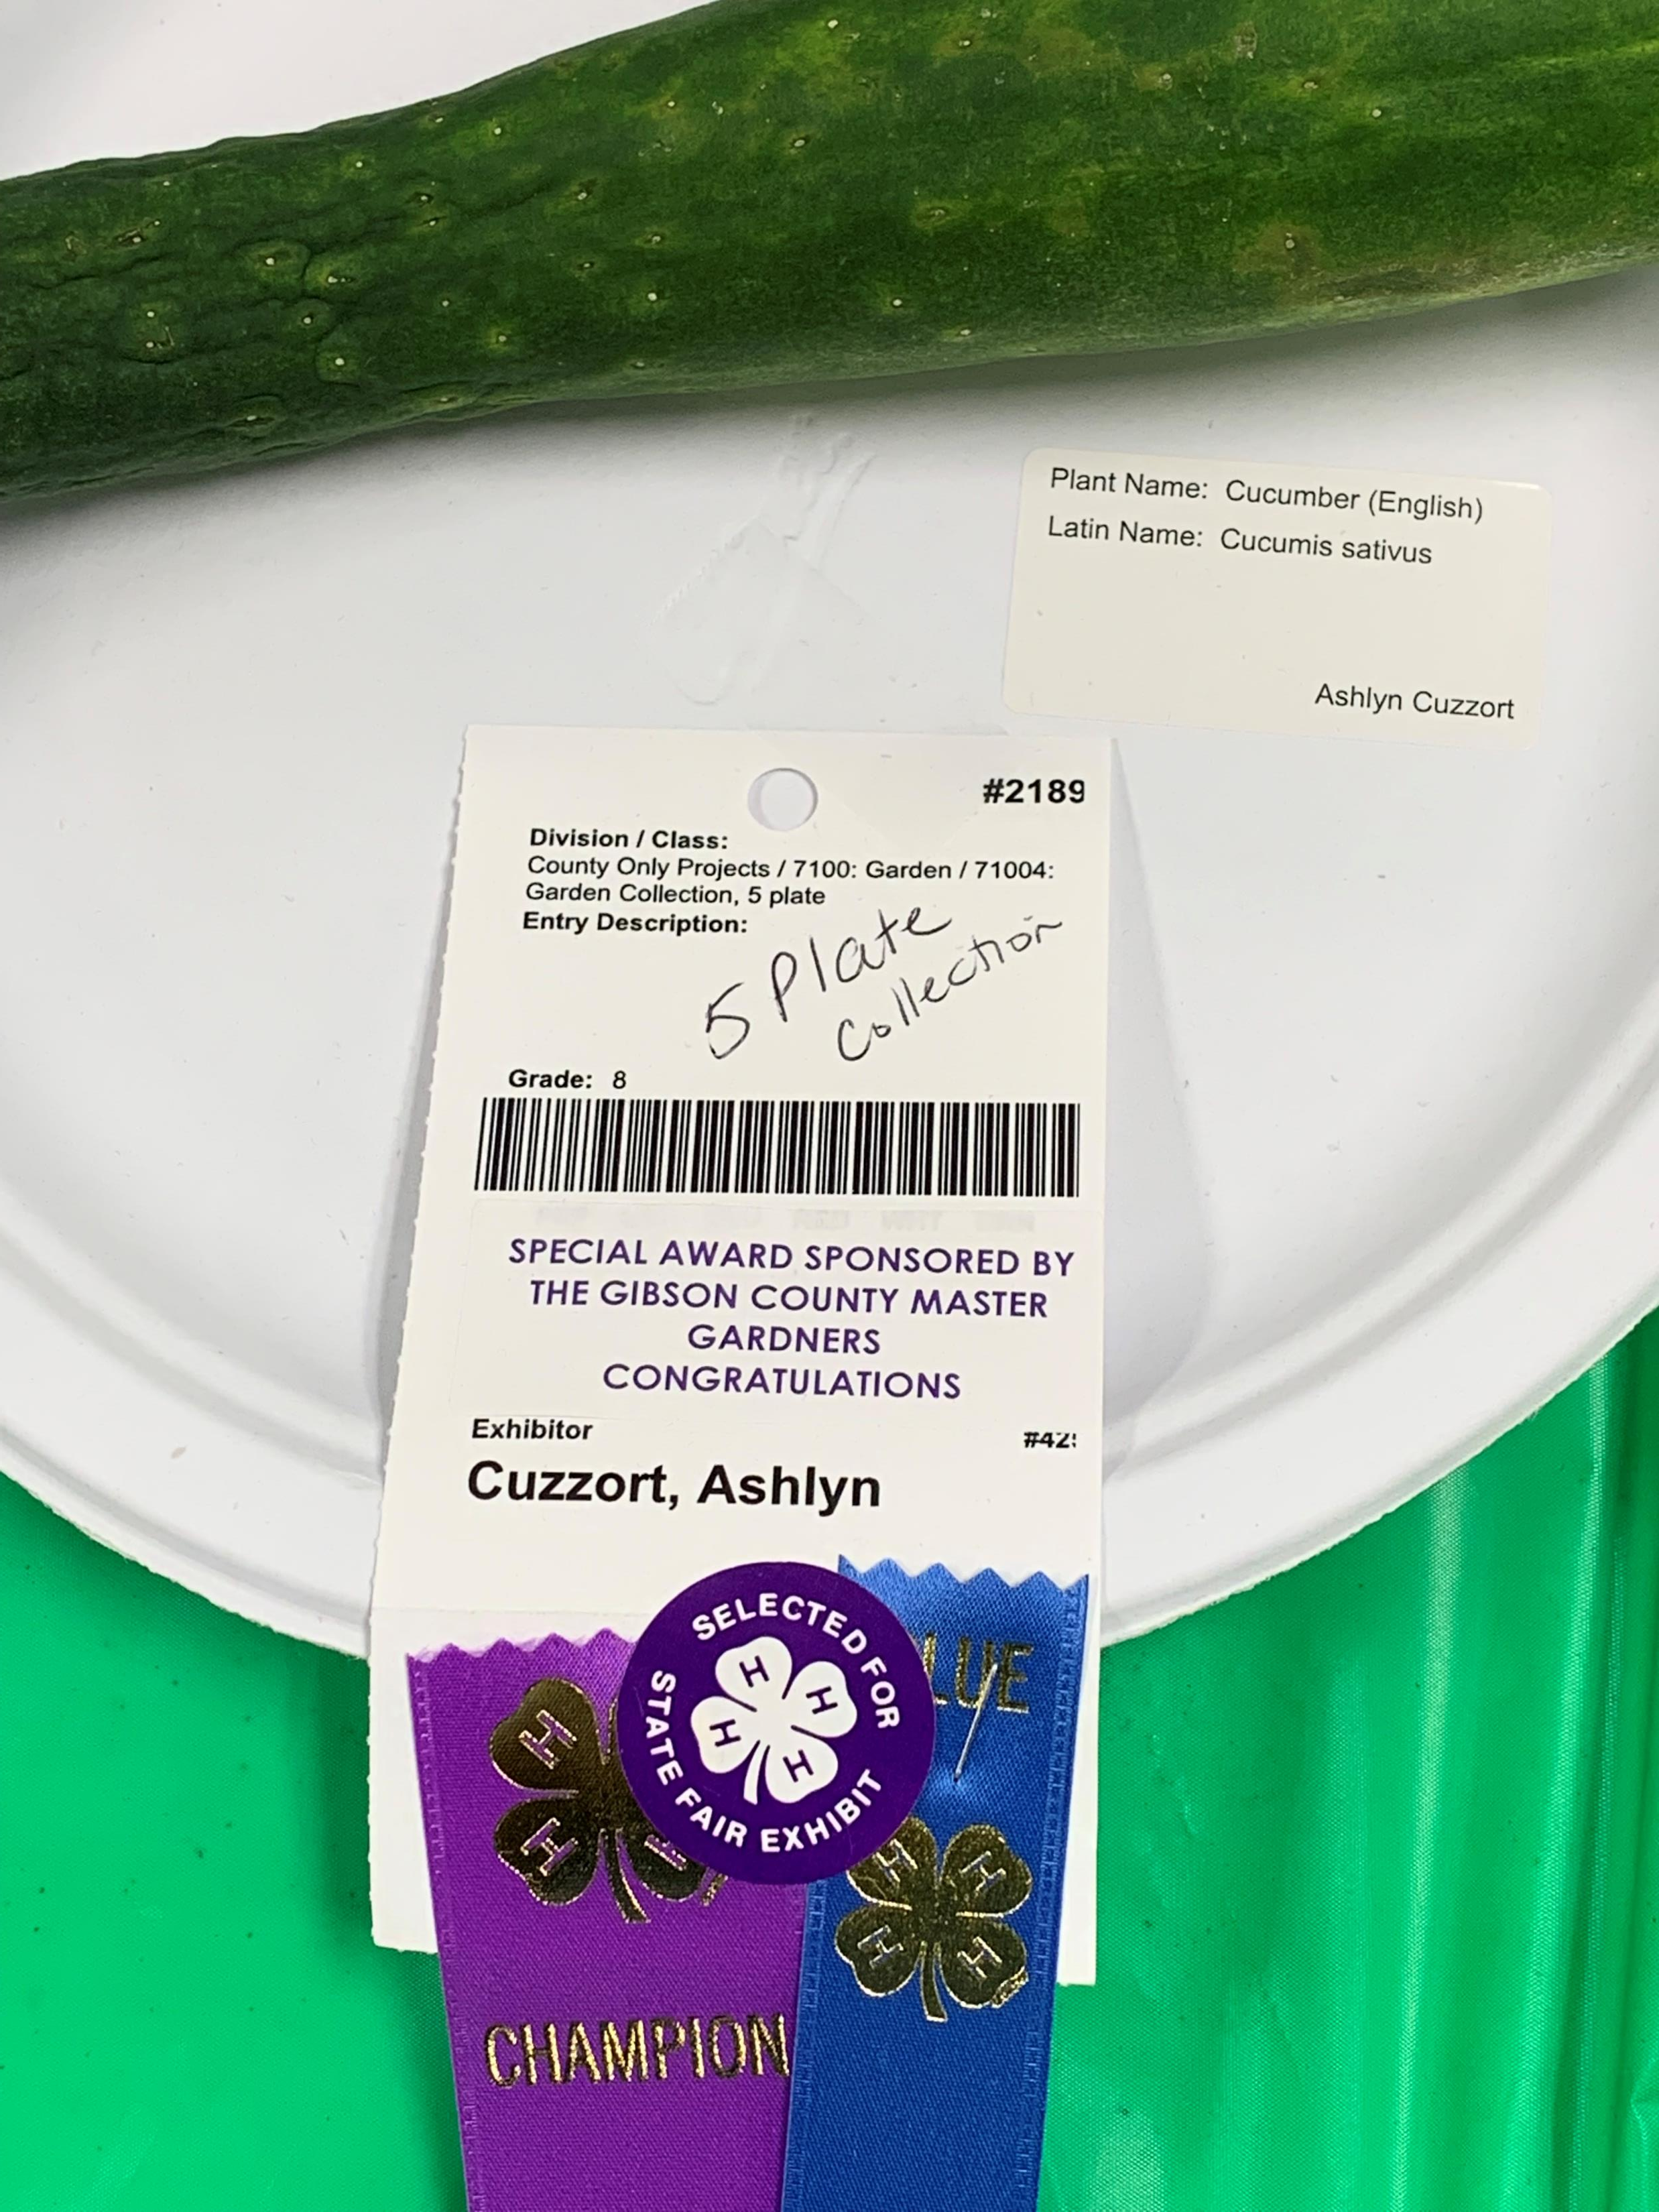
Pride in a great harvest
Youth group learning the different types of vegetables
4H member County Grand Champion
Mobile Market

Slide 11
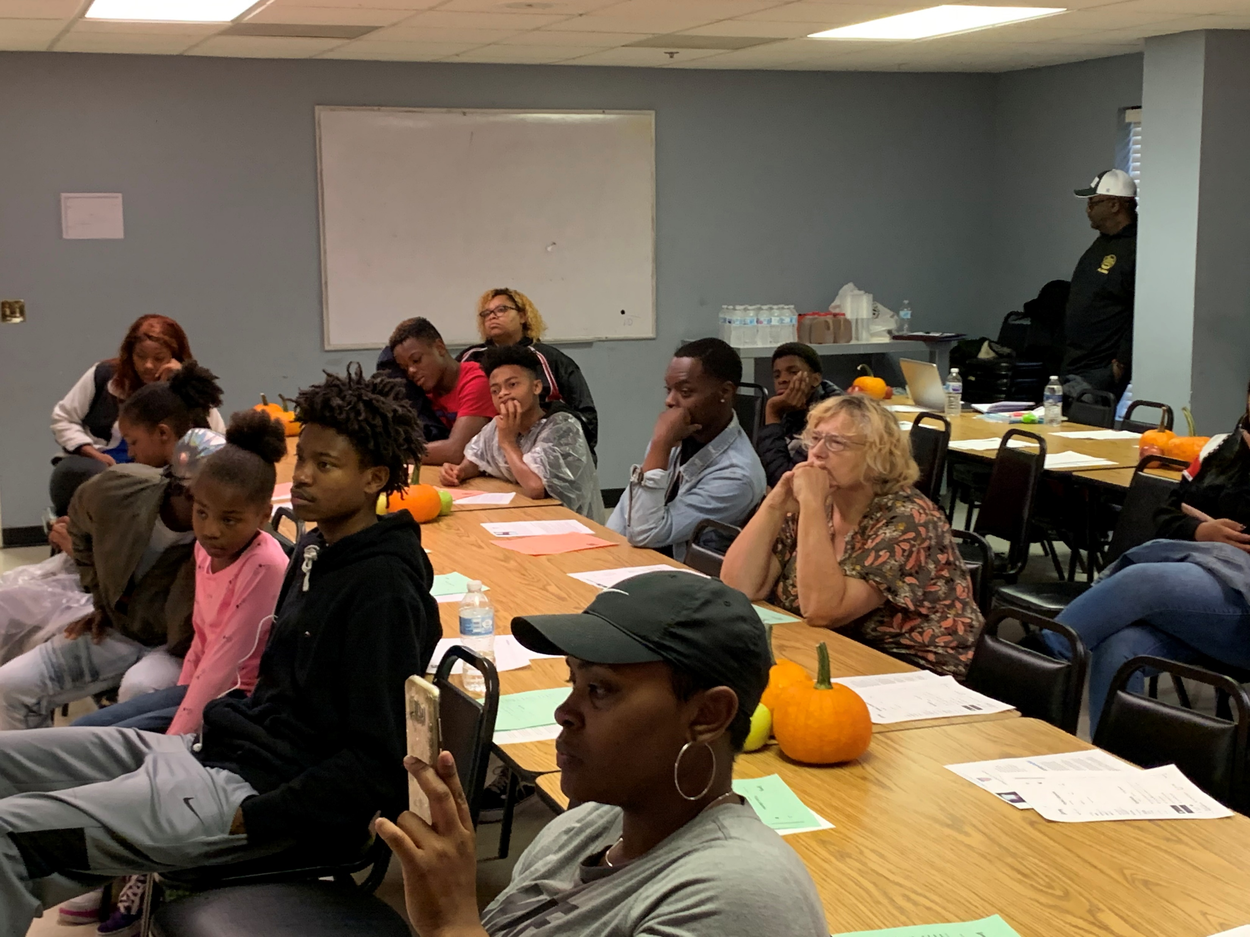
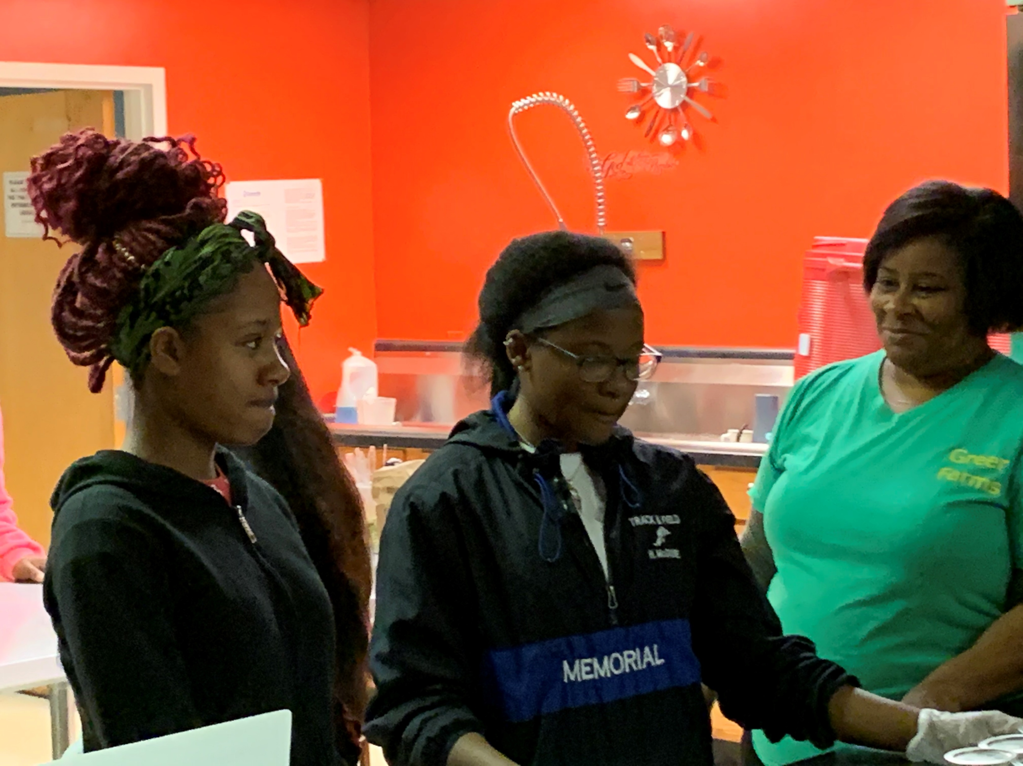
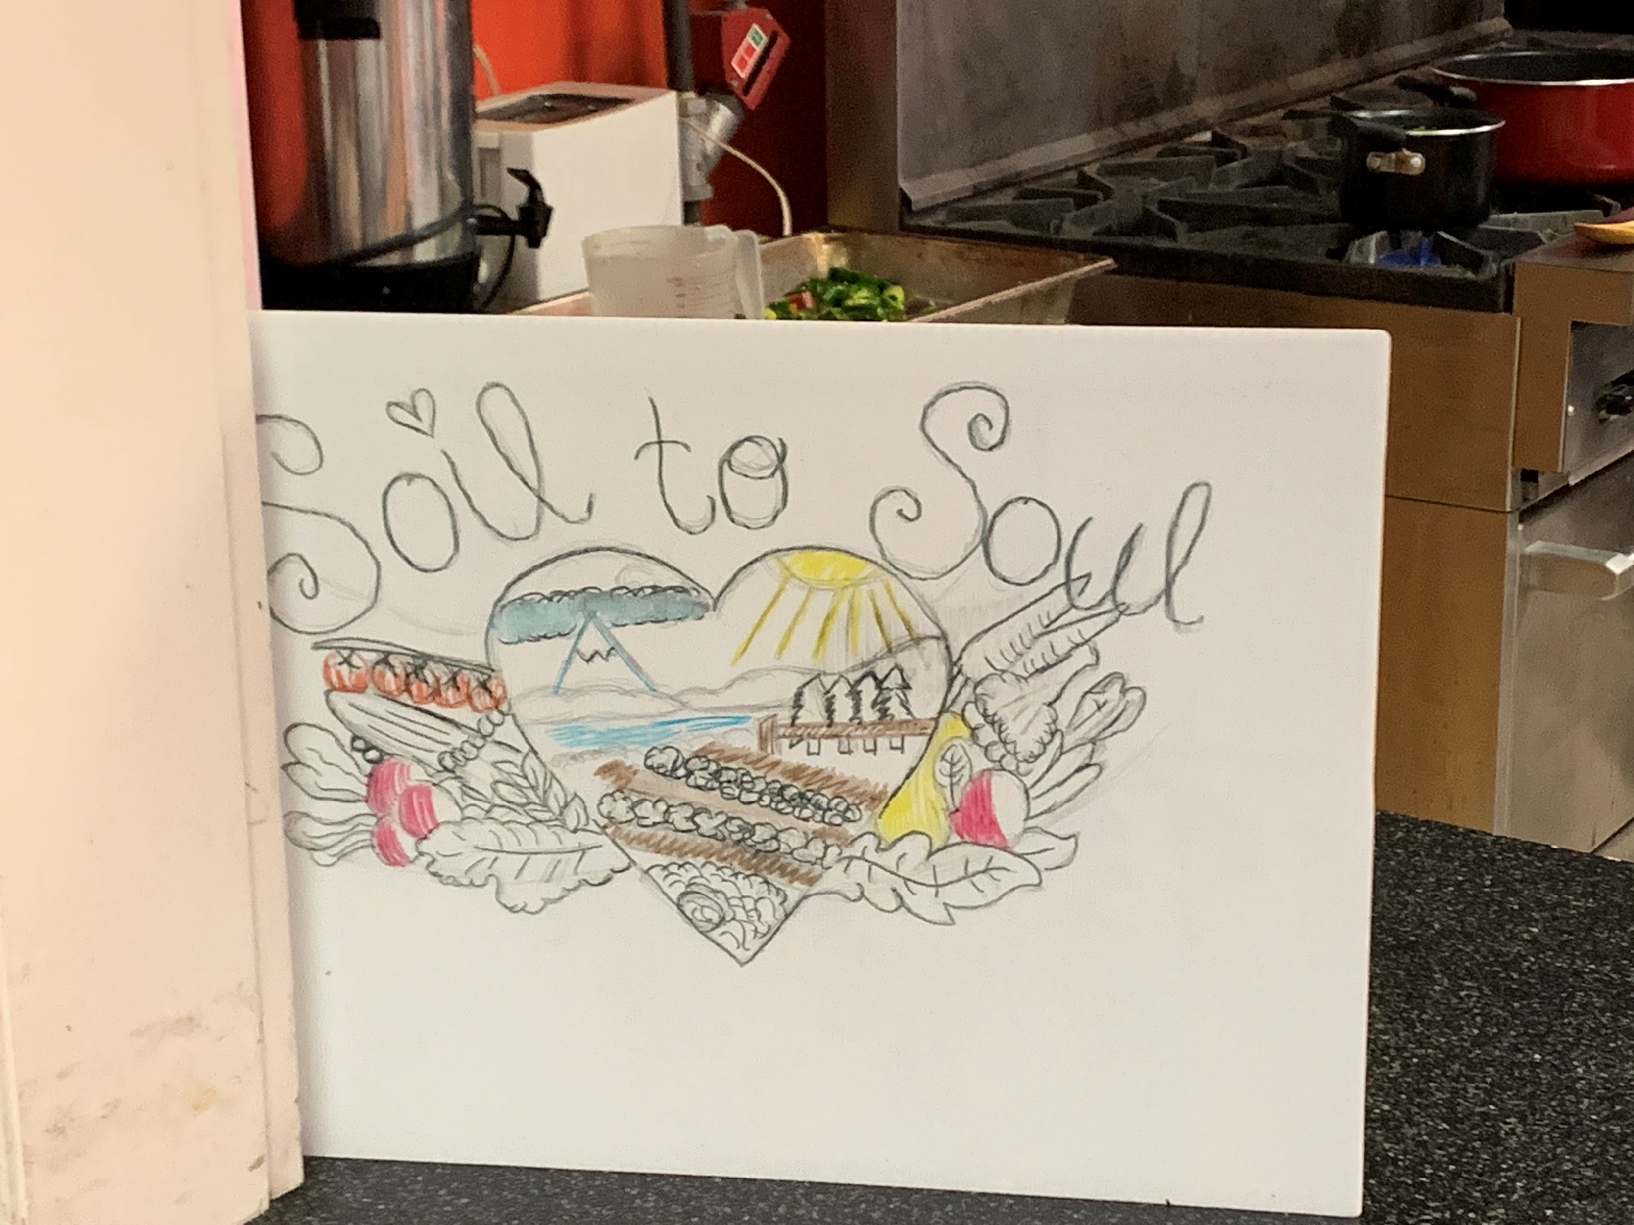
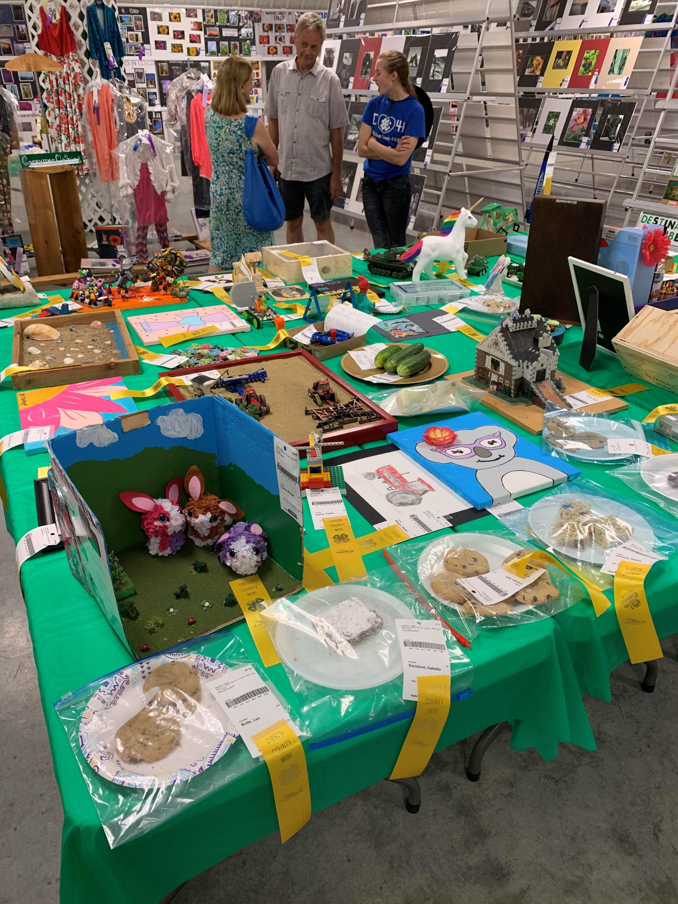
Presentations
Youth presenting what they learned
Canning
Community Education
Value Added

Slide 12
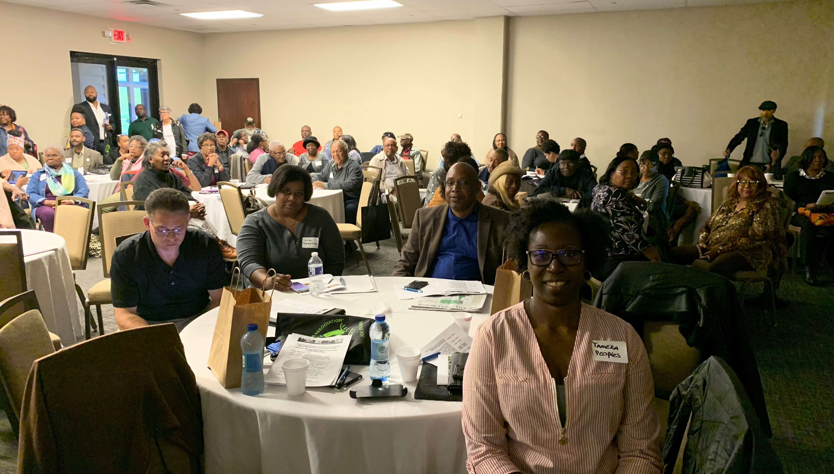
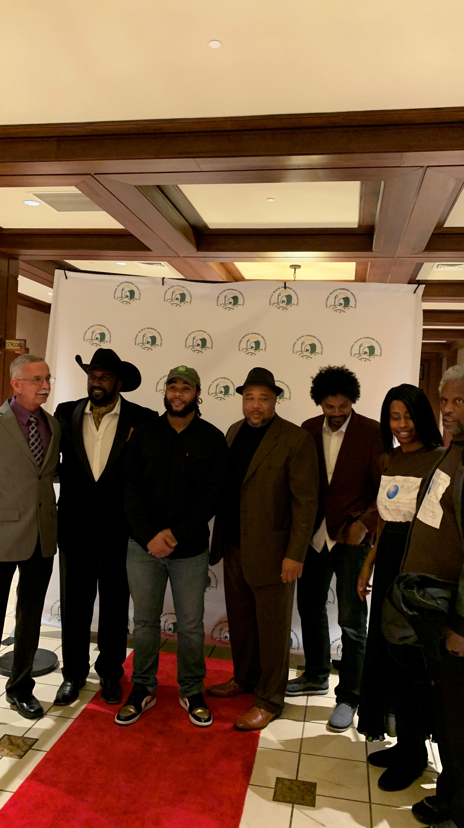
Partnerships
NBFA National Black Farmers Assoc.
Legacy Farming and Health Group
AgrAbility
Purdue Extension
Local Organizations: Churches, Groups and Hospitals

Slide 13
Legacy taste of the garden llc (812)385-0159
2019: SARE Grant Awardee
2019: 2501 Grant Awardee
Purdue Master Gardener member
Jr Master Gardener instructor
Trauma Nutrition
Indiana Black Farmers
B.I.G.
Indiana Grown

Slide 14
Where to begin Climate & environment change

Slide 15
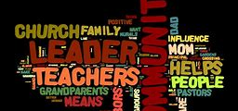
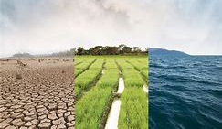
Key points to a great community communication strategy
Identify Community Needs (Issues and Affects)
Identify Community Leaders (Those who are actively Involved)

Slide 16
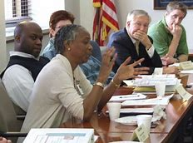
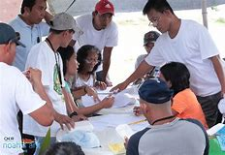
How to relate your message
Keep Ownership (LEGACY) with Community Members as active participants in Designing, Decision making and Development of programs.
Build a Trustworthy Relationship: Know Your Why; Humble Your Opinion; Listen/Respect Their Point of View and Be Open to Root Causes.

Slide 17
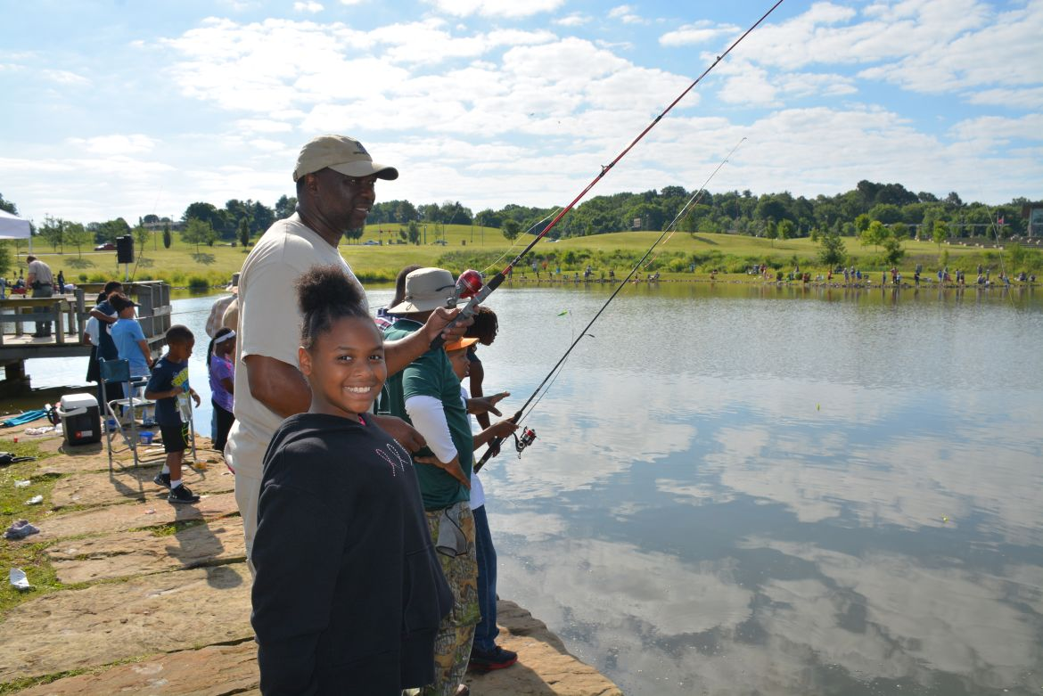
Making it work
Grass Roots
You are a Tool (Education is Key: Teach them to Fish)

