Slide 1
Leveraging Biodiversity
To improve profitability on a small scale vegetable farm

Slide 2
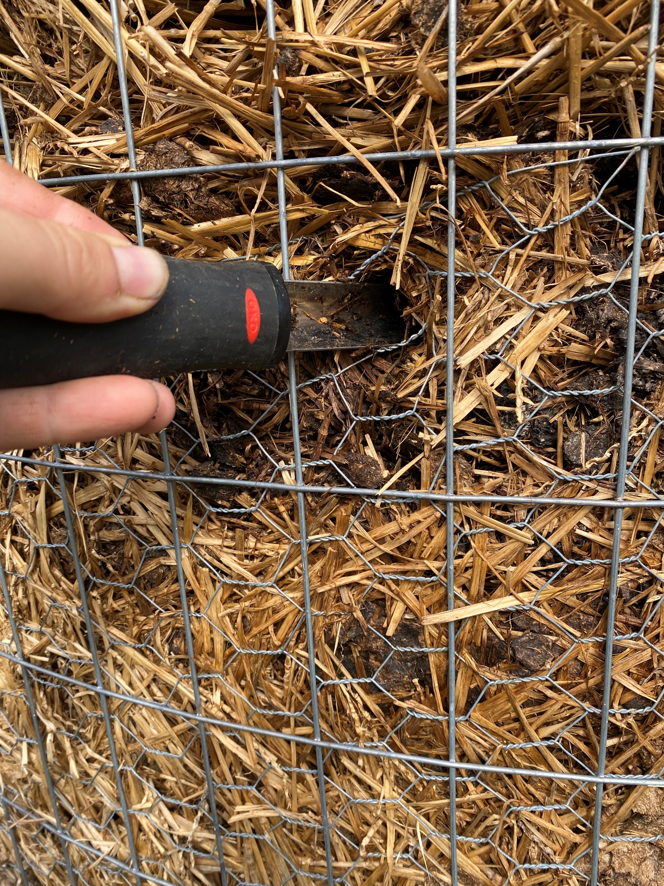
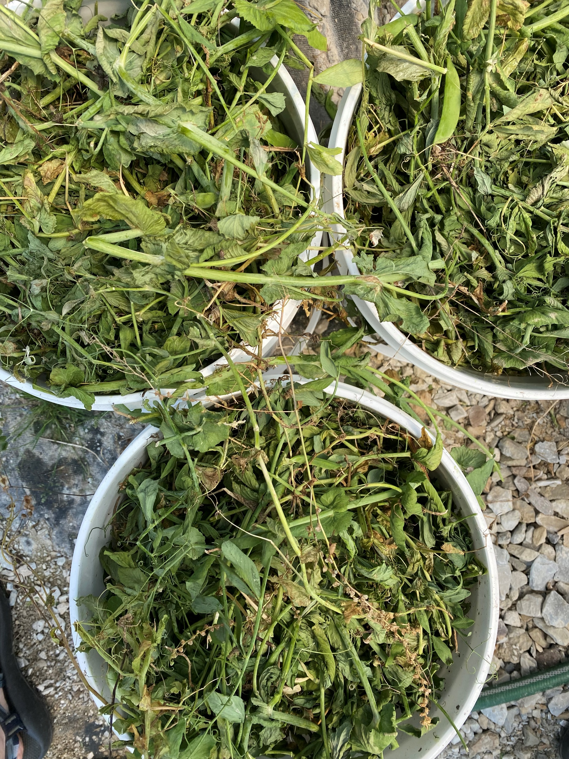
The Compost

Slide 3
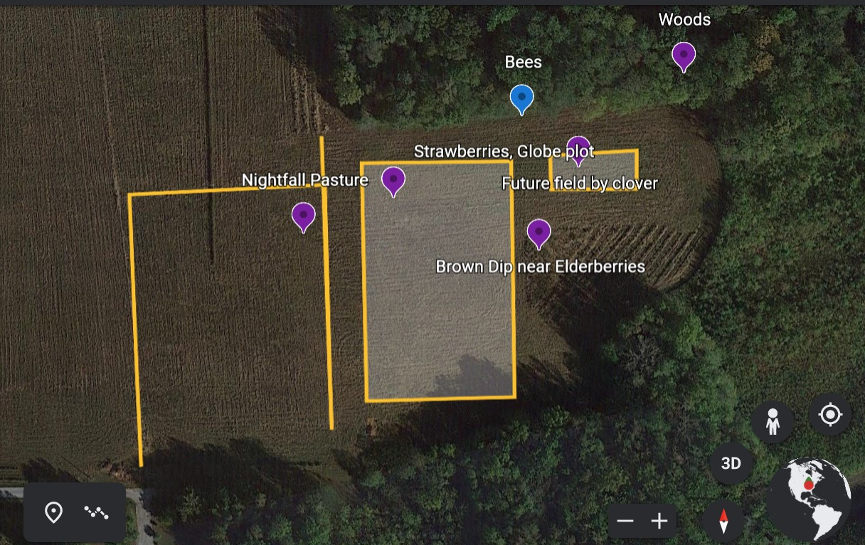
The Field

