Slide 1
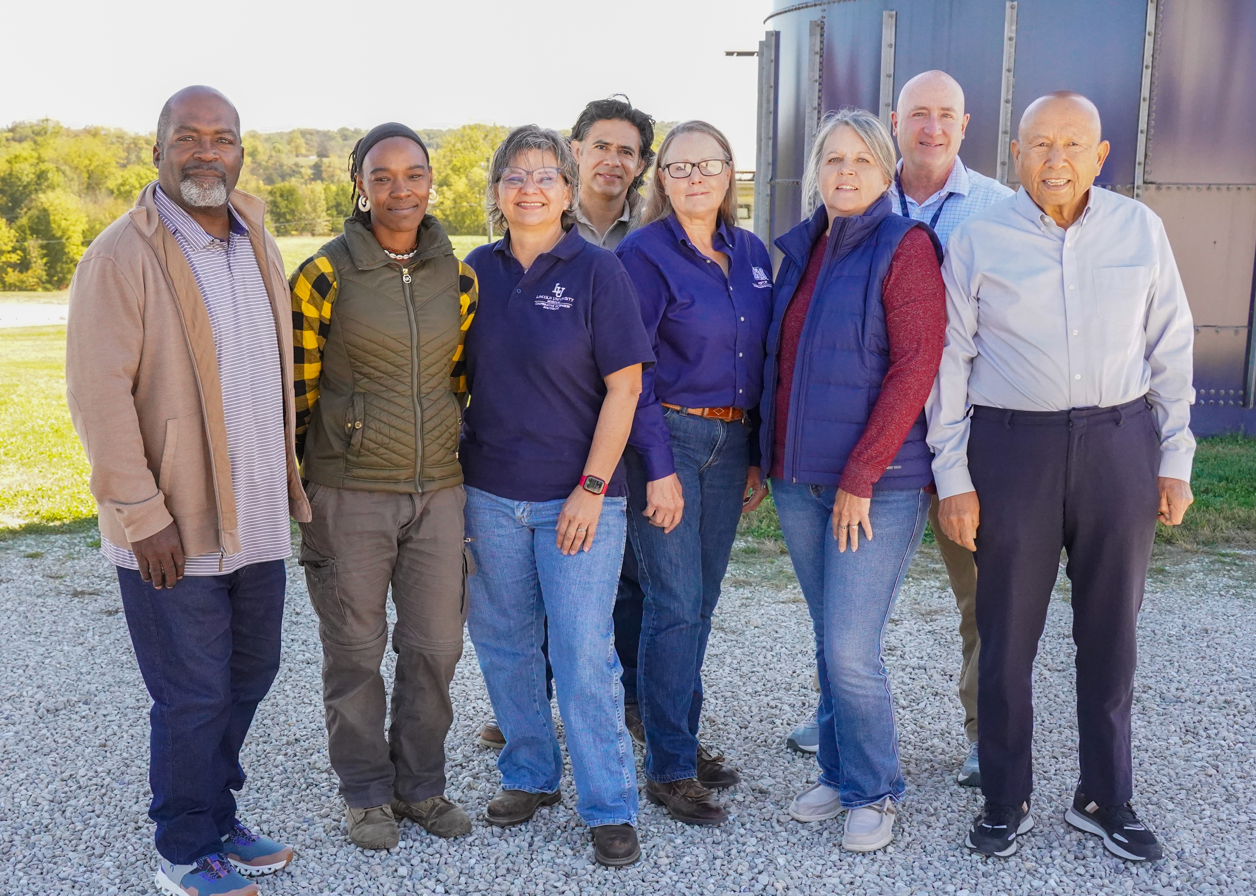
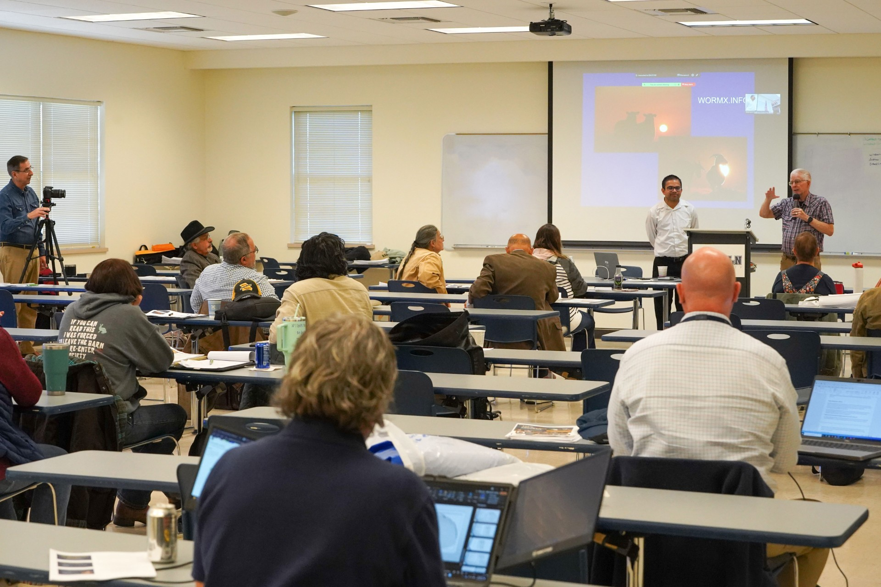
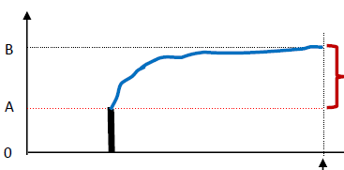
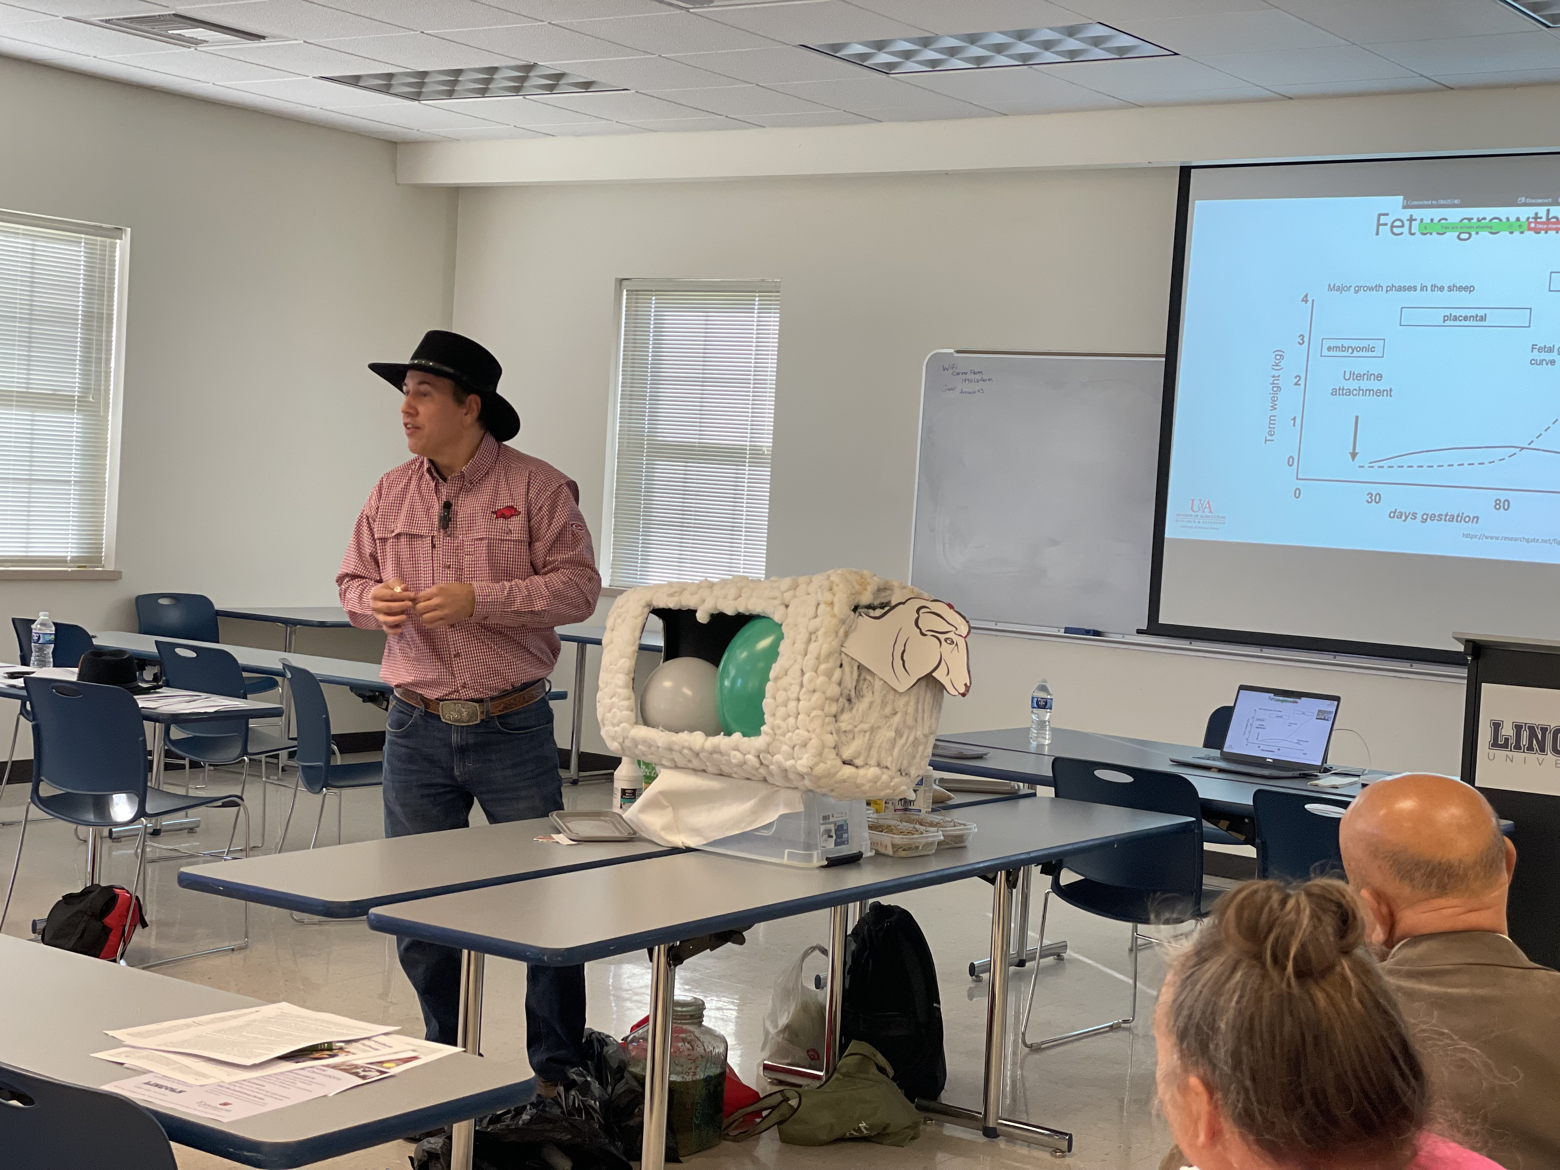
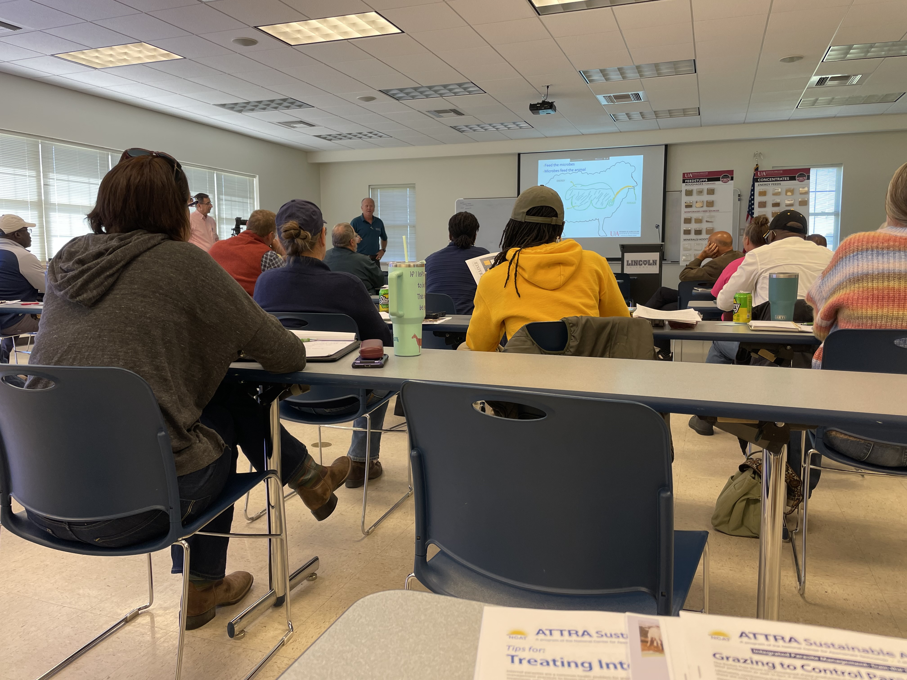
Extending Pasture-based Sheep and Goat Production Information to the Farmers through Train-the-Trainer program
Mohan Acharya &Tanner Tipton| Lincoln University, Jefferson City, MO 65101
Background Information
Outcome
Evaluations by participants were conducted immediately after each session.
94.68% were satisfied with the relevance information that participants were seeking for, expertise of the speakers, and quality of lecture delivery by the instructors.
Before the workshop, 72.8% of the participants had knowledge about forage-based sheep and goat production which increased to 82.8% after the training.
80% of the participants expressed interest to include forage finished sheep and goat production in their curriculum to train other sheep and goat producers.
Lincoln University and future of work
There will be one train-the-trainer even in October of 2025 and same month in 2026 at Lincoln University of Missouri. Major areas covered will be Forage finished sheep and goat production, Small ruminant economics, and disease control in ruminants. Please follow https://www.facebook.com/LUCAEHS Facebook page for details regarding upcoming programs.
Non-Discrimination Statement
As an equal opportunity employer and provider, Lincoln University does not discriminate based on race, color, religion, national origin, sex, sexual orientation, age, disability, or other factors prohibited by law in any of its educational programs, activities, services, admissions, or employment practices.
Participants
Animal protein should be produced in a sustainable manner for human consumption that do not compete with grain grown for human consumption.
Access to high quality forage can produce leaner-lamb carcass without grain supplementation and a healthier fatty-acid profile.
NCR SARE in collaboration with Lincoln University Cooperative of Extension organized train the trainer program to extend forage finished sheep and goat production information to the farmers through train-the-trainer program.
Analytical Approach
Before versus After approach was used to compare their knowledge, skills, perception, and attitude before the training and label of change of the same individual after the training
Training Methods
Practical demonstration
Lecture series
Most of our participants were Lincoln University Small Farm Outreach Staffs, University of Missouri Extension Specialists, County educators, Livestock consultants, Farmers and Graduate Students.
Impact
Indicator
After the training
Before the training
Before
Impact Assessment
Demonstration of sheep digestion by Dr. Dan Quadros
Feed formulation software training by Dr. Ken Coffey
Additional lectures on
Web re-sources for sheep/goat production by Ms. Linda Coffey
Forage finished sheep or goat production by Dr. Bruce Shanks
This program is made possible by NCR SARE professional development grant (ENC23-220).

