Slide 1
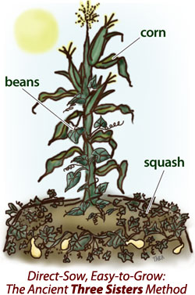
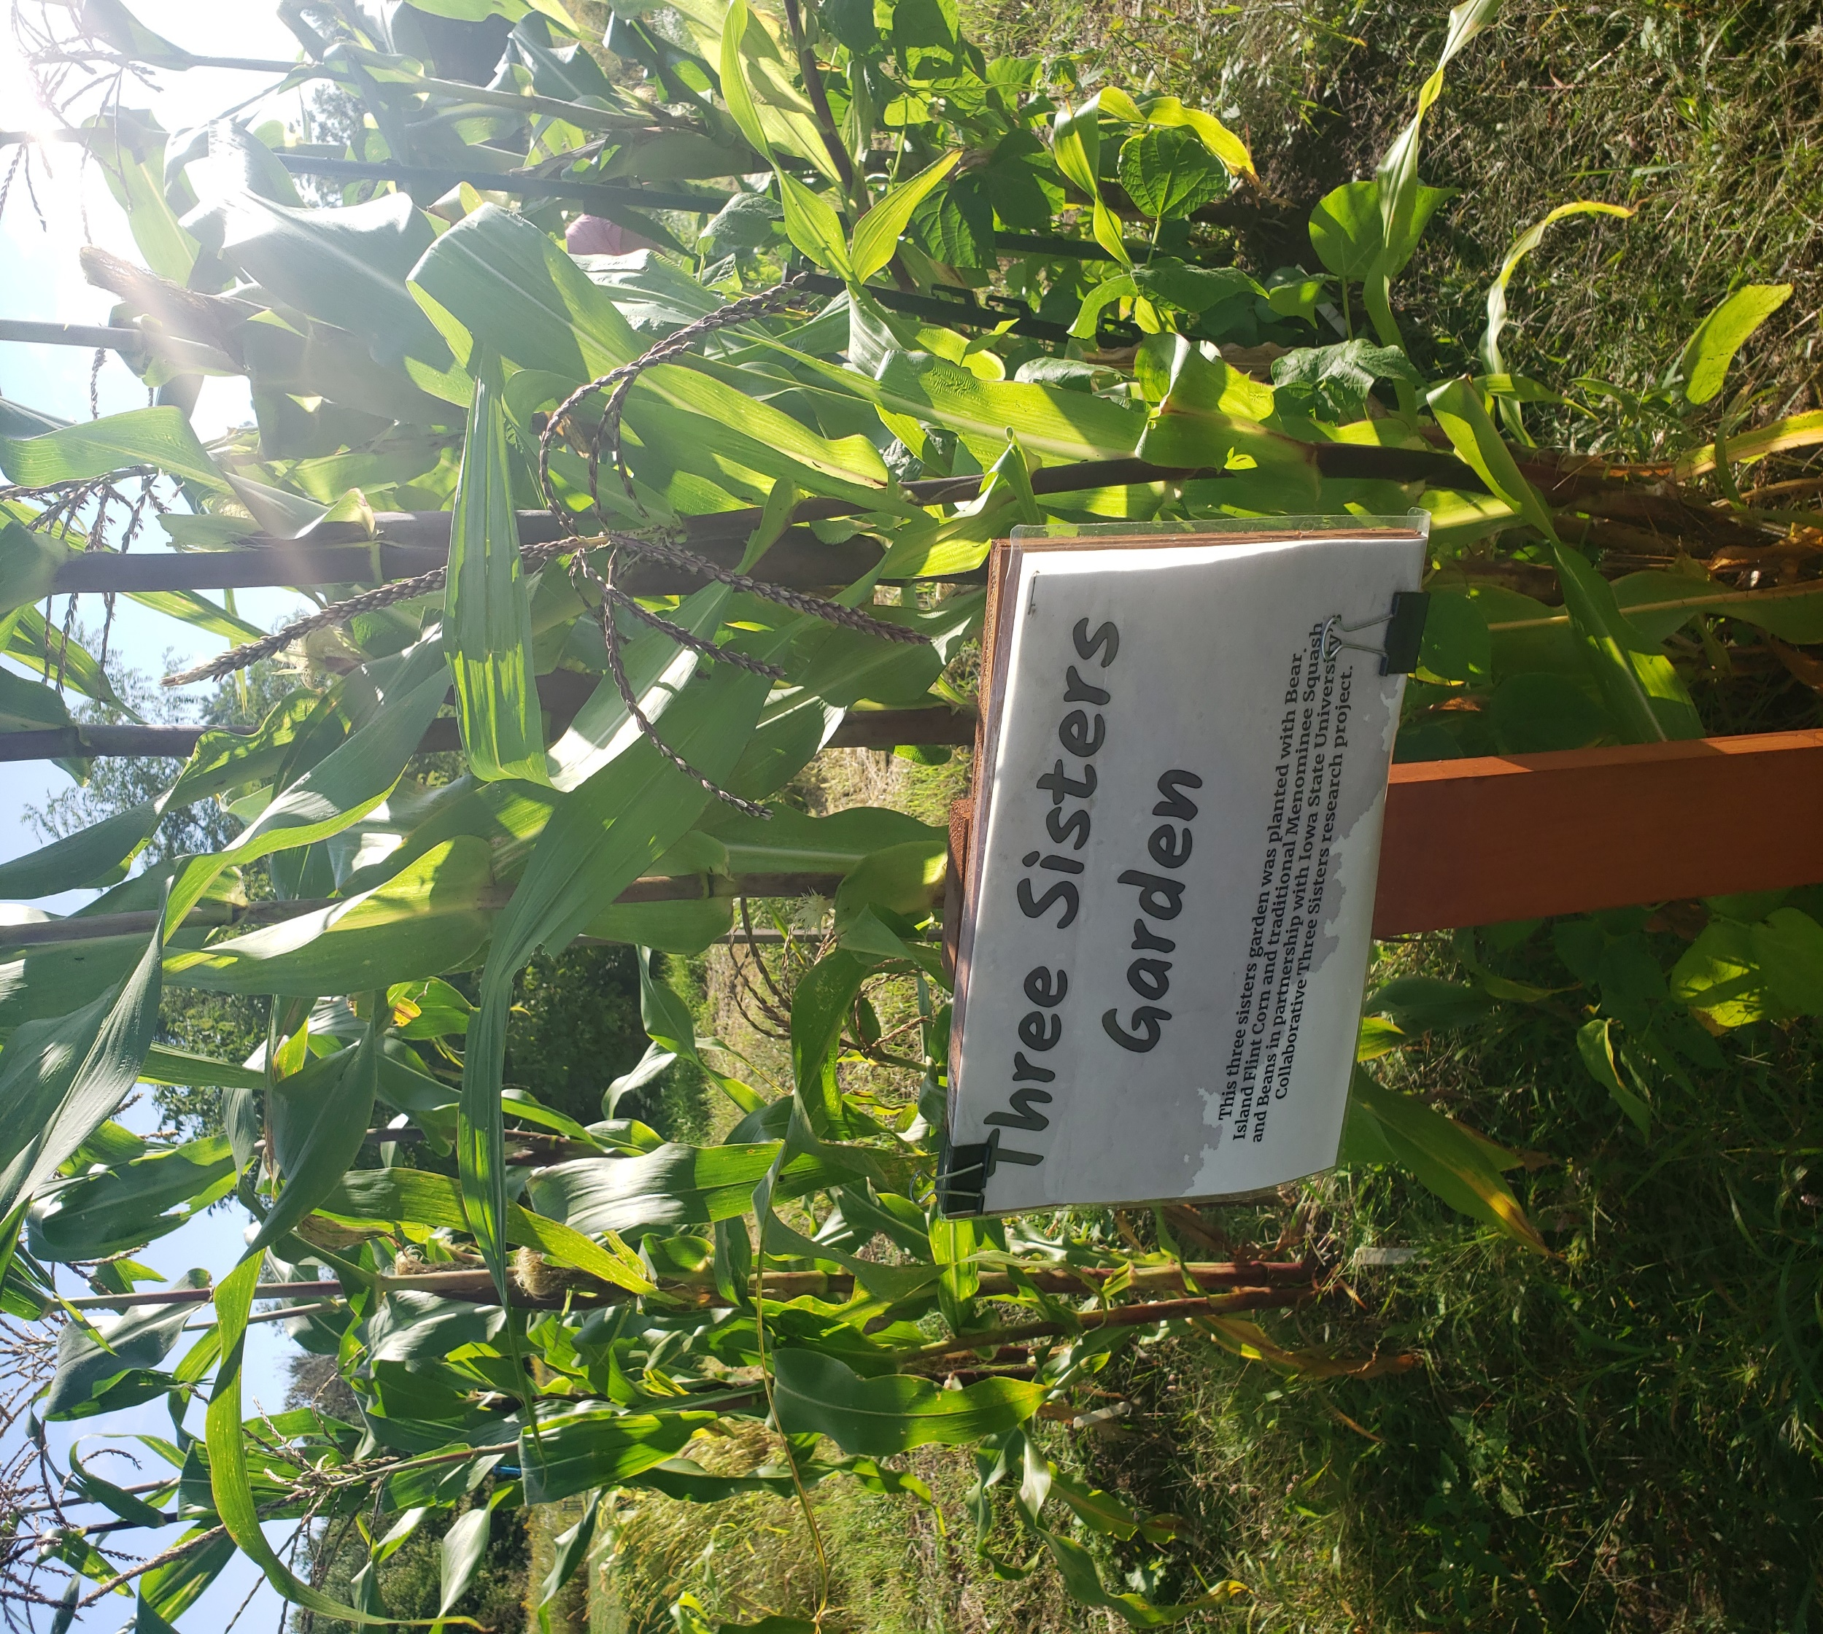
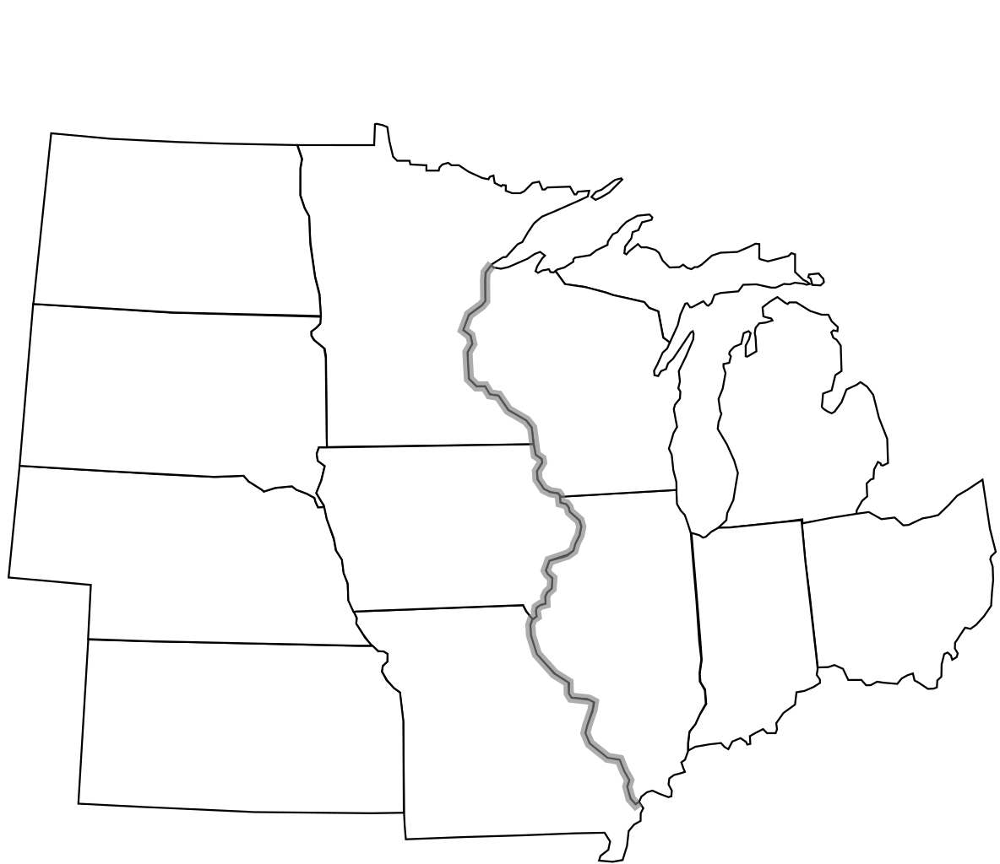
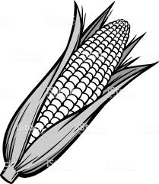
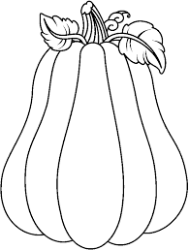
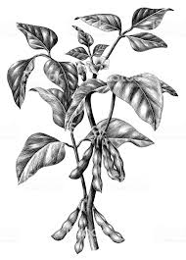
Reuniting the Three Sisters: Cultural and Agronomic Underpinnings of Corn, Squash, and Bean Intercropping
Derrick Kapayou; Christina Gish-Hill; Marshall McDaniel
IOWA STATE UNIVERSITY
Introduction
This is a cross-disciplinary project that combines both anthropological data, and soil health measurements
By working collaboratively with Native gardeners, our research will provide evidence for the socio-cultural, nutritional, and agroecological benefits of rejuvenating Native agriculture. (see Figure 1)
Our work will help to support increased awareness of the cultural, nutritional and environmental value of Three Sisters (3SI) to Native communities, as well as improved agricultural practices for soil health.
Materials & Methods
Anthropological Methods
Focused on cultural ties to gardens, as well as exploring the relationships between soils, plants, and people in the 5 midwestern Tribal communities that we are collaborating with. Example questions for interviews:
-Who taught you about your cultural ties to soil?
-What characteristics make a soil good?
-Does your tribe incorporate soils into cultural stories?
Soil Science Methods
Analysis of soil samples collected from within 3SI gardens and comparing them to monocrop (single species) plots, in order to quantify the differences in soil health between Native agriculture and contemporary agricultural practices. (see Figure 2)
Preliminary Observations
Participating Native communities value biodiverse cropping systems, both for agroecological and cultural reasons.
Soil and agriculture are incorporated into cultural stories and ceremonies.
Sustainable use of natural resources is highly valued.
Biodiverse cropping systems score higher during soil health analysis than do single species systems. (McDaniel and Grandy, 2016)
Native gardening culture favors site specific management, rather than a one-size fits all approach.
Cultural values determine whether an agriculturalists will act with respect to the environment.
Discussion
More seasons of controlled garden plots to gather soil health data are needed, as well as more seasons of ethnographic data collection.
Collaborative science with Native farmers can overcome barriers to improve soil and community health
Culture
History
Food/Health
Native Community
Citizen Science
Manage Fertility
Soil Health
Healthy Soils
Sustainability
Three Sisters Intercropping
Fertility
Biodiversity
Sustainability
Figure 1: Plant-soil-human conceptual cycle. Native cultural practices determine their relationship with their soils, helping to healthy crops that support a happy community
A.
B.
Soil health indicators
C.
M = Maize (Corn) Zea mays
M
B
SYNERGISTIC EFFECT OF M,S, & B COMBINED
B = (Bean)
Phaseolus vulgaris
AVERAGE EFFECT OF M,S,B ON SOIL HEALTH
S = (Squash)
Cucurbita
S
3SI
3SI= Corn, Squash, & Bean
M
B
S
3SI
Figure 2: Description of experimental design and associated hypothesis. Items A. and B. describe plot layouts. Item C. describes the synergism effect we expect from the 3SI working together on soil health
Citizen Science Benefits:
Puts the generation of farm knowledge back into that hands of the famers, helping create feelings of empowerment
Helps to build interconnections between farmers
Helps researchers to see agricultural problems from a different perspective
More data! (Ryan et al. 2019)
Barriers to gardening within collaborator communities
Lack of agricultural knowledge
Not enough time to build and maintain a garden plot
Animal influence (dogs especially)
No water source near garden
Inability to find available space for a garden
Networks of gardeners within some communities not yet built so new gardeners lack outside assistance
Childcare issues
Lack of access to seeds and gardening equipment
DREAMS OF WILD HEALTH
MENOMINEE
SANTEE SIOUX
ONEIDA
OMAHA
IOWA STATE UNIVERSITY
Acknowledgements
FUNDING:USDA-NIFA-CARE; Sustainable Agriculture Research and Education; Bridging the Divide Grant –Iowa State University
Figure 3. Map of the United States Upper Great Lakes region showing locations of collaborator tribal communities.

