Slide 1

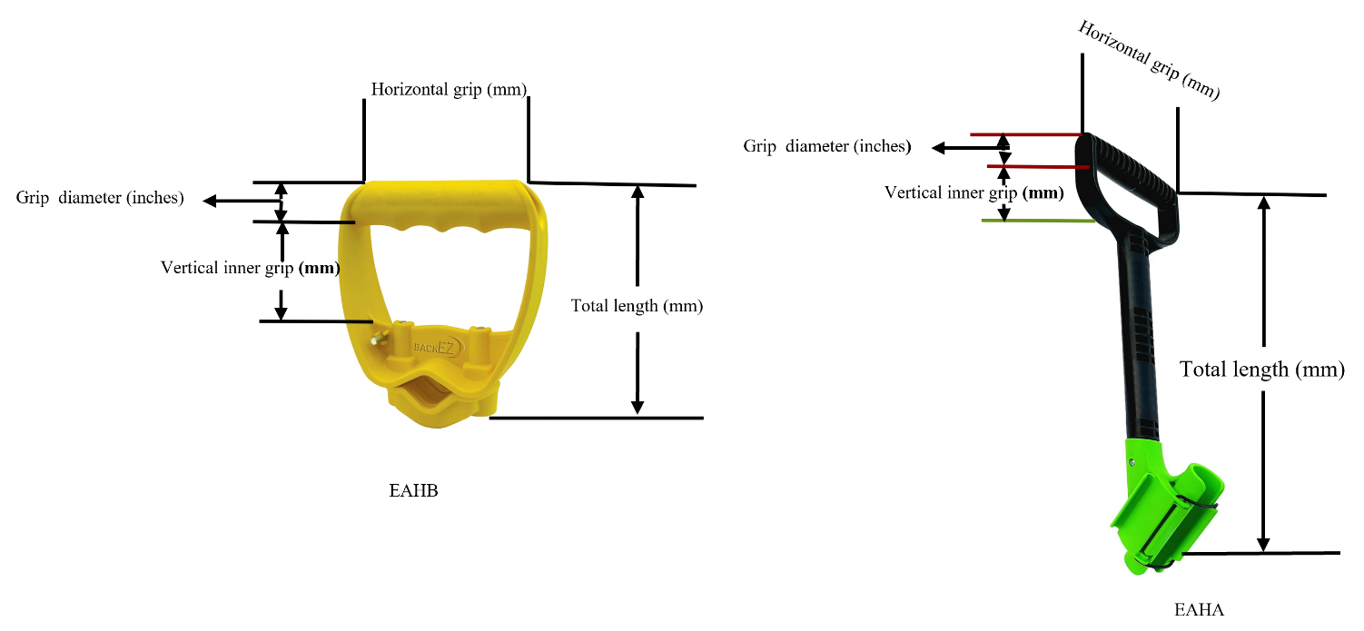
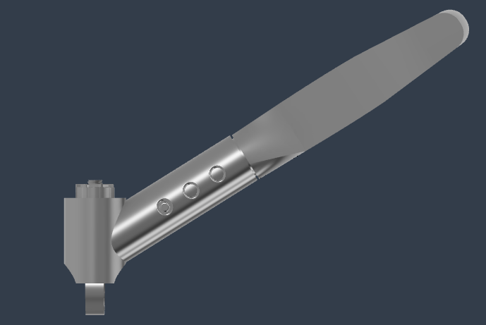
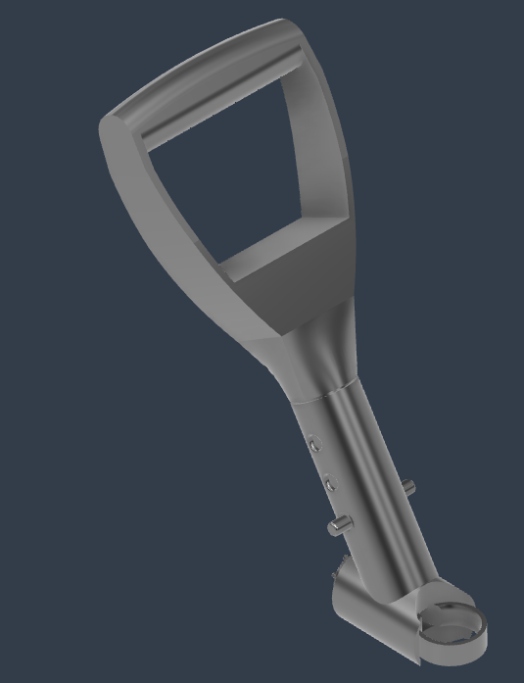
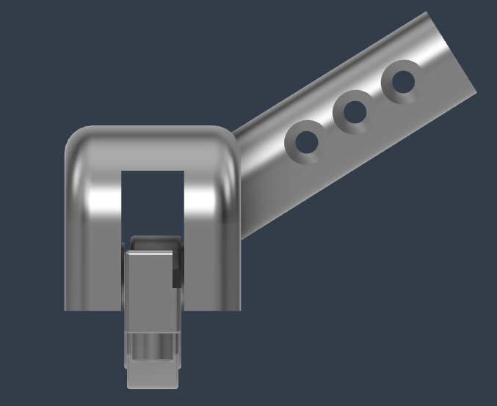
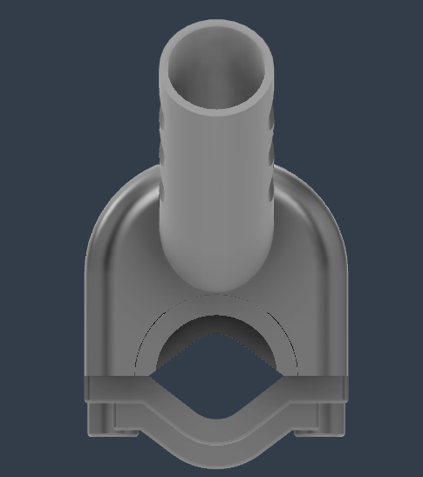
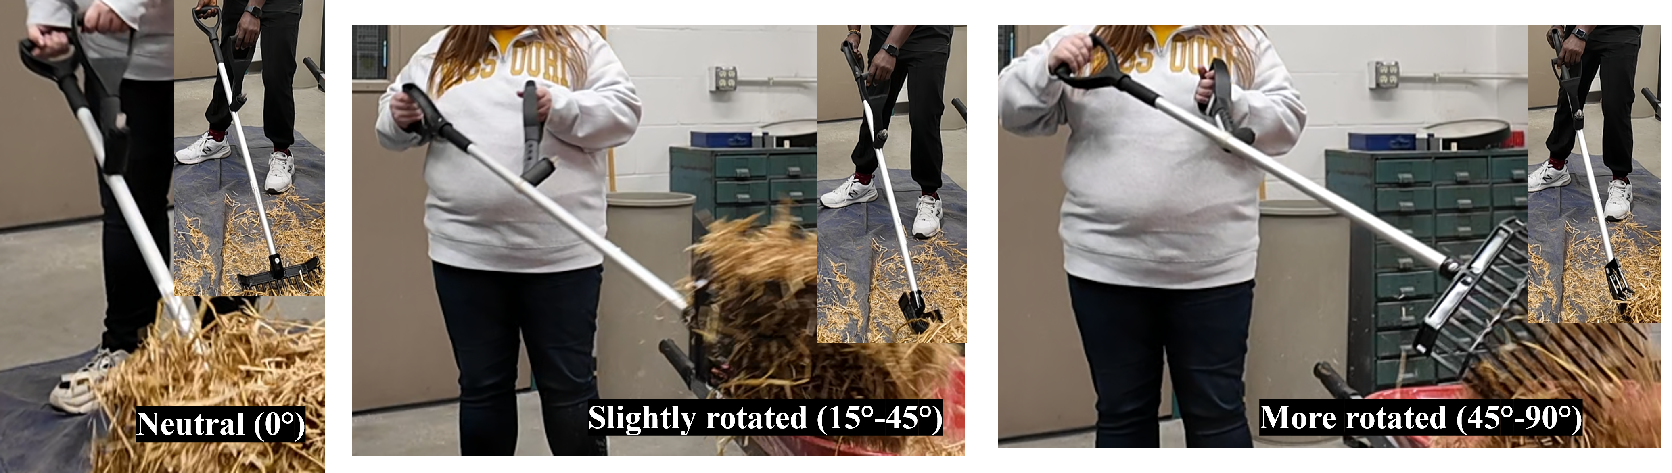







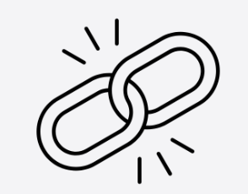
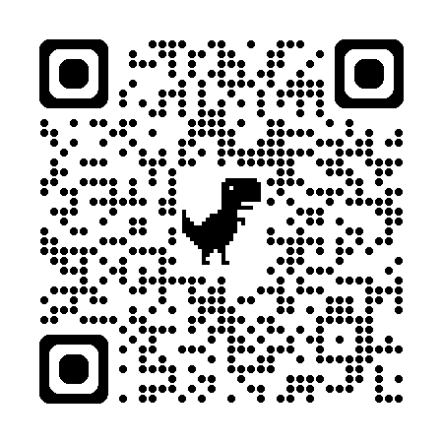



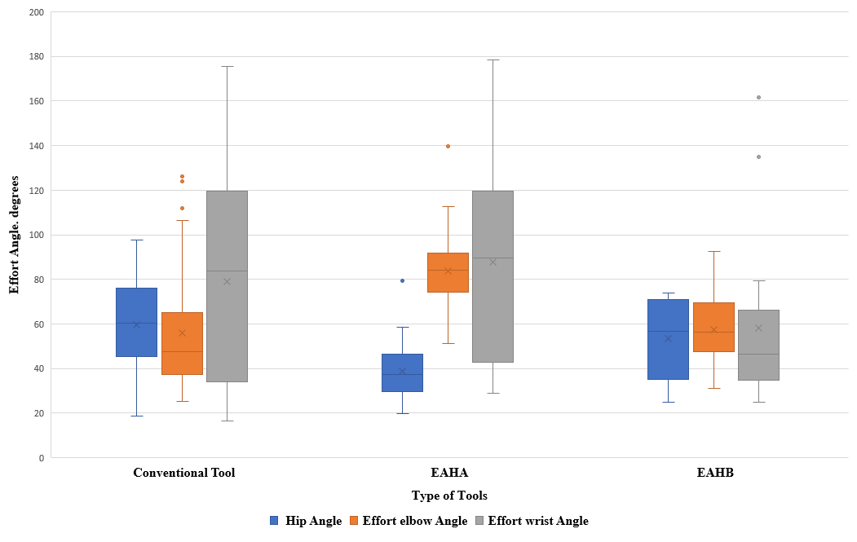
Ergonomic auxiliary handles have been shown to reduce strain, lower heart rate, and decrease energy use by up to 15% with particularly significant benefits for women farmers.
Rotational Design: Aims to improve ergonomic handling and reduce upper body strain.
Optimizing Tool Ergonomics for Farmers: Development of Adjustable Auxiliary Handles for Reduced Strain
Results of Static Handle Study (Current Market Tools):
Cardiovascular Benefits: Lowered heart rate by 5 bpm, energy use decreased by 15%.
Strain Reduction: Reduced hip angle by 15°, improved wrist alignment; elbow strain indicated the need for more adjustability.
PRESENTER:
Felix Michael Oguche
BACKGROUND:
Traditional agricultural tools often lack ergonomic designs, which are especially needed by women farmers.
Previous Study Findings:
Existing static auxiliary handles reduced strain but lacked adjustability for individual body mechanics, causing some areas (including the elbow, and shoulder) to experience additional strain.
Objective:
To design an ergonomic handle with rotation and height adjustability, promoting natural body alignment for each user.
METHODS
Static Handle Study:
Participants: Eight women tested existing static auxiliary handles.
Key Findings:
Reduced Heart Rate: 5 bpm decrease
Energy Use Reduction: approximately 15%
Improved Hip Angle by 15°
Elbow and Shoulder Strain: Increased due to lack of adjustability
New Design Features (Not Yet Tested)
Adjustable Heights: 3-point adjustability (30 mm intervals for custom height based on elbow level.
Rotational Movement: Allows natural motion, reducing strain on the elbow, shoulder, and wrist.
RESULTS
Yellow Auxiliary Handle (BackEZ)
Green Auxiliary Handle with Shaft EAHA (RAH! handle)
Our innovative adjustable and rotating handle design aims to enhance these benefits by aligning with individual body mechanics for improved comfort and reduced strain.
Elbow, Hip, and Wrist Strain Comparison: Strain on Key Joints During Use of Different Handle Types
Anticipated Benefits:
Three-Point Adjustability: Custom height for natural posture.
Rotational Design: Aims to improve ergonomic handling and reduce upper body strain.
Side view
Isometric View
Side view
Front View
Rotational Adjustability of Ergonomic Handle: Three positions: Neutral (0°), Slightly Rotated (15°-45°), and More Rotated (45°-90°), allowing for reduced wrist strain and enhanced comfort.
Prototype Design 1: 3D model of an ergonomic auxiliary handle clamp attachment designed to allow rotational movement for enhanced tool ergonomics.
Prototype Design 2: 3D model of an ergonomic auxiliary handle clamp attachment designed to securely hold a hand tool within a rotating handle support for improved tool ergonomics.
Felix Michael Oguche, Jianfeng Zhou,
Karen Funkenbusch, Marcia C. Shannon,
University of Missouri, Columbia, MO
(contact: fofdt@missouri.edu)
Flexibility, Adjustability, Rotation, Custom Fit, Durability
Take a picture to download the full paper
Energy Expenditure Relative to Average Heart Rate: Physiological Impact of Conventional vs. Ergonomic Handles
This material is based upon work that is supported by the National Institute of Food and Agriculture, U.S. Department of Agriculture, under agreement number 2021-38640-34714 through the North Central Region SARE program under project number LNC21-458. USDA is an equal opportunity employer and service provider. Any opinions, findings, conclusions, or recommendations expressed in this publication are those of the author(s) and do not necessarily reflect the view of the U.S. Department of Agriculture
Notes:
Notes:
In Powerpoint, click View > Guides
Keep text within gutter guides.
Author list: Don’t split names onto two lines (e.g., “Jimmy [break] Smith”). If that happens, use a new line, unless you need the space. Bold the first names of anybody who’s presenting in person.
Intro/methods/result: Do not drop below font size 28, but if you have extra space, jack up the font size until the space is full.
Do not use color in the sidebars except in graphs/figures. It’ll pull attention from the center and slow interpretation for passersby.

