Slide 1
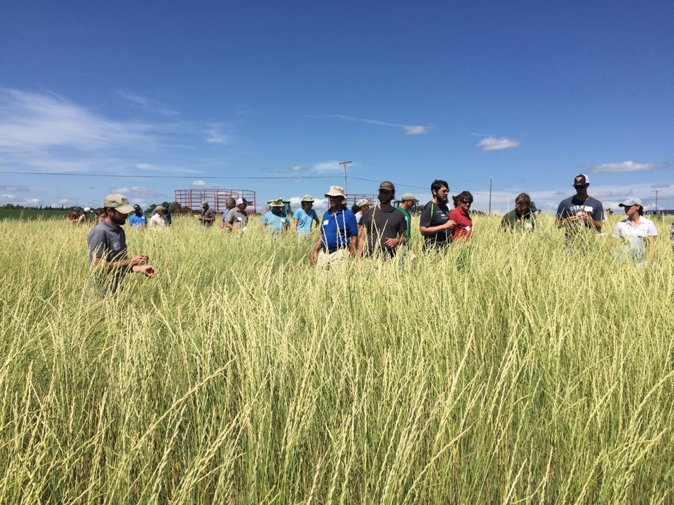
Promises, problems, and progress with perennial grains in New York
Matthew Ryan - December 8, 2016
Soil and Crop Sciences, Cornell University
Notes:
1) Dual purpose grain and forage experiment, 2) Survey of famers in US and France, 3) New on-farm research in New York
Why am I working on perennial grains?
Compatibility
Clear climate change adaptation and mitigation benefits
Research programs has focused on using cover crops to increase the sustainability of cropping systems. Started describing the work that we are doing as a way to increase the “perenniality” of annual cropping systems.
Dovetails with work on increasing resilience in forage production and the use of agroecological management practices.
Opportunity
More students contacted me about these two words than anything else that I am doing (2 words out of a 100 words description)
Timing was right for a NE SARE grant. Commercial production just starting, and in 2015 Wes Jackson was keynote speaker at NOFA NY meeting
Research Focus
My research aims to increase cropping system sustainability through ecological intensification. By working with farmers, students, and other scientists, I research and develop solutions to problems in agriculture. I am currently focused on expanding the utility of cover crops by overcoming obstacles that limit their adoption and developing management practices that maximize their benefits. I am also interested in perennial grains, ecological weed management, conservation agriculture, agroecological theory, and the role of diversity in adapting to climate change. Much of my research is field based and conducted either on-farm or at the Musgrave and Willsboro Research Farms.
Why perennial grains?
Extension of program focused on cover crops
Ecosystem services
Climate change adaptation and mitigation
How are they made?
Pipeline for domestication and examples
Multi-site forage experiment
Steve Culman and preliminary results
Farmer perspectives (Valentine and Sandra)
Survey results
New experiments (Sandra and Eugene)
Annual vs. perennial and on-farm trials

Slide 2
Take home messages
Perennial grains are becoming an option
Increasing interest and consumer demand
Provide ecosystem services and increase the sustainability of cropping systems
Integration strategy important for success
Guidelines are needed to optimize production

Slide 3
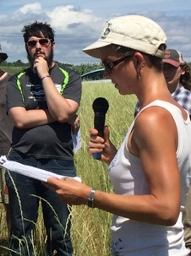
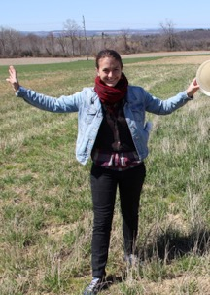
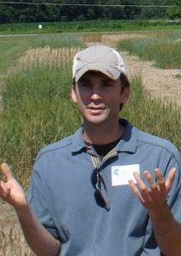
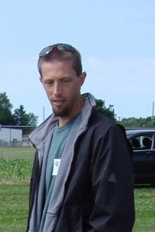
Key people involved in this research
Sandra Wayman – Cornell Sustainable Cropping Systems Lab
Valentine Debray – Cornell Sustainable Cropping Systems Lab
Eugene Law – Cornell Weed Ecology and Management Lab
Steve Culman – The Ohio State University, Wooster, Ohio
Lee DeHaan – The Land Institute, Salina, Kansas
Notes:
Sandra Wayman – Cornell Sustainable Cropping Systems Lab
Valentine Debray – Cornell Sustainable Cropping Systems Lab
Eugene Law – Cornell Weed Ecology and Management Lab
Steve Culman – The Ohio State University, Wooster, Ohio
Lee DeHaan – The Land Institute, Salina, Kansas

Slide 4
Why focus on perennial grains?
Effective strategy for mitigating and adapting to climate change
Recent advances in crop breeding can potentially accelerate progress
Mounting support for multifunctional agriculture that enhances ecosystem services
Notes:
Cultivation often has a negative impact on provision of [ecosystem] services. For example, cultivated systems tend to use more water, increase water pollution and soil erosion, store less carbon, emit more greenhouse gases, and support significantly less habitat and biodiversity than the ecosystems they replace
The 2005 Synthesis Report of the United Nations’ Millennium Ecosystem Assessment program labeled agriculture the “largest threat to biodiversity and ecosystem function of any single human activity.”[4]
Most agricultural land is devoted to the production of grain crops: cereal, oilseed, and legume crops occupy 75% of US and 69% of global croplands. These grains include such crops as wheat, rice, and maize; together they provide over 70% of human food calories.[5]
All these grain crops are currently annual plants which are generally planted into cultivated soil.
Frequent cultivation puts soil at risk of loss and degradation.[4]
This "central dilemma"[6] of agriculture in which current food production undermines the potential for future food production could be escaped by developing perennial grain crops that do not require tilling the soil each year.
No-till technology enables short-lived (annual) crops to be grown with less intense tillage, but perennial plants provide the most protection for the soil.[7]
A dense stocking of perennial plants-whether trees, shrubs, or herbs-in an agroecosystem increases the likelihood that the soil will be covered continuously, moderating oscillations in temperature and humidity that can damage the soil
J.J. Ewel (1986)[7]

Slide 5
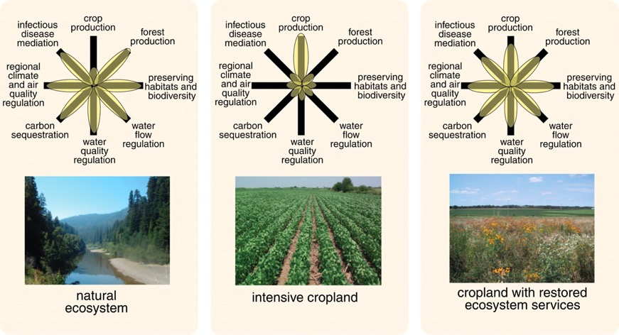
Overcoming trade-offs of in agriculture
The spider plot
Foley et al. 2005. Global Consequences of Land Use. Science 309:570-574
Notes:
Fig. 3. Conceptual framework for comparing land use and trade-offs of ecosystem services. The provisioning of multiple ecosystem services under different land-use regimes can be illustrated with these simple "flower" diagrams, in which the condition of each ecosystem service is indicated along each axis. (In this qualitative illustration, the axes are not labeled or normalized with common units.) For purposes of illustration, we compare three hypothetical landscapes: a natural ecosystem (left), an intensively managed cropland (middle), and a cropland with restored ecosystem services (right). The natural ecosystems are able to support many ecosystem services at high levels, but not food production. The intensively managed cropland, however, is able to produce food in abundance (at least in the short run), at the cost of diminishing other ecosystem services. However, a middle ground-a cropland that is explicitly managed to maintain other ecosystem services-may be able to support a broader portfolio of ecosystem services.

Slide 6
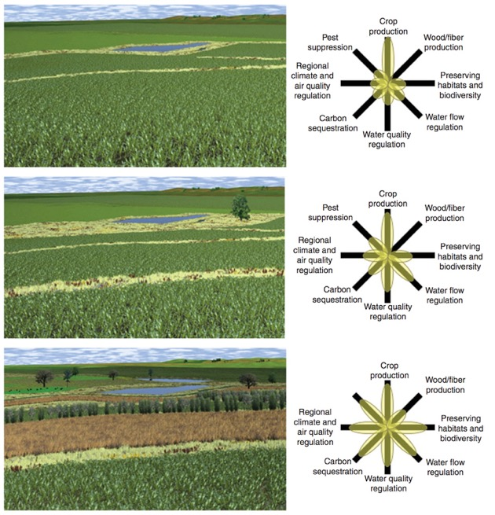

4%
Delivery of ecosystem services in agricultural landscapes is related to the % of land in perennial vegetation
Greatest benefits in annual dominated landscapes
16%
64%
Asbjornsen H. et al. (2013) Targeting perennial vegetation in agricultural landscapes for enhancing ecosystem services. Renewable Ag. and Food Systems.
Notes:
Perennials provide greater benefits when they are present in low amounts.

Slide 7
Annual cropping system ecology
Highly productive monocultures that require relatively large amounts of external inputs
Perpetual state of initial secondary succession
  Resource availability
    Disturbance (e.g. tillage) increases plant resources
  Energy requirements
    Environmental impacts directly related to energy required to maintain succession conditions (Smith 2014)

Slide 8
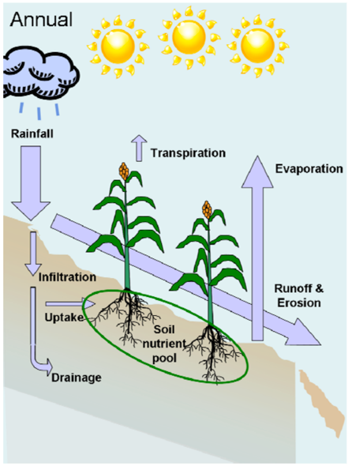
Annual cropping systems are susceptible to extreme weather events such as short-term drought and extreme rainfall
Glover, J.D., C.M. Cox, and J.P. Reganold. 2007. Future farming: A return to roots? Scientific American 297(August):82-89.
Notes:
Fig. S1. Ecosystem functions of annual and perennial crops. (Left) Annual
crops have relatively short growing seasons, shallow rooting depths, and lower
root densities. This limits their access to nutrients and water, leaves croplands
more vulnerable to degradation, and reduces soil carbon inputs and habitat for
wildlife. (Right) Perennial crops capture, retain, and utilize more precipitation,
have access to soil nutrients deeper within the soil, maintain more plant residues
at the soil surface, and intercept sunlight for greater lengths of the year (S1).
S1. J. D. Glover, C. M. Cox, J. P. Reganold, Sci. Am. 297(August), 82 (2007).
From wikipedia:
Compared with annual counter- parts, perennial crops tend to have longer growing seasons and deeper rooting depths, and they intercept, retain, and utilize more precipitation (6–10). Longer photosyn- thetic seasons resulting from earlier canopy development and longer green leaf duration increase seasonal light interception efficien- cies, an important factor in plant productivity (7). Greater root mass reduces erosion risks and maintains more soil carbon compared with annual crops (9). Annual grain crops can lose five times as much water and 35 times as much nitrate as perennial crops (10). Peren- nial crops require fewer passes of farm equip- ment and less fertilizer and herbicide (9), important attributes in regions most needing agricultural advancement.

Slide 9
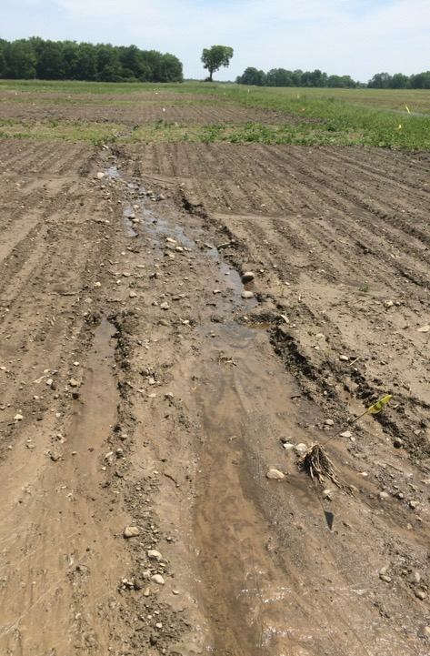
Rill erosion in tilled fields at Musgrave Research Farm
More than double the average rainfall in June 2015
Aurora, NY
Jeff Liebert, PhD Student, Cornell University

Slide 10
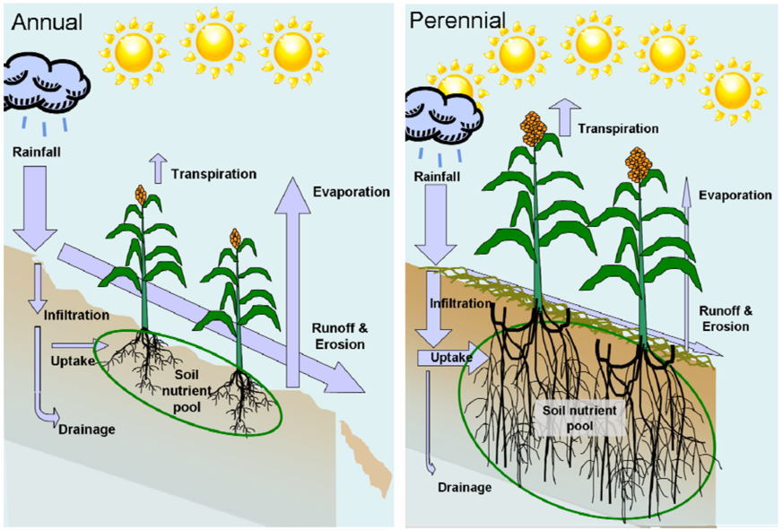
Glover, J.D., C.M. Cox, and J.P. Reganold. 2007. Future farming: A return to roots? Scientific American 297(August):82-89.
Notes:
Fig. S1. Ecosystem functions of annual and perennial crops. (Left) Annual
crops have relatively short growing seasons, shallow rooting depths, and lower
root densities. This limits their access to nutrients and water, leaves croplands
more vulnerable to degradation, and reduces soil carbon inputs and habitat for
wildlife. (Right) Perennial crops capture, retain, and utilize more precipitation,
have access to soil nutrients deeper within the soil, maintain more plant residues
at the soil surface, and intercept sunlight for greater lengths of the year (S1).
S1. J. D. Glover, C. M. Cox, J. P. Reganold, Sci. Am. 297(August), 82 (2007).
From wikipedia:
Compared with annual counter- parts, perennial crops tend to have longer growing seasons and deeper rooting depths, and they intercept, retain, and utilize more precipitation (6–10). Longer photosyn- thetic seasons resulting from earlier canopy development and longer green leaf duration increase seasonal light interception efficien- cies, an important factor in plant productivity (7). Greater root mass reduces erosion risks and maintains more soil carbon compared with annual crops (9). Annual grain crops can lose five times as much water and 35 times as much nitrate as perennial crops (10). Peren- nial crops require fewer passes of farm equip- ment and less fertilizer and herbicide (9), important attributes in regions most needing agricultural advancement.

Slide 11
Developing perennial grain crops
Two main approaches
  Domesticate a wild perennial
  Cross annual crop with a perennial relatives
Combine multiple desirable traits including:
  Reliable regrowth and high grain yield and quality
  Tolerance to abiotic stressors, such as water and nutrient deficiencies
  Resistance to pests and diseases
  Glover et al. Science 2007.

Slide 12
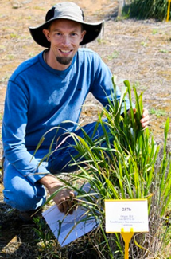
Intermediate Wheatgrass
Scientific name: Thinopyrum intermedium
Trade name: Kernza
Native to Europe and Western Asia
Productive forage, persists for decades
Candidate for development based on work by Peggy Wagoner in 1983, who evaluated ~100 perennial grass species
Selected for multiple characteristics including perenniality, large seed size, and flavor
Dr. Lee DeHaan
Notes:
known commonly as intermediate wheatgrass, is a sod-forming perennial grass in the Triticeae tribe of Pooideae. It is part of a group of plants commonly called wheatgrasses because of the similarity of their seed heads or 'ears' to common wheat. However the wheatgrasses in general are perennial, while wheat is an annual. The grass is native to Europe and Western Asia.[1]
Trials with intermediate wheatgrass, the product of which is trademarked by the Land Institute as "Kernza," show that it can be grown as a “multi-functional” crop, yielding various commodities as well as ecosystem services. Whereas annuals such as corn tend to deplete soil organic matter and require inputs, a perennial grain such as intermediate wheatgrass, can yield crops while building soil organic matter.[2][3]
Forage
Thinopyrum intermedium is among the most productive forage species for the western United States. Because it heads relatively late, it can be grown effectively in mixture with alfalfa to increase its productivity, longevity, and forage quality. It regrows slowly after grazing or cutting, making it best suited to management with a single harvest per year.[8] If multiple harvests are needed per year, other species will be more produtive. If managed well, stands can persist for up to 50 years.
Habitat
Habitat for wildlife - intermediate wheatgrass can be an excellent food source for grazing and browsing animals. Left unharvested, the vegetation is good nesting habitat for some birds and waterfowl. Generally, it is not an invasive plant, and coexists well with native plant species.
Soil management
Erosion control and land rehabilitation are uses also. It establishes quickly to form a protective mat of roots and rhizomes, even when planted on soils degraded by earth moving or mining. Within five years, stands have produced up to 7000 pounds of dry root mass per acre in the top 8 inches of soil.[8] Heavy root production holds the soil in place and restores its natural fertility by increasing the soil carbon.
Grain
Thinopyrum intermedium is a perennial grain crop. In 1983, the Rodale Research Center evaluated close to 100 species of perennial grasses to identify those with good potential for development into perennial grain crops. Intermediate wheatgrass was selected as the most promising species based on: flavor, ease of thresing, large seed size, resistance to shattering, lodging resistance, ease of harvest, and perennial growth.[9] Intermediate wheatgrass is nutritionally similar to wheat, and the grain can be ground into flour and used for food products, including muffins, tortillas, pancakes, cookies, crackers, and breads.
Why perennial grains
Examples
Challenges
Current status
Patagonia
My plots at Musgrave
Work with perennial rye
Check TLI website
Show photos from Estes

Slide 13
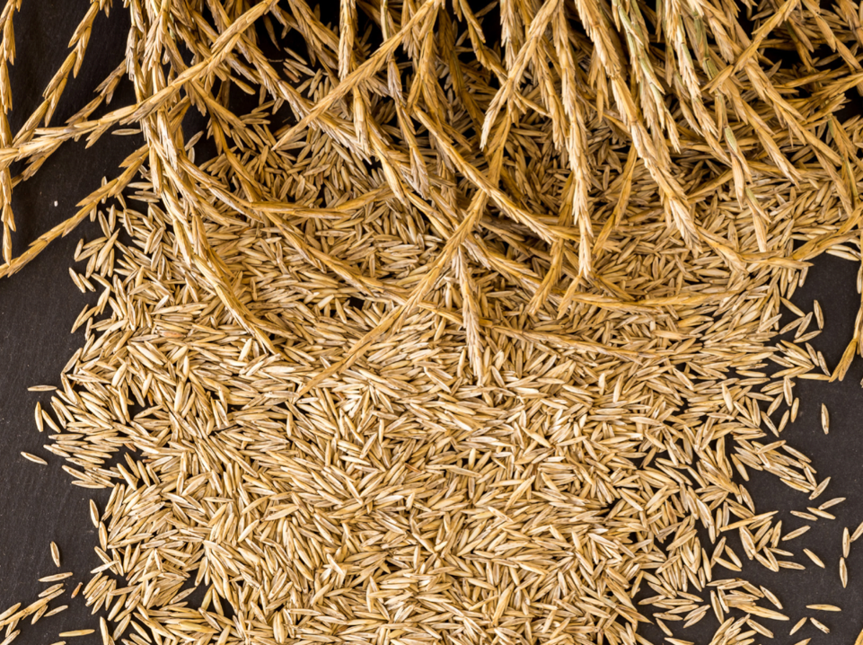
Image courtesy of The Land Institute

Slide 14
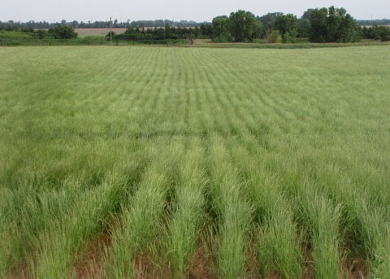
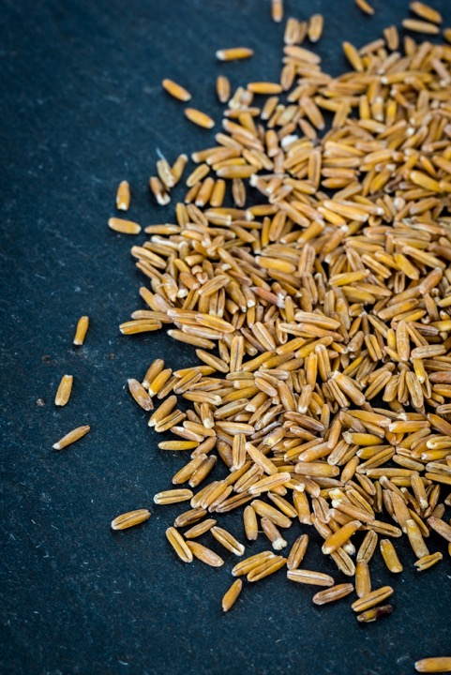
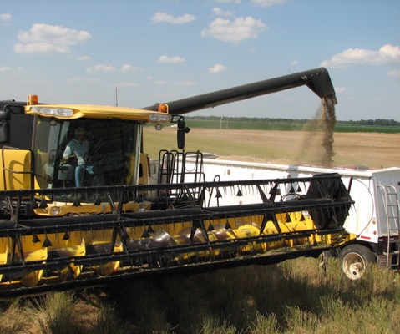
Images courtesy of The Land Institute

Slide 15
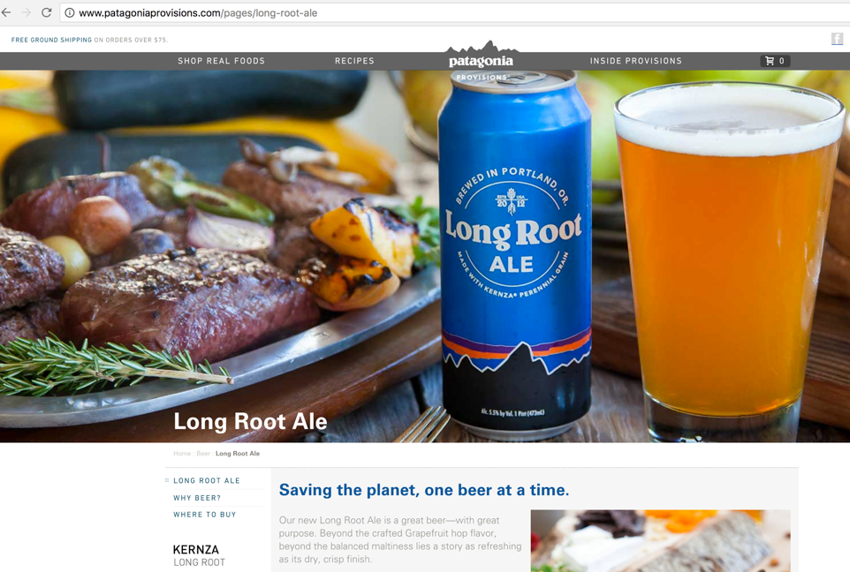
Check out 30 minute film ‘Unbroken Ground’ https://www.youtube.com/watch?v=3Ezkp7Cteys

Slide 16
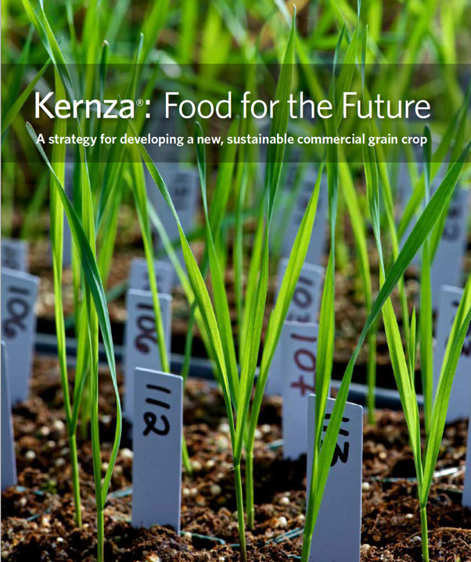

Slide 17
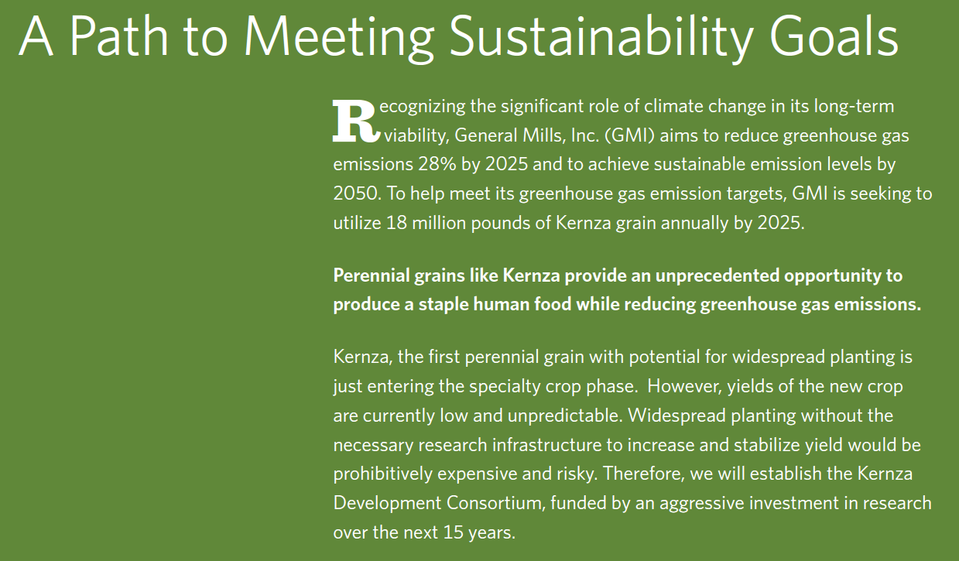
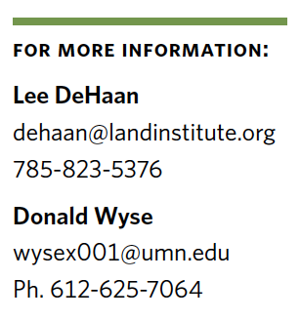
General Mills invited a proposal to support research and has expressed interest in developing Kernza products
Notes:
Same weed scientist that Scott Peters talked about during his presentation last month on Civic Science. 300,000 bu/year = 9000 tons

Slide 18
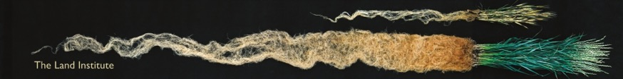
Ecosystem services from perennial grains
Provide grain and food
Soil carbon sequestration
Provide habitat for wildlife
Reduce tillage, erosion, pollution from inputs

Slide 19
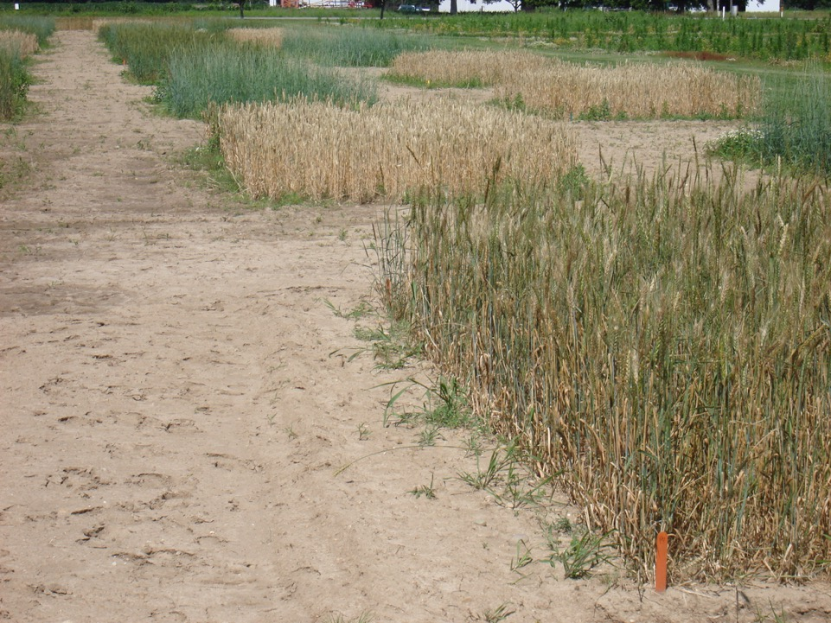
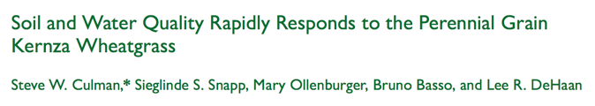
Kernza
Annual wheat
Perennial wheat
Agron. J. 105:735–744 (2013)
Kernza yields were 4.5% (yr 1) and 33% (yr 2) of annual wheat
Kernza reduced N losses and moisture deeper in the soil
Notes:
Over‐arching question:
“Is perenniality or management a larger driver of soil
ecosystem services?”
– 2‐way full‐factorial split plot design
– 3 managements
• Organic (80 lbs N/acre in chicken manure)
• Low N Conventional (80 lbs N/acre in urea)
• High N Conventional (120 lbs N/acre in urea)
– 3 plants
• Annual wheat (Caledonia)
• Perennial wheat (WSU bulked material from 2005) • Intermediate wheatgrass (Kernza)
Kernza yields were 4.5% (yr 1) and 33% (yr 2) of annual wheat
Kernza reduced N losses and moisture deeper in the soil
Agron. J. 105:735–744 (2013)

Slide 20
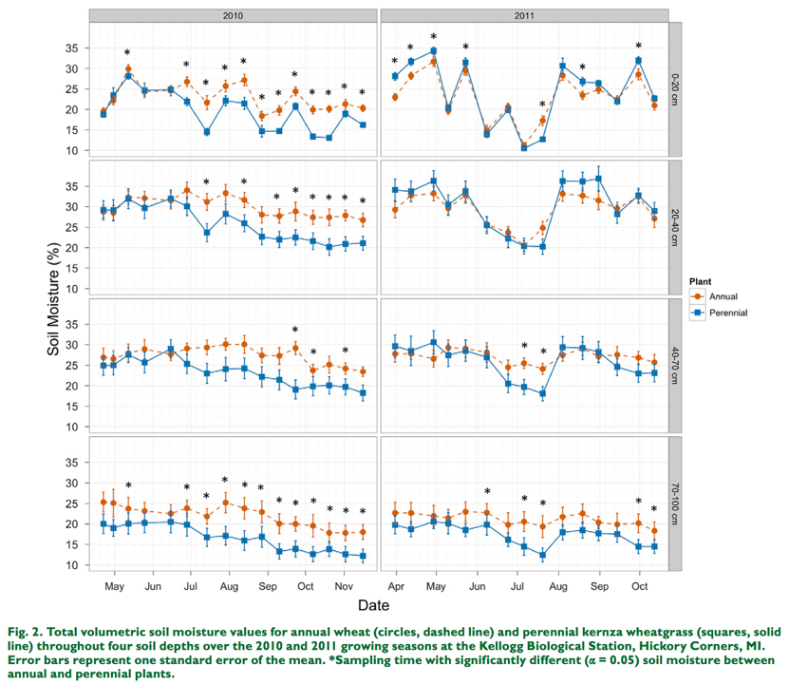
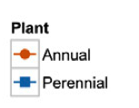

Slide 21
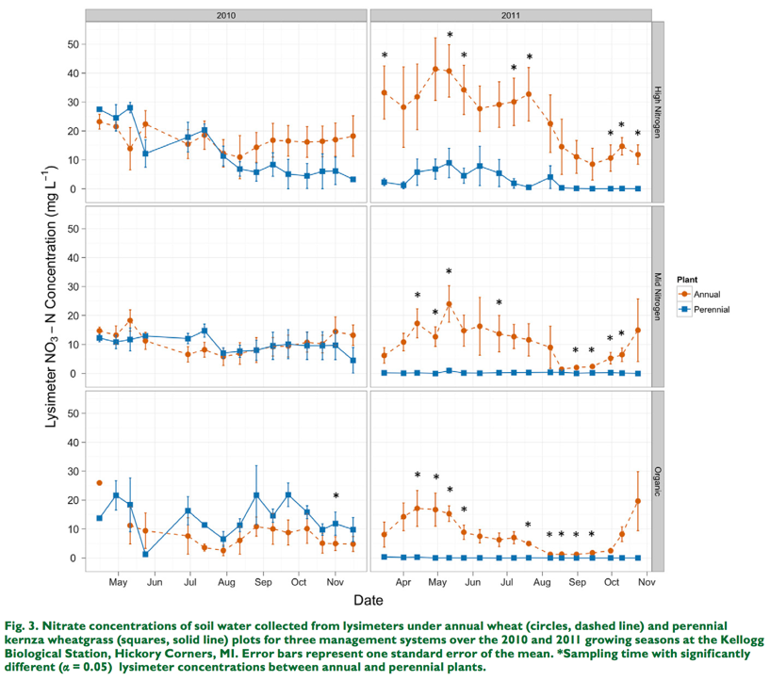
120 lbs N/acre
as urea
80 lbs N/acre
as urea
80 lbs N/acre
as poultry litter

Slide 22
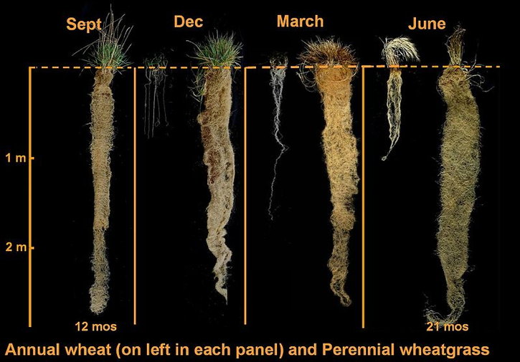
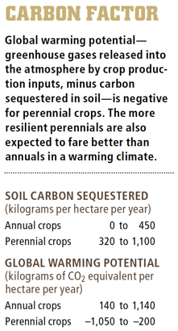
Climate change mitigation
Image courtesy of The Land Institute
Glover, J.D., Cox, C.M. and Reganold, J.P., 2007. Future farming: a return to roots?. Scientific american, 297(2), pp.82-89.

Slide 23
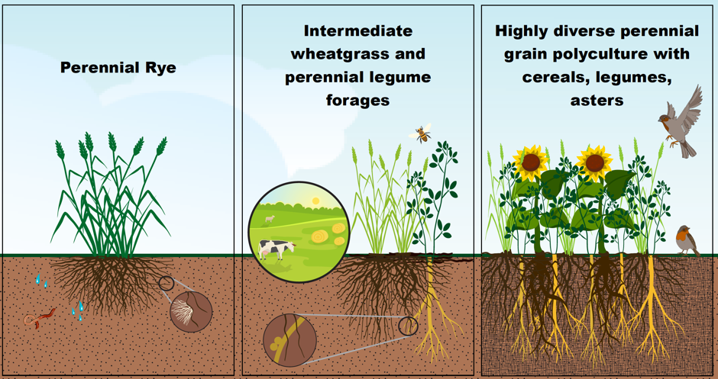
Perennial grain cropping systems
Management Strategies for Perennial Grain Cropping Systems. MR Ryan, MG Bakker, TE Crews, SW Culman, S Damaraju, LR DeHaan, RC Hayes, JM Jungers, and M Nosshi. In-Prep

Slide 24
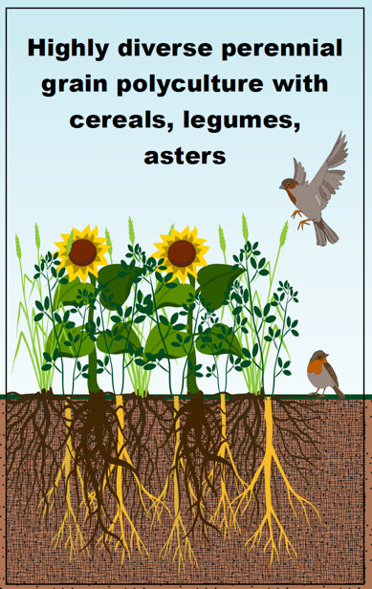
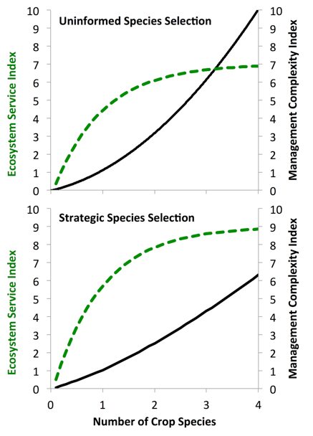

Slide 25
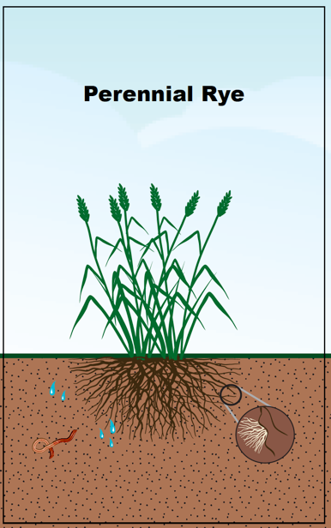
Cross between cereal rye and wild perennial
  Secale cereale x Secale montanum
Relatively high yields
  1.3 Mg ha^{–1}, 73% of annual rye (Jaikumar et al. 2012)
Problems with fungal disease ergot
  Due to sterile florets
Jaikumar, N.S., Snapp, S.S., Murphy, K. and Jones, S.S., 2012. Agronomic assessment of perennial wheat and perennial rye as cereal crops. Agronomy Journal, 104(6), pp.1716-1726.

Slide 26
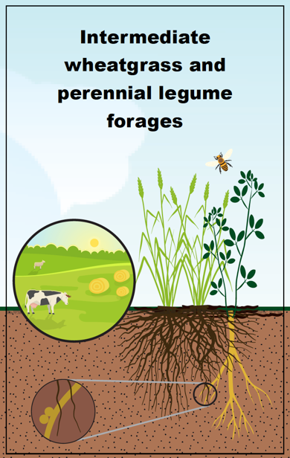
Potential to provide nitrogen to kernza and to increase forage quality
Challenges with managing competition
  Depending on timing of establishment, one species can easily outcompete the other

Slide 27
New experiment comparing perennials and annuals
RCBD with split-plot
2 annual grains
  ‘Endeavor’ malting barley
  ‘Warthog’ hard red winter wheat
2 perennial grains
  ‘ACE-1’ perennial rye
  ‘Kernza’ intermediate wheatgrass
Split-plot
  Red clover frost-seeded in spring at 8 lb/ac
Notes:
Seeded at 7.5 row spacing, all varieties.

Slide 28
Hypotheses
Soil health will be greater in plots with perennial grains compared to plots with annual grains
Pests will be lower in plots with perennial grains compared to plots with annual grains
Red clover will increase grain yields and overall profitability

Slide 29
Measurements
Crop and pests:
  Crop biomass, grain yield, weed abundance (density and biomass), disease (incidence and severity)
Grain quality:
  Test weight, falling number, protein, and vomitoxin
Soil health indicators:
  Total carbon and nitrogen, active carbon, aggregate stability, and water infiltration rates
Soil erosion:
  Determine acreage of perennial grains planted and estimate soil erosion reduction
Notes:
We’ll measure soil health before and after the experiment.

Slide 30
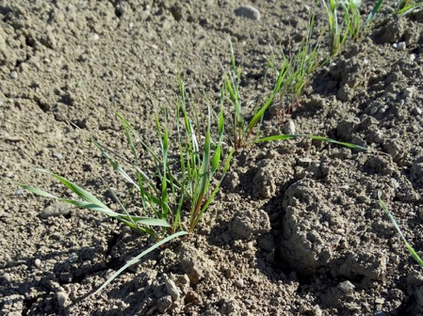
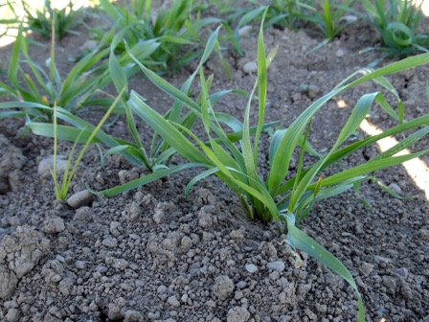
Perennial grain seedlings
28 days after planting
Kernza
ACE-1 perennial rye
Notes:
Photos taken 28 Sept 2016

Slide 31
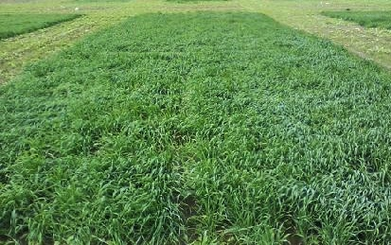
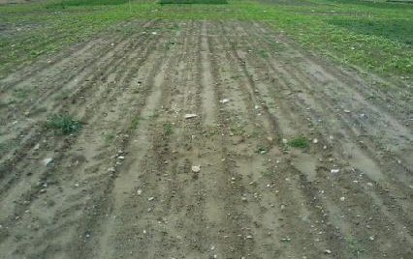
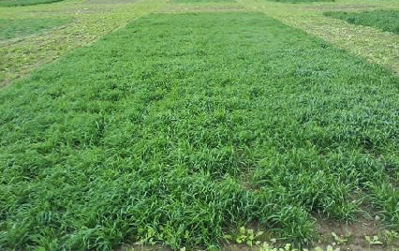
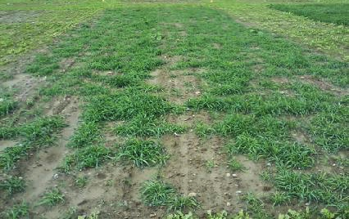
Establishment 55 days after planting
‘Endeavor’ barley
Kernza
‘Warthog’ wheat
ACE-1 perennial rye
Notes:
All photos taken Oct 25, block 1
Endeavor barley is the second two-row winter malt variety released by the USDA-ARS and the IAES. It has excellent test weight and plumps, and has improved yield over the first two-row winter malt variety, Charles, that was previously released. It is average for heading date, height, and lodging. Endeavor will provide producers with a variety with a good malt profile. It has high levels of malting enzymes and is expected to be adapted to both irrigated and dry land regions. It has winter hardiness.
8136 Warthog Winter Wheat OG Triticum aestivum This hard red winter wheat performed wonderfully in the trials conducted in 2011 and 2012 by the Universities of Maine and Vermont. For best overwintering, seed at 100–125#/acre in well-drained fields in early September. Maine-grown at Aurora Farm.
As food grain: Protein levels of 10–11% and high falling numbers make this wheat suitable for an all-purpose flour. Good milling and baking characteristics. Wormtown Brewery in Worcester, MA, uses locally grown Warthog to brew a varietal hefeweizen with “mild cracker [flavor] and some banana notes.”
As feed grain: Protein approximately equivalent to barley, but with lower fiber content. Wheat is the best whole grain to feed to chickens, and at Treble Ridge our preferred base for low-protein finisher and gestation rations for hogs. Highly palatable to ruminants but should be fed carefully to prevent acidosis. This variety is susceptible to fusarium, so be sure to test grain for mycotoxins before feeding. Wheat should not be finely ground before feeding: cracking or soaking is preferable.

Slide 32
Dual purpose kernza experiment
Grain yields are not currently competitive with annual crops; typically < 1000 kg/ha (15 bu/ac)
Grain yield typically peaks at years 1 or 2 then declines over time (Wagoner, 1990; Culman et al., 2013)
Kernza is highly rhizomatous and sod forming and reproductive tiller density increases greatly in years 2-3
Higher nitrogen rates often increase lodging, but not grain yields (Culman et al., 2013)
Can the perennial grain crop Kernza yield both forage and grain? Steve Culman and Jennie Pugliese. November 9, 2016. International meeting of the ASA, CSSA, and SSSA.

Slide 33
Dual purpose kernza experiment
Can we offset the low grain production with added value of forage?
  Document kernza grain and forage yield and quality over range of environments
How do we mitigate declining grain yields over time?
  Determine the effects of defoliation on grain yields over time
Can the perennial grain crop Kernza yield both forage and grain? Steve Culman and Jennie Pugliese. November 9, 2016. International meeting of the ASA, CSSA, and SSSA.

Slide 34
Experiment locations
Site | Location | Institution | PI/ Point Person | Year Planted | Factors Examined
CO | Fort Collins | Colorado State | Meagan Schipanski* | 2014 | Defoliation, N
KS | Salina | Land Institute | Tim Crews*, Lee DeHaan | 2014 | Defoliation, N, Legumes
MD | Beltsville | USDA | Jude Maul* | 2010 | Defoliation, Varieties
MN | St. Paul | U of Minnesota | Jake Jungers, Craig Sheaffer | 2014 | Defoliation, Spacing
NY | Ithaca | Cornell | Matthew Ryan | 2014 | Defoliation, N
OH | S. Charleston | Ohio State | Mark Sulc | 2014 | Defoliation
OH | Wooster | Ohio State | Steve Culman* | 2014 | Defoliation, N
IA | Ames | Iowa State | Mary Wiedenhoeft | 2015 | Defoliation
WI | Madison | U of Wisconsin | Valentin Picasso | 2015 | Defoliation, Maybe N
SD | Brookings | SDSU | Chris Graham | 2015 | Defoliation, Maybe N
Alberta | Lethbridge | Ag-Canada | Jamie Larsen | 2015 | Defoliation
*received PhD from Cornell University
Can the perennial grain crop Kernza yield both forage and grain? Steve Culman and Jennie Pugliese. November 9, 2016. International meeting of the ASA, CSSA, and SSSA.

Slide 35
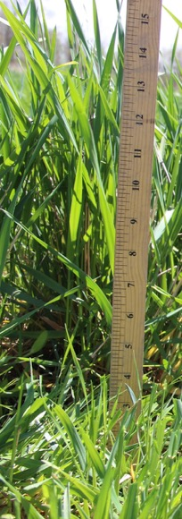
Forage Harvest Treatments
Control
  Harvested for grain only
Summer Cut, aka ‘Grain’
  Summer straw collection after grain harvest
Spring Cut, aka ‘Forage & Grain’
  Spring vegetative forage AND summer straw cut after grain harvest
Fall Cut*
  Fall and summer cut after grain harvest
  *Not implemented at Cornell in 2015

Slide 36
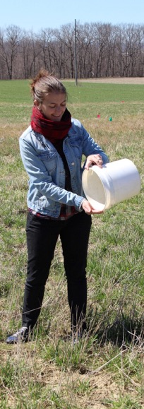
Nitrogen Fertilizer Treatments
Broadcast urea split application
N-120
  60 lb N/ac at green-up (early spring)
  60 lb N/ac after grain harvest
N-80
  40 lb N/ac at green-up (early spring)
  40 lb N/ac after grain harvest
Notes:
Background rate of N applied of 10 lb/a in 2015 applied before the treatments, so we applied 55 and 55 for N120, for example
Is this N120 as in 120 lbs of NITROGEN itself, or 120 lbs of UREA? From the protocol it seems to be 120 lbs of N.

Slide 37
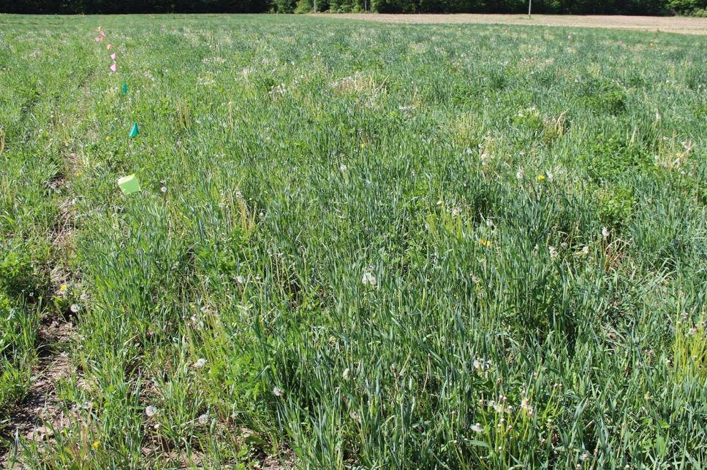
Spring growth on May 22, 2015
Notes:
Just over a month later

Slide 38
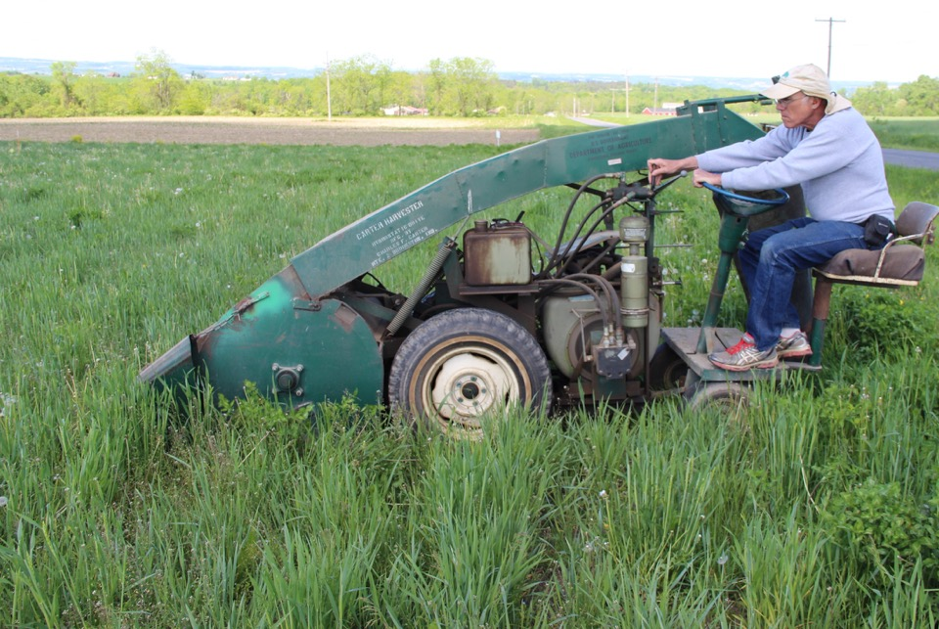
Brian Caldwell harvesting forage on May 22, 2015
Notes:
Spring forage cut

Slide 39
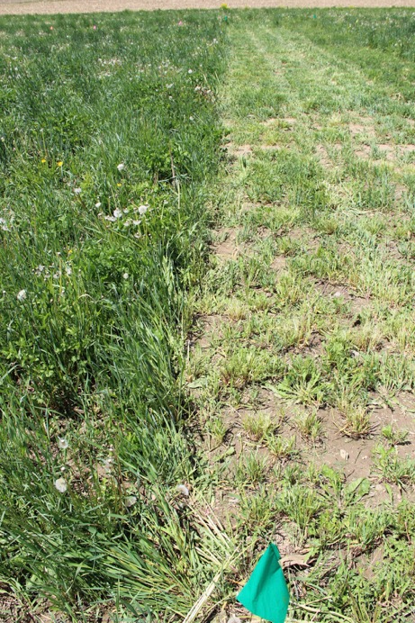
Spring harvest in Forage & Grain treatment
Cut to height of 4 inches
May 22, 2015

Slide 40
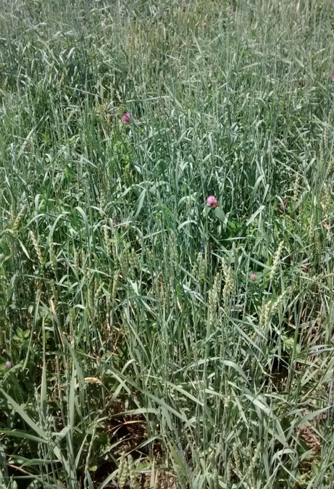
Major infestation of annual wheat
June 11, 2015
Notes:
Worked to de-head the annual wheat from the plots so it wouldn’t increase the seedbank

Slide 41
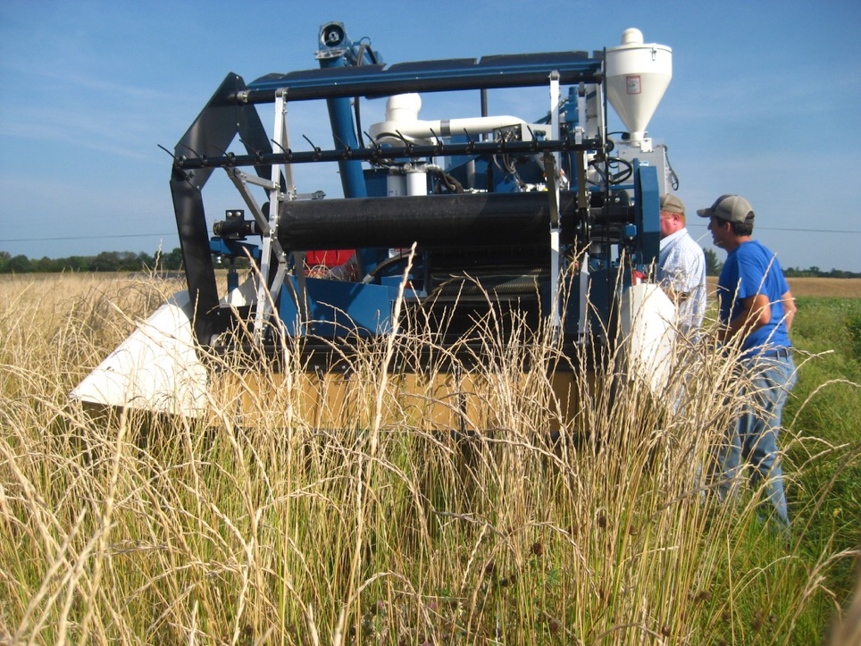
Almaco plot combine
Weeds and wet material caused periodic clogging
Notes:
Grain head level: how high the head is on the plant, and how much non-grain material that gets cut.
Cylinder: the rotor is cylinder shaped and spinning in rotations. The rotor breaks up the panicle material even more before it can be separated.
Concave: concave sits against the rotor. Narrow setting for small kernza, wider setting for bigger thing like corn.
Screen: after the rotor, and after the auger, then the screen. It gets dropped onto the screens. Paul found a smaller one even than 10mm AFTER we harvested….
Fan: fan blows wind across the screens as the grain falls onto the screeen, separates the grain from the chaff.
Small grain head set very high
Cylinder speed 1200 rpm
Concave setting narrow
10mm screen (smallest)
Fan speed 800 rpm
Weeds and wet material caused periodic clogging
~100 lbs grain uncleaned

Slide 42
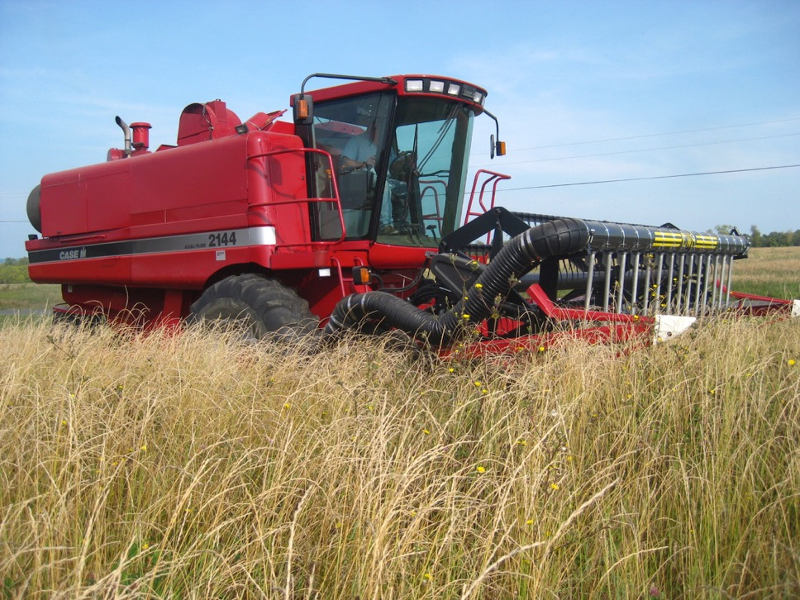
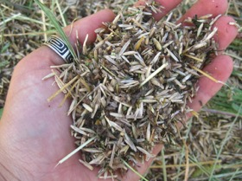
Harvest on September 11, 2015
Material was dirty
Notes:
Main difference between Case and Almaco is the type of rotor. Axial rotor in the Case is more “chewing” of the plant matter, than “chopping”

Slide 43
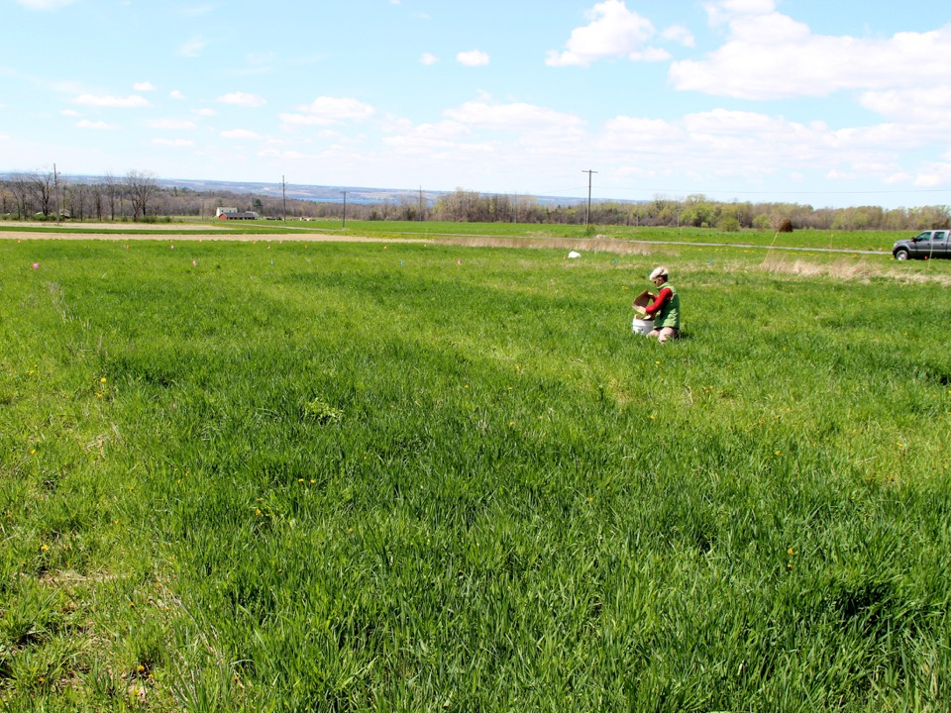
Areas that received urea on May 9, 2016
Notes:
Although we saw no difference between N80 and N120 rates, we did see a visual difference between no urea and some urea (alleys).

Slide 44
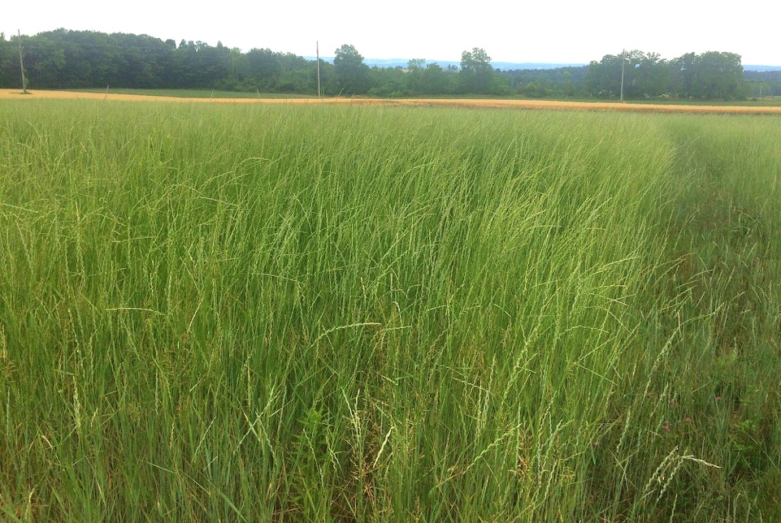
Kernza plants post-anthesis on July 1, 2016

Slide 45
Grain yields across 9 sites
Average grain yield over all sites:
2015 = 704 kg/ha
2016 = 363 kg/ha
Can the perennial grain crop Kernza yield both forage and grain? Steve Culman and Jennie Pugliese. November 9, 2016. International meeting of the ASA, CSSA, and SSSA.

Slide 46
Straw forage cut: 9/11/15 and 8/23/16
Vegetative forage cut: 5/22/15 and 5/9/16
Notes:
This graph shows both “spring cut” and “summer cut” together. Only Summer-cut and Spring-cut plots are shown.
Results from Anovas testing forage quality parameters:
Within the straw harvest, there was no difference for any of the 6 forage quality parameters (Crude Protein, ADF, etc) among the SP, SU, and FA plots or between N rates
Within the Spring plots, there was a significant difference between vegetative cut and straw cut (i.e., Season Factor) for all 6 FQ parameters. No difference by N rate.
This makes sense that the vegetative growth would have significantly higher FQ than the straw.

Slide 47


Forage quality from spring and summer 2015
 | Spring cut Kernza | Summer cut Kernza | Prime forage standards
Crude Protein % | 19 (1.2) | 30 (1.7) | > 19
Total Digestible Nutrients % | 77 (0.2) | 68 (0.3) | --
Relative Feed Value | 214 (2.9) | 144 (2.6) | > 151
Acid Detergent Fiber % | 16 (0.3) | 29 (0.5) | < 31
Neutral Detergent Fiber % | 33 (0.4) | 43 (0.6) | < 40
Net Energy Mcal/100 lb | 83 (0.3) | 67 (0.7) | --
Numbers in parentheses indicate standard error
Prime forage standards from “What is Forage Quality”, Ashley Pierce, Rensselaer County Cornell Cooperative Extension
Notes:
Getting standard errors from the forage sheet in 2015 data
The CCE presentation is available:
https://blogs.cornell.edu/capitalareaagandhortprogram/files/2016/03/Preentation-What-is-Forage-Quality-2lj5wt1.pdf

Slide 48
Does harvesting forage reduce grain yield?
a
b
a
b
Forage + grain
Grain
Forage + grain
Grain
Grain
Forage + grain
Forage + grain
Grain
Grain
Forage + grain
Grain
Forage + grain

Slide 49
Dual purpose kernza experiment
Yields vary widely across sites and environments
Control treatments yielded less grain in 2016
  Need to remove straw after grain harvest
Spring clipping reduced plant height, but few declines in grain occurred
  Could help with lodging

Slide 50
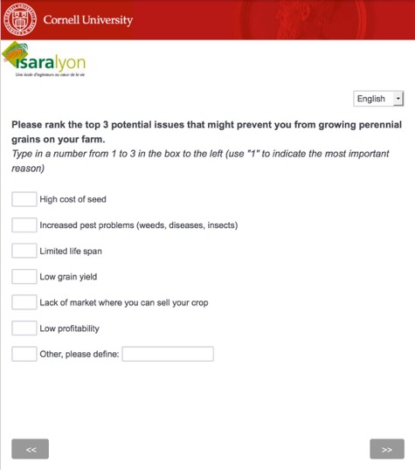
Survey on perennial grains
Farmers & Processors
Gauge interest and current knowledge
France and USA
Inform research and market goals
Notes:
Encourage conference attendees to send around the survey.
264 in france
114 in USA
1 in canada

Slide 51





Survey responses by state and region
88 US farmers
319 French farmers
Perspectives on Perennial Grain Crop Production Differ Between Organic and Conventional Farmers in the United States and France. Valentine Debray, Sandra Wayman, Christophe David and Matthew Ryan. In-Prep
Notes:
There was an “other” category for farmer type, but not reporting.
319 French farmers

Slide 52
Motivations for growing perennial grains
Perspectives on Perennial Grain Crop Production Differ between Organic and Conventional Farmers in the United States and France. Debray, V., S. Wayman, C. David, and M. Ryan. In-Prep

Slide 53
Concerns about perennial grains
Perspectives on Perennial Grain Crop Production Differ between Organic and Conventional Farmers in the United States and France. Debray, V., S. Wayman, C. David, and M. Ryan. In-Prep
Notes:
Perspectives on Perennial Grain Crop Production Differ between Organic and Conventional Farmers in the United States and France
Valentine Debray, Sandra Wayman, Christophe David and Matthew Ryan. In-Prep

Slide 54
Farmer agreement with targeted statements

Slide 55

Developing perennial grain cropping systems and market opportunities in the NE (NE SARE Grant LNE16-351 )
20 farmers establish perennial grains on a total of 400 ac, reducing erosion by an average of 2 t/ac/yr, and contributing to the creation of a new niche market and sale of 150 t of perennial grain in the NE
Outstanding organic farmers and project manager (Sandra Wayman) who are committed to the project
On-farm trials designed by farmers and focused on practical questions; new experiment at Musgrave comparing perennial and annual grains
Workshop, tasting event with bakers, brewers, and distillers, and on-farm field day

Slide 56

Farmer collaborators evaluate kernza plots on July 19, 2016

Slide 57
Establishing on-farm trials in 2016
Kernza and ACE-1 perennial rye planted in September
  About 1 ac of each crop at each of the 3 sites
Research questions
  Direct combining vs. Swathing (Thor Oechsner)
  Spring fertility application vs. None (John Myer)
  Kernza seeding rates (Klaas Martens)
Notes:
Thor Oechsner – In June 2015, Thor lost a great deal of soil during a storm that dumped 5-inches of rain in 1 hour.

Slide 58




Planting at Thor Oechsner’s on September 9
Lost soil in storm in June 2015 (5 inch in 1 hour)
Inspired by Wes Jackson’s writings
Experience with harvesting crops for seed including buckwheat and red clover
Organic grain farmer and part owner of flour mill and bakery near Ithaca
Notes:
So impossibly rocky in that field.

Slide 59


Thor Oechsner’s Farm – 1 month after planting
Kernza
ACE-1 Perennial Rye

Slide 60




Planting at John Myer’s on September 15
Longtime collaborator with Cornell researchers
Excellent farmer, pays close attention to detail
Organic grain farmer and owner of distillery specializing in local grains
Notes:
So impossibly rocky in that field.

Slide 61


John Myer’s Farm – 41 days after planting
Kernza
ACE-1 Perennial Rye

Slide 62




Planting at Klaas Martens’ on September 21
Involved locally and nationally
Along with wife Mary-Howell, operates organic seed and feed company
Innovative farmer with long history of good collaboration with researchers
Notes:
So impossibly rocky in that field.

Slide 63


Klaas Martens’ Farm – 35 days after planting
Kernza
ACE-1 Perennial Rye

Slide 64
Farmer Feedback (fall 2016)
Early thoughts about perennial grains on their farms
Thor Oechsner
  Excited about kernza (heard about it years ago), but skeptical of the “pathetic” looking kernza plants coming up. Interested to see how it does on “poor” fields.
John Myer
  Curious. So far pretty quiet about the process
Klaas Martens
  Concerned about small seed size. Lots of ideas about breeding Kernza. Compares it to emmer. Thinks that forage will be important for kernza success.

Slide 65
Compared to annual grain crops, perennial grain crops have benefits and drawbacks
Benefits
Drawbacks
Utilize solar radiation at start and end of annual crop season
Greater access to soil resources and ability to use them more efficiently
Can be grown sustainably on marginal lands
Decreased erosion and improved soil and water quality
Soil carbon accumulation
Do not address immediate food security needs
Lower yields than annual counterparts
Quality traits maybe lacking
Potential build up of pests and pathogens
Reduced of ground- and surface water recharge
Notes:
Does not address food security today. Perennial grain crops are in the early stages of development and may take many years before achieving yields equivalent to annual grains.
Makes crop rotation more difficult. Crop rotations with perennial systems are possible, but the full rotation will necessarily take longer. For example, a perennial hay crop.[10] like alfalfa is commonly rotated with annual crops or other perennial hay crops after 3–5 years. The slower pace of rotation—compared with annual crops—could allow a greater buildup of pathogens, pests or weeds in the perennial phase of the rotation.
Builds soil organic matter at the expense of plant productivity. In the absence of tillage, and in soils with depleted organic matter, crops with large root systems may build up organic matter to the point that nearly all of the soil nitrogen and phosphorus is immobilized. When this happens, productivity may decline until either the organic matter builds up to a level where equilibrium is reached between nutrient mineralization and nutrient immobilization or fertilizer is added to the system.
Hydrological impacts. Perennial plants may intercept and utilize more of the incoming rainfall.[2] than annual plants each year. This may result in water tables dropping and/or reduced surface flow to rivers.
Reduced nutrient delivery to downstream farms. Wide replacement of annual with perennial plants on agricultural landscapes could stabilize soils and reduce nitrate leaching to the point that the delivery of sediment and dissolved nitrogen to downstream landscapes could be reduced. Farmers in these areas may currently rely on these nutrient inputs. On the other hand, other sectors might benefit from improved water quality.
Improved habitat for pests. If fields are not left bare for a portion of the year, rodents and insects populations may increase. Burning of the stubble of perennial grains could reduce these populations, but burning may not be permitted in some areas. Furthermore, rodents and insects living underground would survive burning, whereas tillage disrupts their habitat.
Advantages of perennial crops[edit]
Several claims have been published:[6]
Greater access to resources through a longer season.Perennial plants typically emerge earlier than annuals in the spring and go dormant in the autumn well after annual plants have died. The longer growing season allows greater interception of sunlight and rainfall. For example, In Minnesota, annual soybean seedlings emerge from the soil in early June. By this time perennial alfalfa has grown so much that it is ready for the first harvest. Therefore, by the time a soybean crop has just begun to photosynthesize, a field of alfalfa has already produced about 40% of the season’s production.[11]
Greater access to resources through a deeper rooting zone. Most long—lived plants construct larger, deeper root systems than short-lived plants adapted to the same region . Deeper roots enable perennials to "mine" a larger volume of soil each year.[2] A larger volume of soil also available for exploitation per unit of cropland also means a larger volume of soil water serves as a reservoir for periods without rainfall.
More efficient use of soil nutrients. Leaching of nitrogen from fertilizer has been found to be much lower under perennial crops such as alfalfa (lucerne) than annual crops such as maize.[12] A similar phenomenon is seen in unfertilized fields harvested for wild hay.[13] While adjacent wheat fields required annual inputs of fertilizer, the wild perennial grasses continued to produce nitrogen-rich hay for 75 to 100 years with no appreciable decline in productivity or soil fertility. Presumably, the larger root systems of the perennial plants and the microbial community they support intercept and cycle nutrients passing through the system much more efficiently than do the ephemeral root systems of crop plants.
Sustainable production on marginal lands. Cassman et al. (2003) wrote that for large areas in poor regions of the world, “annual cereal cropping …is not likely to be sustainable over the longer term because of severe erosion risk. Perennial crops and agroforestry systems are better suited to these environments.”[14] Current perennial crops and agroforestry systems do not produce grain. Grain provides greater food security than forage or fruit because it can be eaten directly by humans (unlike forage) and it can be stored (unlike fruit) for consumption during the winter or dry season.
Reduced Soil erosion U.S. Forest Service et al. cite perennial grasses as a preventative for soil erosion.[15] Perennials of all kinds establish thick root systems which tie up soil and prevent surface erosion by wind and water. Since water runoff is slowed, it has a longer time to soak in and enter the groundwater system. Net water inflow into streams is marginally reduced due to groundwater infusion, but this also reduces high flow rates in streams associated with fast-flowing water-based erosion of streambeds. .
Increased wildlife populations U.S. Forest Service et all cite slower release of water into streams, which makes water levels more consistent instead of alternating between dry and flash-flood situations common to deserts. Consistent water levels contribute to increased wildlife populations of fish, amphibians, waterfowl, and mammals dependent upon a consistent water source.[15]

Slide 66
Take home messages
Perennial grains are becoming an option
Increasing interest and consumer demand
Provide ecosystem services and increase the sustainability of cropping systems
Integration strategy important for success
Guidelines are needed to optimize production

Slide 67


Thank you!
Surya Acharya
Kristine Averill
Matthew Bakker
Brian Caldwell
Timothy Crews
Siva Damaraju
Christophe David
Richard Hayes
Jacob Jungers
Jamie Larsen
Maged Nosshi
Chris Pelzer
Paul Stachowski
Research assistants

Slide 68
Dates of “activities”, Kernza Culman
Activity | Applied to what treatment? | Plant Stage | Date in 2015 | Date in 2016
Spring urea application* | All treatments | Early vegetative | 5/4/15 | 4/20/16
Spring cut | Spring Cut (aka ‘Forage & Grain’) | Vegetative/elongation | 5/22/15 | 5/9/16
Summer harvest & Straw cut | Spring Cut, Summer Cut (aka ‘Grain’), Fall Cut | Grain maturity | 9/11/15 | 8/23/16
Post-harvest urea application | All treatments | Post-harvest | 10/2/15 | 8/31/16
Fall cut | Fall Cut | Vegetative | NA | 10/18/16
Planting: 8/26/14 at 15 lbs/ac
*urea applications were the N-rate split plots at 80 lb/ac and 120 lb/ac
NOTE: these dates are for the actual management activity itself, not the sample collection corresponding to it (sometimes sampling and management happened at different times). Also: sometimes there was a range of dates, in which case the given date is the start date.

Slide 69
On Farm Seeding
Farm Info |  |  | Kernza |  |  | ACE1 Perennial Rye
Farmer | Equipment | Planting Date | Actual seeding rate (lb/ac) | Area covered | Drill Setting | Actual seeding rate (lb/ac) | Area covered (ft) | Drill Setting
Thor Oechsner | 10-foot IH5300 grain drill | 9-9-16 | 23 | 400 x 80 ft 0.73 ac | 12 | 95 | 400 x 60 (0.55 ac) | 12
Klaas Martens | Amazone Airstar Prafi | 9-21-16 | Targeted 15 lb/ac 25 lb/ac | 290 x 60 ft (low rate) 290 x 60 ft (high rate) aka 0.40 ac each | 0 (15 lb/ac) 8 (25 lb/ac) | 50 | 120 x 290 (0.80 ac) | 6
John Myer | Case III 5400 No-till Drill | 9-15-16 | 14 | 75 x 600 ft 1 ac | 12 | 51 | 60 x 600 (0.83 ac) | 12
Notes
Thor: half inch rain the day before, but field had previously been “talcum powder” dry.
Martens: drill is not accurate under 40 lb/ac rate. Field was rolled after planting. Klaas only field site to plant 2015 Archarya ACE1 lot)
Myer: fairly dry planting conditions.

