Slide 1
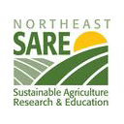
Farmers as Makers
Shall we build a MakerSpace in the Hilltowns?
Sustainable
Hilltowns
Notes:
I am April Roggio. My husband and I ran the now closed Medusa General Store on the south side of Rensselaerville for five years. We are both lifelong residents of the hilltowns, and are committed to building greater prosperity for families here on the hill. I am also an independent researcher by training and, on a whim, decided to apply for some funding to ask some questions about the economic future of the hill.
The Northeast SARE apparently agreed with our characterization of important questions. The Medusa General Store, in collaboration with numerous farmers and a supportive community, propose a feasibility study to investigate the potential community benefit to developing a Maker Space for local farmers and small businesses in our region. This project will serve as the first step in a larger project to boost sustainable economic development in our largely agricultural region.

Slide 2
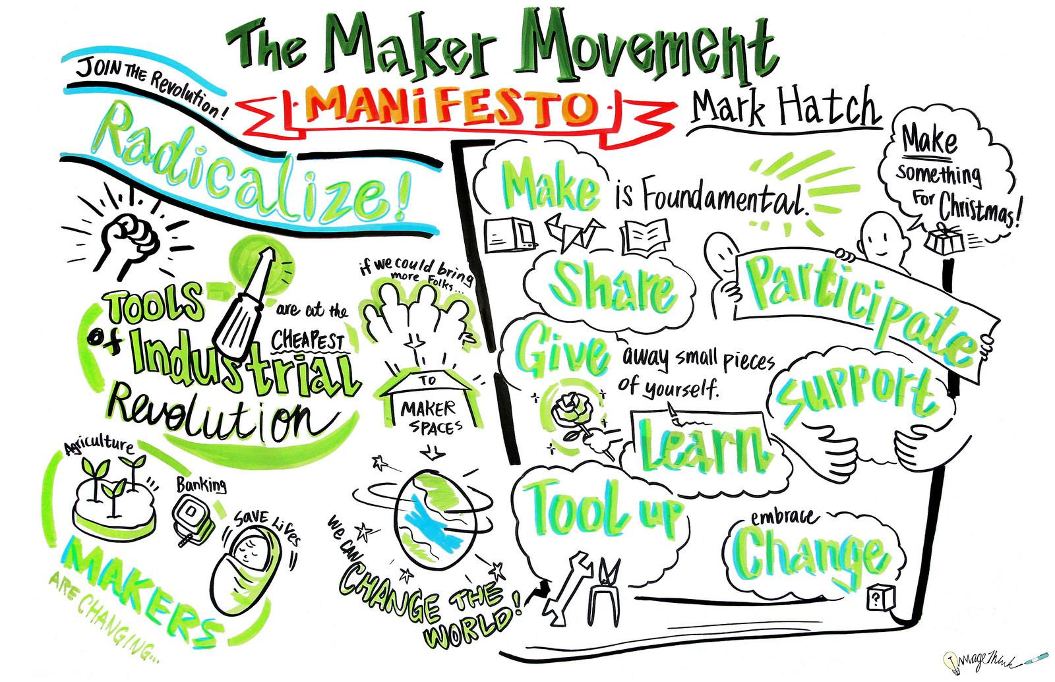
Notes:
So what on earth is the Maker Movement? (Ask for a show of hands: who is familiar with the Maker Movement?)
Maker Spaces are a relatively new concept. A brainchild of the Make movement, which developed as a result of Make: magazine’s 2005 launch as a publication to support the growing community of hackers, hobbyists and tech entrepreneurs who embraced the democratizing appeal of the do-it-yourself culture. Maker Spaces, as physical places that support a community’s do-it-yourself projects, have popped up all over the world, but they have become especially popular in the United States. While their usefulness in filling a gap - test-anxious schools in particular have become less interested over time in providing the kinds of spaces that used to support tinkerers and innovators - part of their appeal is undoubtedly the rekindling of the age old desire to make things ourselves, as is evident in this claim made in a recent Atlantic Monthly piece:
“In these [Maker] spaces, students who no longer have access to wood and machine shops in school, entrepreneurs who have a great idea but little capital to invest in the equipment necessary to build a prototype, and adults who long for a creative break from staring at computer screens all come together to work, to collaborate, to create.”
There been some criticism that the Maker movement has not been as cognizant of their roots as they should be: perhaps in the rush to develop innovative new widgets, they have foregone the opportunity to use this movement as a strategy that brings us closer to long term sustainability. Moreover, it is essential that in addition to addressing access to the “convivial tools”, as remarked by an author in a New Yorker piece, we cannot forget the underlying social and political constructs that are shaping our world. We cannot, as the argument goes, lose the grassroots democratizing appeal of the Maker movement in favor of pumping out more products for a consumer society.

Slide 3
Notes:
Dale Dougherty: We are Makers
Some words of wisdom from Dale, in the event that his talk doesn’t load: “I think of makers as accidental entrepreneurs. Entrepreneurship always seems to be framed as “I’ve got to have a idea to start a business.” Makers seem to start off with building a physical project and that leads to ideas about possible innovations and then they realize that what they’re doing can be turned into a business. The process is such that they would keep doing it, not because the goal is to have a business, but because they enjoy it. It’s about how they learn and derive meaning from the work they do.”
Also, if there is interest, re education, “I’m really excited about the potential for the maker movement to reshape our education system at every level. Hands-on education is not found in our schools anymore. “Learning by doing” was once a familiar phrase in education but now it is foreign. We don’t value hands-on learning the way that we should. Making is currently at the edge but it belongs in the center, and I think enlightened parents and students themselves will cause this change to happen. Making is an engaging and authentic way to learn, especially about science and technology, which are changing the world we live in. I want every child to learn how they can gain the power to contribute to those changes, not just be subject to them.”
“The maker community is developing new talent that can discover and exploit these new opportunities. They have a different perspective, one that is gain from being hands-on. This is the kind of talent that you saw flourishing during the personal computer revolution: people wanting to do this so badly that they’re determined to figure out how to do it the best way they can and learn from each other. I always want organize people doing something, bringing them together so that they can learn from each other. It’s huge to meet face to face.
The maker market is one with a “thousand flowers blooming”. The early Web was like this. There were a lot of people creating websites for all kinds of reasons and for all kinds of applications. Today, people who combine creative and technical talent are making physical, interactive objects — almost like a website that doesn’t live on a computer anymore.”
See https://theblueprint.com/stories/dale-dougherty/ for more from this interview.

Slide 4
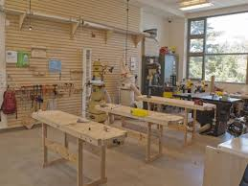
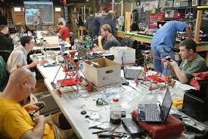
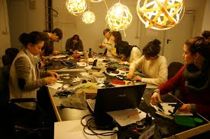
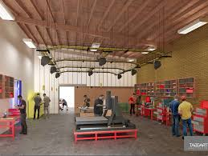
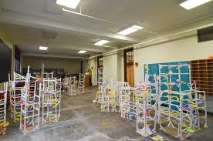
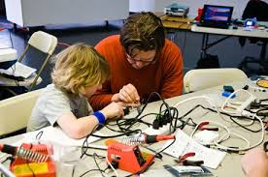
Defining a Makerspace
Notes:
Makerspaces, sometimes also referred to as hackerspaces, hackspaces, and fablabs are creative, DIY spaces where people can gather to create, invent, and learn. In libraries they often have 3D printers, software, electronics, craft and hardware supplies and tools, and more.
From Wikipedia: The rise of the maker culture is closely associated with the rise of hackerspaces, Fab Labs and other "maker spaces", of which there are now many around the world, including over 100 each in Germany and the United States.^{[8]} Hackerspaces allow like-minded individuals to share ideas, tools, and skillsets.^{[9][10]} Some notable hackerspaces which have been linked with the maker culture include Noisebridge, NYC Resistor, A2 Mech Shop, Pumping Station: One, Artisan's Asylum,^{[11]} and TechShop. In addition, those who identify with the subculture can be found at more traditional universities with a technical orientation, such as MIT and Carnegie Mellon (specifically around "shop" areas like the MIT Hobby Shop and CMU Robotics Club). As maker culture becomes more popular, hackerspaces and Fab Labs are becoming more common in universities^{[12]} and public libraries. In Europe the popularity of the labs is more prominent than in the US: about three times more labs exist there.^{[13]}

Slide 5
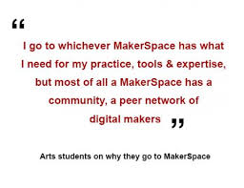
Notes:
From an art student… So why should we create one? After all, a number of our local libraries are already on board with MakerSpaces. (Berne, in particular has an active Make movement program.)

Slide 6
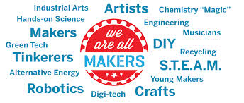
Why here? Why this?
Notes:
We would like to add small farmers to this list. Having been born and raised here, my first experience with Makers, long before the term became popular, was small farmers.
Surprisingly, while the Makers have left their mark on organizations from big business to education, and inspired designers, young and old, it tends to be an urban movement. We think now’s the time to change that: we want to reach out to our community and design a maker space that promises to support our small farmers, especially in a region that has not yet recovered from a recession economy. Farmers are, after all, the very first “makers” and have longed thrived on their ingenuity and entrepreneurship. Our version could include an extensive resource library, a workshop with relevant tools and a space for sharing ideas and collaborating with other farmers and small businesses. It could precede a complementary effort to build a full scale rural business incubator in our region.
Moreover, the economics our region are tenuous, at best. Our population, on the hill continues to decline and the makeup of people tends to be significantly weighted towards commuters and second home owners, despite our prosperous past, when hamlets like these used to contain multiple commercial enterprises, including stores, taverns, mills and boarding houses. Moreover, much like the rest of the nation, the economics of our region continue to decline: folks are sliding from middle class into working poor, or worse, much like is happening throughout the nation.
One way to stem this deterioration is to consider how we can bring more wealth, for as little cash as possible. Providing the space and tools for the DIY movement, here in our hamlets, and in our hilltowns, to thrive, provides that possibility. I am focusing on small farmers and, most recently, homesteaders, because in a rural area, that represents low hanging fruit.

Slide 7
Crosspollination!
Notes:
Some of the greatest ideas are born when people talk. Really, when people from different fields, with different passions and different skill sets get together and dream out loud. These are a few examples of what is happening at the intersection of sustainability, small farming, and the growing DIY / Maker movement. This talk took place at the MakerFaire in NYC in September of 2013.
It is long and quite dry, but the gist of it is simply that there are others thinking along these lines as well - how do we use this growing movement, and the energy and inspiration it provokes, to reshape and rebuild our own communities?

Slide 8
What could we do?
Processing
Canning and preserving
Cooking and sharing
Value added production
dairy products - cheeses, yogurts, etc.
extracts and herbals
tea
Building
Homesteading
devices for building
tools
renewable energy equipment
Agricultural devices
Hives and beekeeping
Mapling
Small animal keeping and processing
Small scale grain production
Notes:
The ways in which we could use a Makerspace, or collection of spaces is pretty expansive. If it is remotely related to making, we could construct a space to address any of these.
And it could be done with the support of such organizations as farmhack.org: We are a worldwide community of farmers that build and modify our own tools. We share our hacks online and at meet ups because we become better farmers when we work together.
Or through organizations such as the Ellen MacArthur Foundation, which is a leader in the reuse, reinvent, circular economy movement. It defines the circular economy as “one that is restorative by design, and which aims to keep products, components and materials at their highest utility and value, at all times.” This is necessarily what we are talking about when we refer to small farming makerspace innovations. How to find useful ways to reestablish our connection to our resources, such as our land, and promote greater prosperity.
http://www.resilience.org/stories/2015-09-16/a-tale-of-pollen-and-empowerment

Slide 9
Ways to move forward...
What are our next steps?
Complete the upcoming survey
Provide feedback
...to me directly or
via the survey
or through some sort of web portal.
Find collaborators and funding, if necessary.
Notes:
Complete upcoming survey, which can be emailed to you, or downloaded via the web, or submitted directed on surveymonkey. Provide feedback. (We could use Sustainable Hilltowns’ Facebook page, which tends to be broadly focused on the hilltowns’ four town region. Or design something else, hamlet by hamlet. Or we could even put up something at a brick and mortar location - either at a firehouse, or a post office, or something like my store.)
Find collaborators and funding, if necessary. ...which brings us to...

Slide 10
Other possibilities
Further funding through Northeast SARE or other small grant programs to investigate questions of significance or provide funding for planning and project design (i.e. Hamlet Harvest: It takes a village to feed a village!)
Albany County Microenterprise program
New York State Enhancements program (NYSDOT)
Historical registry programs: see attached spreadsheet of buildings in R’ville listed in the NYS CRIS system
New York State Main Street Program
Notes:
There are many other possibilities for funding. It would be nice to have a supportive local government, but that is not essential. Albany County has offered their help, for example. Sustainable Hilltowns could also get our nonprofit designation, which would enable us to become an applicant on many of these projects.

Slide 11
Thank you!
Notes:
And as this is a beta run of this project, I really appreciate your help with tweaking any pieces that were not clear!

