Slide 1
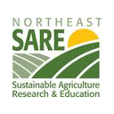

Farmers as Makers
Shall we build a MakerSpace in the Hilltowns?
Spring, 2016
Sustainable
Hilltowns
Notes:
Welcome back to those of you who were able to make these gatherings last fall - and welcome to those of you just discovering this project. I am April Roggio (sometimes April Caprio) and I am the former co-owner and operator of the Medusa General Store, in nearby Rensselaerville, and a conspirator behind Sustainable Hilltowns, a citizens group in the hilltowns, focusing on sustainable economics and resilient communities.
I am also a research scholar by training, earning a PhD at UAlbany a few years ago, a mom to a small tribe of hilltown kids, and a lifelong resident committed this region’s prosperity.
Last fall, we were funded through Northeast SARE to investigate the feasibility and the potential community benefit of developing a Maker Space for local farmers and small businesses in our region. This project will serve as the first step in a larger project to boost sustainable economic development in our largely agricultural region. This presentation will hopefully be brief - I don’t want to take up your whole evening. I am going to outline the key themes that came out of last fall’s gatherings, as well as the information gained through our surveys and some data gotten through CDRPC.

Slide 2
Your answer? It depends
Who is our audience?
  Farmers as makers - *homesteaders* as makers
Who benefits?
  Makerspace? Grangerspace? Farmer networks?
How does it address transition?
  Climate disruption, economic instability, income inequality
Can a Makerspace address a broad range of hilltown challenges?
  Circuit riding

Slide 3
Farmers and Homesteaders Aligned?
Small Farmers and
Market Producers
Hilltown Homesteaders
Interest in shared (or community
owned) services
Interest in the development
of a food hub
Ethic of land conservation
Focus on
community resilience
Interest in market development
Notes:
Our gatherings all tended to coalesce around a particular set of facts. Small farming on the hill is critical, both because we need to be developing strong local foodsheds, and small farmers are the ones that are keeping our region rural, for whatever other reasons are important that we stay rural, such as recreation and ecotourism, or just nostalgia. But our farmers cannot survive without additional markets - while the size of the population might theoretically exist, the demographics suggest that folks cannot or will not buy enough of their products locally to keep our farmers thriving.
So what do we do? Encouraging additional small farmers in the hilltowns solves one problem - we are working toward building a local foodshed - but we are also condemning additional families to poverty, as it often seems like a zero-sum game. We are effectively adding to the stock of people who cannot afford to buy their meats, produce and other goods locally.
We need a new model… And, from your responses, it is clear that just convening, even in a particular space, with specific people, namely farmers, is not going to provide for greater prosperity here, nor is it a substanial enough response to the problems we are facing.

Slide 4
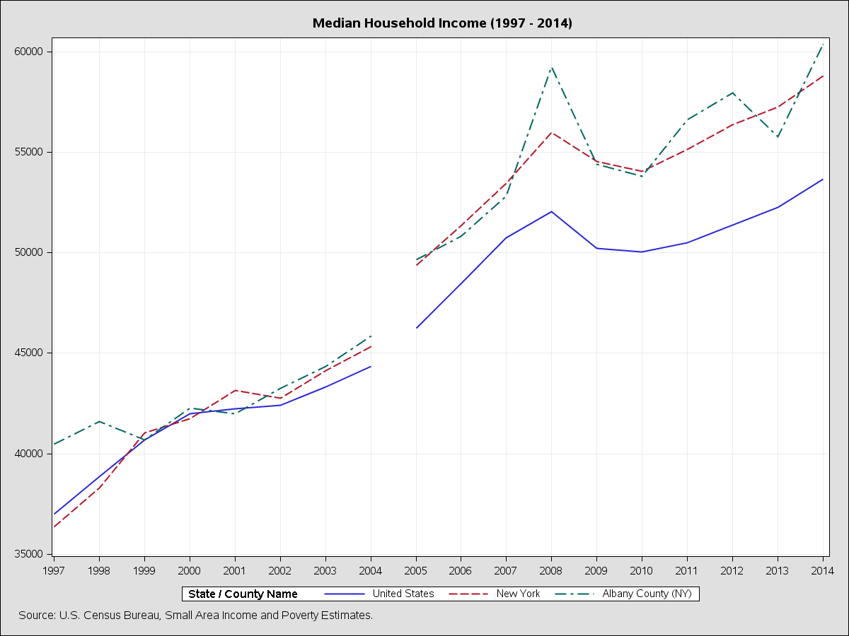
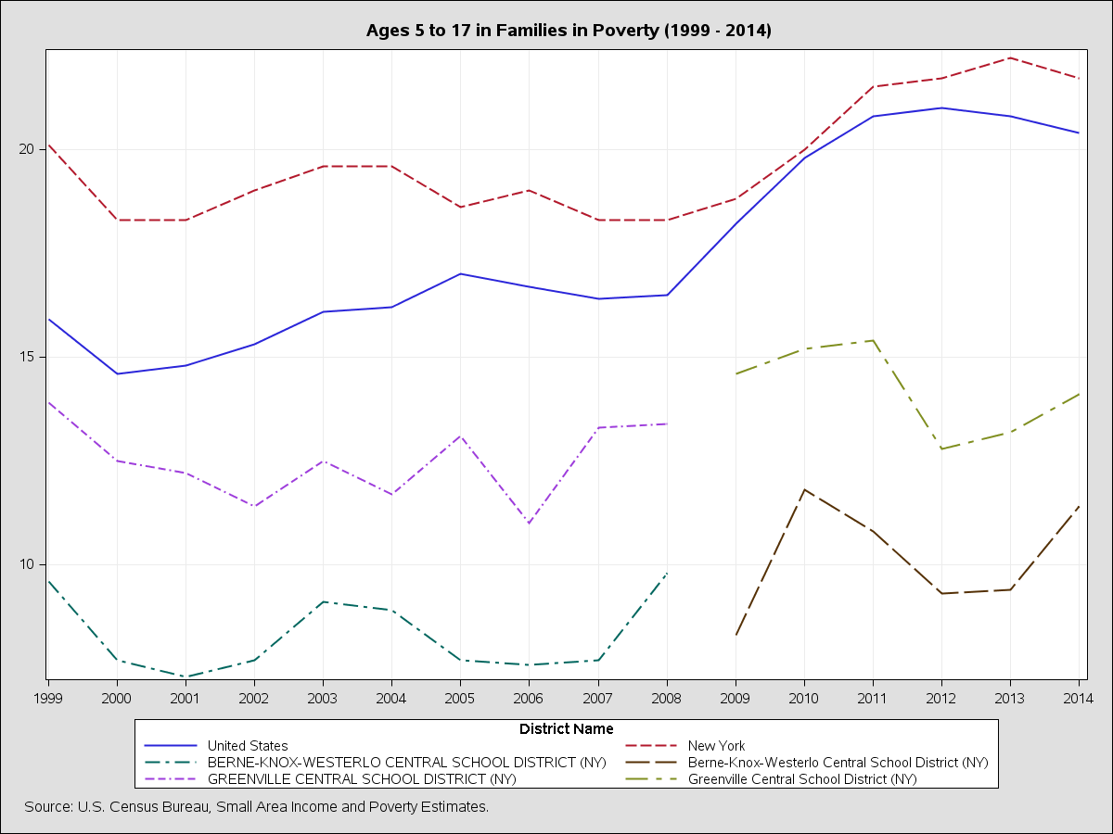
Census data
Notes:
So this is interesting, right? First, since you asked, I contacted the Capital District Regional Planning Commission, to talk about data. They, and more specifically, the Census Bureau, has a lot of data - they prefer snapsots, not over time data, but you can still extract some interesting things.
They happen to have some time, right now, to work with us, to identify the data that could best inform our planning. Indeed, they seemed eager to help.

Slide 5
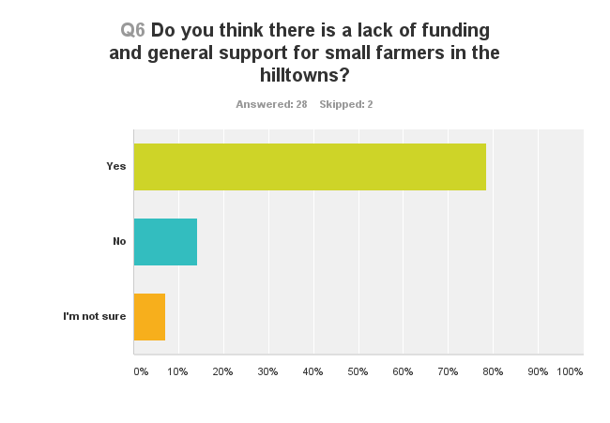
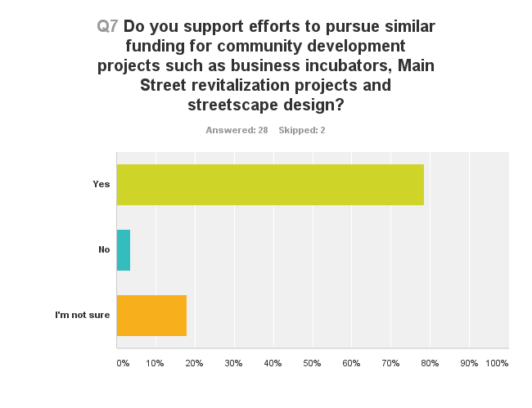


Slide 6
MakerSpace? GrangerSpace?
Survey results
  Building something…
  Cautious hope
Development of a hybrid approach
Funding?
  Volunteer?
  Grants
  Direct government assistance
Notes:
The survey results were pretty interesting - I will have a complete report posted by our final workshop on April 30. But to summarize, there is pretty overwhelming agreement that developing something would be useful for our region. That funding is necessary, but limited and that there are few saviors on white horses coming to our rescue.
There aren’t a whole lot of options, to be honest - my group is prepared to form, this spring, as a 501C3, which would enable us to both apply for funding to create things, make spaces, build programs, and also seek out funding on your behalf as well. It would be an uphill battle, with a tremendous amount of effort being expended on development.
On the other hand, we don’t really have a choice. For one thing, we are a fairly small rural area. For another, as was obvious from our gatherings last fall, and from the email addresses I collected from our survey, there are a mere handful of people in any one of our townships that are ready and willing to devote time to these kinds of projects. I think I could name all of them, right now.
...which should also not necessarily be cause for alarm - I suspect that is the way it goes in most places. You are here because you are ready to lead.

Slide 7
Addressing transition through a Makerspace?
Climate change, energy and economic instability, and income inequality came up frequently, in our gatherings, as well as in the survey
Use of a space as a linkage among neighbors working on common problems
Use of a space to champion particular strategies, i.e. renewables
Notes:
...which brings me to another theme, which is that...
There has been a pretty strong sense of urgency, throughout all of these workshops, from newly elected local legislators who are building support for solar farms, to CSA farmers and market growers who are forced to include the potential challenges of climate change in their plans.
A Space for small farmers, homesteaders, residents is critical on it’s own. But when partnered with these additional crises, it almost seems like a given. This is especially true as our churches and firehouses have lost parishioners and members

Slide 8
Addressing broader challenges: Circuit riding
Staff or funding devoted to Hilltown issues
Identified challenges with a toolbox of solutions
Use of a Grangerspace as a portal for rural solutions
Notes:
There is some sense that if we had people and resources devoted to our “issues” , then solutions would be more readily available. This is probably somewhat true, but it is also unlikely that we’ll get staff or money, so how to move forward?

Slide 9
Your thoughts?
Feedback about this project in general
Thoughts on future hilltowns projects
Responses to my interpretation of data and participation

Slide 10
Thank you!
Notes:
And as this is a beta run of this project, I really appreciate your help with tweaking any pieces that were not clear!

