Slide 1

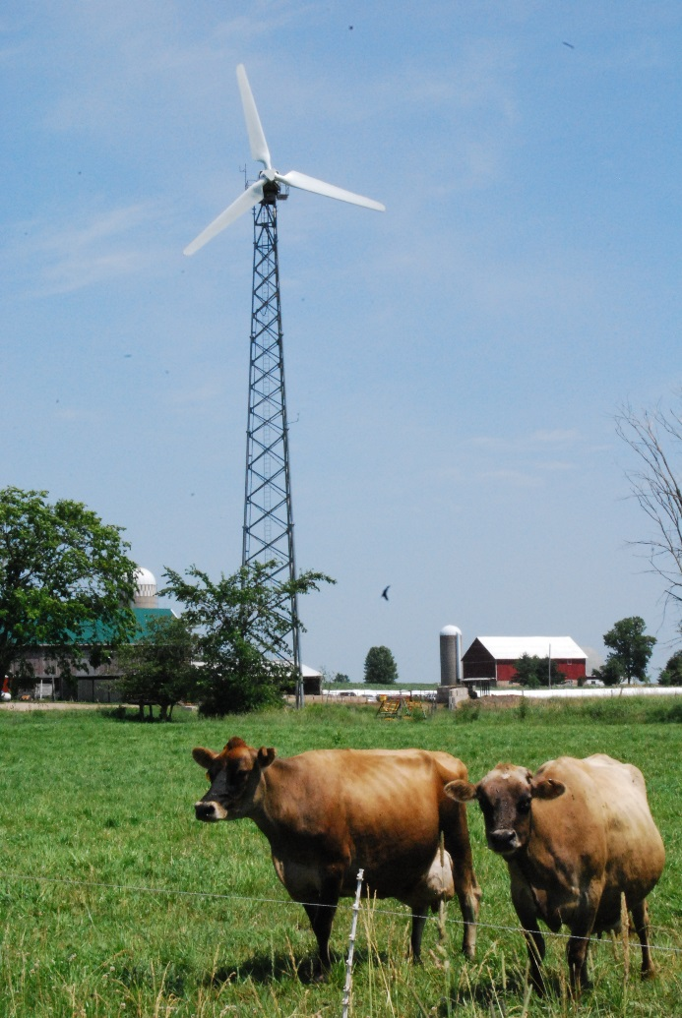
Guide to Managed Grazing:
& Organic Pastures
Click on the audio icon to hear the lecture
Valerie Dantoin
Northeast Wisconsin Technical College
Green Bay, Wisconsin
Valerie.Dantoin@nwtc.edu
Funded in part by:
SARE

Slide 2
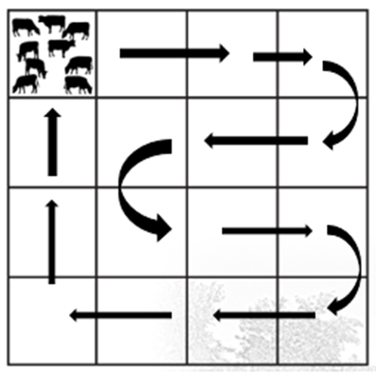
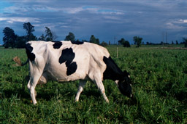
What is Managed Grazing?
It is a system in which livestock move around a field in a controlled manner.
They eat fresh, whole plants everyday directly in the field.
It is a win-win-win-win method of sustainable farming.

Slide 3
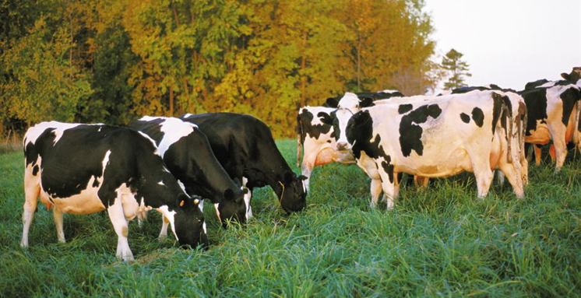
Why is it important?
It is a win-win-win-win method of sustainable farming.
A win for land and water stewardship.
A win for animal care.
A win for food quality.
A win for the farmer.

Slide 4
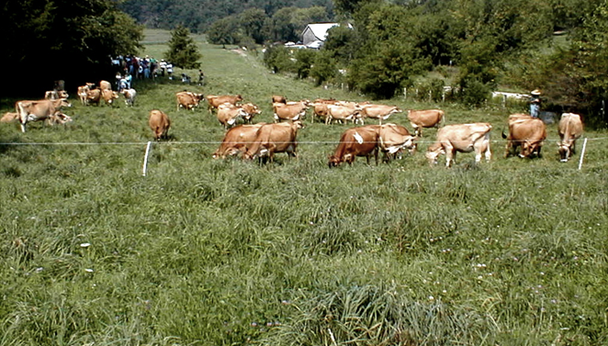
The components of managed grazing.
Grazers are animals that eat whole fresh plants out in the field.
A farmer who manages the animal and plant interactions on the field is called a grazier.
A field of perennial plants that feed grazers is called a pasture.
Pastures are subdivided into smaller areas called paddocks.
The paddock
The grazier
The grazers
The pasture

Slide 5
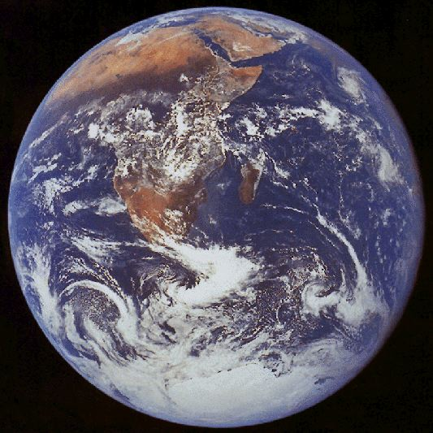
Farming:
Capturing the sun’s energy and converting it to crops.
Sustainable farming:
Capturing the sun’s energy as crops without compromising the earth’s ability to regenerate and sustain life.

Slide 6
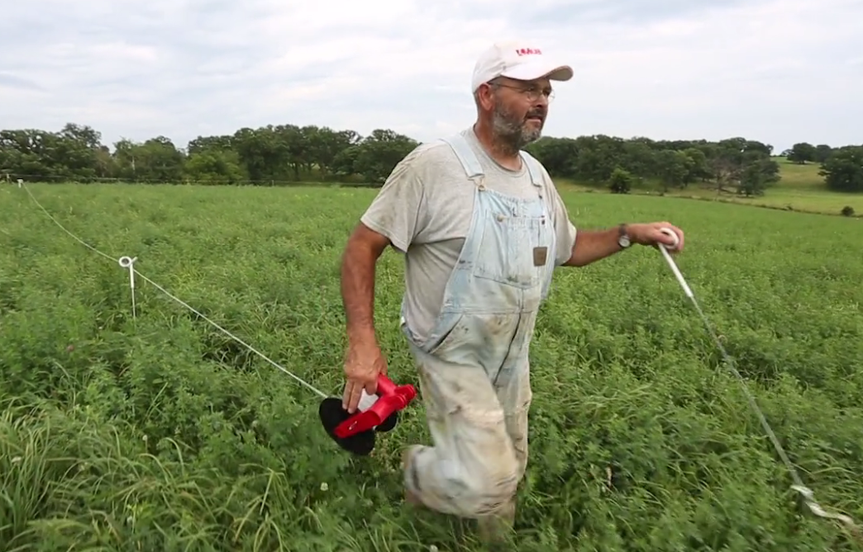
A farmer uses portable electric fence to create paddocks, which are divided fields.
Paddocks control how much the animals eat.
If the animals over-graze the plants, the plants loose vigor and productivity.
How does managed grazing work?

Slide 7
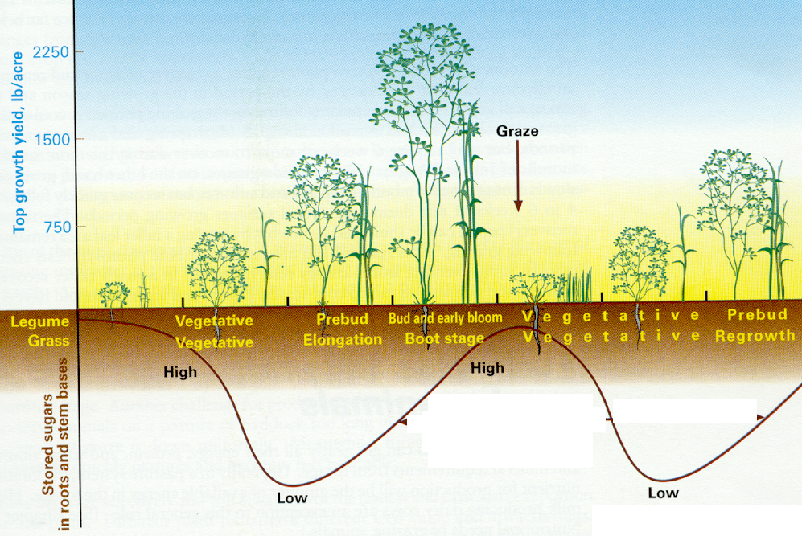
Just like a lawn, pasture plants can be cut (or grazed) about every 3 weeks. They need a rest in between.
Rest
Rest

Slide 8
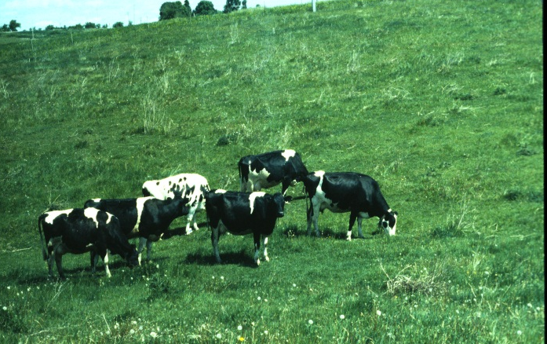
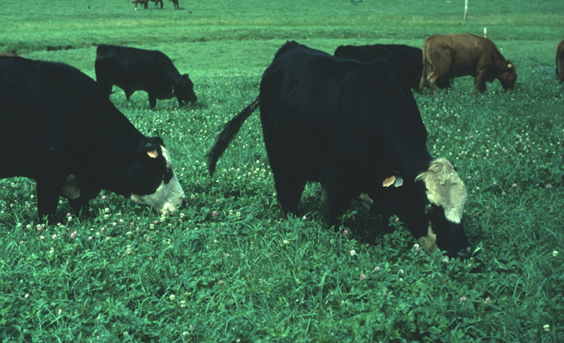
Animals are rotated through paddocks to control over grazing.
In Managed Grazing, animals eat everything in their paddock including weeds. Then cows are excluded from the paddock. This allows plants to recover and regrow.
Overgrazing results as animals go back for seconds on tender, sweet regrowth. They skip the weeds.
30 days
1 paddock
30 days
30 paddocks

Slide 9
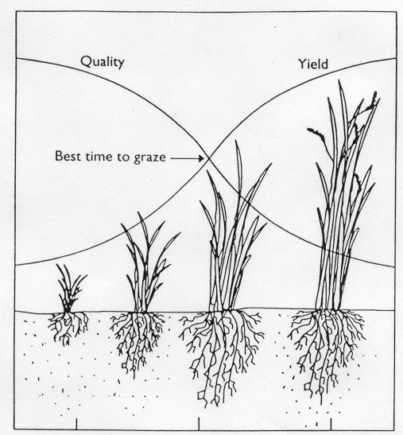
Plant re-growth and the timing of grazing improve the productivity of pastures and help the animals make a lot of meat or milk.
Regrowth

Slide 10
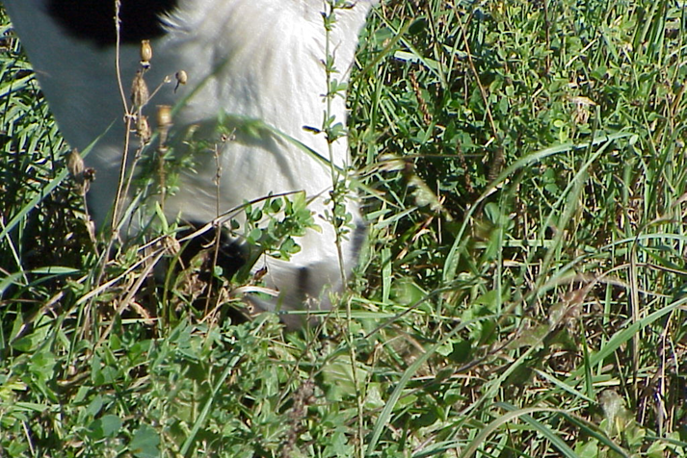
Ration, Rotate, Residual, Rest
Information from Undersander et al. 1993. Pastures for Profit, bull. #A3529

Slide 11
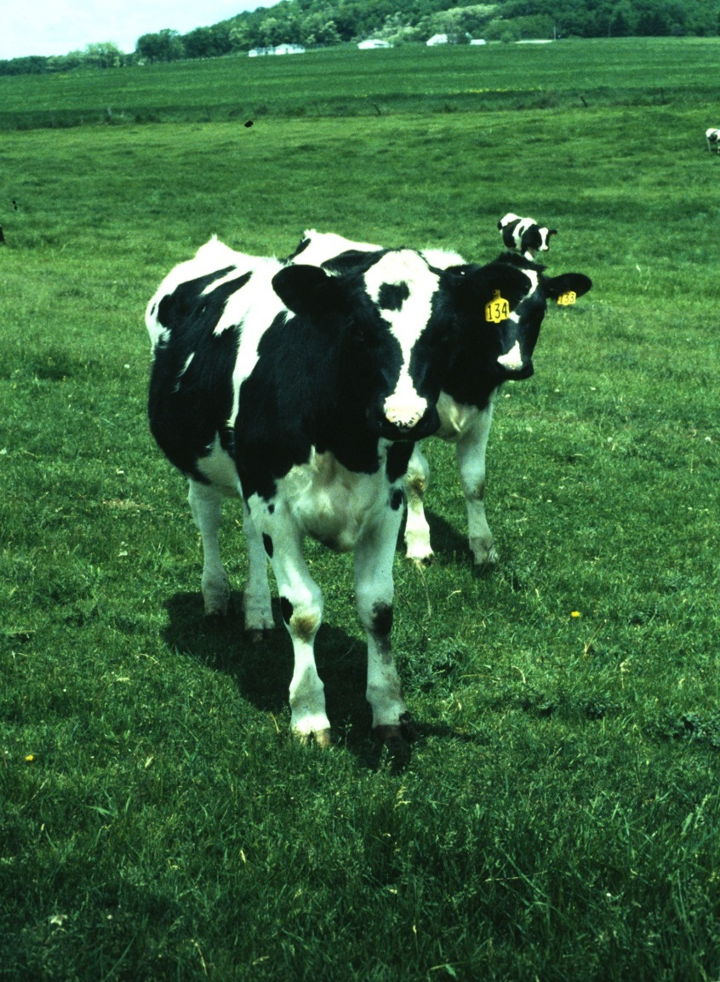
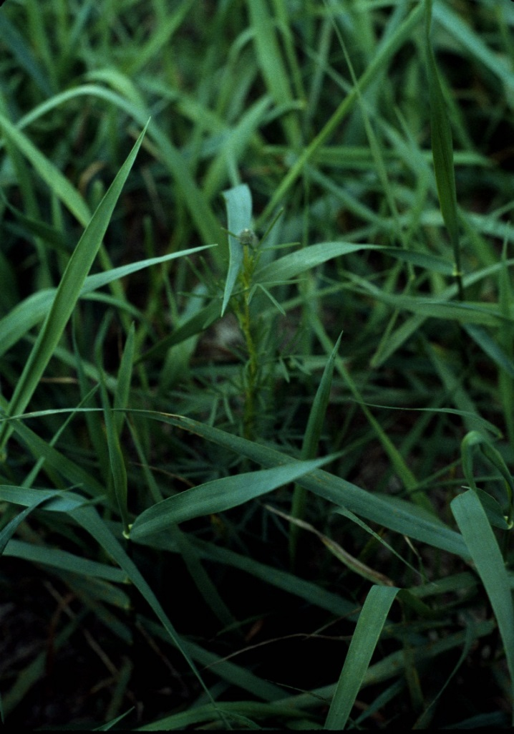
Residual – what remains is as important as what was eaten
Too short!
The motto of Managed Grazing
“Take Half/Leave Half”

Slide 12
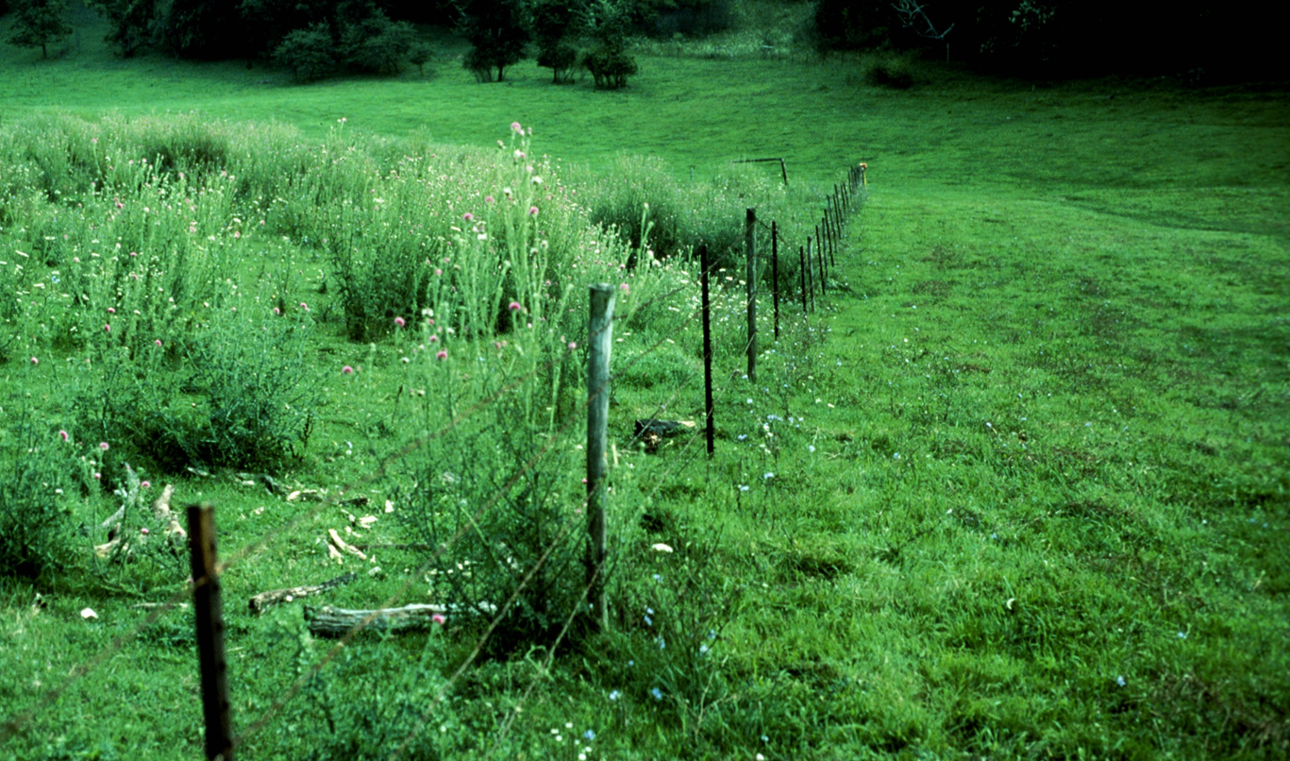
The field on the left was over grazed, cows were left in the field for weeks at a time. They avoided the weeds and ate only the new growth.
Unmanaged grazing
Managed grazing

Slide 13
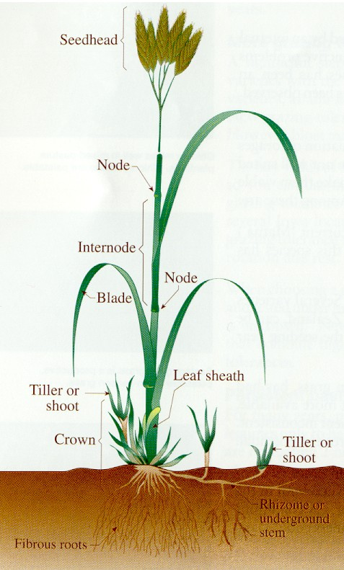
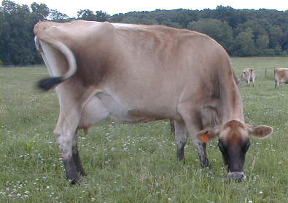
Ruminants & Grasses Co-Evolved with this cycle of rest and rotation

Slide 14
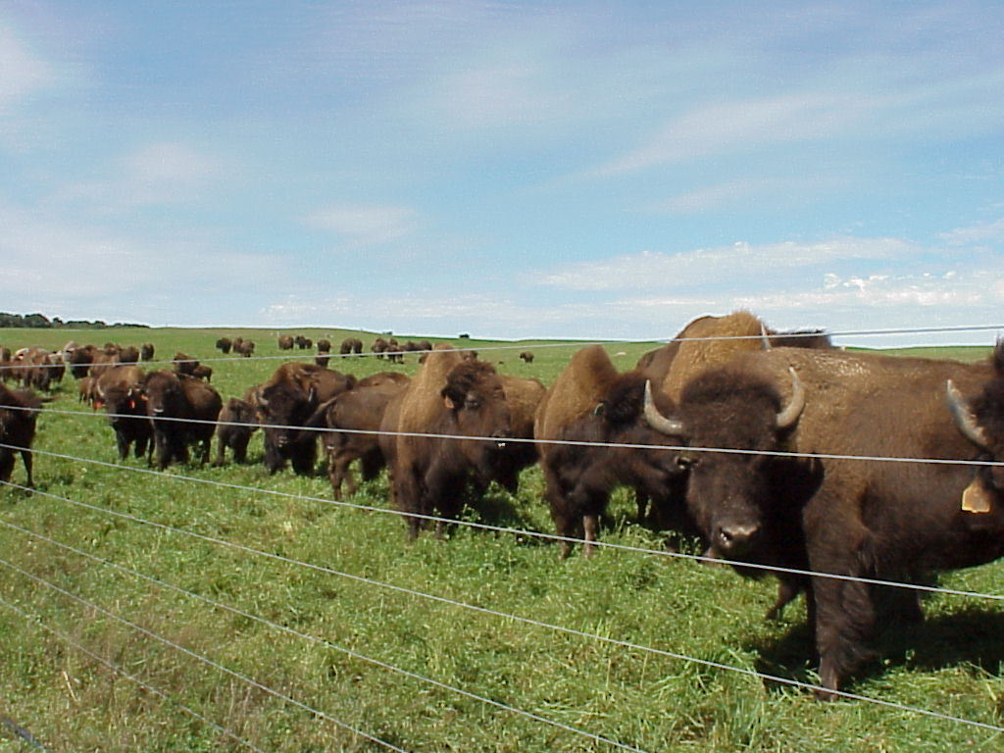
The Original Grazers – the Midwestern plains were sustainable for thousands of years. A beautiful balance between plants & animals.

Slide 15
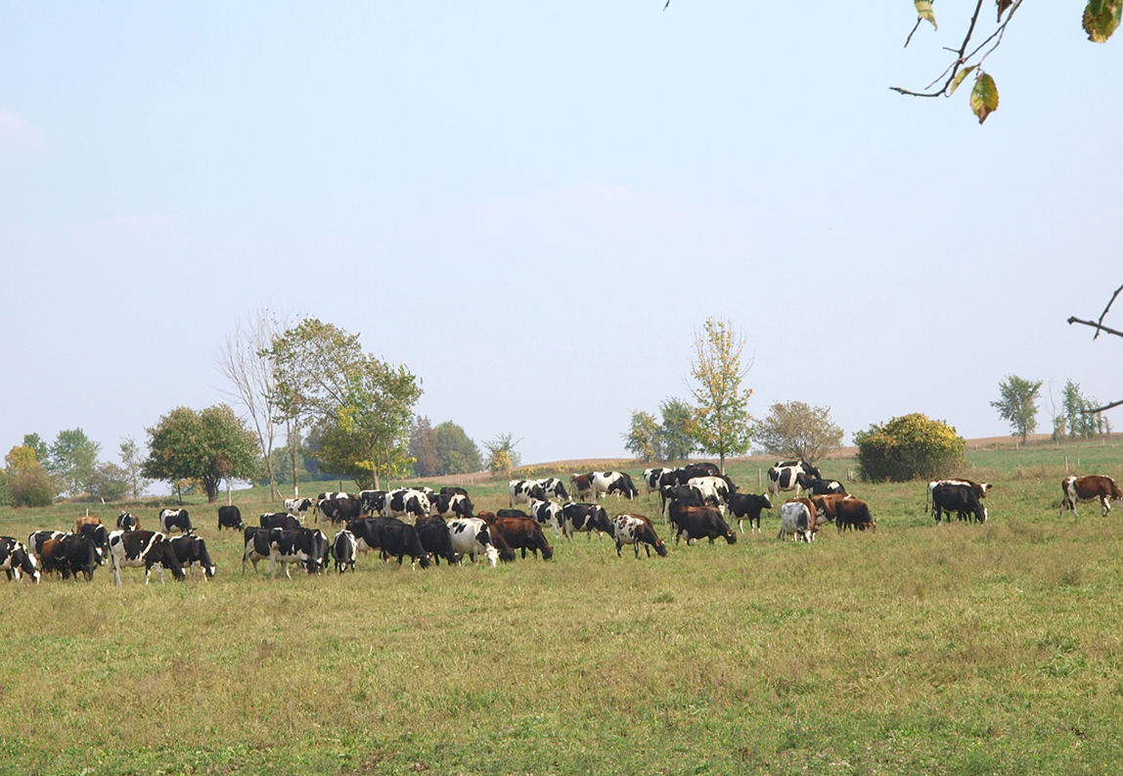
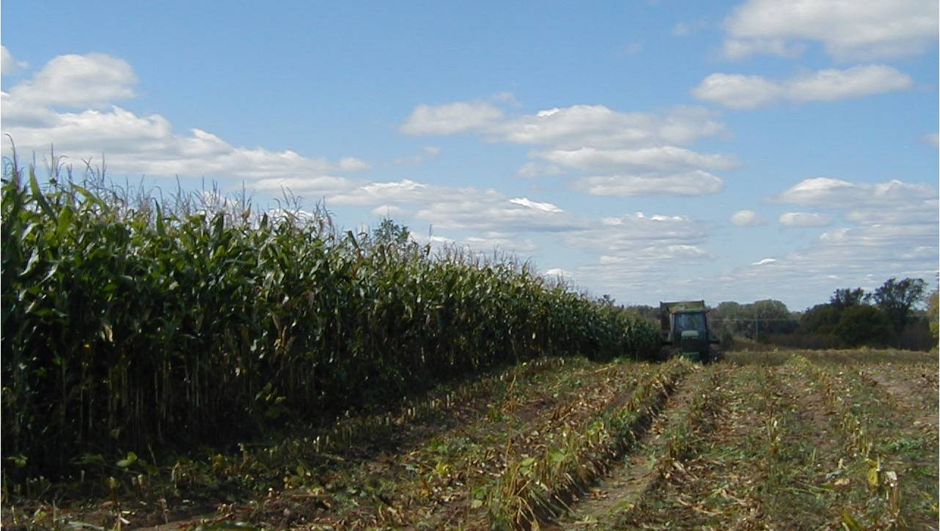
It is sustainable to balance the plants and animals using managed grazing
However, the balance is broken by the plow and annual cropping.
Pasture plants are perennial
Solar energy is captured by crop plants whether they are annuals like corn and soybeans or perennials like pasture clovers and grasses. Both kinds of crops are used to feed animals.
Corn
Annual crops are plowed, planted and harvested every year.

Slide 16
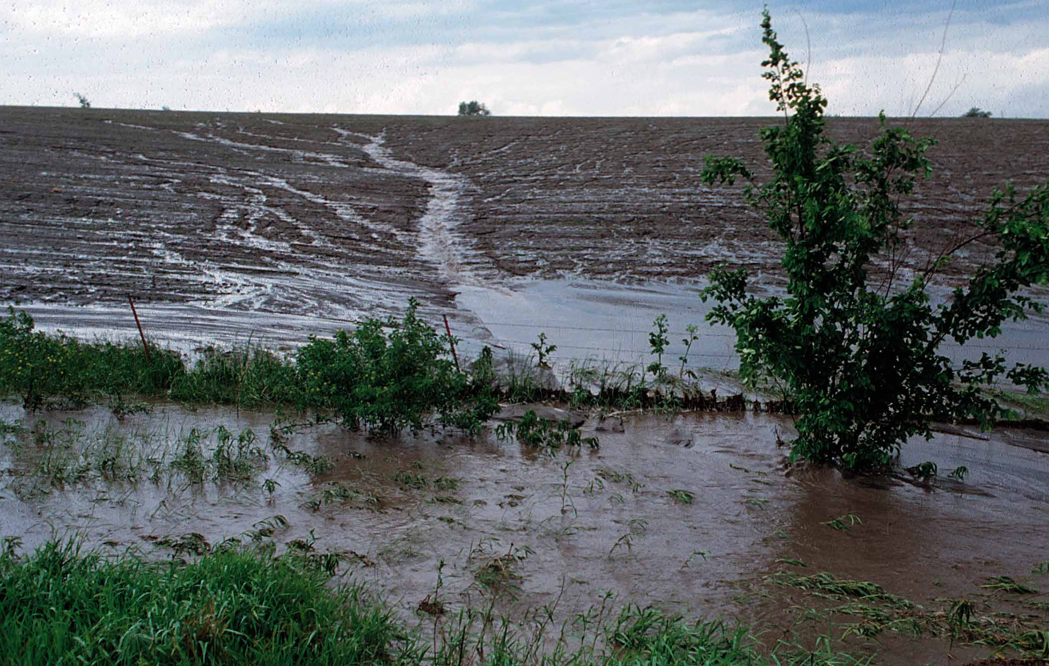
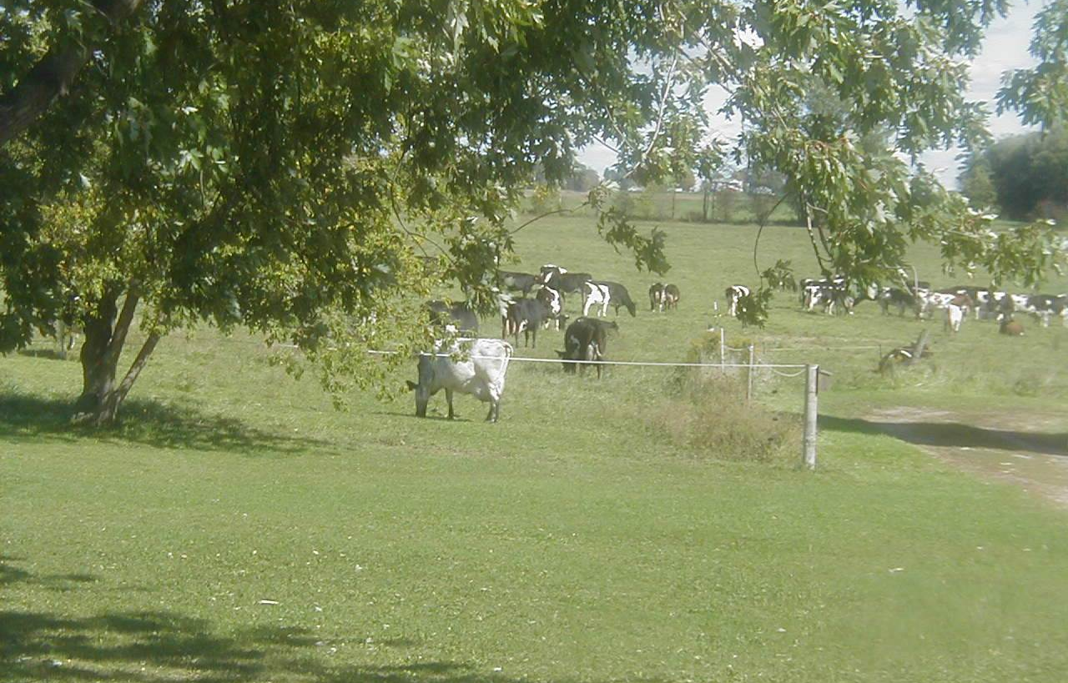
Why is grazing a WIN for the land & water?
Plowed & planted vs. Perennial
The field on the left was plowed and prepared for either corn or soybean planting.
Bare ground is subject to runoff and erosion which pollute our waterways.
The pasture field on the right did not have to be plowed because the perennials regrow on their own every year. The sod in pastures reduces the impact of rain on the field..

Slide 17
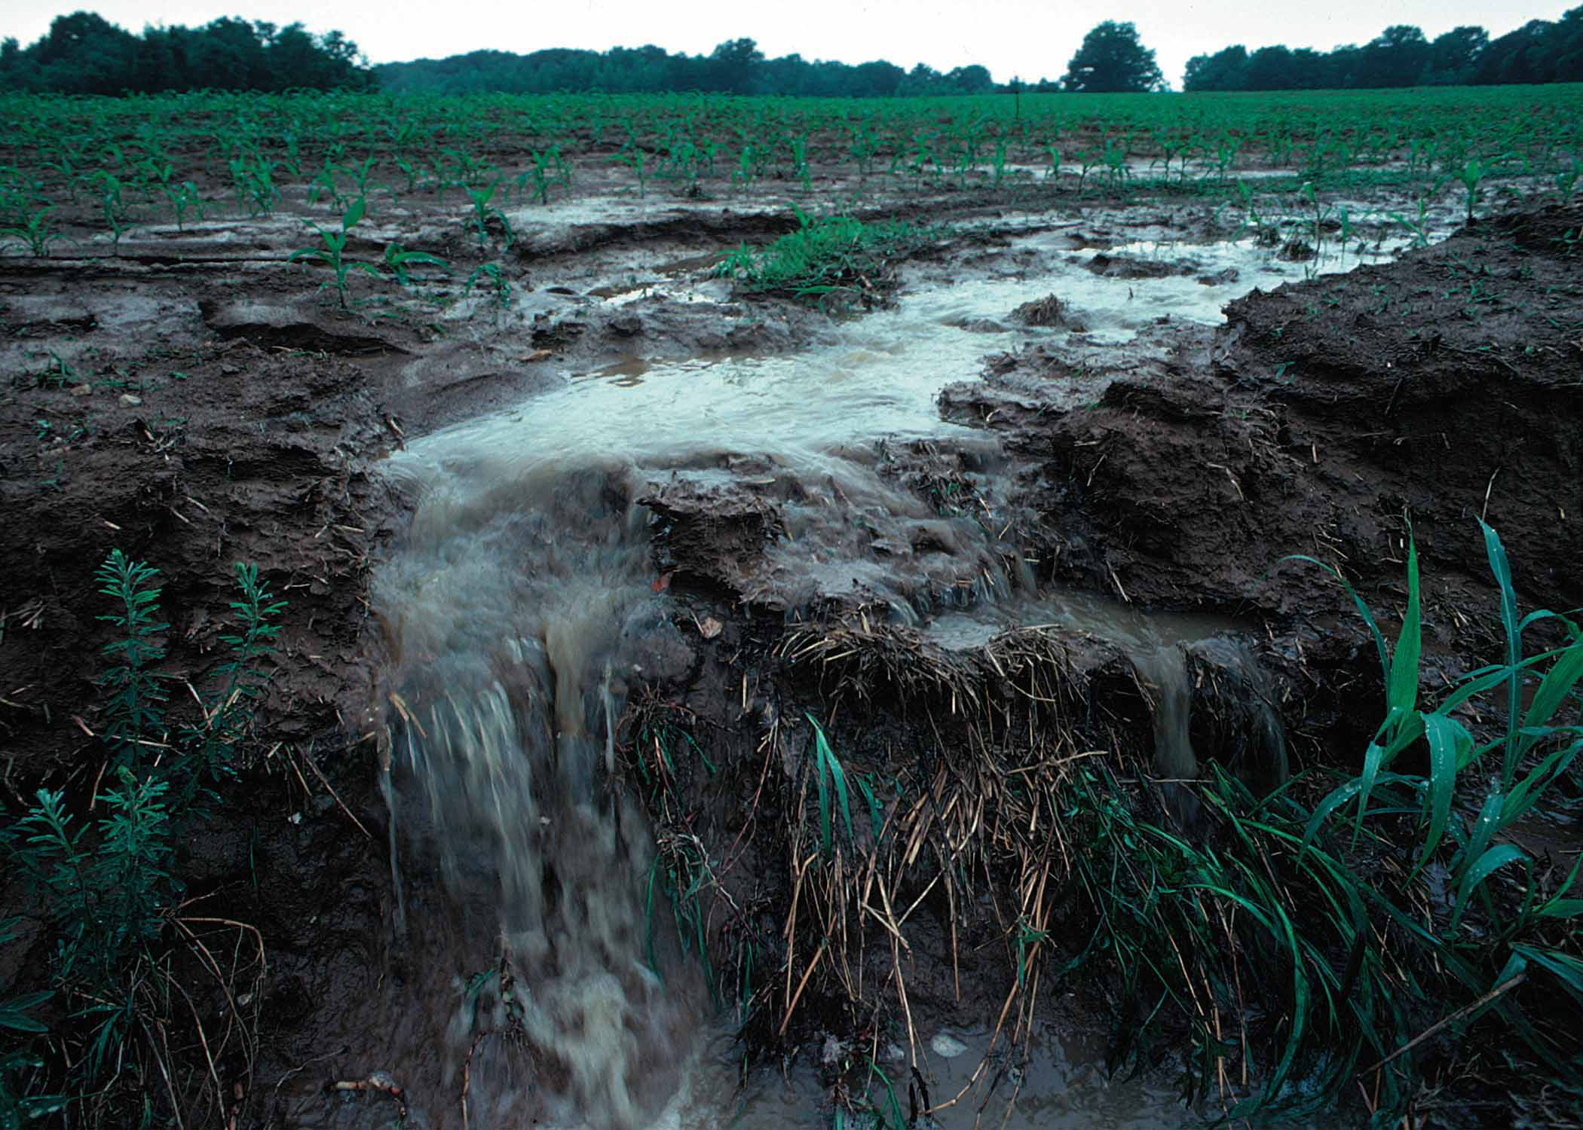
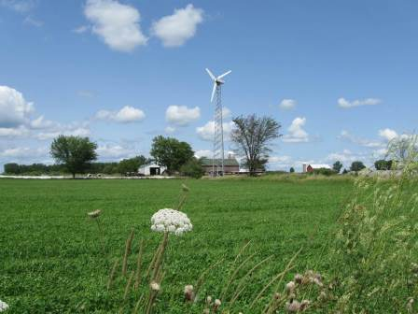
Why is grazing a WIN for the land & water?
6 months of cover vs. 12 months of cover
Perennial plants (left) keep the ground covered all year. They begin growing in Wisconsin as early as March and they continue on through November.
Annual crops (right) don’t get planted until May, they don’t “canopy” or cover the soil until June, and they get harvested in October or November.

Slide 18
When water moves across, and off, farm fields, water pollution occurs.
The Bay of Green Bay is dying of hypoxia because of run-off events in the spring and the fall from plowed farm fields. ***

Slide 19
Soil Organic Matter is important – the best soils have high levels organic matter
Start of cultivation
Total soil
organic matter
Organic matter acts like a sponge. It protects against both drought and flood.
Restoration of pasture cover and living roots in the ground all year long

Slide 20
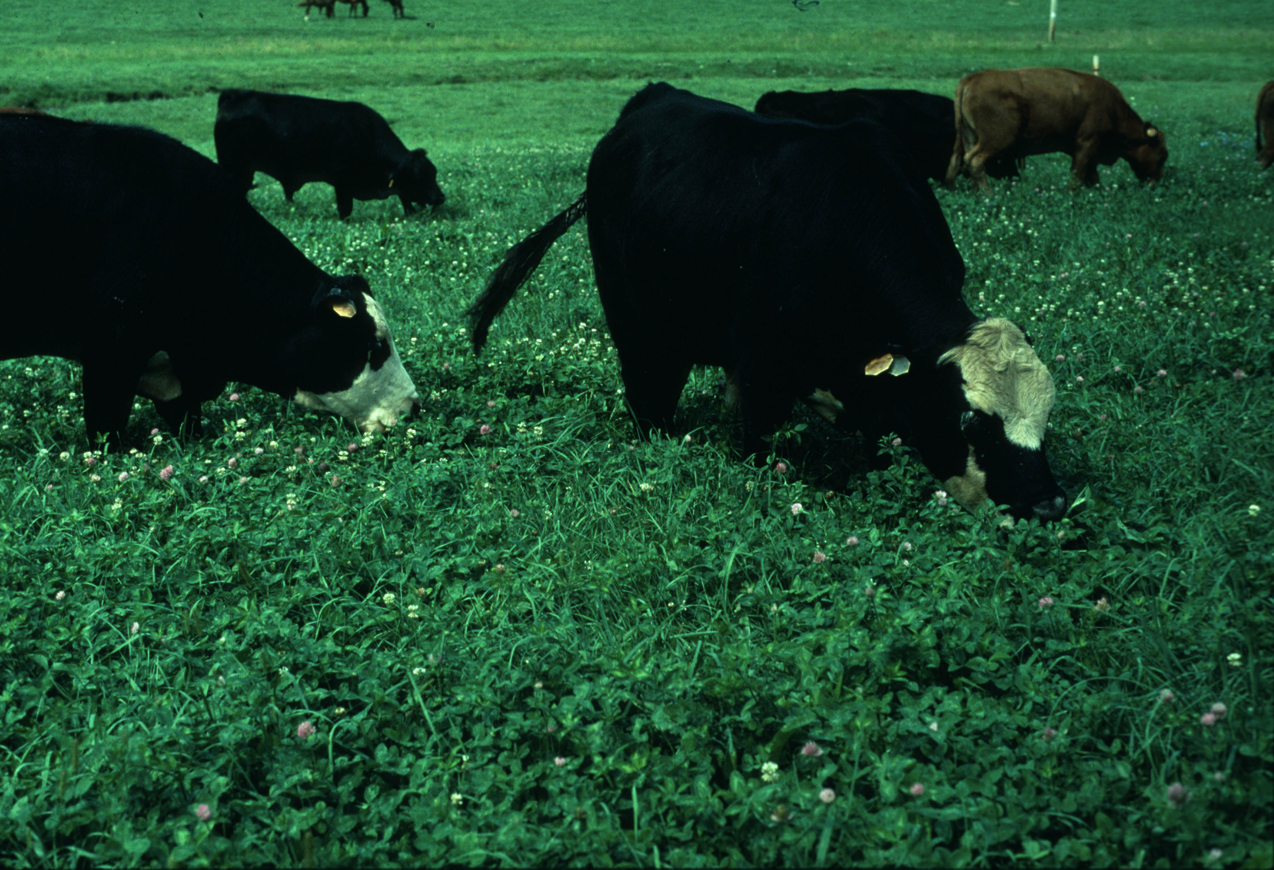
Herbivores have grazed for millennia. Only in the last 50 years have they been fed corn and soybeans
Grazing builds organic matter. Corn & soy do not

Slide 21
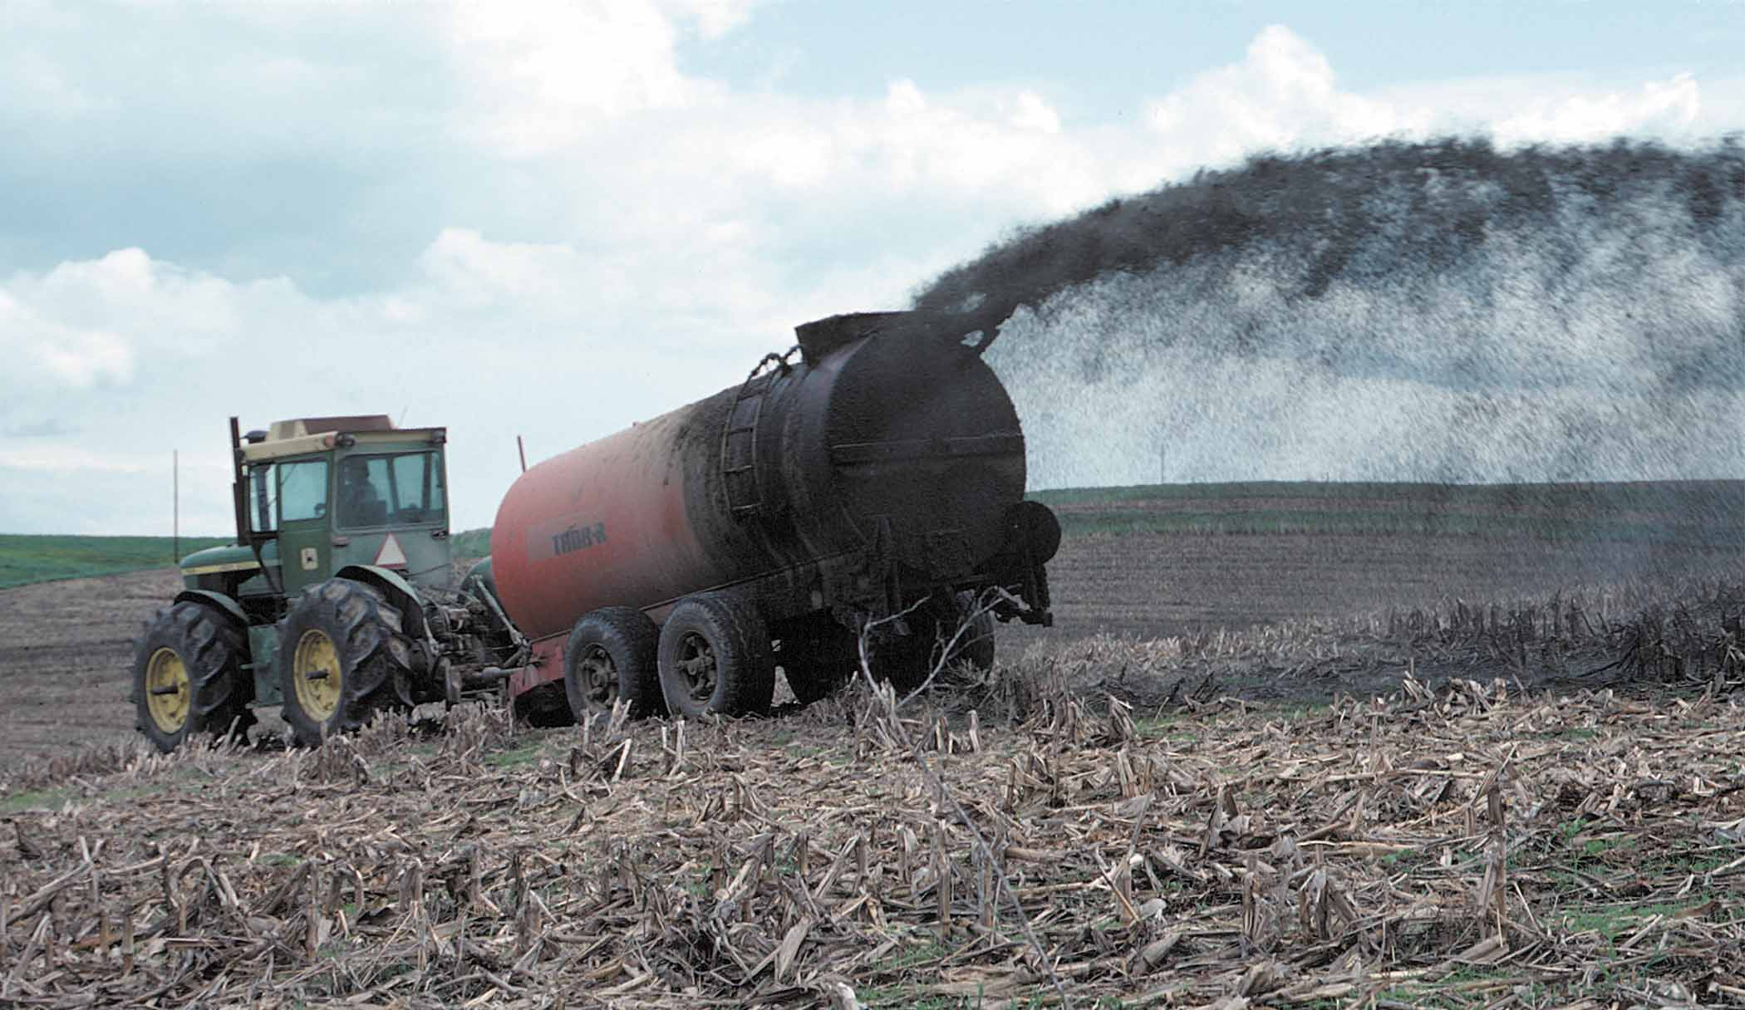
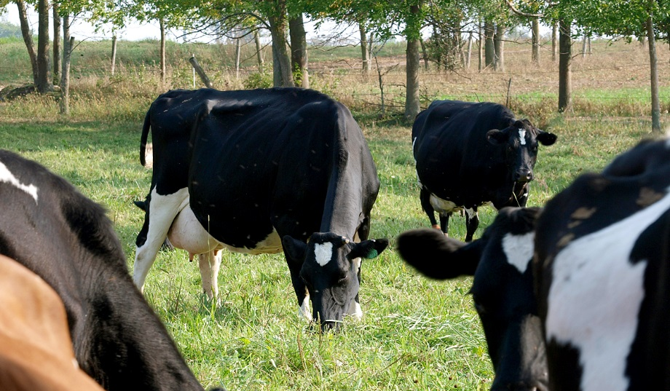
Why is grazing a WIN for the land & water?
Farmers spread manure vs. Grazers distribute manure
Farmers in our region generally collect manure in large pits for six months at a time. They spread manure on fields usually before crops are planted in spring or after crops are harvested in fall. Manure stored in pits or spread all at once can spill or runoff and contaminate water. Also, manure handling requires a lot of energy.
Well-managed grazing animals spread their own manure on fields where it does not run off. They harvest the feed themselves. No tractors or fossil fuel needed.

Slide 22
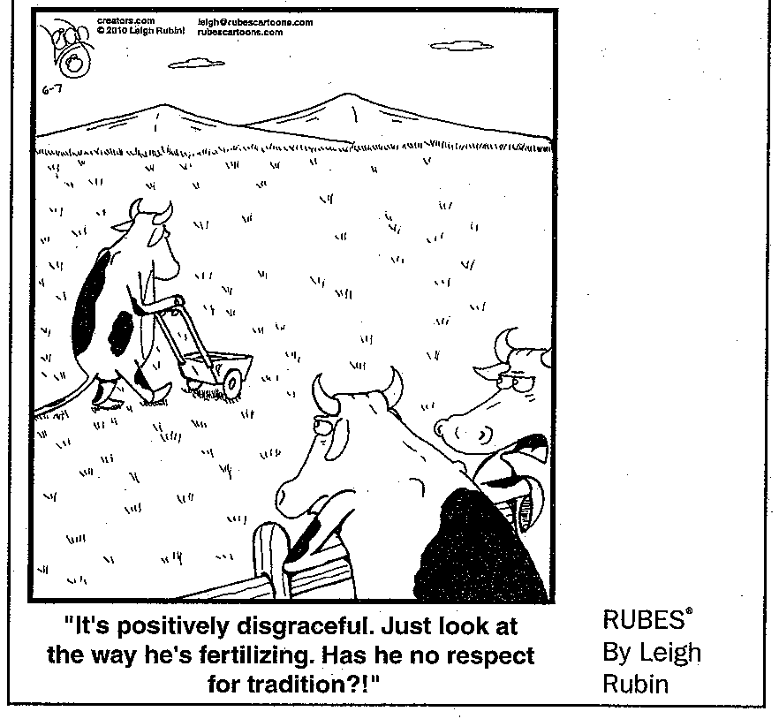

Slide 23
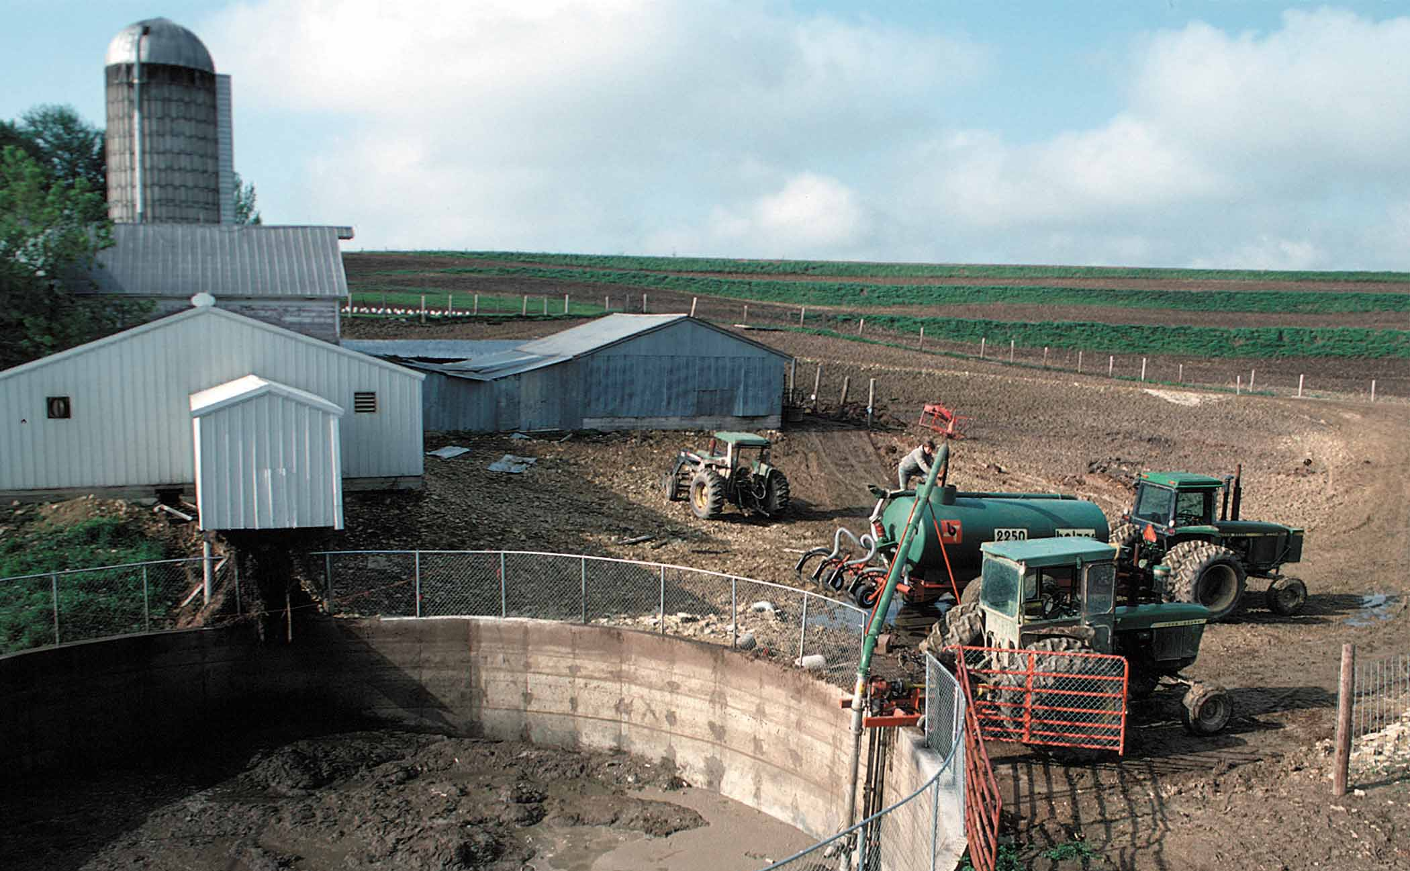
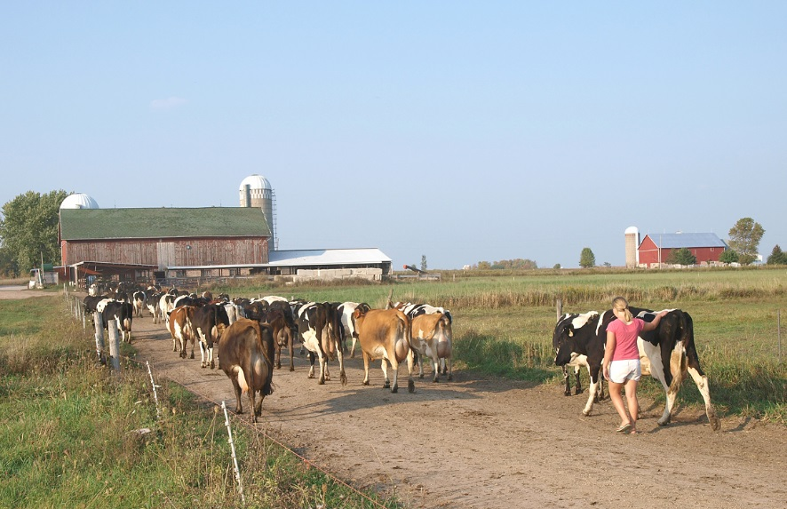
Why is grazing a WIN for the land & water?
Tractors vs. Four feet
Plowing, planting, harvesting, storing, mechanical feeding and then hauling manure is an energy intensive way to farm.
Grazing is a low energy-use way to farm. The four-legged animals walk out to the fields to harvest food for themselves. They spread their own manure. No plowing or planting by the farmer is required. Fossil fuel use on grazing farms is typically about 1/3 of the energy used on farms where the cattle stay at the barn and are fed. (***)

Slide 24
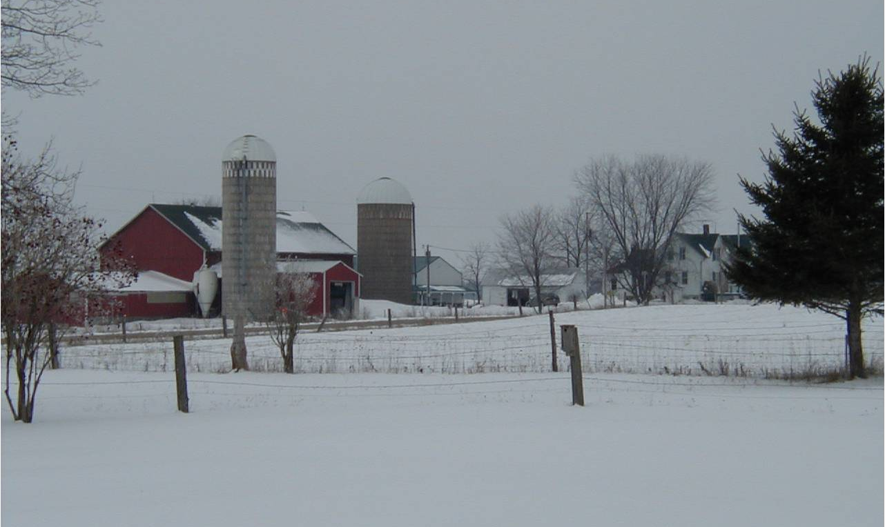
What do grazing farms do in winter?
In cold climates, animals come off the farm fields and are housed in a barn.
They are fed stored feed from mid-November until mid-March.
But, at least for six out of twelve months, they can eat fresh grass.

Slide 25
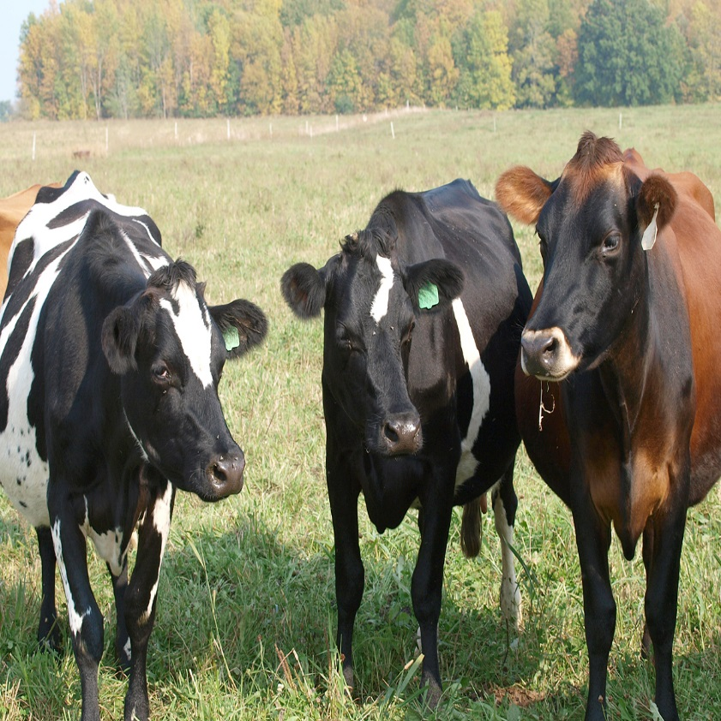
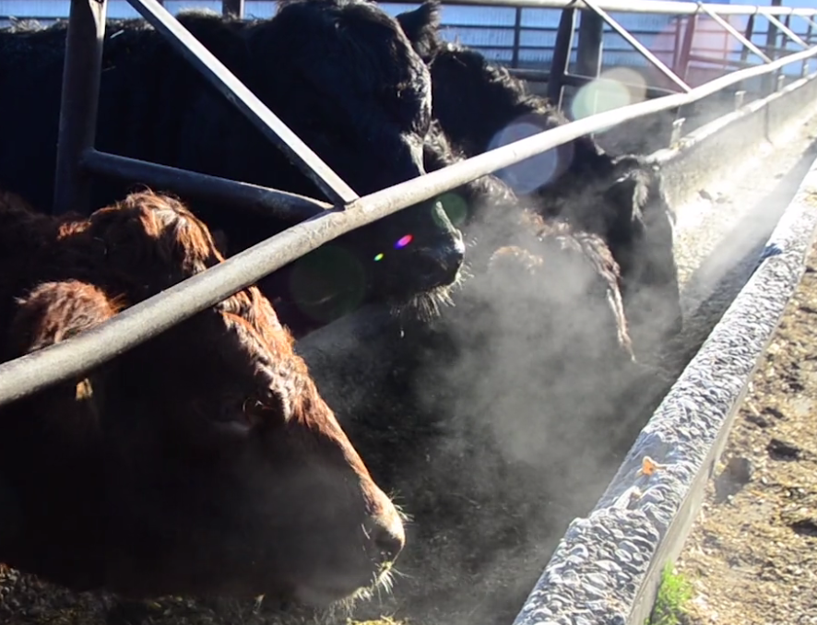
Why is Managed Grazing a WIN for animals?
Grazers eat fresh, green plants rather than corn and soybean rations.
They easily express natural breeding behaviors that become more difficult if they are raised on concrete.
There feet and legs are sturdy because they are on sod rather than concrete all day

Slide 26
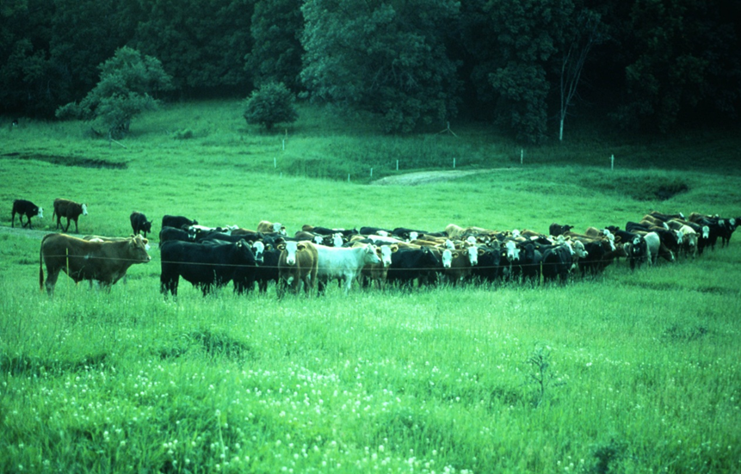
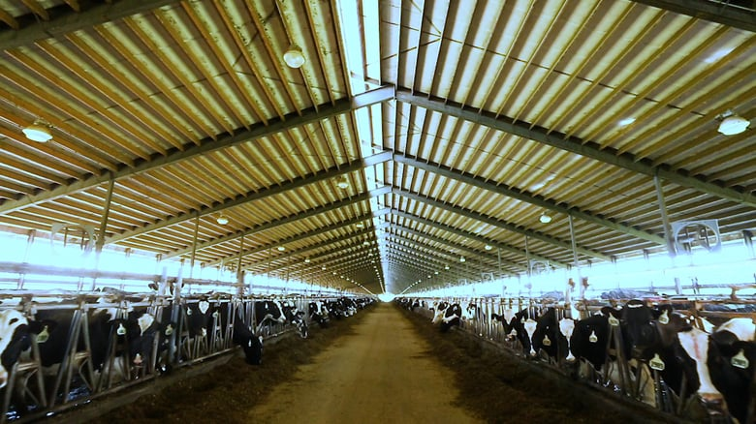
Cattle on pasture live longer and have fewer veterinary bills (****) than cows confined to barns with concrete floors the majority of their life
Grazers have the sun on their back so they do not need supplemental vitamins in summer

Slide 27
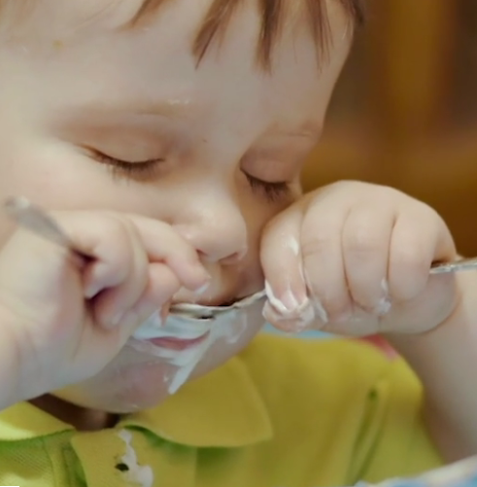
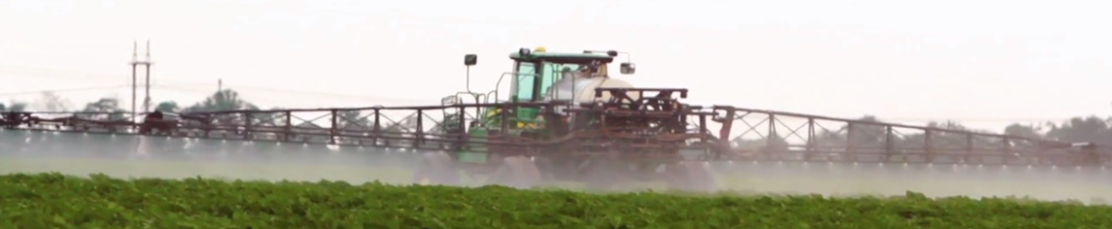
Why is grazing a WIN for food quality?
Grazing is the foundation of organic dairy production.
Pastures require fewer herbicides and pesticides than annually cropped fields.
Organic foods are proven to have fewer pesticides and herbicides in them than foods from conventional farming sources (****)

Slide 28
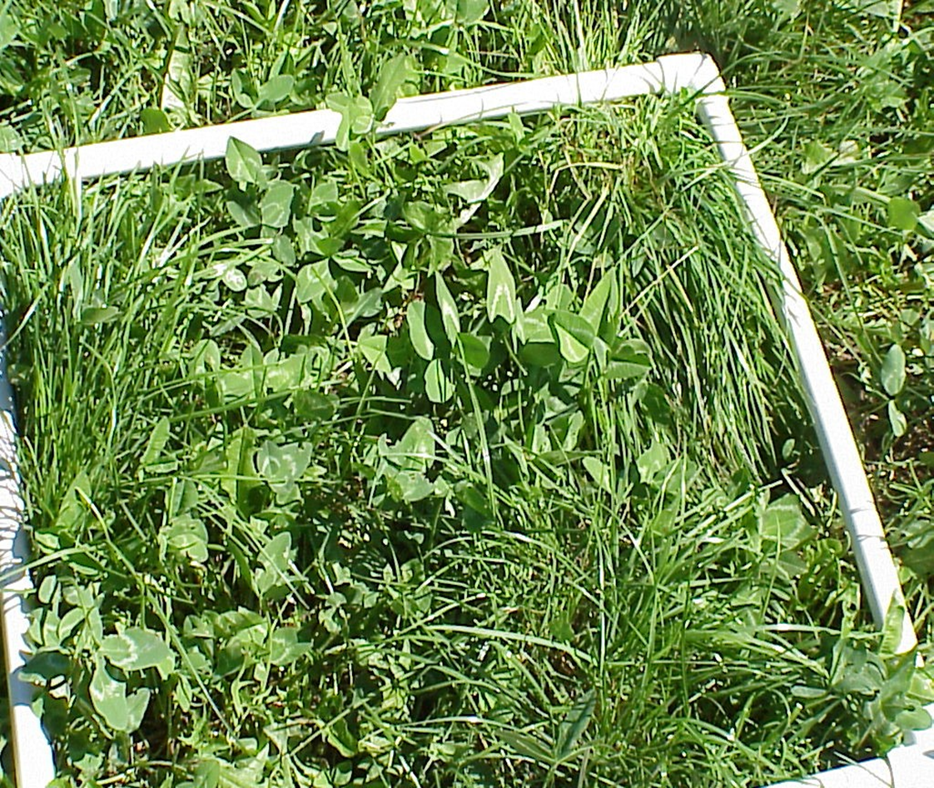
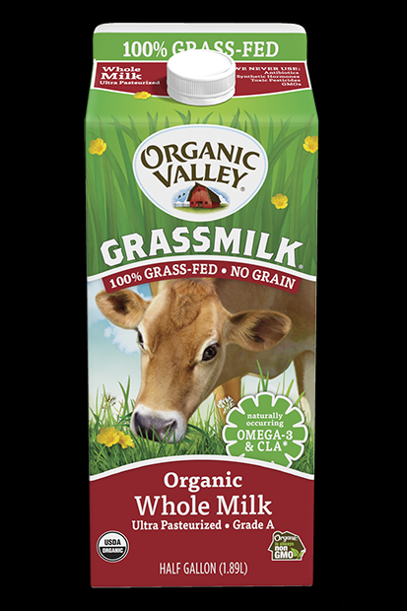

Managed Grazing is a requirement for certified organic MILK. (****)
Organic companies buy milk from Organic famers and insist that the farms feed their cows on pasture every day of the growing season.

Slide 29
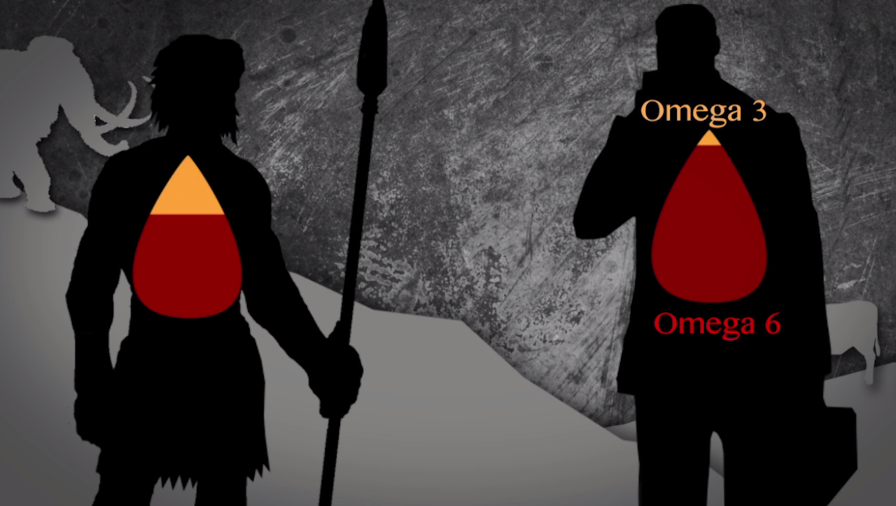
Why is grazing a WIN for food nutrition?
The recent change in the diet of cattle to now include corn and soybeans, has changed the nutritional qualities of the meat and milk they produce.
This, in turn, has changed our diet to a less healthy ratio of good/bad fats.

Slide 30
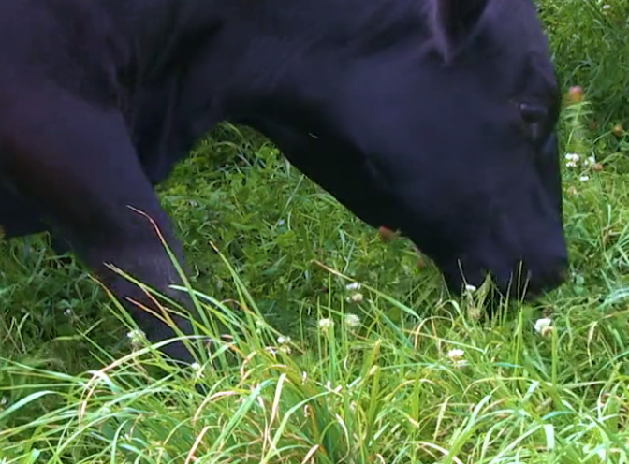
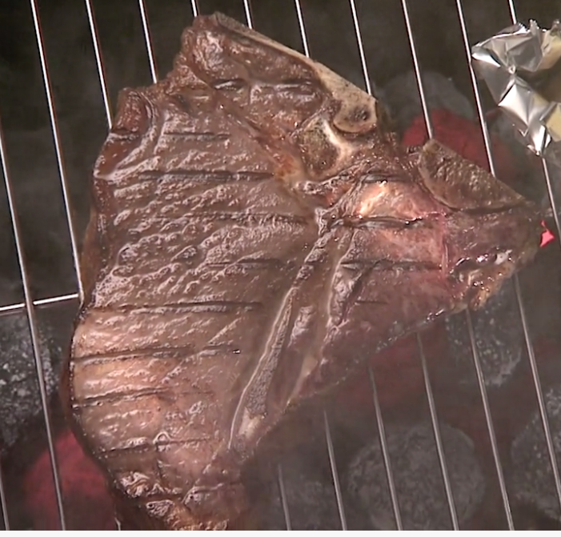

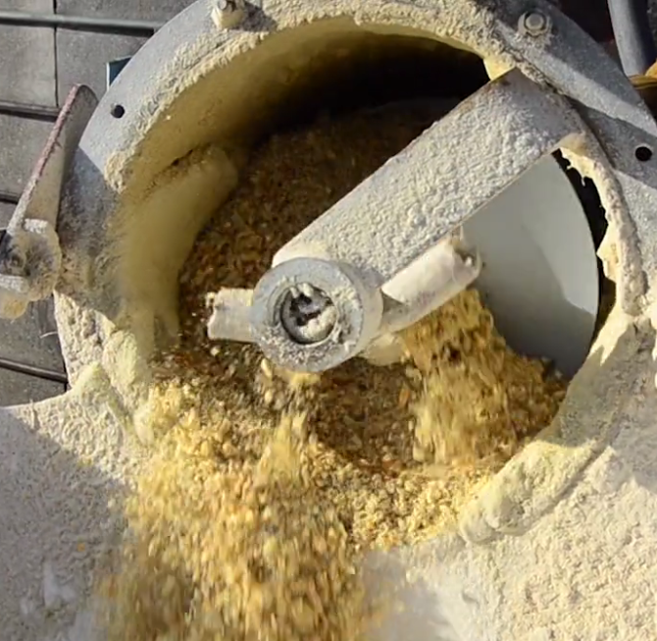
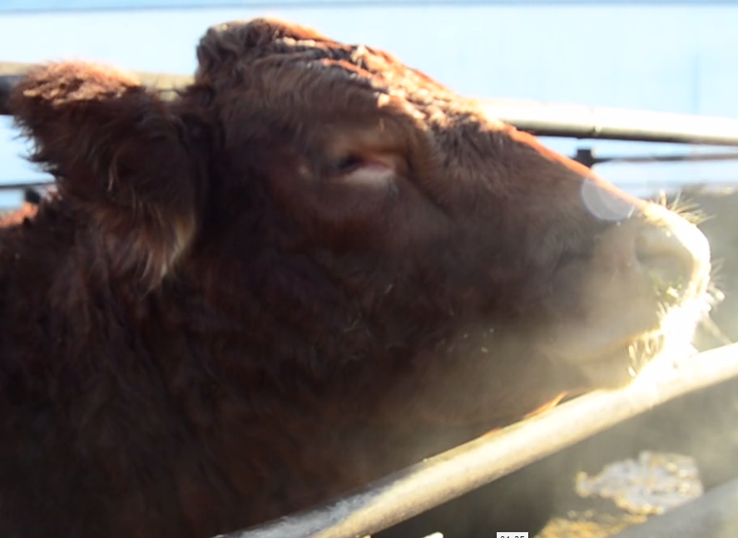
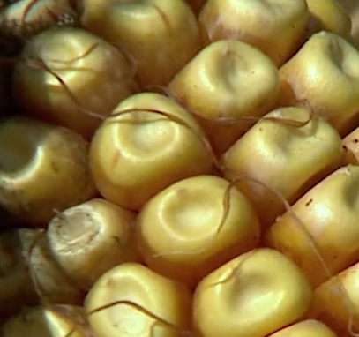
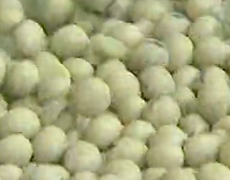
There’s more than one way to grow a steak: a) grass-fed or b) corn/soy-fed.
Meat & milk from Grass-fed animals has more Omega-3 (good) fats and less Omega-6 (bad) fats than grain-fed cattle

Slide 31
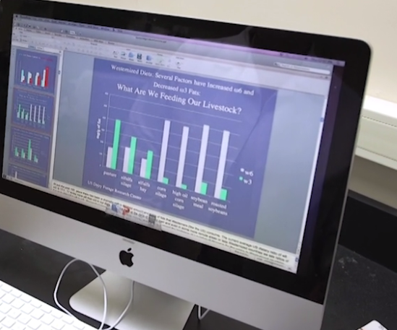
You are what you eat. Cows are what they eat.
Fat profiles of meat from cattle on different diets
Grazing diet
Grain diet
Omega 3
Omega 6
“More Omega-3 in our diet, bringing Omega-6 down, is clearly advantageous in terms of lowering our risk of heart disease.” – Dr. Debra Pearson, University of Wis. Green Bay

Slide 32
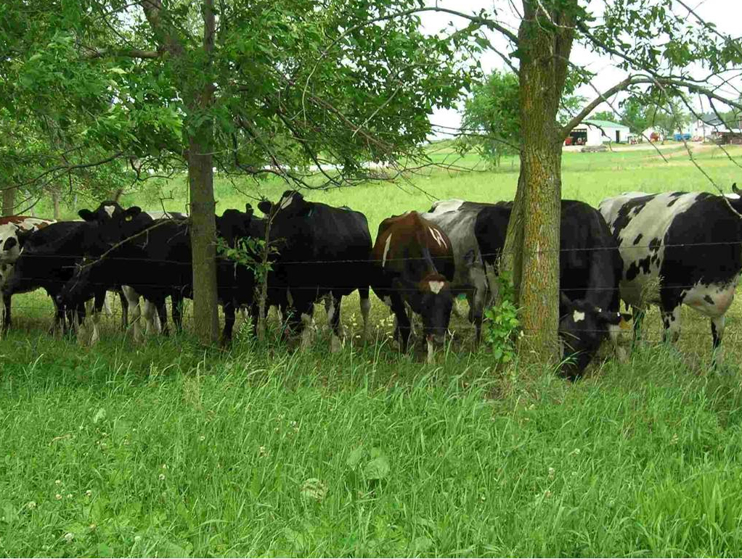
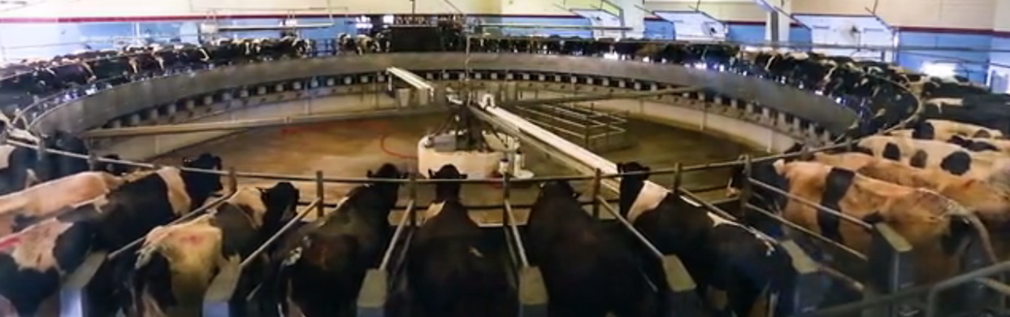
Why is grazing a WIN for the farmer?
Managed grazing is the most efficient type of dairy farm in Wisconsin. (****)
For every dollar this farm turns through its gate, it earns 25 cents.
Large confinement dairy farms earn just 14 cents for every dollar they turn through the front gate.
Grazing and organic farms are not on the
merry-go-round of more and more production when milk prices fall.

Slide 33
The capital ($$$$) needed to farm this way is cost prohibitive so farmers need investor partners. They have less control of this farm.
Buildings, manure pits, digesters, and rotary parlors put the price tag into the $$$$ of million dollars.

Slide 34
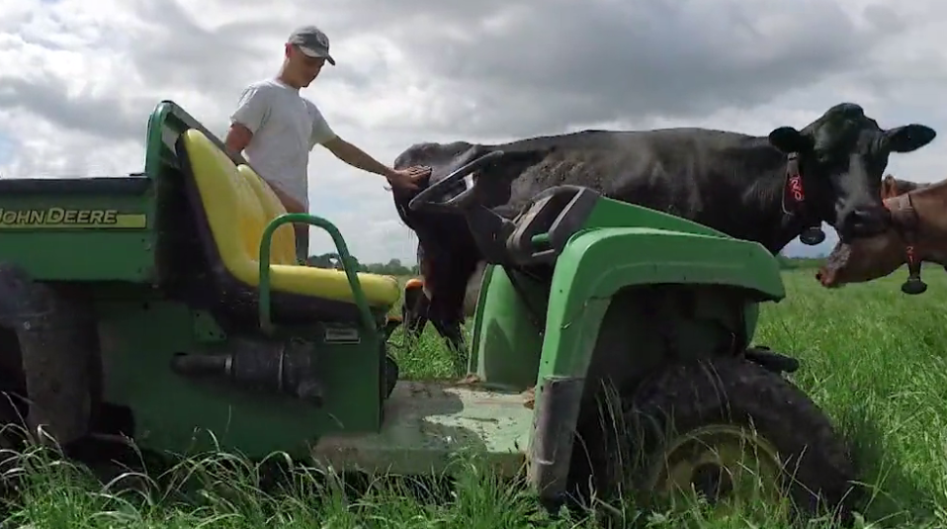
Grazing is an inexpensive way for new dairy farmers to get started.
A small tractor, ATV, skid steer, and a small herd on small acreage can get a person started farming at very low cost. The Dairy Grazing Apprenticeship Program is a career pathway for new dairy farmer.

Slide 35

Graziers report higher quality of life and satisfaction than non-grazing farmers ****

Slide 36

Managed Grazing – a quadruple win for sustainability.
A win for land and water stewardship.
A win for animal care.
A win for food quality.
A win for the farmer.

