Slide 1
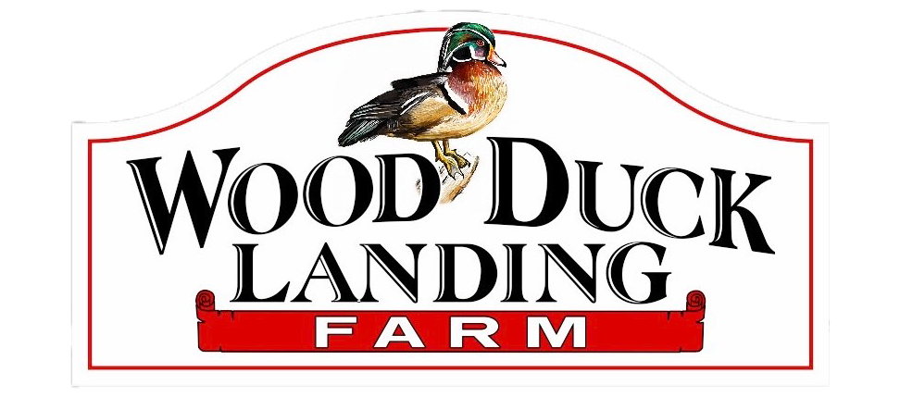
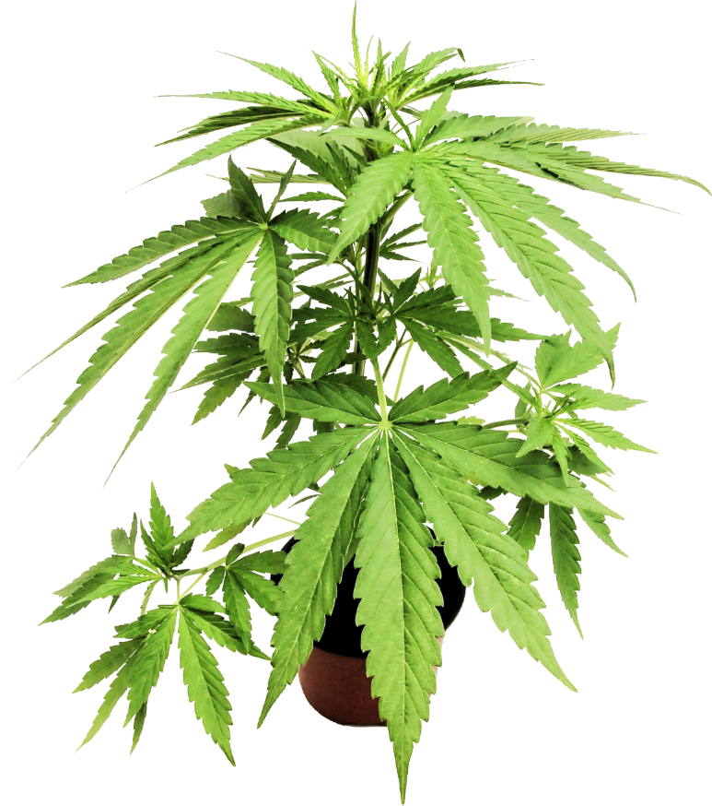
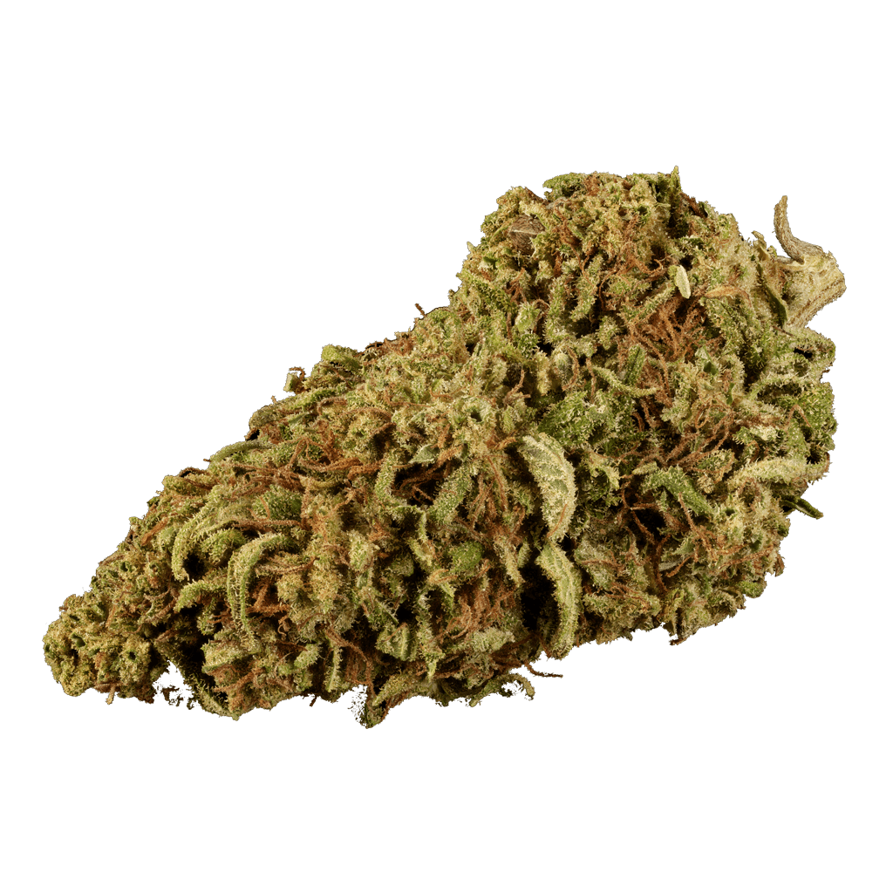
Managing Corn Earworm in Hemp Field by Using Sweet Corn as a Trap Crop
Michael Edwards and Simon Zebelo
2020 Northeast SARE Farmer Grant

Slide 2
Introduction
Hot Hemp
Congressional Research Service (2019)
The new definition of hemp by Congress, quote “the plant Cannabis sativa L. and any part of that plant, including the seeds thereof and all derivatives, extracts, cannabinoids, isomers, acids, salts, and salts of isomers, whether growing or not, with a delta-9 tetrahydrocannabinol concentration of not more than 0.3 percent on a dry weight basis”
Agriculture Improvement Act HR 2, 115th Cong, 2nd Sess. 2018.
“Hot hemp,” a new term coined by hemp farmers describes the spike of D9THC above the 0.3% threshold, that must be confiscated by state agencies
Notes:
Read the slide

Slide 3
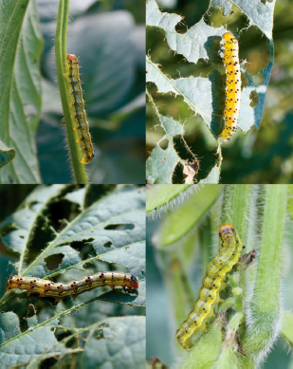
Introduction
Com earworm (CEW) Helicoverpa zea (Boddie)
Because of its generalist feeding habits CEW has multiple approved common names, including corn earworm, bollworm, tomato fruitworm
In soybean, CEW larvae are known as podworms.
In hemp “ No name”….!?!
Emerged as number one damaging insect pest in hemp
Swenson etal, 2013

Slide 4
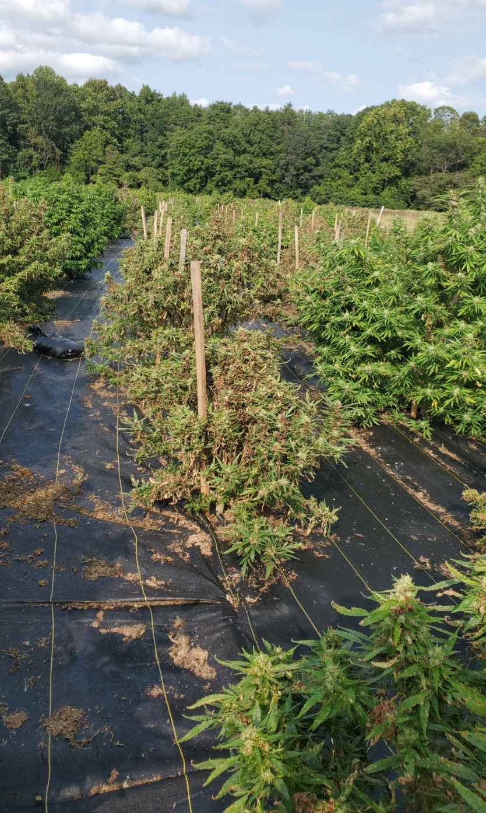
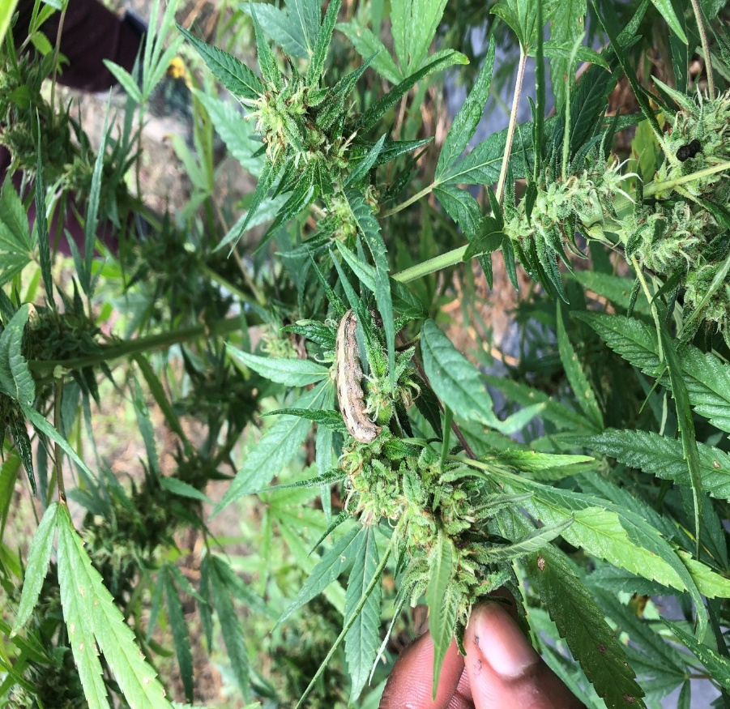
Introduction
Corn earworm
Few botanical pest control products have been registered for hemp. However, CBD hemp extraction will harbor the chemicals used to control pests and will contaminate CBD oil. In result, growers have many challenges growing CBD hemp varieties
Notes:
Here are examples of massive infestation
Corn earworm enjoying leaves and flowers
As the corn earworm feeds it burrows through the canopy leaving discoloration and frass on flowers
Here you can see weak hemp plants due to massive infestation

Slide 5
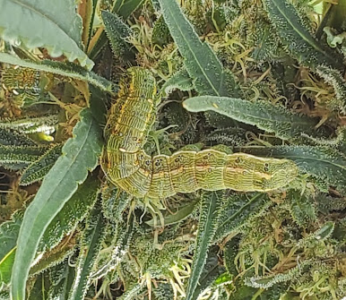
Caterpillar Complex in Hemp field
Pic @ Wood Duck Landings Hemp Farm, Princess Anne MD

Slide 6
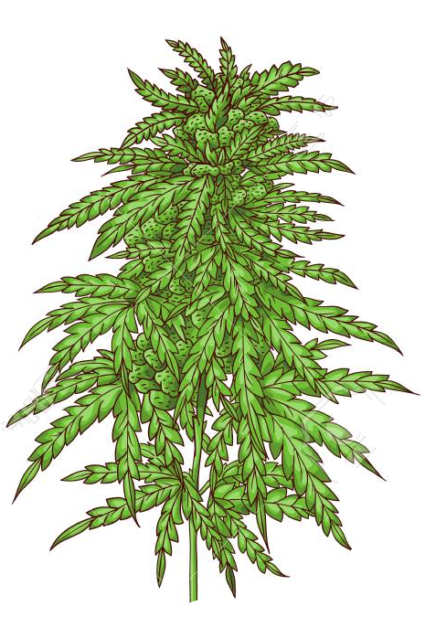
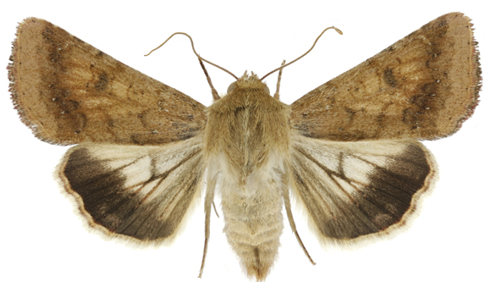
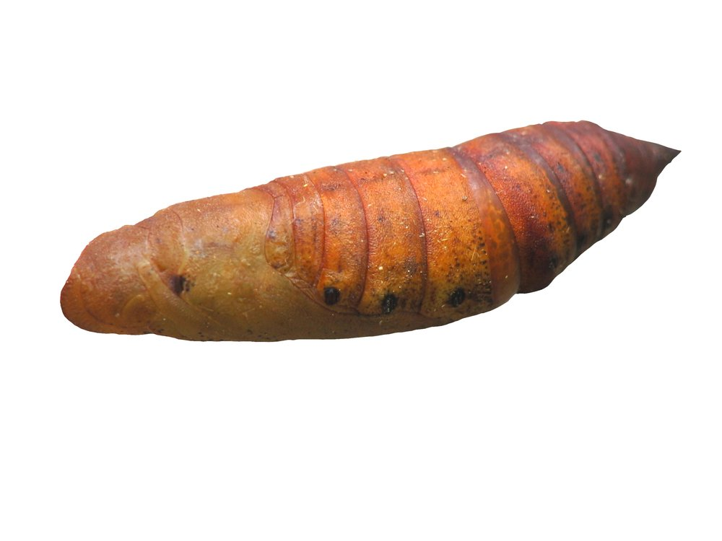
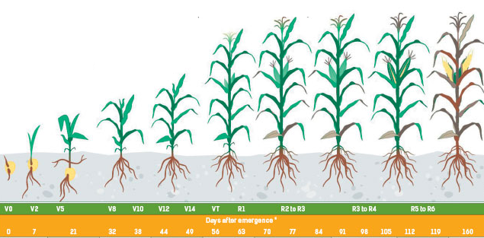
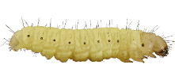
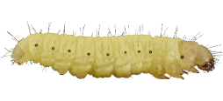
Com earworm (CEW) Helicoverpa zea (Boddie)
eggs
eggs
Larva
pupa
End of April
May
June
July
August
September
October
November
Notes:
Of equal importance is the fact that com serves as the primary nursery for generation turnover of CEW populations which eventually shift to soybean later in the growing season.

Slide 7
Objectives
Objective 1: To develop a sustainable way of controlling CEW by using sweet corn as a trap crop
Objective 2: To assess the impact of insect herbivore damage in the level of cannabinoids.

Slide 8
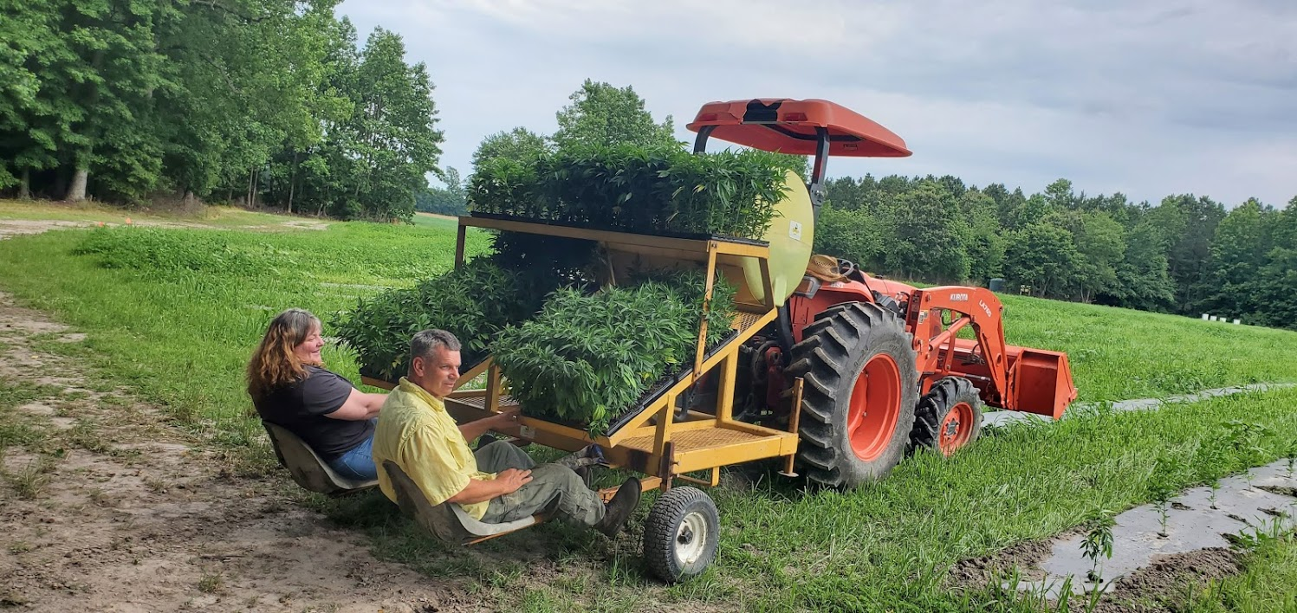
Materials and Methods
Plant Growth in the Field
10-week-old seedlings transplanted to a raised bed covered with black plastics
Notes:
Later to be transplanted by a local farmer Mike and his wife

Slide 9
Farm plot

Slide 10
Hemp plants plot with sweet corn in the perimeter (2020)
Sweet Corn

Slide 11
This experiment was progressing well, while the hemp about to be bloomed in august being struck by tropical storm Isaias

Slide 12
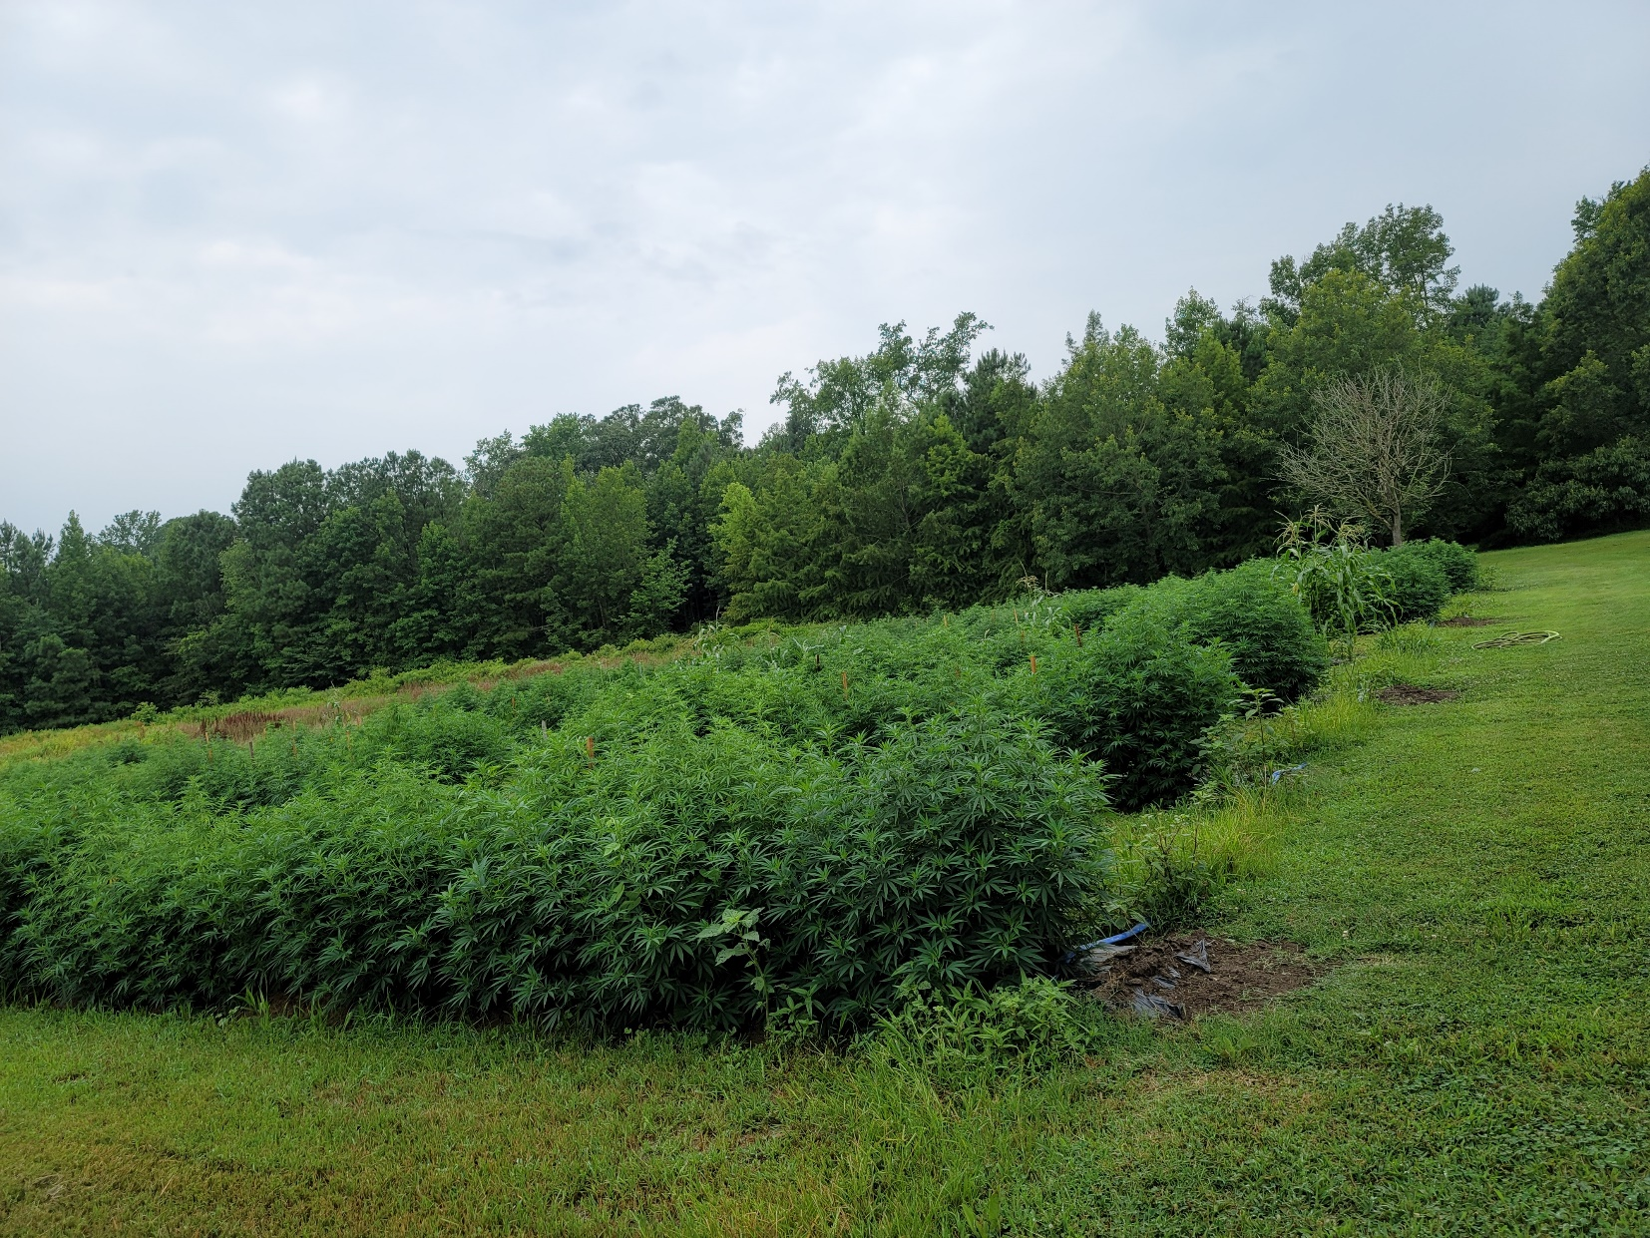
2021 trial in progress

Slide 13
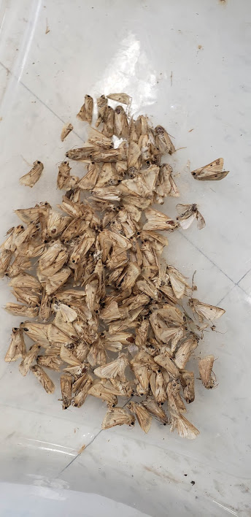
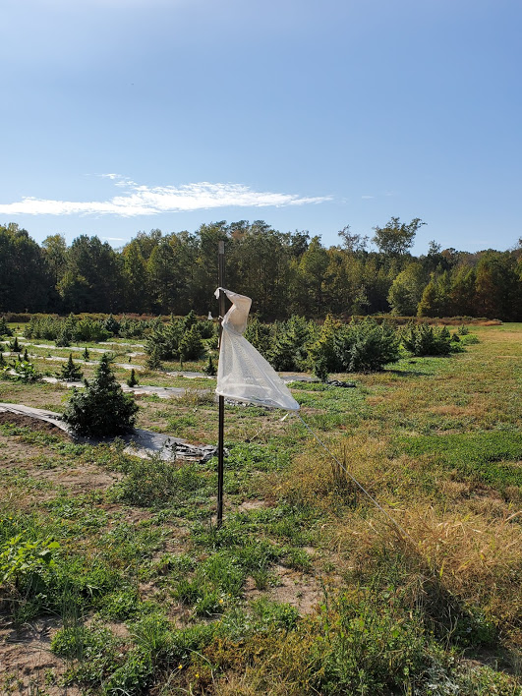
Com earworm (CEW) Helicoverpa zea (Boddie) Sampling was made in hemp field
Pic @ Wood Duck Landings Hemp Farm, Princess Anne MD

Slide 14
Preliminary results were collected on Corn Earworm (CEW) moth traps placed on hemp field at Wood Duck Landing Farm

Slide 15
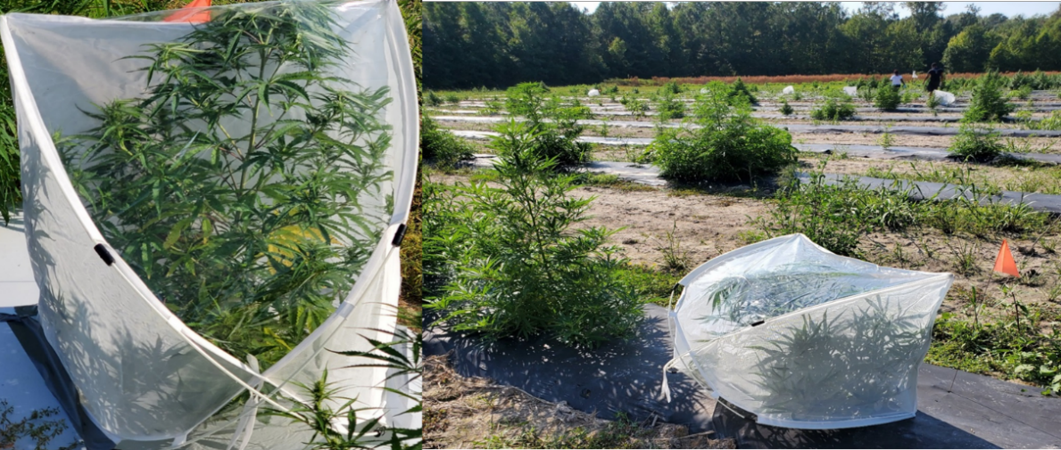
Methods and Material Field Experiment
Herbivore damage cage (HDC): Six cages housed twenty-five, pre-starved fourth instar larvae introduced to each hemp flower and leaf to inflect herbivore damage for 24 hrs
Control Cage (CC): Six cages were kept as a control cage (CC) without the introduction of insects
Control without a cage (CWC): Six plants from each variety were selected and flagged as Control without a cage (CWC) for a treatment sensitive to environmental factors
Notes:
In the field experiment 3 Treatments of HD , MD, and control were used
In HDC 25 pre-straved fourth instar larvae were placed on hemp flowers and leaves in 6 cages
In CC Plants plants were kept without the insects
In CWC there was no HD or MD
After 24 hours flowers and leaves were collected for cannabinoid extraction

Slide 16
Results Field Trial
Data are means ± standard error. Tukey’s test (n=6,α =0.05)
Notes:
The CBD levels in this trial show that Cherry Blossom has a increase in CBD in response to herbivory damage
This increase of CBD in Cherry Blossom shows significant difference over the CWC and CC in both varieties.
The wife shows no significant difference in all treatments. And yields low THC undesirable for extraction

Slide 17
Results Field Trial
Data are means ± standard error. Tukey’s test (n=6,p<0.05)
Notes:
The D9THC levels in this trial show that Cherry Blossom has a increase in D9THC that is significant difference over the CWC and CC in both varieties.
The wife shows no significant difference in all treatments. The D9THC threshold is maintained at legal limit

Slide 18
Summary
We are repeating the 2020 experiment on the use of sweet corn as a trap crop of corn earworm this year, the plants are growing, and we have started collecting data.
High CBD was prevalent in Cherry Blossom varieties. However, legal levels of D9THC in the Wife were maintained.
Cherry Blossom compared to the Wife shows higher yields of CBD in the field experiments.
Further research is underway using different hemp varieties to investigate insect herbivory's impact on the level of cannabinoids.

