Slide 1
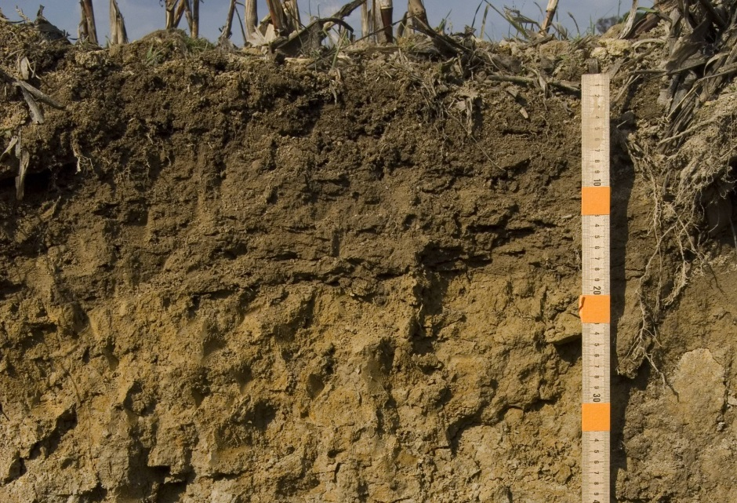

Managing, Measuring, and Interpreting Soil Carbon Levels
Charlie White, 2020 Mid-Atlantic Crop School

Slide 2
Why should you care about managing soil carbon?
Soil health and productivity
  Nutrient availability
  Aggregation
  Infiltration
  Resilience to compaction
  Resilience to drought
  Resilience to excessive rain
Carbon sequestration
  Reverse the trend in global warming
  Participate in carbon markets

Slide 3
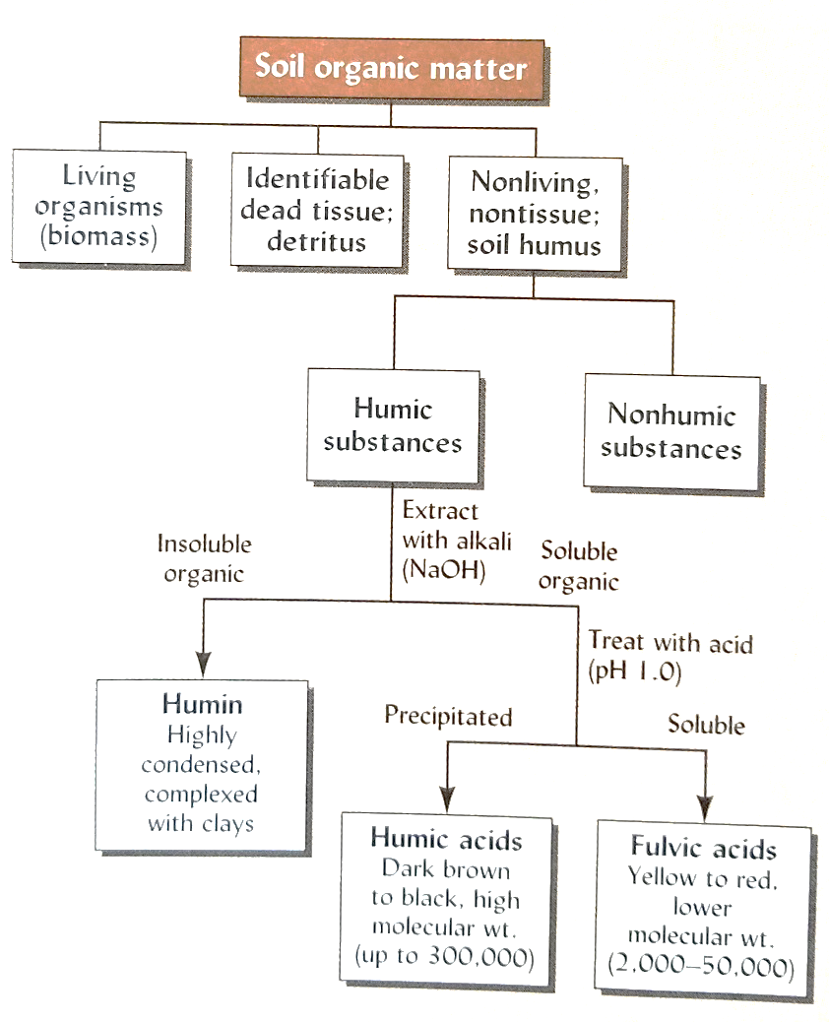
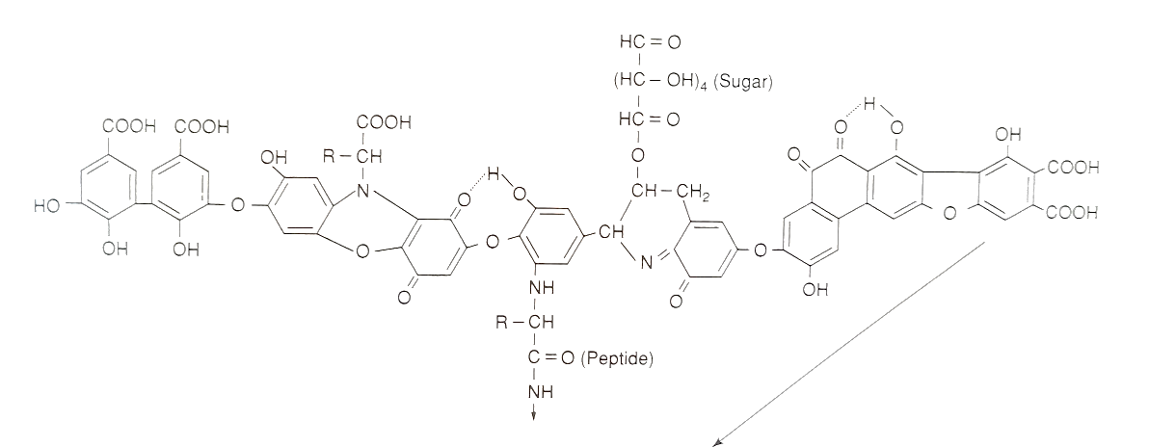
Old and New Perspectives on Soil Carbon Dynamics
Old View
  Soil organic matter is formed from large complex molecules that are resistant to decomposition because of their size and complexity
Suggested Structure of Humic Acids
Figure 2-8. Soil Fertility and Fertilizers, 7th edition. Havlin et al., 2005
Figure 12.11. The Nature and Properties of Soils, 11th edition. Brady and Weil, 1996

Slide 4
Old and New Perspectives on Soil Carbon Dynamics
New View
  Soil organic matter is formed from simple molecules left over from microbial biomass and is stabilized by association with mineral surfaces
Figure Source: M. Kleber et al. Biogeochemistry (2007) 85:9-24.

Slide 5
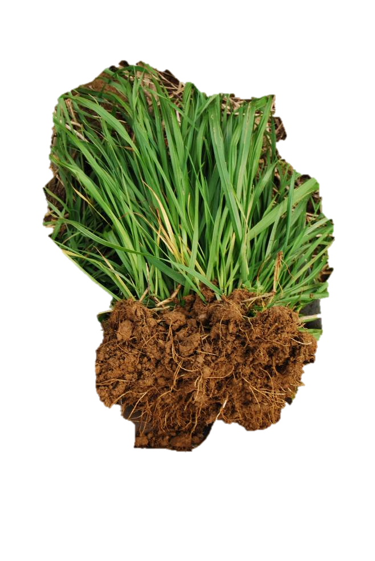

Carbon’s journey to stabilization
Carbon Inputs
Crop residues, roots, manures
CO₂
Stabilization
Respiration
Microbial Biomass
Microbial Decomposition
Byproducts
Mineral Surfaces (Clays)
Decomposition

Slide 6
How much carbon is in each pool
Mineral Associated Carbon
~80% of total organic carbon
Carbon Inputs
Particulate Organic Matter
Undecomposed litter
~15-20% of total organic carbon
Microbial Biomass
~1-3% of total organic carbon
CO₂
Stabilization
Respiration
Microbial Biomass
Microbial Decomposition
Byproducts
Mineral Surfaces (Clays)
Decomposition

Slide 7
If a soil had 1% carbon (2% organic matter)…
There would be 20,000 lbs/ac of carbon in an acre furrow slice…
Particulate Organic Matter
~3,900 lbs C/ac
Mineral Associated
~15,900 lbs C/ac
Microbial Biomass
~200 lbs C/ac
CO₂
Stabilization
Respiration
Microbial Biomass
Microbial Decomposition
Byproducts
Mineral Surfaces (Clays)
Decomposition

Slide 8
Factors affecting carbon stabilization
Quantity of carbon inputs
Quantity: More C inputs, more C stabilized (assuming other limiting factors don’t arise)
CO₂
Stabilization
Respiration
Microbial Biomass
Microbial Decomposition
Byproducts
Mineral Surfaces (Clays)
Decomposition

Slide 9
Factors affecting carbon stabilization
Microbial carbon use efficiency (CUE)
Proportion of decomposed C that is built into microbial biomass versus respired
Higher CUE = more microbial biomass = more byproducts = more stabilization
Fungi have greater CUE than bacteria
No-till promotes fungi
CO₂
Stabilization
Respiration
Microbial Biomass
Microbial Decomposition
Byproducts
Mineral Surfaces (Clays)
Decomposition

Slide 10
Factors affecting carbon stabilization
Quality of Residue Inputs
High quality residues are more efficiently used to grow microbial biomass versus respired as CO₂ (increased CUE)
High quality residues = more microbial biomass = more byproducts = more stabilization
CO₂
Stabilization
Respiration
Microbial Biomass
Microbial Decomposition
Byproducts
Mineral Surfaces (Clays)
Decomposition

Slide 11
Factors affecting carbon stabilization
High quality residues
Carbohydrates
Proteins
Legumes
Fresh manure
Root exudates
Lower quality residues
Lignins
Polyphenols
Straw and corn fodder
Mature grasses
Composted manures
CO₂
Stabilization
Respiration
Microbial Biomass
Microbial Decomposition
Byproducts
Mineral Surfaces (Clays)
Decomposition

Slide 12
Factors affecting carbon stabilization
Temperature
In warm temperatures, microbes respire more C and less is converted to biomass and byproducts that can be stabilized
Soil temperature affected by climate zone, but also residue cover
No-till keeps soils cooler
CO₂
Stabilization
Respiration
Microbial Biomass
Microbial Decomposition
Byproducts
Mineral Surfaces (Clays)
Decomposition

Slide 13
Factors affecting carbon stabilization
Texture
Higher clay content provides more surface area for stabilization
When microbial byproducts are stabilized, they are less likely to undergo further decomposition and respiration
CO₂
Stabilization
Respiration
Microbial Biomass
Microbial Decomposition
Byproducts
Mineral Surfaces (Clays)
Decomposition

Slide 14
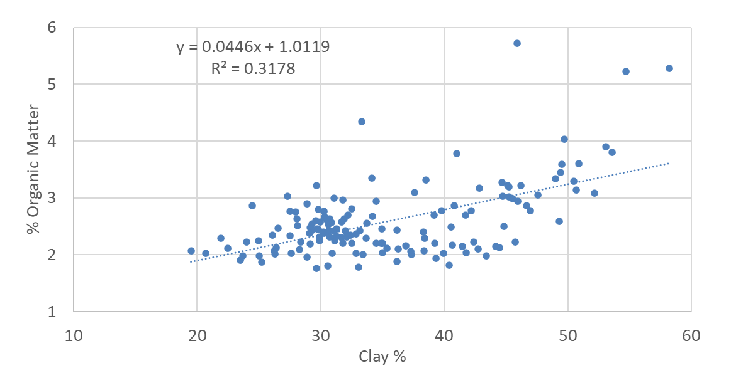
Factors affecting carbon stabilization
Texture
Higher clay content provides more surface area for stabilization
When microbial byproducts are stabilized, they are less likely to undergo further decomposition and respiration
Soil Samples from Rock Springs Research Farm
Grain Rotations with No Manure

Slide 15
Factors affecting carbon stabilization
Carbon Saturation
When mineral surfaces are saturated, byproducts are not stabilized, so increasing inputs does not increase stable C, just increases microbial biomass and respiration
Problem in no-till systems where residues are not mixed into the soil – carbon stratification
CO₂
Stabilization
Respiration
Microbial Biomass
Microbial Decomposition
Byproducts
Mineral Surfaces (Clays)
Decomposition

Slide 16
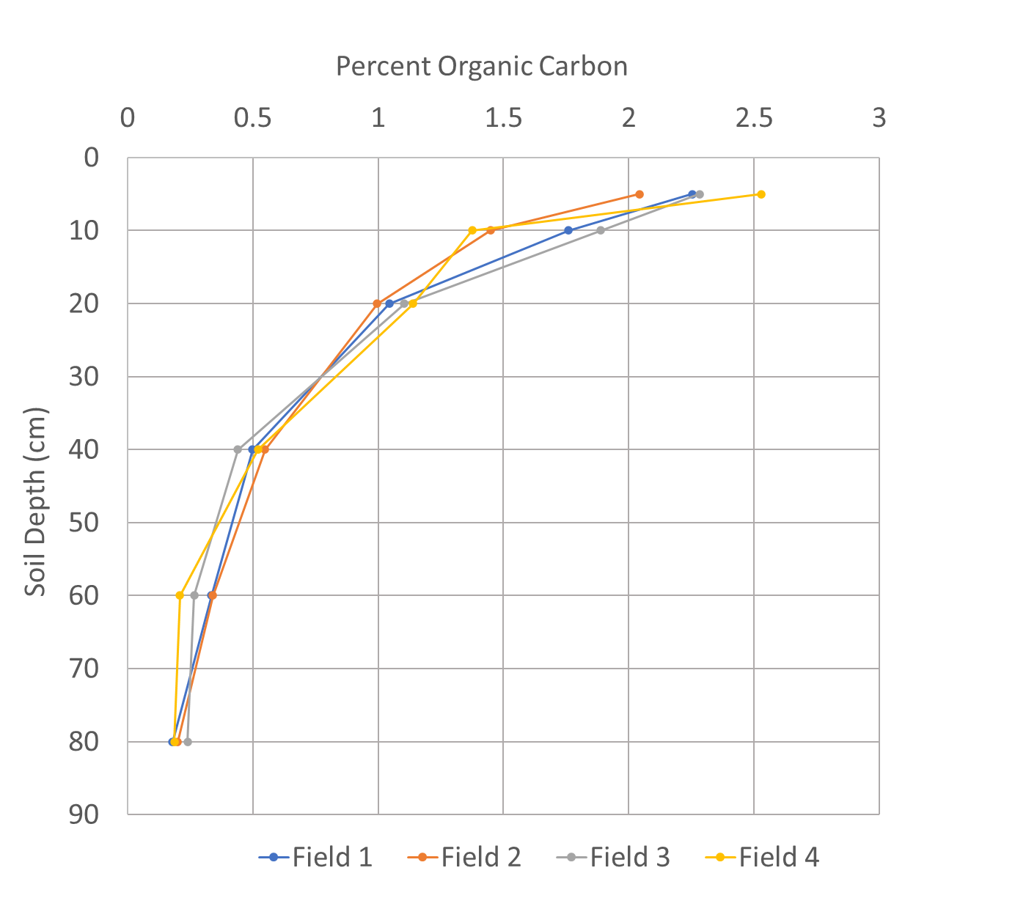
Carbon stratification and saturation
Soil Samples from no-till dairy farm in central PA
Corn-alfalfa rotation
No-till since year 2000
6,000 gal/ac manure in fall and spring
Rye cover crop, sometimes harvested
Data Courtesy Zack Sanders

Slide 17
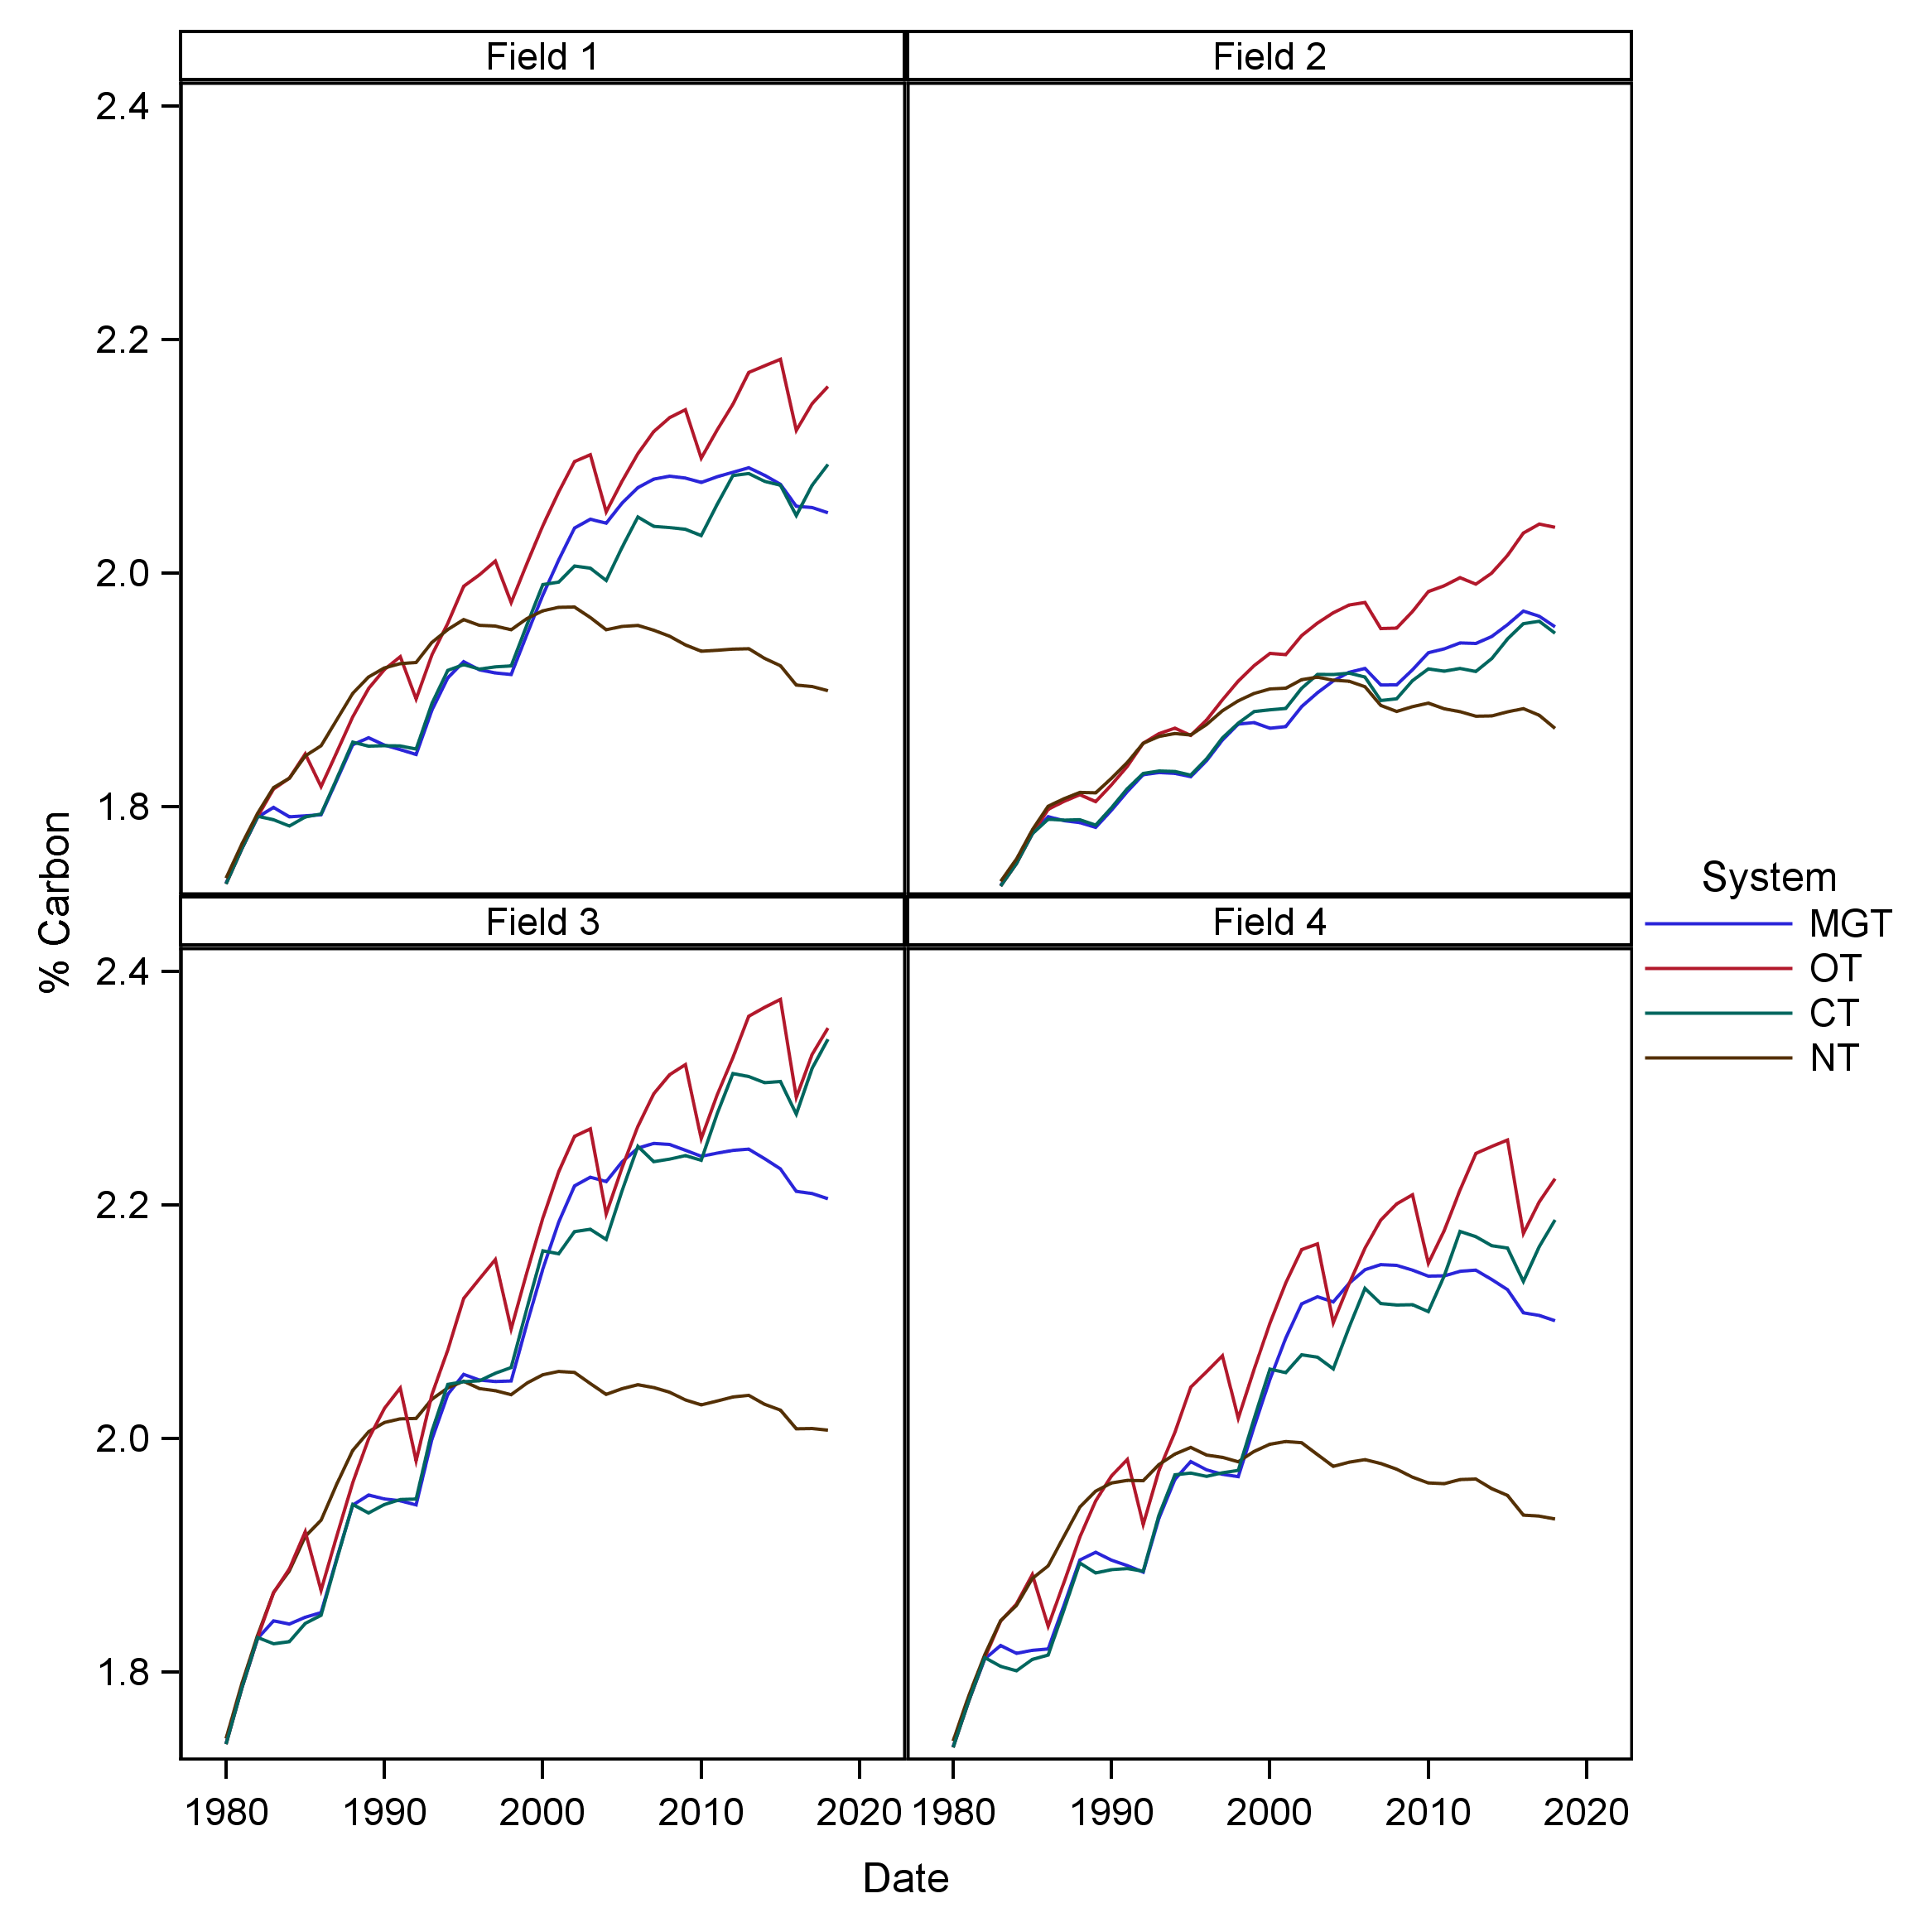

Occasionally mixing no-till soils may alleviate C saturation and increase C stabilization
Cycles Simulation Model
40-year dairy rotation with cover crops
Soil %C in 0-20cm soil layer
Tillage
No-Till since 2000
Tillage once every 6 years
Continuous Tillage
Continuous No-Till since 1980
https://cycles-model.psu.edu/Cycles/CyclesModel.html
Simulations by Zack Sanders and Jillian Barskey

Slide 18
Cycles Model Demonstration

Slide 19
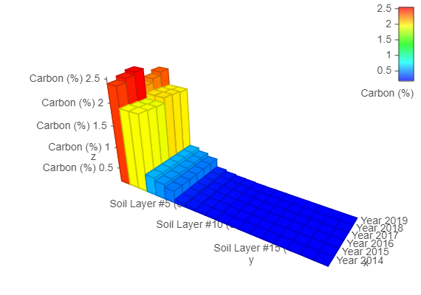
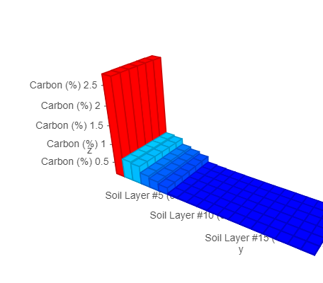
Management Scenarios Tested in Cycles
Hagerstown soil in Central Pennsylvania climate (2014-2019)
+ cover crop
+ 3T/ac poultry litter
Corn
60.0
78.2
59.6 Mg/ha C
w/ tillage every 6 yrs
w/ tillage every 6 yrs
61.0
106.6
w/ tillage every 6 yrs
61.0

Slide 20
Management Scenarios Tested in Cycles
Hagerstown soil in Central Pennsylvania climate (2014-2019)
+ cover crop
+ 3T/ac poultry litter
Corn
60.0
78.2
59.6 Mg/ha C
w/ tillage every 6 yrs
w/ tillage every 6 yrs
61.0
106.6
w/ tillage every 6 yrs
61.0
+ cover crop
+ 3T/ac poultry litter on corn
Corn/Soy
62.6
77.7
60.6 Mg/ha C
w/ tillage every 6 yrs
w/ tillage every 6 yrs
96.4
102.9
w/ tillage every 6 yrs
95.2

Slide 21
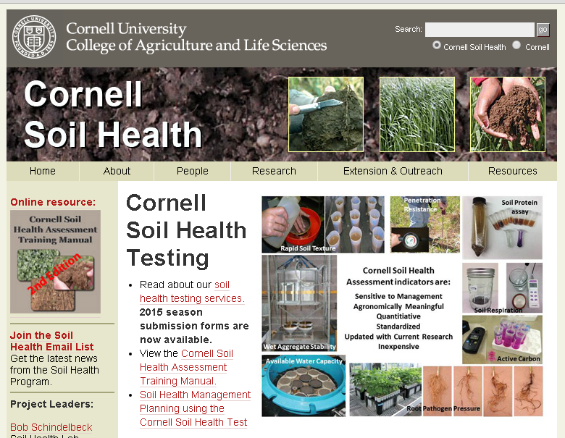
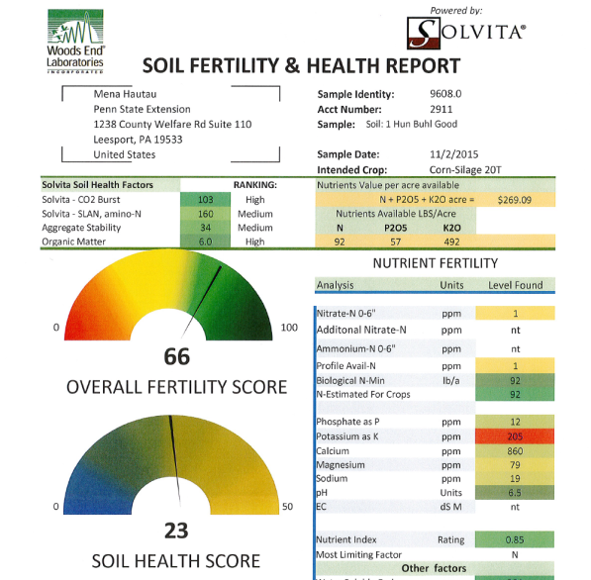

There are lots of different ways to measure soil C, particularly through various “Soil Health” testing services
Cornell Soil Health Test
Woods End Laboratory Soil Health Tool
Standard soil test labs usually offer total C and total OM
Notes:
http://soilquality.org/images/structure_photo2.jpg
It is difficult to comprehensiely measure the health of a soil so we measure chemical, physical, and biological indicators of soil health
http://www.nrcs.usda.gov/wps/portal/nrcs/main/soils/health/assessment/
Soil health is an assessment of how well soil performs all of its functions now and how those functions are being preserved for future use. Soil health cannot be determined by measuring only crop yield, water quality, or any other single outcome. Soil health cannot be measured directly, so we evaluate indicators. Indicators are measurable properties of soil or plants that provide clues about how well the soil can function. Indicators can be physical, chemical, and biological properties, processes, or characteristics of soils. They can also be morphological or visual features of plants.
Changes in aggregate stability may serve as early indicators of recovery or degradation of soils. Aggregate stability is an indicator of organic matter content, biological activity, and nutrient cycling in soil. Generally, the particles in small aggregates (< 0.25 mm) are bound by older and more stable forms of organic matter. Microbial decomposition of fresh organic matter releases products (that are less stable) that bind small aggregates into large aggregates (> 2-5 mm). These large aggregates are more sensitive to management effects on organic matter, serving as a better indicator of changes in soil quality. Greater amounts of stable aggregates suggest better soil quality. When the proportion of large to small aggregates increases, soil quality generally increases.
Stable aggregates can also provide a large range in pore space, including small pores within and large pores between aggregates. Pore space is essential for air and water entry into soil, and for air, water, nutrient, and biota movement within soil. Large pores associated with large, stable aggregates favor high infiltration rates and appropriate aeration for plant growth. Pore space also provides zones of weakness for root growth and penetration. Surface crusts and filled pores occur in weakly aggregated soils. Surface crusts prevent infiltration and promote erosion; filled pores lower water-holding and air-exchange capacity and increase bulk density, diminishing the conditions for root growth.

Slide 22
Soil Health Indicators Measured by Each Testing Package
= measures some aspect of soil carbon
Soil health indicator | Cornell | Woods End | Standard Soil Lab
Soil Organic Matter | $ | $$ | ✓
Total C | $ | $$ | ✓
Permanganate Oxidizable Carbon (POXC) | $
Microbial Respiration | $$ | $
Amino/Protein Nitrogen | $$ | $
Soil-borne Diseases | ✓
Soil Chemistry (P, K, Ca, Mg, pH) | $ |  | ✓
Soil Compaction | $
Aggregate Stability | $ | $
Soil Texture | $$ |  | ✓
Available Water Capacity | $$
Costs of Soil Health Testing Packages
$=$70 Cornell/$60 Woods End: $$=$110 Cornell/$80 Woods End
✓ = A la carte at $5-25
Notes:
http://soilquality.org/images/structure_photo2.jpg
It is difficult to comprehensiely measure the health of a soil so we measure chemical, physical, and biological indicators of soil health
http://www.nrcs.usda.gov/wps/portal/nrcs/main/soils/health/assessment/
Soil health is an assessment of how well soil performs all of its functions now and how those functions are being preserved for future use. Soil health cannot be determined by measuring only crop yield, water quality, or any other single outcome. Soil health cannot be measured directly, so we evaluate indicators. Indicators are measurable properties of soil or plants that provide clues about how well the soil can function. Indicators can be physical, chemical, and biological properties, processes, or characteristics of soils. They can also be morphological or visual features of plants.
Changes in aggregate stability may serve as early indicators of recovery or degradation of soils. Aggregate stability is an indicator of organic matter content, biological activity, and nutrient cycling in soil. Generally, the particles in small aggregates (< 0.25 mm) are bound by older and more stable forms of organic matter. Microbial decomposition of fresh organic matter releases products (that are less stable) that bind small aggregates into large aggregates (> 2-5 mm). These large aggregates are more sensitive to management effects on organic matter, serving as a better indicator of changes in soil quality. Greater amounts of stable aggregates suggest better soil quality. When the proportion of large to small aggregates increases, soil quality generally increases.
Stable aggregates can also provide a large range in pore space, including small pores within and large pores between aggregates. Pore space is essential for air and water entry into soil, and for air, water, nutrient, and biota movement within soil. Large pores associated with large, stable aggregates favor high infiltration rates and appropriate aeration for plant growth. Pore space also provides zones of weakness for root growth and penetration. Surface crusts and filled pores occur in weakly aggregated soils. Surface crusts prevent infiltration and promote erosion; filled pores lower water-holding and air-exchange capacity and increase bulk density, diminishing the conditions for root growth.

Slide 23
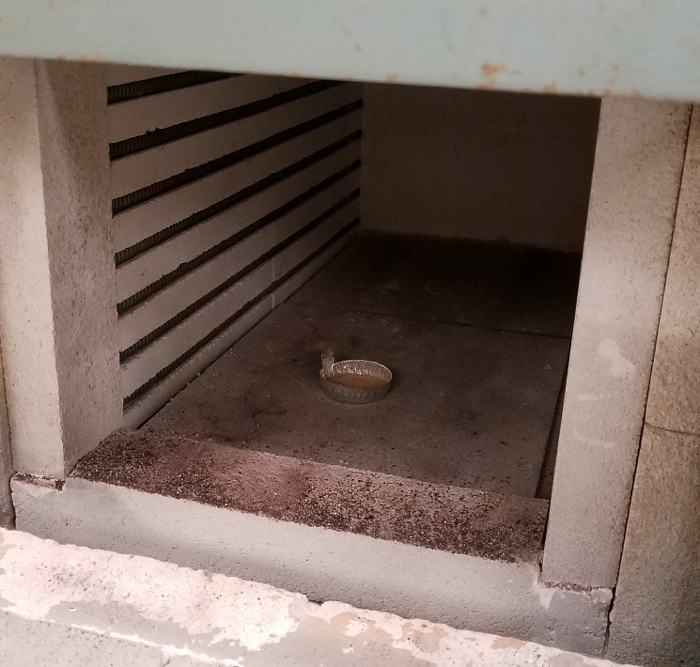
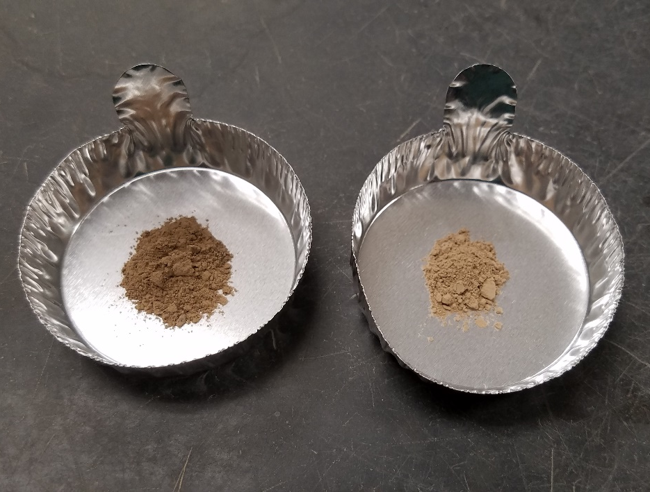
Soil Organic Matter (SOM) by Loss on Ignition
Soil sample is heated to the burning point of soil organic matter, measure % weight loss
Cheapest and most widely available method to approximate total soil carbon
Carbon is the most abundant element in soil organic matter (~50% by mass)
Total SOM is Highly correlated with other measurements of soil carbon
Disadvantage- total soil C changes slowly with management
Muffle Furnace @ 350 to 500 C
Soil Samples Before and After Ignition
Before
After

Slide 24
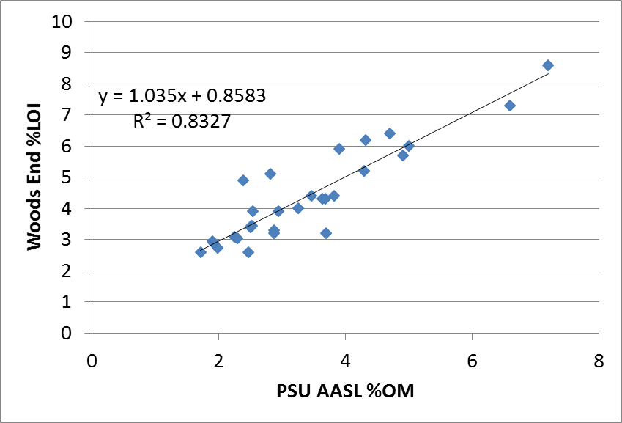
Beware of inconsistency across labs in soil organic matter measurements
Some labs report raw % Loss on Ignition
Other labs have a conversion to a historical method of organic matter analysis, the Walkley-Black Method
%LOI is about 0.8% points greater than converted to %OM

Slide 25
Beware of inconsistency across labs in soil organic matter measurements
Labs use different temperatures and durations in the muffle furnace
Cornell lab is about 0.5% points higher than PSU AASL
Both labs convert to Walkley-Black %OM

Slide 26
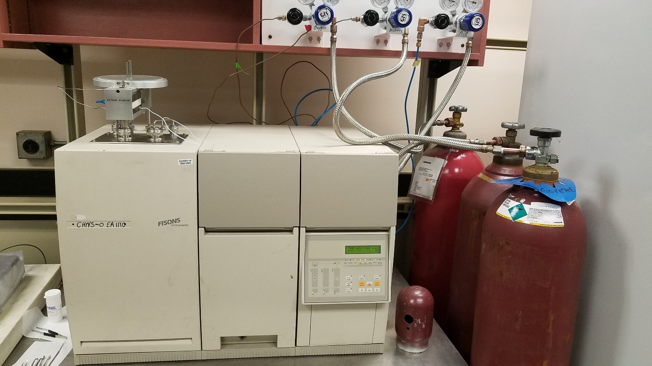
Total Carbon by Elemental Combustion Analysis
Soil sample is heated to the burning point of carbon
Gas stream of helium carries CO₂ released from combustion to a detector
Measures total carbon in the soil sample, including carbonates
More expensive method to measure soil C than %SOM, but highly accurate and definable
Disadvantage- total soil C changes slowly with management

Slide 27
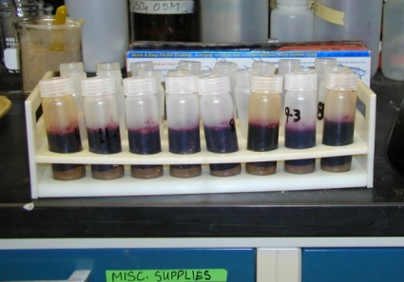
Permanganate Oxidizable Carbon (POXC) or “Active C”
  Carbon in soil organic matter oxidized by weak solution of potassium permanganate
  Intermediately labile fraction of soil carbon
  Only available via Cornell Soil Health Test
  Correlated to microbial biomass
  Sensitive to short-term changes in soil management
Notes:
http://soilquality.org/images/structure_photo2.jpg
It is difficult to comprehensiely measure the health of a soil so we measure chemical, physical, and biological indicators of soil health
http://www.nrcs.usda.gov/wps/portal/nrcs/main/soils/health/assessment/
Soil health is an assessment of how well soil performs all of its functions now and how those functions are being preserved for future use. Soil health cannot be determined by measuring only crop yield, water quality, or any other single outcome. Soil health cannot be measured directly, so we evaluate indicators. Indicators are measurable properties of soil or plants that provide clues about how well the soil can function. Indicators can be physical, chemical, and biological properties, processes, or characteristics of soils. They can also be morphological or visual features of plants.
Changes in aggregate stability may serve as early indicators of recovery or degradation of soils. Aggregate stability is an indicator of organic matter content, biological activity, and nutrient cycling in soil. Generally, the particles in small aggregates (< 0.25 mm) are bound by older and more stable forms of organic matter. Microbial decomposition of fresh organic matter releases products (that are less stable) that bind small aggregates into large aggregates (> 2-5 mm). These large aggregates are more sensitive to management effects on organic matter, serving as a better indicator of changes in soil quality. Greater amounts of stable aggregates suggest better soil quality. When the proportion of large to small aggregates increases, soil quality generally increases.
Stable aggregates can also provide a large range in pore space, including small pores within and large pores between aggregates. Pore space is essential for air and water entry into soil, and for air, water, nutrient, and biota movement within soil. Large pores associated with large, stable aggregates favor high infiltration rates and appropriate aeration for plant growth. Pore space also provides zones of weakness for root growth and penetration. Surface crusts and filled pores occur in weakly aggregated soils. Surface crusts prevent infiltration and promote erosion; filled pores lower water-holding and air-exchange capacity and increase bulk density, diminishing the conditions for root growth.

Slide 28
Comparison of POXC to % Organic Matter

Slide 29
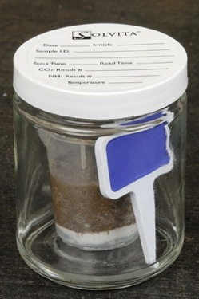
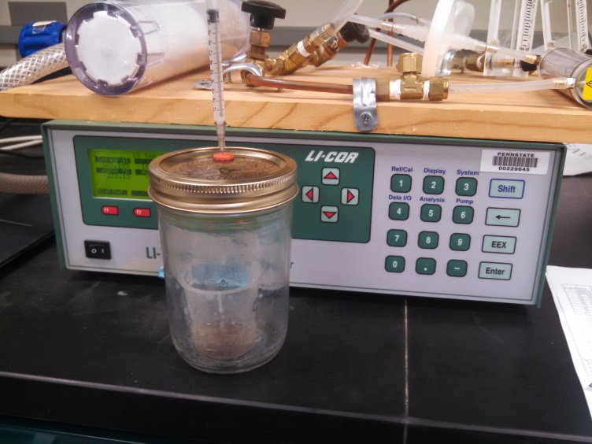
Microbial Respiration
  Quantity of CO₂ respired by microbes over 24 or 96 hours in a lab incubation of re-wetted soil
  Available via Solvita Test in Woods End Soil Health Tool, Cornell Soil Health Test, and certain other soil testing labs
  Indicator of size of microbial population and availability of organic matter to decompose
  Potential indicator of N mineralization
  Unclear whether this test is related to “soil building” versus “soil depleting” processes, since what is actually measured is C loss

Slide 30
Comparison of Microbial Respiration to % Organic Matter
Woods End
=24 hr CO₂ Burst
Cornell
=96 hr CO₂ Burst

Slide 31
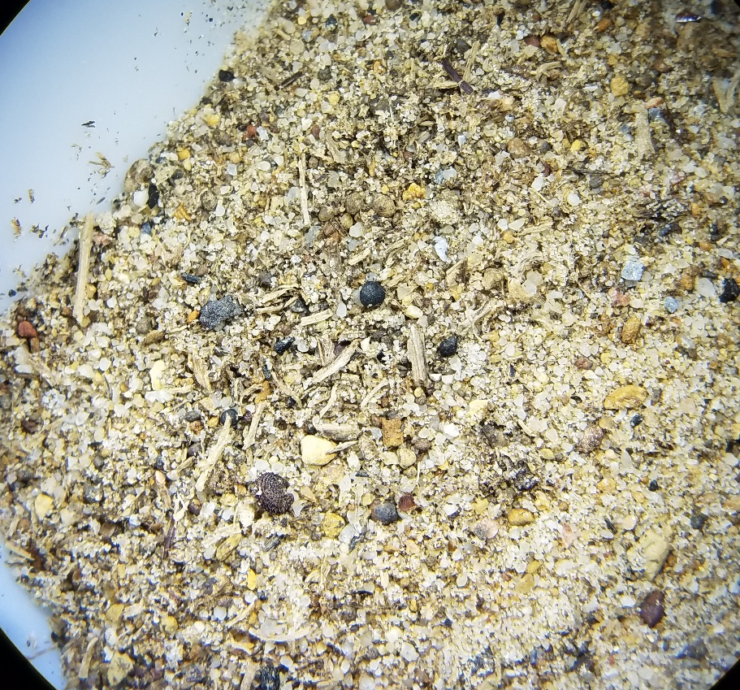
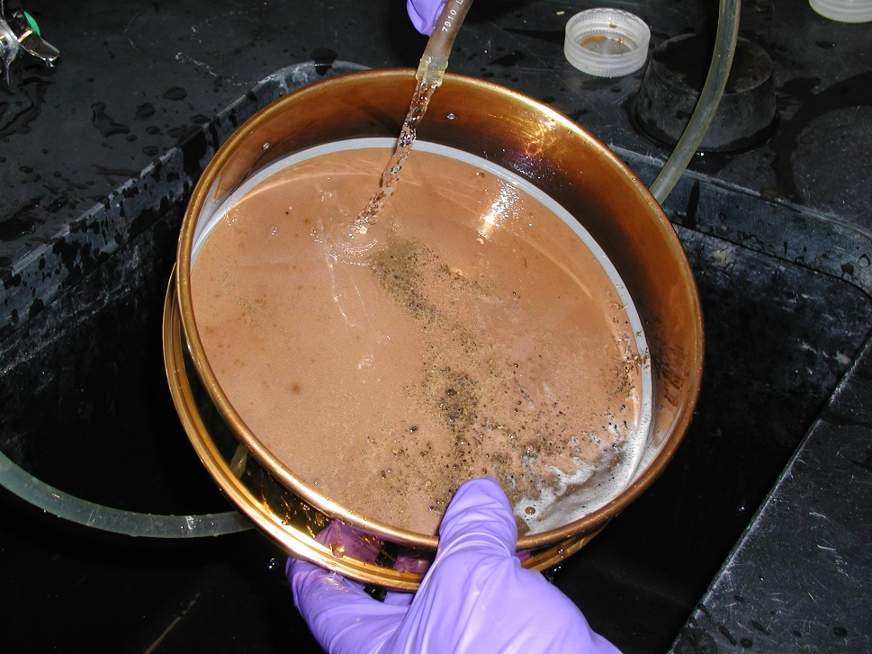
Particulate Organic Matter
  Sieve the sand-sized fraction of soil (2 mm to 250 microns)
  Fragments of non- to semi- decomposed organic matter inputs
  Can be analyzed as %OM by LOI or as %C by elemental combustion
  Sensitive to changes in carbon inputs, which potentially indicates direction of soil C storage

Slide 32
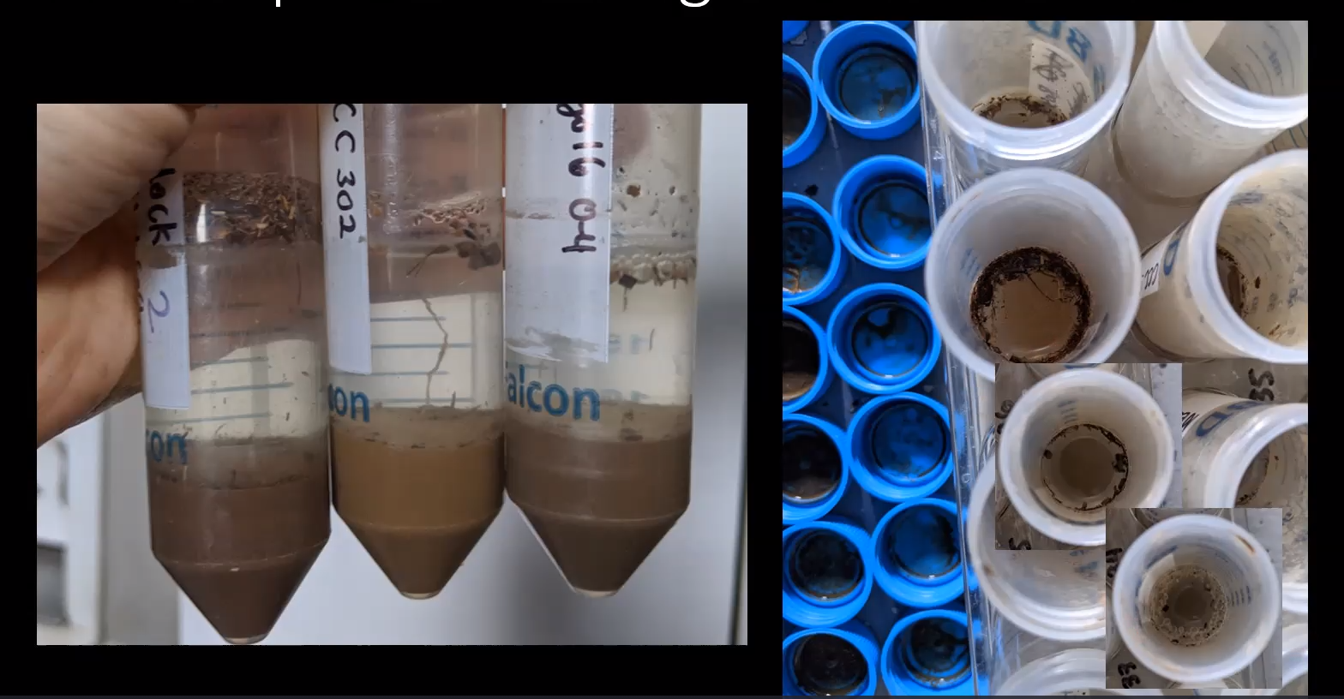
Simple POM Test in the Field
  Float POM in a solution of 0.01M CaCl₂
  Shake soil in a test tube for 1 minute and let soil settle out
  POM will float to the surface
Courtesy Nina Camillone

Slide 33
Conclusions
There are lots of factors that regulate soil C dynamics
Some processes of soil C dynamics may result in counterintuitive outcomes for management practices
  e.g., occasional tillage and legumes in rotation
There are lots of different ways to measure soil C, with challenges for cost and interpretation
There could be lots of opportunity to improve soil C management

Slide 34
Thank You!
Feel free to contact me for more information:
Charlie White - cmw29@psu.edu - 814-863-1016
LNE18-367 - Carbon Gaps, Nitrogen Bulges, and Phosphorus Imbalances: In Search of Sustainable Soil Organic Matter Management

