Slide 1
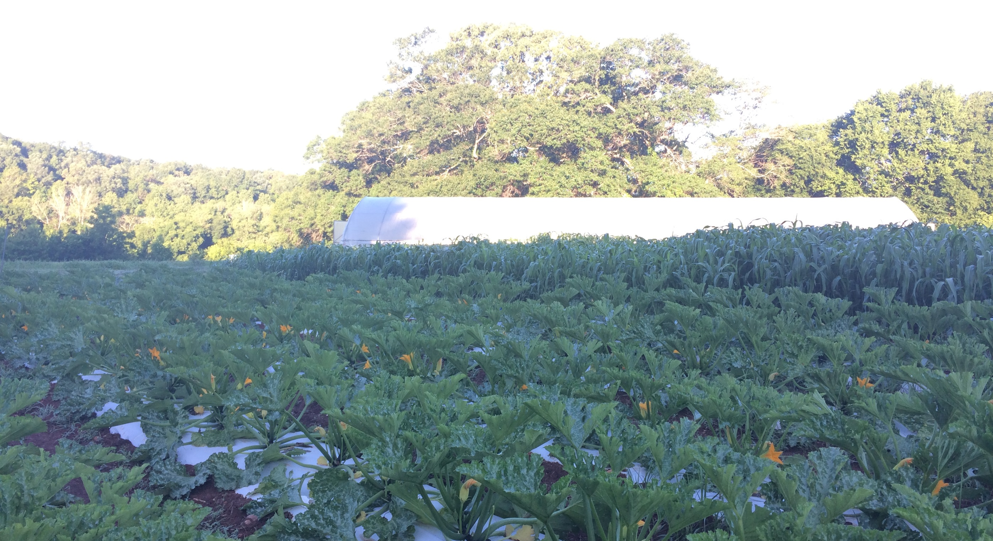

Maximizing High tunnel production
Joe Rowland
Organic Initiatives Coordinator
Notes:
Please stop me if you have a question or want more information on anything.
These presentations will be made available online.

Slide 2
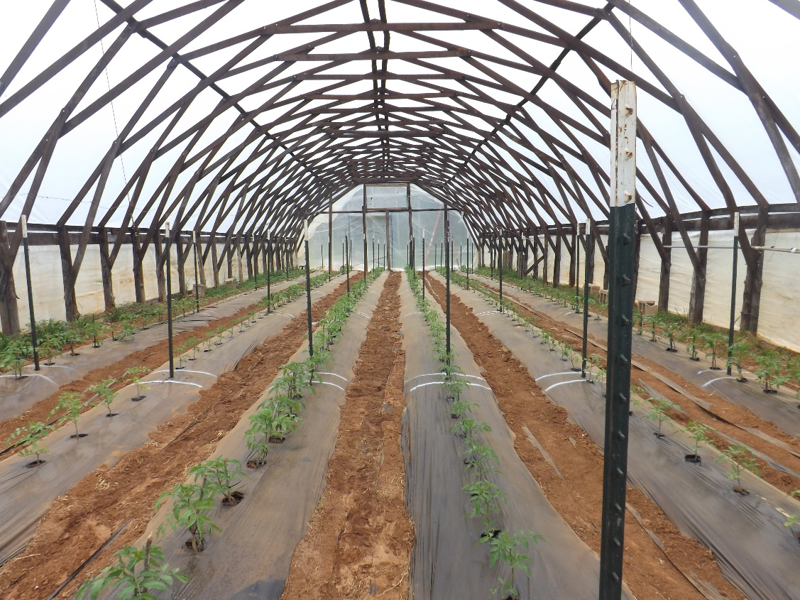
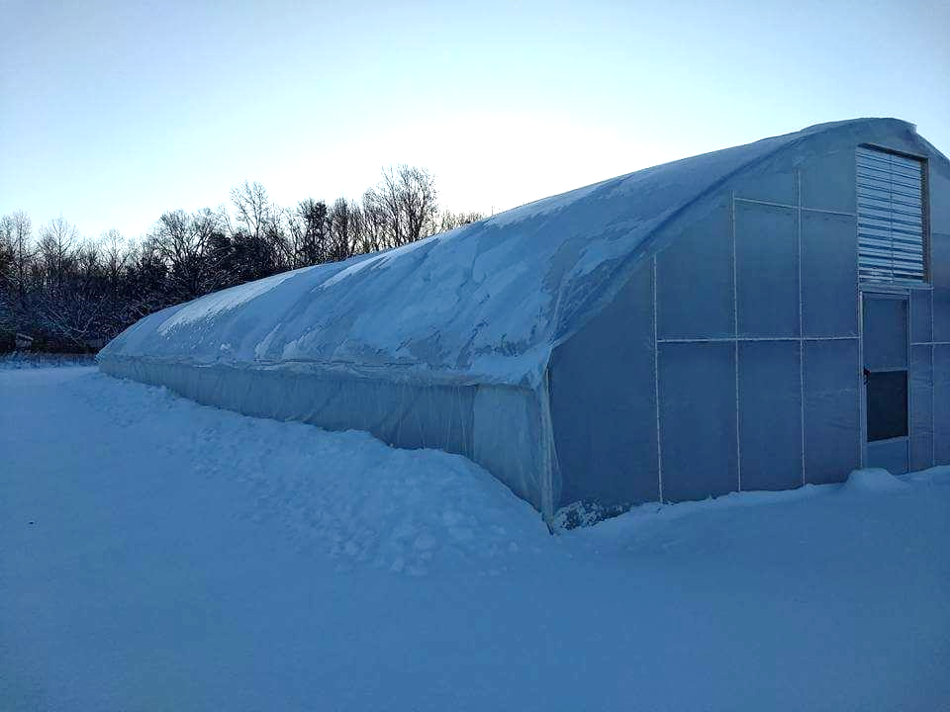
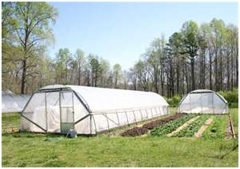
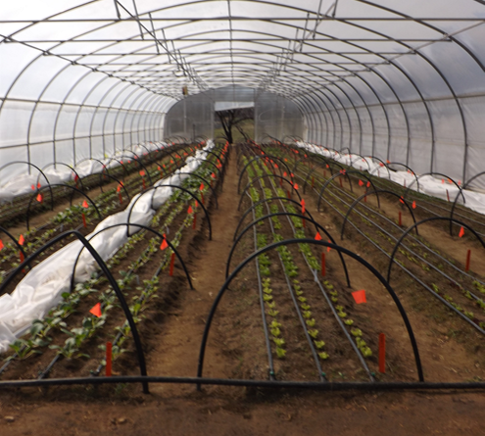
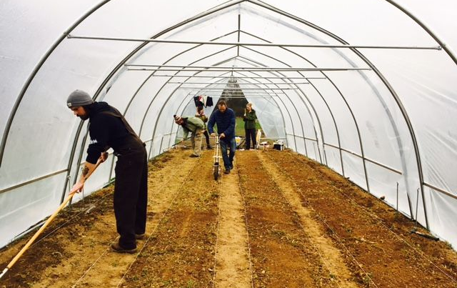
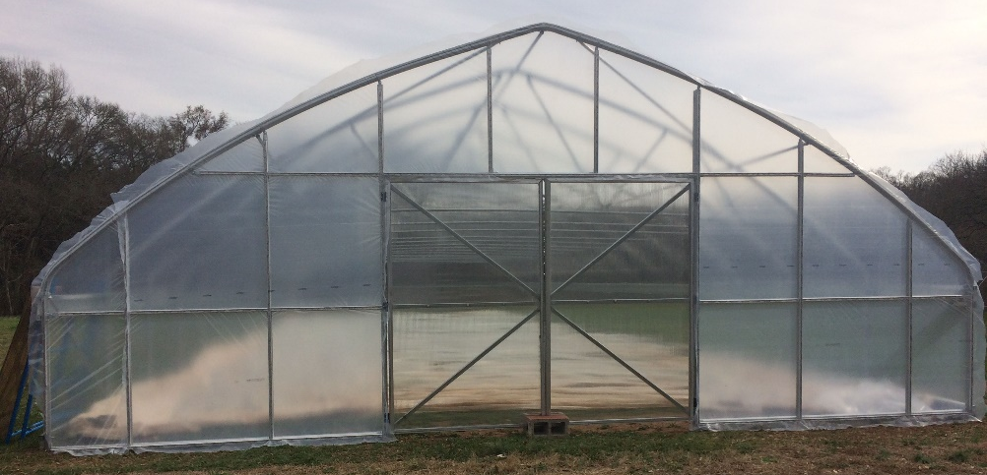
What is a high tunnel?

Slide 3
Benefits to high tunnel production
Season Extension
  Early spring, late fall, and winter production
Clean fruit/plants
Protected from elements
Reduced disease pressure
Controlled growing environment
Slower to freeze, faster to thaw
4-6 degrees protection, I assume 4!
Bigger, cleaner, better quality, earlier/later in season

Slide 4
Season Extension
What is the need?
Crops
Benefits
  Higher profit margins
  Capturing customers early in season
  Helps in a competitive marketplace
  High fruit quality
Capturing shoulder season markets
Tomato
Pepper
Cucumber
Lettuce
Greens/Spinach
Many others

Slide 5
Winter Production
Year-round harvests
Possible in all parts of NC
Great for restaurants, year-round farmers markets/CSAs
Can only produce cool season crops
Limiting factors: day length, soil temperature, viable market
Special Considerations:
Management needs
Double plastic layer/blower
Row Covers
Temperature/humidity monitoring
Crop variety selection
Extending the harvest

Slide 6
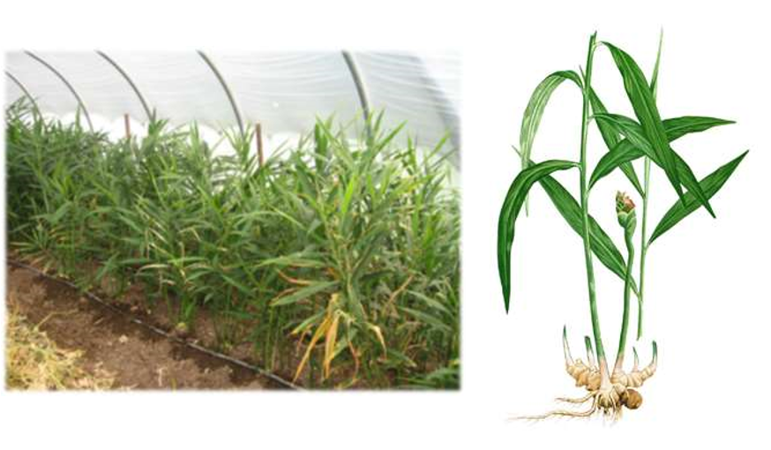
Exotic Crops
Crops that are unable to grow in the field
Niche market
Ginger
Turmeric
Berries, small fruits
Special needs: soil fertilizer inputs, shade cloth, irrigation, seed prep and post harvest

Slide 7
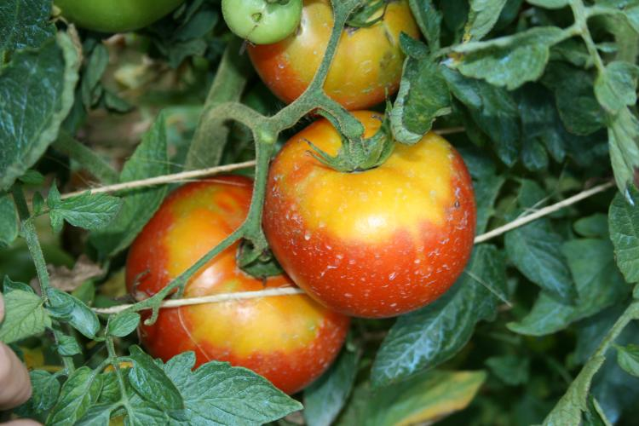
Drawbacks to high tunnel production
Pollinator Exclusion
Temperature Swings & Extremes
Summer Heat
Humidity
Soil Health
Maintenance Inputs
Perimeter Weed Management
Timothy Coolong, University of Kentucky

Slide 8
Drawbacks
Runoff – Water diverted from roof can cause drainage issues
Shading – High tunnel will cast shade potential changing field planting capacities
Grading – Top soil movement, sediment runoff
  Placement can create odd shaped fields, difficult to plant in
Cost – expensive to construct and continually manage
Worrying about the structure during extreme weather events

Slide 9
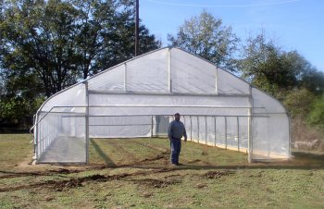
Cost of a High Tunnel
Size, type, truss system!
Price Estimate for 30 x 72
  Low end $10,000
  High End $20,000
  Atlas Budget Plus →

Slide 10
Cost Continued
Many outside cost not included in original purchase of kit
  Grading
  Driving sidewall post (contracting or renting equipment)
  Hired labor or contracting for installation
  Drills, Impact Drivers, Chop Saw, Reciprocating Saw, Drill Bits, Nut Drivers, Ratchets
  Materials for endwalls
  Doors

Slide 11
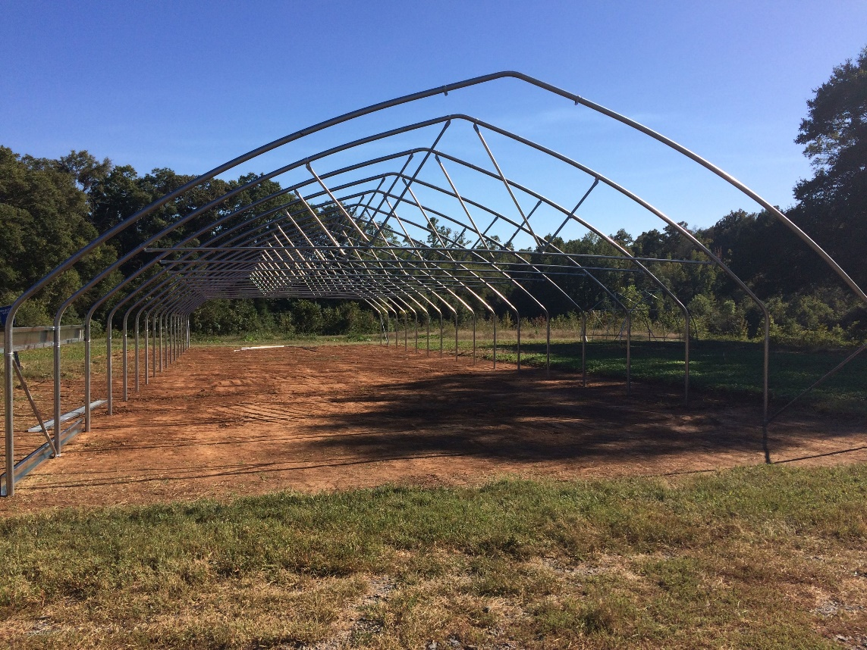
Site Selection
Site selection is more important than orientation!!!
Maximize the morning sun
  Why? Warm up sooner, evaporate moisture build up
Afternoon Sun
Ventilation
Irrigation Access
Level Ground
Lomax Incubator Farm Concord, NC

Slide 12
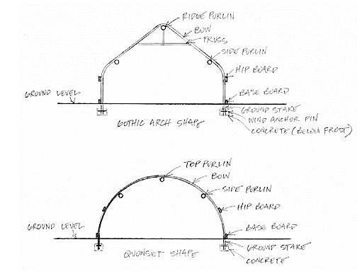

Slide 13
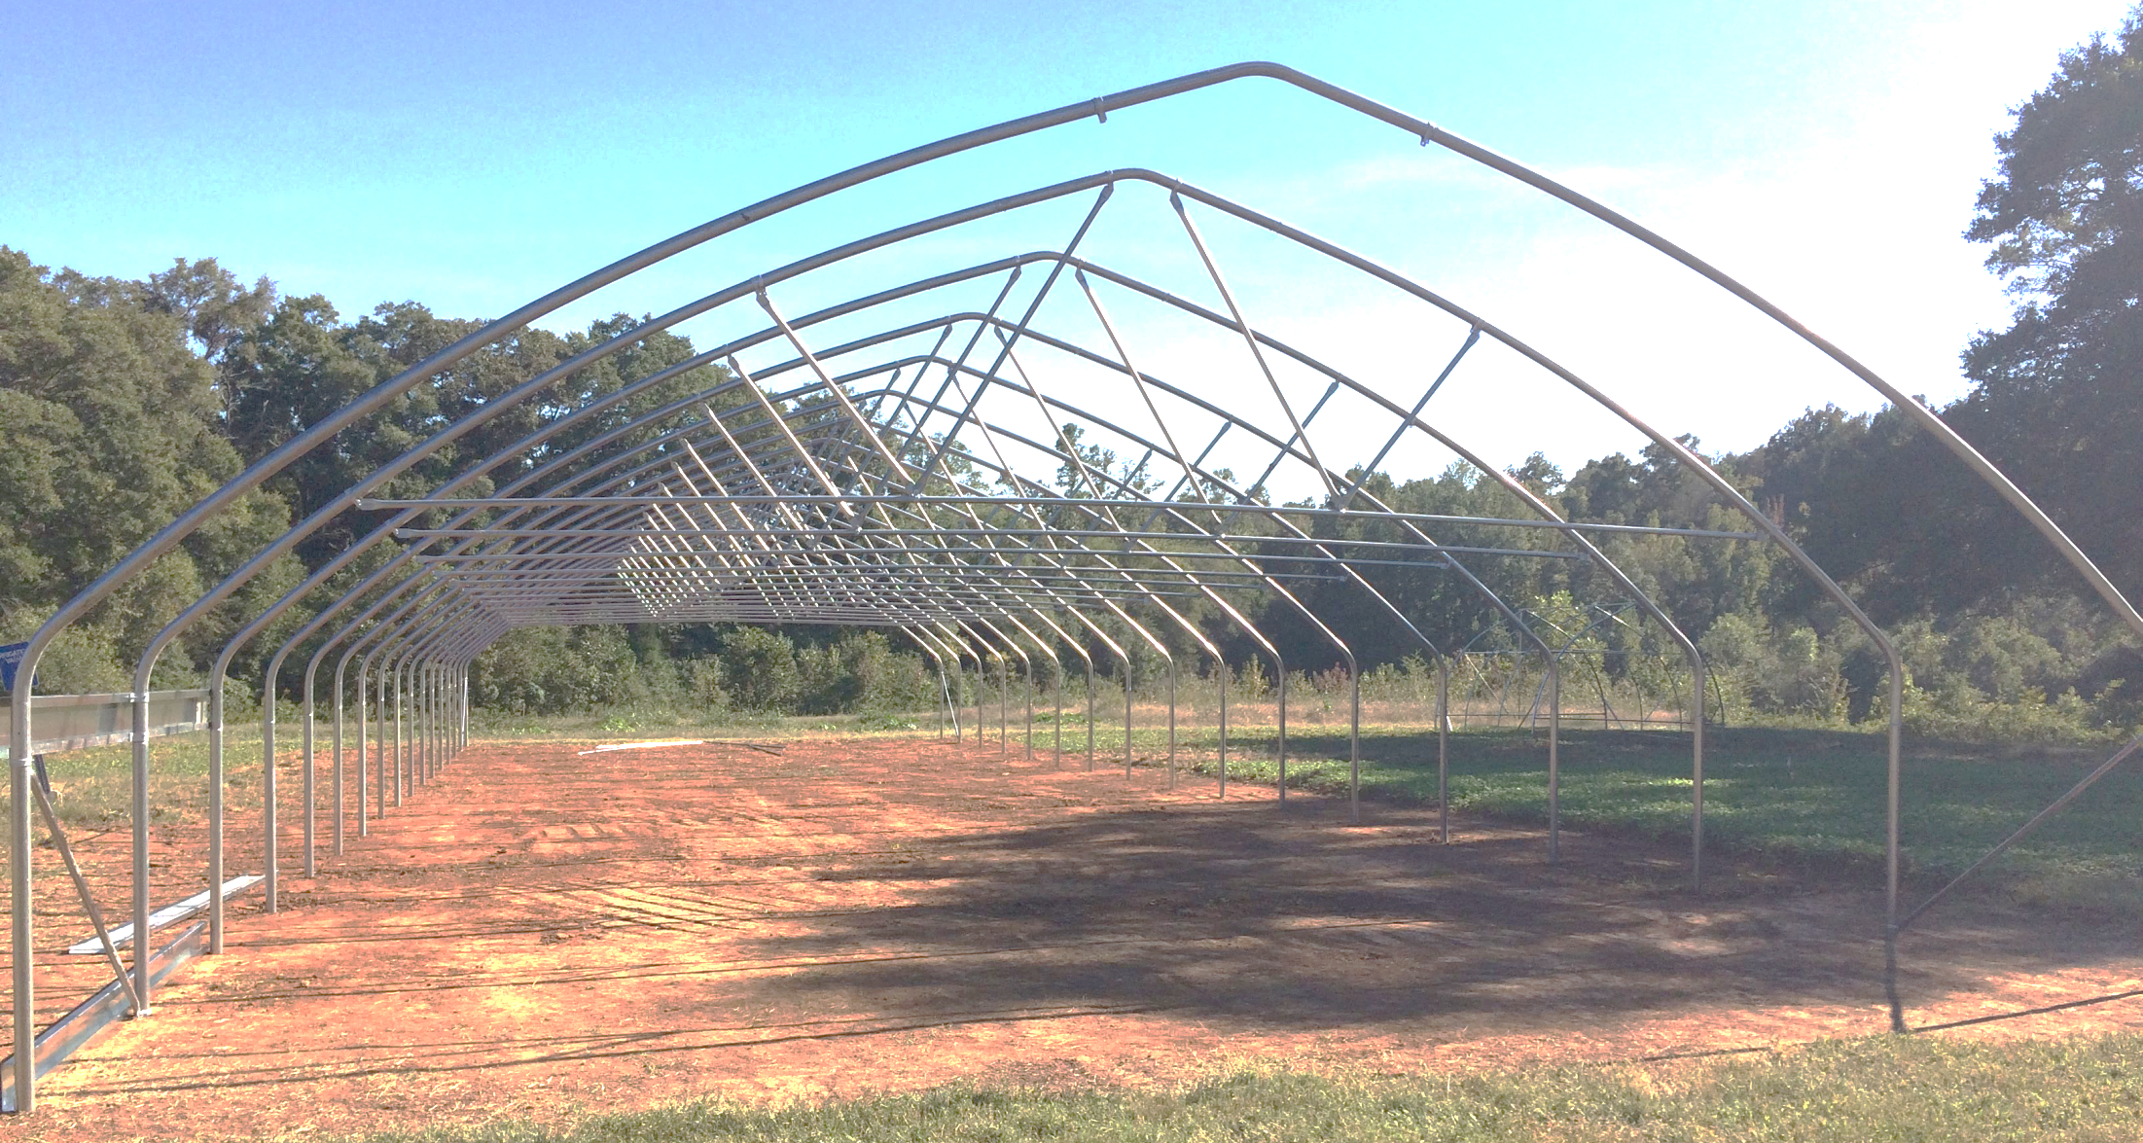
6’
Lomax Incubator Farm Concord, NC

Slide 14
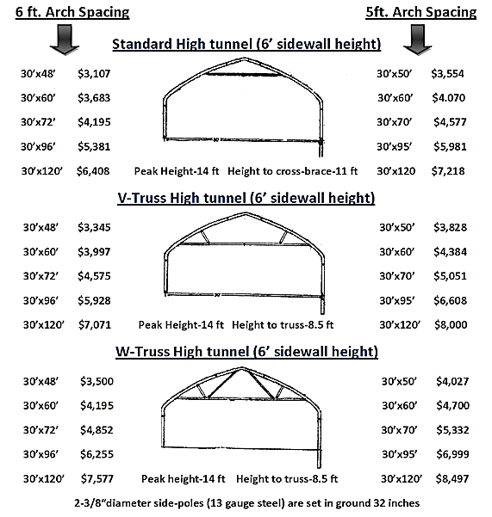
www.zimmermanhightunnels.com

Slide 15
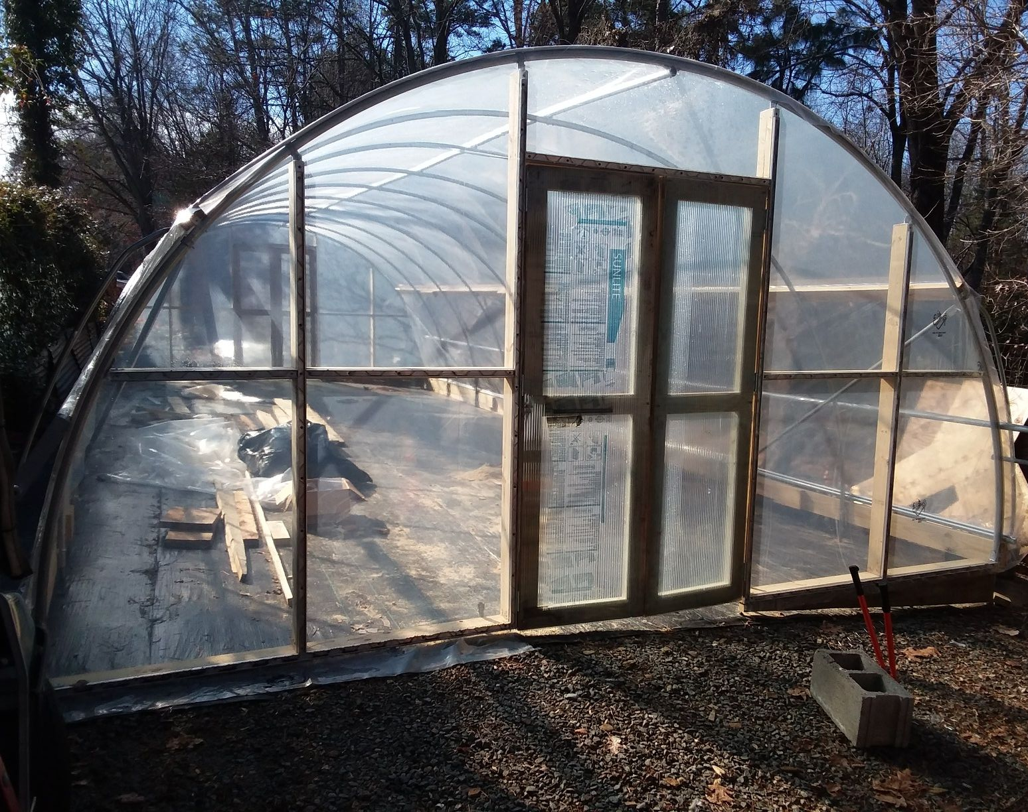

Lomax Incubator Farm Concord, NC UNC Charlotte Botanical Garden Charlotte, NC

Slide 16
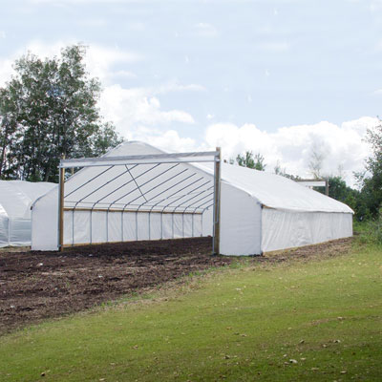
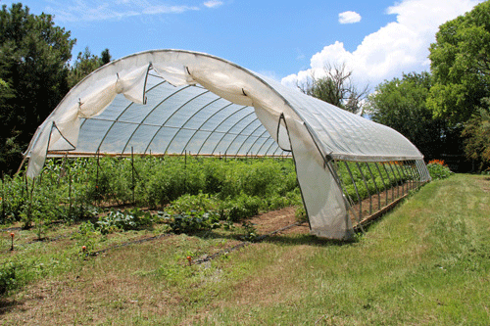
www.nrcs.usda.gov
www.growerssupply.com

Slide 17
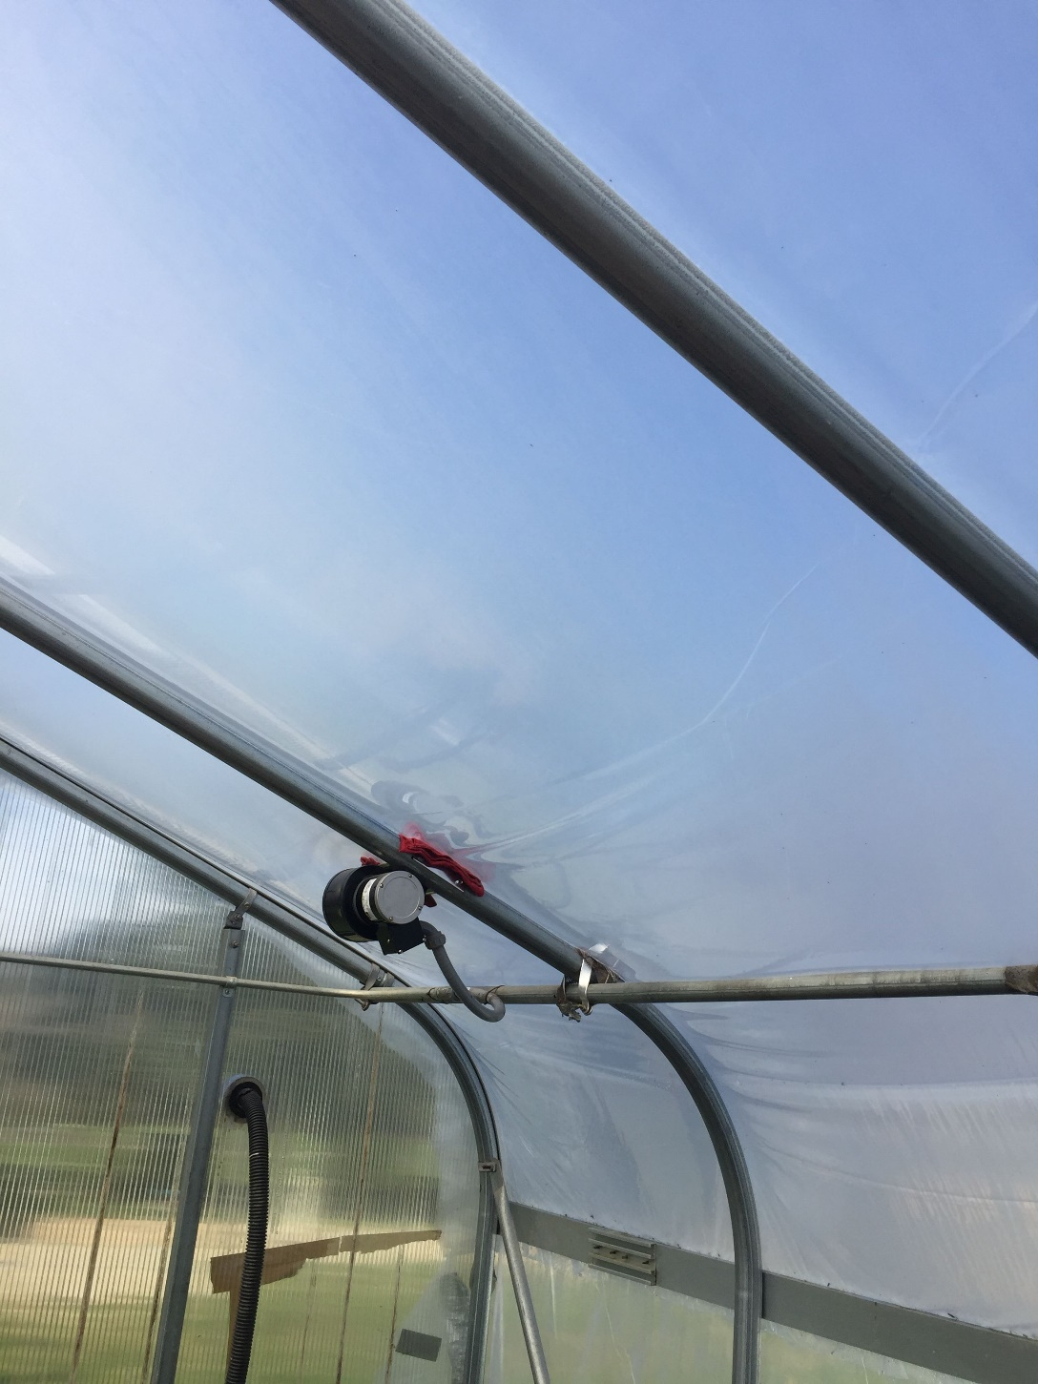
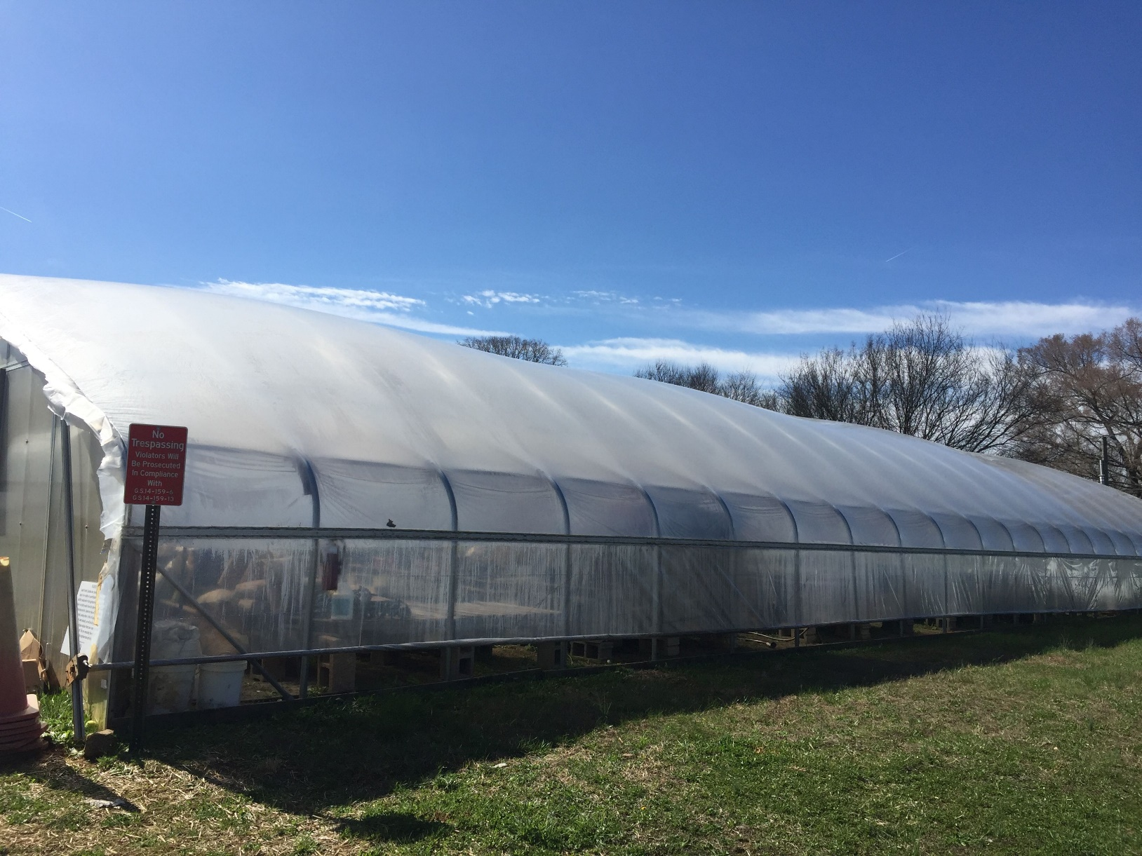
Lomax Incubator Farm Concord, NC
Double plastic layer on greenhouse

Slide 18
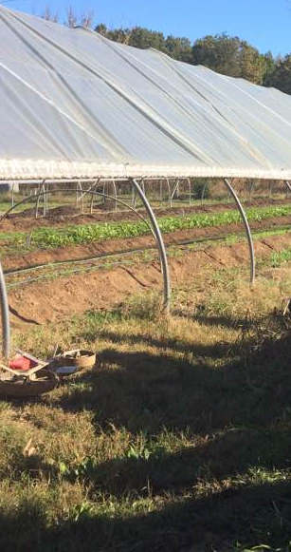
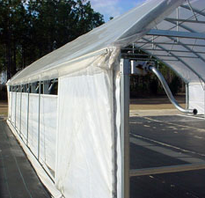
Side Walls:
Drop Down
Roll Up
**Tunnel Height
Dancing Pines Farm
Efland, NC
www.growingformarket.com
Notes:
Side walls. All the differences.

Slide 19
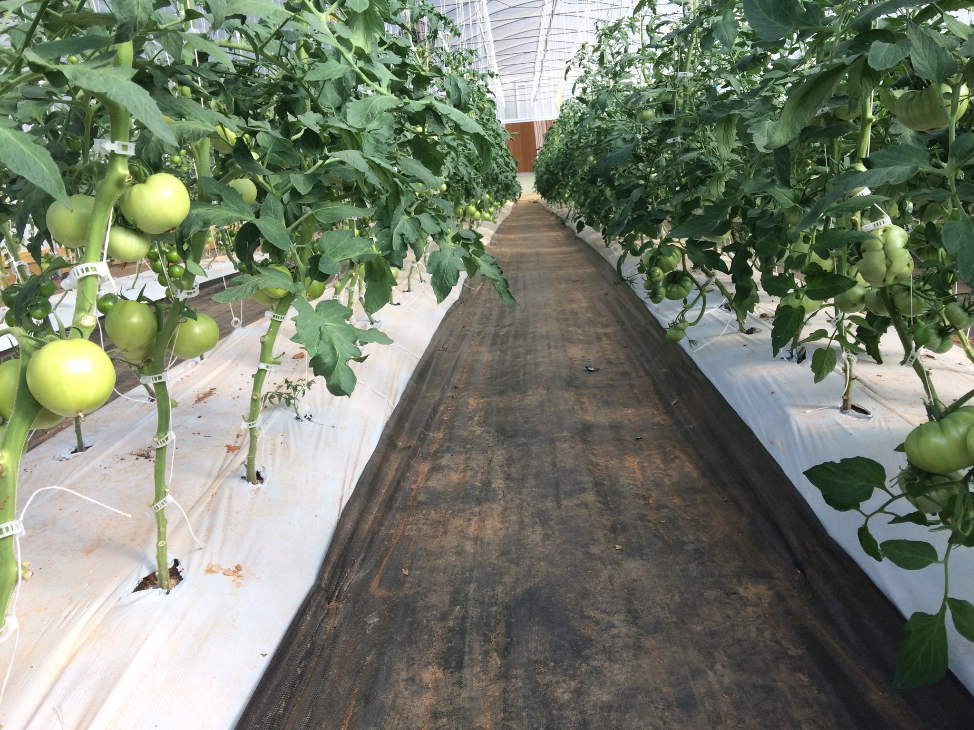
Sylvan Farm
Saluda, SC

Slide 20
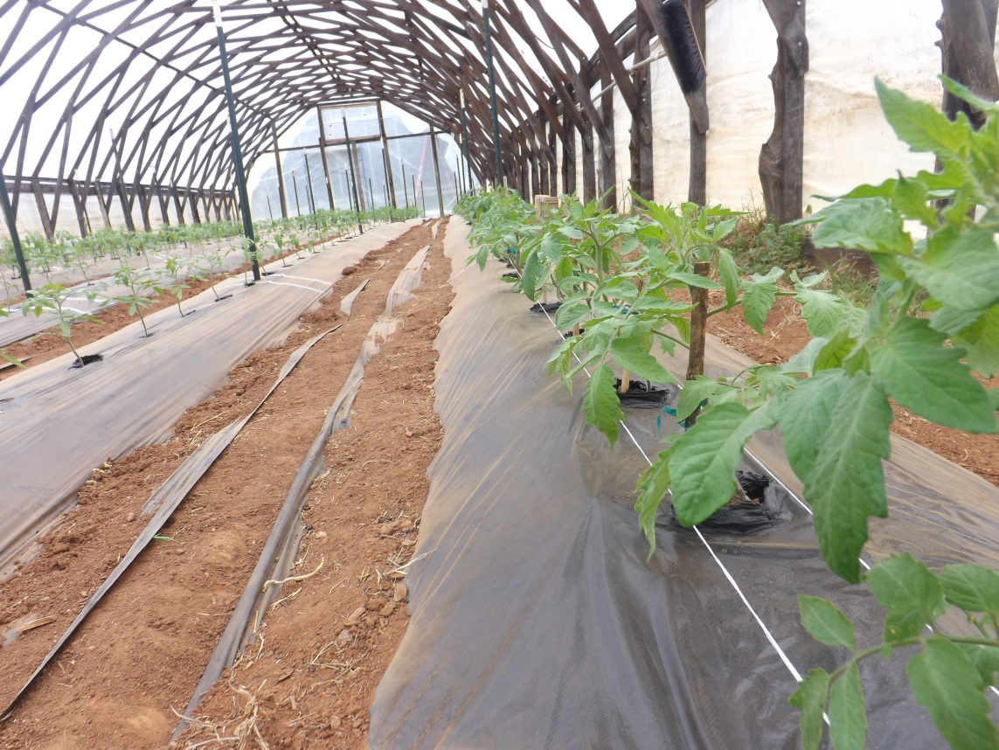
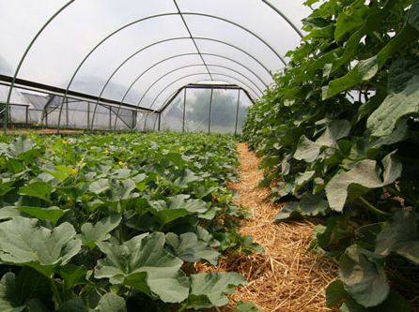
Mulch
https://growingsmallfarms.ces.ncsu.edu
Notes:
Why Mulch? Soil moisture and temperature. Weed reduction. Reduced labor. Clean plants/fruit. What types?
Pictures
Pulling the black plastic off mid season.

Slide 21
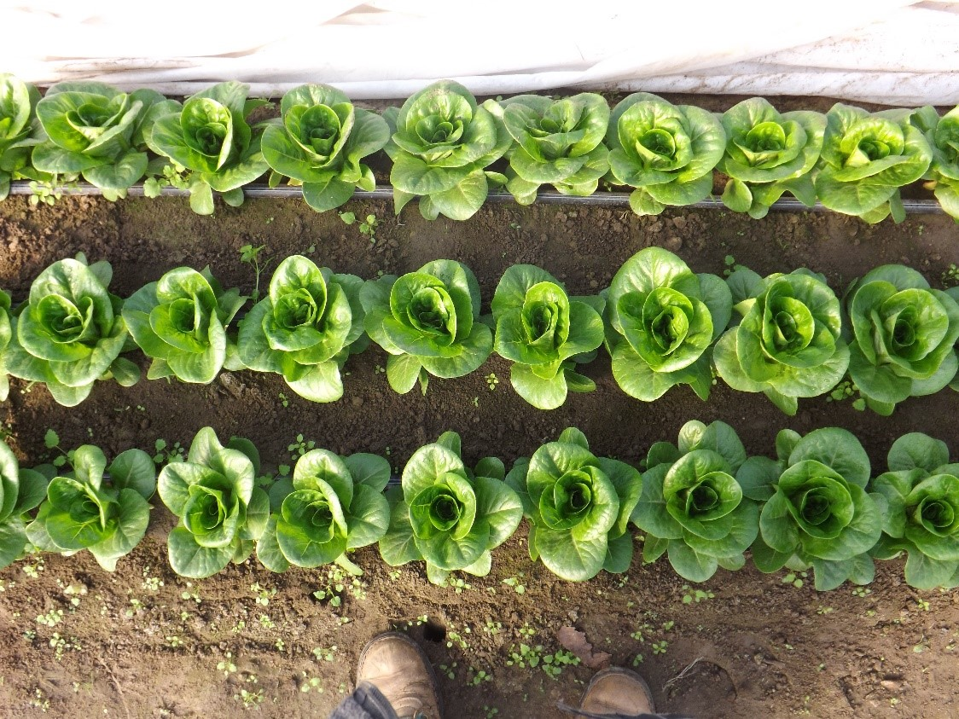
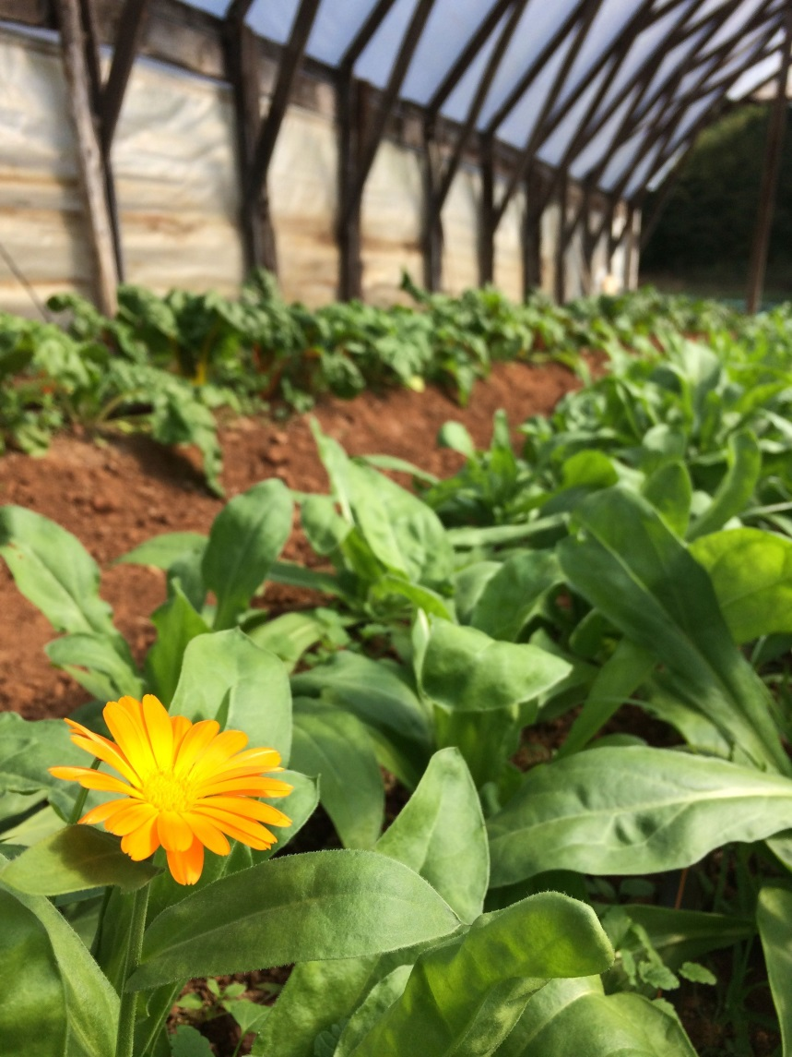
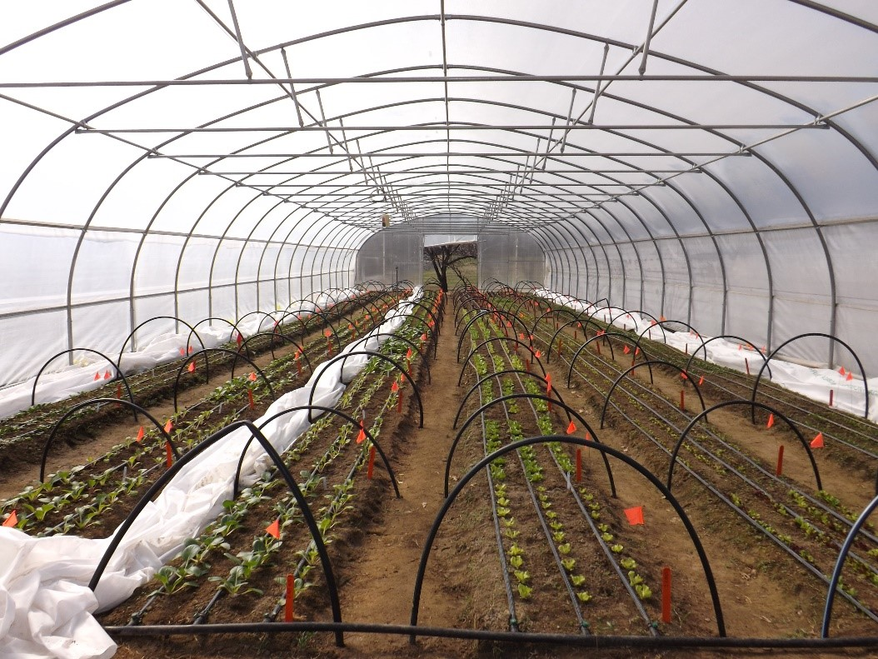
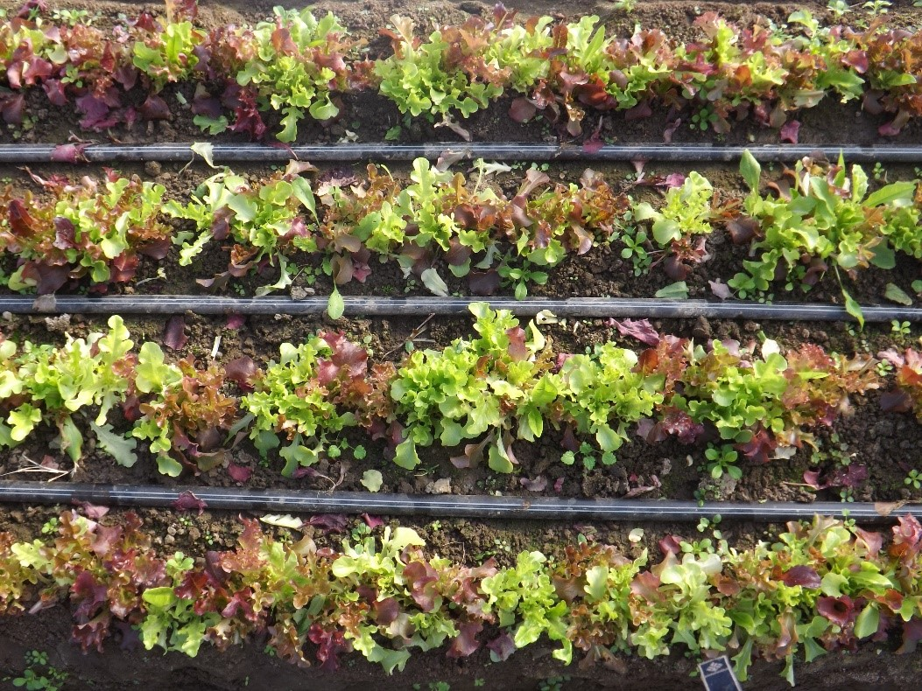

Slide 22
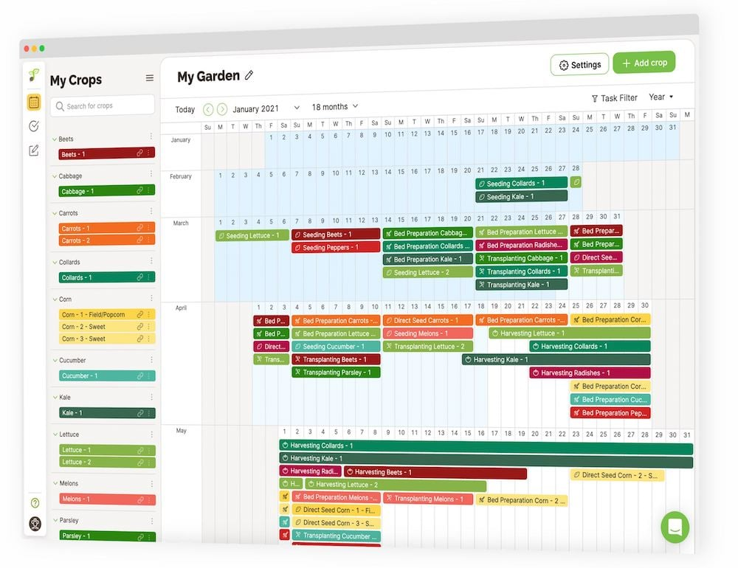
Production Planning
This is Production Planning, NOT complete recordkeeping
  Harvest data, financials, business planning
What to grow?
When to plant?
Where to plant?
How much to grow?

Slide 23
30’
Front Space
Side Wall Beds
Interior Beds
Walkways
Other Considerations:
Irrigation
Ventilation
Side wall type
Notes:
Basic bed set up
What about horizontal beds? Efficiency. Managing the space. Row cover. Multiple crops. Irrigation.

Slide 24
Row 1 Planting Date 3 February 20 Why outer last?
Row 2 Planting Date 2 February 10
Row 3 Planting Date 1 February 1 Why inner first?
Row 4 Planting Date 1 February 1
Row 5 Planting Date 2 February 10
Row 6 Planting Date 3 February 20
Notes:
Talk about planting dates
Middle rows are a little warmer

Slide 25
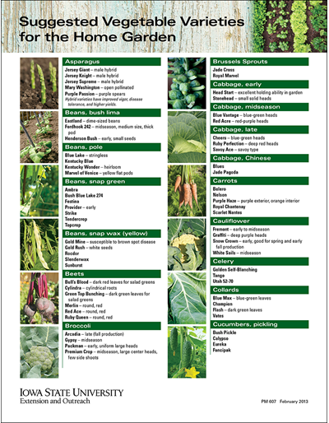
Crop & Variety
Ex: Belstar, Broccoli
Ex: Spinach, Corvair
Good to differentiate between varieties:
    Days to Maturity
    Spacing
    Germination
    Fertility
Lacinato Kale is a good example!
High Tunnel Crops & Varieties

Slide 26
Variety selection
Cool Season
Warm Season
Spring
  Bolt resistant varieties
Summer
  Heat loving varieties
Fall
  Cold loving varieties
Winter
  Day neutral OR extend the harvest with cold loving varieties
Spring
  Indeterminate tomatoes
  Early producers
Summer
  Usually carrying through spring plantings
Fall
  Determinate tomatoes
  High disease resistance varieties

Slide 27
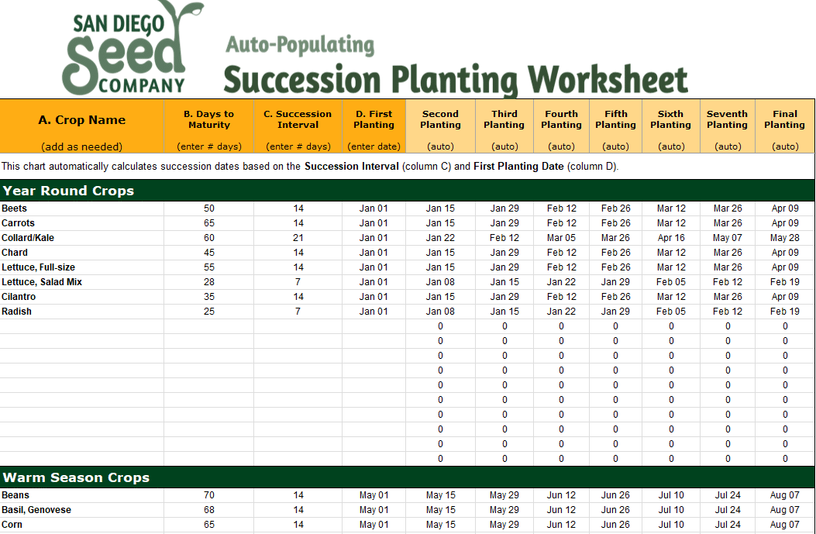
Successions & Intervals
Succession – Additional plantings, “rounds”, of same/similar crops/varieties
Interval - Amount of time between planting similar crops?
  This can be the same variety or same crop or family
  Weekly, Bi-Weekly, Monthly, up to you!
  Depends on projected harvest date and market demands
  How long can I successfully grow this crop per season, know your crop and seasonality

Slide 28
Continual Harvest – Important for Tunnels
Base the plantings on the projected harvest period, ex: 2 week harvest = start next planting every 2 weeks
Intensive, flip & replant quickly, base planting dates off of final harvest date, back up amount of maturity time needed to begin harvest on time
Filling gaps immediately may lead to doubling later harvests
Fill any gaps of 4 weeks or more with quick succession, radish, baby greens, etc. or COVER CROPS, Cucumber
High Tunnel Winter Article
Think of it as stacking multiple production plans based on projected harvest and when bed space is free
Do a cover crop production plan too!
You can choose to let beds/fields “play out” and transition to cover crops and prep for future plantings but it limits production in those areas and leaves fallow ground for extended periods of time
Don’t limit production in covered space in shoulder seasons

Slide 29
Production Planning Templates
Production Planning Resources 2023
10 Year Rotation_2023

Slide 30
Management techniques

Slide 31
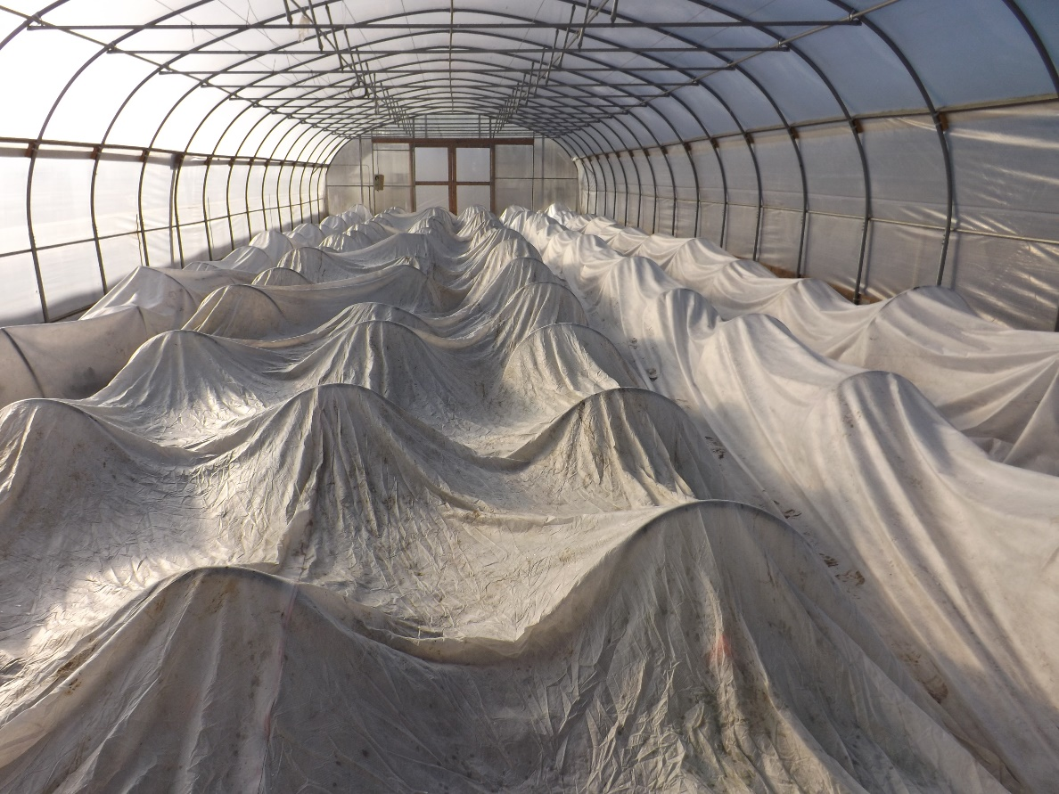
Row Cover
Thick fabric
High light penetration
Good frost protection
Overwintering
Avoid soggy row covers by mulching aisle ways
NC A&T University

Slide 32
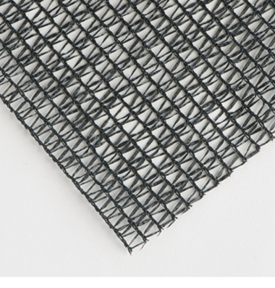
Shade Cloth
Used on:
  Green houses
  High tunnels
  Low tunnels
Inhibits light penetration
Lessens greenhouse effect in tunnels
Different shade out values available
http://www.johnnyseeds.com/p-8450-knitted-shade-cloth-50-shade-10-x-100.aspx

Slide 33
Crop Rotation
Year One
Tomatoes
Why?
  Soil health
  Disease
Monoculture
  Whole tunnel rotation
  Tomato and lettuce
Section or row crop rotation
  Integrate as possible
Cucumbers
Year Two
Cucumbers
Tomatoes

Slide 34
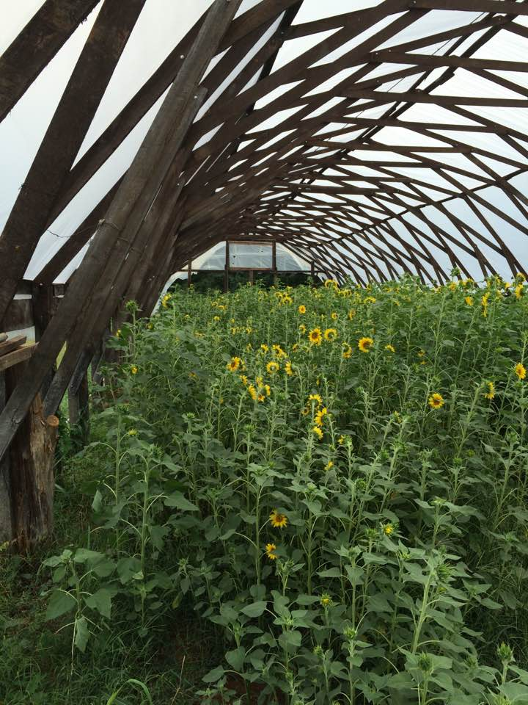
Cover Crops
Why?
  Soil health
  Beneficial's
  Crop rotation
Entire tunnel cover cropping
  Done during fallow production time (summer)
Section or row cover cropping
  Permanent beds

Slide 35
Irrigation
Basics
  Drip is best
  Plants can be placed at each emitter
  Needs: pressure reducer, filter, fittings, injection system
  Over head is necessary for cover crops. Install above the maximum height of the cover crop and irrigate as needed.
  Higher pressure is needed to run these
  Good for germination of some crops and summer greens production with misters on timers

Slide 36
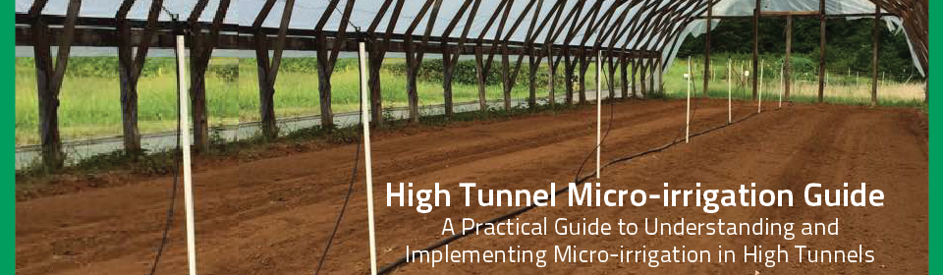
https://www.carolinafarmstewards.org/high-tunnel-micro-irrigation-guide/

Slide 37
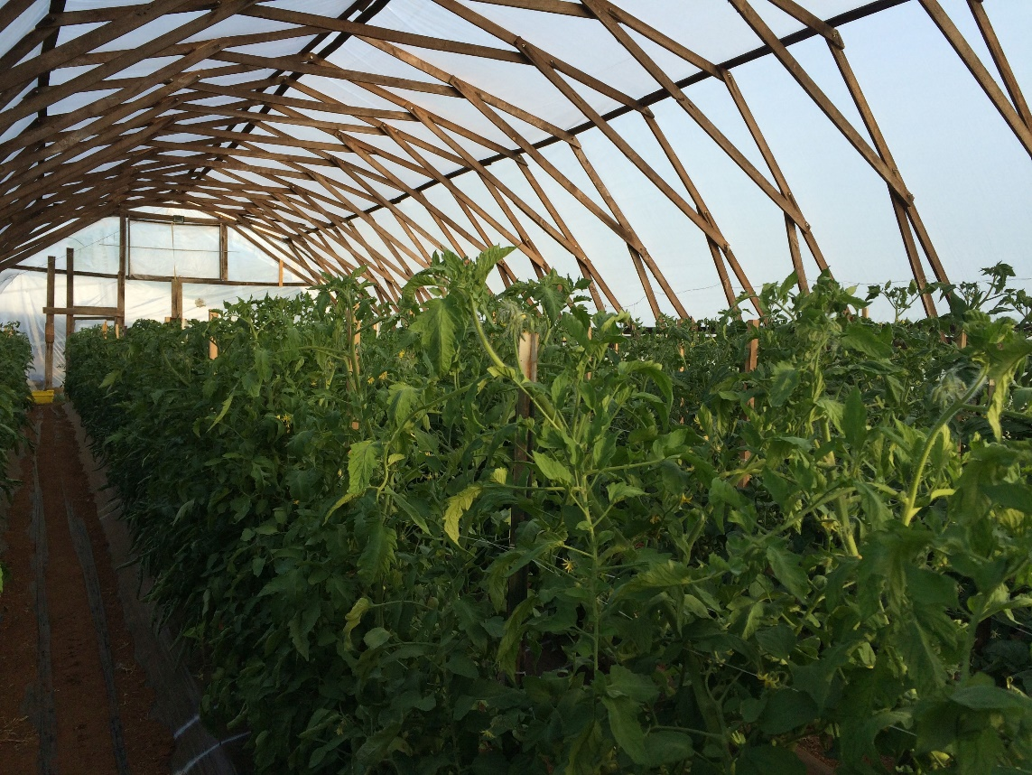
Trellising
Proper trellising makes management easy
Less Inputs
Choices
  Roller hook/line trellising
  Florida weave
  Cages
  Single stakes
  Mesh wire/fence

Slide 38
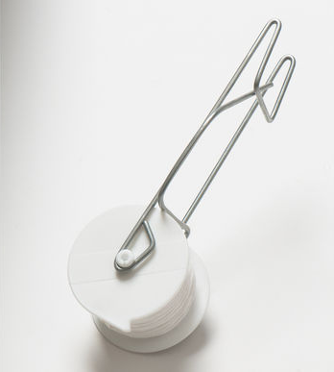
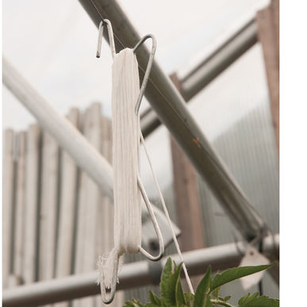
Trellising Equipment

Slide 39
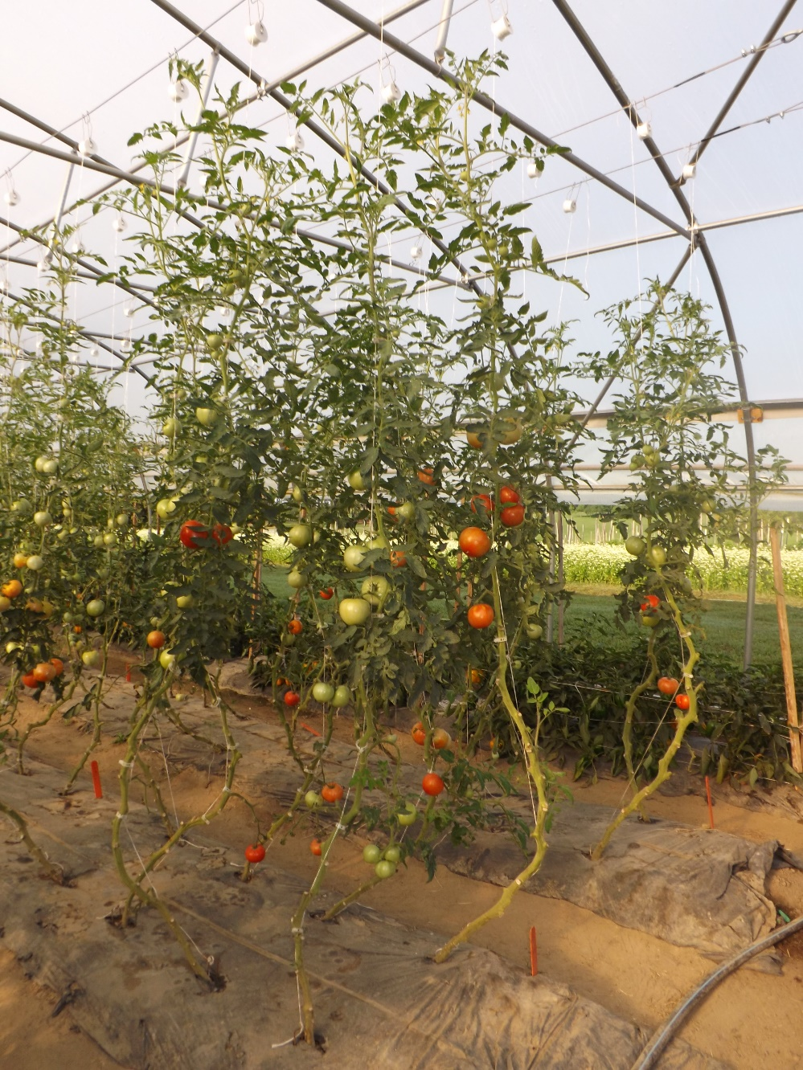
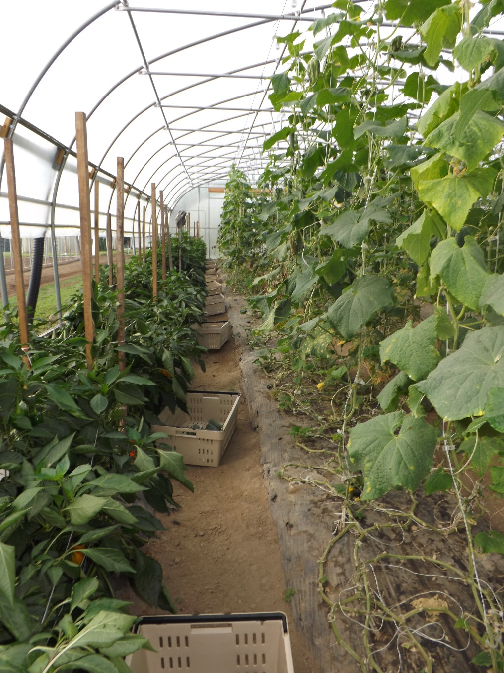
NC A&T University

Slide 40
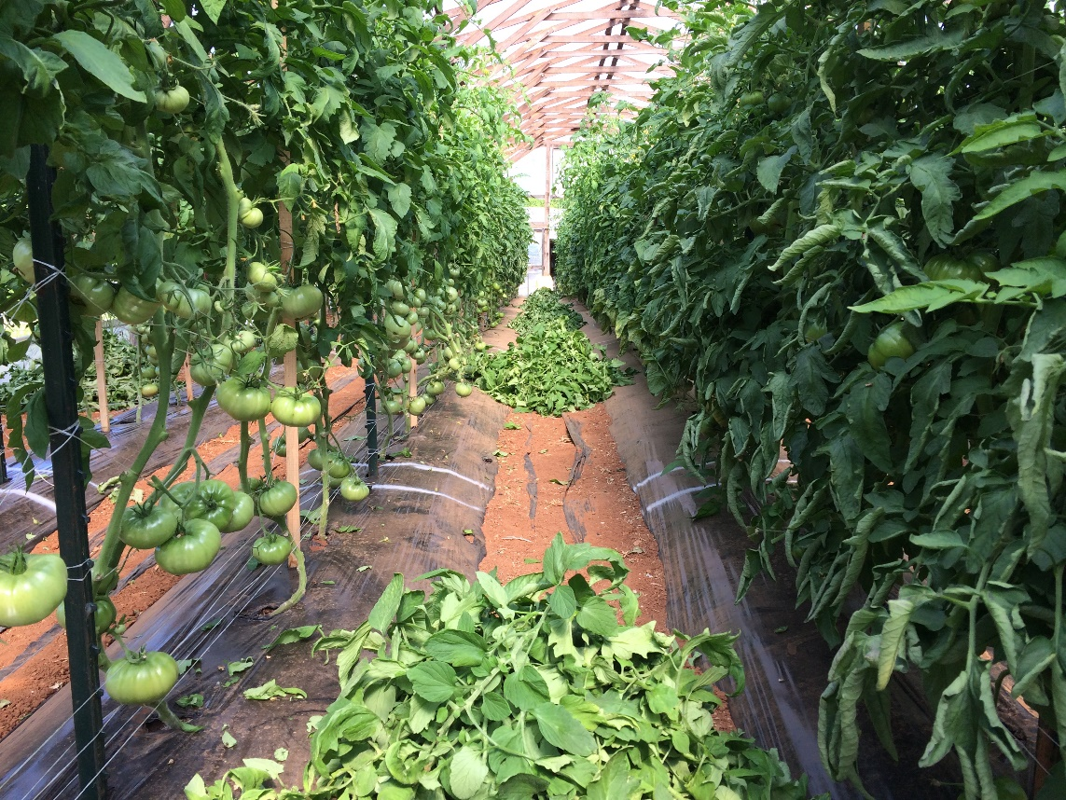
Pruning and culling
Increases ventilation
Reduces disease
  Reduces spread of disease
Reduces pest pressure
Easier harvesting
Healthier plants!

Slide 41
Ventilation tips
Opening and close sides at appropriate times can be critical to plant health and quality of produce
Ventilation practices will depend on the crop. Warm season vs Cool season
  Warm season: base temperature of 50°F
  Cool season: base temperature of 40°F
Cold damage
  Warm season: anything at or below freezing
  Cool season: typically at or below 25°F but it varies
Humidity! Vent the tunnel to decrease humidity and leaf wetness

Slide 42
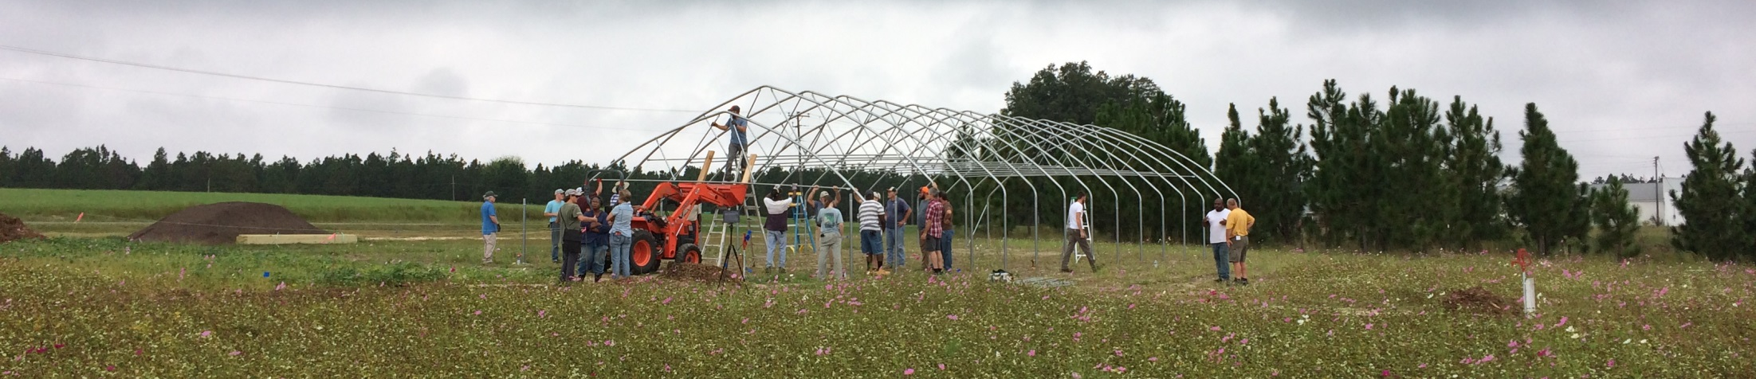
Ventilation Continued
Close the sides in the evening soon enough the trap in some heat for that long cold night
Heat accumulates fast during sunny conditions so get those sides up early
Avoid high leaf wetness and humidity while maintaining heat can be difficult
  Vent the tunnel during high moisture conditions even if it’s a little chilly, you need the air movement

Slide 43
Record Keeping

Slide 44
Project Your Harvest
Break it down to a “per plant” basis
Use estimated harvest amounts:
  Past production records
  Seed information
  Online records
Don’t forget about production and labor cost

Slide 45
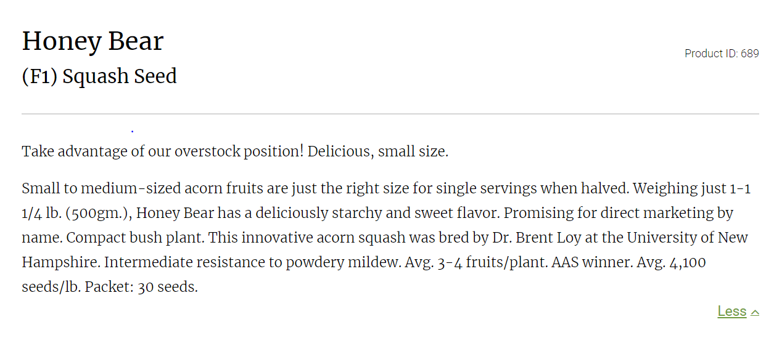
Notes:
Lbs per plant. Heads. Fruit per plant.
Find the info that will give you what you need i.e. how do you sale your product (weight, heads etc…)

Slide 46
Spring High Tunnel Lettuce
Specifics:
30’ x 96’ Tunnel
  6 beds 3.5’ x 90’
Mini head lettuce spacing
  6” in row spacing
  8-10” between rows
Beds
  3.5’ x 90’
  3 rows of lettuce per bed
So, how many?
  180 plants per row
  540 plants per bed
  3240 plants per tunnel
Break it into 3 planting dates, 7-10 days apart
  Why various planting dates?

Slide 47
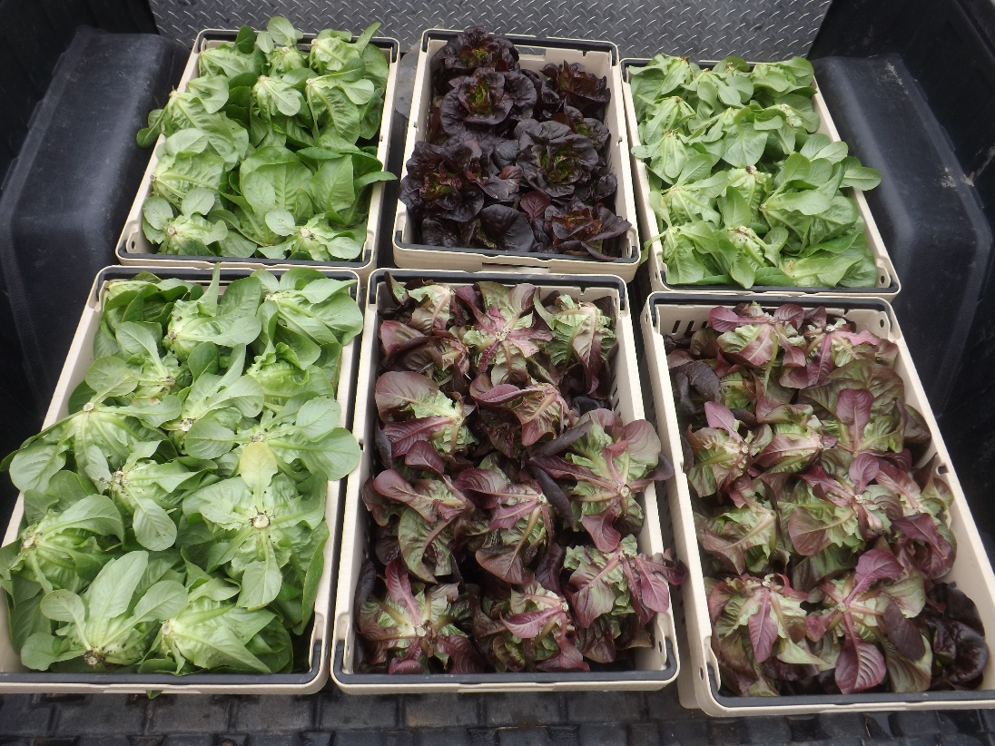
The Harvest
Harvesting for roughly 3-4 weeks
Potentially harvesting 1080 heads at a time (2 rows)
Assume 80% success rate (I’m always this optimistic)
  2,592 heads
  At $1 a head
  $2,592
As you harvest your lettuce, prepare for warm season crops
NC A&T University

Slide 48
Crop Economics
High tunnels can gross more per square foot as compared to field production
Input cost vary from farm to farm
Tomatoes | High Tunnel | Field
Row Feet | 400 of 30” bed | 400 of 30” bed
Bed Spacing | 2 rows at 2’ spacing | 1 row at 18” spacing
Total Plants | 400 | 266
Avg Marketable Harvest | 20 lbs per plant | 10 lbs per plant
Total Marketable lbs | 8,000 | 2,660
Avg Price per lb | $2.00 | $1.75
Gross Income | $16,000 | $4,655

Slide 49

NCSU, Clemson, Cornell, Purdue
County Cooperative Extension
Carolina Farm Stewardship Association
Veggie Compass, Seed Time, other Spreadsheets
Attra, SARE
Elliot Coleman, JM Fortier, Ben Hartmann, Connor Crickmore
QUESTIONS:
Joe Rowland
joe@carolinafarmstewards.org
Notes:
These are the things you need to consider when planning out the space in your tunnel.
I’ll touch a little more on each of these.
Picture and why that set up works in there for that production.

