Slide 1
Mediating Leases Webinar
Cara Cargill, Land For Good
June 2017

Slide 2
Hand Shake vs. Written Agreement

Slide 3
Over 38% of all U.S. farmland is rented

Slide 4
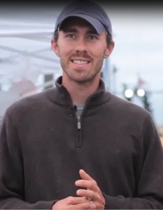
Motivation for Farmers to lease land:
It’s Economic!
Can’t afford to buy land
Can’t afford all of the land base that they need (own some, rent some)
Or, want to put capital into the business assets and not real estate and make a conscious choice to lease.
As one farm management professional states, “Control, not ownership, is the critical issue in efficient production.”
“
Finding and securing land can be a difficult task.
Derek Christianson
Brix Bounty Farm, MA
”

Slide 6
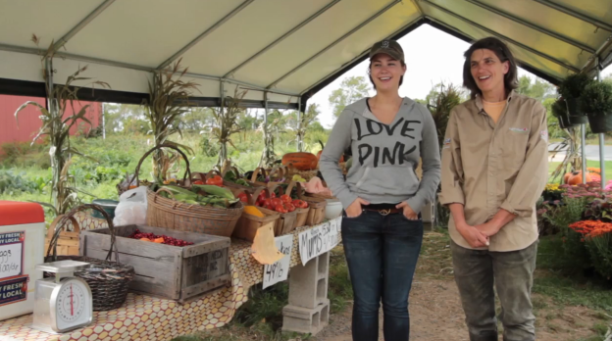
Financial Stresses in Farming
The best laid plans can still go south.
Weather, health issues, changes in markets and regulations, and cost of production (fuel or grain price spikes), can make it difficult for a farmer to follow through with their plan.

Slide 9
Motivations for Landowners to lease their land:
Retired farmers without successors who want to keep the land active
Many landowners have their land as part of a family legacy
The land gets handed down to non-farming heirs, who sometimes don’t even live in the same state, but want to keep the land in active use.
Primary and vacation homeowners who bought the place for the rural aesthetic, but don’t want to farm
Business owners who bought commercial property with ag land attached
Investors looking to make money off of ag land through rent or appreciation
Non-profits/community groups/public entities who bought land to keep it in agriculture.
Public entities who own land for other purposes
Watershed protection, future cemetery expansion, public park/access but want to keep land active
All of the private landowner groups are often motivated by property tax breaks from keeping land active and/or they don’t want the land to grow to brush/trees.
80% of all rented farmland is owned by non-farming landlords

Slide 14
A Decision Tree for Farmers
Notes:
Adapted with permission from Holding Ground: A Guide to Northeast Farmland Tenure and Stewardship © 2004
New England Small Farm Institute

Slide 15
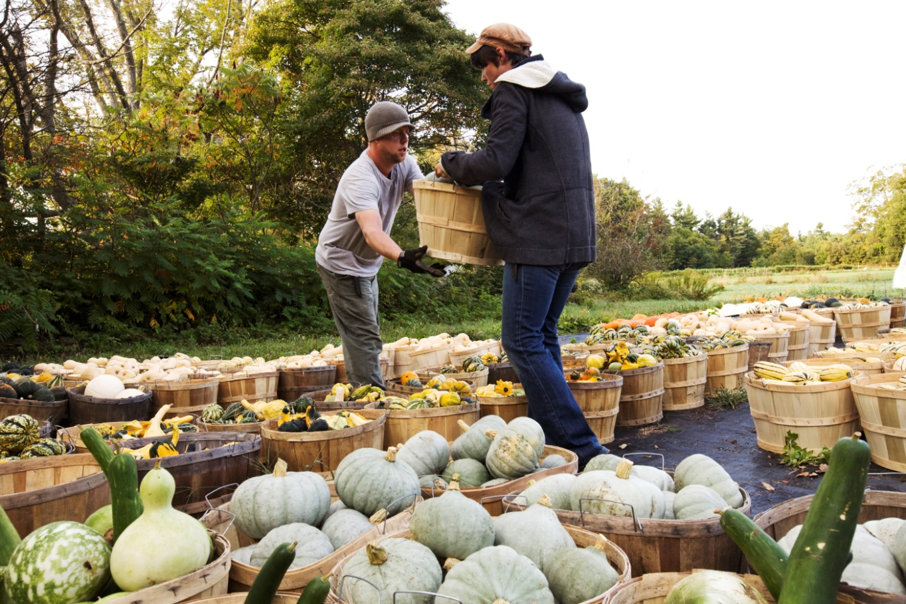
Principles of Land Tenure
Access
Security
Affordability
Legacy
Stewardship
Notes:
Access - Access addresses the user’s rights to get onto and control the land sufficiently to meet farming goals. If a farmer owns the land, he or she enjoys maximum rights and control. Tenancy offers a farmer access to the property, subject to the conditions in the agreement. In practical terms, access also means that the operator must be able to get to and onto the land without undue constraint. For example, if a landlord keeps the gate to the leased property locked or blocked, the tenant may have an agreement to use the land, but experiences barriers to access.
Security: For tenants, security means that the farm operator is (relatively) free from fear that he or she will be arbitrarily kicked off the land, or that the terms of use will be altered without due process. It also means that the length of the lease agreement is sufficient for the farmer to meet his or her goals. While shorter leases offer flexibility (which has advantages), the longer the lease, the more secure the tenure. While the research is inconclusive, a common thought is that the longer the lease, the more likely the tenant is to treat the land well, rather than mine it for short-term gain. Longer-term agreements are more likely to foster longer-term conservation practices such as crop rotations, fallowing and application of certain soil amendments.
Affordability: Housing is often a bigger challenge in terms of affordability than the land. Sometimes the house is part of the farm property and sometimes the farmer can find appropriate housing nearby. Certain non-traditional arrangements address the affordability issue. For example, some long- term and ground leases build in affordability provisions, so that the land is affordable for farming in perpetuity. Easements can reduce the price of a property. Share-lease agreements remove some of the risk from rental payments, making them more affordable. Owner financing and new mission-driven investor financing can offer friendlier terms for farm purchasing.
Legacy: If you own a farm, you can arrange for it to be passed on – within the family, or however else you might choose. Sometimes a farm family will pass the farm to a non-family member, or to a charity such as the church or a land trust.
long-term leases can be inheritable. Ground leases also are inheritable. In the case of a ground lease, you can pass on the improvements you own, as well as the lease itself.
Stewardship: Stewardship implies both values and responsibilities. Most farm property owners feel responsible for making sure that the land is cared for and not abused. Of course, people have different ideas about what constitutes use and abuse. If the owner is the operator of the land, her uses will correspond to her values and goals for it. If the user and owner are different entities, there needs to be an agreement about how both parties’ stewardship goals and values are addressed.

Slide 16
What is a lease?
It is a contract between the property owner and property user.
It specifies the rights, limitations, and obligations of both parties.
Notes:
Land tenure arrangements determine who can use what resources for how long, and under what conditions. Tenure arrangements may be well defined or poorly defined, characterized by ambiguities leading to confusion and exploitation. Tenure arrangements may be formalized by written documents or may be informal based on a handshake agreement, longstanding relationships or generally accepted understanding within a community. Many informal agreements often are clear enough to work most of the time, but they may not help resolve unforeseen disputes or be legally enforceable if disputes do arise. A written document is more likely to be clear and legally enforceable.
Land For Good strongly recommends that land tenure agreements are thorough, carefully crafted and put into writing. This makes them legally enforceable and enables all parties to review the agreements whenever a question arises.

Slide 17
Types of leases
Short-term (annual to 3-5 years)
Long-term (5-99 years)
Ground lease (long-term, where tenant rents the ground and owns the improvements)
Rolling term (term “rolls forward” so that it’s always, for example, 3 years)
Residential lease (preferably separated from the lease for land and farm structures)

Slide 18
Lease to own models
Lease with option to purchase
The lease grants the tenant an option to purchase the property at a time in the future.
Usually the price and the terms of the purchase are set forth at the outset.
The option may run for the length of the lease or for only a portion of the lease period.
The lease payments are not part of the consideration of the purchase price unless the terms specifically allow for that.
(2) Lease-Purchase Agreement
The tenant leases the property and is obligated by the terms of the lease to buy the property.
The rent can go towards the purchase price.

Slide 19
What’s in a lease
Five basic, minimum provisions make a lease a legal contract.
The parties (tenant and landlord)
Start and end date
Rental rate
Identification of tenant and landlord that are parties to the contract
Signatures of the parties

Slide 20
Other items to cover in a lease
1. Conditions of access to leasehold
2. Repairs and maintenance
3. Means for establishing and modifying the rental rates
4. Payment requirements and schedule
5. Permitted and prohibited uses of the property and any land use restrictions
6. Capital improvements (i.e., what is permitted, procedure for approval, who owns them)
7. Communication
Notes:
(2)Care and maintenance of the relationship is of crucial importance. An annual report from the lessee to the lessor detailing what has happened in the year just ending and hopes/plans for the coming year should precede an annual meeting/farm walk.
(7) All agreements should have a section that calls for regularly scheduled meetings and farm walks. These should be at predetermined times and be preceded by an exchange of topics to be covered such that people can come fully prepared.

Slide 21
Other items to cover in a lease
8. Termination
9. Subleasing and assigns
10. Insurance and liability issues
11. State and Federal lease law considerations
12. Default and eviction
13. Reference to easements and/or other liens on the property
14. Landlord’s right to enter
15. Procedures to resolve disputes
Notes:
The original agreement should state the protocol for calling in a mediator should re-negotiation be needed. Once the agreement is in place, there should be firm rules about the circumstances under which it is altered or decisions are made. For example, the agreement should state that, while ideas may be discussed informally, decisions must be made at a sit-down meeting with careful notes recorded.

Slide 22
Advantages of leasing
The ability to get on with farming without the enormous capital investment required to purchase land.
Some farmers like short-term lease arrangement because they can experiment with new enterprises or locations without a long-term commitment. This flexibility is particularly useful for start up farmers.
A short-term lease can enable a farmer to test whether her farm plans are financially feasible or whether he is comfortable with his landlord. It allows both parties to decide if a longer-term arrangement would work.
A short-term lease also allows the tenant to limit financial risk.

Slide 23
Disadvantages to leasing
Insecurity of tenure can lead to disruption of the operation and difficult in making long-term business plans or personal decisions.
Inability to build equity in the land.
Lenders may balk at financing long-term assets such as equipment or livestock if the borrower does not have a written lease covering the loan period.
Tenants may have less financial incentive to invest in longer-term conservation practices or install conservation structures.

Slide 24
Advantages of short term leasing
Lower costs (initial and monthly) than purchasing
Tax deductions for leasing costs
Rights to terminate
Allows savings or investment in short-term capital needs
Test period for enterprises, locations, and markets

Slide 25
Disadvantages of short term leasing
Cannot recover lease costs as equity in land
Cannot benefit from appreciation in land value
Limited control over land and improvements
Less ability to plan or make improvements
May be unable to get credit from lenders
May lose investment in infrastructure and land if lease is terminated.

Slide 26
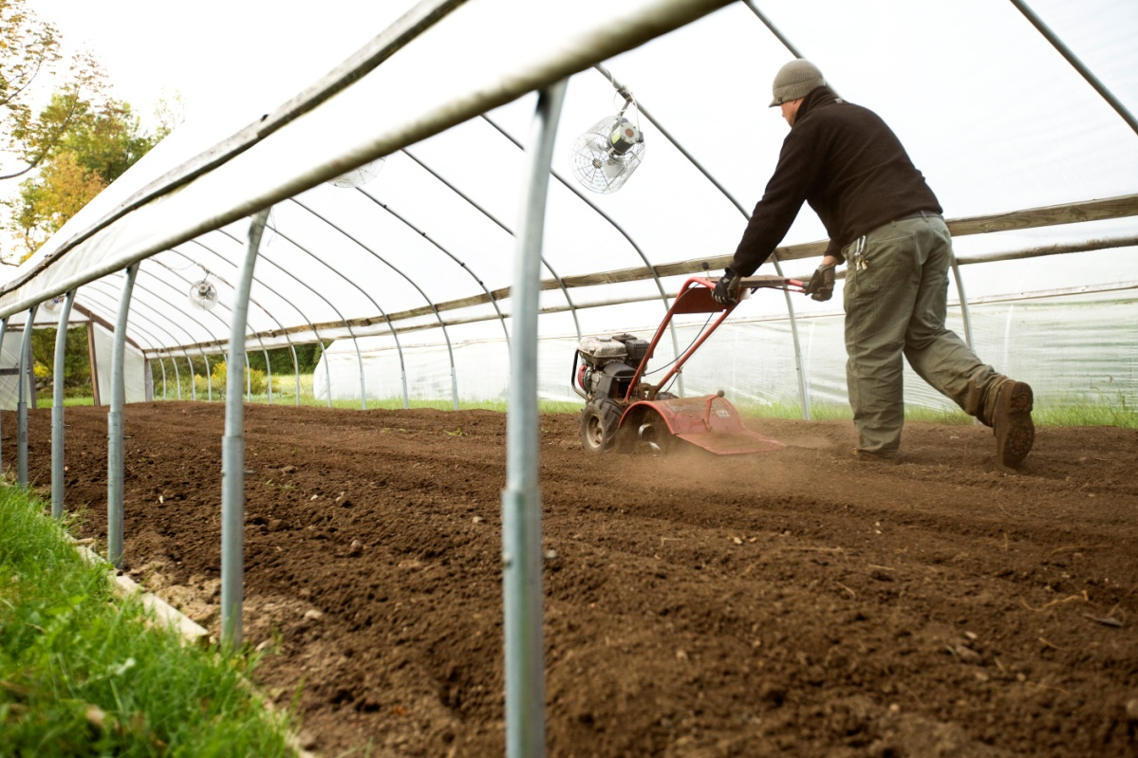
Long Term Leases
Offer more security than short-term leases.
It gives the operator time to build the business as well as the soil, and establish markets as well as community relationships.
It is possible to borrow against a long-term lease and to participate in USDA conservation programs.

Slide 27
Advantages of long-term leasing
Longer planning horizon for business and resource stewardship
Allows farmer to capture the useful life of investments made to the leasehold
Legacy to the next generation with renew and inherit lease provisions
Security to participate in community life
May increase borrowing capacity when the value of the lease is used for security along with tenant-owned improvements on the property.

Slide 28
Disadvantages of long-term leasing
Reduces net income without contributing to long-term accumulation of wealth in a property
Cannot rely on land appreciation as a retirement fund
Typically more complex legal documents and higher legal costs
Can make loans more difficult or impossible to get without land as security for a loan

Slide 29
Best Practices for Avoiding Problems
Work for clarity in communication.
Capture all agreements and decisions in writing. Let each participant review the written record and either agree that it is an accurate record or suggest changes for accuracy.
When speaking/discussing, be sure to be clear and repeat what you think the other party is saying so that they can confirm whether this is what they meant.

Slide 30
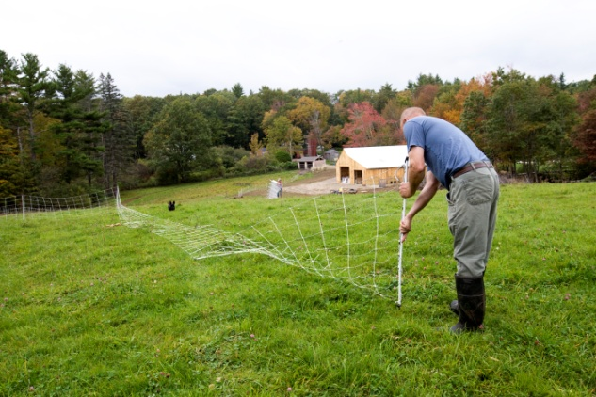
Best Practices for Avoiding Problems
Use measurable standards.
Use photos to show before and after condition of tools, equipment, buildings, livestock – anything that is being leased over a period of time.
Attach $ amounts to all "goods and services" that are exchanged. If labor is used to pay rent, determine ahead of time what an hour is worth or how many hours of labor will pay for a month's rent (or a year's)
Use a description of the outcome of the labor (the fruit trees will be pruned. The rotten fence posts will be replaced and any broken wire will be mended.) Also specify the date by which various tasks will be done.
It is not proper payment if you agree to prune the fruit trees but don't get to it until late May. If you agree to mow the hay field, it
must be done when the hay is at its prime. The
barn roof has to be mended before the hay is put
in it for the winter.
Use maps or aerial (satellite) photos with
boundaries drawn on and various areas defined.
Create a legend for identifying key features that
relate to the agreement.

Slide 31
Best Practices for Avoiding Problems
Anticipate problems that COULD come up and pre-plan procedures for dealing with them.
Schedule regular meetings (at lease annually) so that face-to-face communication about the property & the agreement can be anticipated & occur at a specified time.
The lessee should supply the lessor with an annual report, delivered at least a week before the annual meeting, that details what happened on the property in the past year & what is in the plans for the upcoming year. This report should serve to keep the lessor abreast of how the property is being employed by the lessee as well as to help the lessor anticipate what it to come. This report might serve as a major focus of the meeting.
Establish a method for communications that fall between formal meetings. Perhaps a quarterly email with a "snapshot" of what is happening on the leasehold - especially anything that was not listed in the annual report. Perhaps periodic phone calls or farm walks would serve to keep communications open - those creating the lease agreement should choose the method that would work best for their situation.

Slide 32
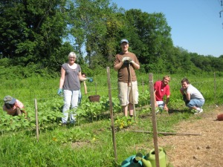
Best Practices for Avoiding Problems
Keep business businesslike.
Many people who are friends enter into lease agreements or end up becoming friends during the term of the agreement. Separate friendship from business.
Never make a decision based solely on an informal conversation. If you are weeding the carrots together and bat some ideas around for a change in your agreement, those changes are not binding based on the informal conversation.
All binding changes to the agreement should occur at a formal, sit-down meeting at which notes are taken and reviewed/approved by all. These changes get recorded, in writing, on the lease document with the date and signatures of all.

Slide 33
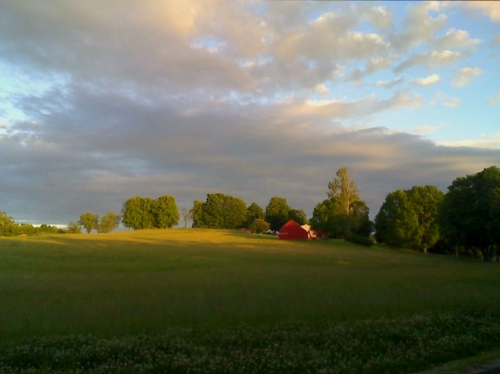
Vignette One
A guy bought a storybook Maine farm in the 1970s with the thought that he'd farm it but now lives on the west coast.
It has an old farmhouse and several fields. There is a small barn and a tractor that he uses to annually cut the fields. He comes to the property for a couple of weeks each summer. He is offering the use of it to a young couple in exchange for labor. He would get skittish whenever the couple wanted to have specificity about what labor, how much labor, what standards they'd be held to, etc. He just wanted it to be a friendly agreement. "Do whatever seems to need to be done. It will be hard for me to say from across the country”.

Slide 34
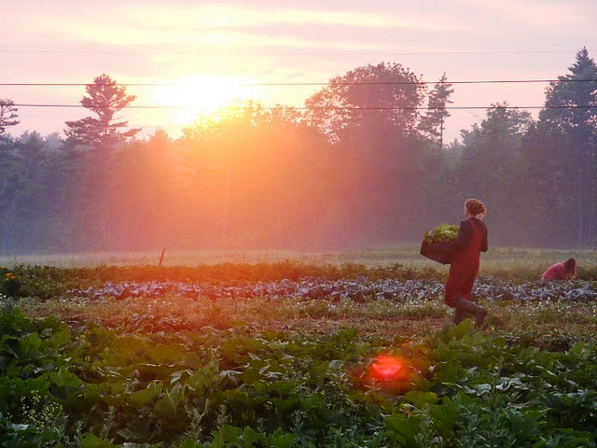
Vignette One
For mediation, I asked the couple where he would stay
during his two weeks and they said in the farmhouse with them. I asked if he
would have any expectations as to how they were keeping the house. Would
they use his furnishings? Move them out and move theirs in? Would a room in
the house be left untouched for his use? Would he mind if his things were taken
off the walls and replace with theirs? What if the rugs got worn or soiled? None
of this was being addressed. I coached them to create a list of such questions
to send him before their first meeting. I also suggested
that they agree with him on an hourly rate for the labor
that they would provide and ask him for a detailed list of
jobs that he'd like to see get done. If other things came
up, they could call or email him before doing the work.
They'd also need to clarify who would pay initially for
supplies and how any reimbursement would be handled
They also would need to agree how they would share the farmhouse during the two weeks each summer.

Slide 35
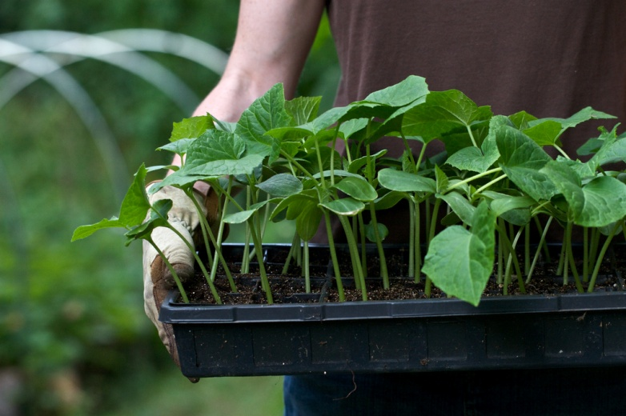
Vignette Two
Nick and Ellen are leasing a cabin on the farm of Leslie and Al. They have the use of an acre of garden land, which has a 17' x 96' greenhouse on it. There are many perennials on the acre that were planted with permaculture practices in mind and Al & Leslie would like for them to be maintained. Nick and Ellen are welcome to harvest these plants and sell the produce from them. Ellen and Nick are welcome to use the tractor with several useful attachments and are expected to help with the maintenance and repair of the machines.

Slide 36
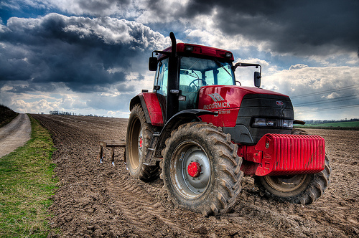
Vignette Two
For mediation, I suggested that keeping up with oil changes, and lubrication would be a fine expectation but that repairs get tricky. They are going to go to a nearby implement dealer that rents out equipment to see what like- new, wonderfully maintained equipment rents for and have agreed that Ellen and Nick will pay one-third that much per hour, keeping an equipment use log in the tractor shed. With this arrangement, Al and Leslie will take care of all repairs. Ellen and Nick will photograph the perennials before they begin farming in order to document their condition (they haven't been properly managed for years).They anticipate that the care of these plantings will take a lot of work their first year, with little yield in produce and are working to budget the time to do the work.

Slide 37
Vignette Three The Background
The Snyder family owns High Acres Farm, 750 acres of tillable farmland, which they use for commercial crops. Multiple generations have farmed it, mostly for potatoes and grain corn. They are in Maine Department of Agriculture, Conservation and Forestry’s Farms for the Future (FfF) program, which they are using to research options for transition to the next generation over the next 5-10 years. Susan is the point person for the family’s dealings with the FfF process. The principal family is made up of Chuck D, his wife Lucy, and their 3 adult children. Chuck D and their son are the general partners in their Limited Partnership (LP), while Lucy and the two daughters are limited partners. Chuck D. and Lucy have been in charge of the High Acres grain corn operation as well as the management of the forested land (approximately 1,000 acres). Chuck D’s nephew, Chuck R, has been farming with Chuck D since 1983. He runs his own heifer operation and is in charge of the High Acres potato operation. Chuck R’s wife, Marion, has retired. The farm consists of 9 parcels of land in two different towns. They do not want to sell development rights to a land trust but do want to preserve the land for agriculture.

Slide 38
Vignette Three The Team
Susan and the DACF assembled a team of advisors:
2 University of Maine Cooperative Extension Educators
1 agronomist
1 note-taker
2 Maine DACF reps, including a soil specialist
1 Land For Good Field Agent
2 NRCS reps
5 members of the Snyder family

Slide 39
Vignette Three The Conversation
A meeting of this team was called to discuss topics such as:
Bringing in new partners
Best use of land and equipment as they currently exist
Other possible use of the land (beef, replacement heifers, solar
installations, etc.)
What is included in a strong farm lease
Ways to make a farm lease support the goals of the landowners
Ways to keep a leasing relationship running smoothly and give
security to both parties
How to structure and direct lease payments (payable to the LP?)
Clarify who (or which entity) owns each parcel

Slide 40
Vignette Three Insights
Do you have any specific thoughts on multiple service providers being at the table when working on complex farm operations?
It was great. We were able to think of the farm family’s complex issues from every conceivable angle, adding ideas others didn't come up with or adding nuance to one another's ideas. It was also good to get affirmation from the other providers about certain ideas. We were able to directly deal with how the various aspects of the project would affect the others.

Slide 41
Vignette Three Insights
Could you speak to how any of the following have been resolved or are in the process of being worked on? Generally speaking, I was called in to add the LFG perspective to the leasing portion of the project. After I'd provided tools and input, my role was over. I don't know what decisions they ended up making.
A meeting of this team was called to discuss topics such as:
Best use of land and equipment as they currently exist - Diversify operations by trying new crops and rotating crops
Other possible use of the land (beef, replacement heifers, solar installations, etc.) - none of this got decided while I was involved but it was all on the table
What is included in a strong farm lease - I think they were going to have the LP be the lessor - as opposed to the senior generation alone. This seemed like a good idea so that the leasing situation will be seamless when the elders stop being involved.
Ways to make a farm lease support the goals of the landowners - Their main goal was to make some income on the parcels that they were not currently using so that they didn't have to sell any land in order to meet the bottom line.
Ways to keep a leasing relationship running smoothly and give security to both parties - Clarifying each party's goals and needs then negotiating honestly and forthrightly - in detail with graphics and carefully chosen language to add to the clarity.
Clarify who (or which entity) owns each parcel - This is simply a matter of going to the registry of deeds to see who owns the parcels currently. Then they might decide to have the LP own some that are currently held privately by individuals.

Slide 42
Other discussion points
Talking about the long term picture
How do you resolve conflict with an organization (who is the landowner that the farmer is leasing from)?
Identity & stewardship
Additional Questions

Slide 43
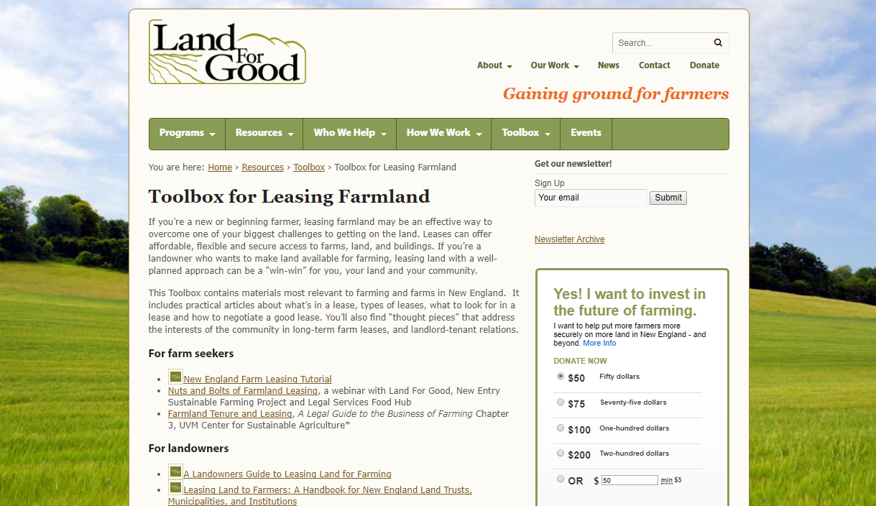
landforgood.org/toolbox

Slide 44
Stay connected!
landforgood.org
Thank You
Cara Cargill
New Hampshire Field Agent
Land For Good
cara@landforgood.org

Slide 45
ACKNOWLEDGEMENT: “This material is based upon work supported by the National Institute of Food and Agriculture, U.S. Department of Agriculture, through the Northeast Sustainable Agriculture Research and Education program under subaward number ONE 17-301.”

