Slide 1
Irrigation Systems The Basics
Prepared by:
Joe Tuquero, Jesse Bamba, Bob Barber, & Mark Acosta
Guam Cooperative Extension Service

Slide 2
Irrigation?
The supply of water to land or crops typically by artificial means.

Slide 3
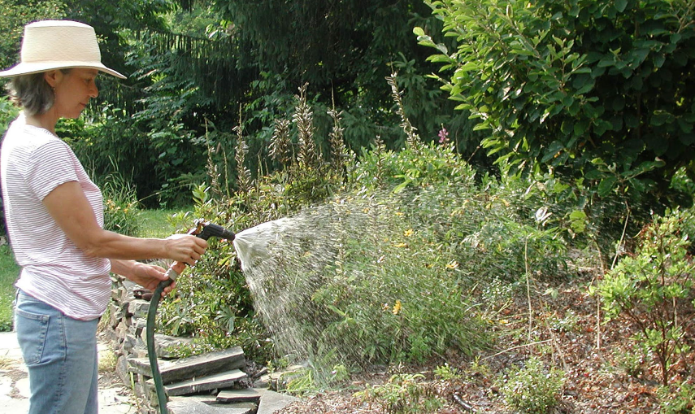
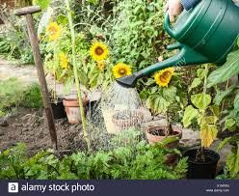
Common Irrigation Techniques
Low-tech Hand Watering
http://www.startribune.com/tools-to-simply-hand-watering-in-the-garden/390014891/
https://www.alamy.com/hand-watering-plants-in-backyard-image276453849.html

Slide 4
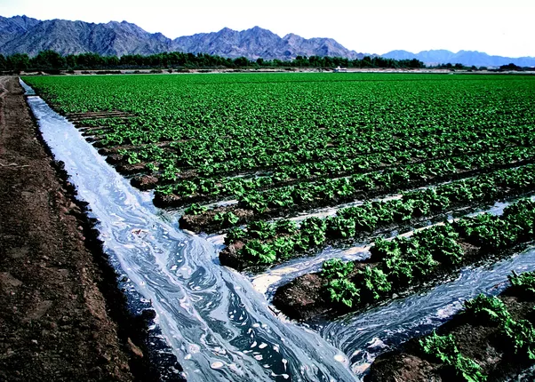
Common Irrigation Techniques
Furrow/Flood irrigation
https://www.quora.com/What-is-the-difference-between-sprinkler-irrigation-and-furrow-irrigation

Slide 5
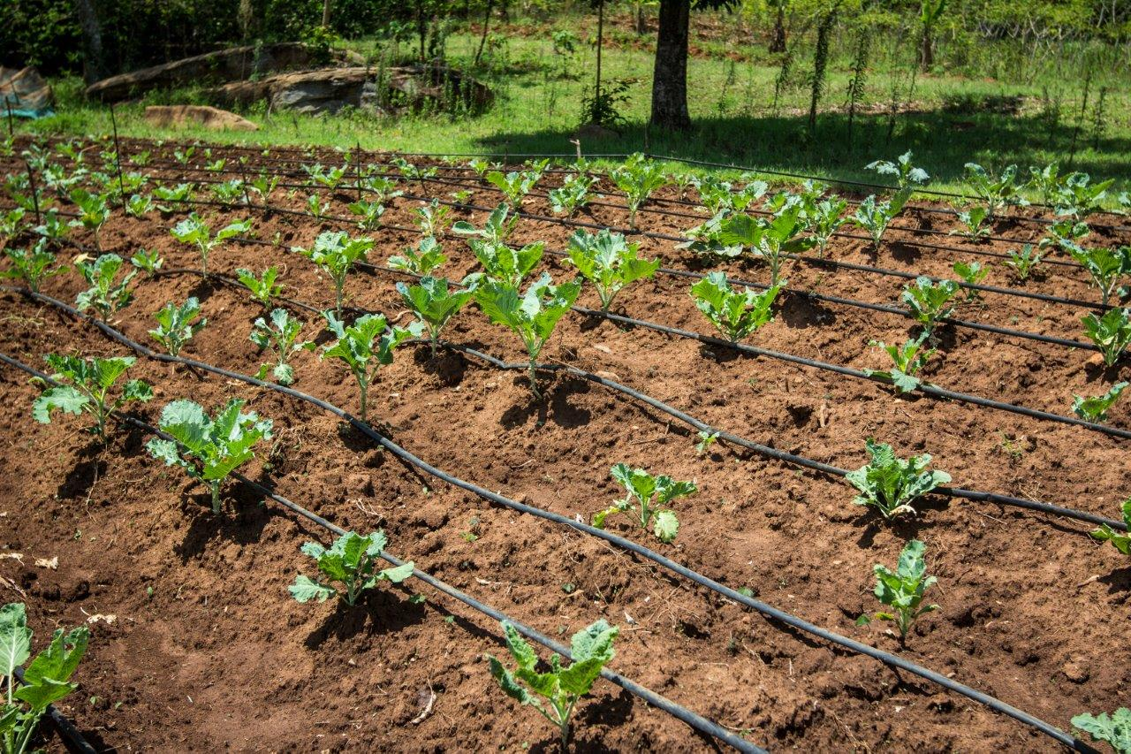
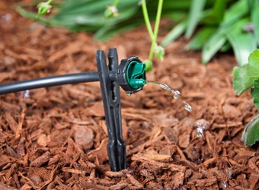
Common Irrigation Techniques
Drip-irrigation
Drip tape / Drip - line
Button emitter / Bubbler
https://www.agrilinks.org/blog/introducing-drip-irrigation-technologies-smallholder-farmers
https://www.dripirrigation.com/1-gph-button-drip-emitter

Slide 6
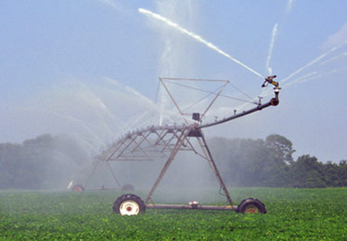
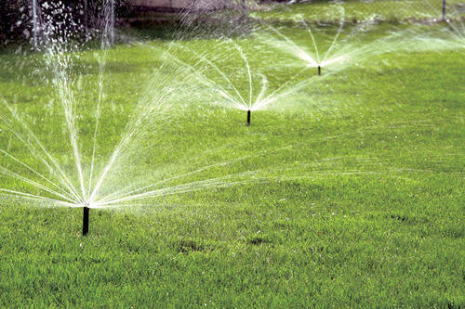
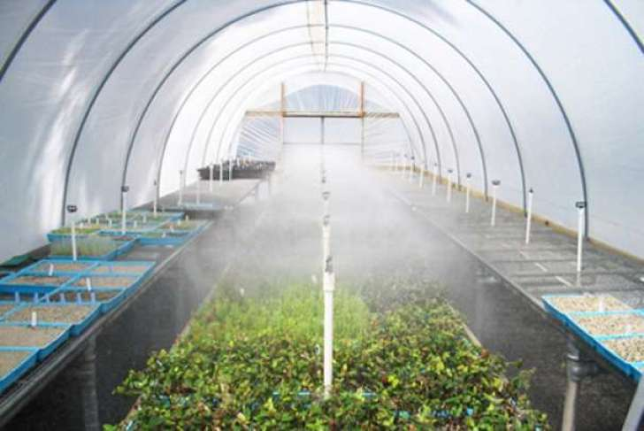
Common Irrigation Techniques
Spray/Sprinkler/Mist Irrigation
https://water.usgs.gov/edu/irsprayhigh.html
https://www.indiamart.com/proddetail/sprinkler-irrigation-system-14061781491.html
https://english.mathrubhumi.com/agriculture/agri-news/keep-plants-cool-with-mist-irrigation-system-english-news-1.1222129

Slide 7
Micro Irrigation
Usually refers to
Drip irrigation
Smaller spray/sprinkler and mist

Slide 8
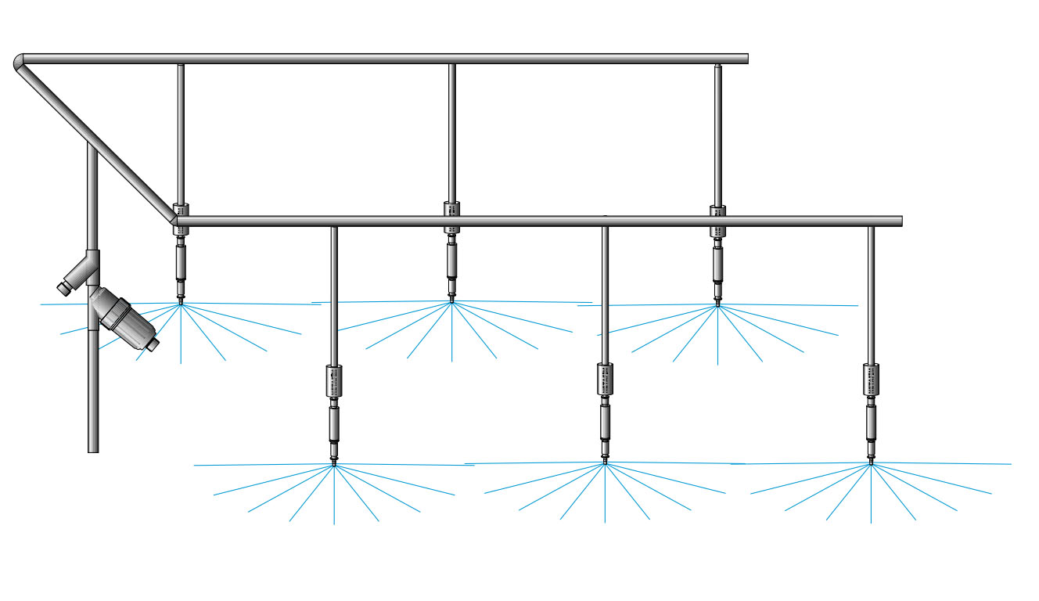
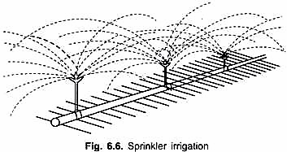
Mist or sprinkler Basic Design
http://cdn.yourarticlelibrary.com/wp-content/uploads/2015/06/image693.png
https://www.aisgreenworks.com.au/water-systems/overhead-sprinklers/#iLightbox[963b385300d8ea72fae]/0

Slide 9
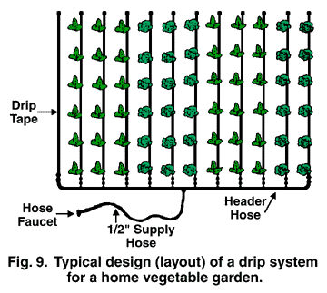
Basic Field Layout of Drip Tape/Bubbler Irrigation System
https://aggie-horticulture.tamu.edu/earthkind/drought/efficient-use-of-water-in-the-garden-and-landscape/

Slide 10
Why Use Drip Irrigation?
Pros:
Even/Accurate watering – Efficient
Improves plant growth and development
Timely mannered watering
Less labor
Reduce water waste/erosions/run-off - Conservation
Cons:
Can be costly up front
Not all parts always ready available in our region
System needs to be maintained and cleaned frequently
Lines get clogged
If not installed correctly contaminants (if used for fertilizing/pesticide application) can enter main waterline

Slide 11
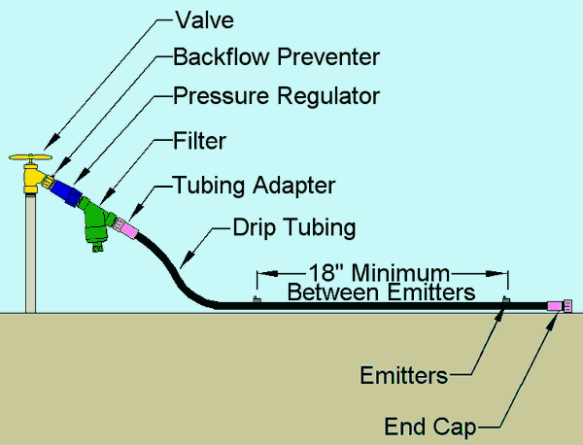
Basic Components of Micro-Irrigation System (Drip and Sprinkler/mist systems)
https://www.irrigationtutorials.com/drip-system-basic-parts-valves-backflow-preventers-filters-tubing-emitters-and-more/

Slide 12
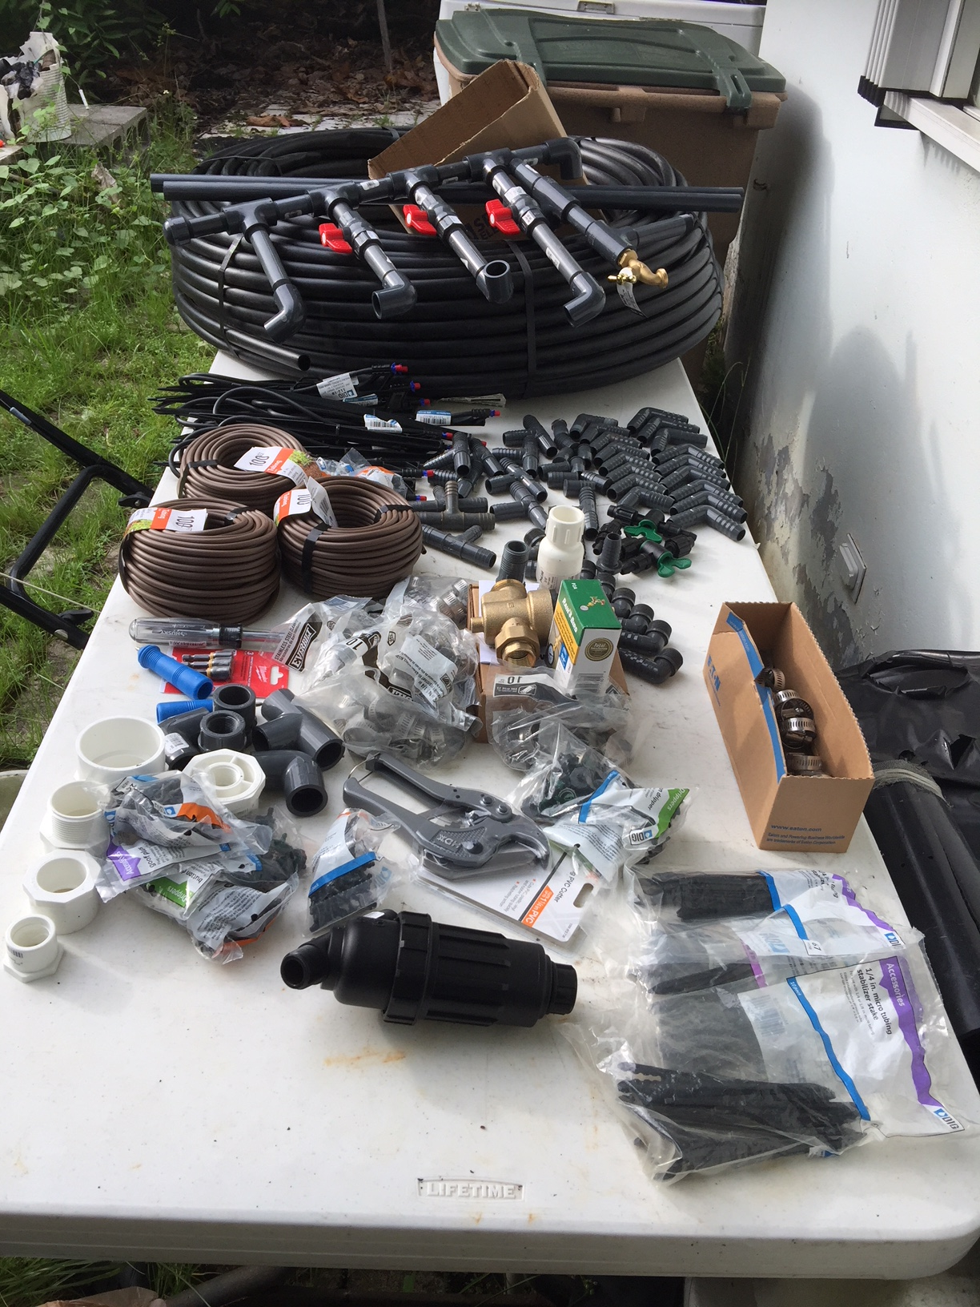
Drip Tape Installation

Slide 13
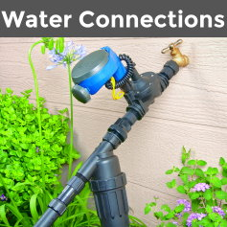
Basic Components of Micro-irrigation Drip-line system (common faucet)
https://www.dripirrigation.com/

Slide 14
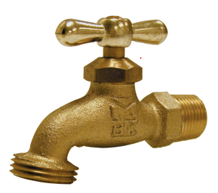
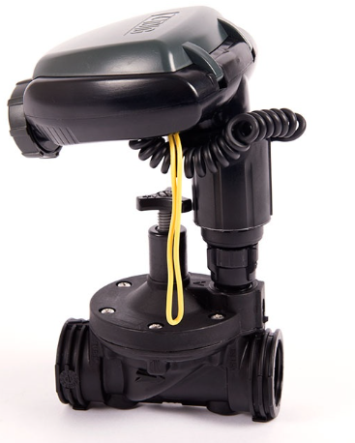
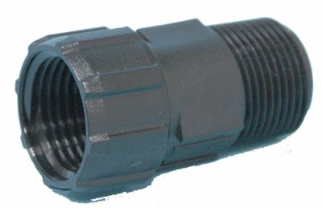
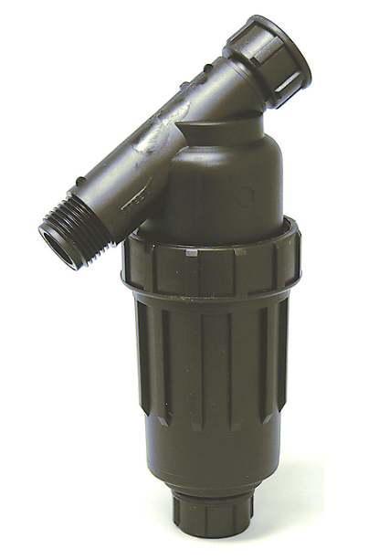
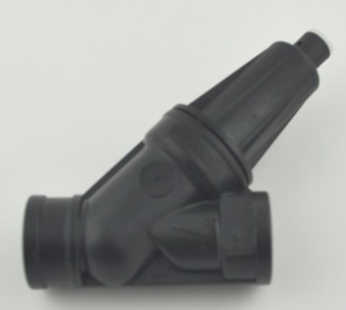
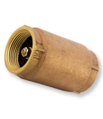
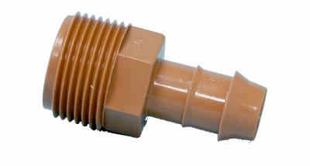
Basic Components of Micro-irrigation Drip-line and Sprinkler system
Spigot / Hose bib faucet / Valve
Hose thread to Pipe thread adaptor
Timer / Controller
Check Valve / Backflow Preventer
Pressure Regulator
Pipe to Polyhose Insert
Filter
https://www.dripirrigation.com/

Slide 15
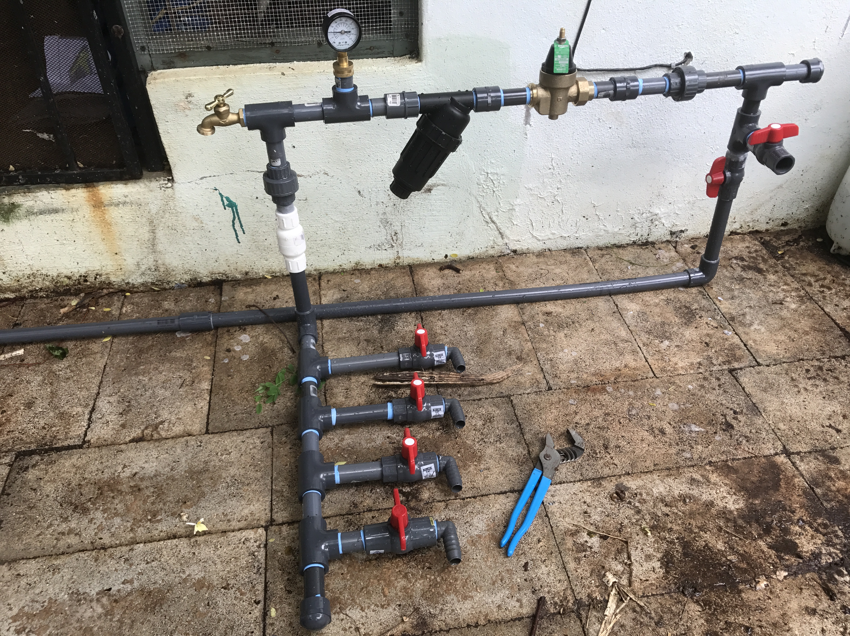
Basic Components of Micro-irrigation Drip-line system (from pipe fitting)

Slide 16
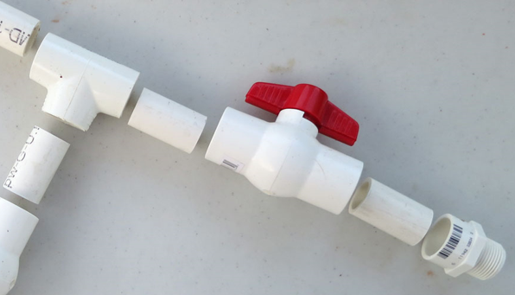
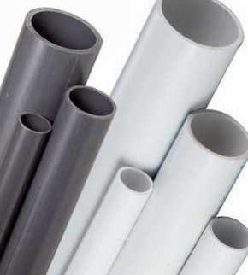
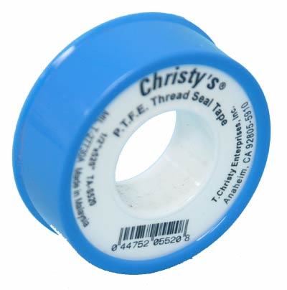
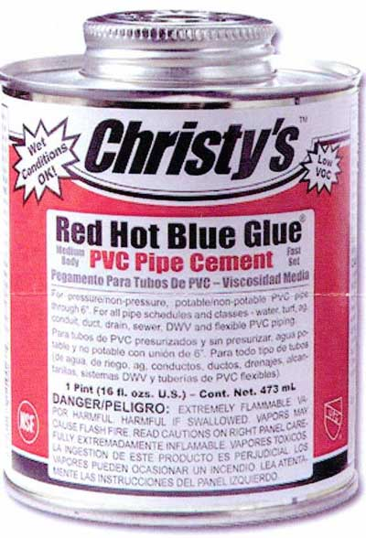
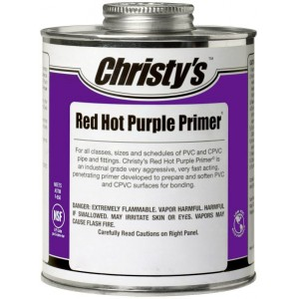
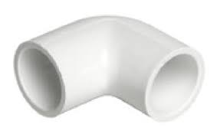
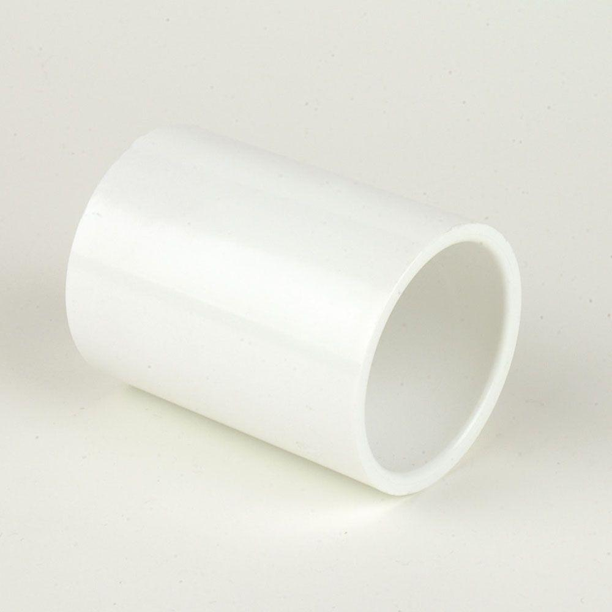
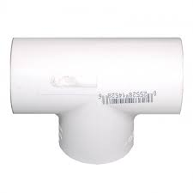
Basic Components of Micro-irrigation Drip-line system (PVC pipe fitting)
Shut-off valve
PVC pipe
Teflon Tape
PVC cement/glue & primer
Tee
90° elbow
Coupling
https://www.dripirrigation.com/

Slide 17
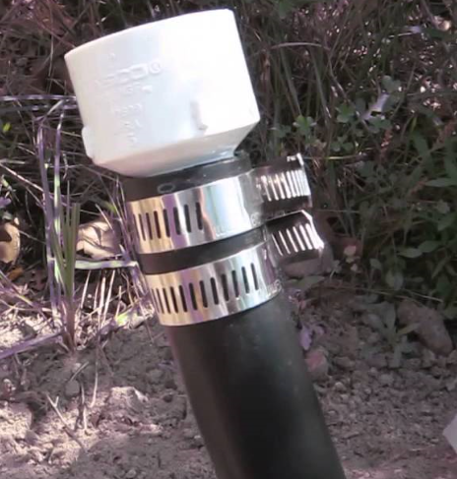
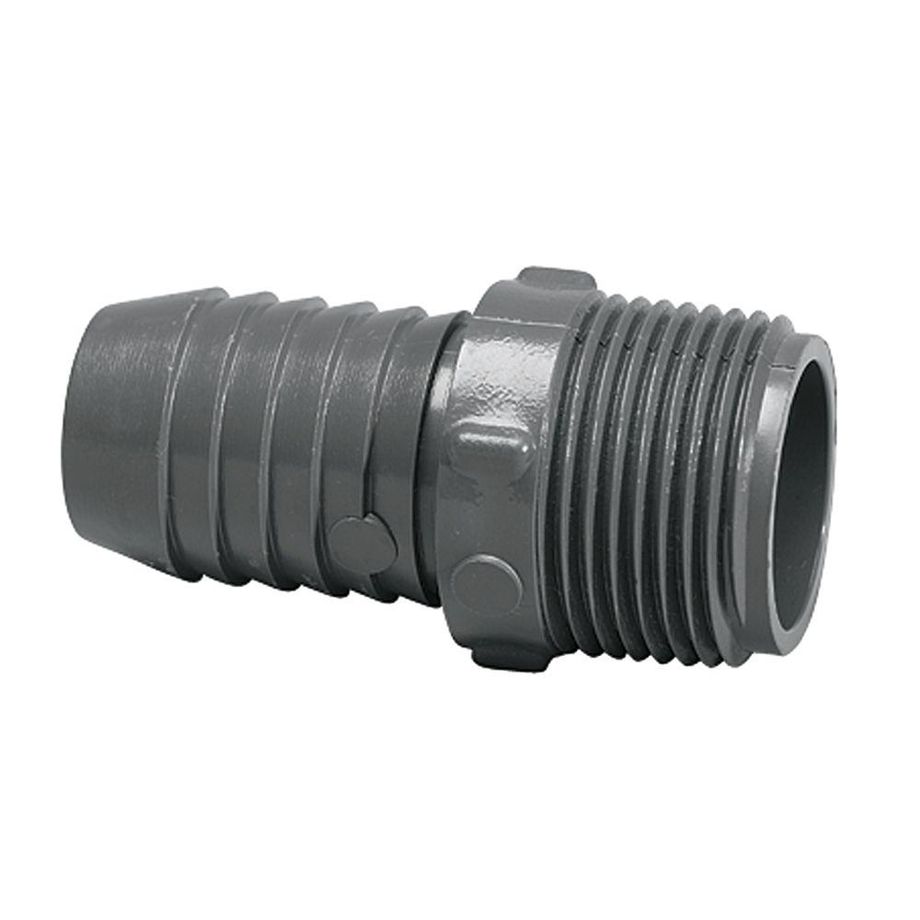
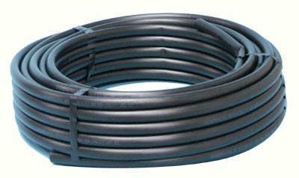
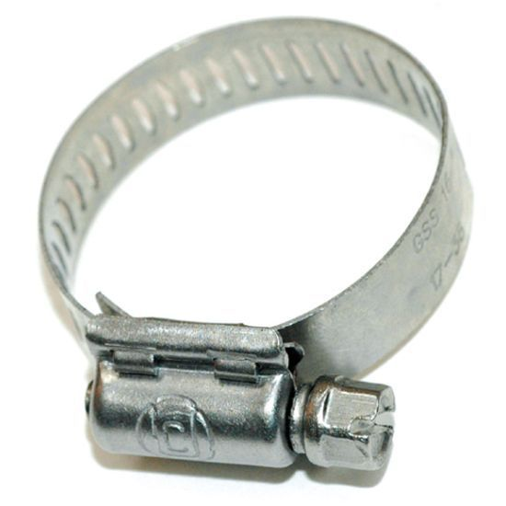
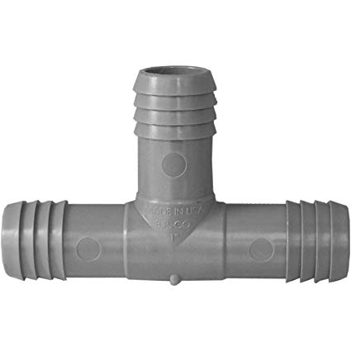
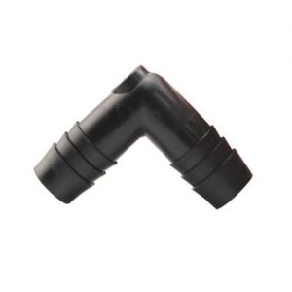
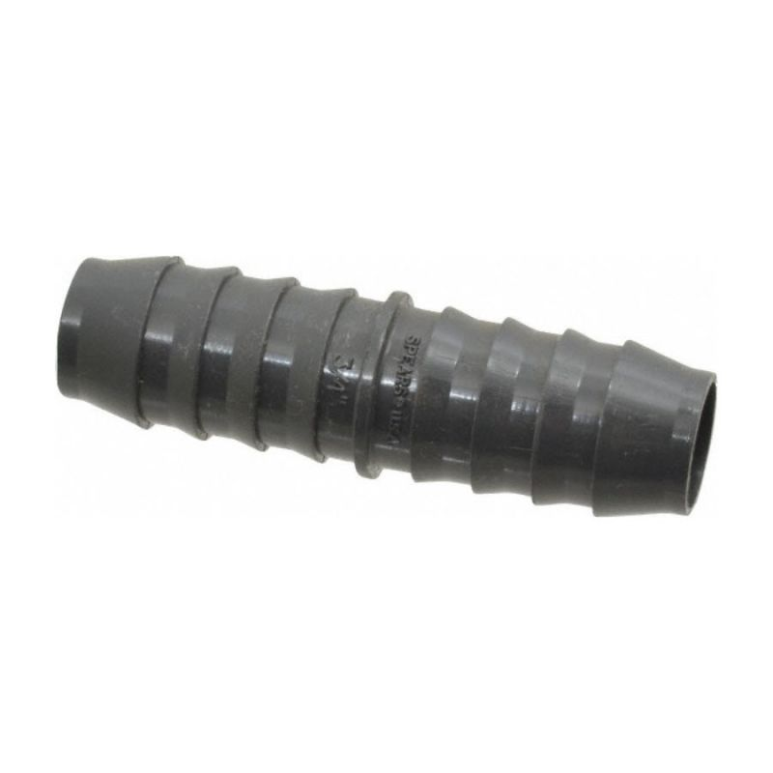
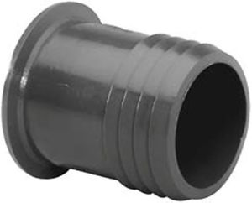
Basic Components of Micro-irrigation Drip and Sprinkler/mist system (water source to sub-main connections)
Pipe to polyhose barbed insert
Hose clamp
Polyhose / Sub main
Polyhose nipple insert / extension
Polyhose elbow insert / extension
Polyhose tee insert / extension
Polyhose end plug
https://www.dripirrigation.com/

Slide 18
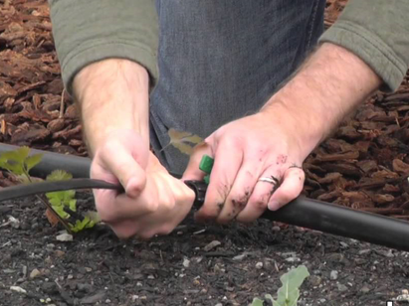
Basic Components of Micro-irrigation Drip line system
(sub-main polyhose to drip line)
https://www.youtube.com/watch?v=iRo5CiKsd_w

Slide 19
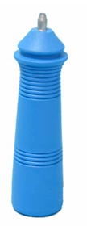
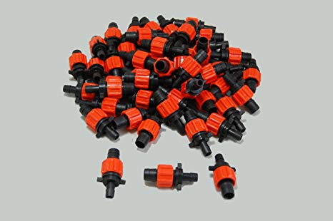
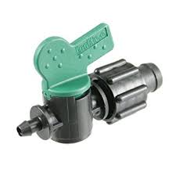
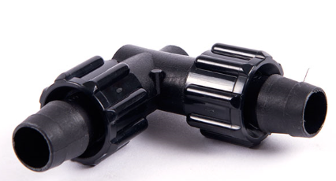
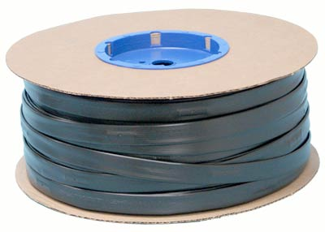
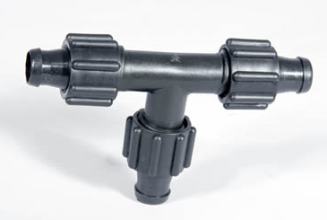
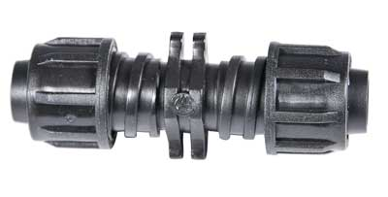
Basic Components of Micro-irrigation Drip line system
(sub-main polyhose to drip line)
Polyhose / Sub main line
Hole puncher
Connectors – Sub main to drip line
Drip tape/line/tube
Drip line extenders/connectors/repair
https://www.dripirrigation.com/

Slide 20
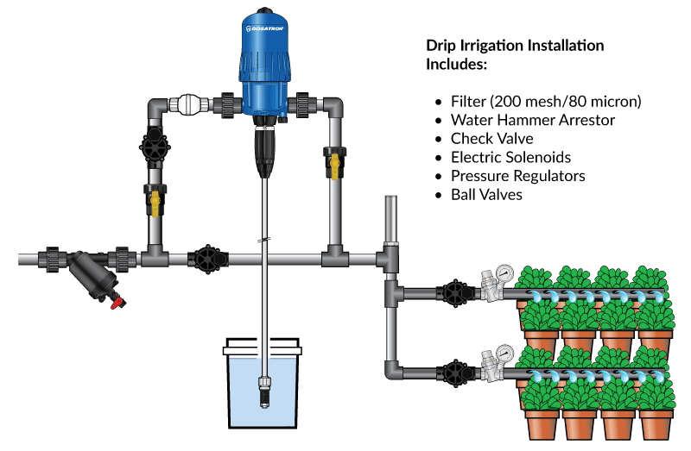
Advanced Micro-irrigation Drip line system
(Fertigator)
https://www.dosatronusa.com/essential_grid/drip-irrigation-installation/

Slide 21
Sustainable Practices Irrigation Management
Drip-irrigation
Even watering
Controllers
Timely watering
Fertigators
Efficient fertilizing

Slide 22
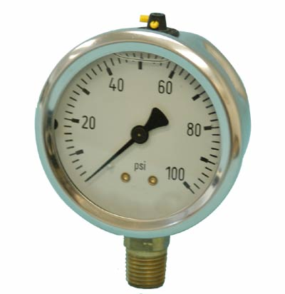
Water Pressure
Pounds per Square Inch (PSI)– measure of water pressure.
Most drip systems work best in the range of 20-40 PSI. Emitter flow rates may slightly fluctuate at different PSI’s
Drip systems will not operate correctly if PSI is too low or too high.
PRESSURE GAUGE – measures PSI
https://www.dripirrigation.com/

Slide 23
Water Pressure
Flow Rate – amount of water that moves through pipes at a given time.
Gallons Per Hour (GPH)
Gallons Per Minute (GPM)
Ensure your Flow Rate from main water source can accommodate your field
Example Question:
Emitters (drippers on drip-line) are spaced 1 ft apart on drip line.
Each emitter drips 0.39 gallons per hour at 20 PSI
PSI measures at 20 from main water pipeline faucet
Your flow rate from main water pipeline faucet is 300 gallons per hour
How many feet of drip line can be accommodated with this Water Pressure?

Slide 24
Emitters (drippers on drip-line) are spaced 1 ft apart on drip line.
Each emitter drips 0.39 gallons per hour at 20 PSI
PSI measures at 20 from main water pipeline faucet
Your flow rate from main water pipeline faucet is 300 gallons per hour
How many feet of drip line can be accommodated with this Water Pressure?
We know that the PSI will accommodate the drip-line to ensure that 0.39 GPH will be emitted from each drip line.
Basic Calculation
300 GPH / 0.39 GPH = 769 ft. of Drip Line
About 769 emitters at 1 ft. apart can be accommodated with this water pressure

Slide 25
Understand the capacity of the type of Drip line you choose
Drip lines are available with different features
some drip lines are designed to be stretched within a certain length before they do NOT operate appropriately to the specifications
Emitter spacings can differ – 4” apart, 8” apart, 12” apart…etc.
Some dripline emitter GPH may fluctuate with PSI
Some dripline offer even watering despite change in terrain and PSI (Pressure Compensating). Some don’t.

Slide 26
KEY Concepts to successful Drip Line installation and operation
Proper parts (including repair parts) and sizes for desired Drip-line system
Proper tools
Understanding Water Pressure (PSI & Flow Rate) and drip-line requirements and capacity

Slide 27
Disclaimer Mention of a company or organization is to provide an example and is not an endorsement or recommenda­tion in preference to others that may also be suitable.

