Slide 1
Mobile Unit Survey 1-21-20
SARE Mobile Unit
January 21st 2020, 11:59 am MST

Slide 2
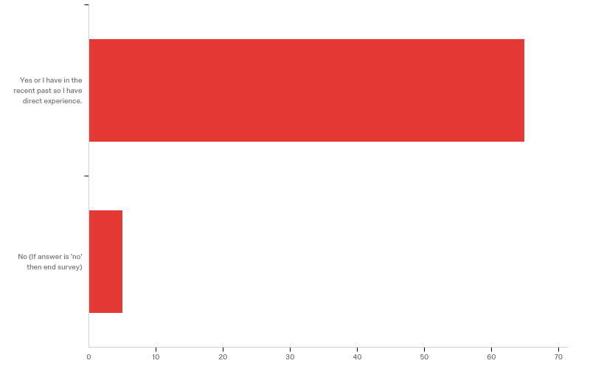
1 - Do you rotationally graze cattle?

Slide 3
1 - Do you rotationally graze cattle?
# | Field | Minimum | Maximum | Mean | Std Deviation | Variance | Count
1 | Do you rotationally graze cattle? | 1.00 | 3.00 | 1.14 | 0.52 | 0.27 | 70

Slide 4
1 - Do you rotationally graze cattle?
# | Answer | % | Count
1 | Yes or I have in the recent past so I have direct experience. | 92.86% | 65
3 | No (If answer is 'no' then end survey) | 7.14% | 5
 | Total | 100% | 70

Slide 5
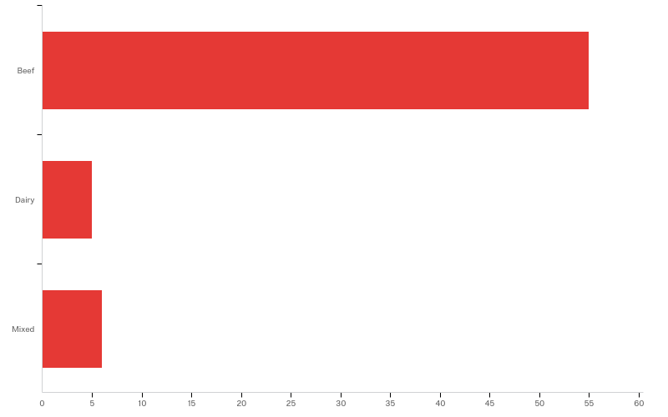
2 - Do you graze beef or dairy cows?

Slide 6
2 - Do you graze beef or dairy cows?
# | Field | Minimum | Maximum | Mean | Std Deviation | Variance | Count
1 | Do you graze beef or dairy cows? | 1.00 | 3.00 | 1.26 | 0.61 | 0.37 | 66

Slide 7
2 - Do you graze beef or dairy cows?
# | Answer | % | Count
1 | Beef | 83.33% | 55
2 | Dairy | 7.58% | 5
3 | Mixed | 9.09% | 6
 | Total | 100% | 66

Slide 8
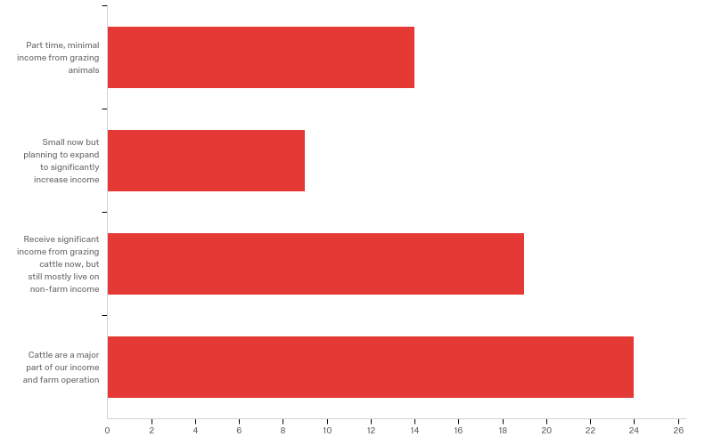
3 - Classify your grazing operation.

Slide 9
3 - Classify your grazing operation.
# | Field | Minimum | Maximum | Mean | Std Deviation | Variance | Count
1 | Classify your grazing operation. | 1.00 | 4.00 | 2.80 | 1.14 | 1.31 | 66

Slide 10
3 - Classify your grazing operation.
# | Answer | % | Count
1 | Part time, minimal income from grazing animals | 21.21% | 14
2 | Small now but planning to expand to significantly increase income | 13.64% | 9
3 | Receive significant income from grazing cattle now, but still mostly live on non-farm income | 28.79% | 19
4 | Cattle are a major part of our income and farm operation | 36.36% | 24
 | Total | 100% | 66

Slide 11
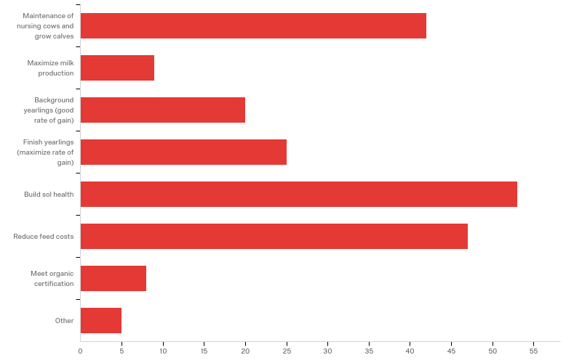
4 - What is your goal of grazing? Check (click) all that apply.

Slide 12
4 - What is your goal of grazing? Check (click) all that apply.
# | Answer | % | Count
1 | Maintenance of nursing cows and grow calves | 20.10% | 42
2 | Maximize milk production | 4.31% | 9
3 | Background yearlings (good rate of gain) | 9.57% | 20
4 | Finish yearlings (maximize rate of gain) | 11.96% | 25
5 | Build sol health | 25.36% | 53
6 | Reduce feed costs | 22.49% | 47
7 | Meet organic certification | 3.83% | 8

Slide 13
4 - What is your goal of grazing? Check (click) all that apply.
# | Answer | % | Count
8 | Other | 2.39% | 5
 | Total | 100% | 209

Slide 14
4 - What is your goal of grazing? Check (click) all that apply.
4_8_TEXT - Other
Other - Text
Maximize profit - this is different than max milk production. When will extension switch terminology?
It's best for my land situation
Wild Life, Consumer Education,
utilize crop nresidue from harvest without much machinery expense and labor
Utilize our land assets as a way of raising dairy heifers

Slide 15
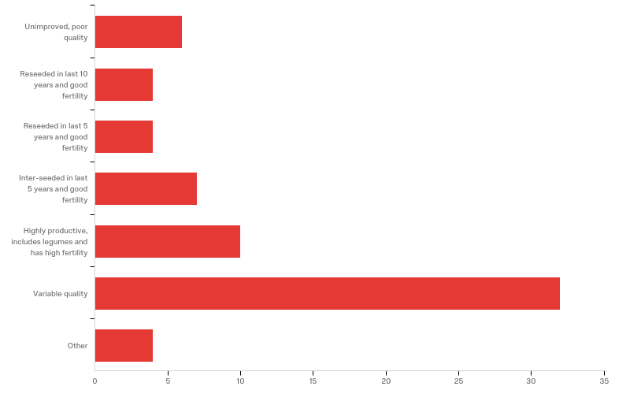
5 - How would you classify your pastures?

Slide 16
5 - How would you classify your pastures?
# | Field | Minimum | Maximum | Mean | Std Deviation | Variance | Count
1 | How would you classify your pastures? - Selected Choice | 1.00 | 7.00 | 4.84 | 1.73 | 3.00 | 67

Slide 17
5 - How would you classify your pastures?
# | Answer | % | Count
1 | Unimproved, poor quality | 8.96% | 6
2 | Reseeded in last 10 years and good fertility | 5.97% | 4
3 | Reseeded in last 5 years and good fertility | 5.97% | 4
4 | Inter-seeded in last 5 years and good fertility | 10.45% | 7
5 | Highly productive, includes legumes and has high fertility | 14.93% | 10
6 | Variable quality | 47.76% | 32

Slide 18
5 - How would you classify your pastures?
# | Answer | % | Count
7 | Other | 5.97% | 4
 | Total | 100% | 67

Slide 19
5 - How would you classify your pastures?
5_7_TEXT - Other
Other - Text
We Bale Graze in the winter. We have pastures that are Highly to medium, Most have be reseeded in the last 10. We are building soil
Need some reseeding to get more diversity and have some fertility issues on certain paddocks.
have variabilityn as have original prairie and interseeded and planted sections of pasture
All of the above

Slide 20
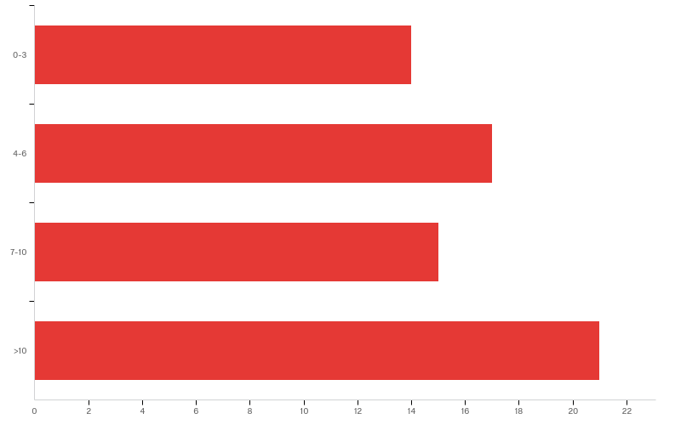
6 - How many years have you been rotationally grazing?

Slide 21
6 - How many years have you been rotationally grazing?
# | Field | Minimum | Maximum | Mean | Std Deviation | Variance | Count
1 | How many years have you been rotationally grazing? | 1.00 | 4.00 | 2.64 | 1.13 | 1.27 | 67

Slide 22
6 - How many years have you been rotationally grazing?
# | Answer | % | Count
1 | 0-3 | 20.90% | 14
2 | 4-6 | 25.37% | 17
3 | 7-10 | 22.39% | 15
4 | >10 | 31.34% | 21
 | Total | 100% | 67

Slide 23
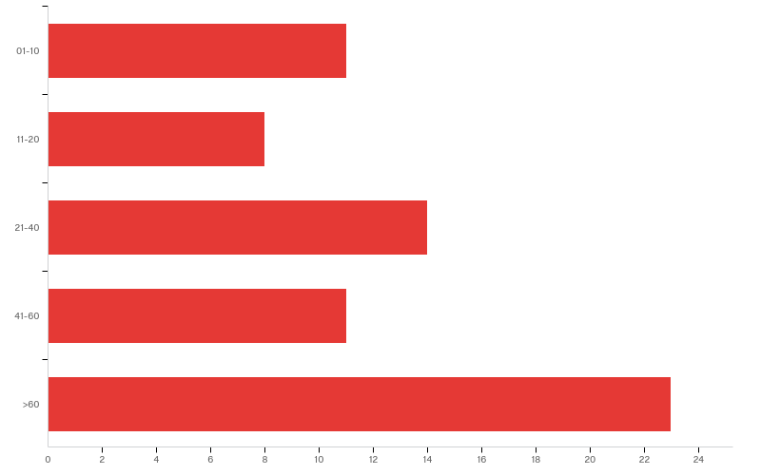
7 - Number of cows or yearlings or total of both? (do not count nursing calves.)

Slide 24
7 - Number of cows or yearlings or total of both? (do not count nursing calves.)
# | Field | Minimum | Maximum | Mean | Std Deviation | Variance | Count
1 | Number of cows or yearlings or total of both? (do not count nursing calves.) | 1.00 | 5.00 | 3.40 | 1.47 | 2.15 | 67

Slide 25
7 - Number of cows or yearlings or total of both? (do not count nursing calves.)
# | Answer | % | Count
1 | 01-10 | 16.42% | 11
2 | 11-20 | 11.94% | 8
3 | 21-40 | 20.90% | 14
4 | 41-60 | 16.42% | 11
5 | >60 | 34.33% | 23
 | Total | 100% | 67

Slide 26
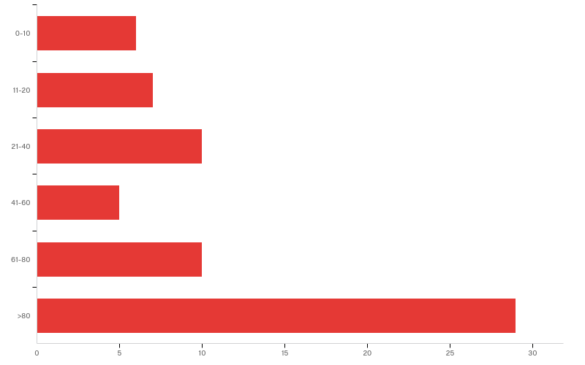
8 - Number of pasture acres.

Slide 27
8 - Number of pasture acres.
# | Field | Minimum | Maximum | Mean | Std Deviation | Variance | Count
1 | Number of pasture acres. | 1.00 | 6.00 | 4.39 | 1.76 | 3.10 | 67

Slide 28
8 - Number of pasture acres.
# | Answer | % | Count
1 | 0-10 | 8.96% | 6
2 | 11-20 | 10.45% | 7
3 | 21-40 | 14.93% | 10
4 | 41-60 | 7.46% | 5
5 | 61-80 | 14.93% | 10
6 | >80 | 43.28% | 29
 | Total | 100% | 67

Slide 29
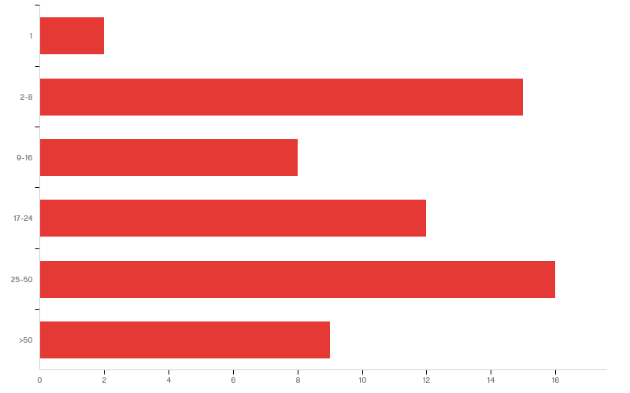
9 - Number of paddocks (pasture subdivisions.)

Slide 30
9 - Number of paddocks (pasture subdivisions.)
# | Field | Minimum | Maximum | Mean | Std Deviation | Variance | Count
1 | Number of paddocks (pasture subdivisions.) | 1.00 | 6.00 | 3.84 | 1.48 | 2.20 | 62

Slide 31
9 - Number of paddocks (pasture subdivisions.)
# | Answer | % | Count
1 | 1 | 3.23% | 2
2 | 2-8 | 24.19% | 15
3 | 9-16 | 12.90% | 8
4 | 17-24 | 19.35% | 12
5 | 25-50 | 25.81% | 16
6 | >50 | 14.52% | 9
 | Total | 100% | 62

Slide 32
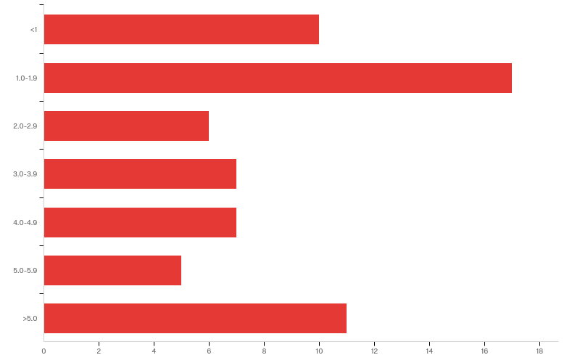
10 - Size of paddocks (acres.) They may change during the season but what it your average paddock size.

Slide 33
10 - Size of paddocks (acres.) They may change during the season but what it your average paddock size.
# | Field | Minimum | Maximum | Mean | Std Deviation | Variance | Count
1 | Size of paddocks (acres.) They may change during the season but what it your average paddock size. | 1.00 | 7.00 | 3.68 | 2.12 | 4.50 | 63

Slide 34
10 - Size of paddocks (acres.) They may change during the season but what it your average paddock size.
# | Answer | % | Count
1 | <1 | 15.87% | 10
2 | 1.0-1.9 | 26.98% | 17
3 | 2.0-2.9 | 9.52% | 6
4 | 3.0-3.9 | 11.11% | 7
5 | 4.0-4.9 | 11.11% | 7
6 | 5.0-5.9 | 7.94% | 5
7 | >5.0 | 17.46% | 11
 | Total | 100% | 63

Slide 35
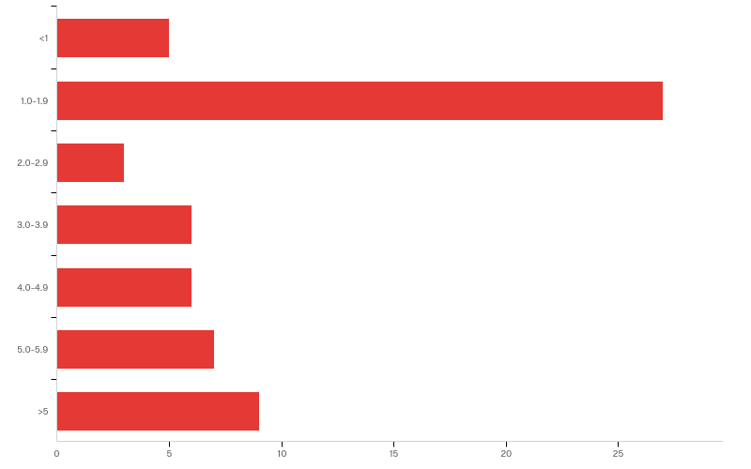
11 - Average number of days between paddock moves (~number of days in a paddock.)

Slide 36
11 - Average number of days between paddock moves (~number of days in a paddock.)
# | Field | Minimum | Maximum | Mean | Std Deviation | Variance | Count
1 | Average number of days between paddock moves (~number of days in a paddock.) | 1.00 | 7.00 | 3.60 | 2.04 | 4.14 | 63

Slide 37
11 - Average number of days between paddock moves (~number of days in a paddock.)
# | Answer | % | Count
1 | <1 | 7.94% | 5
2 | 1.0-1.9 | 42.86% | 27
3 | 2.0-2.9 | 4.76% | 3
4 | 3.0-3.9 | 9.52% | 6
5 | 4.0-4.9 | 9.52% | 6
6 | 5.0-5.9 | 11.11% | 7
7 | >5 | 14.29% | 9
 | Total | 100% | 63

Slide 38
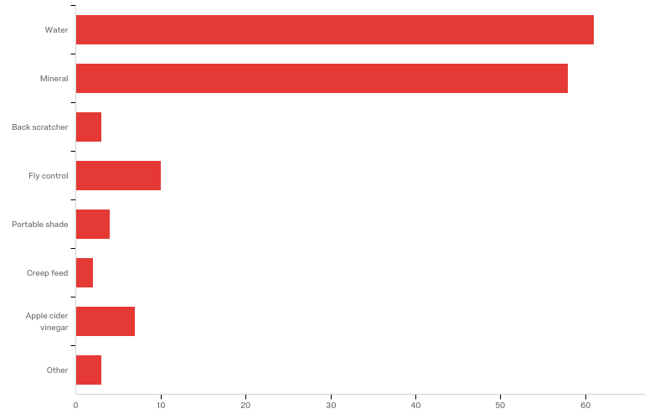
12 - What are you providing for cattle and calves in each paddock, check all that apply. .

Slide 39
12 - What are you providing for cattle and calves in each paddock, check all that apply. .
# | Answer | % | Count
1 | Water | 41.22% | 61
2 | Mineral | 39.19% | 58
3 | Back scratcher | 2.03% | 3
4 | Fly control | 6.76% | 10
5 | Portable shade | 2.70% | 4
6 | Creep feed | 1.35% | 2
7 | Apple cider vinegar | 4.73% | 7
8 | Other | 2.03% | 3
 | Total | 100% | 148

Slide 40
12 - What are you providing for cattle and calves in each paddock, check all that apply. .
12_8_TEXT - Other
Other - Text
salt, dried kelp
supplemental hay at times and cuttiong, spray for weed control and added fertility for grass growth supplementation
Windbreaks

Slide 41
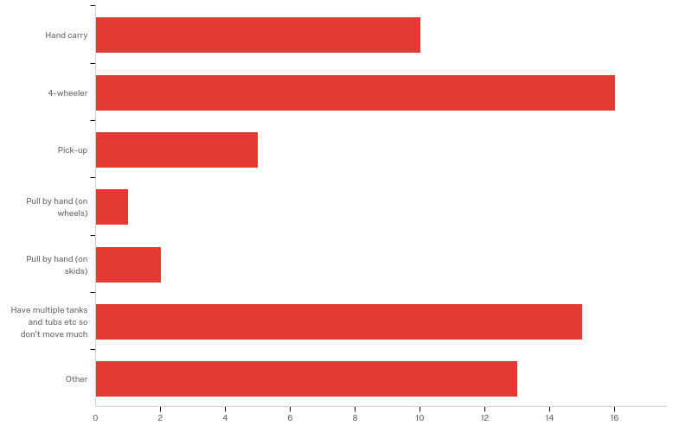
13 - How do you move these items now?

Slide 42
13 - How do you move these items now?
# | Field | Minimum | Maximum | Mean | Std Deviation | Variance | Count
1 | How do you move these items now? - Selected Choice | 1.00 | 7.00 | 4.06 | 2.33 | 5.45 | 62

Slide 43
13 - How do you move these items now?
# | Answer | % | Count
1 | Hand carry | 16.13% | 10
2 | 4-wheeler | 25.81% | 16
3 | Pick-up | 8.06% | 5
4 | Pull by hand (on wheels) | 1.61% | 1
5 | Pull by hand (on skids) | 3.23% | 2
6 | Have multiple tanks and tubs etc so don't move much | 24.19% | 15
7 | Other | 20.97% | 13
 | Total | 100% | 62

Slide 44
13 - How do you move these items now?
13_7_TEXT - Other
Other - Text
loader tractor and 4-wheeler
Cows can walk back to the feedlot from several pastures...
Have 2,500 ft of waterline which provides for most paddocks, and mineral change with 4 wheeler
make a single pathway connecting between all paddocs that leads to waterer and mineral and shelter
Water is small tank that is hand carried and minerals are pulled by ATV
We have water Lines for troughs but move the minerals with a tractor
hand, pickup and tractor with and without trailer
Have multiple tanks, pull mineral feeder with 4-wheeler
Drag with golf cart and by hand depending on distance and access.
water lines movable tanks

Slide 45
13 - How do you move these items now?
13_7_TEXT - Other
Other - Text
Tractor
Because our dairy cows move so often and return to the buildings to be milked, they don't normally have access to minerals, portable shade or moveable water in paddocks
main water line with connections to floats in small tanks

Slide 46
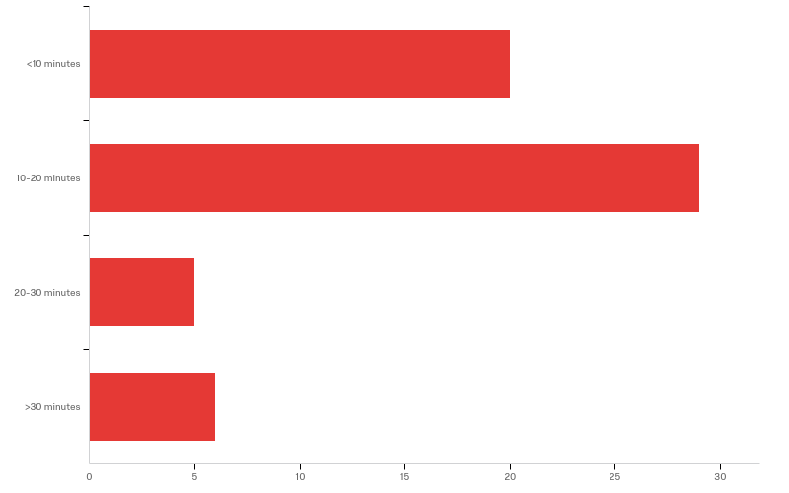
14 - How long does it take you to move items from each paddock?

Slide 47
14 - How long does it take you to move items from each paddock?
# | Field | Minimum | Maximum | Mean | Std Deviation | Variance | Count
1 | How long does it take you to move items from each paddock? | 1.00 | 4.00 | 1.95 | 0.90 | 0.81 | 60

Slide 48
14 - How long does it take you to move items from each paddock?
# | Answer | % | Count
1 | <10 minutes | 33.33% | 20
2 | 10-20 minutes | 48.33% | 29
3 | 20-30 minutes | 8.33% | 5
4 | >30 minutes | 10.00% | 6
 | Total | 100% | 60

Slide 49
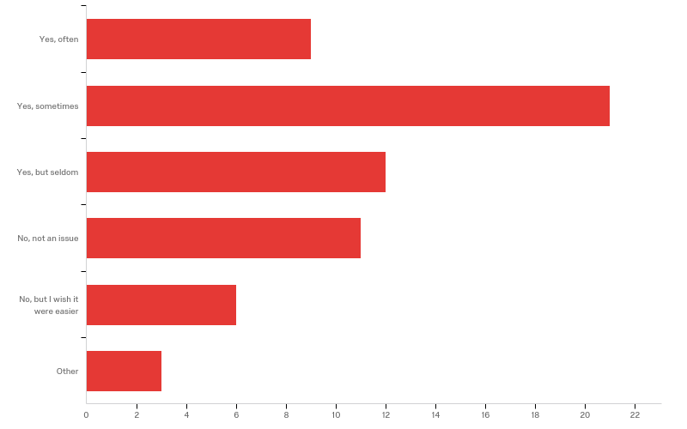
15 - Does the hassle of moving items tempt you to move cattle less than the ideal or to compromise by leaving back gates open so cattle can get back to water or you are using other less than ideal shortcuts?

Slide 50
15 - Does the hassle of moving items tempt you to move cattle less than the ideal or to compromise by leaving back gates open so cattle can get back to water or you are using other less than ideal shortcuts?
# | Field | Minimum | Maximum | Mean | Std Deviation | Variance | Count
1 | Does the hassle of moving items tempt you to move cattle less than the ideal or to compromise by leaving back gates open so cattle can get back to water or you are using other less than ideal shortcuts? - Selected Choice | 1.00 | 6.00 | 2.89 | 1.38 | 1.91 | 62

Slide 51
15 - Does the hassle of moving items tempt you to move cattle less than the ideal or to compromise by leaving back gates open so cattle can get back to water or you are using other less than ideal shortcuts?
# | Answer | % | Count
1 | Yes, often | 14.52% | 9
2 | Yes, sometimes | 33.87% | 21
3 | Yes, but seldom | 19.35% | 12
4 | No, not an issue | 17.74% | 11
5 | No, but I wish it were easier | 9.68% | 6
6 | Other | 4.84% | 3
 | Total | 100% | 62

Slide 52
15 - Does the hassle of moving items tempt you to move cattle less than the ideal or to compromise by leaving back gates open so cattle can get back to water or you are using other less than ideal shortcuts?
15_6_TEXT - Other
Other - Text
No, but I’d like mobile shade
No, I move water or have setup for next. The mineral may follow a day late to the next pasture
No, we could certainly graze better if we had a watering system

Slide 53
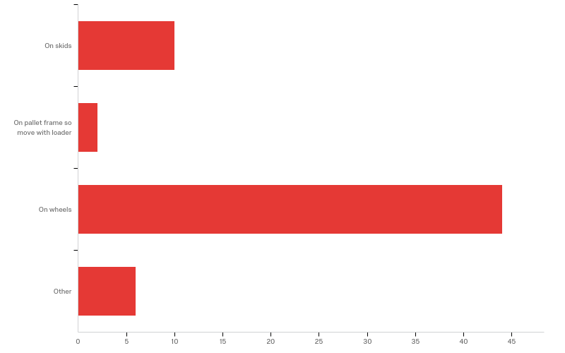
16 - If a mobile unit contained water, mineral etc how would you prefer it be transportable?

Slide 54
16 - If a mobile unit contained water, mineral etc how would you prefer it be transportable?
# | Field | Minimum | Maximum | Mean | Std Deviation | Variance | Count
1 | If a mobile unit contained water, mineral etc how would you prefer it be transportable? - Selected Choice | 1.00 | 4.00 | 2.74 | 0.84 | 0.71 | 62

Slide 55
16 - If a mobile unit contained water, mineral etc how would you prefer it be transportable?
# | Answer | % | Count
1 | On skids | 16.13% | 10
2 | On pallet frame so move with loader | 3.23% | 2
3 | On wheels | 70.97% | 44
4 | Other | 9.68% | 6
 | Total | 100% | 62

Slide 56
16 - If a mobile unit contained water, mineral etc how would you prefer it be transportable?
16_4_TEXT - Other
Other - Text
wheels or pallet frame
not interested. my system works just fine
self propelled (single unit that's movable from the pasture without use of different equipment -Electric or gas/diesel engine - Can be hooked up to machinery incase the motor on the mobile unit does not work
The minerals is currently on Skids. The water is a 25 Gallon tank. I would prefer skids or wheels
I have ideas for a self-propelled on wheels mobile unit

Slide 57
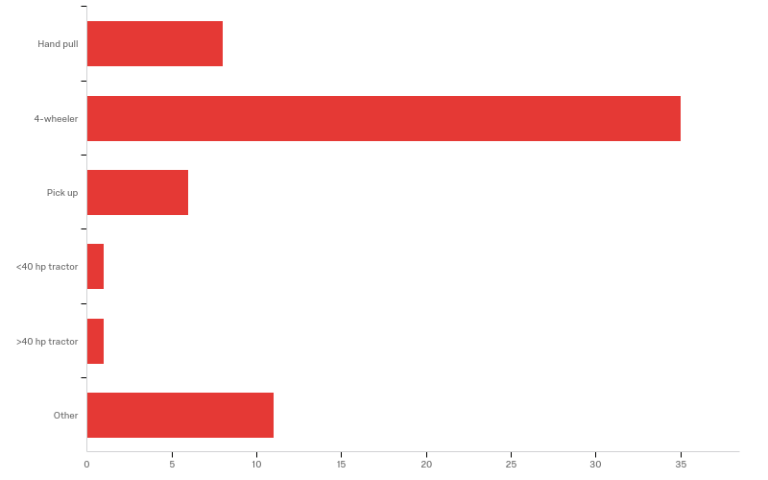
17 - How would you want to transport it?

Slide 58
17 - How would you want to transport it?
# | Field | Minimum | Maximum | Mean | Std Deviation | Variance | Count
1 | How would you want to transport it? - Selected Choice | 1.00 | 6.00 | 2.76 | 1.64 | 2.70 | 62

Slide 59
17 - How would you want to transport it?
# | Answer | % | Count
1 | Hand pull | 12.90% | 8
2 | 4-wheeler | 56.45% | 35
3 | Pick up | 9.68% | 6
4 | <40 hp tractor | 1.61% | 1
5 | >40 hp tractor | 1.61% | 1
6 | Other | 17.74% | 11
 | Total | 100% | 62

Slide 60
17 - How would you want to transport it?
17_6_TEXT - Other
Other - Text
4-wheeler or small tractor
Hand pull or 4-wheeler
no need to answer
self propelled
4 wheeler or an old riding lawn mower
skid steer
Electric solar powered which would also run the fencer any any other power demands you may have
pickup and or small tractor
Golf cart and by hand if needed
It would be great to have the option of how to move it
Truck or tractor

Slide 61
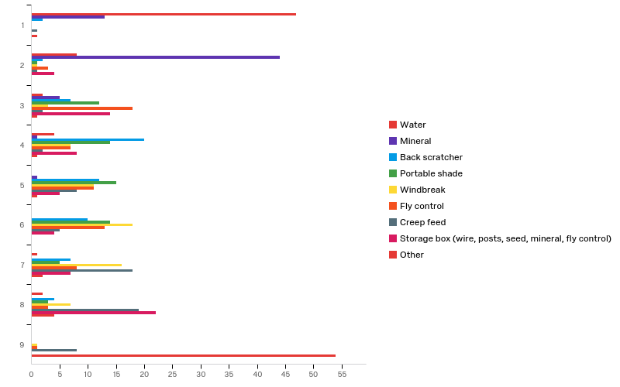
18 - What are you most likely to provide in each paddock on a mobile unit, Rank from 1 to 8 or 9. Drag and Drop.

Slide 62
18 - What are you most likely to provide in each paddock on a mobile unit, Rank from 1 to 8 or 9. Drag and Drop.
# | Field | Minimum | Maximum | Mean | Std Deviation | Variance | Count
1 | Water | 1.00 | 8.00 | 1.69 | 1.56 | 2.43 | 64
2 | Mineral | 1.00 | 5.00 | 1.95 | 0.69 | 0.48 | 64
3 | Back scratcher | 1.00 | 8.00 | 4.81 | 1.63 | 2.65 | 64
4 | Portable shade | 2.00 | 8.00 | 4.88 | 1.43 | 2.05 | 64
5 | Windbreak | 2.00 | 9.00 | 5.92 | 1.45 | 2.10 | 64
6 | Fly control | 2.00 | 9.00 | 4.84 | 1.73 | 3.01 | 64
7 | Creep feed | 1.00 | 9.00 | 6.83 | 1.75 | 3.08 | 64
8 | Storage box (wire, posts, seed, mineral, fly control) | 2.00 | 8.00 | 5.56 | 2.20 | 4.84 | 64

Slide 63
18 - What are you most likely to provide in each paddock on a mobile unit, Rank from 1 to 8 or 9. Drag and Drop.
# | Field | Minimum | Maximum | Mean | Std Deviation | Variance | Count
9 | Other | 1.00 | 9.00 | 8.52 | 1.47 | 2.16 | 64

Slide 64
18 - What are you most likely to provide in each paddock on a mobile unit, Rank from 1 to 8 or 9. Drag and Drop.
# | Question | 1 |  | 2 |  | 3 |  | 4 |  | 5 |  | 6 |  | 7 |  | 8 |  | 9 |  | Total
1 | Water | 73.44% | 47 | 12.50% | 8 | 3.13% | 2 | 6.25% | 4 | 0.00% | 0 | 0.00% | 0 | 1.56% | 1 | 3.13% | 2 | 0.00% | 0 | 64
2 | Mineral | 20.31% | 13 | 68.75% | 44 | 7.81% | 5 | 1.56% | 1 | 1.56% | 1 | 0.00% | 0 | 0.00% | 0 | 0.00% | 0 | 0.00% | 0 | 64
3 | Back scratcher | 3.13% | 2 | 3.13% | 2 | 10.94% | 7 | 31.25% | 20 | 18.75% | 12 | 15.63% | 10 | 10.94% | 7 | 6.25% | 4 | 0.00% | 0 | 64
4 | Portable shade | 0.00% | 0 | 1.56% | 1 | 18.75% | 12 | 21.88% | 14 | 23.44% | 15 | 21.88% | 14 | 7.81% | 5 | 4.69% | 3 | 0.00% | 0 | 64
5 | Windbreak | 0.00% | 0 | 1.56% | 1 | 4.69% | 3 | 10.94% | 7 | 17.19% | 11 | 28.13% | 18 | 25.00% | 16 | 10.94% | 7 | 1.56% | 1 | 64
6 | Fly control | 0.00% | 0 | 4.69% | 3 | 28.13% | 18 | 10.94% | 7 | 17.19% | 11 | 20.31% | 13 | 12.50% | 8 | 4.69% | 3 | 1.56% | 1 | 64
7 | Creep feed | 1.56% | 1 | 1.56% | 1 | 3.13% | 2 | 3.13% | 2 | 12.50% | 8 | 7.81% | 5 | 28.13% | 18 | 29.69% | 19 | 12.50% | 8 | 64
8 | Storage box (wire, posts, seed, mineral, fly control) | 0.00% | 0 | 6.25% | 4 | 21.88% | 14 | 12.50% | 8 | 7.81% | 5 | 6.25% | 4 | 10.94% | 7 | 34.38% | 22 | 0.00% | 0 | 64

Slide 65
18 - What are you most likely to provide in each paddock on a mobile unit, Rank from 1 to 8 or 9. Drag and Drop.
# | Question | 1 |  | 2 |  | 3 |  | 4 |  | 5 |  | 6 |  | 7 |  | 8 |  | 9 |  | Total
9 | Other | 1.56% | 1 | 0.00% | 0 | 1.56% | 1 | 1.56% | 1 | 1.56% | 1 | 0.00% | 0 | 3.13% | 2 | 6.25% | 4 | 84.38% | 54 | 64

Slide 66
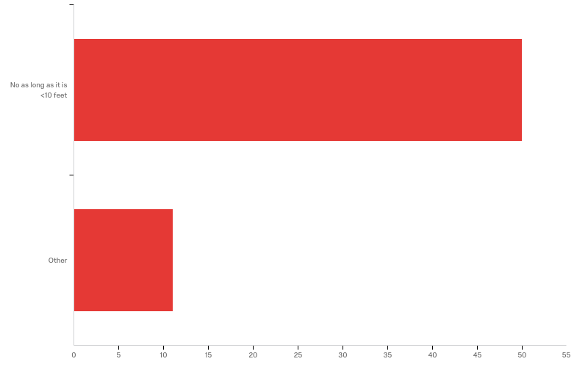
19 - Do you have width limitations to get through gates? Check all that apply

Slide 67
19 - Do you have width limitations to get through gates? Check all that apply
# | Answer | % | Count
4 | No as long as it is <10 feet | 81.97% | 50
11 | Other | 18.03% | 11
 | Total | 100% | 61

Slide 68
19 - Do you have width limitations to get through gates? Check all that apply
19_11_TEXT - Other
Other - Text
15.5 ft
Width of a pickup
15
under 14 feet, 12 is about right for stability
No if less than 15’
a couple of 8' gates. could also add fold out or pull out extensions which would allow for more options!
25 feet
8ft
25 feet. Though it should be built so it can drive over fences without snagging.
15 feet
15 feet wide

Slide 69
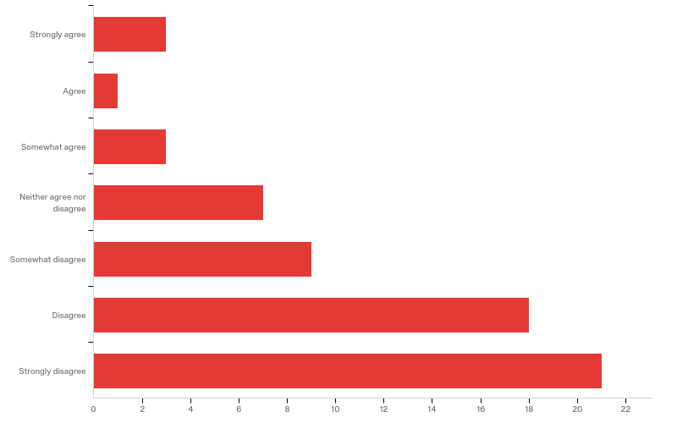
20 - I would pay $10,000 for a mobile unit that drastically simplified paddock moves and allowed me to maximize grass productivity and cattle health and productivity and saves me significant time? (Assuming it has all the stations you need)

Slide 70
20 - I would pay $10,000 for a mobile unit that drastically simplified paddock moves and allowed me to maximize grass productivity and cattle health and productivity and saves me significant time? (Assuming it has all the stations you need)
# | Field | Minimum | Maximum | Mean | Std Deviation | Variance | Count
1 | I would pay $10,000 for a mobile unit that drastically simplified paddock moves and allowed me to maximize grass productivity and cattle health and productivity and saves me significant time? (Assuming it has all the stations you need) | 1.00 | 7.00 | 5.52 | 1.61 | 2.60 | 62

Slide 71
20 - I would pay $10,000 for a mobile unit that drastically simplified paddock moves and allowed me to maximize grass productivity and cattle health and productivity and saves me significant time? (Assuming it has all the stations you need)
# | Answer | % | Count
1 | Strongly agree | 4.84% | 3
2 | Agree | 1.61% | 1
3 | Somewhat agree | 4.84% | 3
4 | Neither agree nor disagree | 11.29% | 7
5 | Somewhat disagree | 14.52% | 9
6 | Disagree | 29.03% | 18
7 | Strongly disagree | 33.87% | 21
 | Total | 100% | 62

Slide 72
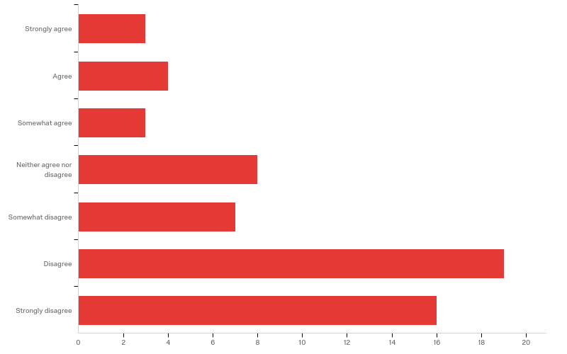
21 - I would pay $7,500 for a mobile unit that drastically simplified paddock moves and allowed me to maximize grass productivity and cattle health and productivity and saves me significant time? (Assuming it has all the stations you need)

Slide 73
21 - I would pay $7,500 for a mobile unit that drastically simplified paddock moves and allowed me to maximize grass productivity and cattle health and productivity and saves me significant time? (Assuming it has all the stations you need)
# | Field | Minimum | Maximum | Mean | Std Deviation | Variance | Count
1 | I would pay $7,500 for a mobile unit that drastically simplified paddock moves and allowed me to maximize grass productivity and cattle health and productivity and saves me significant time? (Assuming it has all the stations you need) | 1.00 | 7.00 | 5.22 | 1.75 | 3.07 | 60

Slide 74
21 - I would pay $7,500 for a mobile unit that drastically simplified paddock moves and allowed me to maximize grass productivity and cattle health and productivity and saves me significant time? (Assuming it has all the stations you need)
# | Answer | % | Count
1 | Strongly agree | 5.00% | 3
2 | Agree | 6.67% | 4
3 | Somewhat agree | 5.00% | 3
4 | Neither agree nor disagree | 13.33% | 8
5 | Somewhat disagree | 11.67% | 7
6 | Disagree | 31.67% | 19
7 | Strongly disagree | 26.67% | 16
 | Total | 100% | 60

Slide 75
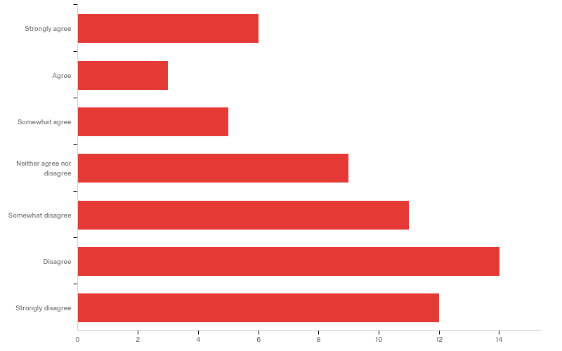
22 - I would pay $5,000 for a mobile unit that drastically simplified paddock moves and allowed me to maximize grass productivity and cattle health and productivity and saves me significant time? (Assuming it has all the stations you need)

Slide 76
22 - I would pay $5,000 for a mobile unit that drastically simplified paddock moves and allowed me to maximize grass productivity and cattle health and productivity and saves me significant time? (Assuming it has all the stations you need)
# | Field | Minimum | Maximum | Mean | Std Deviation | Variance | Count
1 | I would pay $5,000 for a mobile unit that drastically simplified paddock moves and allowed me to maximize grass productivity and cattle health and productivity and saves me significant time? (Assuming it has all the stations you need) | 1.00 | 7.00 | 4.77 | 1.87 | 3.51 | 60

Slide 77
22 - I would pay $5,000 for a mobile unit that drastically simplified paddock moves and allowed me to maximize grass productivity and cattle health and productivity and saves me significant time? (Assuming it has all the stations you need)
# | Answer | % | Count
1 | Strongly agree | 10.00% | 6
2 | Agree | 5.00% | 3
3 | Somewhat agree | 8.33% | 5
4 | Neither agree nor disagree | 15.00% | 9
5 | Somewhat disagree | 18.33% | 11
6 | Disagree | 23.33% | 14
7 | Strongly disagree | 20.00% | 12
 | Total | 100% | 60

Slide 78
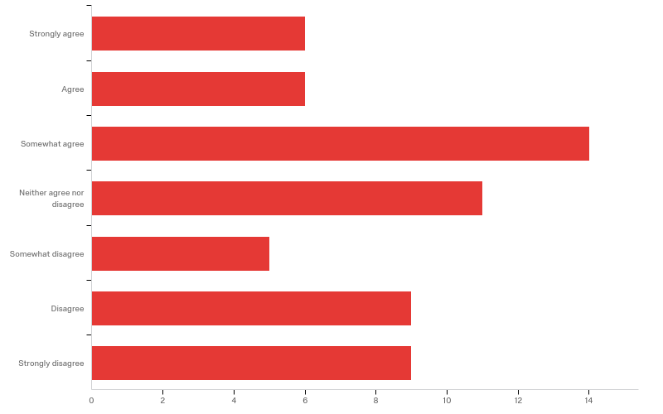
23 - I would pay $4,000 for a mobile unit that drastically simplified paddock moves and allowed me to maximize grass productivity and cattle health and productivity and saves me significant time? (Assuming it has all the stations you need)

Slide 79
23 - I would pay $4,000 for a mobile unit that drastically simplified paddock moves and allowed me to maximize grass productivity and cattle health and productivity and saves me significant time? (Assuming it has all the stations you need)
# | Field | Minimum | Maximum | Mean | Std Deviation | Variance | Count
1 | I would pay $4,000 for a mobile unit that drastically simplified paddock moves and allowed me to maximize grass productivity and cattle health and productivity and saves me significant time? (Assuming it has all the stations you need) | 1.00 | 7.00 | 4.10 | 1.89 | 3.56 | 60

Slide 80
23 - I would pay $4,000 for a mobile unit that drastically simplified paddock moves and allowed me to maximize grass productivity and cattle health and productivity and saves me significant time? (Assuming it has all the stations you need)
# | Answer | % | Count
1 | Strongly agree | 10.00% | 6
2 | Agree | 10.00% | 6
3 | Somewhat agree | 23.33% | 14
4 | Neither agree nor disagree | 18.33% | 11
5 | Somewhat disagree | 8.33% | 5
6 | Disagree | 15.00% | 9
7 | Strongly disagree | 15.00% | 9
 | Total | 100% | 60

Slide 81
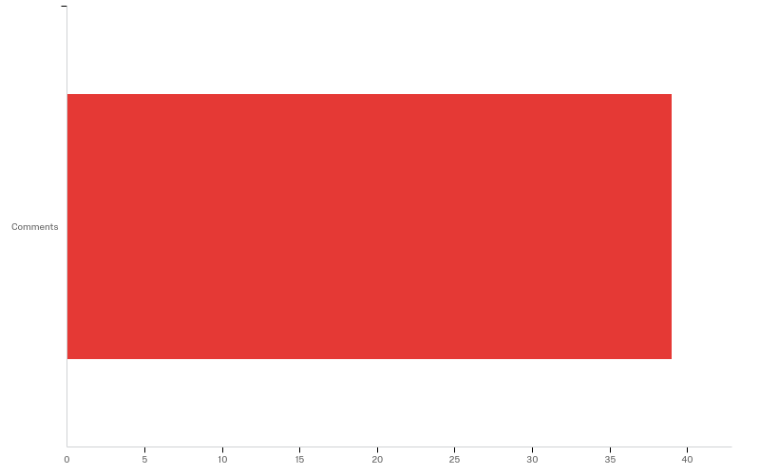
24 - What else would you need to know about this mobile unit before making a purchase decision?

Slide 82
24 - What else would you need to know about this mobile unit before making a purchase decision?
# | Field | Minimum | Maximum | Mean | Std Deviation | Variance | Count
1 | What else would you need to know about this mobile unit before making a purchase decision? - Selected Choice | 1.00 | 1.00 | 1.00 | 0.00 | 0.00 | 39

Slide 83
24 - What else would you need to know about this mobile unit before making a purchase decision?
# | Answer | % | Count
1 | Comments | 100.00% | 39
 | Total | 100% | 39

Slide 84
24 - What else would you need to know about this mobile unit before making a purchase decision?
24_1_TEXT - Comments
Comments - Text
We currently have 35 permanent watering locations but are considering some changes to improve cattle movement.
Durability
I already have to haul water to half my pastures, so technically that is my mobile unit, a trailer with a 100 gallon tank behind the four wheeler. I can easily throw a 100 gallon water tank on it and a mineral tub, and I have a storage bin for holding posts and reels. I’ve also tried sticky fly paper on a plastic barrel but when I got to more than 10 cattle it was too much work and money to be effective. The only advantage of a mobile unit for me would be the addition of shade. I probably can’t justify an expense over $2.5k, and knowing the current price of mobile shade units I figure I’m better off investing in heat tolerant cattle.
$ return
water capacity or does it connect to existing pipeline?
Capacity of water, or is it tanks to be connected to water lines?
I would like to build a unit rather than buy

Slide 85
24 - What else would you need to know about this mobile unit before making a purchase decision?
24_1_TEXT - Comments
Comments - Text
If it could be outfitted to serve other classes of livestock. We primarily rotationally graze sheep.
Durability, ease of repairs, ability to use in winter/snow
How easy is it to pull in an actual pasture (i.e. chest high grass heads in spring, chicory stalks, orchardgrass clumps, etc.)
The positioning of the water tank is critical to the stability of the wagon so it does not tip over. The water tank could be filled and then drained before moving, then filled again in the new pasture. Could be placed on the ground then filled in each new pasture??? Weight of the water on a trailer could be a major issue when moving or setting still???
How easy will it travel down the road.
How well it holds up to bull abuse.
Chances are I will build my own for much cheaper than one could be built and purchased
nothing

Slide 86
24 - What else would you need to know about this mobile unit before making a purchase decision?
24_1_TEXT - Comments
Comments - Text
What is the water holding capacity? How would I move this machine on hills and make it more accessible to cattle there?
water capacity, 1000 gal wouuld be nice. I may have to pull it home to fill it.
Have to see it. Se what options there are for it. See it in action.
Life expectancy/durability. Costshare?
Size of wheels and cost
How well constructed it was and how easily it is maintained.
I'd want to see it in use
cost
I prefer direction on how to make one instead of purchasing
If this unit comes on wheels would it contain some type of break system so cattle don't push it away from desired site?

Slide 87
24 - What else would you need to know about this mobile unit before making a purchase decision?
24_1_TEXT - Comments
Comments - Text
how likely is it to roll away
simplicity and quality (strength) AND ABILITY TO LOWER OR sections that could be lowered to the optional feeding level so both cows, calfs, yearling heifers, etc. all have access to all of the options. To reduce coss, it could be sold as a starter unit with other options to be purchased as needed or affordable. broken down so farmer / rancher could save money by self assembly. m unit portions
Would need to be able to be pulled by ATV and used by 150 cow/calf pairs. Unlikely something that could be moved daily by atv would service that many head
ease of movment durability
How it will pay for itself.
Would need to be able to drive over fences. If it incorporated a mobile bale feeder I might be persuaded to pay more for it.
I would need to see that it would add enough value to improve my bottom line.
Since water is the main concern, Its functionality would be directly rated to how much water it could hold and how many animals it could handle

Slide 88
24 - What else would you need to know about this mobile unit before making a purchase decision?
24_1_TEXT - Comments
Comments - Text
cold weather performance
How the unit would fit the context of each situation/paddock on the farm.
If it could actually work fully integrated, especially on rainy days.
details, what is included
Life of unit. It has to be proven profitable. And adaptable for winter watering
Durability, Customizability

Slide 89

25 - What other feedback or advice can you provide us as we design and test a mobile unit? Someone mentioned a brake might be needed for hilly terrain.

Slide 90
25 - What other feedback or advice can you provide us as we design and test a mobile unit? Someone mentioned a brake might be needed for hilly terrain.
# | Field | Minimum | Maximum | Mean | Std Deviation | Variance | Count
1 | What other feedback or advice can you provide us as we design and test a mobile unit? Someone mentioned a brake might be needed for hilly terrain. - Selected Choice | 1.00 | 1.00 | 1.00 | 0.00 | 0.00 | 44

Slide 91
25 - What other feedback or advice can you provide us as we design and test a mobile unit? Someone mentioned a brake might be needed for hilly terrain.
# | Answer | % | Count
1 | Comments | 100.00% | 44
 | Total | 100% | 44

Slide 92
25 - What other feedback or advice can you provide us as we design and test a mobile unit? Someone mentioned a brake might be needed for hilly terrain.
25_1_TEXT - Comments
Comments - Text
Easy hitch, flexability
Skids would not work with many areas of my terrain, plus with the amount of rain we’ve been having it would tear up too much ground. But I worry about cattle scratching on anything with wheels that could potentially move on them. I’d also love more experimenting and feedback from other farmers on what does work for organic fly control, or a system for using fly paper that doesn’t involve myself and my tools getting sticky daily.
Need to consider continous water filling (float valve and water hookup)
Durable
weather proof
Fairly weather proof
Make it human scale
Brakes are essential!
Make sure the cattle (bull) can't destroy it if he scratches his head on it. Can it or a similar design also be used for sheep?

Slide 93
25 - What other feedback or advice can you provide us as we design and test a mobile unit? Someone mentioned a brake might be needed for hilly terrain.
25_1_TEXT - Comments
Comments - Text
Light enough to pull with a smaller utility vehicle, yet strong enough to take some abuse from cattle.
Brake or blocks for the wheels. Water weight is a big concern...
Blocks or brakes for Wheels, so animals dont push the unit around
It needs to be able to take strong winds.
I feel that skid would be nice because it would not move as easily when animals use it, however they would need to be wide to accommodate wet conditions. Also having wheels that could be put on for longer no moves or down the road moves would be a good idea.
It would be nice to have a unit capable of being used in below freezing conditions.
If I did not have underground water line, I probably would not do paddocks, or at least less of them
good weight balance
Put the water holding tank either under the water trough so that the water will not be hot, or scummy.

Slide 94
25 - What other feedback or advice can you provide us as we design and test a mobile unit? Someone mentioned a brake might be needed for hilly terrain.
25_1_TEXT - Comments
Comments - Text
Low cost, easy to reproduce
Brake yes, stabilizer legs, adjustible hitch that can be locked in upright position , wide tires to pull through muddy areas, high clearance,
If it is going to have a scratcher on it platform legs may be nice
I was think a brake also for hills and cattle pushing it. Stabilizers if has shade canopy so wind doesn’t blow it over?
All-terrain wheels
Do you really think a portable shade option is economically feasible. I have explored portable shade and it's easy to send $10K.
flotation tires
You need to address the cost and possibly provide instruction on constructing one for themselves
What size water tank would be used? I'm assuming it would need to be emptied when moving to the next site.

Slide 95
25 - What other feedback or advice can you provide us as we design and test a mobile unit? Someone mentioned a brake might be needed for hilly terrain.
25_1_TEXT - Comments
Comments - Text
And audible noise so that the cattle trained to sound and people know that it’s in motion
Does it have a way to drain the stock tank before moves. pulling 120gallons of water would not be easy by hand.
or old fashened block stops as on old stage coaches
needs to be very sturdy/cow-proof
duribility and how do you keep it in place
Portable enough to move from one property to another property and light enough to get through wet areas
Attachments for electric hot wire and jumper clip to existing fence to keep cattle from rubbing on it.
It would have to be pretty sturdy; cattle might break it or tip it over. Big wheels would be needed for long grass and brush.
Would it stay in the paddock? If so how do you also keep the cattle from moving it

Slide 96
25 - What other feedback or advice can you provide us as we design and test a mobile unit? Someone mentioned a brake might be needed for hilly terrain.
25_1_TEXT - Comments
Comments - Text
I ranked shade very low not because it isn't important to have rather because it seems important that it NOT be close to water.
Modular design, so you can add the features you need to keep purchase price down by not buying things you dont need
A brake would likely be needed just from cattle rubbing. If watering large herds you need to address flow capacity of water sources and if a reservoir is needed, etc.
A brake would be nice
Yes, a break. Outriggers. Floatation tires.
Maybe some L.E.D lights if needing to work on something in the dark
rubbing protection
Size of water tanks or tubs (big or small)

Slide 97
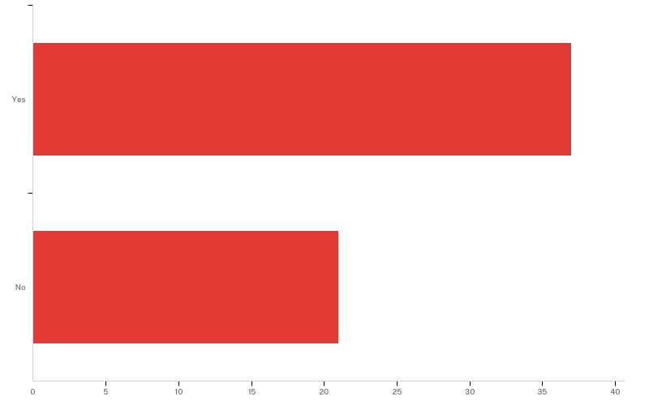
26 - Would you be willing to be in a focus group to discuss the concept in more detail?

Slide 98
26 - Would you be willing to be in a focus group to discuss the concept in more detail?
# | Field | Minimum | Maximum | Mean | Std Deviation | Variance | Count
1 | Would you be willing to be in a focus group to discuss the concept in more detail? | 1.00 | 2.00 | 1.36 | 0.48 | 0.23 | 58

Slide 99
26 - Would you be willing to be in a focus group to discuss the concept in more detail?
# | Answer | % | Count
1 | Yes | 63.79% | 37
2 | No | 36.21% | 21
 | Total | 100% | 58

Slide 100
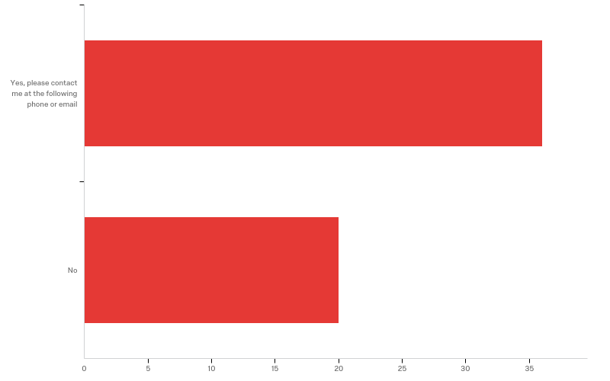
27 - Would you be willing to test a prototype that would involve providing written comments and suggestions, possibly hosting a field day, possibly being interviewed for a video or article?

Slide 101
27 - Would you be willing to test a prototype that would involve providing written comments and suggestions, possibly hosting a field day, possibly being interviewed for a video or article?
# | Field | Minimum | Maximum | Mean | Std Deviation | Variance | Count
1 | Would you be willing to test a prototype that would involve providing written comments and suggestions, possibly hosting a field day, possibly being interviewed for a video or article? - Selected Choice | 1.00 | 2.00 | 1.36 | 0.48 | 0.23 | 56

Slide 102
27 - Would you be willing to test a prototype that would involve providing written comments and suggestions, possibly hosting a field day, possibly being interviewed for a video or article?
# | Answer | % | Count
1 | Yes, please contact me at the following phone or email | 64.29% | 36
2 | No | 35.71% | 20
 | Total | 100% | 56

Slide 103
27 - Would you be willing to test a prototype that would involve providing written comments and suggestions, possibly hosting a field day, possibly being interviewed for a video or article?
27_1_TEXT - Yes, please contact me at the following phone or email
Yes, please contact me at the following phone or email - Text
rhandeen@hotmail.com
jolsons101@gmail.com
6124902186
Ggelhar@msn.com
judith.worm@isd181.org (previous submitted survey was sent before full address was given.
judith.worm@isd181.org
Jill@bevarafarms.com
507-240-5004
mike.scheibel@newulmtel.net
My farm is not large enough to test but would be willing to help a producer that may be in the area....Gary Wyatt - wyatt@umn.edu

Slide 104
27 - Would you be willing to test a prototype that would involve providing written comments and suggestions, possibly hosting a field day, possibly being interviewed for a video or article?
27_1_TEXT - Yes, please contact me at the following phone or email
Yes, please contact me at the following phone or email - Text
sleepybisonacres@gmail.com
cotterfarm@hotmail.com
omnifarmlaura@gmail.com
Walkerfarmsm@gmail.com
320-221-1943
jmm22250@gmail.com
Maybe, mjorge016@msn.com
scanlancrew@gmail.com
zipzapp@me.com
ajauhola@yahoo.com
612-590-2999 or tkfarms@prtel.com

Slide 105
27 - Would you be willing to test a prototype that would involve providing written comments and suggestions, possibly hosting a field day, possibly being interviewed for a video or article?
27_1_TEXT - Yes, please contact me at the following phone or email
Yes, please contact me at the following phone or email - Text
trinitycreekranchinc@gmail.com
218 395 0409
cloverleafgrassfarm@gmail.com
Pettitpastures@gmail.com
Yes, but only if you're looking for input from a dairy grazier. It seems geared more toward beef operations where animals do not return to buildings regularly. bearpa01@luther.edu 563.419.3780
tdbarch@gmail.com
763.213.9978
2188310698 abebrea@gmail.com
hein0106@umn.edu
712-309-1326

Slide 106
27 - Would you be willing to test a prototype that would involve providing written comments and suggestions, possibly hosting a field day, possibly being interviewed for a video or article?
27_1_TEXT - Yes, please contact me at the following phone or email
Yes, please contact me at the following phone or email - Text
mfarmboy95@hotmail.com
Info@ironshoefarm.com
763-443-1531

Slide 107
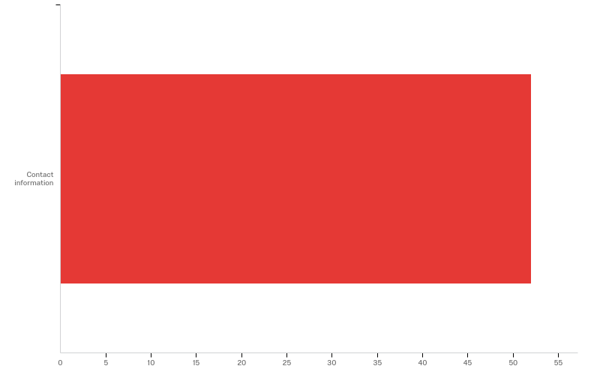
Q28 - Please provide mailing address to receive $10 for fully completed survey.

Slide 108
Q28 - Please provide mailing address to receive $10 for fully completed survey.
# | Field | Minimum | Maximum | Mean | Std Deviation | Variance | Count
1 | Please provide mailing address to receive $10 for fully completed survey. - Selected Choice | 1.00 | 1.00 | 1.00 | 0.00 | 0.00 | 52

Slide 109
Q28 - Please provide mailing address to receive $10 for fully completed survey.
# | Answer | % | Count
1 | Contact information | 100.00% | 52
 | Total | 100% | 52

Slide 110
Q28 - Please provide mailing address to receive $10 for fully completed survey.
Q28_1_TEXT - Contact information
Contact information - Text
50114 140th St., Donnelly,MN 56235
Richard Handeen9060 40th st SW Montevideo MN 56265
PO Box 24 Glenwood MN 56334
Hannah Bernhardt 68393 Scotch Pine Rd Finlayson MN 55735
No need to send $10. Tim Reese, Gale Woods Farm, 7210 County Road 110 Ext, Mound MN 55364 tim.reese@threeriversparks.org
Glenn Gelhar 4115 310th Avenue Clarkfield Mn 56333
Judy Worm, 12607 Red Pine Road, Brainerd, MN 56401
Judy Worm
Chris Kiesz 1341 Quail St. Braham, MN 55006
13413 Ireland Ave. NW Annandale, MN 55302
Keith and Anna Johnson 63326 300th St Gibbon, MN 55335

Slide 111
Q28 - Please provide mailing address to receive $10 for fully completed survey.
Q28_1_TEXT - Contact information
Contact information - Text
14272 County Road 24, New Ulm, MN 56073
Jim Ostlie 752 70th Street NE, Benson, MN 56215
Gary Wyatt, 75057 - 340th St. St. James, MN 56081
15463 257th Ave Sleepy Eye, MN 56085
Ben Dwire. 1473 Terrace Drive. Lake Benton, MN 56149.
Kristi Dwire. 2559 280th Ave. Arco, MN 56113
42184 County Rd 53 Jeffers, MN 56145
David Lindig 17495 cty hwy 15, Fergus Falls Mn 56537
50203 205th st Austin MN 55912
15118 Irish Ave. N Hugo MN 55038
30851 146th st nw Princeton Mn 55398

Slide 112
Q28 - Please provide mailing address to receive $10 for fully completed survey.
Q28_1_TEXT - Contact information
Contact information - Text
4875 county road 12, Moose Lake, mn 55767
35300 MN Hwy 22 South, Eden Valley, MN 55329
Keep the $10 and put it towards the concept
2959 Hornet St, Mora MN 55051
Mike Jorgenson, 33626 660th Avenue, Clinton MN 56225
John Mesko, 11321 Georgia Av. N, Champlin, MN 55316
Bob Scanlan, 2344 Cork Hollow Dr., Brownsville, MN 55919
Thank you but it is not necessary:)
A. Arndt 3639 SE 34th Ave Owatonna, MN 55060
88488 Cty.hwy 61 sturgeon lake MN.55783
Andrew Jauhola, 2959 Hornet St, Mora, MN 55051

Slide 113
Q28 - Please provide mailing address to receive $10 for fully completed survey.
Q28_1_TEXT - Contact information
Contact information - Text
Tipperary-Kerry Farms 31636 160th Ave. Elbow Lake, Minnesota 56531
Mikayla Tabert; 16330 224th St. SE; Red Lake Falls, MN 56750
Tom Olson 5398 Co. Rd. 2 NW Williams MN 56686
9341 125th Ave Milaca Mn 56353
14488 119th Avenue, Park Rapids, mn 56470
Tyler Carlson. 20232 Balsam Drive, Sauk Centre, MN 56378
Lynn Mizner, Chengwatana Farm, 47513 334th Pl., Palisade MN 56469
Aimee Schomburg, W1334 Pierce Road, WI 54614
Thanks for the offer :)
4920 Dalton Ave NE, Buffalo, MN. 55313
Ryan Nelson 1622 Garden St, Ogilvie MN 56358

Slide 114
Q28 - Please provide mailing address to receive $10 for fully completed survey.
Q28_1_TEXT - Contact information
Contact information - Text
27725 business 23 e Paynesville, Mn 56362
12857 Nokasippi River Road, Brainerd MN 56401
46352 State Hwy 329 Morris MN 56267
Jordan W. Ellis 2571 430th Ave. Graettinger, IA 51342
Mike Mammele, 3268 236th St. Dawson MN 56232
Harold Freyholtz 46081 131st avenue Hewitt Mn 56453
31548 136th st Princeton mn 55371
11131 lakeview Heights Road, Pine City MN 55063

