Slide 1
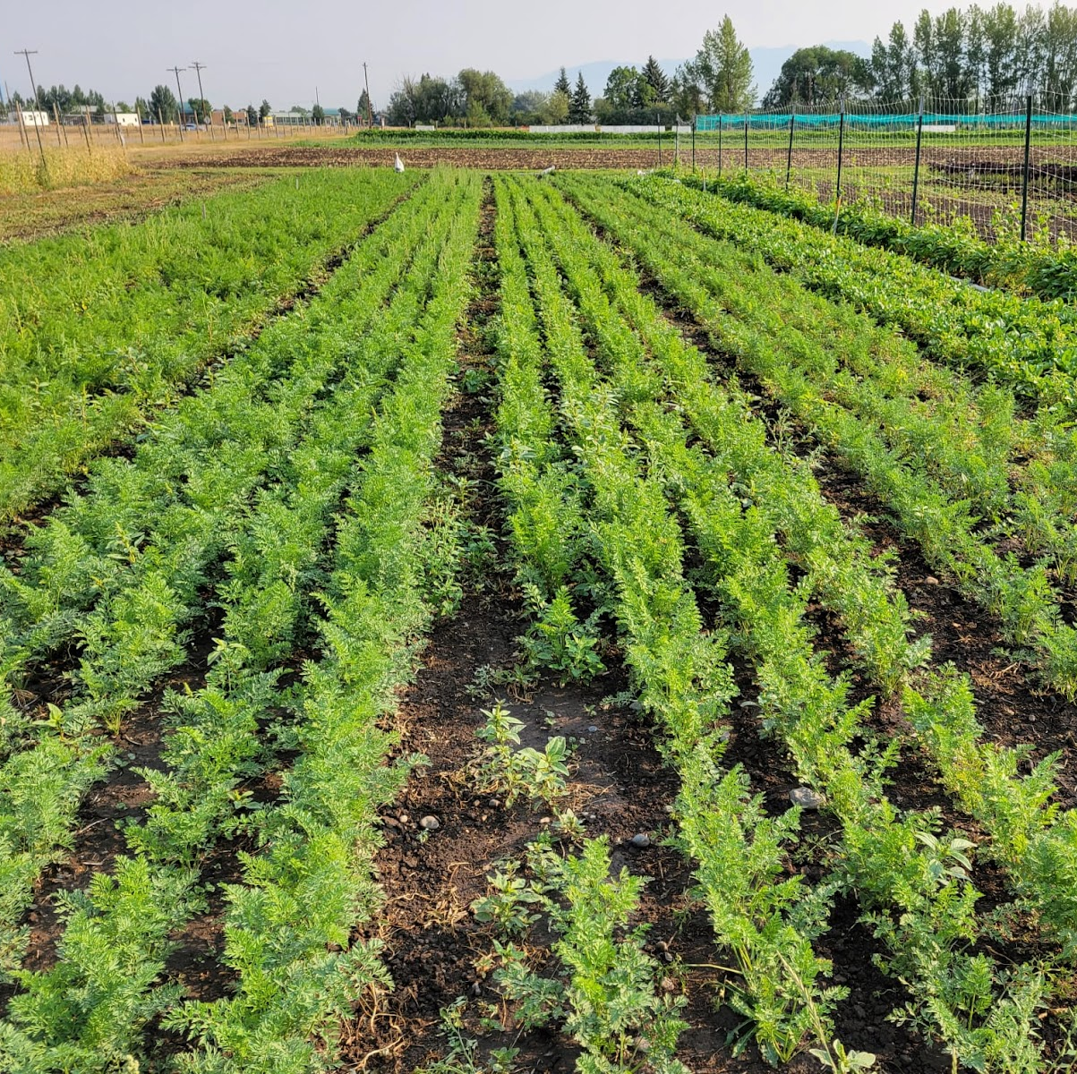
Weed Communities and Management on Organic Vegetable Farms
Presented by Emma Kubinski
Advised by Fabian Menalled, Zach Miller, Roland Ebel, Mac Burgess, and Lisa Rew
Notes:
Don’t need to re-introcue or title

Slide 2
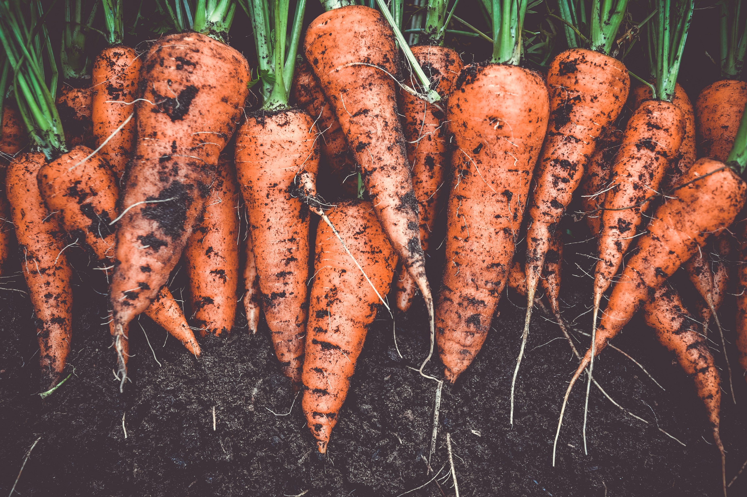
Goal: To jointly assess weed management on Montana organic vegetable farms through community analysis and the critical period of weed control
Evaluate weed communities at different scales around the state and what factors influence them
Define the critical period of weed control in organic carrots
Notes:
Use carrots bc high market value, management challenges, and ability to grow in MT
Connect more to vegetable production- conventional w/ herbicides – look at organoc vegatble production

Slide 3
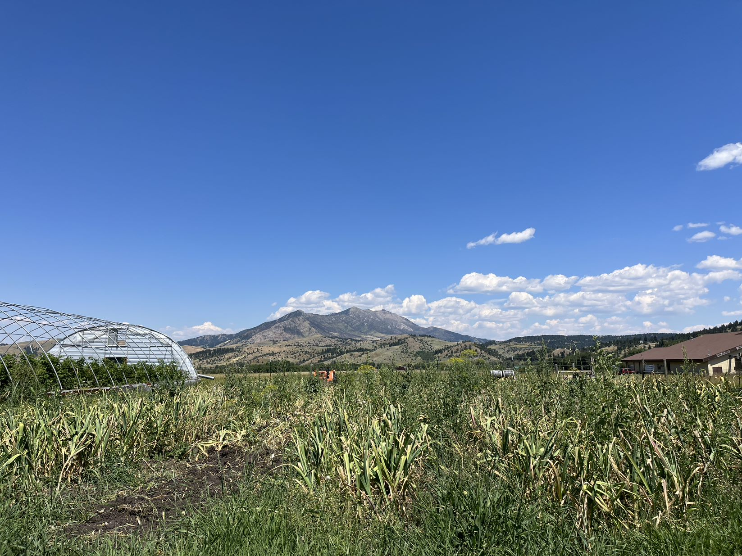
Objective 1: Evaluate weed communities at different scales around the state and what factors influence them

Slide 4
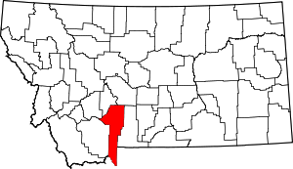
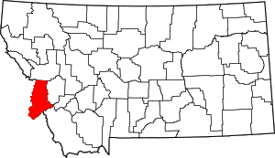
Regions
Two regions
Gallatin Valley
Bitterroot Valley

Slide 5
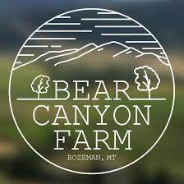
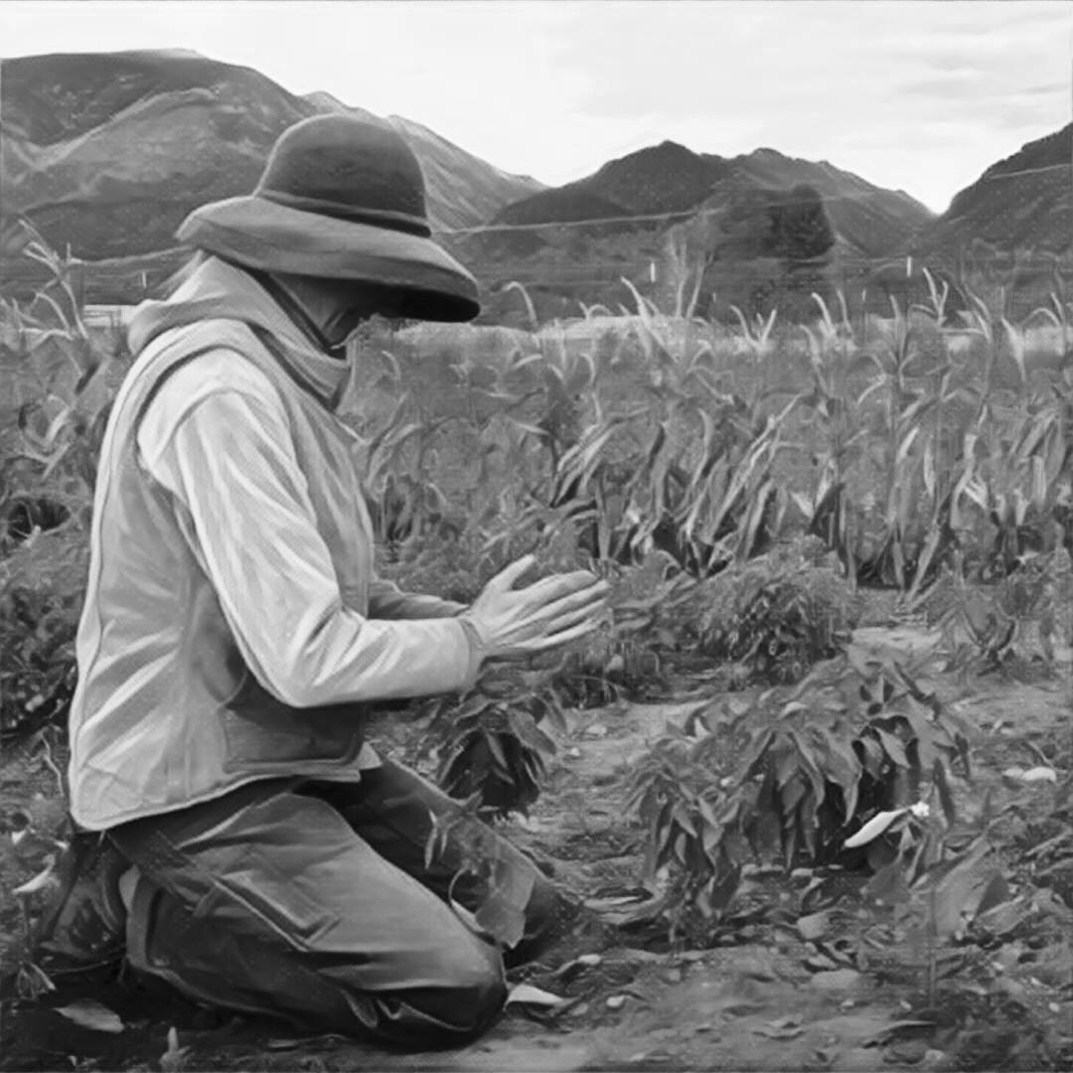
Farms
7 Different farms
Gallatin:
Bear Canyon Farm
Bodhi Farms
Chance Farms
Towne Harvest Garden
Bitterroot:
Sweetroot
Lifeline Produce
Homestead Organics
Homestead Organics

Slide 6
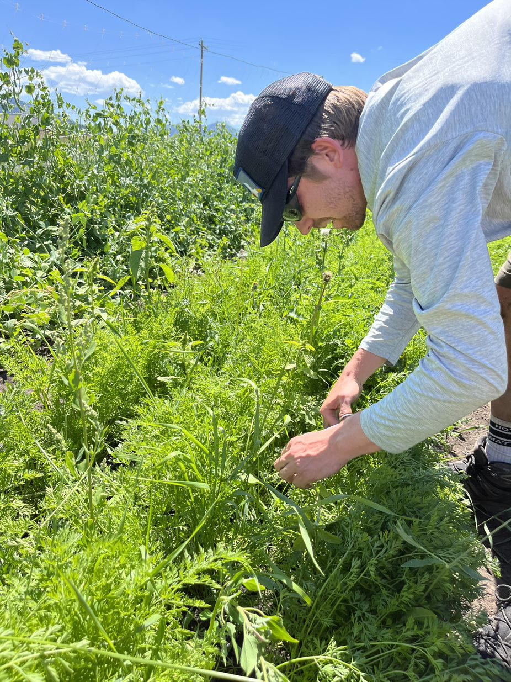
Crops
4 different crop types
Beans
Carrots
Kale
Onions

Slide 7
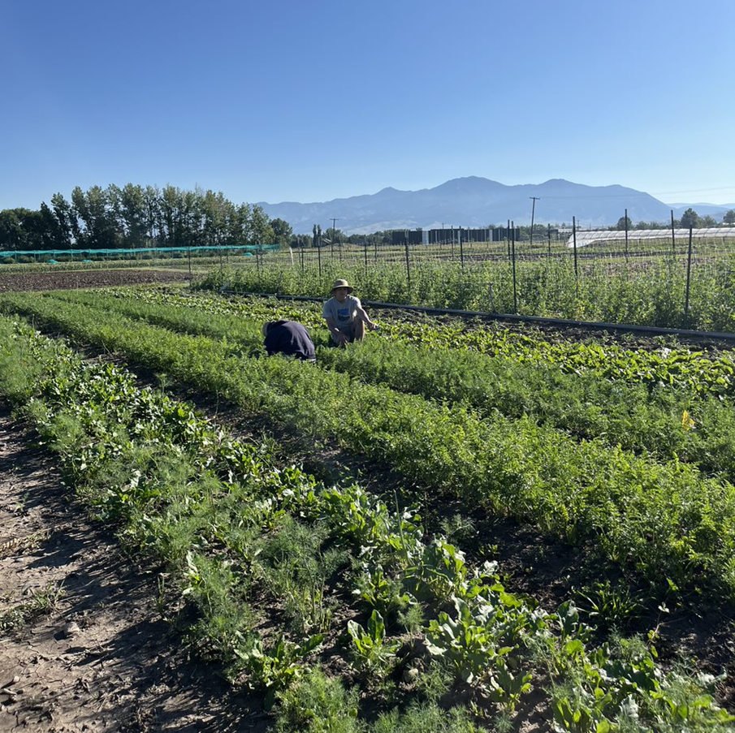
Data Collected
Weed species and their abundance
Soil contents
General management information

Slide 8
Preliminary Findings
Scale | Species #1 | Species #2 | Species #3
Location, Gallatin | redroot pigweed (Amaranthus retroflexus) | Canada thistle (Cirsium arvense) | quackgrass (Elymus repens)
Location, Bitterroot | common sowthistle (Sonchus oleraceus) | redroot pigweed (Amaranthus retroflexus) | quackgrass (Elymus repens)
Crop, Beans | Quackgrass (Elymus repens) | Kentucky bluegrass (Poa pratensis) | redroot pigweed (Amaranthus retroflexus)
Crop, Carrots | common sowthistle (Sonchus oleraceus) | redroot pigweed (Amaranthus retroflexus) | quackgrass (Elymus repens)
Crop, Kale | redroot pigweed (Amaranthus retroflexus | Canada thistle (Cirsium arvense) | common sowthistle (Sonchus oleraceus)
Crop, Onions | common dandelion (Taraxacum officinale) | quackgrass (Elymus repens) | common sowthistle (Sonchus oleraceus)

Slide 9
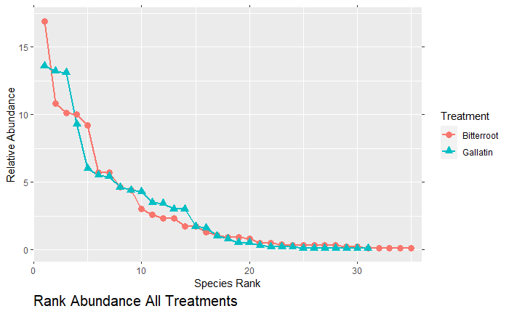
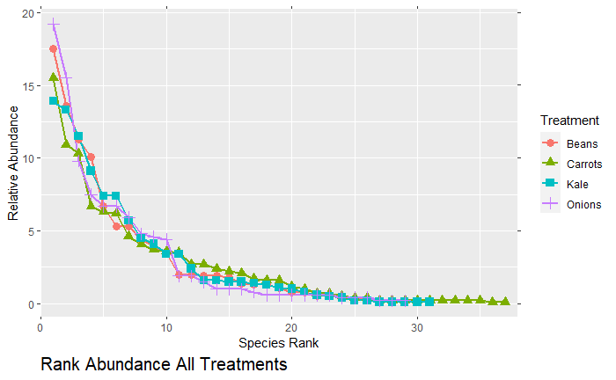
Preliminary Findings

Slide 10
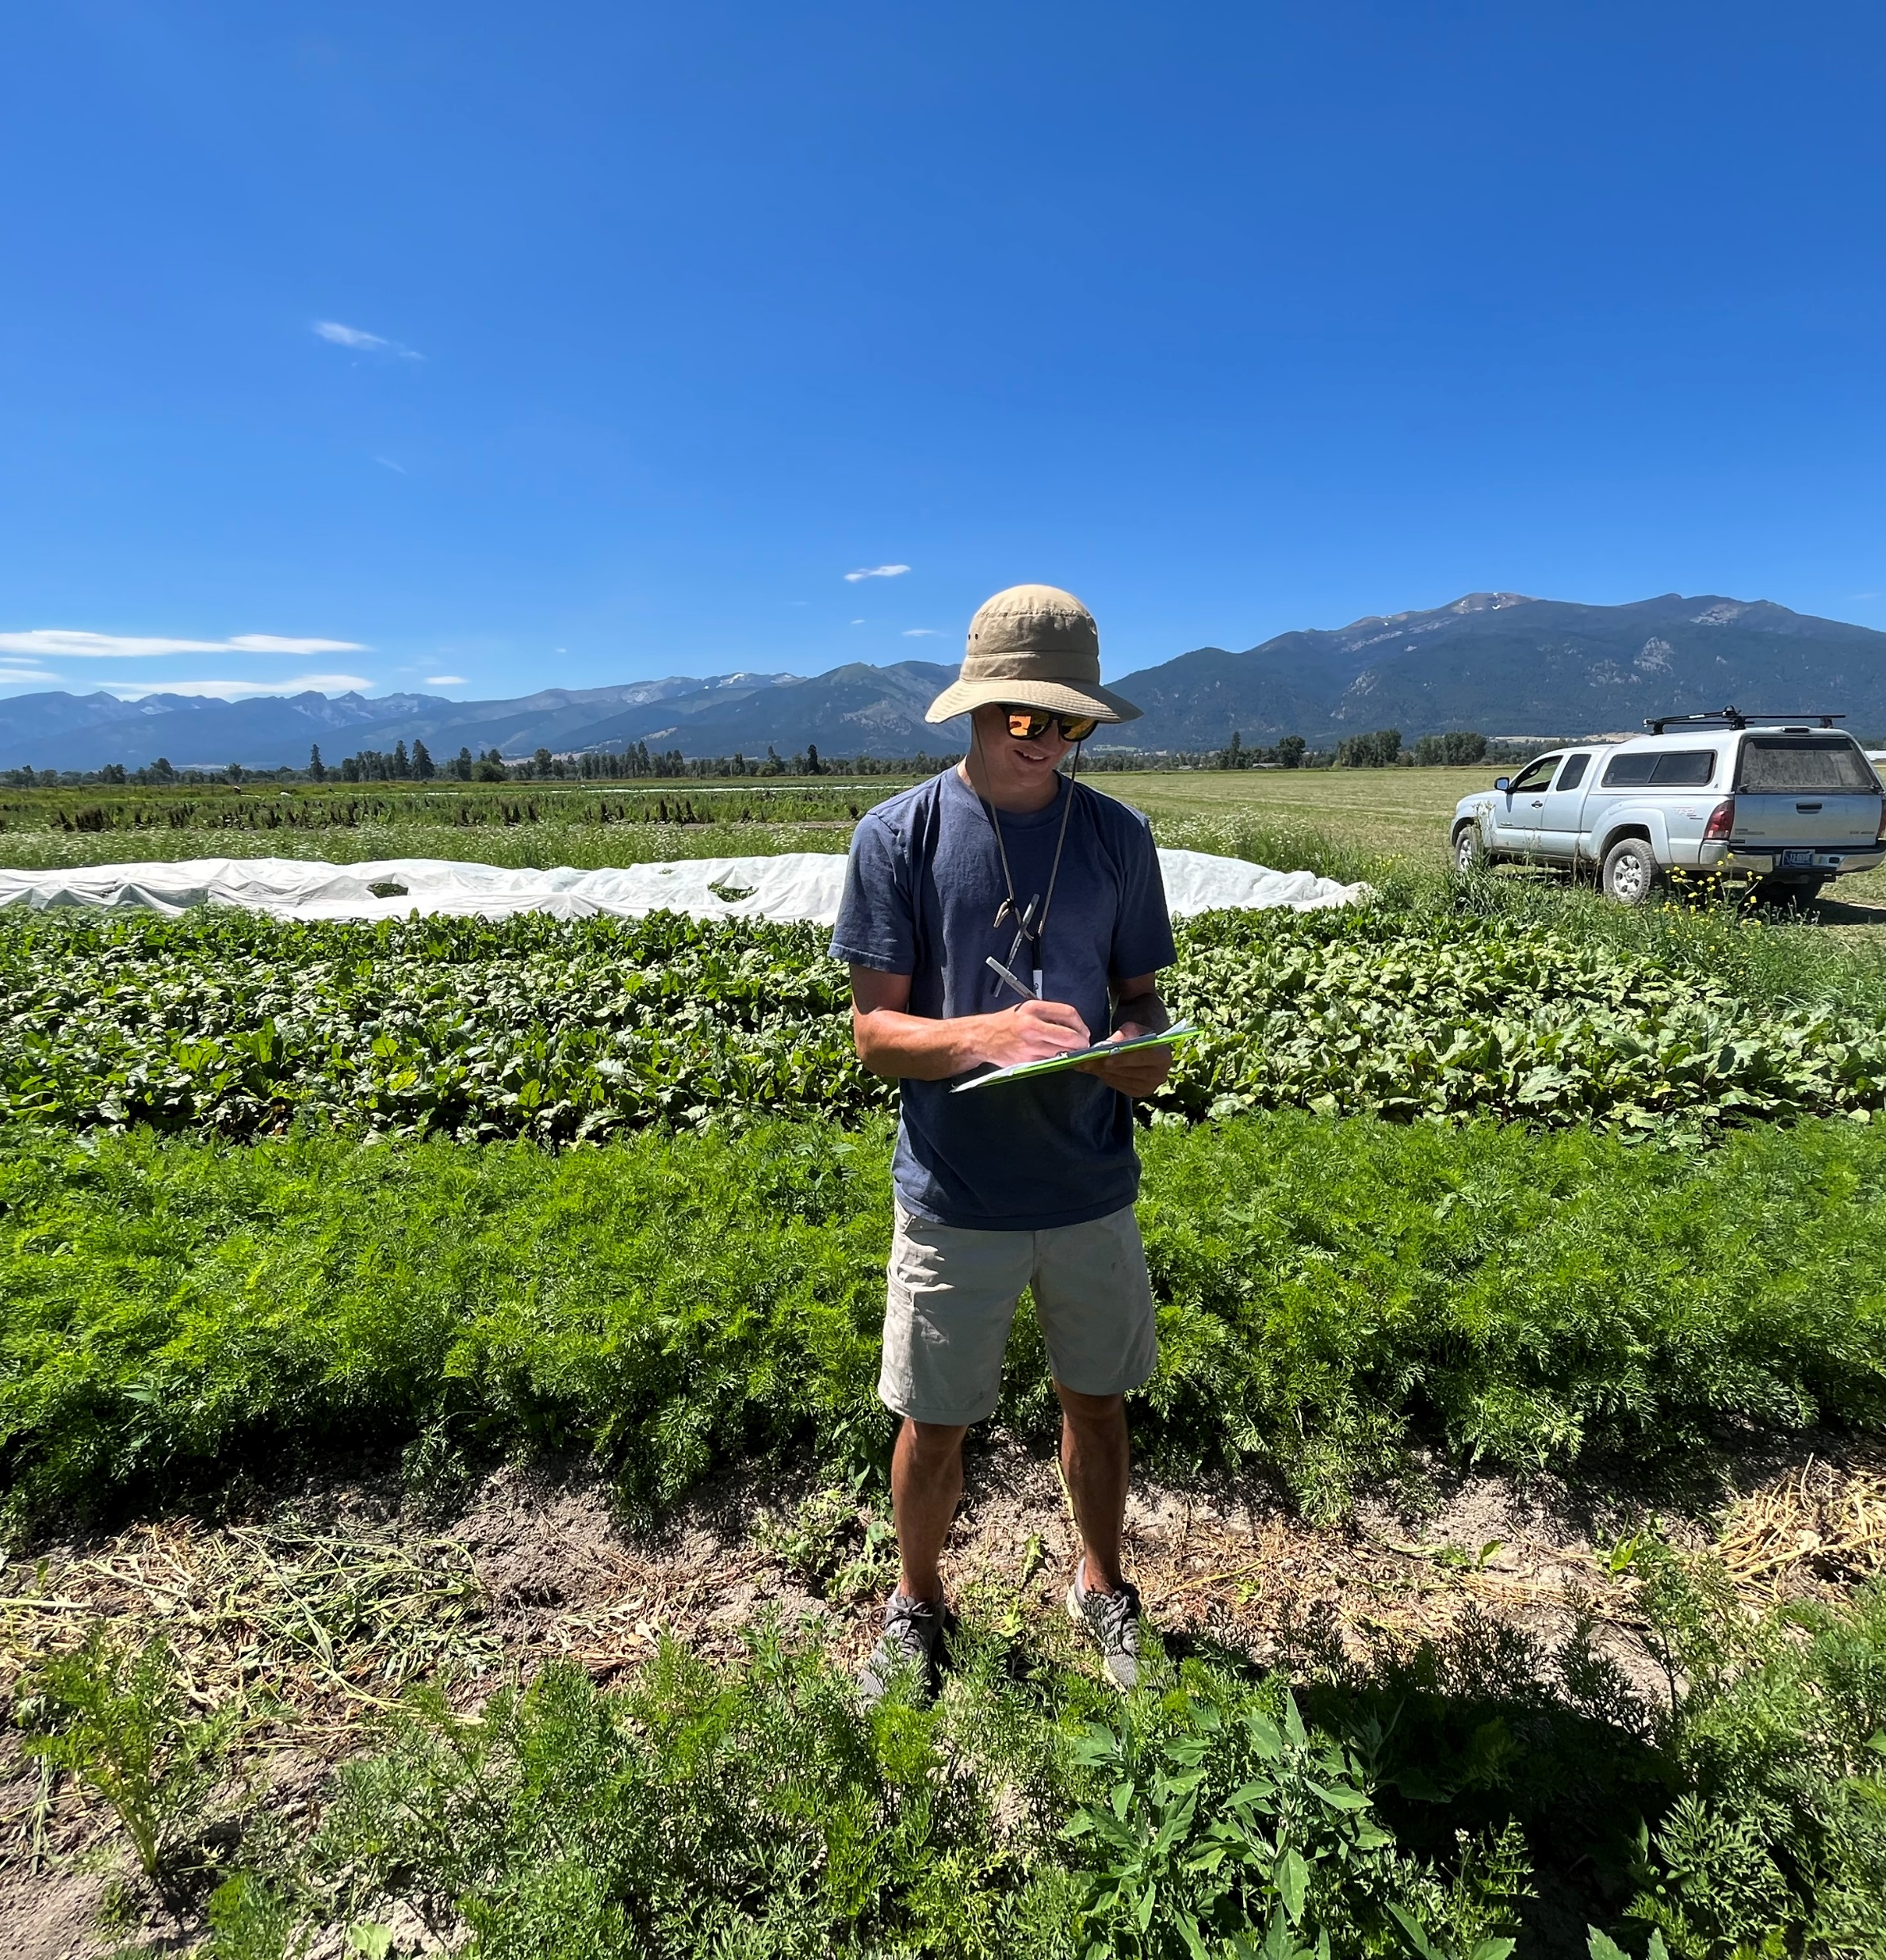
Future work
Determining factors that may be influencing weed community dynamics
Is certain management selecting for species/functional traits?
How are weed communities influenced by soil characteristics (ie nutrient content, soil type, etc.)

Slide 11
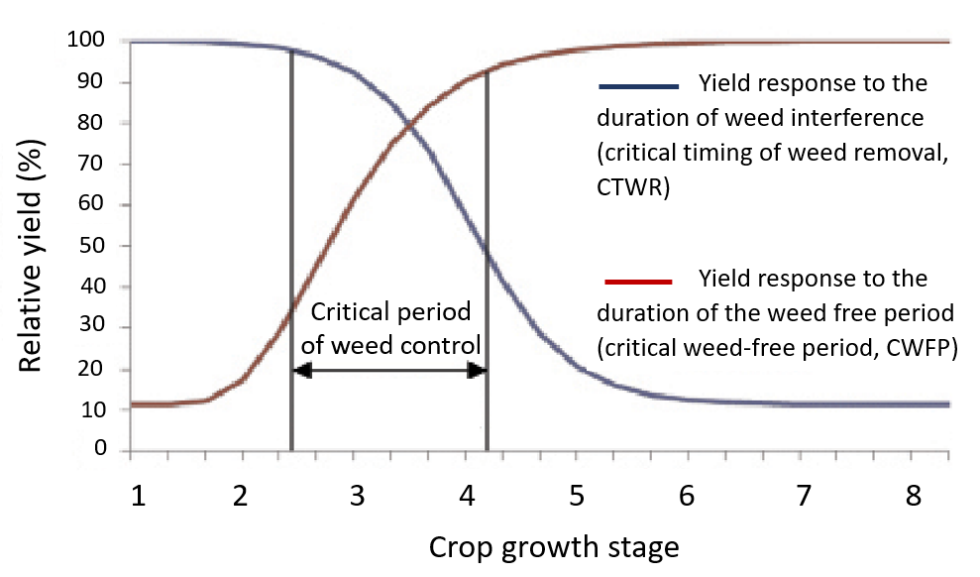
Objective 2: Define the critical period of weed control
Critical period of weed control
The period in which weed removal is necessary to avoid yield and economic loss
Notes:
Yellow- how long crop can coexist yield reduction
Green- how long crops must remain weed free to maintain high yields

Slide 12
Understanding the importance of the critical weed free period…
Seeding
Harvest
Crop
Weed
X
Crop
Weed
Crop
Weed
?
Crop
Weed
Crop
Weed
Crop
Weed
Notes:
No synthetic herbicides

Slide 13
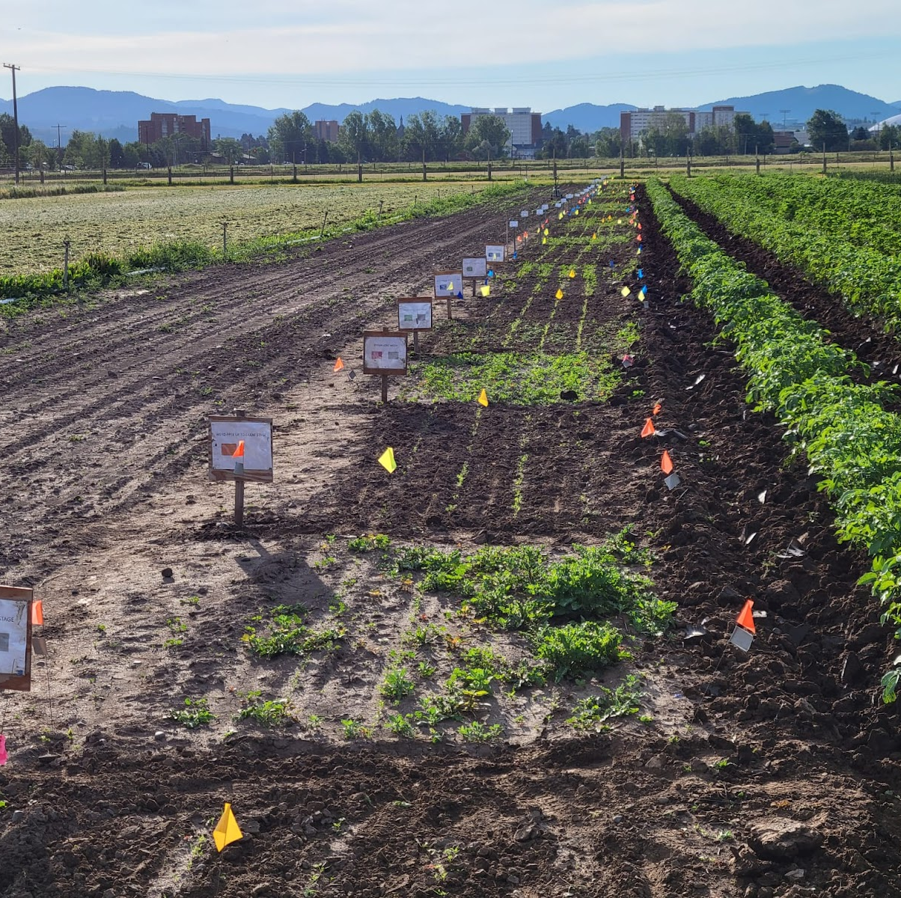
Experimental Design
Townes Harvest Garden, MSU
Complete randomized block design
9 treatments:
Weedy up to the 2, 4 ,10 leaf stage
Weed free up to the 2, 4, 10 leaf stage
Weedy season long
Weed free season long
Weed management based on farmer’s practices
Notes:
Explain where/what Towne Harvest is

Slide 14
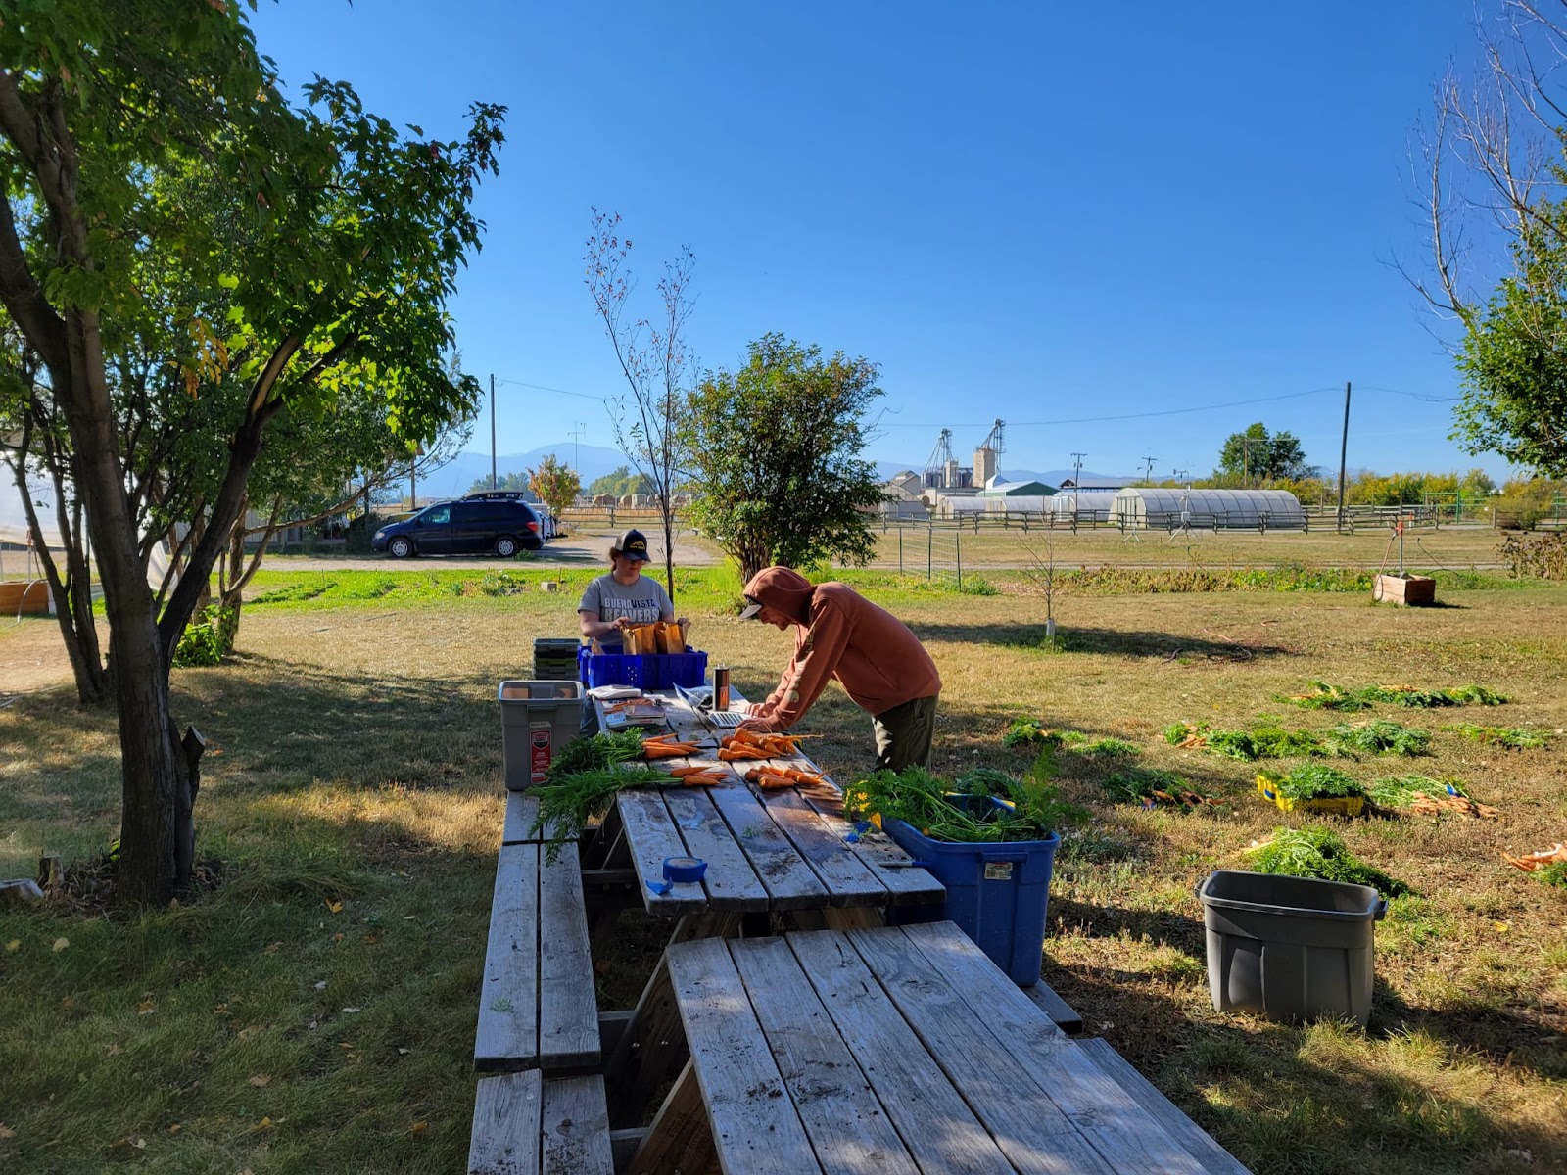
Data Collection- Carrots
Data
Belowground biomass
Aboveground biomass
Sugar content
Marketability
Colorimeter to measure beta-carotene
Notes:
R program GD
DRC
Separate out 2015
Out picture in of example graph that would be integrated
Find shape of non-linear regression

Slide 15
Season long weed free
Weedy after
Leaf 8
Weed free up to
Leaf 8
Weedy after
Leaf 4
Weed free up to
Leaf 4
Weedy after
Leaf 2
Weed free up to
Leaf 2
Season long weedy
Notes:
Include more of curves here and how they relate

Slide 16
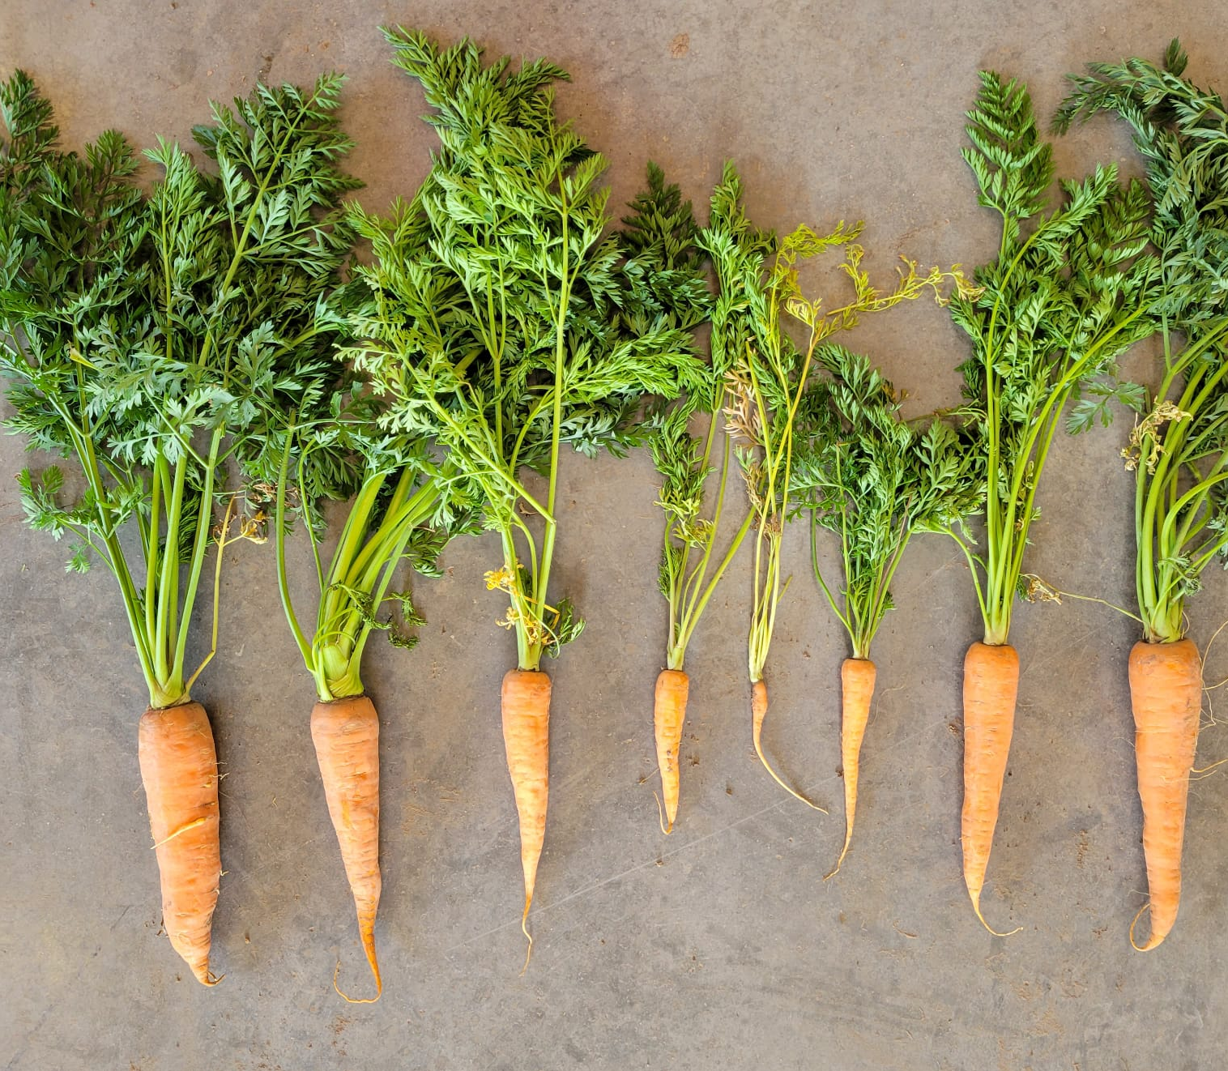
Findings
Based on preliminary findings, the critical period of weed control is around the 4-6 leaf stage
More details on sugar content, marketability, and beta carotene to come
Notes:
Add boxplot photo

Slide 17
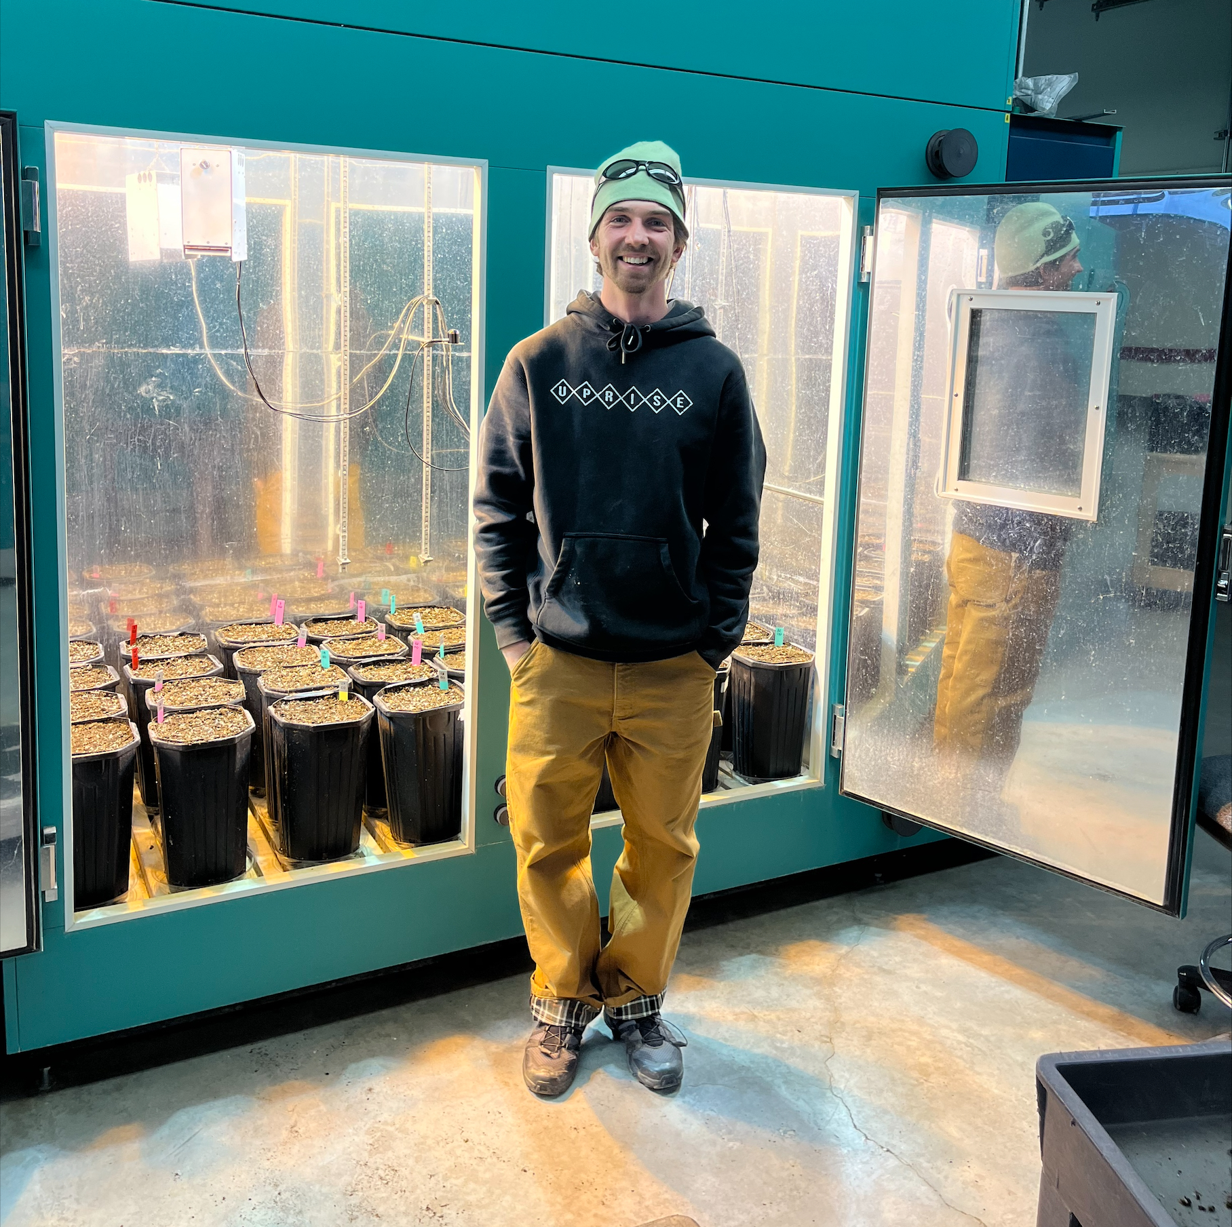
How will the Critical Period of Weed Control change with climate change?
Greenhouse experiment in elevated and ambient CO₂
Kevin Sheridan

Slide 18
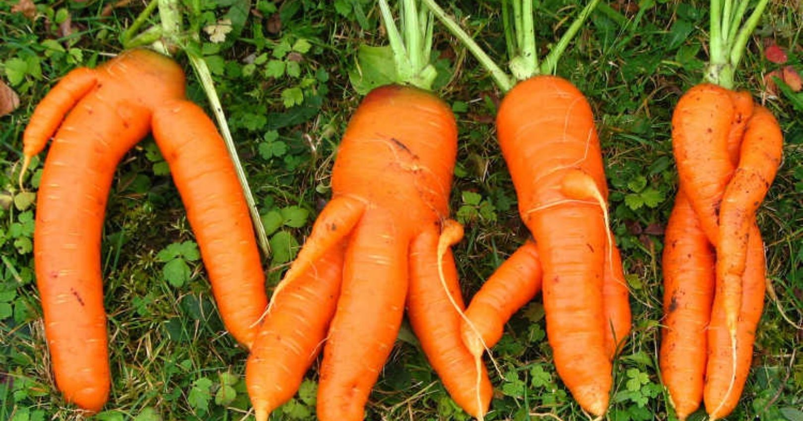
Utah State University

Slide 19
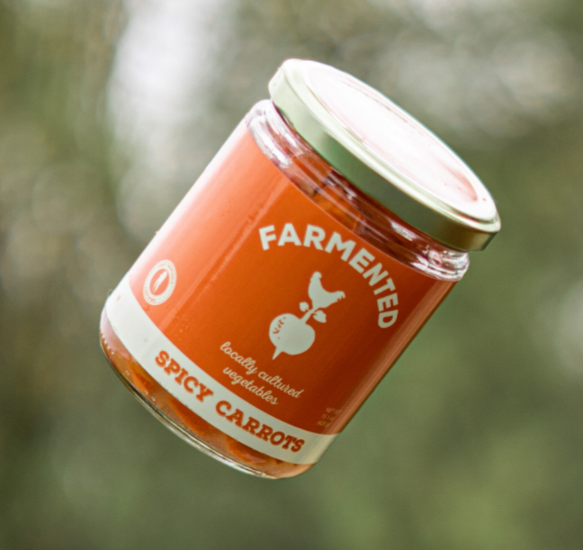
Value-Added Products
Raw products that are enhanced to increase their market value
Local companies will provide information on
Potential value-added products for carrots
Estimation of labor costs
Price “ugly” produce

Slide 20
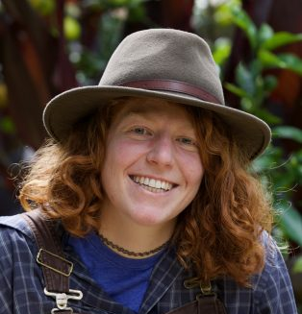
More research coming…
Results and outreach materials for next year coming
New graduate student Sophie Lattes will be expanding research at MSU on weed management on vegetable farms (ie determining the critical period of weed control of multiple crops)
Notes:
Alter legend = make clearer

Slide 21
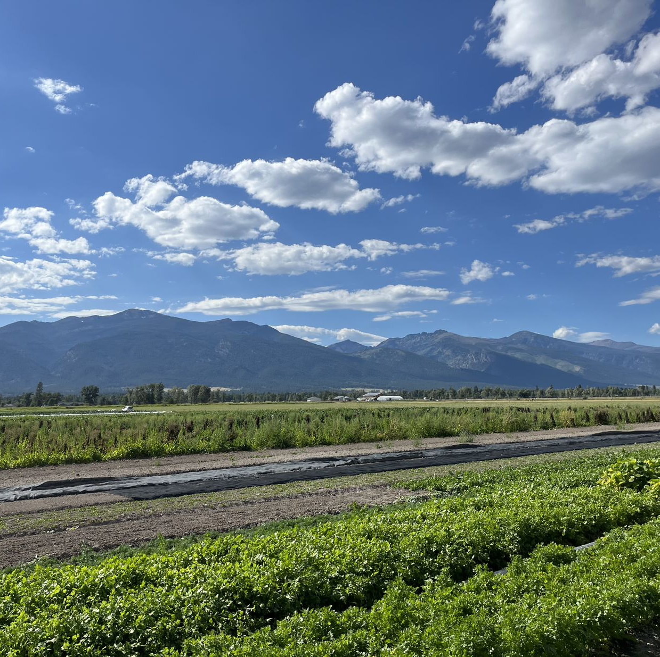
Questions?

