Slide 1

Mushroom Cultivation
With Roger & Mary Winstead
Notes:
Oyster mushrooms come in several distinct types and each one of them is packed with antioxidants, vitamins, and minerals to keep your body healthy and defend against disease. Here’s everything you need to know about oyster mushroom benefits, other medicinal mushrooms, and how to include more oyster mushrooms in your diet.

Slide 2

This material is based upon work that is supported by the National Institute of Food and Agriculture, U.S. Department of Agriculture, under agreement number 2024-38640-42989 through the North Central Region SARE program under project number FNC25-1478. USDA is an equal opportunity employer and service provider. Any opinions, findings, conclusions, or recommendations expressed in this publication are those of the author(s) and should not be construed to represent any official USDA or U.S. Government determination or policy.

Slide 3
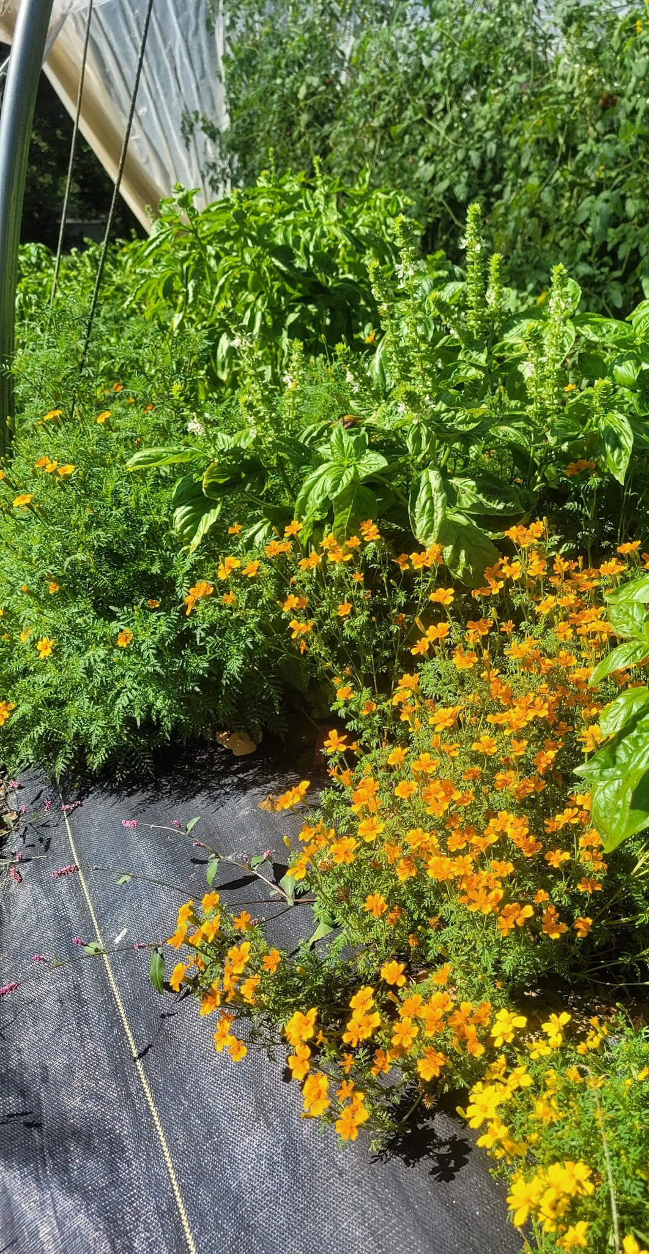
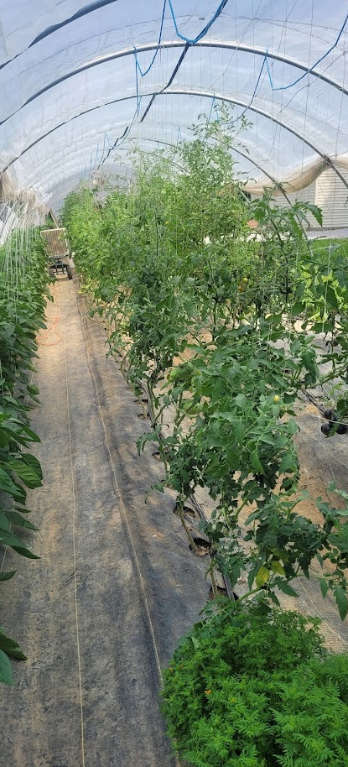
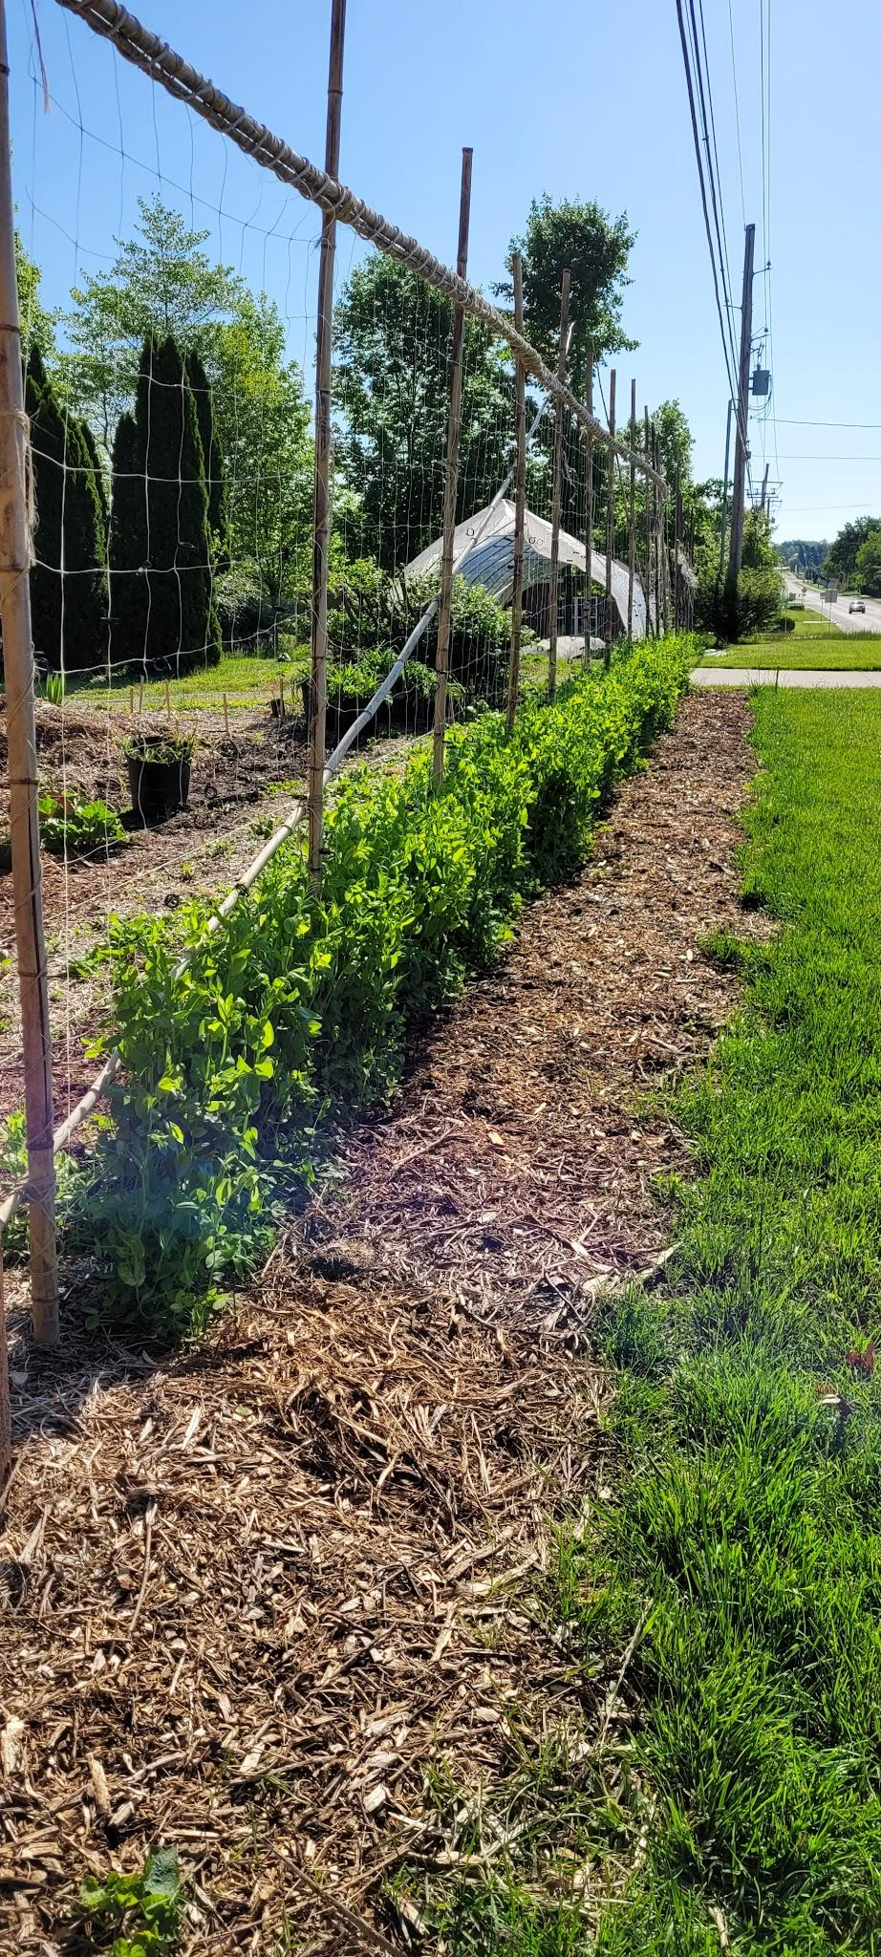
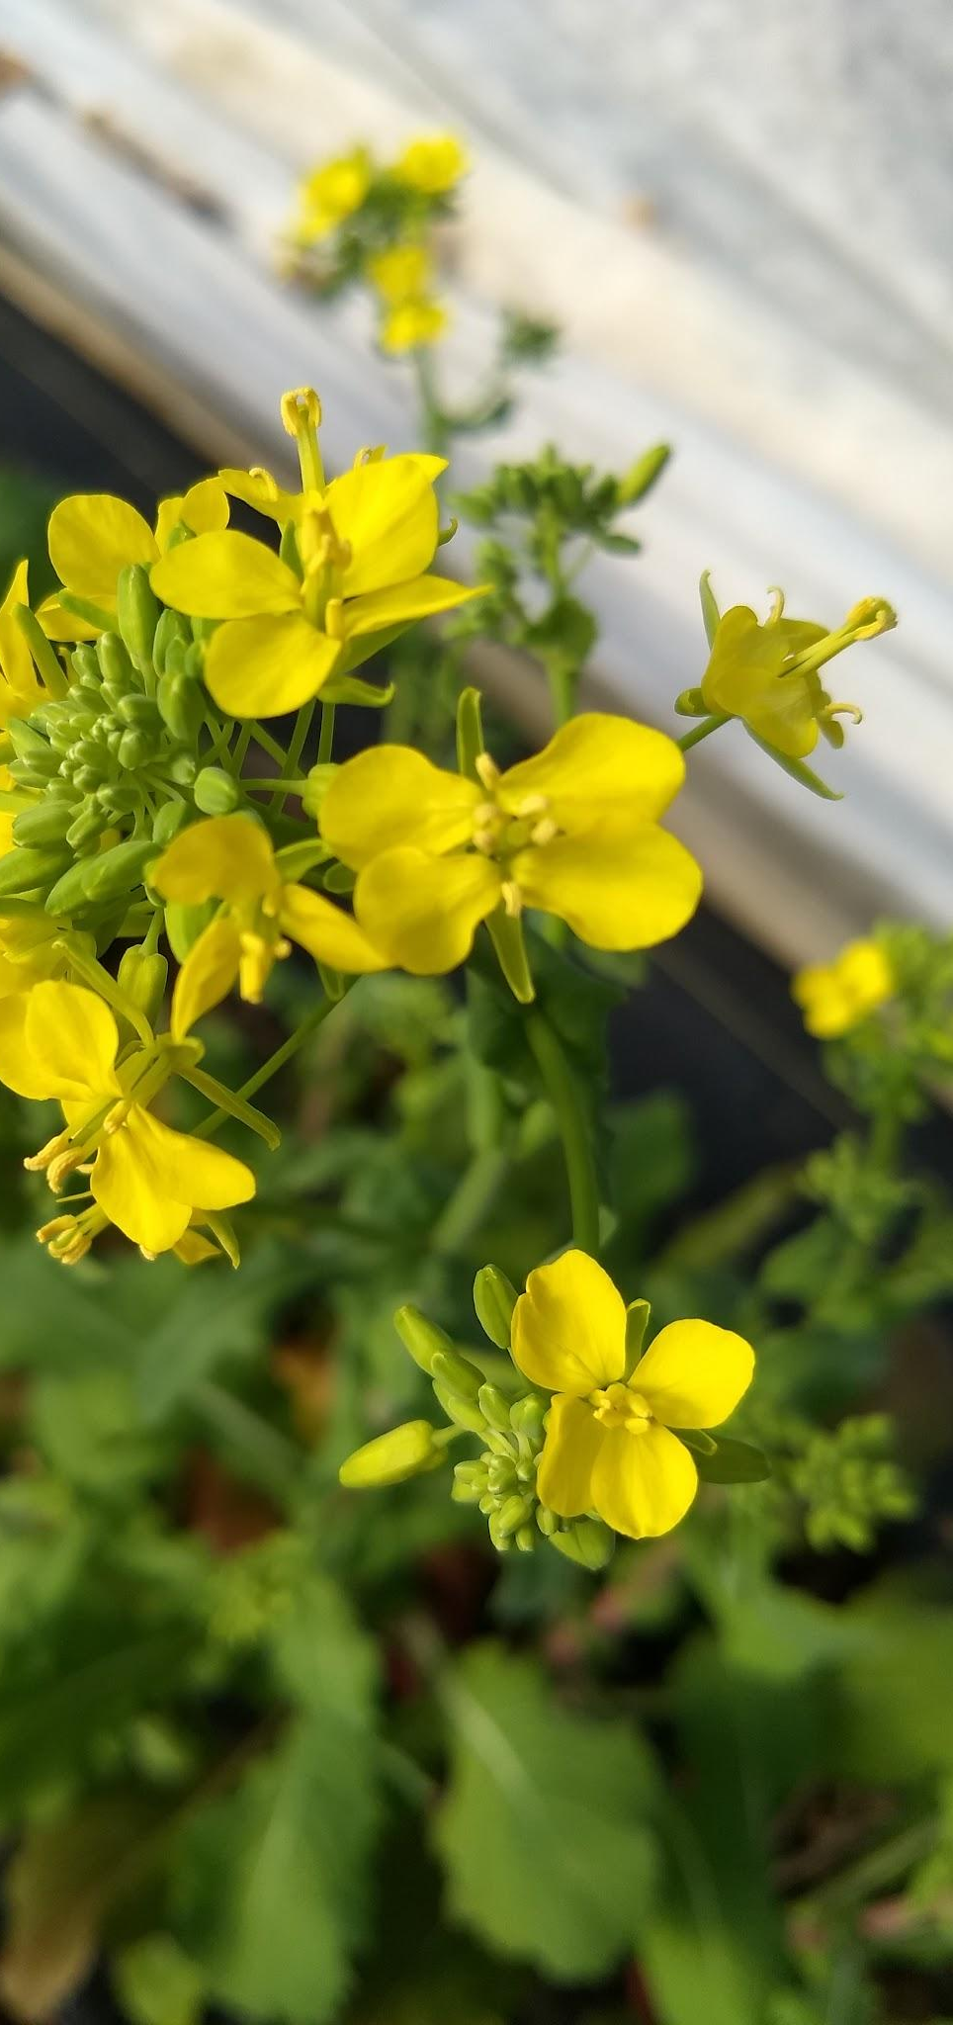
Notes:
We have been growing fresh, local produce year round at our farm in Paradise since 2016. Tomatoes and leafy greens are our main crops. Braising mixes and Edible Flowers are sold for a Snout to Tail vegetable use of all edible parts.

Slide 4
Experience Level with Fungi
30 + years Experience in Foraging wild mushrooms
7 years Experience growing on logs and substrate bags from Field and Forest
5 years Experience Fruiting indoors
Belong to the Bluegrass Mycological Society
Invaluable experts as mentors and foraging wild mushrooms

Slide 5
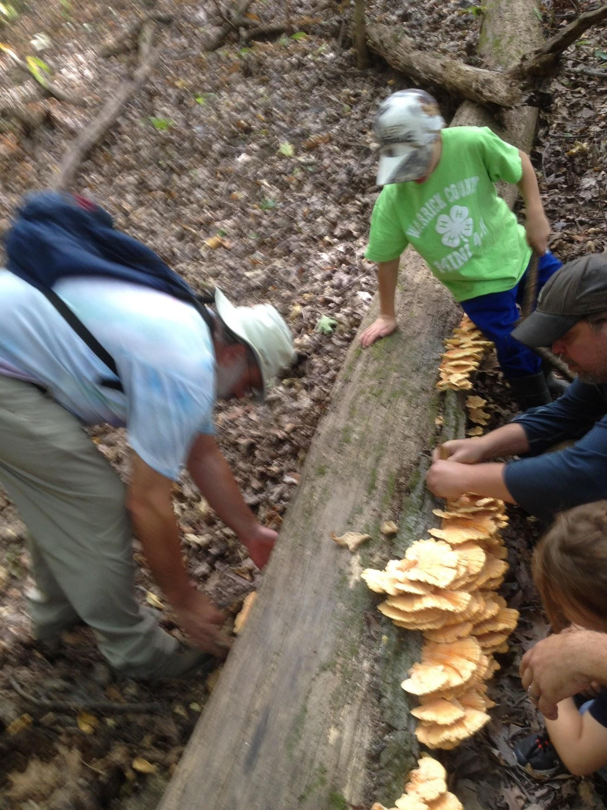
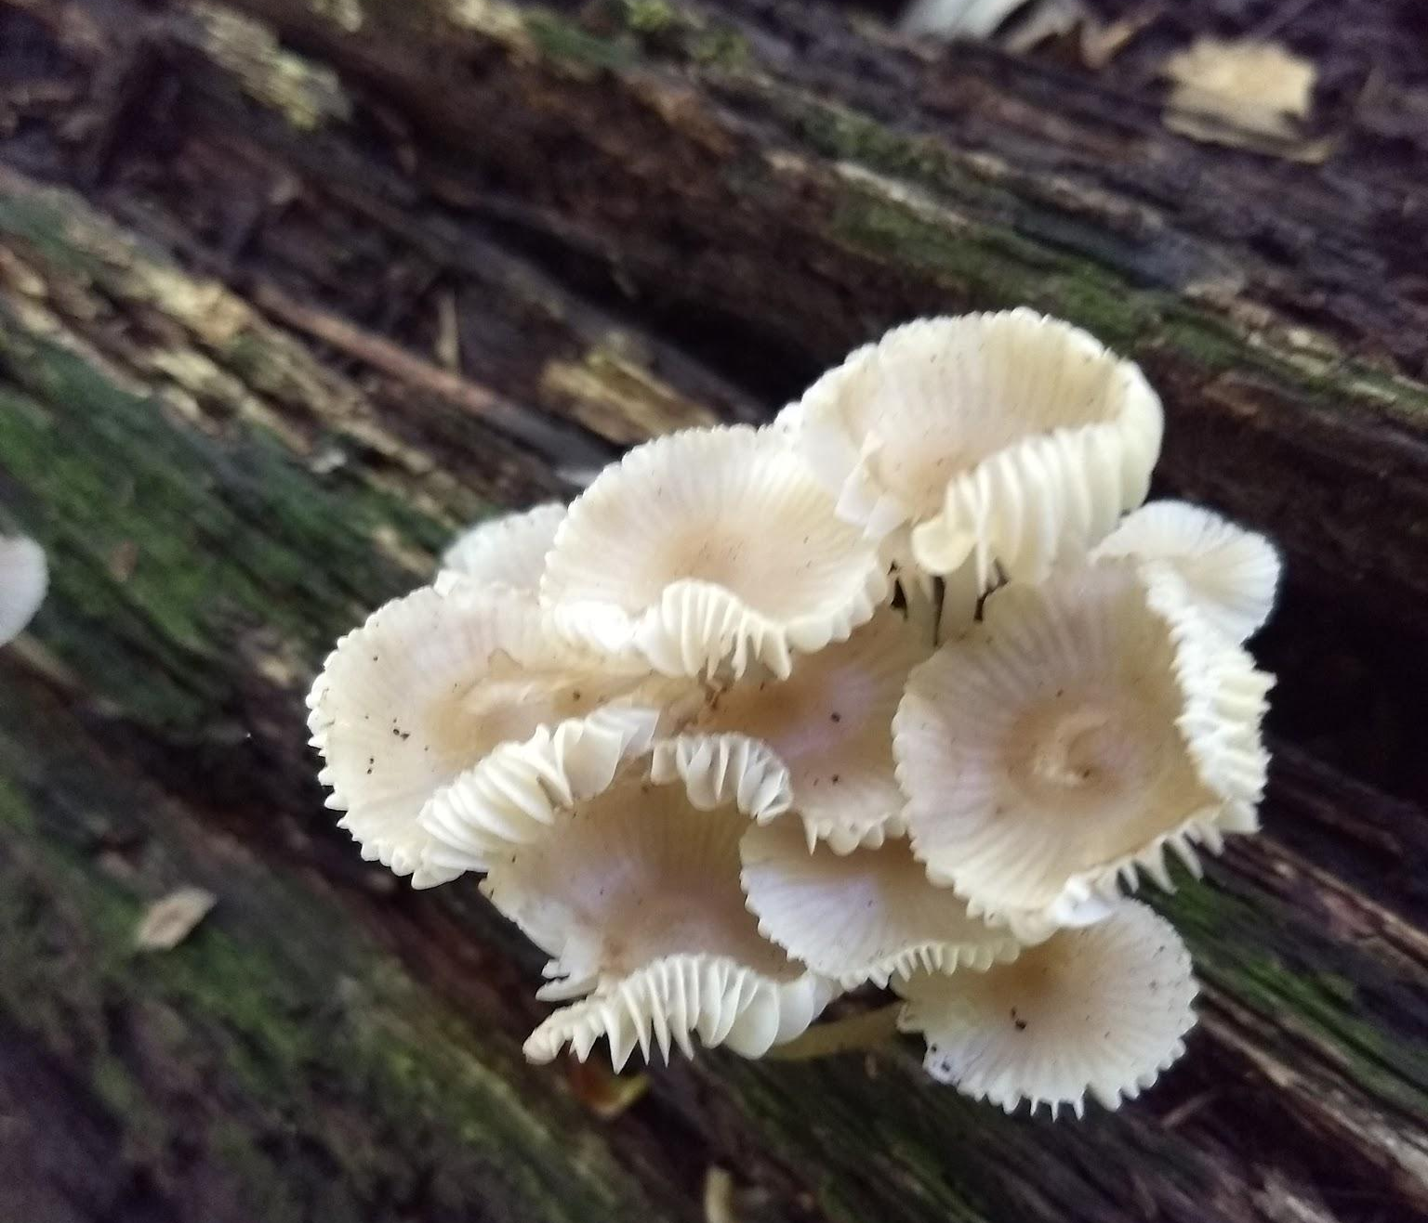
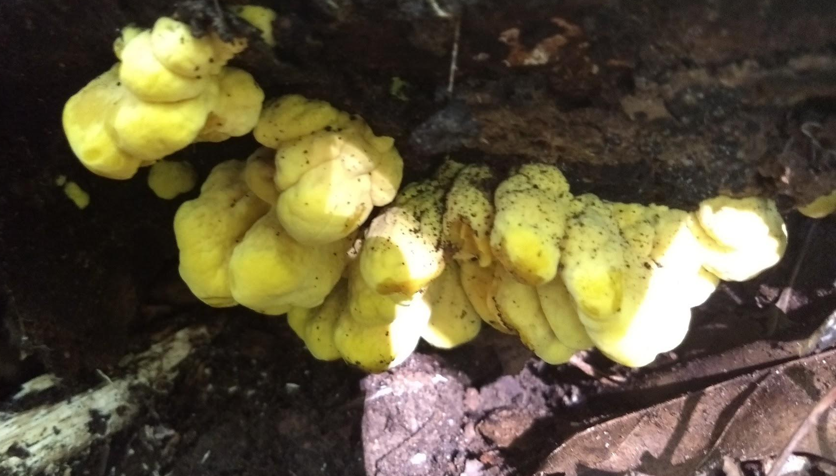
Notes:
We grew and foraged mushrooms for over 15 years and decided to provide mushrooms to our Fall CSA members 2020. . Our experience with fruiting Shiitake logs in our tunnels helped us in designing a low tech mushroom grow.

Slide 6
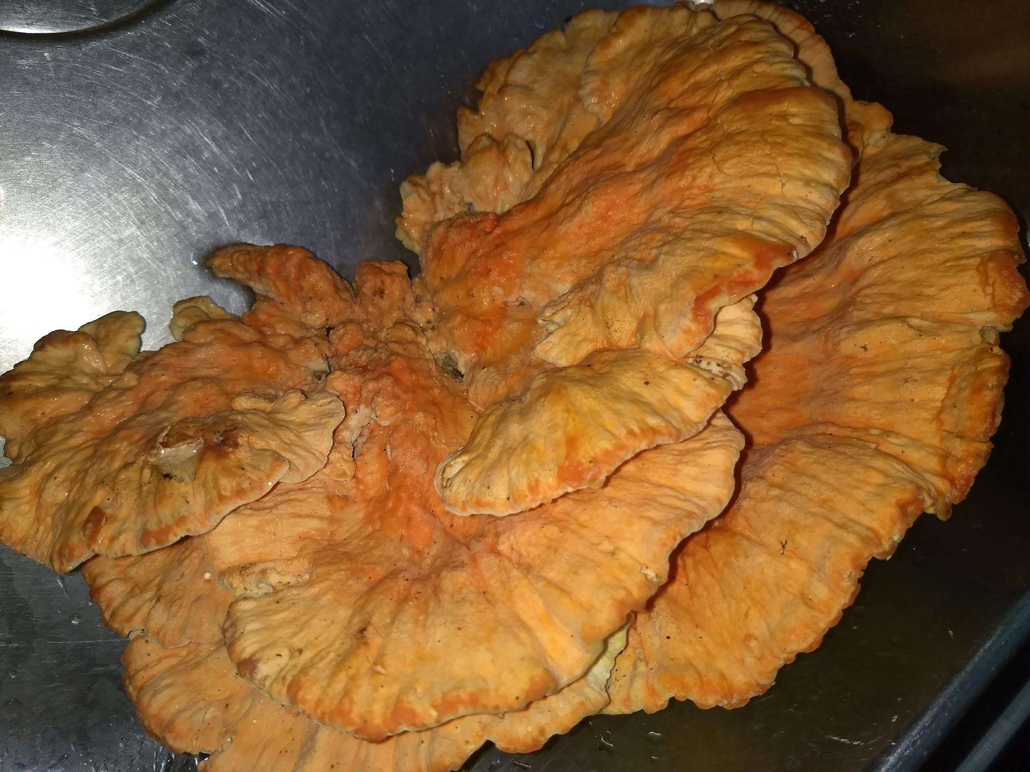
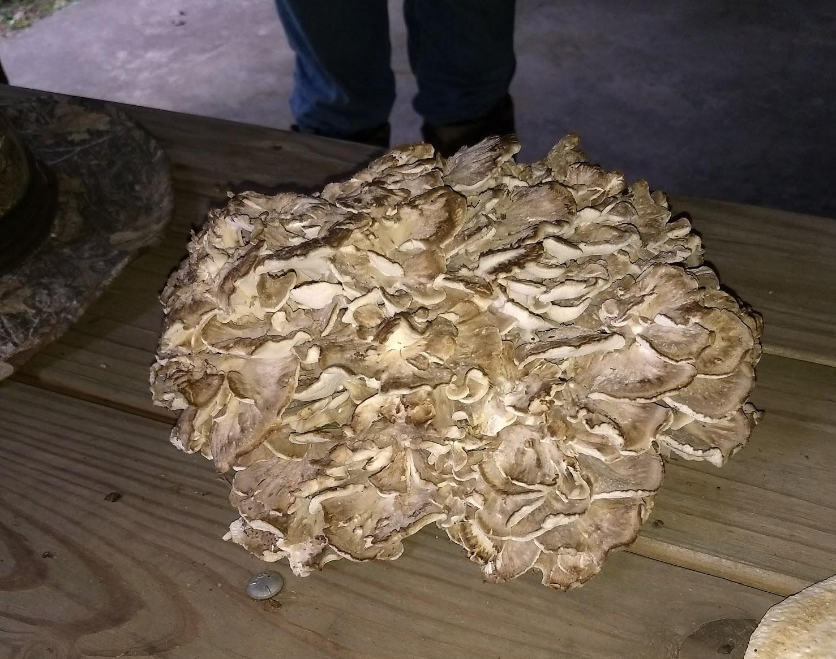
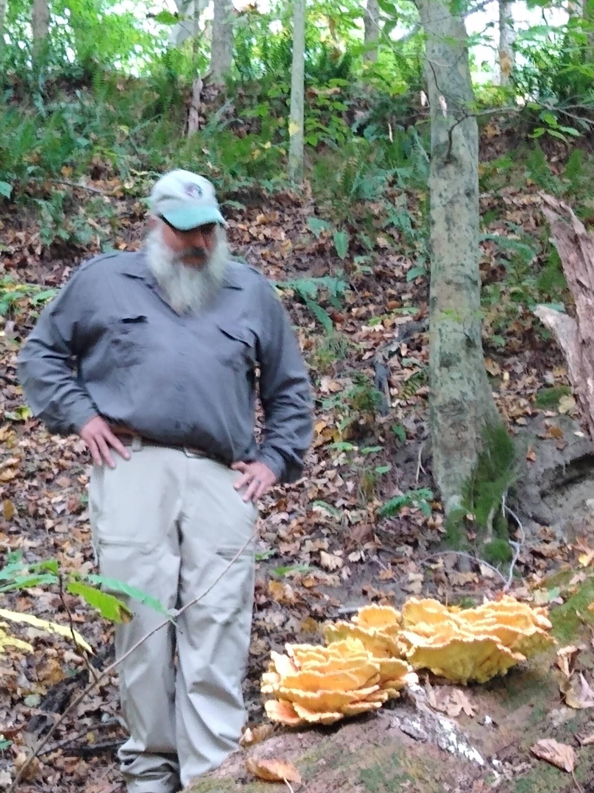
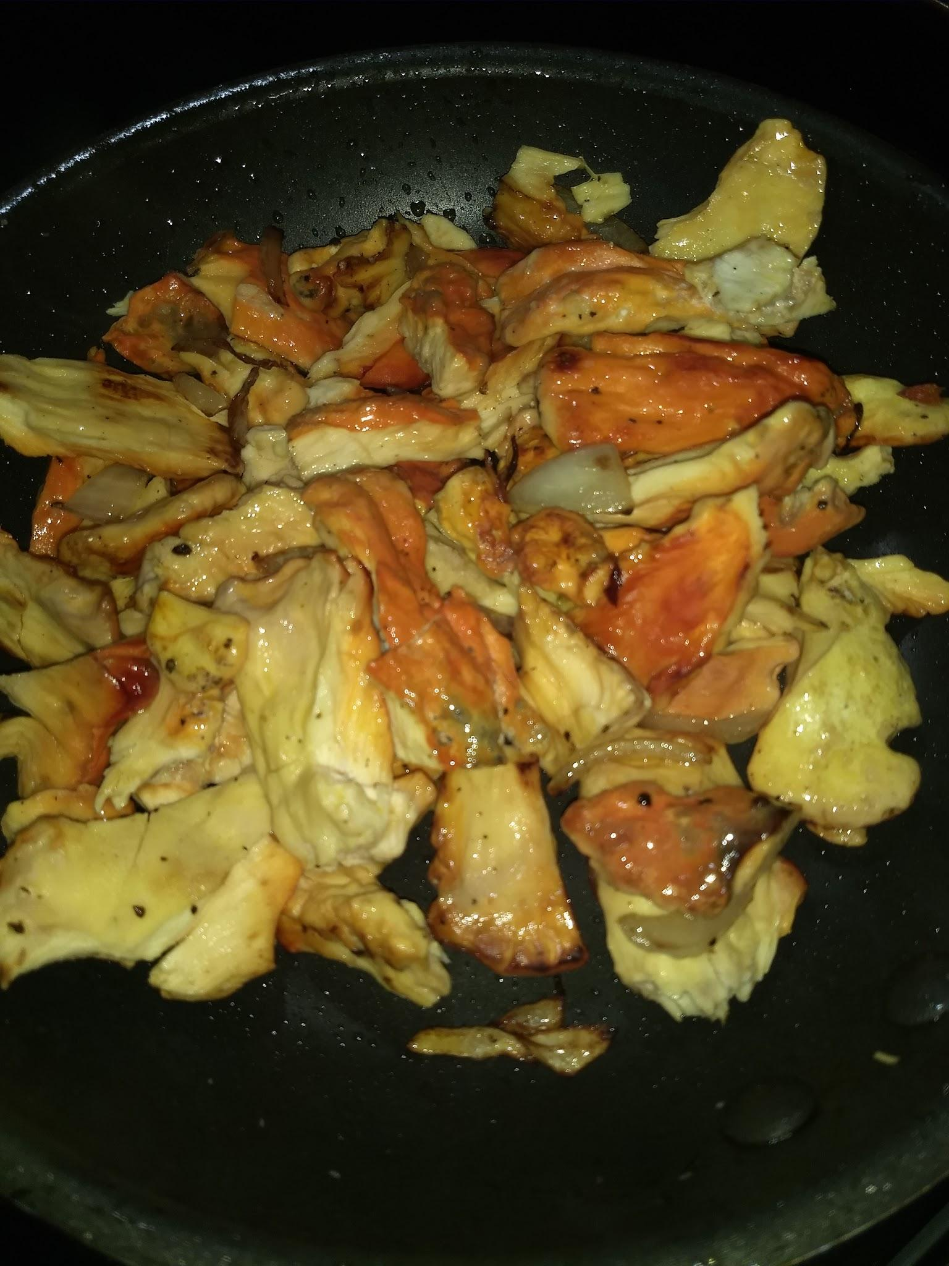
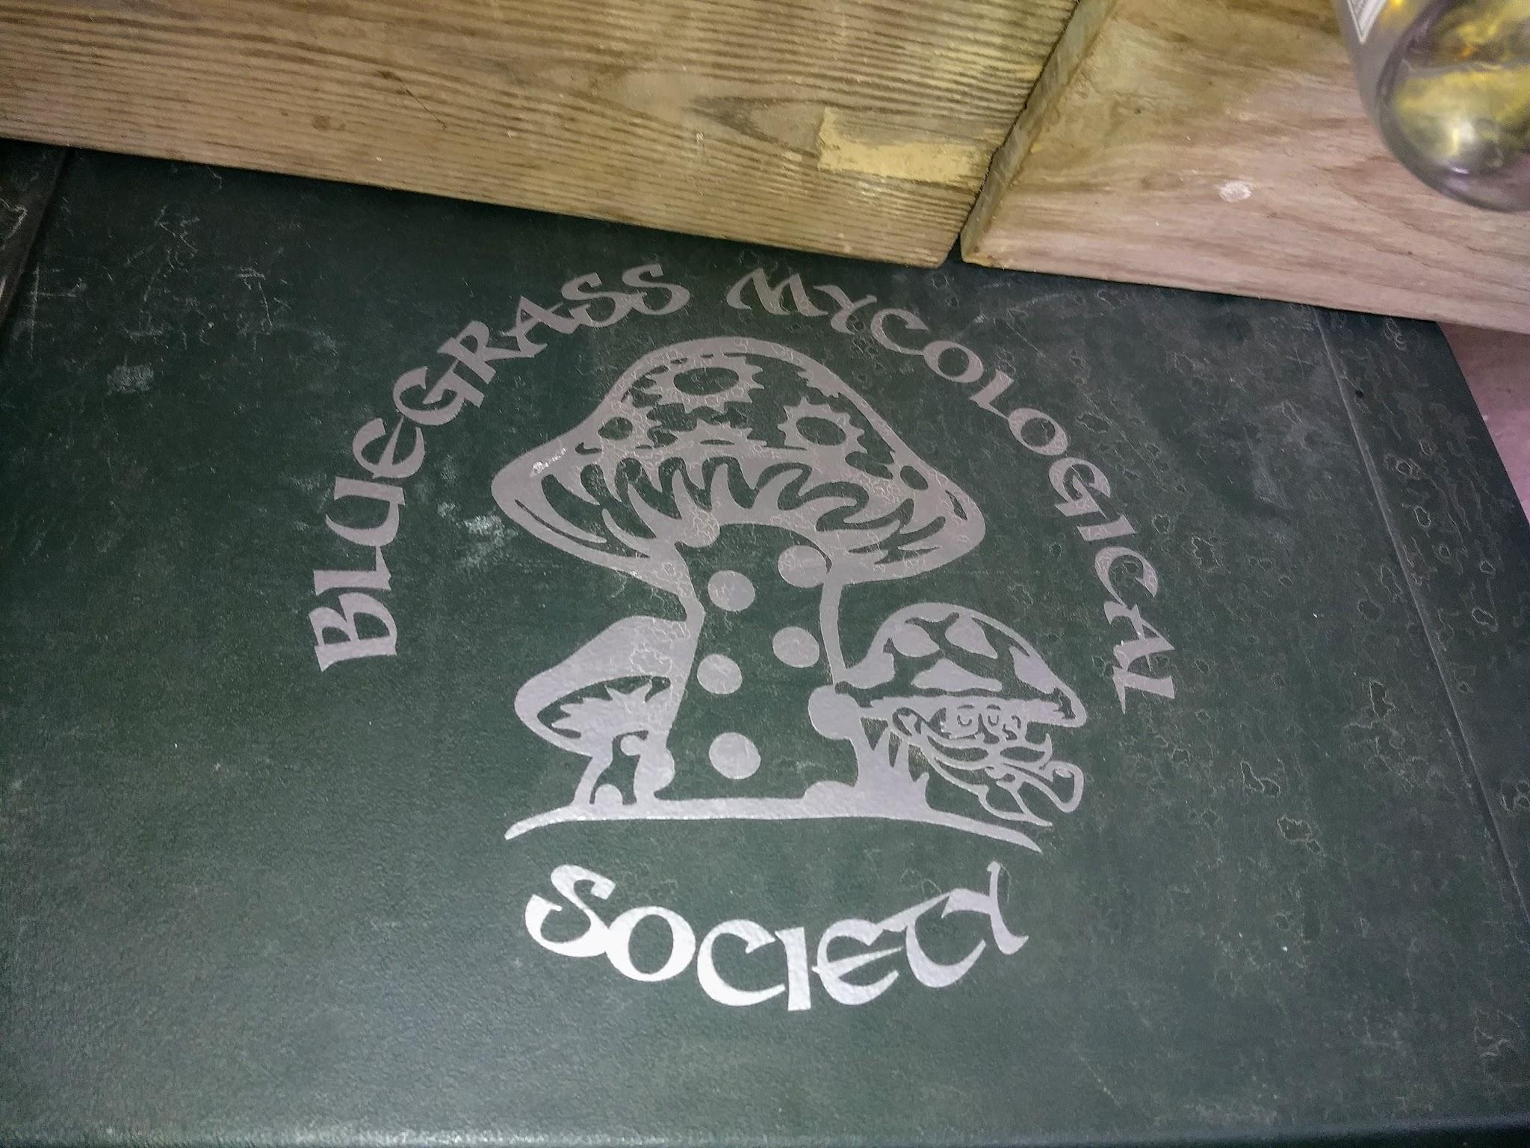

Slide 7
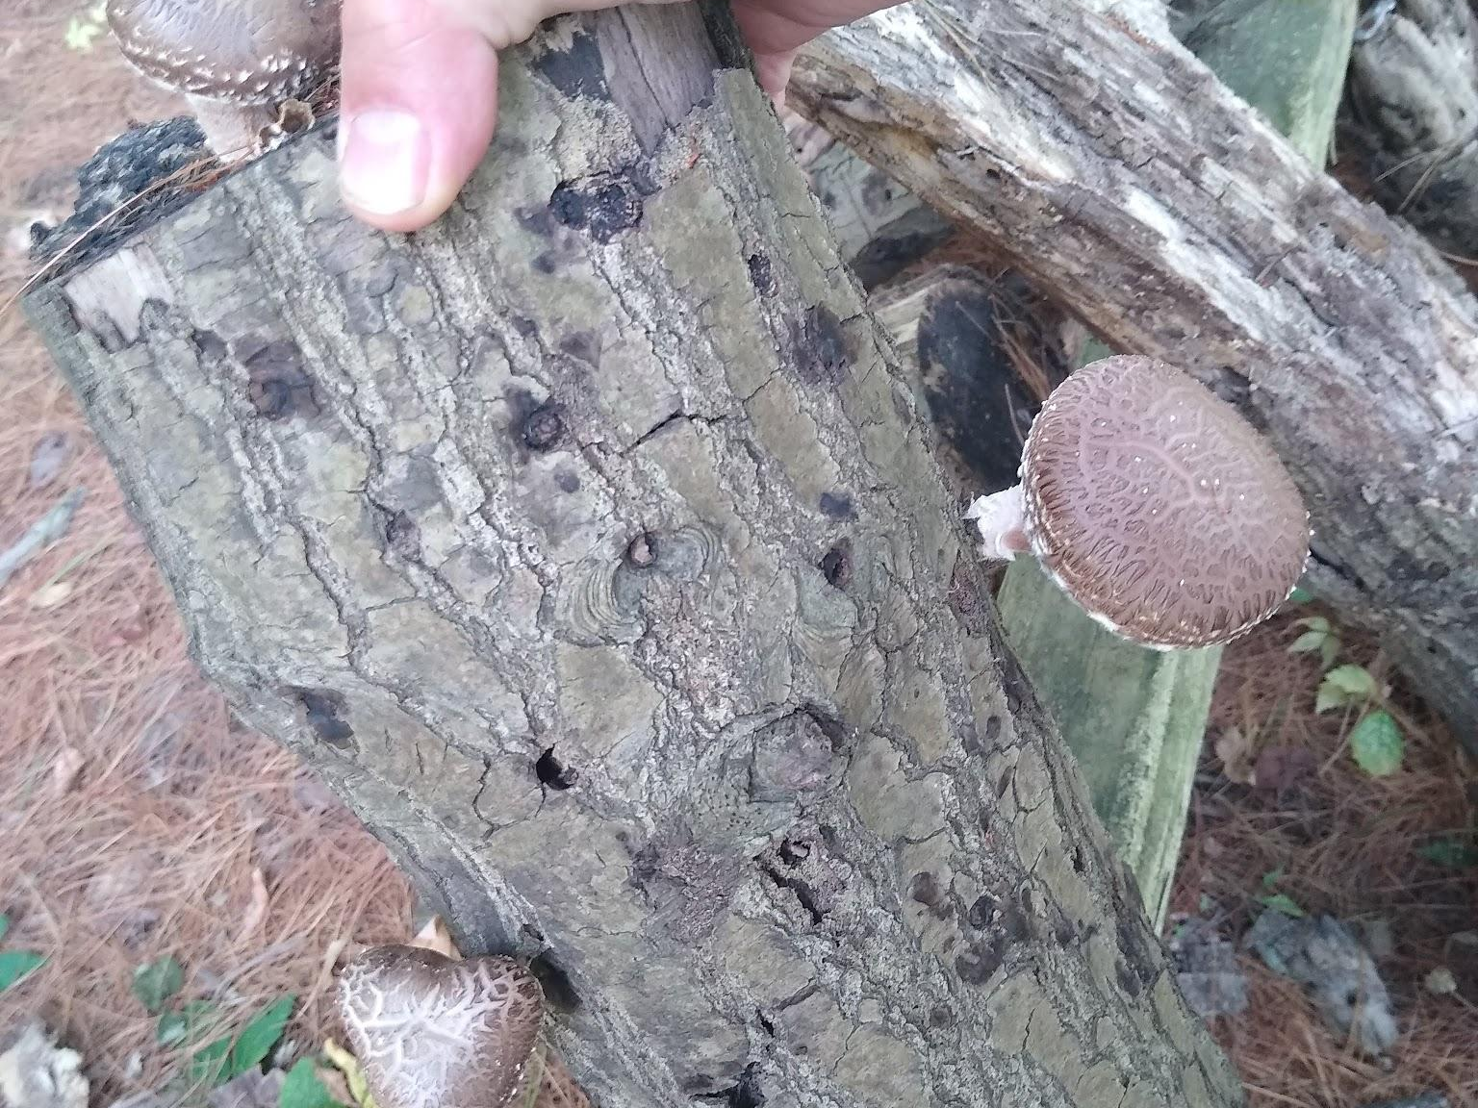
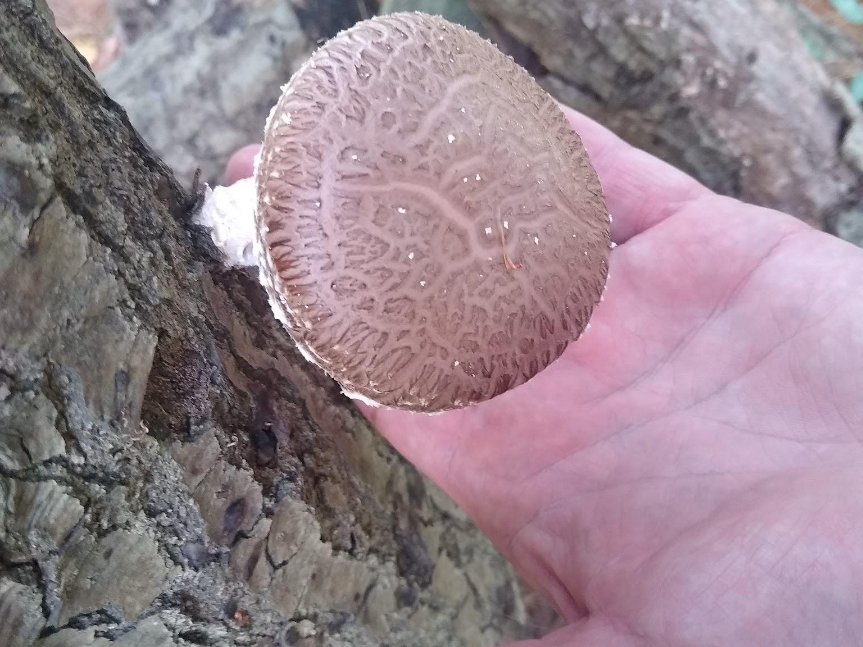
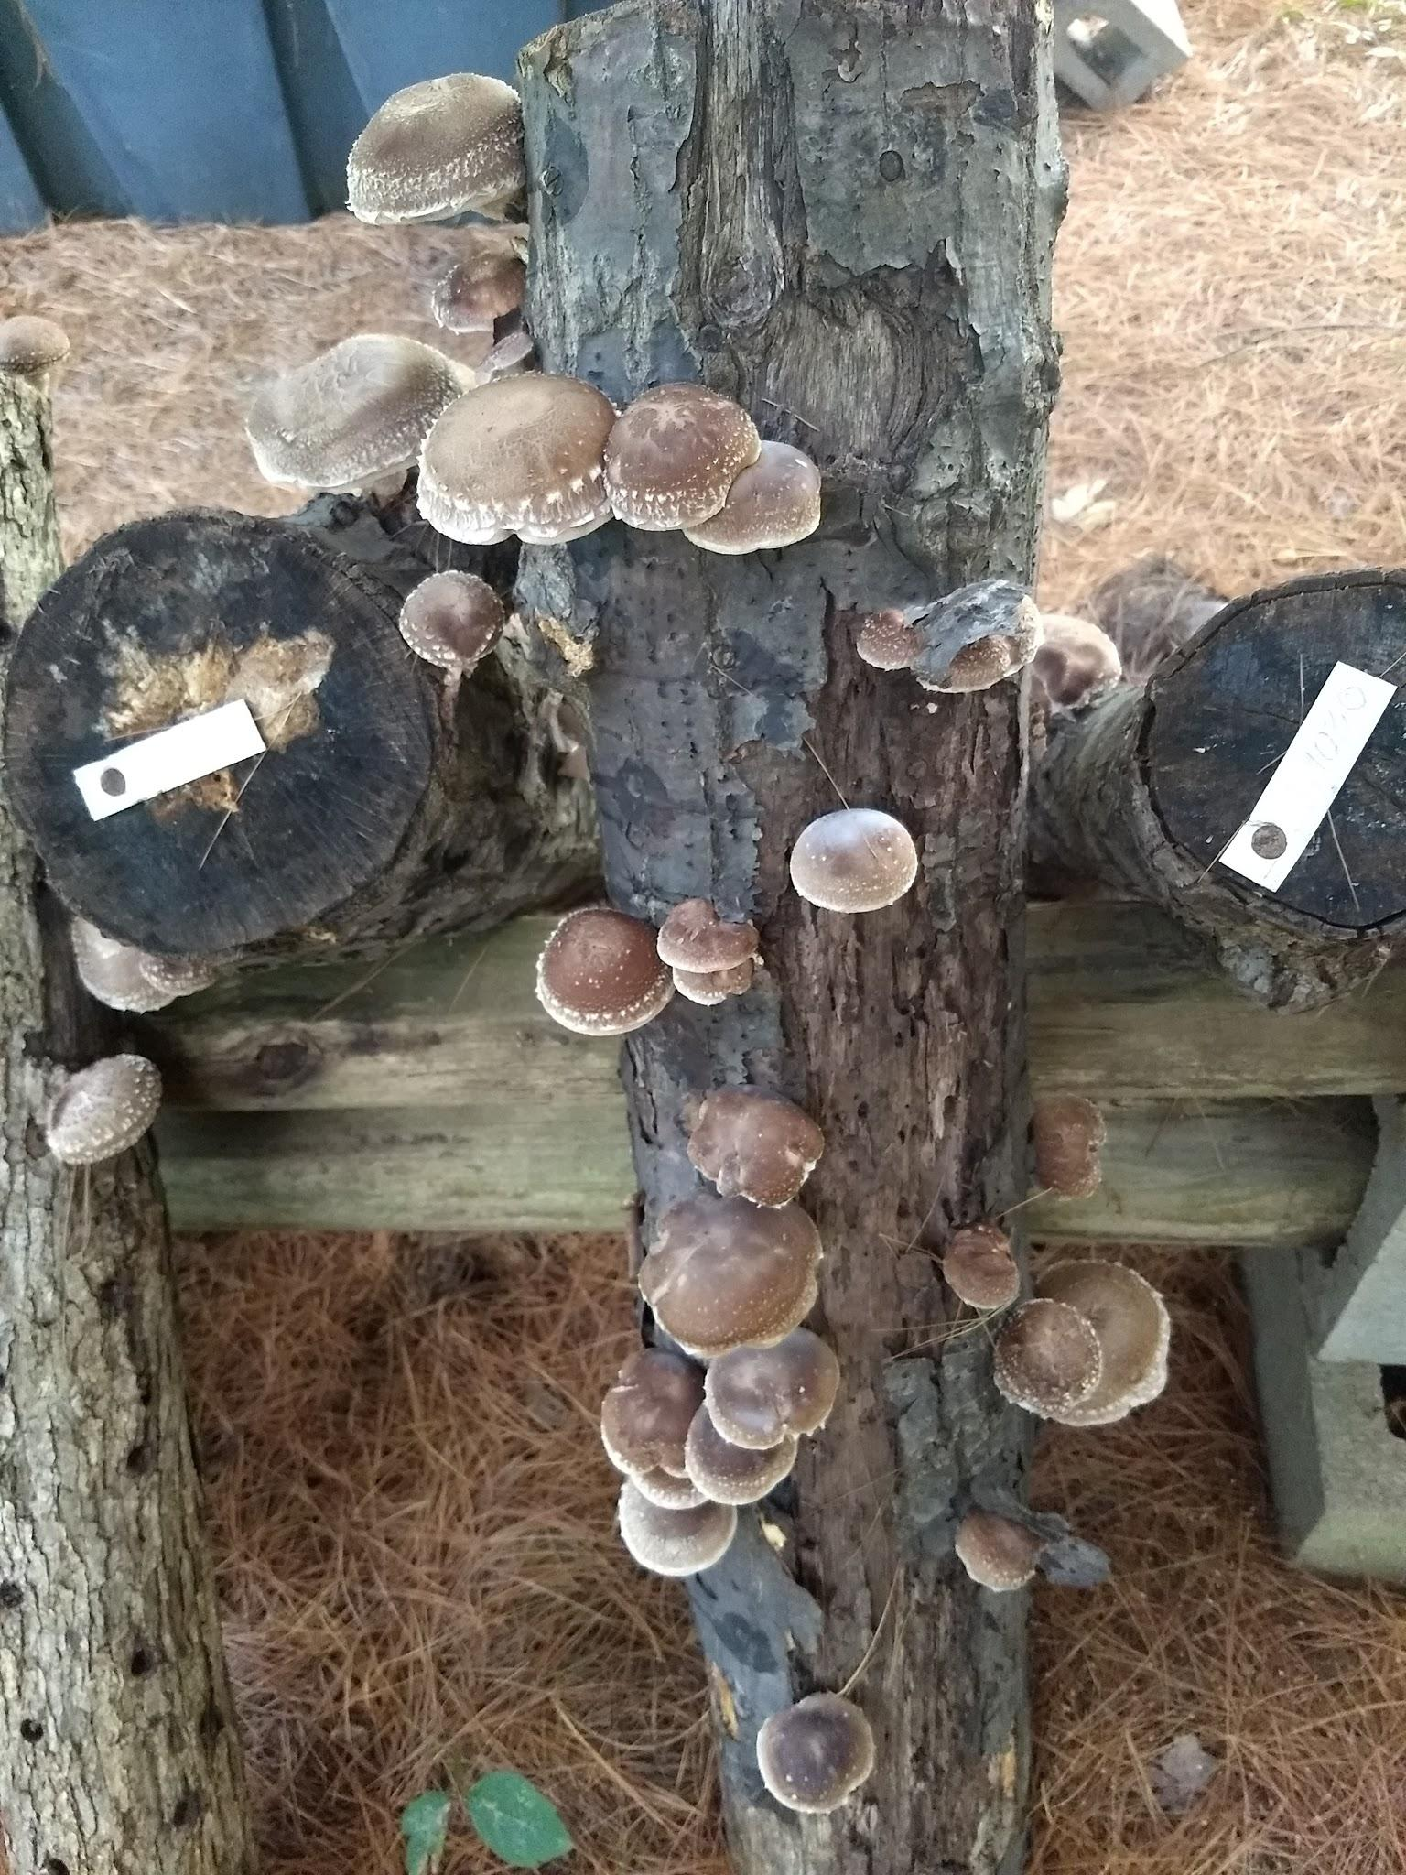
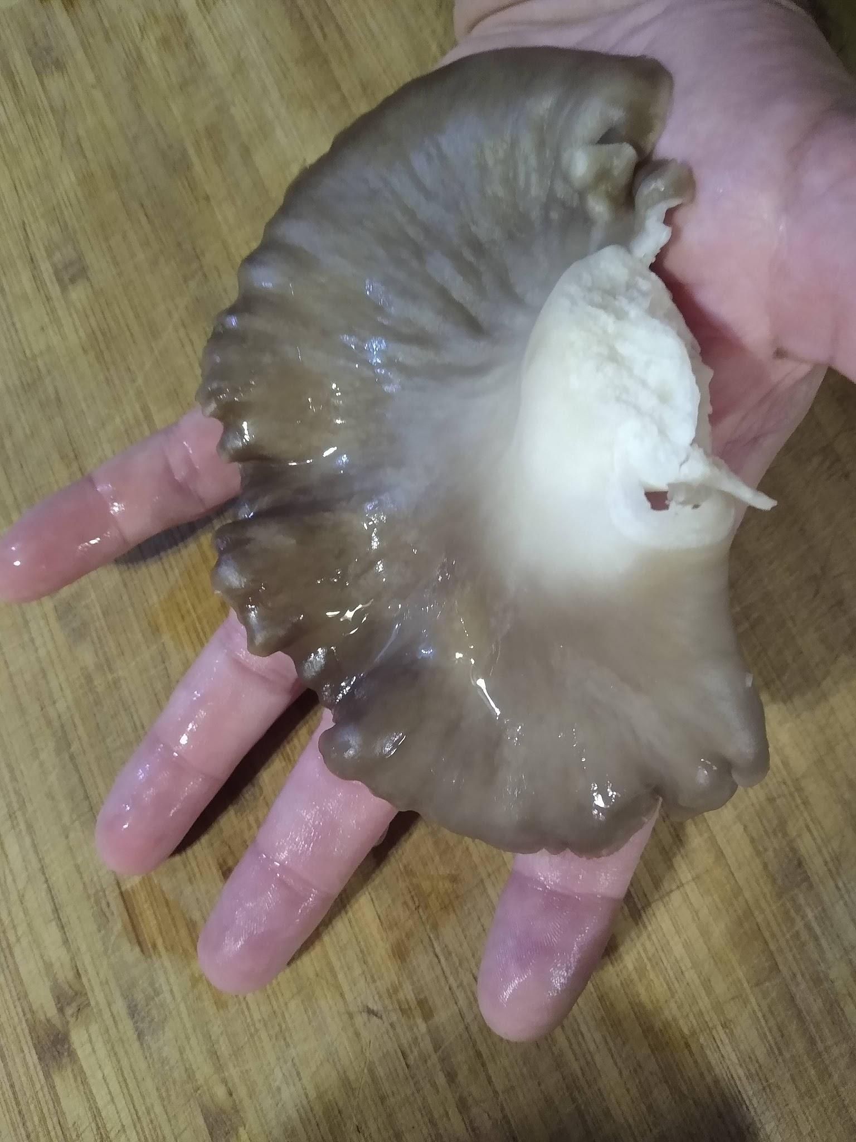
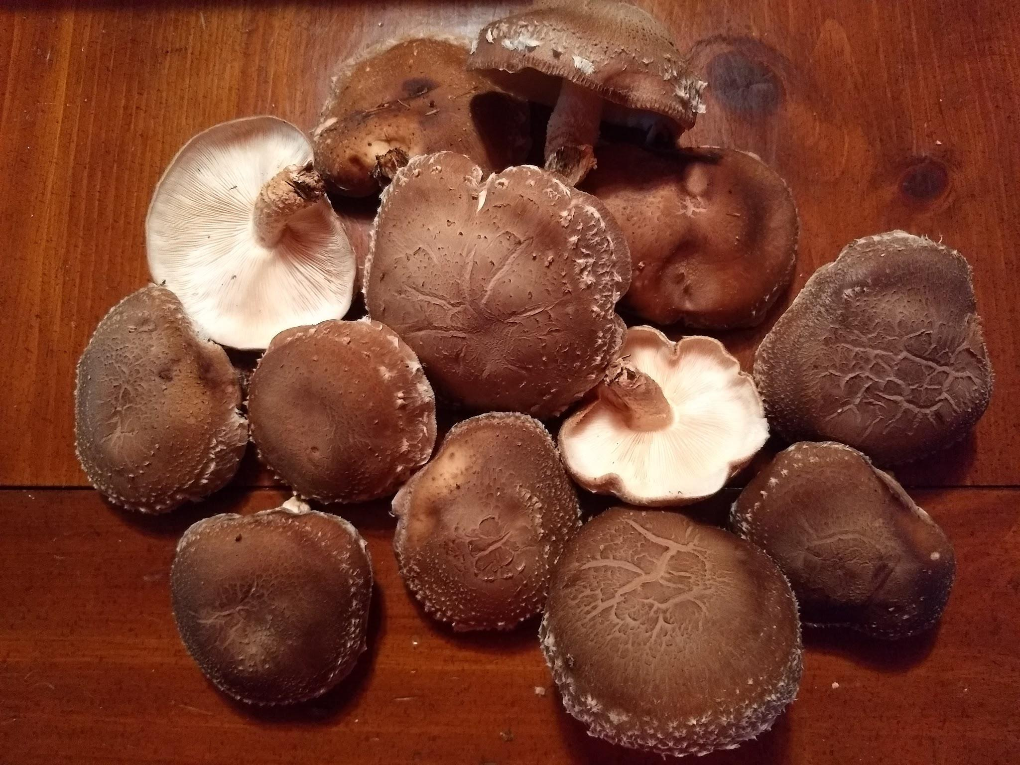

Slide 8
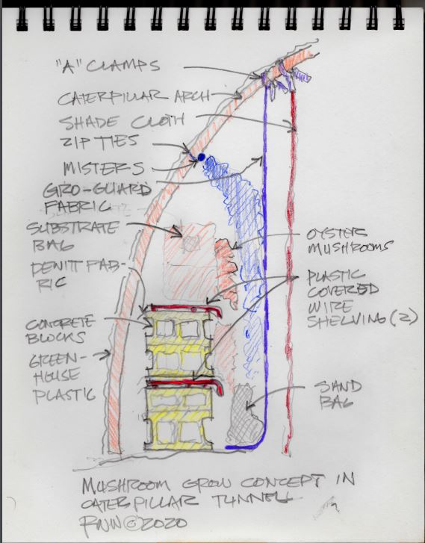
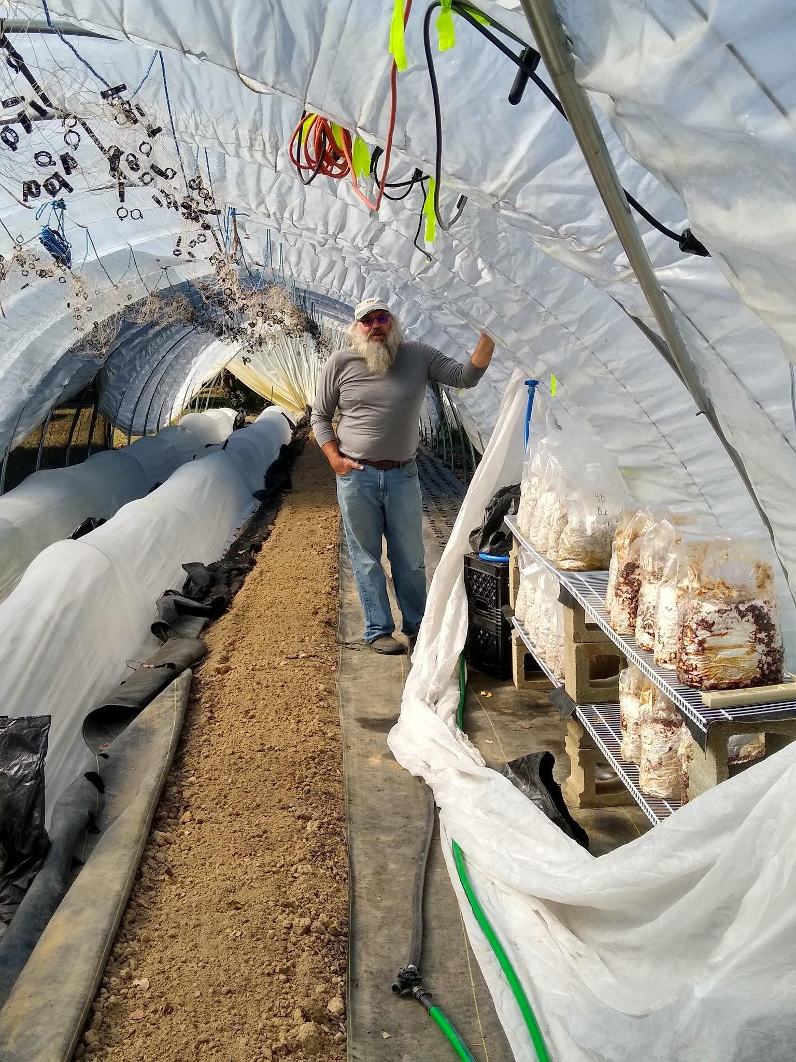
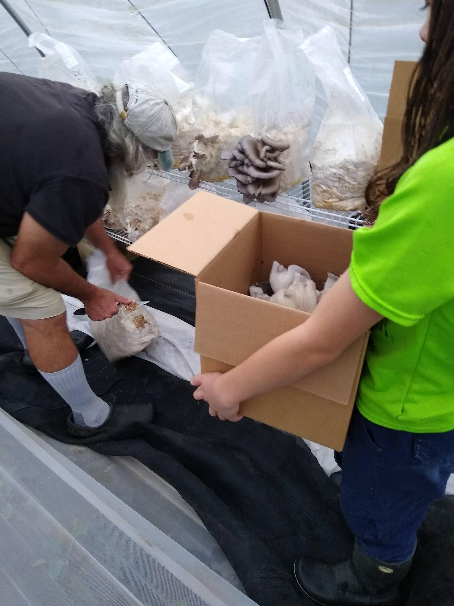
Notes:
Our 2021 Purdue Small Farm Poster Presentation on a Low Tech Caterpillar Tunnel Mushroom Grow

Slide 9
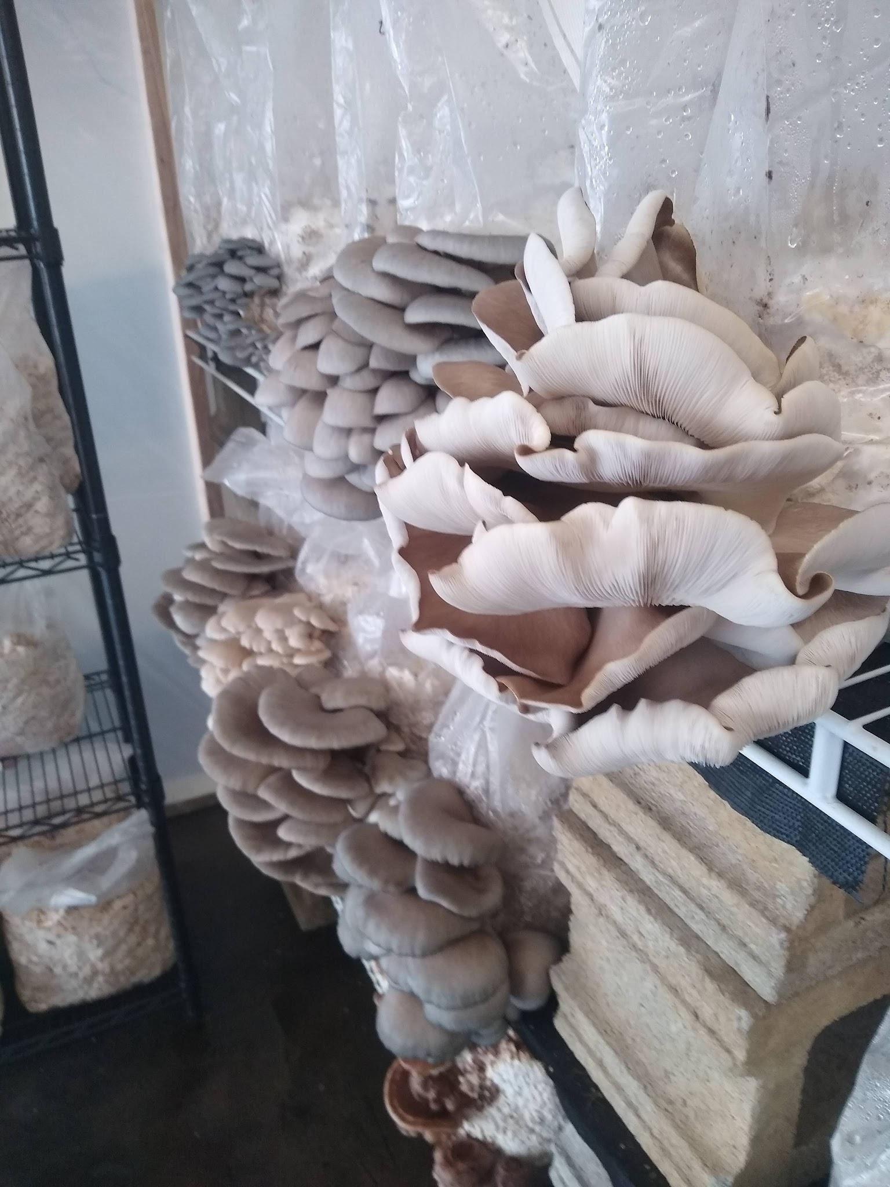
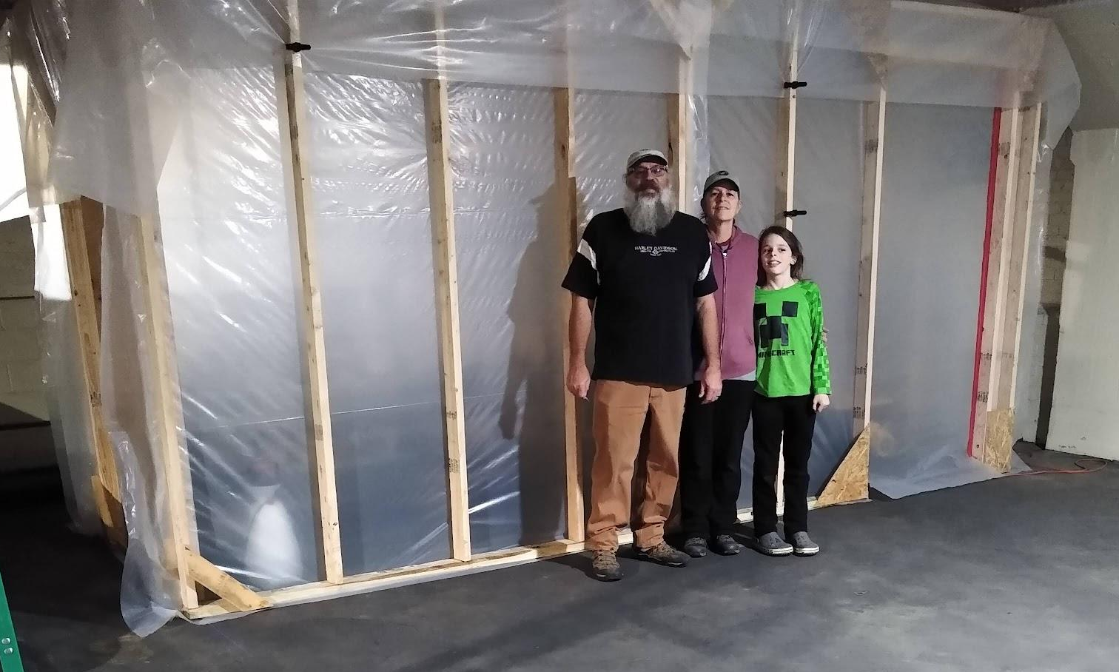
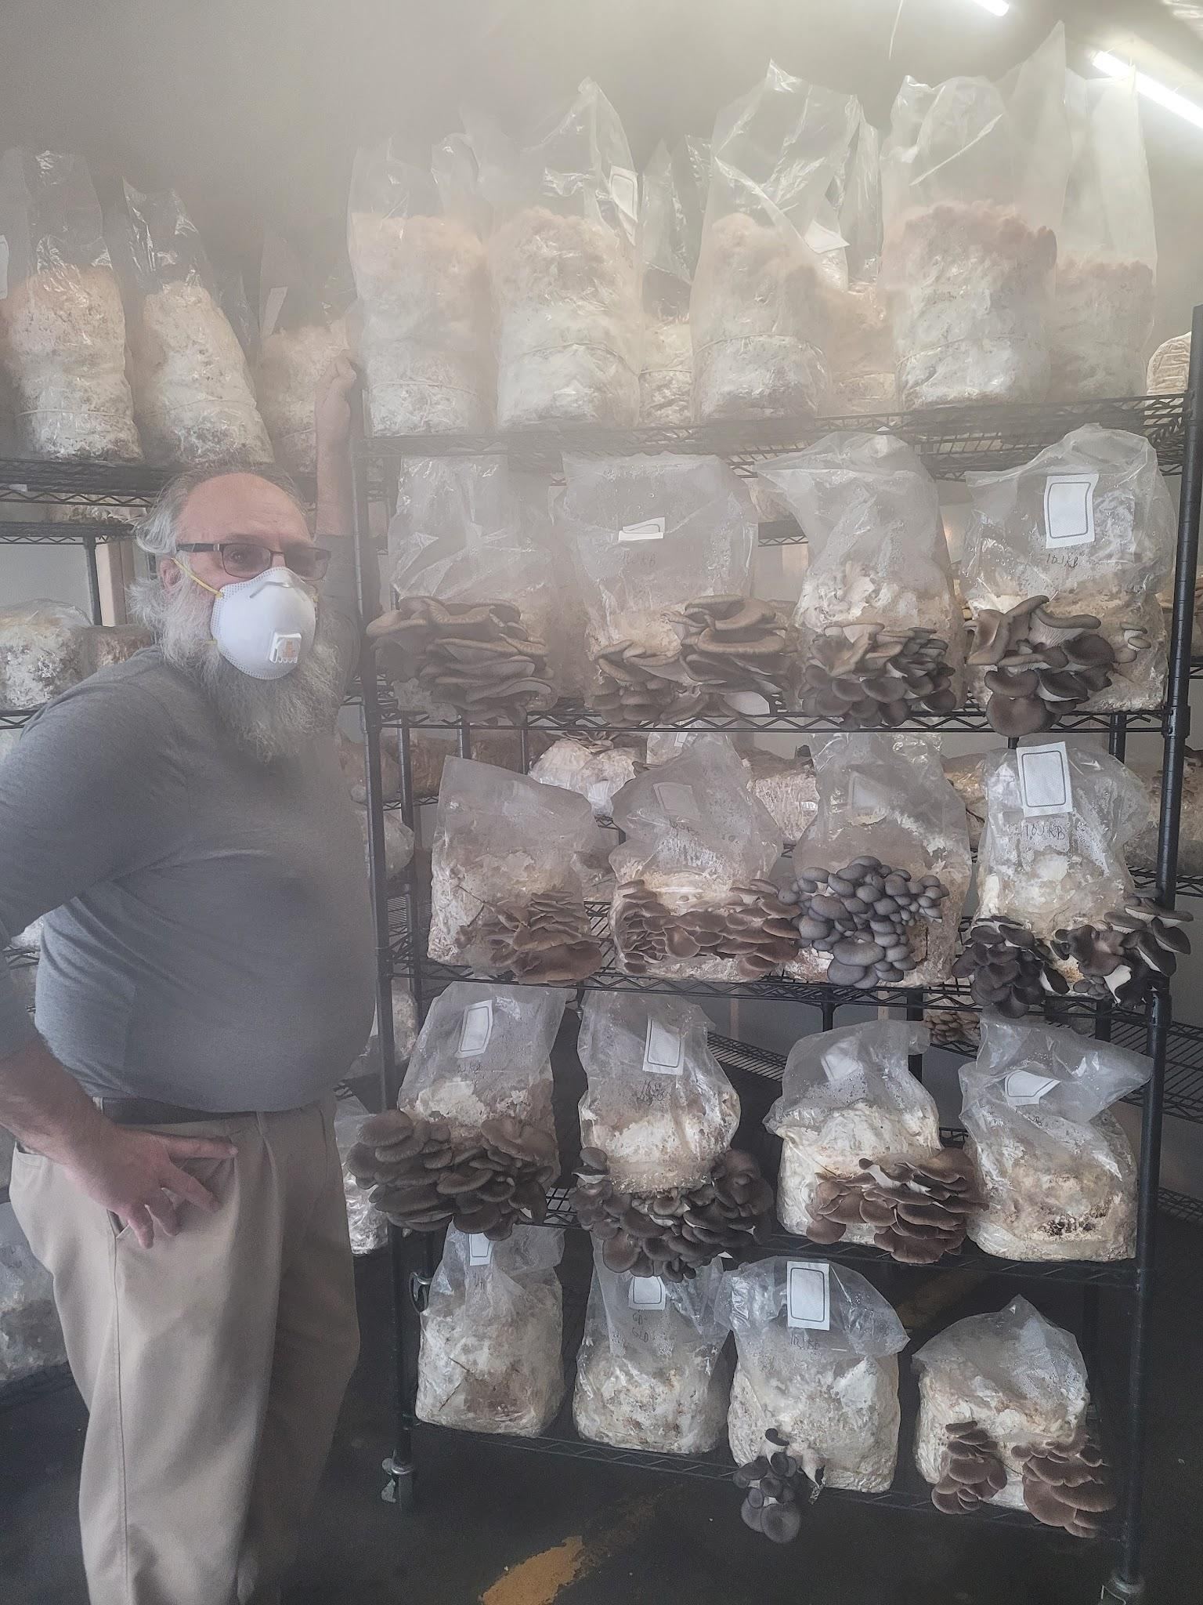
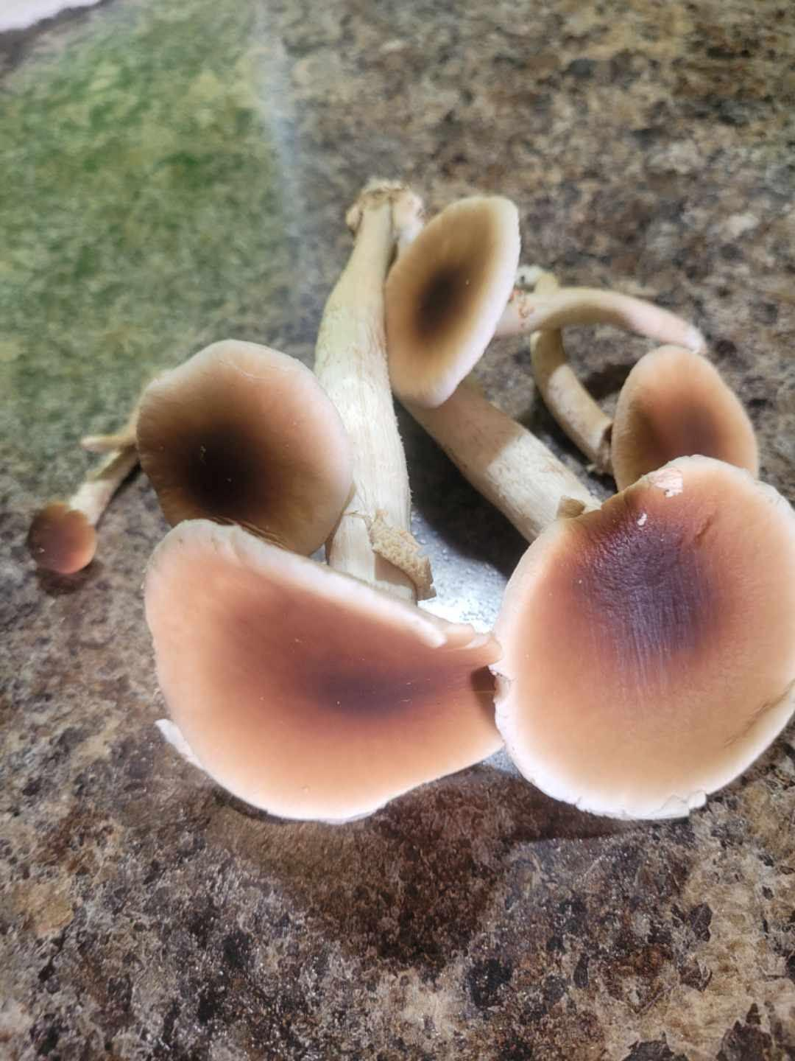
Notes:
When winter temps dropped, we partnered with APE Aquaponics at their urban indoor location and built a year round mushroom grow facility.

Slide 10
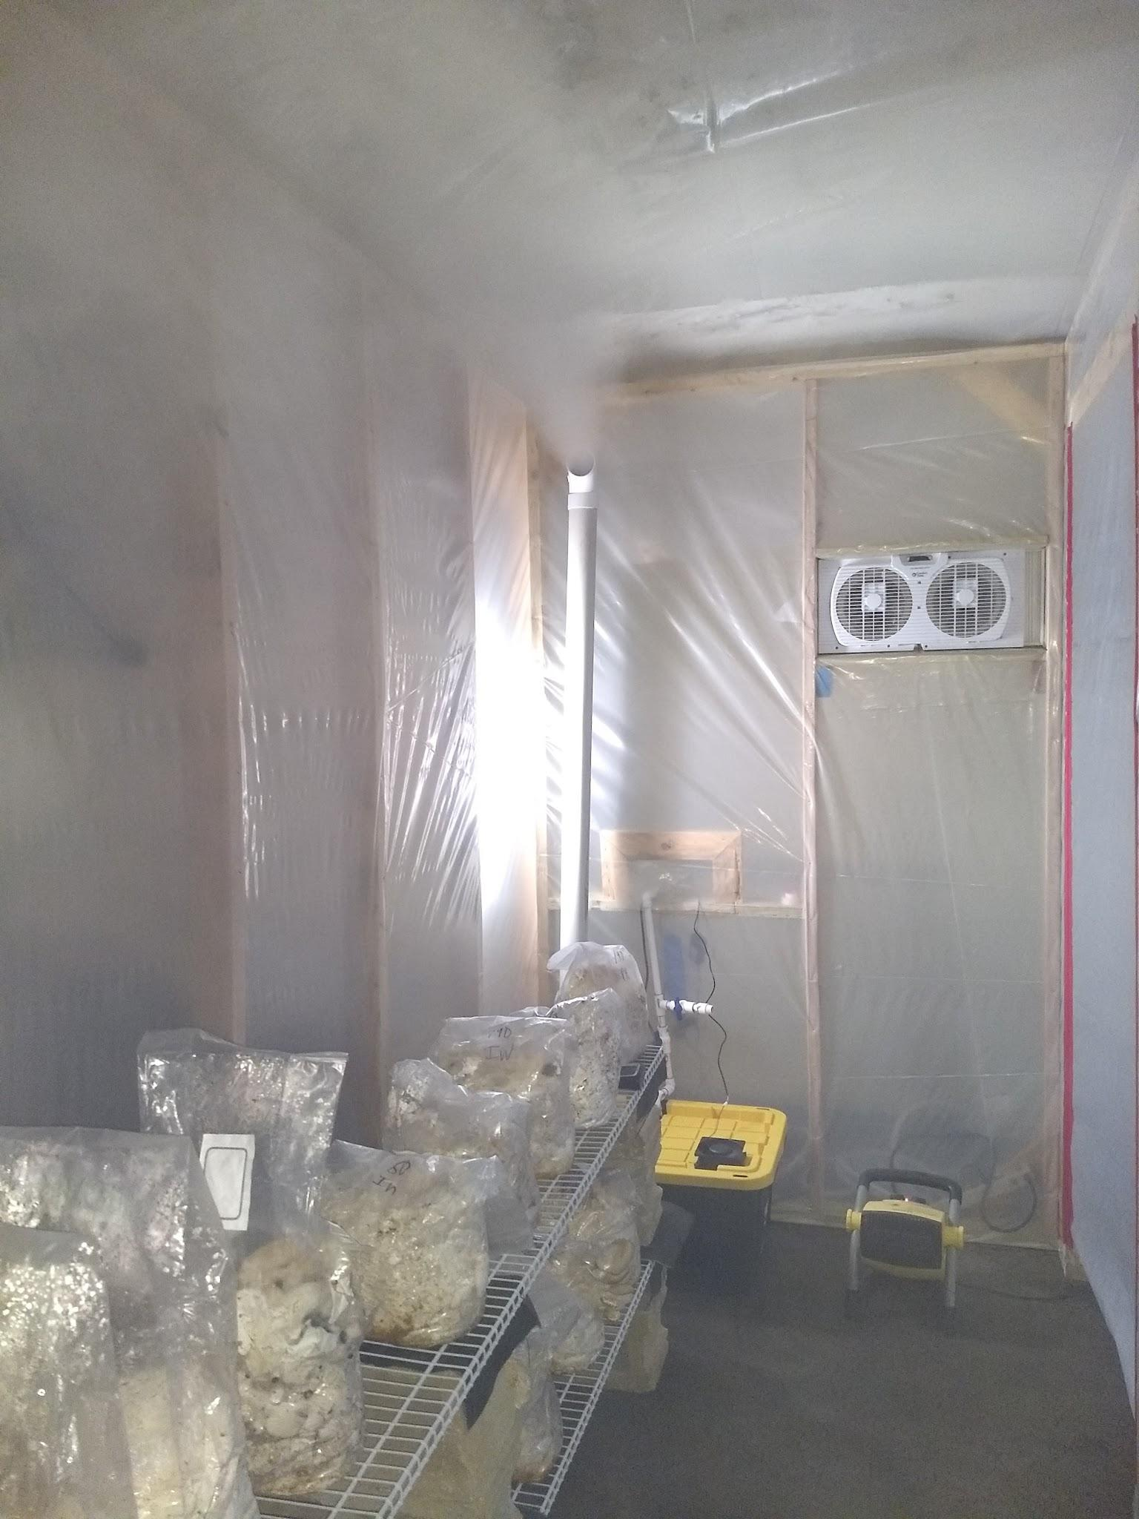
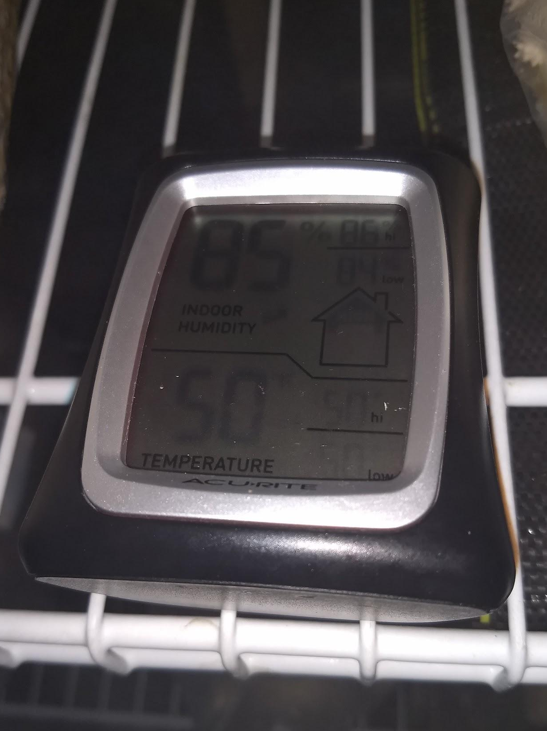
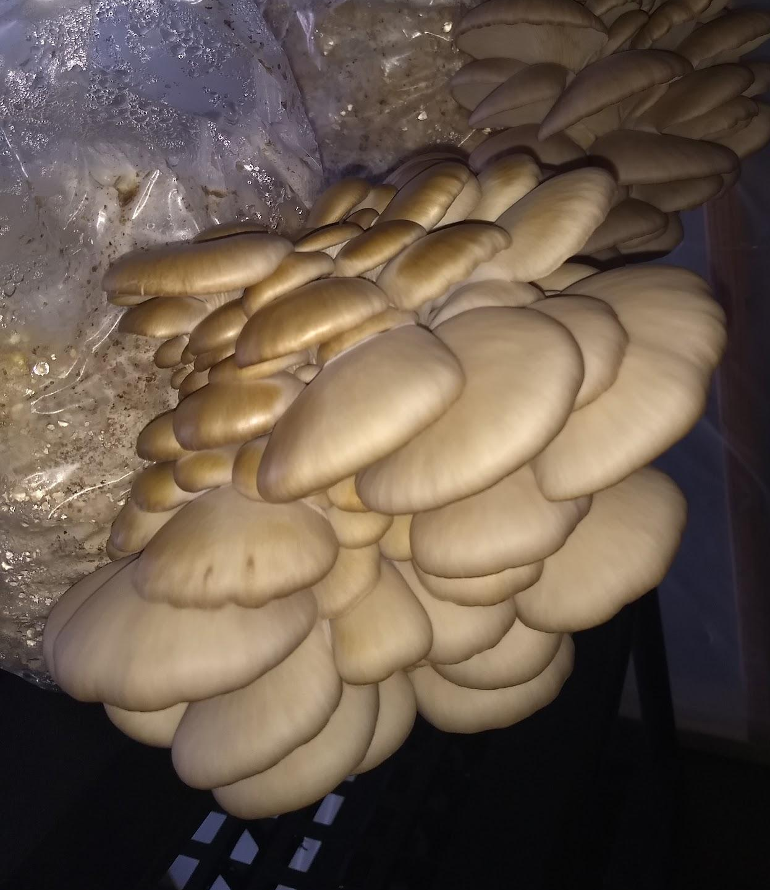
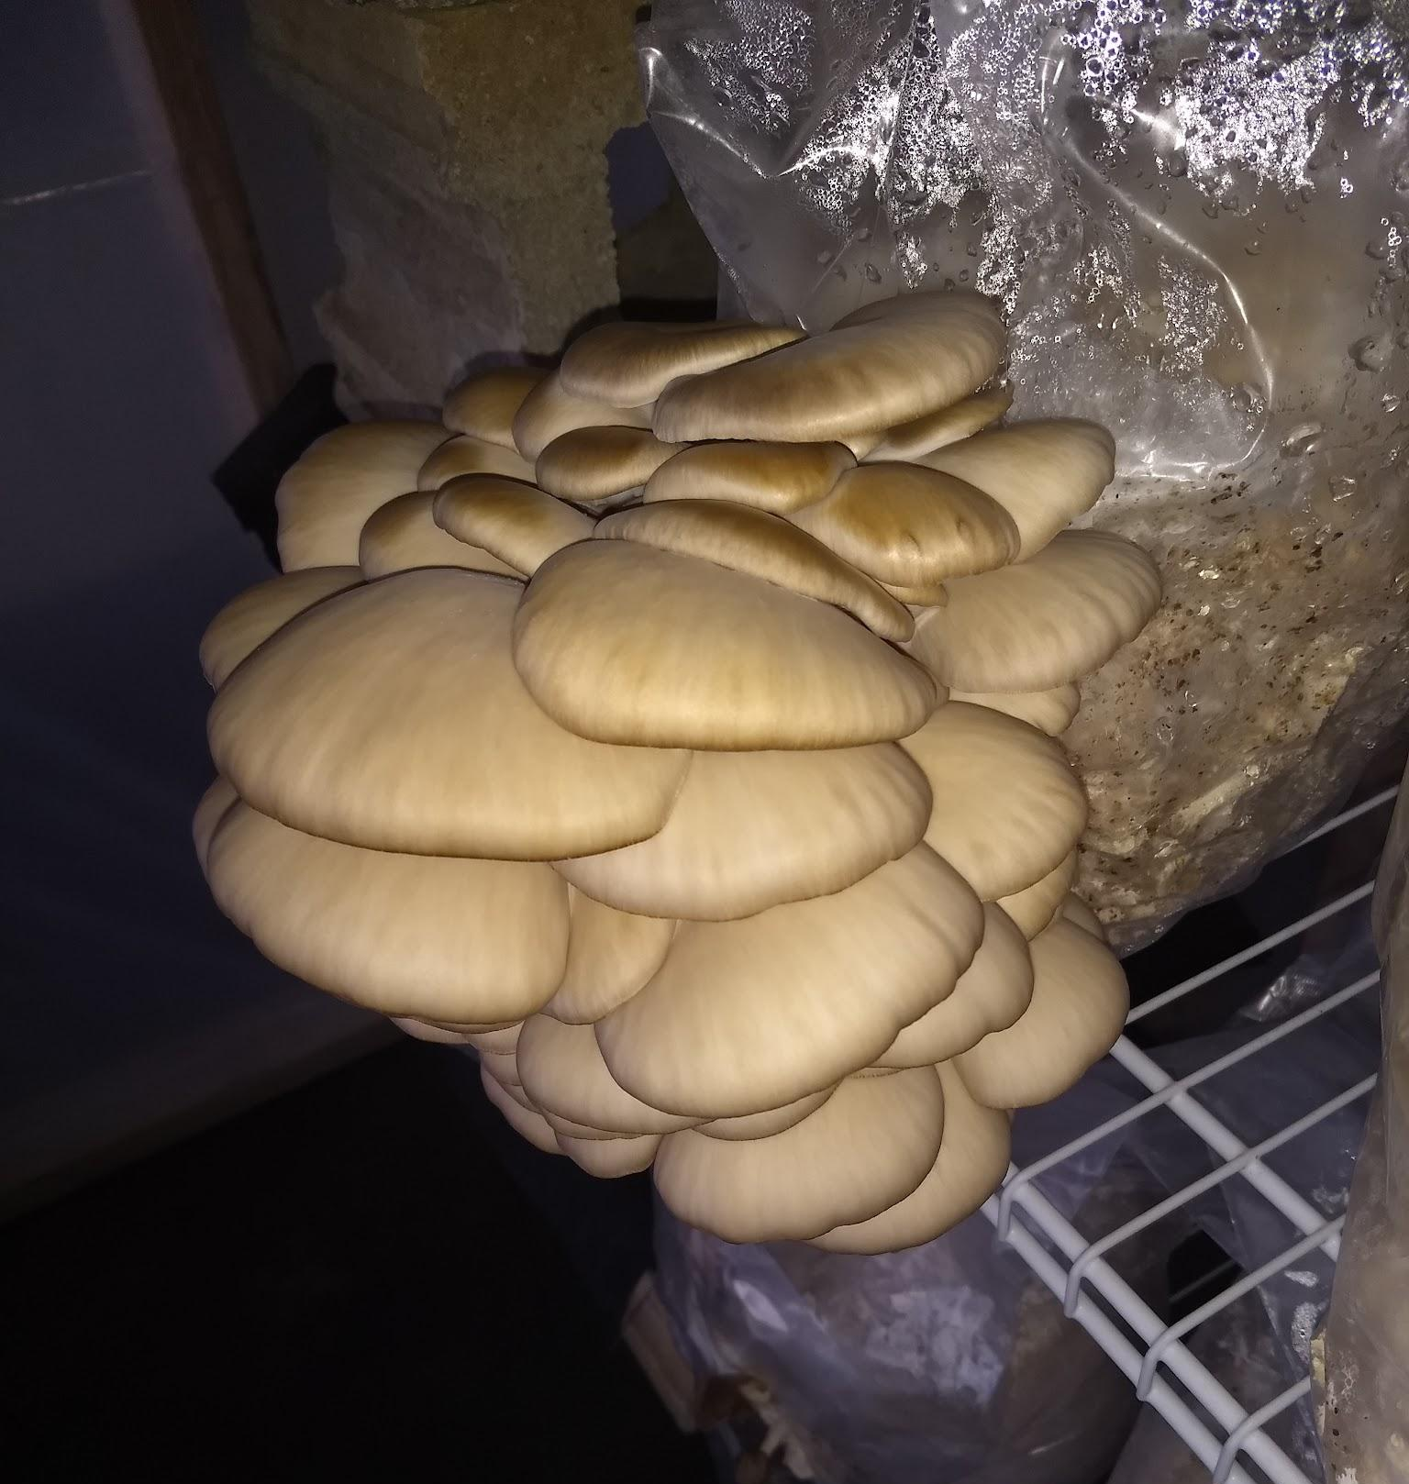
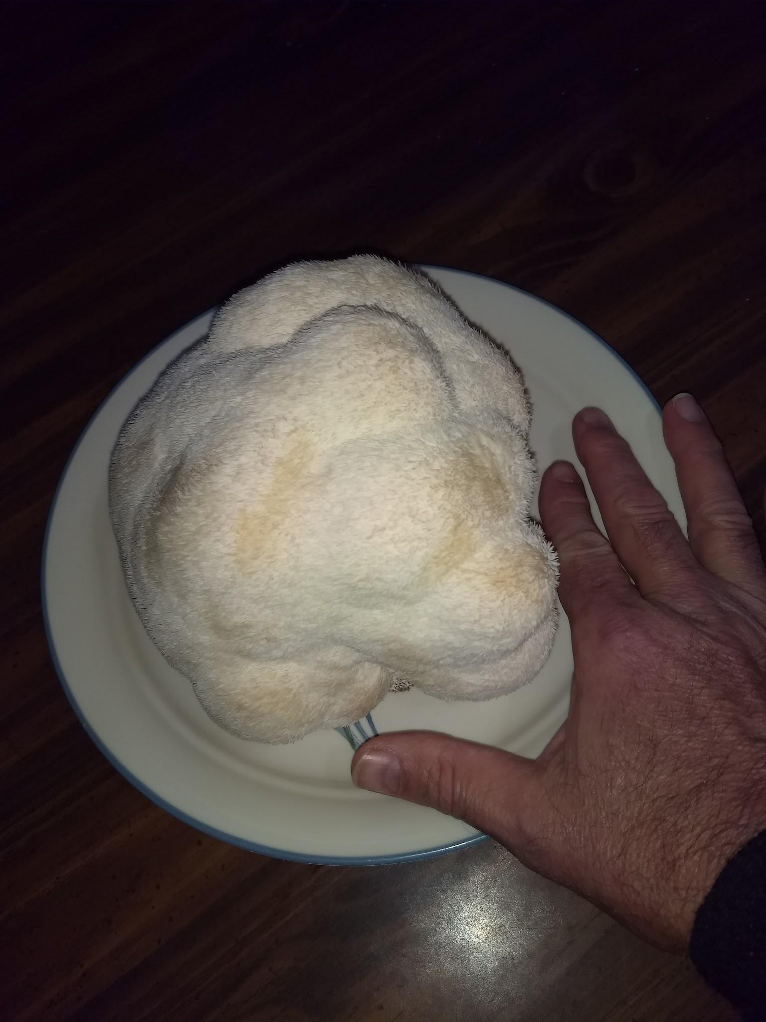

Slide 11
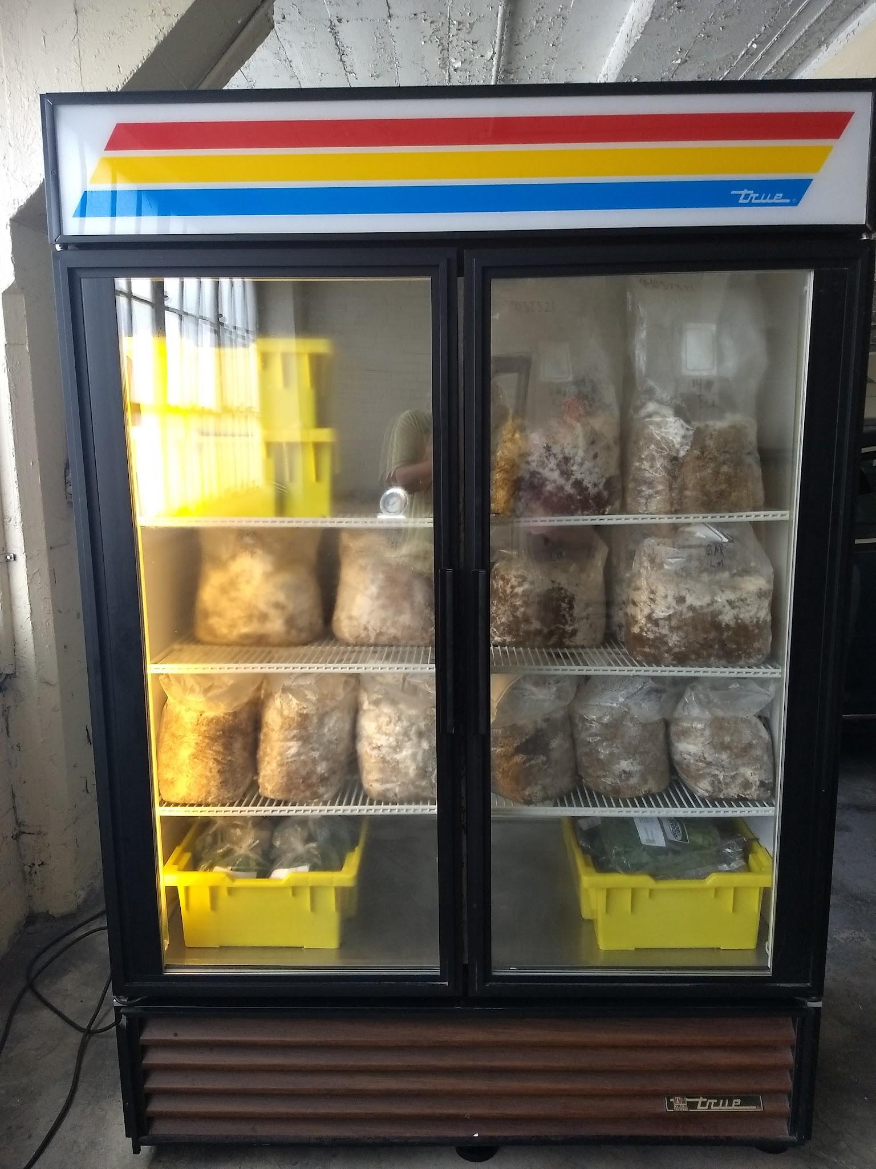
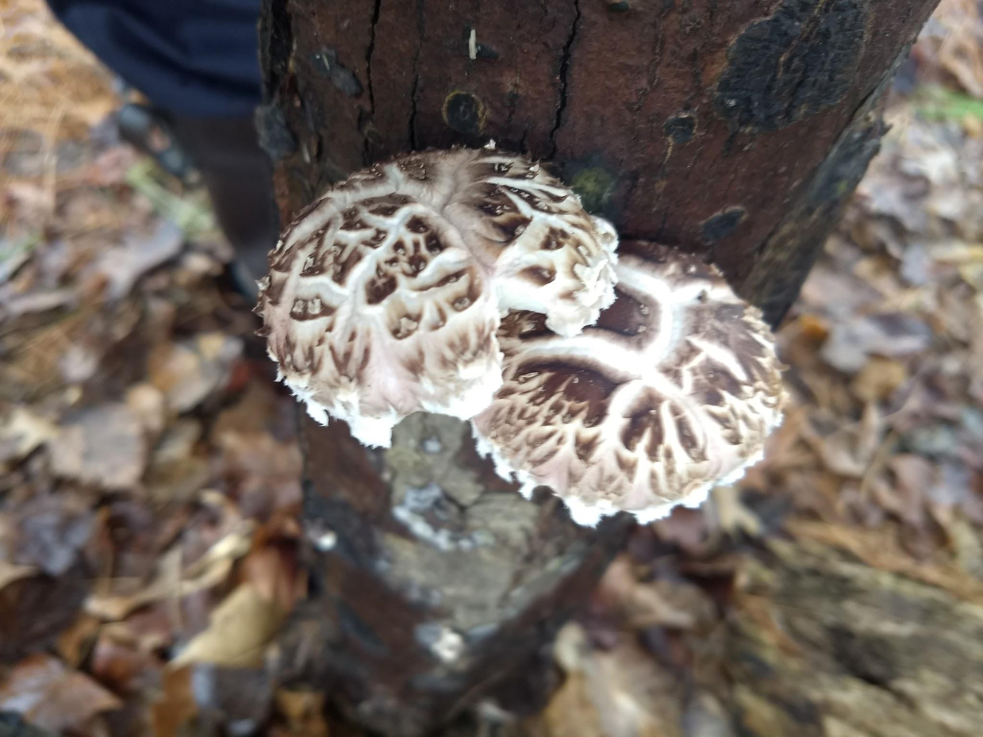

Slide 12
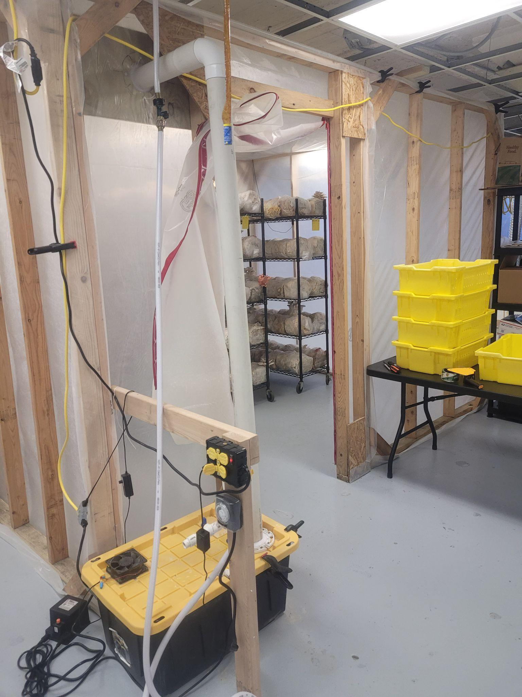
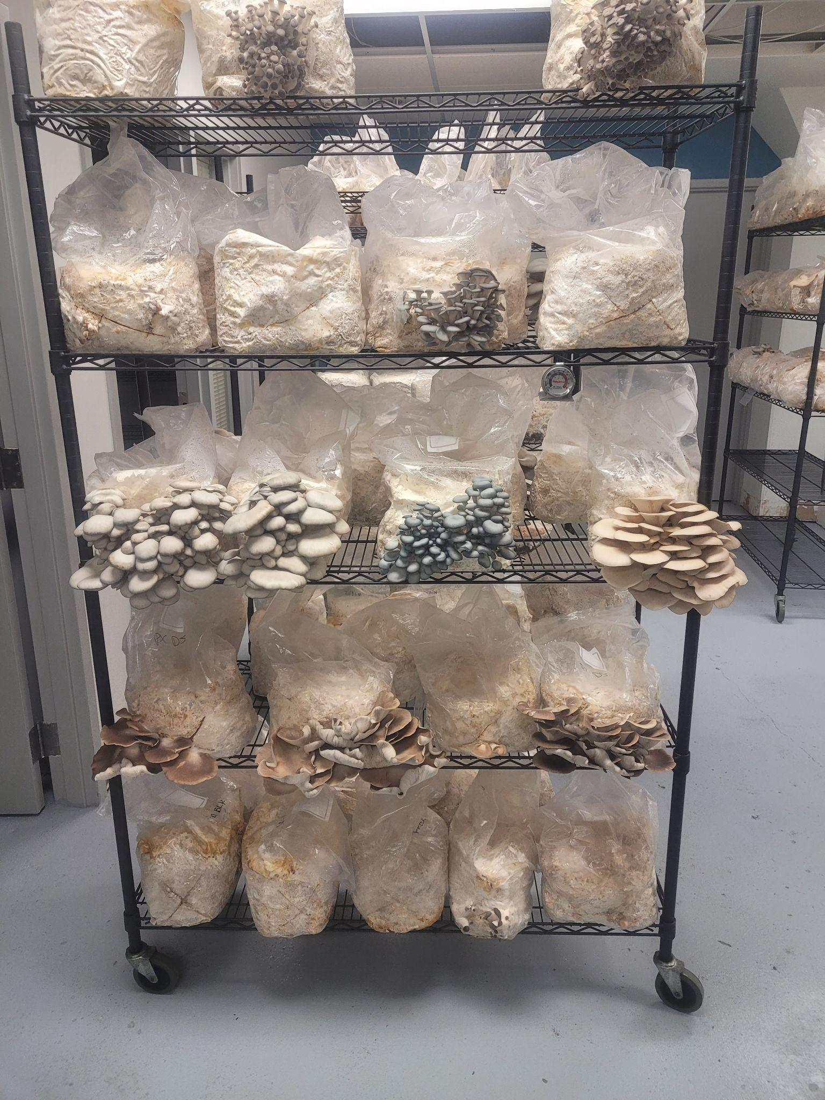

Slide 13
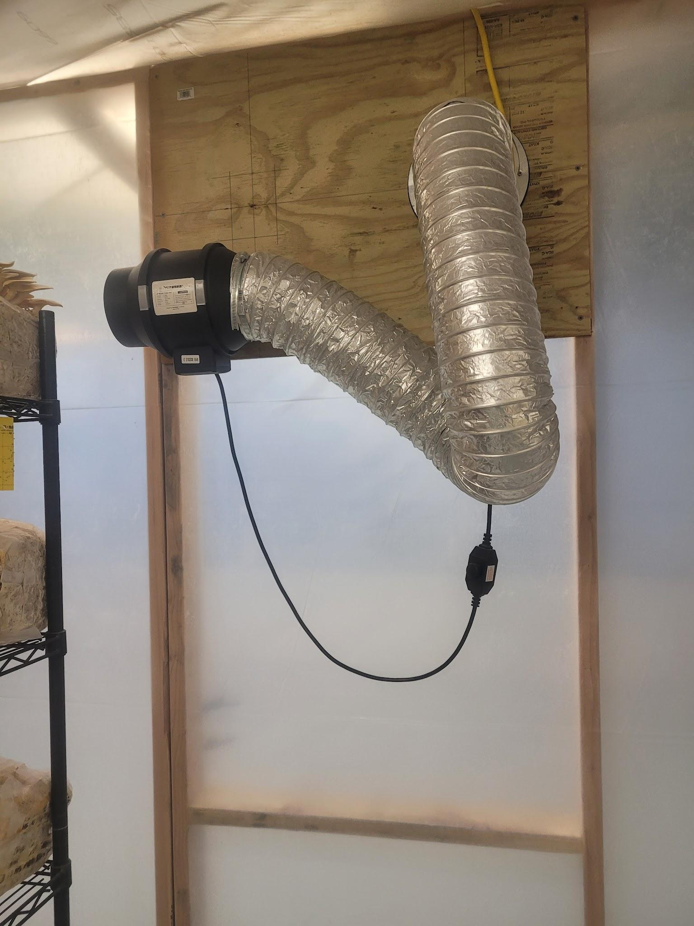
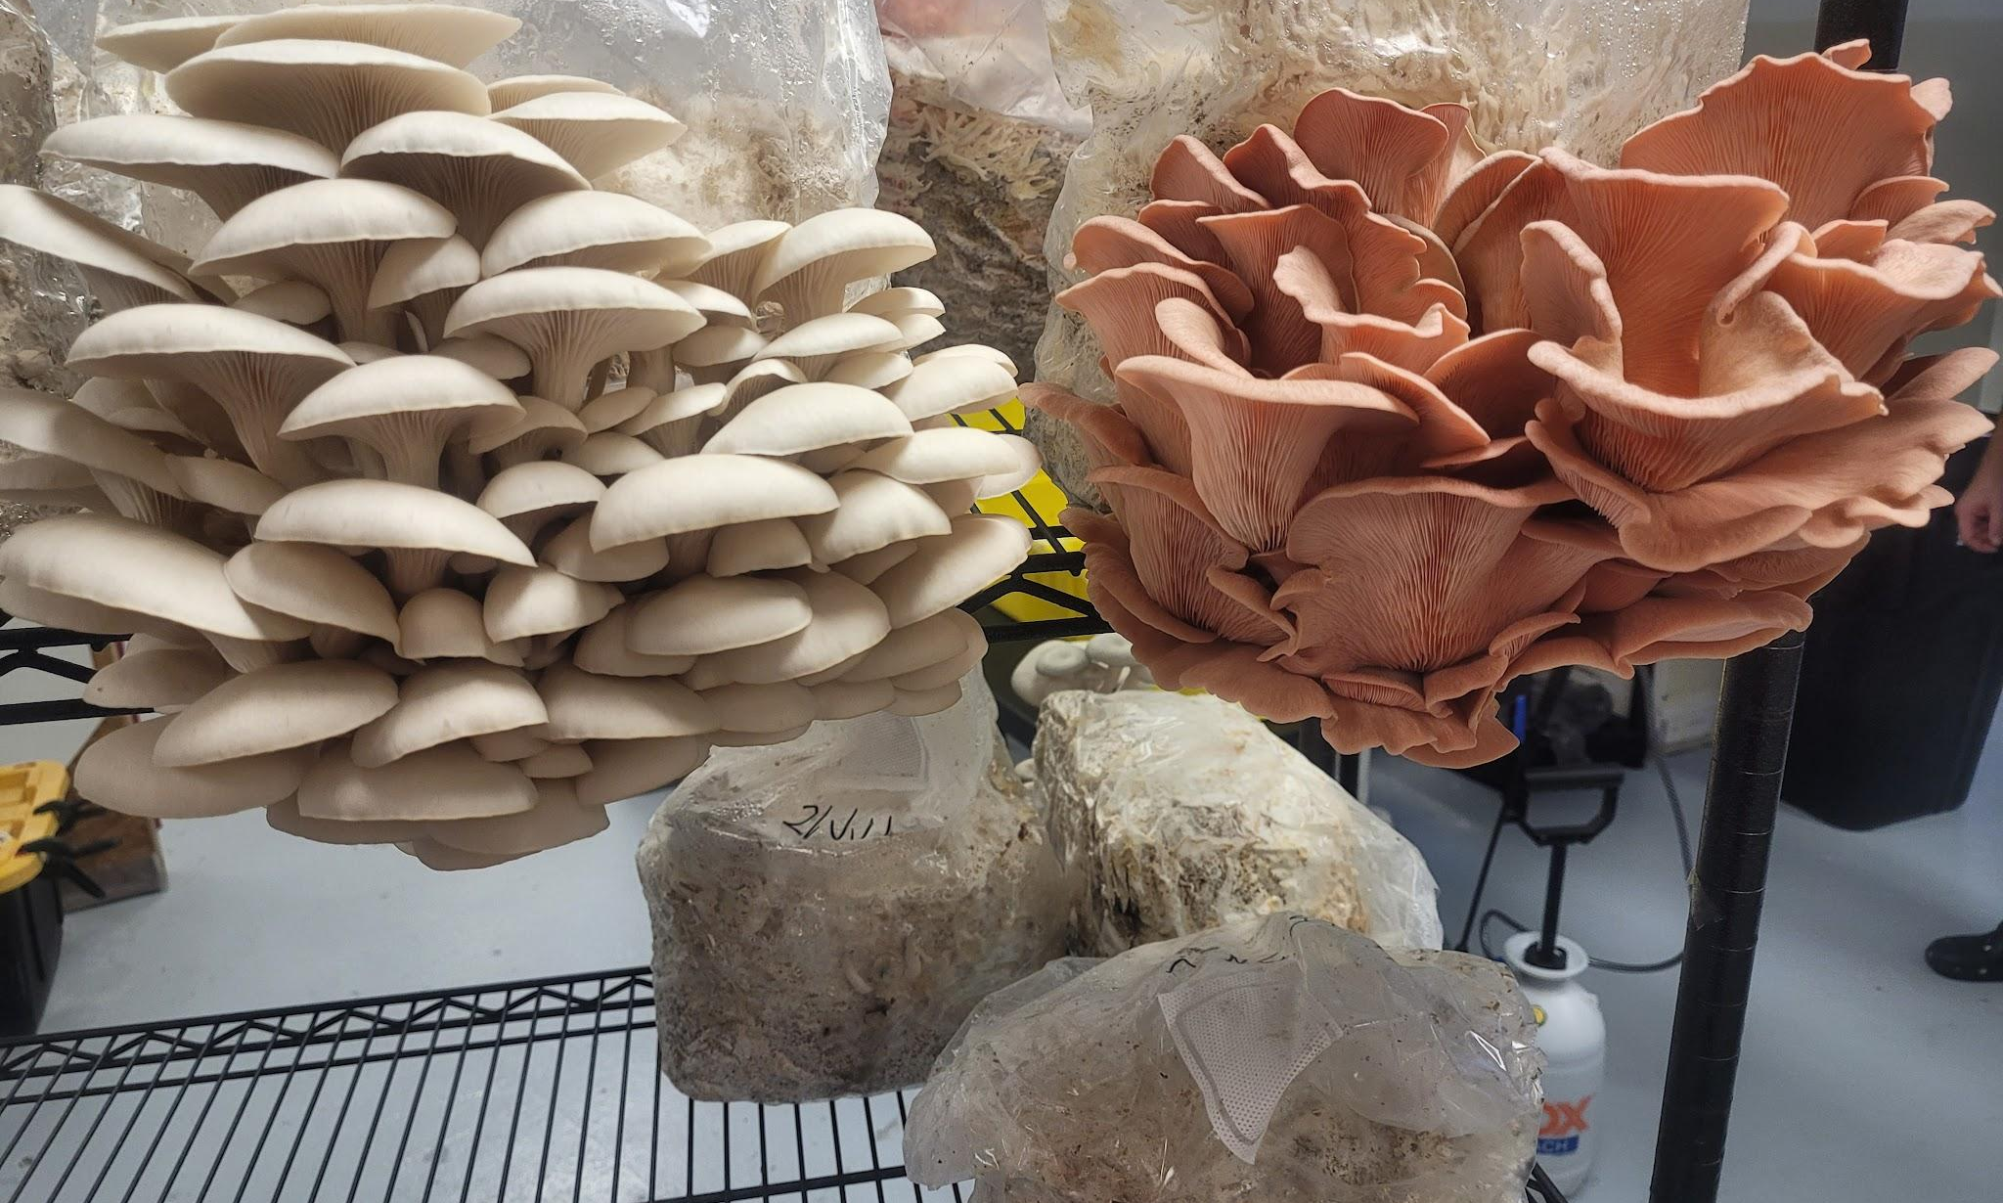
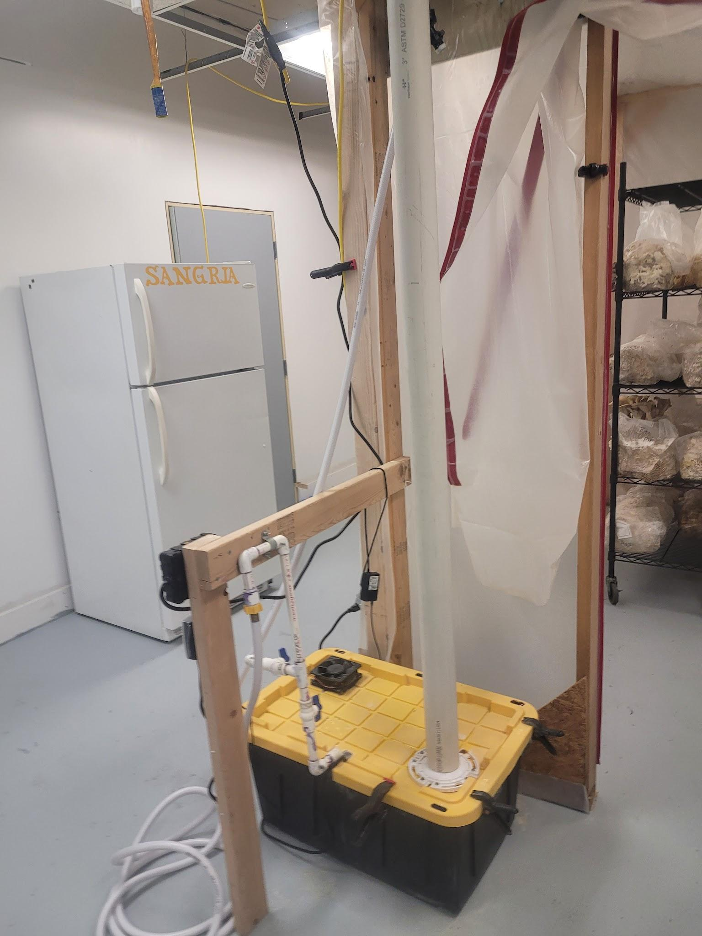
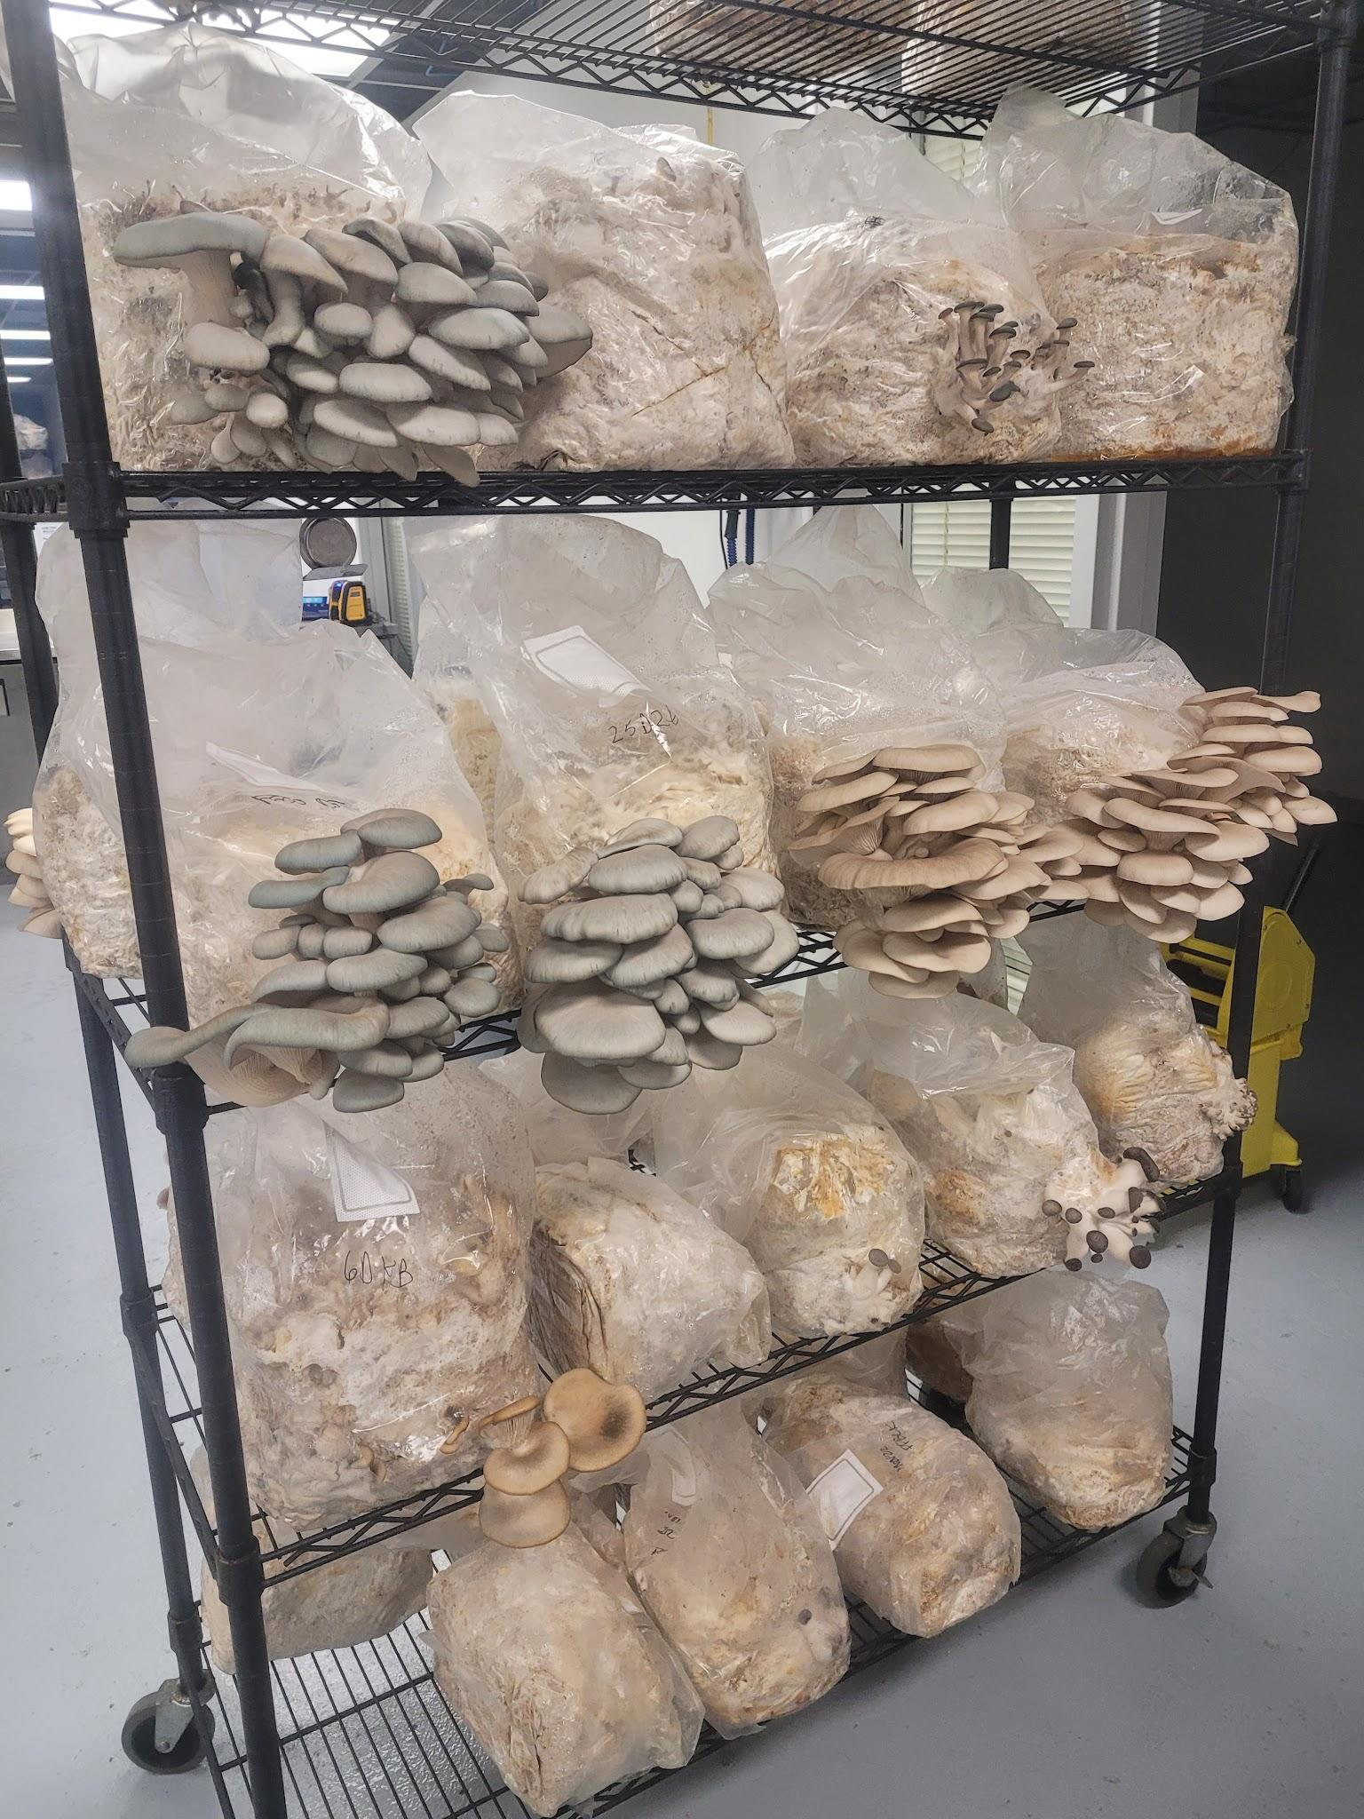
Notes:
When winter temps dropped, we partnered with APE Aquaponics at their urban indoor location and built a year round mushroom grow facility.

Slide 14
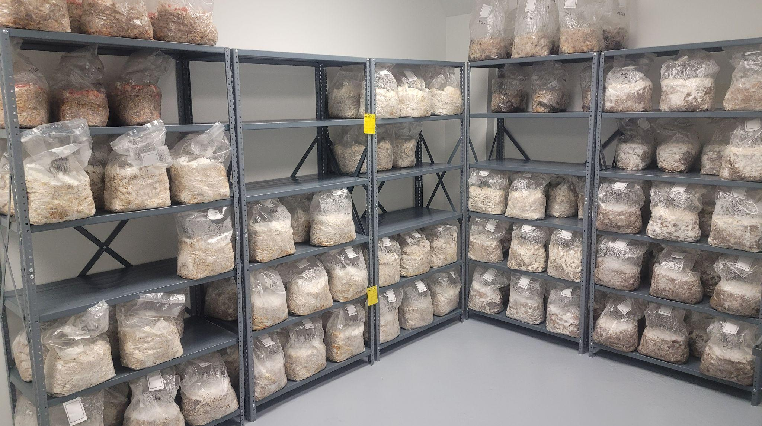

Slide 15
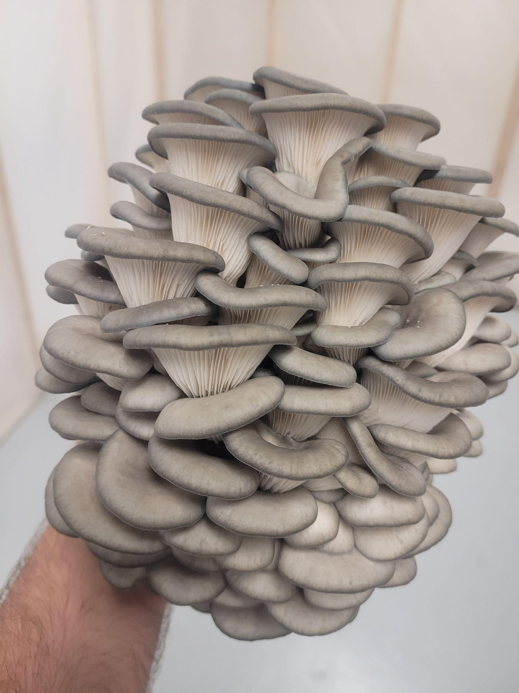
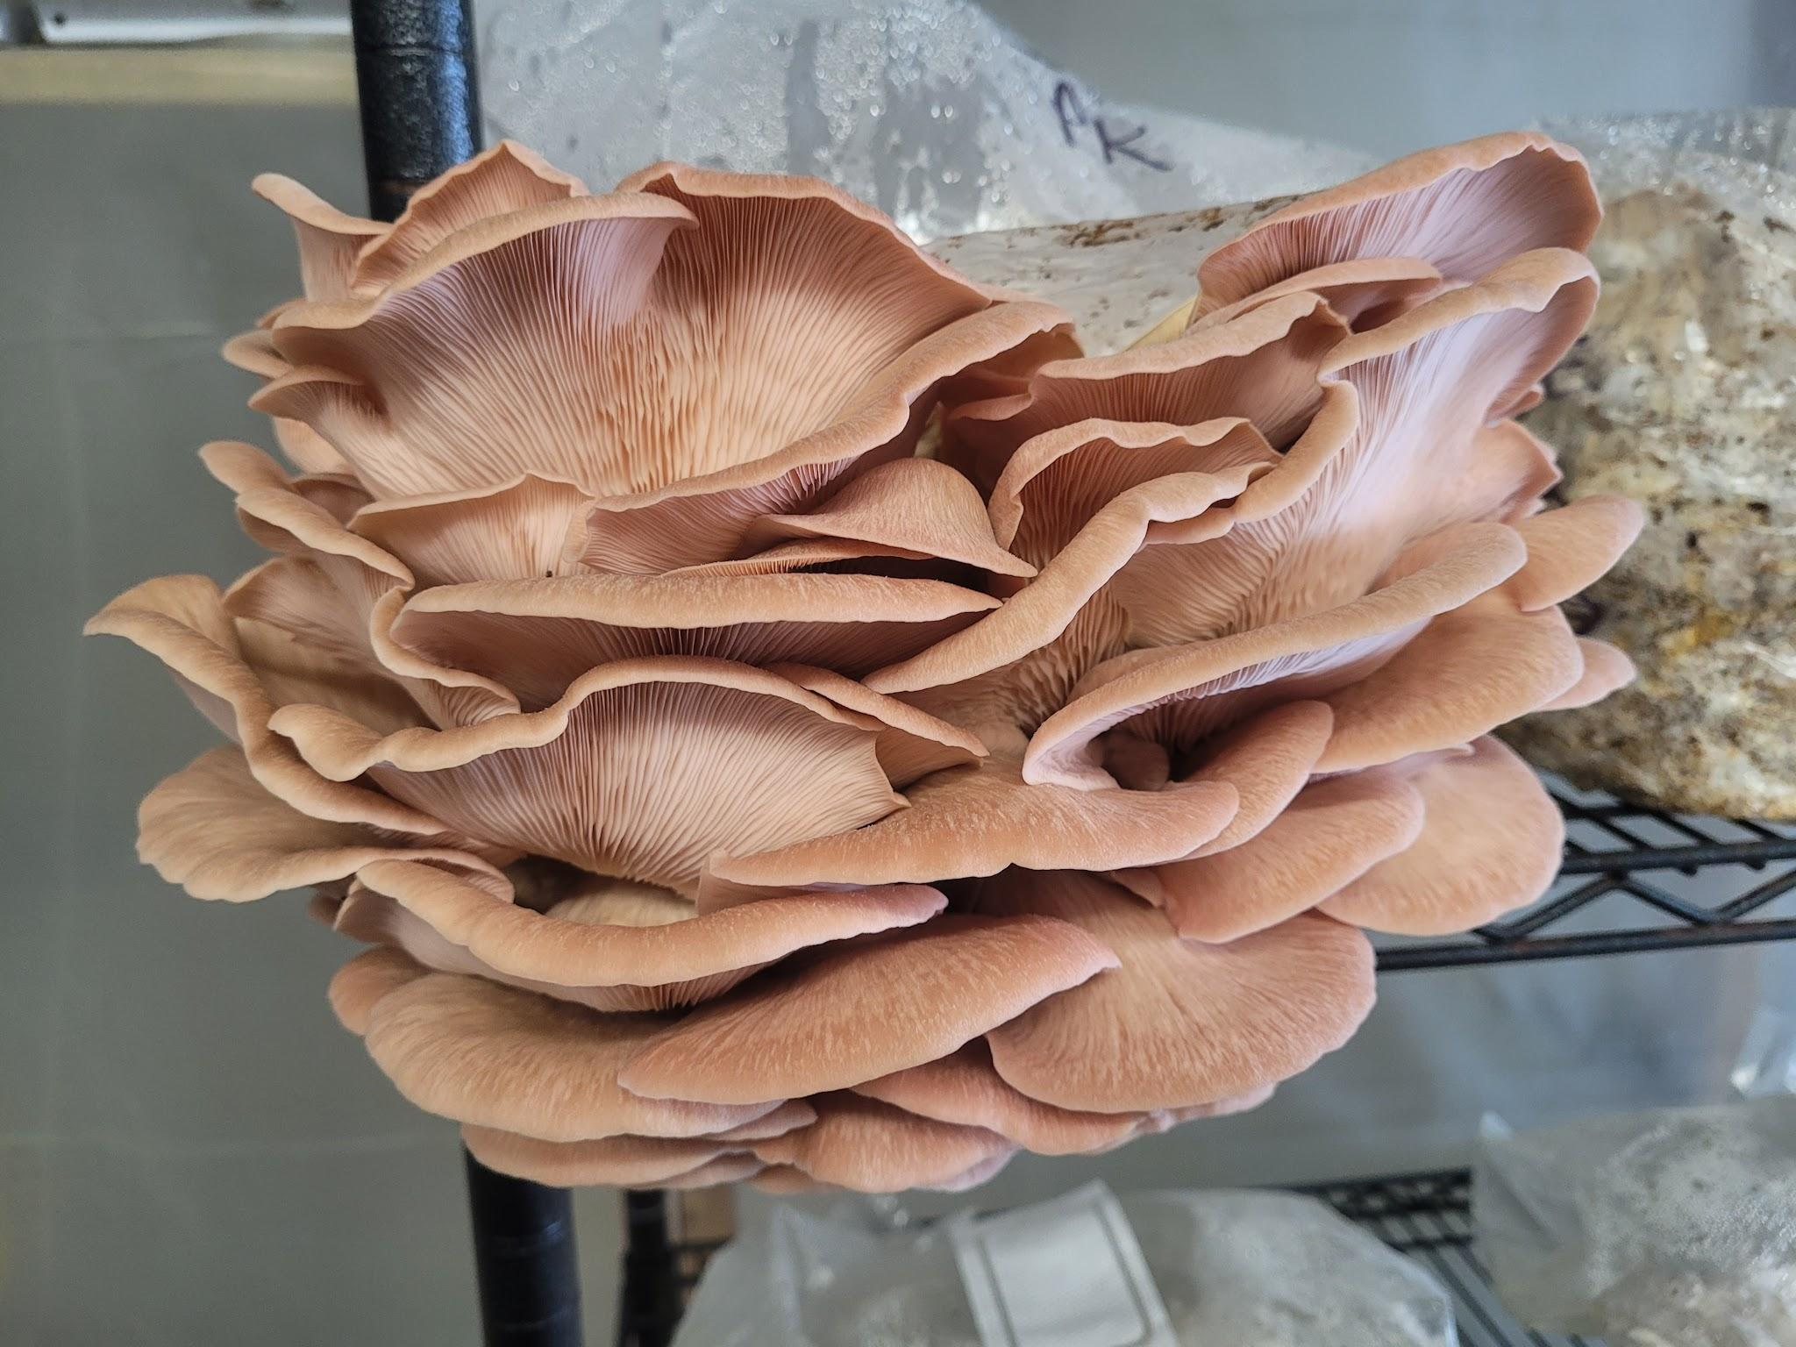

Slide 16
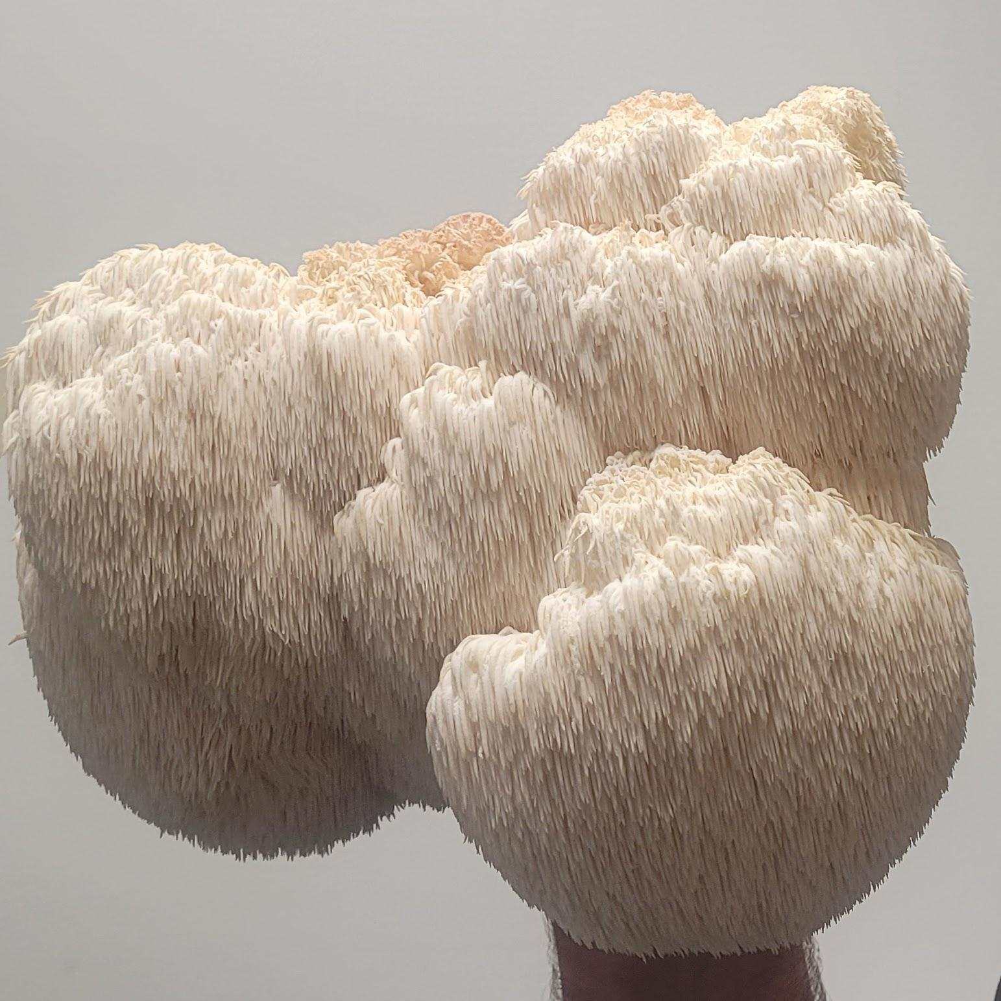
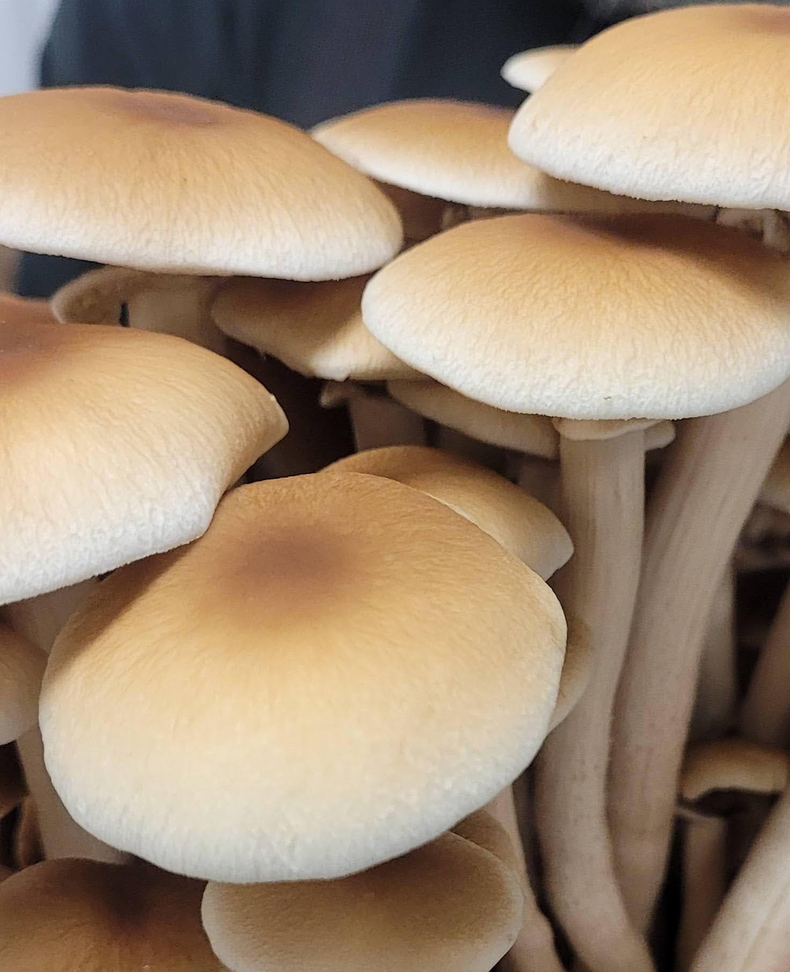

Slide 17
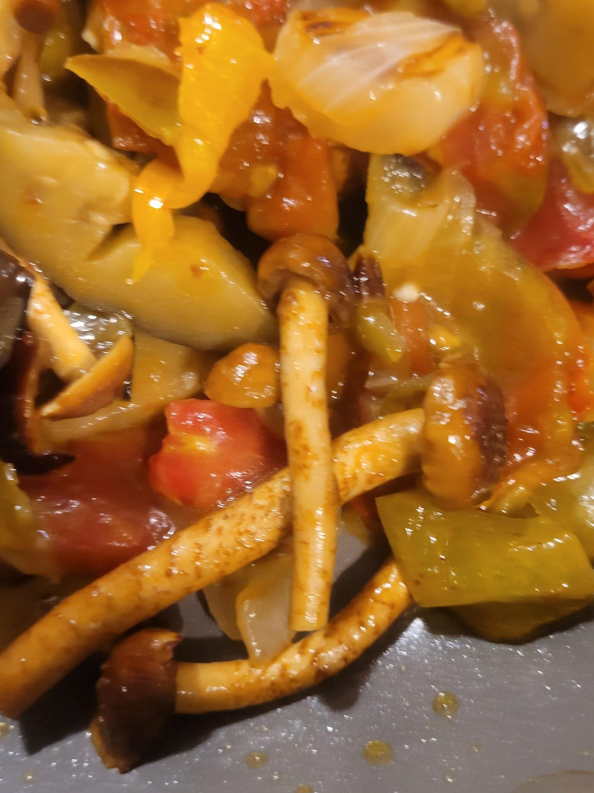
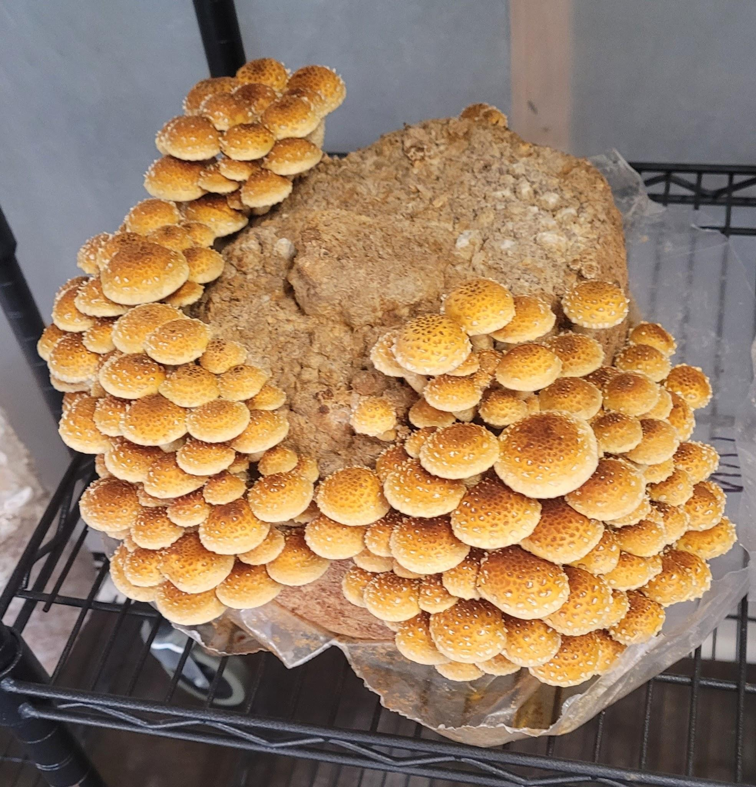

Slide 18
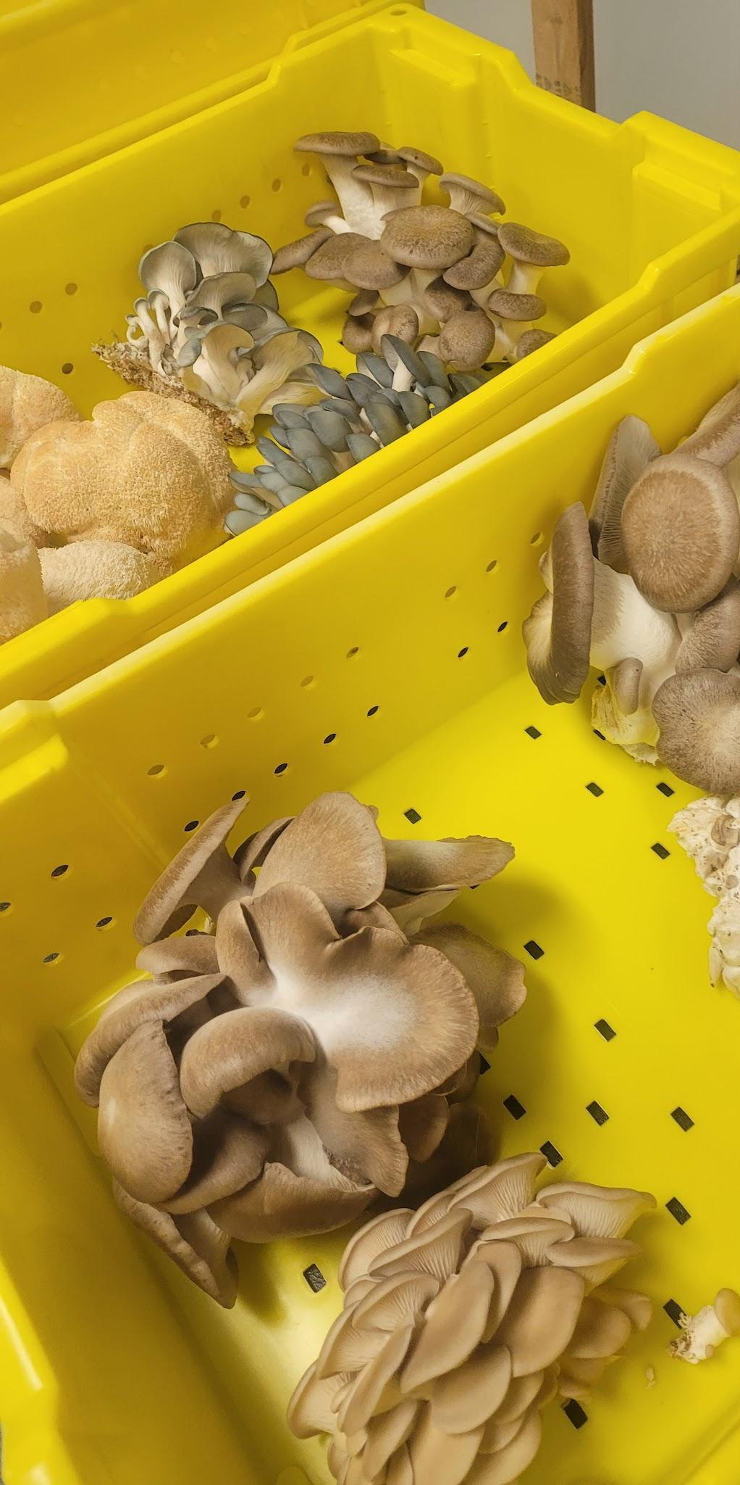
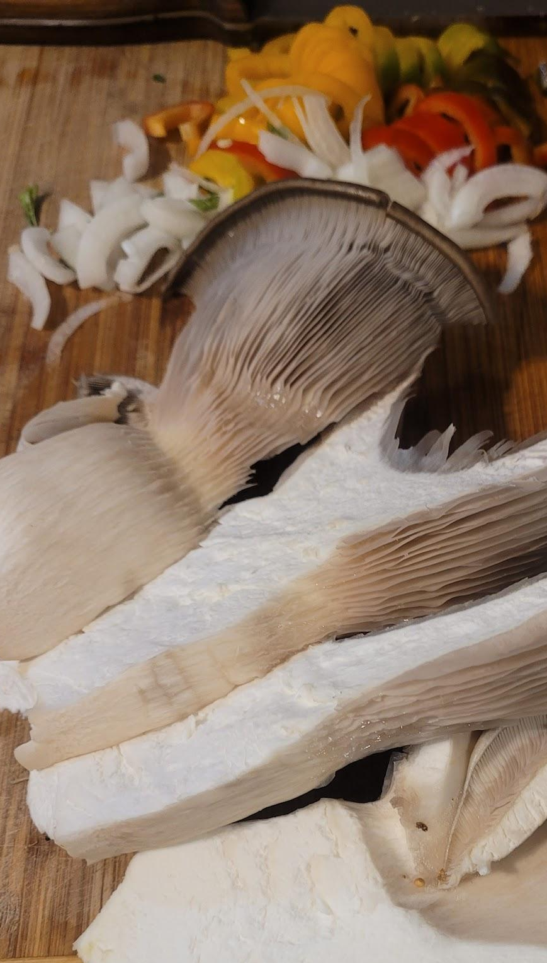
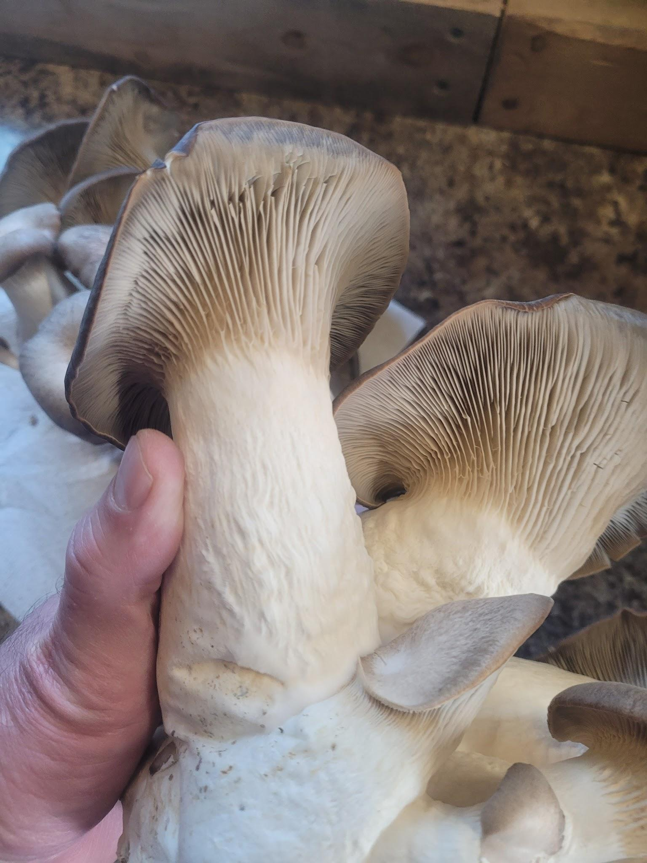
Notes:
What to do with the spent mushroom substrate? Closing our loop by returning the wood substrate and fungi mycelium to the farm as a soil amendment.

Slide 19
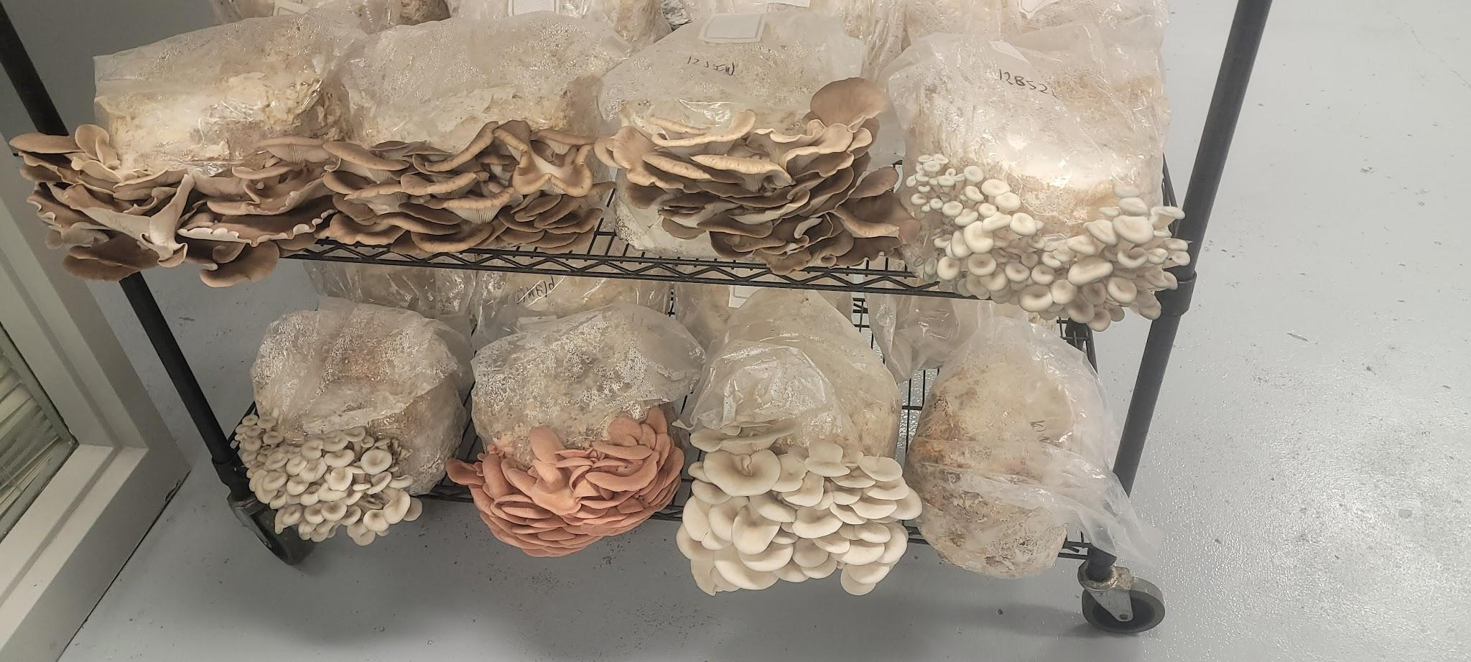

Slide 20
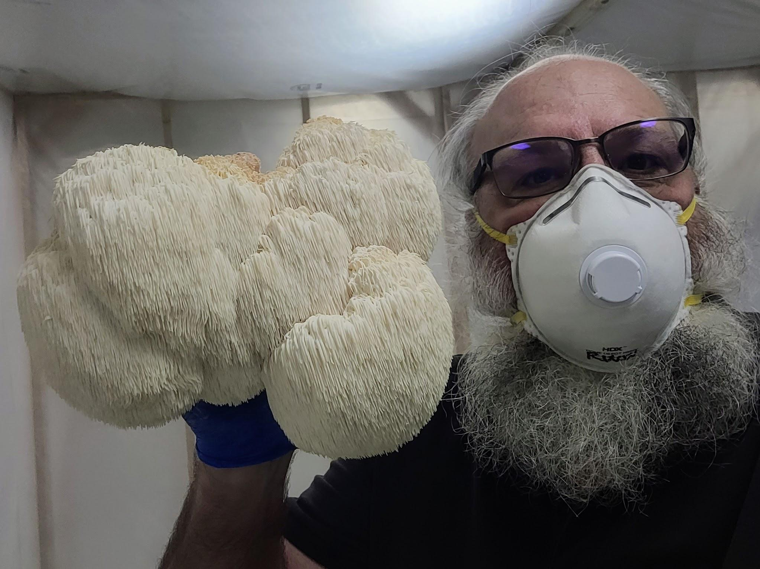

Slide 21
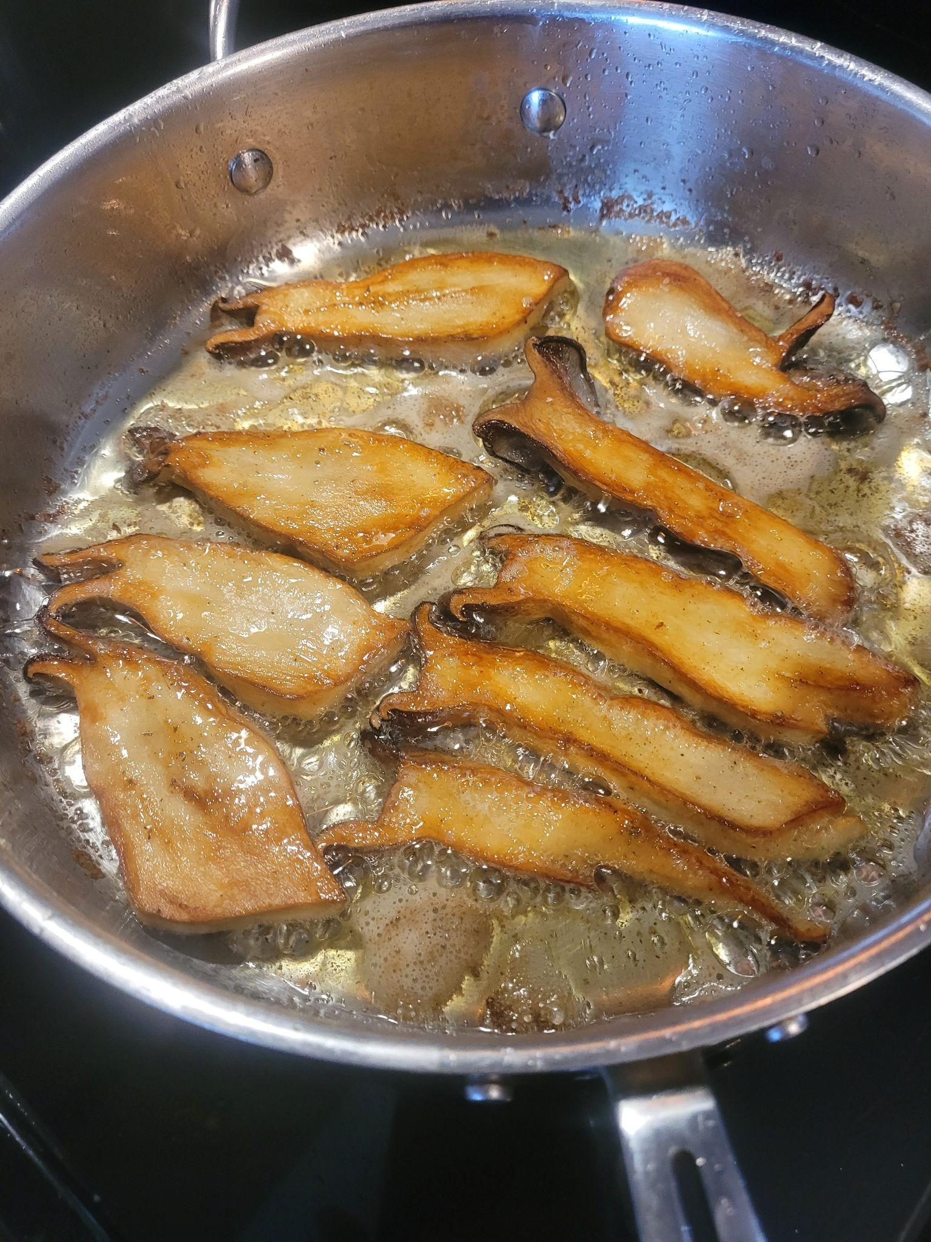


Slide 22





Slide 23


Notes:
What to do with the spent mushroom substrate? Closing our loop by returning the wood substrate and fungi mycelium to the farm as a soil amendment.

Slide 24




Notes:
The benefits of our efforts are evident in the increased soil life and organic matter. Cover crop of Japanese Millet blend in 2020. Spent Mushrooms fruiting in the field.

Slide 25





Notes:
In 2022 we formed a partnership with other farmers to replace several lost markets in our area. Local Source market was born in April providing a year round online farmers market with over 20 producers and weekly orders with a Downtown or Newburgh Pickup. Delivery service is coming soon. Our urban mushroom grow moved into a new location in the downtown building. We are proud to offer many of our produce in Eco Friendly recyclable boxes now. The future looks promising to build more farm entrepreneurs and help other beginning farmers navigate the opportunities to provide fresh, local products for our community.

Slide 26

Thanks for your support
Find us online at Beautifulediblesgrow.com
Click Shop to place an Order
Notes:
You will find our produce at Pangea Kitchen, Copper House, Entwined, Cleo’s Bakery, Belly of the Wolf, Fischer Farms, Grounded, Butcher & Barrel, and Old Fashioned Butcher Shoppe Newburgh.

