Slide 1
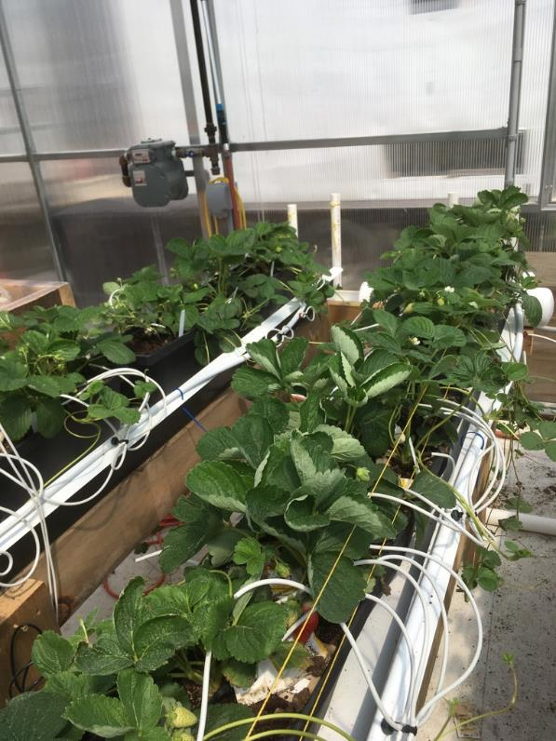
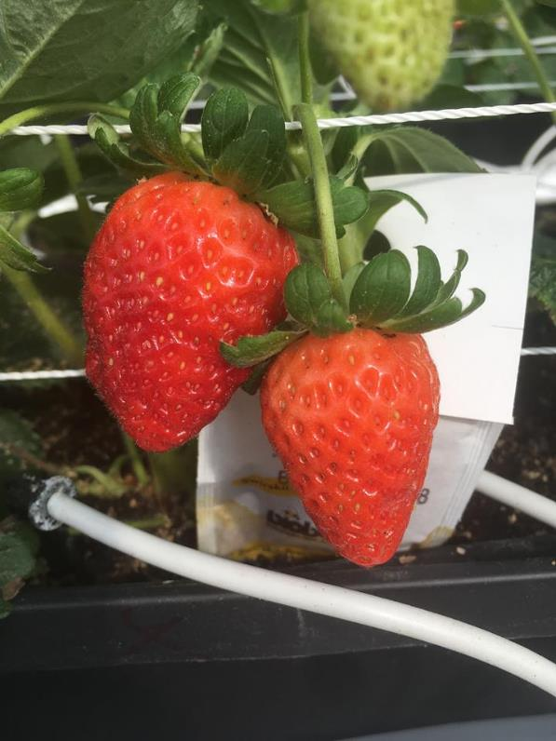
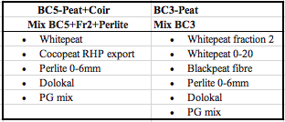
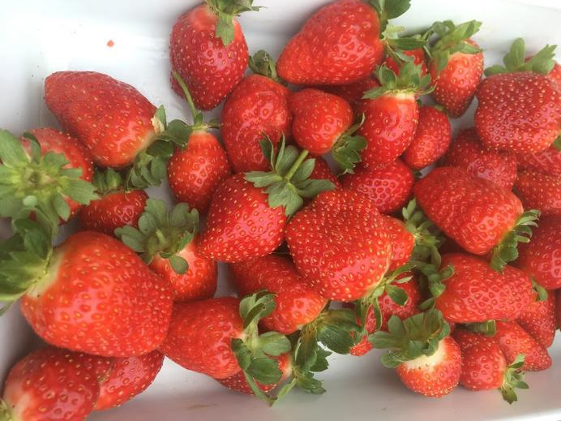
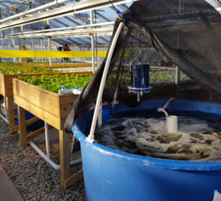
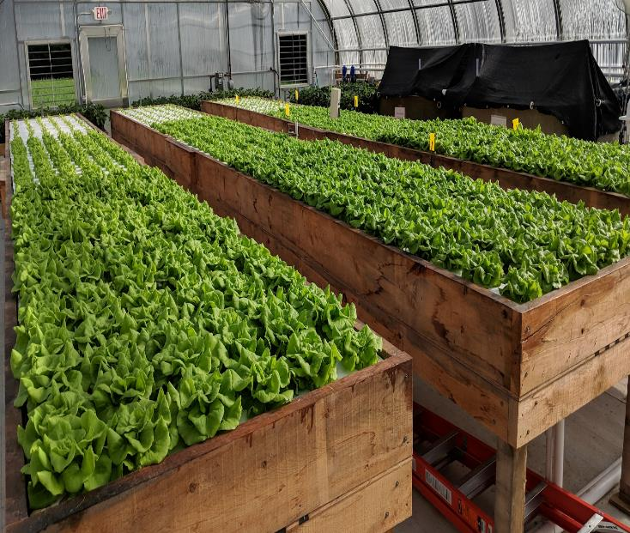
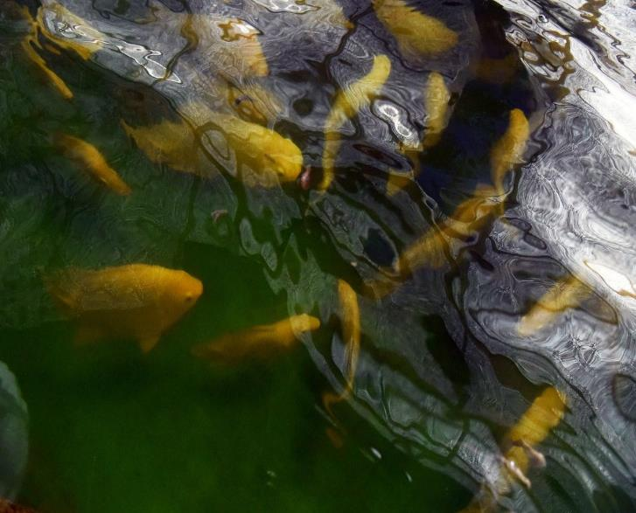
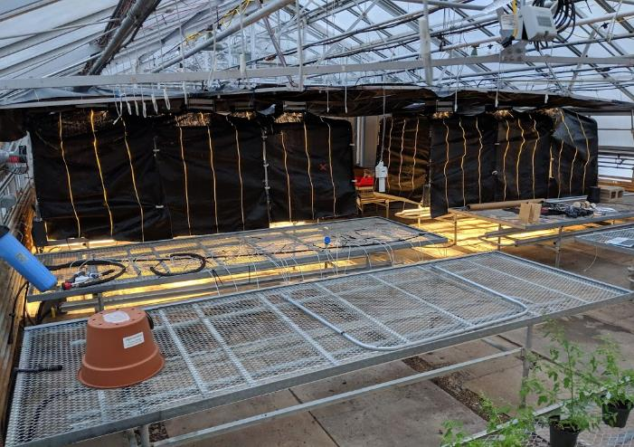
Optimizing Day Neutral Strawberry Production in Controlled Environment Agriculture Systems Anna DeVitto, Anissa Poleatewich, Todd Guerdat Department of Agriculture, Nutrition & Food Systems, University of New Hampshire Durham, NH
-
Sustainable Agriculture at UNH
Greenhouse production of day-neutral strawberries
Objective 2
The department of Agriculture, Nutrition & Food Systems at the University of New Hampshire incorporates all aspects of the food system: soil, plant, animal, and human health. Specifically, my research combines plant (strawberries) and animal (Tilapia) production to reduce off-farm inputs. The implications of this research could expand year-round greenhouse production in the Northeast, thereby creating more food secure communities. Optimizing growing practices not only provides economic benefits for farmers but also can significantly reduce the time and labor required to produce the desired yields.
21-27℃ day/14-18℃ nighttime temperatures (larger DIF than most crops)
High humidity at nighttime (90% or higher)/ ~50% humidity throughout the day (to prevent tip burn)
Substrate (peat/coir/perlite mix)
Drip to drain irrigation
Removal of flowers/fruit prior to
Hand pollination with the use of a leaf blower (introduction of bumble bees on larger scale)
Cultivar x Substrate
Three cultivars (Albion, San Andreas, Seascape, and two substrate blends: peat/perlite and peat/perlite/coir blends were evaluated for effects on strawberry yields
Results of the study showed no significant differences in cultivars or substrates in terms of overall yields
-seascape plants produced misshapen, unmarketable fruit under high heat (temperatures above 90◦F)
A
B
C
D
Table 2: Compositions of substrate used in the study.
Figure 3: (A) Hydroponic strawberry production system at UNH. (B) features UC-Davis cultivar San Andreas. (D) shows the strawberry runners propagated in a coco coir cube made by Smithers Oasis®️.
Objective 1
Figure 1: The Aquaponics cycle describes how fish waste is broken down through microbial activity into plant available nutrients, removing any harmful bacteria along the way
Strawberry nutrient regimes (ppm)
Table 1: Three nutrient solutions tested for effects on fruit yields and crop production
Aquaponics: Alternative nutrient source for hydroponic strawberry production
Nutrient Solution Recipe | NO₃-N | NH₄-N | PO₄-P | K | Ca | Mg | SO₄-S
Yamazaki hydroponic strawberry nutrient solution | 70 | 7 | 15 | 117 | 40 | 12 | 16
Aquaponic nutrient solution | 80 | 0.3 | 0.15 | 185 | 22 | 20 | 23
Aquaponic nutrient solution w/ phosphoric acid | 80 | 0 | 15 | 185 | 22 | 20 | 23
Recycle nutrients from fish waste to fertilize plants (sustainable alternative nutrient source)
All macro/micronutrients available
Through decoupled systems, any additional required nutrients can be supplemented to plants
Intensive filtration process of fish waste through bead and drum filters results in clear solution free of sludge, with available macro/micronutrients in a form that can be taken up by plants
Solids filtered using a drum filter fitted with 50 micron screens
Figure 7: Mean fruit yields of three strawberry cultivars grown peat and coconut coir after 8 weeks.
Less than 10% total nitrogen in form of ammonia for optimal fruit production
Target pH between 5.5-6.0
Supplement aquaponic nutrient solution to add phosphorus and lower pH
A
B
Figure 8: UC Davis cultivar Seascape producing misshapen fruit under daytime temperatures above 32℃
Objective 3
DLI Light Requirements
Current guidelines for supplemental lighting requirements for strawberries range between 12-30 moles photon/m²/day
How will light intensity affect yields, sugar content (brix), and biomass?
Experiment: DLI of 14, 20, and 26 moles photon/m²/day are tested for optimize production
Runner production, fruit yields, plant biomass, brix, and SPAD will be collected and compared between the three lighting treatments
Results of this project could reduce production costs significantly
Figure 2: Aquaponics facilities at the University of New Hampshire. 1000 heads of lettuce are produced weekly and provided to the dining hall. The bottom left figure captures the intense filtration process the fish effluent is exposed to before entering the plant beds.
Figure 4: Preliminary yield comparison of strawberries grown using hydroponic vs. aquaponic nutrient solution. (A) weekly average fruit yield. (B) Mean total yield after 4 weeks of fruiting.
Objectives/goals of research
AQ+PA: 21.36g
AQ:
41.98g
H:
19.78g
AQ+PA
H
To quantify nutrient requirements and the effect of nutrient solutions on day-neutral strawberries
To evaluate the effect of cultivar and substrate on day-neutral strawberry yields
To evaluate the effect of light (DLI) on day-neutral strawberry yields and fruit sugar content
Acknowledgements: This work was supported by New Hampshire Sea Grant and Northeast Sustainable Agriculture and Research & Education. We also thank Luke Hydock, David Goudreault, Evan Ford, and Kyle Quigley for their technical support and expertise. Pictures taken by Anna DeVitto.
Figure 5: Far left berry- Aquaponic + Phosphoric Acid Treatment, Middle berry- standard aquaponic solution, far right berry- hydroponic strawberry nutrient solution.
Figure 6: Root system of two plants sampled from the aquaponic +phosphoric treatment (Left) and hydroponic treatment (right), 15 weeks after planting.
Contact Anna DeVitto
aeg633@wildcats.unh.edu

