Slide 1
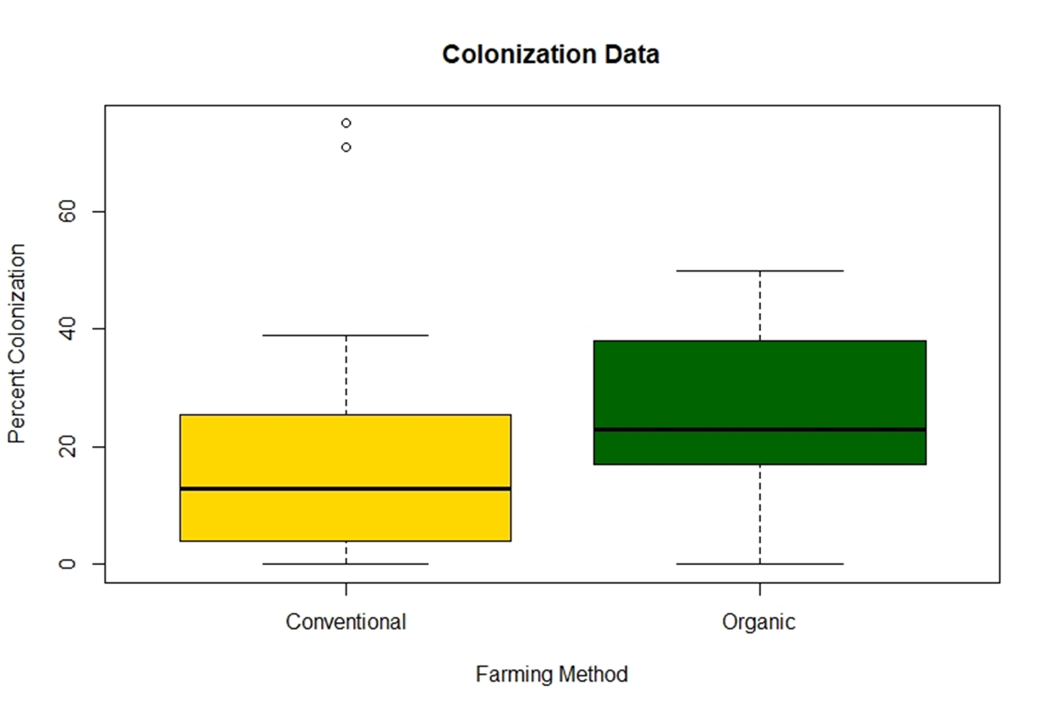
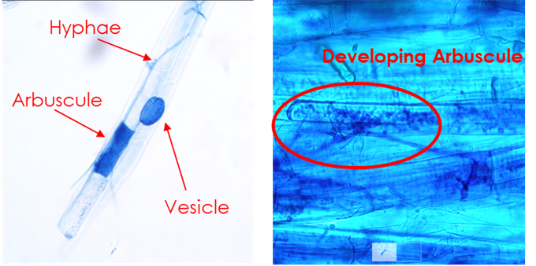
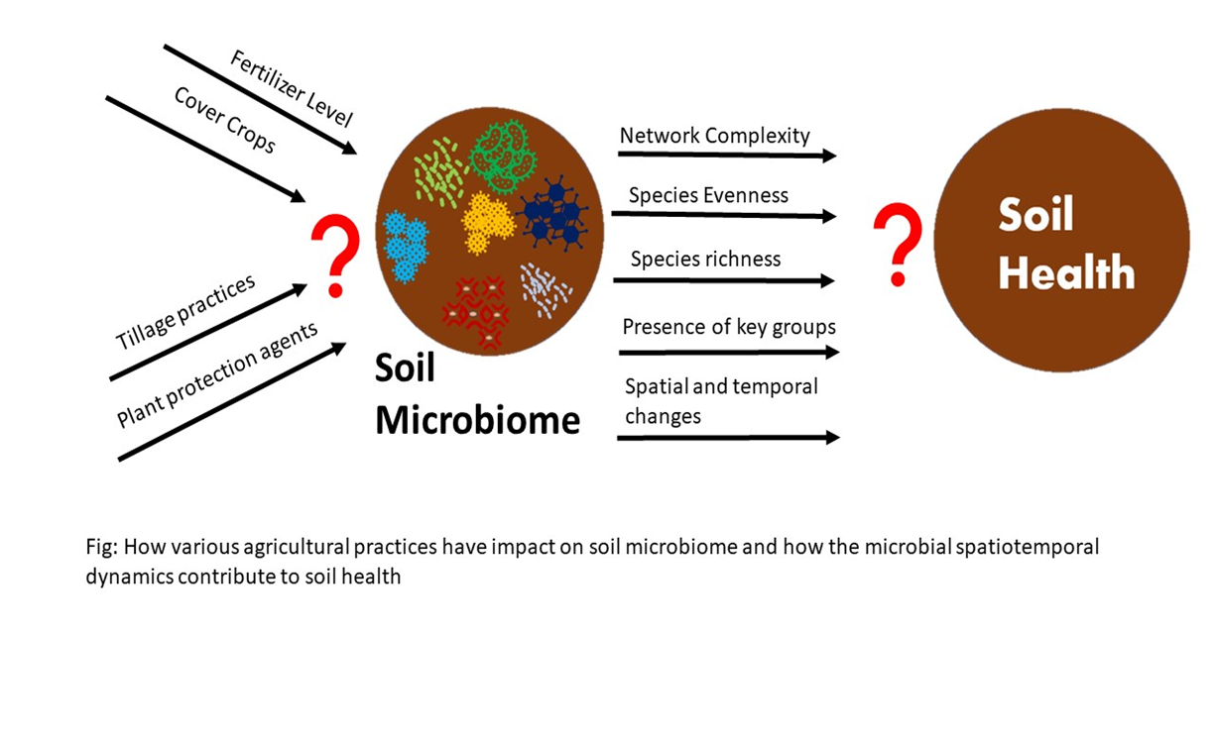
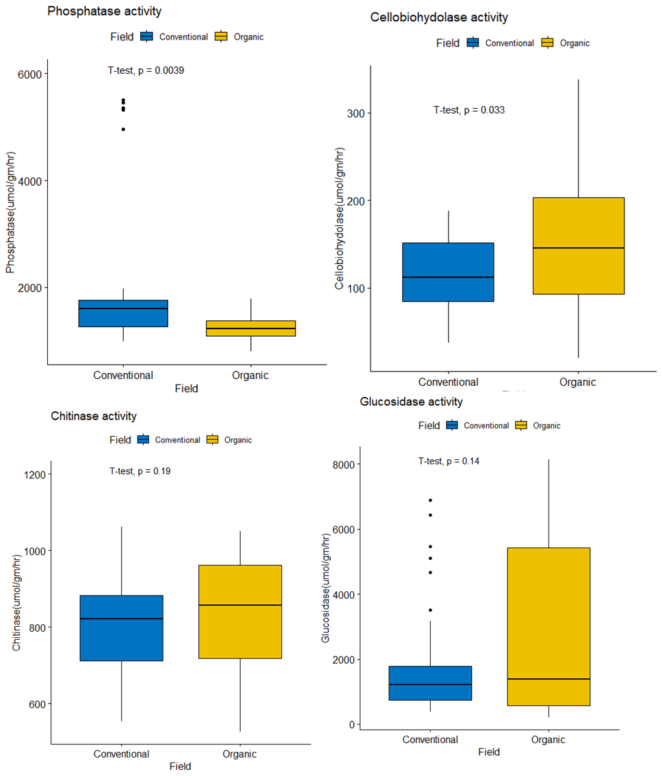
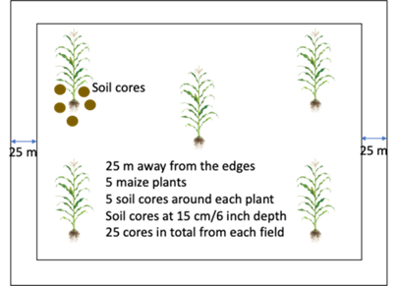
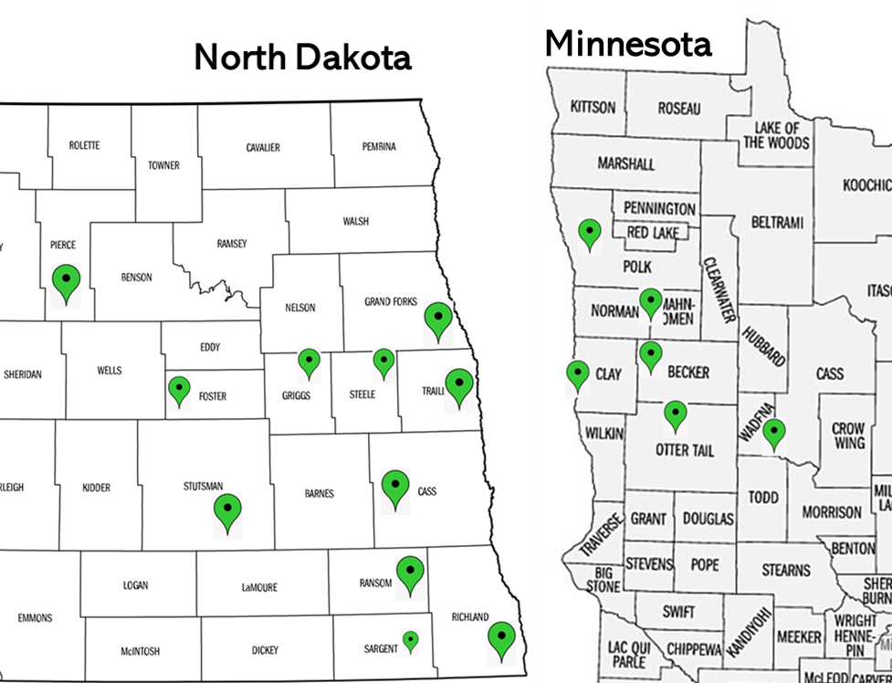
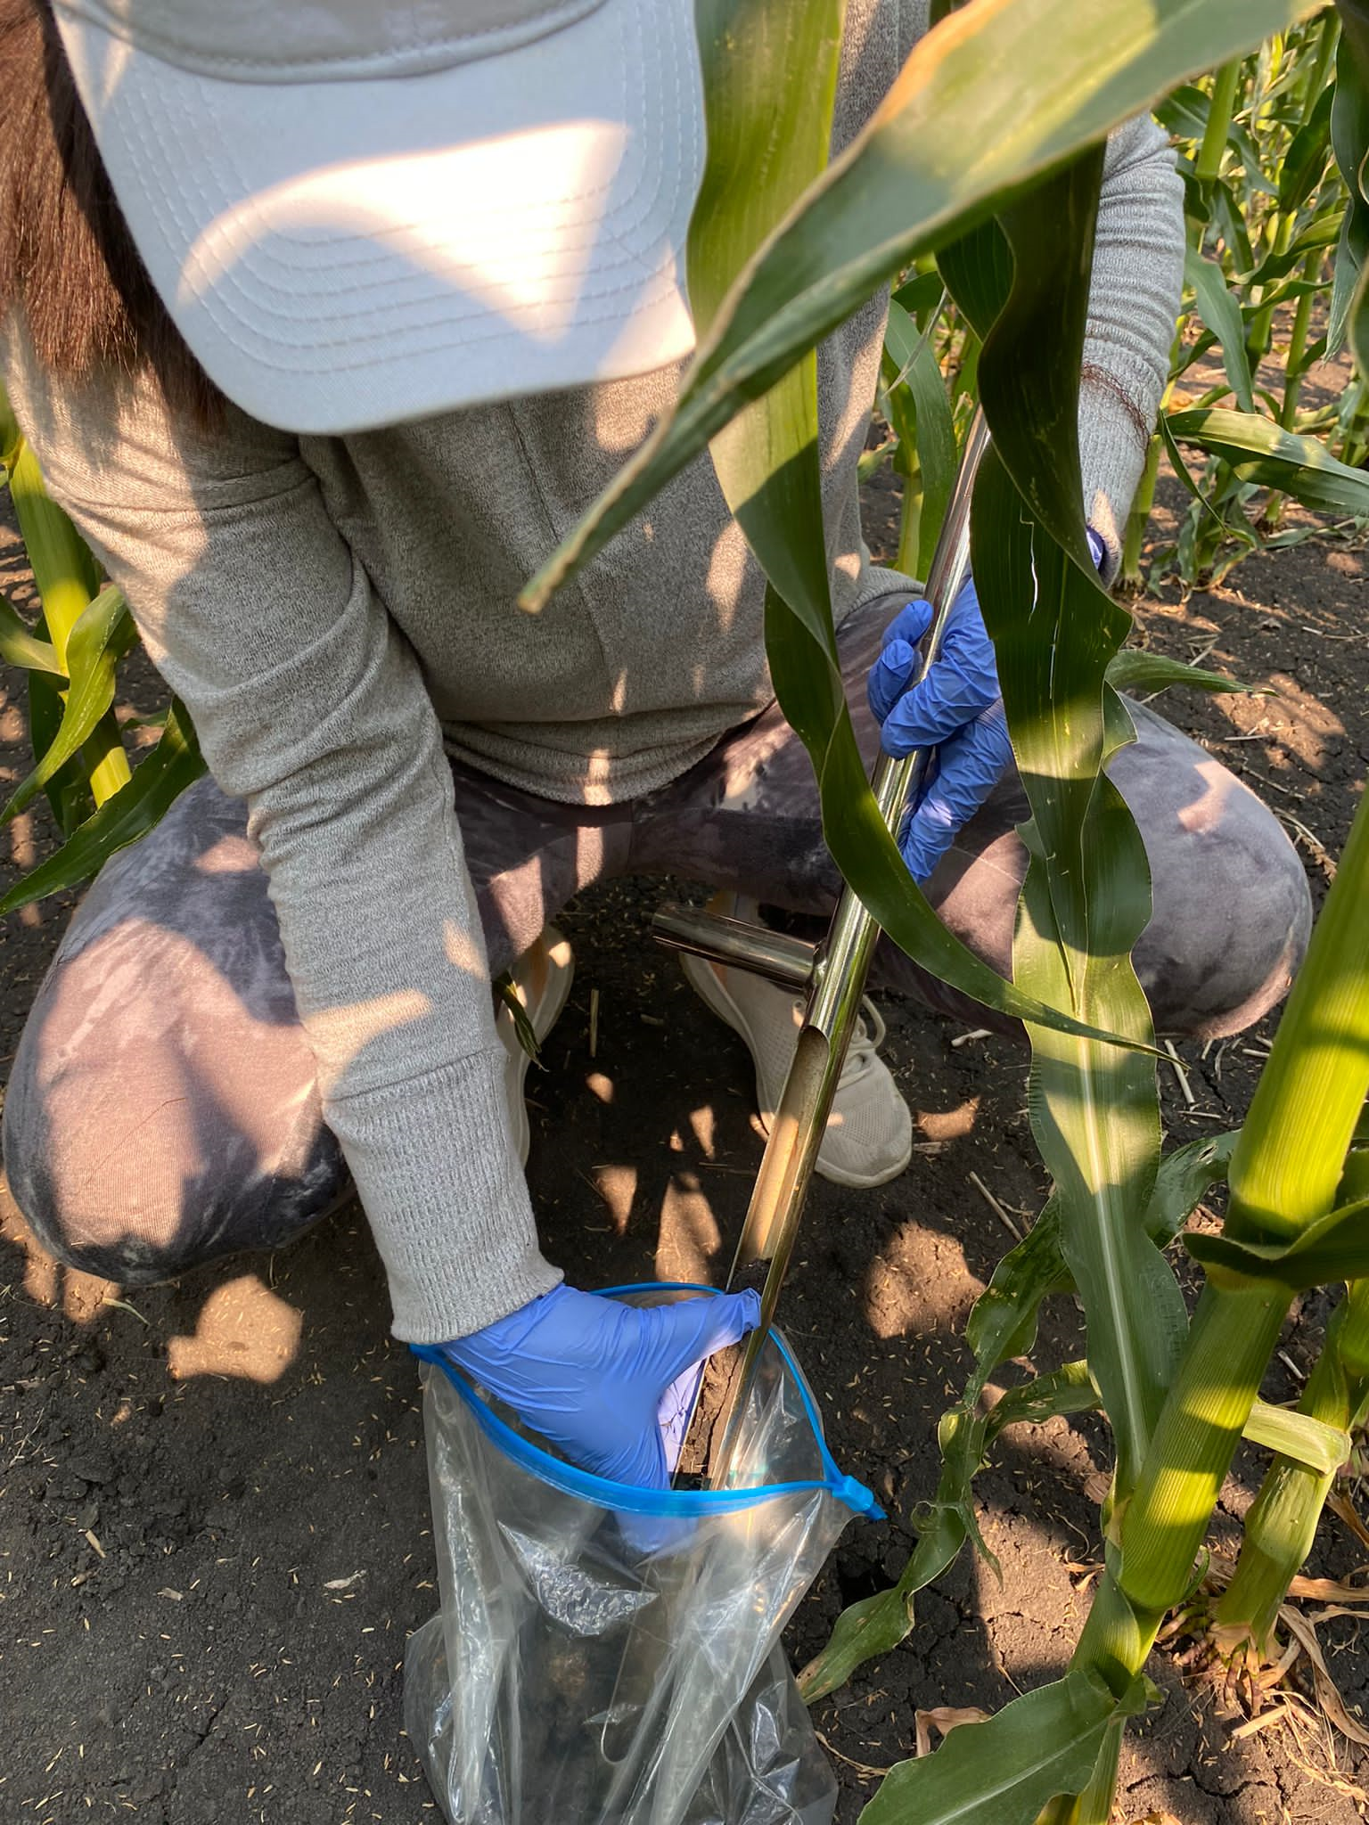
The impact of agricultural practices on microbial contributions to soil health
Sakshi Paudel*, Miranda Vanderhyde, Debarshi Dasgupta, Kimberly Zitnick-Anderson, Samiran Banerjee
North Dakota State University, Department of Microbiological Sciences, Van Es Hall, 1523 Centennial Blvd., Fargo, ND 58102, USA
*Sakshi.Paudel@ndsu.edu
Introduction
Results
Growing population demand for food production in multiple folds.
Key issues that farmers face because of this multiplication pressure are desertification, greenhouse gas emissions, soil nutrient depletion, soil erosion, and so on.
Plant root-microbe symbiosis provides various advantages in sustainable agricultural production systems.
Varied agricultural approaches elicit different responses from the microbial community.
We aim to study soil microbiomes in the same farmlands to see if there is a legacy effect on soil microbiomes and how this affects soil health and productivity.
A
T-test P-value = 3.795e-14
B
C
Objectives
D
To explore the impact of agricultural practices on microbial contributions to soil health
To identify the microbial groups that are consistently linked to soil health and investigate how those groups can be promoted.
To enhance the awareness of soil microbial communities among growers.
Fig. 6. A. Box plots showing mycorrhizal colonization in conventional and organic farms. B. Clear picture of hyphae, vesicle, and arbuscule in 20X C. Developing arbuscule D. Cluster of vesicles
Mycorrhizal colonization was significantly higher in organic fields as compared to conventional fields
Materials and Methods
Survey and Sampling:
Agricultural practices, relevant management information, and soil types were surveyed in 31 conventional and 30 organic fields across North Dakota and Minnesota. The same fields were sampled for the roots, plant biomass, and bulk soil for analysis of microbiome and soil microbial enzymatic and physicochemical properties.
Fig.1 . How various agricultural practices have an impact on soil microbiome and how microbial spatiotemporal dynamics impact soil health
Fig. 7. Box plot showing microbial enzymatic activities for four different enzymes (Phosphatase, Cellobiohydrolase, Chitinase, and Glucosidase)
Fig.4 . Sample collection scheme at each farmland
Cellobiohydrolase activity was significantly higher in organic fields than in conventional fields, which might be attributed to the presence of cellulose-rich organic materials in organic fields. Phosphatase activity was found to be significantly higher in conventional fields than in organic fields.
Fig.2. Sampling sites across North Dakota and Minnesota
Assessment of microbial enzymatic activities:
Plates were incubated at the same temperature for the same amount of time (4 hours for Phosphatase, Glucosidase, and Chitinase, and 16 hours for Cellobiohydrolase).
After incubation, the solution was transferred to 96 well-black plates for analysis, and 10ul of 0.5M NaOH was added to stop the reaction.
Quantification was done in a microplate reader at 365nm excitation and 450nm emission.
Fig.3. Bulk soil sample collection
Conclusions and Future Studies
Assessment of mycorrhizal colonization:
Roots were cleaned and cut into 1cm pieces before being treated with 1M sodium hexametaphosphate and shaken.
After 2 hours, the chemical was rinsed off the roots with milli-Q water, and the roots were treated with 40% KOH and placed in an 80°C water bath for 40 minutes.
After washing off the chemical, the roots were dyed in a water bath for 40 minutes with a 5% ink-vinegar solution.
Each slide was prepared with three rows of five roots, each with two drops of 50% glycerol, and the slide cover was sealed avoiding bubbles.
For analysis, 100 intersections of each slide were analyzed.
Number of vesicles and arbuscules was counted and the presence or absence of hyphae was noted.
In comparison to conventional farmlands, our preliminary findings reveal that organic farmlands have greater mycorrhizal colonization and microbial enzymatic activities such as cellobiohydrolase.
This project extends for four years, and we aim to perform the most recent molecular sequencing approaches on soil and root samples each year to analyze the assembly, recruitment, and functioning of microbial communities under various agricultural practices and to better understand the contribution of microbiomes to the soil health.
Fig. 5. Process of preparing soil mixture for plating to assess microbial enzymatic activities
Acknowledgment

