Slide 1
Leadership for Local Foods
North Dakota Local Foods
Leadership Training
Final Project Sharing
November 10, 2015
Notes:
This slide show is an overview of the North Dakota Local Foods Leadership Training projects as of Nov 2015.
The goal of this project was to provide training, guidance and support to local food leaders, as well as small mini grant to fund projects.
Nearly 20 teams participated in the training and received mini grant to build capacity, education and marketing for local and regional foods.
These slides were presented as part of the Leadership for Local Foods training held on December 2, 2014 in Jamestown at the North Dakota Farmer’s Union. The slides were updated in July to reflect project progress.

Slide 2
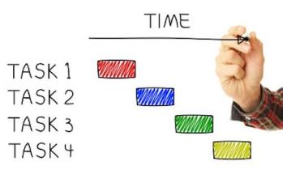
Project Sharing
Please briefly (5-10 minutes) share an overview of your project from beginning to end (and beyond):
Objectives(s)
Notable accomplishments
Struggles along the journey
New relationships made
Any press/media attention?
Plans for the future

Slide 3
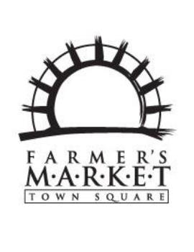
SNAP & Town Square Farmers Market
Molly Soeby
Notes:
Molly Soeby, Family & Consumer Science Agent for Grand Forks County Extension, and Community Health Action Response Team “Take Action” Chair joined the Leadership for Local Foods program in 2013 with the goal of getting Supplemental Nutrition Assistant Program (SNAP) dollars accepted at the Town Square Farmer’s Market in Grand Forks.
SNAP offers nutrition assistance to eligible, low-income individuals, and is the largest hunger safety net in the country. There are numerous benefits to allowing SNAP participants to spend their dollars at farmers markets, including increased access to healthy, locally grown foods, and keeping more dollars in the local community.
The Town Square/SNAP initiative began through a diverse community partnership under the “Take Action” umbrella. This group’s been working to allow SNAP use at the farmers market for a number of years, but without the buy-in and participation of the market vendors, they had little success.
There are many steps to implement SNAP acceptance at a farmers market including obtaining an FNS number (USDA certification), identifying a non-profit to sponsor, covering the cost of the point-of-sale machine (SNAP dollars operate like a credit card and many farmers markets operate on cash only), staffing needs to operate the EBT machine, and the costs associated with bookkeeping, start-up, transaction fees, and recruiting vendors to accept the SNAP dollars.
The “Take Action” group was able to complete nearly all of these important logistical pieces, but they were missing one crucial element – buy in from the market vendors. Shortly after the first Local Foods Leadership Training, Molly connected with Caryl Lester, manager of the Town Square Farmer’s Market, who was in full support of the market accepting SNAP and was able to bring all the vendors on board.
Through grant dollars received in the Local Foods Leadership Training, Town Square was able to cover the cost of hiring a summer employee to run the EBT machine. The market operated SNAP with a token system, allowing SNAP participants to purchase tokens to be exchanged for fresh produce, and vendors to be immediately reimbursed for their products. Also, through connections made in the Local Foods Leadership Training, Molly connected with members of the BisMarket Farmers Market, as they successfully began accepting SNAP the previous year. This connection provided guidance and mentorship to Molly and the TownSquare/SNAP team throughout the process.
The Town Square Farmers Market is gearing up for the 2015 market and its second season accepting SNAP benefits. They have many inspiring ideas for the coming year, and one of the key goals, according to Molly, is marketing the EBT capabilities to those in the SNAP program and to see an increase in the use of EBT SNAP at the market.
The Take Action coalition hopes to continue strong, collaborative effort to promote better health, support the local farmers, and ease poverty in the community.

Slide 4
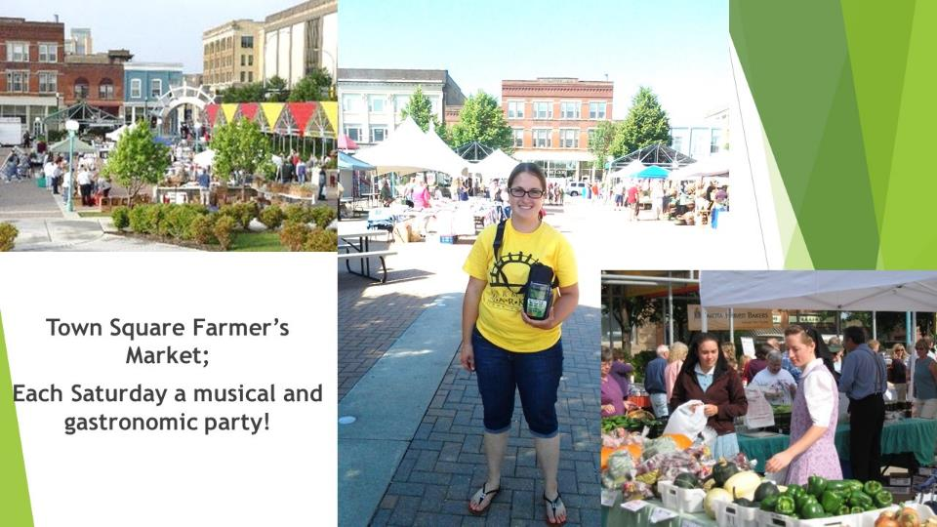
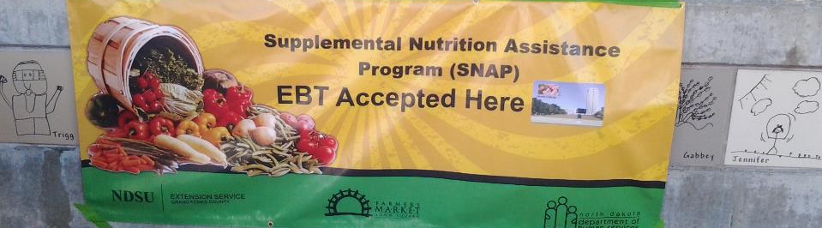
Notes:
Town Square Farmers Market
- Photo of the person hired (Jill Swingen) to operate and manage the EBT machine for the summer.

Slide 5
FAARMS/Economic Development Summit (SOLE)
Sue Balcom
Objective: We need to support farmers meeting economic developers and encourage scaling up through economic development
Summits:
  April 14 and 15, 2015 in Medora
  August 25 and 26th, 2015 in Bottineau with support from USDA Rural Development
Outcomes: To showcase CSAs, farmers markets, food hubs, aggregation, cooperative models and support the ND local food system as a community, small and large, economic development
Goal: Put a face on the farmer will encourage more JDA and Economic Development offices to support projects such as light processing and food hubs to assist with the distribution of locally grown and value added agriculture products.
Notes:
Participant: Sue Balcom
Project: Farmers Showcase at Local Foods Economic Development Summit

Slide 6
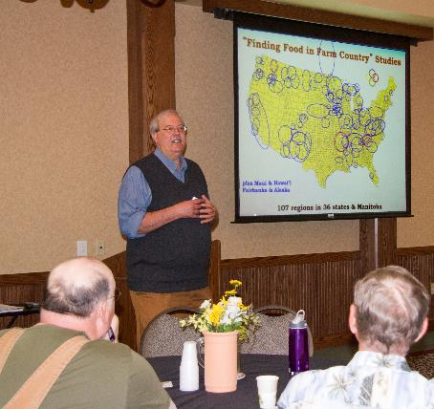
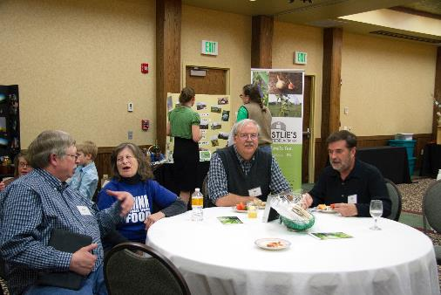
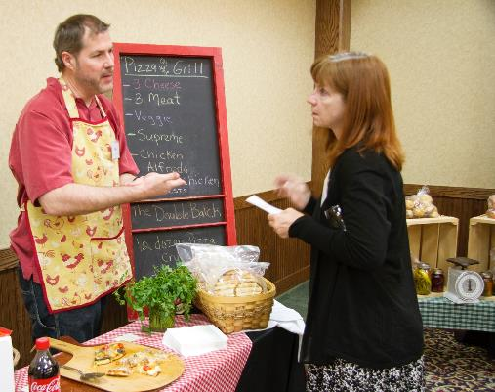

Notes:
Photos: Ken Meters discussing economic impact of local foods.
Logo of SOLE.
Attendees connecting with Ken Meters.

Slide 7
Sustainable Gluten Free Crops in Central ND
Glen Philbrick
Rational: To promote locally grown gluten free foods in central ND and prove that ND can sustainably grow gluten free foods.
How Did it Go? The tour had 20 participants. Had several discussions with people about gluten free foods such as quinoa and amaranth. Distributed recipe cards to provide meal ideas for products.
Main Outcomes: Most people were not aware quinoa and amaranth could be grown in ND. Customers were excited they will have a local option for gluten free grains.
Future Plans:
  Will be hosting another farm tour in August.
  Planning to visit Kevin Murphy, Barley & Alternative Crop Breeding Professor at the University of Washington, Pullman in August 2015.
Notes:
Participant: Glen Philbrick
Project: Sustainable Gluten Free Crops in Central ND

Slide 8
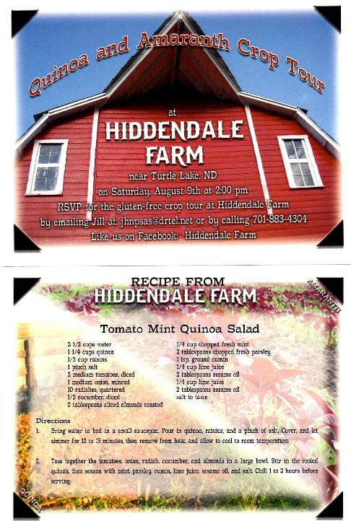
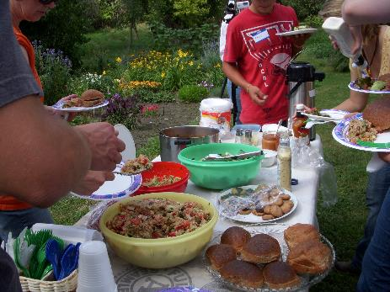
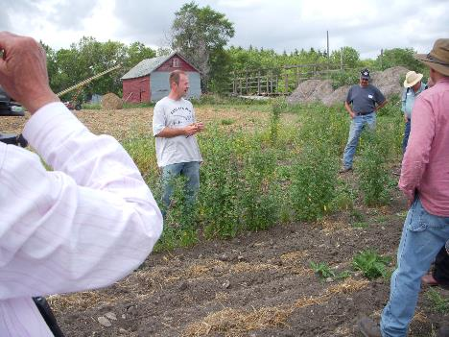
Notes:
Sustainable Gluten Free Crops in Central ND

Slide 9
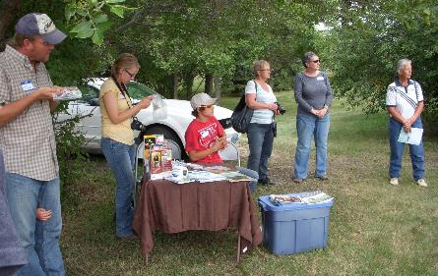
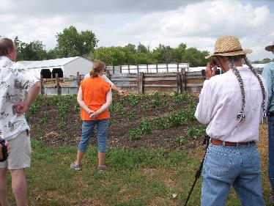
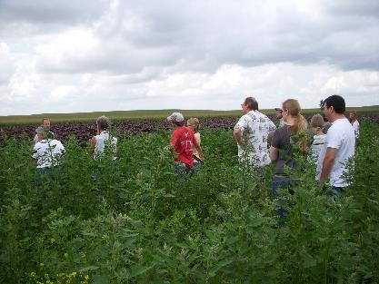
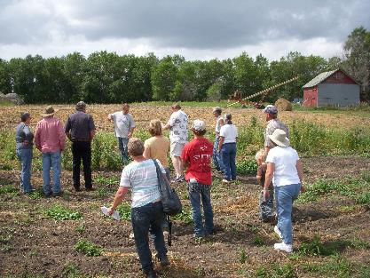
Notes:
Sustainable Gluten Free Crops in Central ND

Slide 10
Cross-Pollination Tour to Farm to Table Co-op
Stephanie Blumhagen
Farm to Table Co-op in Glendive is building a local food system in Eastern Montana and Western North Dakota.
The point of the cross-pollination trip was to take Local Food leaders from eastern and central North Dakota to see what Farm to Table has accomplished, learn from their experience, and share with themwhat North Dakota local food leaders have learned in their own efforts to build local food systems.
Tour Dates: March 20-21, 2015
Notes:
Participant: Stephanie Blumhagen
Project: Cross-Pollination Tour to Farm to Table Co-op
Overview:
Farm to Table Co-op in Glendive, Montana is building a local food system in Eastern Montana and Western North Dakota. The point of the cross-pollination trip was to take a van-load of Local Food leaders from eastern and central North Dakota to see what Farm to Table has accomplished, learn from their experience and share with them what we’ve learned in our own efforts to build local food systems. Like the bees that help our fields and gardens flourish by moving pollen from plant to plant, we will help local food systems across the region flourish through the exchange of knowledge and ideas.
Farm to Table Co-op’s projects:
A Local Buyer’s Guide
An ag marketing co-op to market member’s produce and products to local stores, restaurants and food services
Western Trails Food, a value added business featuring locally grown hull-less barley and beans in pancake, bread, and soup mixes.
Partnership with Dawson Community College’s Culinary Arts program to train chefs to work with local growers and producers.
A Food Development Center with a commercial kitchen which is can be rented by food entrepreneurs.
They documented and photographed their experience, and had great reflections/discussions on the van rides to and from each location, as well as home.
Transportation and lodging for participants was be covered by the SARE grant.

Slide 11
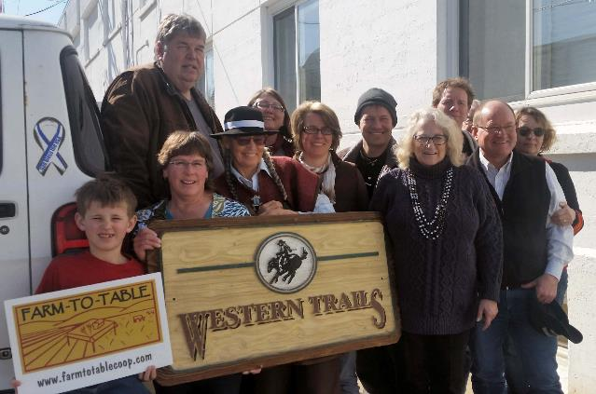
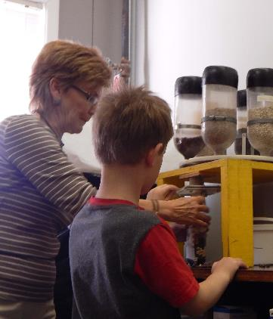
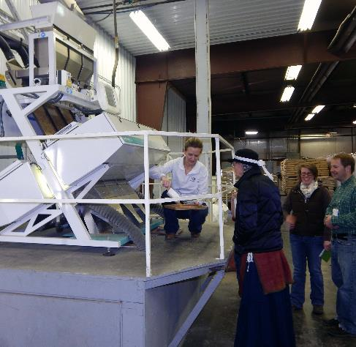
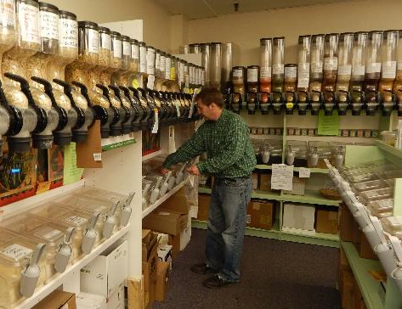
Notes:
Photos of the tours.

Slide 12
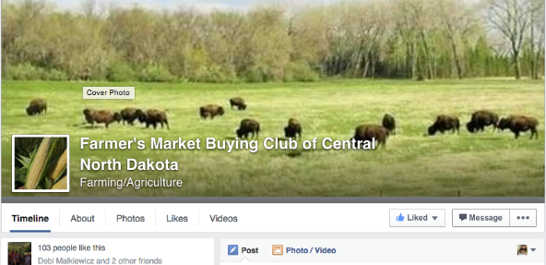
Farmers Market Buying Club of Central ND
Rachel Brazil
A unique collaboration between seven (7) growers and producers in central North Dakota to aggregate products to provide buyers in New Rockford and Carrington an excellent assortment of local goods, as well as a simple buying option.
First delivery began in early July.
35 customers on board to receive a variety of local products: bison, poultry, eggs, produce, and baked goods.
Notes:
Participants: Rachel Brazil
Project: Farmers Market Buying Club of Central ND
Note: Originally, the project was in combination with Jill Louters, Superintendent at New Rockford Public School, trying to increase farm to school participation in the district. After about a year into the grant project, it was identified that in order to build farm to school, they first needed to increase the aggregating capabilities and networking of local producers. Through conversations with various community members interested in local foods, Brazil determined (and with the support of Louters) that it would be a better use of time and grant funding to support aggregation and distribution of local goods through the buying club. They hope this will support further growth of local foods capacity and interest in the area, and lead to more farm to school activities in the near future.

Slide 13
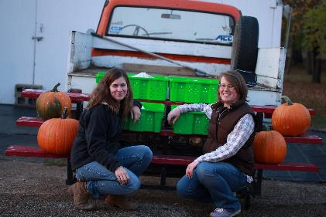
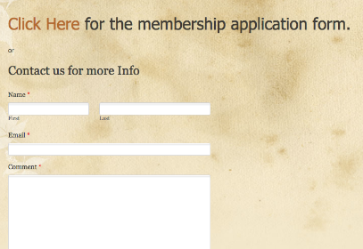
Farmers Market Buying Club of Central ND
Rachel Brazil
In 2015, the FMBCCND helped local farmers direct over $4,500 worth of products to consumers. Throughout the season, 159 orders were filled by 7 growers for 31 customers. This included 118 dozen eggs, 30 dozen ears of corn, and 76 pounds of onions.
http://fmbccnd.weebly.com/
www.facebook.com/fmbccnd
Notes:
Participants: Rachel Brazil
Project: Farmers Market Buying Club of Central ND
Note: Originally, the project was in combination with Jill Louters, Superintendent at New Rockford Public School, trying to increase farm to school participation in the district. After about a year into the grant project, it was identified that in order to build farm to school, they first needed to increase the aggregating capabilities and networking of local producers. Through conversations with various community members interested in local foods, Brazil determined (and with the support of Louters) that it would be a better use of time and grant funding to support aggregation and distribution of local goods through the buying club. They hope this will support further growth of local foods capacity and interest in the area, and lead to more farm to school activities in the near future.

Slide 14
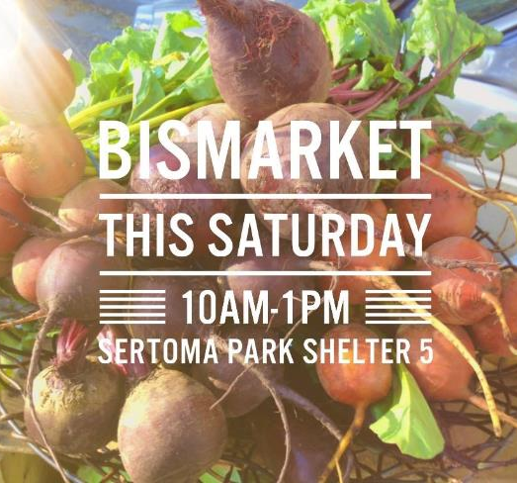
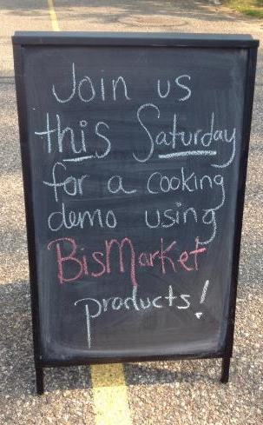
BisMarket Farmers Market
Peggy Netzer

Slide 15

United Tribes Technical College Winter Market
Jana Millner
Notes:
Participant: Jana Millner
Project: UTTC Winter Market
Overview:
The Winter Market completed its second season, running once a month from November 2014 – April 2015. The first season served as a pilot season and was March, April and May of 2014. The market was dedicated to only selling locally grown, or crafted items. The market ranged from local produce, canned foods, baked goods, jewelry, clothing, artwork, pottery, hula hoops, dog treats, plants, soaps, natural products, and more! They wanted to create a warm atmosphere and also included children’s activities at most markets.
ND SARE mini grant dollars were used for three things: advertising, logo development/production and market signage. They hired a graphic design artist to make the Winter Market logo: incorporating shopping locally, food, and a tribal aspect, as UTTC is where the event was hosted.

Slide 16
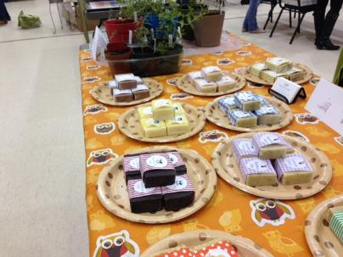
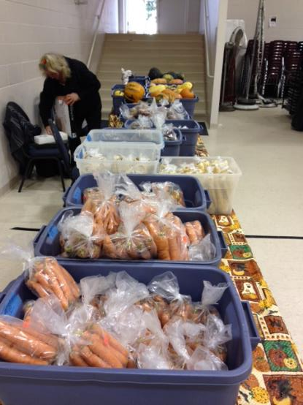
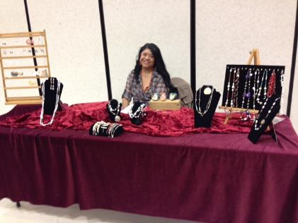
Notes:
The market had a fairly consistent stream of customers.

Slide 17
Notes:
The 2015/2016 Market dates have already been set: November 14, December 19, January 23, February 20, March 19 & April 23 from 10 a.m. – 2 p.m.

Slide 18
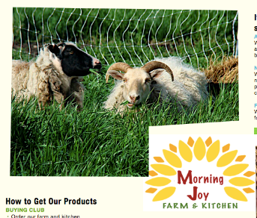

MOSES - February 2015 – La Crosse, WI
Lori Martin & Annie Carlson
ND Leadership for Local Foods supported two participants to attend MOSES 2015
  Roving Donkey Farm – Lori & Kevin Martin
    Bismarck, North Dakota
  Morning Joy Farm & Kitchen – Annie Carlson
    Mercer, North Dakota (north central)
Notes:
The MOSES Conference is the largest event in the US about organic and sustainable farming. Every February, about 3,000 farmers, advocates, educators, students, and others attend educational workshops and keynote speakers in La Crosse, Wisconsin.
Lori Martin and Annie Carlson, both Leadership for Local Foods participants, attended MOSES 2015 with support from ND Leadership for Local Foods.
Lori & her husband, Kevin, attended the 2015 MOSES conference. Lori is a Leadership for Local Foods Participant. Together they own and operate Roving Donkey Farm, a family owned vegetable farm located north of Bismarck.
Annie Carlson own and operates Morning Joy Farm, a third generation, family owned, pasture-based, local-market farm located in central North Dakota. They have an on-farm commercial kitchen and produce pastured eggs, chicken, turkeys, pork and grass-fed lamb.
Here are the key takeaways Martin and Carlson shared from their experience at MOSES:
Walking tractors are not for everyone, and the need to accommodate smaller statured folks in terms of power and size has not yet been addressed. We would love to have one on our farm, as we are 100% human powered, but it may be overkill.
A great idea for managing regular tasks on the farm is to create checklists (with pictures when applicable). This will allow employees and interns to fill in or pick up new tasks with little to no training. Documentation is king!
Downy mildew in basil is becoming a real problem in the US. In our northern climate it is not able to overwinter, but seed sources are still important to consider.
One would think vermicomposting and organic disease management would be boring workshops to attend, but it’s all in the presentation folks. I have heard both presenters at previous conferences and they are amazing! If you ever see Erin Silva or John Biernbaum on an agenda, go see them!
Navigating your state’s cottage food law (or local health district regulations in the case of ND) is vital when planning to produce items for sale from your home kitchen. Presentation is just as important as quality of the product.
There were so many gleanings from the productive packing shed workshop, an entire post could be written on that. Even for the small producer, there are some great DIY options for having a great packing shed. These include:
Color coding tools and containers
Mini pallet jack using a hand truck
Rain gear for cleaning root vegetables
Posted schedules for cleaning tasks – daily, weekly, monthly, seasonally
During design phase, plan for all utilities to be installed outside the walls so any changes are easy to make and have all water drain outside
Vermicomposting on a large scale is being studied in several locations across the country and some successes are being reported. It is a labor-intensive process in that the best results come from raw materials being pre-composted before adding worms.
While there is still a lot of room to grow in the field of solar energy, it can be a viable option for powering all, or at least a portion, of your operation. Additionally, several grant and/or tax credit options exist to help get you started. A proper evaluation of your usage is key, and finding local installers can be difficult in some areas, but who wouldn’t want to use free, continuous energy?
Adam Montri is a ‘numbers’ guy. When laying out his planting plan for the year, especially in the high tunnel, he breaks his earning potential down to $ / square foot / day, even if that number is $0.002. By letting his dollar per square foot goal be a main driving force behind his year-round planting plan, he has laid out a sound financial plan that will increase the chance of success year after year.

Slide 19
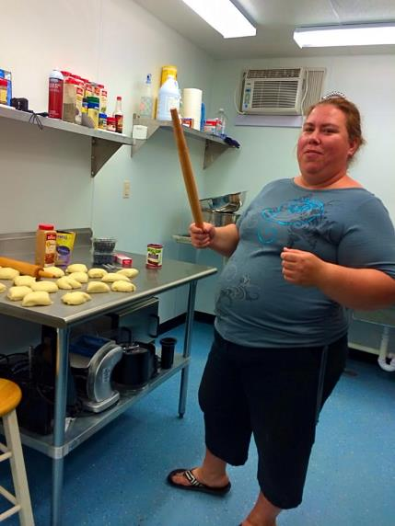
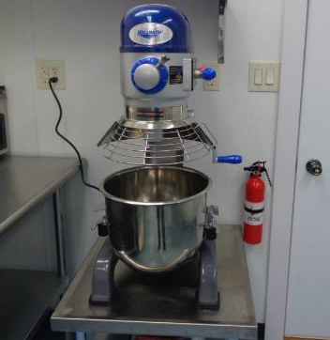
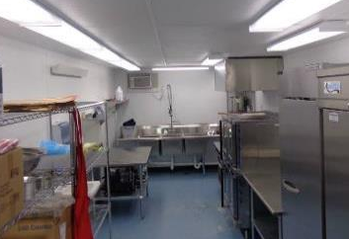
Morning Joy Farms – Annie Carlson
Notes:
Morning Joy Farm is a third generation, family owned, pasture-based farm located near Mercer, ND (central ND).
The newly installed commercial kitchen has expanded the farm business to be able to provide homemade catered meals for special events, freezer meals for busy families, or additional adds to the CSA basket including soup and bread.

Slide 20

Northern Small Farm Alliance
Ross & Amber Lockhart
Four Pillars of NSFA & Actions:
  Local Food Awareness Building
    NSFA Facebook Page
    NSFA Media Message, Marketing Materials & Mission Statement
    Get Local Event
  Farmer-to-Farmer Education
    On Farm Tours/Best Practice Sharing
  Support for New & Emerging Farmers
    NSFA Internship Program
    NSFA Membership Guidelines
  Aggregation of Produce
    Food Truck/Mobile Farmers Market
    www.facebook.com/northernsmallfarmalliance
Notes:
Northern Small Farmer Alliance is a network of small-scale producers in the Red River Valley regions of North Dakota and Minnesota.
They have held four meetings since January 2015. They have created a logo and are working to do some farm tours/sharing of best practices this summer. They are also hoping to host a Get Local event in Fargo. They
They have developed four action pillars for the NSFA and under each pillar listed on the slide, you can see some of the activities they have begun (or hope to begin) in order to meet their goals.

Slide 21
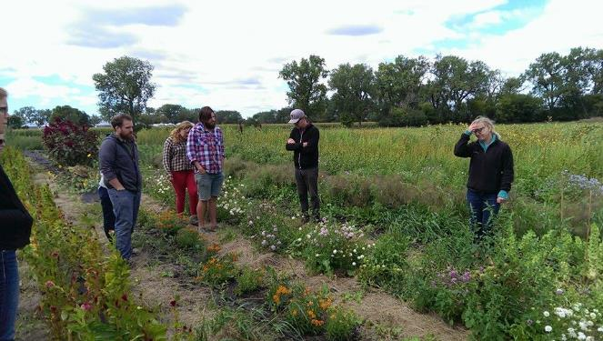
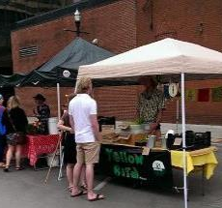

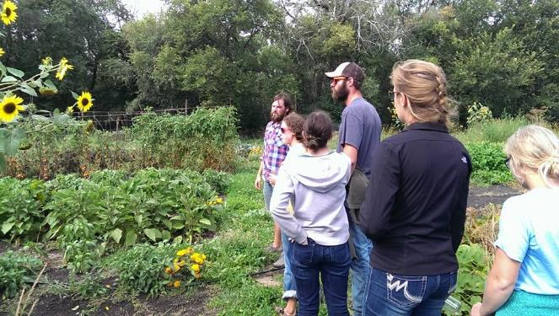
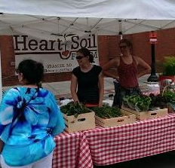

Slide 22
Dickey County Ag Day – April 23
Nicholas Podoll and Breana Kiser
Half-day of programming for 7th and 8th grade students to learn about various aspects of local food.
  Producers talked about what they are doing (vegetable, animal, milk, and eggs)
  Natural Resources Conservation Service (NRCS) talked about the benefits of local food systems for land and soil, fruit trees/community orchards, and importance of shelter belts
  Live goats for students to see/touch, and also taste goat milk
  Had ~65 students attend

Slide 23
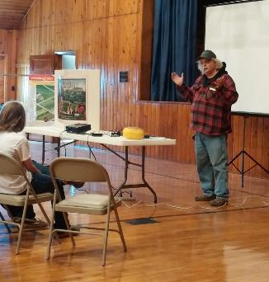
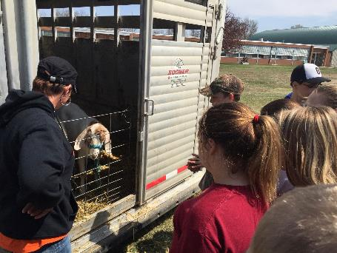
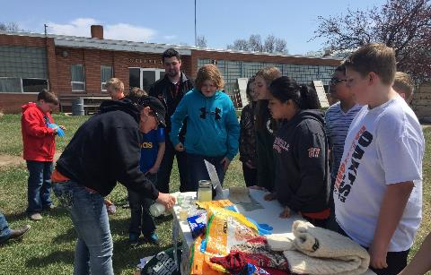
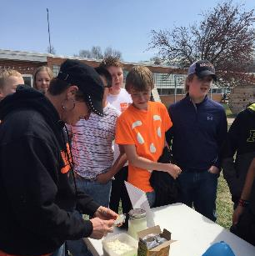

Slide 24

BISMAN Community Food Coop
Tyler & Heidi Demars
Notes:
Participants: Tyler & Heidi Demars
Project: BisMan Community Food Coop
Overview:
The Bisman Community Food Coop currently has 820 members owners/investors. They hit the 600 member milestone in the summer of 2014 (the number necessary to move forward with a physical site).
Three coop members attended the Consumer Cooperative Management Association (CCMA) conference in June 2014 with funding support from the Leadership for Local Foods program. In addition to presentations/sessions, CCMA included various tours in Madison, Wisconsin that the coop members found very valuable including a community garden with various education components and an organic farmer owned cooperative. The conference had difference tracks and Heidi attended the marketing/outreach track, which was very helpful. SARE grant funding was used to offset the costs of the coop members to attend this training.

Slide 25
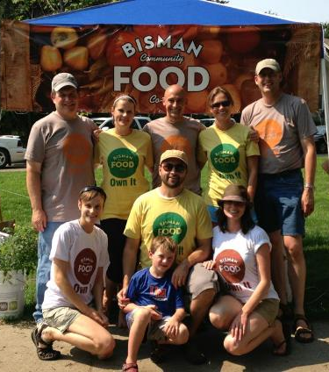
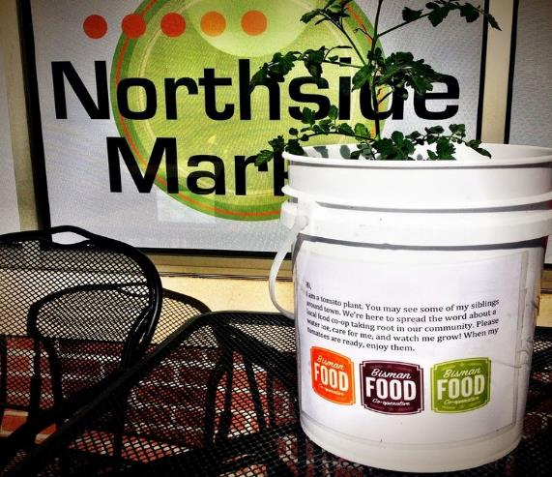
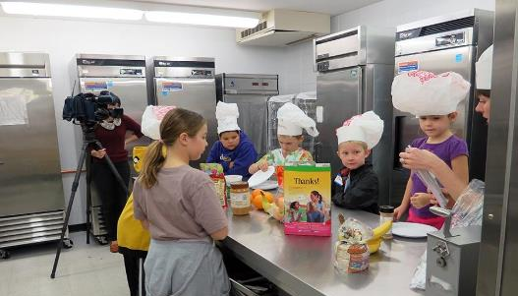
Tomato Bombs were dropped around town to spread the word about the co-op
Young chefs making food art on Food Day Oct 24^{th,} 2013
Notes:
BISMAN Community Food Coop

Slide 26
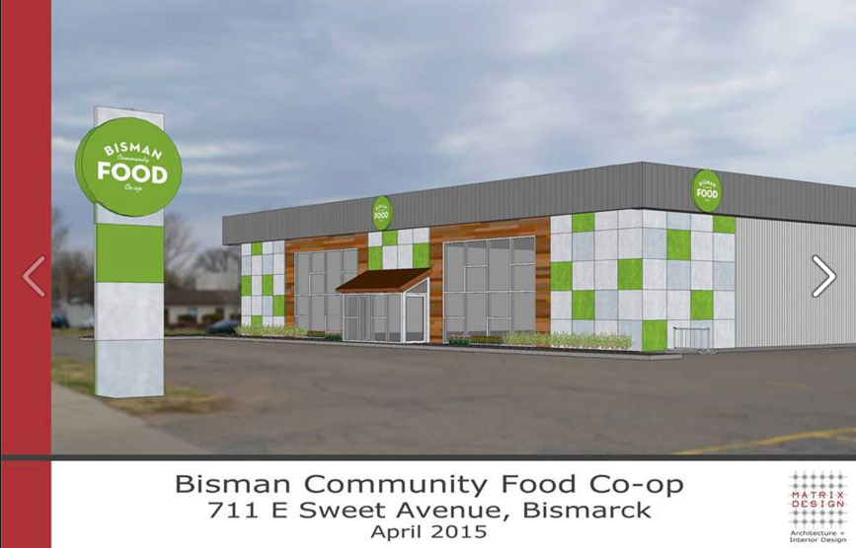

Slide 27
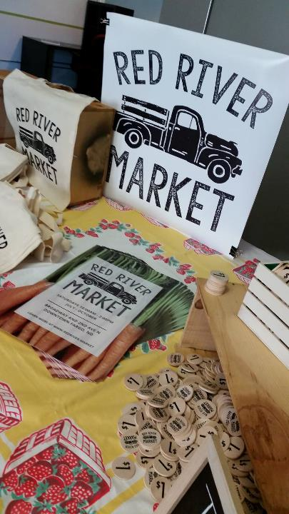
Red River Market
Megan Myrdal
The Red River Market is a new farmers market located in the heart of downtown Fargo, North Dakota.
The Market ran from July – October and attracted ~1200 attendees each week.
ND SARE funding was utilized for marketing/promotion: Market Money tokens and Red River Market totes
Notes:
The market will run every Saturday from July 11th through the October or the food producing season.

Slide 28
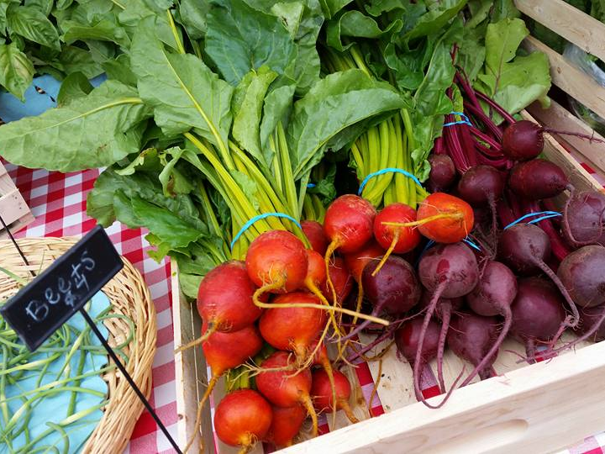
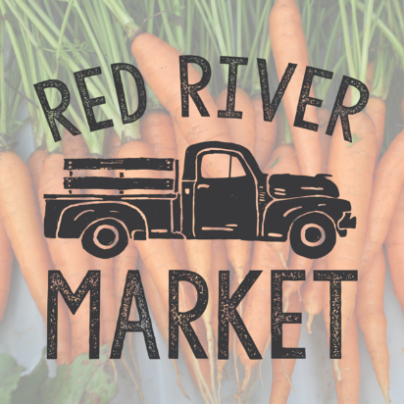
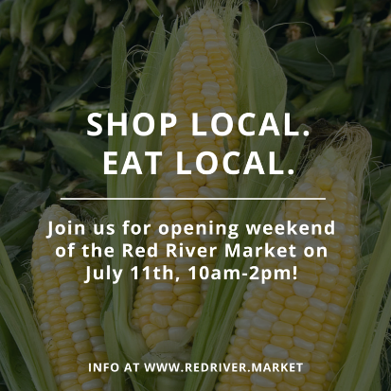
Notes:
Red River Market

Slide 29
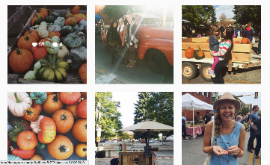
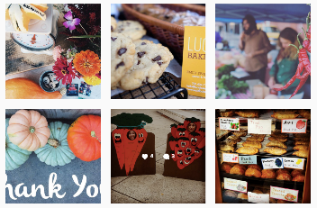
Red River Market By Numbers
17 consecutive Saturdays – July 11 – October 31
Over $100,000 in revenue generated for local producers & makers
20,000 market visitors
18 Season Pass holders & 10 Daily Pass Vendors
2,285 Facebook followers
1,078 Instagram followers
Notes:
Season pass holder & Daily vendors – limited to food producers & makers of household products. Also hosted a variety of featured artists & makers
Live music nearly every Saturday
5 volunteers and ~$5,000 = $100,000 in revenue for local producers and makers.

Slide 30
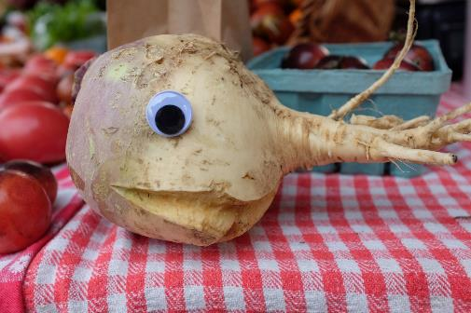
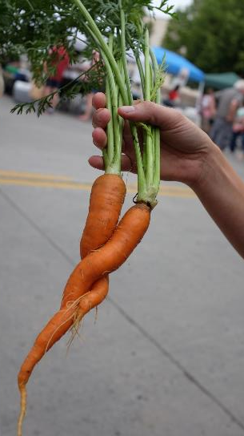

Ugly Food of the North

Slide 31

Ugly Food of the North
Formed in August 2015 & three events to date:
  Ugly Food Market & Potluck (August 29 & September 1)
    Held at the Red River Market & Drekker Brewery
    Over 100 attendees
  Ugly Food Community Conversation & Happy Hour (October 15)
    Rourke Art Museum
    65 attendees
  Local Ugly Food Buffet (November 1)
    Everest Tikka
    118 attendees @ $10.00 = $1,180 in revenue for a new, local food business (+showing that selling local, ugly food = customers!)
  Facebook: www.facebook.com/fmuglyfood
  Instagram: www.instagram.com/fmuglyfood
  Twitter: www.twitter.com/fmuglyfood
  www.fmuglyfood.com

Slide 32




#FMUglyFood

Slide 33


Leadership for Local Foods Blogs
Notes:
To capture some of the success and progress to date on the projects, we created bi-monthly blogs that are posted to the North Dakota State University Extension Food & Nutrition website. This website houses a local foods section that shares the benefits of growing and consuming locally grown food.
Blogs have been published since February 2015, and have been shared with various local food networks around the state. They have been a great way to share success and progress with the participants and the larger local food community in the state, as well as capture our participants stories.

