Slide 1



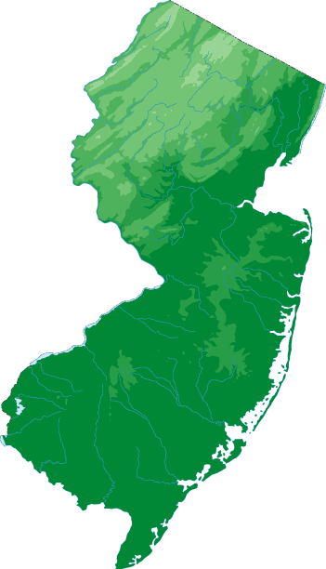
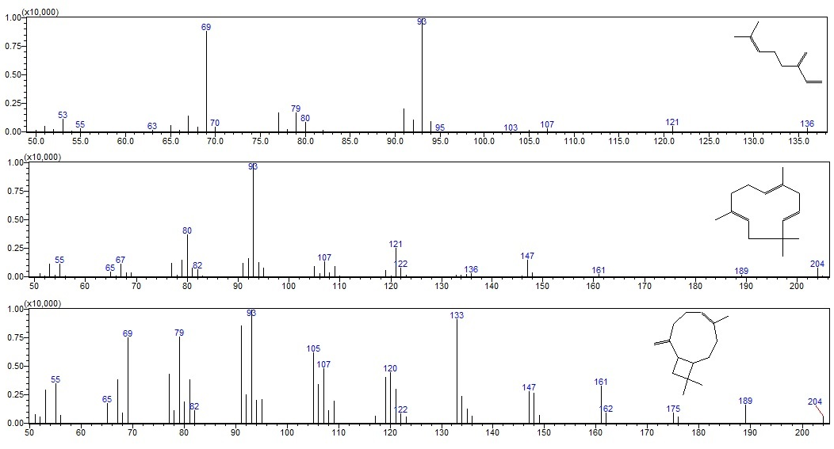
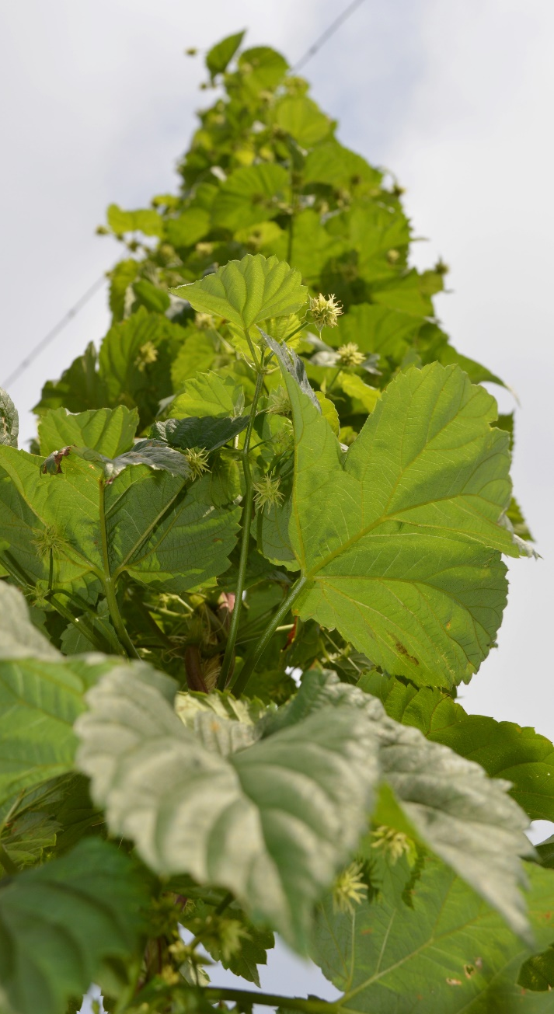
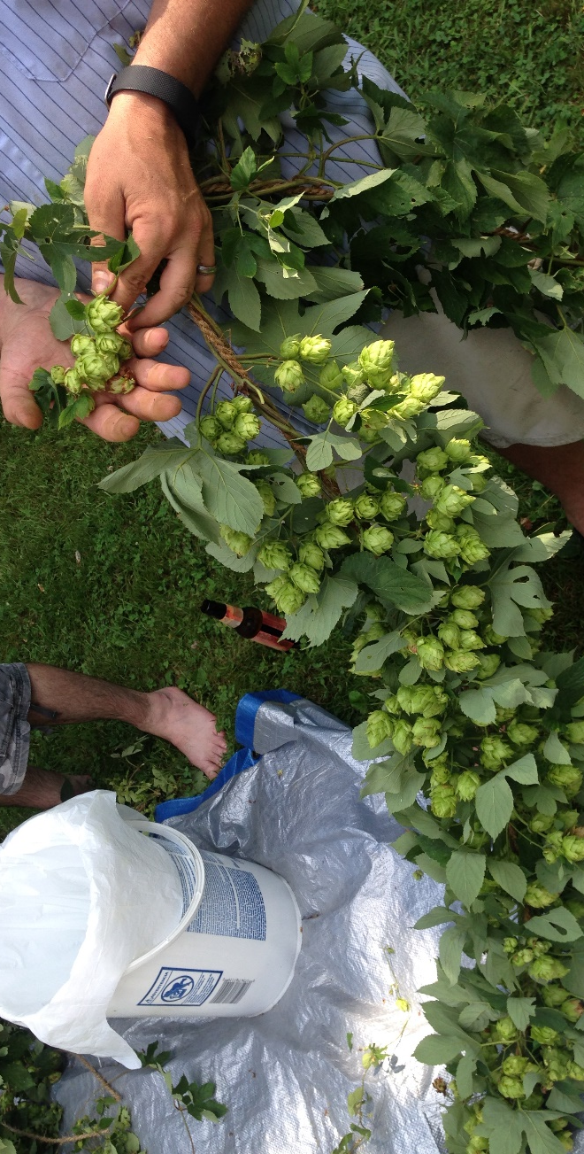
Aroma and Quality Characteristics of
New Jersey grown Hops (Humulus spp.)
Megan Muehlbauer², Robert Pyne^{1,2}, Ed Dager², Dan Giurleo¹ and James Simon^{1,2}
¹New Use Agriculture & Natural Plant Products Program and the
²New Jersey Agricultural Experiment Station (NJAES),
School of Environmental and Biological Sciences Rutgers, The State University of New Jersey, 59 Dudley Road, New Brunswick, NJ
Introduction
Table 1. Bittering acid content of hop varieties grown in New Jersey
Results and Discussion
Hops (Humulus lupulus) are herbaceous, perennial bines cultivated for their female flowers or cones, which are a critical ingredient in beer-making. A burgeoning craft brewery industry has been the impetus for the rise in demand for hops. Although Mid-Atlantic US states account for an estimated 34% of national brewery sales, virtually no hops are grown in this region. As interest in craft brewing and sourcing local ingredients rise, a unique opportunity has emerged for Mid-Atlantic farmers to supply this high value crop. As farmers develop an interest in growing hops, it is important to understand the inputs needed to establish and grow this niche crop in accordance with industry standards. A SARE Partnership Grant-supported study was initiated at Rutgers University to establish a centrally located demonstration hopyard at the Clifford E & Melda C. Synder Research Center for Sustainable Agriculture, Pittstown, NJ to evaluate the performance of 10 commonly grown hop varieties. In addition, hop samples were donated from hop growers throughout New Jersey. Analysis of alpha/beta acid contenst by American Society for Brewing Chemists (ASBC) protocol ‘Hops-14’ and essential oil composition by ‘Hops-17’ provided the essential chemical metrics. Interestingly, major essential oil components (β-myrcene, α-humulene and β-caryophyllene) varied within the same variety at different locations, which provides interesting implications through potential new flavor profiles for local brewers.
Variety | Location ID | ^{y}cohumulone | n + adhumulone | colupulone | n + colupulone | ^{z}α-acids | ^{z}β-acids
Brewers Gold | 2 | 1.97±0.01 | 3.36±0.04 | 2.31±0.02 | 1.33±0.04 | 5.33 | 3.64
Cascade | 2 | 1.3±0.04 | 2.46±0.12 | 3.33±0.05 | 3.36±0 | 3.76 | 6.69
Cascade | 3 | 0.73±0.12 | 1.75±0.29 | 1.36±0.27 | 1.5±0.28 | 2.48 | 2.86
Cascade | 4 | 1.87±0.11 | 4.3±0.27 | 2.25±0.18 | 2.07±0.18 | 6.17 | 4.32
Centennial | 3 | 0.38±0.07 | 1.04±0.17 | 0.31±0.02 | 0.27±0.03 | 1.42 | 0.58
Chinook | 1 | 3.29±0.1 | 6.96±0.22 | 1.48±0.04 | 0.99±0.04 | 10.24 | 2.47
Chinook | 2 | 2.36±0.04 | 5.12±0.06 | 1.3±0.02 | 1.05±0.02 | 7.48 | 2.34
Chinook | 4 | 3.02±0.16 | 7.83±0.21 | 1.35±0.02 | 1.18±0.01 | 10.85 | 2.53
Columbus | 1 | 3.29±0.08 | 8.61±0.02 | 2.07±0 | 1.59±0.02 | 11.91 | 3.67
Galena | 2 | 4.34±0.09 | 6.6±0.19 | 4.77±0.16 | 2.82±0.07 | 10.94 | 7.59
Goldings | 2 | 4.68±0.06 | 12.97±0.26 | 2.51±0.06 | 2.16±0.06 | 17.64 | 4.67
Mount Hood | 3 | 0.51±0.05 | 0.9±0.06 | 1.31±0.06 | 0.87±0.03 | 1.41 | 2.18
Nugget | 2 | 2.06±0.09 | 8.66±0.37 | 1.23±0.09 | 1.66±0.11 | 10.72 | 2.89
Nugget | 3 | 1.18±0.19 | 4.34±0.72 | 0.72±0.09 | 0.88±0.12 | 5.52 | 1.59
Sterling | 3 | 1.08±0.25 | 2.76±0.67 | 0.8±0.14 | 0.72±0.14 | 3.83 | 1.51
Tettanger | 3 | 0.06±0 | 0.14±0 | 0.19±0 | 0.12±0 | 0.2 | 0.31
Willamette | 3 | 0.51±0.02 | 1.38±0.01 | 1.1±0.06 | 1.14±0.03 | 1.89 | 2.24
Bittering Acid Content
Data collected from hopyards from different locations in New Jersey provide some initial insights into the bittering and flavor profiles of hops by variety and location. Both alpha and beta acid content appear to be quite variable within varieties such as ‘Cascade’ and ‘Chinook’ (Table 1), which are among the most widely grown aroma and alpha hops, respectively. Mean α- and β-acid content for ‘Cascade’ ranged from 2.48-6.17% and 2.86-6.69%, respectively, across three NJ locations with two of the three samples falling within range of the expected 4.5-7.0% range (HopUnion). Mean α-acid content for ‘Chinook’ ranged from 7.48-10.85% (Table 1) across three locations, falling short of the expected 12-14% range (HopUnion). Location 3 demonstrated consistently lower α- and β-acids, but were observed to have an apparent high water content, which is likely to have decreased the percentage acids by weight. Improved horticultural practices (Fig. 3) coupled with more effective drying/harvesting methods may increase aid in acid levels and decrease variation in NJ hops.
Volatile Profile
Analysis of major hop essential oil volatiles (Table 2.), representing flavor/aroma profile, demonstrated differences for identical varieties across locations. The relative percentage of β-myrcene in NJ grown ‘Chinook’ ranged from 39.16-53.28% across three locations with all samples higher than the expected 35.5% (HopUnion) (Fig. 4). This data suggests that ‘Chinook’ grown in NJ may be more appropriately marketed as a dual-purpose hop with flavor profile unique from that of the Pacific Northwest. Differences in major volatile composition of NJ hops showed substantial deviation from the expected profiles (HopUnion) in every variety evaluated with the exception of ‘Nugget’, Location 5. Environment-dependent aroma/flavor profiles suggests the potential for terroir as a marketable feature of hops in the Mid-Atlantic and a potential selling point for brewers using locally grown hops.
^{y}Acid components reported as the mean percentage by weight of two biological replicates ; ^{z}Alpha acids are equal to the sum of cohumulone and n + adhumulone; Beta acids are equal to the sum of colupulone and n + colupulone
Table 2. Major Volatile Oil Composition of Hop Varieties Grown in New Jersey as Compared to HopUnion LLC (Washington, USA)
Materials and Methods
Variety | Location ID | β-myrcene | α-humulene | β-caryophyllene | % of Total Oil
Cascade | 3 | 61.63% | 12.30% | 5.43% | 79.36%
Cascade | HopUnion | 52.50% | 13.00% | 4.50% | 70.00%
Cascade | 4 | 56.34% | 15.09% | 6.56% | 78.00%
Chinook | HopUnion | 35.50% | 13.00% | 4.50% | 53.00%
Chinook | 4 | 47.09% | 19.43% | 7.77% | 74.28%
Chinook | 1 | 39.16% | 24.10% | 9.95% | 73.20%
Chinook | 5 | 59.46% | 13.86% | 7.49% | 80.81%
Columbus | HopUnion | 45.00% | 15.00% | 10.00% | 70.00%
Columbus | 1 | 67.41% | 10.22% | 6.99% | 84.62%
Nugget | HopUnion | 51.50% | 17.50% | 8.00% | 77.00%
Nugget | 5 | 51.47% | 23.71% | 9.76% | 84.94%
Plant Material
SARE partnership growers contributed dried hop cone samples from four locations in New Jersey (Fig. 1) representing 12 hop varieties, which were analyzed for bittering alpha/beta acid contents (Table 1). Six samples representing four varieties were analyzed for volatile oil composition (Table 2).
Identification, quantification and analysis of hop bittering and flavoring compounds
α-acids and β-acids
Bittering acids cohumulone, n + adhumulone, colupulone, n + adlupulone were separated and identified by HPLC-UV. Dried cone samples were submitted by growers. For each samplen two 10 gram subsamples were removed and extracted as biological replicates. Each of the four bittering acids were quantified for each sample according to ASBC method Hops-14, using the International Calibration Extract 3 (ICE-3) to calculate response factors. Acids are reported as percentage of component by weight.
Major essential oil volatiles
Hop essential oils were extracted from dried cones by hydrodistillation according to ASBC method Hops-13. Oil samples were prepared and analyzed according to ASBC method Hops-17 with adjustments. 10µl of pure hydrodistilled oil were dried over anhydrous sodium sulfate was pipetted into 1.0 ml of MTBE. A 1µl injection volume of dilute sample was separated on a Shimadzu gas chromatograph 2010 Plus using a column SH-Rxi-5Sil column. Compounds were identified using a Shimadzu TQ8040 MS heated from 35°C with a hold of 4min to 250°C with a hold of 1.25min at 20°C/min. The relative percentage of essential oil constituents was calculated using peak areas peak areas of those constituents in each sample.
7
β-myrcene
α-humulene
2,5
β-caryophyllene
6
Fig 2. Mass spectra of three major hop essential oil volatiles
Fig 4. Major Volatiles for Hop Variety 'Chinook' Grown in
New Jersey
3
a
b
Conclusion
1
Given the infancy of this crop in the Northeastern US, these initial results provide encouraging results for the potential of hops as a value-added crop in NJ. However, multi-year data is needed for the locations surveyed in this study to determine whether this consistency is being achieved. Success of New Jersey and Mid-Atlantic hop growers will be dependent upon grower ability to provide consistent hop chemical quality as well as sufficiently high and profitable yields across harvests to obtain multi-year contracts with breweries. Conversely, differences in volatile composition due to environment represent a potential opportunity derived from variability for Mid-Atlantic growers to exploit their terroir. This opportunity may be augmented by increased demand and higher prices for high alpha hops.
4
Fig 1. Location IDs for 5 growers in New Jersey
Fig 3a. Growing bine and b. mature cones of hop variety ‘Chinook’
Acknowledgements
Funds for this research were provided by SARE partnership grant # UNIV OF VERMONT-ONE15-247-29001. We are grateful to Shimadzu Scientific Instruments, Rutgers Center for Sensory Sciences & Innovation, the NJAES & Clifford E. & Melda C. Snyder Research and Extension Farm.
Contact: Prof. James Simon; jimsimon@rutgers.edu
References
ASBC Methods of Analysis, online. Method Hops-14. α-Acids and β-acids in hops and hop extracts (International Method). Approved 1990, rev. 2008. American Society for Brewing Chemists, St. Paul, MN, U.S.A. doi: 10.1094/ASBCMOA-Hops-14
HopUnion. https://www.hopunion.com/hop-varieties/
USDA-National Agricultural Statistics Service (NASS). National Hop Report. “2015 Hop Production Up 11 Percent from Last Year”. Released December 17, 2015. ISSN: 2158-7825.

