Slide 1
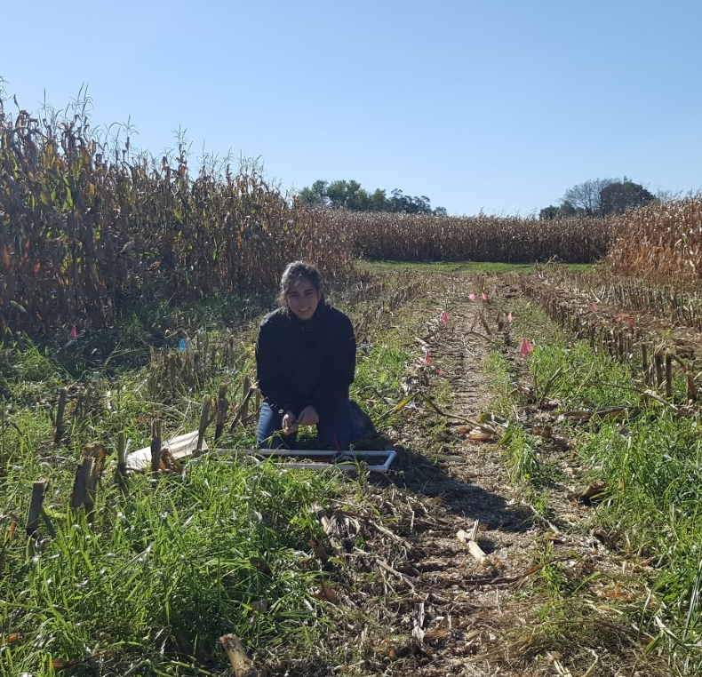
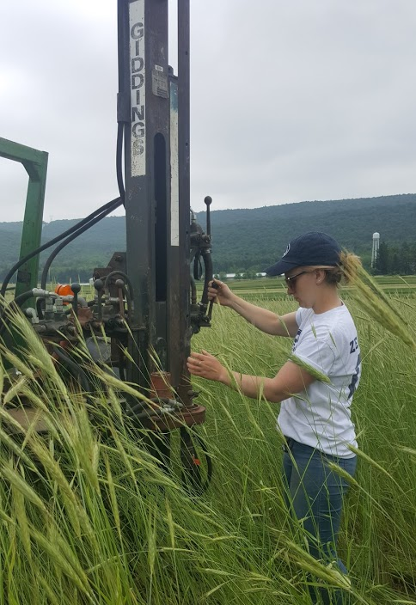
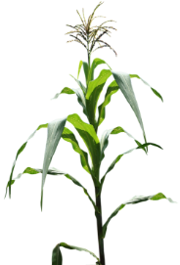
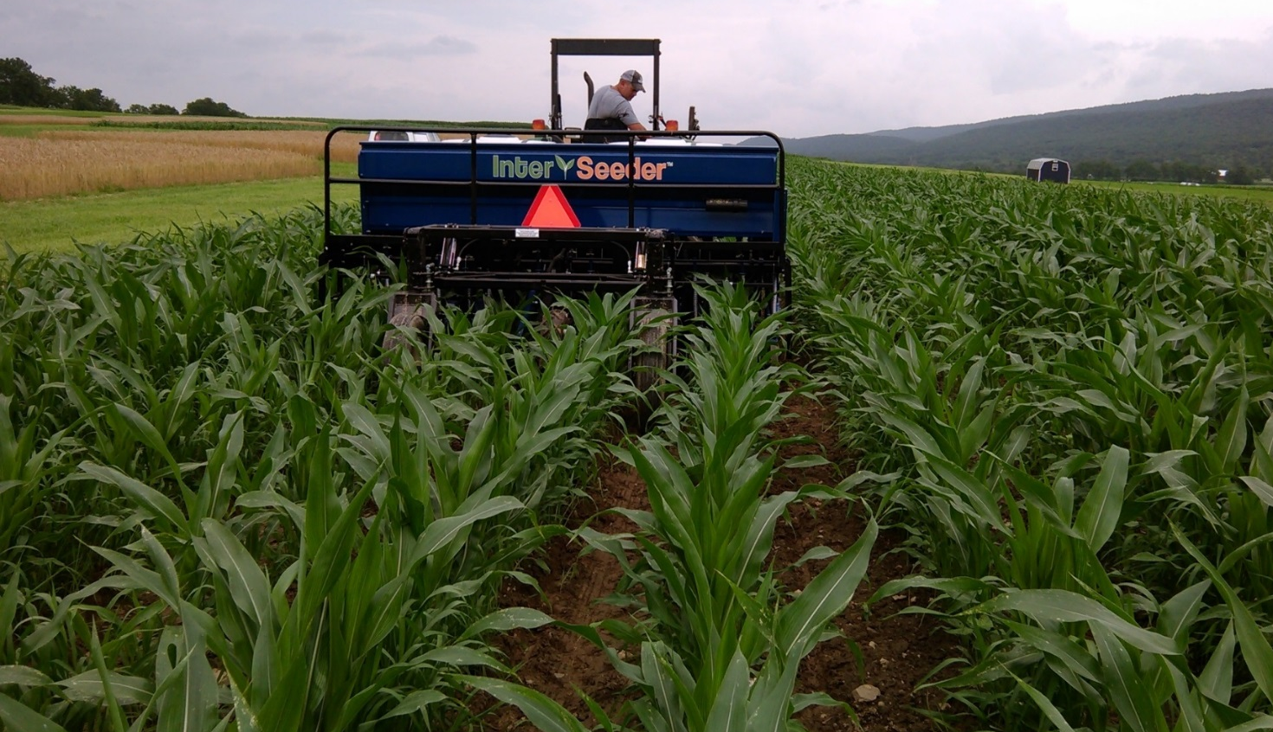
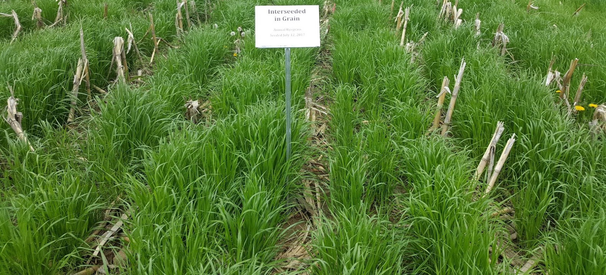
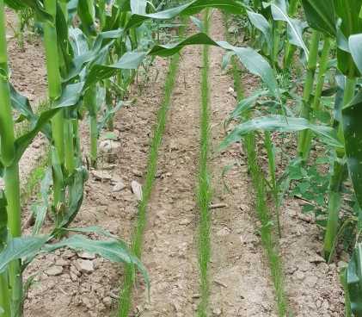
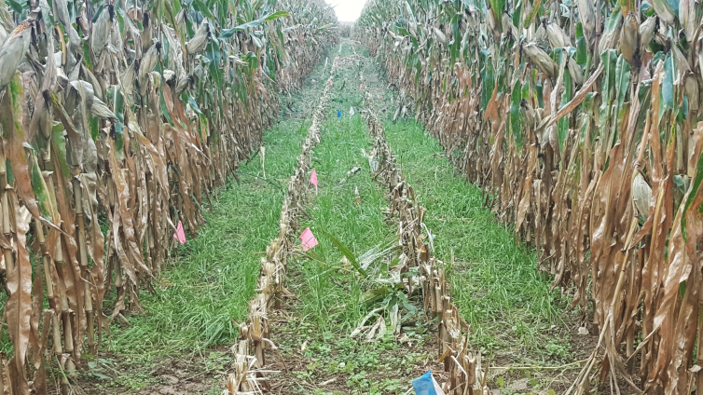
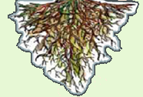
Nitrogen services provided by interseeded cover crops in organic corn systems
Sarah A. Isbell, Jason P. Kaye
The Pennsylvania State University
GNE16-122
Interseeding cover crops:
A strategy to reduce Nitrogen (N) losses
CHALLENGE: Limited window for fall plant growth, difficulty in establishing a cover crop (CC) after corn grain harvest
OPPORTUNITY: Establish a CC by interseeding into a standing corn crop
→ While interseeding CCs has increased interest from farmers, there is little scientific information documenting the magnitude or mechanisms of change in the nitrogen (N) cycle from this practice
Experimental Design
Organically managed corn grain system
Three Cover Crop treatments:
Two levels of organic N inputs: Standard (300# N) and High (375# N)
Randomized block design, four replications
Sampling Methods
FALLOW
POST-Harvest
Cereal rye
INTERSEEDED
Annual Ryegrass
Aboveground biomass sampling
Aseptic surface soil sampling
Deep soil coring
Results
1. N retention in aboveground biomass similar in ryegrass (INT) and cereal rye (POST)
2. Similar potential for reduced N leaching from ryegrass (INT) and cereal rye (POST)
July
May
Aug
Oct
Std
A year in the life of an interseeded cover crop
Counterclockwise from top left: 1. Drill interseeding into corn in mid-summer; 2. Annual ryegrass CC establishment by late summer; 3. Ryegrass CC puts on biomass rapidly after corn harvest; 4. Spring CC biomass before termination.
High Nitrogen Treatment, Spring
3. Potential of soil microbial biomass as N sink
4. Corn residue is large C input in all systems, impacting signal of C inputs from treatments
Hypothesis
Interseeded CCs will reduce N losses through increased N retention in the CC biomass and the soil microbial biomass (Fig 1.)
Total Phospholipid Fatty Acid (PLFA) Biomass – 10 cm depth
Figure 1. Living roots of a grass CC exude carbon compounds (blue arrow) that are assimilated into the soil microbial biomass. The microbial biomass exchanges with the soil nitrogen pool (orange rectangle). Any residual nitrate in the soil N pool that is not taken up by either plants or microbes is susceptible to loss by leaching (red arrow).
Carbon inputs
Microbial Biomass
Conclusions
Similar capacity for N retention and reduced N leaching in interseeded ryegrass and post-harvest cereal rye
Reduced leaching driven by N storage in plant biomass
Microbial biomass similar in all treatments – influence of carbon from other sources dominate
Future work
Explore taxonomic differences in soil microbial communities with PLFA data
Explore functional differences in soil microbial communities through soil incubations and substrate induced respiration
NH4+, NO3-, DON
N leaching losses
Contact: Sarah Isbell, szi5054@psu.edu

