Slide 1
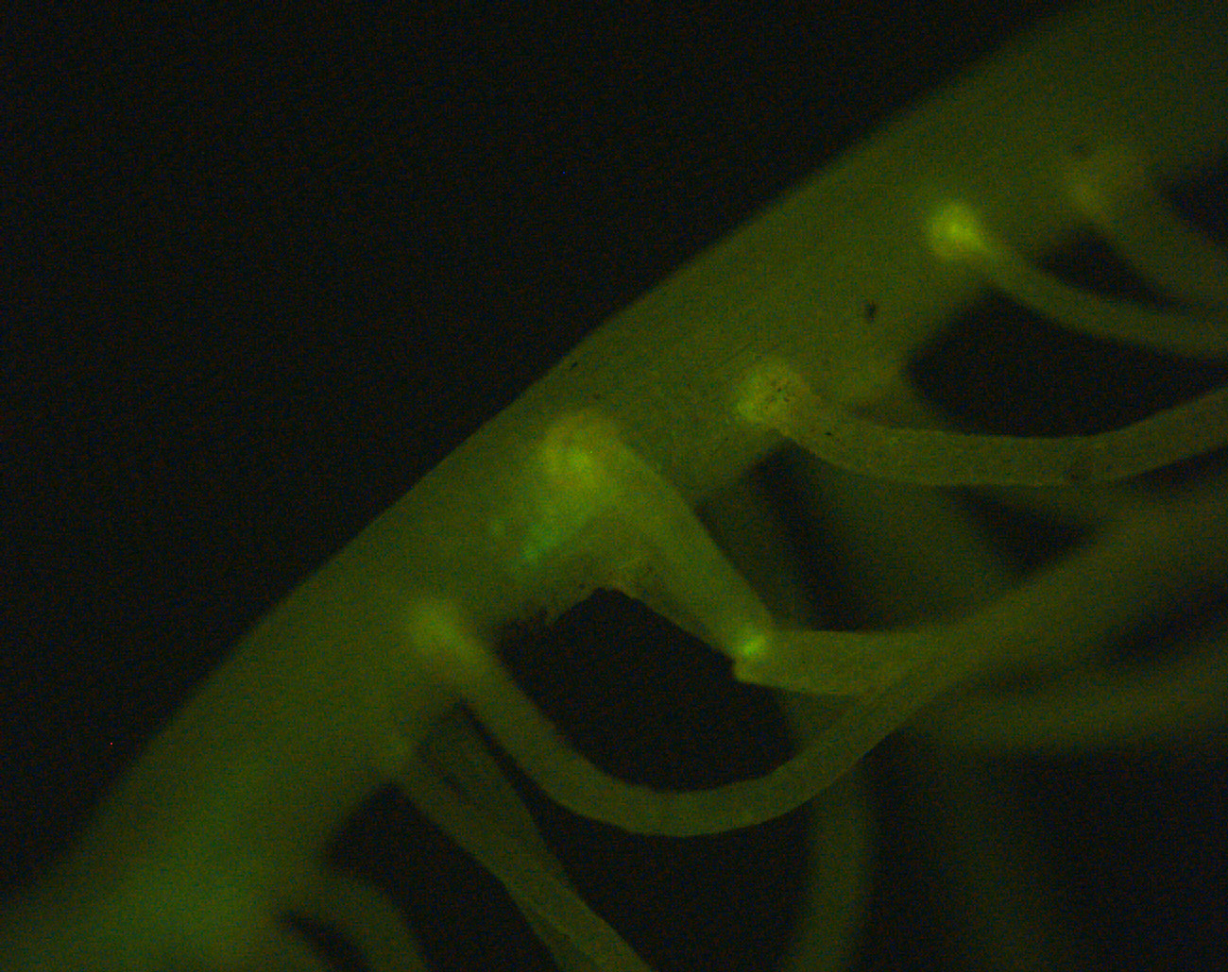
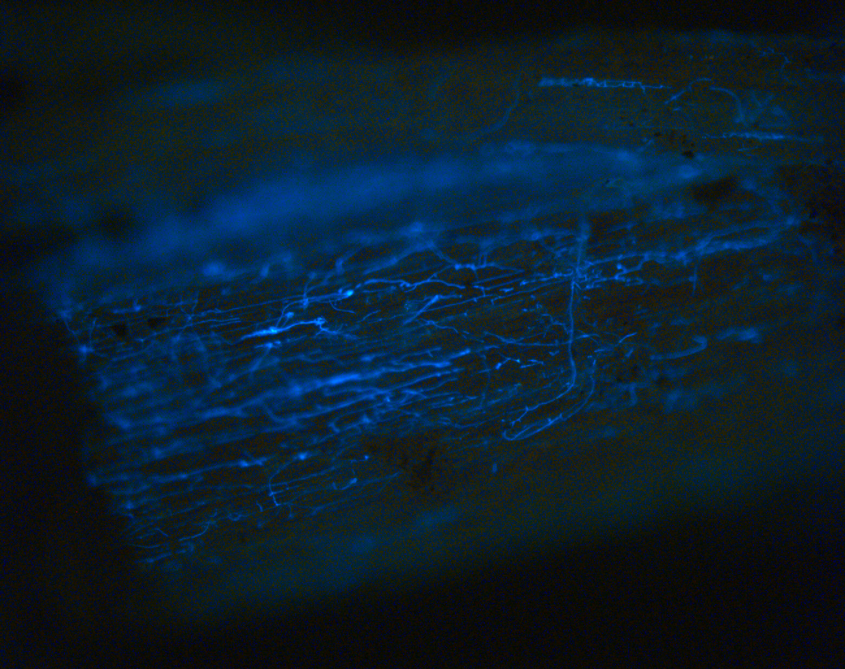
A
B
Figure 1. GFP-labeled F. graminearum hyphae on maize seedling root surface. Fluorescence microscopic photographs of A. mock-inoculated, and B. F. graminearum spores inoculated B73 maize seedling roots taken at six days post-inoculation. Fungal hyphae shown in bright blue color.

Slide 2
N.D.
Figure 2. F. graminearum inoculation induces shoot elongation. Each column represents the average ratio of fungal- and mock-inoculated seedling height of 9 commercial maize hybrids inoculated with the same F. graminearum isolate measured at different days post-inoculation (DPI). This phenotype was not determined (N.D.) for Gz941 inoculated seedlings at 9 DPI.

Slide 3
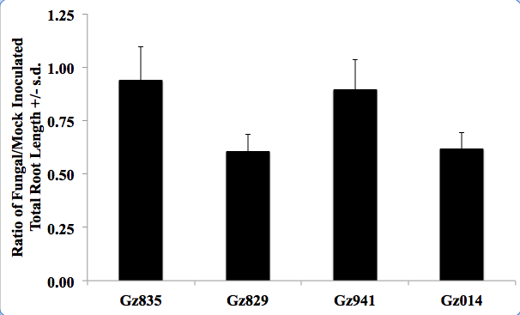
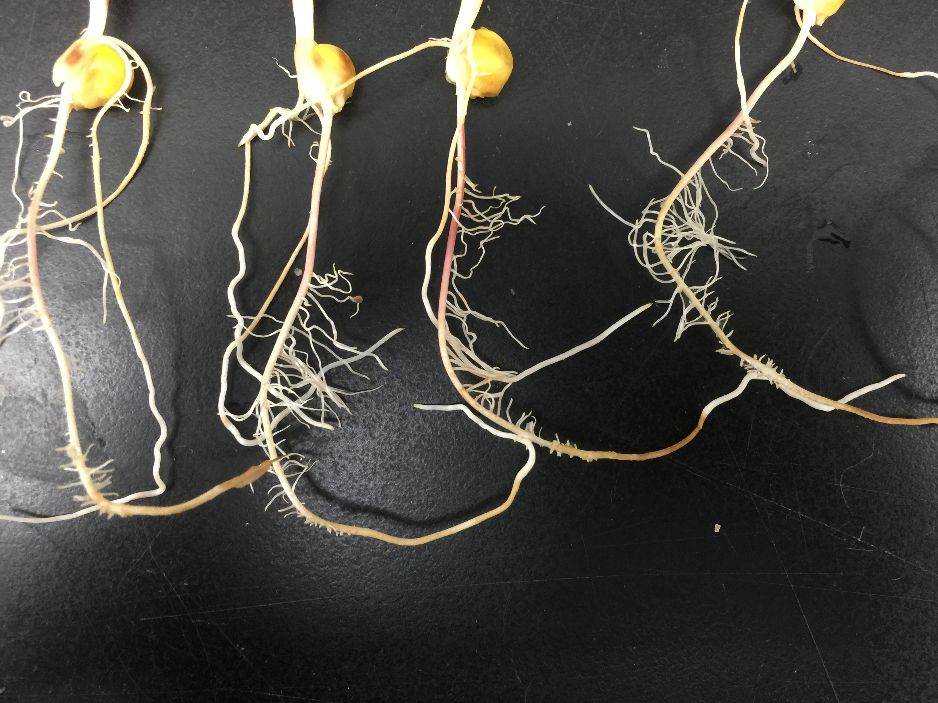
A
B
C
Mock
Gz014
Figure 3. F. graminearum inoculation induces root reduction. Total root length measured by an image analysis algorithm implemented in RootReader 2D software (A). Each column represents the average ratio of fungal- and mock-inoculated seedling height of 9 commercial maize hybrids inoculated by the same F. graminearum isolate measured at 9 DPI (B). Local root browning and shrinkage at 11 DPI (C).

Slide 4
 | Df | Sum Sq | Mean Sq | F value | Pr (>F)
Fungal Isolate | 1 | 1.4 | 1.4 | 21.113 | 0.000128
Maize Genotype | 1 | 0.0034 | 0.0034 | 0.051 | 0.823373
F.I. : M.G. | 1 | 0.0533 | 0.0533 | 0.804 | 0.379069
Residuals | 23 | 1.5251 | 0.0663
Table 1. Summary of analysis of variance on F. graminearum-induced seedling lodging rate measured at 14 DPI.

Slide 5
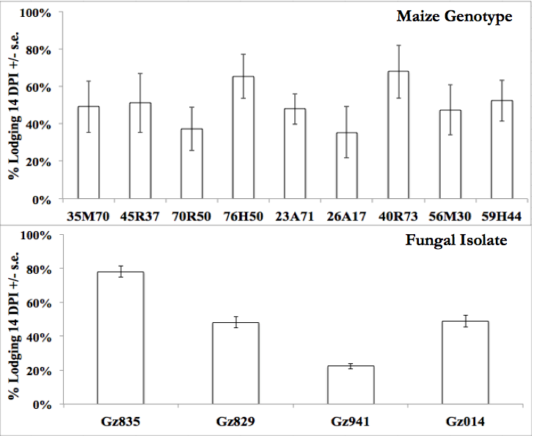
A
B
Figure 4. F. graminearum-induced lodging rate is primarily determined by fungal isolate. Each column represents the average lodging rate of A. the same maize hybrid inoculated with four different fungal isolates, or B. nine maize hybrids inoculated with the same fungal isolate.

Slide 6
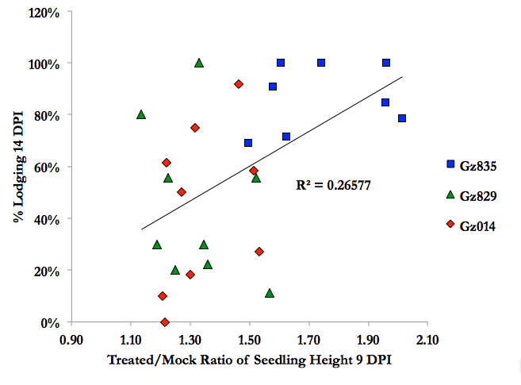
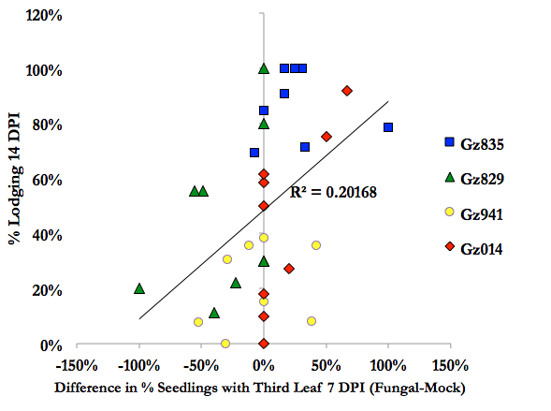
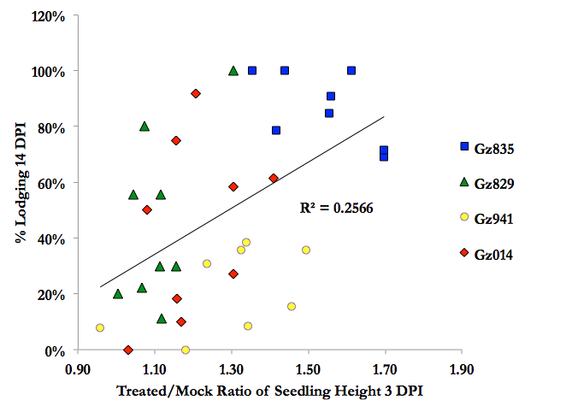
A
B
C
Figure 5. Extent of F. graminearum-induced changes in shoot growth positively correlates with later seedling lodging rate. F. graminearum-induced changes in seedling elongation measured at A. 9 DPI and B. 3 DPI, and C. earlier third leaf emergence measured at 7 DPI are positively correlated with seedling lodging rate measured at 14 DPI.

Slide 7
 | Seedling Elongation |  |  |  | Third Leaf Emergence
 | 3 DPI | 5 DPI | 7 DPI | 9 DPI | 5 DPI | 7 DPI
r | 0.539 | 0.481 | 0.692 | 0.776 | 0.683 | 0.557
r^2 | 0.291 | 0.231 | 0.479 | 0.602 | 0.466 | 0.311
t | 3.735 | 3.196 | 5.586 | 7.168 | 5.450 | 3.915
p | 6.87E-04 | 3.00E-03 | 2.98E-06 | 2.74E-08 | 4.47E-06 | 4.13E-04
Table 2. F. graminearum-induced root reduction, quantified by ratio of total root length of fungal-/mock-inoculated seedlings, is positively correlated with accelerated shoot growth and development.

