Slide 1
Impact of Partial Saltwater Agroecosystems on Weed Competition in Watermelon
Joseph Bazzle,
M. Cuttulle, B. Ward, S. Branham,
A. Levi, H. Schopp
LS22-369

Slide 2
Research Objectives
Optimize watermelon genotype selection due to salt related stress.
Identify potentially salt resistant rootstocks.
Investigate the impact of saline soil on watermelon-weed interactions.

Slide 3
Hypothesis
Long term exposure to saline conditions will negatively impact the health of watermelons while also reducing the overall quantity of weeds present.
There will be a difference in tolerance to salt based on watermelon and root stock genotypes.

Slide 4
Effects of Salt on Plants
Salt induced stress is often expressed similarly to water stress – salt directly interferes with a plant’s ability to absorb water.
Additionally, as ions accumulate inside of a plant symptoms of salt toxicity may appear.
Generally plants that are salt tolerant have the ability to isolate unwanted ions before they reach the plant’s leaves, preventing a toxic buildup of salt. (R. Munns 2002)
Right: Variety Extazy grown in saline soil
Left: Variety Extazy grown in untreated soil

Slide 5
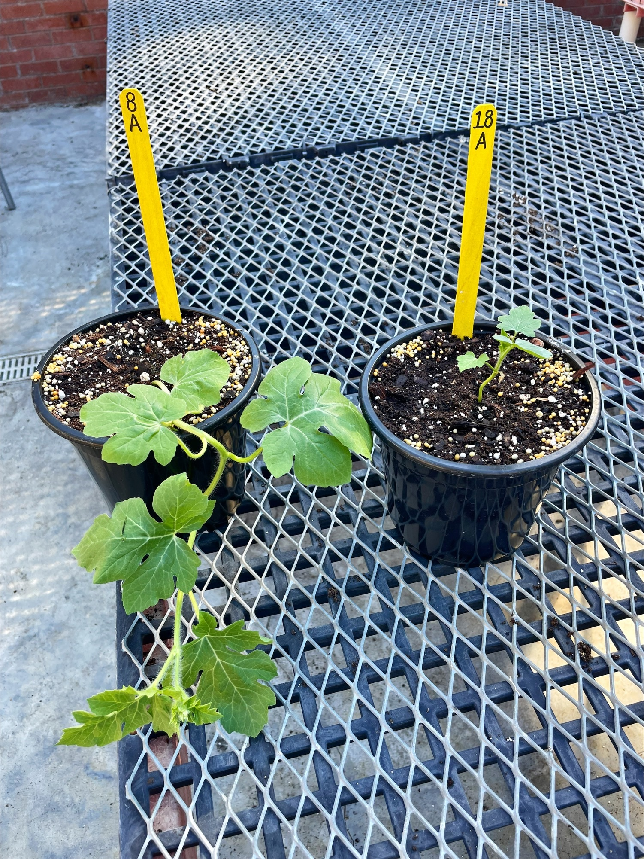
Effects of Salt on Cucurbits
Left: Variety Melody grown in untreated soil.
Right: Variety Melody grown in salt damaged soil.
Bottom: Variety Sweet Dawn in untreated(left) and treated(right) soil.

Slide 6
Impact of Salt on Weeds
Weeds are generally more resilient in a saline environment than most crop species.
Variations in salt tolerance can result in modified crop-weed interactions and may give an advantage to certain weed species. (V. Cirillo et. al)

Slide 7
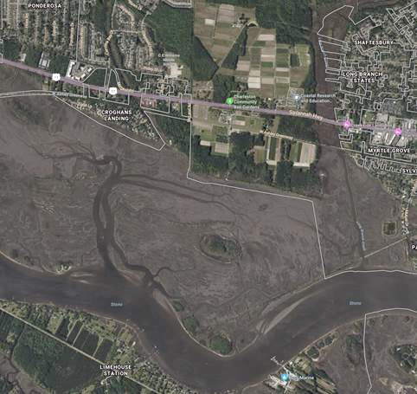
Charleston, SC
Field F16
Atlantic
Ocean
Marsh
Courtesy of Bing Maps © 2024 Microsoft

Slide 8
Weed Control in Watermelon
To reduce weed pressure many growers have adopted the use of polyethylene mulch and a combination of pesticides and cultural practices. (M. B. Bertucci et al.)
In spite of this, yellow nutsedge (C. esculentus) remains a major pest in watermelon fields, and season-long interference by nutsedge can contribute to significant yield losses. (Buker et al. 2003)

Slide 9
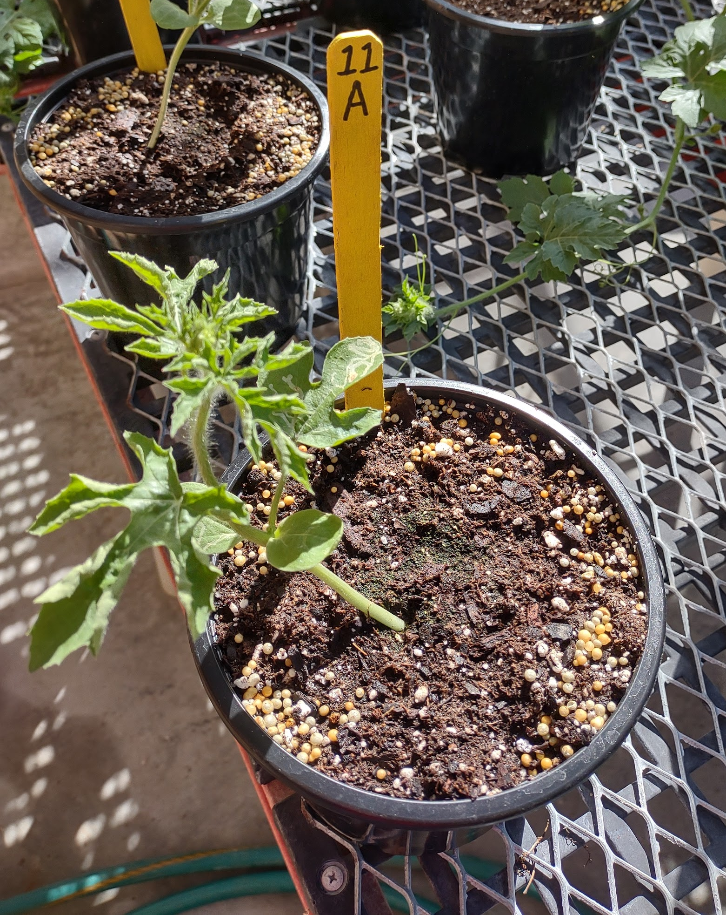
Finding Resistant Cultivars
A trial of 9 seedless watermelon varieties that are popular in the Southeastern US grown in salt inundated soil.
The plants were arranged in a greenhouse using a complete randomized block design.
After a period of four weeks, the varieties were assessed and compared based on their overall growth and flowering behaviors.

Slide 10
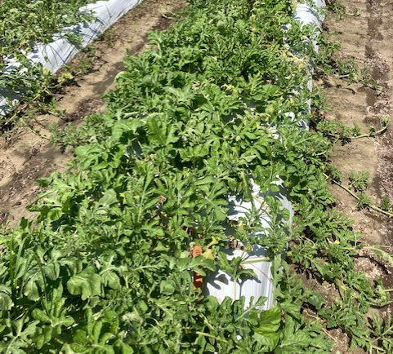
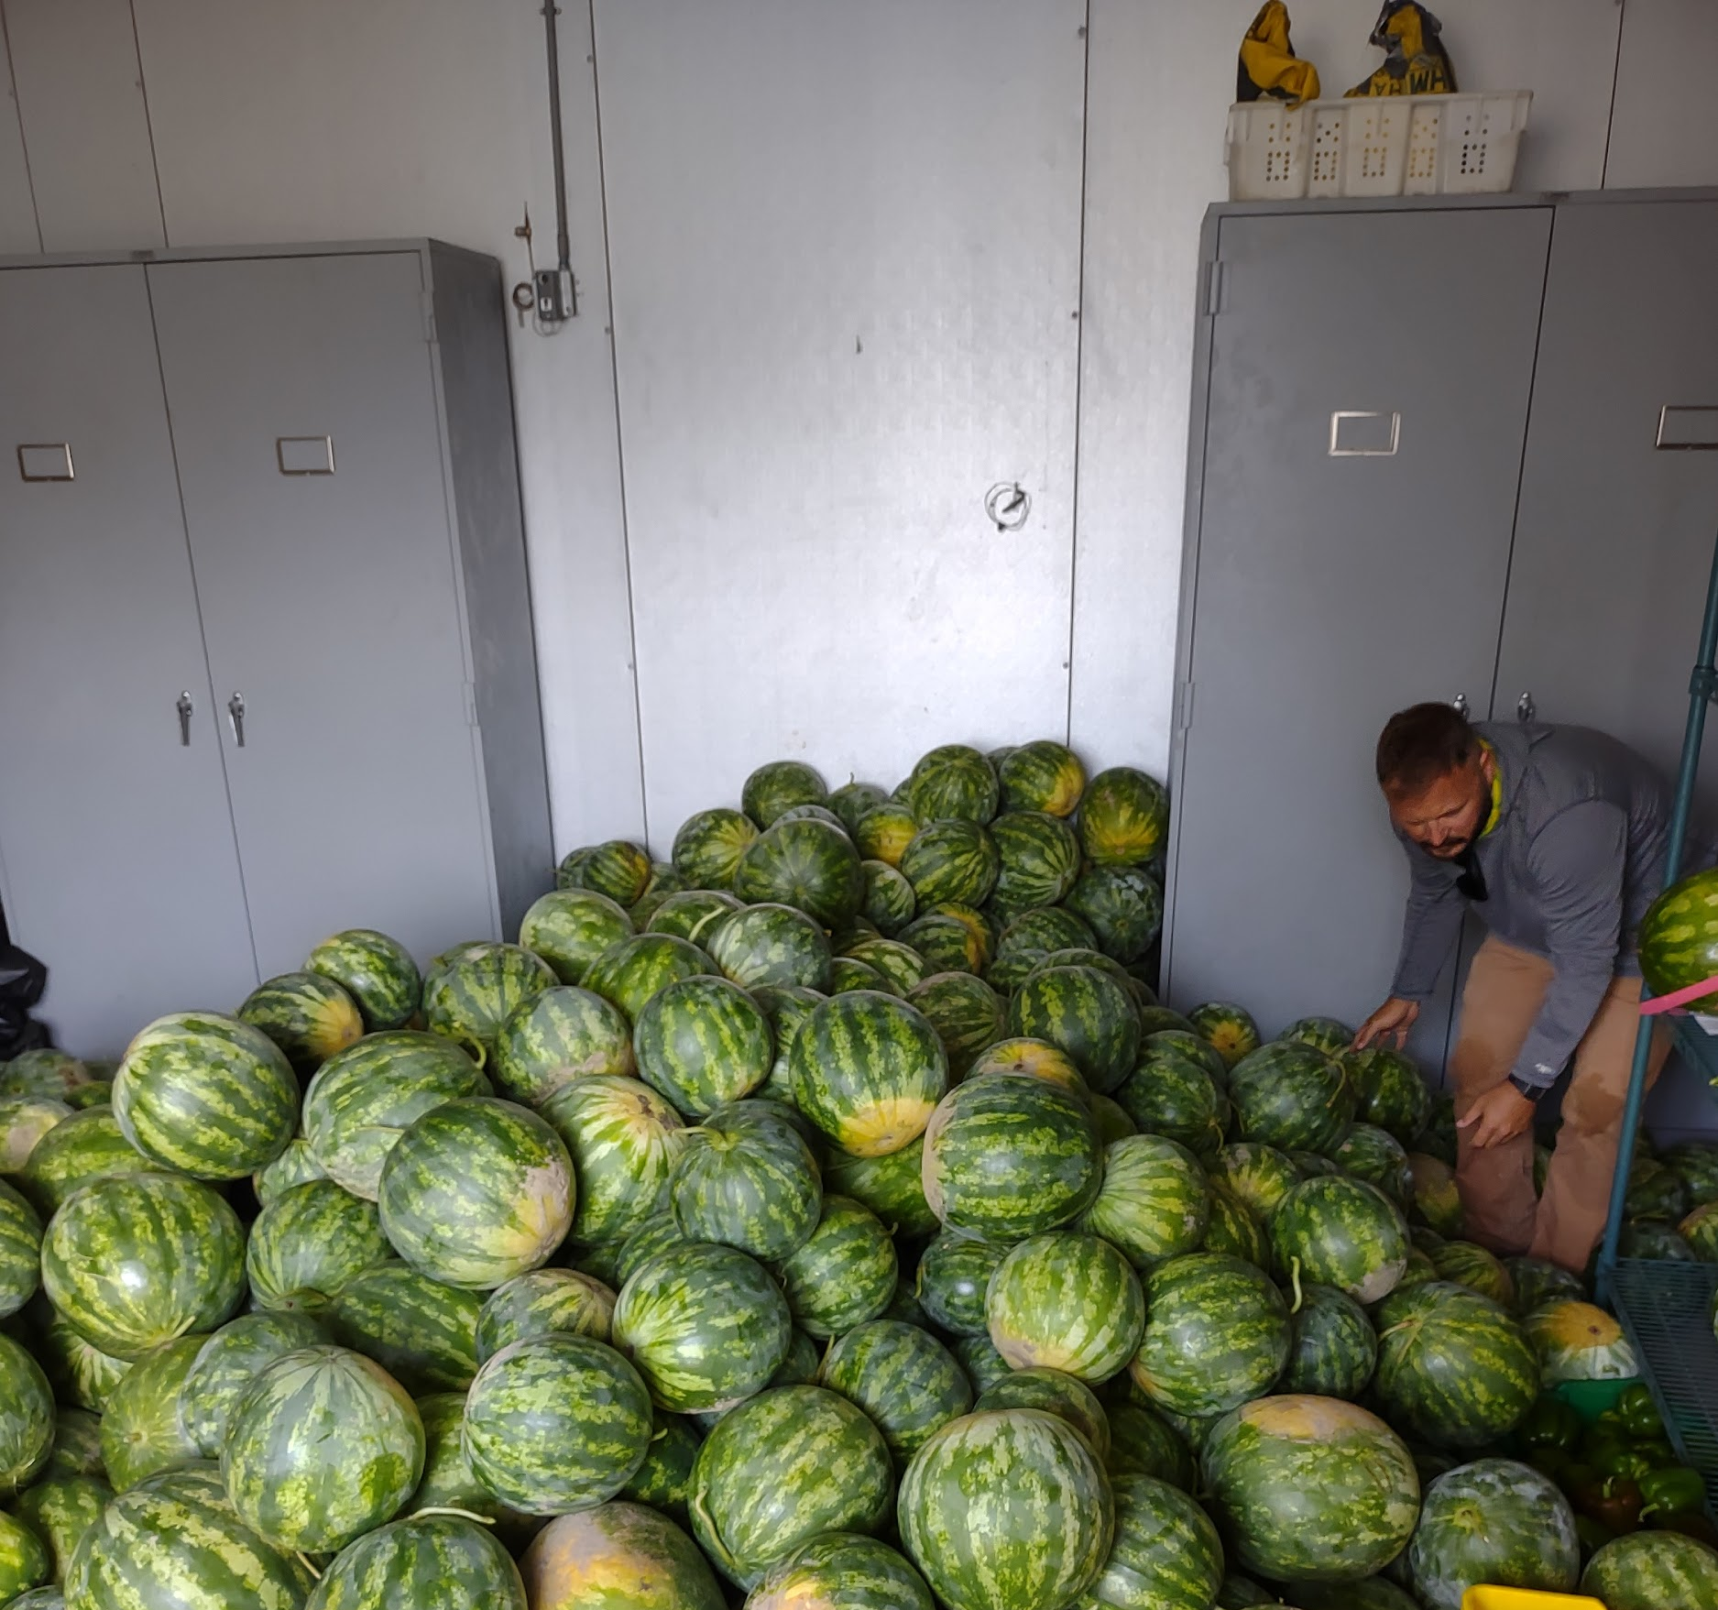
Summary
Of the varieties tested, the watermelon variety Melody showed moderate resistance to salt induced stress, with plants that were more likely to have healthy flowers.
While still suffering from delayed growth and development, it showed the greatest potential to yield healthy fruit in saline conditions.

Slide 11
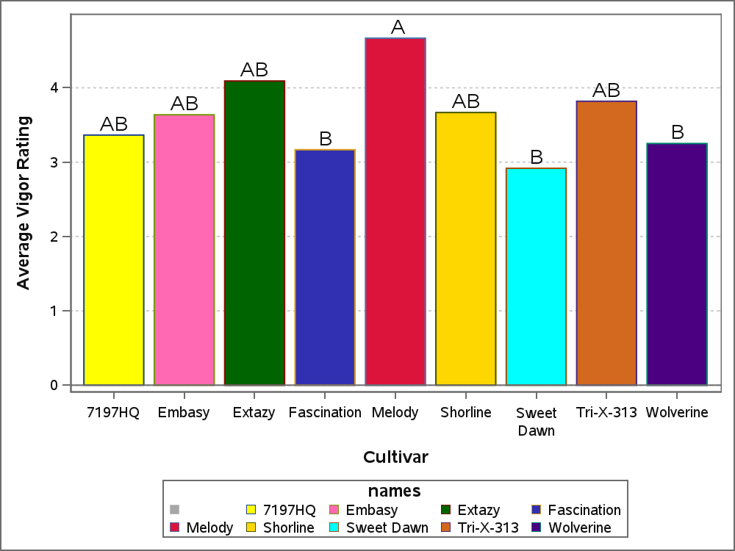
Plant Vigor Ratings After One Month
A pairwise comparison of the watermelon varieties used in this study.
P = 0.0023

Slide 12
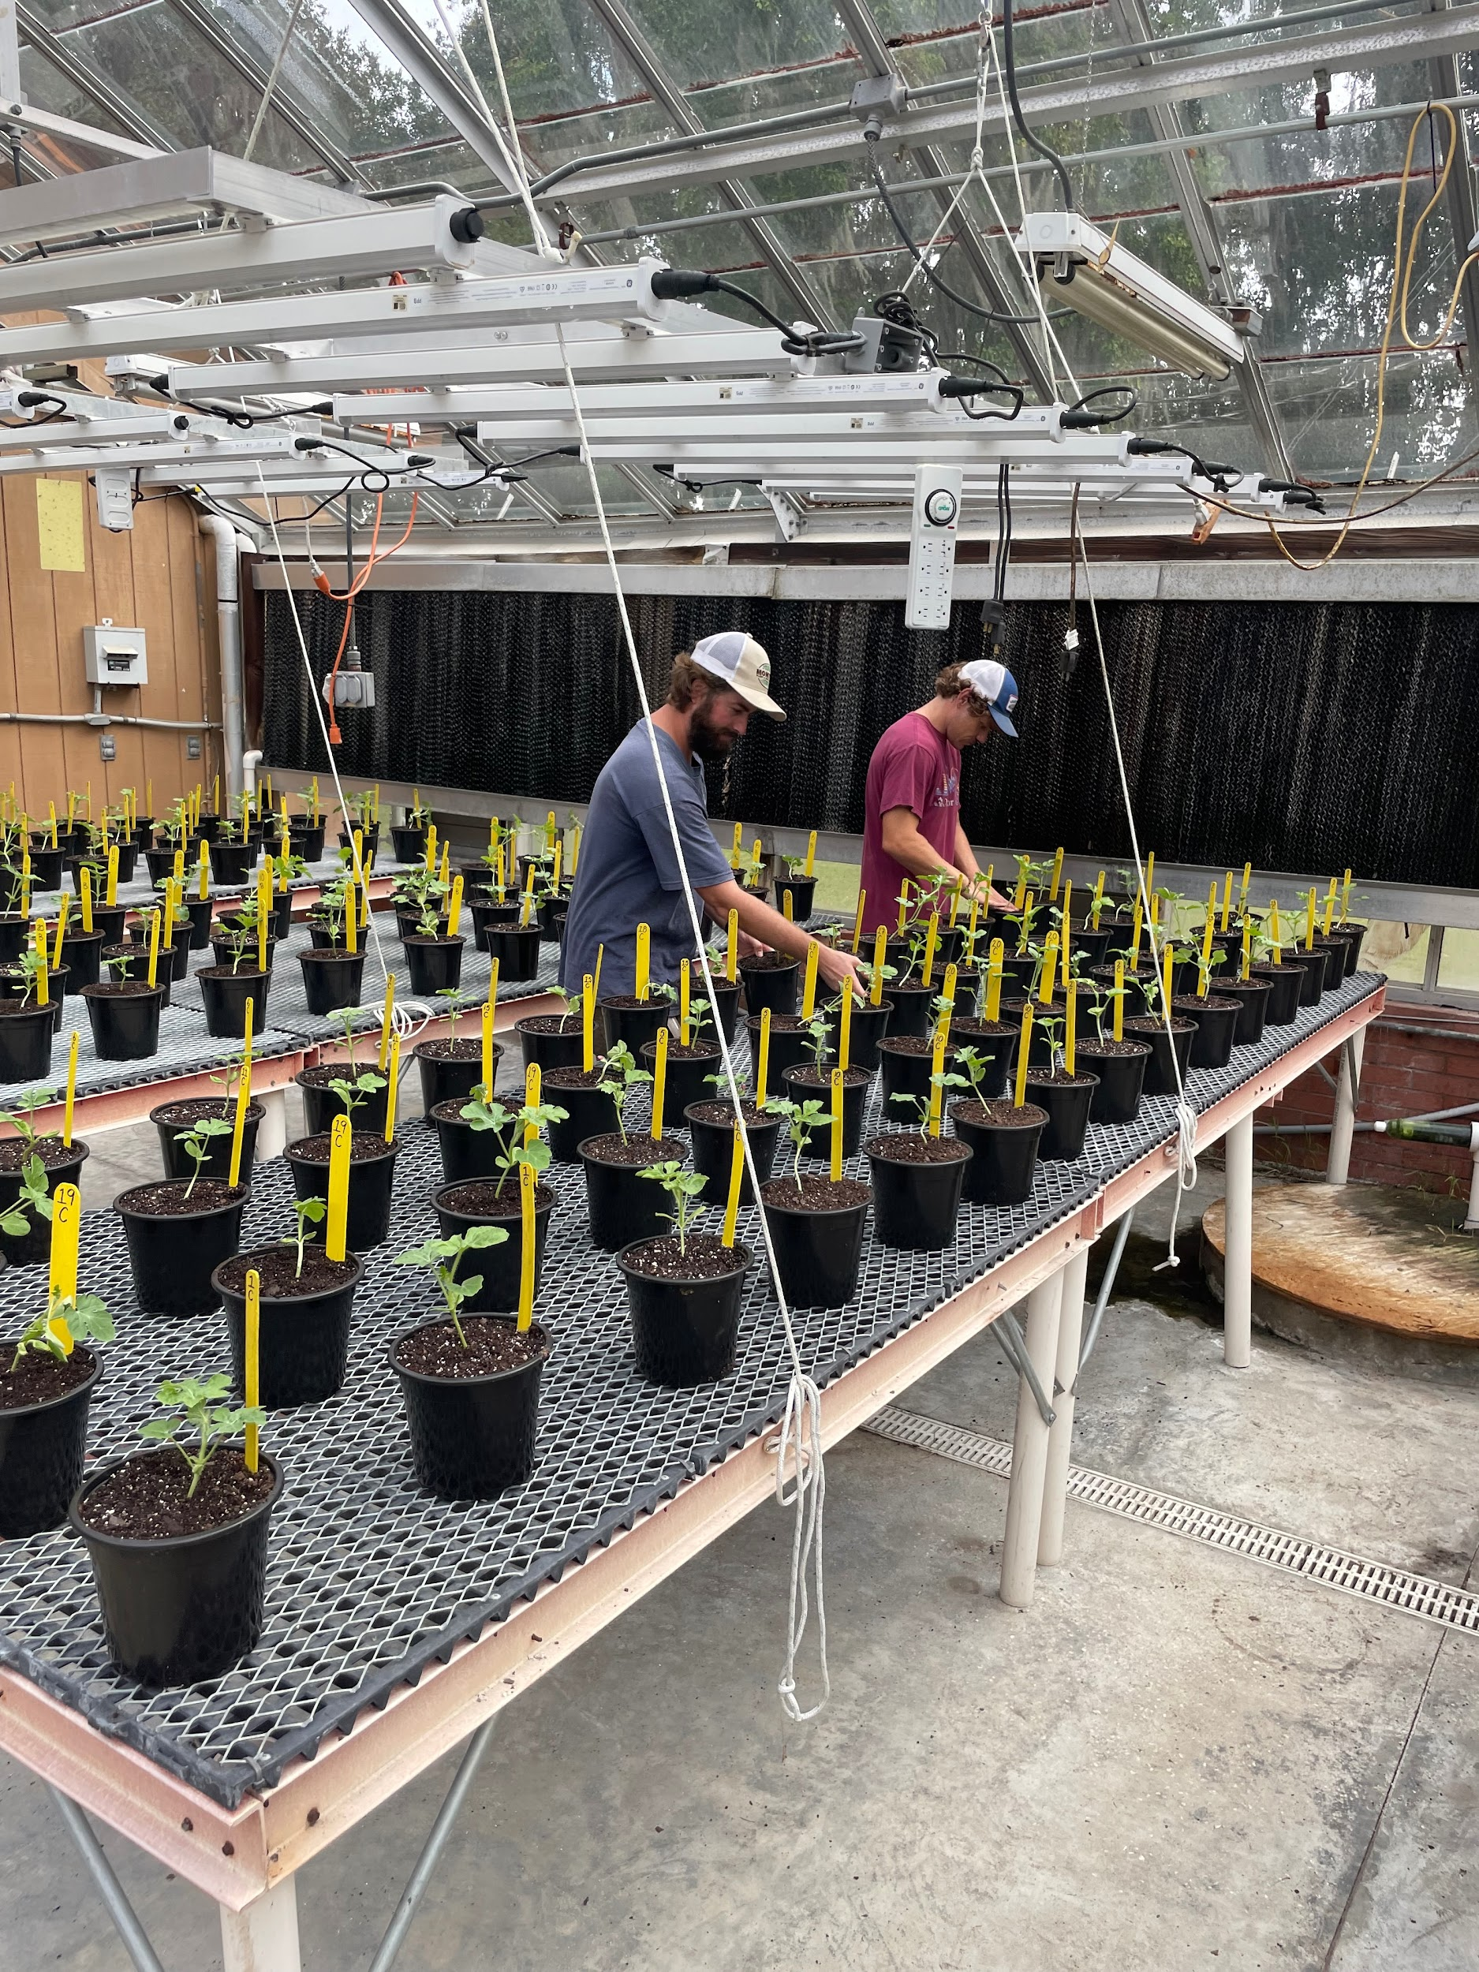
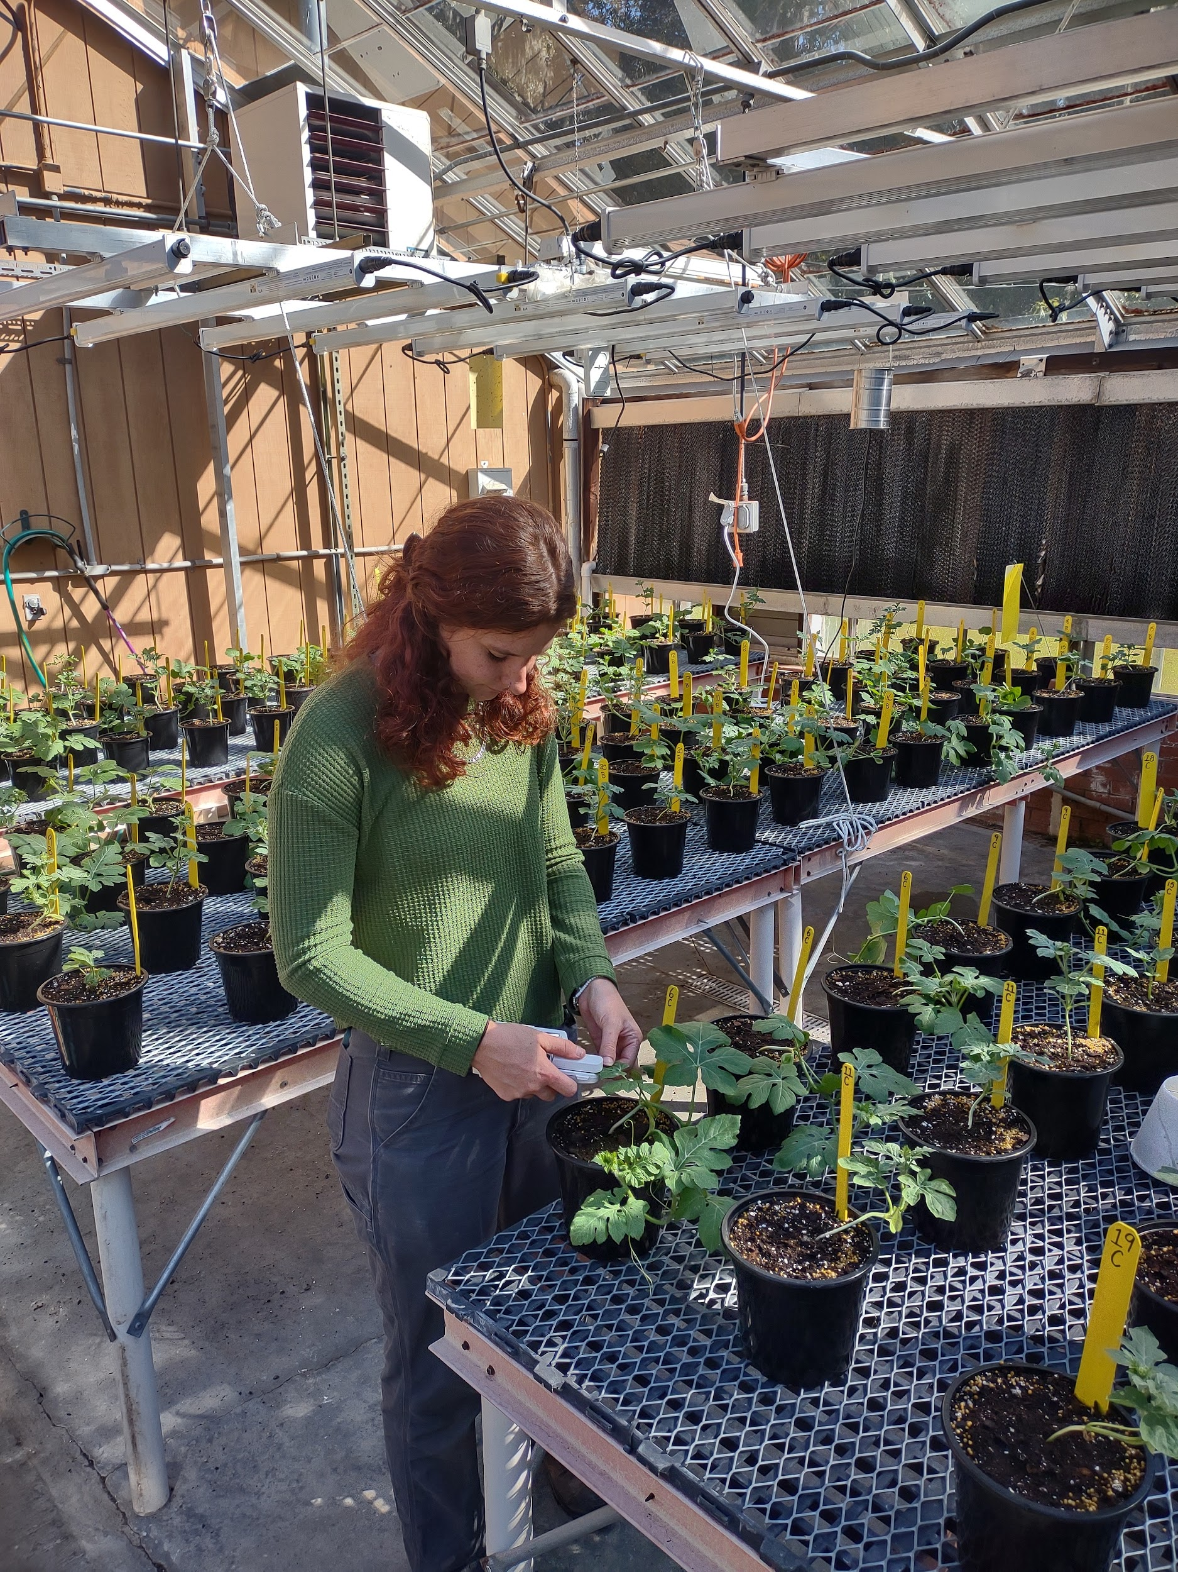
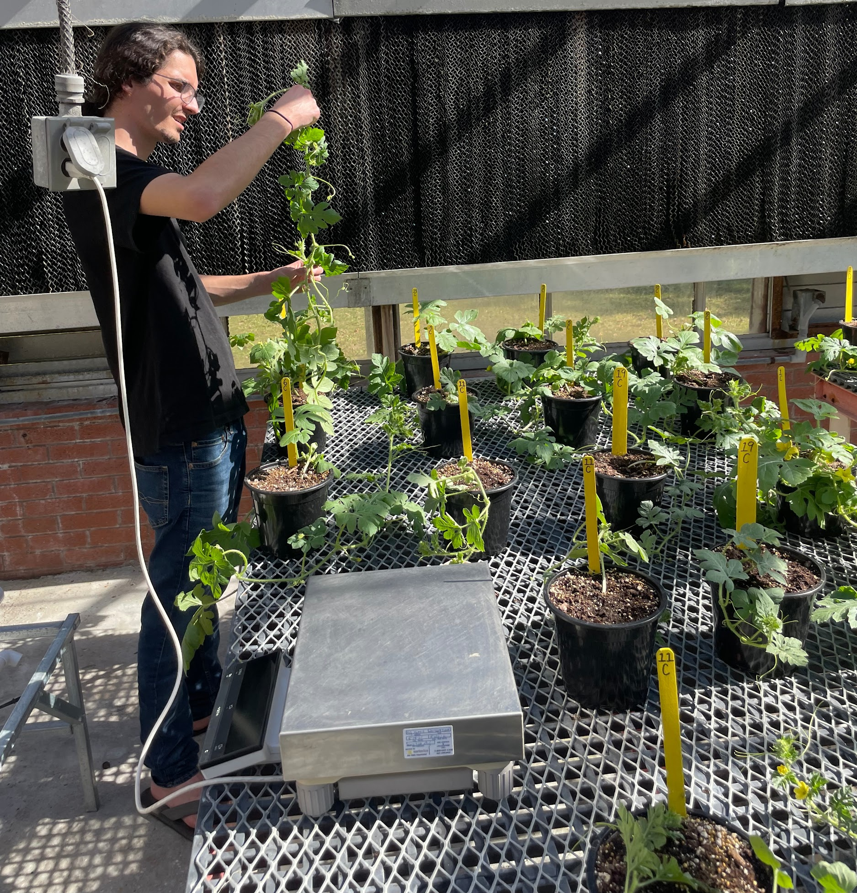
Right: Counting Flowers and Measuring Fresh Biomass
Center: Collecting SPAD Measurements for each plant
Left: Planting the Greenhouse

Slide 13
Salinity in the Field
Watermelons are often grafted onto more resilient rootstock varieties to improve yield, or combat disease.
For this experiment two rootstock varieties were tested for enhanced resistance to salt damaged soils, and the seedless variety Melody was used as a scion.
The experiment was conducted in an organic field setting.
Two yellow nutsedge counts were performed and watermelons were assessed using yield data and vigor scores.
Transplanting watermelons into the field

Slide 14
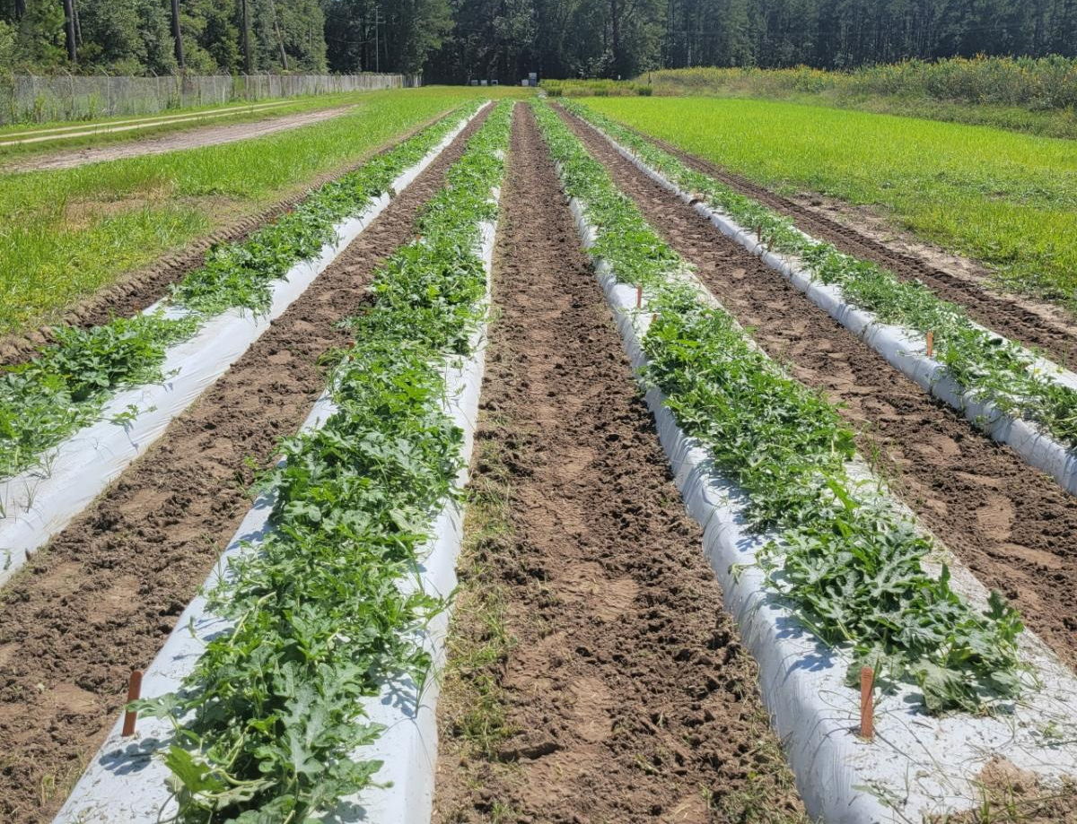
Field Layout
The field was divided into four rows, with each row receiving a different dilution of saltwater.
Saltwater dilutions were prepared from seawater obtained locally.
The experiment was arranged in an incomplete randomized block design.
Plants were grown in 15’ plots with four plants per plot and 3’ spacing between plants.
From Left to Right: Watermelon rows treated with 0, 10%, 20%, and 30% sea water dilutions.

Slide 15
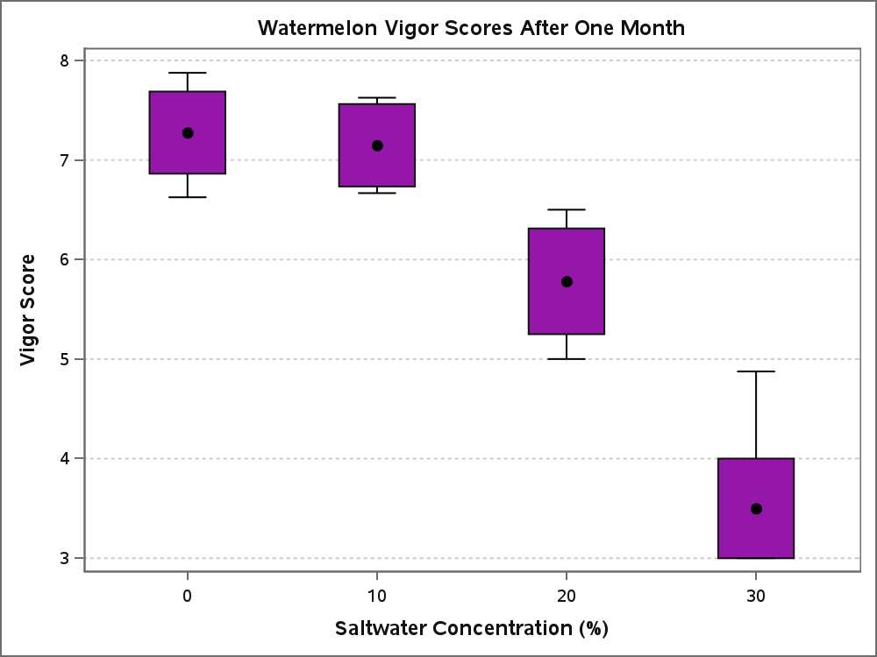
Watermelon Response
All watermelons saw a significantly lower vigor rating at higher concentrations, and grafting did not have a significant effect.
Vigor Ratings collected after one month of treatment
(p < 0.0001)

Slide 16
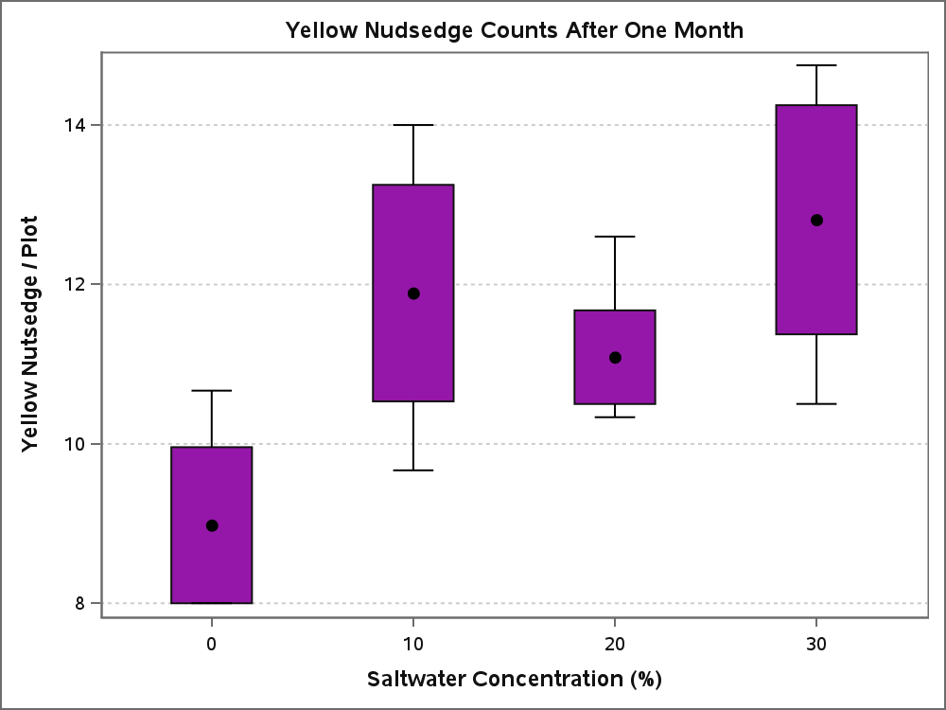
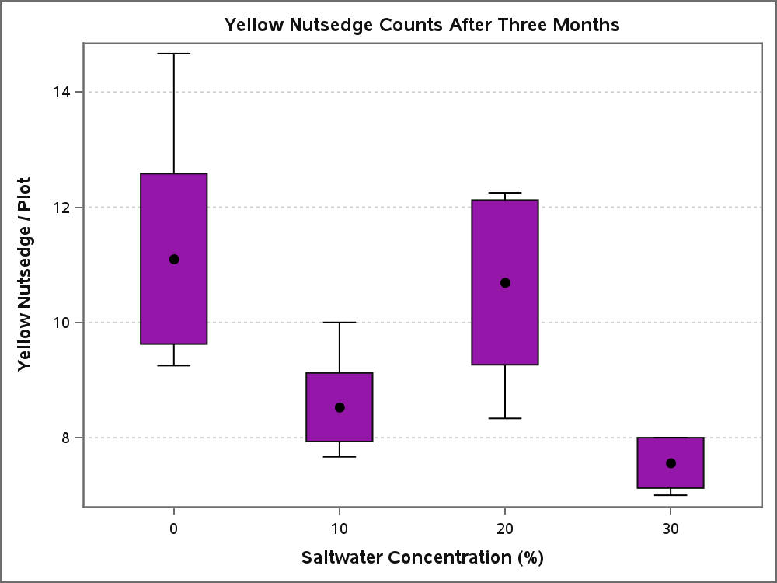
Weed Response in the Field
Month 1
Month 3
Left: Weed counts after one month of treatment (P = 0.024) Right: Weed counts after three months of treatment (P = 0.0261)

Slide 17
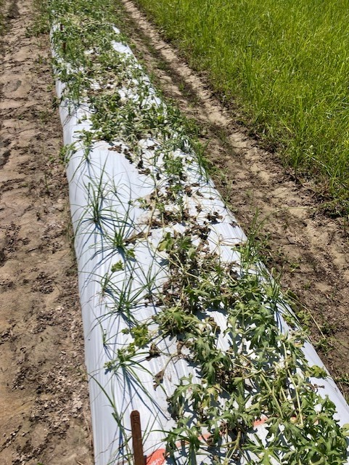
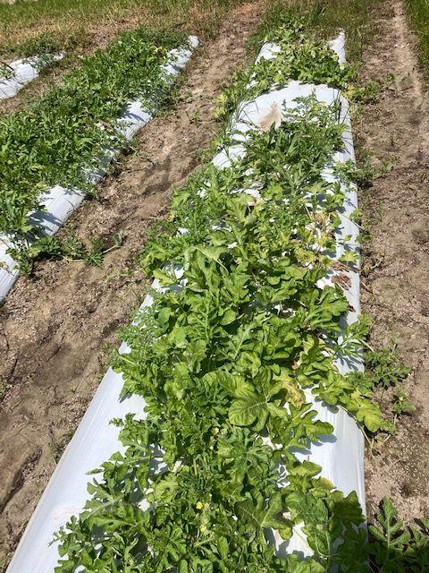
During the first month of the trial, yellow nutsedge demonstrated an enhanced appearance in the treated soils.
The increased stress of moderately saline soil types provides a new opportunity for competitive weed species.
Left: A watermelon bed overrun with yellow nutsedge after one month of saline irrigation
Right: An untreated bed of watermelon after one month

Slide 18
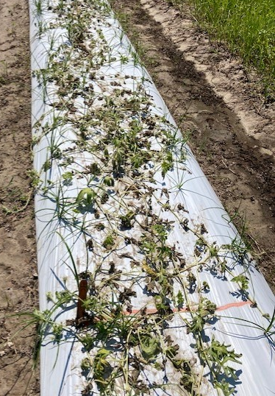
Conclusion
Optimize watermelon genotype selection due to salt related stress.
Melody is more salt tolerant than the other cultivars examined in this study.
Identify potentially salt resistant rootstocks.
No rootstocks were found that could improve resistance to saline conditions beyond that of a resistant cultivar.
Investigate the impact of saline soil on watermelon-weed interactions.
Saline soil provides an advantage to yellow nutsedge over watermelons, especially during the early stages of growth.
A bed of watermelons overrun with yellow nutsedge following treatment with salt water

Slide 19
Conclusion
Long term exposure to saline conditions will negatively impact the health of watermelons while also reducing the overall quantity of weeds present.
Exposure to saline conditions can lead to an increased quantity of weeds when competing against a crop species.
There will be a difference in tolerance to salt based on watermelon and root stock genotypes.
While the Melody variety was found to have an increased tolerance for salt no rootstock variety was found to further increase this effect.

Slide 20
Special Thanks
Committee:
Chair – Dr. Matthew Cutulle
Co-Chair – Dr. Brian Ward
Dr. Sandra Branham
Dr. Amnon Levi
Dr. William Bridges
LS22-369

