Slide 1
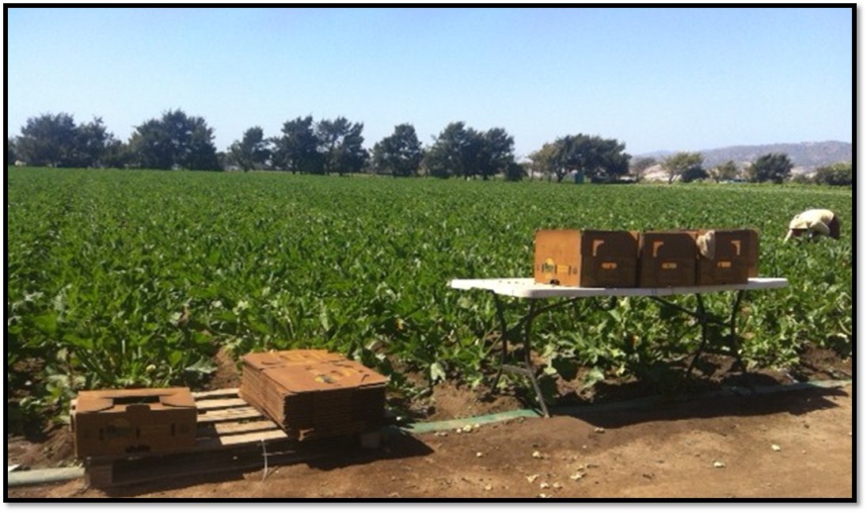
Food Safety for Farm Incubators

Slide 2
Do you like a challenge?
Food Safety in a
farm incubator
NEVER ENDS!!!!

Slide 3
Overview
ALBA background
FSMA key compliance dates
What is a food safety plan?
Food Safety Program Development
Key Staffing and allocation of responsibilities
ALBA’s pathway to GAP certification of all farmers and incorporating Group GAP

Slide 4
Growing Opportunities through Organic Agriculture
2001-ALBA incorporated
2002- ALBA Organics food hub developed
2006- ALBA Organics exponential growth
2010-first time all land was leased to incubator participants (150 acres)
2010-food safety program development
2011-1st group of farmers GAP Certified
2014-Pilot USDA Group GAP Certification

Slide 5
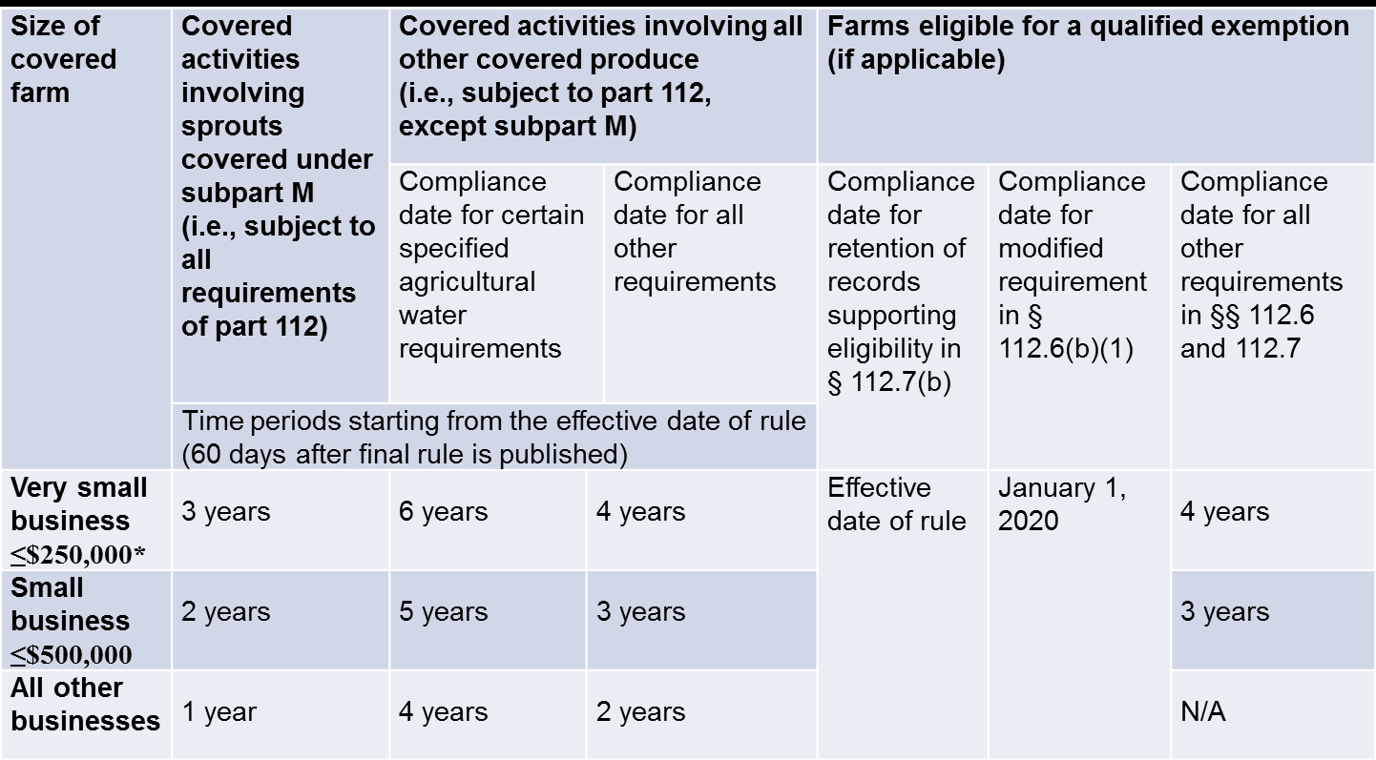
FDA Definition of Business Size & FSMA Requirements Produce Safety Rule Effective Date: January 26, 2016

Slide 6
Food Safety Plan
Standardized Policies and Procedures (SSOP’s) to minimize:
physical,
chemical, and
biological risks and contamination of crops.
ALBA Food Safety Plan
Physcial | Chemical | Biological
Glass and brittle plastic | Use of Fertilizer and Pesticides, Fungicides etc. | Bacteria in soil and water -E.coli, salmonella, Listeria, Shigella, Hepatitis A.
Personal Effects | Diesel, Oil and Gasoline | Parasites- cross contamination from humans
Metal | Cleaning Chemicals | Feces, blood, saliva

Slide 7
Food Safety Program Development
Create Organizational Food Safety Program
Pre-Farm Gate (Ranch)
Post-Farm Gate (Cooler)
Create bilingual verification log templates
Trainings
Grower & Farming class
Staff (cooler and non-profit)
Considerations
Grower backlash
Housing of Records?
Creating farmers’ own food safety plan from the beginning?

Slide 8
Key Roles/Responsibilities #1

Slide 9
Is this an effective combination for one position? Consider separating these responsibilities among 2 different positions, if budget allows.
Auditor and Teacher ?

Slide 10
Key Roles/Responsibilities #2

Slide 11
Food Safety Certification at ALBA

Slide 12
Grower Group
Grower Group
PEPA
(Student farming class)
1st Year
(0.5 acres)
2nd Year
(1-2 acres)
3rd year
(2-4 acres)
Cooler

Slide 13
Food Safety Requirements per Year in Incubator
PEPA
Turn in monthly food safety log packets to ALBA
Part of Group GAP
Incubator Farmers (1-2 years)
Turn in monthly food safety log packets to ALBA
Part of Group GAP
Incubator Farmers (3 years)
Turn in monthly food safety log packets to ALBA
Part of GROUP GAP
Incubator & Graduates (4 years +)
Turn in monthly food safety log packets to ALBA
Individual Food Safety plan
Responsible for managing other paperwork.
Individual Food Safety certification
Individual Food Safety plan

Slide 14
Best Practices
Focus on regulation that is the most important and dominant (Food Safety vs Ag Order)
Phase-in regulatory compliance, don’t expect farmers to understand and do everything all at once
Develop standardized farm records and farmer training on how to fill them out. Have an employee trained to double check paperwork prior to accepting
Develop a farm plan with requirements they are expected to meet and tie land leases to references these policies/ practices
Good relationship with certifying / auditing agency and auditors

Slide 15
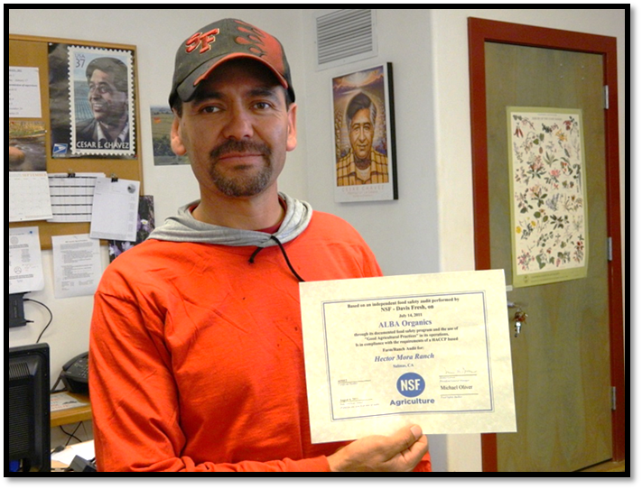
Questions?
Contact
Kaley@albafarmers.org
Bilingual Food Safety Toolkits
Food Safety Plan Template
Verification Log templates
QMS Template
Farm Food Safety Guide
Food Safety and Organic Compliance Guide and Chart

