Slide 1
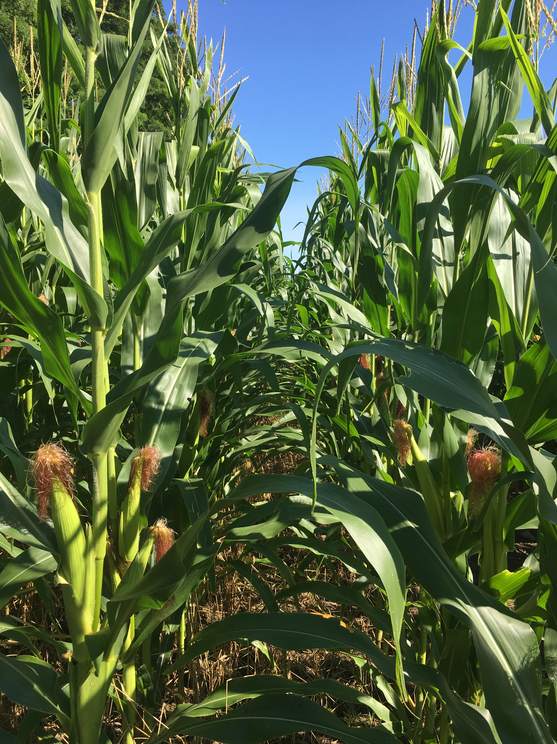
Mitigating Gaseous Nitrogen Losses from Northeastern Agricultural Soils via Alternative Soil Management Practices
Kyle M. Dittmer
University of Vermont
Rubenstein School of Environment and Natural Resources

Slide 2

Why care about nitrogen?
Limited nutrient in agricultural systems.
Nitrogen is a component of:
  Chlorophyll
  DNA and RNA
  Amino acids → Proteins
  Adenosine triphosphate (ATP)
    i.e., cellular energy
Photo: Leisa India

Slide 3
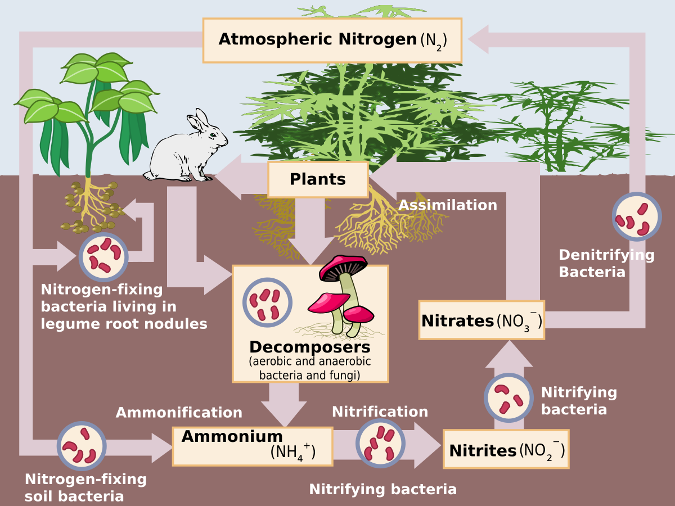

Slide 4
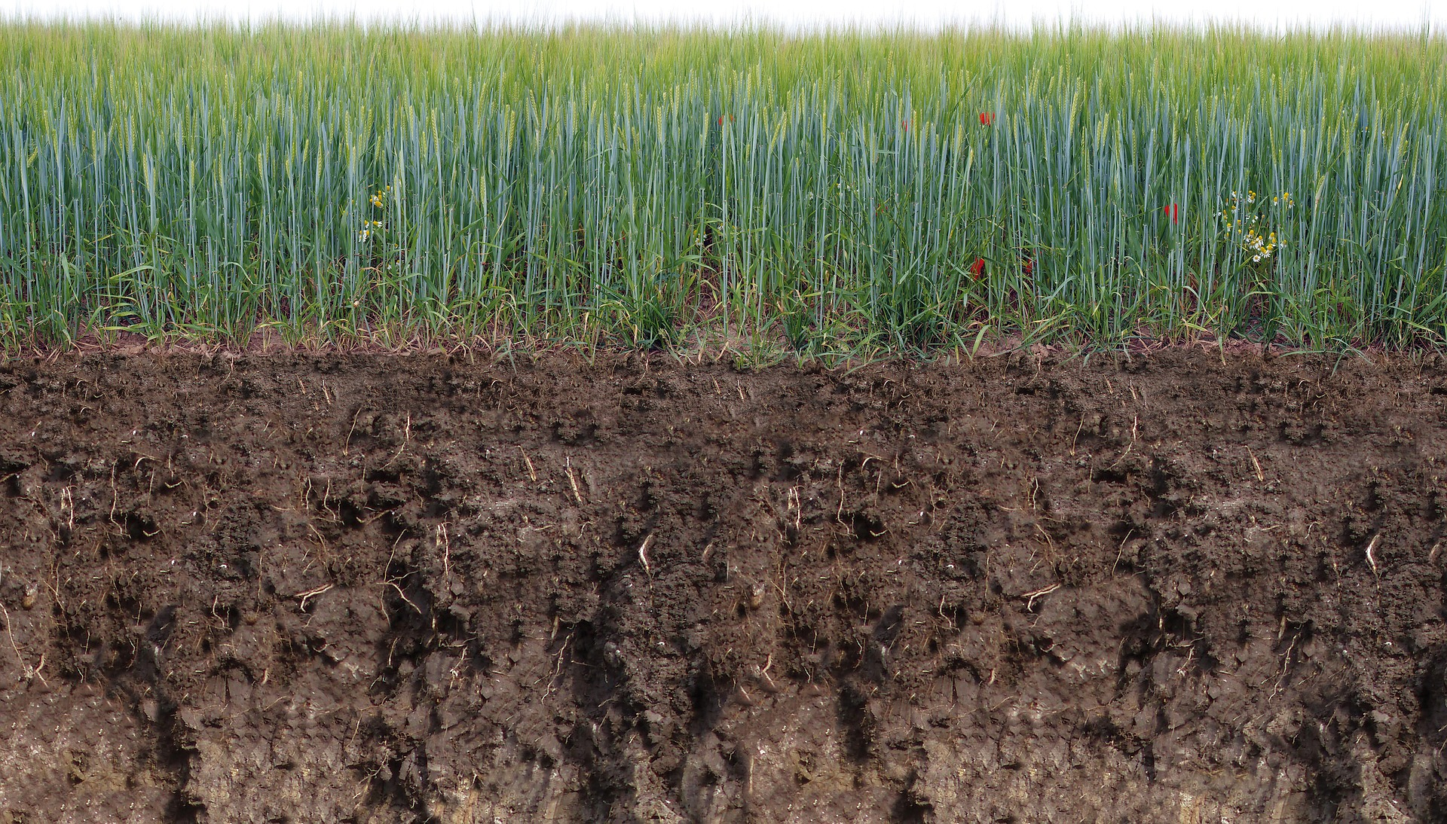
Nitrogen Losses from Agriculture
Nitrous Oxide (N₂O)
Ammonia
(NH₃)
Nitrification
Denitrification
Volatilization
Runoff
Nitrate (NO₃⁻)
Ammonium
(NH₄⁺)
Leaching
Notes:
Soil particles contain negative charges; Positively charged molecules are held onto soil particles.

Slide 5
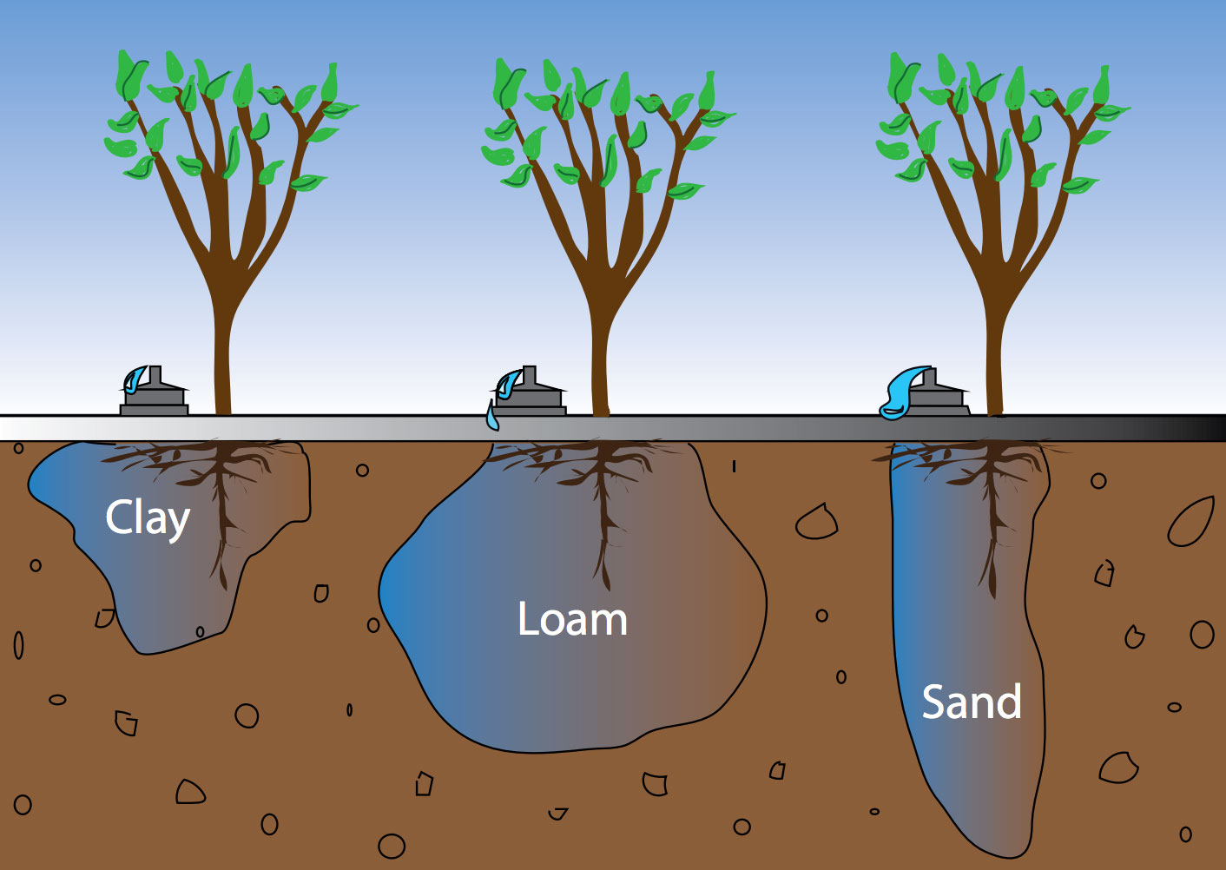
Nitrate Leaching
Rate of leaching is dependent on soil properties:
Soil texture: The proportion of small (clay), medium (silt/loam), and large (sand) particles in a soil.
Soil structure: The arrangement of soil particles into stable units (aggregates).
Soil porosity: The space between soil particles that is occupied by air and water.
Soil permeability: A measure of water moving through the pores of a saturated soil.
  Determined by soil texture and structure.
Photo: https://www.dripworks.com/blog/tips-for-gardeners-and-growers-irrigation-tips-for-clay-soil-sandy-soil-and-loam/

Slide 6
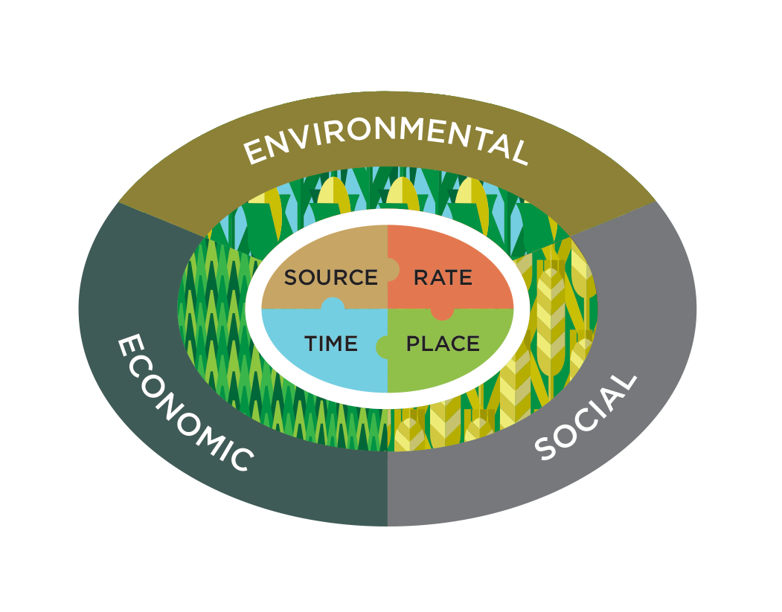
Reducing Nitrate Leaching
Rate of leaching is dependent on management practices.
Fertilizer Management:
Right rate
    Soil testing to determine available nutrients in soil.
    Identify target yields and crop specific nutrient requirements.
Right timing
    Pair fertilization with crop’s greatest nutrient demand.
    Avoid fertilization before heavy rainfall, if possible.
Crop Management:
Reduce fallow periods with cover crops.
  Non-legume cover crops reduced leaching by 70%. Legume cover crops reduced leaching by 40%, with little to no reduction in yields (Tonitto et al., 2008).
Photo: Mosaic Crop Nutrition

Slide 7
Gaseous nitrogen represents nutrient losses from agricultural systems.
Nitrous Oxide (N₂O)
Ammonia
(NH₃)
Ammonia:
Promotes eutrophication
Soil acidification
Nitrous oxide (N₂O)
Greenhouse gas
Heat absorption value 298 times greater than carbon dioxide.
Atmospheric lifetime of more than 114 years.
Nitrification
Volatilization
Denitrification
Nitrate
(NO₃⁻)
Ammonium
(NH₄⁺)
Notes:
Soil acidification: NH4 ←→ NH3 + H

Slide 8
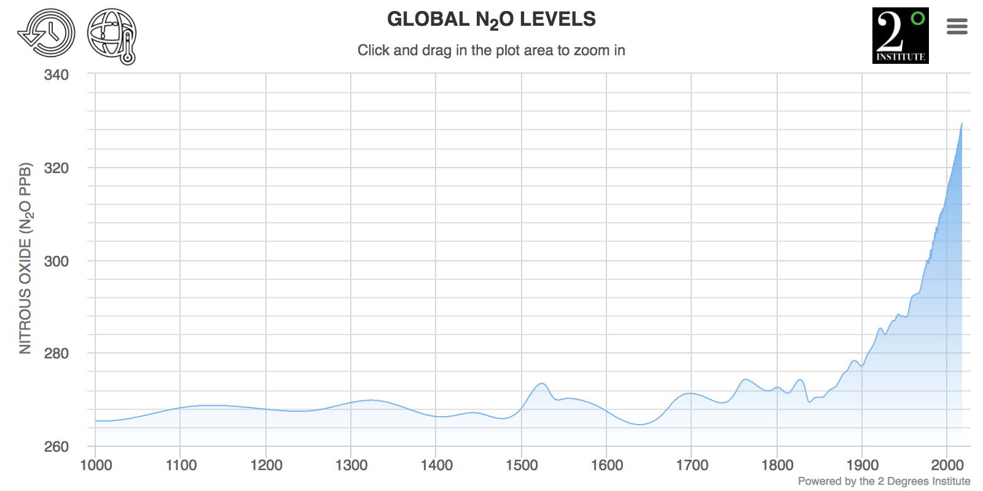
Global atmospheric N₂O concentrations over time
Advent of Haber-Bosch process
Notes:
Haber-Bosch process (1910) fixing ammonia at faster rates– large loss via nitrification
More reactive N entering the environment than is being removed via denitrification.

Slide 9
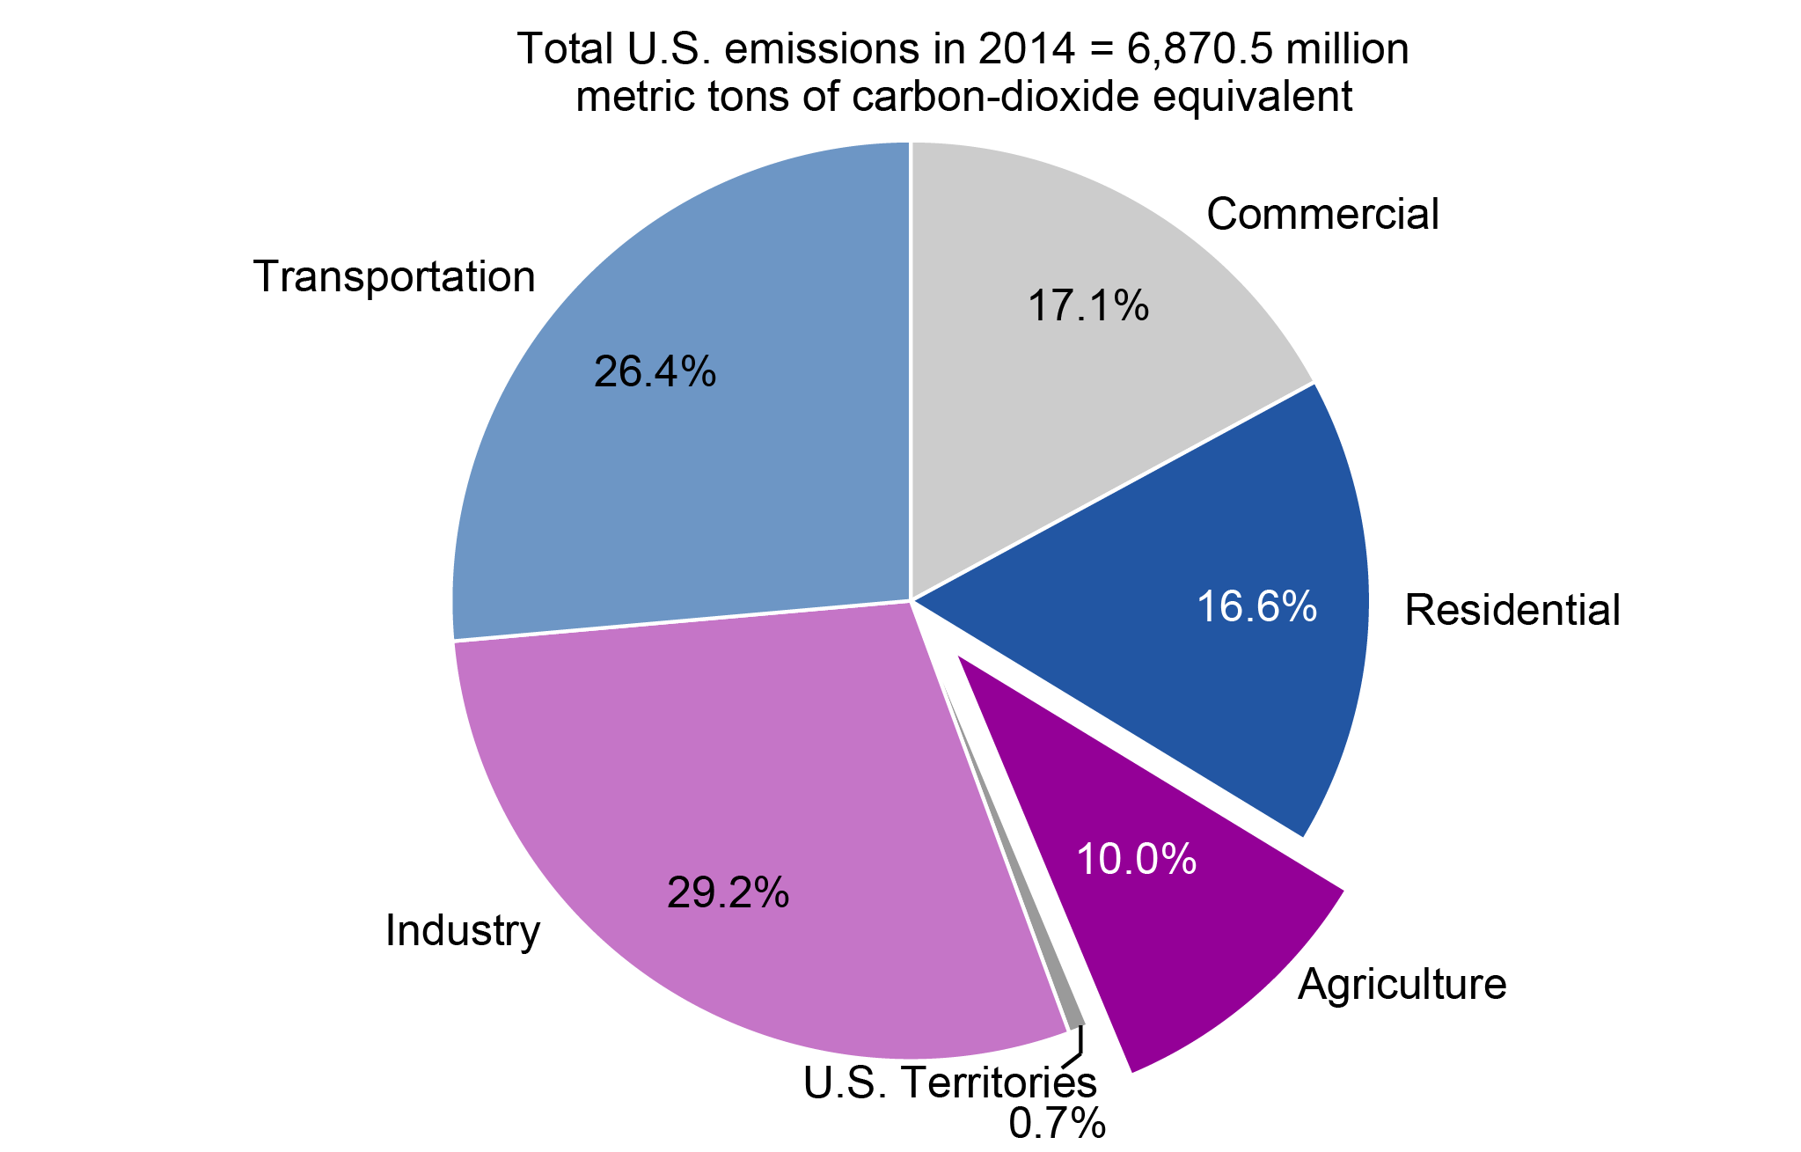
U.S. Greenhouse Gas (GHG) Emissions
U.S. EPA, 2016. Inventory of U.S. Greenhouse Gas Emissions and Sinks: 1990-2014.

Slide 10
U.S. Agricultural GHG Emissions
Archibeque et al., 2012
Notes:
How does cropland soils contribute?

Slide 11
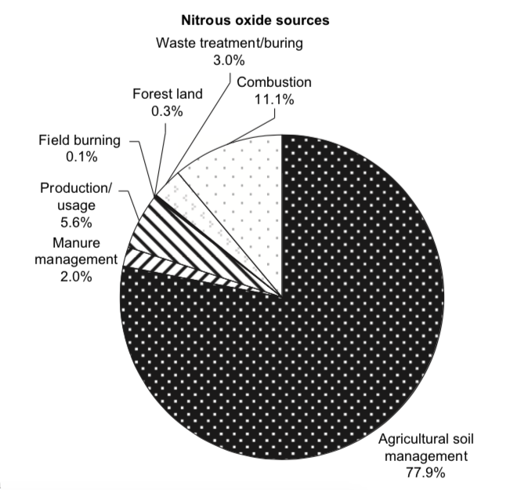
Nitrous Oxide (N₂O) Emissions from U.S. Agriculture
Greenhouse Gas Emissions from U.S. Agriculture (Mt CO₂ eq.)
CO₂
109
17%
N₂O
377
CH₄
377
57%
26%
Johnson et al., 2007
U.S. EPA, 2007
Notes:
Examples that increase emission – tillage allows more oxygen to enter the soil which impedes denitrification

Slide 12
Mechanisms driving N₂O emissions from soils
Denitrification: Stepwise biological reduction of NO₃⁻ → N₂
Anaerobic conditions (low/no oxygen availability).
NO₃⁻ must be present.
Organic carbon as microbial energy source.
  NO₃⁻ NO₂⁻ NO N₂O N₂
Nitrate reductase
Nitrite reductase
Nitric oxide reductase
Nitrous oxide reductase
Nitrification: Stepwise biological oxidation of NH₄⁺ → NO₃⁻
Aerobic conditions (requires oxygen).
NH₄⁺ as energy source
CO₂ for biomass production
N₂O
NH₄⁺ NH₂OH NO₂⁻ NO₃⁻
Ammonium monooxygenase
Hydroxylamine oxidoreductase
Nitrite oxidoreductase
Notes:
GHGs a product of microbial respiration
Mention how traditional ag practices can influence these fluxes
N2O from nitrification: high carbon content during the time of nitrification will stimulate decomposition, exhausting the O₂ supply, and in turn impede nitrification from proceeding.

Slide 13
NO₃⁻
NO₃⁻
NH₄⁺
NH₄⁺
NO₃⁻
NH₄⁺
NH₄⁺
NO₃⁻
NH₄⁺
NO₃⁻
NO₃⁻
NO₃⁻
NO₃⁻
NH₄⁺
NO₃⁻
NO₃⁻
NO₃⁻
NH₄⁺
NO₃⁻
Notes:
Reiterate that this is available nitrogen that is being lost

Slide 14
NH₃
NH₄⁺
NH₃
N₂O
NH₄⁺
N₂O
NO₃⁻
NO₃⁻
NO₃⁻
NH₄⁺
NH₄⁺
N₂O
NO₃⁻
NO₃⁻

Slide 15
Best Management Practices
Conservational tillage
No tillage
Manure application method (broadcast v. injection)
Manure application timing (fall v. spring)
Cover cropping
https://www.stonepierpress.org/gardeningnews/notillgardening
https://hayandforage.com/article-719-manure-after-alfalfa-consider-the-options.html
https://www.practicalfarmers.org/blog/2014/12/03/study-iowa-farmers-finds-23-using-cover-crops/

Slide 16
Objectives and Expected Results
 | N₂O | NH₃ | Corn Yield
No-till
Tillage
Injection
Broadcast
Fall manure
Spring manure
Cover crop
No cover crop
Objective 1: Quantify gaseous N and C emissions under a combination of no-till, vertical till, manure injection, broadcast manure application, fall or spring manure application, and presence or absence of cover crops.
Objective 2: Observe corn yield and corn protein content with treatments listed above.
X
X
?
X
X

Slide 17
Objectives and Expected Results
 | N₂O | NH₃ | Corn Yield
No-till
Tillage
Injection
Broadcast
Fall manure
Spring manure
Cover crop
No cover crop
Objective 1: Quantify gaseous N and C emissions under a combination of no-till, vertical till, manure injection, broadcast manure application, fall or spring manure application, and presence or absence of cover crops.
Objective 2: Observe corn yield and corn protein content with treatments listed above.
X
X
?
X
X
Notes:
Based of literature that I’ve read this is what I expected to find
e.g., Seeding was paired with spring manure application

Slide 18
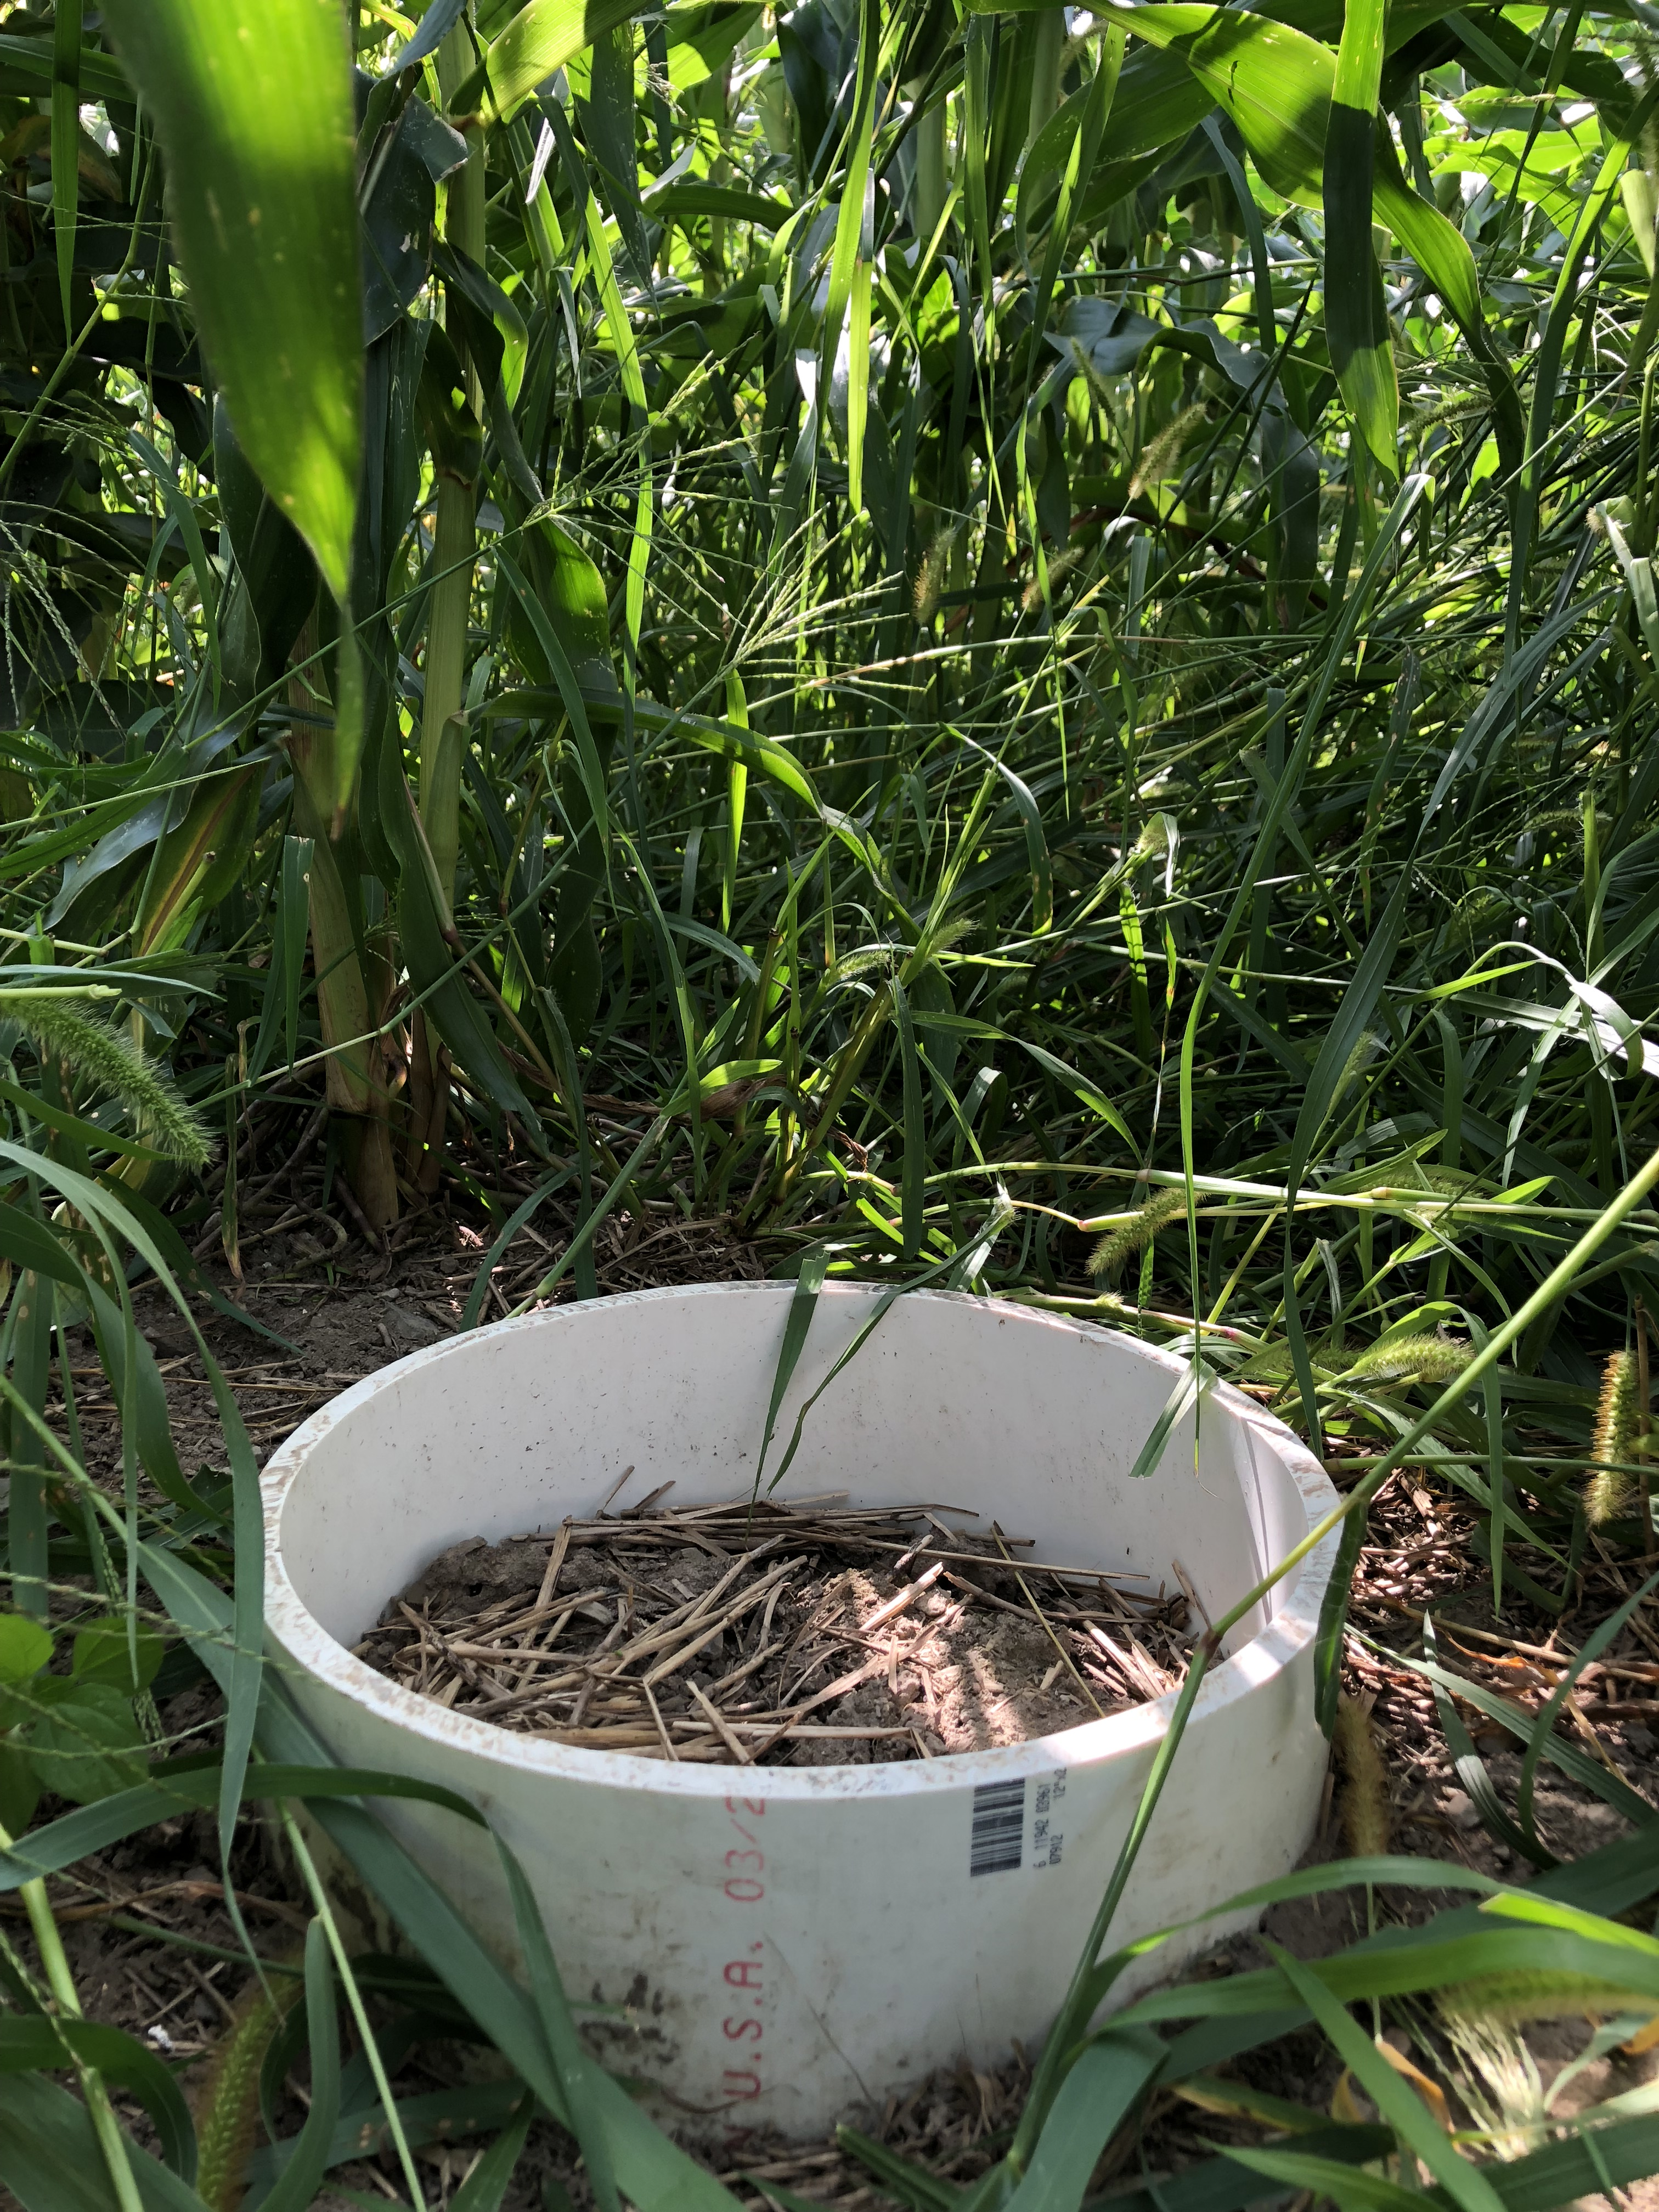
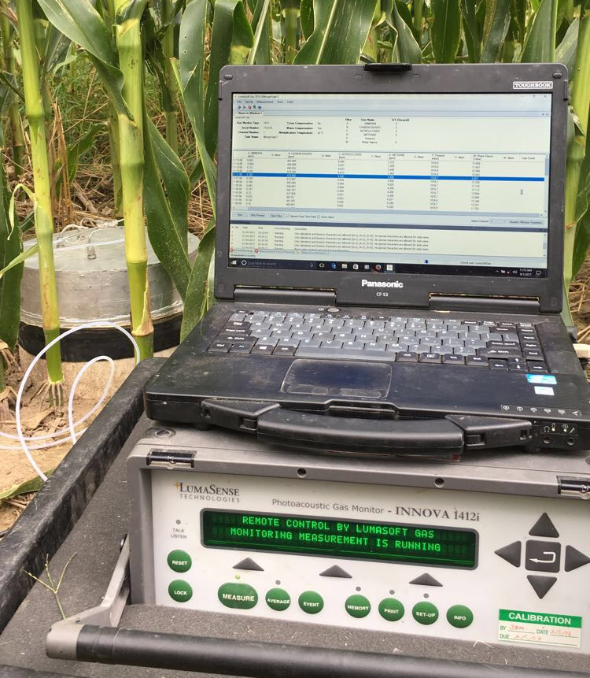
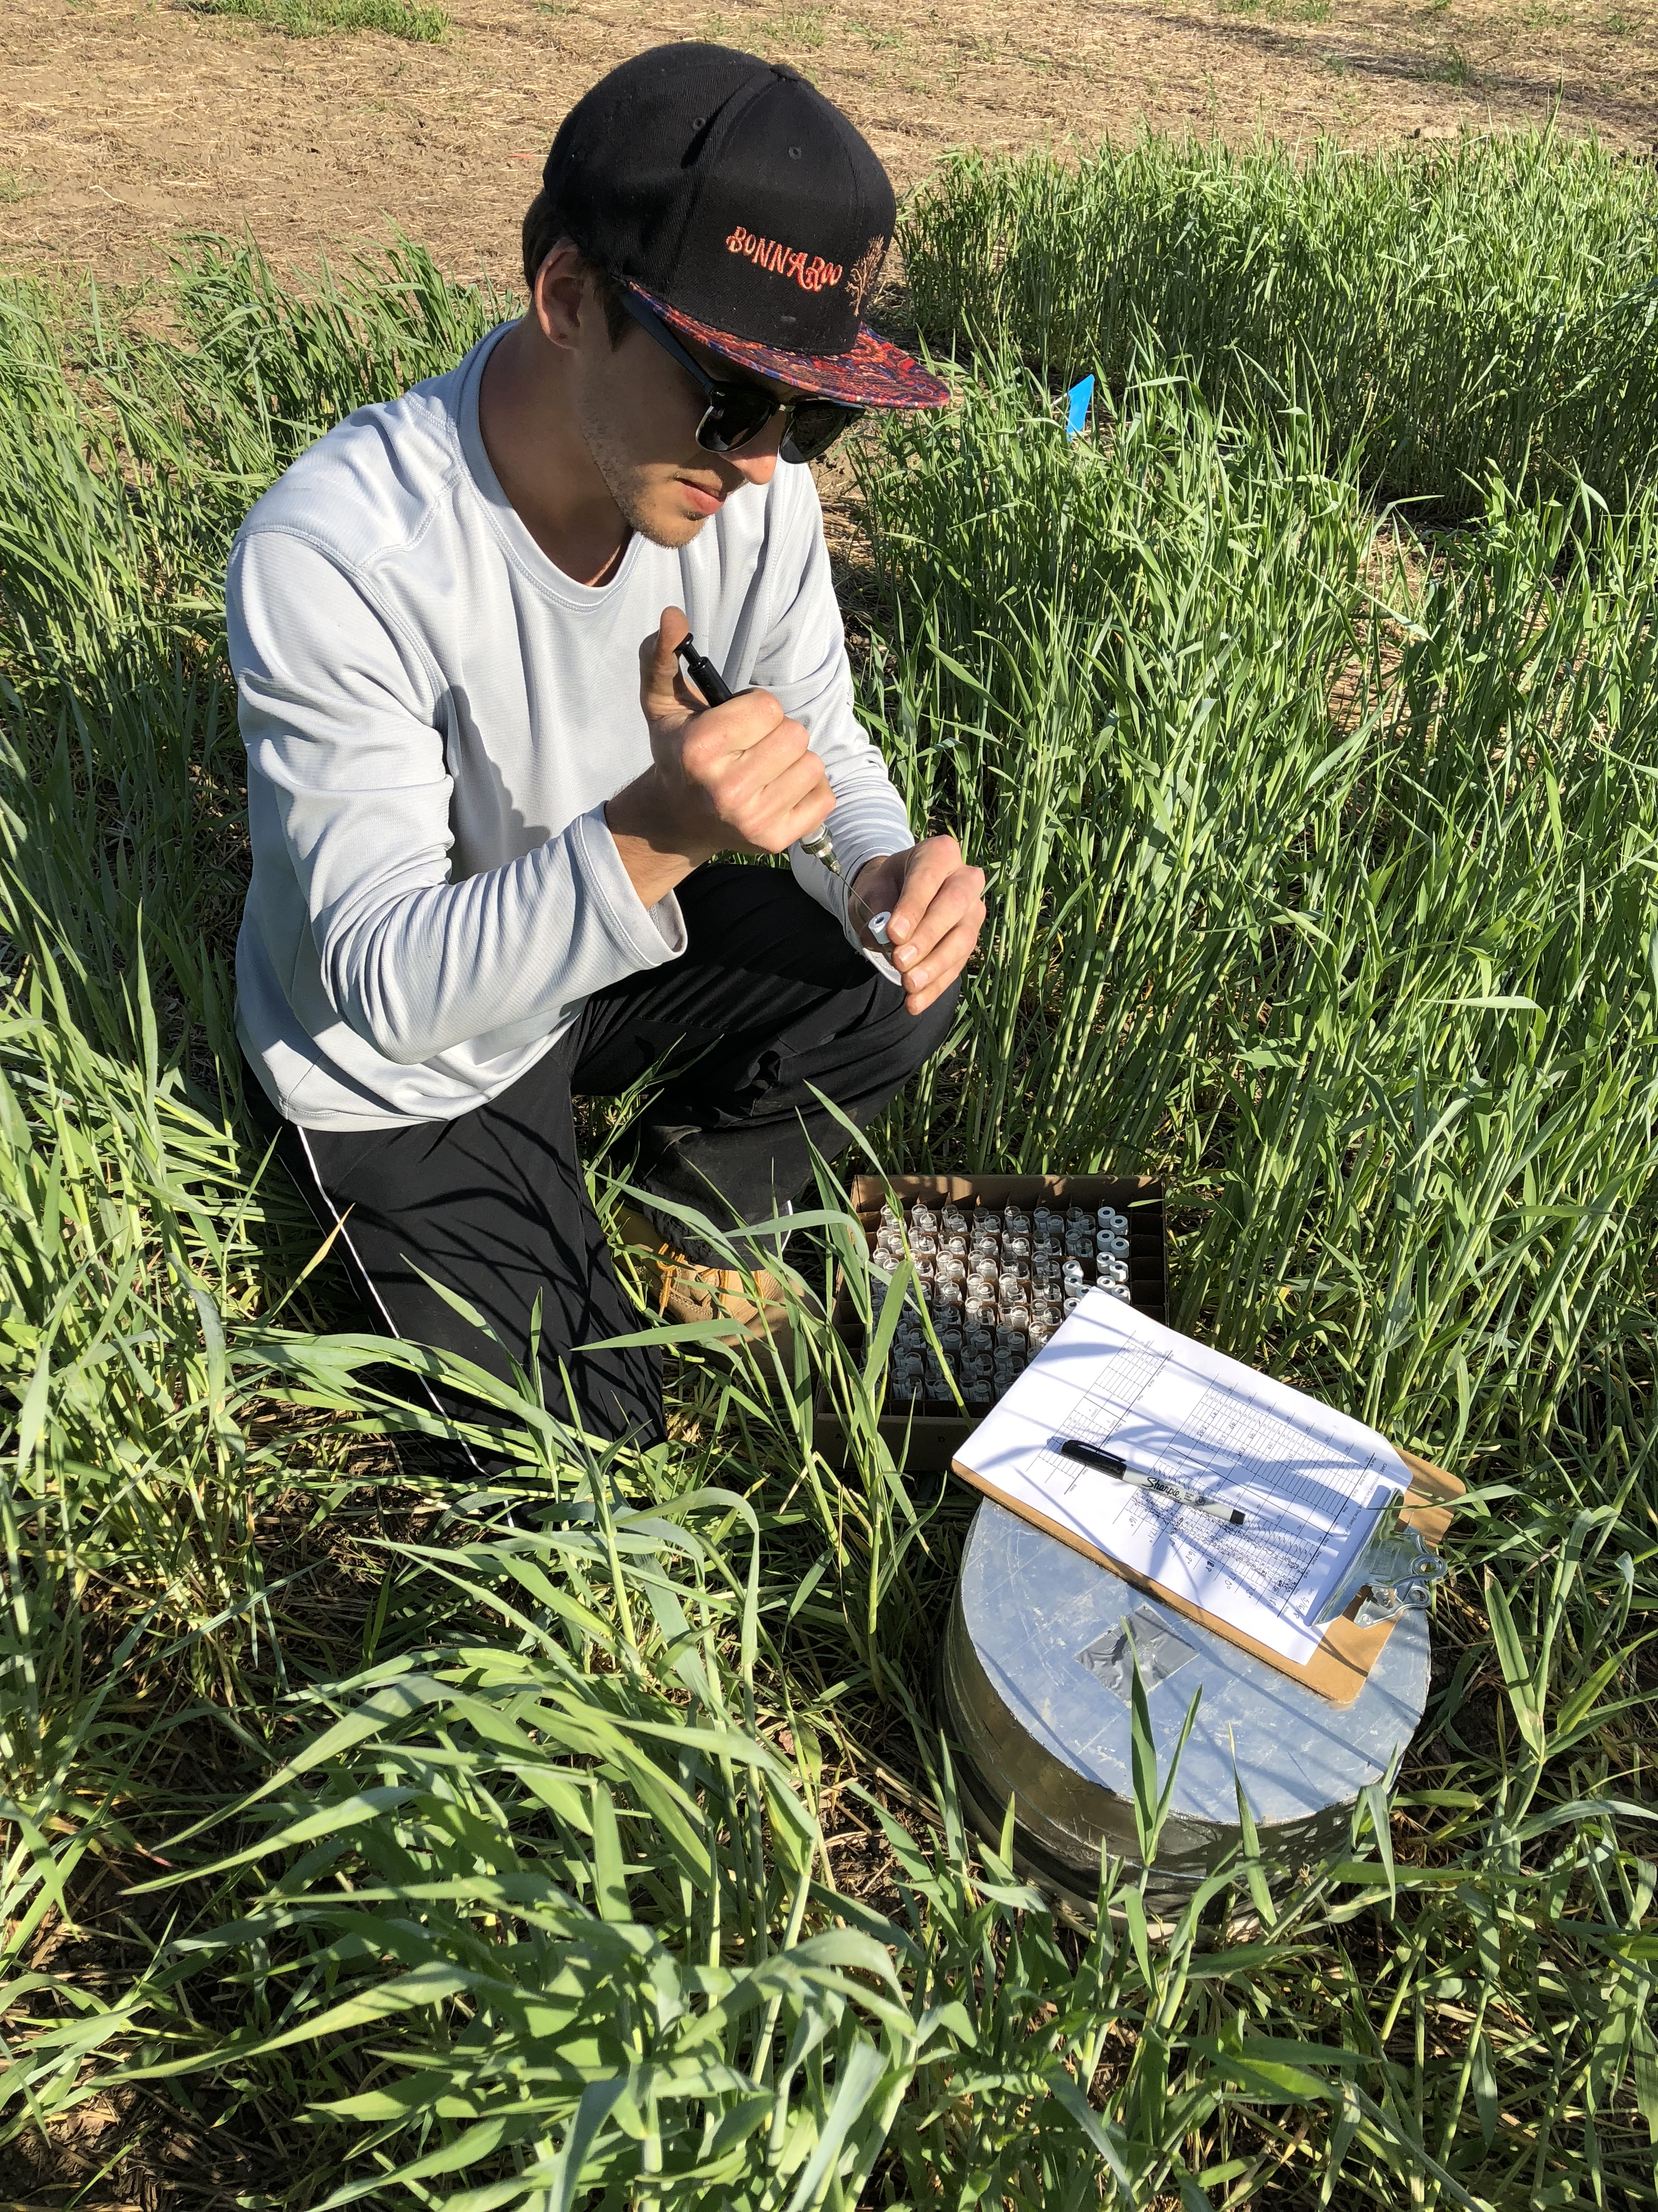
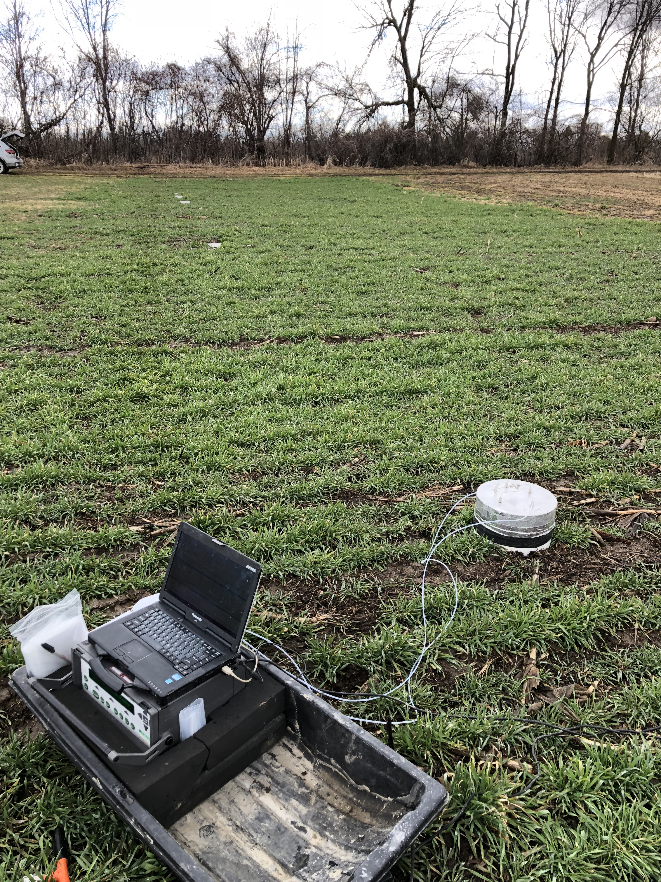
Methods
GHG sampling
Ammonia sampling
GHGs measured via static chamber-based method.
Measured twice a week.
  More intensive sampling after management/rain events.
NH₃ measured via photoacoustic gas spectroscopy.
Measured day of manure application, 24 hours, and 48 hours post application.

Slide 19
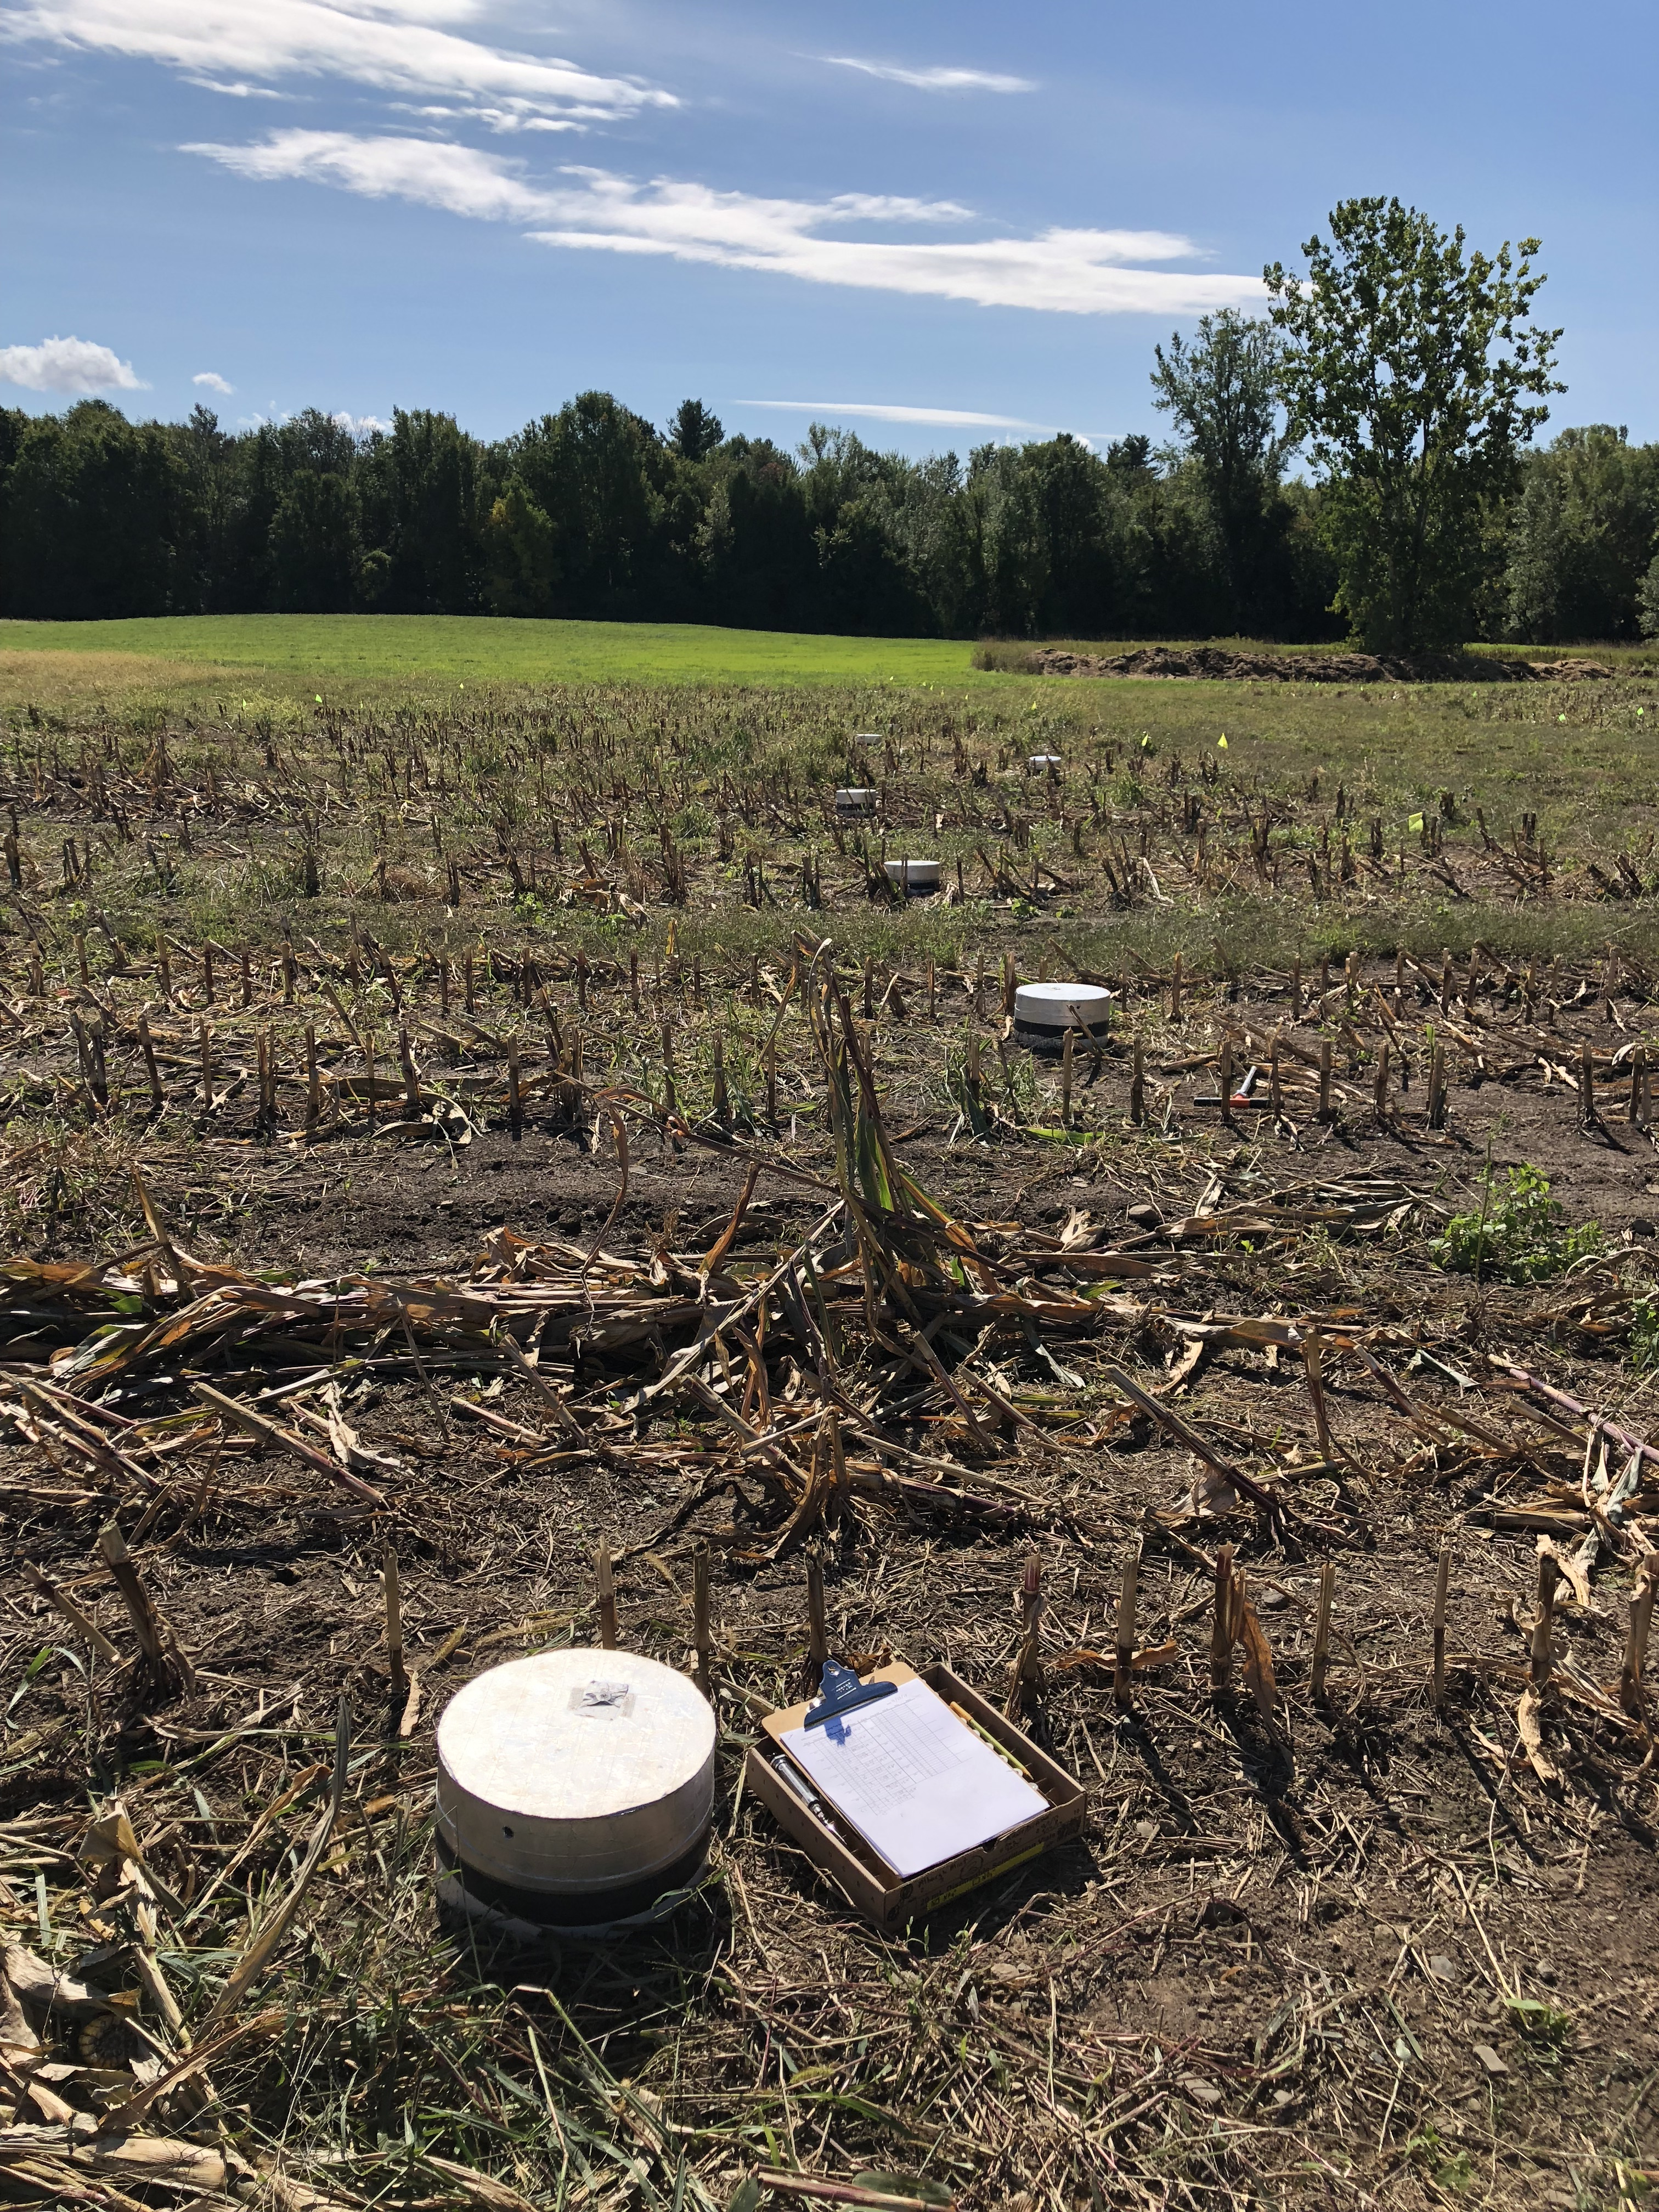
Experimental Design: CARE field trial
Established fall 2017 in a continuous corn silage system.
Isolates the effects of cover crops, manure timing, and tillage method.
Treatments (4 replicates/treatment):
  Spring and fall conventional tillage with cover crops
  Spring and fall conventional tillage with no cover crops
  Spring and fall no-tillage with cover crops
  Spring and fall no-tillage with no cover crops
  Control plots (bare soil)
Notes:
Not the correct control IDs, but makes more sense for presentation
Use a picture of CARE – explain what care stands for

Slide 20
CARE Preliminary Results:
N₂O emissions
Cover crops increased N₂O emissions (p = 0.002).
  1.5 to 2.3 times greater relative to no cover crops.
No significant covariates
Notes:
Significant interactions: cover crops by date, season by date, and tillage by season by date.
Why the decrease after fall application?

Slide 21
CARE Preliminary Results:
NH₃ emissions
Tillage and season significantly impacted NH₃ emissions (p < 0.0001 and p = 0.0481, respectively).
  3.2 times greater from no-till plots compared to conventional till plots.
  2.9 times greater from spring manure application compared to fall application.

Slide 22
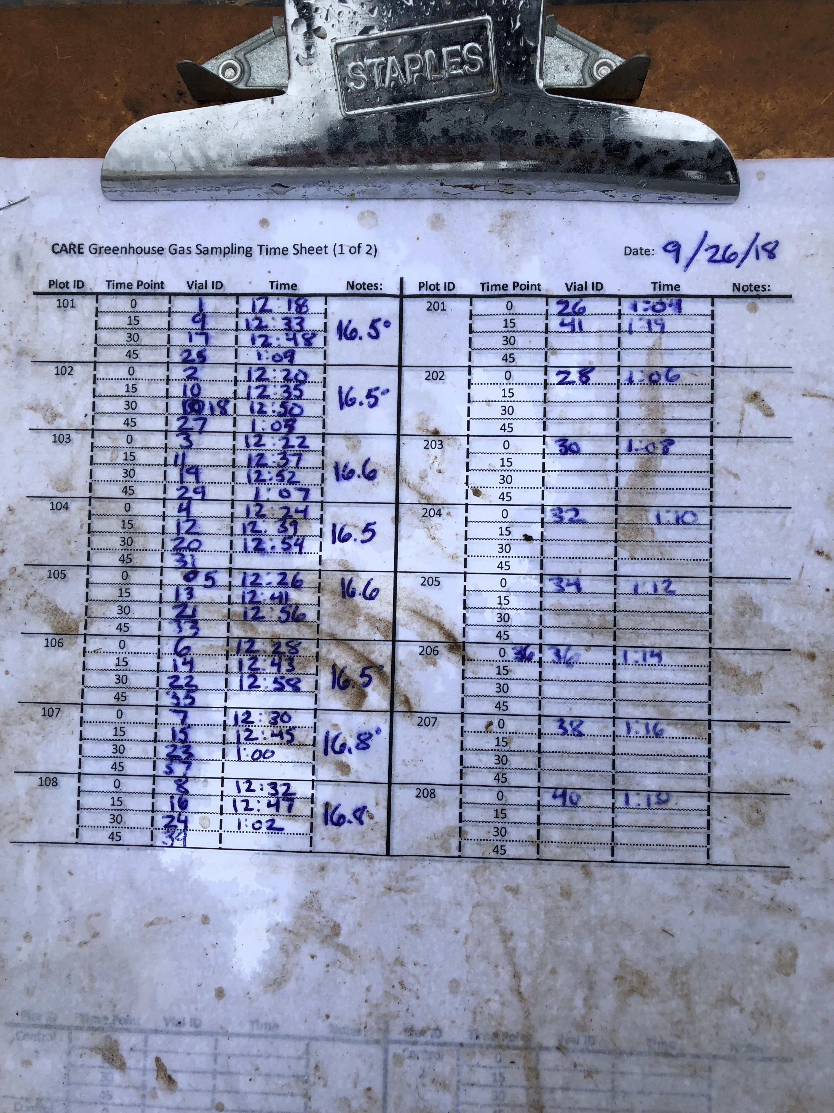
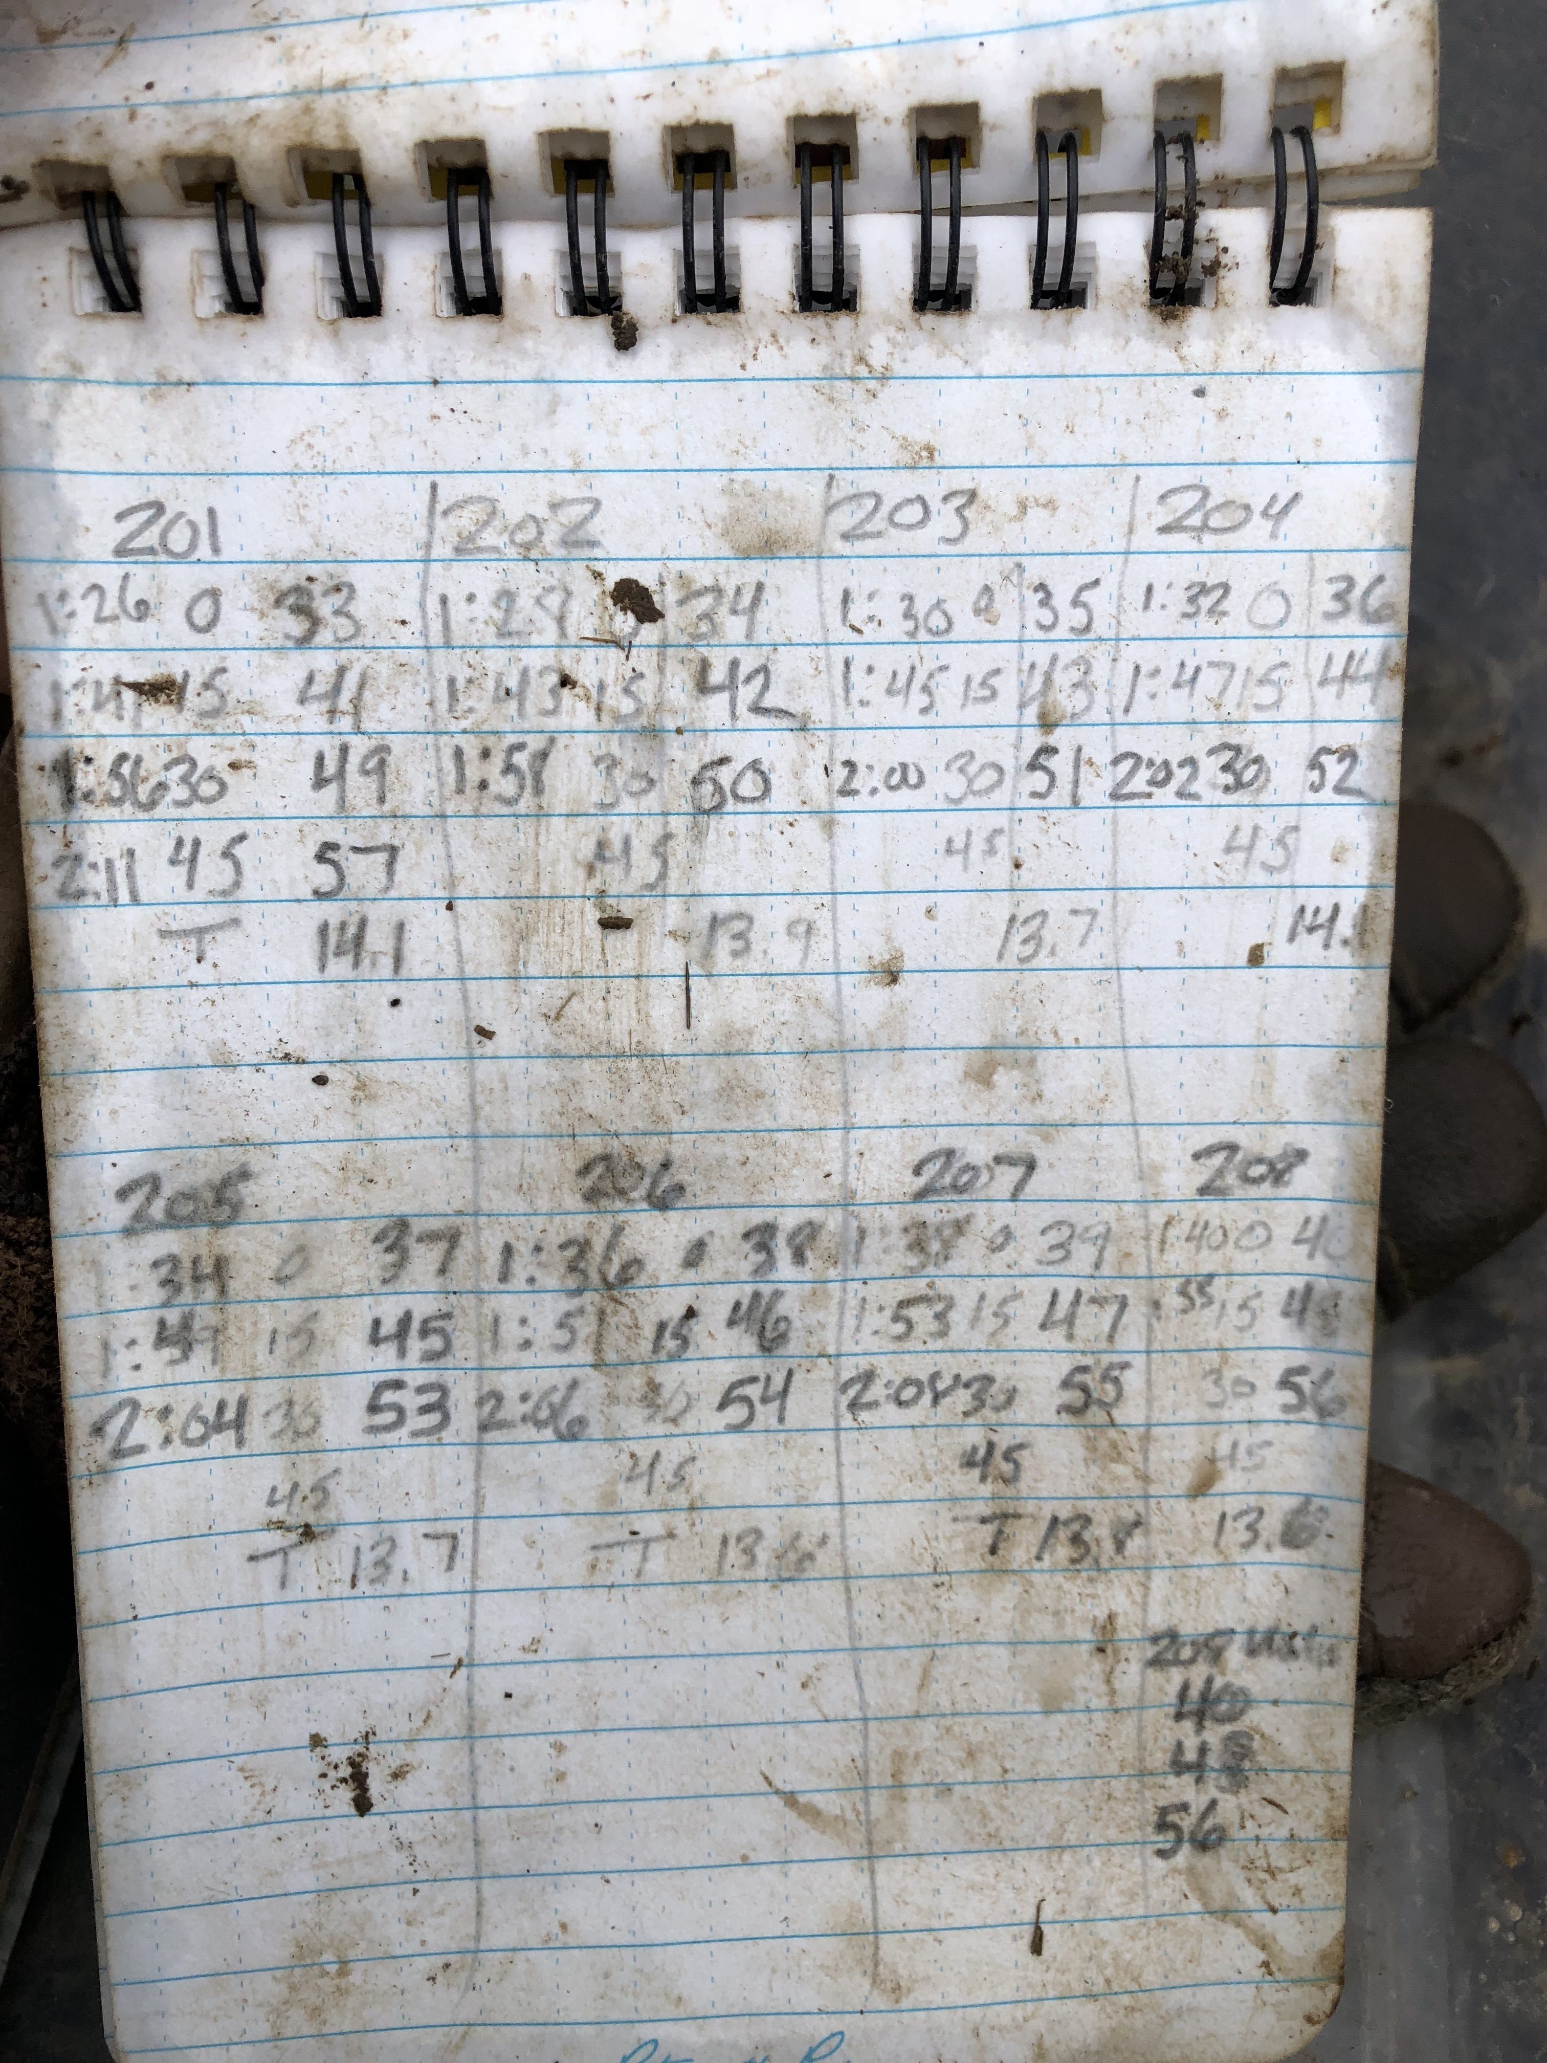

CARE Preliminary Results:
Soil Nitrate
Tillage and season significantly impacted soil nitrate concentrations (p = 0.0001 and p = 0.0148, respectively).
  1.5 times greater in conventional till relative to no-till
  1.4 times greater with spring manure application relative to fall.
Manure application date
Notes:
No till with little nitrate concentrations after fall manure possibly because of rain two days following manure application
Half an inch of rain on the 25th and 26th

Slide 23
CARE Preliminary Results:
Soil Ammonium
No significant differences between tillage, cover crop, or seasonal treatments.
Manure application date
Notes:
Significant two-way interaction between season by date (p < 0.001).
Significant three way interaction between tillage by season by date (p = 0.0173).
Significant four way interaction between cover crops by tillage by season by date (p = 0.0348).

Slide 24
What are the molecular mechanisms driving N₂O pulses directly after manure application?
How does this change with manure amendment and different management practices?
Future Work

Slide 25
Future Work: Methods
Denitrification: Stepwise biological reduction of NO₃⁻ → N₂
Sample CARE plots one week before and one week after manure application.
Perform a real-time qPCR analysis with extracted RNA
  Target gene for nitrification: amoA
  Target genes for denitrification: nirK/nirS, nosZ
Pair molecular data with GHG data.
nirK
nirS
nosZ
  NO₃⁻ NO₂⁻ NO N₂O N₂
Nitrate reductase
Nitrite reductase
Nitric oxide reductase
Nitrous oxide reductase
Nitrification: Stepwise biological oxidation of NH₄⁺ → NO₃⁻
N₂O
amoA
NH₄⁺ NH₂OH NO₂⁻ NO₃⁻
Ammonium monooxygenase
Hydroxylamine oxidoreductase
Nitrite oxidoreductase
Notes:
amoA - Nitrification is typically studied using the marker gene amoA because its nucleotide sequence is highly conserved amongst this functional group and due to its potential to clarify the effect of the amoA gene community structure on N₂O flux rates.
Nir - a key enzyme; catalyzes the reduction of soluble nitrite into NO (the precursor to N₂O)

Slide 26
Take home messages:
Tradeoffs exist between management practices that retain nitrogen in soils and promote nitrogen emissions.
Gaseous nitrogen mitigation possibly achieved through optimizing fertilizer rates.
Notes:
What practices would I recommend or not recommend?

Slide 27
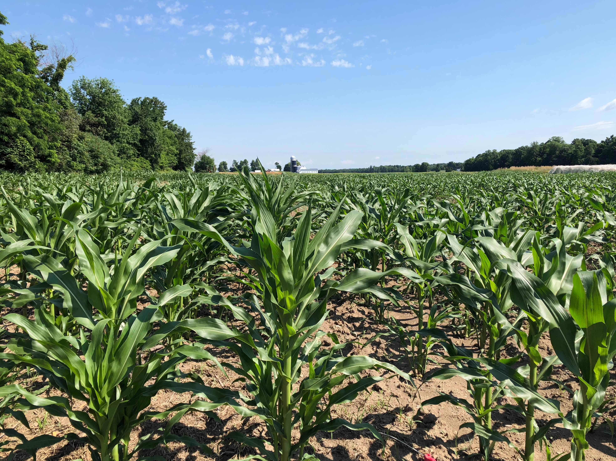
Acknowledgments
Thank you for:
Field Assistance
Laboratory Assistance
Farm/Experimental Design Upkeeping
Leadership
Lauren Bomeisl
Natalie Ceresnak
Adrian Wiegman
Lindsay Barbieri
Amanda Cole
Samantha Mosley
Julia Pupko
Roger Rainville
Sara Ziegler
Carol Adair, Asst Prof
Heather Darby, Ext Prof
Eric Roy, Asst Prof
Funding
Questions?
Notes:
STATS: Gas emission measurements will be analyzed using a repeated measures ANOVA.
All treatments will be considered as fixed effects.
The same structure will then be used to perform a repeated measures ANCOVA with soil inorganic N (NO₃⁻ and NH₄⁺), soil temperature, soil pH, SOM, soil moisture, crop yield, and crop protein content as covariates without interactions.

Slide 28
Nitrogen Management Scenario Tool
Lindsey Ruhl
UVM Extension
Agronomy Outreach Professional
2019 NOFA Conference

Slide 29

Notes:
This analysis tool is housed in goCrop, a nutrient management tool. We will login into goCrop soon to play around with the NMS tool, but before that. I’d like to give a few last caveat before we proceed.

Slide 30



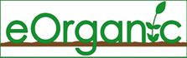
Who helped make this?
Project Leads
Michelle Wander, Professor of Soil Fertility/Ecology, University of Illinois
Heather Darby, Associate Professor of Agronomy, University of Vermont Extension
Model Work
Ho-Young Kwon, Research Fellow, International Food Policy Research Institute
Yushu Xia, Research Assistant, University of Illinois
Carmen Ugarte, Research Specialist in Agroecology, University of Illinois
Penelope Hobbs, goCrop Developer
Support
Emily Marriott, eOrganic Soils Coordinator, University of Illinois
Lindsey Ruhl, Agronomy Outreach Professional, University of Vermont Extension
Funded by: Organic Transitions Program of the USDA National Institute of Food and Agriculture
Notes:
Before I begin my presentation, I would like to pause and acknowledge our collaborators in creating this tool and our funder.
At this heart of this project is the goal to create an Agricultural Information System specific for organic operations.
Furthermore, section 2709 of the Food, Conservation and Energy Act of 2008 requires that the organic sector document GHG emissions. As a result of this, the USDA was directed to prepare technical guidelines and science based methods to measure environmental services derived from conservation and land management activities.

Slide 31
What does the Nitrogen Management Scenario Tool do?
Outputs
Plant available N
Leached N
Soil organic matter
Water holding capacity
N₂O emissions
Scenarios, based on rotations
Weather variability
Year in rotation
Timing of fertility
Style of tillage
Use of cover crops
Notes:
Kyle just demonstrated on volatile, how slippery, and how quickly nitrogen can move in the soils and in the air and is deeply influenced by weather and management practices. Nitrogen can also underline your bottom line. This tools runs different rotation and management practices to help evaluate trade offs. Knowing how much plant available N is in your soil or how much can be lost to leaching can help determine the best time and rate of N applications. Organic matter and water holding capacity can impact your crop yield and health, as well as soil health and the environment, especially when it comes to mitigating the extreme weather effects of climate change. SOM can help hold the water your crops needs during dry times and keep water flowing through those downpours we get. With that in mind, we also know, and as Kyle pointed out, that we should keep a watchful eye on nitrous oxide emissions to do our part to reduce green house gas emissions. So, what does this have to do with this tool?
Have you ever wondered how your crop rotations effect the available of nitrogen in your system or where it goes? Compared to an average year, are nitrogen losses greater in a dry year or a wet year? How do cover crops effect your plan available nitrogen?

Slide 32
How does the Nitrogen Management Scenario Tool work?
Based On
Field Validation
Long-term SOM data from 10 experimental sites
Management histories of 72 Illinois farms
Cover crop and soil samples collected from
10 fields in NY
9 fields in VT
24 fields in IL
Greenhouse gas samples collected from
2 farms in VT
3 farms in IL
DayCent model
  Soil Organic Matter Submodel
County level
Land use history
Climate
Soil type (bulk density, pH, erosion,
texture)
Estimate of carbon inputs
IPCC guidelines for greenhouse gas accounting
Meta-analysis of yields and decomposition
  Yields
  C:N ratios
  Root:shoot ratios
Notes:
Before we dive into this tool, I’d like to tell you a little bit about how those outputs are determined. The Nitrogen Management Scenario Tool integrates models and field validation to assess the impact on nitrogen in soils. The CENTURY model is a general model of plant-soil nutrient cycling which has been used to simulate carbon and nutrient dynamics. This model is used by the Department of Energy’s Greenhouse Gases, Regulated Emissions, and Energy Use in Transportation (GREET). CENTURYS’s, Soil Organic Matter submodel tracks changes in organic matter resulting from management and runs simulations for organic matter as plant matter, decomposing plant matter, and very decomposed plant matter otherwise known as the active, slow, and passive phases of organic matter. The submodel take into account land use history data for dominant soil types at a county level, climate and soil layers, and estimates of C inputs for conventional grain based systems.
IPCC activity data is used to estimate N₂O emissions resulting from anthropogenic nitrogen (N) inputs such as synthetic fertilizers, animal wastes and other organic fertilizers, biological N fixation by crops, N deposition, and mineralization of crop residues returned to the field.
The meta-analysis by Ugarte will help estimate carbon and nitrogen release based on how much yield (plant matter), the above ground and below ground biomass, and the C:N ratio. The ideal rations is somewhere between 25-30 parts to one part nitrogen, outside that ratio and the rate of decomposition slows.
Using long-term SOC data obtained from 10 experimental sites where corn, soybean, or wheat were grown with a range of tillage, fertilization, and organic matter additions, our collaborators at the University of Illinois have calibrated the model to for cover crops use and manure applications.
DayCent, a version of the CENTURY, models expected emission rates for dominant fertility and rotation practices, soil types and climate regimes for all USDA Land Resource Regions.
On fields representing common rotations with cover crops in NY, VT, and IL we collected cover crop and soil samples. The geolocations of four locations on each of these fields was recorded, percent weed biomass recorded, height of cover crop measured, photos taken for percent cover analysis, cover crop biomass was collected for yield information, and three soil samples were taken from where the area of the biomass was collected for nutrient analysis. On select fields from these locations in VT and IL, greenhouse gas emissions were collected in the fall to assess the effects of cover crop termination of tillage on emissions. Soil samples, moisture, and soil temperature where also collected at this time.

Slide 33
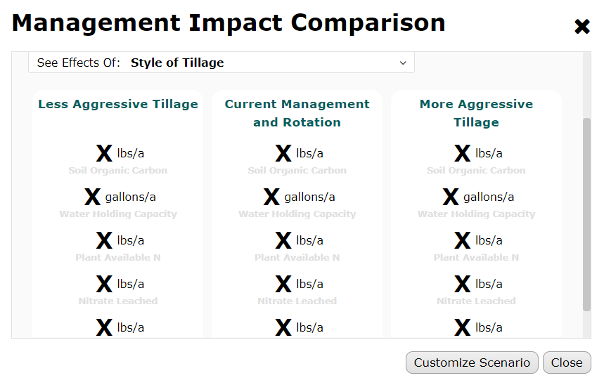
What are the limitations of Nitrogen Management Scenario Tool?
Based on models
Based on county level data
Not absolute values
Notes:
The Nitrogen Management Scenario Tool is in it’s beta form and really only is designed to provide relative difference. There are some limitations. Although we did collect field data to ground-truth, it is based on models. For example, CENTURY underestimates the benefit of practices like organic amendments and hay production in organic systems. However, the models are more accurate with when more detail is provided. The NMS tool allows for customization of broad land use history, soil type, and field specific rotations. The data the tool uses is based on county averages. Everyone knows, especially in Vermont, that the weather can be quite different 10 miles away. And finally, I do want to underscore that the numbers presented here are not absolute. For example, if the tool shows that 30 pounds of nitrogen are lost if the field is harrowed and 50 pounds is lost if tillage is moldboard plowed, it does not mean that 20# more of nitrogen is lost, only that more nitrogen is lost during spring tillage.
Instead of showing you slides of how the tool works, let’s walk through a scenario together. Please join a group with an ipad or laptop. The ipad login code is 1234. Please open Chrome and type in….(this will be shown on screen).

