Slide 1
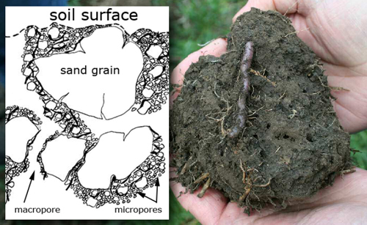



Soil Carbon Sequestration
and
Other Soil Ecosystem Service
Dr. Barbara C. Bellows and Scott Hardeway

Slide 2
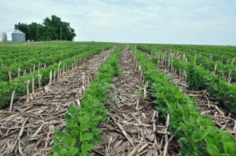
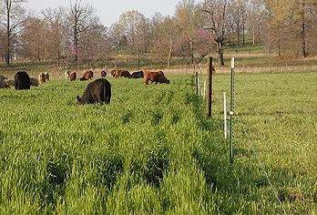
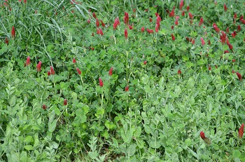
Conservation Farming Practices
Rotational Grazing
Cover Cropping
No - Till

Slide 3
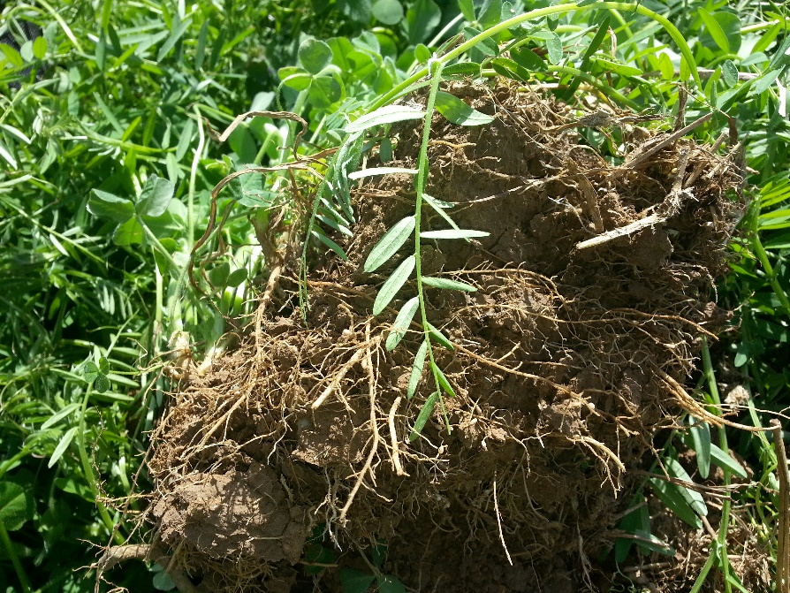
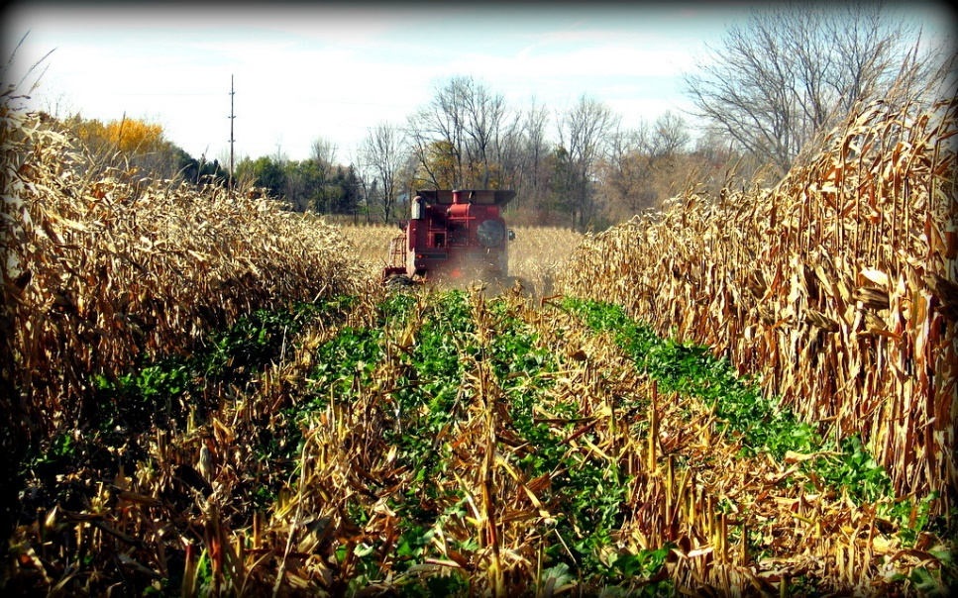
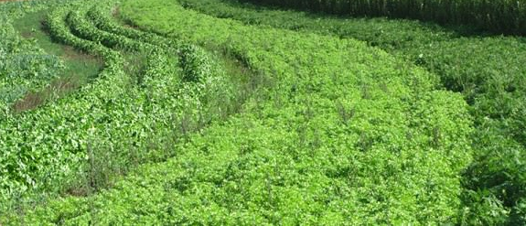
Characteristics of Conservation Farming Practices
Soil is covered at all time
Live root in the ground throughout the year
Biodiversity in the field

Slide 4
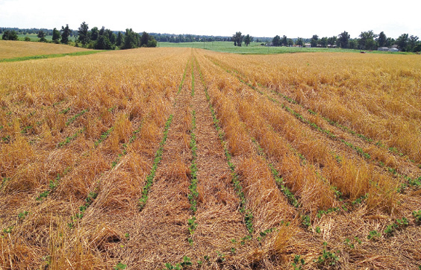
Farm Benefits of Conservation Farming Practices
Deeper and wider root growth
Better water holding capacity
Better nutrient holding capacity
Less energy used in production
Reduced erosion resulting in sustained productivity
More efficient nutrient use

Slide 5
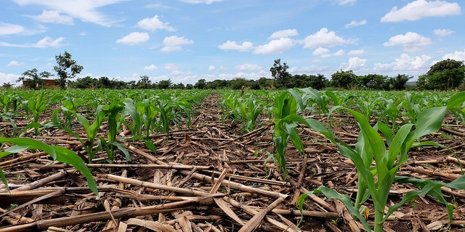
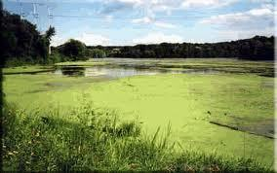

Off-Farm or “Societal” Benefits of Conservation Farming Practices
Reduced erosion movement into water bodies
Reduced nutrient movement into water bodies – less eutrophication
Less nutrient leaching
Less sediment build up behind dams
Soil carbon sequestration

Slide 6
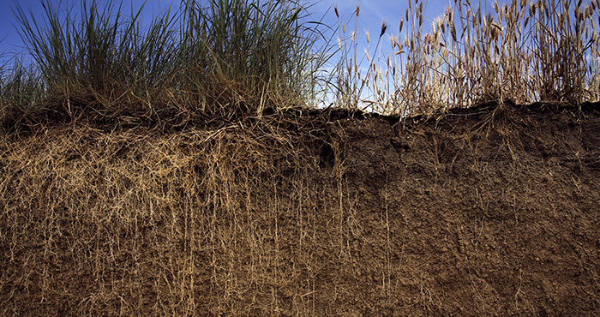
Soil and Conservation Practice Jargon
Soil Quality – productive soil with good physical, biological, and chemical properties
Soil Health – similar to soil health but with greater emphasis on soil biological processes
Resilience to Extreme Weather Conditions – soil and farm management practices that conserve water, nutrients, and energy
Soil Carbon Sequestration – ability of the soil to hold carbon in living cells and in organic matter for an extended period of time – considered to help reduce global climate change
Soil Ecosystem Services - societal benefits from soil and soil management practices

Slide 7
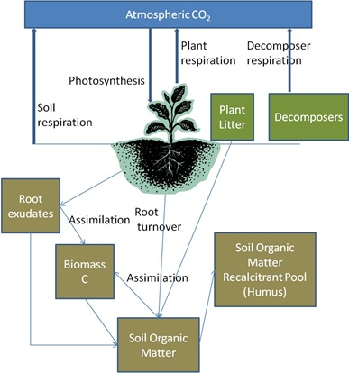
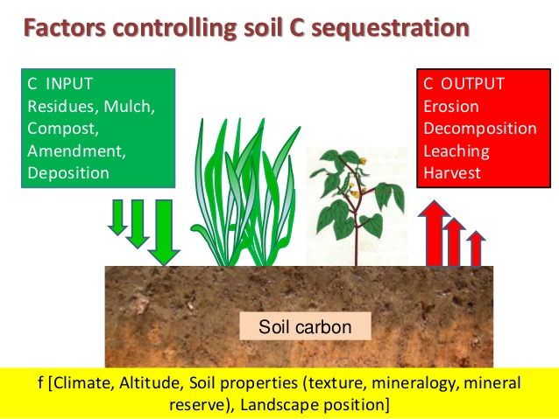
Soil Carbon Sequestration

Slide 8
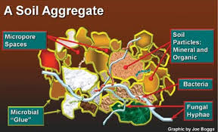
What are the Characteristics of a Soil that is Involved in Carbon Sequestration?
It has soil aggregates

Slide 9
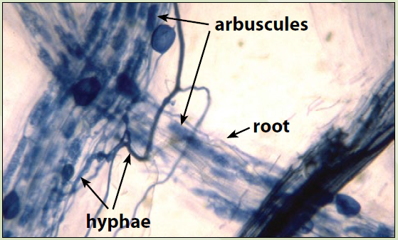
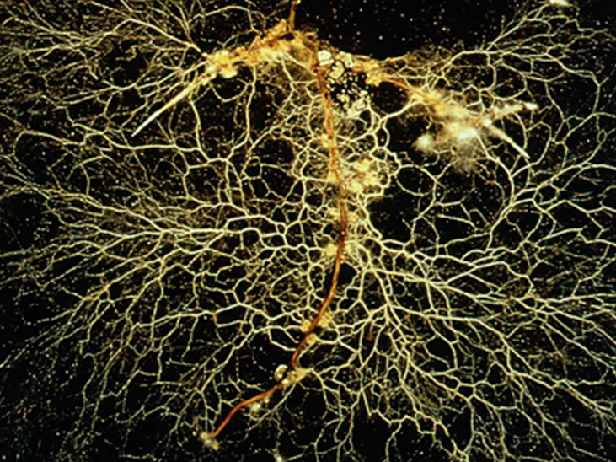
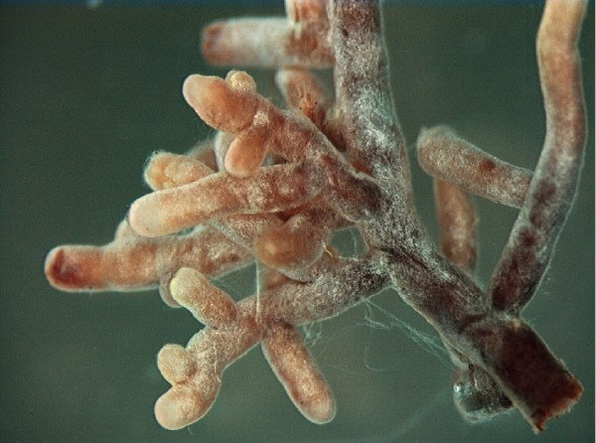
Aggregates are primarily held together by mycorrhizae

Slide 10
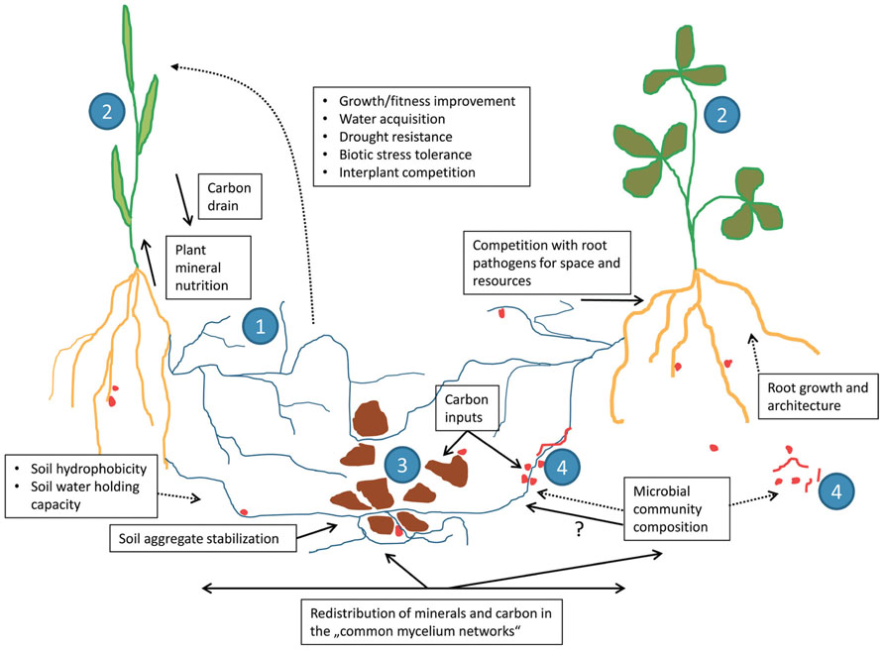
Mycorrhizae not only help form aggregates
Mycorrhizae also facilitate “plant communication” or the transfer of nutrients, hormones, and other substances among plants

Slide 11
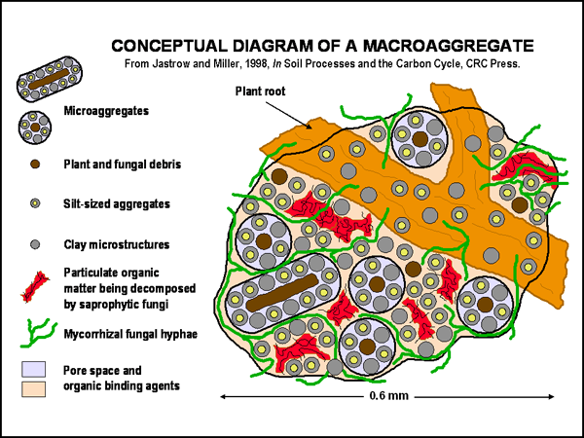
Other Critical Components of Soil Aggregates
Plant roots
Clay minerals
Bacterial slime
Earthworm castings
Particulate organic matter

Slide 12

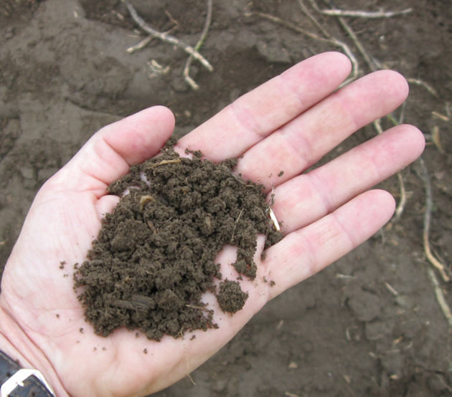
Why Should Farmers Care about Soil Carbon Sequestration?
Soil carbon sequestration involves increases in organic matter which increase soil water and nutrient holding capacity and improves root growth
Farmers may have the opportunity to get paid for soil carbon sequestration

Slide 13
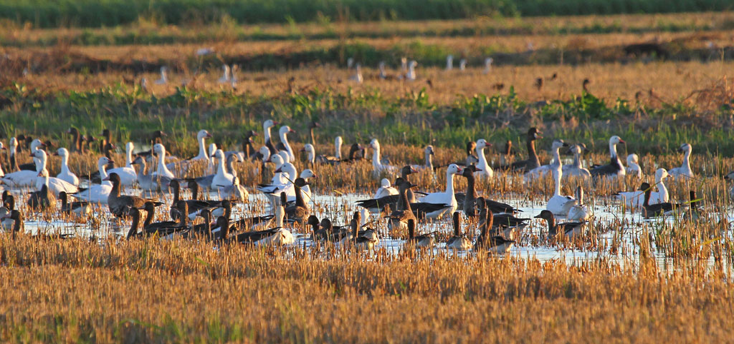
How Might Farmers be Paid for Soil Carbon Sequestration?
Process has been tested in California and in Arkansas
Tested on rice fields
Involves conservation-based irrigation practices
Sequesters carbon in soil
Reduces nitrous oxide emissions
Decreases methane emissions

Slide 14

How do Farmers Get Paid for Soil Carbon Sequestration?
Carbon Dioxide emitters – such as airlines, trucking companies, energy producers, industries – pay into an “offset market”
An offset credit represents an exchangeablepermanent greenhouse gas nit (GHG) emission reduction/elimination
1 Offset Credit = 1 Metric Ton of Carbon Dioxide (Equivalent)
Offset credits can be sold to private sector entities through programs such as:
    California Compliance Offset Program
    Voluntary Carbon Market
USD settlement price for Compliance Credits between 2016-2018 = $15.05 per credit.

Slide 15
How do Soil Carbon Sequestration Programs Relate to Agriculture Today?
The California Compliance Offset Program
  Rice Cultivation Compliance Offset Protocol
    Applies to rice farmers in California as well as Mid-Southern States (Arkansas, Louisiana, Mississippi, and Missouri)
    Utilizing the DeNitrification-DeComposition (DNDC) biogeochemical process model, rice farmers can generate offset credits by implementing specific conservation practices.
    In Arkansas, these practices are NRCS Irrigation Practices
    Eligible conservation practices for the Mid-South include:
      Intermittent flooding; and/or
      Early drainage at the end of the growing season.

Slide 16
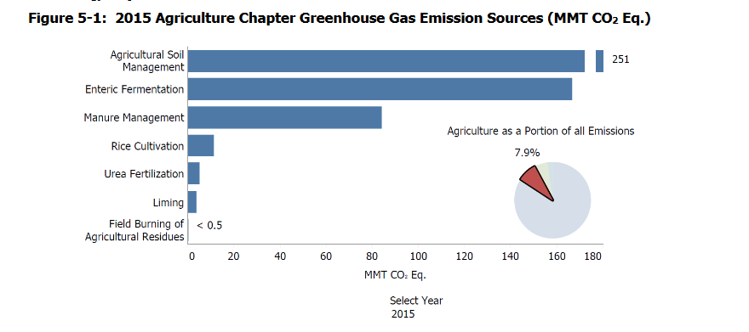
How do Soil Carbon Sequestration Programs Relate to Agriculture Today?
According to the EPA in 2015, Louisiana rice cultivation resulted in 3.8 million metric tons of carbon dioxide equivalent worth of methane emissions.
Offset credits must be "real, permanent, quantifiable, verifiable, and additional" to be eligible for sale in the Joint Compliance Auction.

Slide 17
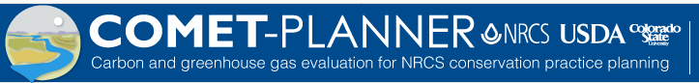
Why Have Soil Carbon Sequestration Markets not been Widely Adopted?
High cost of verification of soil carbon sequestration occurring
  Based on soil management practices?
  Based on COMET?
  Based on soil analyses? What analyses?
  Do different soil types sequester soil carbon differently?
  Who is involved in the verification process?
  How often does verification occur?

Slide 18
Why Have Soil Carbon Sequestration Markets not been Widely Adopted?
Current low value of carbon credits
Current value is near $15/ gtonne
Price that would be viable for farmers to make changes in their practices would be closer to $30/gtonne
Potential for price to increase as more farmers become involved

Slide 19
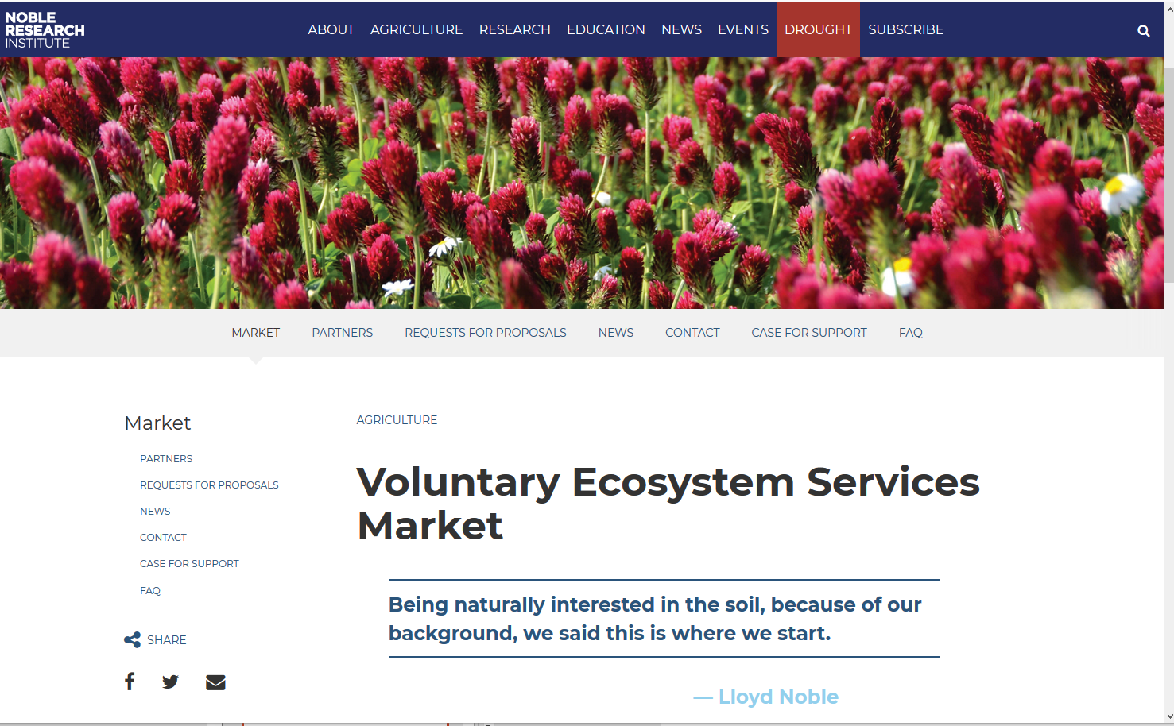
Voluntary Ecosystems Service Market- A Potential Alternative

Slide 20
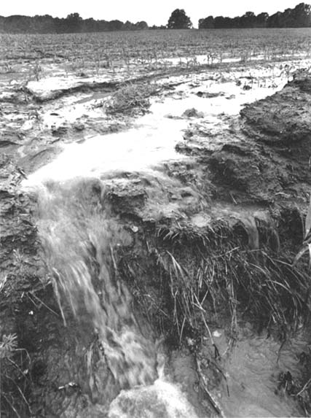
Voluntary Ecosystems Service Market- A Potential Alternative
Potential Benefits
  Market and private sector based – does not rely on government policies or funding
  Verification processes (to be developed) will be relatively easy to assess
  Provides credits for a variety of ecosystem services that can be provided by land management practices including
    Water quality protection
    Air quality protection
    Water conservation
    Soil carbon sequestration

Slide 21
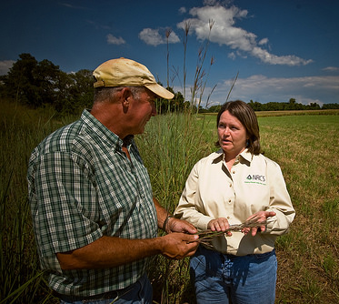
Potential Barriers to Overcome
Mixed messages and confusion over appropriate conservation practices for location
Hesitancy of some farm support personnel to promote conservation farming practices
Limited locally – based research on soil and water quality impacts of soil conservation farming practices

