Slide 1


Next Steps in Agricultural Conservation Leasing Education
Sarah Everhart
Managing Director
ALEI
This work is supported by the National Institute of Food and Agriculture, U.S. Department of Agriculture, through the Northeast Sustainable Agriculture Research and Education program under subaward number ENE18-151.

Slide 2
Next Steps-
Farmers/Landowners
Use the information and resources received.
Contact us with questions.
We will contact you in 6 months and 1 year to ask about initiated communications regarding leasing goals or efforts to use conversation practices on leased acres.

Slide 3
Next Steps-
Farmers/Landowners
Examples of making efforts to use conservation practices:
    agreeing to follow the terms of a conservation plan;
    applying for cost-share funding or technical assistance for a practice;
    entering into a new lease with conservation practice provisions;
    amending an existing lease to include conservation practices;
    using an agricultural conservation practice; or
    expanding the use of an agricultural conservation practice.
  If you take any of these steps, please let us know!

Slide 4
Next Steps-Service Providers
Use the information from today’s workshop to educate landowners and farmers.
Use the powerpoint presentation to help you (available on the Hughes Center website).
We will provide you two years of technical support.

Slide 5
Technical Support
Examples of technical support:
additional materials
in person support
telephone support with farmer/landowner
a listserve with frequently Q&A from other providers
informational webinars
conference or video call with other service providers to trade ideas peer-to-peer

Slide 6
Collaborative Steps for Future Education
We need your help assessing the impact of your education efforts.
Hughes Center can handle registration for your educational events.
Send the Hughes Center/ALEI a copy of your registration list.
We need to contact the attendees and ask about the impact of the education for grant reporting purposes.

Slide 7
Next Steps with you - Future Education
We will contact you 6 months and 1 year following today’s workshop to follow up on progress regarding farmer/landowner communication or efforts to implement conservation practices.
You can report impacts on an online reporting form (Hughes Center website).

Slide 8
Project Goals
40 agricultural service providers provide education to 75 farmers and 15 landowners.
20 of the farmers and 8 of the landowners who receive the education will initiate communication about agricultural conservation leasing goals.
10 farmers make efforts to use conservation practices on leased acres.

Slide 9
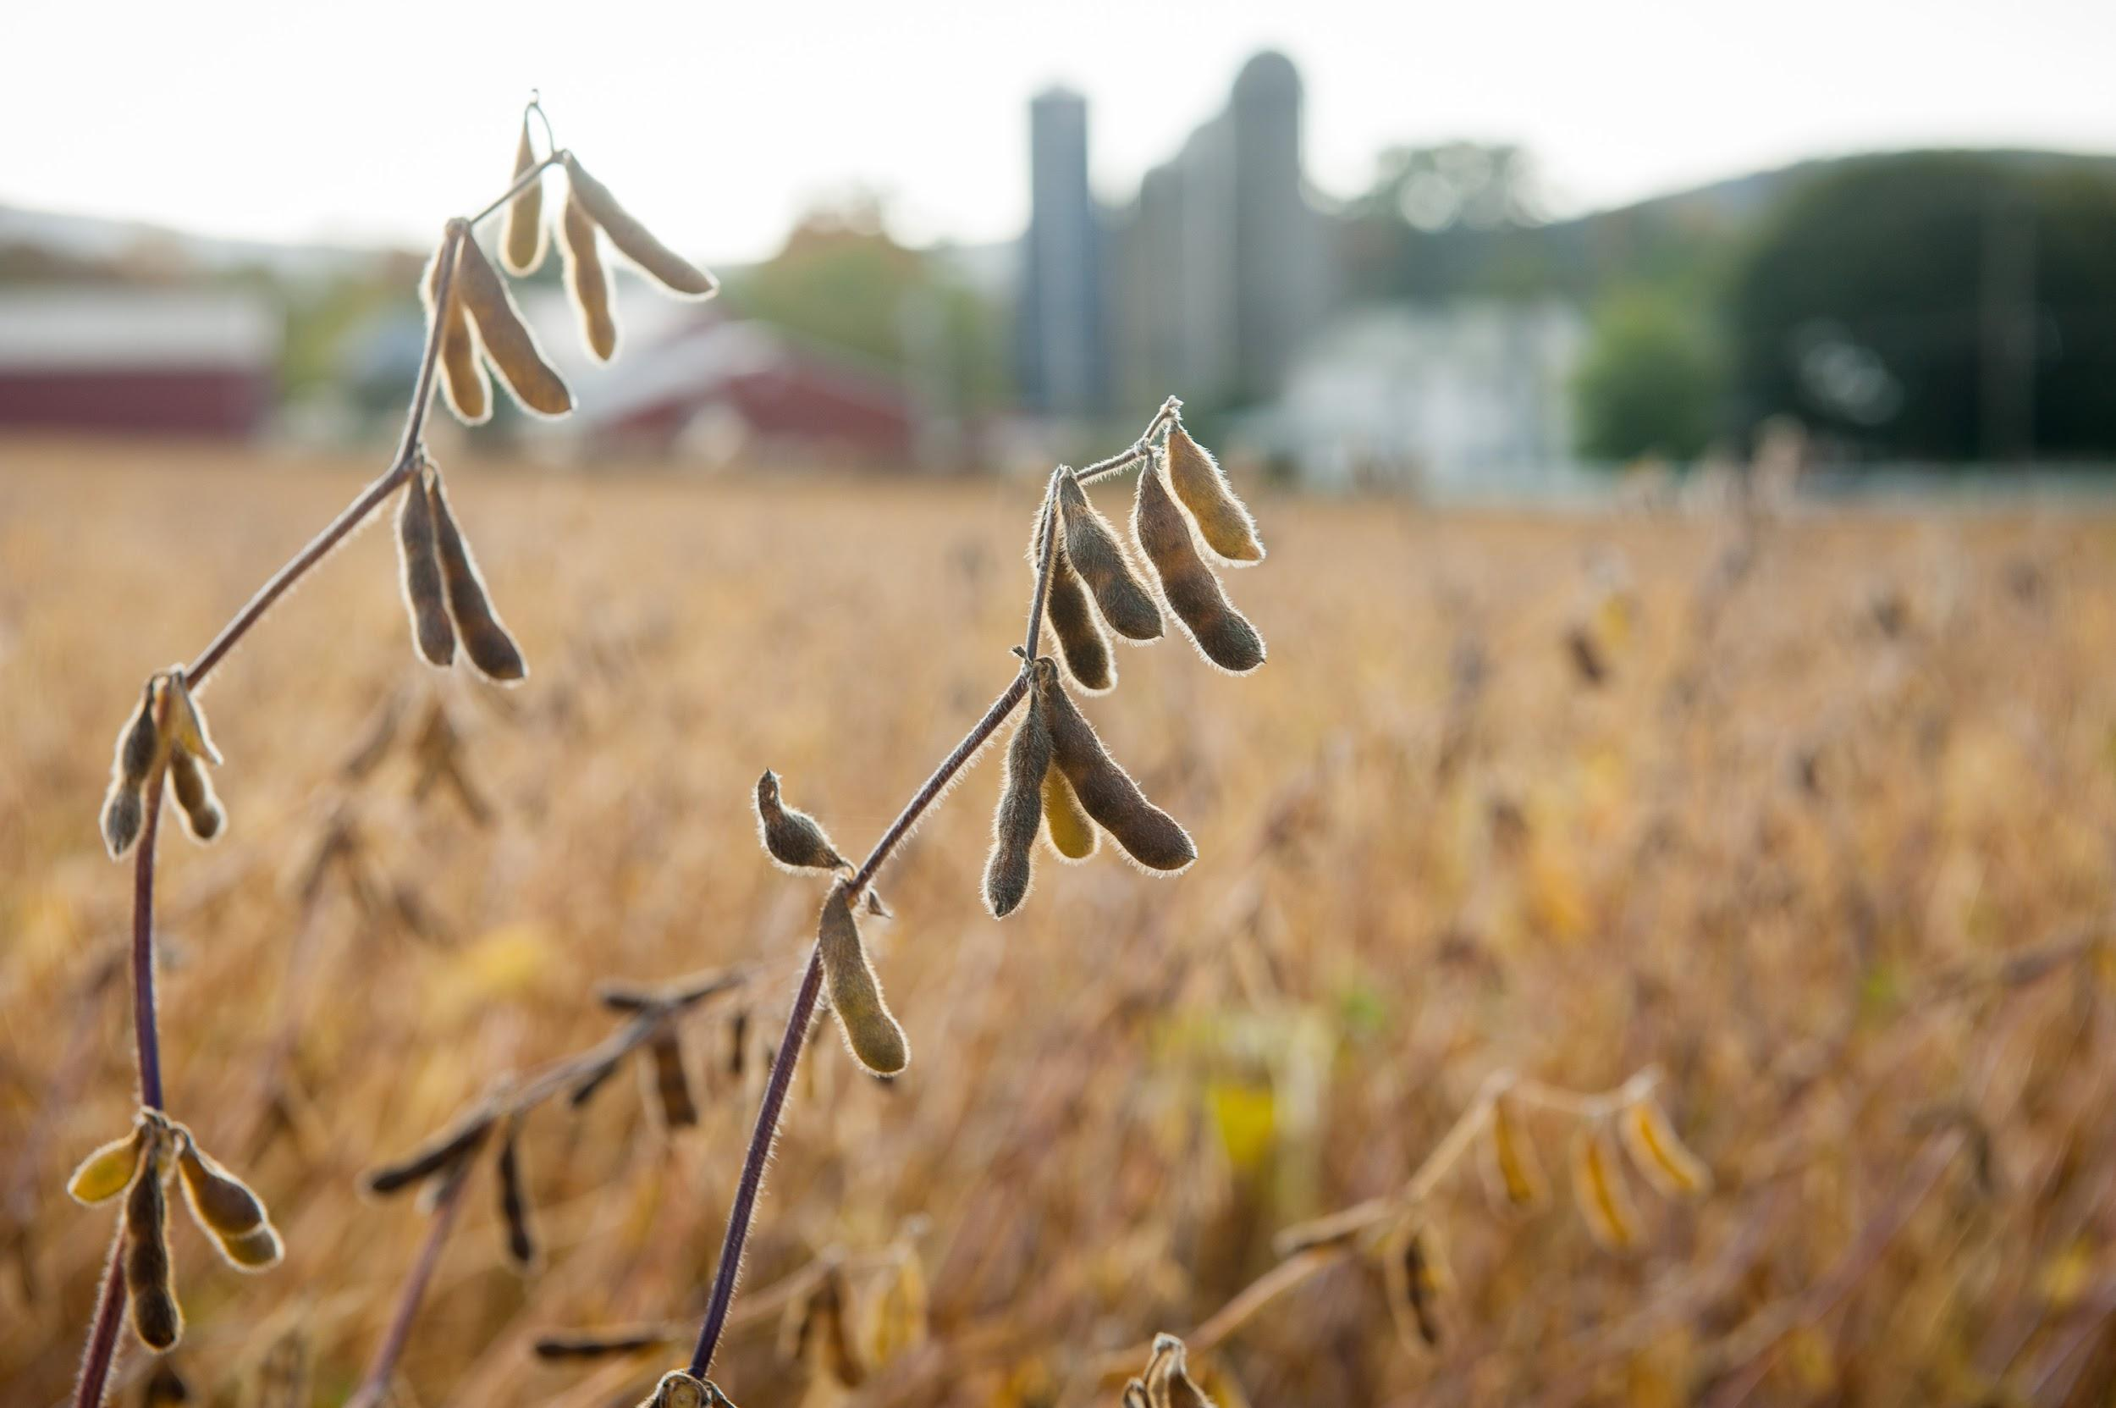
Thanks
Questions?
Sarah Everhart
severhart@law.umaryland.edu/ 410-458-2475

