Slide 1
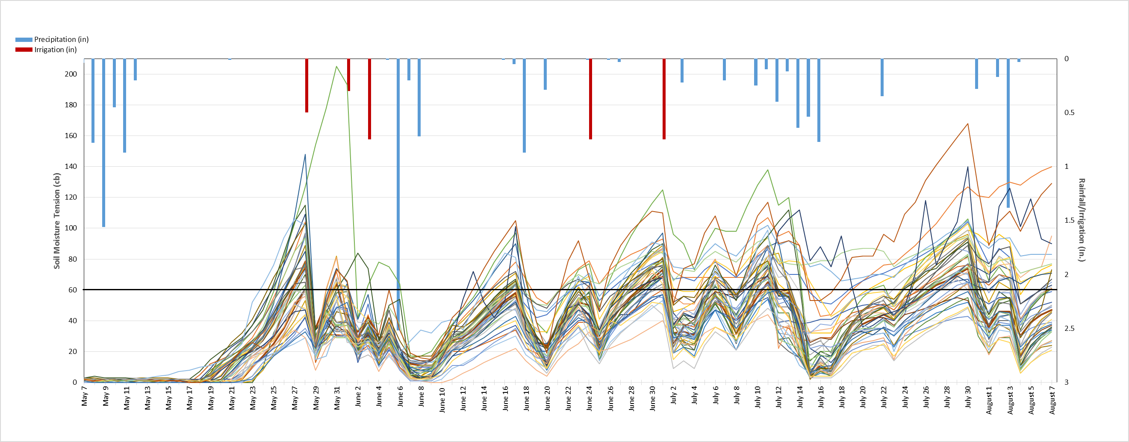
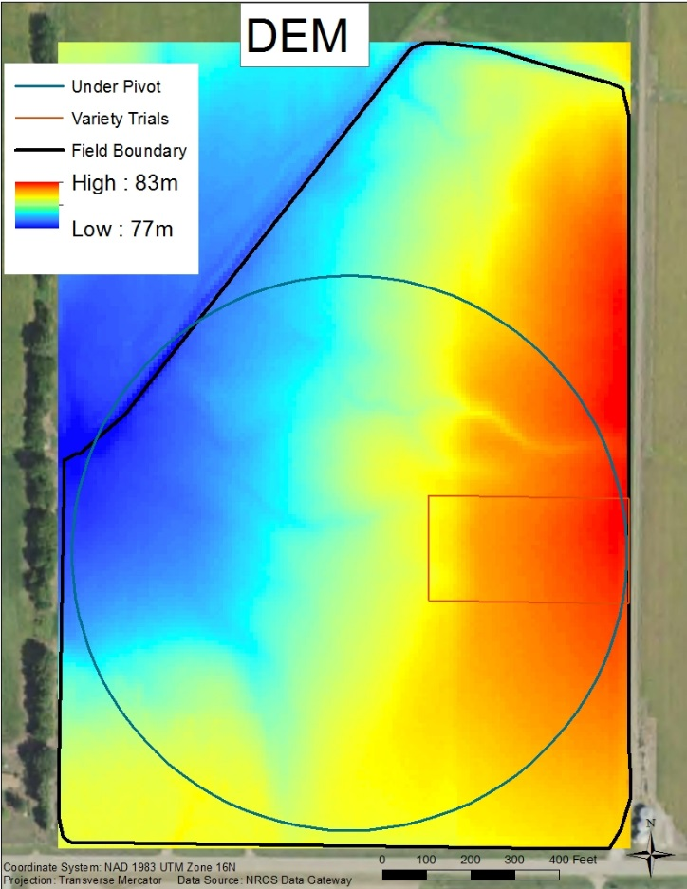
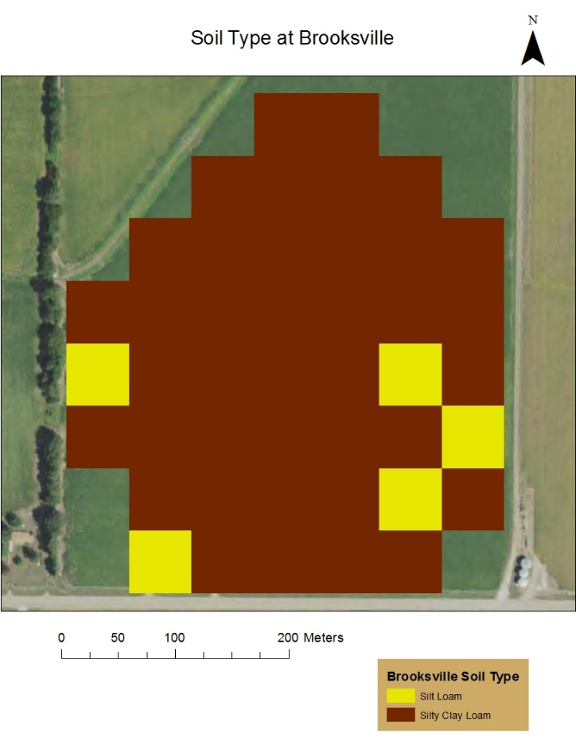
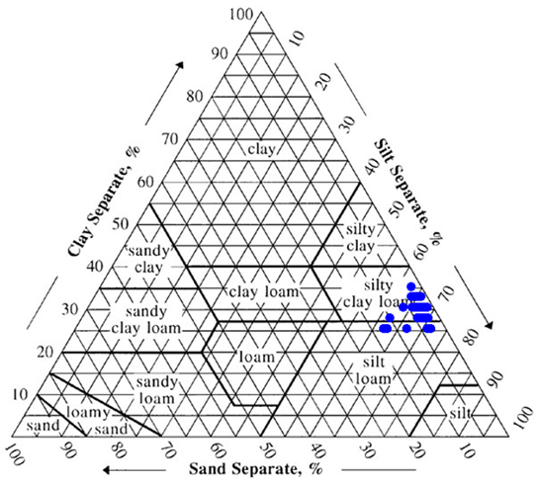
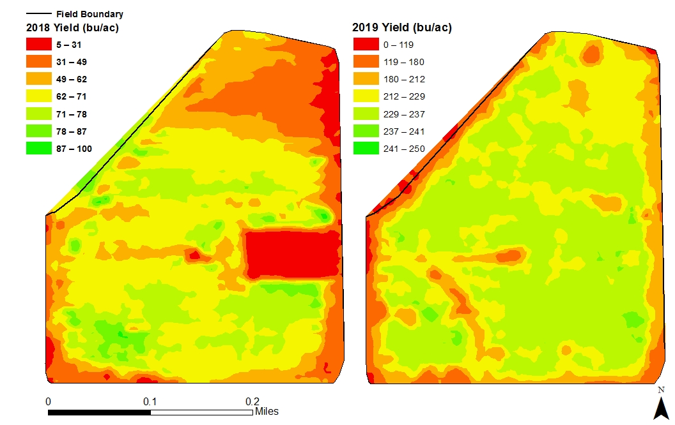
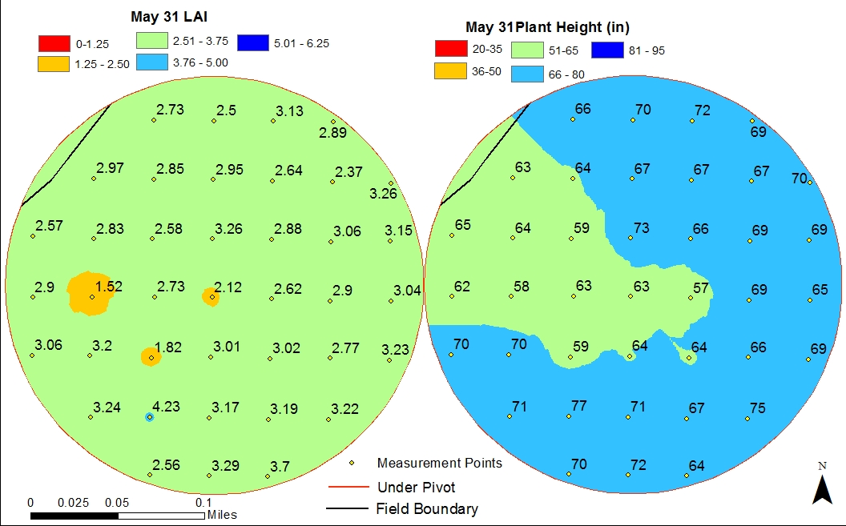
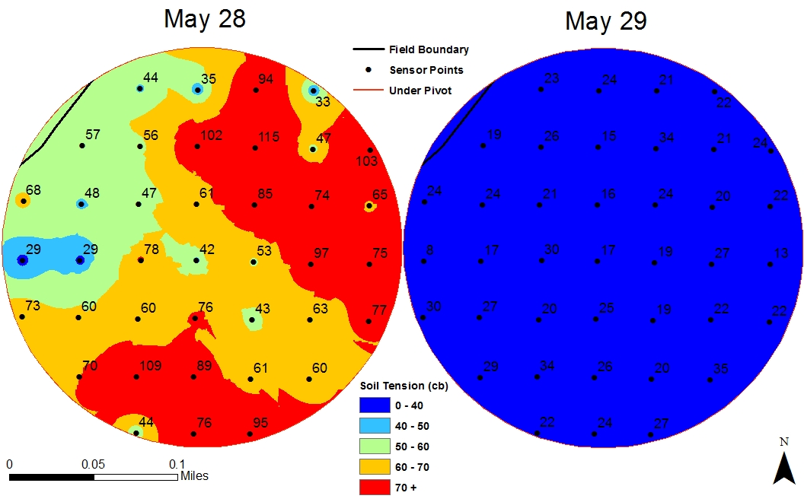
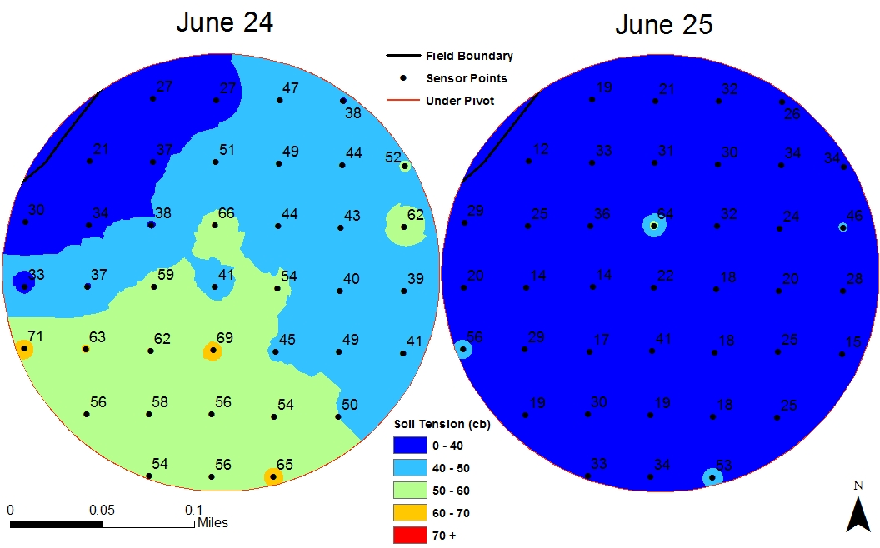
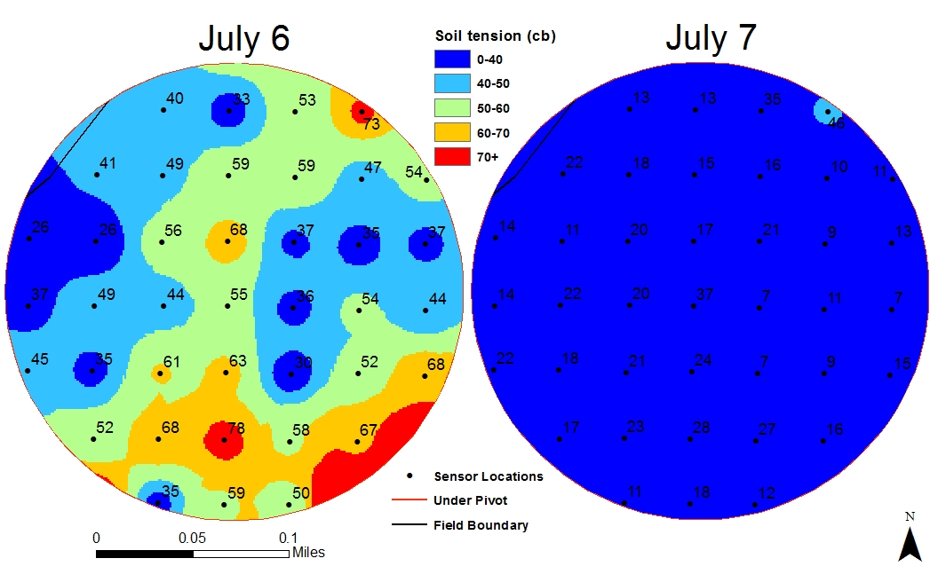
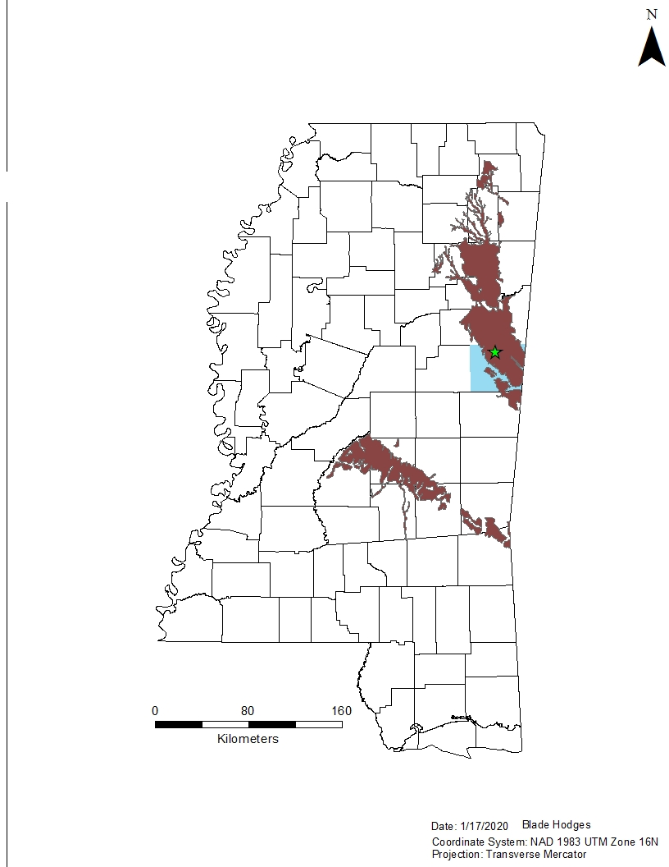
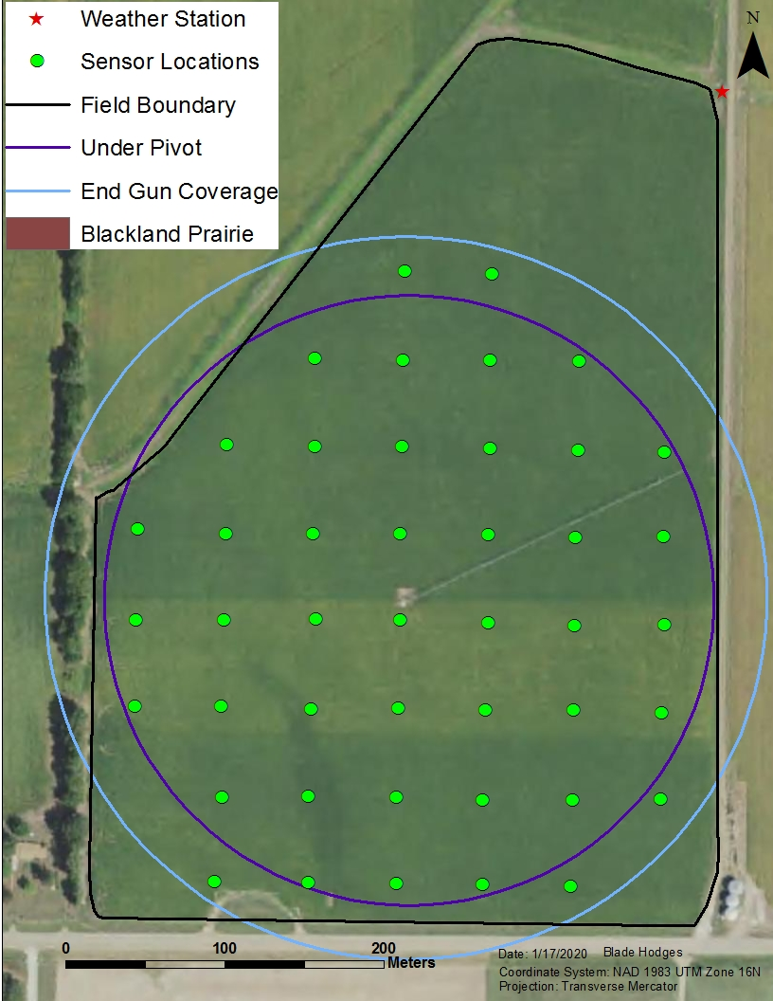
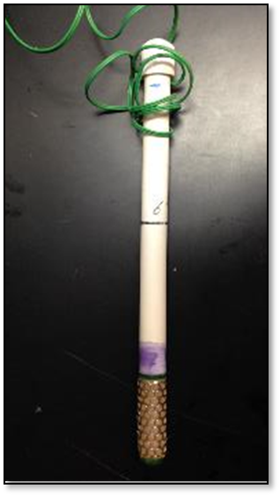
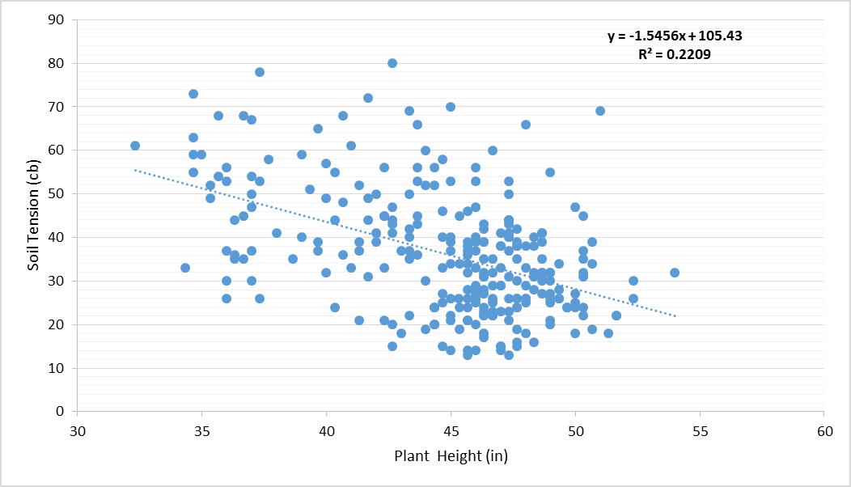
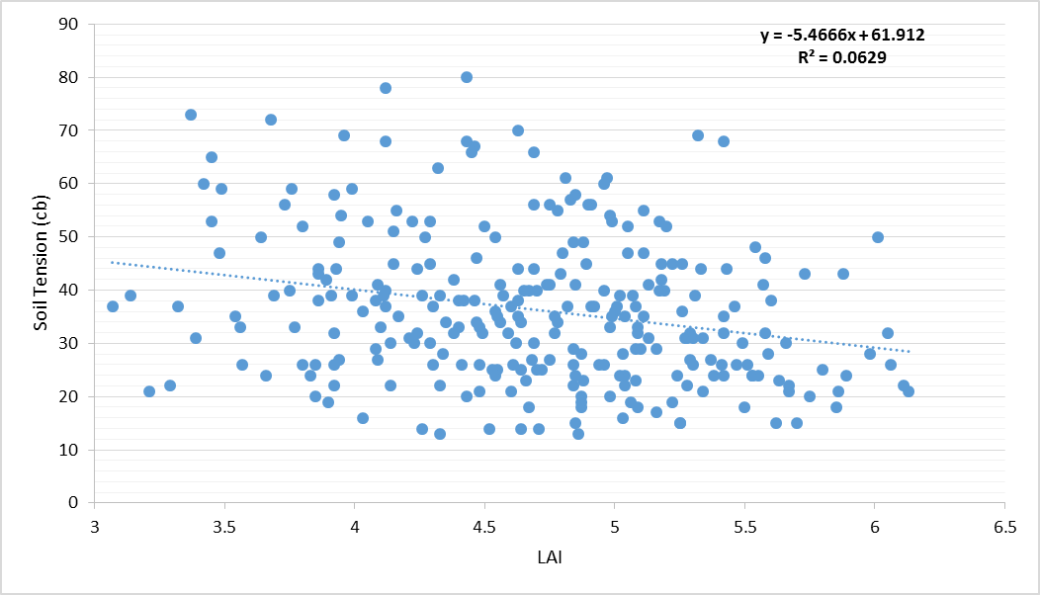
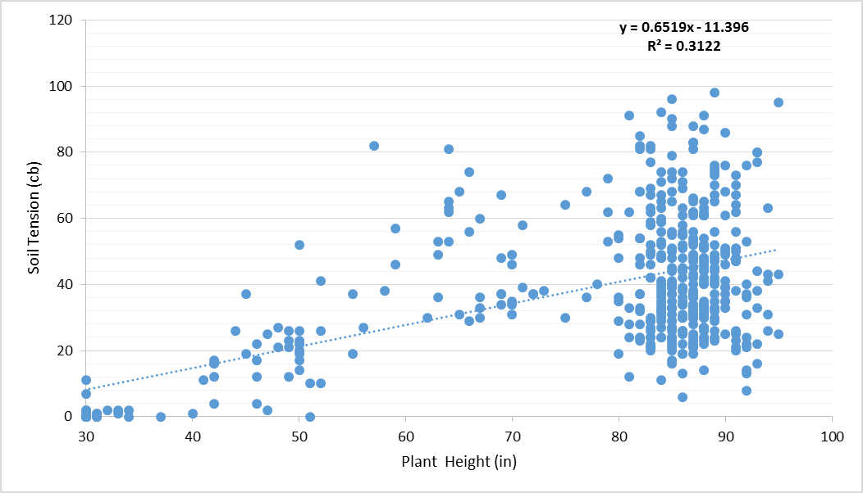
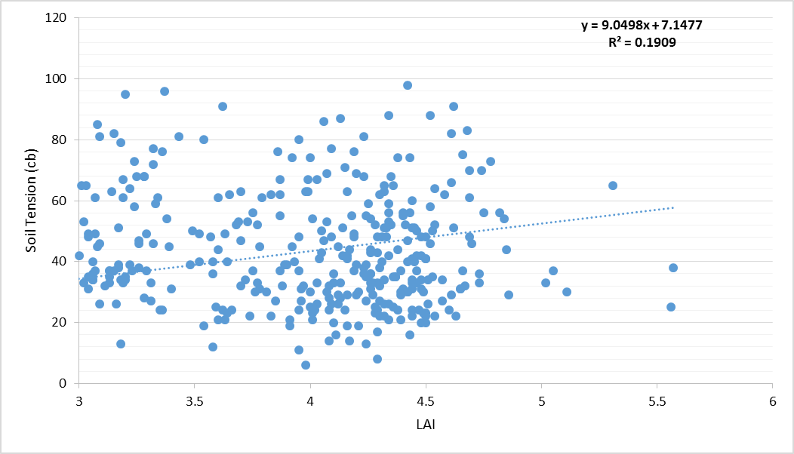
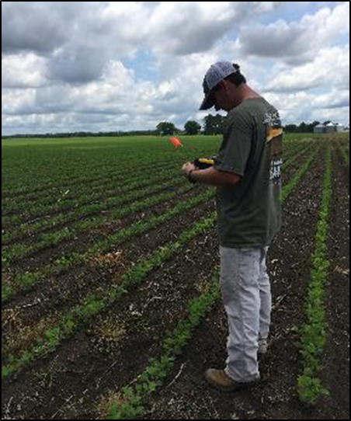
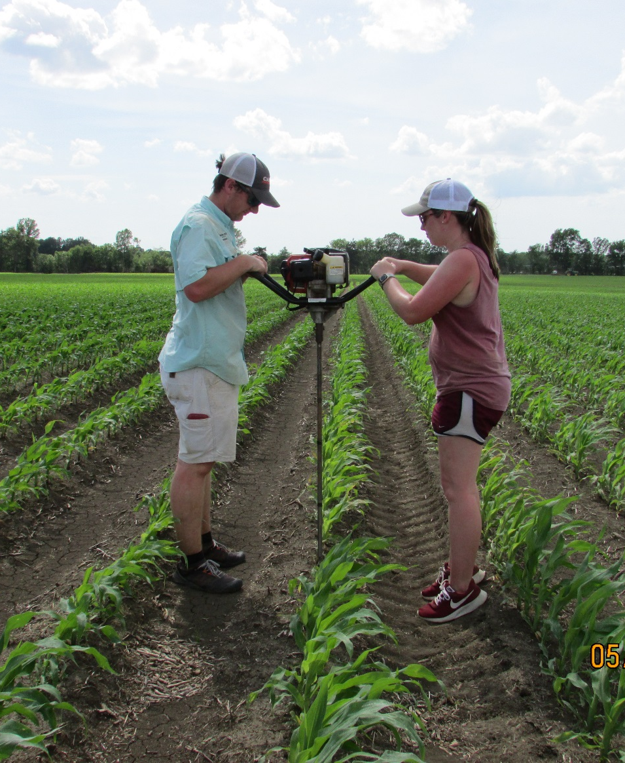
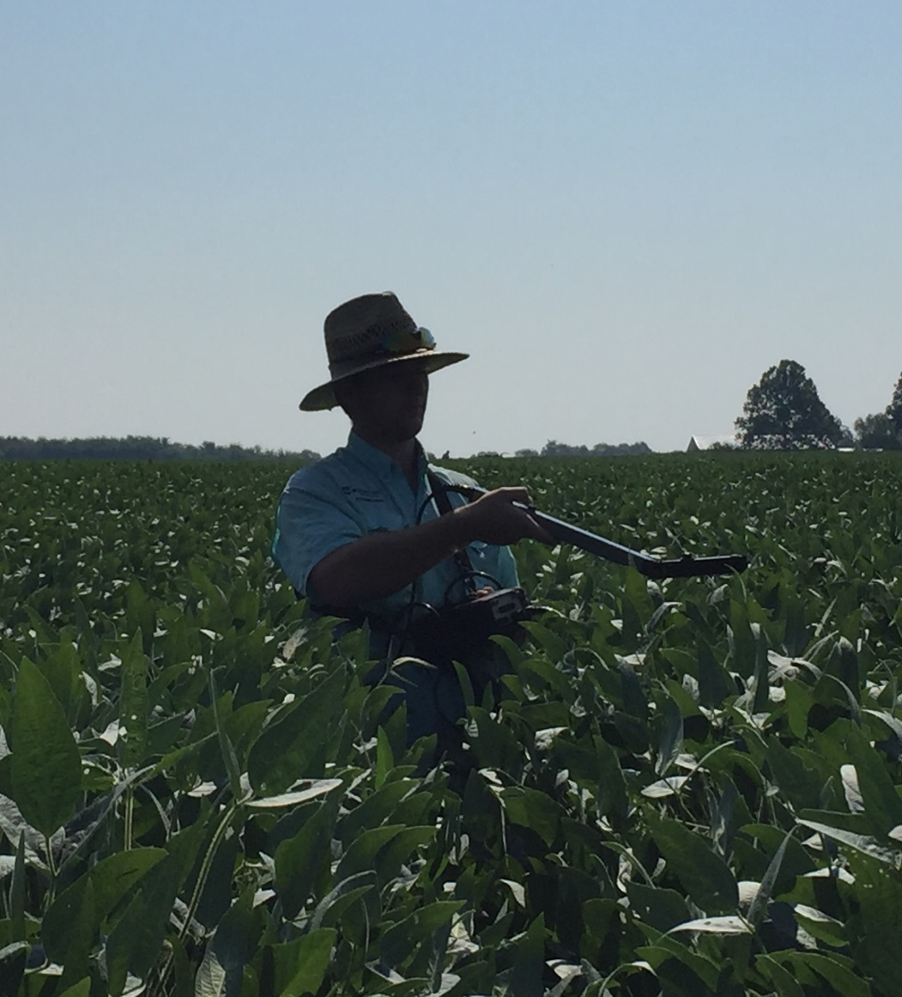
Evaluating In Field Soil Moisture Variability and Factors Affecting It
B.C. Hodges¹, M.L. Tagert², J.O. Paz¹, and D. B. Reginelli³
Department of Agricultural and Biological Engineering¹, Mississippi State University Extension Service²,
Mississippi Soybean Promotion Board³
Background
There have been numerous studies characterizing and estimating soil moisture, particularly as it relates to irrigation, but most of this work has focused only on the top portion of the soil profile. Due to heterogeneous soils and variability of vegetation and topography, soil moisture can be variable over space and time, making irrigation decisions a challenge at times. In Northeast Mississippi, producers must conserve water due to limited surface water sources and deep ground water sources that are expensive to access. In Mississippi, Watermark Granular Matrix Sensors (GMS) are commonly used to determine irrigation timing because they are relatively inexpensive and easy to use. Soil moisture sensors have been shown to decrease water usage while maintaining yields, and even sometimes boost yields because of a better understanding of plant water needs. Questions remain about the best placement and density of these sensors across a field. Where do producers place the sensors, and how many do they need for the most efficient irrigation applications?
Results
Project Objectives
1. Measure in-field spatial and temporal variability of soil moisture in the active rooting zone using Watermark GMS sensors.
2. Evaluate the correlation of root zone soil moisture to soil texture, topography, and vegetative characteristics.
Determine if the variability of in-field soil moisture is great enough to indicate a different irrigation schedule for different areas of the field.
Figure 8. Soil water tension (cb) in the active rooting zone at each point from May 7 to August 7 with rainfall and irrigation events during that time.
Study Site and Methodology
The study has been conducted during the 2018 and 2019 growing seasons on an 18-ha production field in a soybean/corn rotation under center pivot irrigation near Brooksville, MS. The producer allowed us to use the field as we needed to execute our study. He also provided us with information about his management practices, gave us remote access to monitor the flow meter attached to the pivot, and supplied yield data from the field. Watermark GMS sensors were used to measure soil water tension under the pivot at 12- and 24-inch depths in 2018 for the soybean crop; an additional sensor was added at 30 inches in 2019 for the corn crop. Farm Works software was utilized on a Trimble Yuma tablet to create and traverse a 55-m grid. The sensor sets were installed at the center point of each grid cell, resulting in 44 point locations irrigated by the pivot. Sensors were installed between May 23 and June 15 for the 2018 growing season and on May 2 for the 2019 growing season. The sensors were connected to a data logger which recorded hourly soil tension measurements. Each week during the growing season, soil tension measurements were downloaded from the data loggers, and leaf area index (LAI) and plant height measurements were recorded for each grid cell. In addition, 24-inch composite soil samples were collected and analyzed for each grid cell, to determine the soil texture throughout the soybean active rooting zone. The producer was given soil moisture maps from the field and soil analysis results. Interpolation maps were created to show the spatial variability of the LAI, plant height, and soil tension across the field using inverse distance weighted (IDW) interpolation in ArcMap. Also, the measured data from LAI, plant height, and soil tension were used in scatter plots to model the relationships between the variables. The data from five points irrigated only by the end gun of the pivot were removed from the analysis because they were not receiving the same amount of irrigation water and were acting as outliers in the data.
Figure 9. DEM of field.
Figure 10. Soil texture.
Figure 11. 2018 and 2019 Yield maps.
Figure 12. LAI and plant height on May 31, 2019.
Figure 13. Soil tension measurements before and after May 28, 2019 irrigation event.
Figure 14. Soil tension measurements before and after June 24, 2019 irrigation event.
Figure 15. Soil tension measurements before and after July 6, 2018 irrigation event.
Figure 16. Soil tension vs plant height for 2018 soybean growing season.
Figure 17. Soil Tension VS LAI for 2018 soybean growing season.
Figure 18. Soil tension vs plant height for 2019 corn growing season.
Figure 19. Soil Tension VS LAI for 2019 corn growing season.
Conclusions
The digital elevation model (DEM) in Fig. 9 represents the topography of the field. There is a relatively large elevation difference of 6 meters between the highest and lowest points in the field. Fig. 10 shows the primary soil type, which is silty clay loam. The field has a homogenous soil type over the majority of the field, with a secondary soil type of silty loam. As a result, it is assumed that soil texture would have a relatively uniform effect on soil water tension throughout the field. Soil texture results are mapped on the soil texture triangle in Fig. 10, showing the similarity in texture for all grid cells. Yield data for 2018 and 2019 is shown in Fig. 11, where the pivot circle is defined by higher yielding areas. Also, a valley in the southwest quadrant of the field had a negative effect on yield in 2019. More spatial variability is shown in Figs. 12 - 14 across the field before the irrigation event when soils are drier than after the irrigation application, which is a trend observed over both growing seasons. Results to date show different areas of the field that could be grouped together as management zones. In addition, one set of sensors may not be sufficient for irrigation scheduling, even over a field with homogenous soils. While neither relationship is strong, year 1 soybean and year 2 corn data show that plant height has a stronger correlation than LAI with soil water tension according to the graphs in Figs. 16 - 19. In addition, the producer may benefit from Variable Rate Irrigation (VRI), which would apply needed water to plants in drier areas of the field and less water to the plants in already wet areas. Precision VRI can cut energy costs, increase production, and conserve water, but more in-depth economic research must be done on a field by field basis to make this decision.
Figure 1. Study area and sampling points.
Figure 2. Watermark GMS soil moisture sensor.
Figure 3. Watermark 900m data logger with sensors.
Figure 4. Flagging the field in 2018 using the Trimble Yuma .
Figure 5. Drilling holes for sensor installation in 2019 with 7/8” drill bit.
Figure 6. Recording LAI measurements in 2018.
Funding Agencies
Future Work
Year 1 and 2 data show that soil moisture varies over the field throughout the growing season, and future work will determine the best indicator of soil moisture variability by applying more robust statistical analysis. The DSSAT suite of crop models is being utilized to model different irrigation schedules over multiple areas of the field.
Figure 7. Study site being irrigated by center pivot.

