Slide 1
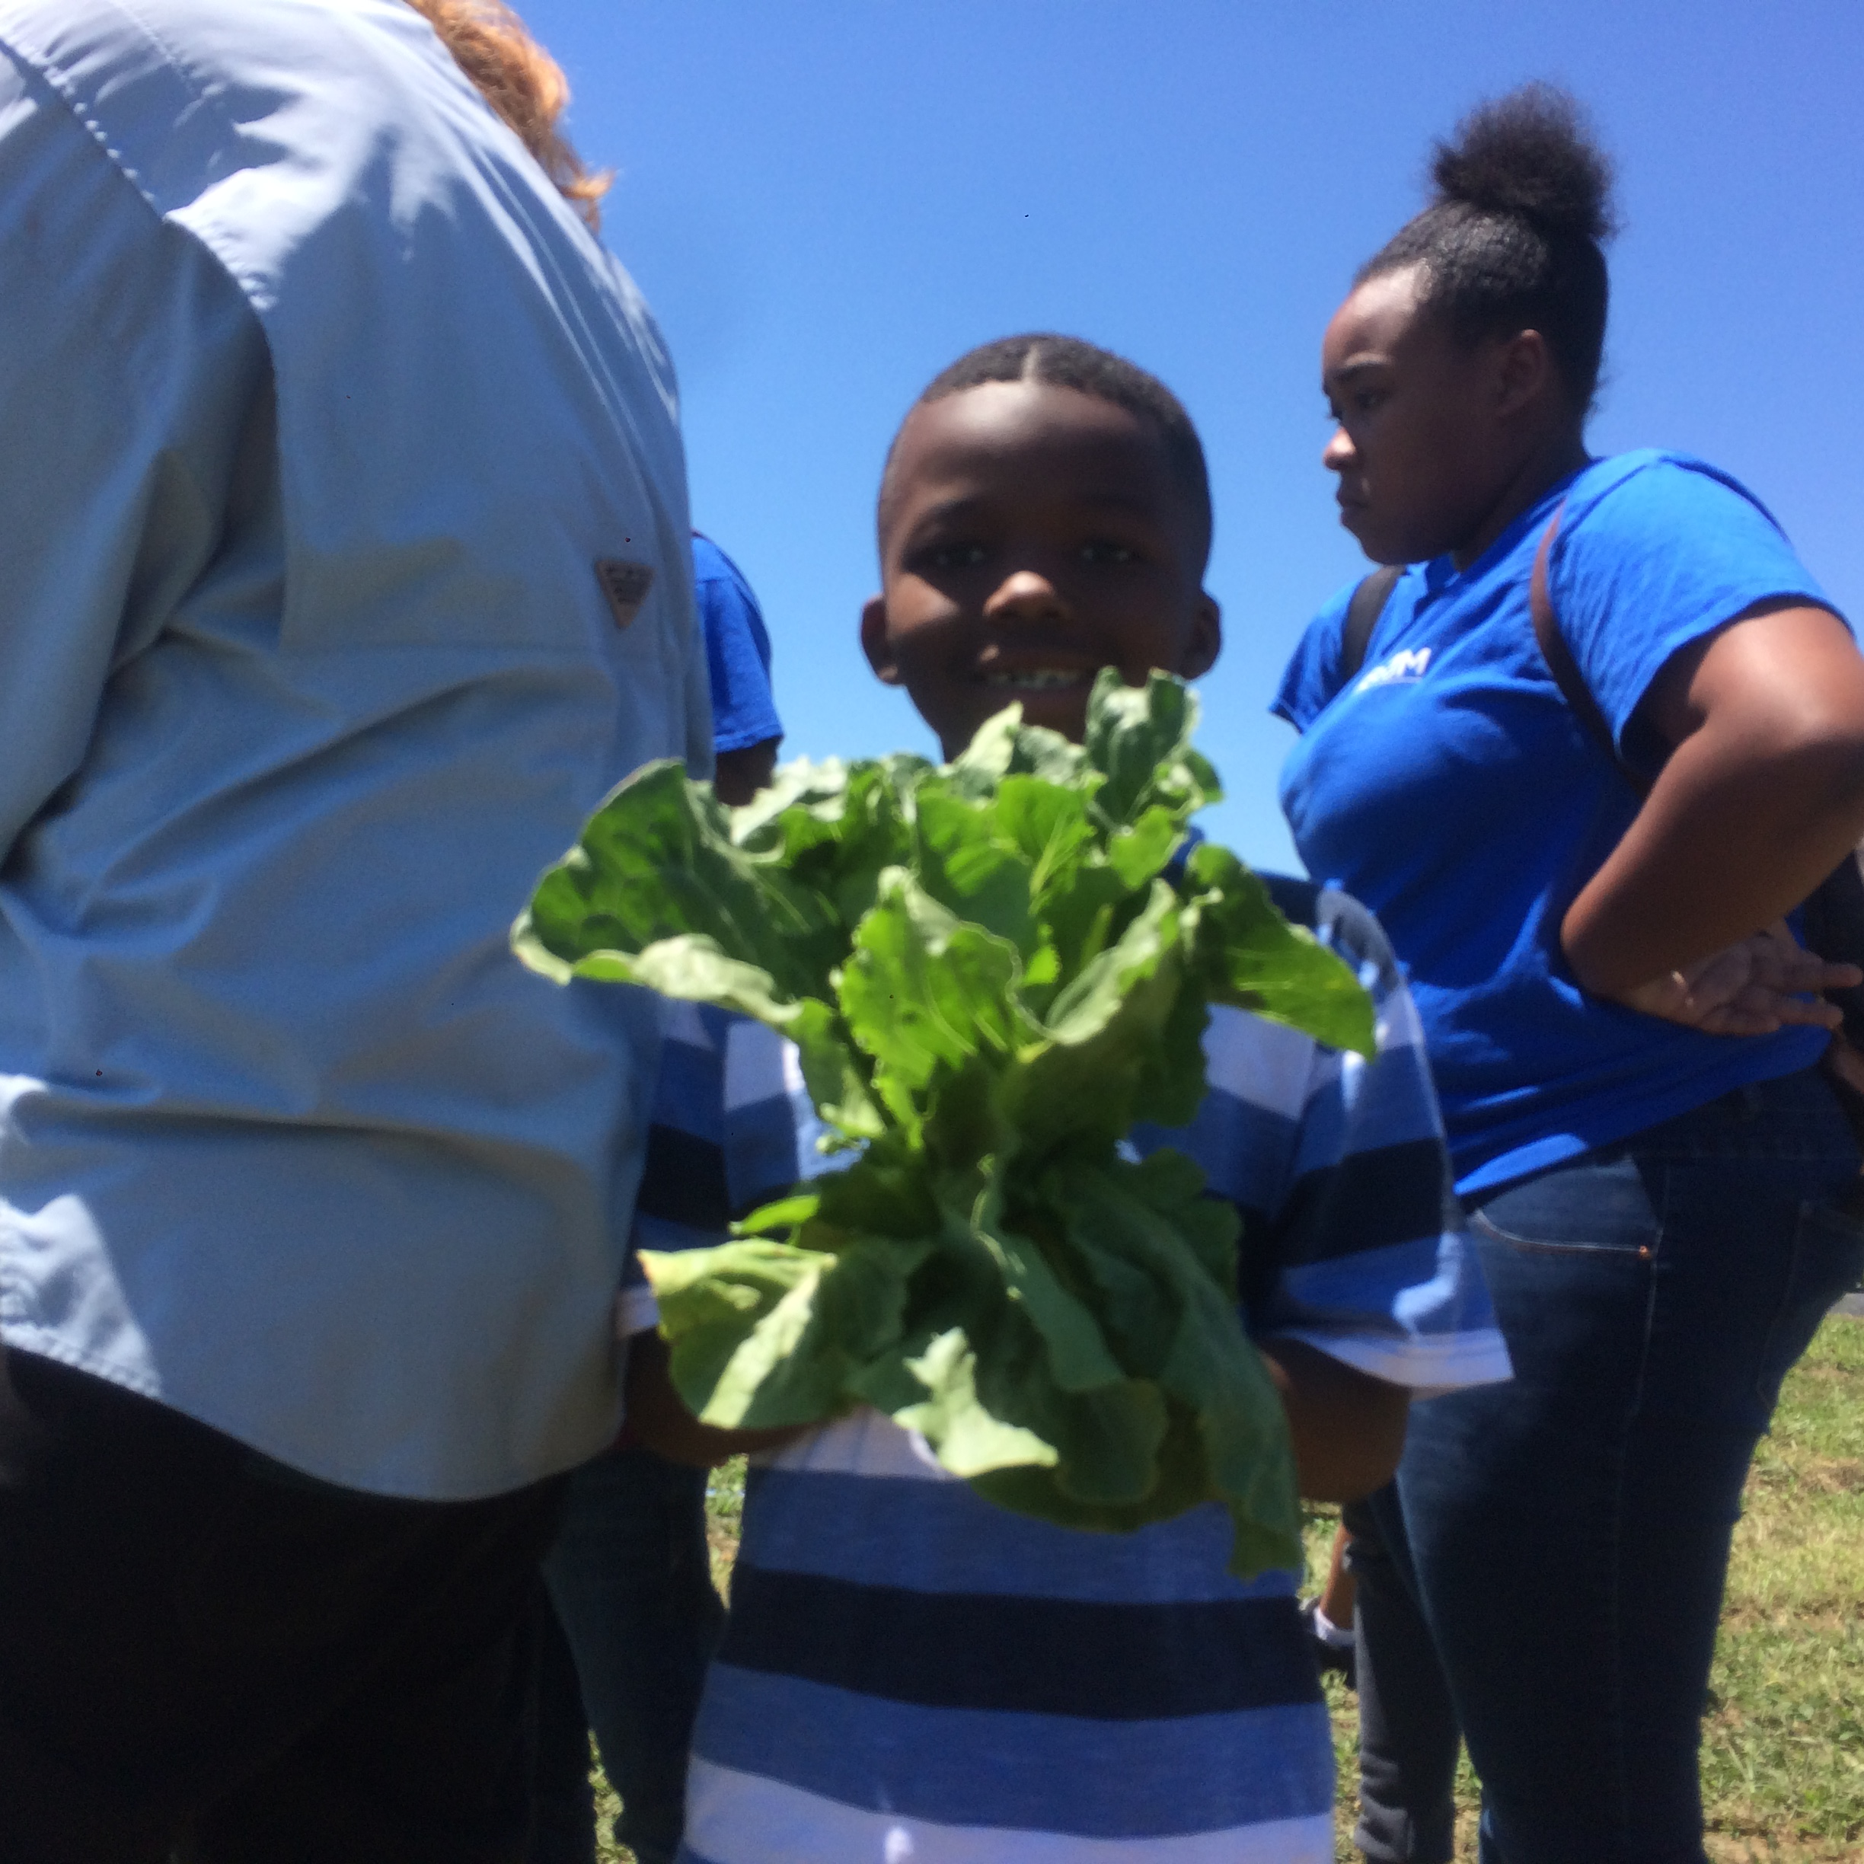
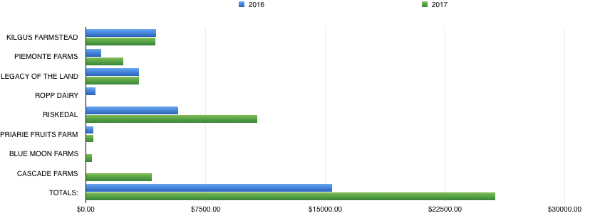

SARE/ATTRA Our Farms Our Future Conference
FNC17-1101
Ann Swanson
Increasing the Use of Farm Fresh Food in Institutional Settings by Educating Chefs, Youth, and Local Farmers Through Demonstrations, Workshops, and Visual References
Summary of Project
I am providing farm to table education to foodservice providers, youth, farmers and the local community to encourage moving away from prepackaged, pre-processed, unhealthy food that institutionalized kitchens often provide while also creating awareness of the importance of supporting local farms in the community.
First Year Results
Hendrick House increased local food sales, supporting other farms, by 60% from fall of 2016 to fall of 2017. This increase is due to a wider knowledge of the handling and preparation of local food from foodservice workers within the company and also new markets available to local farms. This also shows the willingness of local farmers to become more comfortable meeting large scale demand from high production kitchens.
Youth workshops held at the farm with DREAAM House where children ages pre K – 3rd grade learned how to identify fresh vegetables and make easy snacks out of their harvest.
Visual Reference Guide for Food Service Workers
I produced a workbook given to 25 head cooks that assisted in the education of foodservice workers within the company. The workbook has pictures of produce coming directly from Hendrick House Farm so the cooks are able to identify size and color of produce they will be receiving. It also provides proper storage information, facts about the variety of vegetable and recipe ideas on how to prepare them. This workbook has been shared with SARE and The Land Connection to be used as an educational guide for the community.
Workbook produced for foodservice workers to be used as an educational tool for handling Hendrick House Farm Produce.
This chart tracks local food purchases made by Hendrick House in 2016 and 2017. Each of the farms listed on the left side of the graph are farms in the Champaign, Urbana area that supply local produce to Hendrick House.
This project is supported by the National Institute of Food and Agriculture, U.S. Department of Agriculture, under award number XXXX-XXXXX-XXXXX through the North Central Region Sustainable Agriculture Research and Education program under subaward number FNCXX-XXX. Any opinions, findings, conclusions, or recommendations expressed in this publication are those of the author(s) and do not necessarily reflect the view of the U.S. Department of Agriculture or SARE. USDA is an equal opportunity employer and service provider.

