Slide 1
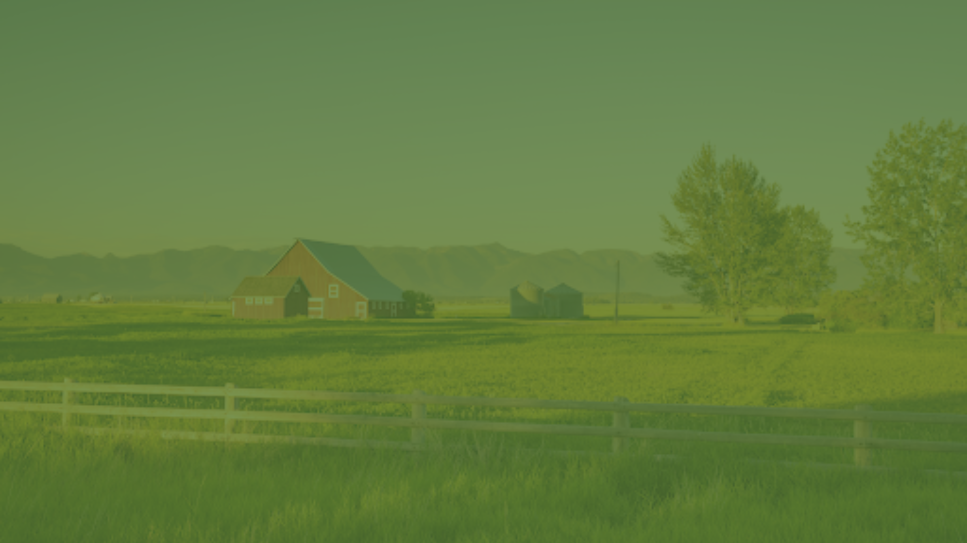
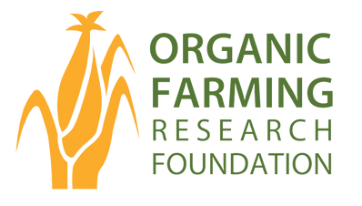
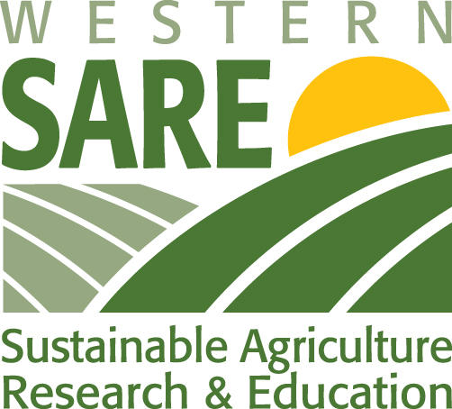
Organic 101 for Extension Agents:
Understanding Certification, Standards, and Producer Journeys
ORGANIC FARMING RESEARCH FOUNDATION
January 29, 2026, 1pm ET
Notes:
welcome webinar attendees and introduce topic. Share with attendees that certified crop advisor continuing education credits will be available (QR code to scan at the end of the webinar).
This webinar is a part of a Western SARE Professional Development project in partnership with Oregon Tilth and eOrganic.

Slide 2

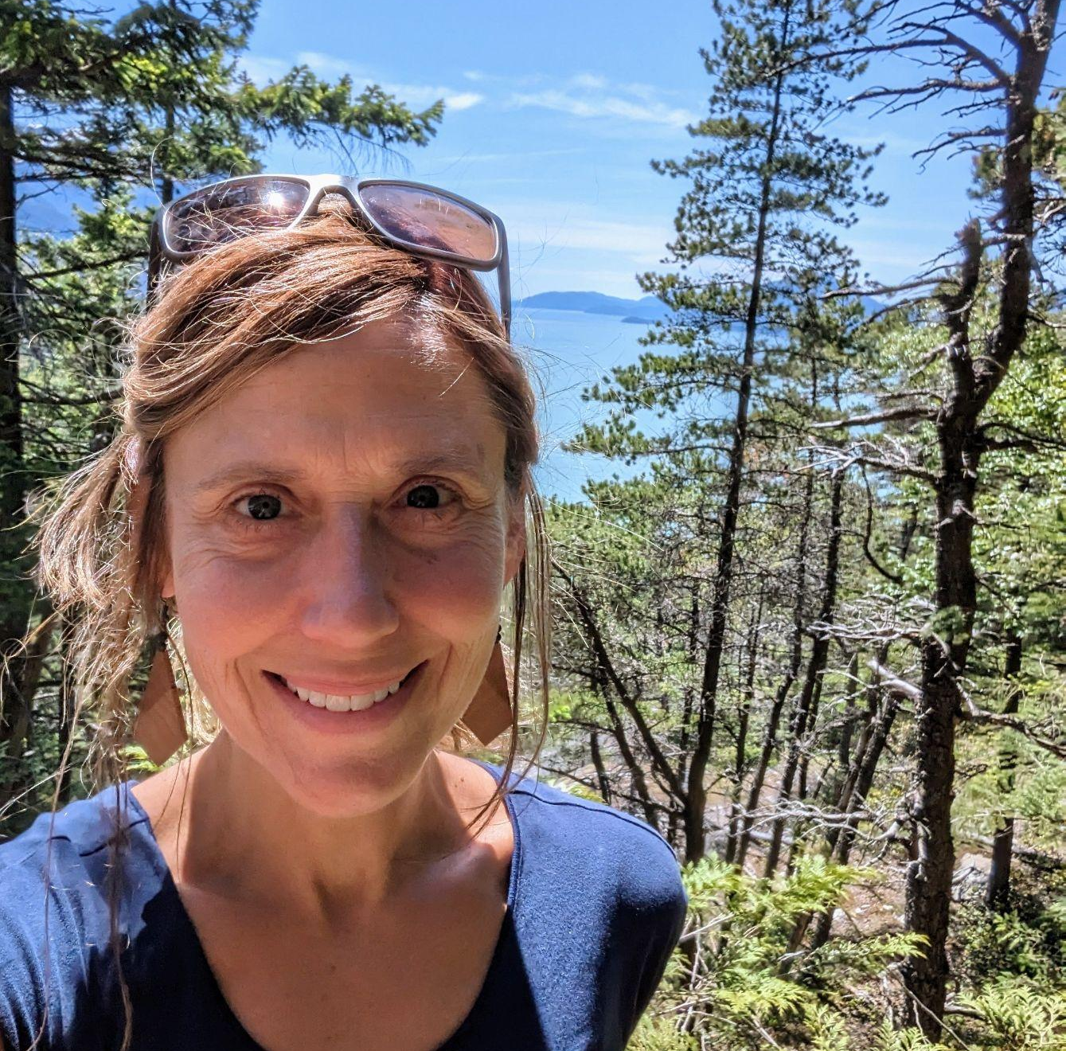
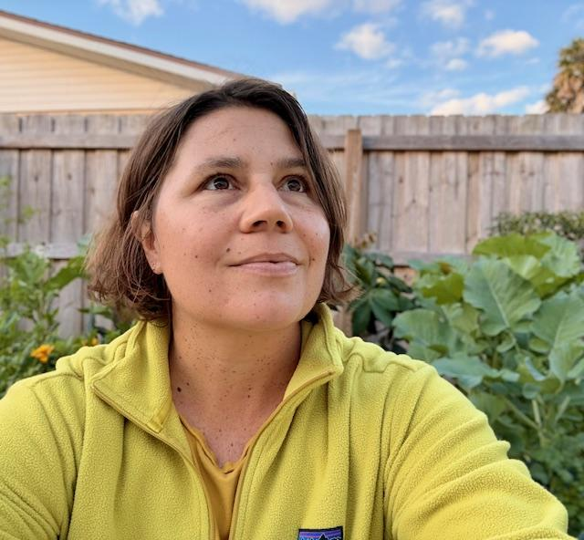
Rebecca Champagne, PhD
Conservation Scientist
Presenter
Heather Estrada, PhD
Research & Education Senior Scientist
Moderator
Mary Hathaway, MS
Research & Education Program Manager
Moderator
Notes:
Mary - brief intro of todays moderators/presenters.

Slide 3
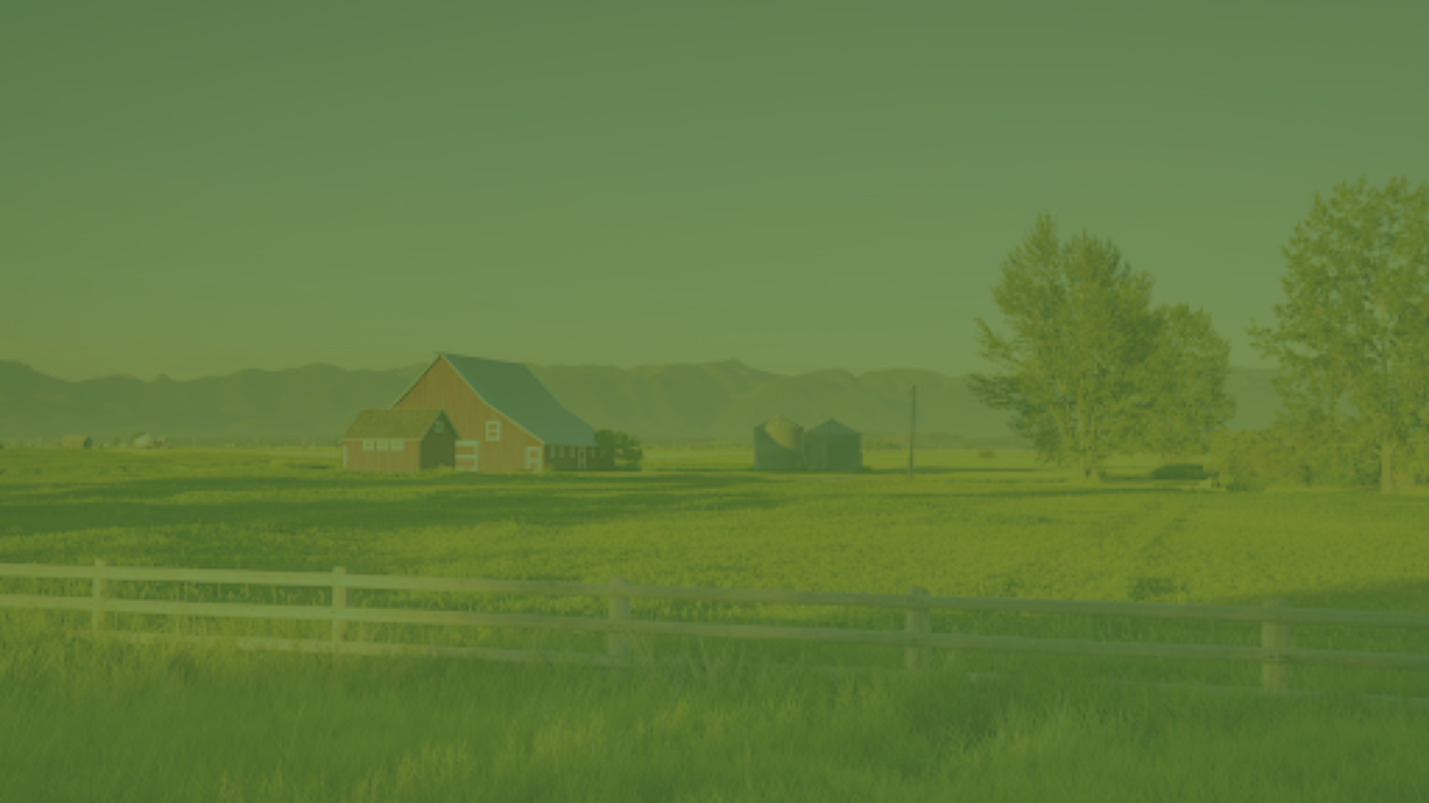

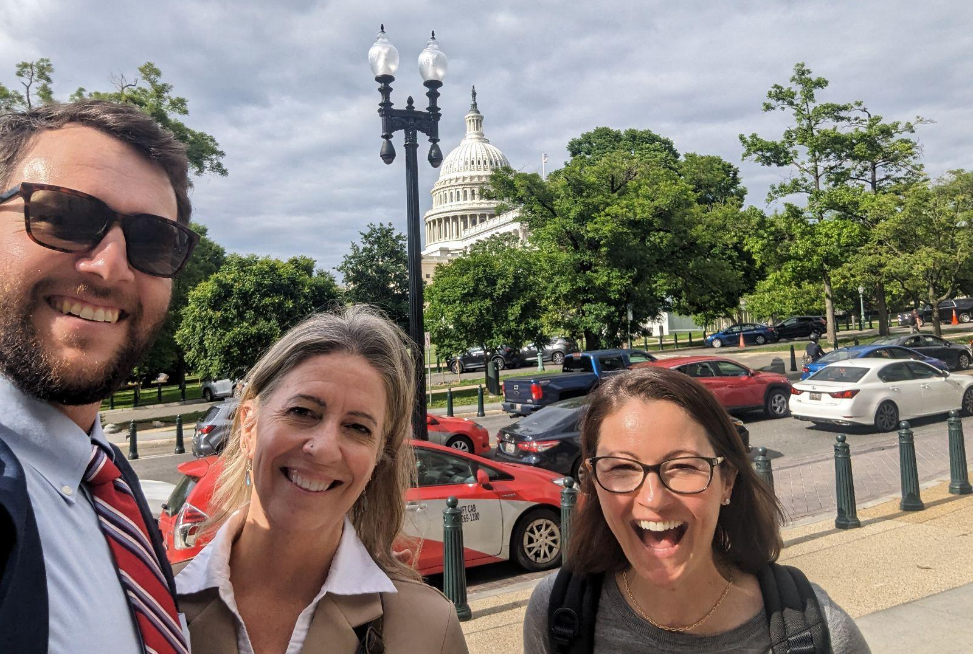
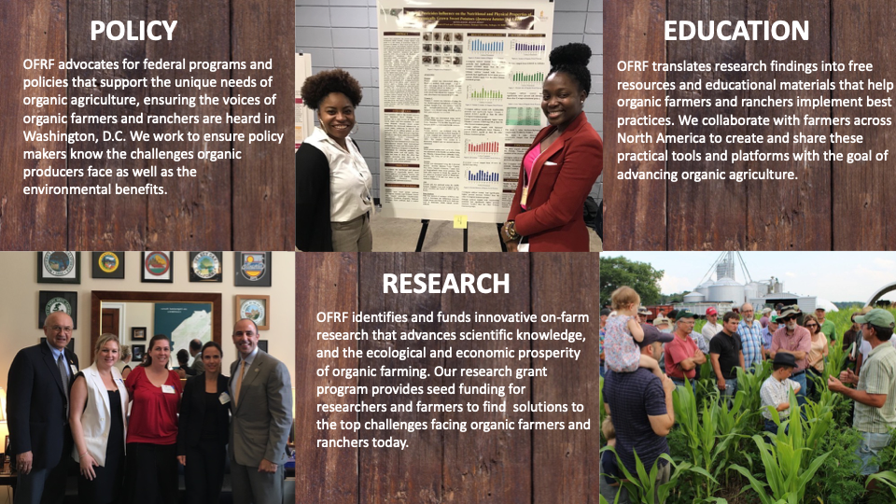
Organic Farming Research Foundation
ADVOCACY
RESEARCH
EDUCATION
OFRF advocates for federal programs and policies that support the unique needs of organic agriculture, ensuring the voices of organic farmers and ranchers are heard in Washington, D.C. We work to ensure policy makers know the challenges organic producers face as well as the environmental benefits.
OFRF identifies and funds innovative on-farm research that advances scientific knowledge, and the ecological and economic prosperity of organic farming. Our research grant program provides seed funding for researchers and farmers to find solutions to the top challenges facing organic farmers and ranchers today.
OFRF translates research findings into free resources and educational materials that help organic farmers and ranchers implement best practices. We collaborate with farmers across North America to create and share these practical tools and platforms with the goal of advancing organic agriculture.
Notes:
Mary - Brief introduction of OFRF -
Organic Farming Research Foundation (OFRF), a non-profit organization founded in 1990, advance organic agriculture through scientific research.
we work to foster the improvement and widespread adoption of organic farming systems
We make our impact in three key arenas -
Our Research work has been our foundation - From the beginning, OFRF has worked to ensure that there is funding for organic research that advances scientific knowledge and improves the practices, ecological sustainability, and economic prosperity of organic farming.
Providing educational resources is also an important part of our mission. We work hard to make sure that cutting edge organic research is available in applicable and actionable resources for farmers. These educational resources include guidebooks, online courses, factsheets, webinars and more. All of our educational materials are online and available for free.
Our third core area is advocating for federal programs and policies that support the unique needs of organic agriculture and working to ensure the voices of organic farmers and ranchers are heard in Washington, DC. OFRF has been instrumental in securing federal funding for policies and programs that support organic farmers.

Slide 4
Introduction
What is Organic?
What is the NOP?
Compliance basics
Notes:
Rebecca

Slide 5
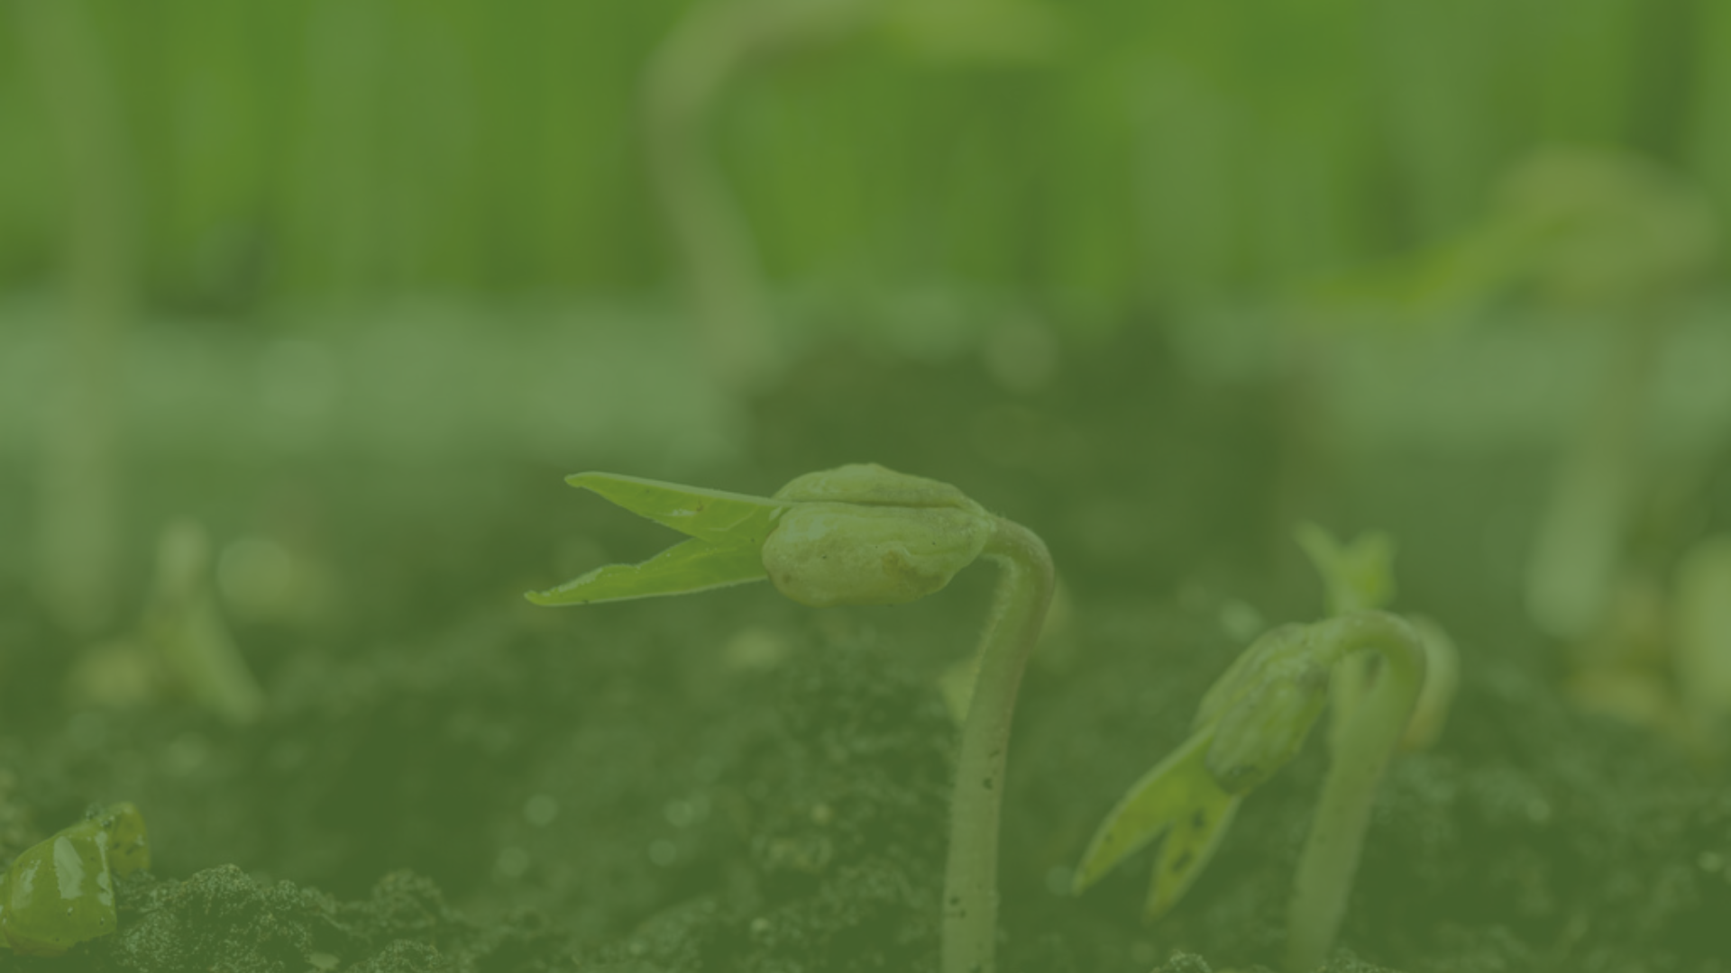
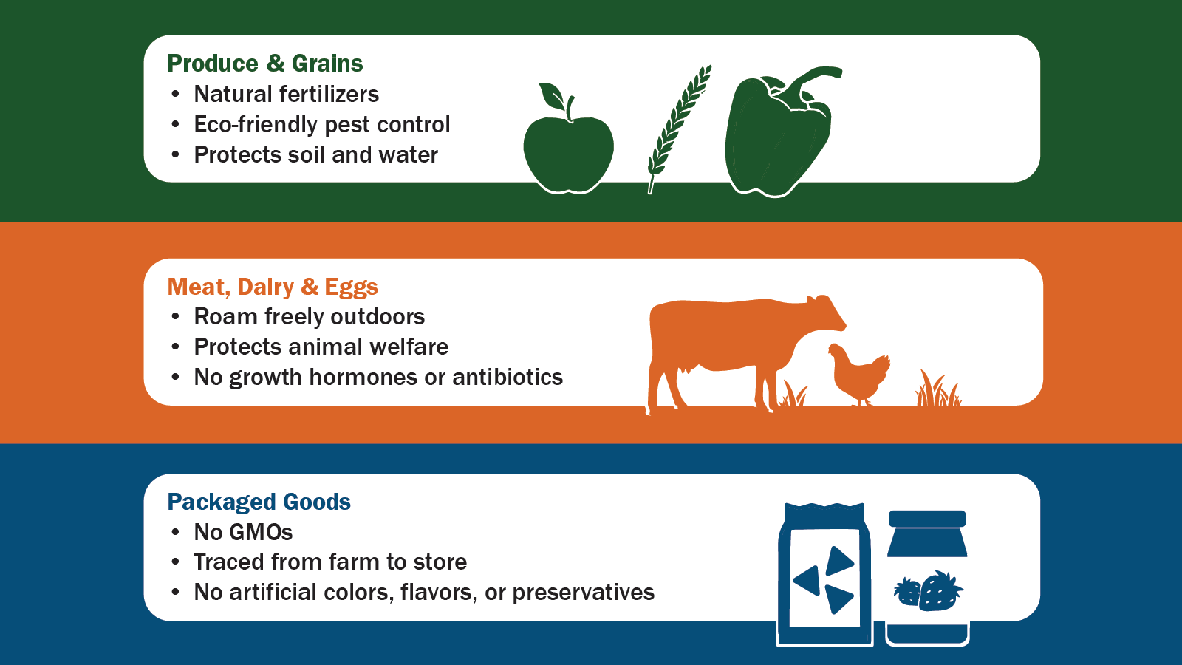
What is Organic?
System focused on healthy soils, plants, people, and environment
Mimics ecological and biological processes
Emphasizes soil health and biodiversity
Image: USDA AMS

Slide 6

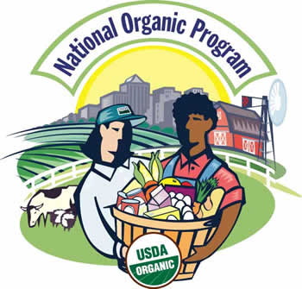
The National Organic Program (NOP)
Develops and enforces the organic standards
  Crops, livestock, products, handling, imports
Investigates complaints of regulation violations
Manages the Organic Integrity Database
Uses input from the National Organic Standards Board (NOSB)

Slide 7
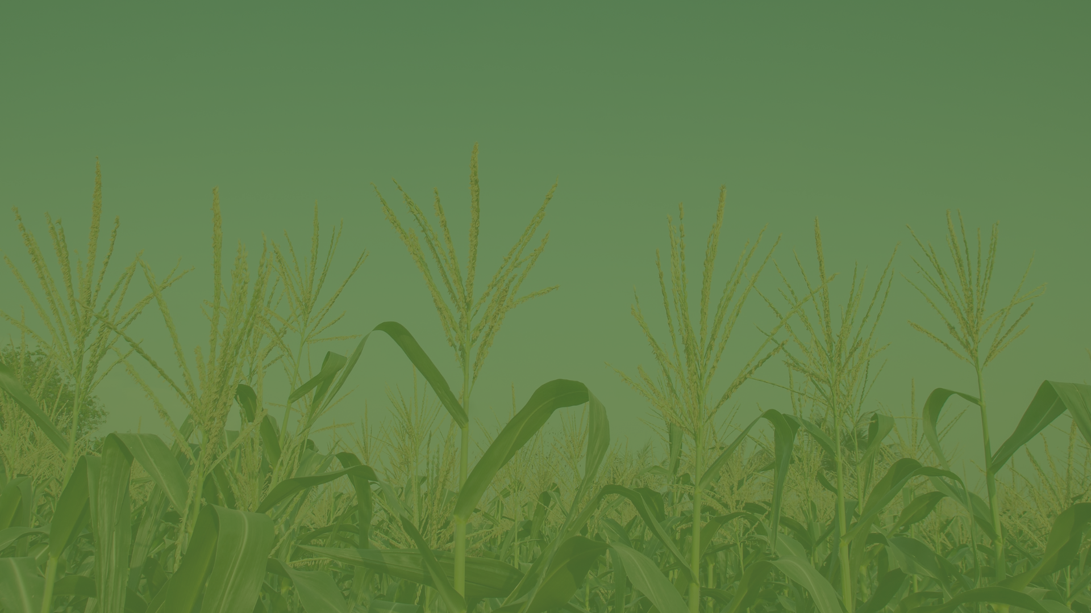
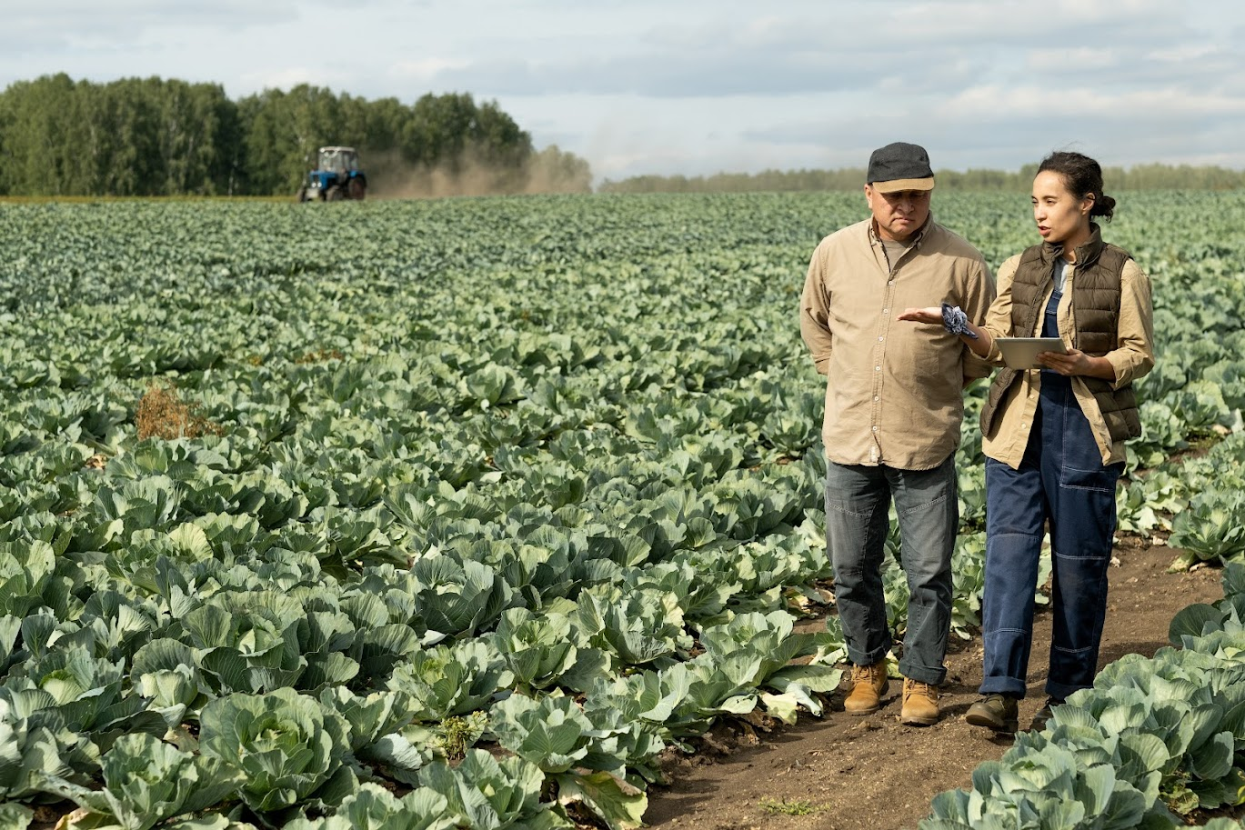
Compliance Basics - Enforcement
NOP accredits certifiers, who must ID and report violations.
Strengthening Organic Enforcement (SOE) rule implemented March 2024
  Minimize fraud in organic chain
AMS “Penalty Matrix”:
  Minor issues
  Notice of Non-compliance
  Major Non-compliance
    suspension of certification
  Major Non-compliance
    revocation of certification

Slide 8
Regional Overview
Organic farms and acreage in the WSARE region
Organic survey information

Slide 9
Organic Agriculture in the WSARE Region
Number of Organic Farms
5,462
across 13 states
Number of Organic Acres 2,292,219
across 13 states
Value of Organic Sales $5,930,768,632
across 13 States
State | No. Organic Farms
California | 3,061
Washington | 730
Oregon | 491
Colorado | 265
Idaho | 245
Montana | 206
Hawaii | 144
New Mexico | 93
Arizona | 62
Wyoming | 60
Utah | 53
Nevada | 43
Alaska | 9
State | Organic Acreage (ac)
California | 813,710
Montana | 319,722
Oregon | 228,152
Idaho | 215,668
Colorado | 190,809
Wyoming | 158,214
Washington | 134,911
Utah | 90,633
Nevada | 81,356
New Mexico | 33,160
Arizona | 22,644
Hawaii | 3,117
Alaska | 123
State | Value of Sales (USD)
California | 3,550,489,000
Washington | 1,139,532,000
Oregon | 386,245,000
Colorado | 252,696,000
Idaho | 219,655,000
Arizona | 162,265,000
New Mexico | 101,608,000
Montana | 49,180,000
Utah | 31,415,000
Wyoming | 20,124,000
Hawaii | 17,497,000
Nevada | 62,632
Alaska | N/A
Source: USDA NASS

Slide 10
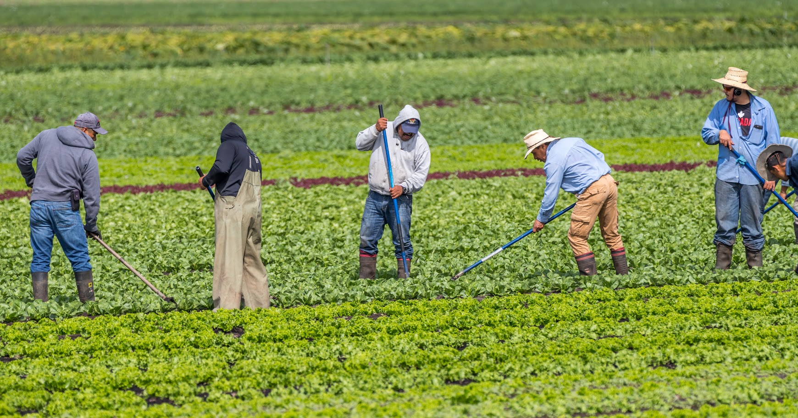
2022 National Organic Research Agenda
Farmers in the Western region identified the following challenges:
  More prolonged droughts
  Need for more farm labor
  Markets for organic products
Technical assistance needs identified:
  Challenges with water limitations
  Weed, pest, and disease management
  Soil fertility and health

Slide 11
Certification Basics
Timeline and process
Recordkeeping basics
What a certifier expects during a farm visit

Slide 12
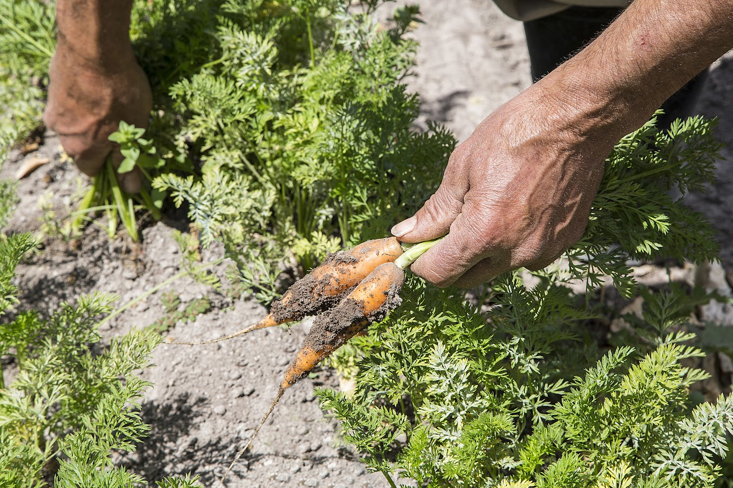
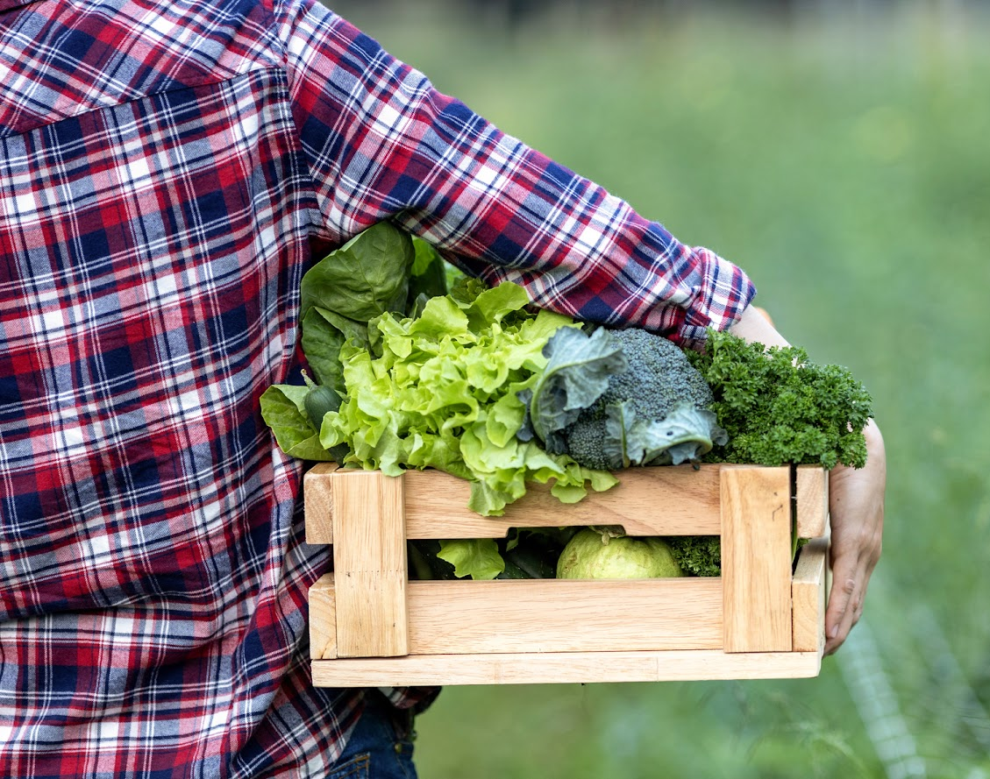
Transitioning Land
Manage land by NOP standards for 36 months with no prohibited substances
  Non-organic pesticides
  Synthetic fertilizers
  GMO and treated seeds
  Reference Organic Materials Review Institute (OMRI)
Timeline can vary
  Land has never been farmed
  Hay field with no inputs for >36 months
  Corn field with herbicide application - 36 months from date of application

Slide 13
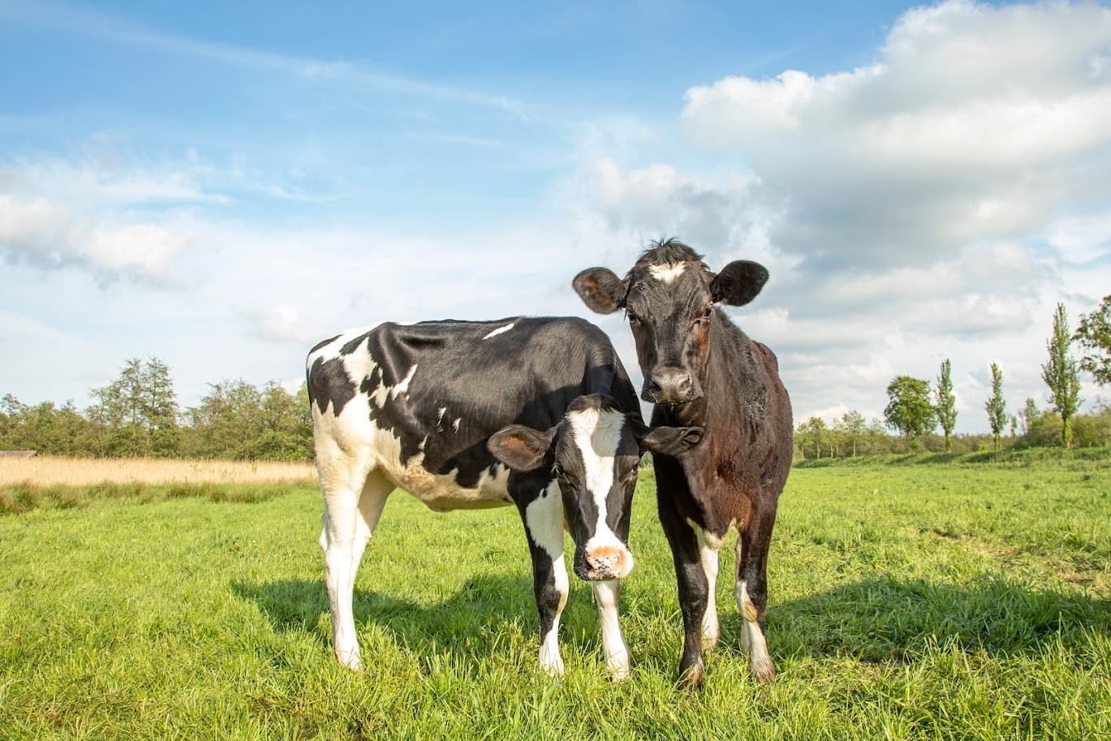
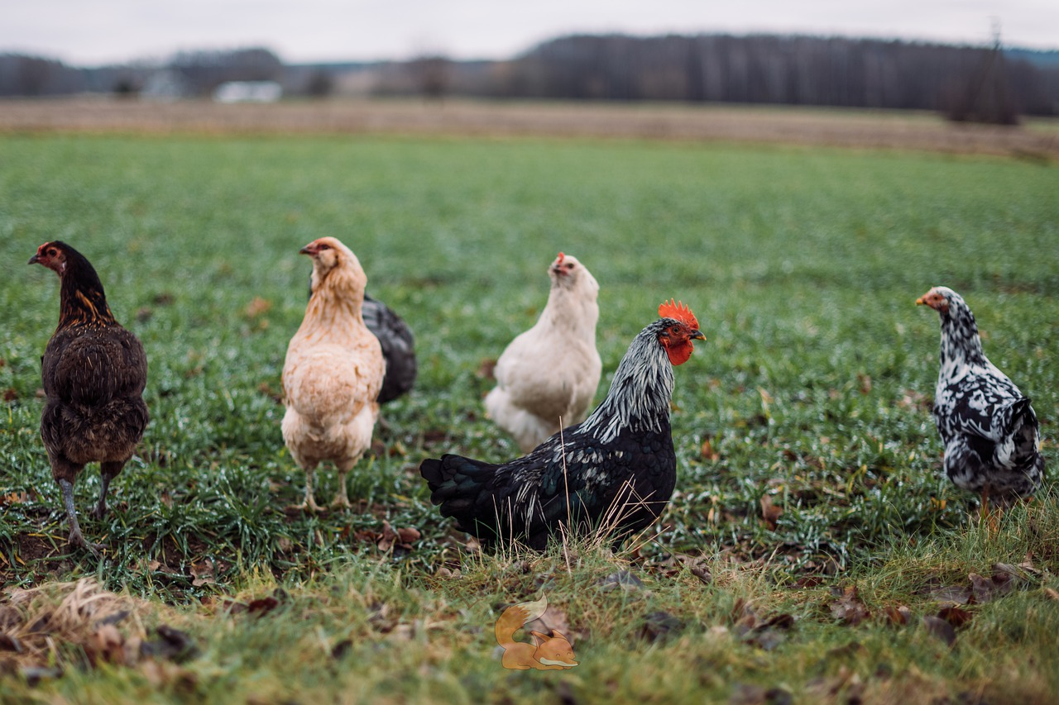
Transitioning Livestock
Milk animals - one year of organic management before products certified
  Organic feed, no antibiotics or growth hormones, pasture/outdoor access and DMI met
Meat and fiber animals - varies
  Starting from at least the last third of gestation - mother must adhere to all organic requirements
  Poultry starting 2nd day of life
  Same requirements as above - feed, outdoor access, etc.

Slide 14
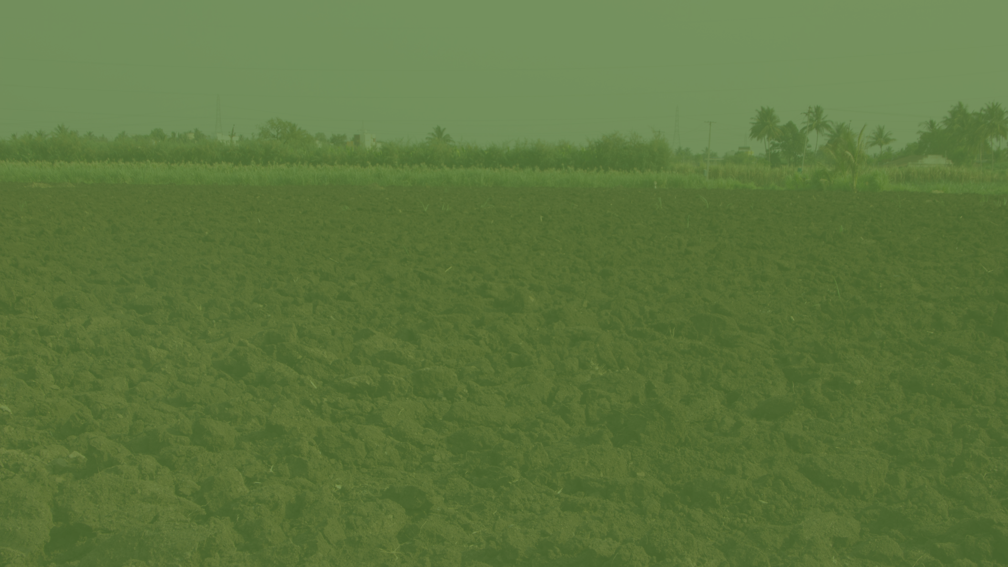
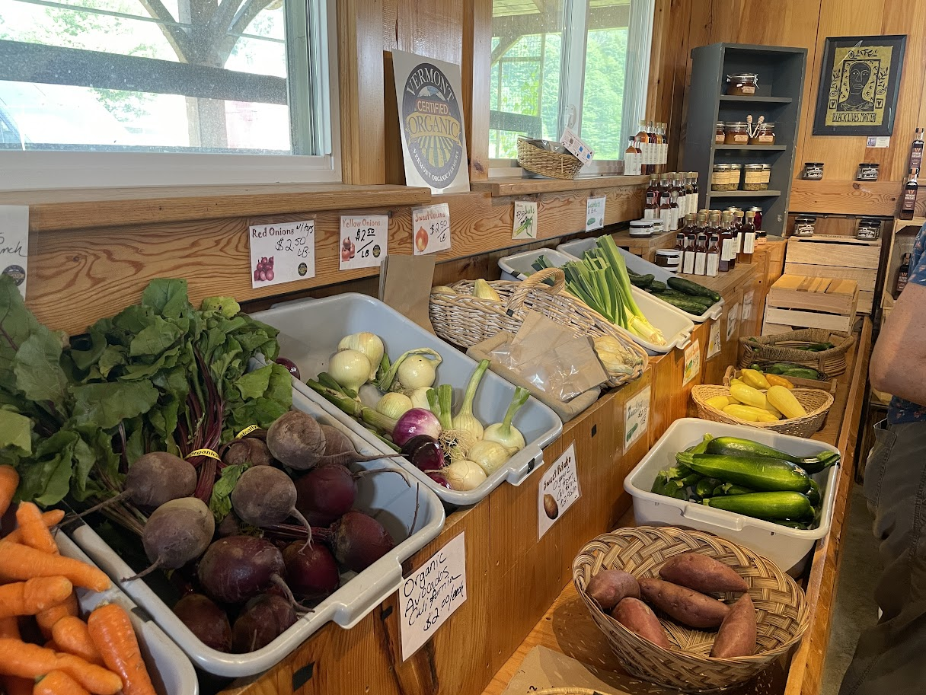
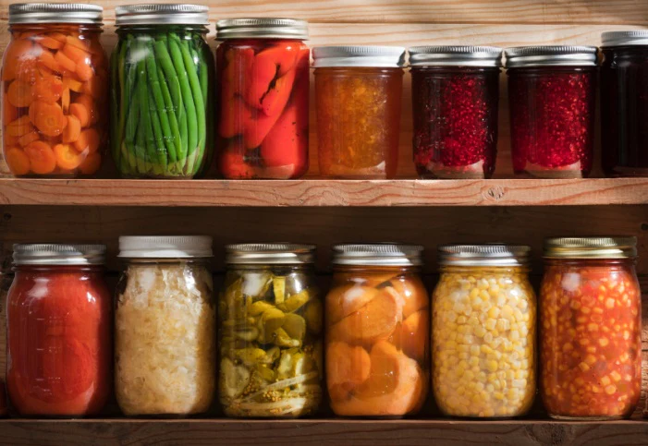
Processing/Handling
Marketing raw goods direct to consumer, restaurant, or retail - producer certification
Any sort of processing - handler certification
  Slaughtering animals
  Pasteurizing milk
  Fermenting, distilling, extracting
  Cooking, baking, curing
  Canning, drying
Examples:
  Roasting coffee
  Grinding whole corn into cornmeal
  Pressing fresh apples for cider
  Fermenting milk for yogurt

Slide 15
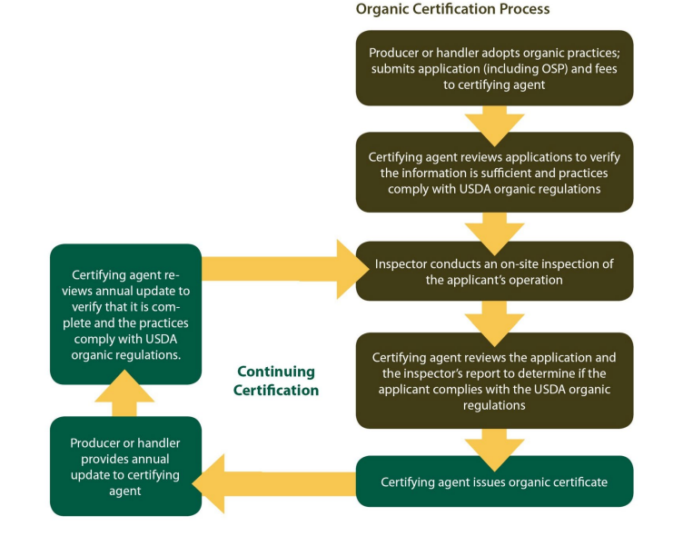
Image: USDA AMS

Slide 16
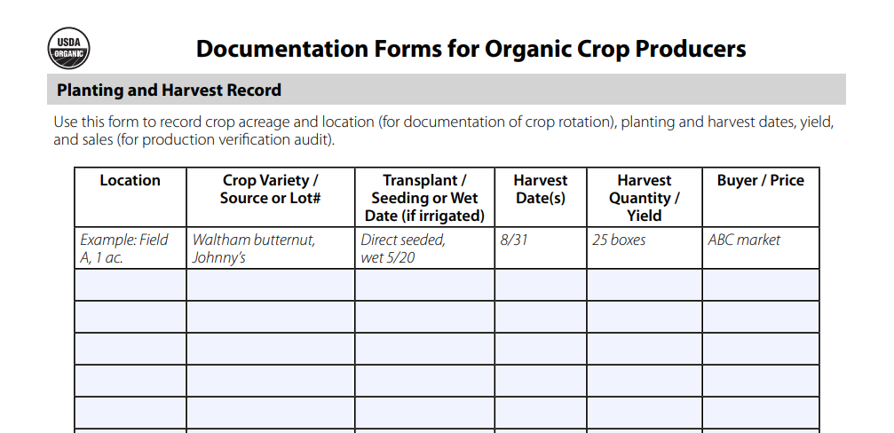
What a Certifier Expects - Recordkeeping Basics
Field history, including all crops planted, & materials applied and sources
Activity log (ex: planted cover crop)
Crop planting & harvest record
Manure application record
Seed sources & seed inoculants
CSA and/or farmers market sales records
Total farm sales record
If split operation: equipment cleaning log

Slide 17
Demystifying Organic
What kinds of other labels exist?
Certified labels vs non-certified
Organic mythbusting

Slide 18
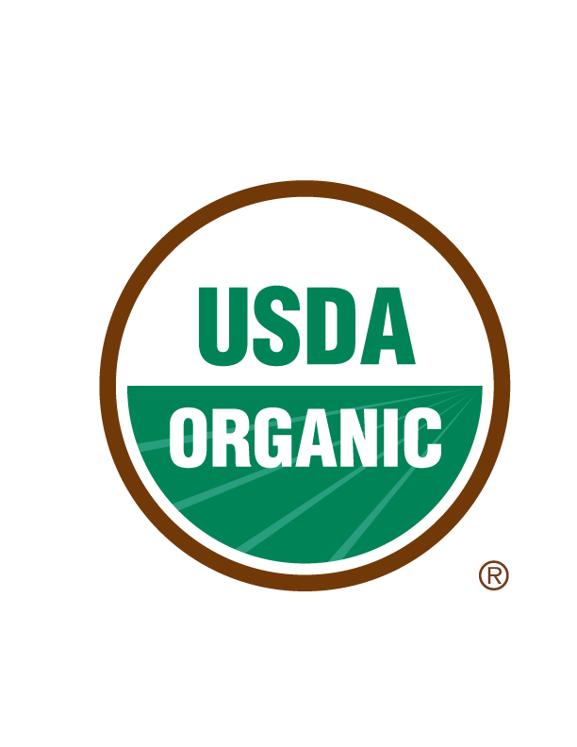
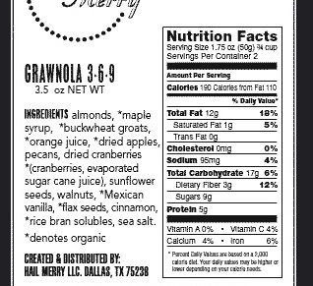
What does the organic label mean?
“Organic” contains minimum 95% organic ingredients
  Up to 5% may be non-organic products approved for use by the National List of Allowed and Prohibited Substances (§ 205.601)
  Ex: hydrogen peroxide, petroleum-based plastic mulch, pheromones for insect management
“Made with Organic __” contains at least 70% organic ingredients
  Cannot include USDA organic seal
  Must identify which ingredients are organic

Slide 19
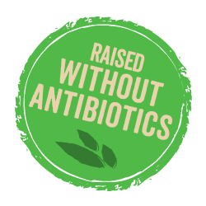

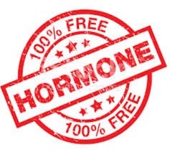


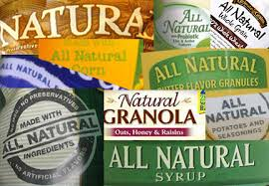


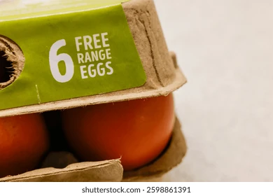
Other Certified Labels
Non-Certified Labels

Slide 20
Organic Mythbusting!

Slide 21
Myth
Organic farming is only small-scale or urban
Fact
Many small-scale and urban producers are interested in organic practices, but USDA certification and regulations apply to all farm scales and locations equally

Slide 22
Myth
Organic farming doesn’t use pesticides
Fact
Organic farming uses NOP-approved, non-synthetic pesticides as a last resort option for insect, weed, and disease control
Neem oil
Pyrethrin
Insecticidal soap
Diatomaceous earth
Plant essential oils

Slide 23
Myth
Organic farming yields and profit are much lower than conventional
Fact
Organic farming yields and profit can match or surpass conventional
Lower input costs
Increased resilience to climate risks
Improvements to soil health and biodiversity provide long-term benefits

Slide 24
Organic Practices and the NOP
Nutrient management
Seeds
Pest management
Livestock
…and more!

Slide 25
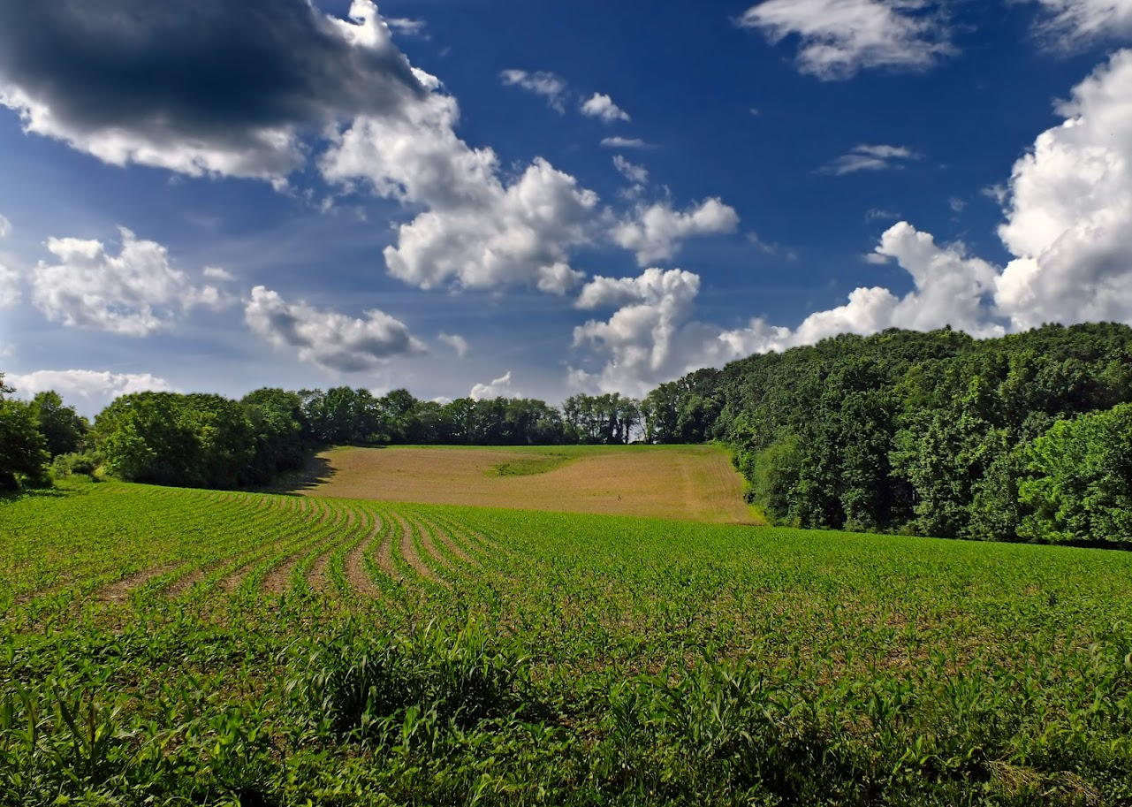
§ 205.202 Land requirements
Any field or farm parcel from which harvested crops are
intended to be sold, labeled, or represented as "organic,"
must have:
No prohibited substances applied for a period of 3 years immediately preceding harvest of the crop
Distinct, defined boundaries and buffer zones to prevent unintended application of a prohibited substance to the crop

Slide 26
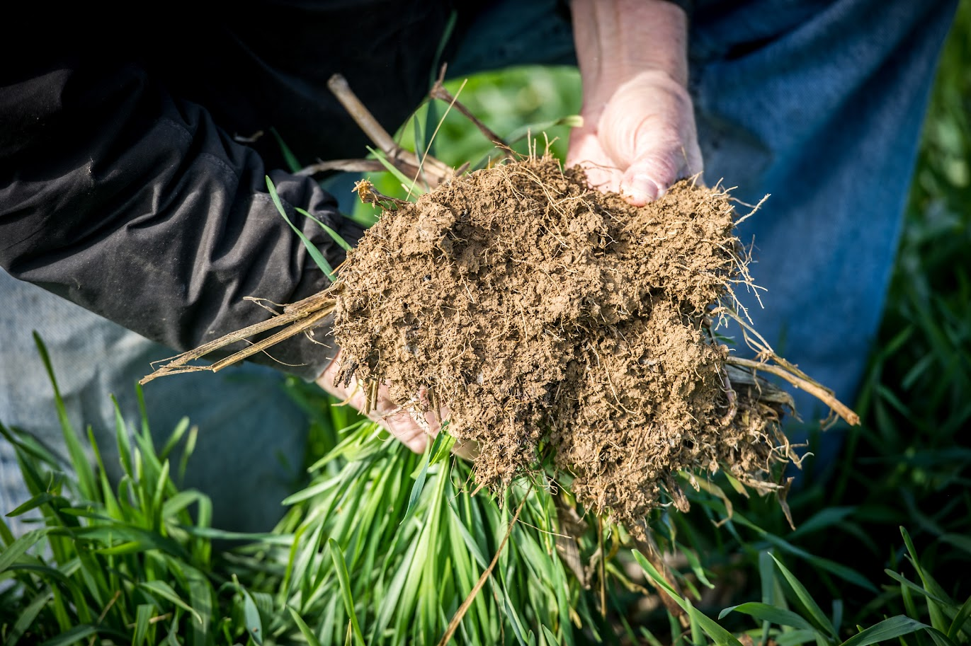
§ 205.203 Soil fertility and crop nutrient management
Tillage and cultivation - maintain/improve soil conditions; minimize erosion
Manage nutrients and fertility: rotations, cover crops, plant and animal materials
Manage nutrients and fertility to maintain/improve soil organic matter content without contributing to contamination of crops, soil, or water
Use of OMRI-approved materials or those on National List of synthetic substances allowed for use in organic crop production (§ 205.601)

Slide 27
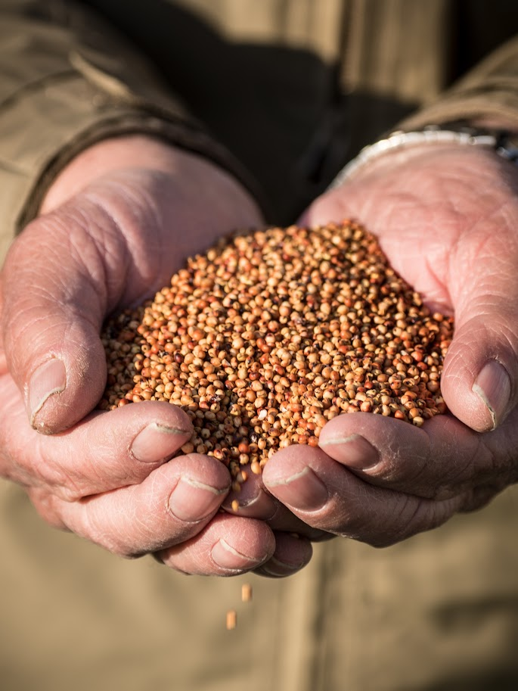
§ 205.204 Seeds and planting stock
Producer must use organic-certified seeds, seedlings, and planting stock, except:
Non-organic, untreated seed and stock when an organic equivalent is not commercially available
Seeds, seedlings, and planting stock treated with prohibited substances may be used to produce an organic crop when the application of the materials is a requirement of Federal or State phytosanitary regulations

Slide 28
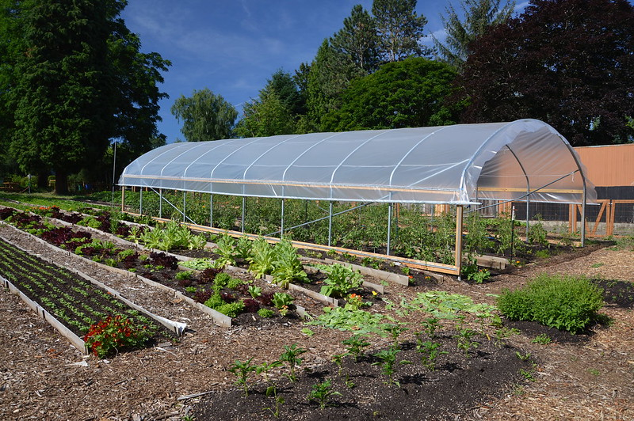
§ 205.205 Crop rotation
Producer must implement a crop rotation including but not limited to sod, cover crops, green manure crops, and catch crops that provide the following functions:
Maintain or improve soil organic matter content
Provide pest management
Manage deficient or excess plant nutrients
Provide erosion control

Slide 29
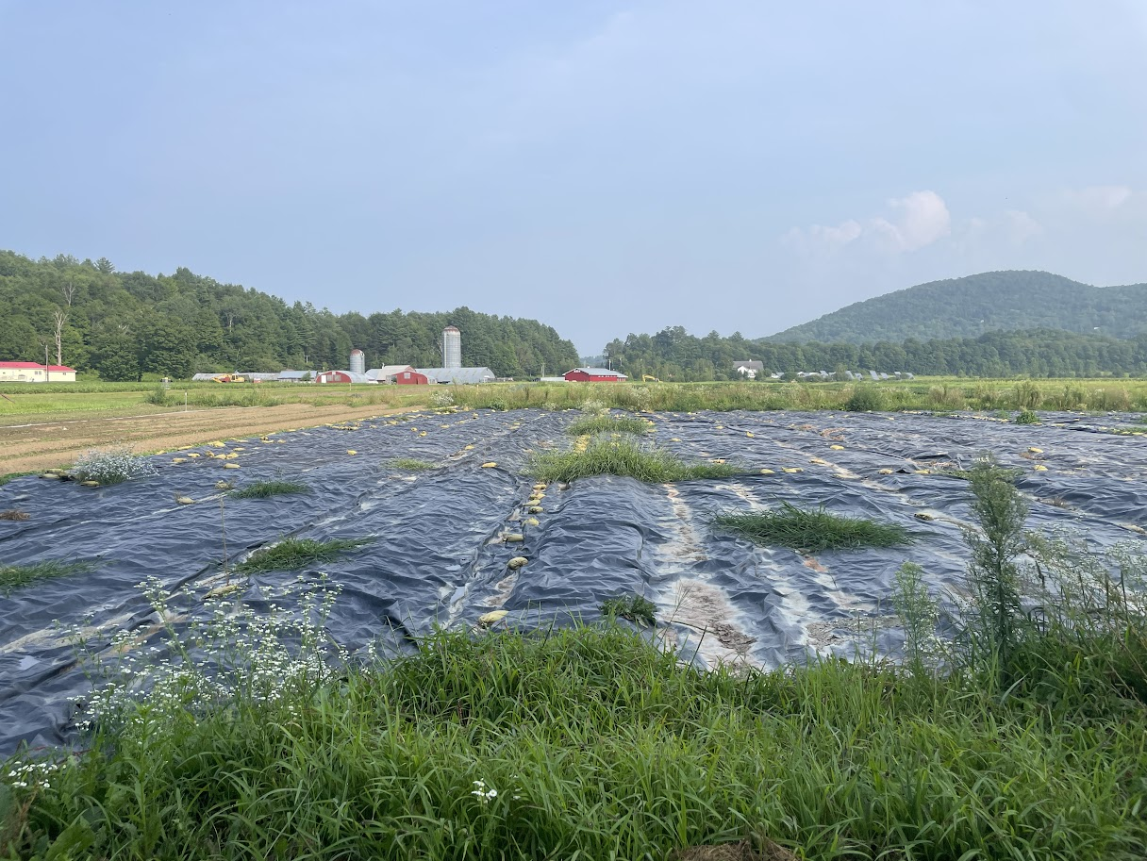
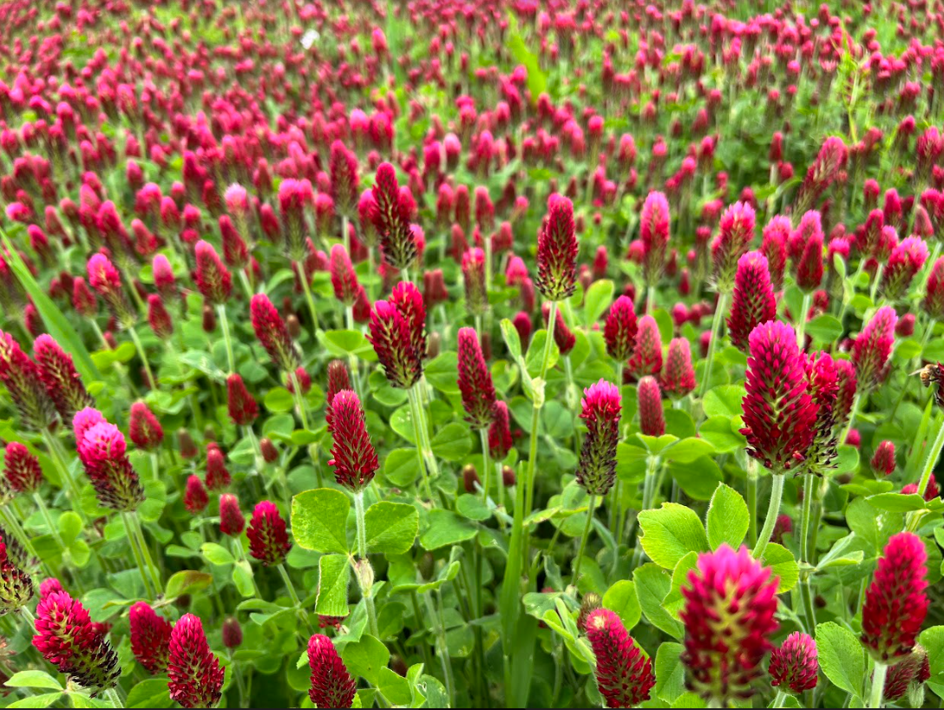
§ 205.206 Crop pest, weed, and disease management
Producer must manage crop pests, weeds, and diseases using:
Crop rotation
Proper selection of plant species and varieties
Habitat for natural enemies of pests
Mulching (plant and plastic), grazing, flame weeding, mowing
Sanitation measures (remove disease vectors, weed seeds, and habitat for pests)
Use of approved biological controls

Slide 30
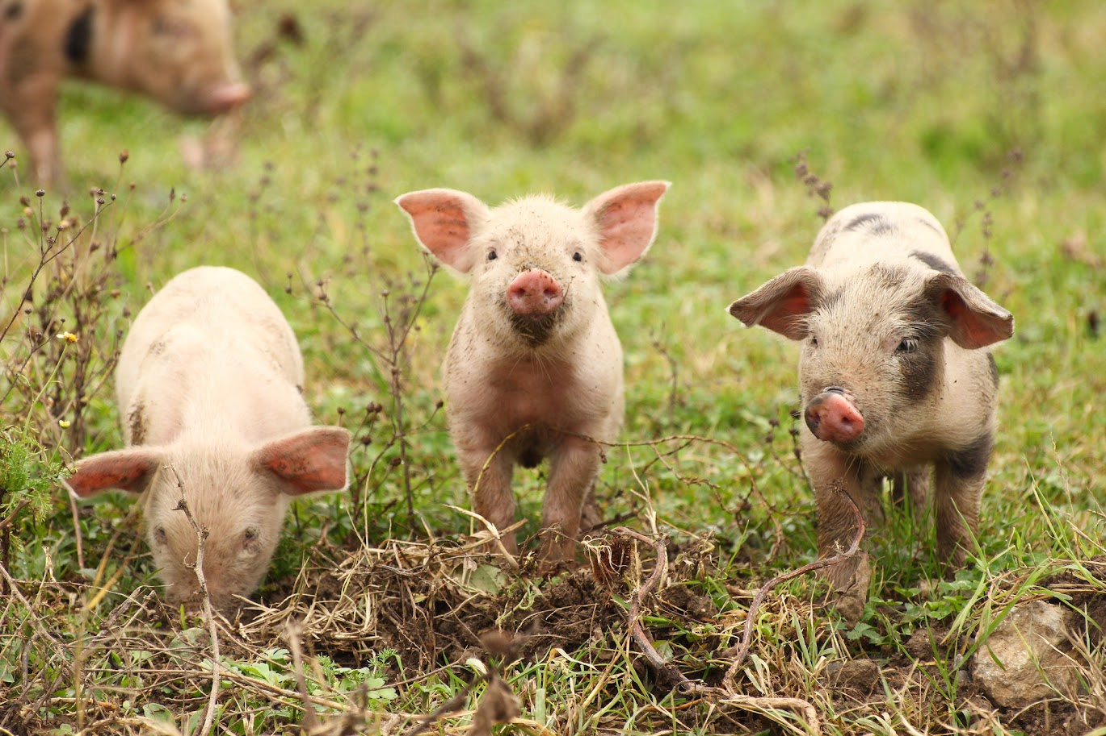
§ 205.236 Origin of livestock
Livestock sold or labeled as organic must be under continuous organic management from the last third of gestation
For poultry, continuous organic management must begin no later than the second day of life
Dairy animals must be under continuous organic management for a minimum of 12 months immediately prior to production of milk
Animals in transition to organic must be outlined in the OSP

Slide 31
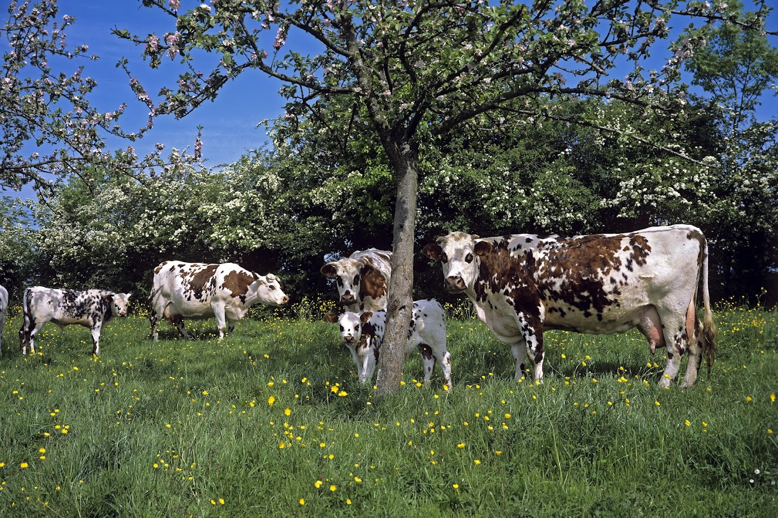
§ 205.237 Livestock feed
Ration of pasture, forage, feed and any needed concentrates, produced and handled organically
Ruminant animals shall graze no less than 120 days per calendar year (may not be continuous due to weather/climate)
Not less than 30% of dry matter intake from grazing

Slide 32
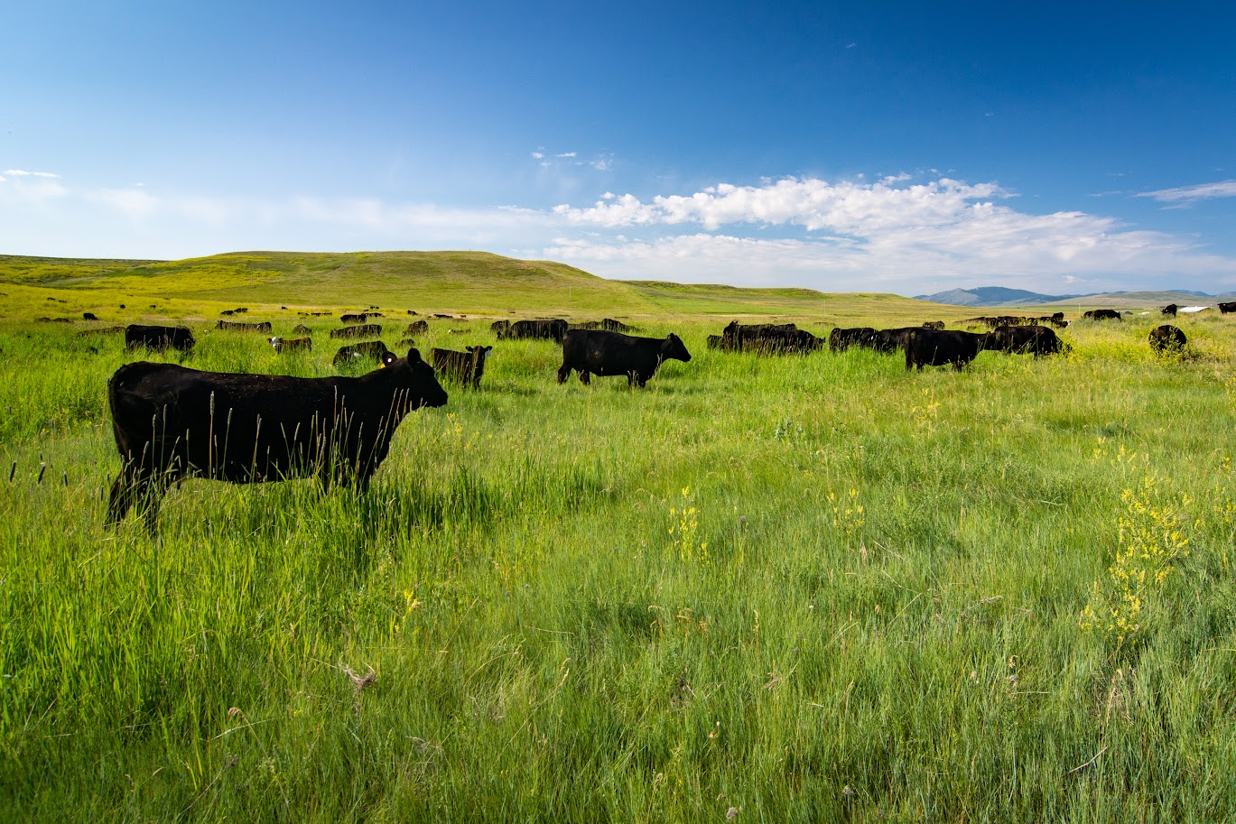
§ 205.238 Livestock care and production
General rules:
Preventive health care, including: species selection, sufficient feed to meet nutrition, housing, freedom of movement
Physical alterations for identification purposes only
Parasite prevention plan

Slide 33
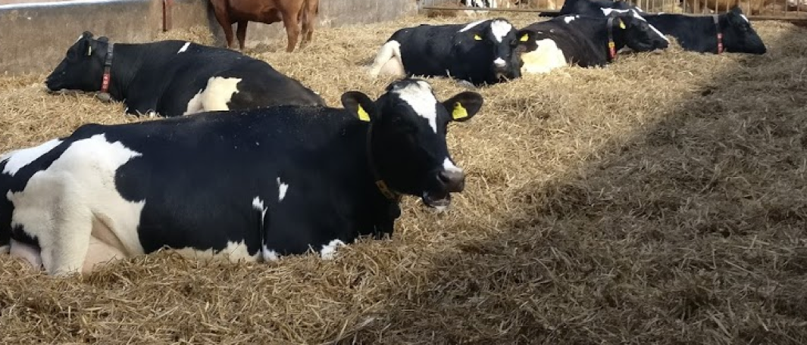
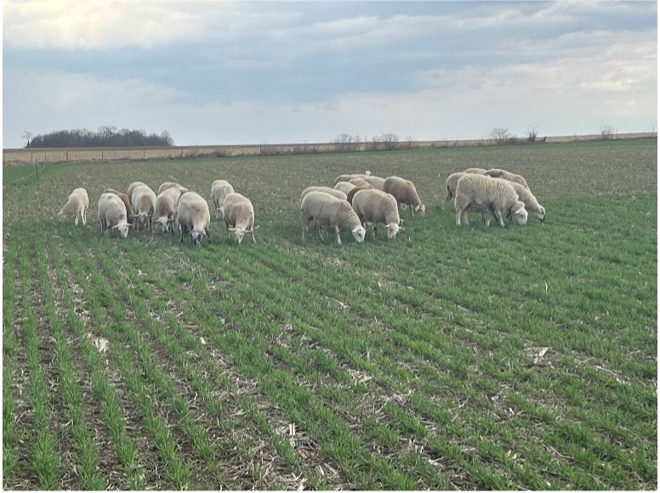
§ 205.239 Livestock living conditions
General rules for all livestock include:
Living conditions meeting the needs of animal’s health and natural behavior
Year-round access to: outdoors, shade, shelter, exercise areas, fresh air, clean water for drinking, sunlight
Continuous confinement prohibited. Temporary confinement allowed for inclement weather, health conditions, breeding, 4-H/FFA events, shipping/sales

Slide 34
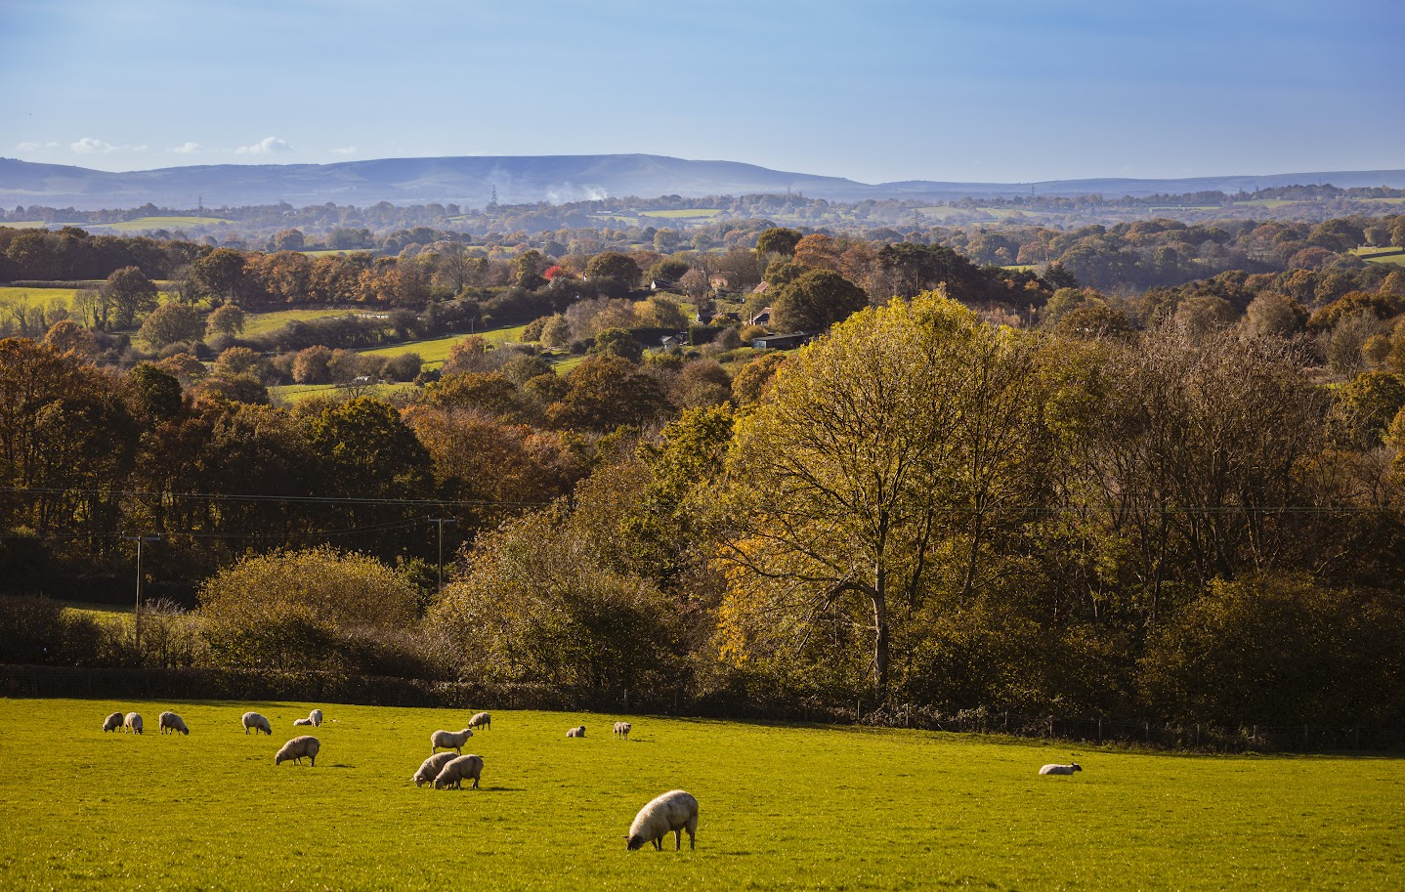
§ 205.240 Pasture
Pasture plan must be included in OSP
Meet pasture feed requirements
Ensure sufficient quality and quantity
Areas of shade and drinking water
Fencing cannot use treated wood
Soil fertility considerations
Erosion control and protection of natural wetlands and riparian areas

Slide 35
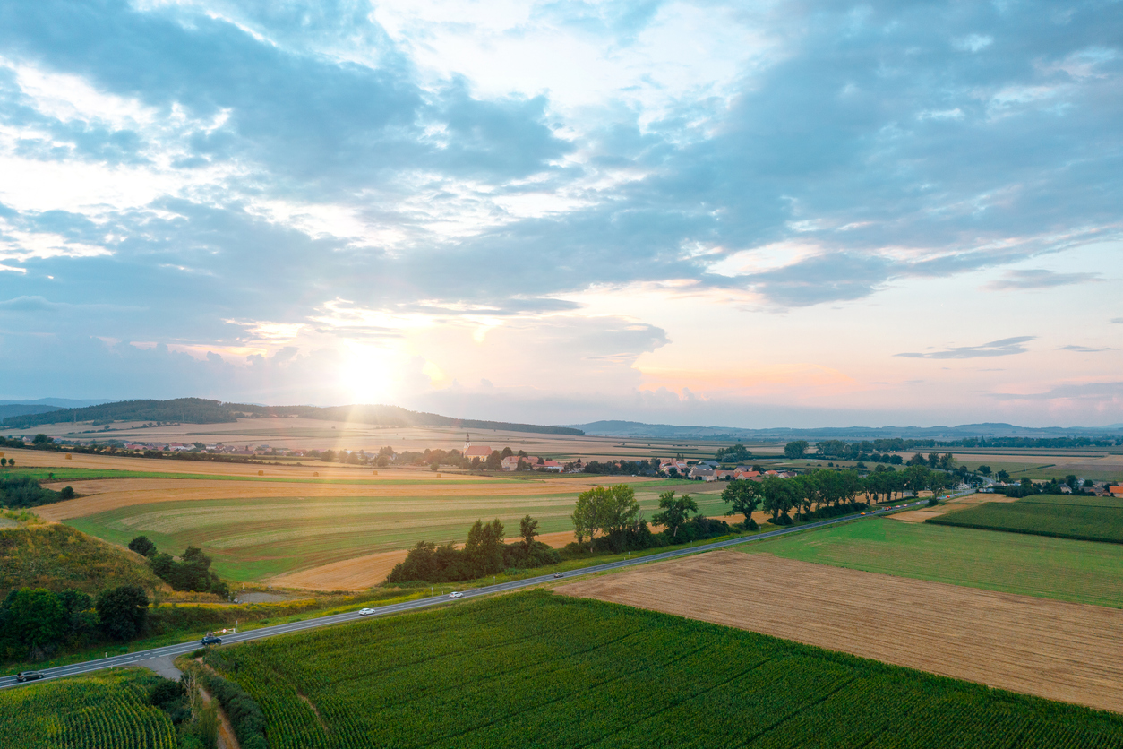
§ 205.272 Commingling and contact with prohibited substance prevention
Implement measures to prevent commingling of organic and non-organic products; protect organic products from contact with prohibited substances.
Packaging materials/storage containers containing synthetic preservatives, fungicides, or fumigants not permitted.
Reusable bags/containers which have been in contact with non-organic substances must be thoroughly cleaned before reuse.

Slide 36
Other Helpful Resources

Slide 37
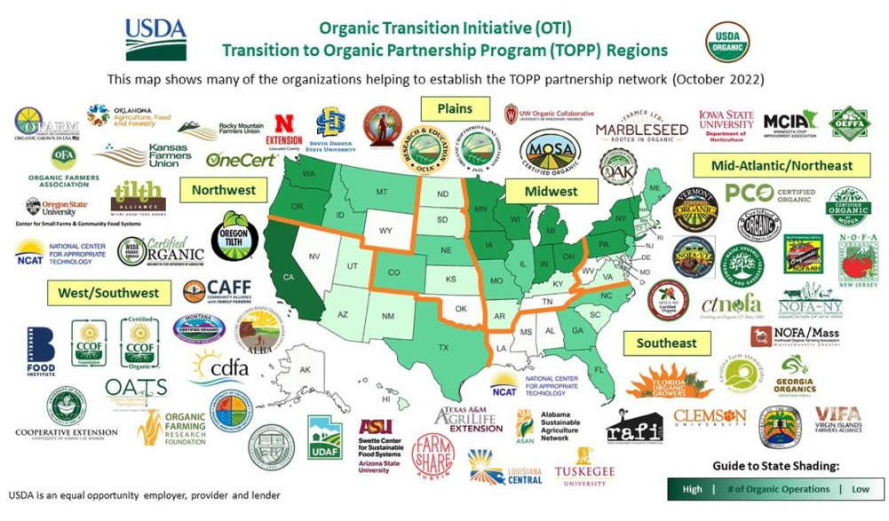
ORGANIC FARMING RESEARCH FOUNDATION
Networking &
Farmer Panel:
Understanding Producer Journeys

Slide 38
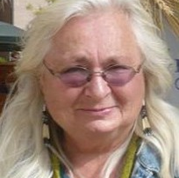
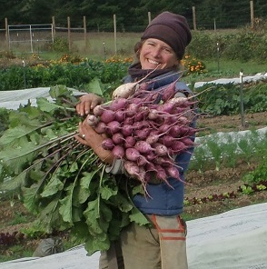
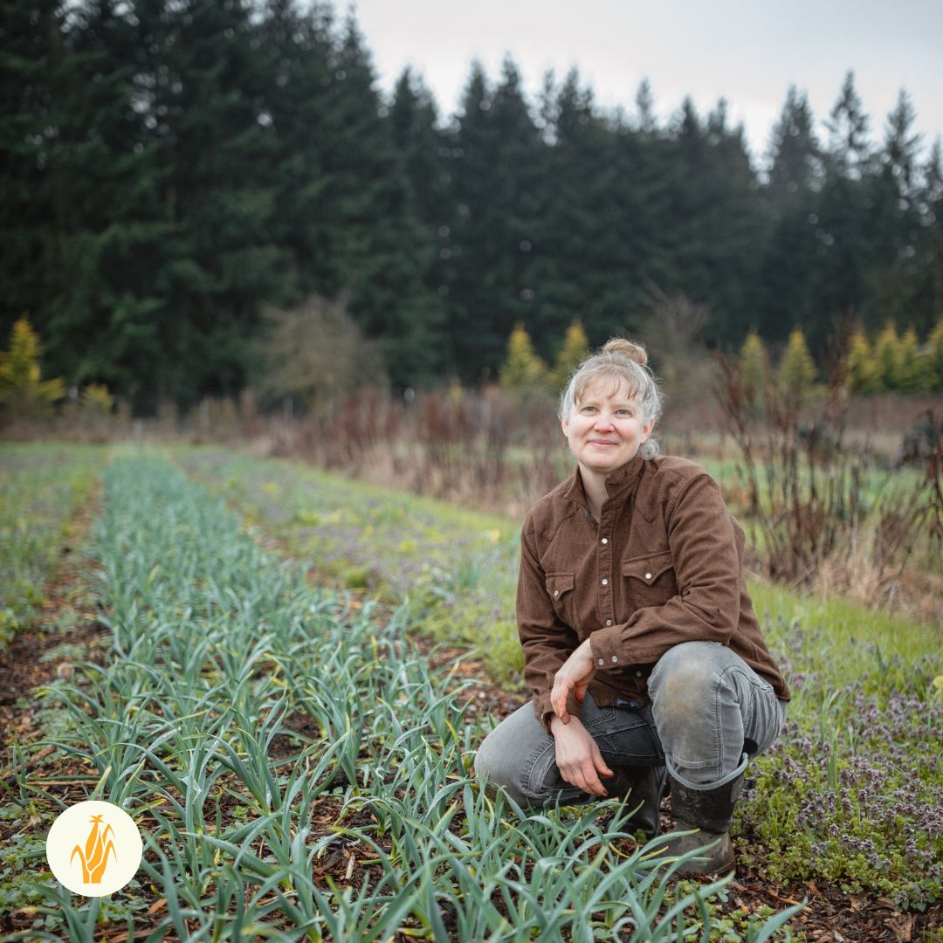
Diane Green
Greentree Naturals
Sandpoint, ID
Beth Hoinacki
Goodfoot Farm
Philomath, OR
April Jones Thatcher
April Joy Farm
Ridgefield, WA
Notes:
Diane Green and her husband own and operate Greentree Naturals, a certified organic farm near Sandpoint, Idaho, since 1992. They cultivate and market over 130 varieties of organic produce, including vegetables, herbs, flowers, gourmet garlic, hops, seeds, and berries, with many grown from open-pollinated seeds saved on the farm for decades. Diane co-founded the University of Idaho Cultivating Success Small Farms program in FY2000 and collaborates with University Extension educators across the region as a consultant, mentor, and educator for small acreage farmers. Currently, Diane serves as a mentor for the Northwest Transition to Organic Partnership Program with Oregon Tilth and the Organic Seed Alliance. Greentree Naturals also hosts summer farm tours, organic gardening workshops, and on-farm research.
Beth Hoinacki lives and farms with her family at Goodfoot Farm, a small, diversified Biodynamic® market farm in the Coastal foothills of Oregon’s Willamette Valley. The farm is also home to chickens, geese, sheep, horses, cats and dogs, and a multitude of wildlife. A deep appreciation for the natural environment was likely instilled in her during her early years, growing up in rural Southern Illinois. Over the years and in many places she has been a horseback riding instructor, a food server, a maid, a whitewater raft guide, a ski technician, an educator, an organic and Biodynamic certification inspector, and a scientist. Now she farms full time and whole heartedly. She also frequently collaborates with university and industry partners to support organic producers.
April Jones Thatcher is founder and farmer of April Joy Farm, a diversified crop-livestock farm near Ridgefield, WA. Her WSDA certified organic farm has served Clark County since 2009. April has an undergraduate degree in civil engineering and an M.B.A. in entrepreneurship. She is passionate about soil health, animal welfare, and nurturing community. In 2019, she co-founded the Farm to Heart Food Justice Initiative. April is also the President of the OFRF Board of Directors!

Slide 39
Upcoming Field Day!
February 25th, 2026
Stepping Stone Farm
The Dalles, Oregon

Slide 40

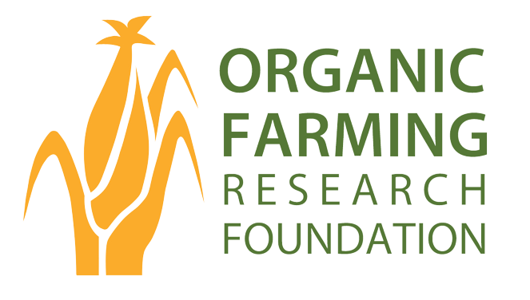
Thank You!
www.ofrf.org
rebecca@ofrf.org
heather@ofrf.org

