Slide 1
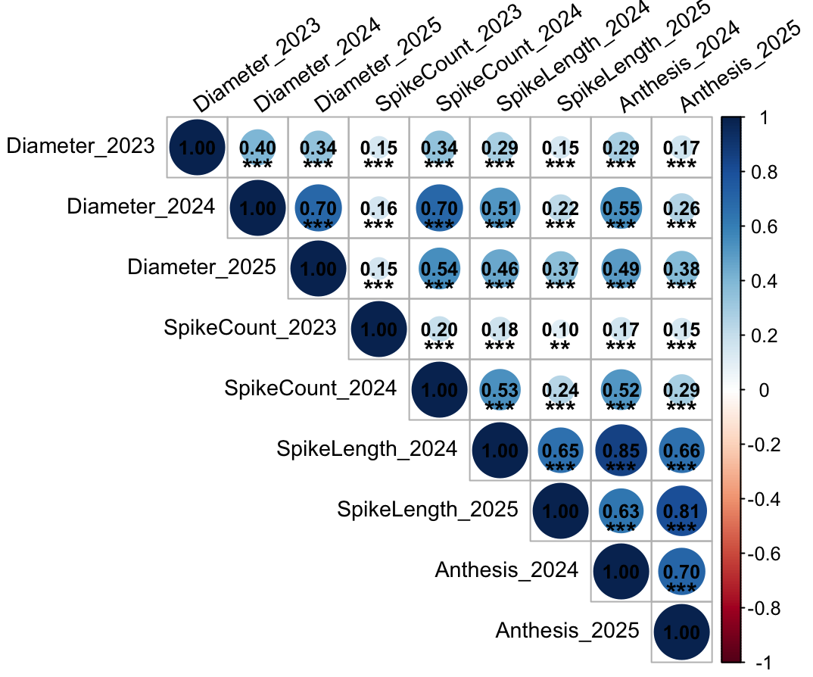
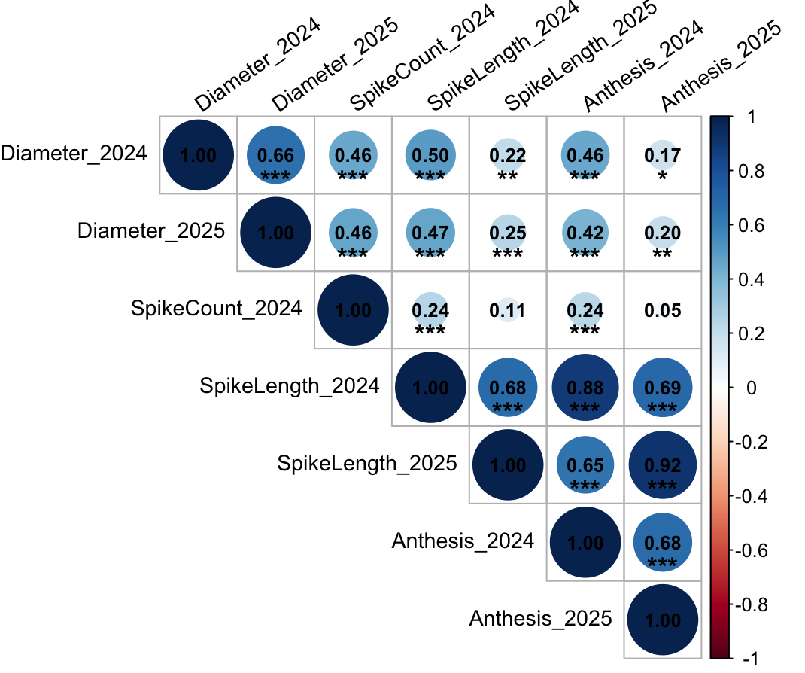
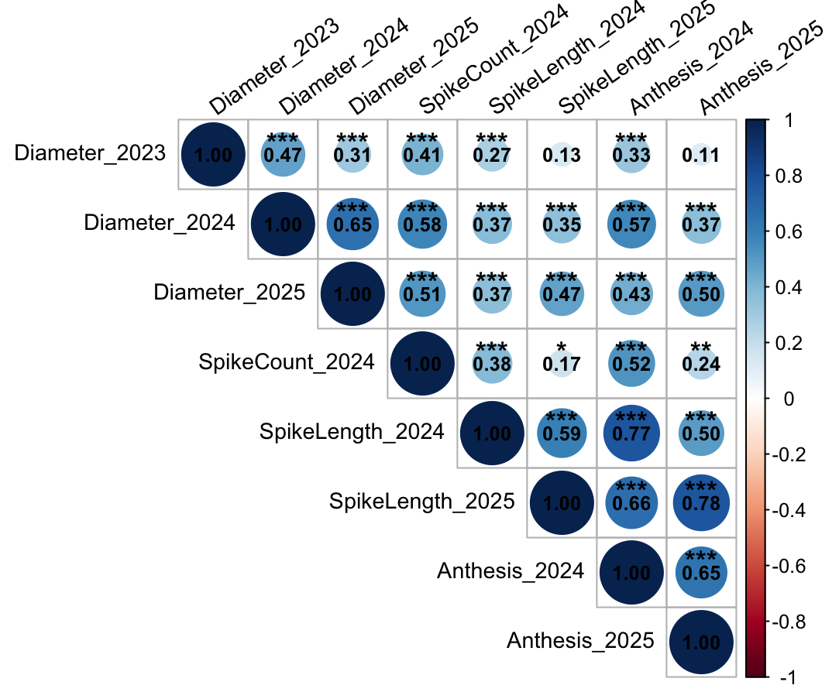
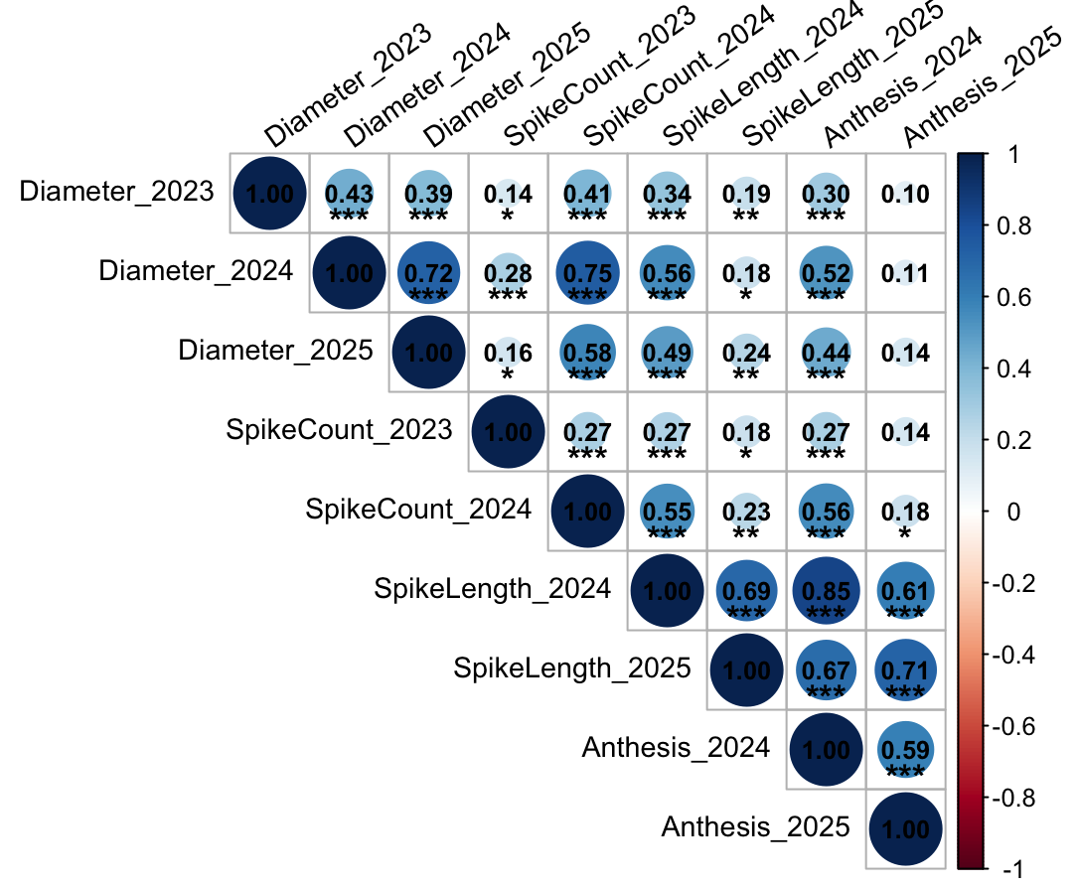
LEX
PRN
QKS
WDF
Figure 1. Trait correlation by location from year 2023-2025. Asterisks indicate significance levels at p < 0.05 (*), p < 0.01 (**) and p < 0.001 (***).

