Slide 1
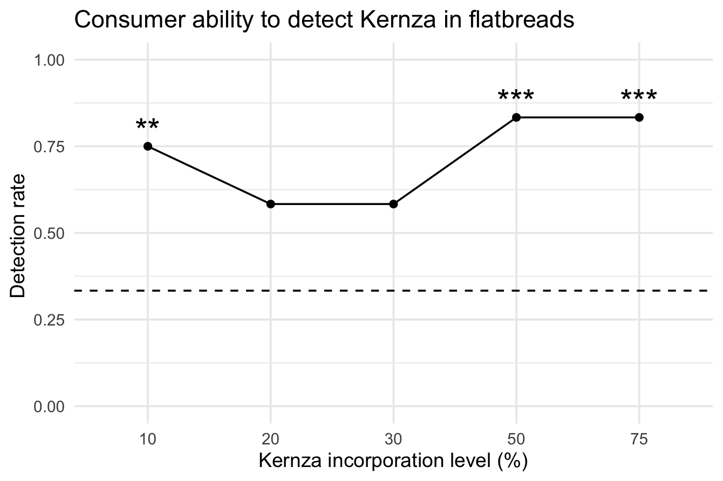
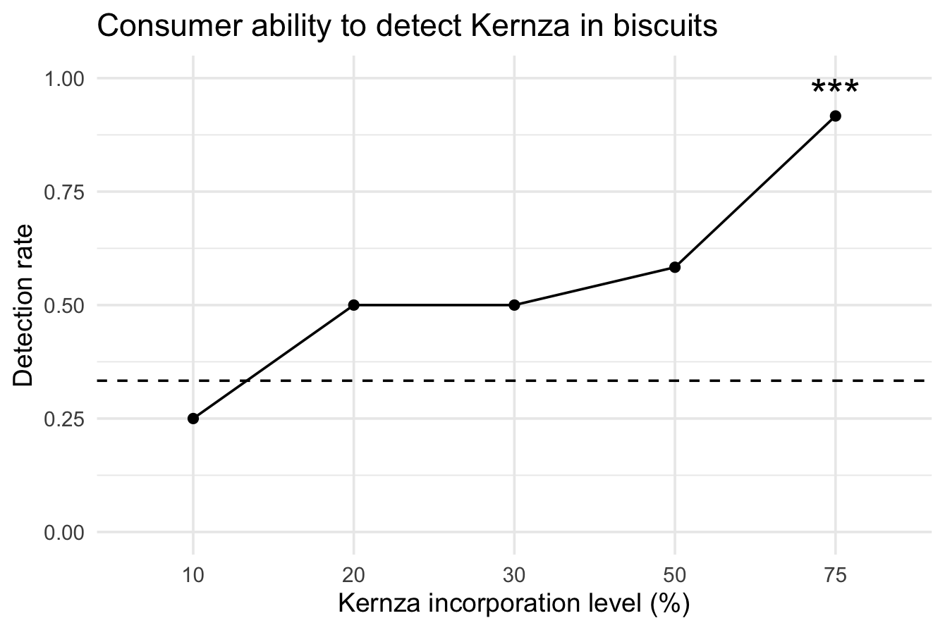
A
B
Figure 1. Triangle test results for (A) flatbreads and (B) biscuits containing different levels of Kernza incorporation. Dashed line is random guessing probability of a correct response (1/3). Asterisk represents significance (* p < 0.05, ** p < 0.01, *** p < 0.001).

